Slide 1
User-Friendly Decision Tools
Clifford Bridges
April 14, 2023
Notes:
Abstract: Personal experience and anecdotal evidence suggest that presenting analyses to sponsors, especially technical sponsors, is improved by helping the sponsor understand how results were derived. Providing summaries of analytic results is necessary but can be insufficient when the end goal is to help sponsors make firm decisions. When time permits, engaging sponsors with walk-throughs of how results may change given different inputs is particularly salient in helping sponsors make decisions in the context of the bigger picture. Data visualizations and interactive software are common examples of what we call “decision tools” that can walk sponsors through varying inputs and views of the analysis. Given long-term engagement and regular communication with a sponsor, developing user-friendly decision tools is a helpful practice to support sponsors. This talk presents a methodology for building decision tools that combines leading practices in agile development and STEM education. We will use a Python-based app development tool called Streamlit to show implementations of this methodology.
In 20 minutes, all I can do is plant a seed. I encourage you to follow up with questions via email (cbridges@ida.org) or try new things on your own.

Slide 2
Be a Trusted Advisor
What does a trusted advisor do?
Builds a long-term relationship with sponsors through regular communication.
Helps sponsors ask the right questions – does not just give the right answers.
Develops sponsors’ ability to independently reach defensible conclusions.
Notes:
“Trusted advisor” is a term used by The Get Real Project in their learning programs.
See https://thegetrealproject.com/why-get-real/be-a-trusted-advisor/ for information on The Get Real Project and Trusted Advisors

Slide 3
Be a Teacher
What does a teacher do?
Builds a long-term relationship with students through regular communication.
Helps students ask the right questions – does not just give the right answers.
Develops students’ ability to independently reach defensible conclusions.

Slide 4
Help Your Students Earn an A
Grade | Expected Ability
C | Can answer complex questions with significant guidance
B | Can check answers to complex questions
A | Can answer complex questions independently

Slide 5

Help Your Sponsor Navigate Decisions
Able | Desired Ability
 | Can answer complex questions with significant guidance
 | Can check to ensure your answers make sense
 | Can discuss their ideas for solving complex questions with you

Slide 6
Sponsors Are Students (Are Sponsors!)
If your sponsor had to make a complex policy decision without your presence, how well will your tool have prepared them?
Notes:
Goals
Sponsor can communicate your analysis
Sponsor interpret your analysis
Sponsor can predict effects of policy/structural changes

Slide 7
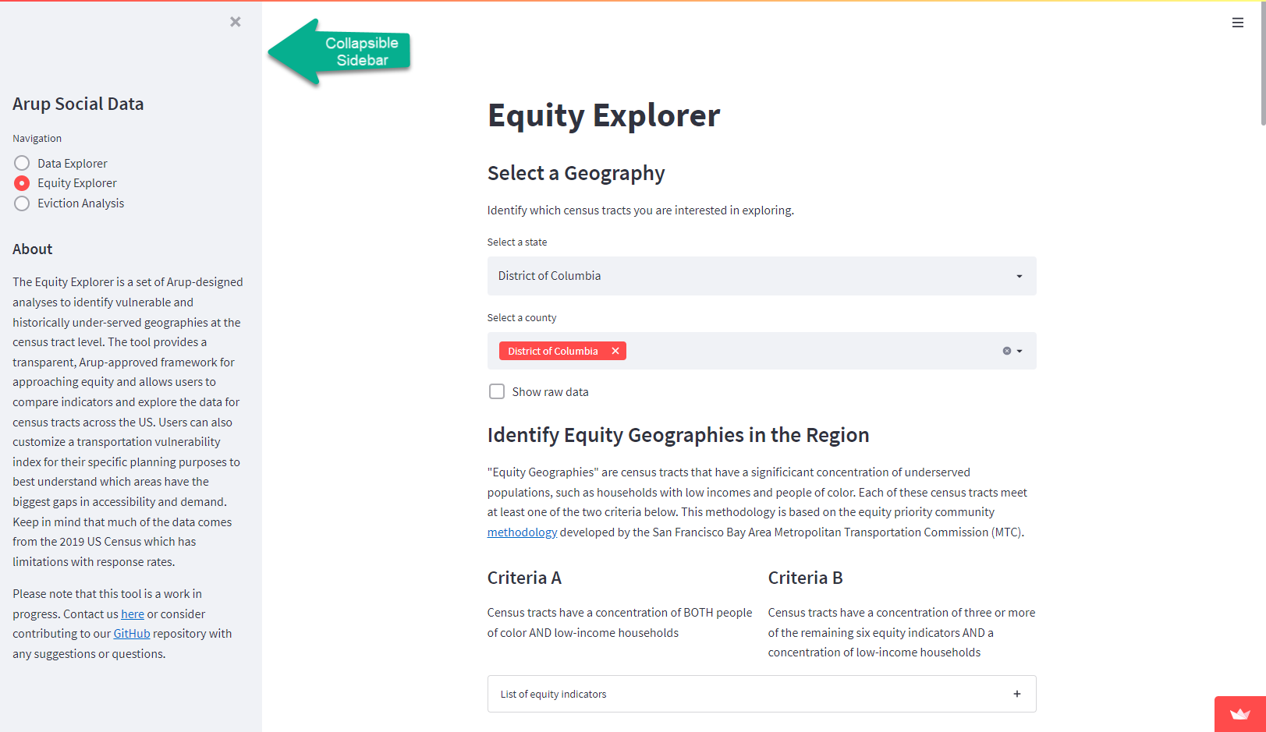
Learning Outcomes
Users are likely not a novice to the field, but may be a novice to your tool. A few lines of code with effectively zero space lost can provide very helpful context.
Notes:
Screenshot taken from https://arup-group-social-data-run-lodl36.streamlit.app/?page=Equity+Explorer.
Note: a collapsible sidebar saves space.

Slide 8
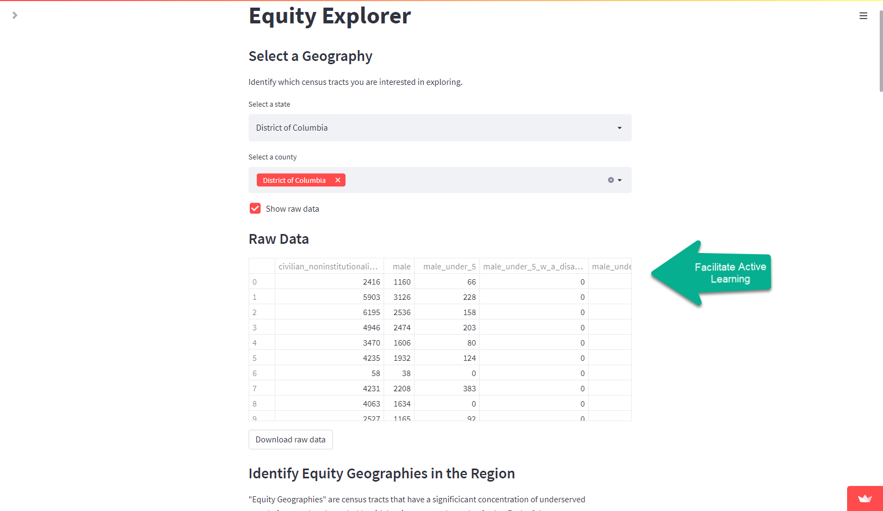
Active Learning
Whenever possible, enable users to complete the same analyses on their own if they want. If their results are inconsistent with yours, something important is happening; either they have a misunderstanding or you do!
Notes:
Screenshot taken from https://arup-group-social-data-run-lodl36.streamlit.app/?page=Equity+Explorer.
Note: radio button to show/hide downloadable data saves space.

Slide 9
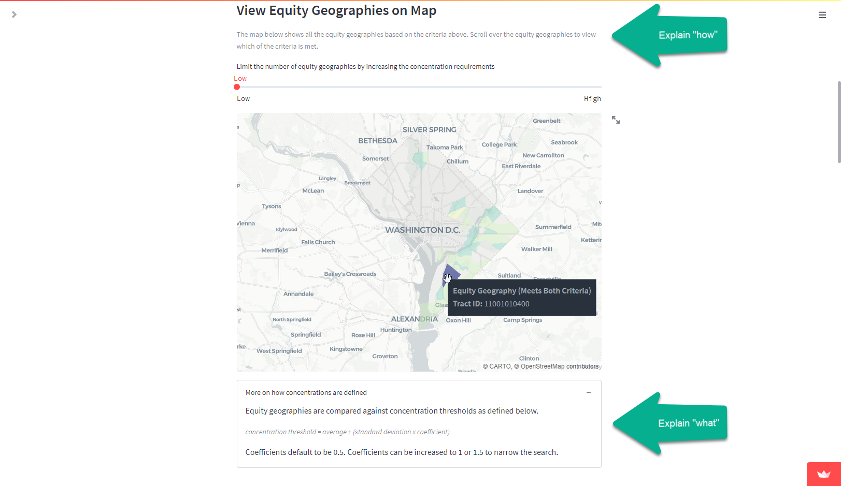
Transparent Assignment Design
There are instructions on how to use the map. The description of what this map shows is given twice, once in general terms and again in full detail.
Notes:
Screenshot taken from https://arup-group-social-data-run-lodl36.streamlit.app/?page=Equity+Explorer.
Note: the detailed “what” is collapsible and labelled appropriately.

Slide 10
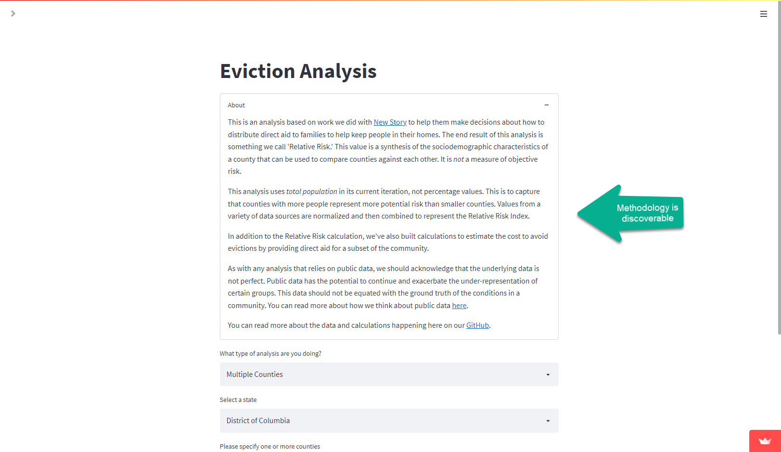
Cognitive Load
Information is presented in a place and at a time where it can be comprehended: at the top of the page and when the user wants.
Notes:
Screenshot taken from https://arup-group-social-data-run-lodl36.streamlit.app/?page=Equity+Explorer.
Note: the methodology is collapsible and labelled appropriately.

Slide 11
Be a Trusted Advisor and Teacher
Integrating what we know about teaching into tools can help us advise sponsors beyond the interaction with the tool.

Slide 12
What are “Decision Tools”?
Tools can be:
Static PowerPoint briefs,
Interactive dashboards,
Dynamic apps,
And more

Slide 13
Who are “Users”?
Users can be
Long-term sponsors who needs to understand the analysis, not just the result;
A sponsor’s team of analysts to whom analysis tools will be transferred;
Anyone who will be using the tool while you are not present. (Tools can grow legs!)

Slide 14
Key Pedagogical Terms
Active Learning – “learning through activities and/or discussion … as opposed to passively listening”
Learning Outcomes – “statements that articulate the knowledge and skills you want students to acquire”
Transparent Assignment Design – “clearly describe the task and how it should be accomplished”
Cognitive Load – “demands and limitations on working memory”
Terms derived from the Washington University in St. Louis Center for Teaching and Learning - https://ctl.wustl.edu/resources/glossary-of-pedagogical-terms/

