Slide 1
DTE&A Test as a Continuum
DATAWorks Session 4A: Transforming T&E to Assess Modern DoD Systems
April 27, 2023
Mr. Orlando Flores
Chief Engineer
Developmental Test, Evaluation, and Assessments
UNCLASSIFIED

Slide 2
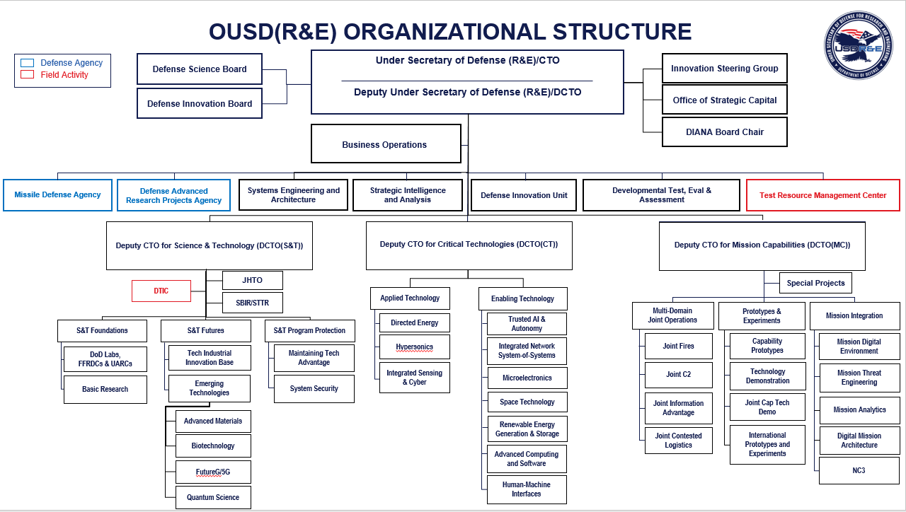
OUSD(R&E) Organizational Structure

Slide 3
ED(DTE&A) Organizational Structure
Government
Executive Director, Developmental Test, Evaluation, and Assessments
Mr. Christopher Collins
Contractor
Administrative Staff
Position | Name
Operations Manager | Mr. Patrick Foster
Director EA | Ms. Caitlin Harris
Budget & Finance | Ms. Michelle Cavey
DTE&A Chief Engineer
Position | Name
Chief Engineer | Mr. Orlando Flores
Senior Engineer | Dr. Epifanovskaya
Tech Advisor | Mr. Shawn Malone
External Organizations
Organization | Lead
MITRE | Torres
IDA | Hong
STAT CoE | Kolsti
JHUAPL | Lytwyn
Specialty Engineering
Capability | Lead
Manufacturing | Hirtle
Reliability | Marshall
Sched & Risk | Sandoval
Software | Richer
DTE&A Cyber Technical Director
Position | Name
Cyber Tech Director | Ms. Sarah Standard
Snr Cyber Engineer | Mr. Dan Rieken
Air Systems (AS)
Mr. Jim Bierstine
Land Systems (LS)
A/ Mr. Rick Donahue
Naval Systems (NS)
Mr. Stephen Stump
C4ISR/NC3 (IS)
Ms. Robbyn Berenda
Space Systems (SS)
Mr. Rick Thomas
Missile Systems (MS)
Mr. Steven Lopes
Plus(+)1: Mr. Bob Mattes
Plus(+)1: Mr. Jim Ward
Plus(+)1: Mr. Jack Clifford
Plus(+)1: Mr. Mike Cribbs
Plus(+)1: Mr. Mike Floresca
Plus(+)1: Mr. Phil Clark

Slide 4
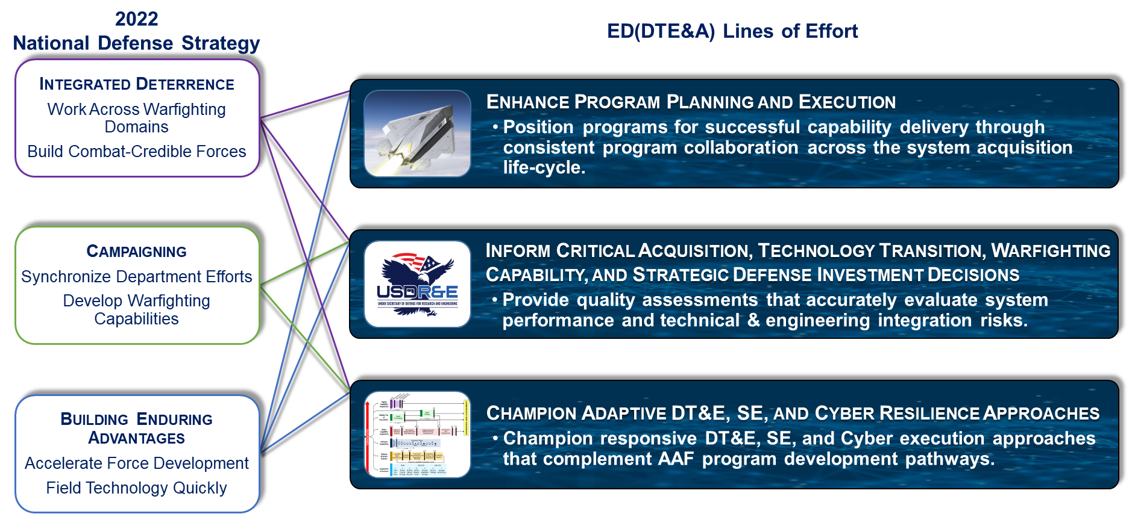
FY23 ED(DTE&A) Mission within OUSD(R&E)
Provides preeminent systems engineering (SE) and test & evaluation (T&E) support to the USD(R&E) enabling rapid program development from concept to delivery of relevant capability for the DoD Joint force.
Offers SE and T&E technical rigor to DoD Adaptive Acquisition Framework (AAF) development pathway programs, USD(R&E) modernization priorities, and strategic defense investment decisions to ensure delivery of relevant and timely warfighting capabilities.
Conducts independent Developmental T&E, Engineering, and Technical Risk Assessments to accurately evaluate technical performance and technology, engineering, and integration maturity in support of critical decisions.
Partners with acquisition Program Managers from the Services and Defense Agencies and other OSD stakeholders including DOT&E, the Test Resource Management Center (TRMC), and OUSD(A&S).
DTE&A engages with approximately 113 AAF
programs on the OSD T&E Oversight List with
SE support to 12 ACAT ID programs.
(Statutory/Regulatory)
  ACAT ID: ITRAs, DTSAs, TEMPs, SEPs, PDRs
  ACAT IB/IC/MTA: DTAs, TEMPs, CDRs, and
  DAB Support
ITRA – Independent Technical Risk Assessment
DTSA – Development Test and Evaluation Sufficiency Assessment
DTA – Development Test and Evaluation Assessment
TEMP – Test and Evaluation Master Plan
SEP – System Engineering Plan
PDR – Preliminary Design Review
CDR – Critical Design Review

Slide 5
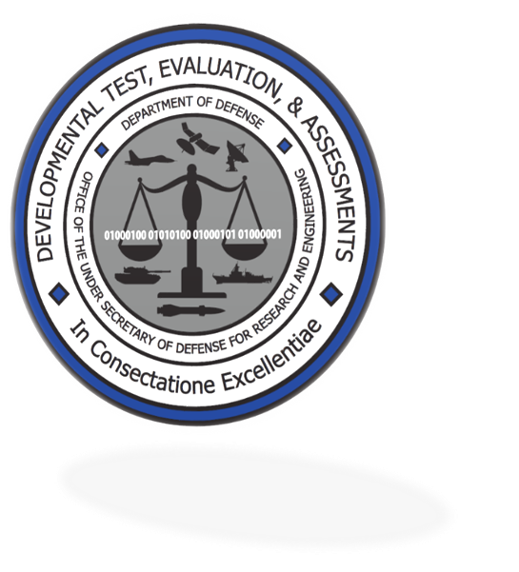
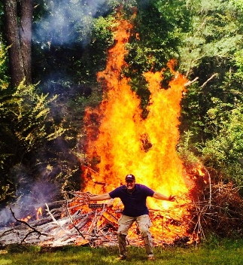
DTE&A
T&E Continuum and Adapting
Systems Engineering
Processes

Slide 6
Shifting the Traditional Testing Paradigm to a “Testing Continuum”
A critical change in how Test and Evaluation (T&E) supports capability delivery is needed to maintain our advantage over potential adversaries.
Making this change requires a new paradigm in which:
  T&E provides focused and relevant information supporting decision-making continually throughout capability development.
  T&E informs from the earliest stages of Mission Engineering (ME) through Operations and Sustainment (O&S).
This new approach moves T&E from a serial set of activities conducted largely independently of Systems Engineering (SE) and ME activities to a new integrative framework focused on a continuum of activities termed T&E as a Continuum.
T&E as a Continuum has key attributes and enablers critical in the conduct of T&E as a continuum and delivery of capability at the Speed of Need.

Slide 7
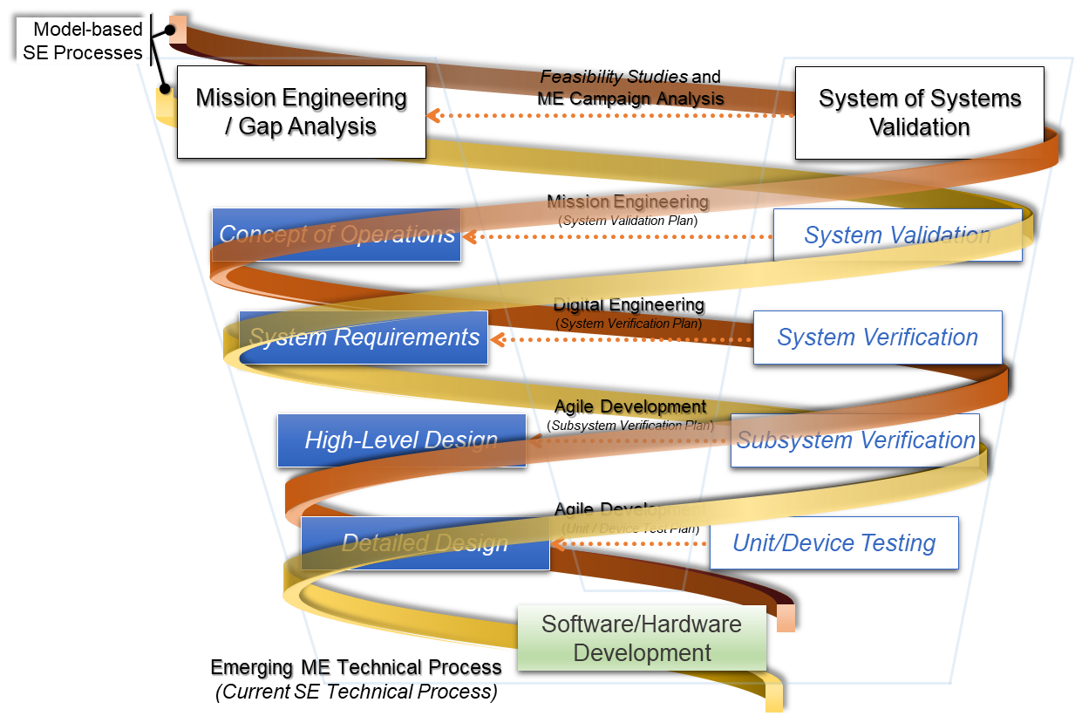
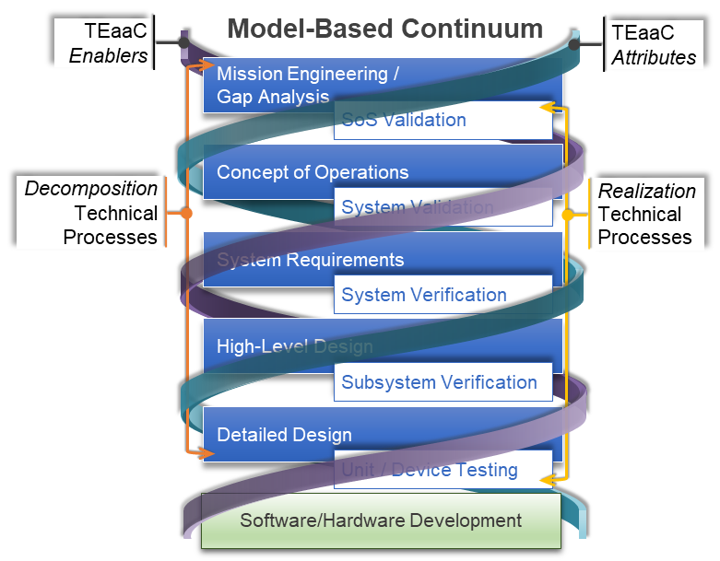
T&E Continuum and the Model-Based Systems Engineering "V"
Model-Based Iterative Processes
The SE community has historically used a
serial interpretation of the SE “V”.
Executing the T&E as a Continuum will integrate
ME, SE, and T&E into parallel, collaborative, and
combined efforts through a dynamic, connected
new model-based SE “V” Environment.
Using this model-based environment, DoD can
transition to a “model-test-validate-design-test” process providing
early and continual information on expected mission capability.
“Collapsing” of the SE “V” does not negate good SE practices. The model-based continuum will allow the SE community to manage the many complex activities being conducted simultaneously within this continuum across the “V”.
MBSE: Model-based Systems Engineering
TEaaC: T&E as a Continuum

Slide 8
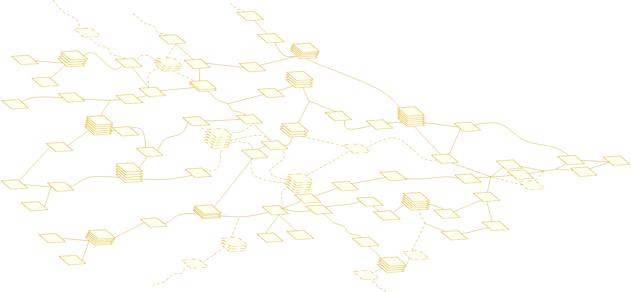

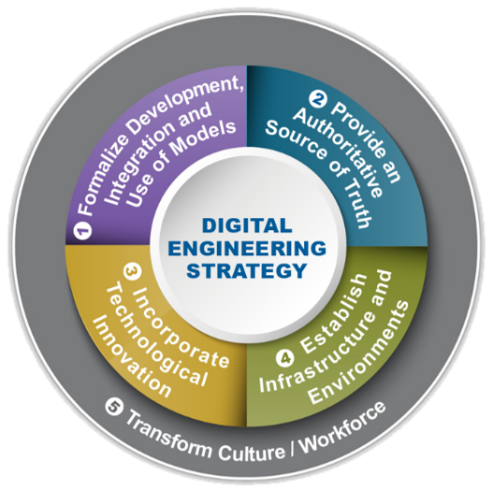


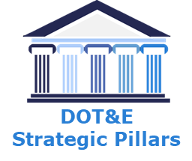
Shifting the Traditional Testing Paradigm to a “Testing Continuum”
Continuum Attributes
DOT&E Strategic Pillar:
Test the Way We Fight
DOT&E Strategic Pillar:
Accelerate the Delivery of Weapons That Work
DOT&E Strategic Pillar:
Pioneer T&E of Weapon Systems Built to Change Over Time
Capability and Outcome Focused Testing
Early, Agile, Scalable Framework
Enhanced Test Design
DE Strategy Pillar:
Establish Infrastructure and Environments
DE Strategy Pillar:
Provide Authoritative Source of Truth
DE Strategy Pillar:
Incorporate Technological Innovation
SE / ME / T&E
Processes
Evaluation
Continuum
Continuum Enablers
DOT&E Strategic Pillar:
Improve the Survivability of DOD in a Contested Environment
DOT&E Strategic Pillar:
Pioneer T&E of Weapon Systems Built to Change Over Time
DOT&E Strategic Pillar:
Foster an Agile and Enduring T&E Enterprise Workforce
Live, Virtual, Constructive
(LVC) Testing
Model - Based Environment
“Digital” Workforce
Decision Scope
Complexity
DE Strategy Pillar:
Provide Authoritative Source of Truth
DE Strategy Pillar:
Formalize Development, Integration, & Use of Models
DE Strategy Pillar:
Transform Culture / Workforce
Decision Space
Delivery Life Cycle
The T&E as a Continuum builds off the DoD 2018 Digital Engineering Strategy and DOT&E 2022 Strategy Implementation Plan making T&E an integral part of the Systems Engineering and Mission Engineering processes.

Slide 9
Attributes and
Enablers
Application

Slide 10
Capability and Outcome
Focused Testing
T&E Continuum Attribute
(Current Snapshot of Ongoing Updates)
Accomplishments
“Shift Left Baseline Framework Strategy”
  Identified key practices and recommended specific action and process modifications to support integrated continuum of testing conducted in a mission context beginning early and continuing throughout development.
Next Steps
Determining Mission-Based Cyber Risk Assessment (MBCRA) Rigor and Efficacy
  Assess how rigorously are MBCRAs conducted, and do they provide a positive return on investment to those programs that implement them.
Advanced Framework for Simulation, Integration and Modeling (AFSIM) Analysis to Illustrate Impact of Cyber Risk on Mission Effects
  Develop AFSIM-based program-agnostic method to assess the impacts of cyber effects on mission execution.
Efficient Space Testing
  Assess how United States Space Force can ensure independent DoD space-related organizations work together to promote efficient space testing.
Develop Quantitative Measures of Operational Resilience (MITRE)
  Encoding operational resilience in model based Future Long-Range Assault Aircraft program.
  PWN2H0NE
  Use PWN2H0NE approach to help programs find more-novel bugs in advance of official government tests while simultaneously providing a training opportunity for cyber testers.
Often called “mission-focused testing” – focus as early as possible on the performance of the military capability when fielded.
“Test like we fight” – ensure early CT & DT engineering and tech verification testing provides information that directly supports evaluation of performance and risk in a mission context culminating in OT
Supports future evolution of discrete KPPs & KSAs to “system behaviors” enabling rapid evaluation against those desired system behaviors within the context of the model-based environment
Focus Cyber contribution on cyber survivability vs. selective vulnerability mitigation
DE Strategy Pillar Link: Establish Infrastructure and Environments
DOT&E Strategy Pillar Link: Test the Way We Fight
Notes:
“Shift Left” Baseline Framework Strategy”
IDA led initiative to identify key practices and recommend specific action and process modifications supporting Warfighter capabilities initiation, as well as an integrated continuum of testing conducted in a mission context beginning early and continuing throughout development.
Initiative resulted in a report (IDA D-22771) that supports the AAF by instituting best practices that increase operational realism in DT and facilitate continual collaboration among testers and stakeholders across the acquisition community, thereby enabling early identification and correction of problems.
Determining Mission-Based Cyber Risk Assessment (MBCRA) Rigor and Efficacy
Overall question: How rigorous and effective are MBCRAs?
IDA study to improve DTE&A's understanding of how programs implement MBCRAs, the type of results generated, and the perceived impacts on programs. Evaluate whether MBCRAs provide a positive return on investment to programs who implement them.
Advanced Framework for Simulation, Integration and Modeling (AFSIM) Analysis to Illustrate Impact of Cyber Risk on Mission Effects
The Advanced Framework for Simulation, Integration and Modeling (AFSIM) is an Air-Force developed and maintained code for mission-level and component-level modeling. It has a native structure for communications connectivity and how potential cyber effects can impact that connectivity. IDA is using AFSIM to:
Create a program-agnostic framework demonstrating why generalized cyber requirements should be viewed in the context of a mission and its interoperability with other essential systems.
Provide quantitative example assessments of platform performance in a mission context so that managers may be able to better understand the importance of a mission-based cyber risk assessment (MBCRA) and strategize for their own MBCRAs, instead of focusing on meeting cyber resiliency requirements, divorced from their impacts on mission success.
Efficient Space Testing
IDA study that will address whether the USSF as the consolidated owner of the technical baseline and lead government organization will be well-positioned to promote and integrate efficient test practices for space systems using the approach to T&E expressed in the March 2022 Space Test Enterprise Vision.
The results of this assessment will identify:
How each of the independent DoD space-related organizations approach T&E.
Where they intersect/overlap/conflict with each other.
Ways that the USSF can ensure these groups work together to promote efficient space test.
PWN2H0NE
IDA study to demonstrate that the PWN2H0NE approach can help programs find novel bugs in advance of official government tests
Help the programs and contractors plan the events, especially the scope and goals, rules of engagement, judging, and overall conduct
Test the PWN2H0NE process on varied programs, and collect lessons learned to improve it

Slide 11
Early, Agile, Scalable Framework
T&E Continuum Attribute
(Current Snapshot of Ongoing Updates)
Accomplishments
Developed tool agnostic model-based IDSK Prototype
  Demonstrated an implementation of IDSK in a government digital engineering environment (DEE) during 3-day Hack-a-Thon
  Provides input to model-based TEMP policy and guidance
  Executing pilot programs to refine concept and understand “rubber meets the road” implementation; updating DoDI 5000.89
  Collaborating with Navy’s Capabilities Based Test & Evaluation (CBTE) Lead to leverage CBTE to define IDSK capability space
  Ship Self Defense System (SSDS) lead exemplar; making significant contributions to policy and guidance updates
  Building digital IDSK to interface with Services’ model-based systems engineering (MBSE) environments – agility not possible with current (static, paper-based) T&E planning processes
  Optionally Manned Fighting Vehicle (OMFV) pilot exploring mid-tier acquisition (MTA, rapid prototyping) and program’s MBSE linkage with digital IDSK
Next Steps
Experience from IDSK pilots used for policy and guidance updates
Digital IDSK prototype refined through continued Service engagement
Socialize benefits of Agile, Scalable Evaluation Framework across pre-PoR (S&T, P&E) communities
Informs decisions across the capability lifecycle - from ME through O&S – develop the foundational and holistic framework before program initiation
Framework is adaptable and scalable across the six AAF pathways – tailorable to pre-Program of Record S&T, P&E efforts, and integrated across DT & OT
Holistic framework underpins a consistent “informed risk management” methodology with knowledge gained from operational and technical capability evaluation
DE Strategy Pillar Link: Provide Authoritative Source of Truth
DOT&E Strategy Pillar Link: Accelerate the Delivery of Weapons That Work

Slide 12
Enhanced Test Design (ETD)
T&E Continuum Attribute
(Current Snapshot of Ongoing Updates)
Accomplishments
Directly assisted 23 ACAT 1 programs to enhance efficiency, effectiveness, and rigor of test strategies & designs (CY 2022)
  Aligned statistical approach with decision needs and quantified risk / information / resources trade space.
  Focused classroom instruction on STAT to 168 students in 14 different class sessions: USMC, AF, Navy, JITC, and programs
Applying STAT to Cyber Test & Evaluation
  Used STAT-based Cyber T&E to assure efficient use of cyber test resources and provide an improved understanding of cyber vulnerabilities.
Next Steps
Strengthen test community's Bayesian statistics awareness and skills
  Offer methodologies for combining system behavior information from numerous sources during the life of the program.
  Complete development of new STAT credential with DAU
  Commence new applied research efforts on application of STAT to improve T&E of emerging technologies
Interoperability Assessments
  Coordinate/collaborate with programs to highlight gaps in the current state-of-the-practice and provide recommendations for improvement.
Holistic Approach to Evidence for Assurance Cases for Autonomous Systems
  Demonstrate assurance case methodologies to support more efficient testing and accelerated deployment of AI-enabled and Autonomous Systems.
  MTA Reliability Risk Mitigation Assessment
  Assess extent of impact of accelerated schedules and limited testing in MTA programs on knowledge of system reliability and associated risk to operational capability.
  STAT CoE ATEAS: Host technical exchange meetings on infrastructure and workforce development; Continue development and distribute T&E of Autonomy Companion Guide.
  Workshop on Systems Engineering Processes to Test AI Right (SEPTAR):
  Gain consensus on the SEPTAR document, along with an action plan to resolve any items that may be blocking consensus; Build collaboration and rapport (which could lead to future working groups/playbooks about topics in the SEPTAR).
Expands recent efforts to improve Integrated Testing and better supports early evaluation of performance in a mission context.
ETD incorporates VV&A across the whole of capability evolution to provide initial data informing whether desired capability outcomes can be achieved.
ETD uses a comprehensive “design-test-validate” approach assessing evolving “system behaviors” enabling capability developers to adapt designs driven by changing operational environments.
Incorporates appropriate Scientific Test and Analysis (STAT) techniques to gain efficiencies and help enable rigorous evaluation of test results.
DE Strategy Pillar Link: Incorporate Technological Innovation
DOT&E Strategy Pillar Link: Pioneer T&E of Weapon Systems Built to Change Over Time
Notes:
Applying STAT to Cyber Test & Evaluation
Use STAT-based Cyber T&E to assure efficient use of cyber test resources and provide an improved understanding of cyber vulnerabilities. Will result in:
Efficient coverage of operational space and potential Cyber vulnerabilities consistent with limited resources and time.
Ability to evaluate a system’s cyber resilience without exhaustively testing all potential vulnerabilities.
Ability to objectively and quantitatively determine of how much testing is enough and risks of insufficient testing.
Quantification of the significance of vulnerabilities.
Interoperability Assessments
IDA study to improve interoperability coordination and support with OSD, JITC, and the Services.
Determine whether DTE&A Staff Specialists are getting the information they need to assess system interoperability from reports and DT tests.
Learn how the different Services, DTAs, and OTAs define and test interoperability. Review and compare their standard interoperability requirements and testing strategies.
Craft a more apt definition and a taxonomy for interoperability, to help requirements writers and testers better express how closely systems need to work together for a particular mission.
Holistic Approach to Evidence for Assurance Cases for Autonomous Systems
IDS study to address how can Assurance Case methodologies support more efficient testing and accelerated deployment of AI-enabled and Autonomous Systems.
What assurance case tools are most ready for easy use and implementation in T&E?
What programs are best suited to begin using assurance case-based testing and evaluation?
MTA Reliability Risk Mitigation Assessment
IDA study to address to what extent are the accelerated schedules and limited testing in MTA programs reducing accurate knowledge of system reliability and increasing risk to operational capability. Study will identify:
Effective practices for mitigating reliability risk among MTA program offices.
Gaps in MTA reliability practices.
By increasing the awareness of current state of reliability in MTA programs, this initiative will increase the probability that such programs provide reliable operational capabilities.
STAT CoE ATEAS:
Host technical exchange meetings on infrastructure and workforce development; Continue development and distribute T&E of Autonomy Companion Guide.
SEPTAR Workshop:
What: Workshop on Systems Engineering Processes to Test AI Right (SEPTAR) (series of two days).
When: 1000 – 1700 on Monday 10 April and 0800 – 1700 Tuesday 11 April.
Where: MITRE Building 4 (J), 7596 Colshire Drive, McLean VA, 22102-7539, in the ACME Lab (Room 3J120)

Slide 13
Live, Virtual, Constructive
(LVC) Environment
T&E Continuum Enabler
(Current Snapshot of Ongoing Updates)
Accomplishments
Monitoring Joint All-Domain Command and Control (JADC2) for potential opportunities to identify the application of robust live, virtual, and constructive capabilities in the context of all-domain experimentation.
Maintaining close collaboration with the TRMC focusing on shared infrastructure within the Digital Engineering environment.
Model validation Levels (MVLs) have a well-defined mathematical framework for assessing model validity
Next Steps
Improve and document MVL implementation methods
Develop a tool to automate the MVL process
Demonstrate the utility of MVLs by applying them to a representative real-world system
Shift Left and Robust Design: Two for One
  Assess how early engineering studies and associated M&S tools can be leveraged to incentivize programs and contractors to reduce design fragility that can lead to testing, cost, and schedule issues.
Increased use of M&S and other constructive approaches, spanning the spectrum of threats and operational environments, is essential to obtaining a comprehensive understanding of systems’ performance.
Implement a model validation level (MVL) metric using simulation results and corresponding referent data to understand model trustworthiness.
LVC approaches enable Systems-of-Systems (SoS) testing – an essential requirement supporting evaluation of emerging concepts and improved capability validation.
Requires continued evolution of test ranges and facilities to incorporate combined LVC capabilities – this evolution will entail a “shared” infrastructure within the DE environment.
DE Strategy Pillar Link: Provide Authoritative Source of Truth
DOT&E Strategy Pillar Link: Improve the Survivability of DOD in a Contested Environment
Notes:
JADC2 Monitoring
Attending Joint All-Domain Command and Control (JADC2) Demonstration Assessment Working Group and Cross Functional Team meetings for potential opportunities to identify the application of robust live, virtual, and constructive capabilities in the context of all-domain experimentation.
The genesis of the JADC2 bullet comes from your T&E as a Continuum article. In the Robust LCV Testing section the article says, “One very tangible benefit of this evolution will be the ability to conduct SoS testing, an essential requirement to support evaluation of concepts, such as Joint All-Domain Command and Control (JADC2), in the context of all-domain operations.” Attending JADC2 WGs and CFT meetings enables C4ISR/NC3 AOs to understand how the program is applying the LVC Enabler.
Shift Left and Robust Design: Two for One
IDA study to address how can we leverage early trade study data/M&S tools to incentivize programs and contractors to design for execution (a.k.a. avoid fragile design point).
The results of this example will:
Improve program outcomes through robust systems engineering and reduced late stage discoveries.
Reduce design fragility by providing quantitative methods for estimating the consequences of fragile designs.
Create positive alignment between technical risk and cost risk.

Slide 14
Model Based Environment
T&E Continuum Enabler
(Current Snapshot of Ongoing Updates)
Accomplishments
PEO IWS Capability Demonstration
  Demonstrating ability to use model-based techniques for SoS level test analysis.
Next Steps
Improve and document MVL implementation methods in concert with Live, Virtual, Constructive (LVC) Environment Enabler.
Host “Connecting the Dots” Workshop
  Examine ongoing MBE efforts in support of T&E.
Create Program Start Up Guide for DE BoK
Develop the Concept of Agile VV&A – Model-Test-Validate Methodology
Develop Techniques for Modeling Data Reuse
Develop in MBTEMP linkage across models and data managed by different tools to enable automated analysis based on IDSK
Investigate Appropriate Data Rights for Model Based T&E
The most critical enabler of a continuum of testing
  Require a digital backbone and model-based approaches to manage the continuum of T&E activities.
  Integrates T&E activities with ME and SE activities conducted in parallel.
  Manages, curates, and analyzes data generated for all ME, SE, and T&E activities
Incorporates the agile, scalable evaluation framework and helps assure consistency with the full range of ME, SE, and T&E activities
Uses “digital threads” displaying progress in modelling system performance beginning early in ME through the potential development of high-fidelity “digital twins
DE Strategy Pillar Link: Formalize Development, Integration, & Use of Models
DOT&E Strategy Pillar Link: Pioneer T&E of Weapon Systems Built to Change Over Time
Notes:
The Digital Engineering - Body of Knowledge (DEBoK) is intended to provide referential resources for the DoD engineering community for implementing Digital Engineering (DE) starting with Systems Engineering and expanding to specific discipline engineering domains and specialty areas. Data, Information, Knowledge, and Wisdom on Digital Engineering is stored and created in a controlled manner.
The purpose of DEBoK is to capture knowledge through documentation to assist with the transition from traditional acquisition processes to a digital environment. The DEBoK will allow professionals to engage with one another with DoD Services and Agencies to include acquisition professionals, analysts, modelers, engineers, and Warfighters. The DEBoK will allow these professionals to bring together all the captured knowledge to support Digital Engineering Transformation.

Slide 15
“Digital” Workforce
T&E Continuum Enabler
(Current Snapshot of Ongoing Updates)
Accomplishments
Assessment of Options for Strengthening DoD’s Digital Engineering Workforce
  IDA paper sponsored by SE&A in FY21. Effectiveness, risk, and cost assessment of previous and ongoing workforce improvement initiatives and proposals.
The DoD T&E Functional Integration Team (FIT) is leading efforts for the T&E community regarding changes to the overall DAWIA certification process.
  This workforce transformation has been initiated at an initial level with the revamping of the DAWIA certification process and associated Functional Domain credentialing.
  Underpinning this adoption of the model-based environment will be the need for a “digital” workforce that is savvy with the processes and tools associated with MBSE, Model-Based T&E (MBTE), and other model-based processes.
Next Steps
Additional efforts to obtain and develop within the DoD the technical and management skills needed to lead and manage a continuum of ME, SE, and T&E activities, conducted in parallel using model-based approaches, are necessary.
Underpinning adoption of the model-based environment requires a “digital” workforce that is savvy with the processes and tools associated with MBSE, Model-Based T&E (MBTE), and other model-based processes.
Digital Engineering for T&E is the only DE credential planned by the T&E Functional Area. However, there are other DE credentials (owned by the ETM Functional Area) that are relevant to the T&E workforce and others.
DE Strategy Pillar Link: Transform Culture / Workforce
DOT&E Strategy Pillar Link: Foster an Agile and Enduring T&E Enterprise Workforce
DAWIA: Defense Acquisition Workforce Improvement Act
Notes:
Digital Engineering for T&E" is the only DE credential planned by the T&E Functional Area. However, there are other DE credentials (owned by the ETM Functional Area) that are relevant to the T&E workforce and others.

Slide 16
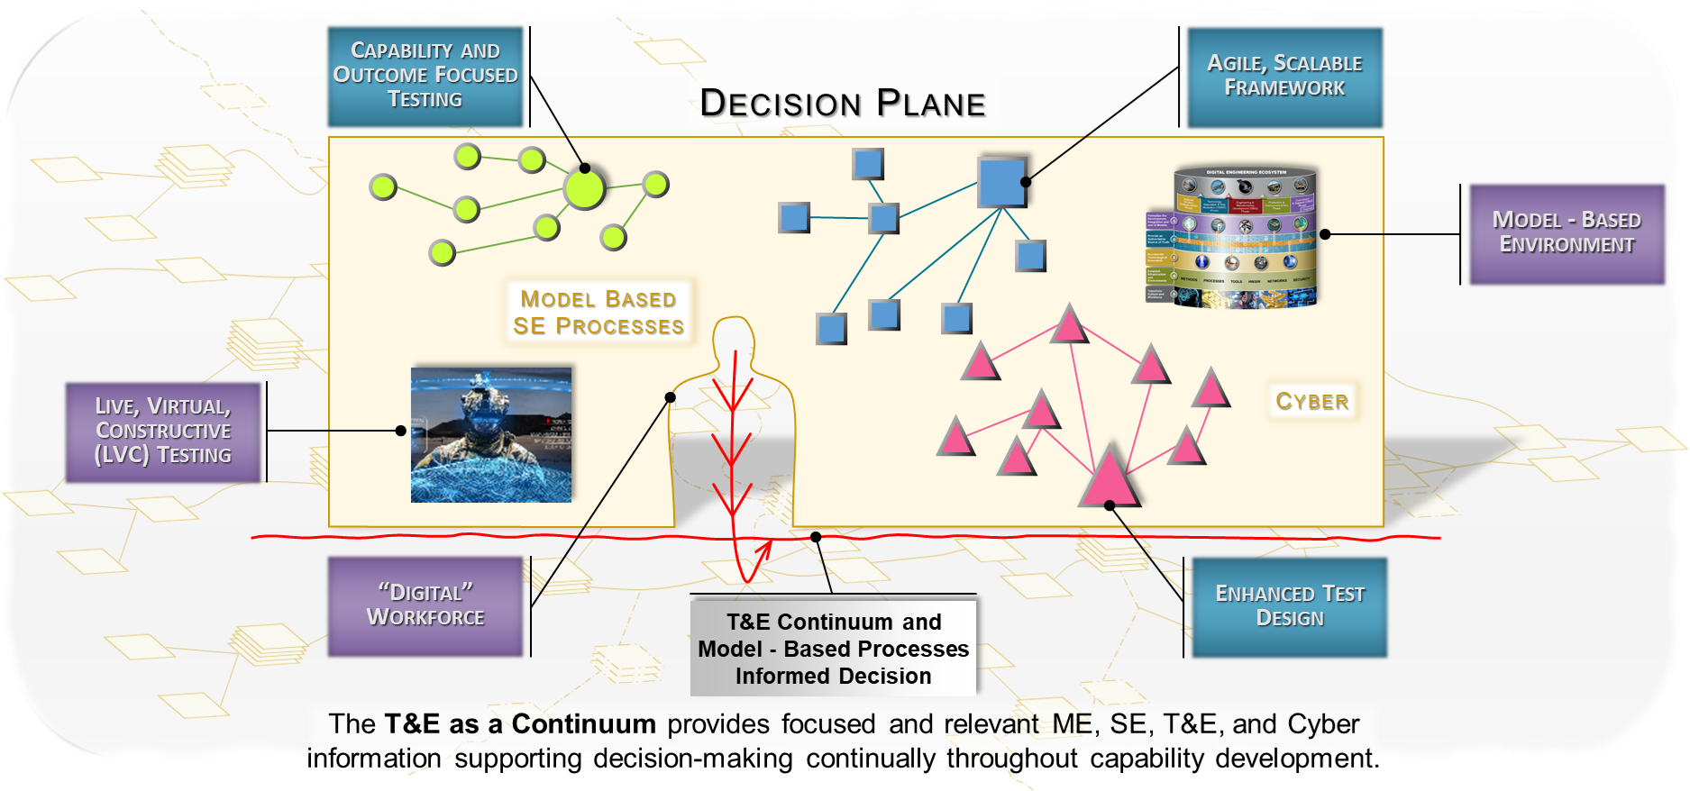
T&E Continuum and Model-Based Processes Informed Decisions
One Decision

Slide 17
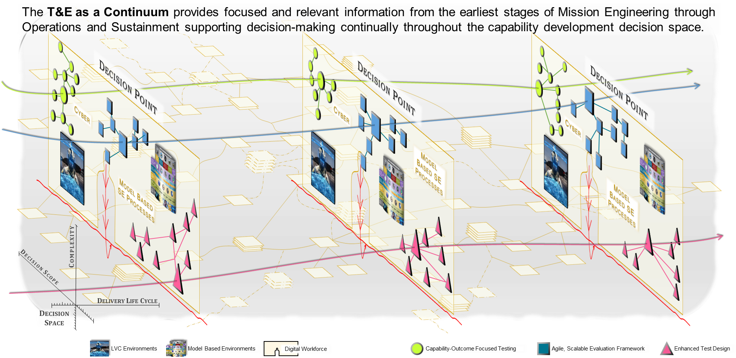
T&E Continuum and Model-Based Processes Informed Decisions
Many Decisions

Slide 18
Challenges
Next Steps and Takeaways

Slide 19
T&E as a Continuum Challenges
Achieving T&E as a Continuum will require surmounting several challenges:
Synchronizing DoD and industry disparate model-based approaches to avoid interoperability issues:
  Establish a coordinated repository identifying community efforts and implementation.
  Develop a consistent T&E modeling schema and data dictionaries with requisite policy and guidance.
Developing iterative T&E approaches for AI/ML and Software systems extending through fielding and O&S to assure the continued “trustworthiness” of these systems.
Adopting a “Model Validation Level” or similar concept to enable defensible use of M&S for evaluating systems and SoS performance.
Evolving and integrating SE and T&E functional domain methods to now work in an iterative testing process:
  Instantiate a “transdisciplinary” holistic approach for SE and T&E vs. current “cross-disciplinary” approach that still relies on SE and T&E to apply their own methods to their specific domains.

Slide 20
T&E as a Continuum Next Steps
Achieving T&E as a Continuum will require several key next steps:
Develop a DoD roadmap implementing T&E as a Continuum Attributes and Enablers for using model-based approaches – focus initially on new start programs.
Establish a core team to assist selected new start and Programs of Record capability development efforts with implementing T&E as a Continuum and sharing lessons-learned.
Develop a consistent reuse of models and data strategy incorporating model/data-driven techniques for conducting VV&A, data standards, and identifying associated supporting infrastructure.
Create an industry partnership to jointly develop key T&E MBSE artifacts, reference models, ontology, and contracting guidance consistent with conducting T&E in a continuum environment.
Socialize an overarching communications strategy across the DoD enterprise explaining the key elements and rationale for conducting T&E as a Continuum.

Slide 21
T&E as a Continuum (TEaaC) Summary Takeaways
The overall acquisition paradigm must transform so DoD can deliver capability at the “speed of relevance”.
TEaaC enables DoD stakeholders to closely align T&E with DoD leadership’s “decision space”.
TEaaC provides “informed risk management” supporting early understanding of development progress across the acquisition lifecycle and confidence in desired capabilities delivery.
  Improvements in risk characterization and overall assurance are critical given the complexity of current DoD capabilities.
The new approach enables DoD to rapidly respond to current and future operating environments changes, rapid advances in threat capabilities, and concepts of operations employment changes – including systems that are “built to change over time” (AI/ML and agile SW)..
TEaaC enables an integration and intertwining of traditional SE and T&E activities providing a transdisciplinary, continuous process coupling design evolution with VV&A.
Conducting T&E as a continuum ensures a more responsive delivery of capability to meet warfighters needs.

Slide 22
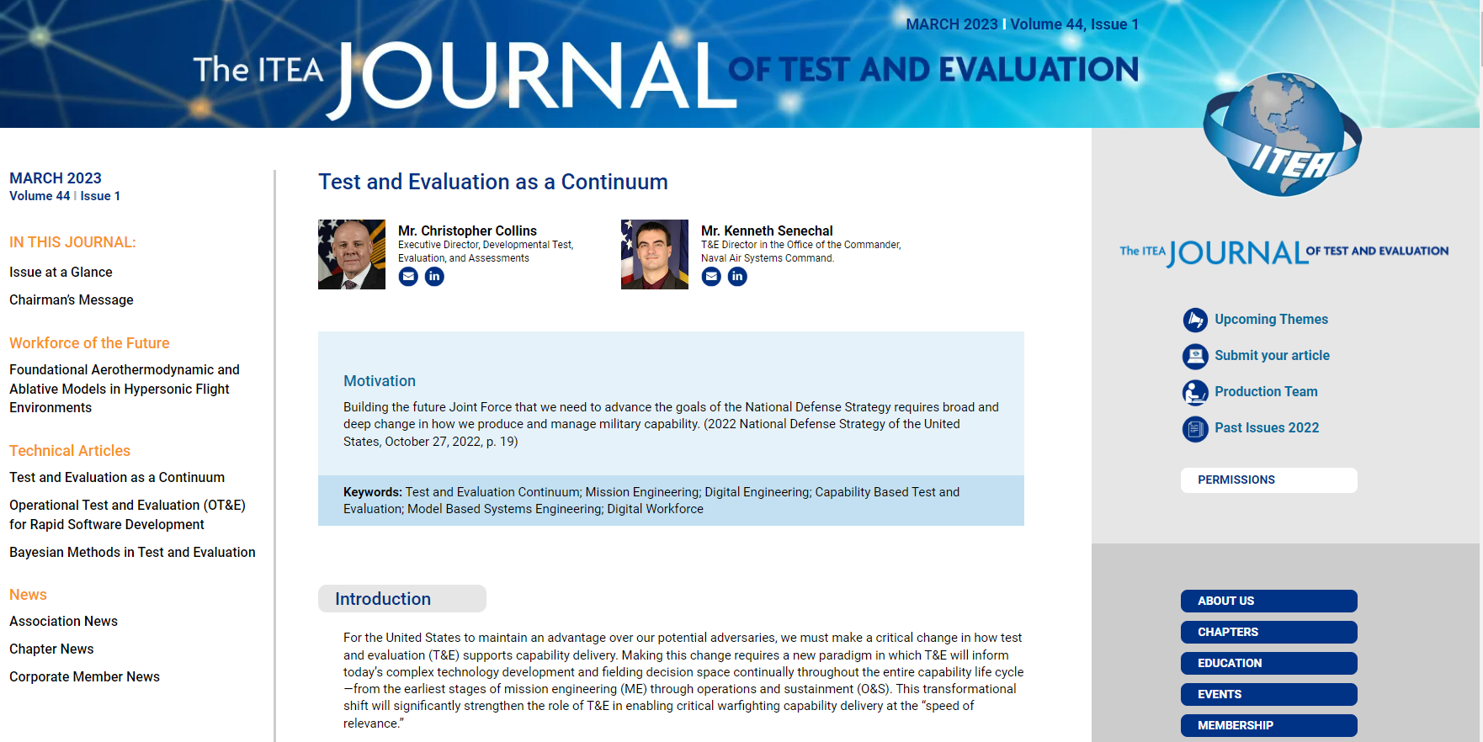
The ITEA Journal of Test and Evaluation
For more information: https://itea.org/journals/volume-44-1/test-and-evaluation-as-a-continuum/

Slide 23
Questions?

Slide 24
BACKUP SLIDES
BACK UP SLIDES

Slide 25
DTE&A Points of Contact
DTE&A Chief Engineer Office
Name | Position | Email
Mr. Orlando Flores | Chief Engineer (CHENG) | orlando.f.flores.civ@mail.mil
Dr. Laura Epifanovskaya | Senior Engineer | laura.w.epifanovskaya.ctr@mail.mil
The MITRE Corporation
Name | Position | Email
Ms. Elizabeth Torres | Project Lead | etorres@mitre.org
Institute for Defense Analyses (IDA)
Name | Position | Email
Dr. John Hong | Assistant Director SED | jhong@ida.org
Johns Hopkins University Applied Physics Laboratory
Name | Position | Email
Mr. Matt Lytwyn | Program Manager | Matthew.Lytwyn@jhuapl.edu
Scientific Test & Analysis Techniques Center of Excellence
Name | Position | Email
Dr. Kyle Kolsti | Acting Director | kyle.kolsti.2@us.af.mil

