Slide 1
Well-Calibrated Uncertainty Quantification for Language Models in the Nuclear Domain
Karl Pazdernik
Pacific Northwest National Laboratory North Carolina State University
PNNL: Lee Burke, Dan Fortin, Ben Wilson, Rustam Goychayev, Sam Chatterjee, Dennis Thomas, Chris Ebsch North Carolina State University: Andrew Hollis, Alyson Wilson, Ralph Smith, John Mattingly University of Michigan: Conrad Hougen, Alfred Hero
Notes:
Image: Abstract Data Visualization – Stock Photo

Slide 2


Introduction and Motivation
Goal: Understand the evolution of literature within the nuclear domain
Identify nuclear-relevant research
Identify new terms/topics within nuclear science
Predict and understand future collaborations
Approach: Use the latest in NLP and Link Prediction
Triage data via document classification
Describe subjects via longitudinal topic modeling
Use evolving topics to provide explainable link prediction

Slide 3
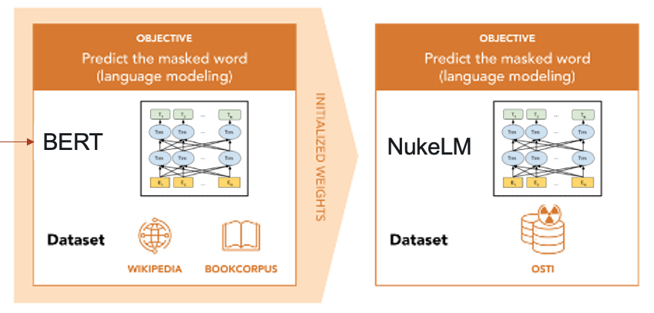
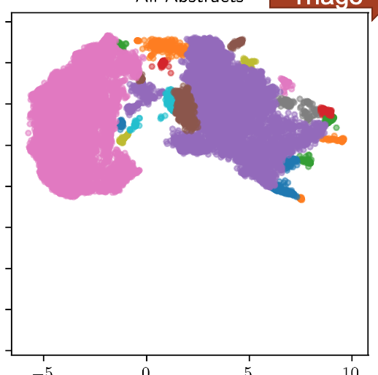
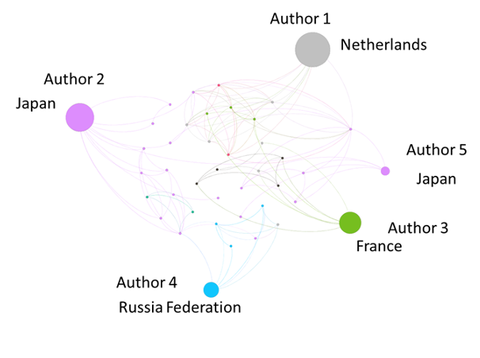
Previous Work
NukeLM: domain adapted language model using a large language model (LLM)
Train models to identify content relevant to nuclear fuel cycle
Triage large document collections
Nuclear Domain Language Understanding
Discover Research Topics
Topic discovery:
NMF, LDA, BERTopic
Community detection, collaboration, and citation networks
Topic aware influence maximization
Collaboration dynamics over time
Key Researchers and Collaborators

Slide 4
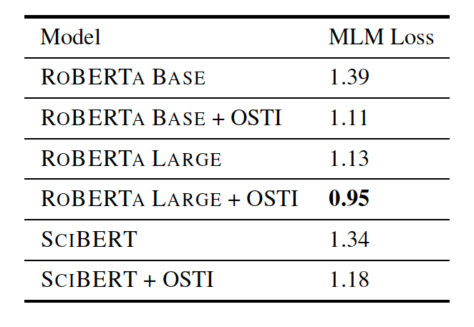
NukeLM: Domain adapted language model
OBJECTIVE
Predict the masked word (language modeling)
t
t
OBJECTIVE
Predict the masked word (language modeling)
NukeLM
BERT
INITIALIZED WEIGHTS
(1.5M Abstracts)
Dataset
Dataset
NukeLM = RoBERTa Large + OSTI
Many possible base models: BERT, RoBERTa, SciBERT, etc
NUKELM: Pre-Trained and Fine-Tuned Language Models for the Nuclear and Energy Domains (2021) ESARDA Bulletin
Notes:
Graphics notes: Need more clear separation between language model graphics and Fine tune model graphics

Slide 5
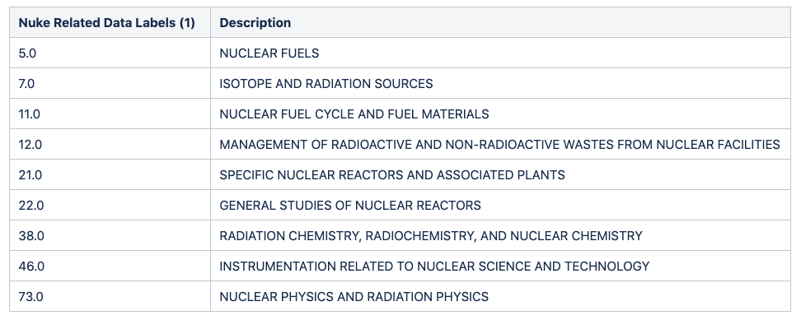
NukeLM classifier using OSTI data labels
Fine-tune model for classification task
t
OBJECTIVE
Predict Document Classification
NukeLM Classifier
Multiclass
The OSTI labels provided in the metadata (60/99 currently used)
Binary
'Nuke’ if it aligns with one of the top level categories of the IAEA physical model.
(190K Abstracts)
Dataset
OSTI LABELS
NFC CATEGORIES WITHIN OSTI
NFC Categories according to Top level of IAEA Physical Model
Notes:
Graphics Notes: The goal here is to create a visual that shows how the OSTI labels were mapped to Nuke/Not Nuke bins. We first used the top level of the IAEA physical model which identified 8 topics categories (not listed on the slide), any OSTI category that corresponded to any those 8 categories was identified and highlighted in the OSTI labels figure. Any paper in OSTI that had one of the OSTI Nuke labels was identified as “Nuke”, other papers were identified as “Not Nuke”. I will make the OSTI label excel file available in the DUDE project share drive. Note that the numbers in the “Nuke related Data Labels” column are topic IDs not counts (i.e. 5 is the topic ID for Nuclear Fuels). We can omit that column to save space since those topic ID numbers are not referenced anywhere else in the slides. IDEA: We might want to add a paper icon getting assigned a Nuke label as part of this graphic as well (Jasmine: we did this together when we met).

Slide 6
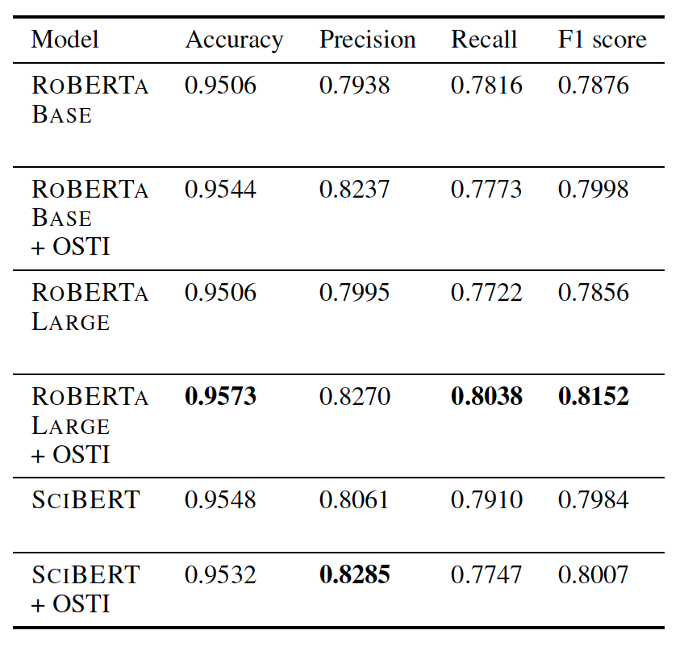
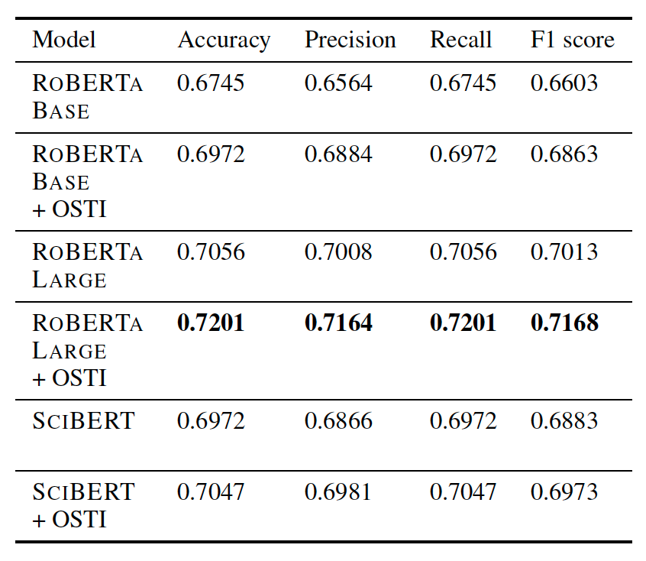
Classification Model Performance Metrics
Binary Classifier
Multiclass Classifier
NukeLM
NukeLM

Slide 7
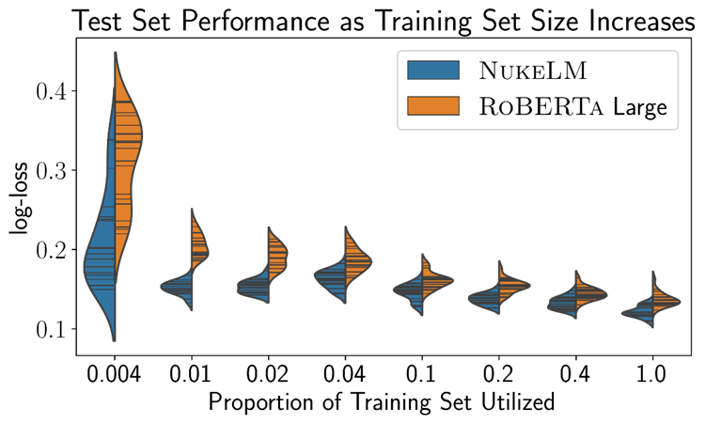
Few-sample Performance
What is the effect of training set size?
NukeLM vs. RoBERTa-Large
Full training set has 188k samples
Conclusion:
NukeLM requires fewer fine-tuning examples to achieve comparable performance to off-the-shelf RoBERTa-Large
…but can we quantify the uncertainty?
Proportion | Number of Samples
0.004 | 754
0.01 | 1886
0.02 | 3773
0.04 | 7546
0.1 | 18865
0.2 | 37730
0.4 | 75461
1 | 188654

Slide 8
Uncertainty Quantification for Text Classification
UQ characteristics:
Efficient: computationally tractable for large text classification models.
Calibrated: confidence is appropriate
Good coverage: coverage rate of credible sets matches threshold, 𝛼
Interpretable: predictive class probabilities agree with our prior notions of class similarity

Slide 9

Efficient: Sampling Time
Assuming at least one GPU is available…
Efficiency = time (seconds/minutes) required to sample draws from a distribution
Distribution = multiple runs or multiple models
Assumes that an analytical solution does not exist
Assumes computational resources are limited
i.e. no massive parallelization

Slide 10
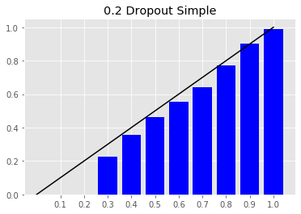
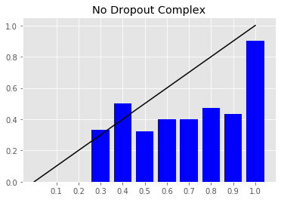
Calibrated: Expected Calibration Error (ECE)
Well-Calibrated
Poorly-Calibrated
Accuracy
Accuracy
Confidence
Confidence

Slide 11
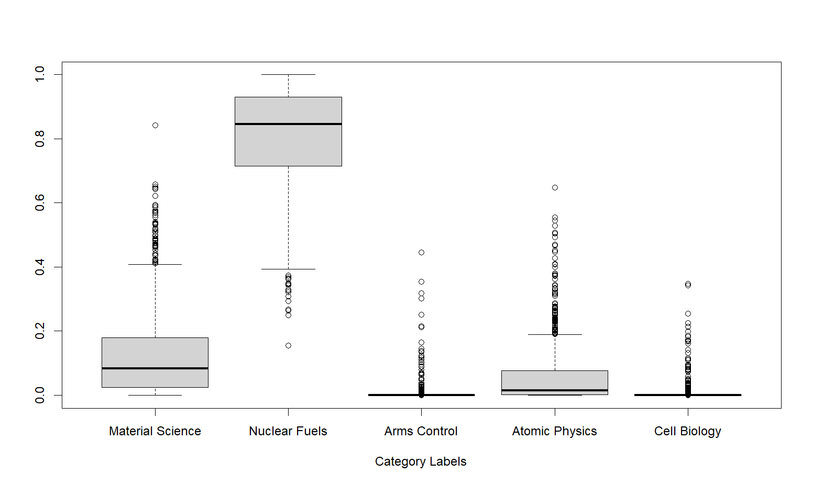
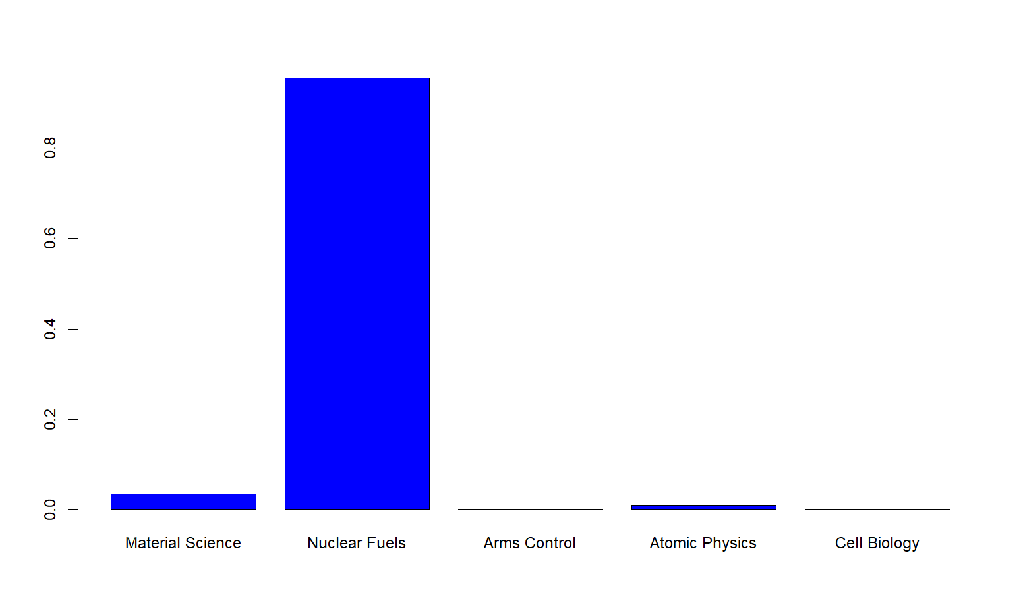



Coverage: Posterior Predictive Coverage (CVG)
Posterior Distribution for $π(x)$
Posterior Predictive for $\hat{y}$
$${cred}_{0.95}(x_{i})$$

Slide 12
Interpretability: Ranking Accuracy (RA)
Ranking by Similarity to Nuclear Fuels
(Nuclear Fuels, Atomic Physics, Material Science, Arms Control, Cell Biology)
Ranking by Predicted Class Probability
(Nuclear Fuels, Material Science, Atomic Physics, Arms Control, Cell Biology)

Slide 13
Previous Work
Weight space Bayesian neural networks:
Attempt to approximate posterior over model weights, 𝑾, using MCMC [8, 12], Laplace approximation [10], variational inference [1, 6], dropout [2], and ensembling [5].
Computationally expensive for models with a large weight set (hundreds of millions for most modern text classifiers).
Induced posterior on class probabilities is hard to control.
Output space UQ:
Variational inference with assumed Dirichlet for class probabilities [4, 7], Laplace approximation on logits and approximate Dirichlet on class probabilities [3].
Fast UQ for large networks and can lead to good calibration
BUT no work has been done to investigate or enforce good coverage and interpretability.
Semantic similarity learning:
Alter standard deep learning loss function to include information about class similarity and encourage sensible ordering of class probabilities by class similarity [9, 11]
No UQ provided.

Slide 14
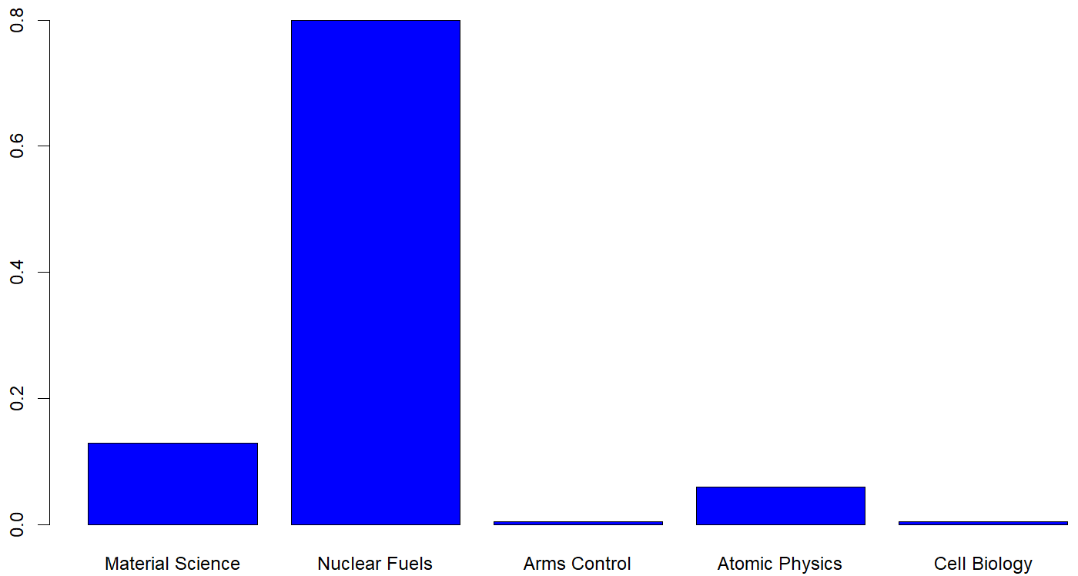






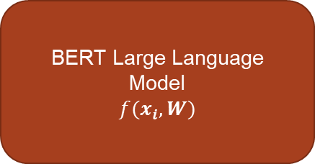

Text Classification
Document
$$x_{i}$$
$${\hat{π}}_{1}(x_{i})$$
BERT Large Language Model
$$f(x_{i},W)$$
$$z_{1}(x_{i})$$
$$⋮$$
Softmax Function
$$⋮$$
$$z_{K}(x_{i})$$
$${\hat{π}}_{K}(x_{i})$$

Slide 15
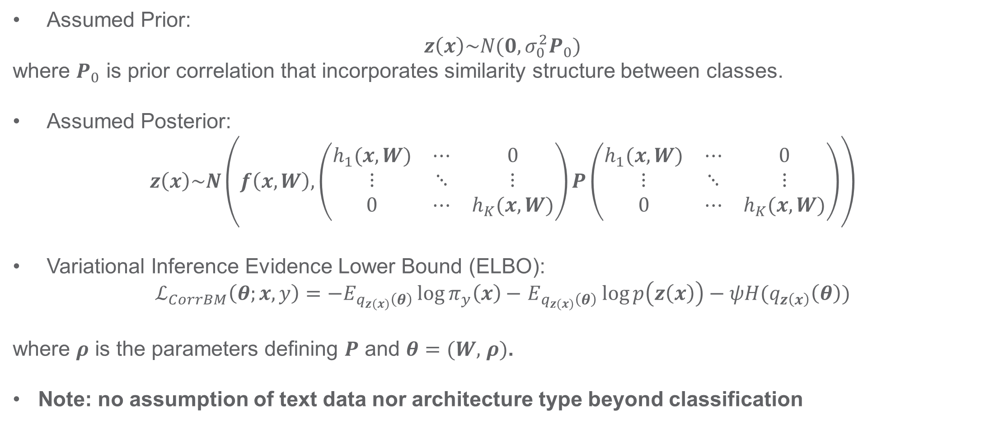
Correlated Belief Matching
Assumed Prior:
$z\left(x\right)\sim N(0,σ_{0}^{2}P_{0})$
where $P_{0}$ is prior correlation that incorporates similarity structure between classes.
Assumed Posterior:
$$z\left(x\right)\sim N\left(f\left(x,W\right),\left(\begin{matrix}h_{1}(x,W) & ⋯ & 0 \\ ⋮ & ⋱ & ⋮ \\ 0 & ⋯ & h_{K}(x,W)\end{matrix}\right)P\left(\begin{matrix}h_{1}(x,W) & ⋯ & 0 \\ ⋮ & ⋱ & ⋮ \\ 0 & ⋯ & h_{K}(x,W)\end{matrix}\right)\right)$$
Variational Inference Evidence Lower Bound (ELBO):
$ℒ_{CorrBM}\left(θ;x,y\right)=−E_{q_{z\left(x\right)}\left(θ\right)}\log{π_{y}\left(x\right)}−$ $E_{q_{z\left(x\right)}\left(θ\right)}\log{p\left(z\left(x\right)\right)}−ψH(q_{z\left(x\right)}\left(θ\right))$
where $ρ$ is the parameters defining $P$ and $θ=(W,$ $ρ)$.
Note: no assumption of text data nor architecture type beyond classification

Slide 16
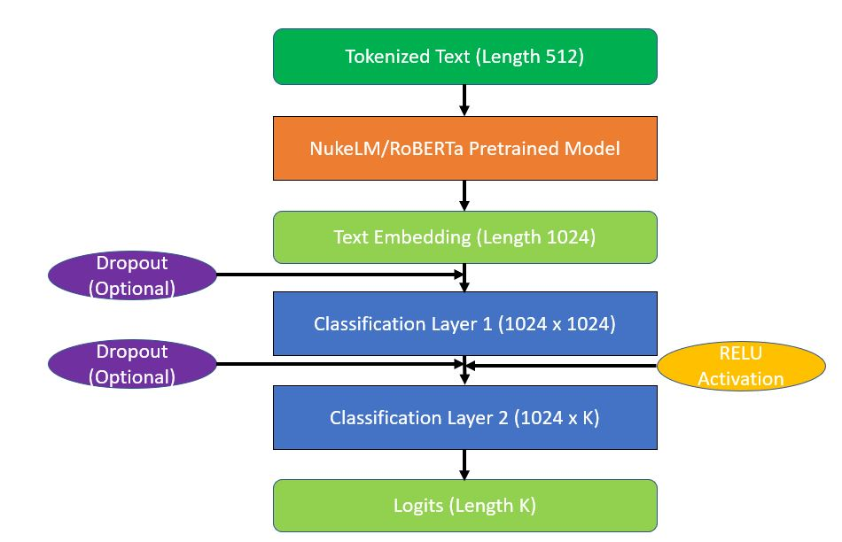
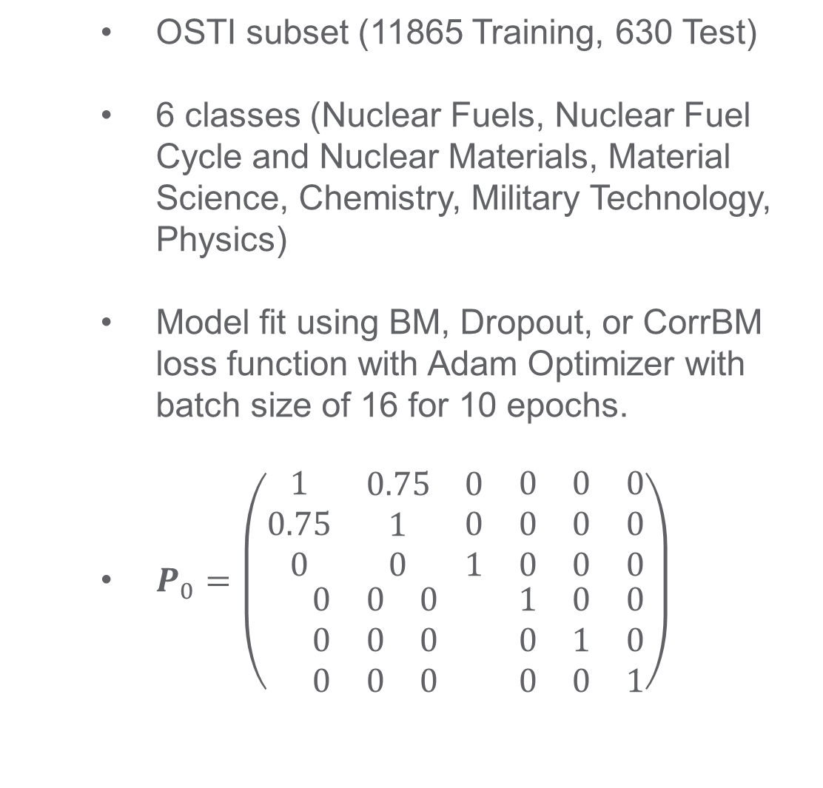
Subset OSTI Data
OSTI subset (11865 Training, 630 Test)
6 classes (Nuclear Fuels, Nuclear Fuel Cycle and Nuclear Materials, Material Science, Chemistry, Military Technology, Physics)
Model fit using BM, Dropout, or CorrBM loss function with Adam Optimizer with batch size of 16 for 10 epochs.
$P_{0}=\left(\begin{matrix}\begin{matrix}\begin{matrix}1 \\ 0.75 \\ 0\end{matrix} & \begin{matrix}0.75 \\ 1 \\ 0\end{matrix} & \begin{matrix}0 \\ 0 \\ 1\end{matrix}\end{matrix} & \begin{matrix}\begin{matrix}0 \\ 0 \\ 0\end{matrix} & \begin{matrix}0 \\ 0 \\ 0\end{matrix} & \begin{matrix}0 \\ 0 \\ 0\end{matrix}\end{matrix} \\ \begin{matrix}\begin{matrix}0 \\ 0 \\ 0\end{matrix} & \begin{matrix}0 \\ 0 \\ 0\end{matrix} & \begin{matrix}0 \\ 0 \\ 0\end{matrix}\end{matrix} & \begin{matrix}\begin{matrix}1 \\ 0 \\ 0\end{matrix} & \begin{matrix}0 \\ 1 \\ 0\end{matrix} & \begin{matrix}0 \\ 0 \\ 1\end{matrix}\end{matrix}\end{matrix}\right)$

Slide 17
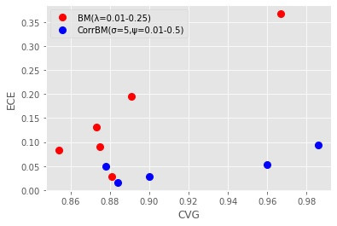
Subset OSTI Data, Results
 | BM | CorrBM | Dropout
Accuracy | 86.7% | 85.1% | 82.4%
ECE | 0.029 | 0.029 | 0.030
CVG | 88.1% | 90.0% | 93.7%
RA | 0.645 | 0.921 | 0.844
Sampling Time | 0.66 minutes | 0.38 minutes | 51.9 minutes

Slide 18
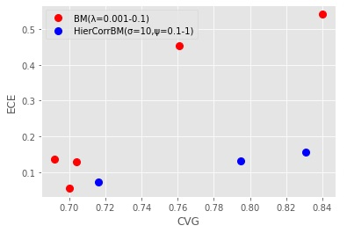
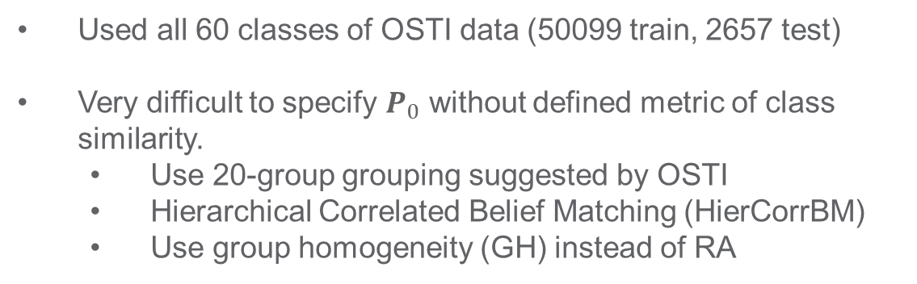
Full OSTI Data
Used all 60 classes of OSTI data (50099 train, 2657 test)
Very difficult to specify $P_{0}$ without defined metric of class similarity.
Use 20-group grouping suggested by OSTI
Hierarchical Correlated Belief Matching (HierCorrBM)
Use group homogeneity (GH) instead of RA
 | BM | HierCorrBM | Dropout
Accuracy | 68.3% | 67.3% | 68.7%
ECE | 0.129 | 0.132 | 0.131
CVG | 70.4% | 79.5% | 83.3%
GH | 0.120 | 0.479 | 0.266
Sampling Time | 2.47 minutes | 1.47 minutes | 216.75 minutes

Slide 19
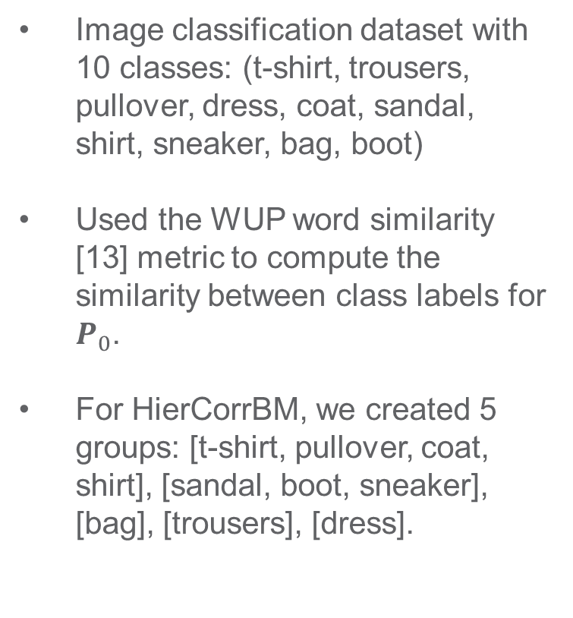
MNIST Fashion Data
Image classification dataset with 10 classes: (t-shirt, trousers, pullover, dress, coat, sandal, shirt, sneaker, bag, boot)
Used the WUP word similarity [13] metric to compute the similarity between class labels for $P_{0}$.
For HierCorrBM, we created 5 groups: [t-shirt, pullover, coat, shirt], [sandal, boot, sneaker], [bag], [trousers], [dress].
 | BM | CorrBM | HierCorrBM | Dropout
Accuracy | 90.4% | 90.1% | 90.2% | 90.1%
ECE | 0.031 | 0.031 | 0.030 | 0.029
CVG | 90.9% | 95.3% | 95.9% | 93.2%
RA | 0.77 | 0.90 | NA | 0.82
Sampling Time | 7.2 seconds | 8.1 seconds | 6.0 seconds | 48.8 seconds

Slide 20
Summary
Nuclear-relevant research is identified by a language model trained for nuclear literature classification (NukeLM)
Achieves improved classification performance over off-the-shelf language models.
Pre-training first helps mitigate the effect of small sample sizes.
UQ added to NukeLM with prior correlation structure
Computationally efficient
Well-calibrated in terms of error and coverage
Interpretable correlation with optimal class ranking

Slide 21
So What?
How do we use subject information about scientific literature to model and explain trends in nuclear research?
Triaging literature is a start
…but scientific categories evolve
…and categorization alone does not characterize research.

Slide 22
Introduction and Motivation
Goal: Understand the evolution of literature within the nuclear domain
Identify nuclear-relevant research
Identify new terms/topics within nuclear science
Predict and understand future collaborations
Approach: Use the latest in NLP and Link Prediction
Triage data via document classification
Describe subjects via longitudinal topic modeling
Use evolving topics to provide explainable link prediction

Slide 23
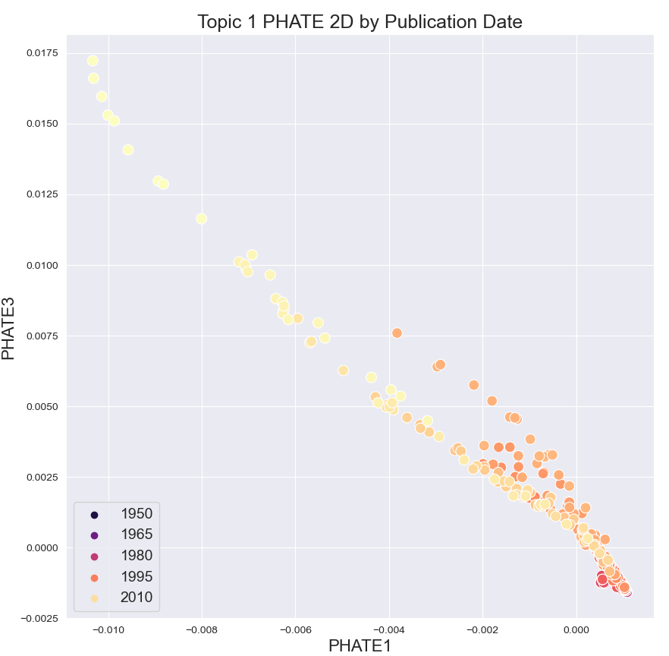
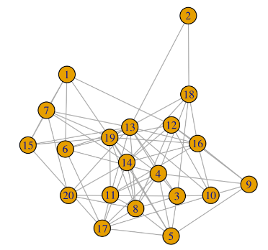
Link Prediction
Notes:
Already subset down to “nuclear” or even “nuclear fuel”.
Within this subset, we can predict future collaborations in the network.

Slide 24
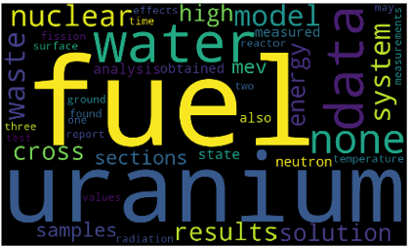
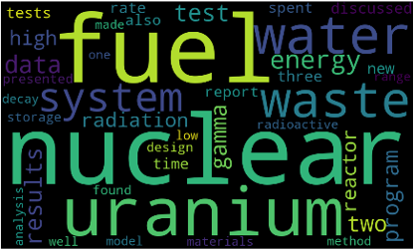
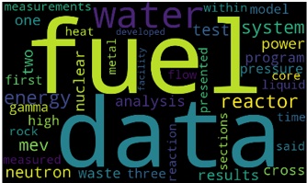
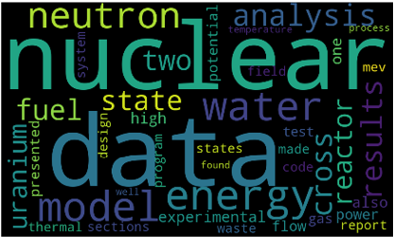
Explainable via Dynamic Topic Modeling
Notes:
We now provide link prediction that is explainable through dynamic topic models.
Predict the black dot, red dot is ground truth.

Slide 25
References
[1] Blundell, Charles, et al. "Weight uncertainty in neural network." International conference on machine learning. PMLR, 2015. (P3-7)
[2] Gal, Yarin, and Zoubin Ghahramani. "Dropout as a Bayesian approximation: Representing model uncertainty in deep learning." international conference on machine learning. PMLR, 2016. (P3-9)
[3] Hobbhahn, Marius, Agustinus Kristiadi, and Philipp Hennig. "Fast predictive uncertainty for classification with bayesian deep networks." Uncertainty in Artificial Intelligence. PMLR, 2022. (P3-13)
[4] Joo, Taejong, Uijung Chung, and Min-Gwan Seo. "Being Bayesian about categorical probability." International conference on machine learning. PMLR, 2020. (P3-12)
[5] ] Lakshminarayanan, Balaji, Alexander Pritzel, and Charles Blundell. "Simple and scalable predictive uncertainty estimation using deep ensembles." Advances in neural information processing systems 30 (2017). (P3-10)
[6] Louizos, Christos, and Max Welling. "Structured and efficient variational deep learning with matrix gaussian posteriors." International conference on machine learning. PMLR, 2016. (P3-8)
[7] Malinin, Andrey, and Mark Gales. "Predictive uncertainty estimation via prior networks." Advances in neural information processing systems 31 (2018). (P3-11)
[8] Neal, Radford M. Bayesian learning for neural networks. Vol. 118. Springer Science & Business Media, 2012. (P3-4)
[9] Olmo, Alberto, Sailik Sengupta, and Subbarao Kambhampati. "Not all failure modes are created equal: Training deep neural networks for explicable (mis) classification." arXiv preprint arXiv:2006.14841 (2020). (P3-14)
[10] Ritter, Hippolyt, Aleksandar Botev, and David Barber. "A scalable Laplace approximation for neural networks." 6th International Conference on Learning Representations, ICLR 2018-Conference Track Proceedings. Vol. 6. International Conference on Representation Learning, 2018. (P3-6)
[11] Tong, Xuezhi, et al. "Semantic correlations loss: improving model interpretability for multi-class classification." 2019 IEEE International Conference on Big Data (Big Data). IEEE, 2019. (P3-3)
[12] Zhang, Ruqi, et al. "Cyclical stochastic gradient MCMC for Bayesian deep learning." arXiv preprint arXiv:1902.03932 (2019). (P3-5)
[13] Zhibiao Wu and Martha Palmer. “Verbs semantics and lexical selection.” In Proceedings of the 32Nd Annual Meeting on Association for Computational Linguistics, ACL ’94, pages 133–138, Stroudsburg, PA, USA. Association for Computational Linguistics, 1994.

Slide 26
karl.pazdernik@pnnl.gov
PNNL-SA-184003

Slide 27
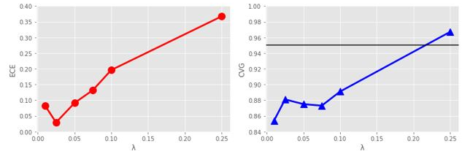
Small Data Experiment, Original Belief Matching
ECE and CVG increase together because BM increase coverage by regularizing posterior to a Dir(1,…,1).
Tradeoff between ECE and CVG!

Slide 28
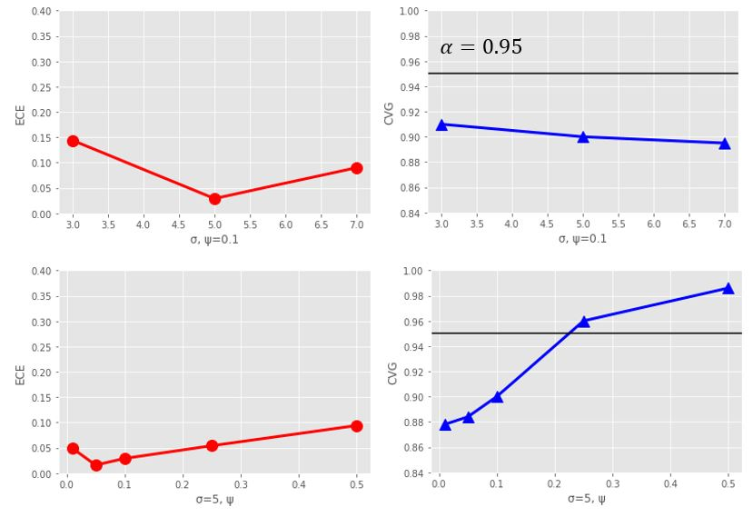
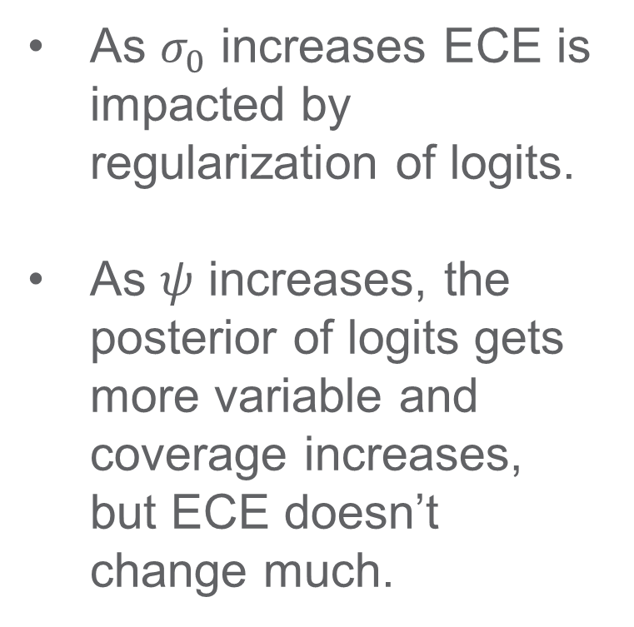
Small Data Experiment, Correlated Belief Matching
As $σ_{0}$ increases ECE is impacted by regularization of logits.
As $ψ$ increases, the posterior of logits gets more variable and coverage increases, but ECE doesn’t change much.

Slide 29
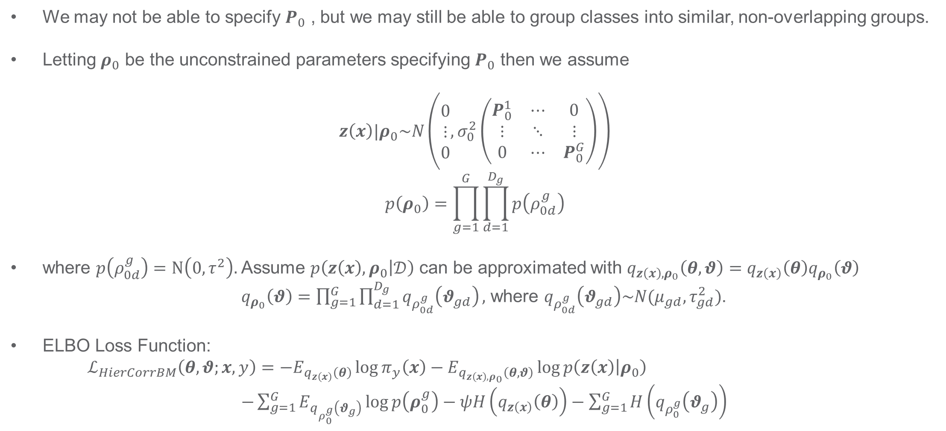
Hierarchical Correlated Belief Matching
We may not be able to specify $P_{0}$ , but we may still be able to group classes into similar, non-overlapping groups.
Letting $ρ_{0}$ be the unconstrained parameters specifying $P_{0}$ then we assume
$$z\left(x\right)|ρ_{0}\sim N\left(\begin{matrix}0 \\ ⋮ \\ 0\end{matrix},σ_{0}^{2}\left(\begin{matrix}P_{0}^{1} & ⋯ & 0 \\ ⋮ & ⋱ & ⋮ \\ 0 & ⋯ & P_{0}^{G}\end{matrix}\right)\right)$$
$$p\left(ρ_{0}\right)=\prod_{g=1}^{G}{\prod_{d=1}^{D_{g}}{p\left(ρ_{0d}^{g}\right)}}$$
where $p\left(ρ_{0d}^{g}\right)=N\left(0,τ^{2}\right).$Assume $p\left(z\left(x\right),ρ_{0} | 𝒟\right)$ can be approximated with $q_{z\left(x\right),ρ_{0}}\left(θ,θ\right)=q_{z\left(x\right)}\left(θ\right)q_{ρ_{0}}\left(θ\right)$ $q_{ρ_{0}}\left(θ\right)=\prod_{g=1}^{G}{\prod_{d=1}^{D_{g}}{q_{ρ_{0d}^{g}}\left(θ_{gd}\right)}},$ where $q_{ρ_{0d}^{g}}\left(θ_{gd}\right)\sim N(μ_{gd},τ_{gd}^{2})$.
ELBO Loss Function:
$ℒ_{HierCorrBM}\left(θ,θ;x, y\right)=−E_{q_{z\left(x\right)}\left(θ\right)}\log{π_{y}\left(x\right)}−E_{q_{z\left(x\right),ρ_{0}}\left(θ,θ\right)}\log{p\left(z\left(x\right) | ρ_{0}\right)}$ $−\sum_{g=1}^{G}{E_{q_{ρ_{0}^{g}}\left(θ_{g}\right)}\log{p\left(ρ_{0}^{g}\right)}−ψH\left(q_{z\left(x\right)}\left(θ\right)\right)−\sum_{g=1}^{G}{H\left(q_{ρ_{0}^{g}}\left(θ_{g}\right)\right)}}$

Slide 30
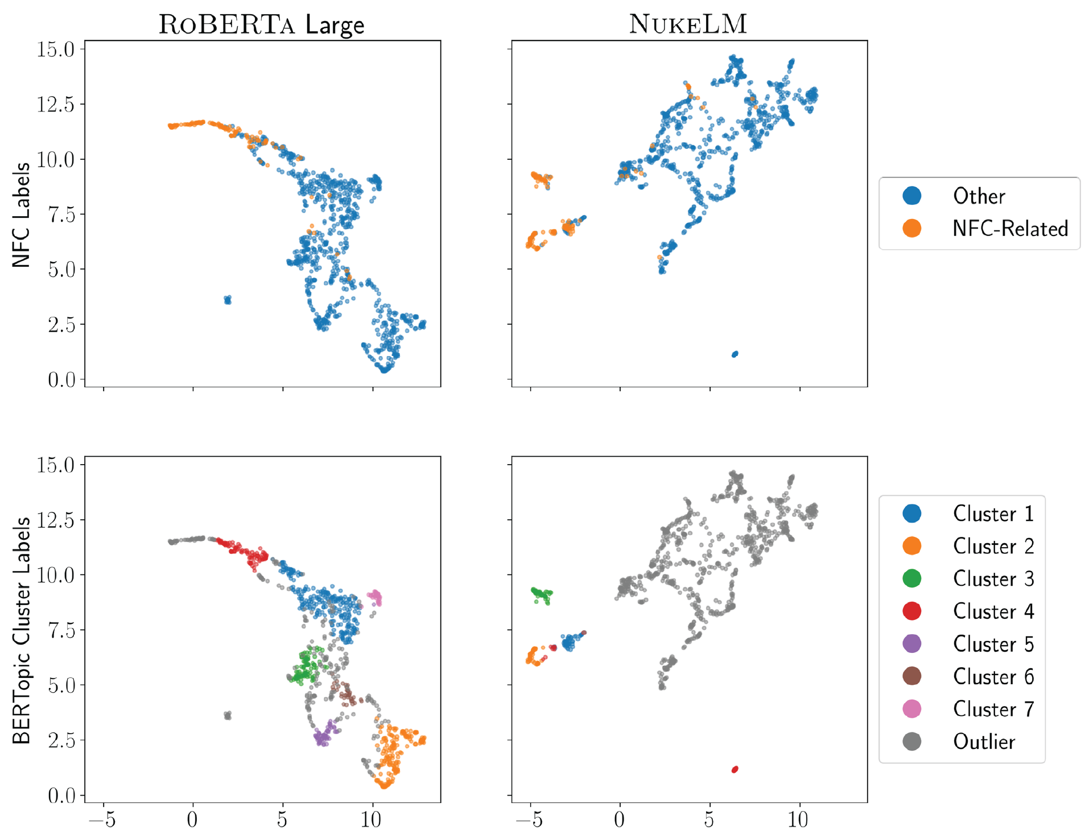
Standard Topic Modeling
NukeLM embeddings have greater separation
Especially within the nuclear domain
Static:
Assumes that vocabulary doesn’t change!
MeV nuclei energies
reactor waste fuel
Waste safety SAR
Scattering interaction generation
Notes:
RoBERTA clusters:
1 beam, ion, states
2 coal, fuel, oil
3 films, alloy, materials
4 waste, nuclear, radiation
5 cells, protein, cell
6 soil, acid, conduit
7 dust, galaxies, observations
NukeLM clusters:
1 waste, safety, SAR
2 reactor, waste, fuel
3 MeV, nuclei, energies
4 Scattering, interaction, generation

