Slide 1
Tools for Assessing Machine Learning Models' Performance in Real-World Settings
Practical approaches to reducing risk
Presented by: Cari Martinez
SAND2023-02427C

Slide 2
Peer review steps
1. Inspect and assess the data used for training and evaluation.
2. Compare the training and evaluation data to data sampled from the deployment domain.
3. Review the ML source code.
4. Independently train and evaluate the ML model in an environment similar to (ideally, identical to) the deployed system.
5. Review methods used to understand model behavior, such as explanations and uncertainty quantification.
6. Document findings, identify risks, and recommend mitigations.
ML Performance Assessment
Does the model perform its task correctly?
Will it perform well in a deployed setting?
What are the limitations of the model? Are they communicated to the end users?
How well does the model perform its task and what risks exist?
No single tool or process captures every scenario.

Slide 3



Easy-to-implement tools reduce ML deployment risk
Existing, accessible methods can be integrated into ML development workflows with little effort.
Topics today:
Review data
Documentation
Feature distribution and correlation
Train-test gaps
Evaluate model
Documentation
Performance metrics
Robustness
Uncertainty quantification
Explainability
Reproducibility

Slide 4

Data review
Goals
Tools
1. Inspect and assess the data used for training and evaluation.
2. Compare the training and evaluation data to data sampled from the deployment domain.
Datasheets for Datasets
Gebru, T., et al. (2021). Datasheets for datasets. Communications of the ACM, 64(12), 86-92.
DeepChecks
Chorev, S., et al. (2022). Deepchecks: A Library for Testing and Validating Machine Learning Models and Data. Journal of Machine Learning Research, 23(285), 1-6.

Slide 5
Data review: Datasheets for Datasets
Motivation
For what purpose was the dataset created?
Composition
What do the instances that comprise the dataset represent (e.g., documents, photos, people, countries)?
Does the dataset identify any subpopulations (e.g., by age, gender)?
Is it possible to identify individuals (i.e., one or more natural persons), either directly or indirectly (i.e., in combination with other data) from the dataset?
Collection Process
How was the data associated with each instance acquired?
If the dataset is a sample from a larger set, what was the sampling strategy (e.g., deterministic, probabilistic with specific sampling probabilities)?
Preprocessing/cleaning/labeling
Was any preprocessing/cleaning/labeling of the data done?
Was the “raw” data saved in addition to the preprocessed/cleaned/labeled data?
Uses
Has the dataset been used for any tasks already?
Is there anything about the composition of the dataset or the way it was collected and preprocessed/cleaned/labeled that might impact future uses?
Distribution
Will the dataset be distributed under a copyright or other intellectual property (IP) license, and/or under applicable terms of use (ToU)?
Maintenance
Who will be supporting/hosting/maintaining the dataset?

Slide 6
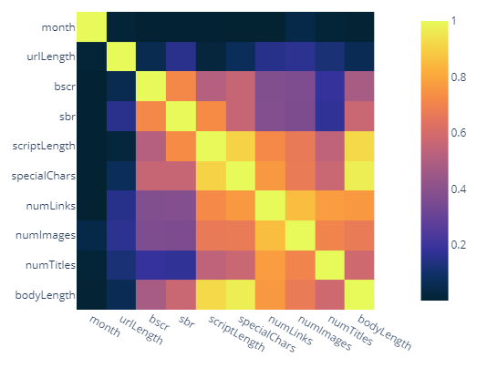
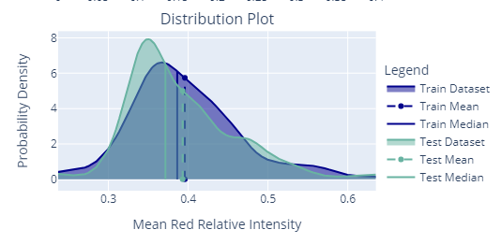
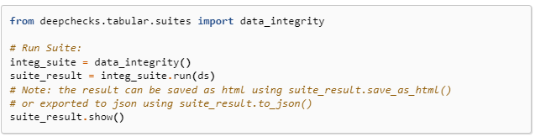
Data review: DeepChecks
Data Integrity Suite
Feature correlations
Label inconsistencies
Uninformative features
Train-Test Validation Suite
Data Leakage
Feature drift
Label distribution
https://docs.deepchecks.com/stable/user-guide/tabular/auto_tutorials/plot_phishing_urls.html
https://docs.deepchecks.com/stable/user-guide/vision/auto_tutorials/plot_classification_tutorial.html

Slide 7
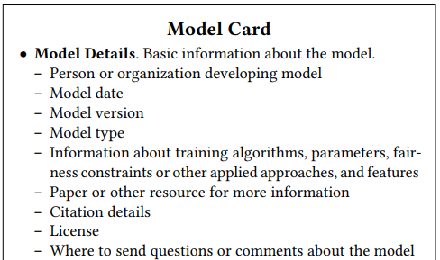
Model review
Goals
Tools
Model cards
Mitchell, M., et al.(2019, January). Model cards for model reporting. In Proceedings of the Conference on fairness, accountability, and transparency (pp. 220-229).
DeepChecks
Chorev, S., et al. (2022). Deepchecks: A Library for Testing and Validating Machine Learning Models and Data. Journal of Machine Learning Research, 23(285), 1-6.
Responsible AI Toolbox
Soklaski, R., et al.. "Tools and practices for responsible AI engineering." arXiv preprint arXiv:2201.05647 (2022).
Adversarial Robustness Toolbox
Nicolae, M. I.., et al. (2018). Adversarial Robustness Toolbox v1. 0.0. arXiv preprint arXiv:1807.01069.
AI FactSheets
Arnold, M., et al.. (2019). FactSheets: Increasing trust in AI services through supplier's declarations of conformity. IBM Journal of Research and Development, 63(4/5), 6-1.
3. Review the ML source code.
4. Independently train and evaluate the ML model in an environment similar to (ideally, identical to) the deployed system.

Slide 8
Model review: Model cards
Model Details
Basic information about the model.
Training algorithms, parameters, fairness constraints or other applied approaches, and features
Intended Use
Primary intended uses, users
Out-of-scope use cases
Factors
Demographic or phenotypic groups
Environmental conditions
Technical attributes
Metrics
Performance measures
Decision thresholds
Training/Evaluation Data
Description/datasheet
Quantitative Analyses
Evaluation set metrics
Subgroup analyses
Ethical Considerations
Data sensitivities
Decision impacts
Caveats and Recommendations
Analysis of results
Mitigation of risks

Slide 9
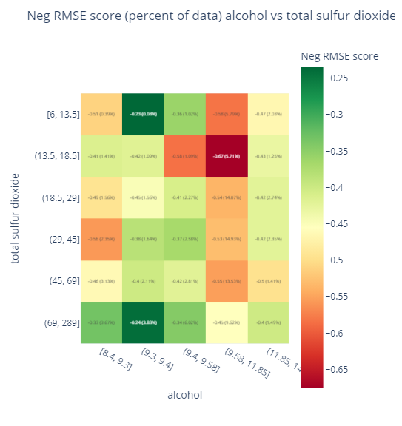
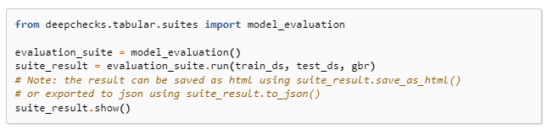
Model review: DeepChecks
Model Evaluation Suite
Train/test performance comparison
Error analysis
Baseline model comparison
Weak subpopulation performance
https://docs.deepchecks.com/stable/user-guide/tabular/auto_quickstarts/plot_quick_model_evaluation.html#WeakSegmentsPerformance-TrainDataset_I3QK2IAGL58KXO9T7E8G8JDP0-section-LVSNU

Slide 10
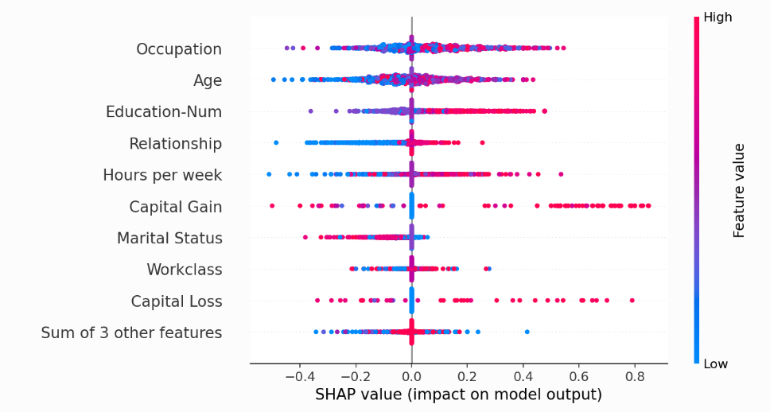
Interpret and document model results
Goals
Tools
5. Review methods used to understand model behavior, such as explanations and uncertainty quantification.
6. Document findings, identify risks, and recommend mitigations.
Ensemble methods – Monte Carlo dropout
Gal, Y., & Ghahramani, Z. (2016, June). Dropout as a bayesian approximation: Representing model uncertainty in deep learning. In International Conference on Machine Learning (pp. 1050-1059). PMLR.
Explainability – SHAP
Lundberg, S. M., & Lee, S. I. (2017). A unified approach to interpreting model predictions. Advances in neural information processing systems, 30.
Reproducibility - Weights and Biases
Biewald, L. (2020). Experiment tracking with weights and biases, 2020. Software available from wandb.com, 2(5).
https://shap.readthedocs.io/en/latest/example_notebooks/tabular_examples/model_agnostic/Census%20income%20classification%20with%20scikit-learn.html

Slide 11
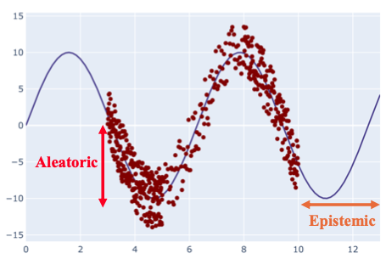
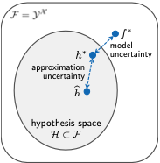
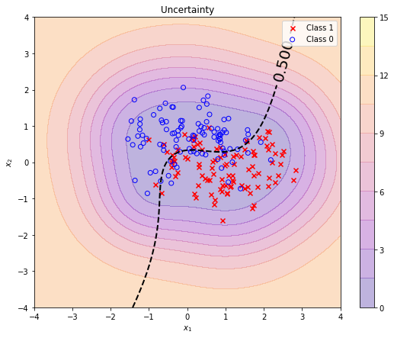
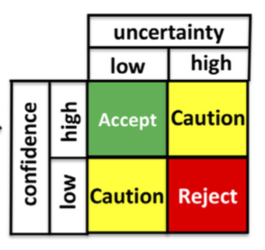
Bayesian Uncertainty Framework
Uncertainty is a term often raised as having dire importance to machine learning, but it is
lacking mathematical formalism
used without qualification (what kind of uncertainty)
decomposed into multiple contradicting taxonomies
deployed in cases where it may not may sense
examples where “uncertainty” appears
Uncertainty
PU = AU + EU
AU: aleatoric uncertainty
EU: epistemic uncertainty
PU: predictive uncertainty
Sandia QUQ LDRD: T. Ganter, et al.
11

Slide 12
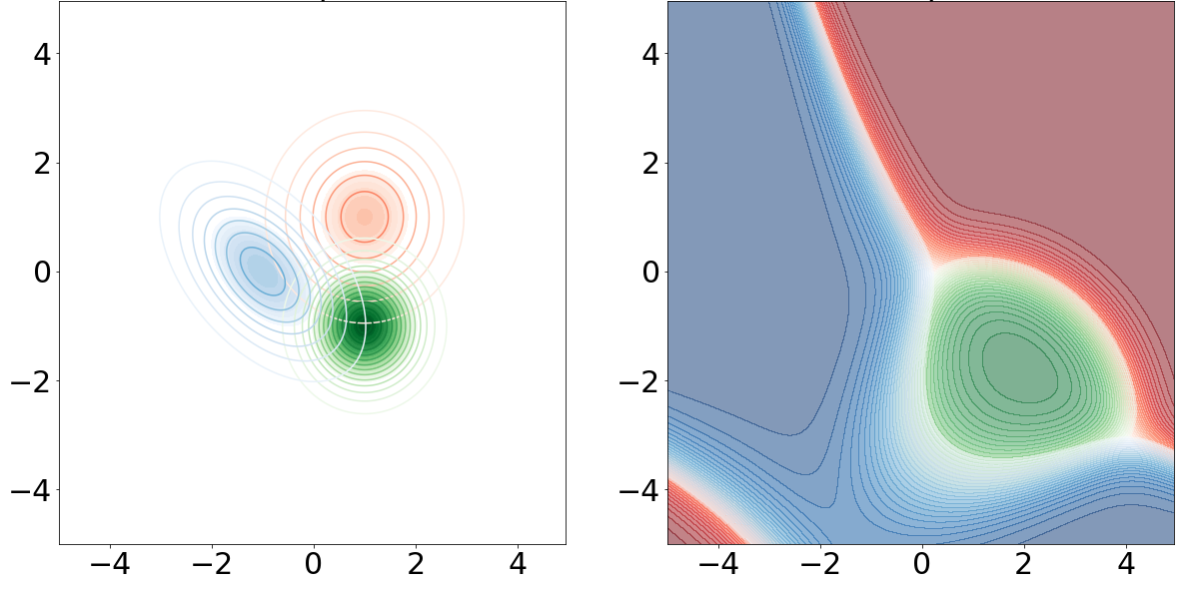
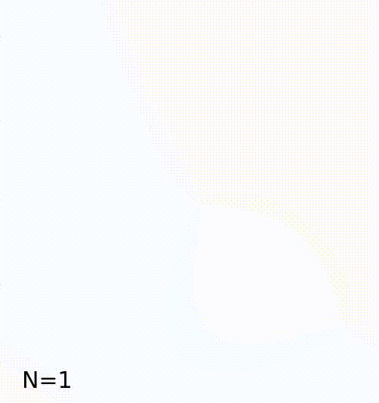
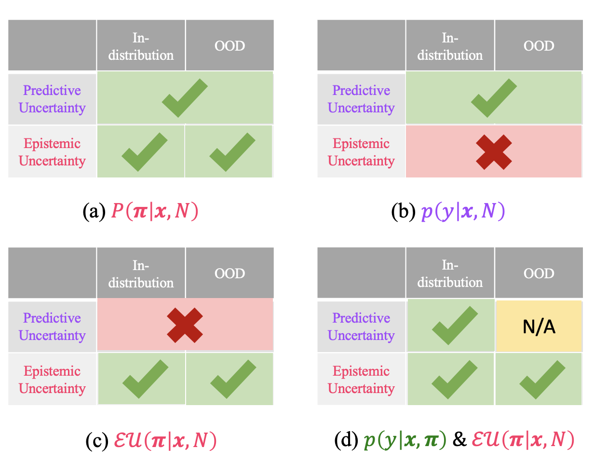
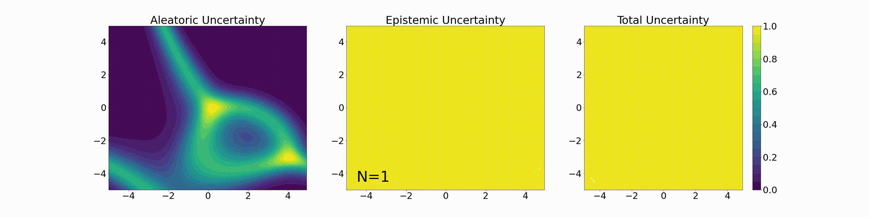
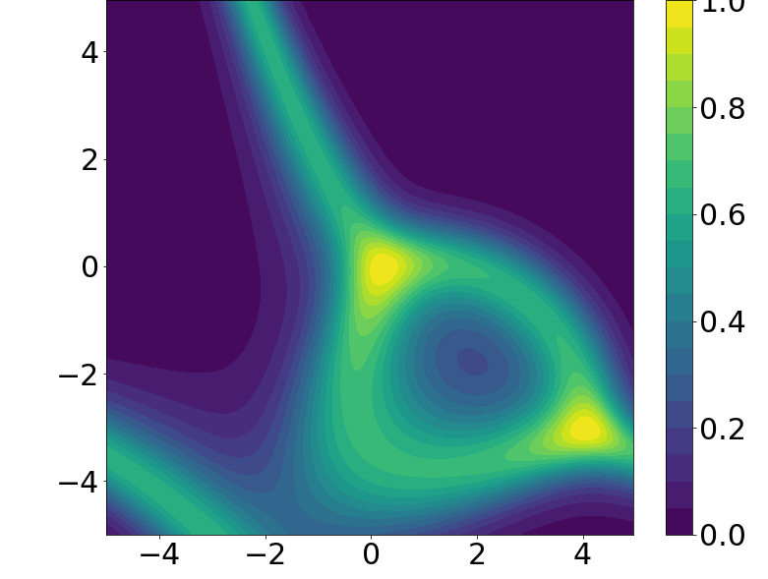
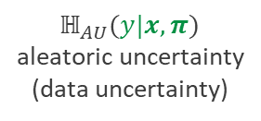




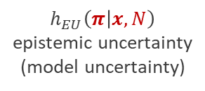

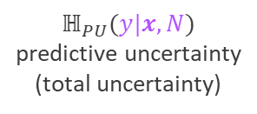
Bayesian Uncertainty Framework
Formal definitions
$$P\left(x|y\right)$$
$$p\left(y|x,π\right)$$
$$p\left(y | x,N\right)=𝔼[π|x,N]$$
A proposed formal framework with clear definitions provides…
clear communication among researchers
a scope of the theoretical capabilities and limitations of UQ
understanding of what evaluation procedures are appropriate considering the type of uncertainty estimated
a capped number of sensible deployment approaches for practitioners
$$x_{1}$$
$$x_{0}$$
Uncertainty
$$ℍ_{PU}(y|x,N)$$
predictive uncertainty
(total uncertainty)
The 4 UQ deployments
$$ℍ_{AU}(y|x,π)$$
aleatoric uncertainty
(data uncertainty)
$$h_{EU}\left(π | x,N\right)$$
epistemic uncertainty
(model uncertainty)
12
Sandia QUQ LDRD: T. Ganter, et al.

Slide 13
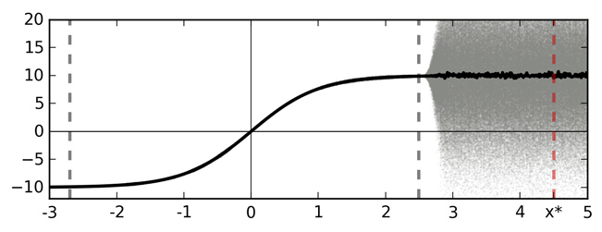
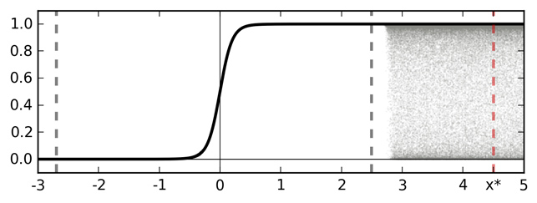
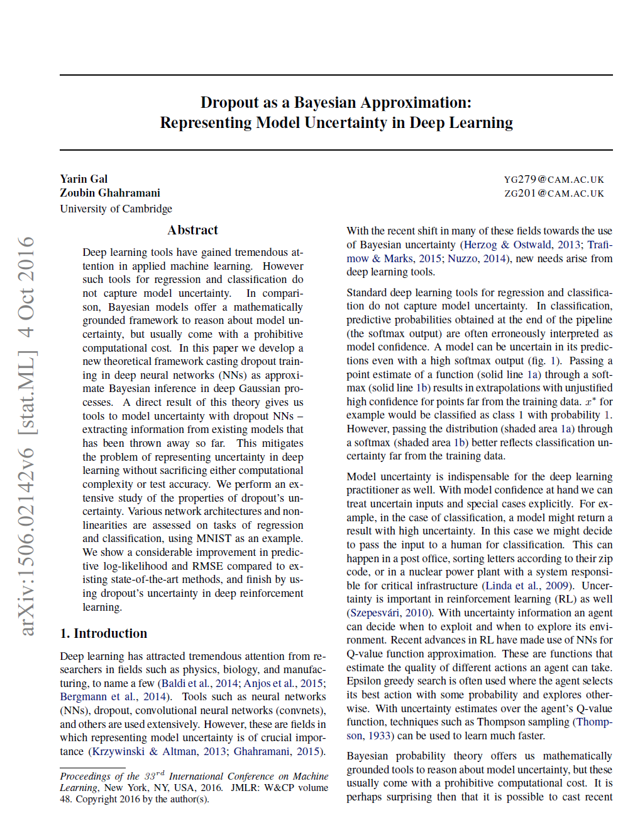
Standard neural network models do not provide error bars
Softmax output is not enough to determine model uncertainty.
Solid black line is the result when dropout is not used.
Grey area shows inputs and outputs when dropout is used during inference.
We can use dropout at inference time to approximate uncertainty.
Training domain
Training domain
Softmax layer input
Softmax layer output
NN input value
NN input value
“Dropout as a Bayesian Approximation” – Gal et. al., 2016
https://www.cs.ox.ac.uk/people/yarin.gal/website/blog_3d801aa532c1ce.html
Notes:
https://www.cs.ox.ac.uk/people/yarin.gal/website/blog_3d801aa532c1ce.html
A sketch of softmax input and output for an idealised binary classification problem. Training data is given between the dashed grey lines (the pale blue area). Function point estimate is shown with a solid line (TanH for simplicity — left). Function uncertainty is shown with a shaded area. Marked with a dashed red line is a point $x^*$ far from the training data. Ignoring function uncertainty, point $x^*$ is classified as class 1 with probability 1.

Slide 14
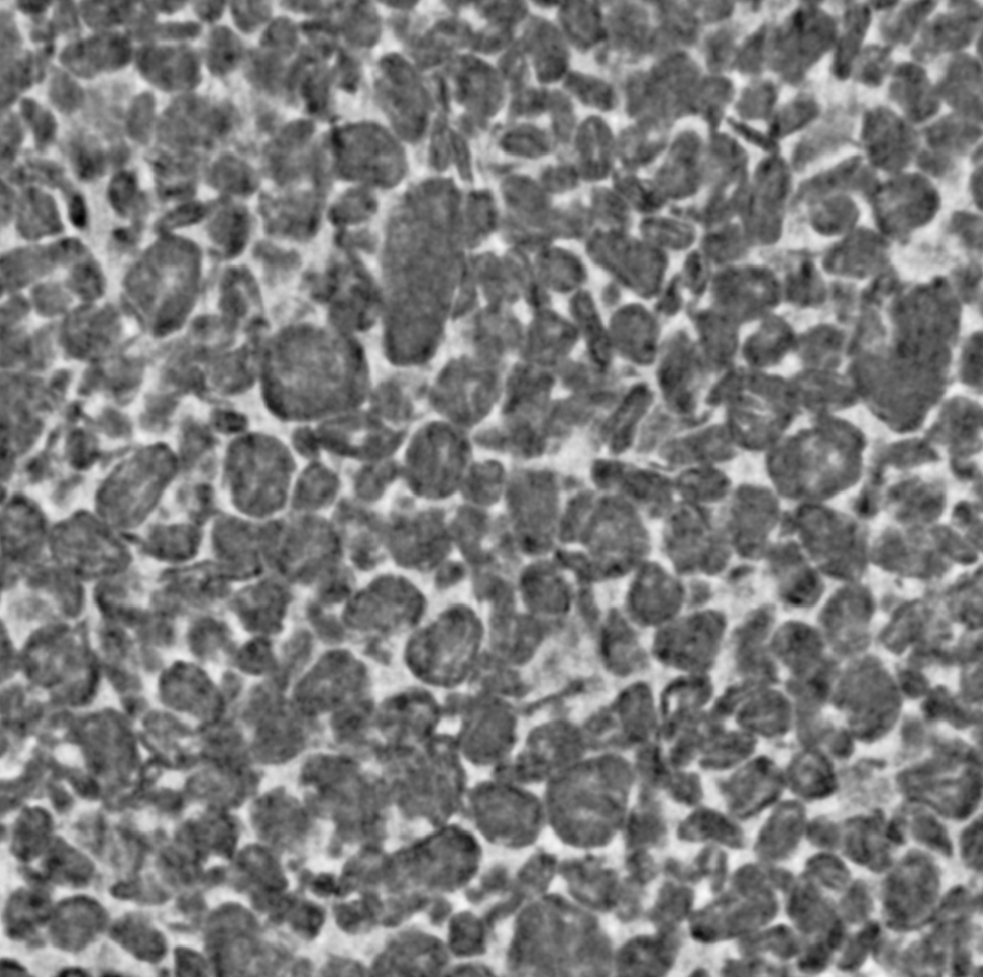
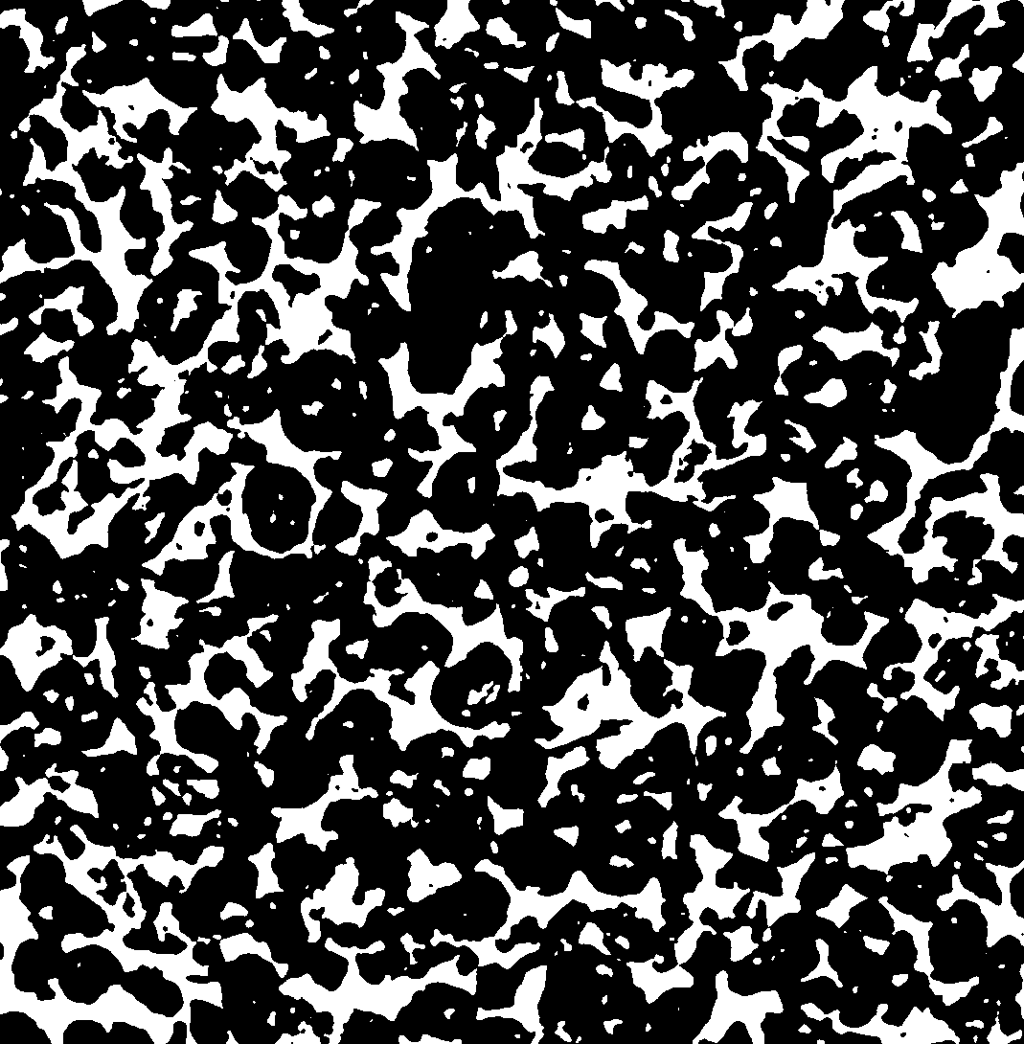
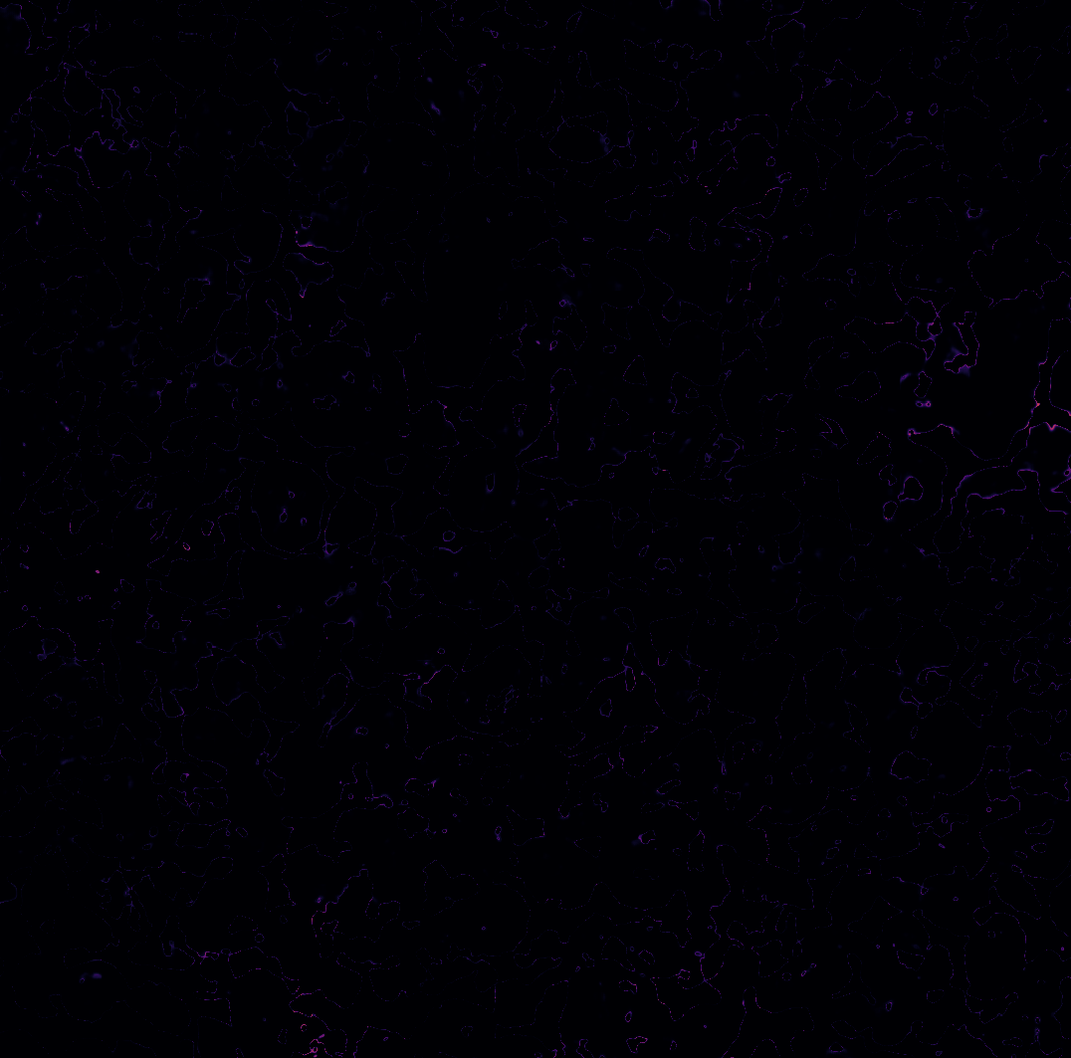
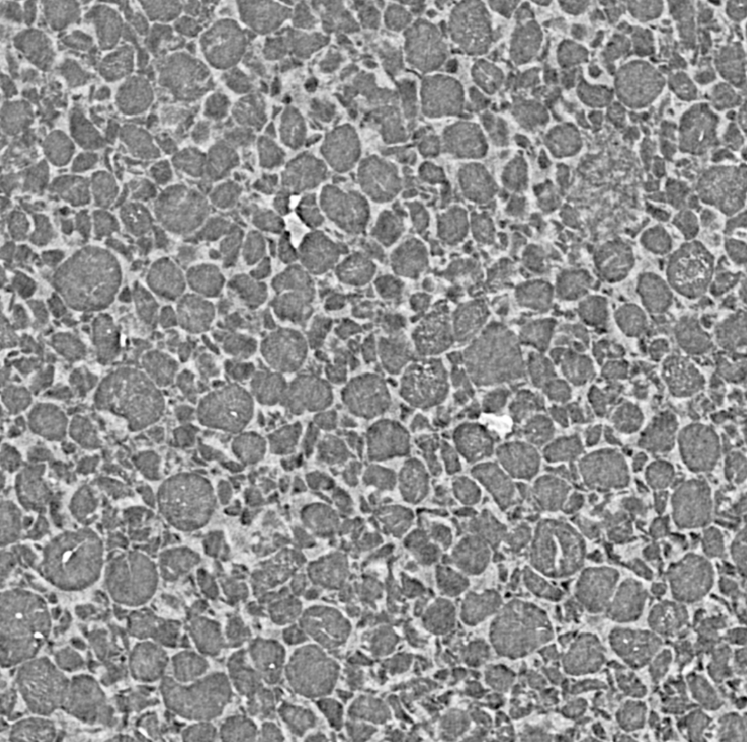
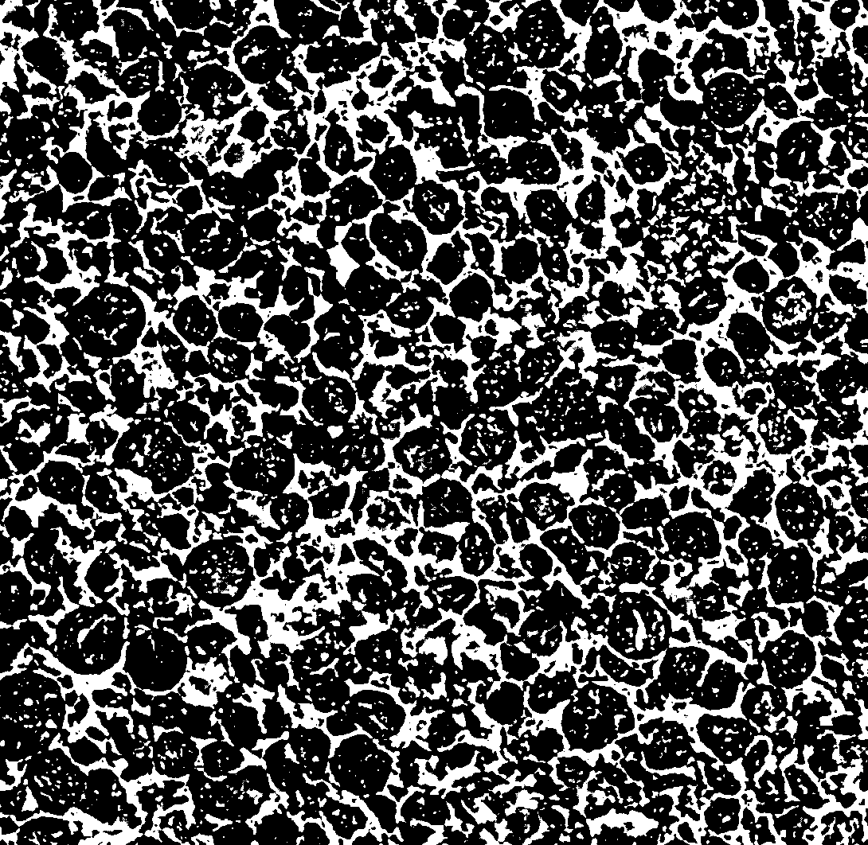
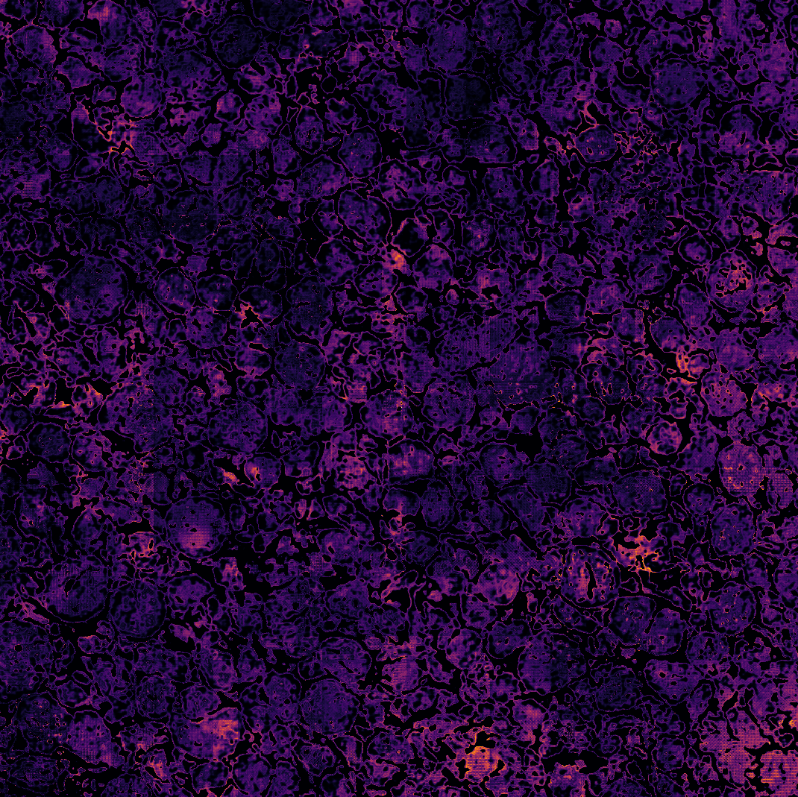
Uncertainty quantification allows us to add error bars to our deep learning models
UQ method:
Sample segmentation results from the trained model. [1]
Quantify variance in distribution of predictions for each pixel. [2]
Assess model viability in deployment domain.
In training domain
Uncertainty map –
brighter pixel values indicate higher uncertainty
CT scan slice
ML segmentation
Outside training domain
[1] Gal, Yarin, and Zoubin Ghahramani. "Dropout as a Bayesian approximation: Representing model uncertainty in deep learning." International Conference on Machine Learning. 2016.
[2] Darling, M. C., Hush, D. R., & Stracuzzi, D. J. (2020). A Novel Measure of Uncertainty For Machine Learning Predictions (No. SAND2020-2424C). Sandia National Labs, Albuquerque, NM (United States).

Slide 15
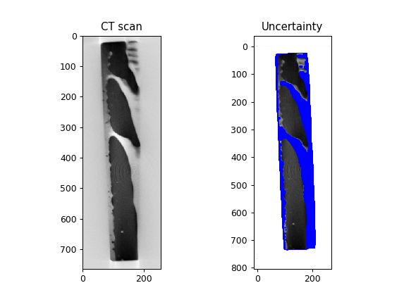
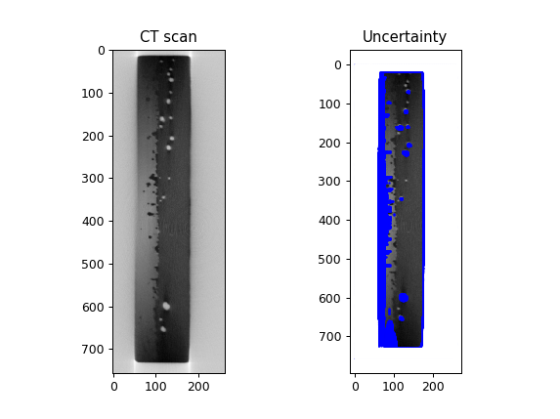
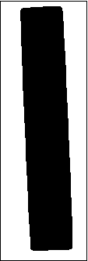
Interpret model: Uncertainty Quantification
Training the neural network on the wrong labels resulted in poor segmentations but high uncertainty around interesting features.
Wrong label

Slide 16
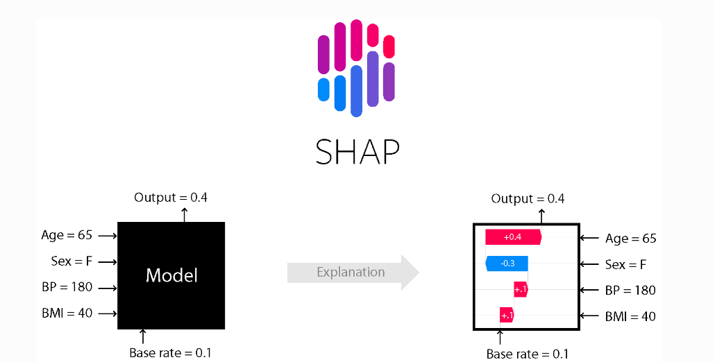
Interpret model: Explainability
Shapley Additive exPlanations (SHAP)
Shapley values: Game theoretic approach to attribute feature contributions to model predictions
SHAP python package includes model-agnostic explainability implementations
Linear approximation to nonlinear mapping will have some error with respect to model behavior
https://shap.readthedocs.io/en/latest/index.html

Slide 17
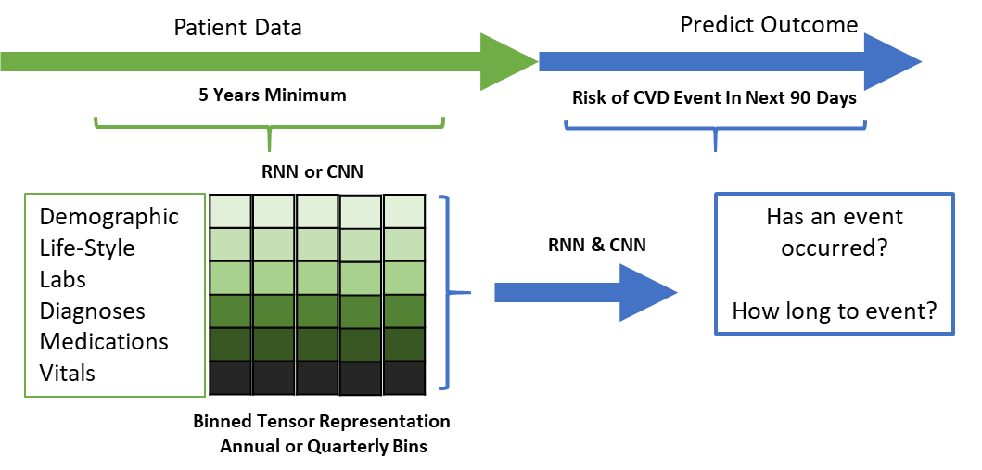
Example: Longitudinal Risk Prediction Using RNNs and CNNs

Slide 18
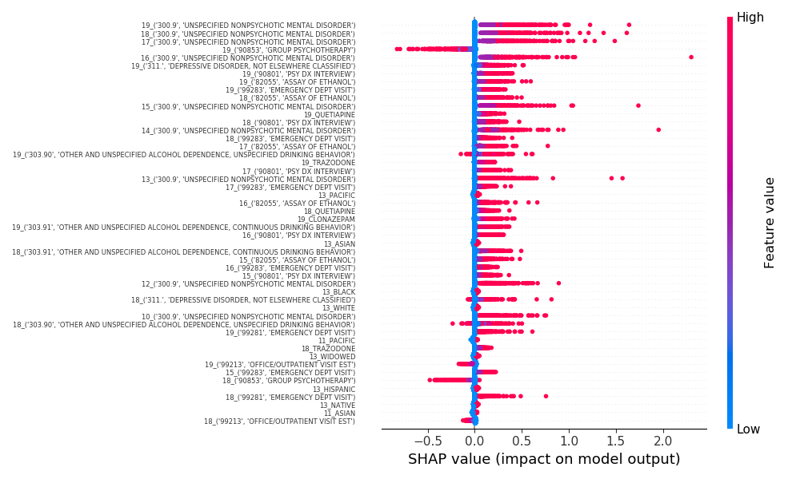

Slide 19
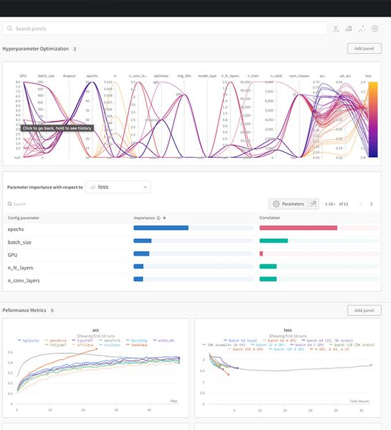
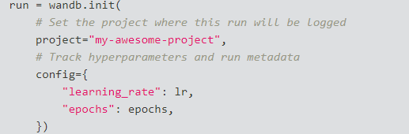
Documentation: Weights and Biases
Weights and Biases experiment tracker
Model and data versioning
Training and evaluation metrics
Configuration management
Hyperparameter tuning
Share results
Interactive reports
https://docs.wandb.ai/quickstart

Slide 20
Conclusion
Developers can implement a few lines of code to reduce ML deployment risks.
Questions? Recommendations?
cmarti5@sandia.gov

