Slide 1
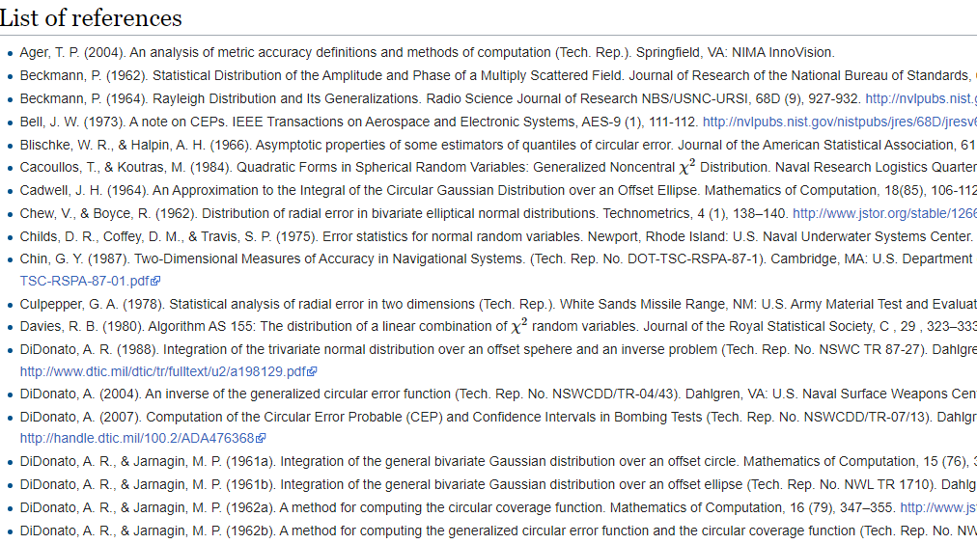
Circular Error Probable and an Example with Multilevel Errors
CEP literature - ShotStat (ballistipedia.com)
82 references as of 8 Feb 2023
Jacob Warren
Assistant Scientific Advisor

Slide 2
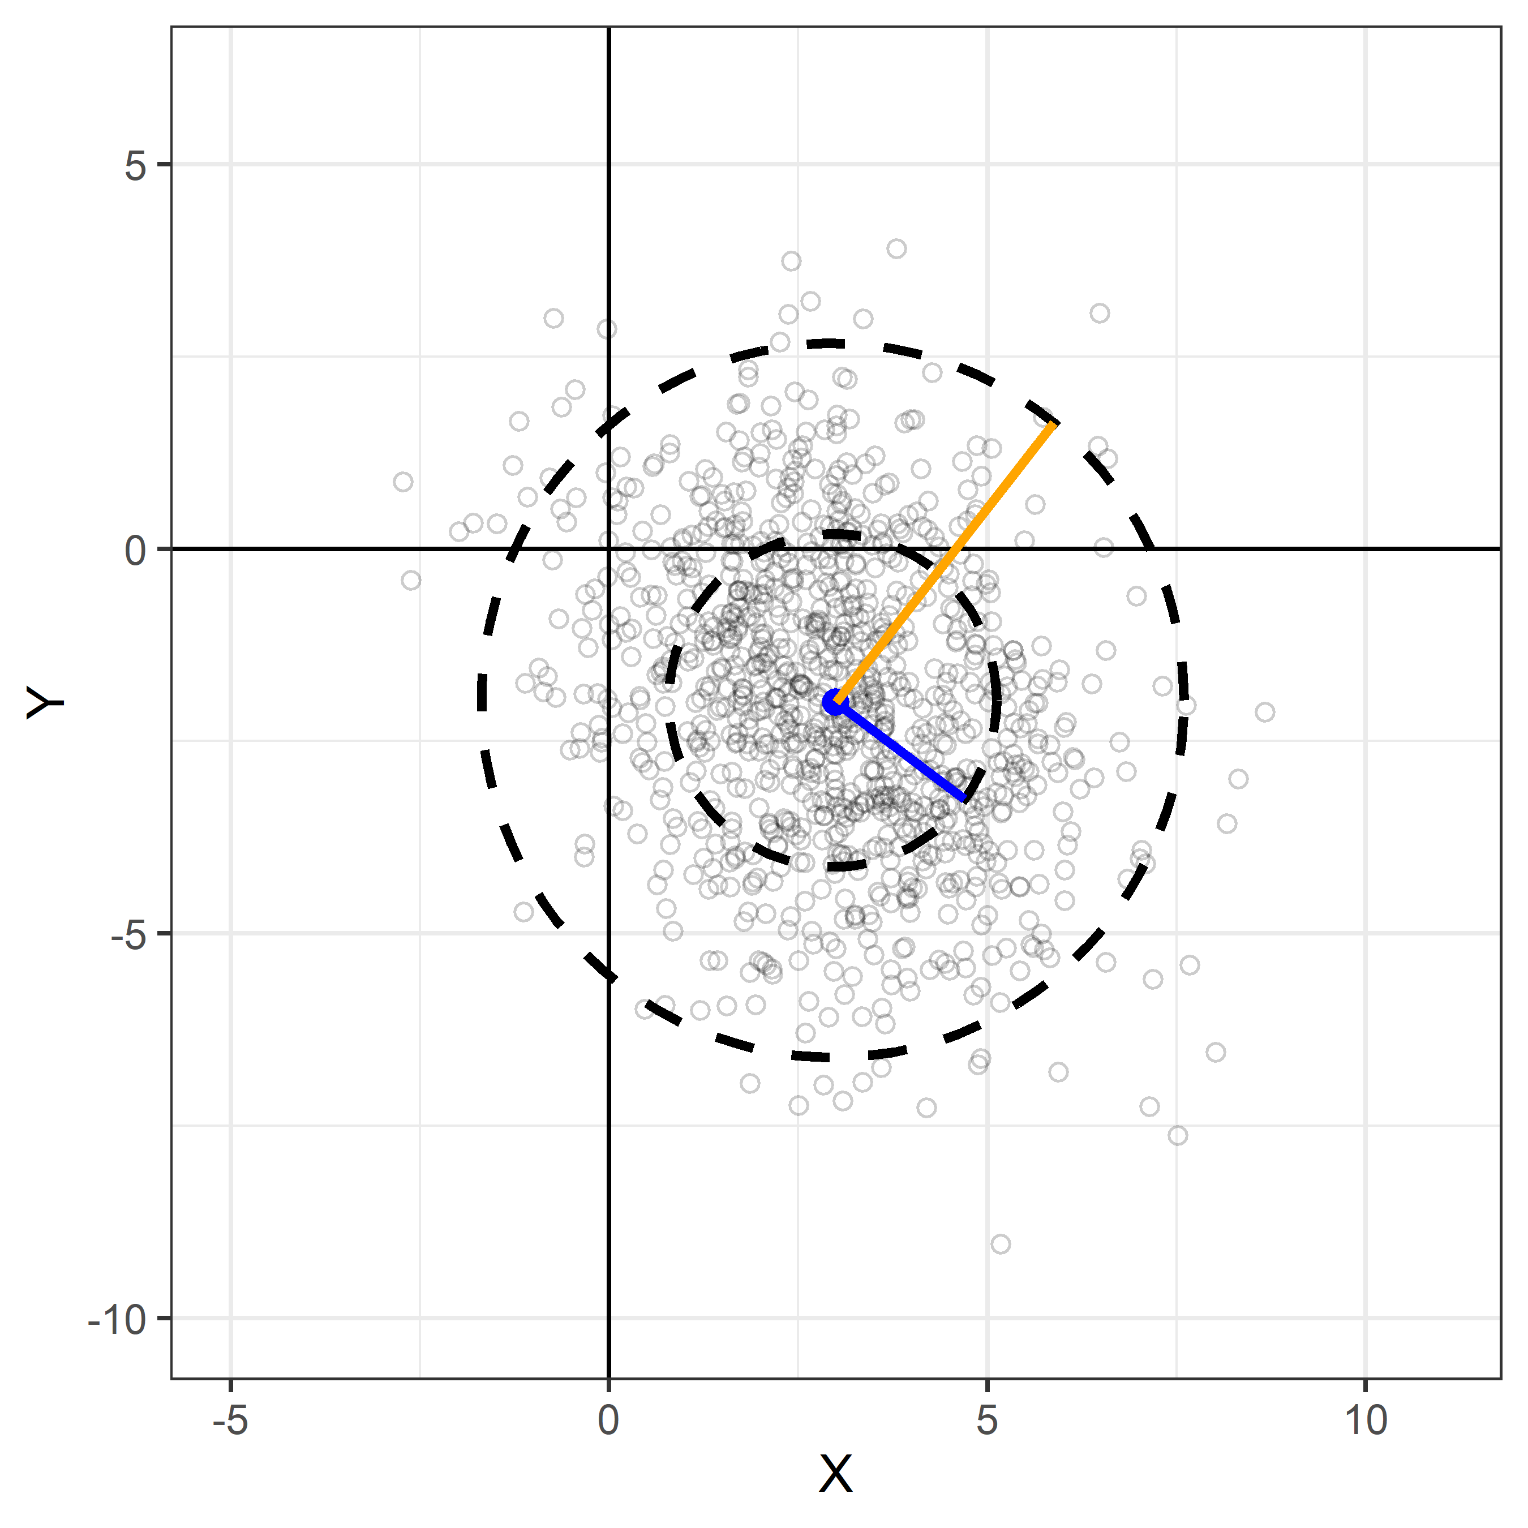
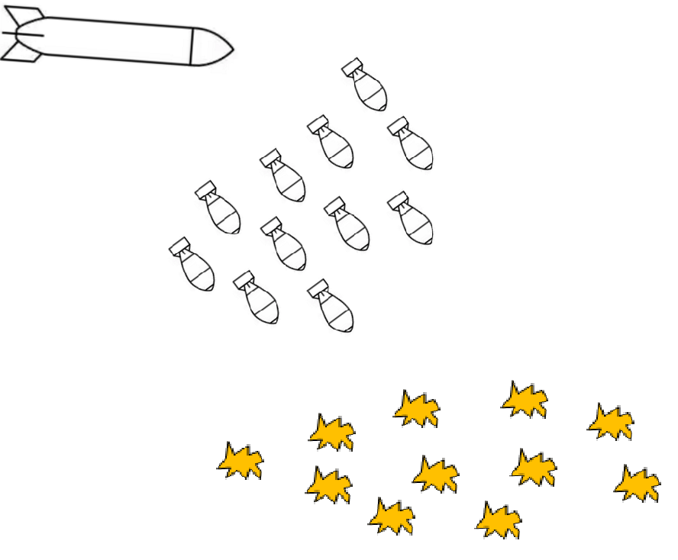
Goals:
Provide a theoretical understanding of CEP
Use understanding for estimation of CEP in simple and complex cases
Background
Example

Slide 3

Circular Error Probable ($CEP\left(p\right)$) is the radius of a circle; centered on the mean, whose boundary is expected to include the landing points of $\left(p\right)$% of the population of rounds.
CEP(95)
Desired Point of Impact
Mean of data in (x, y)
CEP(50)
CEP
Aim point ≠ Mean of data…
CEP don’t care

Slide 4
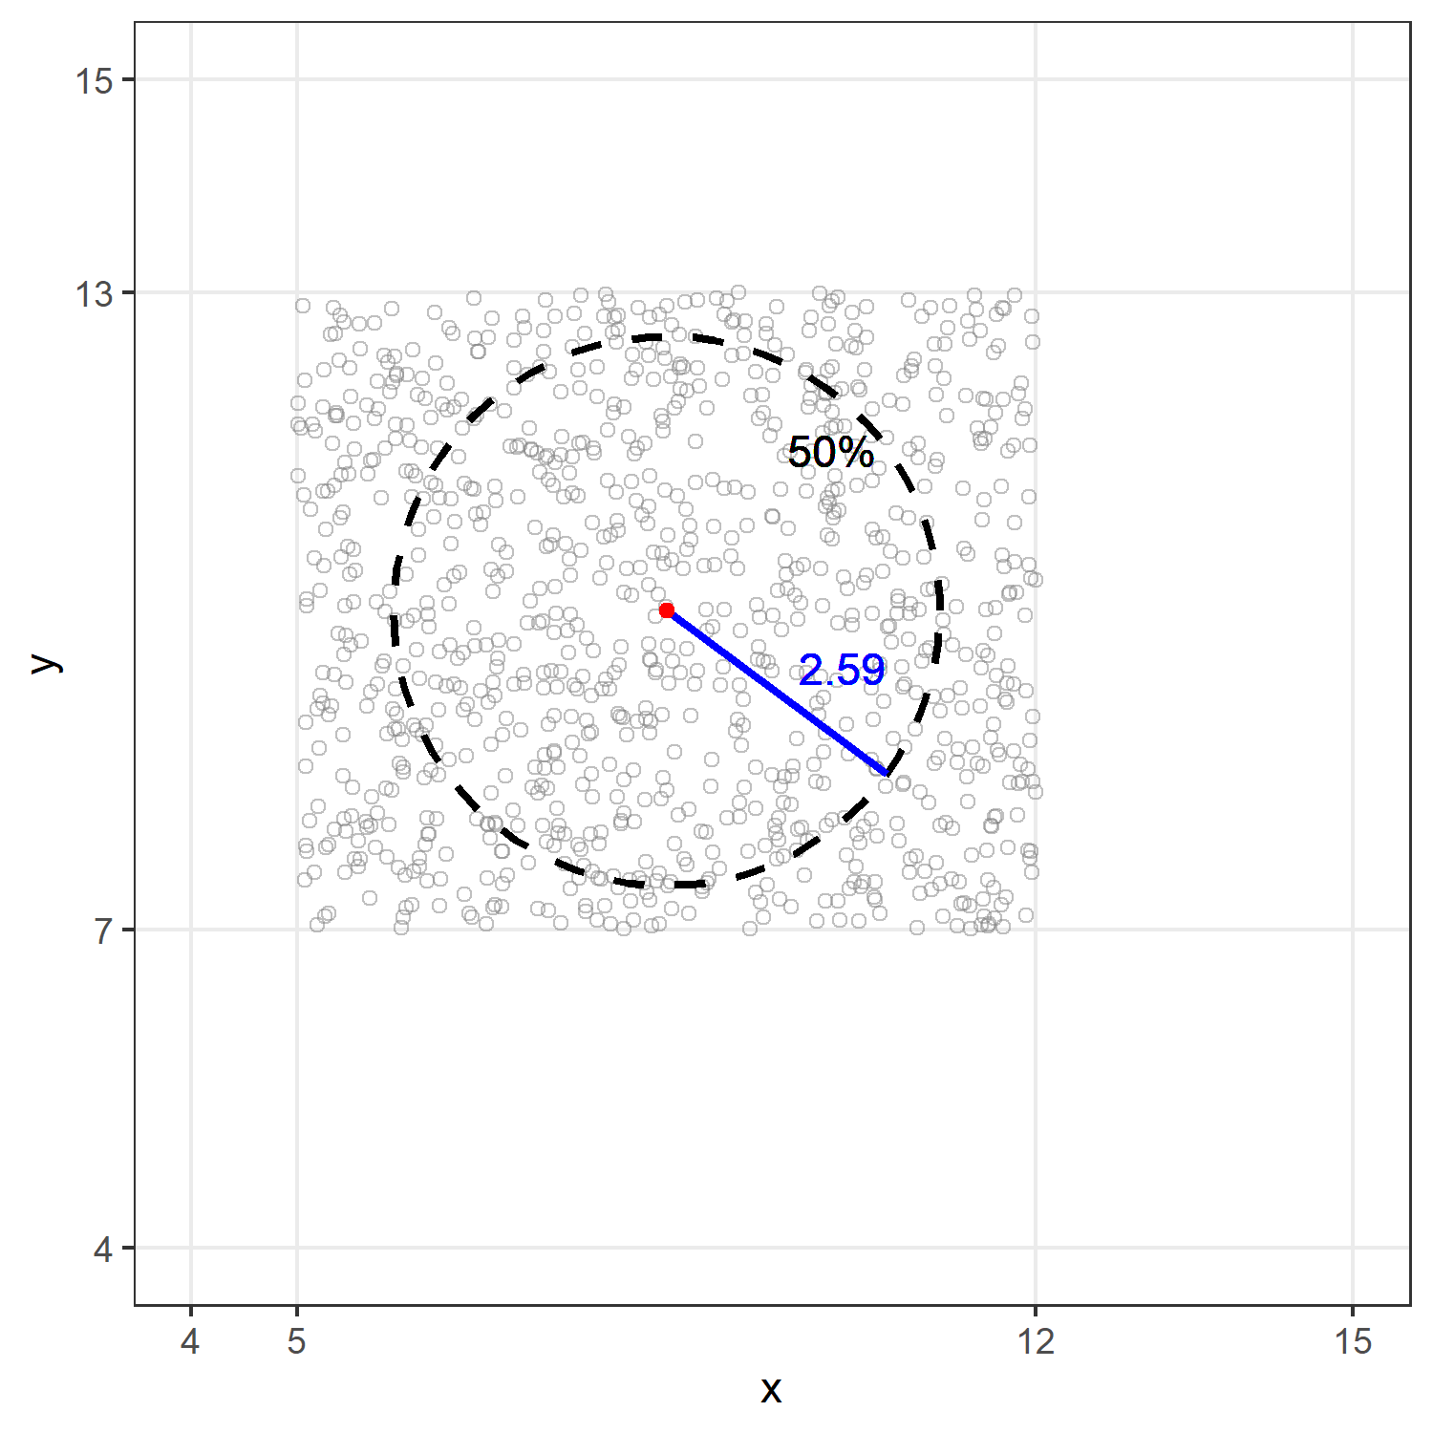
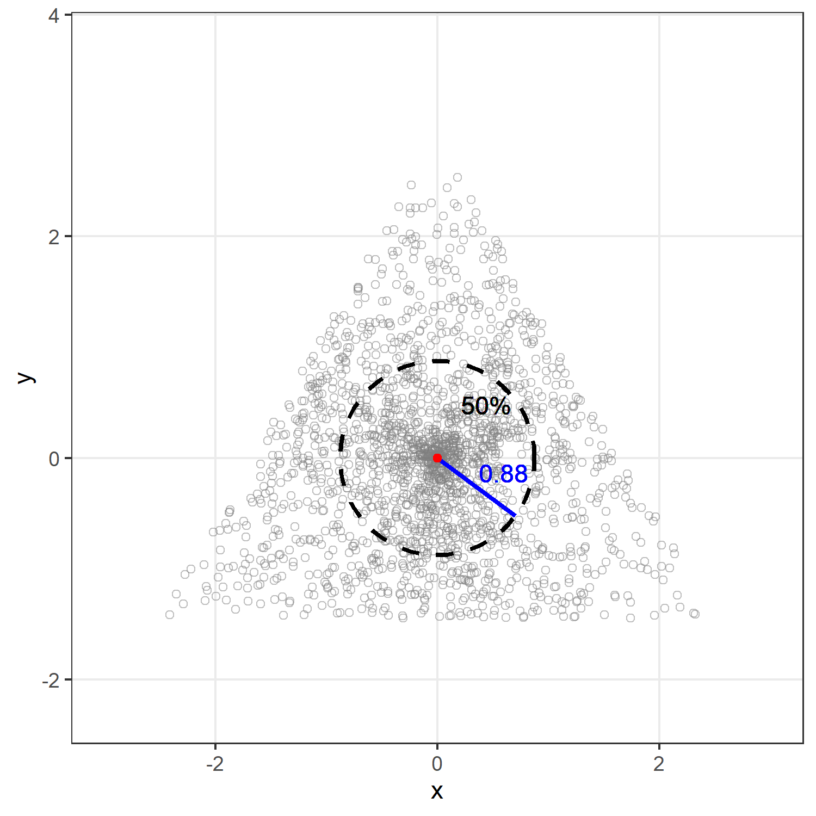
CEP is a measure of radial error, no matter what the underlying data looks like.

Slide 5
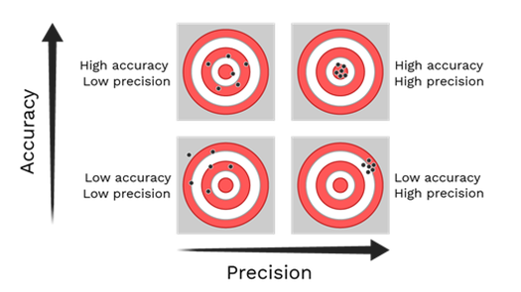
CEP is a measure of precision or spread.
It is not a measure of accuracy or location.
Location
Spread

Slide 6



CEP is a measure of a weapon system’s precision and might be valuable information to a decision maker regarding a weapon system’s performance.
Requirements
Document
(CDD,P-SPEC)
$$CEP ±Error$$
CEP
Decision
CEP might impact OE Decision
CEP might be a requirement
Quantify uncertainty in our estimate

Slide 7
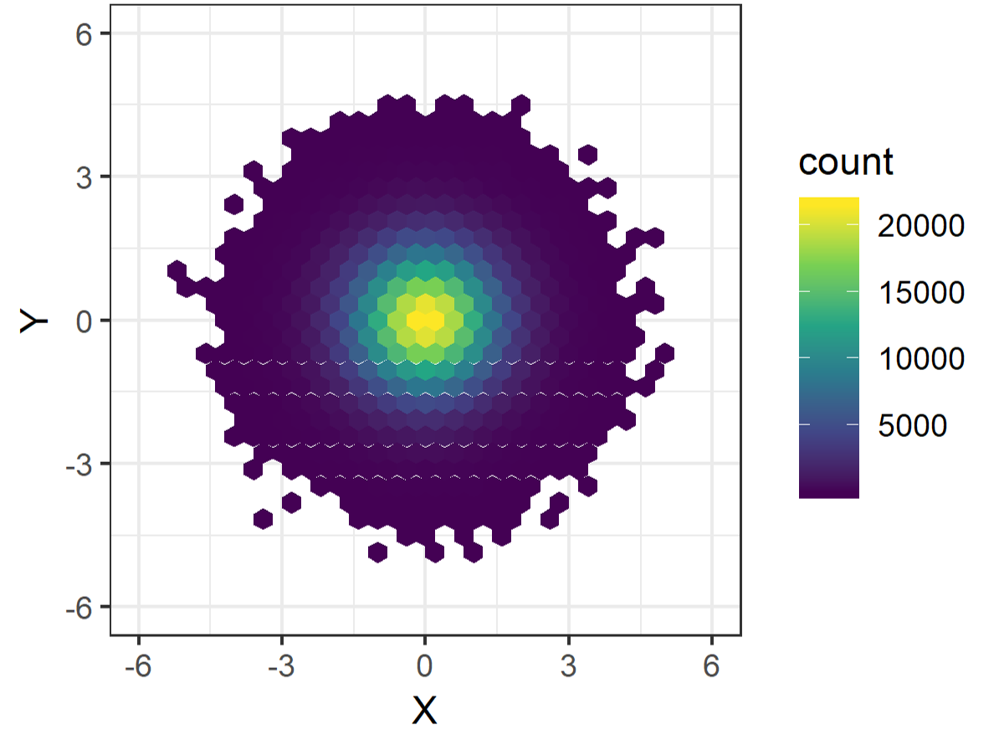

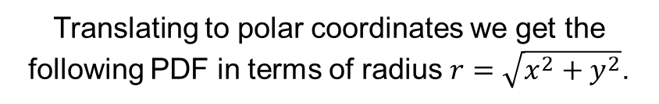
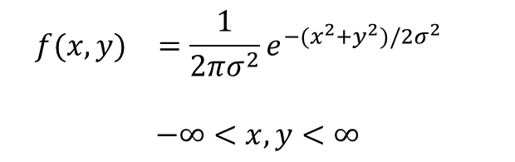

CEP was developed based on integration of the bivariate normal distribution.
d
r
0
0 2π
c
a
b
PDF Circular Bivariate Normal with mean (0,0)
Translating to polar coordinates we get the following PDF in terms of radius $r=\sqrt{x^{2}+y^{2}}$.
$$\begin{matrix}f(x,y) & =\frac{1}{2πσ^{2}}e^{−(x^{2}+y^{2})/2σ^{2}} & \end{matrix}$$
$$−∞<x, y<∞$$
Rayleigh PDF
$$\begin{matrix}f(r) & =\frac{r}{σ^{2}}e^{−r^{2}/2σ^{2}} & \end{matrix}$$
$$r>0$$
Center point of impact ($μ$) is controlled by sighting.
We assume that a gunner can dial $μ≈0$ and leave that parameter out of the question.

Slide 8
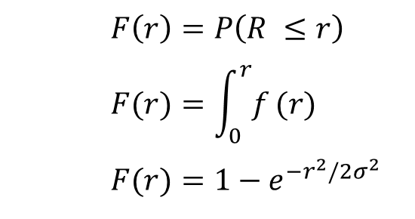


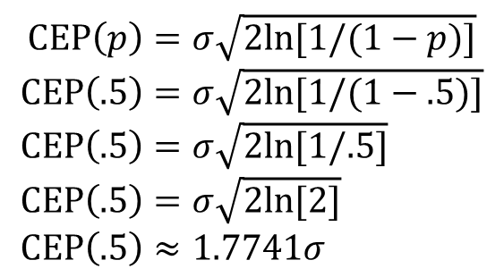
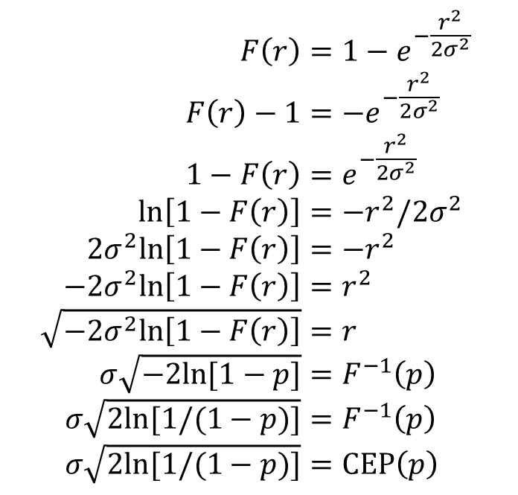
If data is distributed according to the Circular Bivariate Normal distribution, the closed form solution for CEP is the Rayleigh Quantile Function.
CEP is a function of $σ$
Integrate PDF to get Rayleigh CDF
Inverse CDF to get Quantile Function
Simplify for CEP(.5)
$$F\left(r\right)=1−e^{−\frac{r^{2}}{2σ^{2}}} \\ F\left(r\right)−1=−e^{−\frac{r^{2}}{2σ^{2}}} \\ 1−F\left(r\right)=e^{−\frac{r^{2}}{2σ^{2}}} \\ ln\left[1−F\left(r\right)\right]=−r^{2}/2σ^{2} \\ 2σ^{2}ln\left[1−F\left(r\right)\right]=−r^{2} \\ −2σ^{2}ln\left[1−F\left(r\right)\right]=r^{2} \\ \sqrt{−2σ^{2}ln\left[1−F\left(r\right)\right]}=r \\ σ\sqrt{−2ln[1−p]}=F^{−1}\left(p\right) \\ σ\sqrt{2ln[1/(1−p)]}=F^{−1}\left(p\right) \\ σ\sqrt{2ln[1/(1−p)]}=CEP\left(p\right)$$
$$F\left(r\right)=P\left(R ≤r\right) \\ \begin{matrix} & F(r)=\int_{0}^{r}{f}(r) \\ & \end{matrix} \\ F(r)=1−e^{−r^{2}/2σ^{2}}$$
$$CEP\left(p\right)=σ\sqrt{2ln[1/(1−p)]} \\ CEP\left(.5\right)=σ\sqrt{2ln[1/(1−.5)]} \\ CEP\left(.5\right)=σ\sqrt{2ln[1/.5]} \\ CEP\left(.5\right)=σ\sqrt{2ln[2]} \\ CEP\left(.5\right)≈1.7741σ$$
Take note of this value for later
(slide )
For: $0≤p≤1$

Slide 9
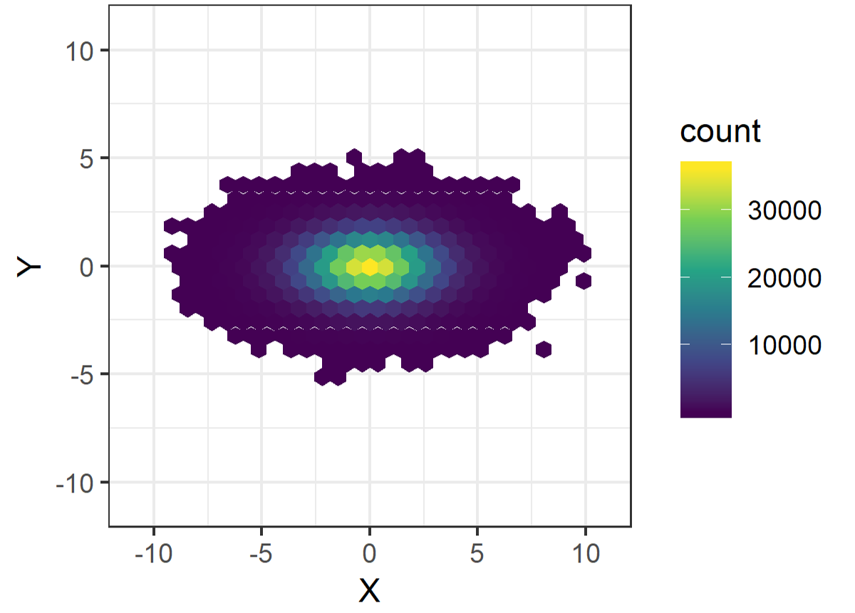
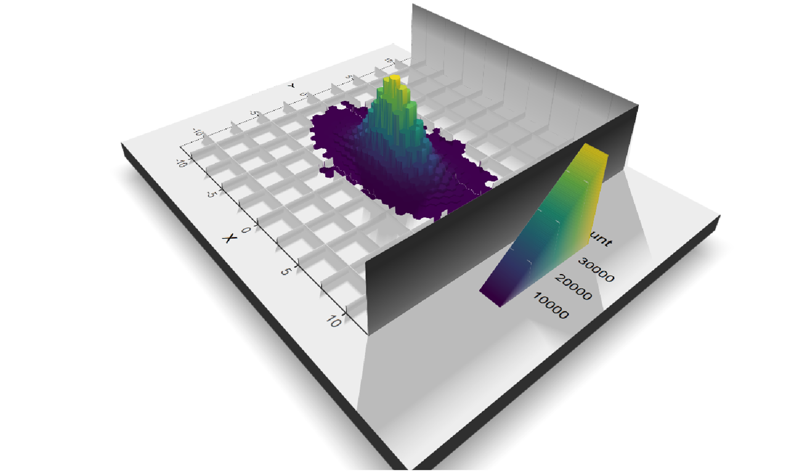
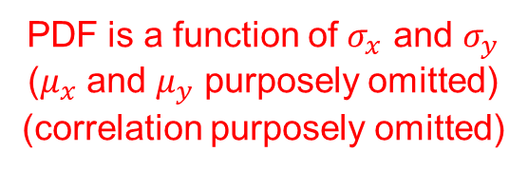
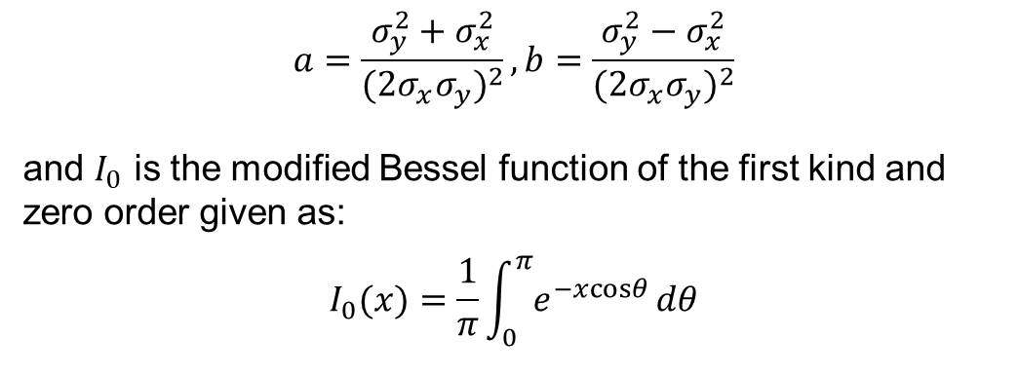
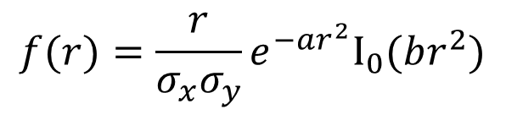
If data is distributed according to the general Bivariate Normal distribution (not necessarily circular), there is no closed-form solution.
General Bivariate Normal PDF in polar coordinates
$$a=\frac{σ_{y}^{2}+σ_{x}^{2}}{(2σ_{x}σ_{y})^{2}},b=\frac{σ_{y}^{2}−σ_{x}^{2}}{(2σ_{x}σ_{y})^{2}}$$
and $I_{0}$ is the modified Bessel function of the first kind and zero order given as:
$$I_{0}(x)=\frac{1}{π}\int_{0}^{π}{e^{−xcosθ}}dθ$$
Where,
$$f(r)=\frac{r}{σ_{x}σ_{y}}e^{−ar^{2}}I_{0}(br^{2})$$
PDF is a function of $σ_{x}$ and $σ_{y}$
($μ_{x}$ and $μ_{y}$ purposely omitted)
(correlation purposely omitted)

Slide 10
We can use our computer to solve for CEP in the general Bivariate Normal (GBN) case.
bvn_polar_pdf <- function(r, sx, sy){
tmp_min <- min(sx, sy)
tmp_max <- max(sx, sy)
sx <- tmp_max
sy <- tmp_min
(r/(sx*sy)) *
exp(-(sx^2 + sy^2)/((2*sx*sy)^2) * r^2) *
besselI((sx^2 - sy^2)/((2*sx*sy)^2) * r^2, nu = 0)
}
integrate(bvn_polar_pdf, sx = 1, sy = 1, lower = 0, upper = sqrt(2*log(2)))
#> 0.5 with absolute error < 5.6e-15
bvn_cep <- function(r, p, sx, sy) {
abs(integrate(bvn_polar_pdf, sx = sx, sy = sy, lower = 0, upper = r,
abs.tol = 1E-10)$value - p)
}
optimize(bvn_cep, p = .5, sx = 1, sy = 1, interval = c(0, 10), tol = 1E-10)$min
#> [1] 1.17741
PDF, given radius (r) and x and y standard deviations (sx, sy), and mean (0, 0)
From slide 8
CDF
✓
Inverse CDF,
Quantile Function
(Function to solve for CEP)
Evaluate
✓
From slide 8

Slide 11
We don’t model CEP, we model the data. Then we use the model to estimate CEP. If the model doesn’t give me an exact form for CEP, I can simulate.
library(mvtnorm)
n <- 500000
s <- 1
df <- rmvnorm(n, mean = c(0,0), sigma = matrix(c(s^2,0,0,s^2), nrow=2))
df <- data.frame(df)
names(df) <- c("x", "y")
df$r <- sqrt(df$x^2 + df$y^2) # Calculate miss distance
quantile(df$r, probs = 0.50) # Find desired quantile of miss distance
50%
1.177425
Simulate can provide a good approximation to exact solution (slides 8 & 10)

Slide 12
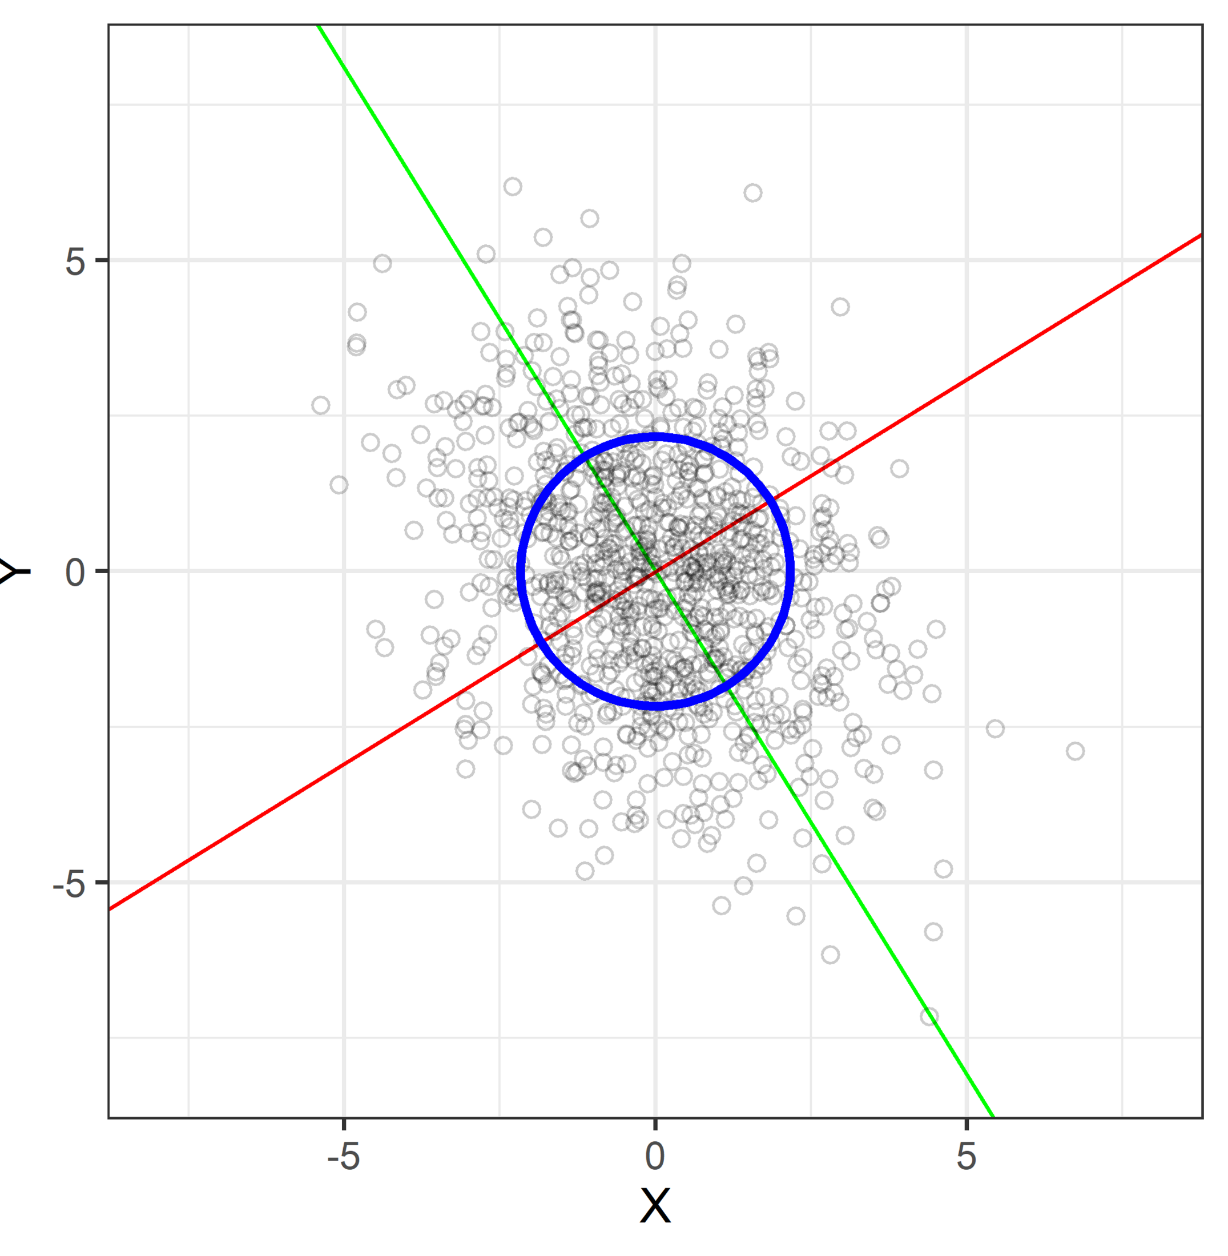
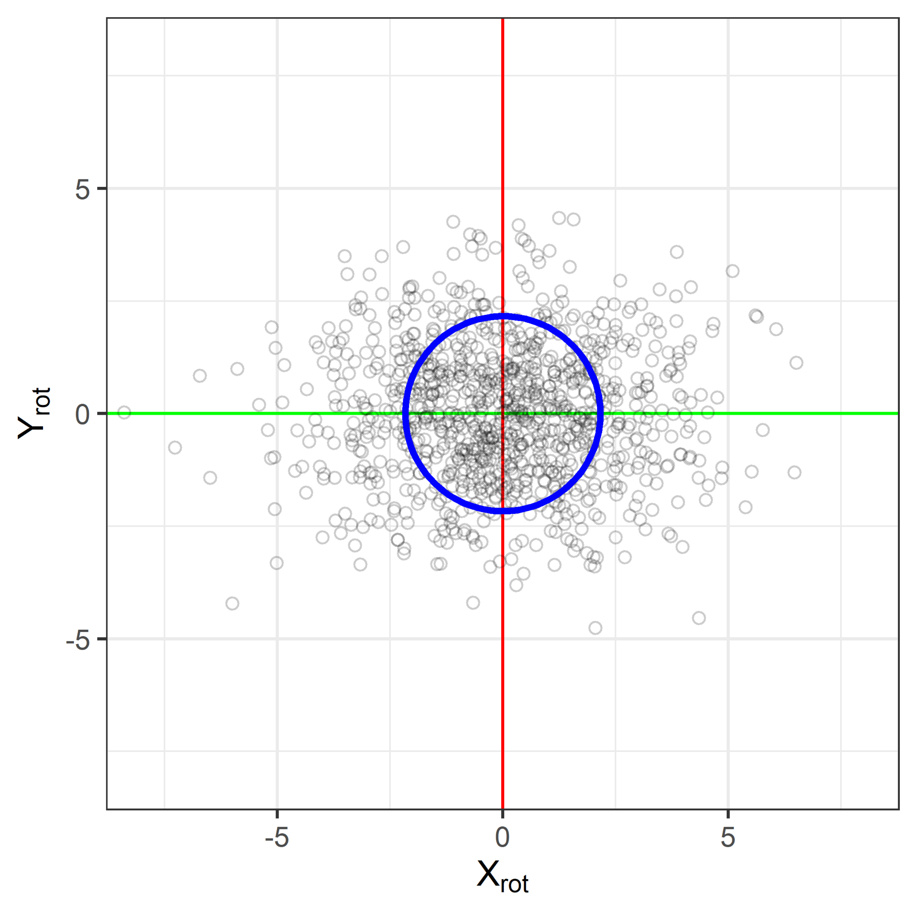
Correlation can be removed by performing a rotation into a non-correlated coordinate system.
 | X | Y
X | 3 | -1
Y | -1 | 4
 | X_{rot} | Y_{rot}
X_{rot} | 4.618034 | 0
Y_{rot} | 0 | 2.381966
Using GBN, $CEP\left(50\right)≈2.17$
Using eigenvalues for $σ_{x}$ and $σ_{y}$ ensures rotation doesn’t affect the CEP estimate

Slide 13
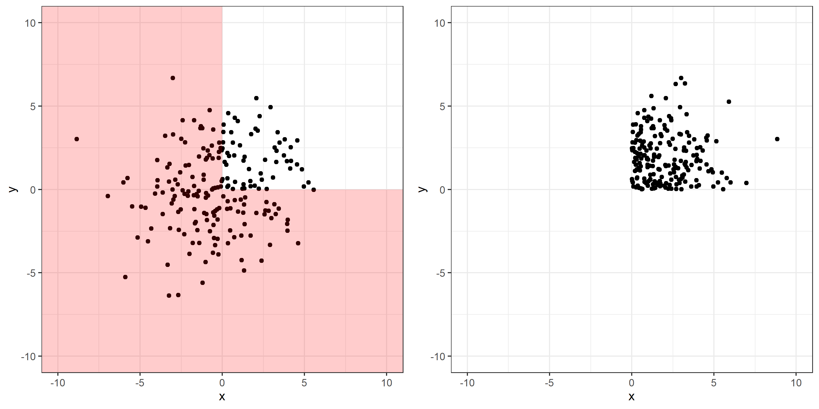
Do not take absolute values. That could reduce variability in your data, and CEP is based on variability.
Absolute Value
Example 1
Absolute Value
Example 2
Data 1
Abs Data 1
-3
0
3
-3
0
3
Data 2
Abs Data 2
-3
0
3
-3
0
3

Slide 14
General Workflow
Exploratory Data Analysis
  Assess viability of normality assumption
  Assess viability of circularity assumption
Model Data
If model Circular or General Bivariate Normal is good, plug estimated model parameters to CEP function.
Else, simulate data according to well-fitting model and calculate miss distances (mean location to observed location), and find quantile of miss distance.

Slide 15
Goals:
Provide a theoretical understanding of CEP
Use understanding for estimation of CEP in simple and complex cases
✓
✓
Background
Example

Slide 16
In practice, estimation of CEP is often required in more than “single sample” cases, meaning we need to be able to account for factors.
One shot, results in multiple (submunition) impacts
The plan: (not everything occurred according to the plan)
F1 | F2 | Shots | Submunitions
A | A | 20 | 220
A | B | 20 | 220
B | A | 20 | 220
B | B | 20 | 220
Does CEP (variability) depend on F1 and F2?
What is CEP at each?
How much variability between shots vs within shots?

Slide 17
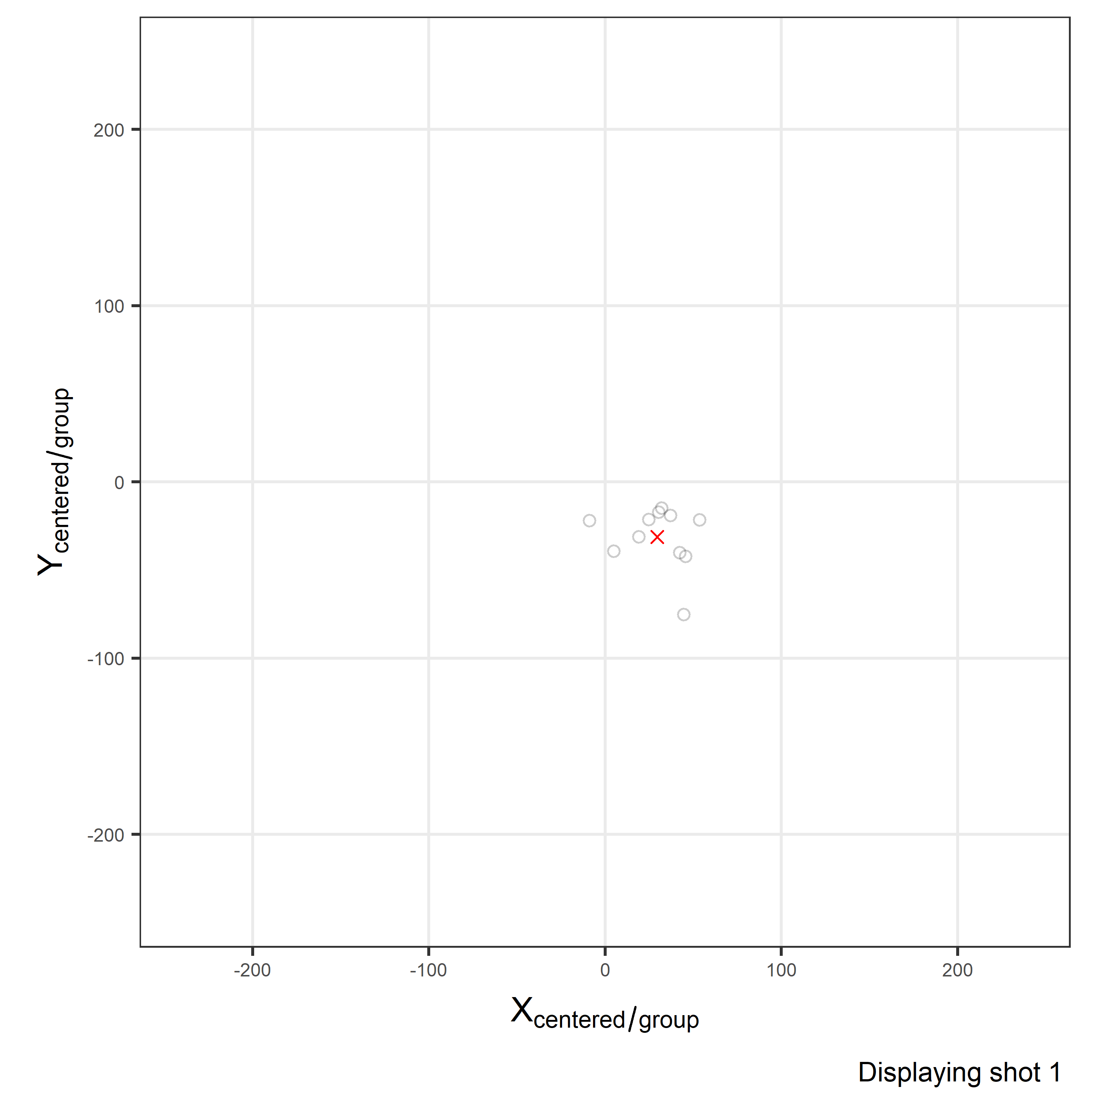
F1 B, F2 A
o | Observed submunition location
x | Shot Center (mean submunition location per shot)

Slide 18
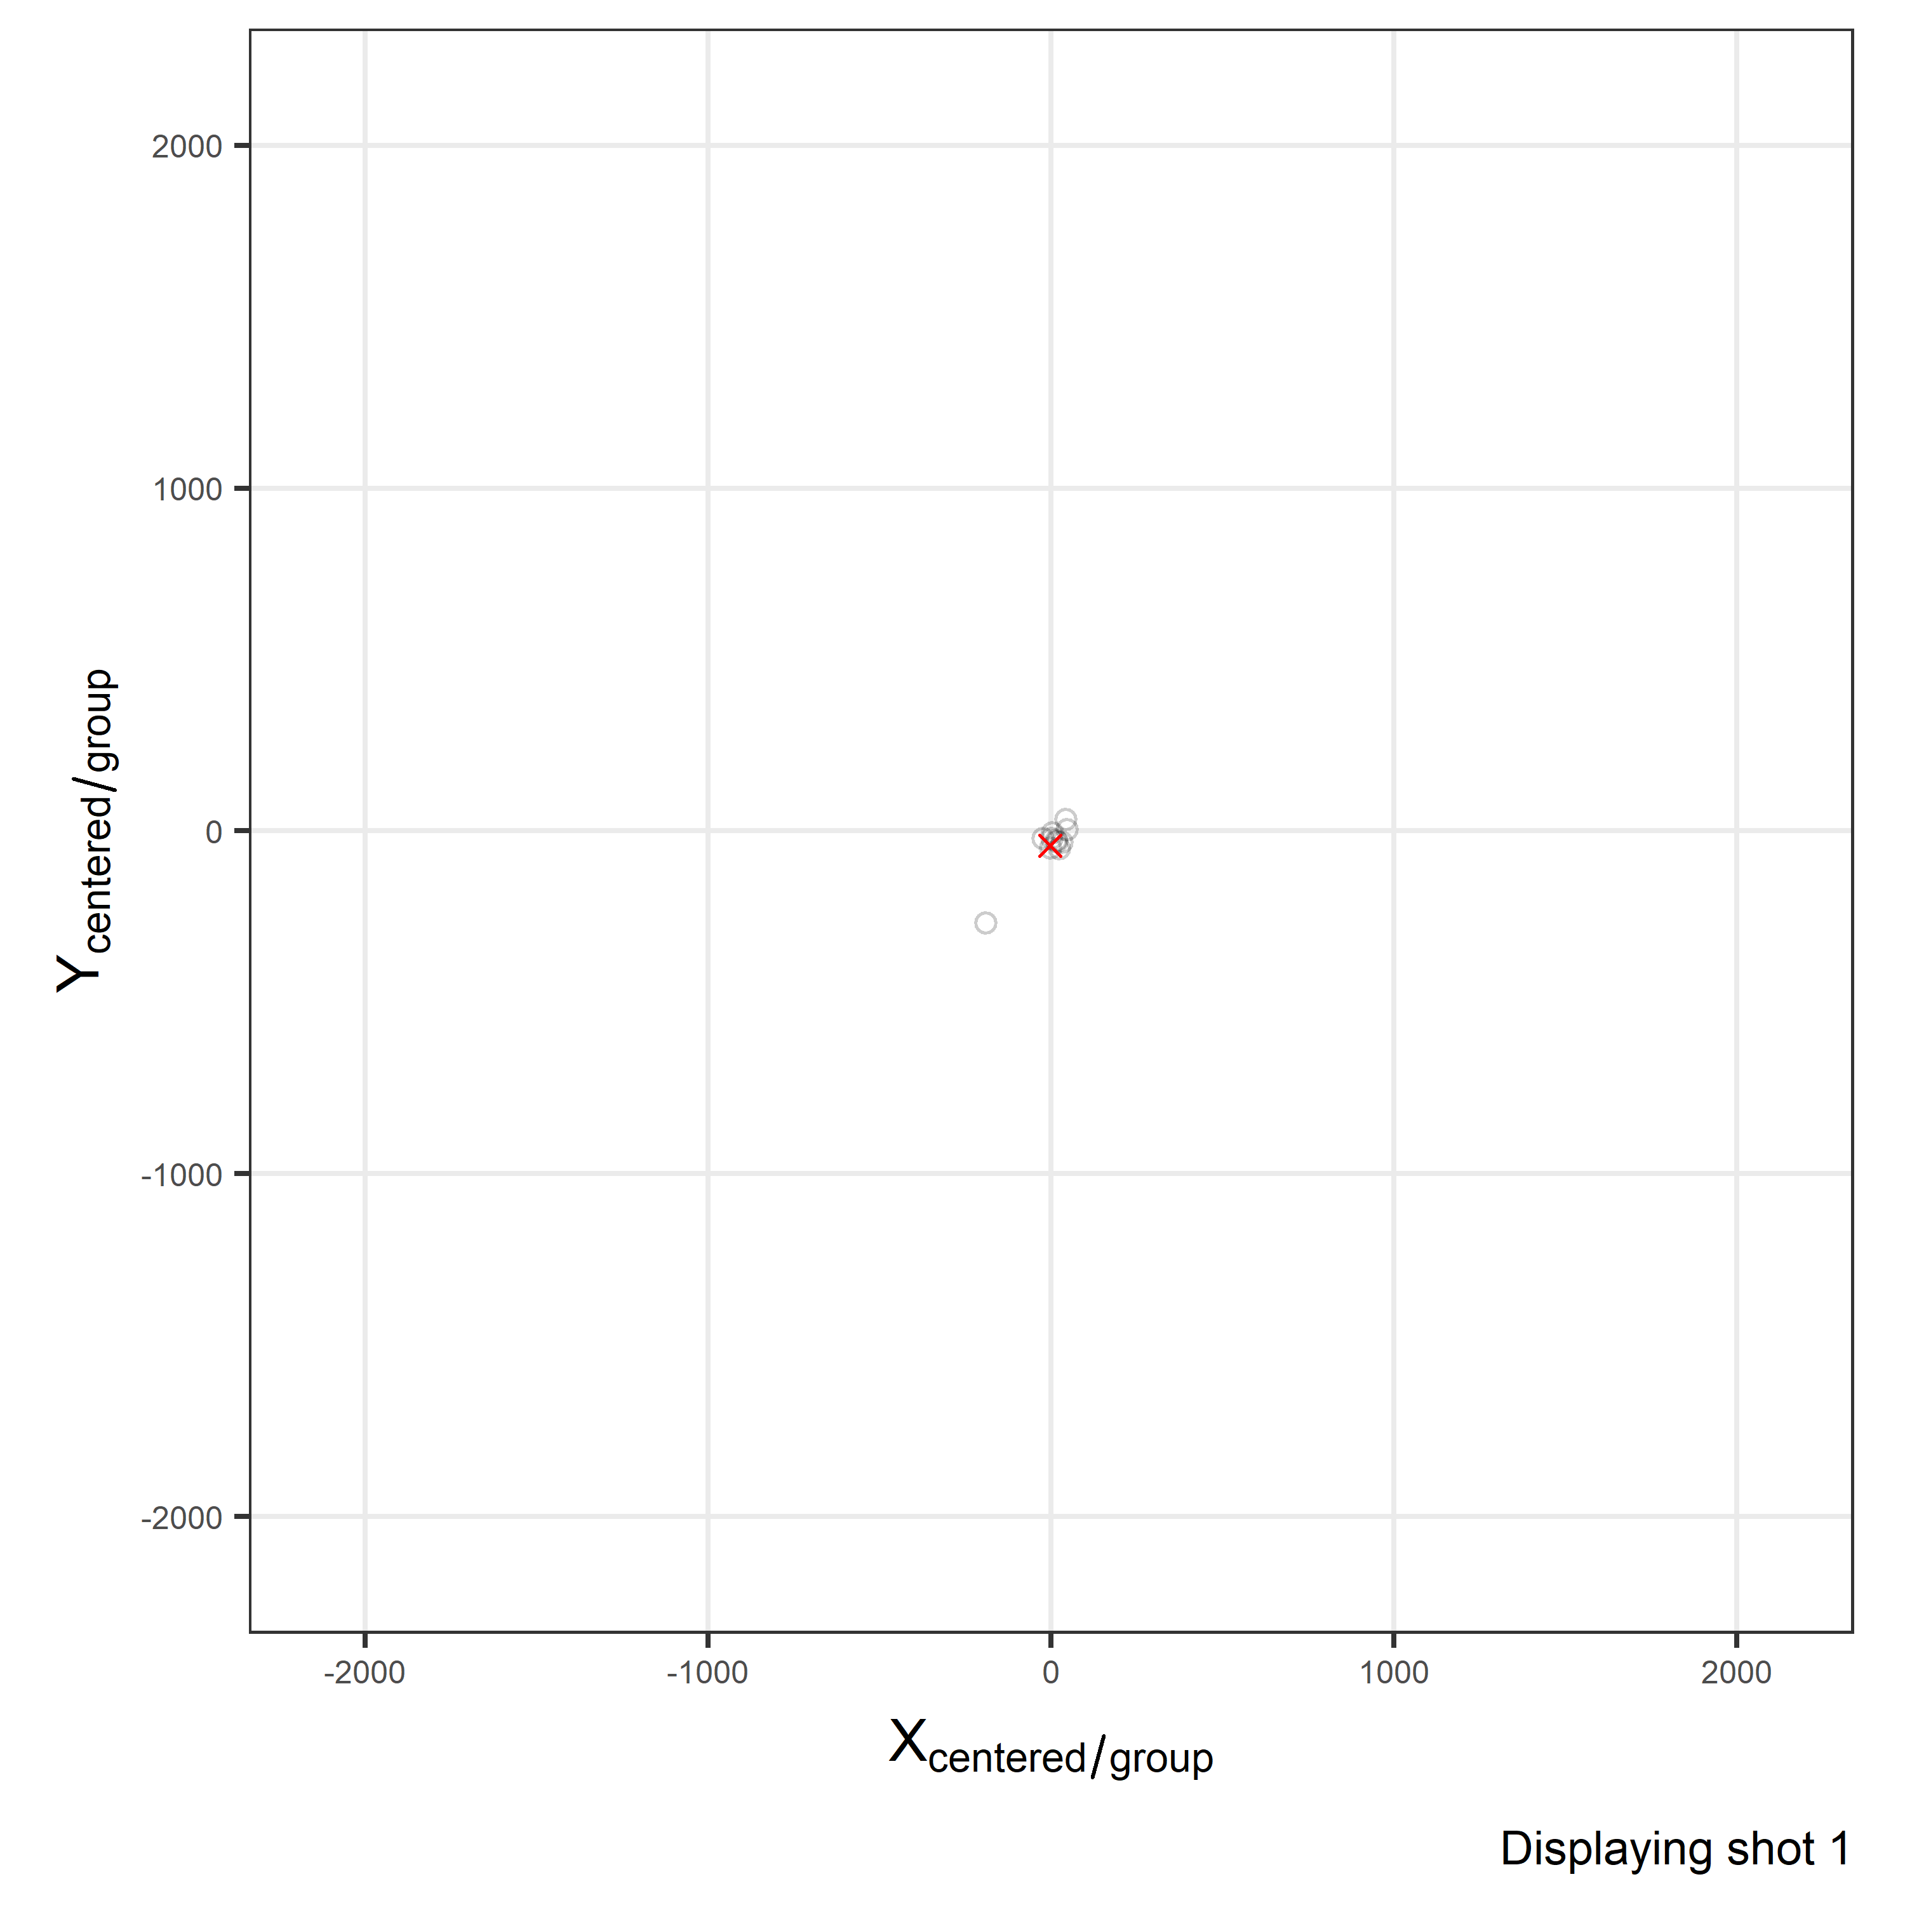
F1 A, F2 A
o | Observed submunition location
x | Shot Center (mean submunition location per shot)
Note: Change in axes scale.
Axis are ~10 times wider than plot in previous slide.

Slide 19
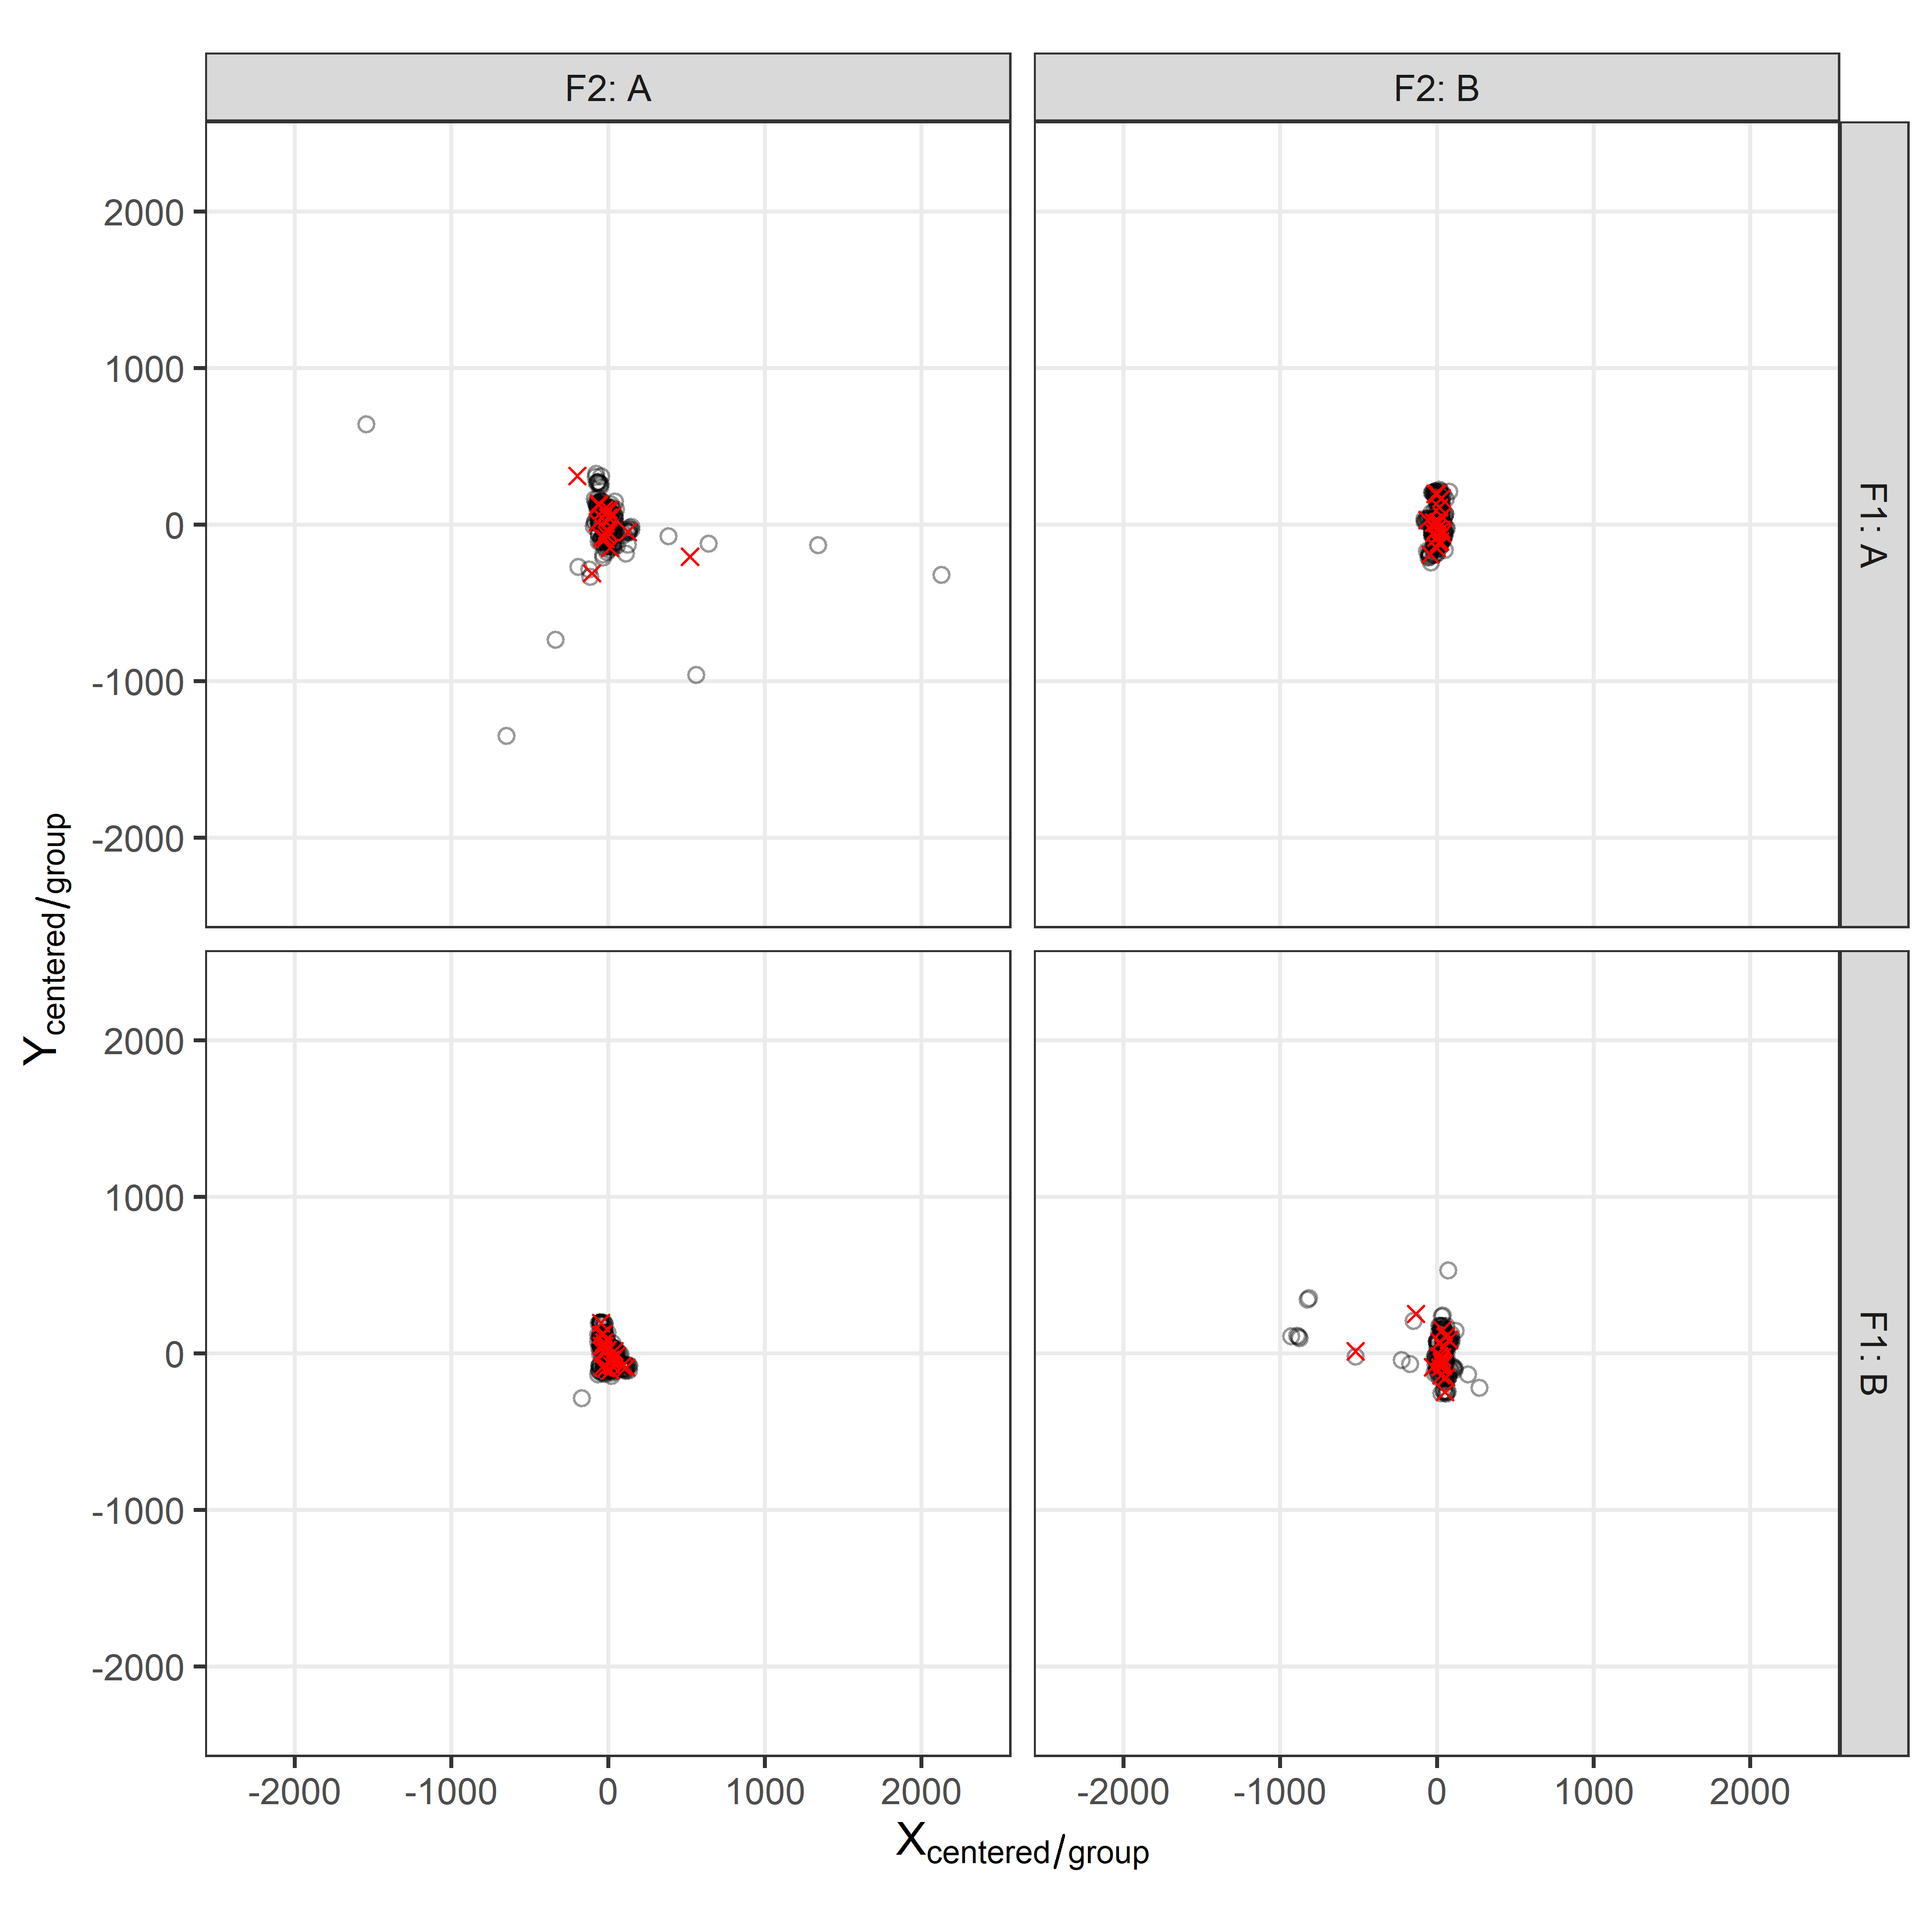
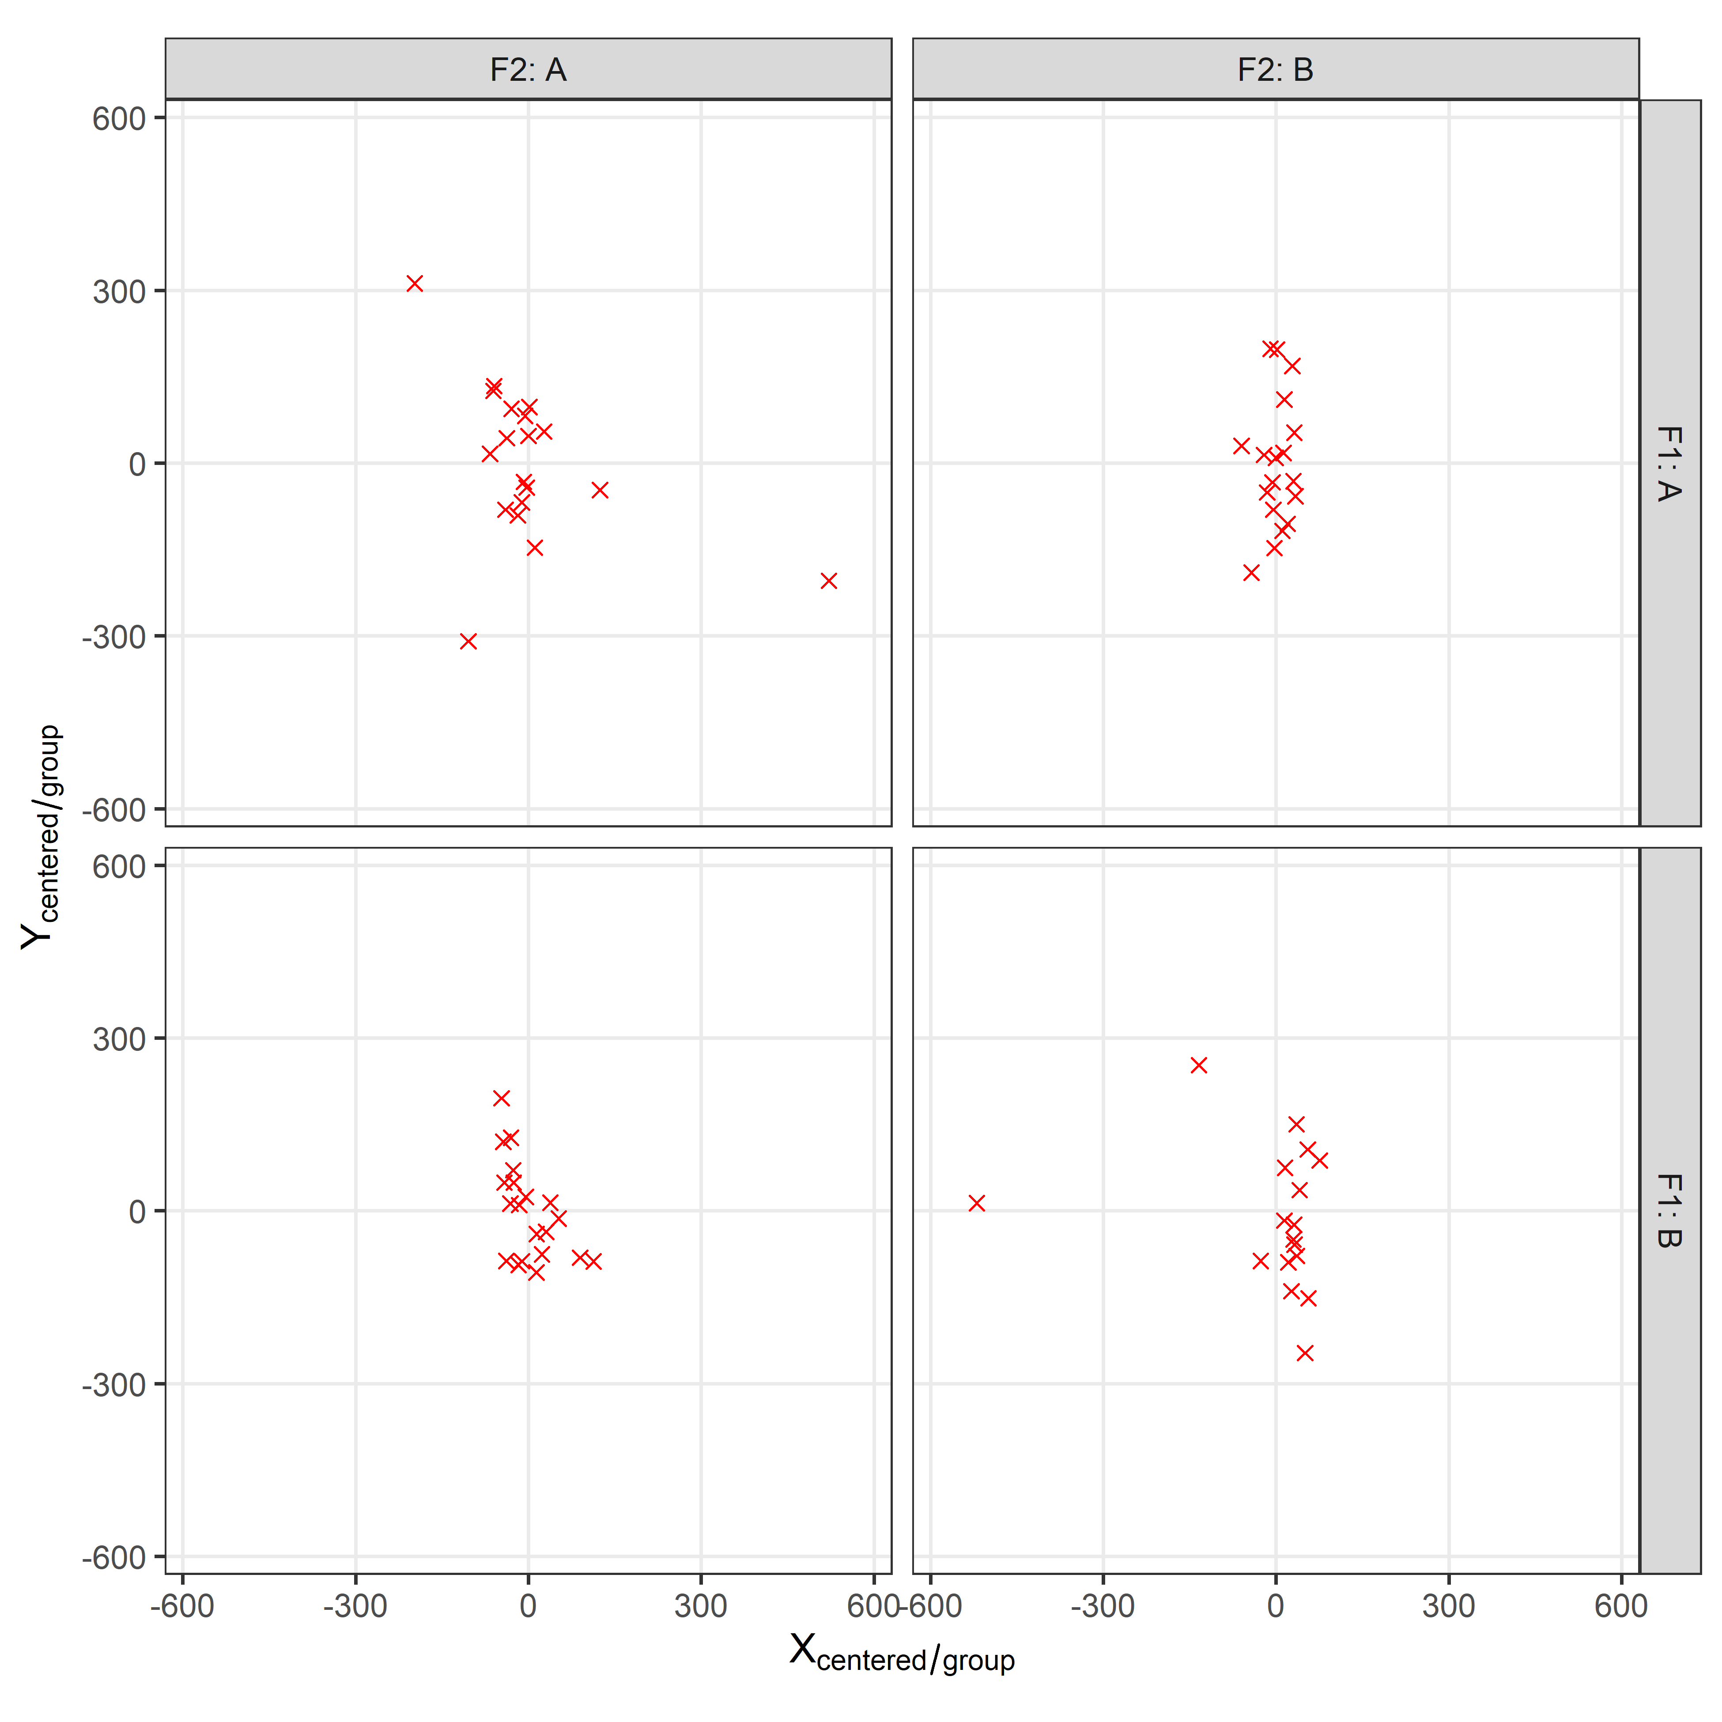
All Data
Zooming In – Shot Centers Only
Note: Data centered so the mean submunition location is (0,0), per group/facet

Slide 20
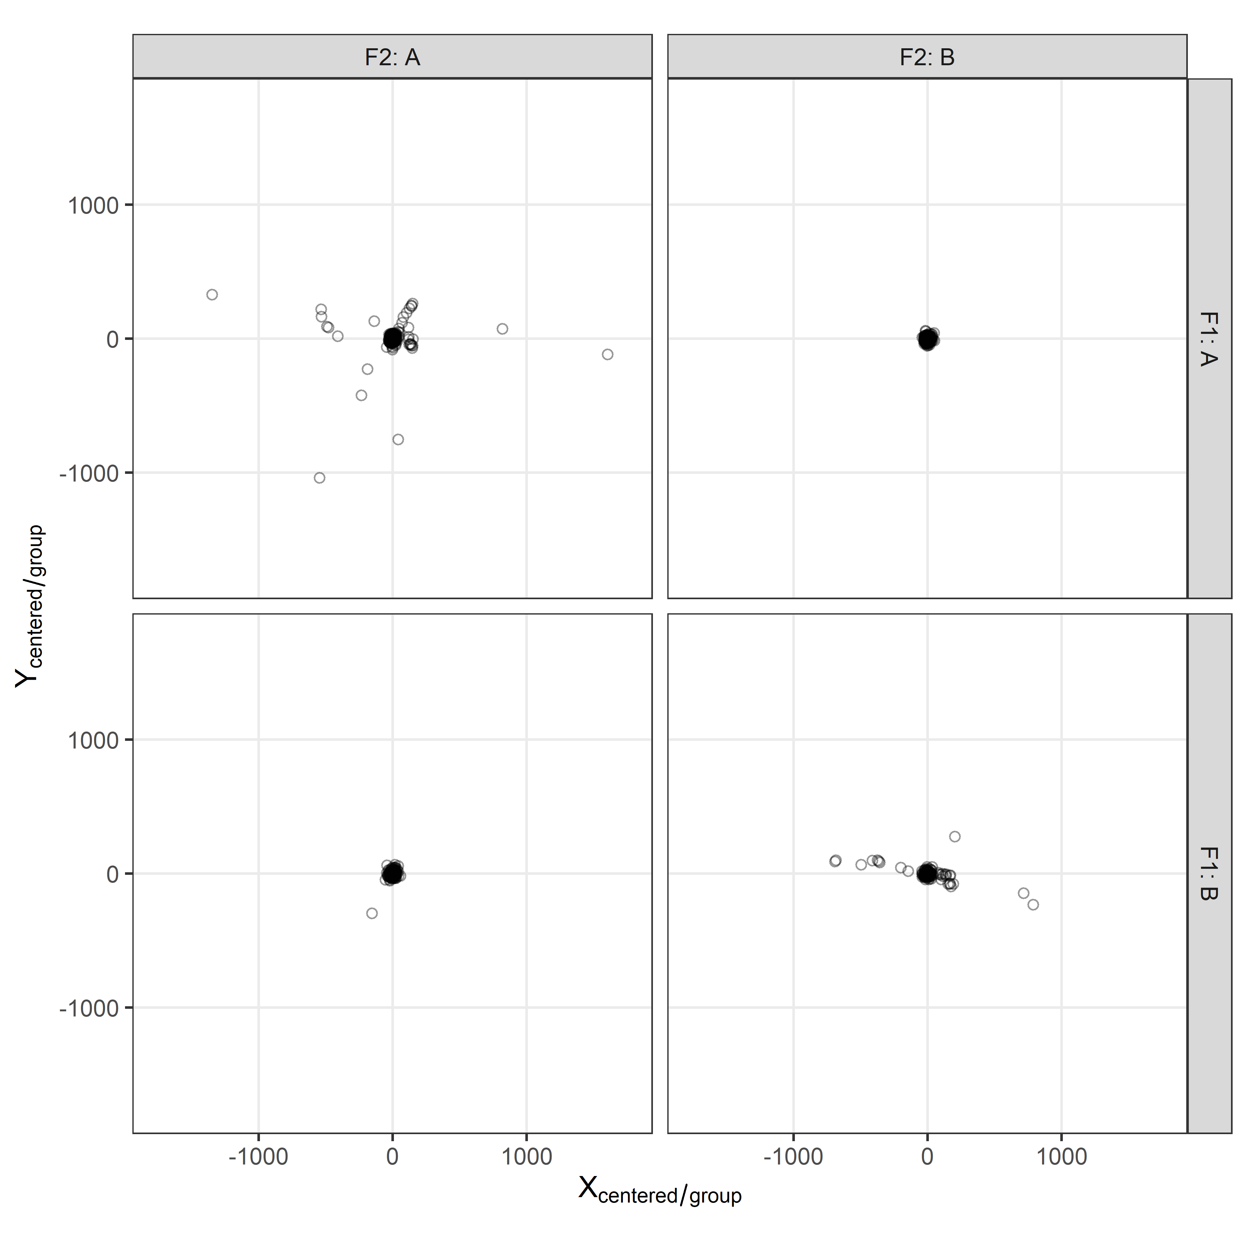
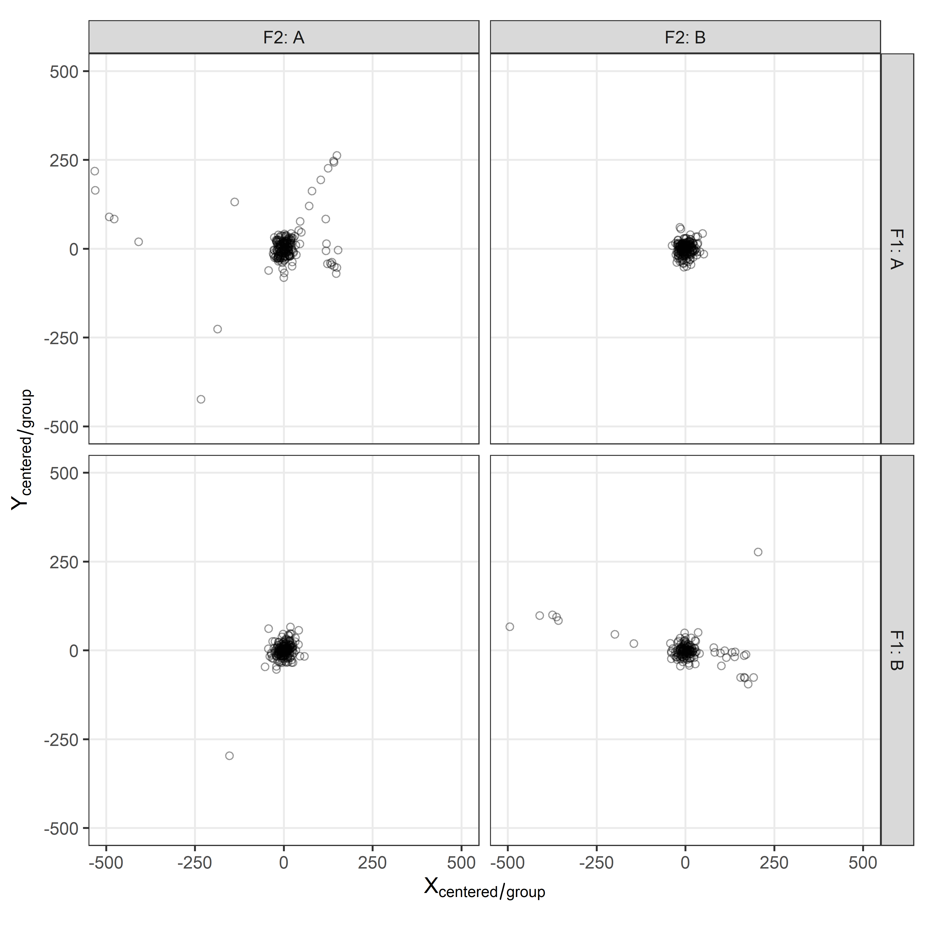
All Data
Zooming In – Outliers Trimmed
Note: Data centered so the mean submunition location is (0,0), per shot

Slide 21
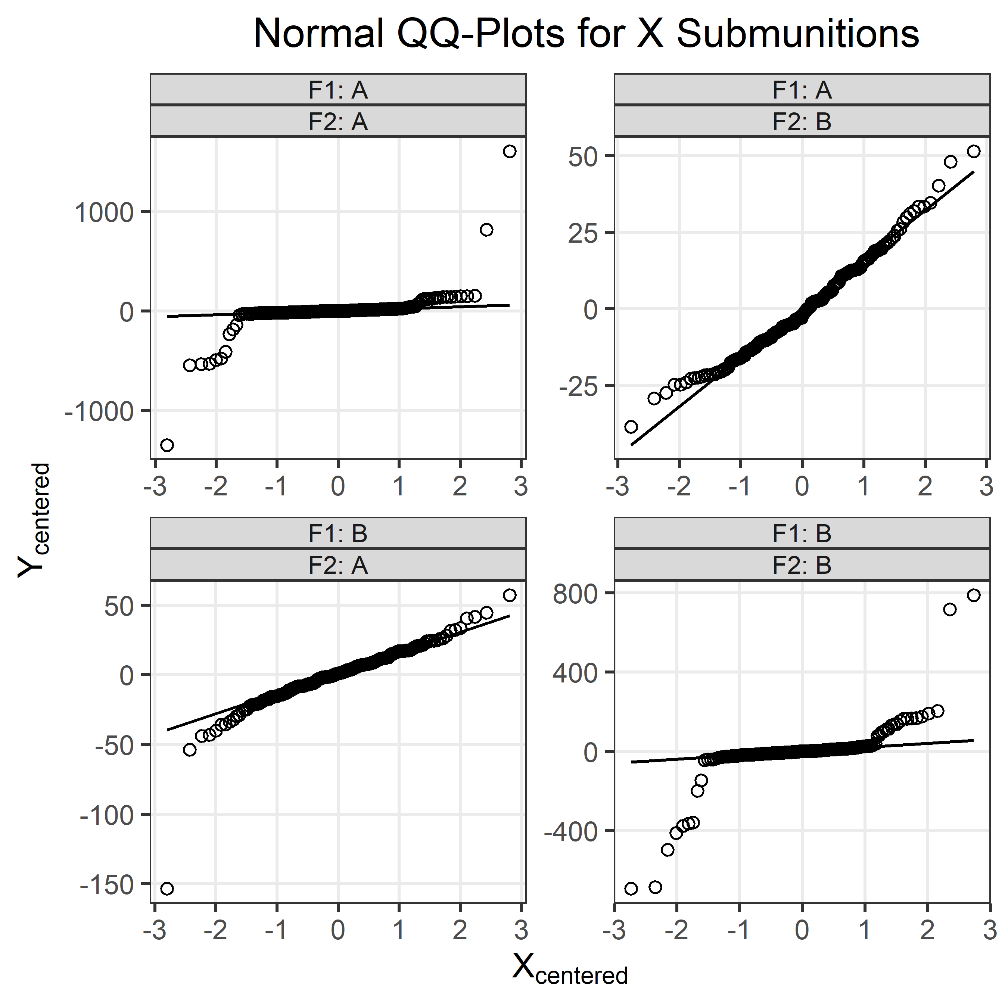
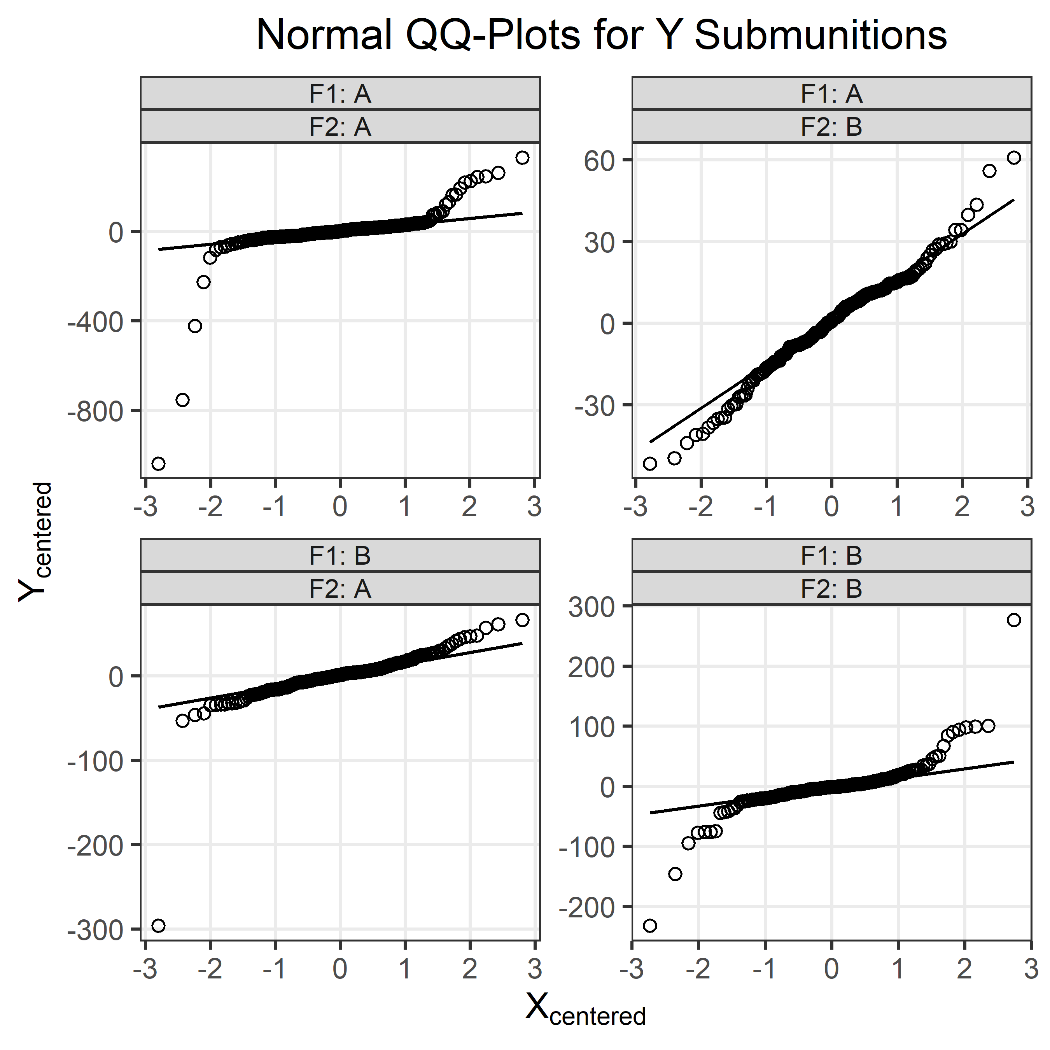
Normal QQ Plots for submunitions show departure from normality.

Slide 22
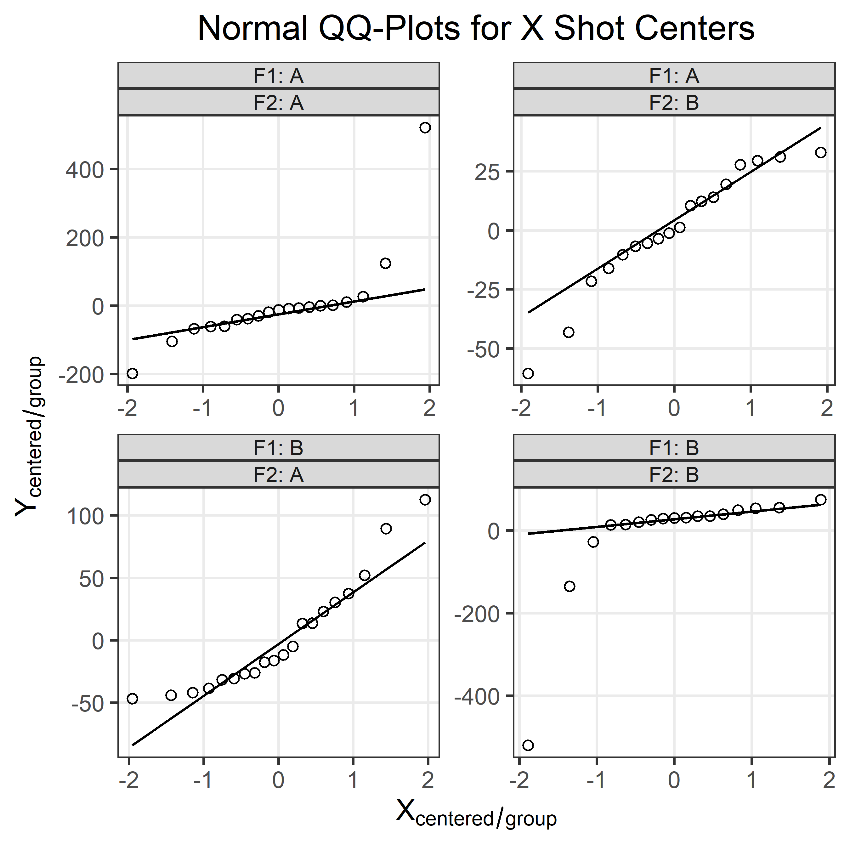
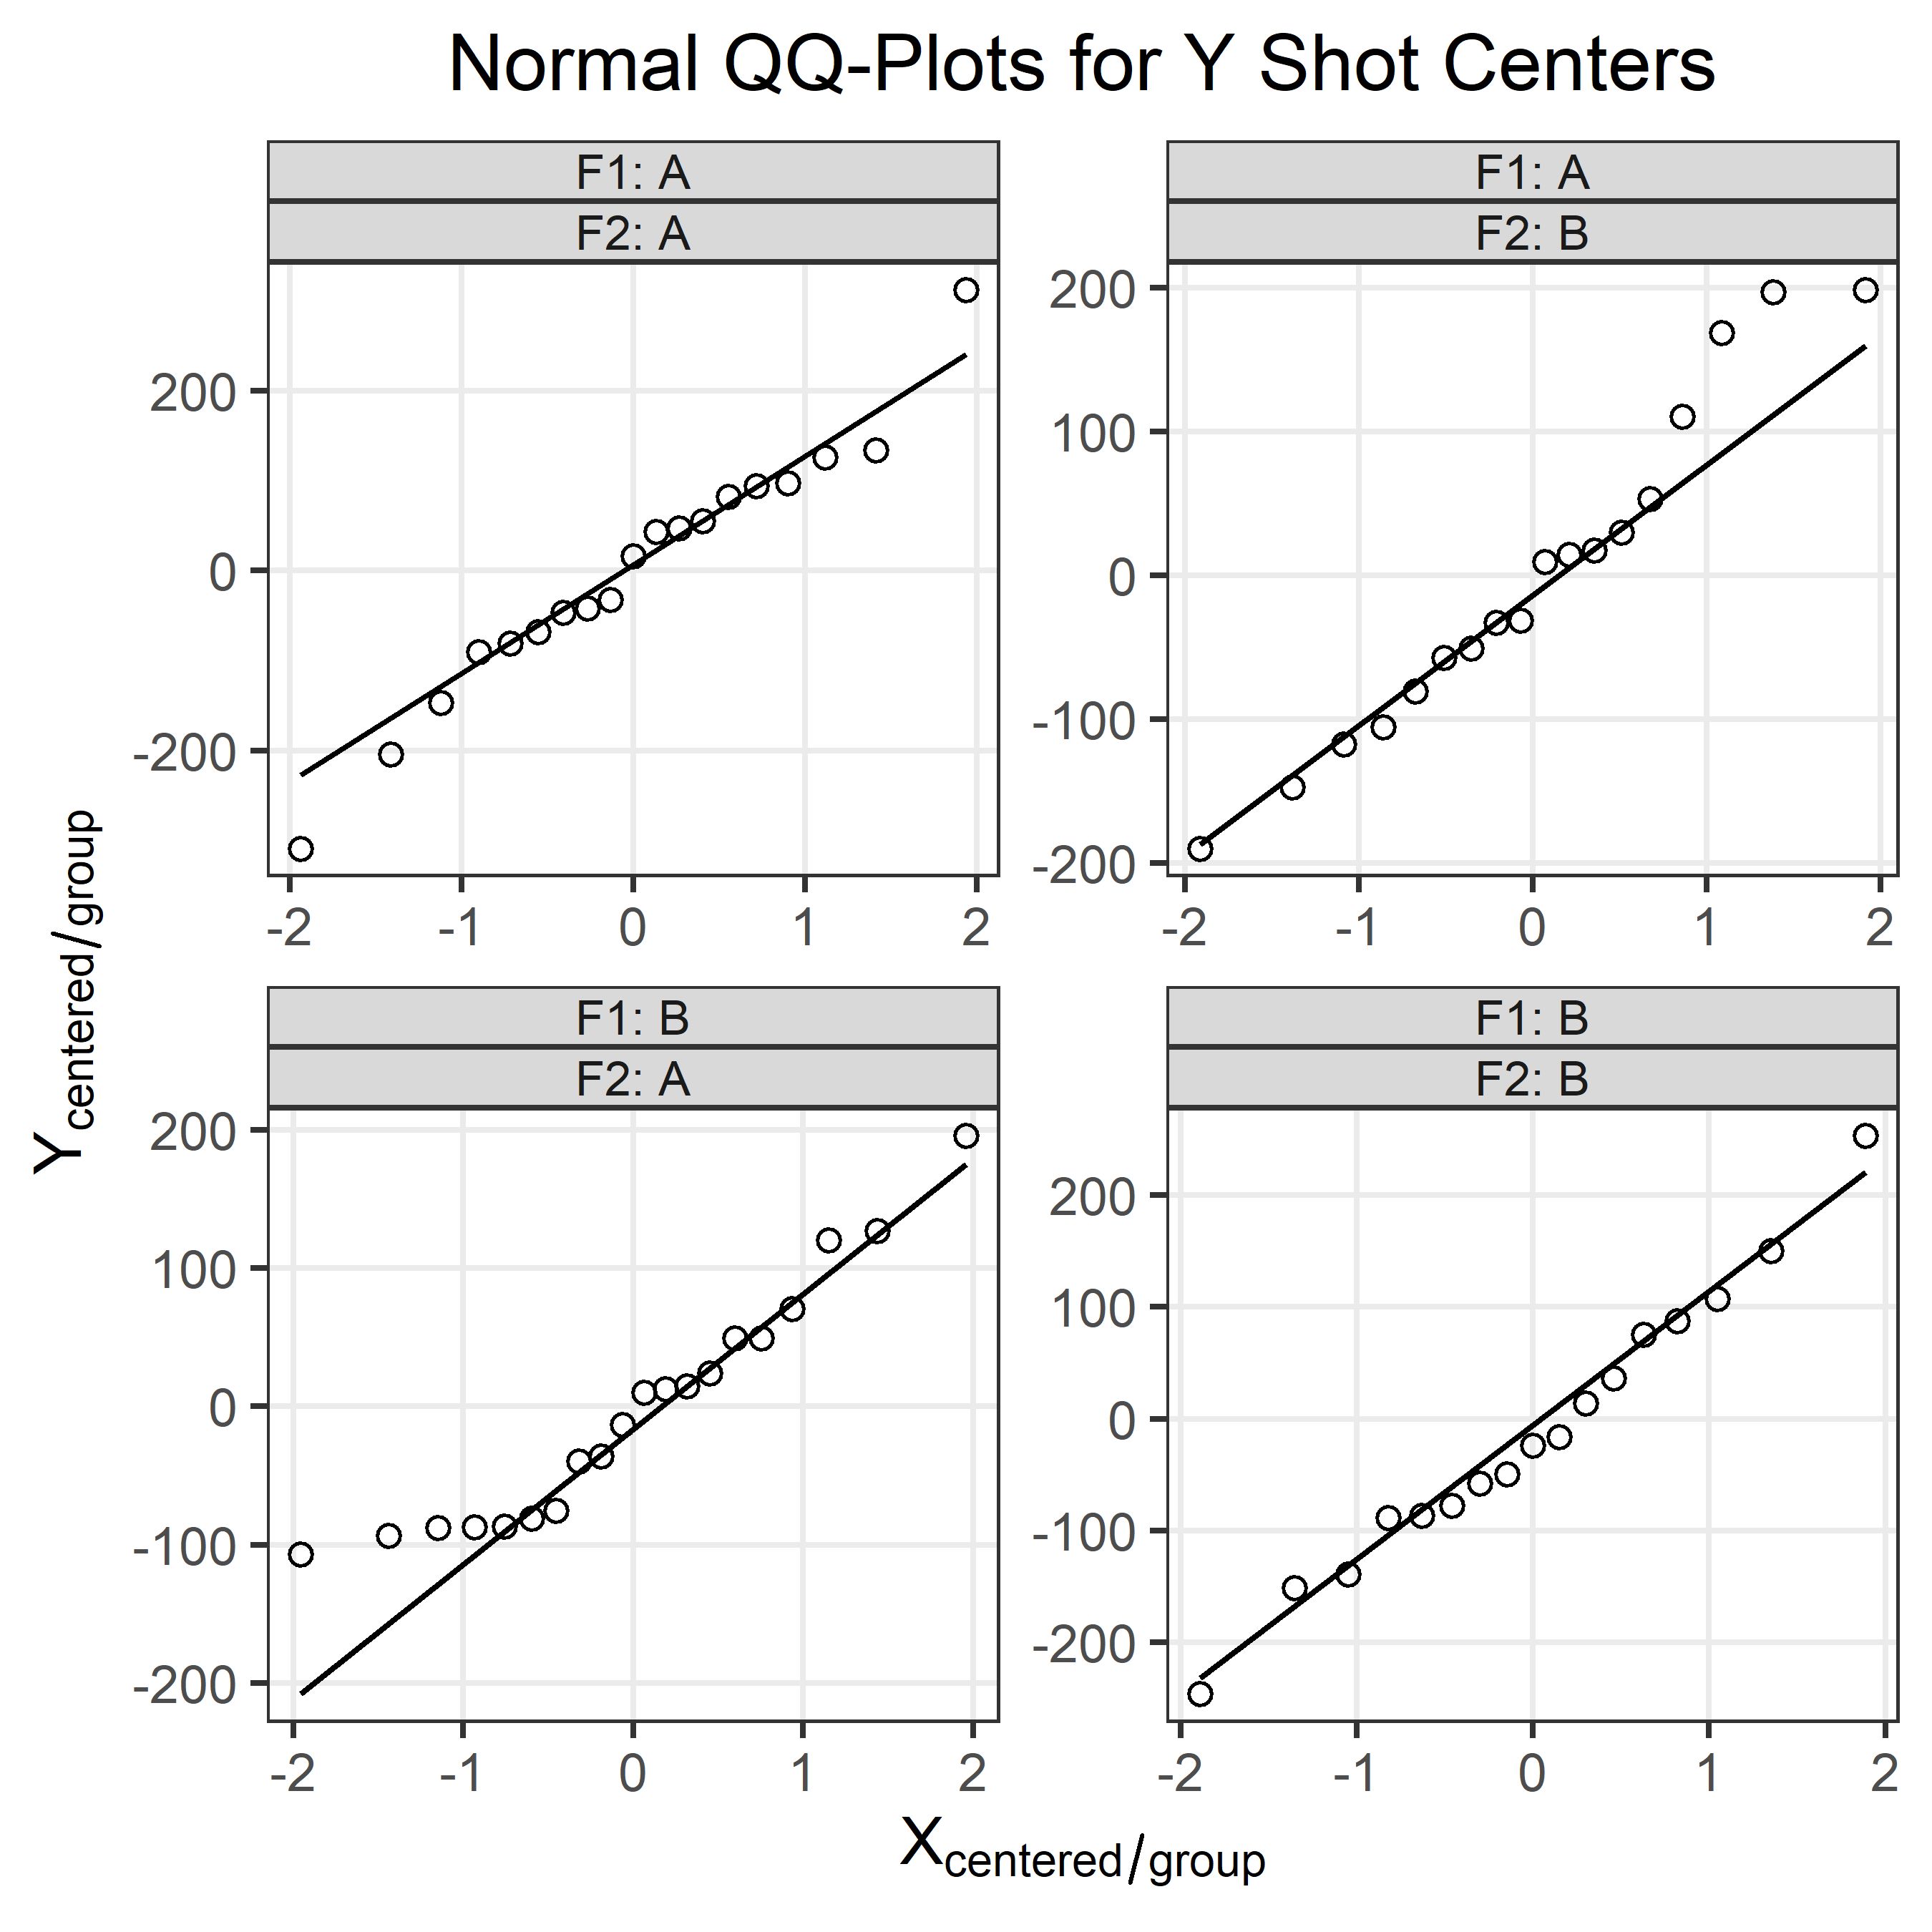
Normal QQ Plots for Shot Centers show departure from normality.

Slide 23
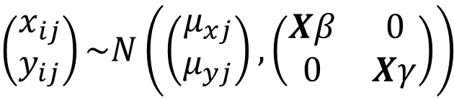


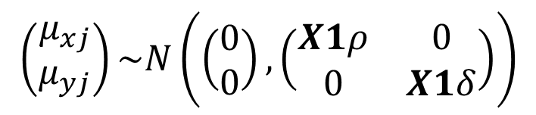
Build model to describe data generating process, and be mindful of assumptions, removing those that aren’t reasonable.
Normality
Circularity ($σ_{x}{=σ}_{y}$)
Bias in mean point of impact can be adjusted out through re-aiming/zeroing the weapon
Assumption doesn’t appear valid, but I’ll try it first
x
Assumption doesn’t appear valid, so I won’t force it in my model
(see explanation on slide 26)
✓
SMs distributed around shot.
Where,
$\left(x_{ij},y_{ij}\right)$ is the ith submunition (SM) location for the jth shot
$\left(μ_{xj},μ_{yj}\right)$ is the shot center for jth shot
$X$ is the submunition level predictor matrix for variance
$X1$ is the shot level predictor matrix for variance
$β, γ$ are coefficient vectors describing submunition x and y spread
$ρ, δ$ are coefficient vectors describing shot center x and y spread
$$\left(\begin{matrix}x_{ij} \\ y_{ij}\end{matrix}\right)\sim N\left(\left(\begin{matrix}μ_{xj} \\ μ_{yj}\end{matrix}\right),\left(\begin{matrix}Xβ & 0 \\ 0 & Xγ\end{matrix}\right)\right)$$
Shots distributed around origin.
$$\left(\begin{matrix}μ_{xj} \\ μ_{yj}\end{matrix}\right)\sim N\left(\left(\begin{matrix}0 \\ 0\end{matrix}\right),\left(\begin{matrix}X1ρ & 0 \\ 0 & X1δ\end{matrix}\right)\right)$$

Slide 24
Stan is a probabilistic programming language that will allow fitting the model described on the previous slide.
functions{}
data{}
transformed data{}
parameters{}
transformed parameters{}
model{}
generated quantities{}
Discussed on next slide, with the goal of building the model on previous slide

Slide 25
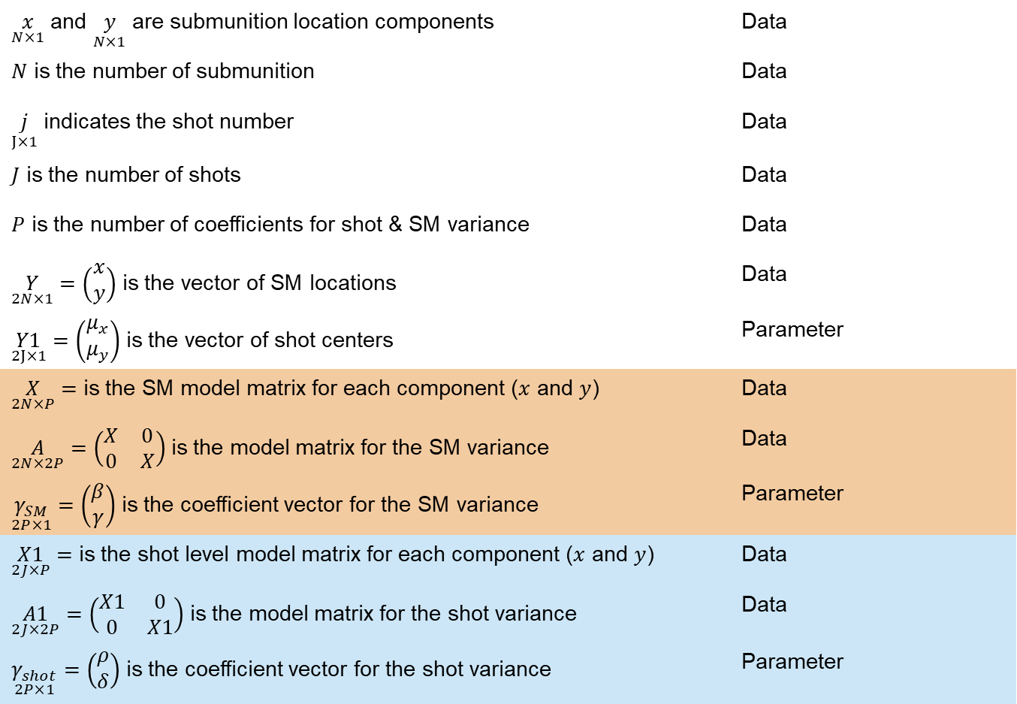
Below are some of the building blocks for our Stan model.
$\underset{N×1}{x}$ and $\underset{N×1}{y}$ are submunition location components | Data
$N$ is the number of submunition | Data
$\underset{J×1}{j}$ indicates the shot number | Data
$J$ is the number of shots | Data
$P$ is the number of coefficients for shot & SM variance | Data
$\underset{2N×1}{Y}=\left(\begin{matrix}x \\ y\end{matrix}\right)$ is the vector of SM locations | Data
$\underset{2J×1}{Y1}=\left(\begin{matrix}μ_{x} \\ μ_{y}\end{matrix}\right)$ is the vector of shot centers | Parameter
$\underset{2N×P}{X}=$ is the SM model matrix for each component ($x$ and $y$) | Data
$\underset{2N×2P}{A}=\left(\begin{matrix}X & 0 \\ 0 & X\end{matrix}\right)$ is the model matrix for the SM variance | Data
$\underset{2P×1}{γ_{SM}}=\left(\begin{matrix}β \\ γ\end{matrix}\right)$ is the coefficient vector for the SM variance | Parameter
$\underset{2J×P}{X1}=$ is the shot level model matrix for each component ($x$ and $y$) | Data
$\underset{2J×2P}{A1}=\left(\begin{matrix}X1 & 0 \\ 0 & X1\end{matrix}\right)$ is the model matrix for the shot variance | Data
$\underset{2P×1}{γ_{shot}}=\left(\begin{matrix}ρ \\ δ\end{matrix}\right)$ is the coefficient vector for the shot variance | Parameter

Slide 26
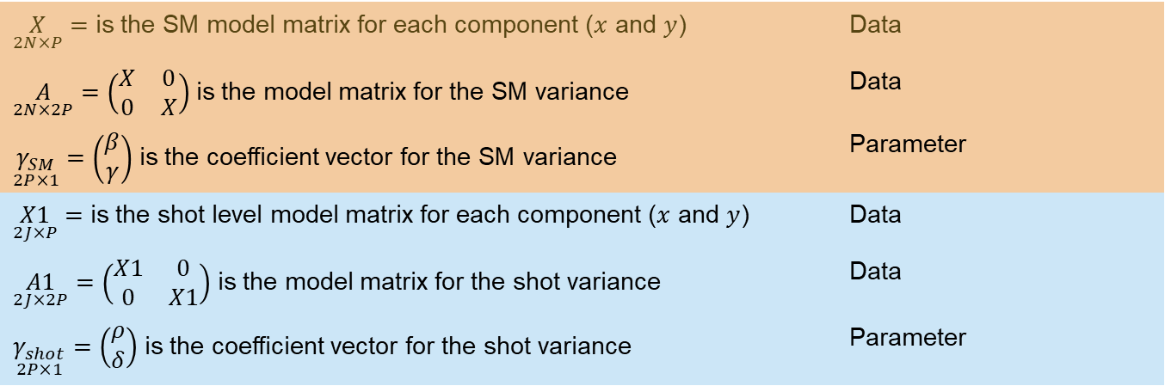
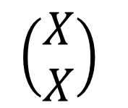
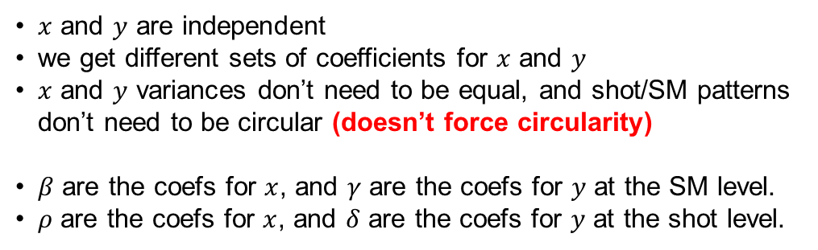
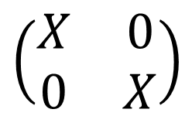
Explaining the $\left(\begin{matrix}X & 0 \\ 0 & X\end{matrix}\right)$ Matrix Structure
$\underset{2N×P}{X}=$ is the SM model matrix for each component ($x$ and $y$) | Data
$\underset{2N×2P}{A}=\left(\begin{matrix}X & 0 \\ 0 & X\end{matrix}\right)$ is the model matrix for the SM variance | Data
$\underset{2P×1}{γ_{SM}}=\left(\begin{matrix}β \\ γ\end{matrix}\right)$ is the coefficient vector for the SM variance | Parameter
$\underset{2J×P}{X1}=$ is the shot level model matrix for each component ($x$ and $y$) | Data
$\underset{2J×2P}{A1}=\left(\begin{matrix}X1 & 0 \\ 0 & X1\end{matrix}\right)$ is the model matrix for the shot variance | Data
$\underset{2P×1}{γ_{shot}}=\left(\begin{matrix}ρ \\ δ\end{matrix}\right)$ is the coefficient vector for the shot variance | Parameter
Model matrix for x-direction components
$x$ and $y$ are independent
we get different sets of coefficients for $x$ and $y$
$x$ and $y$ variances don’t need to be equal, and shot/SM patterns don’t need to be circular (doesn’t force circularity)
$β$ are the coefs for $x$, and $γ$ are the coefs for $y$ at the SM level.
$ρ$ are the coefs for $x$, and $δ$ are the coefs for $y$ at the shot level.
$$\left(\begin{matrix}X & 0 \\ 0 & X\end{matrix}\right)$$
Model matrix for y-direction components
$$\left(\begin{matrix}X \\ X\end{matrix}\right)$$
Does force circularity

Slide 27
Example Stan Model Block for Bivariate Normal
model{
vector[2*N] yhat; //yhat = vector of predicted shot centers // N = number of SMs
//priors can be specified
//j = vector indicating shot number //j[n] = shot number of nth submunition
//Y1 is parameter for shot center (vector of length 2*J)
//yhat is a vector of length 2*N, stating that a group of SMs from the jth shot
// have the same shot center, expanding Y1 from length 2*J to 2*N
for(n in 1:2*N){
yhat[n] = Y1[j[n]];
}
target += normal_lpdf(Y1 | 0, gamma_shot); // Y1 ~ normal(0, gamma_shot)
target += normal_lpdf(Y | yhat, gamma_sm); // Y ~ normal(yhat, gamma_sm)
}

Slide 28
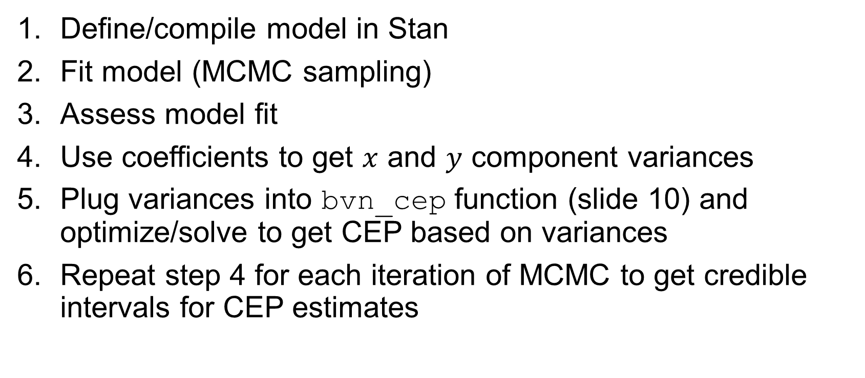
Workflow
Define/compile model in Stan
Fit model (MCMC sampling)
Assess model fit
Use coefficients to get $x$ and $y$ component variances
Plug variances into bvn_cep function (slide 10) and optimize/solve to get CEP based on variances
Repeat step 4 for each iteration of MCMC to get credible intervals for CEP estimates
Model Data
If model is good

Slide 29
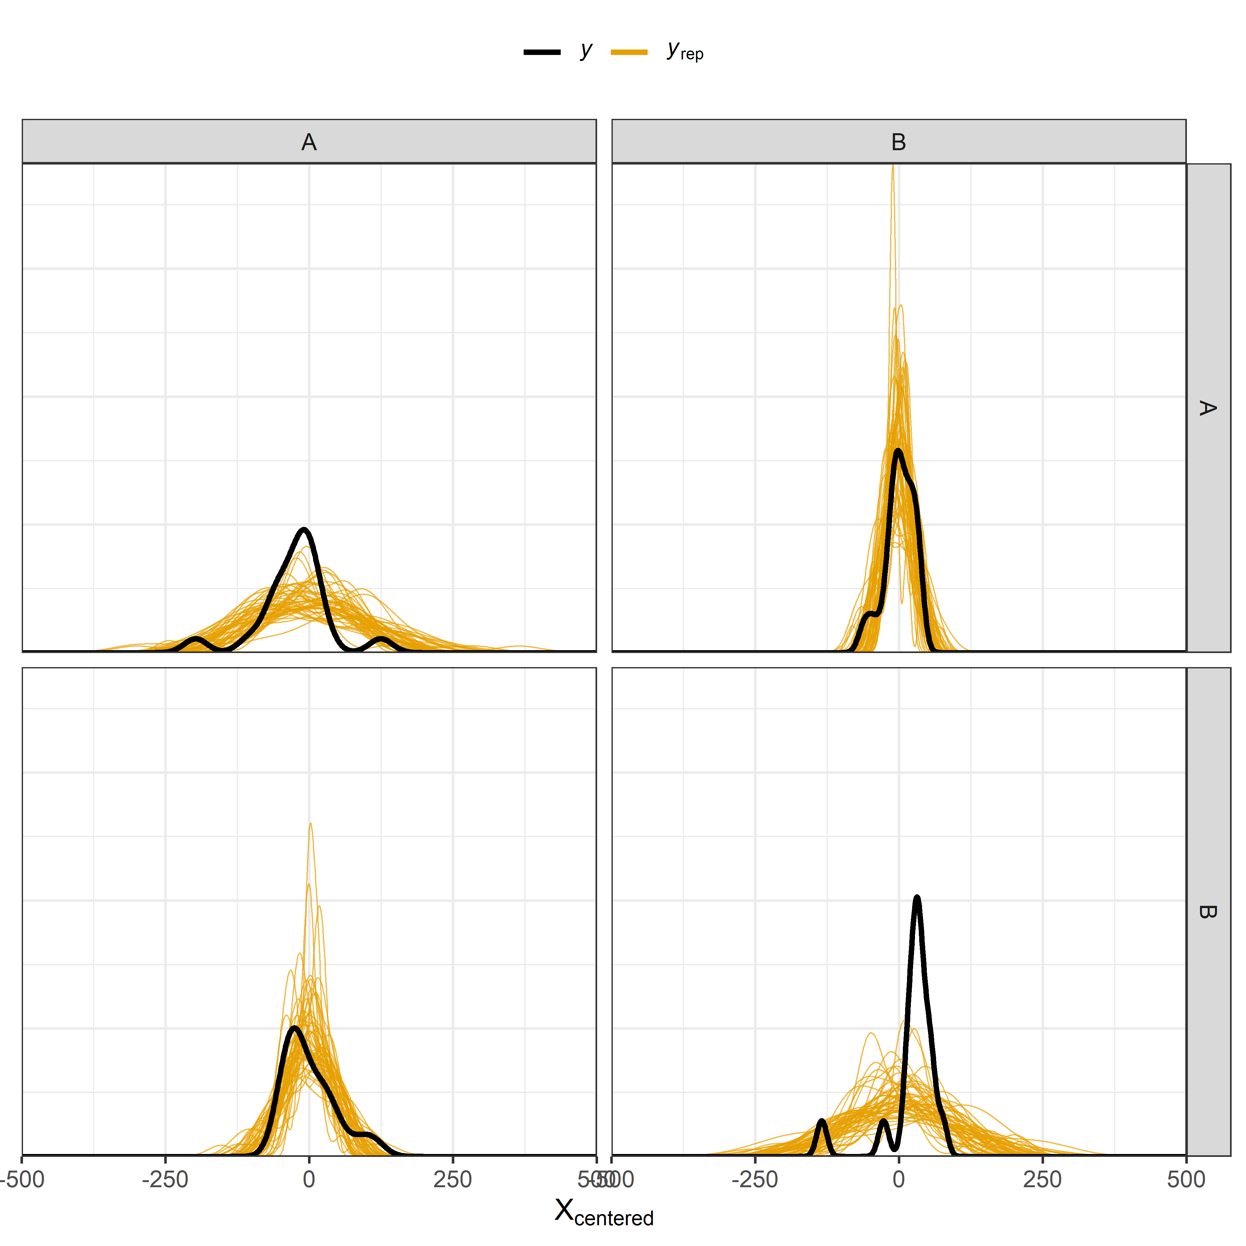
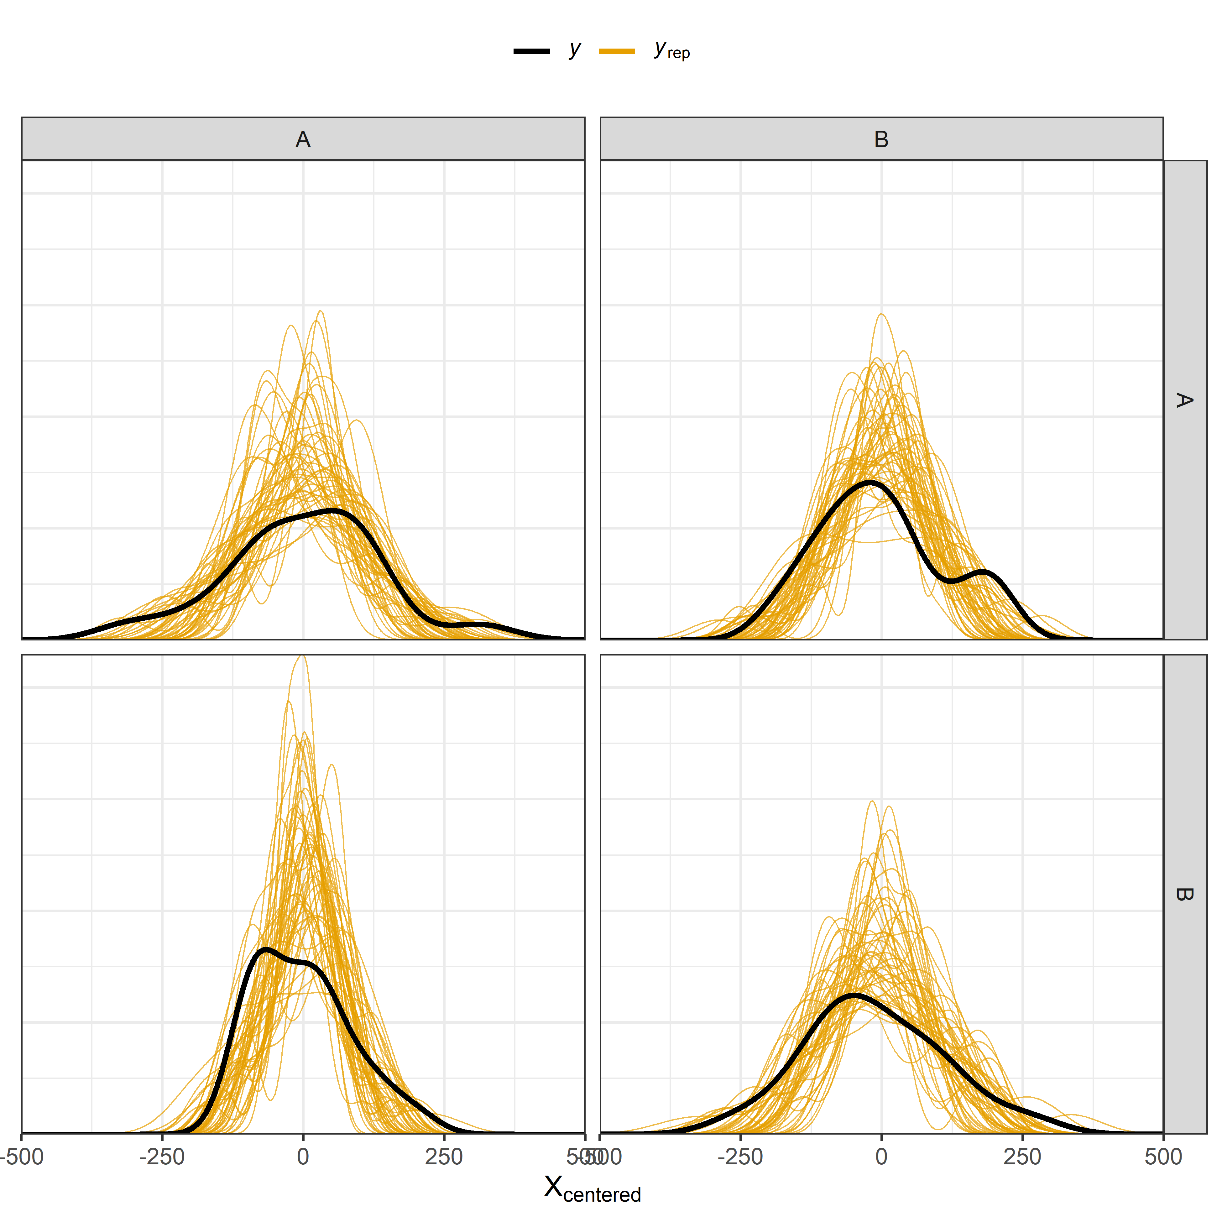
Assessing Bivariate Normal Model Fit
Shot Center X Density Overlay
Shot Center Y Density Overlay

Slide 30
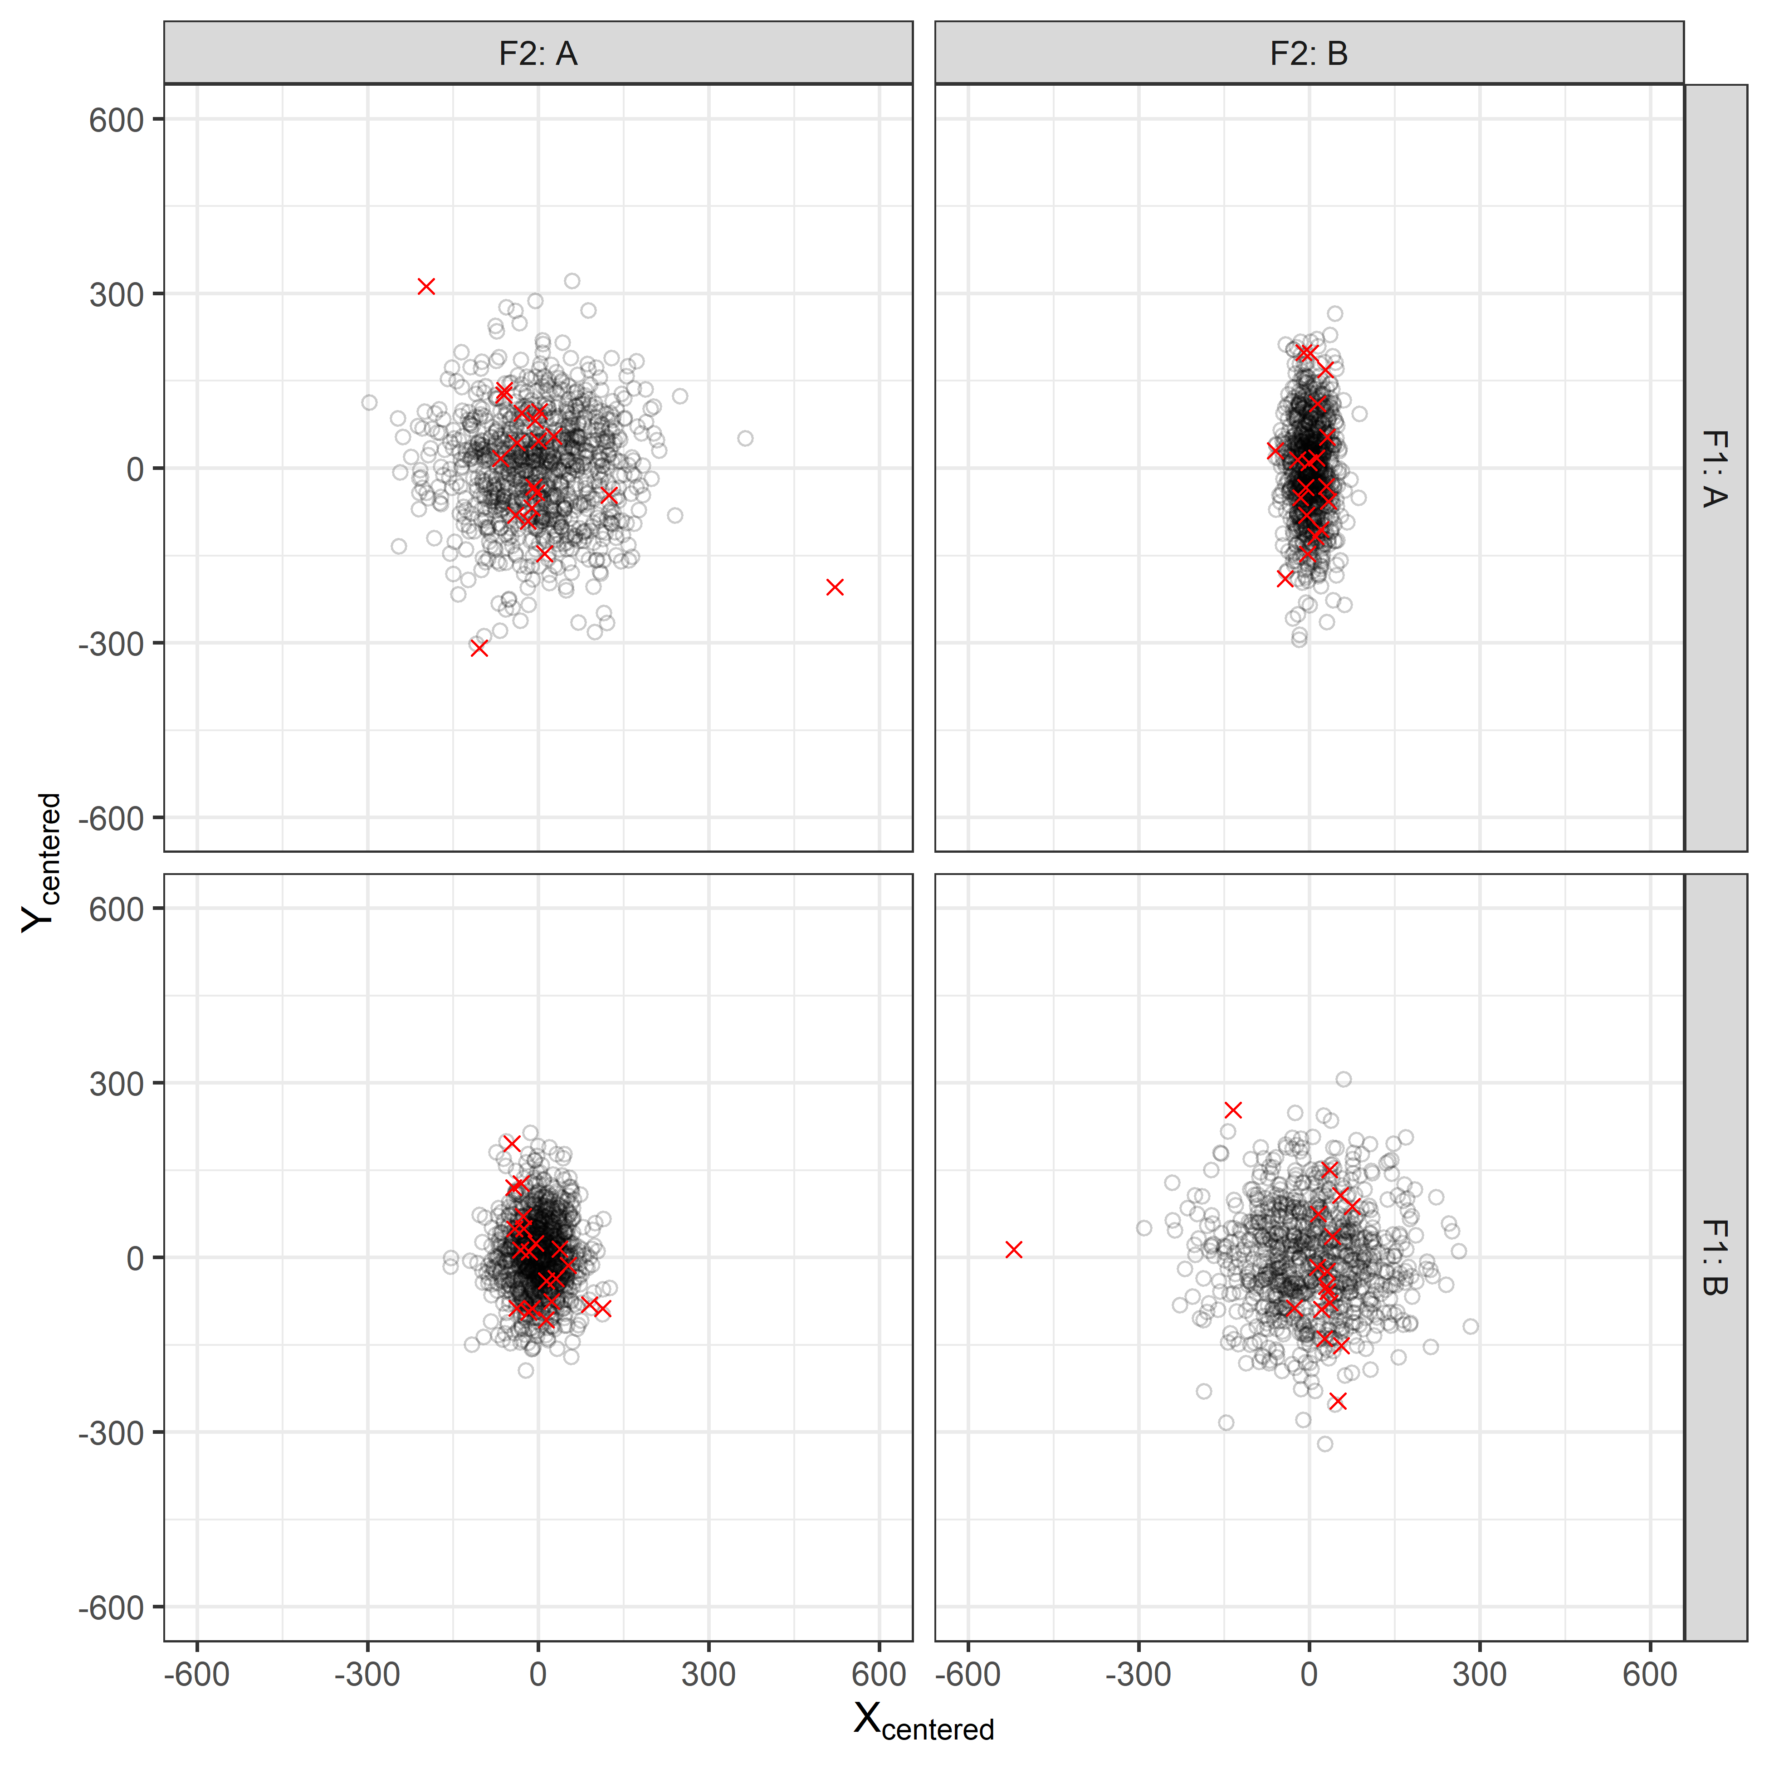
Assessing Bivariate Normal Model Fit
o | Predicted Shot Center
x | Observed Shot Center
Shot Center Pattern

Slide 31
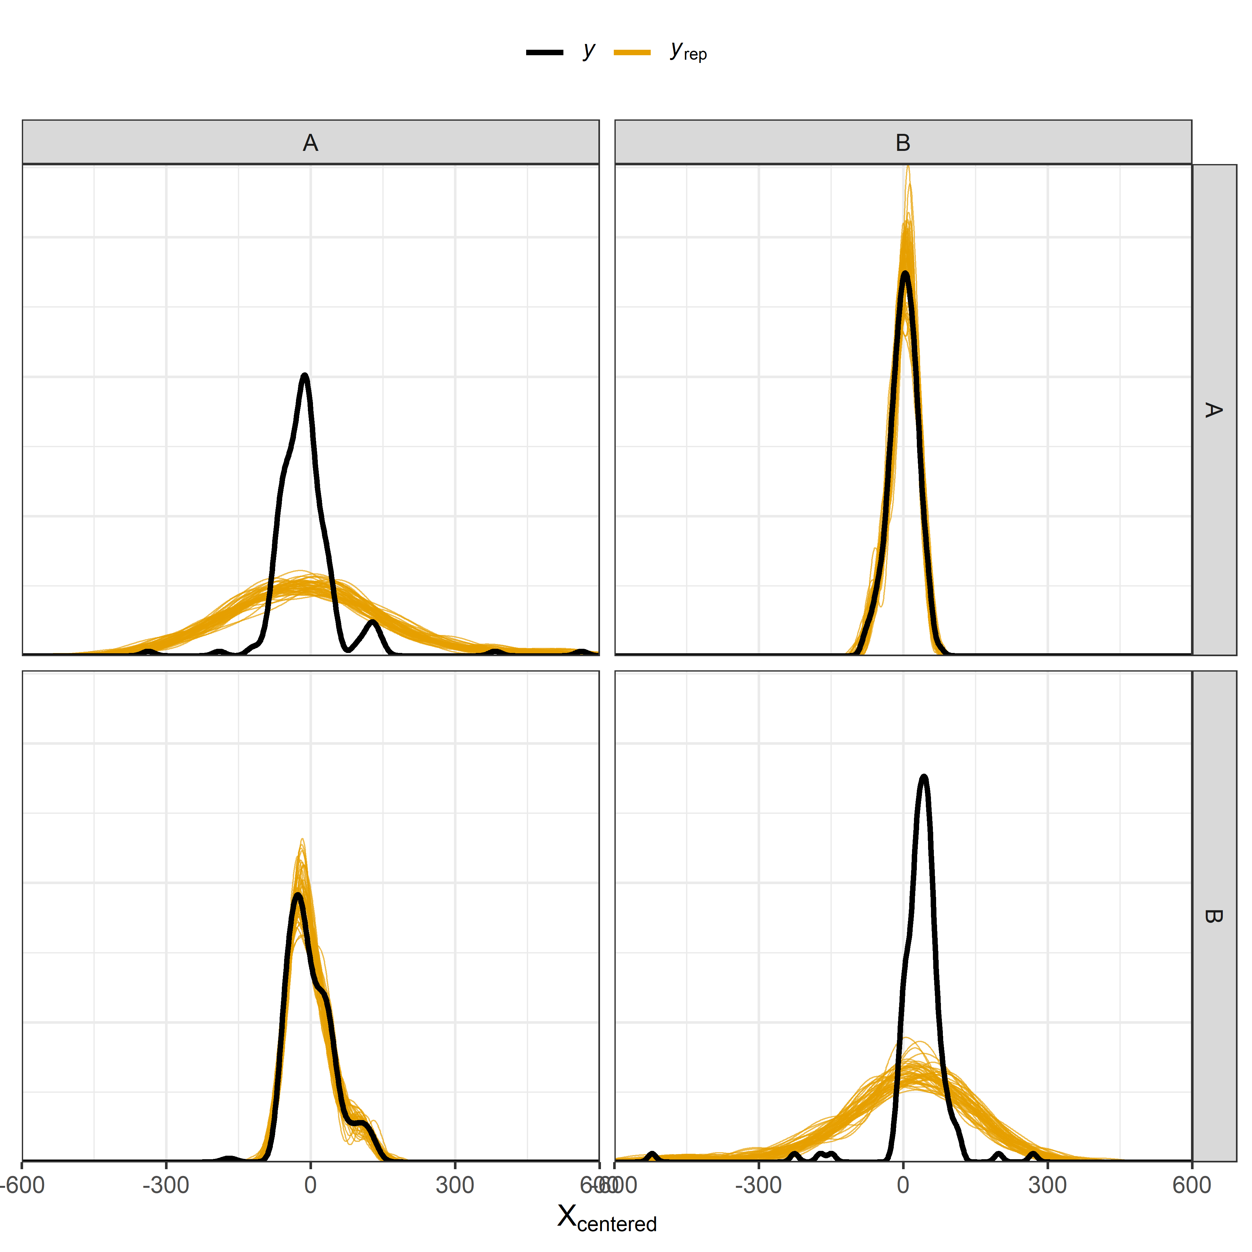
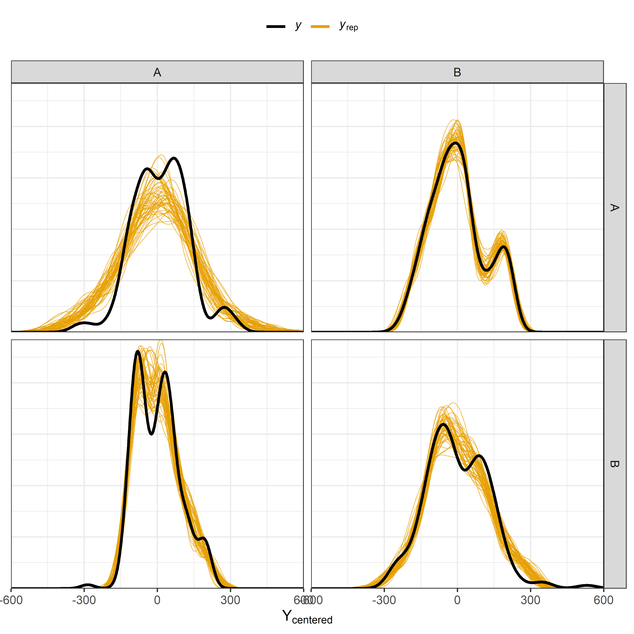
Assessing Bivariate Normal Model Fit
Submunition X Density Overlay
Submunition Y Density Overlay

Slide 32
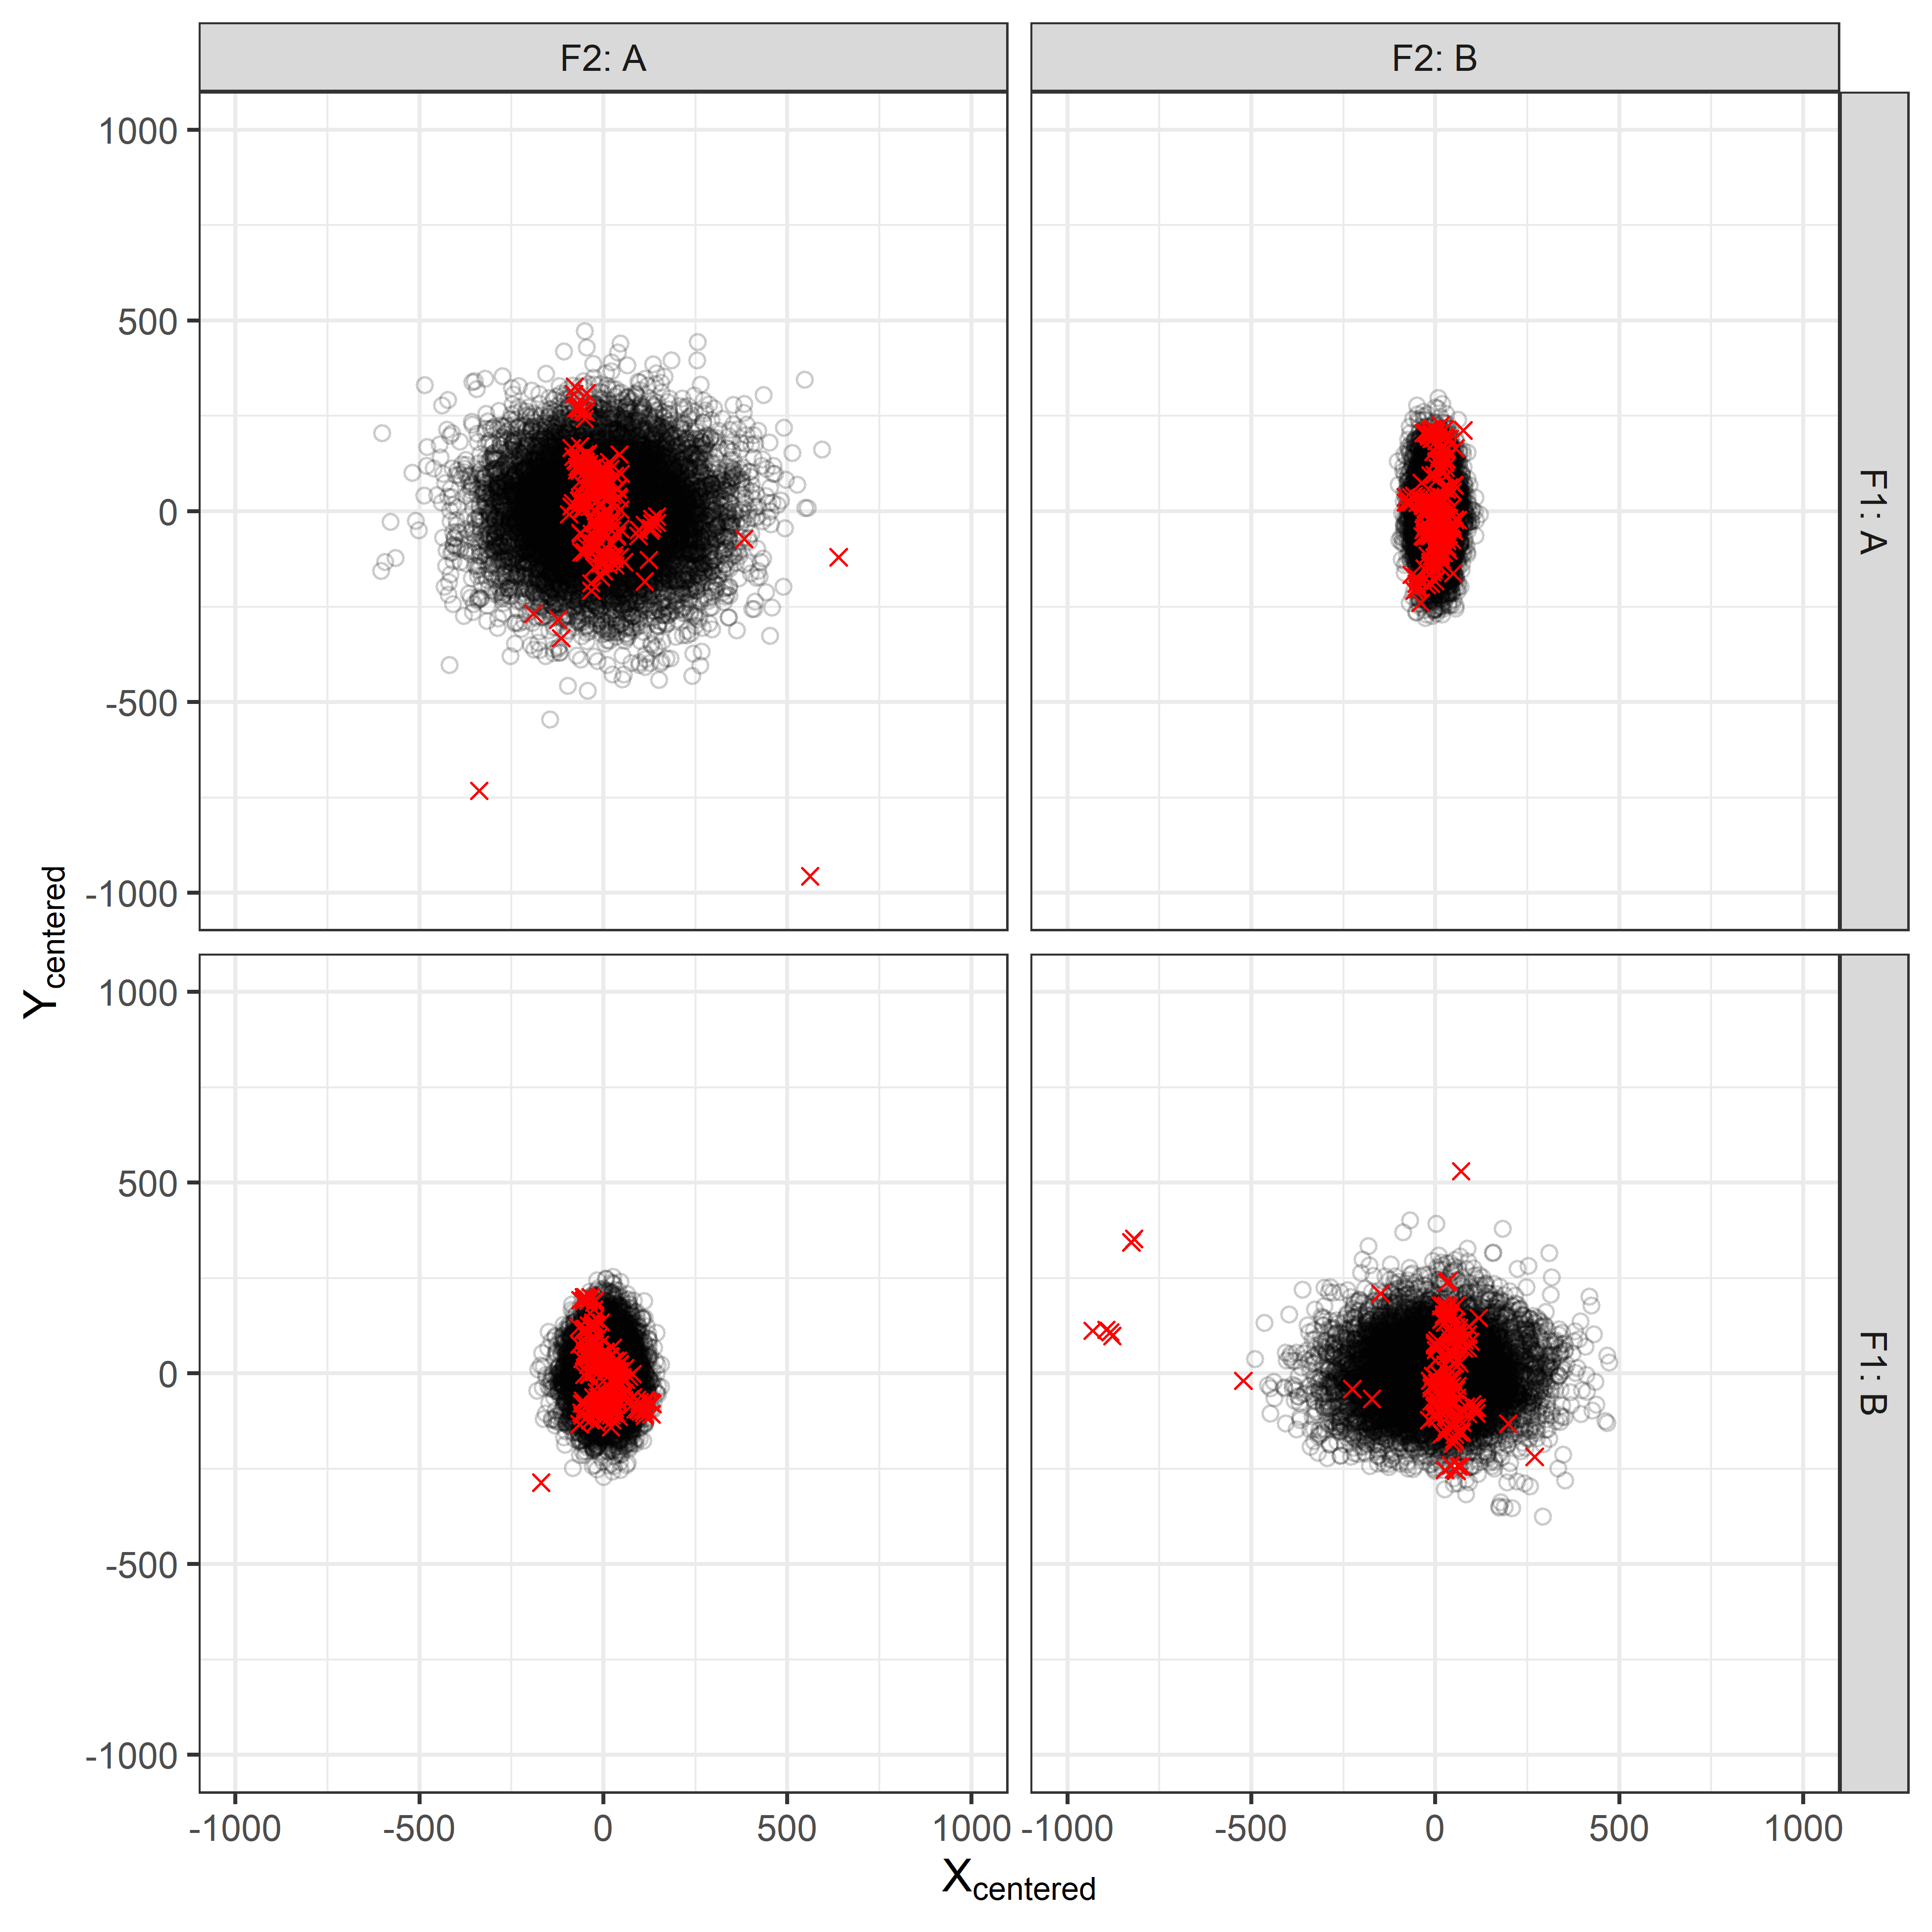
Assessing Bivariate Normal Model Fit
Submunition Pattern
o | Predicted Submunition
x | Observed Submunition
Note: 4 observed SMs trimmed/not shown due to axes scales.

Slide 33
CEP(50) Estimates with 80% Intervals
# Combine errors at both levels to get x & y-direction sds
x1 <- sqrt(post$"s_shot[1]"^2 + post$"s_sm[1]"^2)
y1 <- sqrt(post$"s_shot[5]"^2 + post$"s_sm[5]"^2)
# Function to find CEP based on x and y sds
cep_fn <- function(x,y) {
optimize(bvn_cep, p = .5, sx = x, sy = y,
interval = c(0, 500), tol = 1E-10)$min
}
# Find CEP for each value of x1 & y1
cep1 <- unlist( purrr::map2(x1, y1, cep_fn) )
# Check to make sure that integration from 0 to CEP is close to 0.50
# otherwise may need to change optimize interval
range(unlist(purrr::pmap(list(x1, y1, cep1), check_fn)) - 0.50)
which(abs(unlist(purrr::pmap(list(x1, y1, cep1), check_fn)) - 0.50) > 0.000001)
mean(cep1)
quantile(cep1, probs = c(.1,.9))
Code from bottom of slide 10 wrapped into a function

Slide 34
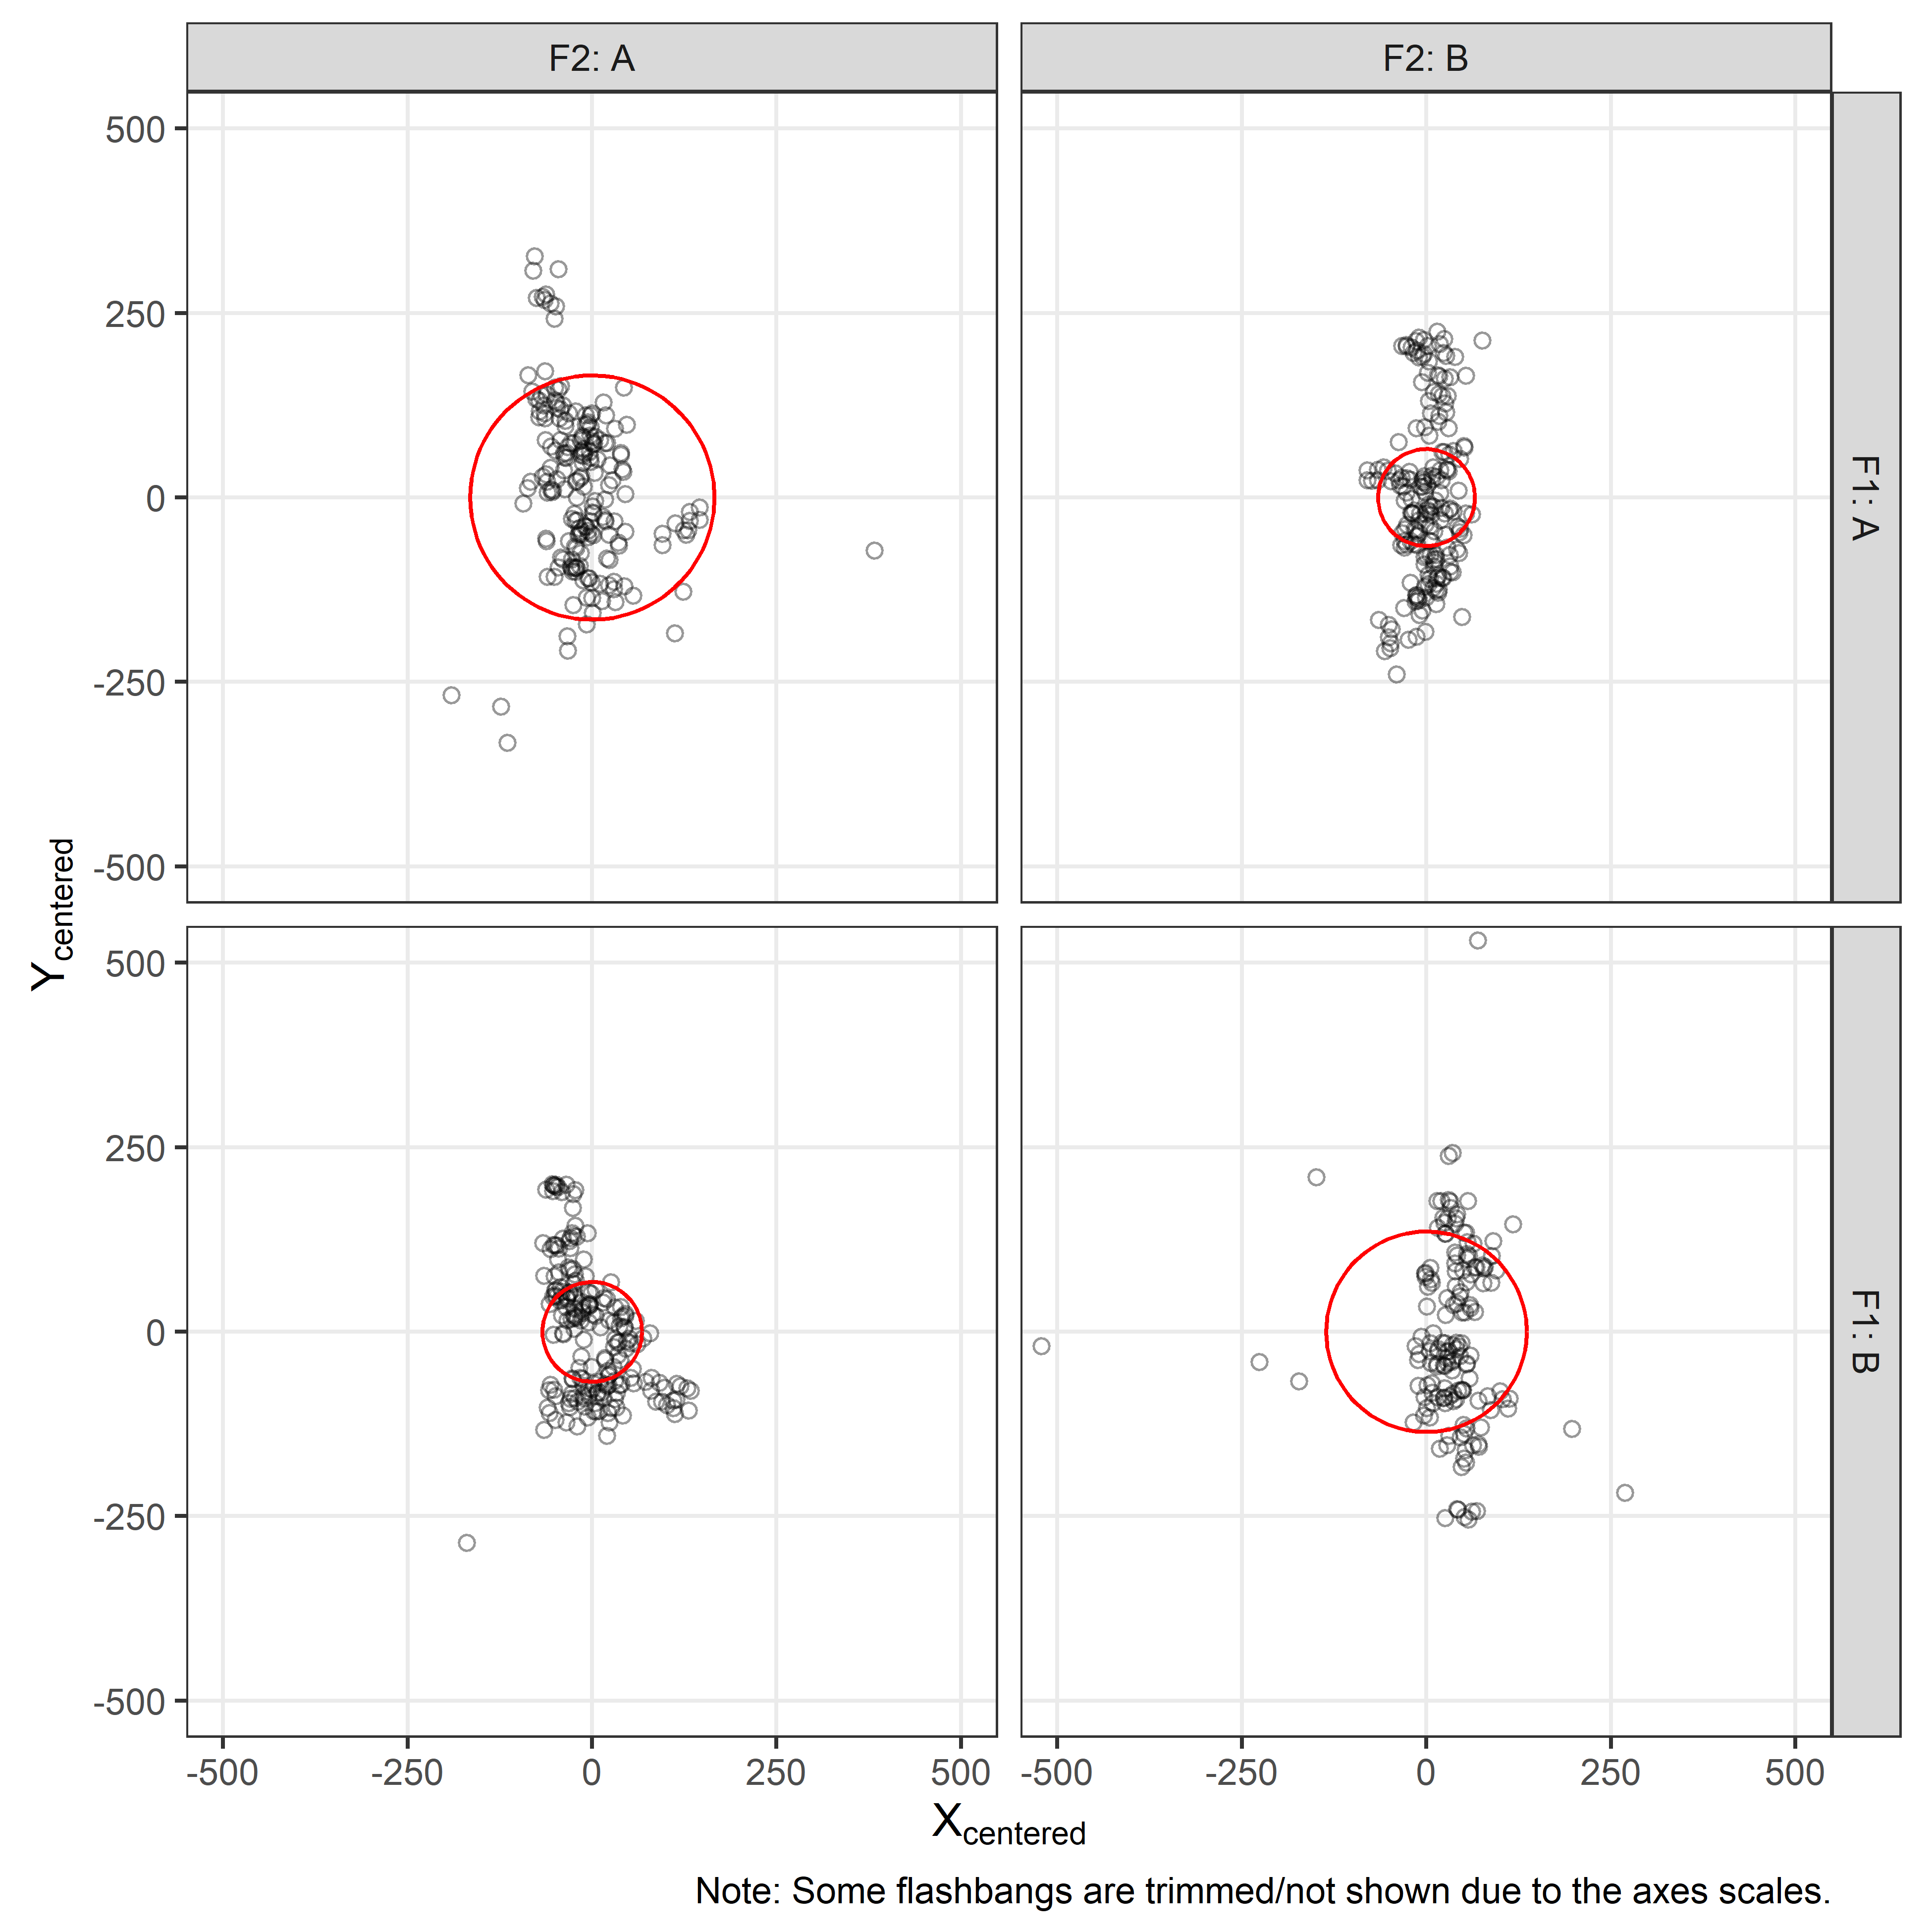
CEP Assuming Bivariate Normal Model
Mean CEP(50) contains 86% of points (85%,87%)*
Mean CEP(50) contains 39% of points (34%,45%)*
Mean CEP(50) contains 38% of points (34%,46%)*
Mean CEP(50) contains 64% of points (60%,70%)*
*Indicates the % of points covered by the CEP(50) 80% credible interval endpoints

Slide 35
Relaxing Model Assumptions
Given the previous diagnostic plots, the Bivariate Normality assumption of shot centers and submunitions does not appear to be adequate especially at F1 A, F2 A and F1 B, F2 B.
As a result, CEP(50) doesn’t appear to be covering the % of points we would expect (see slide 34).

Slide 36
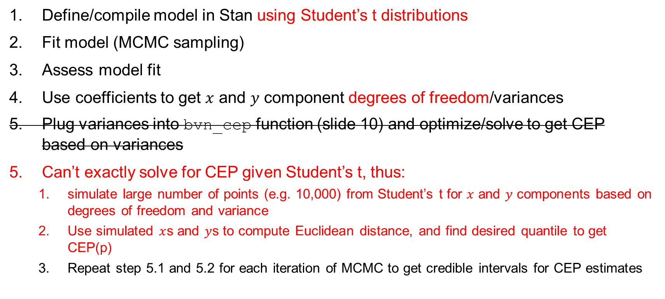
Workflow for Student’s t Model
Define/compile model in Stan using Student’s t distributions
Fit model (MCMC sampling)
Assess model fit
Use coefficients to get $x$ and $y$ component degrees of freedom/variances
Plug variances into bvn_cep function (slide 10) and optimize/solve to get CEP based on variances
Can’t exactly solve for CEP given Student’s t, thus:
  simulate large number of points (e.g. 10,000) from Student’s t for $x$ and $y$ components based on degrees of freedom and variance
  Use simulated $x$s and $y$s to compute Euclidean distance, and find desired quantile to get CEP(p)
  Repeat step 5.1 and 5.2 for each iteration of MCMC to get credible intervals for CEP estimates
Model Data
If model is good

Slide 37
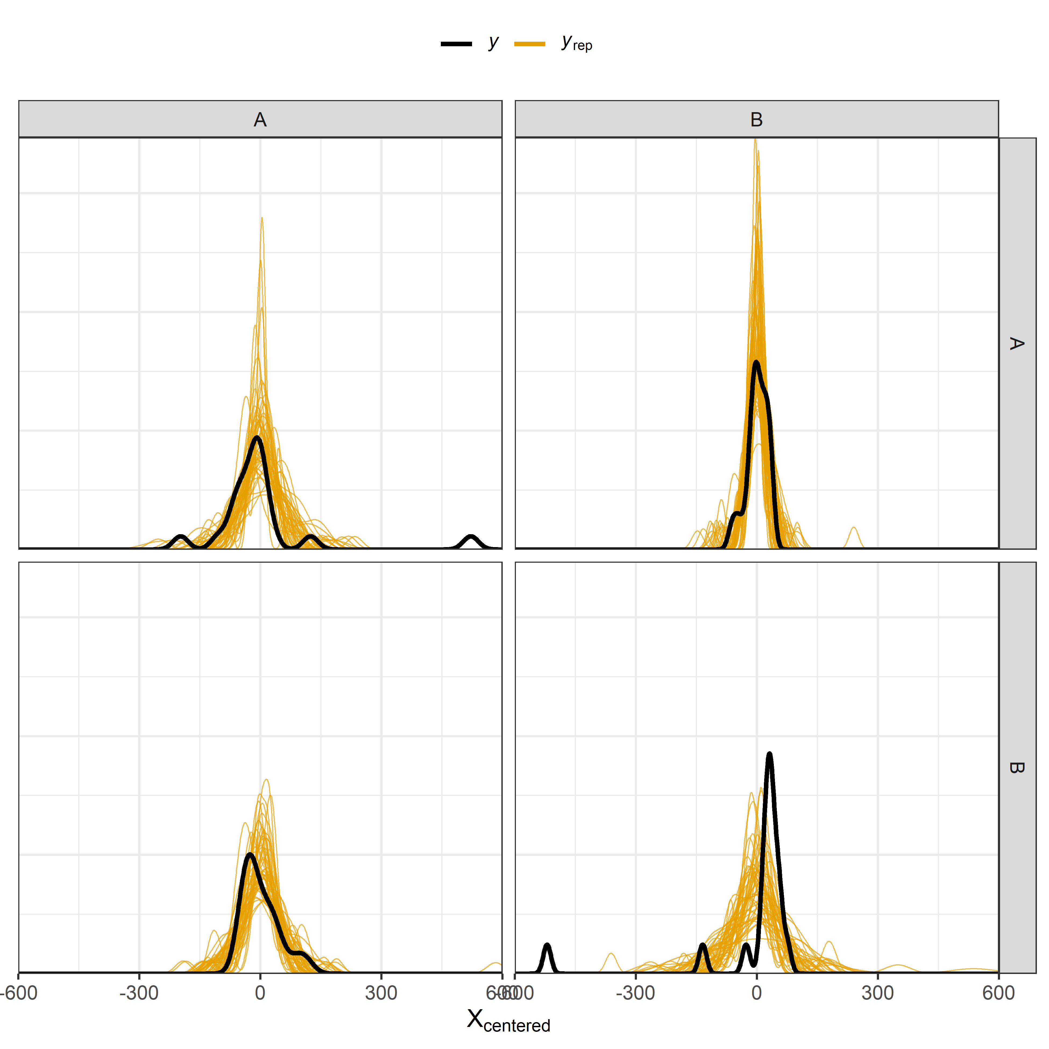

Assessing Student’s t Model Fit
Shot Center X Density Overlay
Shot Center Y Density Overlay

Slide 38

Assessing Student’s t Model Fit
o | Predicted Shot Center
x | Observed Shot Center
Shot Center Pattern

Slide 39


Assessing Student’s t Model Fit
Submunition X Density Overlay
Submunition Y Density Overlay

Slide 40

Assessing Student’s t Model Fit
Submunition Pattern
o | Predicted Submunition
x | Observed Submunition
Note: 4 observed SMs trimmed/not shown due to axes scales.

Slide 41
CEP(50) Estimates with 80% Intervals
euclid_dist <- function(s_shotx, s_smx, s_shoty, s_smy,
n, dofx, dofy, prob){
quantile(
sqrt(
(rt(n, dofx)*sd_shotx + rt(n, dofx)*sd_smx)^2 +
(rt(n, dofy)*sd_shoty + rt(n, dofy)*sd_smy)^2
), prob)
}
cep1 <- rep(0, nrow(post))
for(i in 1:nrow(post)){
cep1[i] <- euclid_dist(
post$"s_shotx"[i], post$"s_smx"[i],
post$"s_shoty"[i], post$"s_smy"[i],
sims = 10000, dofx = 5, dofy = 30, probs = 0.50
)
}
mean(cep1)
quantile(cep1, probs = c(.1,.9))
Sim data from
t-dist to find
approx. CEP
Do for every set of parameters that came from MCMC

Slide 42
CEP(50) Estimates with 80% Intervals
 | F2 A | F2 B
F1 A | 102 (88, 119) | 85 (72, 103)
F1 B | 78 (68, 93) | 109 (93, 129)

Slide 43

CEP Assuming Student’s t Model
Mean CEP(50) contains 55% of points (47%,66%)*
Mean CEP(50) contains 53% of points (44%,59%)*
Mean CEP(50) contains 51% of points (39%,61%)*
Mean CEP(50) contains 49% of points (43%,61%)*
*Indicates the % of points covered by the CEP(50) 80% credible interval endpoints

Slide 44
Model Comparison
elpd_diff se_diff
Student’s t model 0.0 0.0
Normal model -850.6 131.2
Student’s t model improves the expected log-predictive densities
Posterior predictive accuracy of Student’s t model is significantly greater than that of Normal model

Slide 45
Goals:
Provide a theoretical understanding of CEP
Use understanding for estimation of CEP in simple and complex cases
✓
✓
Understanding the assumptions of CEP helps:
  ensure proper use of CEP
  understand how to relax those assumptions when they are not justifiable
First reference (next slide) provides a good framework for estimating CEP using regression methods
Questions?

Slide 46
References
Johnson, TH, Haman, JT, Wojton, H, Freeman, L. Circular prediction regions for miss distance models under heteroskedasticity. Qual Reliab Engng Int. 2021; 37: 2991– 3003. https://doi.org/10.1002/qre.2771
Taub, AE, Thomas, MA. Comparison of CEP Estimators for Elliptical Normal Errors. 1982. https://apps.dtic.mil/sti/pdfs/ADP001580.pdf
Taub, AE, Thomas, MA. Confidence Intervals for CEP when the Errors are Elliptical Normal. 1983. https://apps.dtic.mil/sti/pdfs/ADA153828.pdf
https://mc-stan.org

