Slide 1
Data Literacy
COL Nicholas Clark, Ph.D.
LTC Jim Starling, Ph.D.
Department of Mathematical Sciences
United States Military Academy

Slide 2
“Is Data Scientist Still the Sexiest Job of the 21st Century?”
“Many organizations (still) don’t have data-driven cultures and don’t take advantage of the insights provided by data scientists. Being hired and paid well doesn’t mean that data scientists will be able to make a difference for their employers. – HBR
“We must promote a culture of data-driven decision making, using digital tools to transform the Army” – Development of the Implementation Plan for the Secretary of the Army’s Primary Objectives

Slide 3
Individual Level Data Literacy
Data literacy is: The ability to read, write and communicate data in context, including an understanding of data sources and constructs, analytical methods and techniques applied, and the ability to describe the use-case application and resulting value.
Informally … do you “speak data?”
Data literacy is not solely the role or responsibility of the data expert. If experts develop tools and analytics that Army decision makers cannot use, or do not effectively understand the way the Army makes decisions, the Army is no more data rich than if it had no data at all.
“Every individual is part of the Army’s data workforce.”
Dr. David Markowitz, Army CDO

Slide 4
Why do we need Data Literacy
LST_NM | FRST_NM | DOC_NBR | DOC_EXPR_DT | PHN_NBR | EMAIL_ID | CTZNSHIP
Afg | aqa | 66323572 | 3/13/2028 | 791851888 | XZSGNHV@gmail.com | U. S. A.
SAT | afa | 66162260 | 12/13/2028 | 93702054108 | QASKCQO@gmail.com | afg
Rah | ab | 065-140-152 | 8/2/2027 | 799987377 | VQUAYUJ@gmail.com | afg
sar | lma | 65147245 | 7/27/2029 | 704389382 | KQSYBYR@gmail.com | usa
Ras | rif | 65561372 | 1/1/2028 | 731123227 | VVZZKYE@gmail.com | afg
Azi | d A | 64990169 | 2/28/2026 | 705540142 | NCFPZBX@gmail.com | us
Sha | hah | 063-300-153 | 11/30/2026 | 93777787202 | JOOQFUC@gmail.com | afg
Mir | ora | 68195276 | 1/26/2030 | 5162975532 | QKAHKAA@gmail.com | afg
pam | zoo | 64464504 | 8/6/2026 | 704389382 | DPNMYIH@gmail.com | usa
Yaz | ha | 066-992-121 | 7/25/2029 | 93782535557 | BCTRYSI@gmail.com | afg
Sad | ema | 066-321-123 | 10/10/2027 | 93764645760 | HYKWVOI@gmail.com | pak
Bak | ria | 66873861 | 8/29/2029 | 93786700322 | QIKIIRH@gmail.com | plz usa
Mas | ary | 64435384 | 8/19/2021 | 776112636 | FZSNHWC@gmail.com | America
Moh | ima | 80304685 | 2/26/2028 | 771092561 | JSAQREH@gmail.com | afg
Alo | Gul | 63327682 | 9/30/2026 | 783180430 | NWJAKUJ@gmail.com | plz usa
Akb | an | 063-308-010 | 12/1/2024 | 780436358 | HFWIRVG@gmail.com | ind
Azi | lah | 209471822 | 6/23/2021 | 603-858-5583 | MJHMBLY@gmail.com | afg
Jar | im | 65662103 | 3/1/2027 | 0744932934 or +19162189802 | WNENAKV@gmail.com | AFG
Hab | ja | 062-121-123 | 3/2/2030 | 706536747 | HMXTLEW@gmail.com | afg
Say | lal | 67307788 | 11/29/2029 | 078 507 0077 | WHYTDVT@gmail.com | America

Slide 5
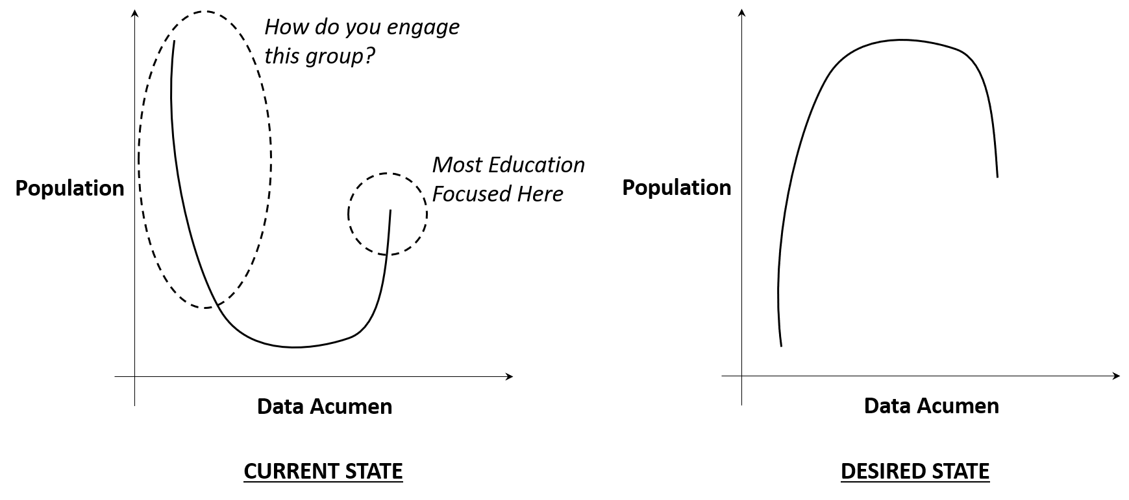
The Problem
Inverting the Fishhook

Slide 6
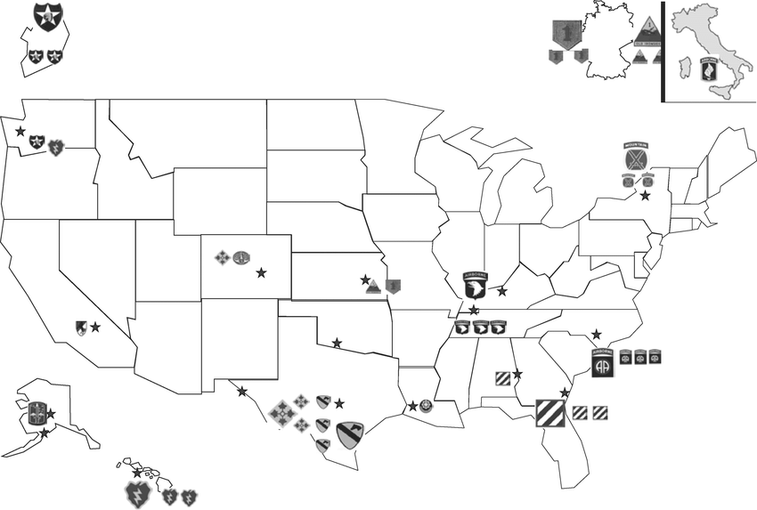
Data Literacy 101
DL101 Developed to provide basic training for Soldiers in Reading Data, Working with Data, Analyzing Data, and Communicating from Data
Training Given
Training Planned
Developed while serving as GAP (JSOC) Chief Data Scientist during Operational Experience
  Demand from both Academia and Gov’t for continued development of these types of courses
Developing a Train-the-Trainer course to be offered June 2023

Slide 7
What is a
Data Driven Question?
Question should be Specific
  Focused on a single topic or idea
Measurable
  Data used to quantify and assess the question
Action Oriented
  Should focus on what we can do
Relevant
  The question should matter and be important
Timebound
  We should provide analyst with idea on what time period to focus on

Slide 8
Types of Analytics
Descriptive Analytics
  What happened in the past?
Are Older Soldiers More/Less Likely to Pass RASP?

Slide 9
Types of Analytics
Diagnostic Analytics
  Why did phenomenon occur?
Are older soldiers weaker and weakness leads to failure?

Slide 10
Types of Analytics
Predictive Analytics
  What will occur in the future
Can we offer a probability that a given soldier will pass RASP?

Slide 11
Types of Analytics
Prescriptive Analytics
  What should I do about it?
If we change our recruiting to only target soldiers with GT score over 110 we can expect our pass rate to go from 30% to 50%, saving $$$ and time

Slide 12
Agenda – Day 1
What is Data Literacy?
  Why is this important to you?
  Importance of asking “Why”?
  What makes a good question?
Types of Analytics
  Descriptive
  Diagnostic
  Prediction Prescriptive
Reading Data
  What are different data types?
  How can we make data more readable?
  Can we trust our data?

Slide 13
Agenda – Day 2
Reading Data Continued
  Critical Consumer of Statistical Results
    Spurious Correlation
Working With Data
  Understand how and why we must format data in order to effective conduct analysis
  How to combine datasets
Analyzing Data
  Tools for Descriptive Analytics
  Tools for Diagnostic Analytics
    How to diagnose causality
  Tools for Predictive Analytics

Slide 14
Agenda – Day 3
Agenda – Day 3
Telling a Data Story
  When is it necessary?
  How do we do it?
    Overcoming Biases
  How do we know when we’ve been successful?
  Principles of Data Visualization
  Common types of graphics
  How we structure a story

Slide 15
Agenda – Day 3
Agenda – Day 4
Putting it all Together
  CRISP-DM
  Use Real Data to Ask a Good Question
  Explore Data
    Issues in Data Wrangling
    Feature Engineering
  Choosing a Good Model
  Overfitting Data
  When are We Done?

Slide 16
Agenda – Day 3
Organizational Level Data Literacy
Does Your Organization Speak Data?
An Assessment Framework
DOTMLPF-P
Doctrine
Organization
Training
Materiel
Leadership and Education
Personnel
Facilities
Policy

Slide 17
Agenda – Day 3
Doctrine
DOTMLPF-P
How does your unit make decisions?
Do commanders require data to support recommendations?
Are analytics presented statically or at time of collect?
How do you use data in each of your staff sections?
  Are there clear requirements?

Slide 18
Agenda – Day 3
Organization
DOTMLPF-P
Have you defined requirements for numbers of Data Scientists/Data Engineers/Programmers needed?
Are Data/Tech experts identified in your organization?
Is there a senior executive who has oversight of the data experts?
Are data experts directly interacting with users?
Are you using best practices for tech development? (Agile methodologies, etc.)

Slide 19
Agenda – Day 3
Training
DOTMLPF-P
Are data challenges presented during training exercises?
Have training pathways been established in your organization for all echelons?
Do you have trainers identified in your formation and are they empowered to make recommendations?
Are you devoting time during your training cycle for data/tech upskilling?

Slide 20
Agenda – Day 3
Materiel
DOTMLPF-P
Does your unit have tech available to rapidly collect data?
Do you have data science tools available for your developers to access the data?

Slide 21
Agenda – Day 3
Leadership and Education
DOTMLPF-P
Are leaders given additional training on leveraging data workforce?
Are leaders being tested on their data acumen?
Are leaders enforcing data standards and collection policy?

Slide 22
Agenda – Day 3
Personnel
DOTMLPF-P
What percentage of your formation has received basic Data Literacy 101 training?
How many individuals have you identified as data literacy trainers, data engineers, data scientists?
  Are these additional duties or are they full time jobs?

Slide 23
Agenda – Day 3
Facilities
DOTMLPF-P
Does your data team have dedicated space to work?
Does your data team have additional workspace collocated with the end user?
Have you established a location for data literacy and data science education?

Slide 24
Agenda – Day 3
Policy
DOTMLPF-P
Have data rules been established for data structuring/storage?
Are your rules nested with other organization’s data rules/standards?
Who has the authority to establish new rules or waive requirements?
Are there clear requirements for data presentation?
  When/where data is mandatory for decisions

Slide 25
Agenda – Day 3
Recommendations
Try starting with a simple question
  Discover pain points unique to your organization
Invest in Education
  We are struggling with the basics
Business Understanding
Data Understanding
Data Preparation
Deployment
Evaluation
Modeling

Slide 26
Agenda – Day 3
Recommendations
Don’t rely on “outside experts” to fix your data Problems
  LinkedIn Graveyard…
Embed Data Team at edge of problem
  Data Team should go out to field/PT with organization/Become a ‘member’ rather than a ‘consultant’
Invest early on in Data Engineers
  “If you build it they will come”
Don’t talk about AI/ML unless you have a use case that requires AI/ML in mind
  Just because “Industry” is doing it doesn’t mean it’s going to work in our case

Slide 27
Agenda – Day 3
Resources I Like
“Be Data Literate” – Jordan Morrow
“Effective Data Storytelling” – Brent Dykes
Any book by Edward Tufte
“Calling Bullshit”
  https://www.callingbullshit.org/

Slide 28
Agenda – Day 3
Questions?
Opinions Expressed in this Brief are solely that of the authors and do not reflect DoD or West Point Policy
Contact Info:
Nicholas.clark@westpoint.edu

