Slide 1
Program Review What’s not to love?
Christine Fox
April 27, 2023

Slide 2
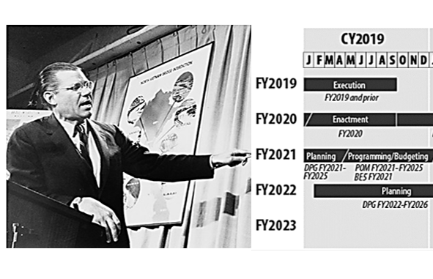
Program Review—my experience
2009-2014
Involved in 5 program reviews
2012-2014 did 2 reviews each year!

Slide 3
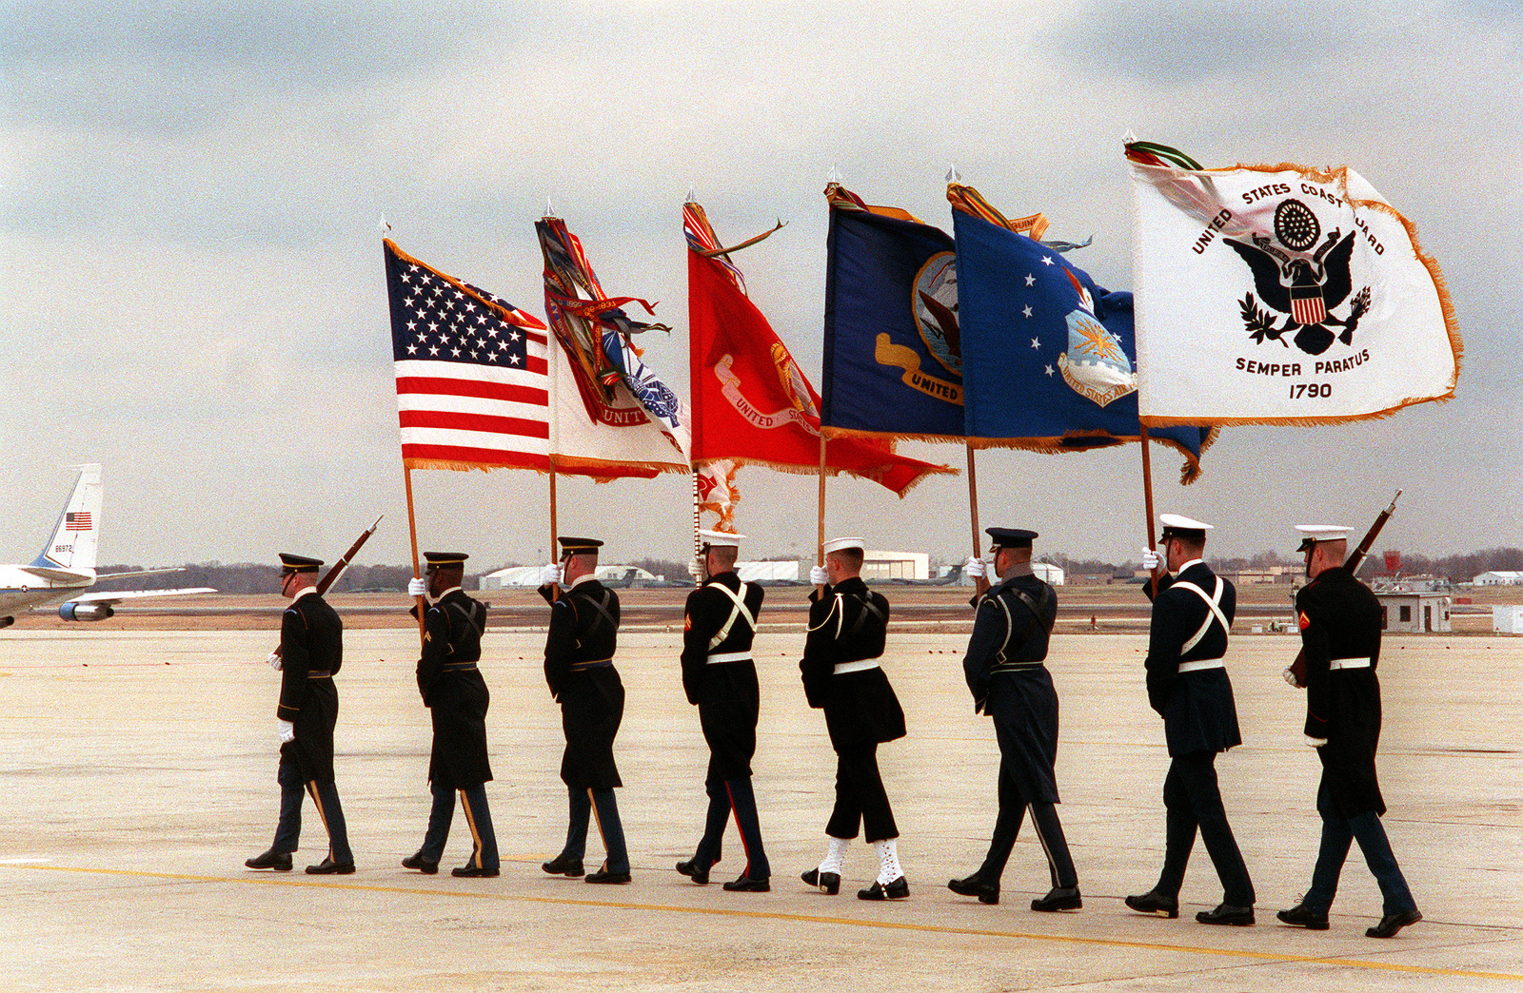
Many strengths

Slide 4

Many strengths

Slide 5

Many strengths

Slide 6

Many strengths

Slide 7
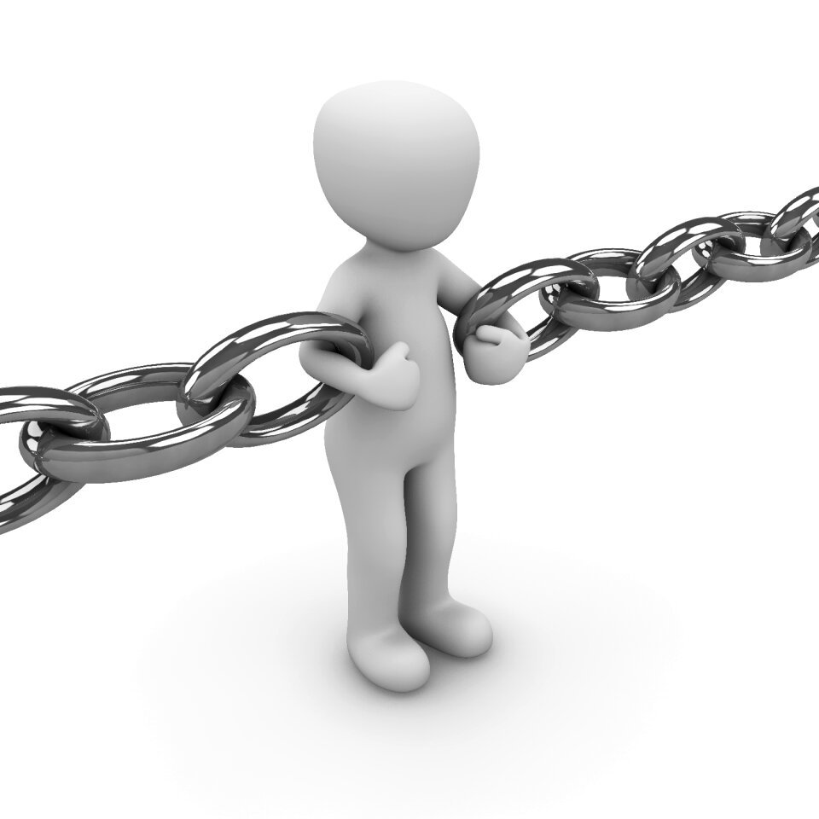
But…there are many weaknesses too
Lack of time for in-depth analysis
Inability to rapidly adopt innovation
Service inputs often based on flawed models and advocacy
Difficult to objectively determine cross-mission, cross-platform trade-offs

Slide 8
Some solutions
Strategic Portfolio Reviews
More focused issue selection
Better analytic tools
Cross-department data sharing
Openness to innovation ecosystem

Slide 9
Some solutions
Strategic Portfolio Reviews
More focused issue selection
Better analytic tools
Cross-department data sharing
Openness to innovation ecosystem

Slide 10
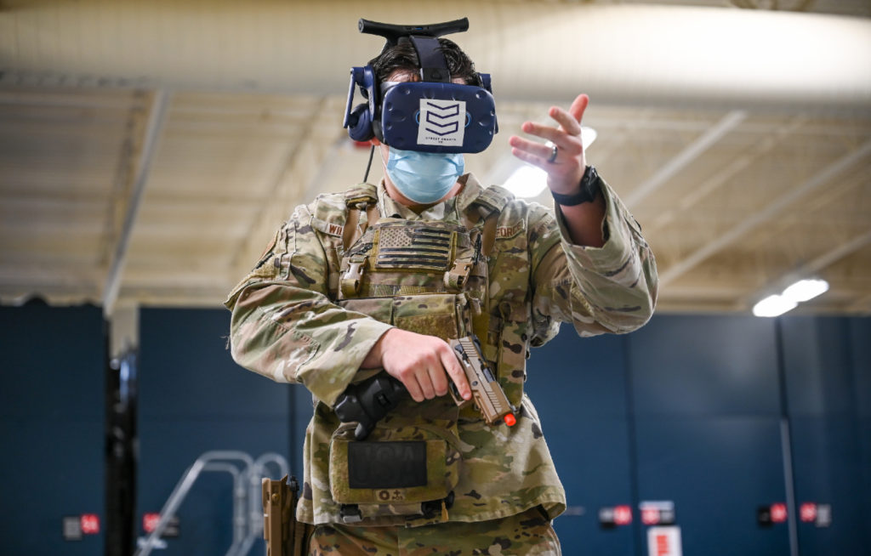

Better analytic tools
Today
Campaign models
Wargames
Tomorrow
Metaverse and virtual worlds
Agent-based simulations
AI (of course!)

Slide 11



Cross-Department Data Sharing

Slide 12


Innovation ecosystem

Slide 13
Innovation ecosystem
Conversation

Slide 14



Innovation ecosystem
Conversation

Slide 15
How you can help
DoD has severe workforce challenges
Inside government
Outside government
Advocate for more data analytic education
Supplement with data/analysis-savvy workforce

Slide 16
How you can help
DoD needs new analytic tools
Inside government
Outside government
Increase your awareness of analytic tool limitations and new options
Develop and introduce new analytic approaches

Slide 17
How you can help
DoD needs better connections to the innovation community
Inside government
Outside government
Be open to the ideas and technologies from outside government
Be informed and connect commercial innovation ideas with DoD needs

