Slide 1

Joint AI Test Infrastructure Capability (JATIC)
Controlled by: CDAO
Controlled by: Test & Evaluation
POC: david.jin5.civ@mail.mil
DISTRIBUTION STATEMENT A
Approved for public release: distribution is unlimited.

Slide 2
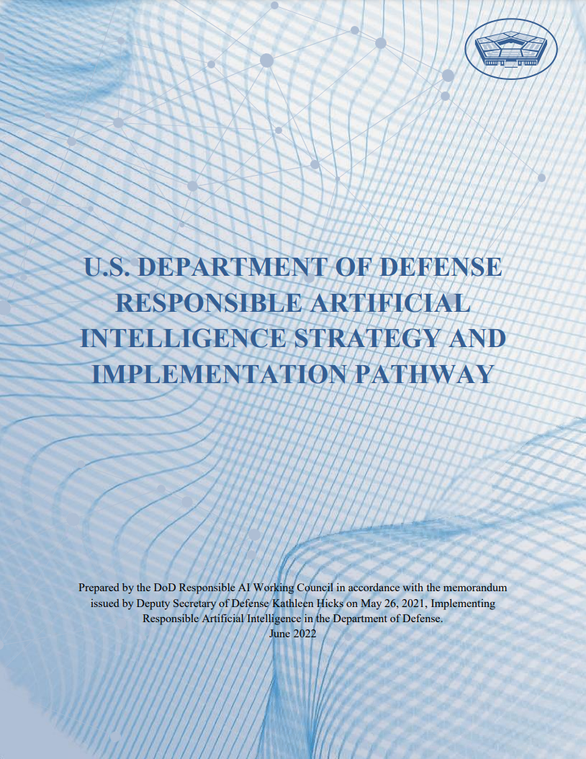
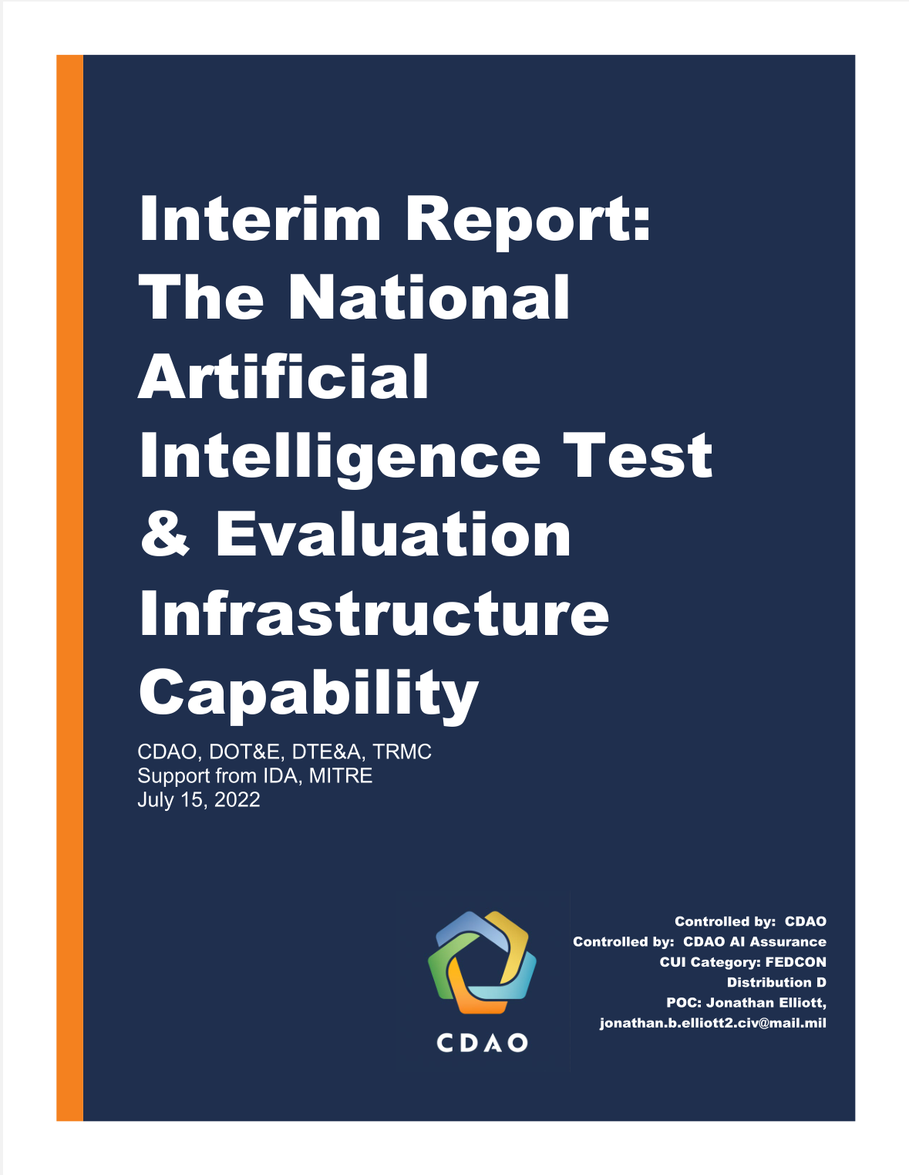
Documented Need
RAI Strategy & Implementation Pathway
Signed by DSD Kathleen Hicks, June 2022
LOE 2.1.2: Develop or acquire AI-related T&E tools to be used as a resource for AI developers and testers… draw upon best practices and innovative research from industry and the academic community, as well as commercially available technology when appropriate.
LOE 2.1.3: Create a central repository of tools for T&E of AI… that enables easy and continuous testing for DoD testers.
Interim Report: The National AI T&E Infrastructure Capability
Report to DSD for data-driven decisions about AI T&E
“There is widespread interest for DoD enterprise-level T&E infrastructure to address the novel and exacerbated challenges posed by the T&E of [AI].”
“While programs are currently investing locally in T&E resources… there is still a consistent desire across survey programs for DoD enterprise support.”

Slide 3
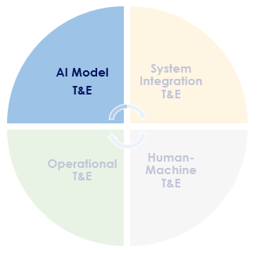
Program Overview
JATIC is developing an interoperable set of state-of-the-art software for rigorous AI model T&E
Designed to support:
Wide integration across DoD environments and mission use cases
MVP operational task: Computer Vision (CV) Classification & Object Detection
Functionality spans dimensions of AI Algorithm T&E, including:
Model performance, reliability, and throughput testing
Competence, confidence calibration, and trustworthiness testing
Explainable and interpretable AI
Data perturbations and transformations
Adversarial attacks and defenses
Dataset sampling, distribution, and bias analysis
Label analysis and assistance
T&E standard reporting formats and report (PPTX) generation tools

Slide 4
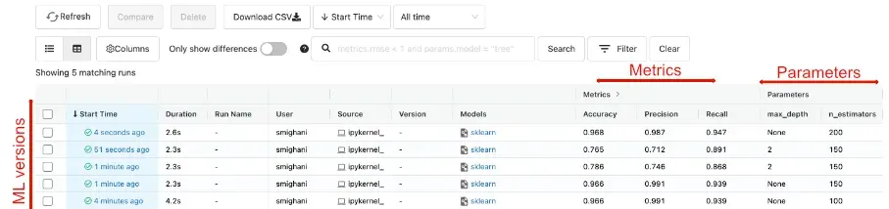
T&E + MLOps
To be effective, AI T&E capabilities must integrate seamlessly with MLOps pipelines
Continuous testing of AI models requires this close integration, especially as AI models are retrained more frequently
Integration into MLOps provides incredible synergies between T&E and other AI/ML capabilities:
T&E + Workflow orchestration -> automated execution of model test plans
T&E + Model registries & experiment tracking -> improved T&E traceability and enhanced model metadata
T&E + Visualization dashboards -> seamless comparison between many models across test cases
T&E + Hyper-parameter optimization -> optimize model hyperparams for robustness, explainability, etc.
T&E + Labeling -> model T&E inference results inform potential errors in ground truth labels
…

Slide 5
Challenges in Integration
While integration is extremely beneficial, it is often extremely challenging
Three primary integration challenges:
Integration into development or testing environments
…which is far more challenging in the case of classified and sensitive environments
Integration with ML platforms, MLOps pipelines, or other AI/ML tools
…which is made more difficult due to the recent explosion of these tools and lack of clear standards or categories
Integration with AI model and data formats
…which is made more difficult due to the variability in formats across libraries and data modalities

Slide 6
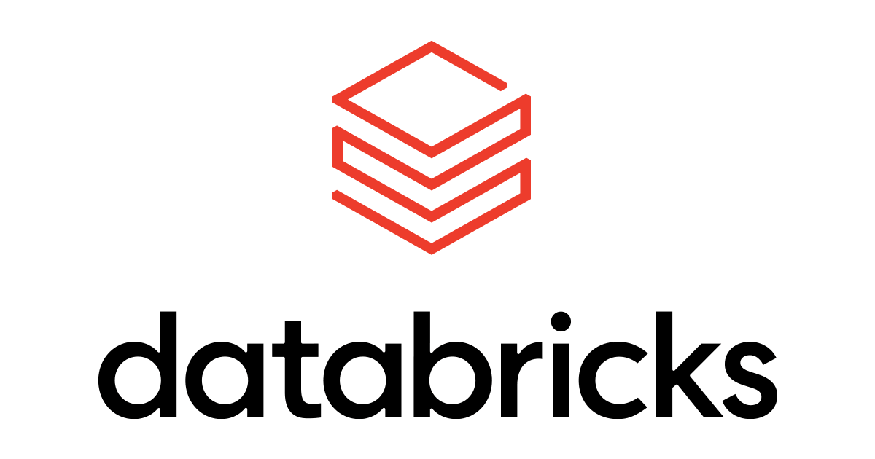
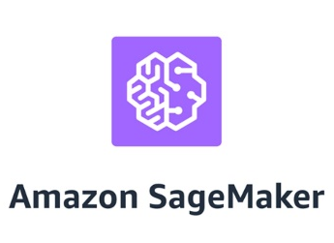
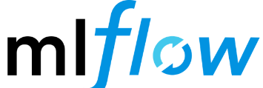
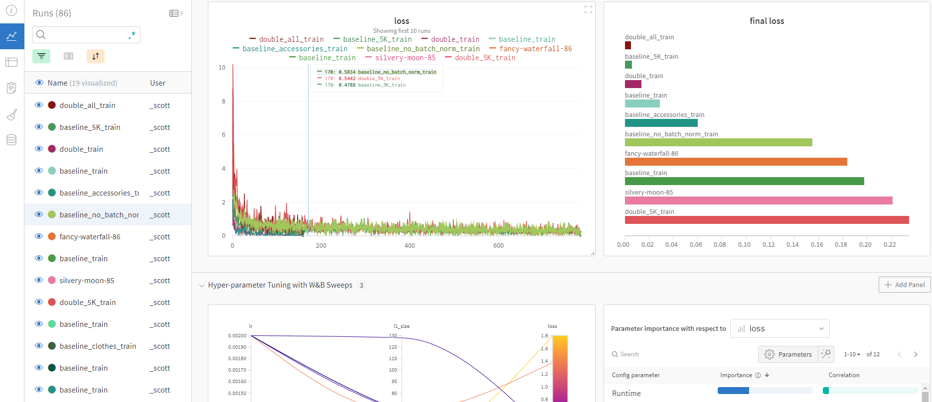




Form factor & Integration
JATIC software tools are developed as python libraries, allowing easy deployment and wide integration
Straightforward deployment, setup, and use within development or testing environments
Seamless integration with key MLOps platforms and capabilities
Standardized JATIC model, data, metrics, and transforms type protocols which are:
widely compatible
easy-to-satisfy
Informative
dependency-free

Slide 7
Existing Capabilities (w/ continuing development)
Tool | AI T&E Capability | Developer
Adversarial Robustness Toolbox* | Absolute state-of-the-art library of adversarial attacks and defenses | IBM
Armory* | Test and compare performance of models against adversarial attacks and defenses | TwoSix Tech
XAI Toolkit* | Generate visual saliency maps on AI predictions using black-box and white-box techniques | Kitware
rAI Toolbox* | Generate data perturbations and augmentations in-silico to test model robustness | MIT
Themis | Scalable AI test harness for rapid and repeatable T&E across a variety of AI models and deployment environments | MORSE Corp
Terminus | Split dataset into training, validation, and test sets, without bias across population subclasses | MORSE Corp
RealLabel | Using model inferences, identify potential ground label errors within data | MORSE Corp
Gradient | Develop standard AI T&E reports in Powerpoint, directly from python | MORSE Corp
ALICE | Assess model competence on given input, based on estimated similarity to training data | JHU
conda-store* | Cross-team python environment management for reproducible and traceable T&E | Quansight
Nebari* | Open-source AI & data science platform, designed for collaboration, scalability, and rapid deployment | Quansight
*indicates open-source capability

Slide 8



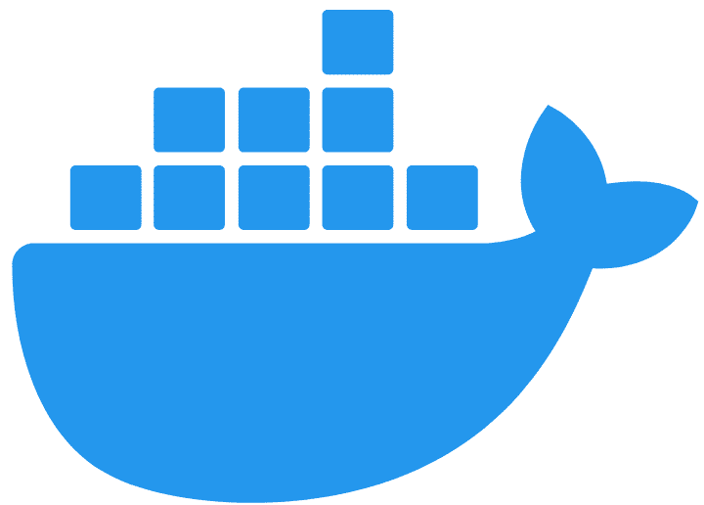
AI T&E Platform
In addition to libraries, JATIC will deliver a comprehensive AI T&E platform, composed of open-source capabilities and tailored for AI/ML testing
JATIC python libraries are ideal for organizations who have already adopted an enterprise MLOps platform, such Databricks or Sagemaker
For those without infrastructure, the JATIC AI T&E Platform provides best-of-breed open-source tools to jumpstart AI T&E from Day 1:
Seamlessly orchestrated and tailored for AI T&E
Deployable quickly to commercial cloud, on-prem, local machines, or HPC using Infrastructure as Code
JATIC AI T&E Platform will provide capabilities for :
Workflow orchestration
Model registry, experiment tracking
Database / object store
Visualization dashboard
Jupyter lab / IDE
Muti-GPU resource management

Slide 9
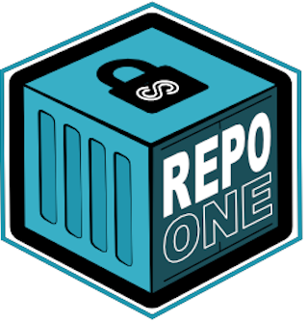

Deployment
JATIC libraries and AI T&E platform will be freely distributed and easily portable to DoD environments
Enterprise-wide availability
Many JATIC python libraries will be made publicly available on GitHub, PyPI, and conda
DoD-specific source code and containers images will be hosted on Repo1 and IronBank
Secure & hardened
JATIC software will be hardened for deployment onto IL-2, IL-6 and other classified information systems
CDAO will work closely with DoD organizations to support deployment of JATIC tools into environments
Your data, your results – JATIC will never collect testing data or results

Slide 10
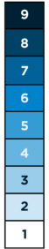
Sustainment & Evolution
JATIC will evolve with the AI/ML state-of-the-art using extensible system designs and continuous collaboration with DoD R&D
TRL
CDAO JATIC
To maintain relevance among rapid AI technology advancement, JATIC will:
Design and sustain extensible capabilities platforms that evolve to include the latest advancements
Continuously integrate SOTA algorithms, architectures, and techniques into existing capabilities
CDAO T&E will collaborate with DoD R&D by:
Sharing useful research directions, informed by capability gaps and operational needs
Maturing and transition prototypes of S&T research into JATIC to make widely available across the enterprise
Mature & Transition
DIU,
DARPA,
Research labs, etc.

Slide 11
Current Capabilities Deep Dive

Slide 12

DARPA GARD Armory
Armory is a platform for measuring AI model robustness to state-of-the-art adversarial attacks and efficacy of adversarial defenses, developed in the DARPA GARD program
Background
DARPA GARD established theoretical ML foundations for adversarial attacks and encouraged the creation of effective defenses
Collaborators included TwoSix, IBM, MITRE, University of Chicago, and Google Research.
Armory combines the attacks and defenses developed within the GARD program into a comprehensive platform
Armory design
Extensible – Supports continuous addition of cutting-edge attacks, defenses, scenarios, datasets, and metrics
Multi-domain – Supports image, FMV, audio, and multimodal operational tasks
Realistic – Evaluates models within realistic operational scenarios and adversarial threat models
https://www.darpa.mil/program/guaranteeing-ai-robustness-against-deception
https://github.com/twosixlabs/armory

Slide 13
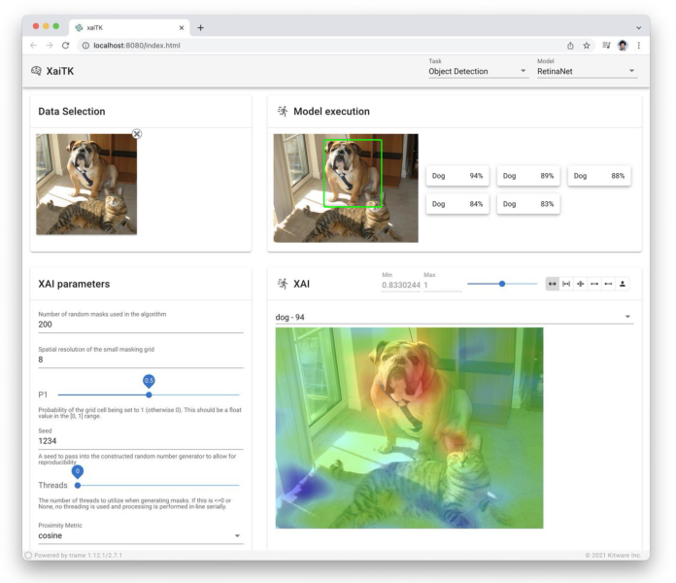


DARPA XAI Toolkit
XAI Toolkit (XAITK) is a platform for visual saliency algorithms to enable human understanding of complex machine learning algorithms, developed in the DARPA XAI program
Background
DARPA XAI created a suite of ML techniques that enabled human users to understand, appropriately trust, and effectively manage the results of artificially intelligent systems
Collaborators included UC Berkeley, UCLA, Carnegie Mellon, UT Dallas, Texas A&M, Rutgers, Oregon State, SRI, Raytheon BBN, and IHMC.
XAITK combines the techniques and research performed throughout the program into a unified and extensible package
XAITK uses cases
Establish justified confidence in AI models, addressing DoD Ethical AI Principles of Traceability and Reliability
Enable feature understanding and analysis for black-box AI models
Provide analysis of model failure modes and edge cases
https://www.darpa.mil/program/explainable-artificial-intelligence
https://xaitk.org
https://github.com/XAITK/xaitk-saliency

Slide 14
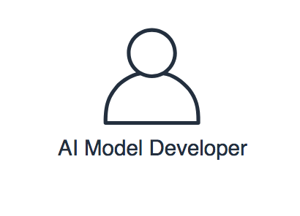
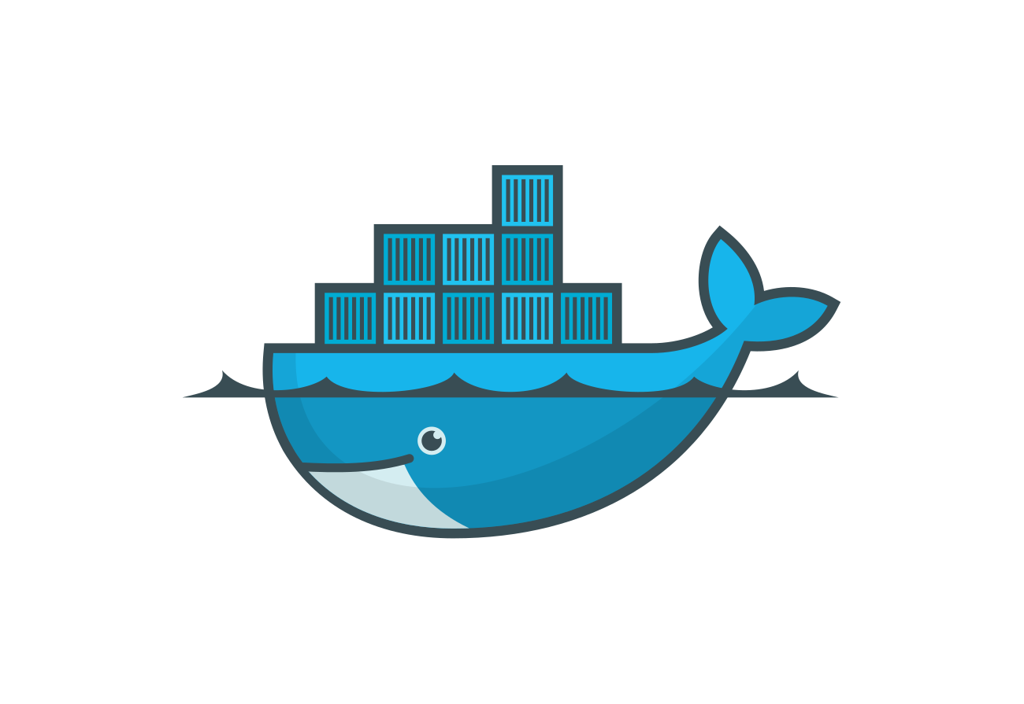
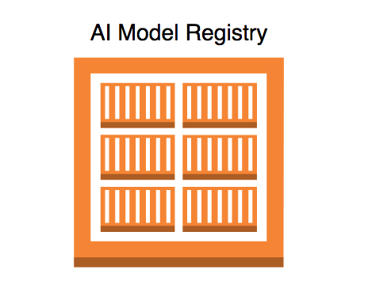

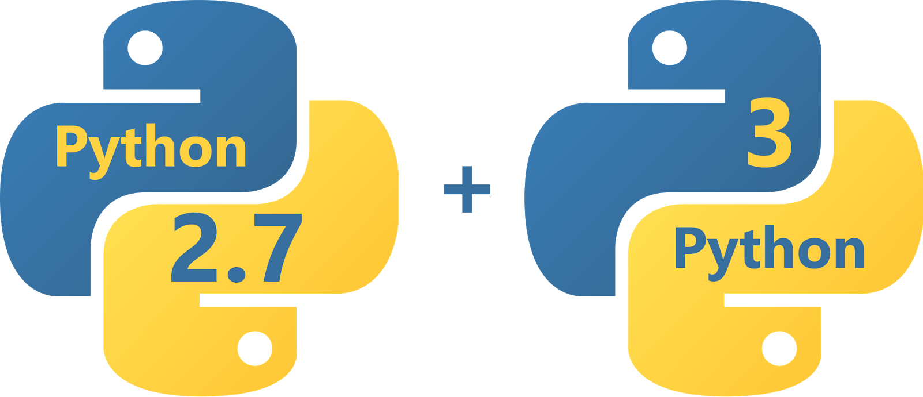




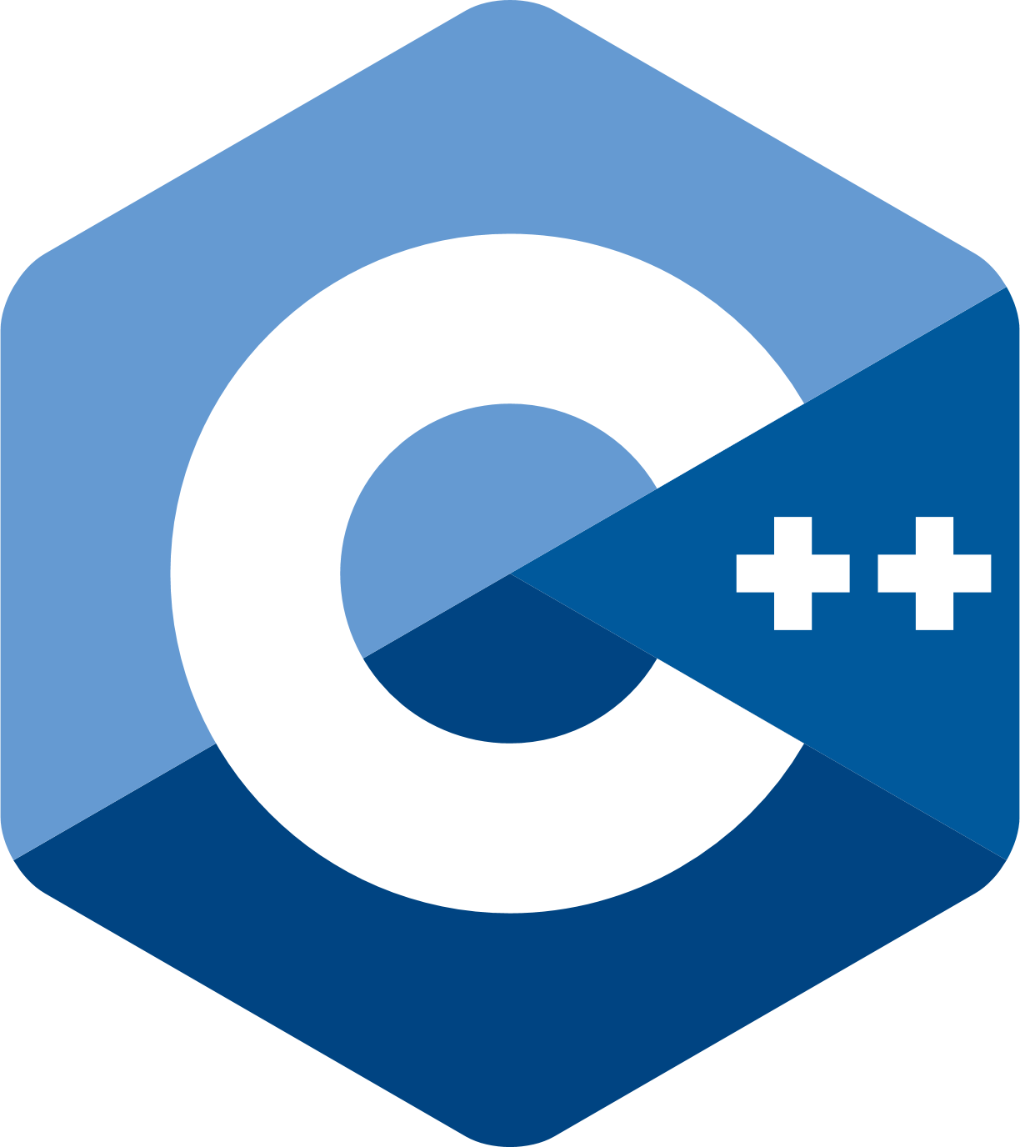



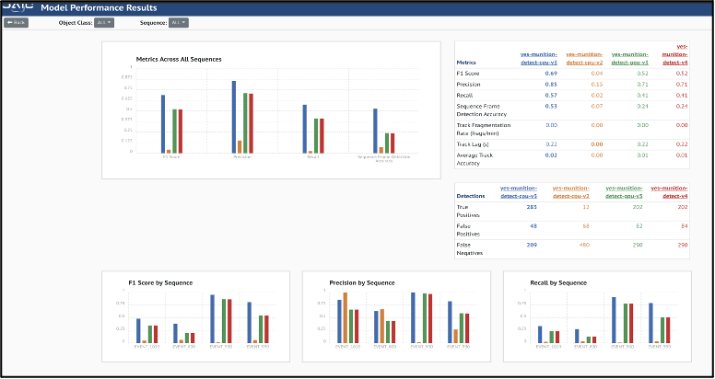

Themis
Themis is a test harness for rapid and repeatable T&E across a variety of AI models and deployment environments
Background
Developed by MORSE Corp to support CDAO T&E, Themis has been leveraged for FMV Object Detection and image segmentation AI T&E
Features
Containerized microservices architecture enables portability and varied deployments
Standardized “black box” model formats and APIs for wide interoperability across vendors
Built in access management with KeyCloak to enable vendor model submission and validation of test results
Inference API
T&E Harness Services

Slide 15
Backup

Slide 16

Key partnerships
Current JATIC Target Platforms:
ADVANA, AWS Databricks platform
CDAO T&E is seeking key government partners leading AI/ML to:
Understand your AI T&E requirements and capability needs
Build and deliver JATIC tools to support your AI T&E requirements
Obtain feedback and iterate to mature capabilities
CDAO T&E currently has several prototype capabilities which can easily be delivered

Slide 17
AI T&E Dimensions Deep Dive

Slide 18
AI T&E Dimensions
Model Performance
Allow T&E stakeholders to assess how well an AI model performs on a labeled dataset and across its population subclasses
Example functionalities include:
A comprehensive set of well-established CV metrics (e.g., precision, recall, mean average precision)
Metrics to assess probability calibration, i.e., the reliability of the model's measure of predictive uncertainty (e.g., expected calibration error, entropy, reliability diagrams)
Metrics to assess fairness and bias in model output across the test dataset (e.g., statistical parity)
Model Computational Performance
Allow T&E stakeholders to measure the computational efficiency, resource usage, and scalability of an AI model
Example functionalities include the computation of:
Model throughput, latency, resource usage, and scalability, as well as constraints on these properties
Model performance across different hardware configurations

Slide 19
AI T&E Dimensions
Dataset Analysis
Allow T&E stakeholders to understand held out T&E datasets, including their quality and similarity to operational data
Example functionalities include the computation of:
Dataset quality (e.g., label errors, missing data)
Dataset sufficiency for a given test (e.g., number of samples, variation)
Biases, outliers, and anomalies in the dataset, which may be naturally occurring or intentionally inserted (i.e., data poisoning)
Comparison of two datasets (e.g., divergence of dataset distributions)
Model Analysis
Allow T&E stakeholders to gain a deeper understanding of a model's capabilities and limitations by uncovering hidden trends and insights across the input space
Example functionalities include algorithms that:
Detect trends in model performance across the entire dataset, such as distinct types of model errors
Identify clusters of the model input space based on model predictions, feature values, network activations, etc.
Identify potentially mislabeled ground truth data based on sets of model predictions

Slide 20
AI T&E Dimensions
Natural Robustness
Allow T&E stakeholders to determine how natural corruptions in data can impact model performance
Focusing on corruptions that emulate realistic noise within operational deployment environment
Example corruptions include:
Pre-sensor, environmental or physical corruptions (e.g., fog, snow, rain, changes in target shape or dimensions)
Sensory corruptions (e.g., out-of-focus, glare, blur)
Post-sensor, in-silico corruptions (e.g., Gaussian noise, digital compression)
Adversarial Robustness
Allow T&E stakeholders to assess how adversarial corruptions on inputs may impact model performance
Focusing on evasion-style attacks (i.e., attacks in which the adversary aims to manipulate the input data to produce an error in the model output, often covertly)
Example types of attack methods include:
White-box and black-box methods
L_p norm-constrained and physically realizable (e.g., patch) attacks
Notes:
This slide has info purely copied from our RFP, which was publicly released

