Slide 1
Saving hardware, labor, and time using Bayesian adaptive design of experiments
With An application to pull testing at Sandia National Laboratories
Daniel Ries, Maj Victoria Sieck (AFIT)
DATAWorks
April 27th, 2023
This Paper Describes Objective Technical Results And analysis. Any Subjective Views Or Opinions That Might Be Expressed In The Paper Do Not Necessarily Represent The Views Of The U.S. Department Of Energy Or The United States Government.
SAND2023-02175C

Slide 2
Problem: Experiments are Expensive
Test engineers often want to gather as much information, about as many variables, as efficiently as possible
Unfortunately, combination of funding, time, and hardware are often at odds with this objective
An efficient way to achieve this is through statistical DOEx
  Avoid change-one-factor-at-a-time!!!
Traditional DOEx methods seem rigid, inflexible, unwilling to pivot directions

Slide 3
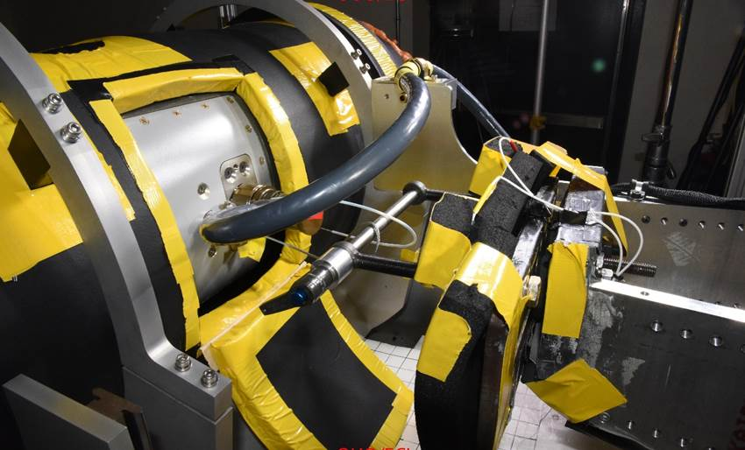
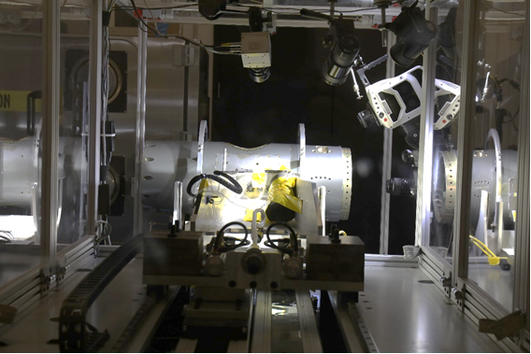
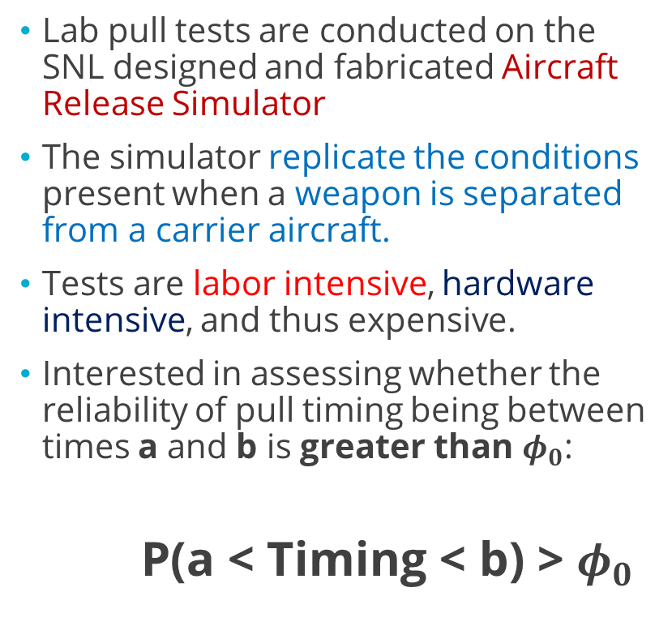
Motivation
Lab pull tests are conducted on the SNL designed and fabricated Aircraft Release Simulator
The simulator replicate the conditions present when a weapon is separated from a carrier aircraft.
Tests are labor intensive, hardware intensive, and thus expensive.
Interested in assessing whether the reliability of pull timing being between times a and b is greater than $φ_{0}$:
P(a < Timing < b) > $φ_{0}$

Slide 4
Traditional DOEx Process
Determine sample size needed for adequate Power and create DOEx
Perform statistical tests/analyses & draw conclusions
Collect all data according to design

Slide 5
Adaptive DOEx Process
Have you completed your original DOEx?
Collect $n_{add}$ additional samples according to DOEx
Collect 𝑛_𝑎𝑑𝑑 additional samples according to DOEx
Perform statistical analysis with all collected data and draw preliminary conclusion
Is this conclusion likely to change if more data was collected?
Stop testing early and draw conclusions
No
Yes
Stop testing and perform analysis as usual
Yes
Stop testing and determine if requirement is met
Create DOEx as usual
Test first $n_{0}$ units in DOEx
Test first 𝑛_0 units in DOEx
No

Slide 6
Adaptive DOEx Process
Have you completed your original DOEx?
Collect $n_{add}$ additional samples according to DOEx
Collect 𝑛_𝑎𝑑𝑑 additional samples according to DOEx
Perform statistical analysis with all collected data and draw preliminary conclusion
Is this conclusion likely to change if more data was collected?
Stop testing early and draw conclusions
No
Yes
Stop testing and perform analysis as usual
Yes
Stop testing and determine if requirement is met
Create DOEx as usual
Test first $n_{0}$ units in DOEx
Test first 𝑛_0 units in DOEx
No
Change factors/levels to maximize information gain in current experiment

Slide 7
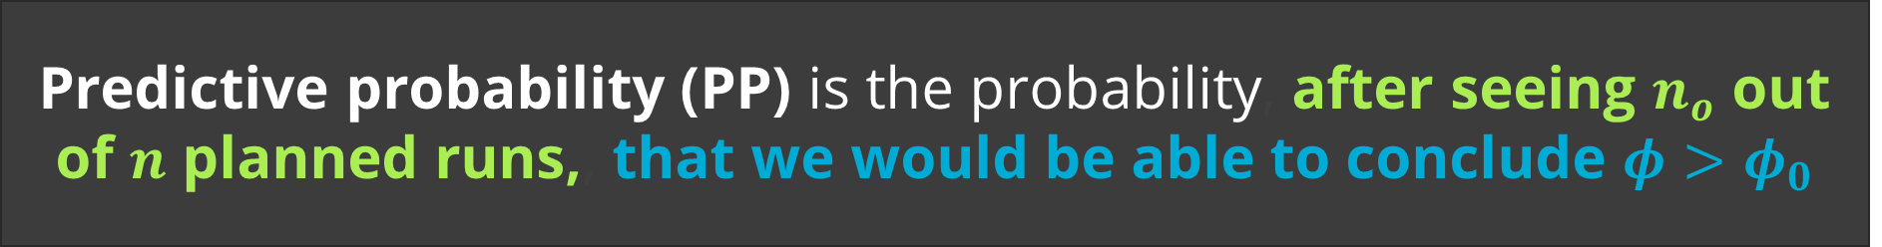

Predictive Probability
Our quantity of interest is $φ=$P(a < Timing < b) where:
$φ$represents the reliability, or probability timing is within bounds a and b
We want assess if $φ>φ_{0}$, that is, if the reliability requirement ($φ_{0}$) is met
Suppose we design an experiment with $n$ runs, then:
Predictive probability (PP) is the probability, after seeing $n_{o}$ out of $n$ planned runs,, that we would be able to conclude $φ>φ_{0}$

Slide 8



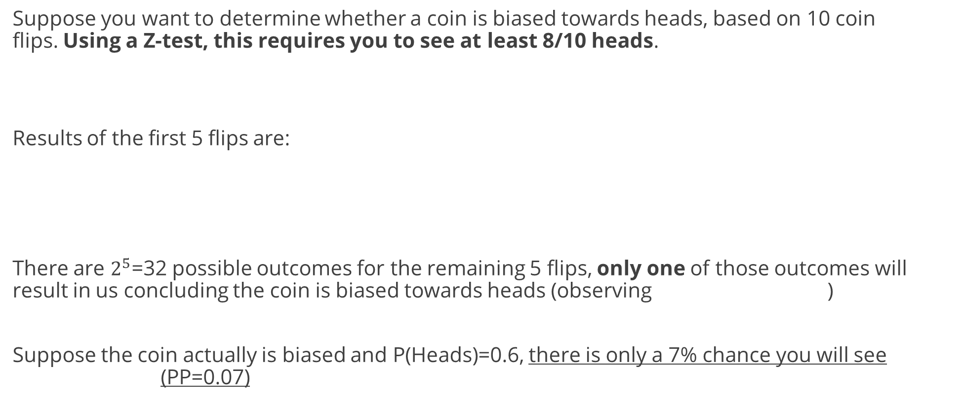
Predictive Probability Illustration
Suppose you want to determine whether a coin is biased towards heads, based on 10 coin flips. Using a Z-test, this requires you to see at least 8/10 heads.
Results of the first 5 flips are:
There are $2^{5}$=32 possible outcomes for the remaining 5 flips, only one of those outcomes will result in us concluding the coin is biased towards heads (observing )
Suppose the coin actually is biased and P(Heads)=0.6, there is only a 7% chance you will see (PP=0.07)

Slide 9
Predictive Probability Illustration
Suppose you want to determine whether a coin is biased towards heads, based on 10 coin flips. Using a Z-test, this requires you to see at least 8/10 heads.
Results of the first 5 flips are:
No combination of 5 remaining flips will give us 8/10 heads
Therefore PP=0, there is no future outcome where you conclude coin is biased

Slide 10

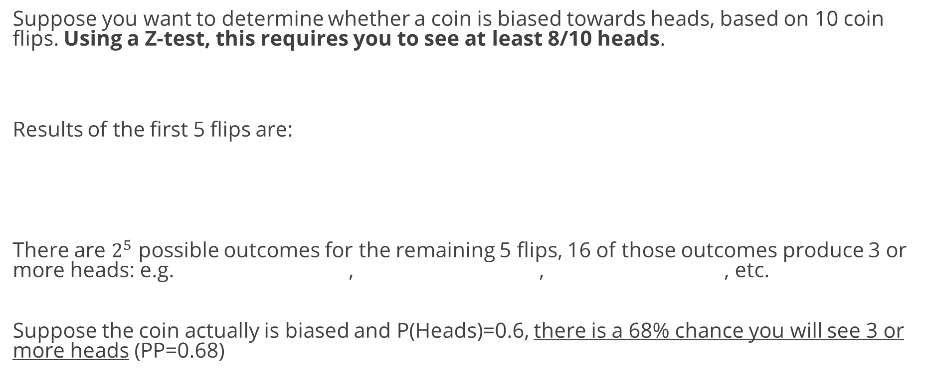
Predictive Probability Illustration
Suppose you want to determine whether a coin is biased towards heads, based on 10 coin flips. Using a Z-test, this requires you to see at least 8/10 heads.
Results of the first 5 flips are:
There are $2^{5}$ possible outcomes for the remaining 5 flips, 16 of those outcomes produce 3 or more heads: e.g. , , , etc.
Suppose the coin actually is biased and P(Heads)=0.6, there is a 68% chance you will see 3 or more heads (PP=0.68)

Slide 11



Predictive Probability Mathematically
Let $X_{1},X_{2},…,X_{n_{o}}=X$ be $n_{o}$ observed responses and $Y_{1},Y_{2},…,Y_{n_{u}}=Y$ be the $n_{u}$ remaining responses to be observed (recall, $n=n_{o}+n_{u}$)
Predictive Probability (PP) =
$$P_{Y|X}(Y:P\left(φ>φ_{0} | X,Y\right)>θ_{T})$$
$$=E_{Y|X}(I(P\left(φ>φ_{0} | X,Y\right)>θ_{T}|X)$$
$$=∫I(P\left(φ>φ_{0} | X,Y\right)>θ_{T} p\left(Y | X\right)dY$$
$$=\int{I\left(\int_{φ_{0}}^{1}{p\left(φ\right|X,Y)dφ }\right)p\left(Y | X\right)dY}$$
Probability of observing Y, the $n_{u}$ remaining data, such that $P\left(φ>φ_{0} | X,Y\right)>θ_{T}$, where the distribution of Y is given by the posterior predictive distribution Y|X
We can compute this probability using the posterior distribution of $φ$ and the posterior predictive distribution Y|X
11

Slide 12
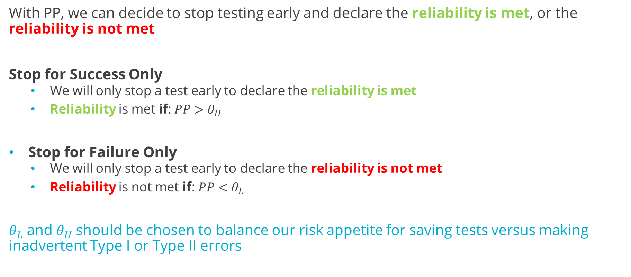
Early Stopping Rules
With PP, we can decide to stop testing early and declare the reliability is met, or the reliability is not met
Stop for Success Only
  We will only stop a test early to declare the reliability is met
  Reliability is met if: $PP>θ_{U}$
Stop for Failure Only
  We will only stop a test early to declare the reliability is not met
  Reliability is not met if: $PP<θ_{L}$
$θ_{L}$ and $θ_{U}$ should be chosen to balance our risk appetite for saving tests versus making inadvertent Type I or Type II errors
12

Slide 13
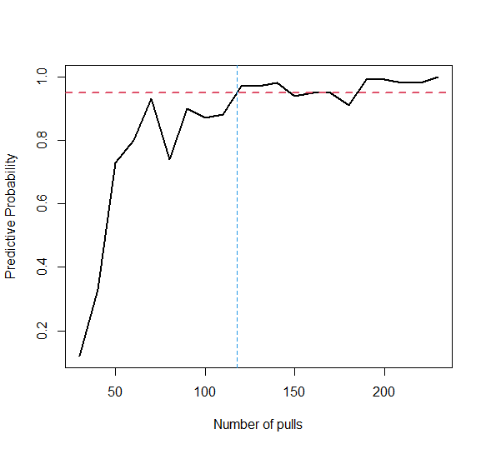
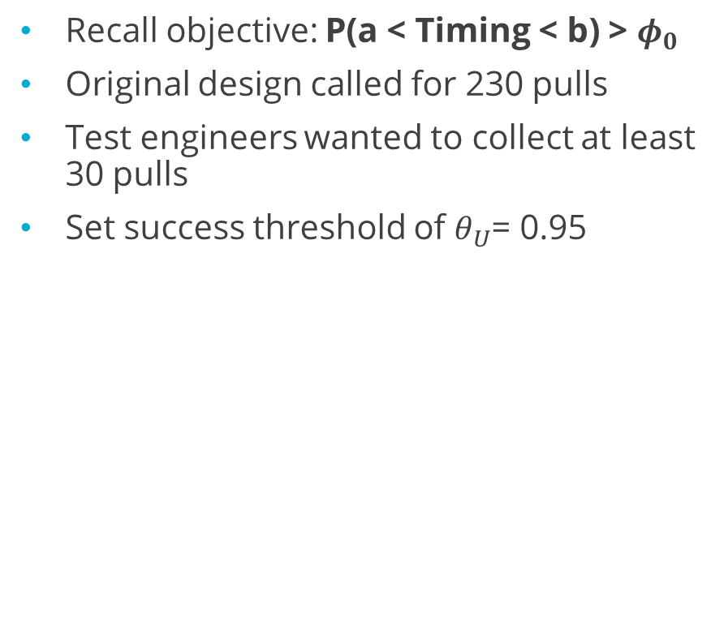

Retrospective Analysis: Applying PP to Pull Testing
Stopping threshold met (blue line)
Recall objective: P(a < Timing < b) > $φ_{0}$
Original design called for 230 pulls
Test engineers wanted to collect at least 30 pulls
Set success threshold of $θ_{U}$= 0.95
$$θ_{U}$$
Could have stopped experiment at 120 pulls, a nearly 50% reduction in time and equipment!

Slide 14
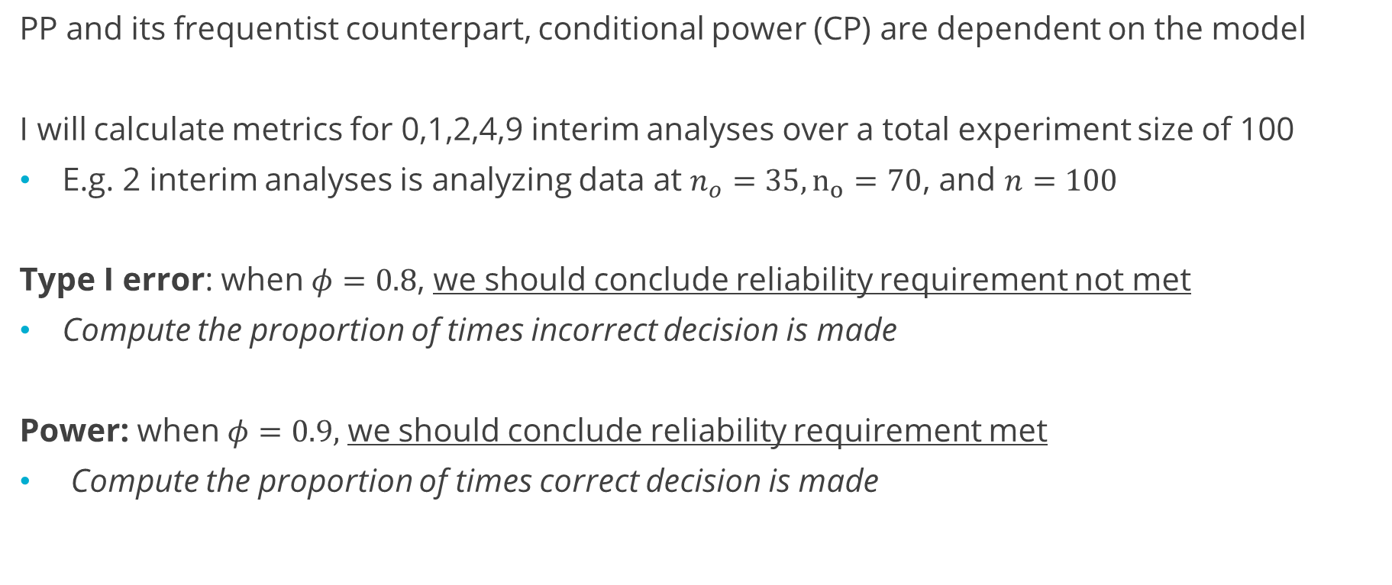
Simulation Study Metrics
PP and its frequentist counterpart, conditional power (CP) are dependent on the model
I will calculate metrics for 0,1,2,4,9 interim analyses over a total experiment size of 100
E.g. 2 interim analyses is analyzing data at $n_{o}=35, n_{o}=70$, and $n=100$
Type I error: when $φ=0.8$, we should conclude reliability requirement not met
Compute the proportion of times incorrect decision is made
Power: when $φ=0.9,$ we should conclude reliability requirement met
Compute the proportion of times correct decision is made
14

Slide 15
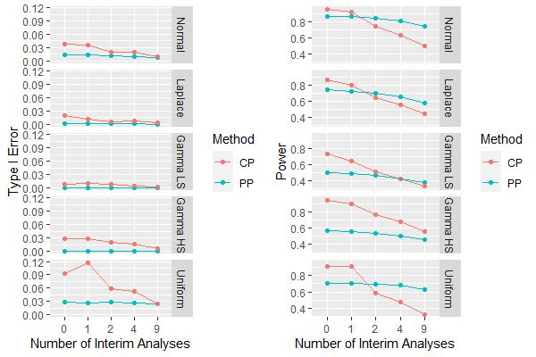
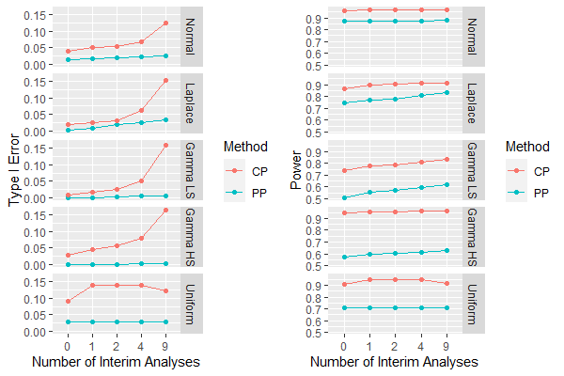
Comparing Metrics for PP and CP
Stop for Failure only
Stop for Success only
15

Slide 16
Comparing Metrics for PP and CP on Binary data
Stop for Failure only
PP is not restricted to Normally distributed data
We can also use PP for binary (pass/fail) data!
Stop for Success only

Slide 17
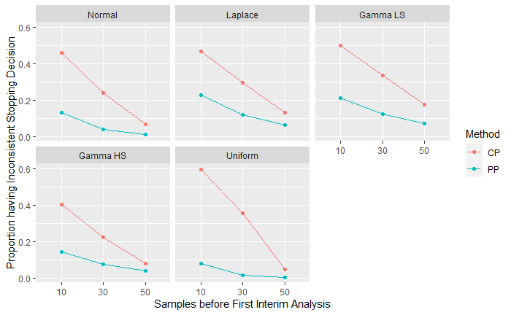
How long should we wait until our first interim analysis?
We looked at the proportion of times a conflicting decision was made based on PP and CP, based on the number of samples before the first analysis
This simulation suggested collecting about ~30% of planned data before first look

Slide 18
Conclusions
Predictive probability can be used to stop an experiment early and save resources
Posterior probability tries to capture the truth, while Predictive Probability captures the likelihood of capturing the truth, given your finite resources
Predictive probability appeared to be more conservative than conditional power
  Small prior sensitivity analysis showed this to be consistent for reasonable priors
In general, selection of priors is important and not always intuitive for PP
  This is partly alleviated by increasing the number of samples before first interim analysis

Slide 19
Thank you for listening!

Slide 20
Backup slides

Slide 21
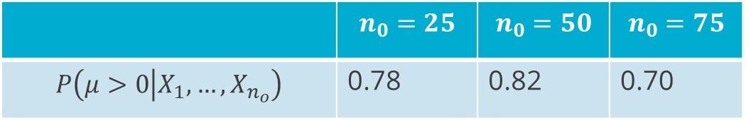
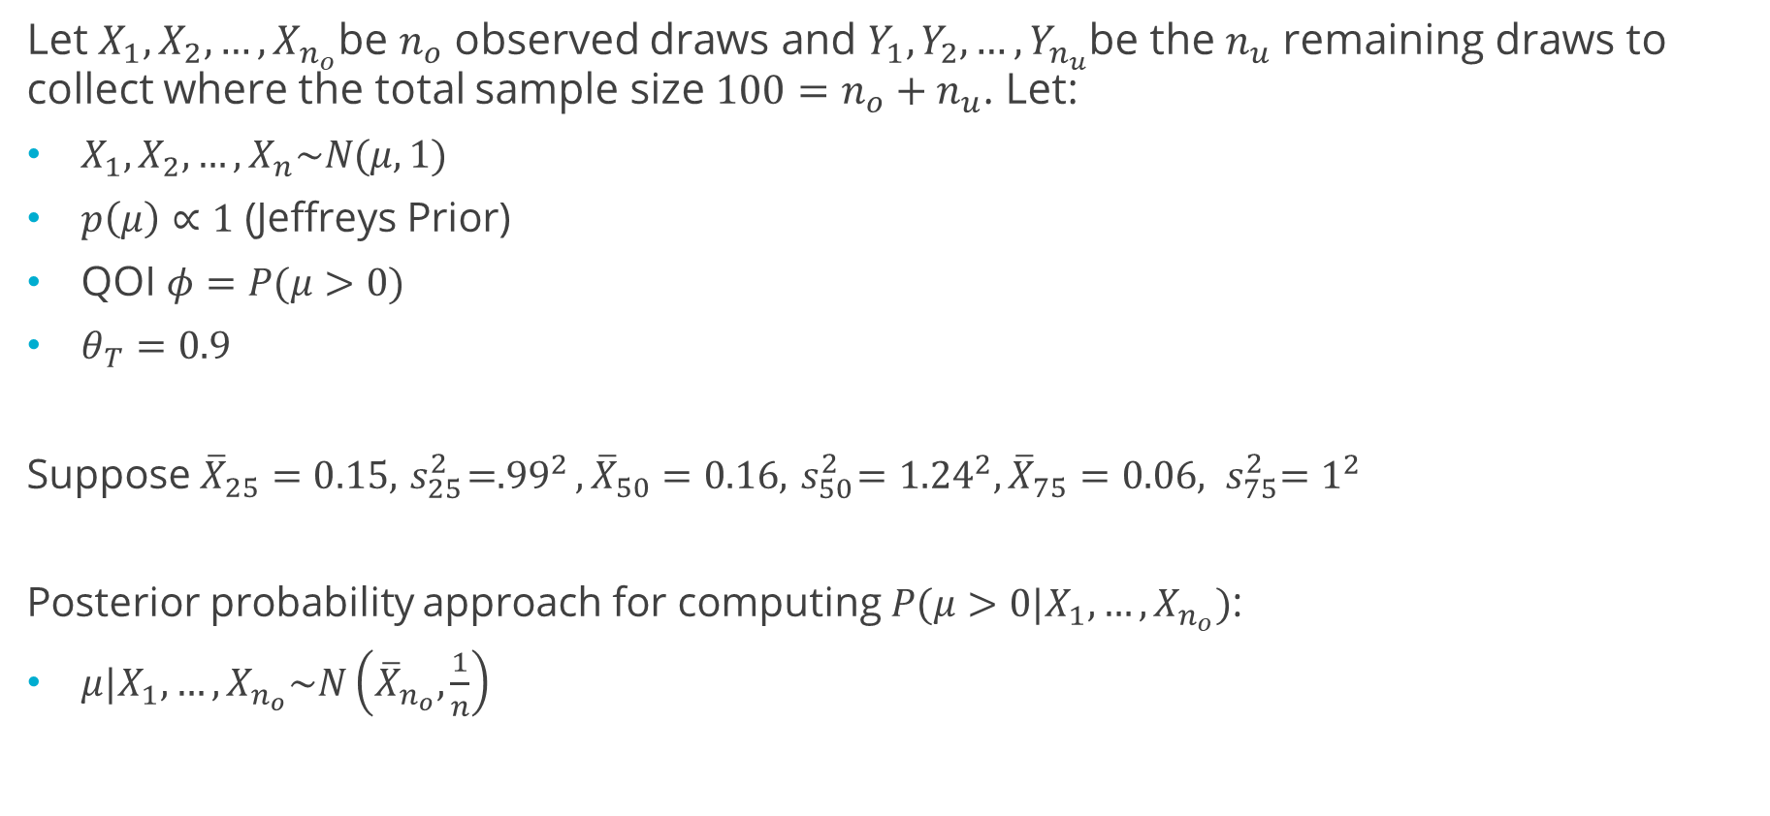
Simple Example comparing Posterior Probability with PP
Let $X_{1},X_{2},…,X_{n_{o}}$be $n_{o}$ observed draws and $Y_{1},Y_{2},…,Y_{n_{u}}$be the $n_{u}$ remaining draws to collect where the total sample size $100=n_{o}+n_{u}$. Let:
$X_{1},X_{2},…,X_{n}\sim N(μ,1)$
$p\left(μ\right)∝1$ (Jeffreys Prior)
QOI $φ=P(μ>0)$
$θ_{T}=0.9$
Suppose ${\overline{X}}_{25}=0.15,{ s}_{25}^{2}={.99}^{2}, {\overline{X}}_{50}=0.16,{ s}_{50}^{2}={1.24}^{2}, {\overline{X}}_{75}=0.06,$ ${ s}_{75}^{2}=1^{2}$
Posterior probability approach for computing $P(μ>0|X_{1},…,X_{n_{o}})$:
$μ|X_{1},…,X_{n_{o}}\sim N\left({\overline{X}}_{n_{o}},\frac{1}{n}\right)$
 | $$n_{0}=25$$ | $$n_{0}=50$$ | $$n_{0}=75$$
$$P\left(μ>0 | X_{1},…,X_{n_{o}}\right)$$ | 0.78 | 0.82 | 0.70
21

Slide 22
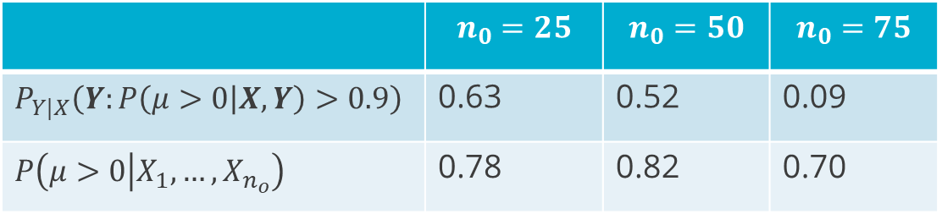
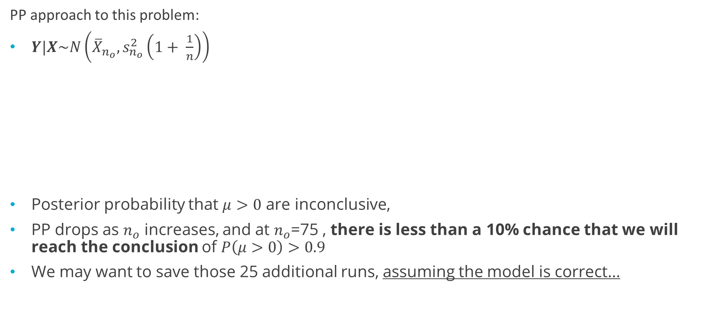
Simple Example comparing Posterior Probability with PP
PP approach to this problem:
$Y|X\sim N\left({\overline{X}}_{n_{o}},s_{n_{o}}^{2}\left(1+ \frac{1}{n}\right)\right)$
Posterior probability that $μ>0$ are inconclusive,
PP drops as $n_{o}$ increases, and at $n_{o}$=75 , there is less than a 10% chance that we will reach the conclusion of $P\left(μ>0\right)>0.9$
We may want to save those 25 additional runs, assuming the model is correct…
 | $$n_{0}=25$$ | $$n_{0}=50$$ | $$n_{0}=75$$
$$P_{Y|X}\left(Y:P\left(μ>0 | X,Y\right)>0.9\right)$$ | 0.63 | 0.52 | 0.09
$$P\left(μ>0 | X_{1},…,X_{n_{o}}\right)$$ | 0.78 | 0.82 | 0.70
22

Slide 23
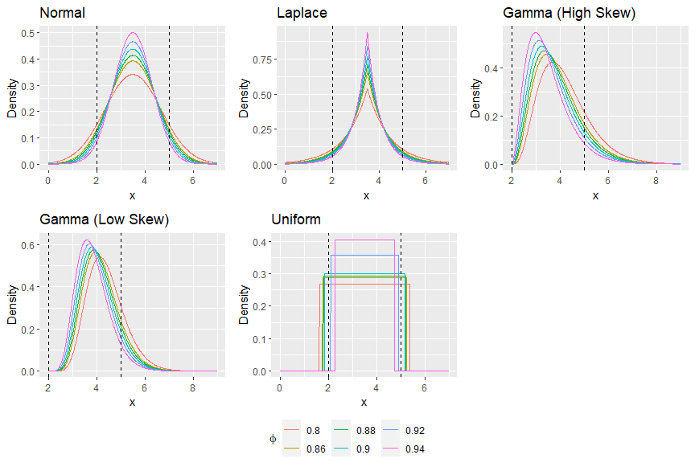

DGM PDFs
$$φ=P(2<Z<5)$$
23

Slide 24
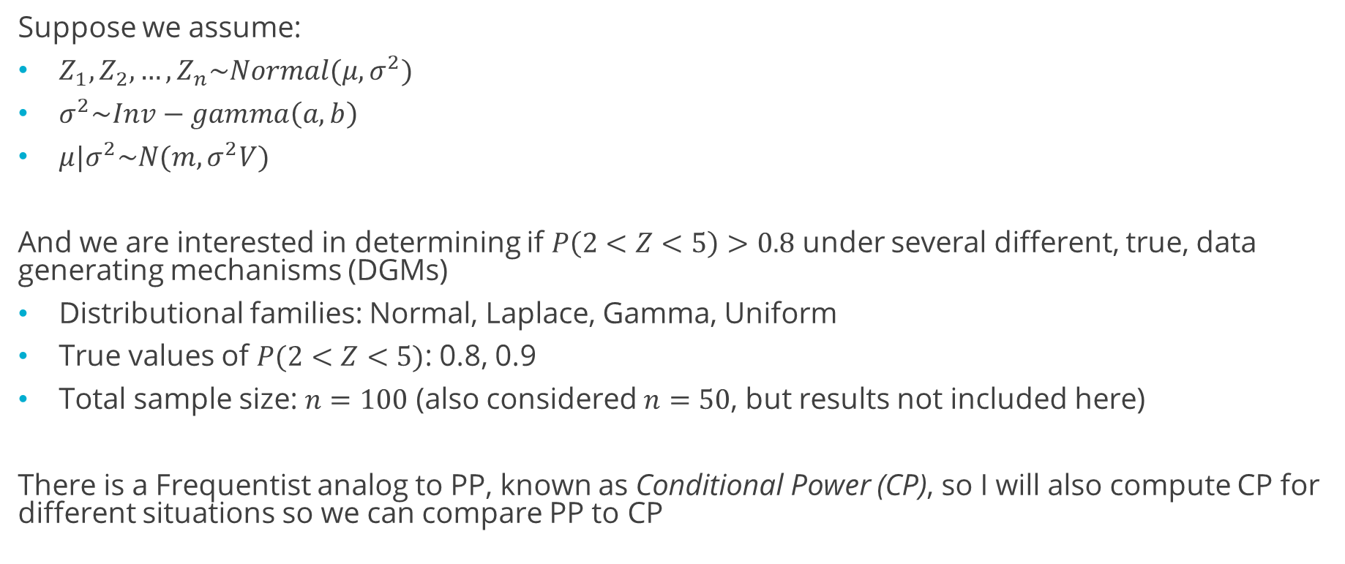
Assessing the Robustness of PP
Suppose we assume:
$Z_{1},Z_{2}, …, Z_{n}\sim Normal(μ,σ^{2})$
$σ^{2}\sim Inv−gamma\left(a,b\right)$
$μ|σ^{2}\sim N(m,σ^{2}V)$
And we are interested in determining if $P\left(2<Z<5\right)>0.8$ under several different, true, data generating mechanisms (DGMs)
Distributional families: Normal, Laplace, Gamma, Uniform
True values of $P(2<Z<5)$: 0.8, 0.9
Total sample size: $n=100$ (also considered $n=50$, but results not included here)
There is a Frequentist analog to PP, known as Conditional Power (CP), so I will also compute CP for different situations so we can compare PP to CP
24

