Slide 1
DATAWorks 2023: Projecting Regional Climate Change Effects on Aircraft Performance
R. Abraham Holland
April 27, 2023

Slide 2
Background & Objective
IDA identified several analytical strategies within the open academic literature for connecting climate change and DoD operations that may interest the test and evaluation community
We will present a McRae et al. Assessing Aircraft Performance in a Warming Climate (2021) inspired example using public data
Notes:
McRae et al Assessing Aircraft Performance in a Warming Climate (2021)

Slide 3
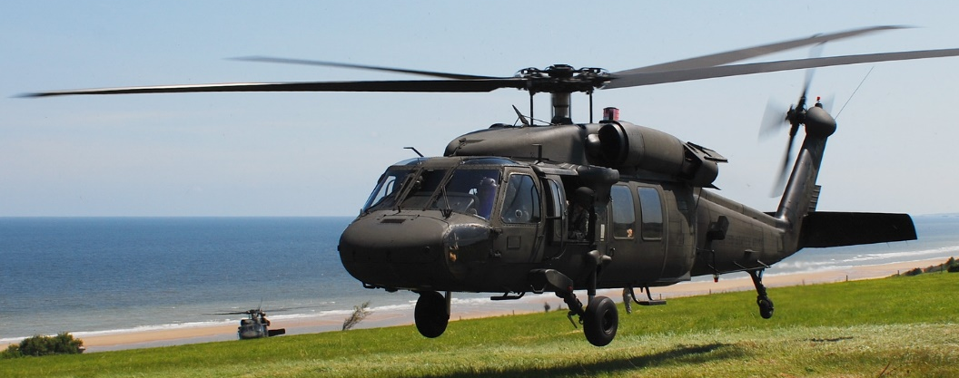
Our key performance metric is the internal load capacity of a military helicopter
Local environmental conditions influence a range of aircraft performance characteristics:
  Power margin
  Maximum gross weight/load capacity
  Hover ceiling
  Max range
  Fuel Consumption
McRae et al. (2021) used climate models and general FAA guidance to project changes in UH-60L Blackhawk performance for aircraft operating at Little Rock Air Force Base, Arkansas

Slide 4
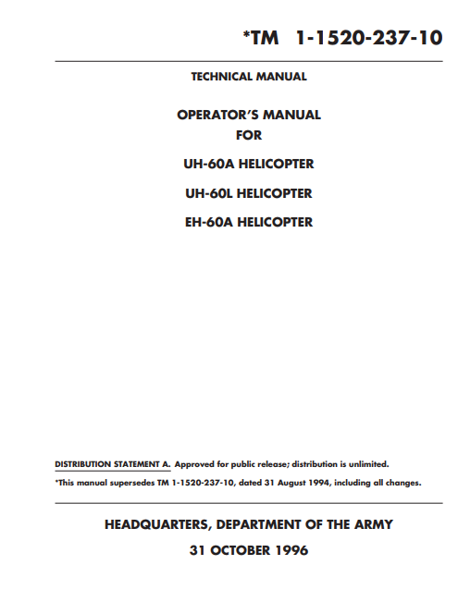

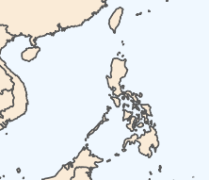

We use Army aircraft performance charts to project internal load capacity changes for a UH-60L operating in Luzon, Philippines in 2050
NCAR CESM2 Large Ensemble
  Global climate model with 100 ensemble members with a combination of different oceanic and atmospheric initial states
  Resolution: 1 degree (~ 111 km²)
  Global coverage from 1980 to 2100
One scenario CMIP6: SSP3-7.0 (which represents the “current trajectory”)
3-hourly data
Notes:
Not just guidance→ These are part of the rules for safely operating an aircraft.
Load capacity: maximum gross weight dictated by conditions minus aircraft weight
Maximum gross weight changes depending on torque, outside air temperature, and pressure altitude
Note that this does not include fuel or other requirements; this could be done in future analyses
Hovering in ground effect is used when carrying internal loads
Northern Luzon region is hot and humid, with average temperatures ranging from 25 to 31 degrees Celsius year round
10ft wheel height subject to stronger in ground effect, allowing for greater load capacity; minimal differences were found

Slide 5
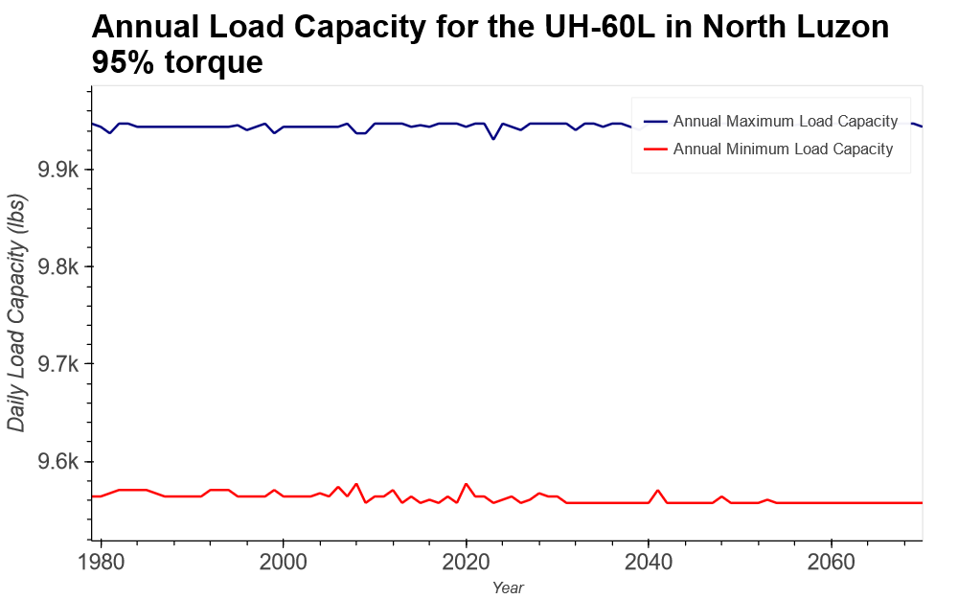
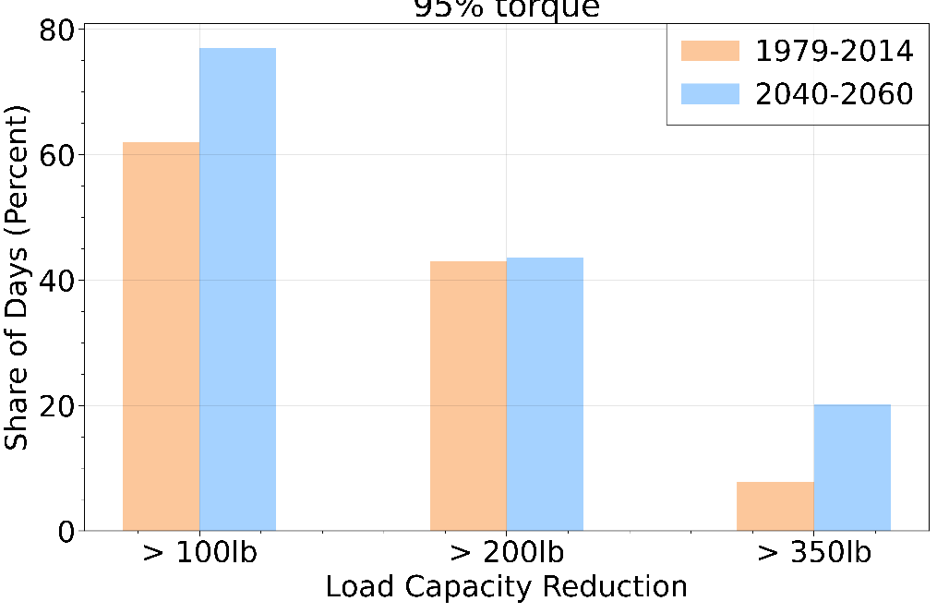

The projected climate change effects are orders of magnitude smaller than existing seasonal variation, but could remain operationally relevant
Annual Maximum Load Capacity
Frequency of Load Capacity Reductions
Mission Max Load Capacity (lbs)
Year
Notes:
95% Torque; ~5 lbs of load capacity reduction on average.
Seasonal variation, ~380 lbs

Slide 6
There is a wide range of potential applications for this analytical approach beyond what has been presented in today’s presentation
Other metrics to analyze include:
  Range
  Required torque
  Hovering out of ground effect
  Carrying external loads
Putting effects into operational context by introducing scenarios used in training exercises
  Example: carrying an external load of 5,000 lbs 150 nautical miles to a landing zone at high altitude

Slide 7
Thank You
R. Abraham Holland
rholland@ida.org

Slide 8
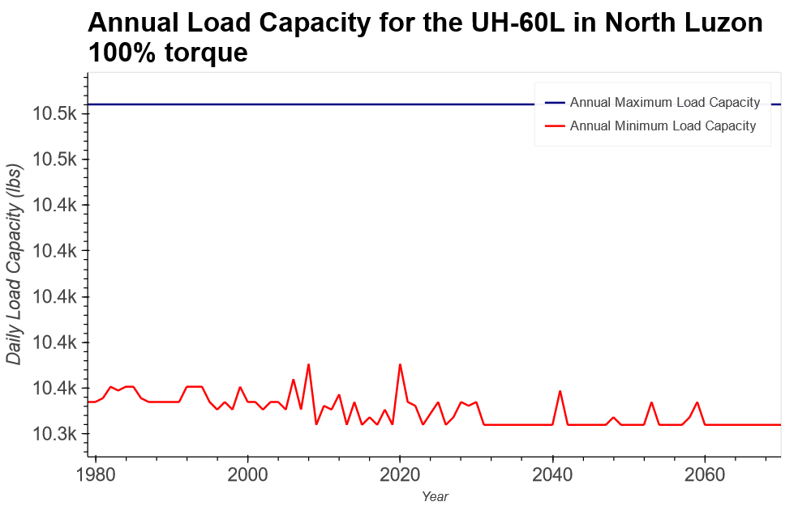
The projected climate change effects are an order of magnitude smaller than existing seasonal variation, but could remain operationally relevant
Annual Maximum Load Capacity
Frequency of Load Capacity Reductions
Mission Max Load Capacity (lbs)
Year
Notes:
100% Torque; 0 lbs on average

Slide 9
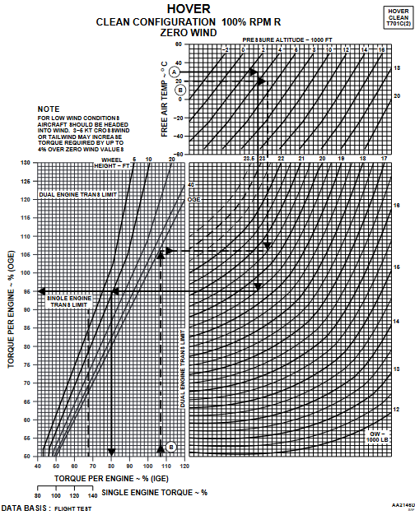
Explanation of hover load capacity calculation
Hover chart (left)
Took temperatures in 5C increments (0C, 5C, 10C, …) and PA
In 1000ft increments (-1000, 0, 1000, 2000, …) and drew line down to gross weight region
Drew line from 100 or 95% torque on bottom to intersect with either 10ft or 20ft line
Took gross weight at the intersection of two lines for each (temperature, PA) pair

