Slide 1
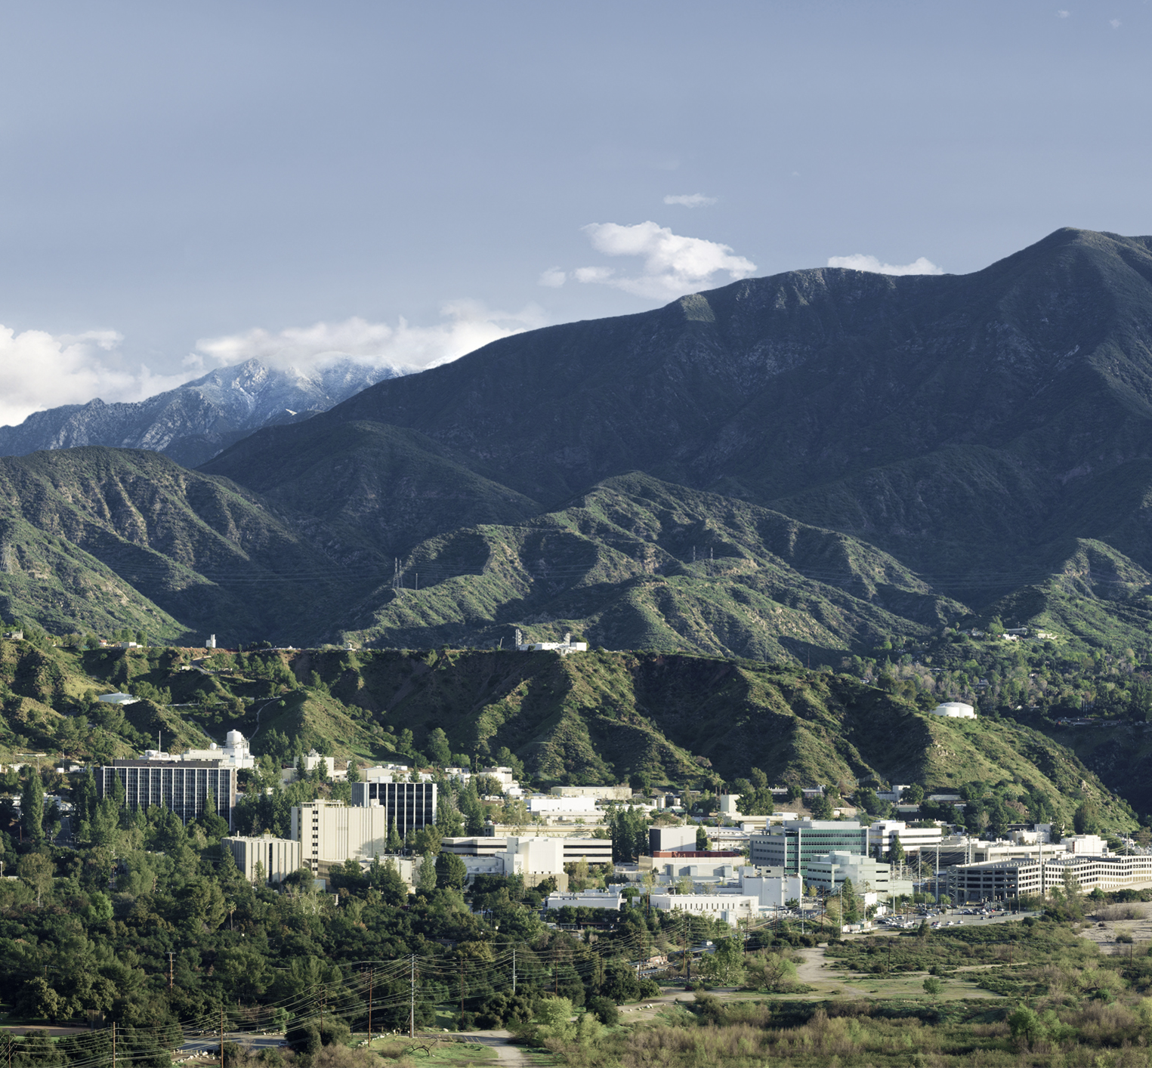

Dataworks 2023
Systems Engineering Applications of UQ in Space Mission Formulation
April 26, 2023
Kelli McCoy, Jet Propulsion Laboratory, California Institute of Technology
Roger Ghanem, University of Southern California
© 2023 California Institute of Technology. Government sponsorship acknowledged.

Slide 2
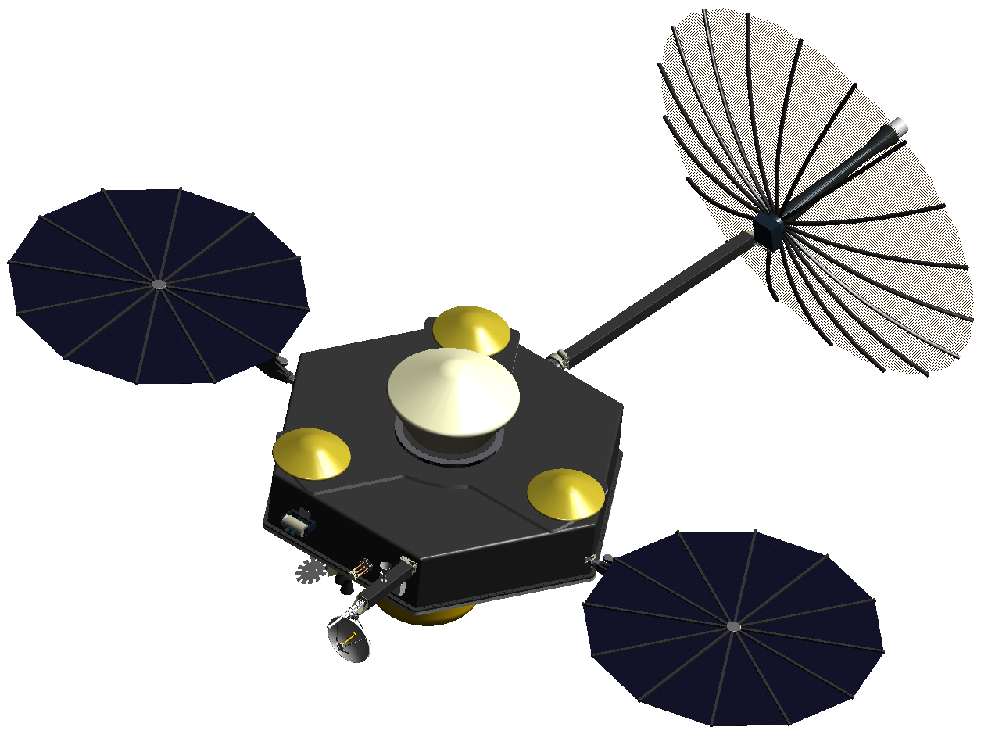
UQ in Systems Engineering
Mission Architecting
Systems engineering is a cross-cutting engineering function that focuses on designing, integrating, and managing complex systems over their life cycles
  The focus of this discussion is early mission formulation
Uncertainty Quantification (UQ) is the exploration of the unknown in computational and real-world applications (using probability and statistics)
How can UQ benefit Systems Engineering? Strategic systems engineering application of UQ techniques in space mission formulation can add value by:
  Stabilizing baselines
  Informing requirements
  Balancing cost and risk
Math
UQ
Risk Management
Requirements development
Domain knowledge
(engineering, physics, science)
Comp Sci (includes AI/ML, data science)
Improved decision-making
V&V
UQ is necessary to capture the variability inherent in all systems and models of those systems
© 2023 California Institute of Technology. Government sponsorship acknowledged.
Notes:
Intersection bigger.

Slide 3
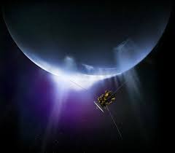
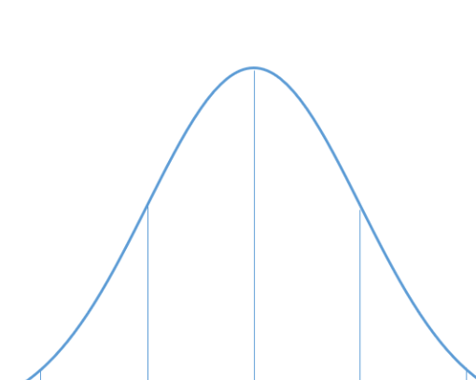
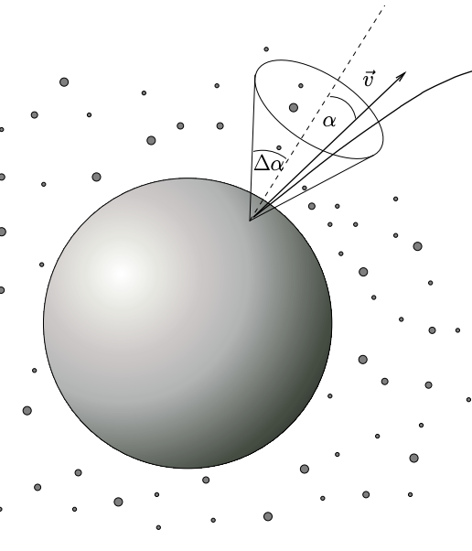
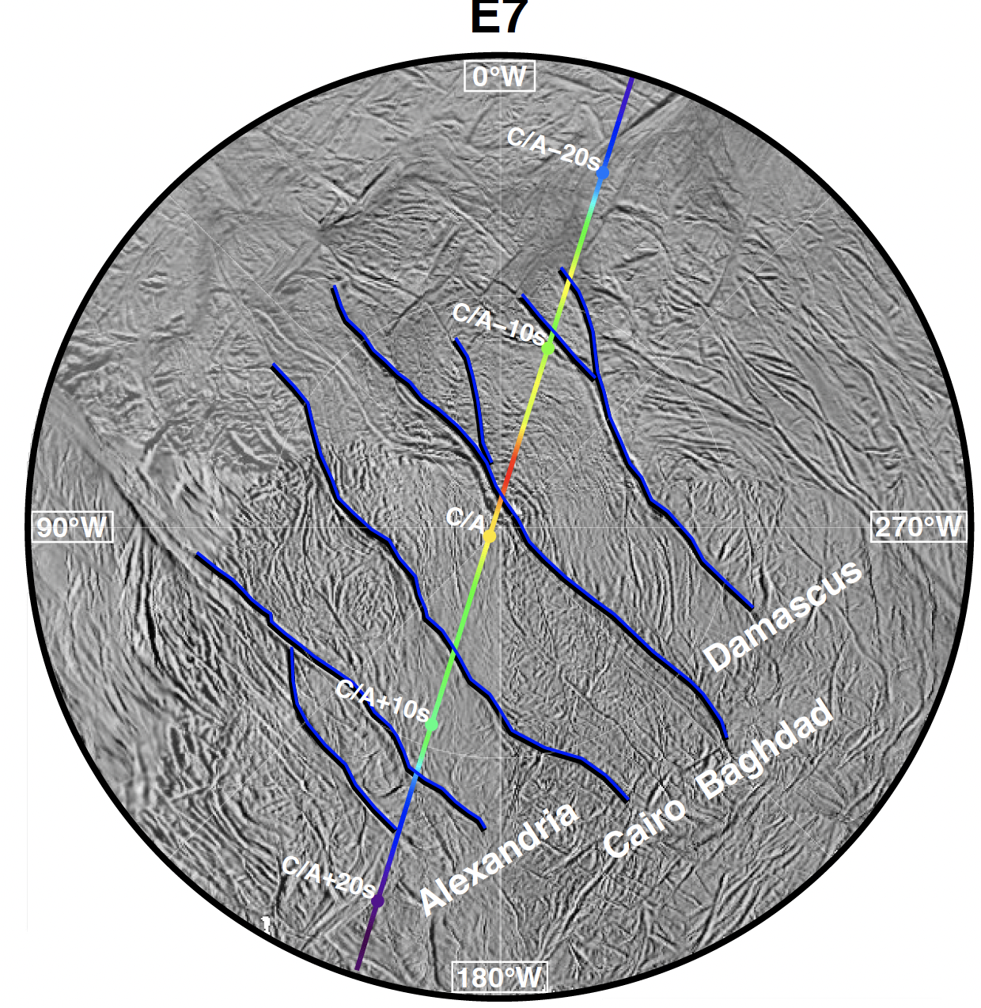
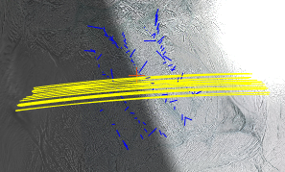
Space Mission Formulation Paradigm
We have some phenomenological data from a previous mission (or another ground-based source)
We need to use the physics model to inform a science baseline, a spacecraft design, and a concept of operations, with consideration of risk and uncertainty
We have one (or more) physics models of the process (e.g. ballistic particle propagator)
e.g. particle counts/sizes from Enceladus plumes (as measured by Cassini HRD)
QoIs: density, mass flux, etc…..
Boiling interface
Cryovolcanic
Informs mass collection, sample collector design, flux sensor design, trajectory selection , etc
Illustration Source: Spahn, F. 2006
95%
Illustration Source: Southworth, B.
© 2023 California Institute of Technology. Government sponsorship acknowledged.

Slide 4
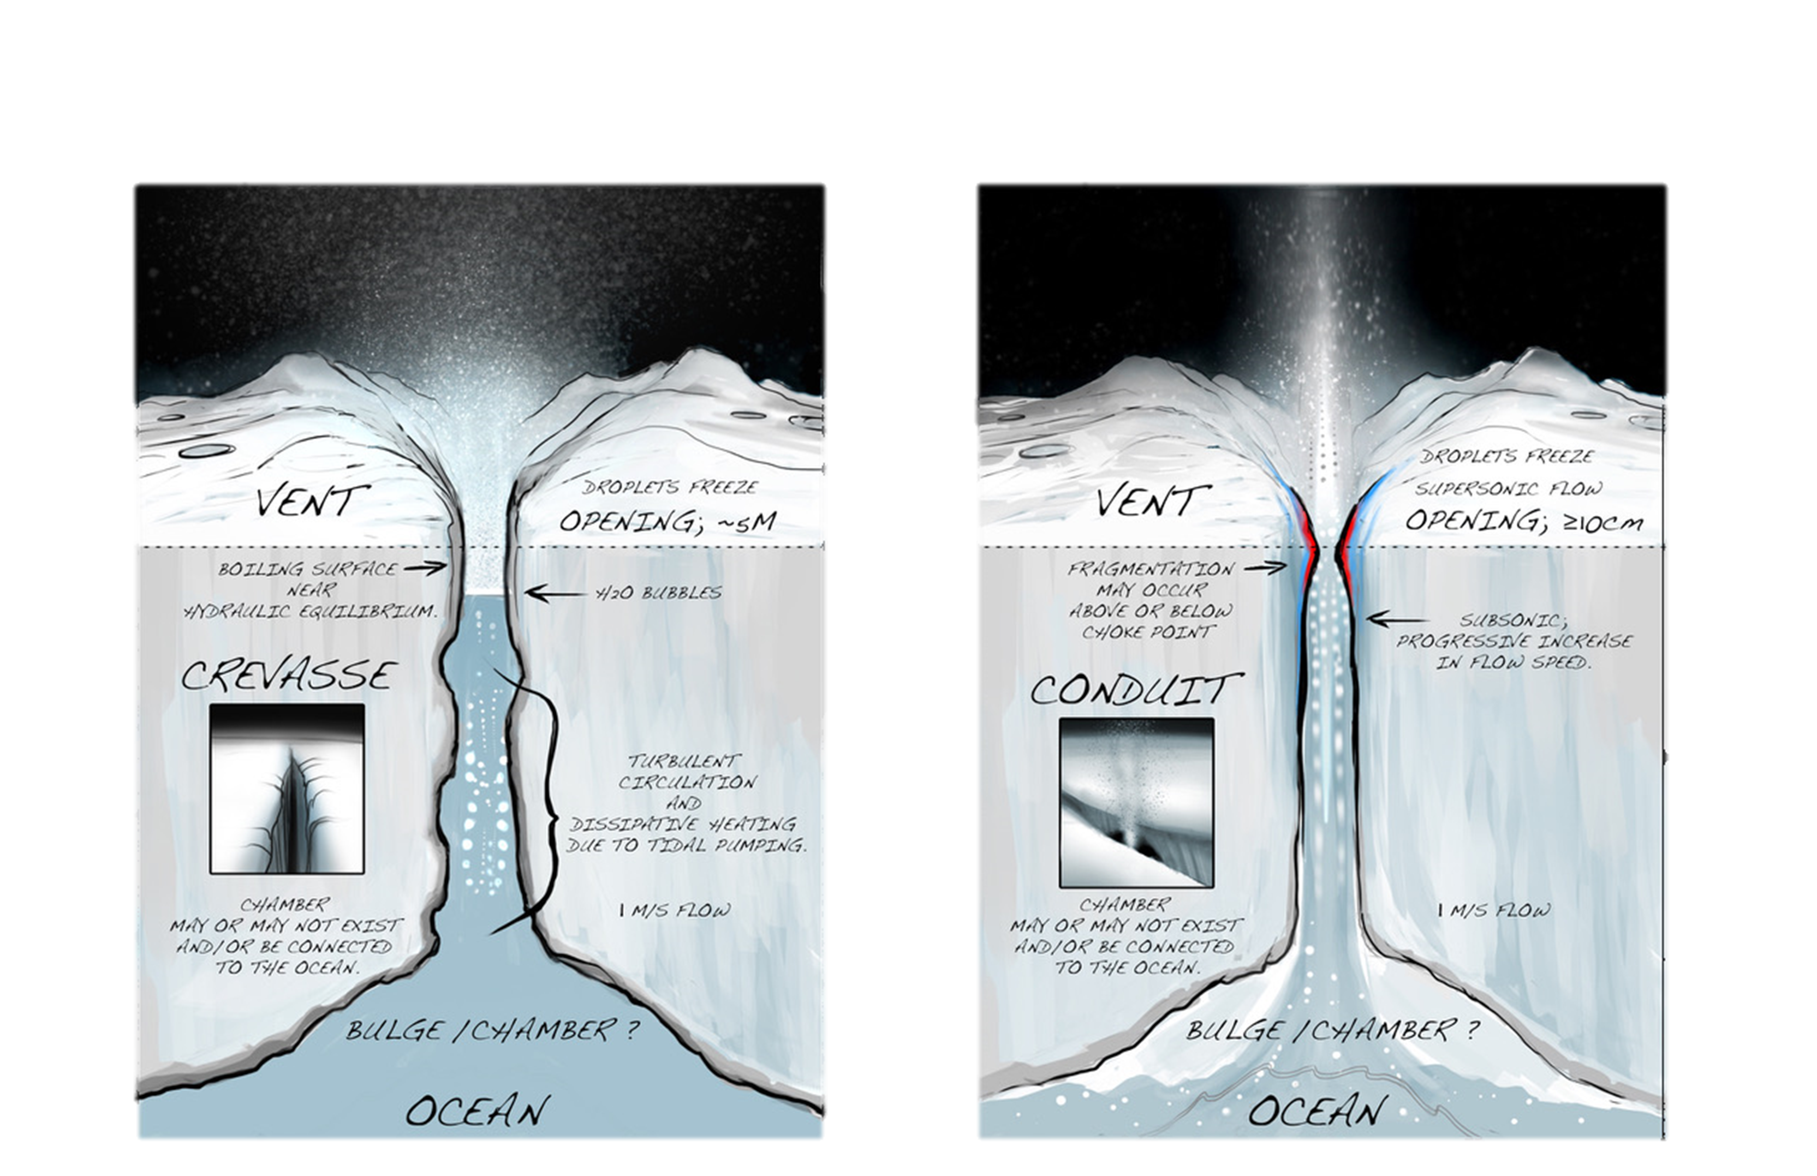
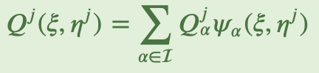
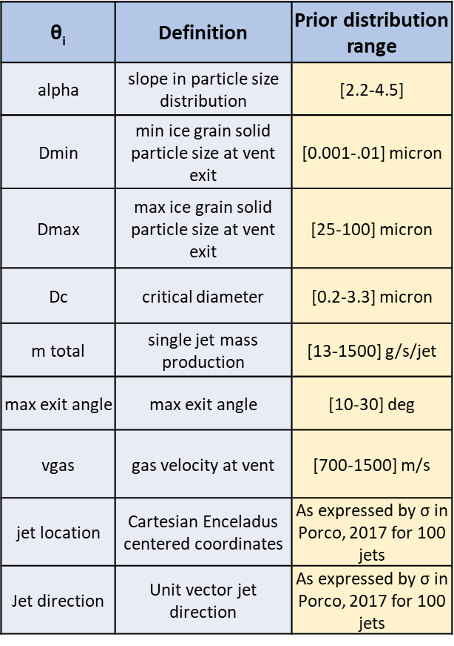

Example: Enceladus Plume Characterization
QoI: quantity of interest
We have 2 flybys of Cassini HRD data, D, (particle count binned by a range of particle sizes). Because of this range, we do not know the exact particle sizes or the flux/mass HRD encountered.
E7: 100km
E21: 50km
We have a physics model (S), a ballistic particle propagator, that takes input θ and propagates ice grains to calculate a QoI, Q (e.g mass collected), along a given trajectory. We need Q=S(θ)≈D when S is provided the E7, E21 trajectories.
S: θ → Q
The physics model is computationally expensive . Polynomial Chaos Expansion (PCE ) can aid in building a surrogate model
Prior distribution, p_{Θ}(θ) formed by using published literature
1
We wish to infer Θ, the set of unknown jet ejection characteristics at the surface, from HRD data. Θ is a joint probability distribution; we don’t know it precisely because HRD did not observe these parameters, but there is prior knowledge posed in literature.
θ= {α, dmax, dmin, dcrit, mtotal, maxexit, vgas, jet position, jet direction}
Once we have an updated joint distribution of θ, we can use this as input to estimate mass collected on future Enceladus trajectories and to inform instrument design
System Design
3
2
To solve this parameter inference problem, we use Approximate Bayesian Computation (ABC)
Notes:
Xi, eta are rVs

Slide 5

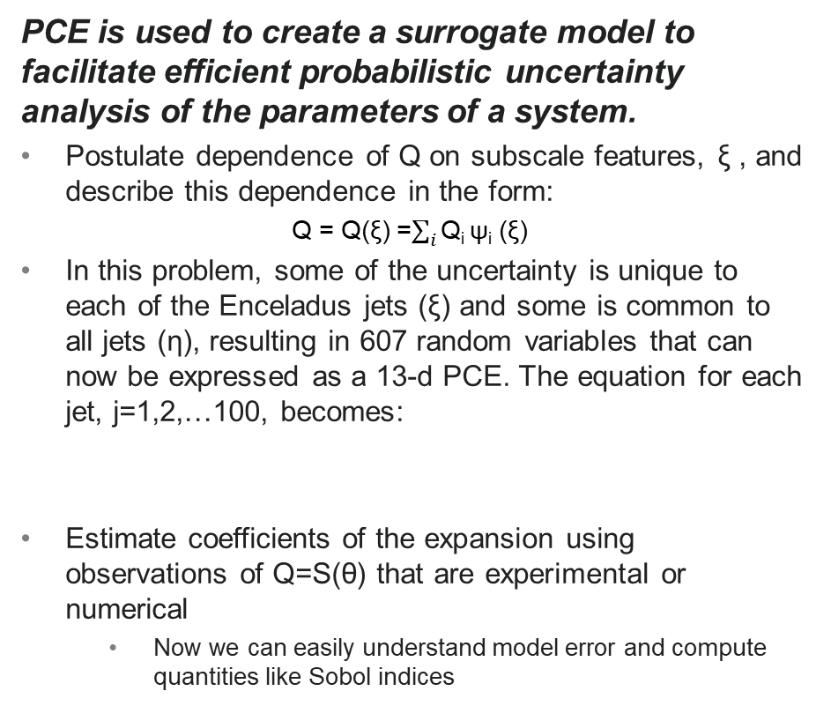
UQ Techniques used to Inform Engineering Analysis
Approximate Bayesian Computation (ABC)¹
Polynomial Chaos Expansion (PCE)²
ABC methods approximate the likelihood function by simulations, the outcomes of which are compared with the observed data
A candidate posterior sample, Q=S(θ), is simulated using model S, specified by a 𝜃 from the prior distribution, p_{Θ}(θ).
If Q=S(θ) is too different from the observed data, d, the sample is rejected. The likelihood for this problem becomes:
Then we can execute Bayes Theorem.
PCE is used to create a surrogate model to facilitate efficient probabilistic uncertainty analysis of the parameters of a system.
Postulate dependence of Q on subscale features, ξ , and describe this dependence in the form:
Q = Q(ξ) =$\sum_{i}{\text{Q}\text{i} \text{ψ}\text{i}\text{ (}\text{ξ}\text{) }}$
In this problem, some of the uncertainty is unique to each of the Enceladus jets (ξ) and some is common to all jets (η), resulting in 607 random variables that can now be expressed as a 13-d PCE. The equation for each jet, j=1,2,…100, becomes:
Estimate coefficients of the expansion using observations of Q=S(θ) that are experimental or numerical
  Now we can easily understand model error and compute quantities like Sobol indices
© 2023 California Institute of Technology. Government sponsorship acknowledged.
Notes:
Change D-hat to S and D to d; Q to S
Data is uncertain—add this; deterministic model; comparing to random data
Distance between d-hat and D.
More dimensions, more samples; attribution (causes of uncertainty/sensitivity (mean and pdf))
Q=S; xi, eta to theta
Introduce variables/theta
What is the best way to relate eta to theta here?
Explaining inference with PCE
What kinds of scenarios would lead to having to re-estimate the PCEs?
How are different plume theories handled by this modeling?
Are beta coefficients updated with flight data, or just theta?

Slide 6
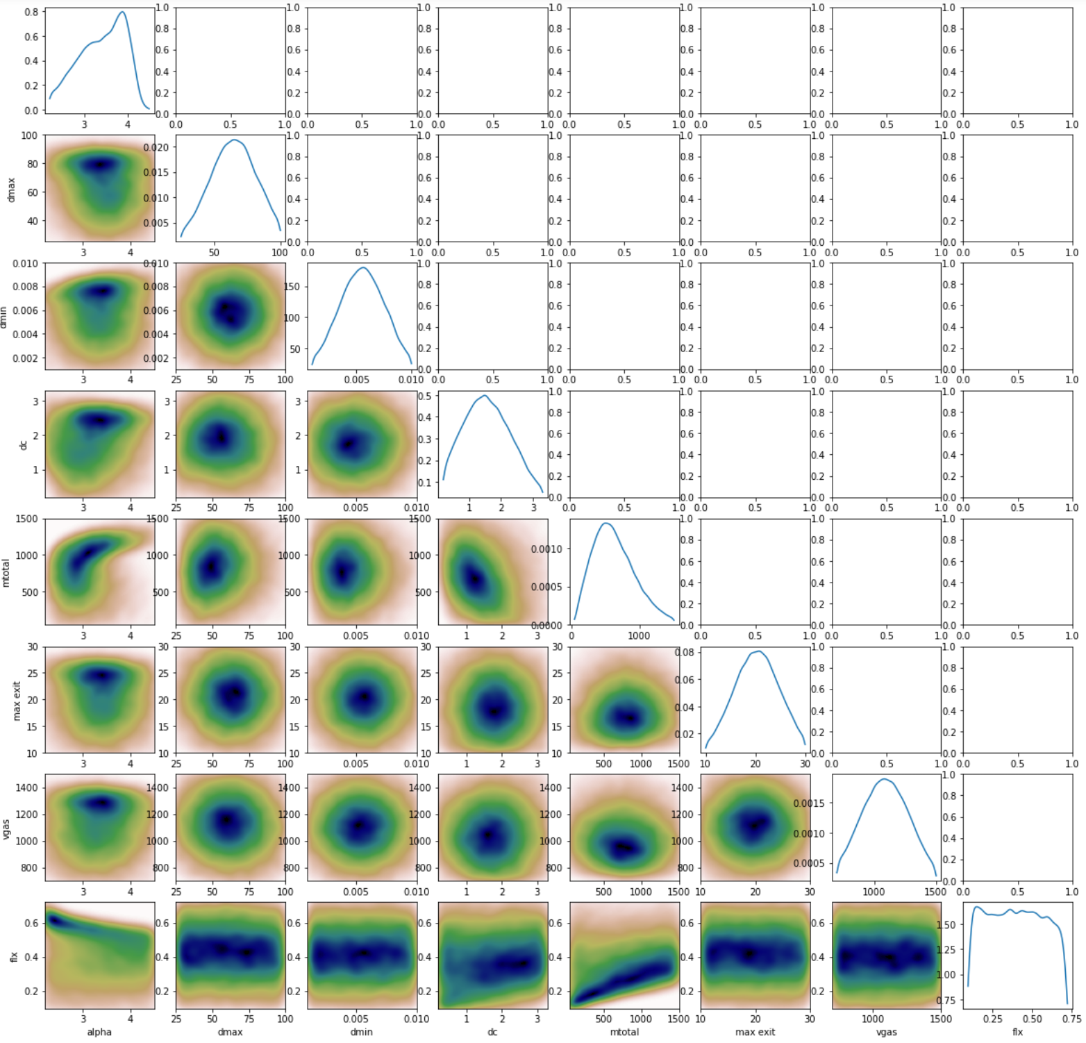
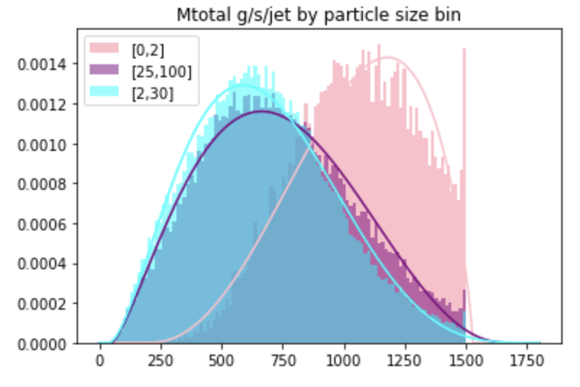
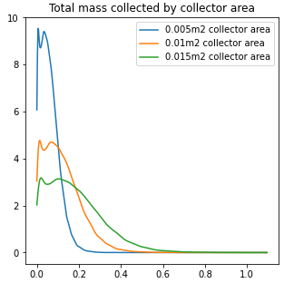
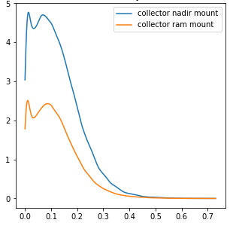
How can we Inform Design and Mitigate Risk with this Model Infrastructure?
© 2023 California Institute of Technology. Government sponsorship acknowledged.
Pdf of Mass flow rate by particle size bin
Derive input parameter linear and nonlinear relationships, given Cassini data
Parameter inference
Do small particle sizes clog insitu instruments?
Do large particles pose safety issue for mission?
Can the mission instrument suite accept this mass flow rate for certain particle sizes or will there be dead time?
Model input parameter nxn comparison
Pdf of Mass Collected over a trajectory for given collector sizes
Pdf of mass collected over a trajectory for different collector mounting positions
More avg mass collected with larger aperture but this may violate other system constraints
More avg mass collected with nadir positioning
What collector size and collector efficiency is needed to ensure high sample collection margin, subject to cost, mass, constraints?
Where on the spacecraft should the collector be mounted to maximize mass collected?

Slide 7
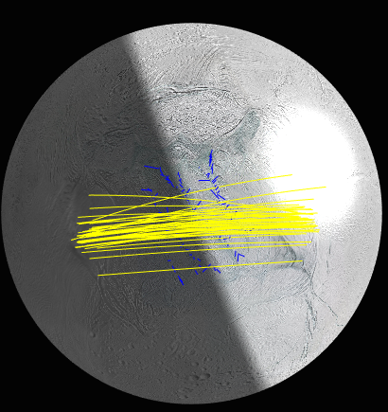
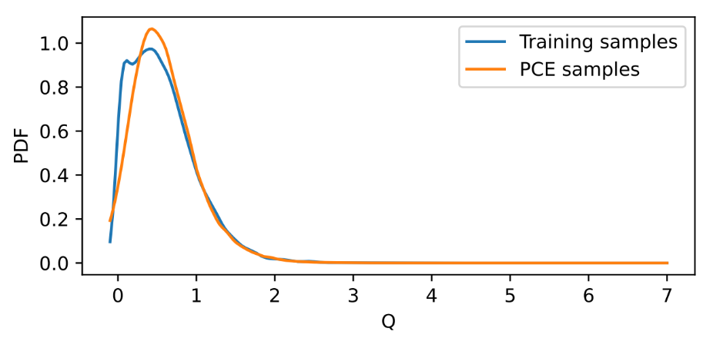

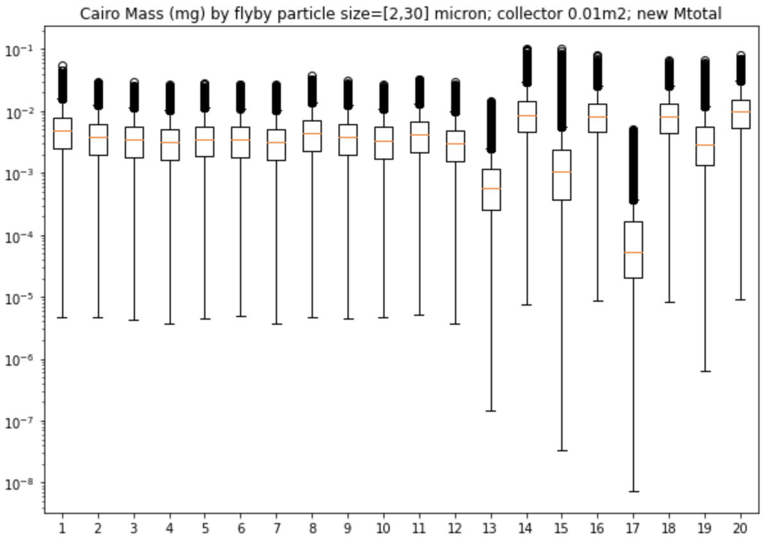
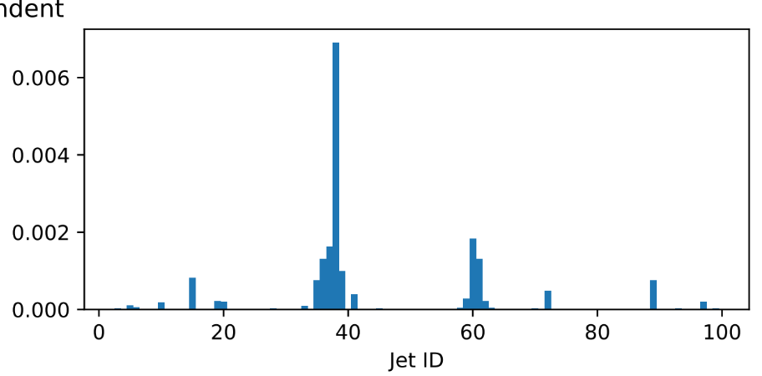
Using PCE to support trajectory design
We can construct a surrogate PCE that closely replicates each flyby and is computationally faster to work with and update with new knowledge (possibly inflight)
Can we learn how to fly optimally to collect the most sample and ensure we meet science objectives? Where should we fly? How low? Target a jet? These decisions all have system design implications…
Mass collected on given trajectory (20 flybys)
Flux contributed
Low altitude jet-targeted flybys (14, 16, 18, 20) get slightly more mass, but does it warrant a sophisticated attitude control system?
We can use the PCE to learn contributions from each jet on each flyby and make trajectory recommendations regarding jets to target in flight and at what angle

Slide 8
Summary
Leveraging Uncertainty Quantification for Systems Engineering analysis and design decisions is critical (especially for highly uncertain planetary environments)
  Without UQ, we do not acknowledge or understand the breadth of risk and therefore it is difficult make informed design decisions
Examples of systems engineering areas where UQ techniques are a logical companion:
V&V/test planning
Technical resource management
Project Protection/cybersecurity
Risk Management
Requirement development
Margin assessments
MMOD/Orbital debris
Reliability
Trajectory optimization
Manufacturing/materials
Autonomy, Controls
© 2023 California Institute of Technology. Government sponsorship acknowledged.

Slide 9
References
1. Sunnaker et al. Approximate Bayesian Computation. Computational Biology, 2013.
2. Soize, Christian; Ghanem, Roger. "Physical Systems with Random Uncertainties: Chaos Representations with Arbitrary Probability Measure. SIAM Journal on Scientific Computing. 26 (2): 395–410, 2004
© 2023 California Institute of Technology. Government sponsorship acknowledged.

