Slide 1

Analysis Opportunities for Missile Trajectories
DATAWorks 2023
David Harrison, Lockheed Martin
Kelsey Cannon, Lockheed Martin
© 2023 Lockheed Martin Corporation

Slide 2
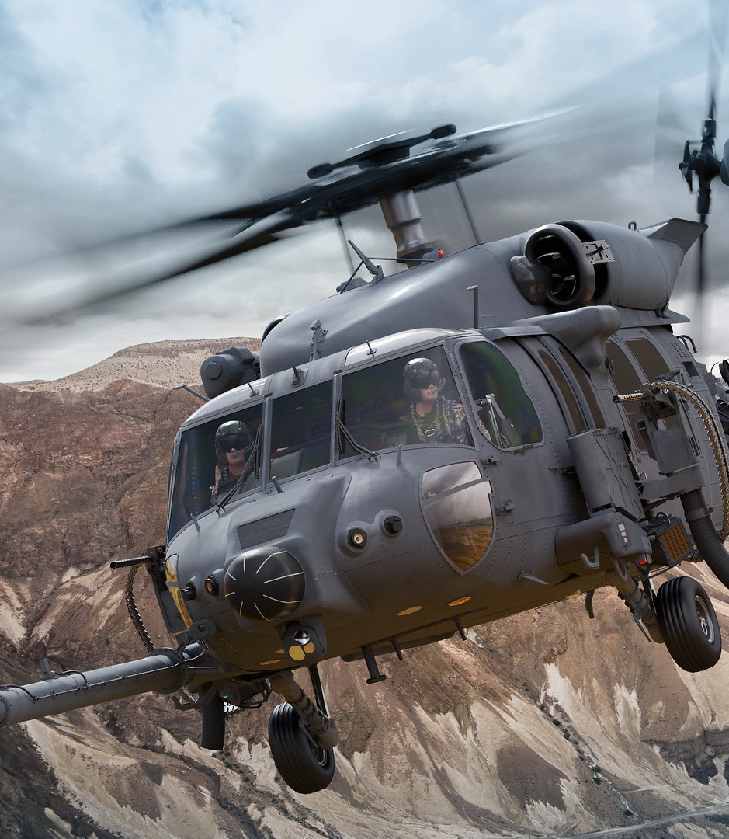
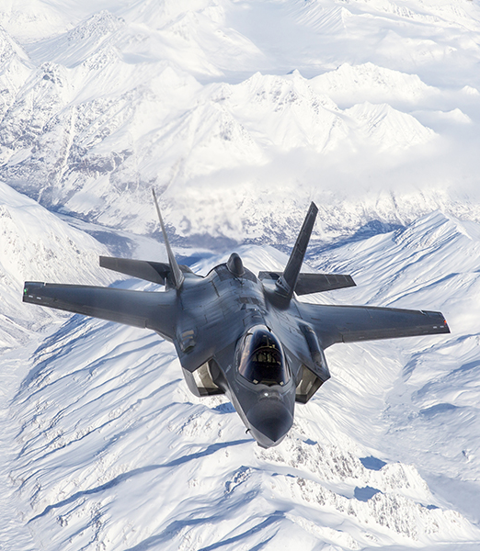
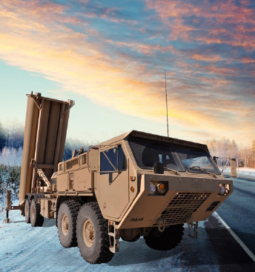
Surveillance & Navigation
Global Communications
Human Space Flight
Strategic Missiles Defense Systems
Lockheed Martin Space

Slide 3

Trajectory Variability Exploration Options
Original Trajectory Formula
Monte Carlo
OR
Space-Filling Test Design
Functional Components Analysis
Functional Principal Components (FPC) Trajectory Factor Table and Formula
FPC Latin Hypercube
We cannot afford 725 full-model runs
We can afford 200 hours:
X High-Fidelity model runs
and
Y Low-Fidelity model runs
Customer desires faster turn around with lower risk or cost
This talk will explore multiple process improvements focused on reducing analysis risks
Notes:
“decoder ring” update with columns from slide 7
Goal is to find a combination of low and high fidelity, time-based models that meet budget

Slide 4
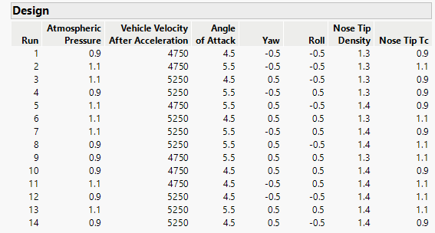
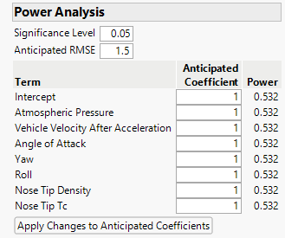
Definitions
Rigorous: give the same assignment to two teams and get (basically) the same answer.
Defensible: state the use of tools and methods in a way that generates confidence and repeatability.
Test Power: the ability to avoid false-positive/negative results.
Test Coverage: no one can ask “did you try this?” at the end of the program.
Faster/Less Expensive: costs less either in time, work hours, and/or computer run hours.
Example: “We created a 7-factor, custom DOE using JMP with a RMSE of 1.5 and a test budget of 10 to 20 runs”
Consistent, accurate feedback that allows the entire team to make confident decisions

Slide 5
Hypersonic Missile Temperature Predictions: Current Practices
The customer delivers 725 monte carlo trajectories
LM runs a short, low-fidelity analysis on each (725 runs in 1 day)
LM picks the “worst” cases by overall heating value (risky?)
LM runs a full analysis on the chosen worst cases to validate
Analysis is completed in about 30 days; hand off to structural analysis
3 months later, customer delivers a new round of 725 monte carlo trajectories that match updated requirements
Current Practices
Might miss a critical issue due to reliance on low-fidelity model
Full model is run only on worst cases, does not generate surrogate/map
What is really being learned every 3 months…
Why are we not covering all possible trajectories at the start?
The Risks
Every step has improvement options
Notes:
every step is an opportunity for improvement to save time and money

Slide 6
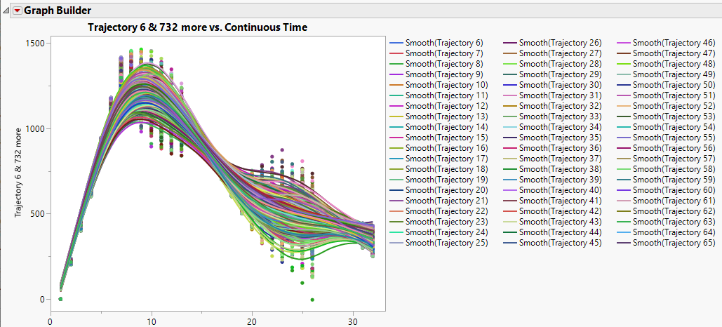
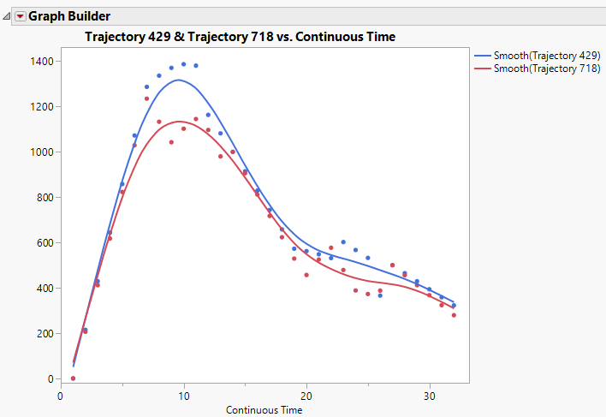
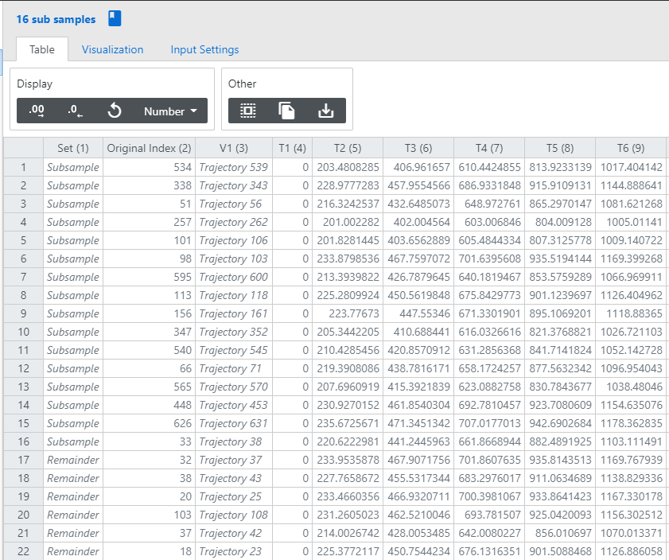
Common Practices
Current Process:
Low-Fidelity Model of all 725 Trajectories
Then pick “the most interesting” for the high-fidelity model
Vision:
Best map of the 725 trajectories with a combination of low and high fidelity models
based on test power and coverage
+
generating a surrogate
Common Practice:
Pick the worst/corner trajectories and run those
Notes:
At least better than the norm or what we used to be

Slide 7
Overview of Analysis Options
Trajectory Formula + Factor Table | Monte Carlo | FPC Values | Space-Filling Test Design | Surrogate Trajectory Model | Output
X | Output |  |  |  | Works, but is inefficient (80% more runs)
X |  |  | Output | Output | #1 Preferred: Skips the inefficient Monte Carlo
X | X |  |  | Output | #2 SmartUQ down-selected best trajectories
X | X |  |  | Output | #3 Generated surrogate in SmartUQ with sensitivities
 | X | Output |  |  | #4 Uses 725 trajectories to generate FPC values
Output |  | X |  |  | #5 FPC can generate initial formula
 |  | X | Output |  | #6 FPC can pick from the original trajectories
 |  | X | Output |  | #7 FPC can also generate new “best” trajectories (why use the originals?)
 |  |  | X | Output | Why use trajectories when you can “solve” a state-space (of all trajectories)
Analysis is only repeated if/when mission requirements change
Notes:
Below the blue dividing line means without a factor table

Slide 8
Option #1: Monte Carlo as Outdated
The Monte Carlo technique is rigorous and has high test coverage,
but Monte Carlo is inefficient compared to space-filling test designs.
Factor | Low | High
Wind | -35 | +35
Cruise Variability | 0 | 100
Atmospheric Pressure | 0.9 | 1.1
NoseTip Density | 0.9 | 1.1
All data and factors shown are notional
Monte Carlo is rooted in factor tables
Can the customer just deliver a trajectory factor table?
Have the customer deliver a factor table (instead of individual trajectories)
Notes:
why deliver 725 runs when they could just deliver the factor table?
is the factor table comparable to the 725 runs?
motif of changing customer habits. Is it easier to change customer habits or just take their runs and back out a factor table?
How do we choose which trajectories to evaluate with the low fidelity model vs high fidelity model?
Require education around what a factor table is

Slide 9
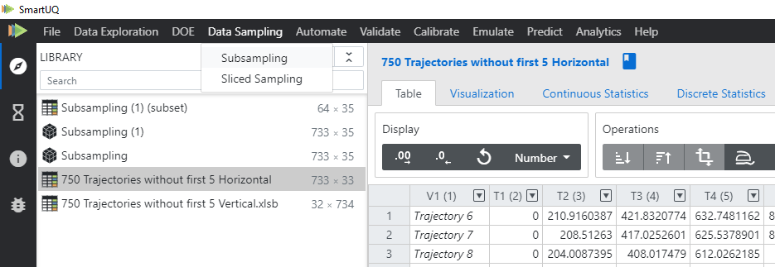
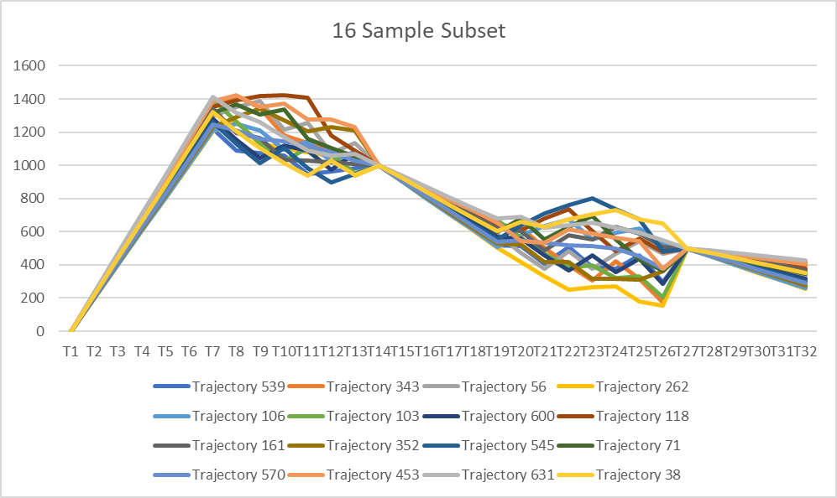
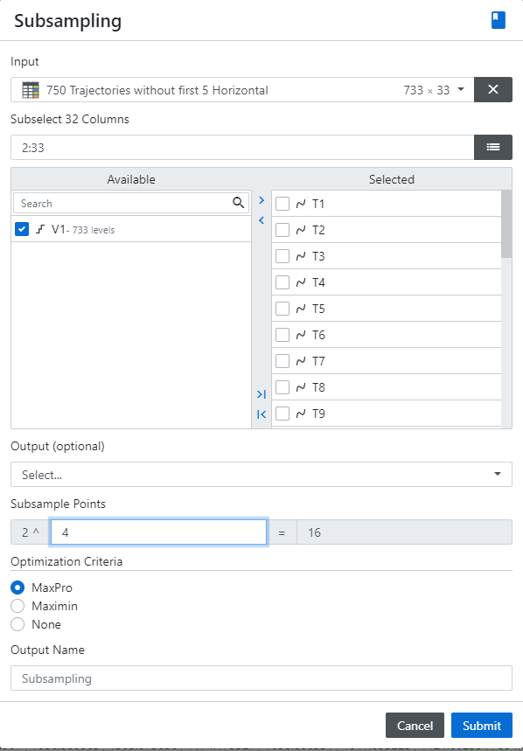
Option #2: SmartUQ Sub-Sampling
Subsampling picks from the current trajectories using a space-filling optimization algorithm
Subsampling with MaxPro or MaxiMin uses space-filling objectives to choose the best model runs
Notes:
Either function chooses the most interesting trajectories
Don’t even need to run the low fidelity model anymore with this information

Slide 10
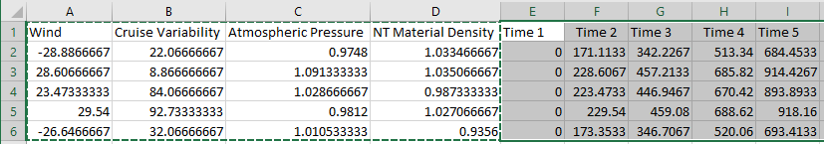
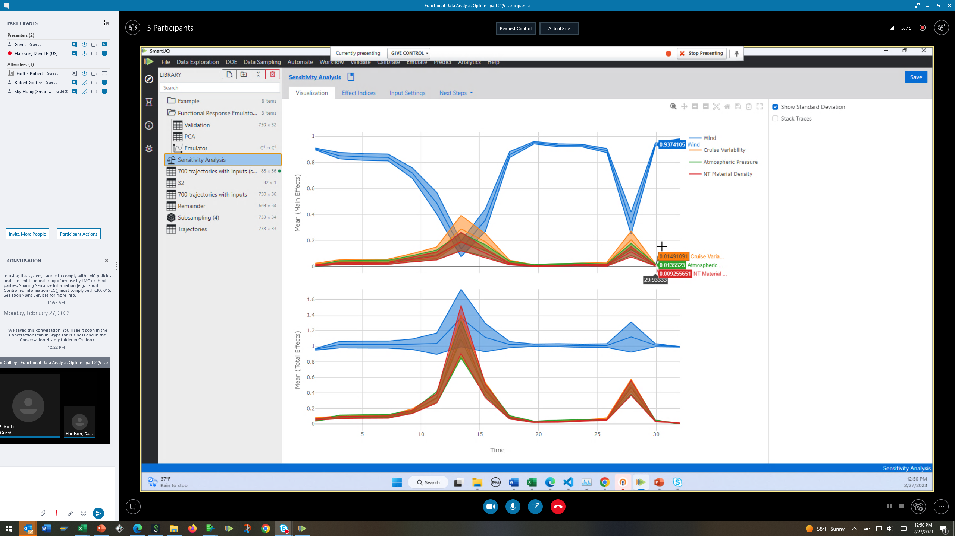

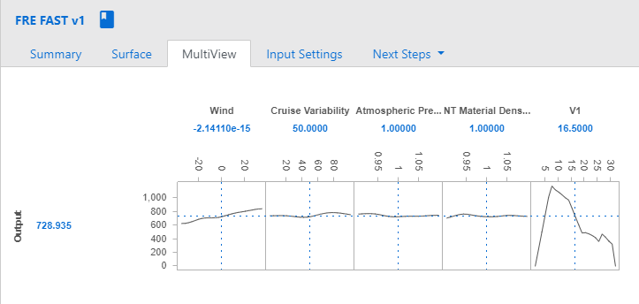
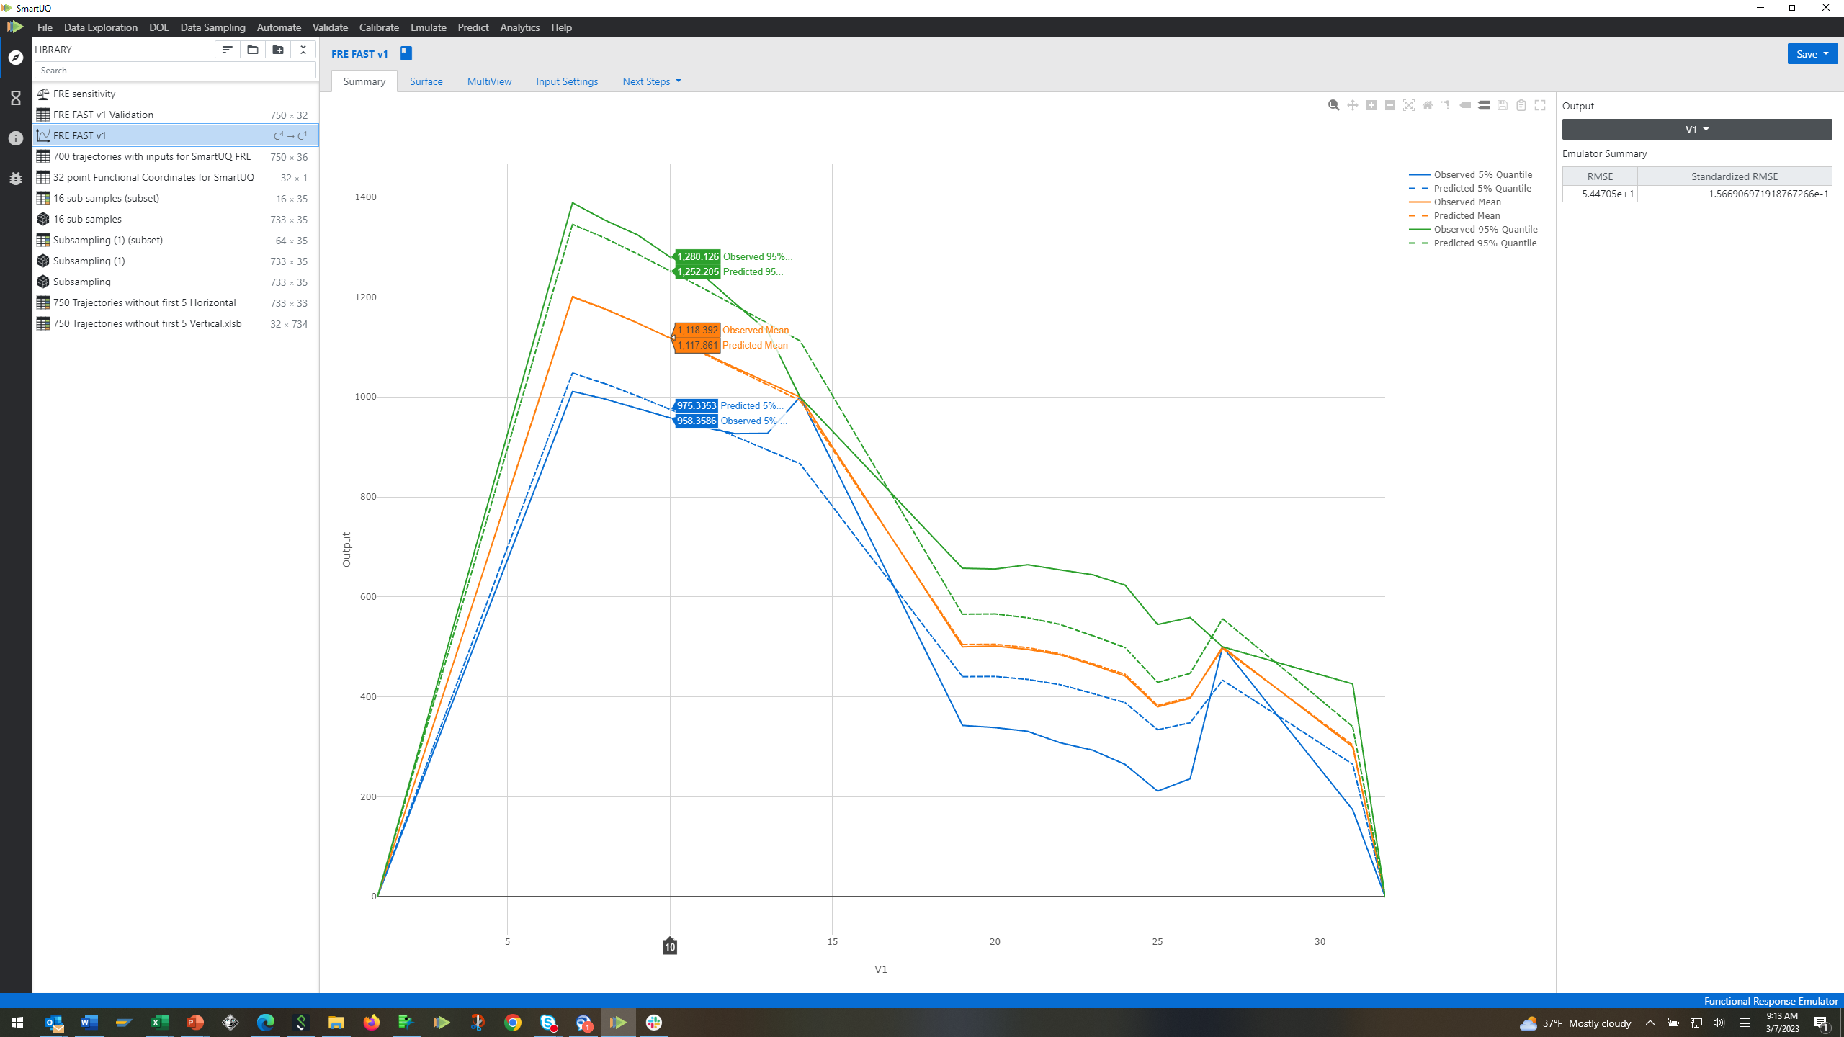
Option #3: SmartUQ Functional Response Emulator (FRE)
Inputs
Outputs
Functional Response Emulator builds a time-based model from the trajectories
Functional Principle Components define the curves
Time Coordinates
Inputs could be from customer or from JMP Functional Response Components (next)
Notes:
Know inputs and outputs
Only know the outputs
But theoretically, we can do the functional response and create sensitivity analysis of which trajectories matter and which do not

Slide 11
Functional Response: Sensitivity Analysis
The FRE successfully back-calculated the sensitivities:
Wind affects initial ascent (Time 1 to 7)
Cruise Variability is main effect during the two cruise periods (Time 7 to 15 and 25 to 30)
Atmospheric Conditions and Material Density have an effect throughout.
SmartUQ FRE requires the input values and the output values but works well

Slide 12
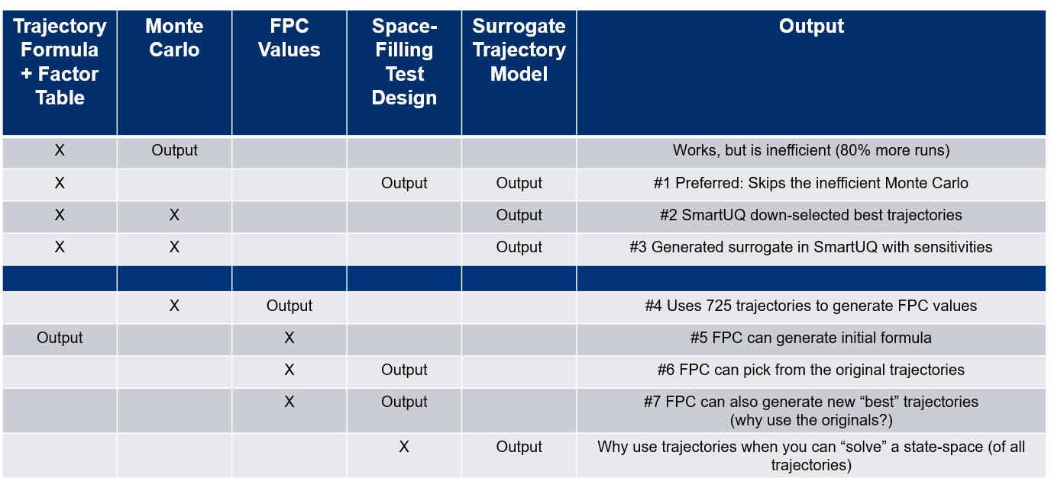
Analysis without Original Factor Table/Formula
We are here

Slide 13
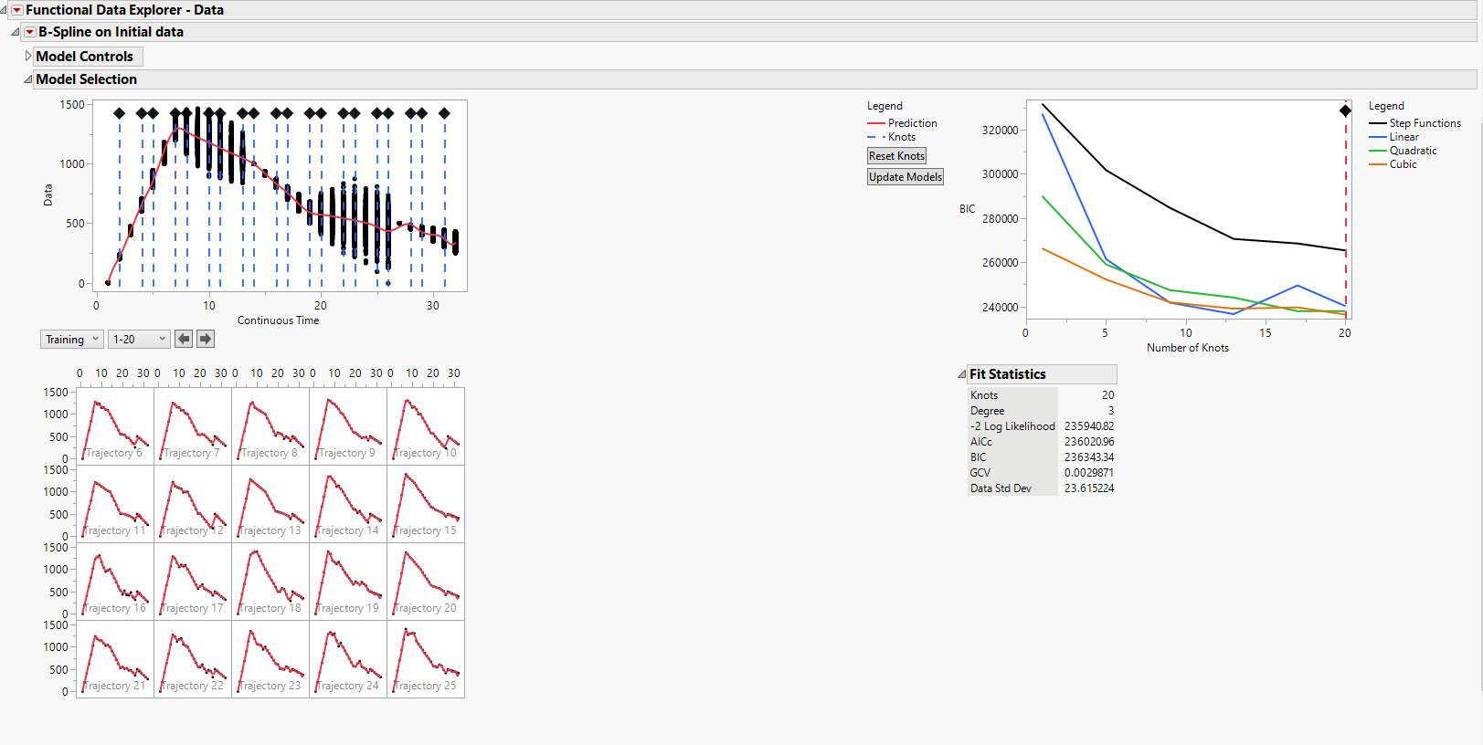
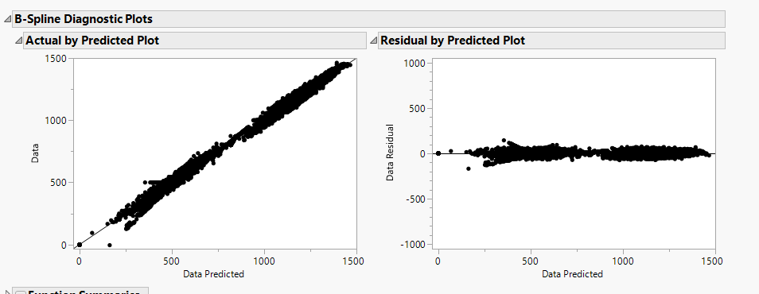
Option #4 JMP Functional Data Explorer
JMP first allows the user to
Visualize each trajectory
Align/adjust data
Evaluate the number of knots
Adjust the knots
Diagnose the accuracy of the splines
Functional data cleanup, visualization, and alignment is an important step
Notes:
Separating the curve into pieces
Knots: landmarks in data (modulus, yield strength, etc), defining characteristics enough to group

Slide 14
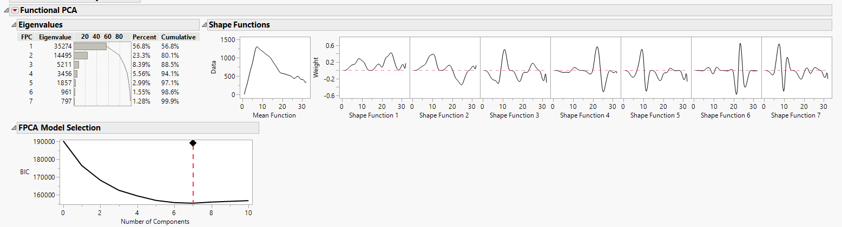
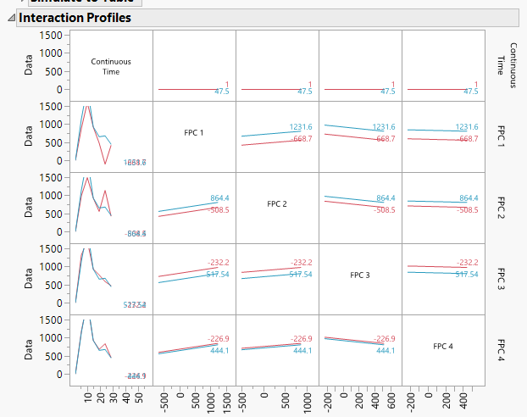
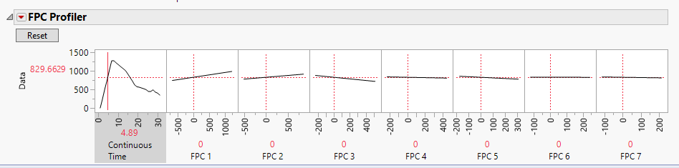
Option #4: JMP Functional Data Explorer Curve Fits
Functional Component Analysis:
Turns the data into spline curves
Generates Functional Principle Components (FPCs)
Users choose number of FPCs (7 in this example)
Generates profiler/ saves FPC values
FPC and Shape Functions
Spline Curves
Max/Min FPC values can be determined
FPC turns curves into numbers

Slide 15
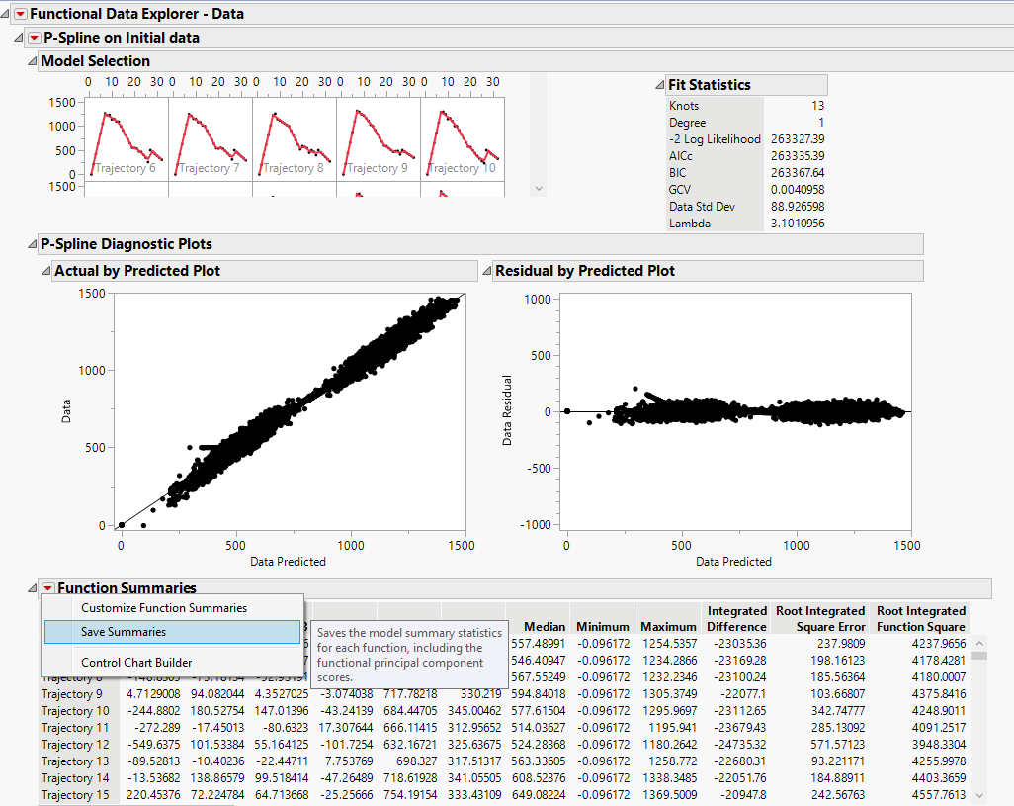
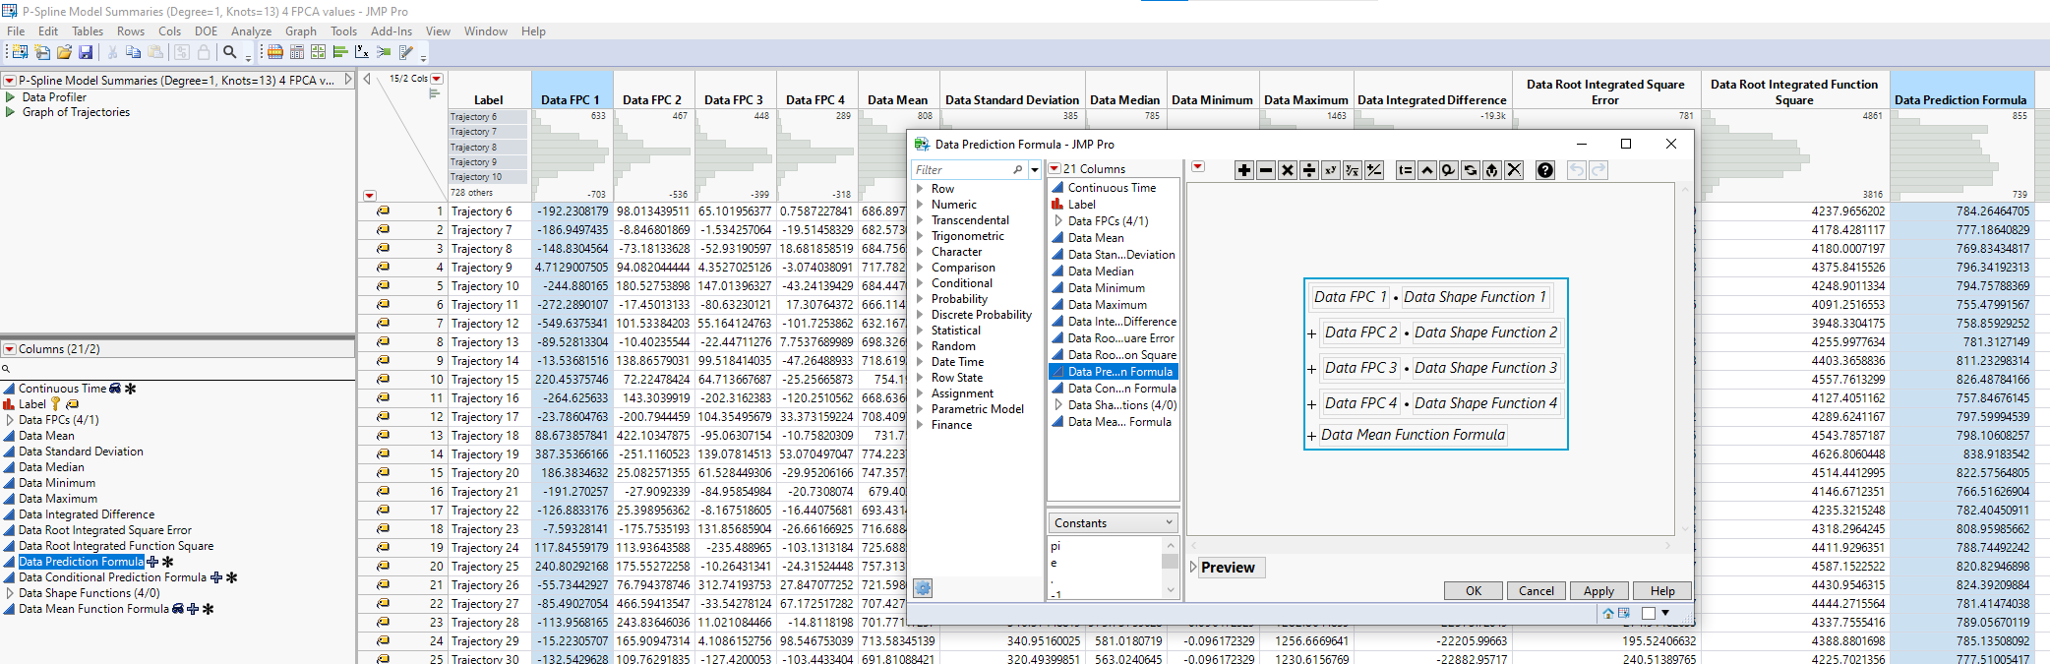
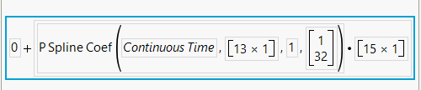
Option #5: Functional PCA Formula Generation
Decide on FPCA Model and Shapes (P-spline, 4)
Save Summaries
Data Mean Function:
The FPCA formula is: FPC₁*Shape₁ +… FPC_{z}*Shape_{z}+ Data Mean Function
Notes:
Reverse engineer to get a formula that was not provided

Slide 16
Note: Comparison of Factor Tables
Engineering Factor Table
FPC Factor Table
Factor | Low | High
Wind | -35 | +35
Cruise Variability | 0 | 100
Atmospheric Pressure | 0.9 | 1.1
Nose Tip Material Density | 0.9 | 1.1
Factor | Low | High
FPC 1 | -668 | +1231
FPC 2 | -508 | +864
FPC 3 | -232 | +517
FPC 4 | -226 | +444
and a function that propagates these variabilities
Engineering Factor Table = PCA Shape Functions
Intuitively, the engineering factor table is easier to understand.
Mathematically, they are equal.
Notes:
#5– now we have a formula and a factor table

Slide 17
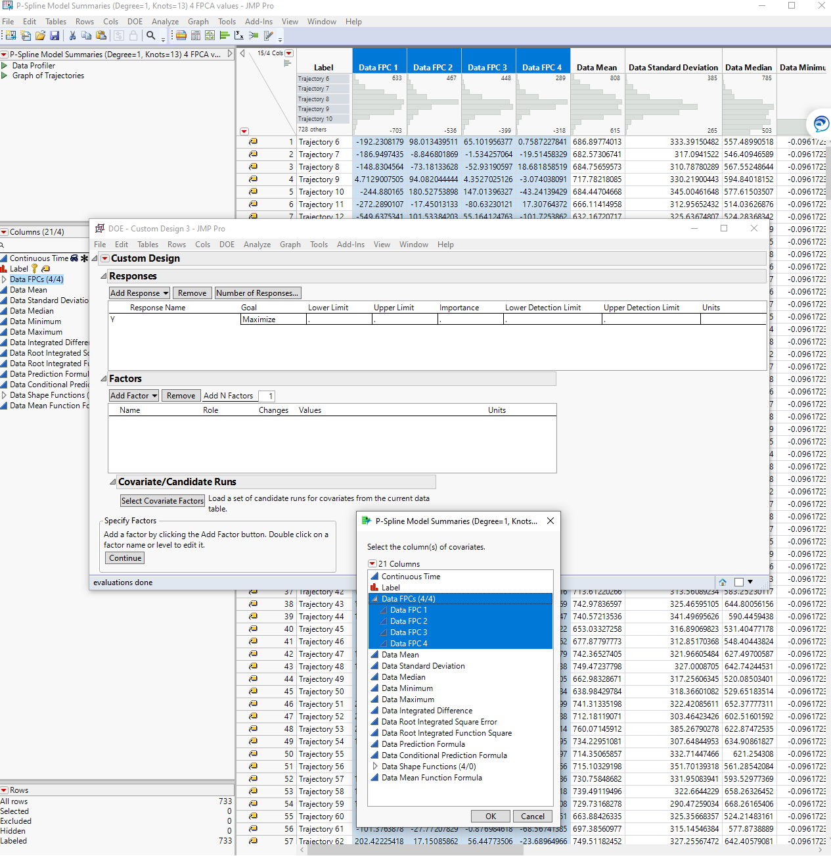
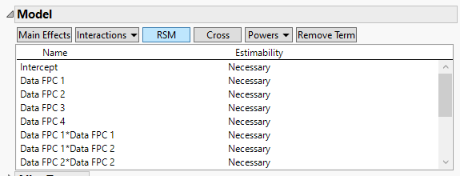
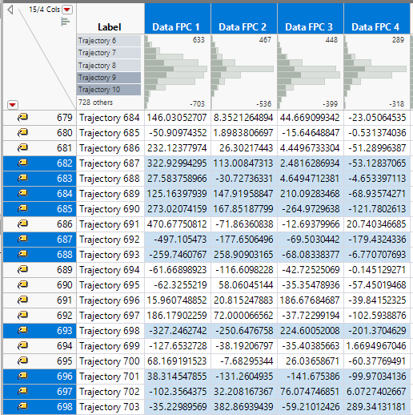
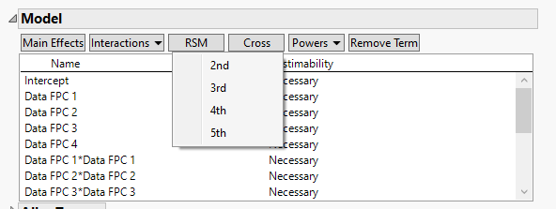

Option #6: FPC Columns Used to Pick Best (Current) Trajectories
RSM
Powers
The DOE generator takes the current list of trajectories and picks the best 80.
Model options would be the RSM and the Powers (1-5).
Notes:
Speaking in the basis of FPC not factor tables
Of the 725 trajectories, here are the most interesting

Slide 18
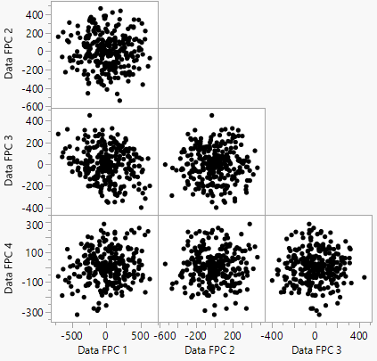
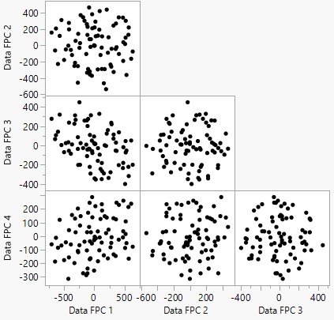
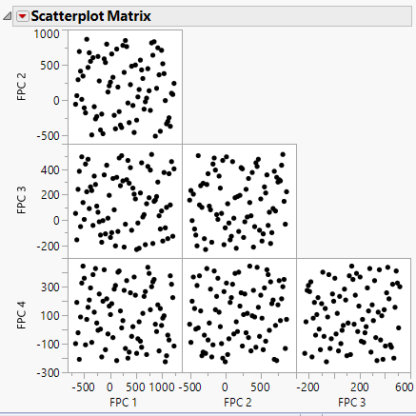
Comparison of Test Designs
Exploit
Explore
RSM
Powers
Latin Hypercube of FPC
Exploiting Slopes
Mix of Exploring and Exploiting
Mapping/
Exploring
Using the current trajectories is not as focused on mapping all possible trajectories.
RSM and power coverage goals would depend on program needs.
Notes:
Different ways to tell JMP to choose the best method given the same inputs
Exploring (map what is over the hill) or exploiting (know what is over yonder). Explore to exploit

Slide 19
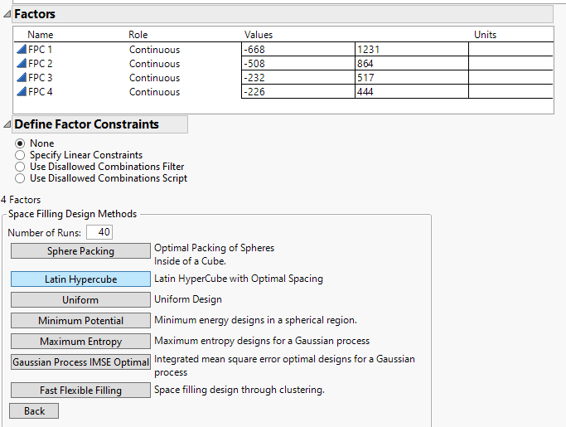
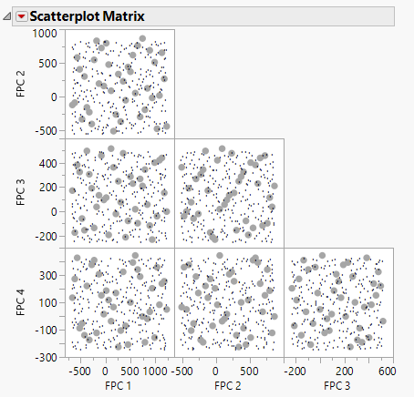
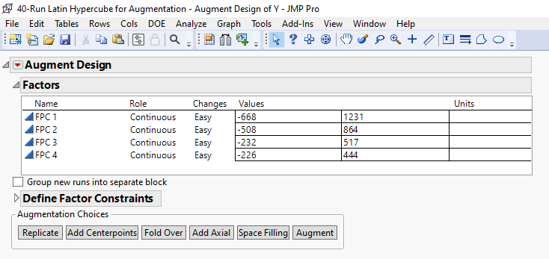
Option #7: FPC Factor Table to Model Run Lists
Use original factor table or FPC
Generate 40-run Space-Filling design for high-fidelity model
Augment those 40 runs with 260 more for 300 total low-fidelity model runs
Or
Augment to 340 and use the new runs as low fidelity to add to the high fidelity runs
Result: compare exact runs “old school style”
Result: compare models and surfaces “new school style”
This can be done in FPC coefficients or from the list of trajectories
Notes:
Why use the 725 given trajectories when we can make a better list? Why limit to what is provided? 725 allowed us to create the equation that in turn allows us to create infinite trajecotries
Solve the original problem. Where do we run the fast low fidelity model and where do we run the slow high fidelity model
Take factor table, first 40 runs are high fidelity (big dots in middle) and use low fidelity model to cover additional space between. Augmenting

Slide 20
Improved Analysis Summary
Original Trajectory Formula
Monte Carlo
OR
Space-Filling Test Design
Functional Components Analysis
Functional Principal Components (FPC) Trajectory Factor Table and Formula
FPC Latin Hypercube
Analysis options for a variety of inputs and desired outputs
Options allow for improved analysis and meeting our goal:
Best map of the 725 trajectories with
a combination of low and high fidelity models
based on test power and coverage
+
generating a surrogate
Thank you for your time.
Notes:
“decoder ring” update with columns from slide 7
Goal is to find a combination of low and high fidelity, time-based models that meet budget

Slide 21

© 2023 Lockheed Martin Corporation

Slide 22
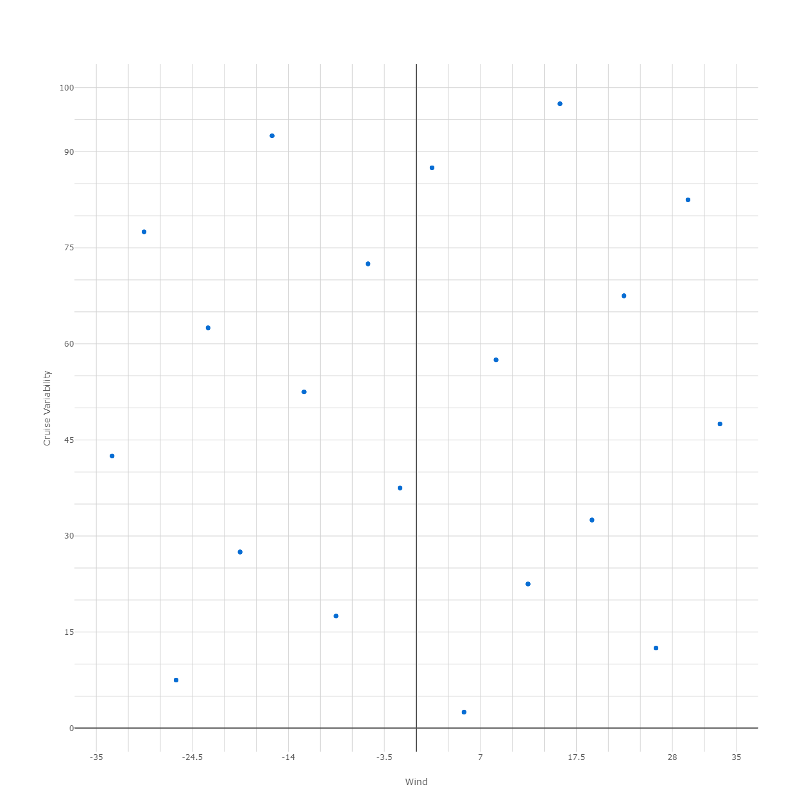
Fast Run 725 Trajectories or Surrogate Modeling?
Fast Run
Reduced order model does not have:
Internal heating
Cold wall
And more
Fast-run provides a worse analysis with more coverage
(300 runs x 40 minutes)
Run time is the new currency for program development
The choice of analysis and test architecture is a critical skill
Why not try both fast run and surrogate modeling?
Schedule Budget = 200 hours in both cases
Slow Run
Surrogate modeling provides full analysis with (slightly) less coverage
(40 runs x 5 hours)
Strategy is defensible and different for each program
Notes:
running/schedule budget = 200 hours
In the end, why not try both? budget is computing power.

Slide 23
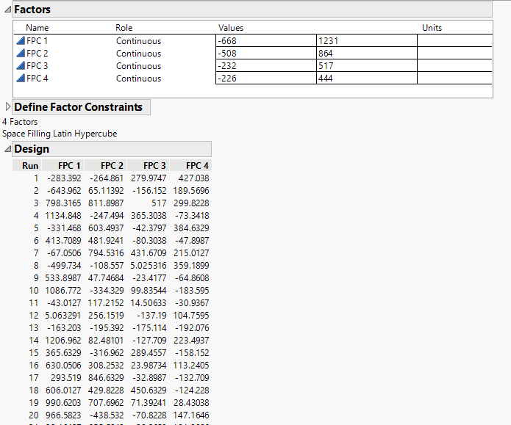
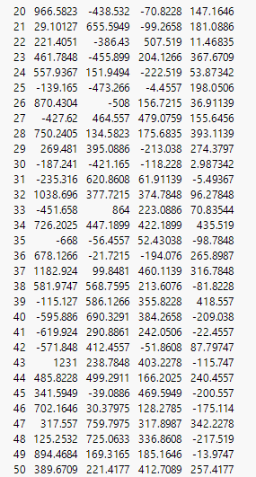
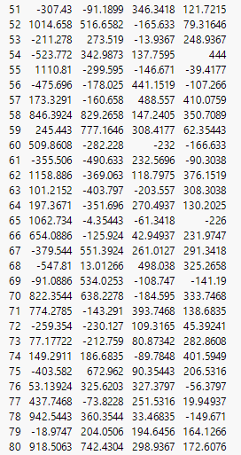
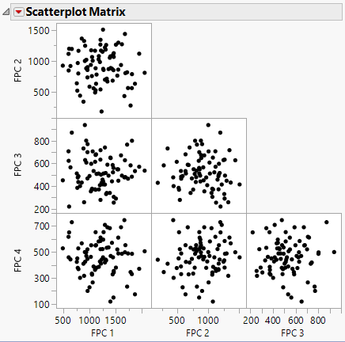
JMP 80-Run Latin Hypercube
Knowing the Functional Principle Components, we can now map the 700+ runs with a 80-run latin hypercube
This “completes the circle” showing the transform from monte carlo, to factor table/FPC, to space-filling test design.
80-run FPC Monte Carlo
80-run FPC LHD
We have the tools to work in all situations, but the latin hypercube and factor table is the best starting point

Slide 24
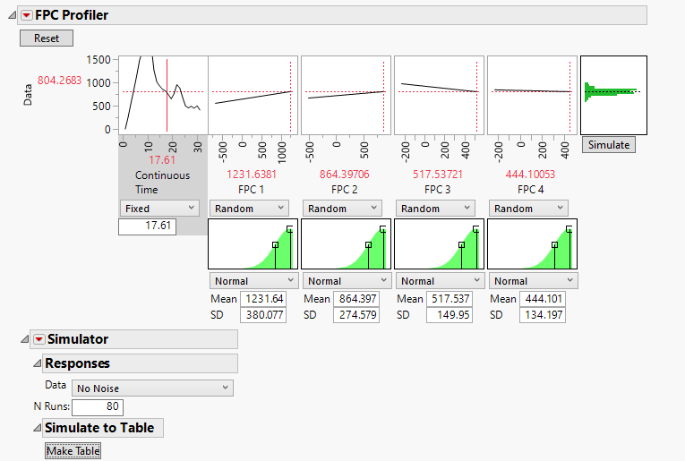
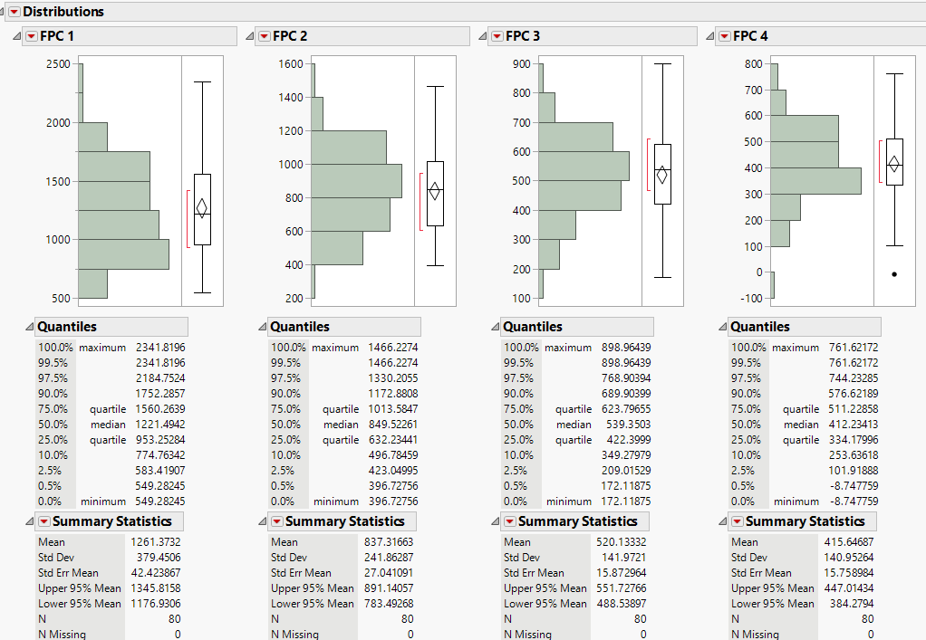
JMP: 80-run Simulator Experiment
JMP includes a “Simulator” to re-generate monte carlo using the FPC inputs. Rule of thumb: 20 runs per FPC.
Set each FPC to “random” and choose the number of runs

Slide 25
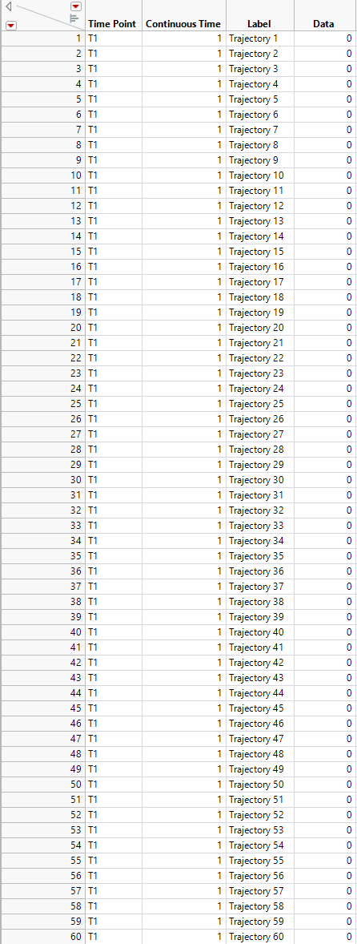
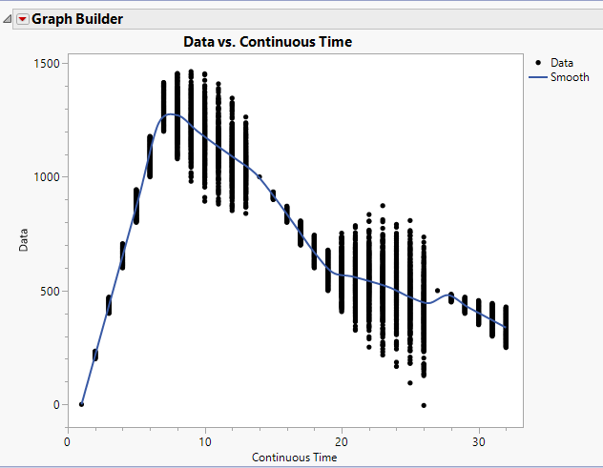
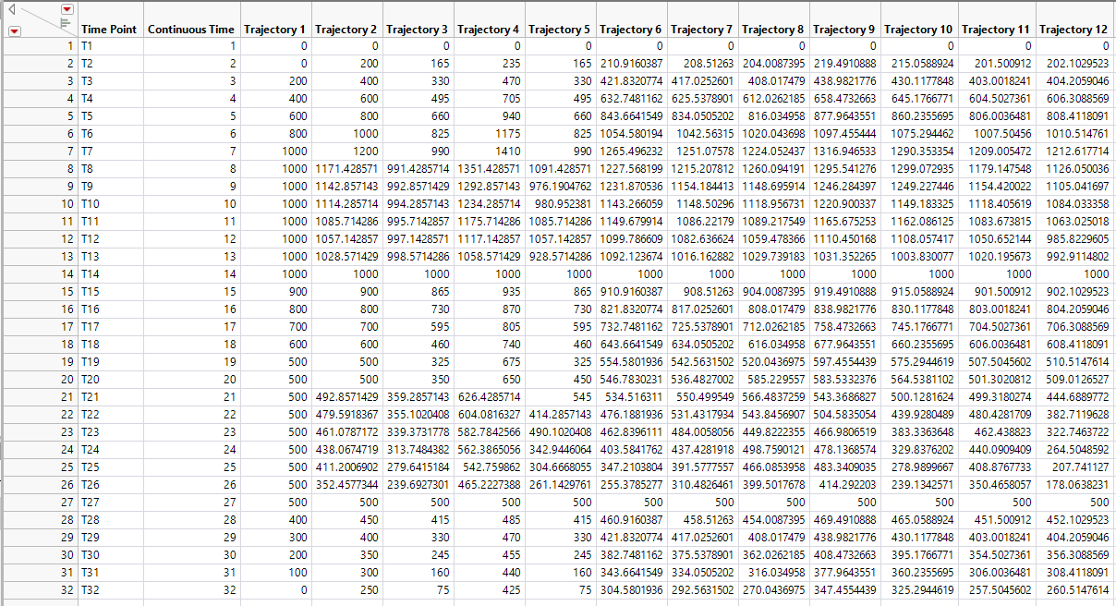
JMP: Stacking the Data
The JMP Functional Data Explorer requires an ID/Label column for each data set
Notes:
Upper left: 32 time points and trajectories

Slide 26
FDA stratified by FPC 1
Function summaries: save summaries
Save DATA
In b-spline: Save DATA
Profiler…
Spline, functional data/model, prediction
“plus sign” in data columns
Unhide shape and mean columns
Run FDA with all data
Evaluate Splines, p-splines, wavelets for best fit
23-knot B-spline was the best fit
Model Bspline with Grid range of 20 to 30 Quad and Cubic
29 quadratic 29k AIC vs 22k AIC but overfit
Stratify by DATA FPC: FPC 1; ave function summaries (0.11/0.44/0.44)
Joined by label to original data; graph with three different groups
B-Spline “save data” (upper red triangle) (Prediction and resid columns)
Copy Pred and Residual to orig file. Actual vs Predicted graph with Data, RSME, R^2 for all three groups.

Slide 27
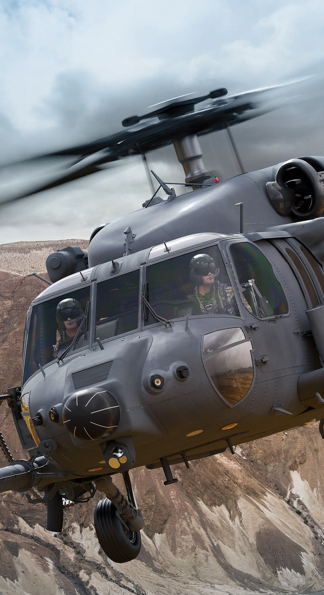
Example Trajectory Equations
Phase 1: Initial Altitude Gain = 6 Time Increments
200 foot elevation gain + WIND
Phase 2: Cruise 1 = 7 time increments
Previous Altitude – Gap to 1000 feet + CRUISE VAR*RND(-1 to 1)
Phase 3: Adjust = 5 time increments
Previous Altitude + WIND – 100 feet
Phase 4: Cruise 2 = 7 time increments
Previous Altitude – Gap to 500 feet + CRUISE VAR*RND(-1 to 1)
Phase 5: Final Approach
Previous Altitude + WIND – 50 feet

Slide 28
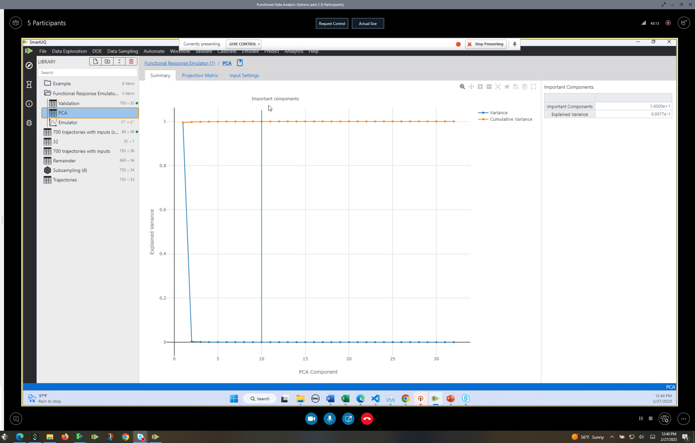
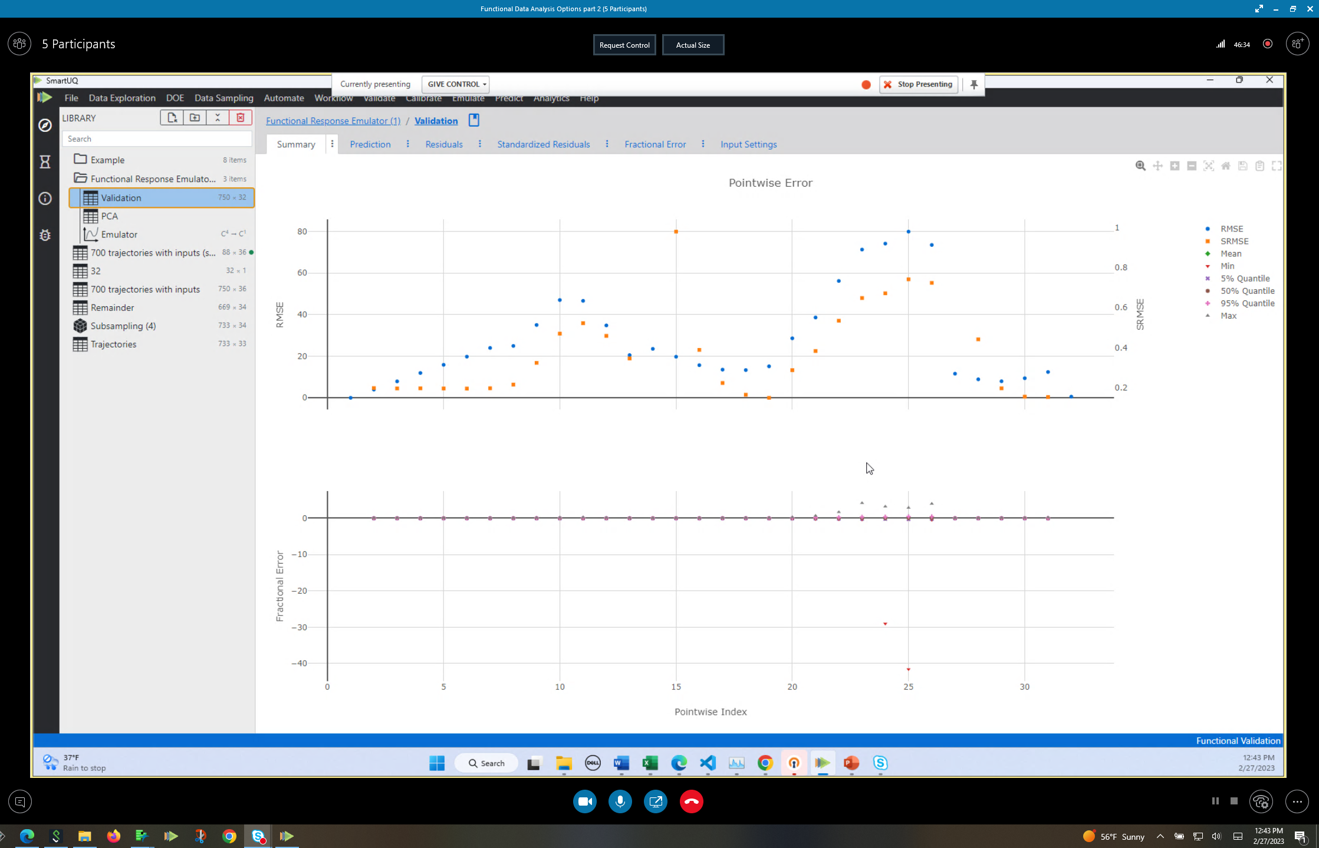
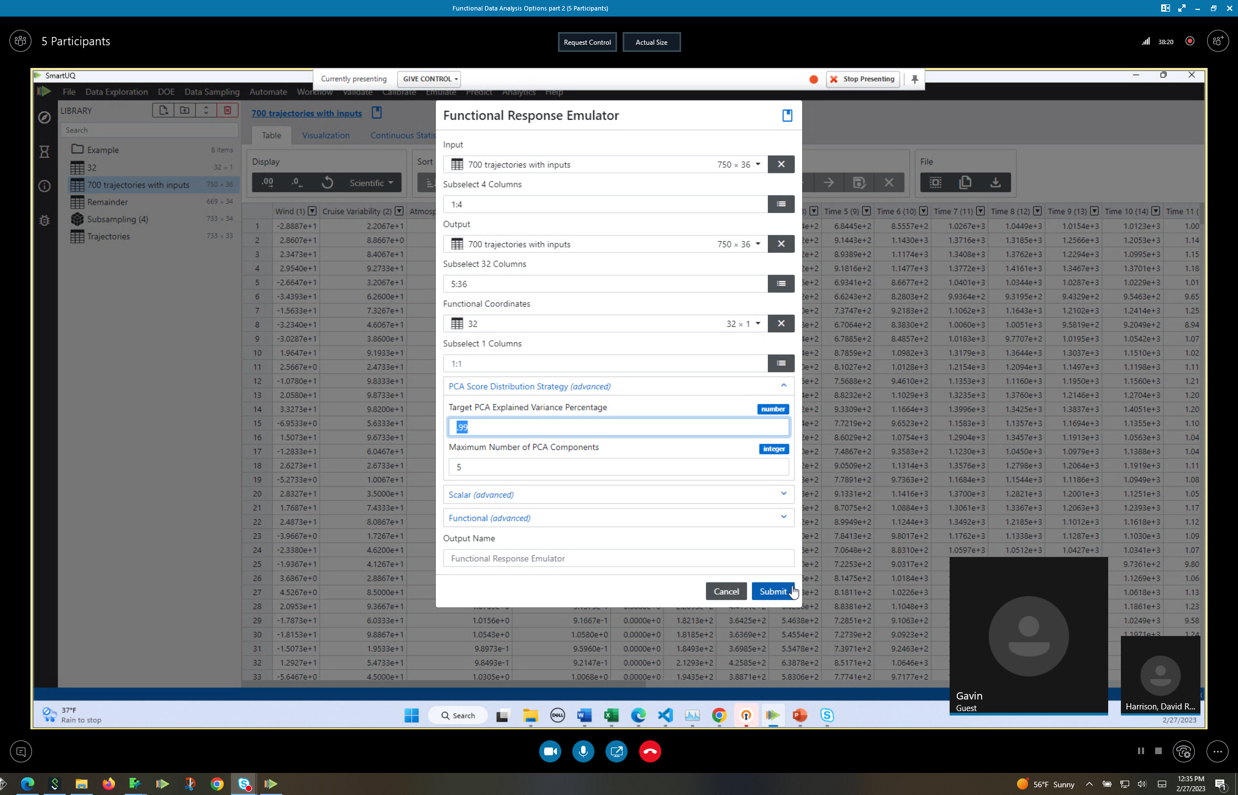
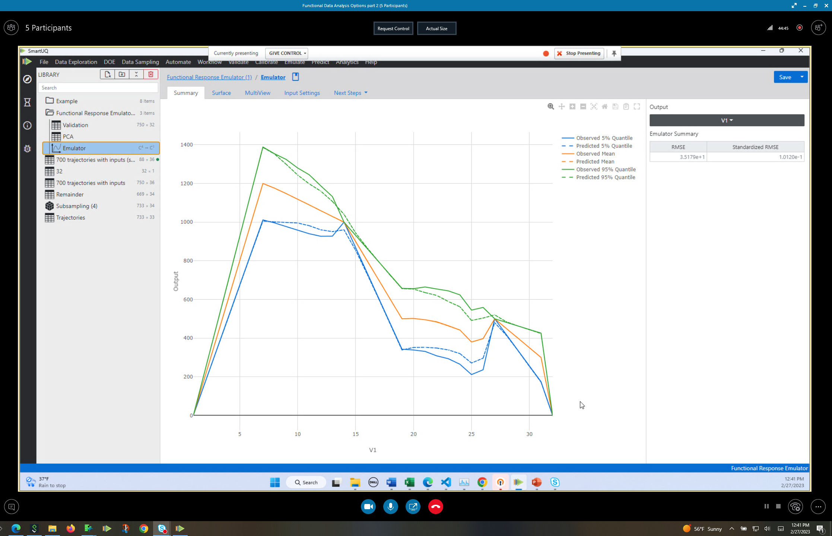

Functional response Emulator
Assess the functional fit (# components or fitting strategy
Can use a validation data set to validate—next steps validate
Start with PCA components then try kernels
Feedback on emulator accuracy: do you need more data or more runs?
Play with # of PCA components until you get best fit of dotted line and solid line

Slide 29
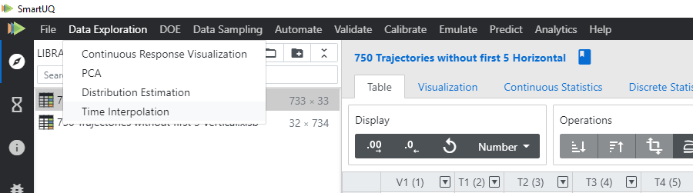
SmartUQ Time Interpolation
Assess the functional fit (# components or fitting strategy
Can use a validation data set to validate—next steps validate
SmartUQ offers a way to align inputs with a time interpolation function

Slide 30


Cover the state space preemptively
Use the 725 runs to model the trajectories and create any trajectory needed.
Reverse engineering their equation

