Slide 1
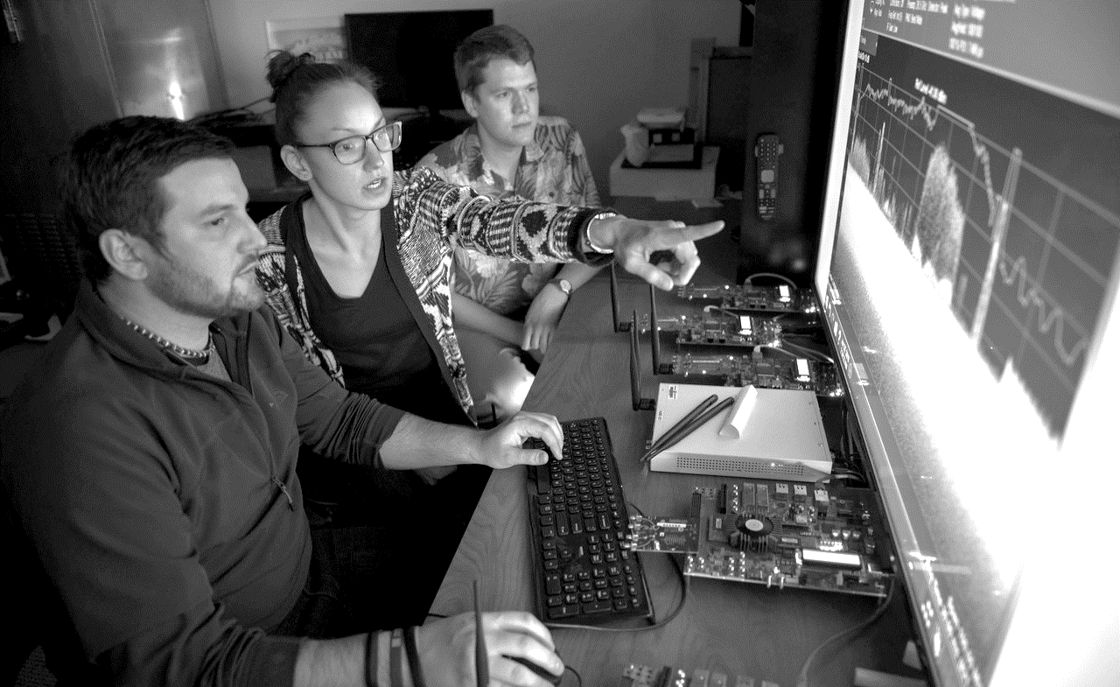



UNCLASSIFIED
Dodging Pitfalls in AI/ML Packages
DataWORKS 2023 Contributed Session
Justin Krometis| Research Assistant Professor
April 26, 2023
DISTRIBUTION STATEMENT A. Approved for public release: distribution unlimited.

Slide 2

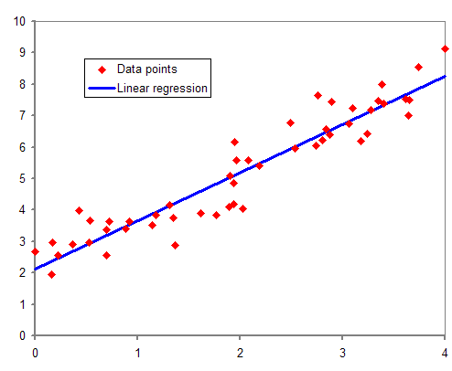

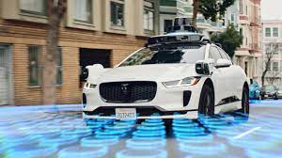
Data-Driven Models
Increased data availability and progress in algorithms and hardware have led to rise in data-driven modeling:
  Often: Given a series of inputs X and outputs Y (the data), find a model that (approximately) maps X to Y
  Common model: Neural network
Contrast to models based in, e.g., physics

Slide 3






AI/ML Packages
Readily available
Algorithms already implemented
Computationally efficient
  CPU and GPU
Large user base
Great documentation
Data-driven modeling has never been easier!

Slide 4
Issues
How do we check a data-driven model?
No physics to guide us
Limited theory
Model structure is opaque, and existing packages can make them even more so
Hyperparameters selection (typically) either requires a brute force search or is somewhat arbitrary
So it’s unclear…but this doesn’t mean it’s not important!

Slide 5
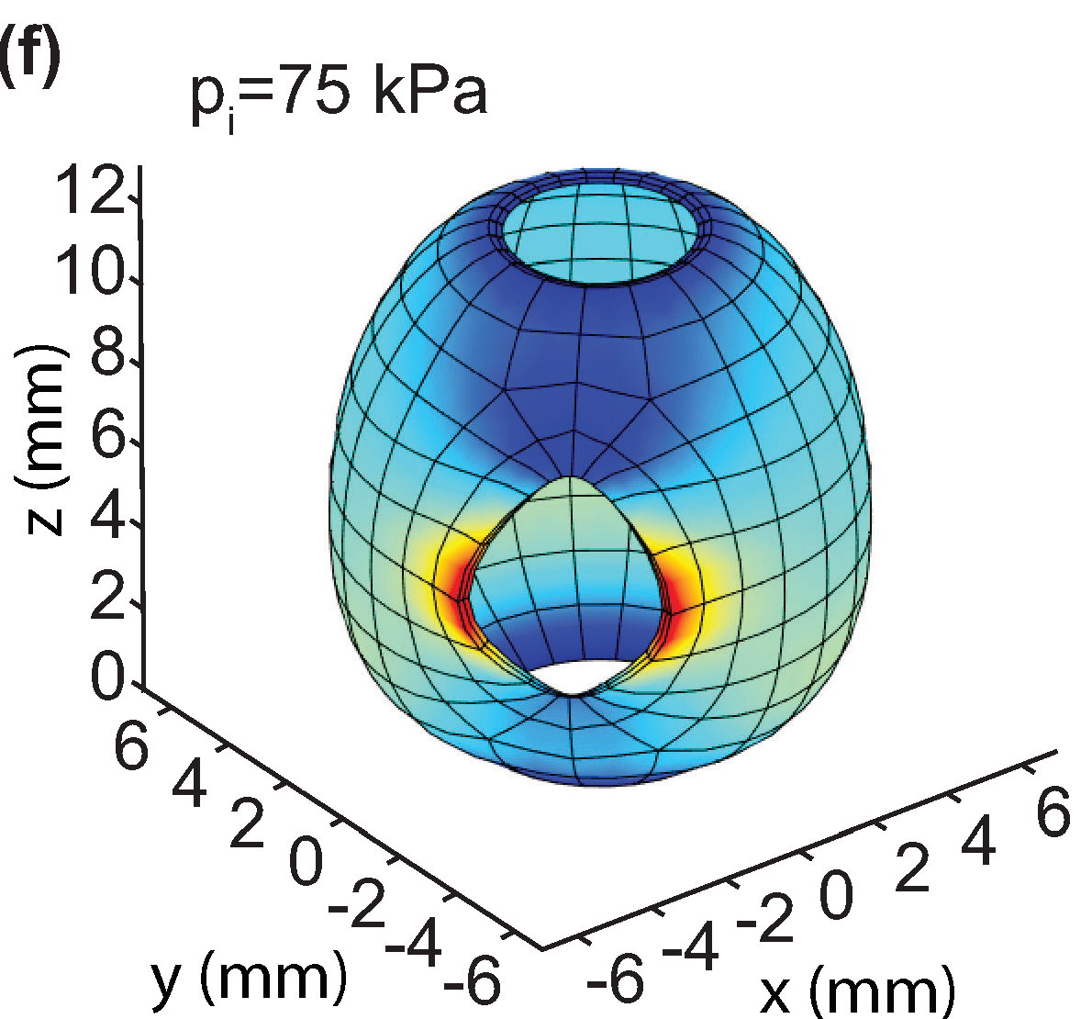
Example #1: Classic Deep Learning
Given a series of inputs X and outputs Y, find a model that maps X to Y
In this project, X and Y were from a physics-based model
  We know the true map, but it’s expensive to compute
Model chosen:
  Fully-connected deep neural network
  Play with hyperparameters (activation functions, layer
  sizes, depth) to try to find the best model
  Implementation: TensorFlow
Goal: Use ML model as cheaper surrogate model
  Compare with physics-based reduced order models (ROMs)

Slide 6
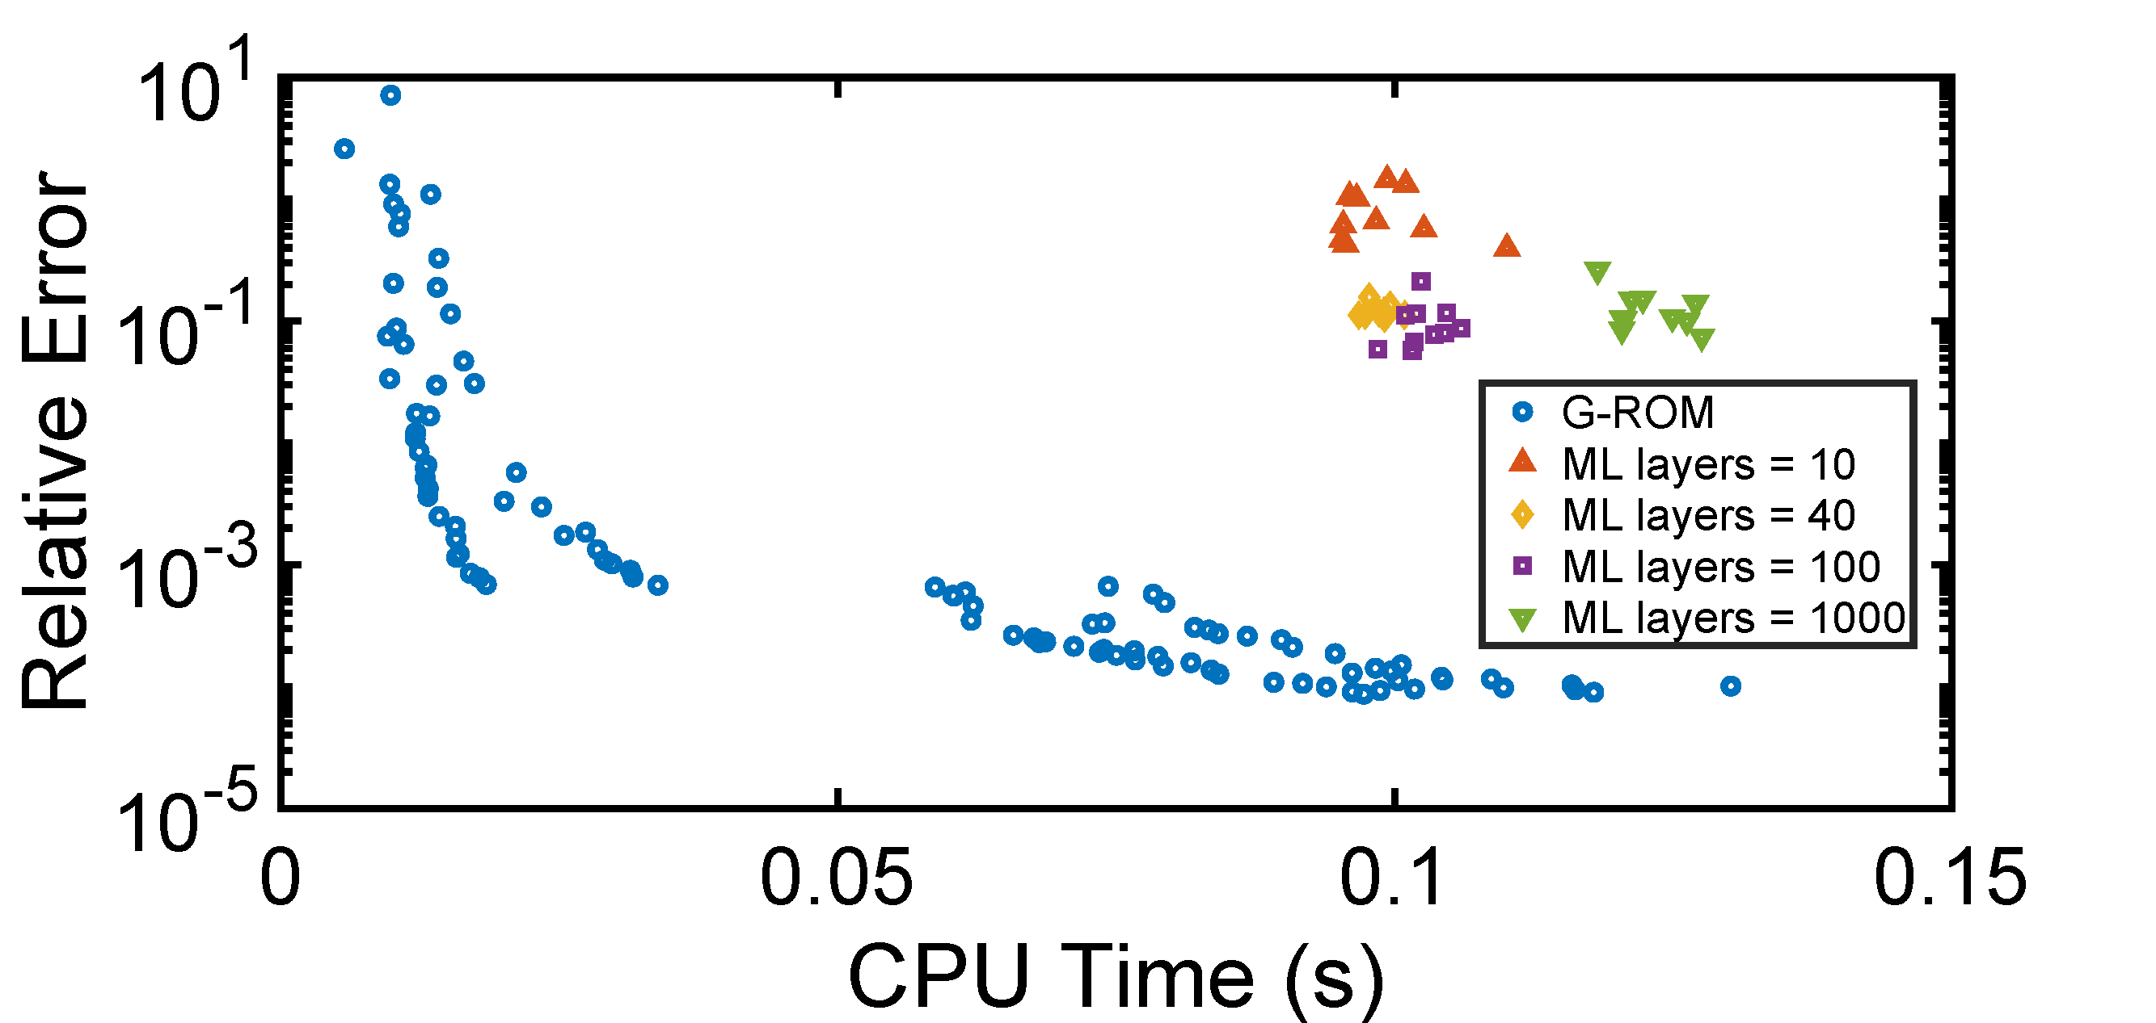
Results, Part 1
Conclusion: ML uncompetitive in either accuracy or computational cost
But why is a small ML model so computationally expensive?

Slide 7
Conclusions, Part 1
ML model is not competitive with physics-based reduced order models in either accuracy or computational cost
But…
…why is a neural network of layer size 10 so much more computationally expensive than a small matrix-multiply?

Slide 8
The Solution
TensorFlow has two types of execution:
  Eager: Evaluate each step immediately. Easier. Default in TF 2.x
  Graph: Build a computational graph. Faster. Default in TF 1.x
“TensorFlow sets the eager execution as the default option and does not bother you unless you are looking for trouble” ¹
¹ https://towardsdatascience.com/eager-execution-vs-graph-execution-which-is-better-38162ea4dbf6

Slide 9
Changing Execution Time
Eager Execution:
  pred = model.predict(x)
Graph Execution:
  model_predict = tf.function(model) #switch execution mode
  pred2 = model_predict(x)
Result:
  Mean time (s) prediction: 0.04915548801422119
  Mean time (s) of wrapped prediction: 0.002743711471557617

Slide 10
Results, Part 1 (Revisited)

Slide 11
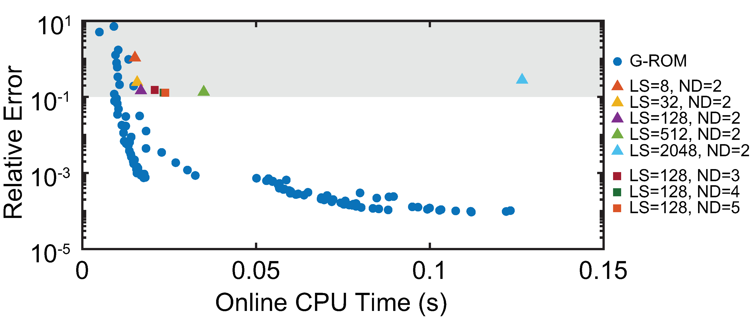
Results, Part 2
Computational Improvement:
ML competitive for small model sizes
An obscure setting (could have)
meaningfully affected our project
conclusions

Slide 12
Example 2: Reinforcement Learning
RL: Train agent(s) to maximize a reward
  Highly successful in many applications: Game playing, autonomous vehicles, etc.
Our application:
  Multi-agent RL (MARL)
  Package RLlib
  Train model and the reward seems to be improving nicely
  But when we replay the episode, some of the agents do not do what we want
  Possible causes:
    Poorly defined reward (doesn’t match what we want to see)?
    Mistake in our implementation (disconnect between inputs and outputs)?
    Mistake in our visualization (what we’re seeing doesn’t reflect underlying model)?

Slide 13
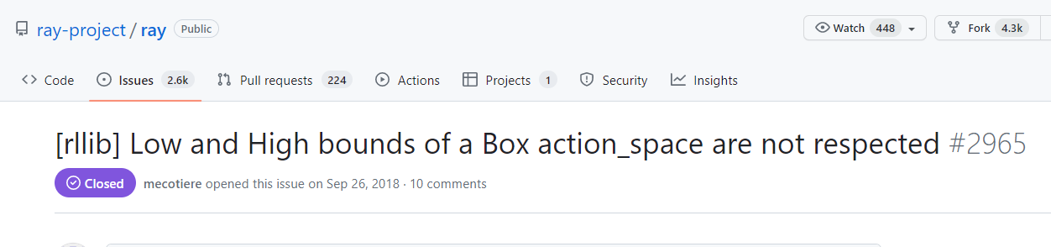
RL: Dig into details to understand
Agent actions should be between -1 and 1
When we replayed the trained model, the actions looked like:
  Agent 1: [-0.033573, -0.077042]
  Agent 2: [-0.005468, -0.105586]
  Agent 3: [ 7.379264, 60.314358]
  Agent 4: [37.62081 , 44.019726]
Why?
A software bug (these things happen) broke
our simulation. We worked around this
by generating the actions via a different
function call.

Slide 14
Example 3: Classification
Typical machine learning application (e.g., MNIST)
Our case: Given a series of images, classify them into one of two groups
Solution: Deep neural network made up of convolutional, batch normalization, max pool, and linear layers
Package used: PyTorch

Slide 15
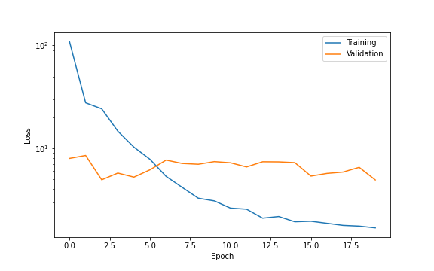
Classification Results
Training converges nicely, and fast
But validation…not so much
Normal solution:
  Problem may be too hard
  Try different models
  Tune hyperparameters

Slide 16
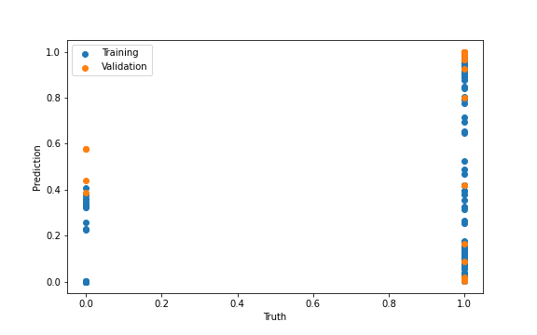
Alarm Bells
However:
  Got 118 correct out of 200 data points for 59.00% accuracy on training data.
  Got 15 correct out of 24 data points for 62.50% accuracy on validation data.
Why are these (roughly) the same?

Slide 17
Answer – Part 1
PyTorch has two model modes:
  model.train(): Used for training – computes gradients, etc
  model.eval(): Used for prediction – only computes outputs
We used train() during training and eval() for validation and post-training predictions
  This is the right way to use them!
However

Slide 18
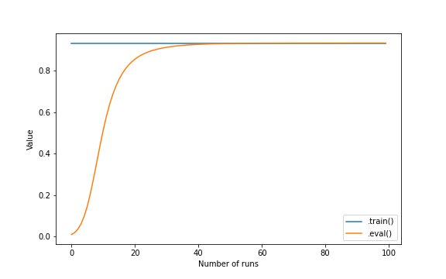
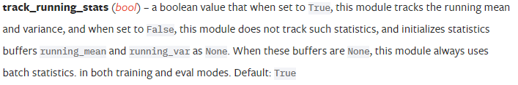
Answer – Part 2
However: BatchNorm2d layers behave differently in the two modes
And there is a setting that controls the behavior:
The default tells the layer to forget the normalization factors learned during training!

Slide 19
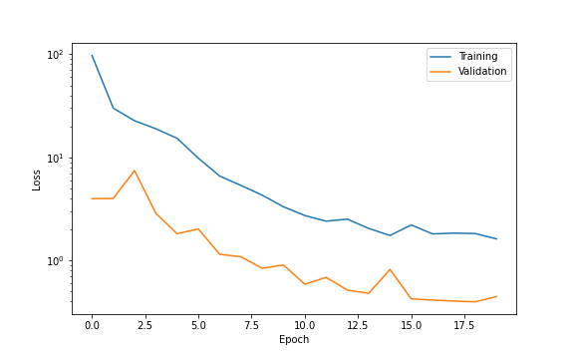
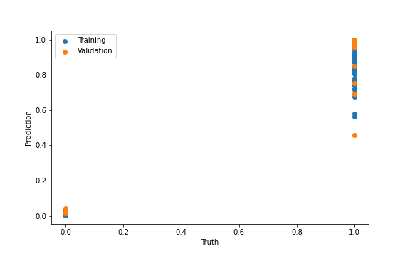
A Simple Solution
With track_running_stats=False:
Got 200 correct out of 200 data points for 100.00% accuracy on training data.
Got 23 correct out of 24 data points for 95.83% accuracy on validation data.
A (different) obscure setting drastically
reduced our model performance,
meaningfully affecting our results

Slide 20
Example 4: Same as Example 1

Slide 21
Example 4: Same as Example 1
What drives this gap?
What did we do wrong?
Answer: We think this is correct – we
tested a lot of hyperparameters.
But we can’t know for sure.

Slide 22
Conclusions
AI/ML models are powerful, but opaque
What might be wrong with them (if anything!) isn’t always clear
There can be pressure to just believe them:
  Deadlines
  Deliverables
  Publications
Testing is very important:
  Does what my model is telling me make sense?
  Have I checked it from every angle that I can think of?
If something doesn’t make sense: Dig deeper and understand why

