Slide 1
Case Study on Test Planning and Data Analysis for Comparing Time Series
Phillip Koshute
DATAWorks Conference
April 26, 2023

Slide 2
Acknowledgements
Funding from United States Army Medical Materiel Development Activity (USAMMDA)
Collaboration with Johns Hopkins University Applied Physics Laboratory (JHU/APL) Canine Thermal Model team
  Including M. Steve Rountree, Rekha Holtry, Tanya Tebcherani, and others
Input from additional JHU/APL colleagues

Slide 3
Disclaimer
This material is based upon work supported by the Department of Defense, U.S. Army Medical Materiel Development Activity (USAMMDA), Warfighter Health, Performance and Evacuation (WHPE), Mobile Health Product Management Office under Contract N00024-13-D-6400
The views expressed are those of the authors and do not necessarily reflect the policy or positions of the Department of Defense, Naval Sea Systems Command, or U.S. Government
Commercial support was not received for this activity

Slide 4
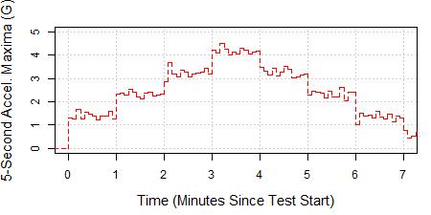
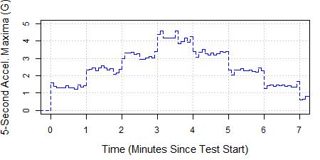
Do These Two Time Series Match?
Reference Device*
Test Device*
Complications include (1) non-aligned time stamps, (2) autocorrelation
* Data are motivated by real test results but have been simulated to more easily illustrate time series comparison methods

Slide 5
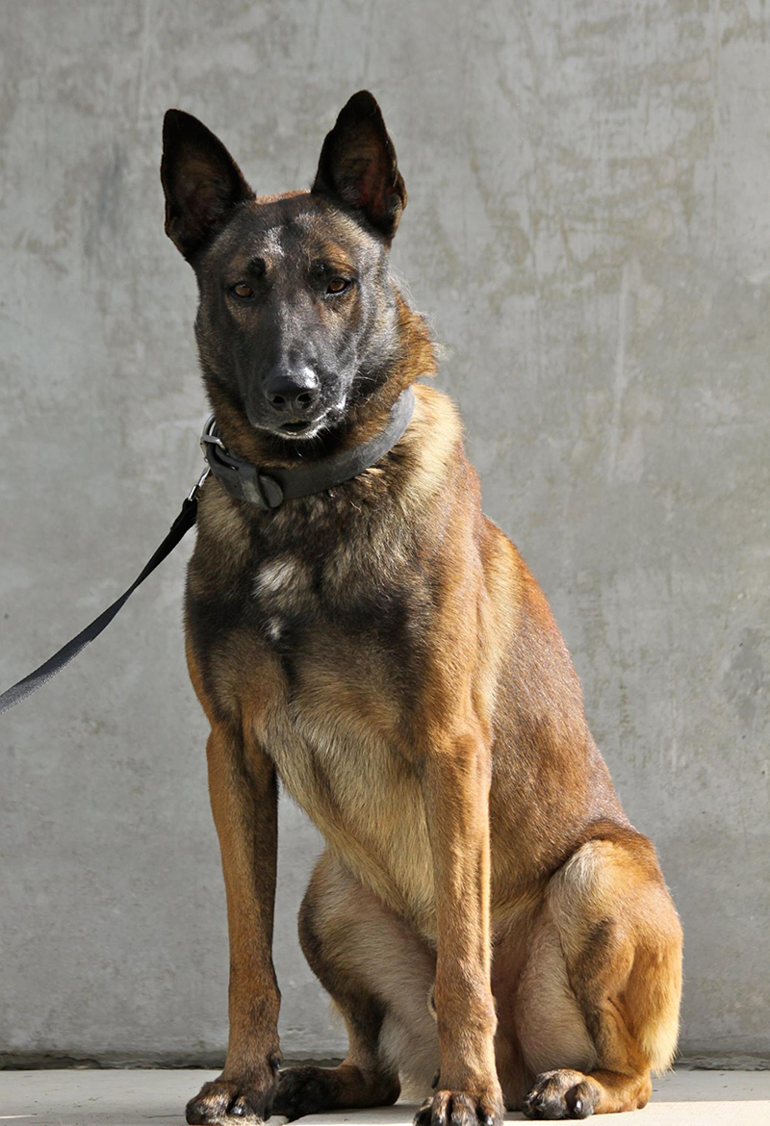
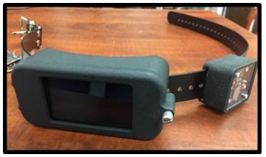
Outline
Background and motivation
Algorithm
Data
Analysis approaches
Dogs
Devices
Data
Source: https://home.army.mil/detrick/application/files/9516/5659/1003/June_Working_final.pdf
Source: https://www.defense.gov/Multimedia/Experience/Four-Legged-Fighters/
Focusing on comparing time series for Canine Thermal Model component validation

Slide 6
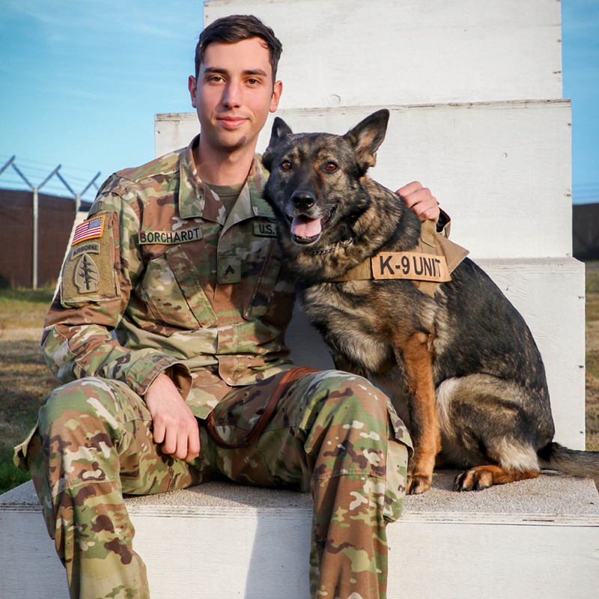
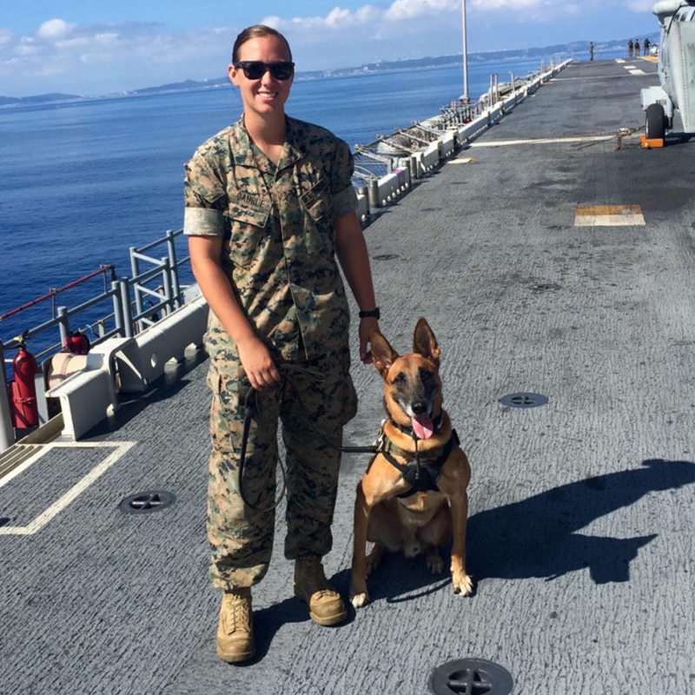
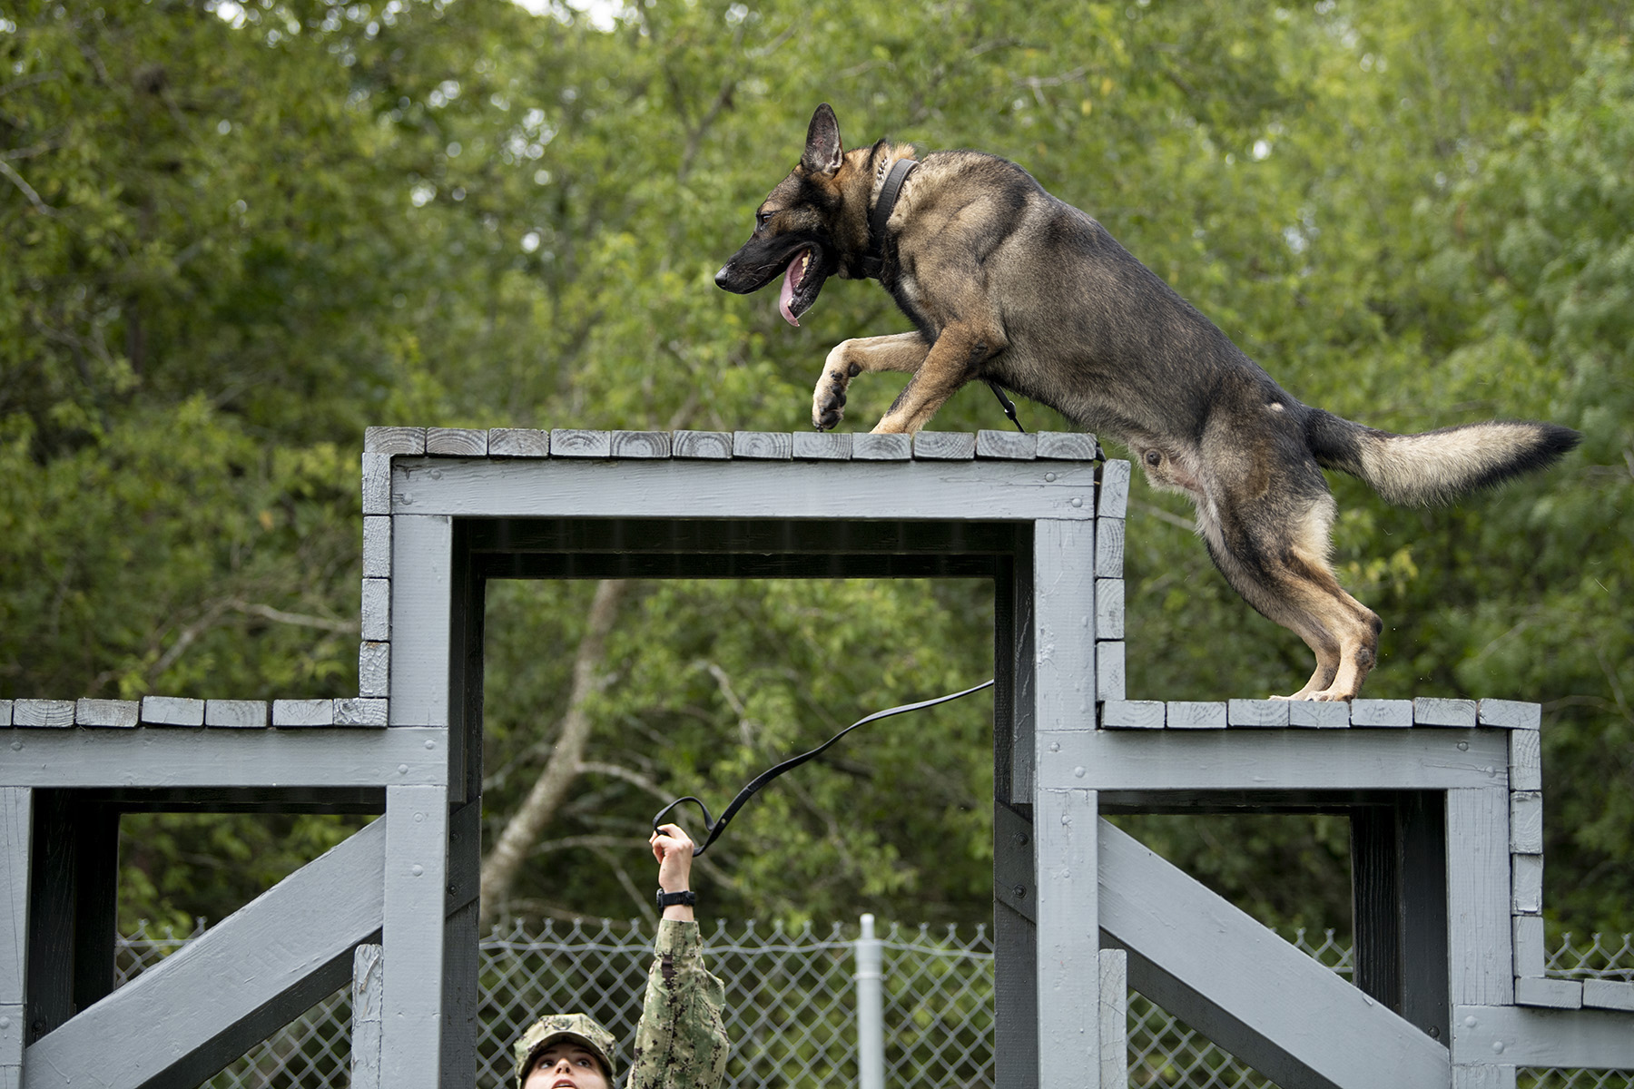
Military Working Dogs
Source: https://www.defense.gov/Multimedia/Experience/Four-Legged-Fighters/
Military working dogs (MWDs) provide key support in a variety of missions
Notes:
Data to be analyzed come from a device that support military working dogs, which support a variety of missions

Slide 7
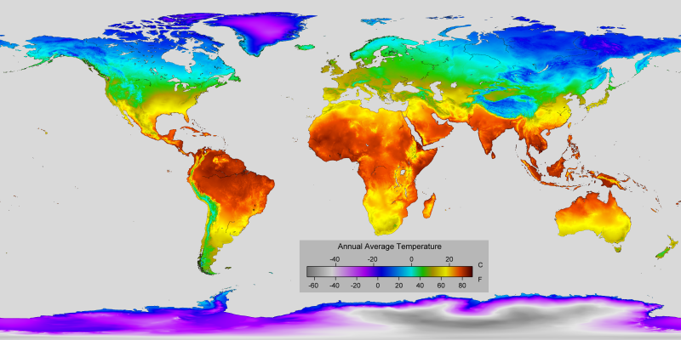
Potential Temperature Strain
Source: https://commons.wikimedia.org/wiki/File:Annual_Average_Temperature_Map.png
Many MWD missions take place in hot places

Slide 8
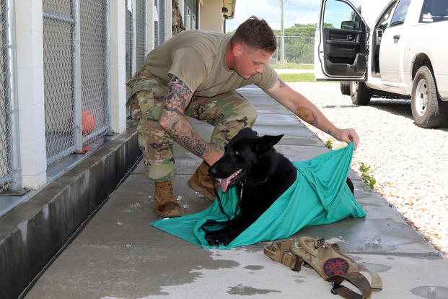
Risk and Cost of Overheating
Quickly increasing MWD core temperature during high-temperature missions
Risk of MWD heatstroke or death
Handlers’ keen observations of their dog’s wellbeing made more difficult during intense missions
Source: https://www.military.com/off-duty/summer-heat-army-vet-tips-keeping-pets-cool
Preventing MWD heat injury is critical for MWD survival and continued mission support
Notes:
In high-temperature missions, MWD can get hot and potentially overheat
Overheated MWD can die or suffer heatstroke, preventing them from serving
Handlers generally have a keen sense of their dog’s wellbeing, but heatstroke monitoring during a mission can be more challenging

Slide 9
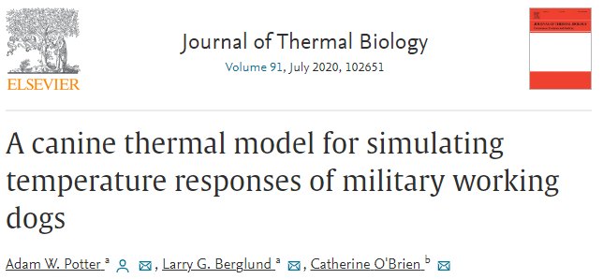
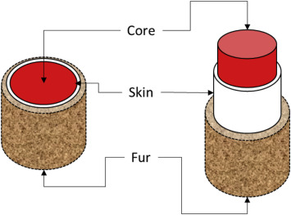

Canine Thermal Model
Predicts MWD core temperature under various conditions
Based on thermo-physiological principles
Incorporates environmental factors and metabolic activity
Developed by United States Army Research Institute of Environmental Medicine (USARIEM)
Source: Potter, Adam W., Larry G. Berglund, and Catherine O'Brien. "A canine thermal model for simulating temperature responses of military working dogs." Journal of Thermal Biology 91 (2020): 102651.
Canine Thermal Model (CTM) helps to anticipate MWD overheating and plan cool-down

Slide 10
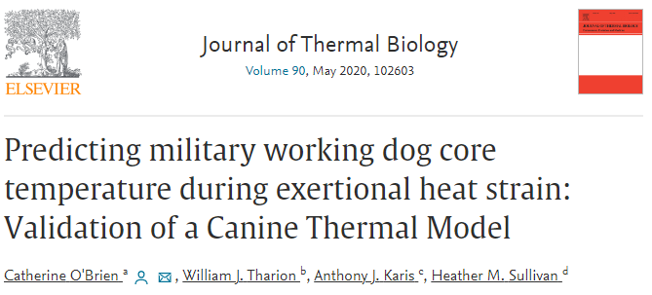
Estimating Metabolic Activity from Acceleration
Metabolic ratio (MET) found to be a crucial model input during high-intensity scenarios
Findings confirmed by both field test data and simulations
MET estimated by variation in acceleration; provides a potential surrogate for invasive MWD monitoring
Algorithm leverages real-time MWD acceleration measurements
MET = 10*SD + 1 (computed each minute)
SD = standard deviation of acceleration magnitude within a five-second interval, averaged over each minute
Source: O'Brien, Catherine, et al. "Predicting military working dog core temperature during exertional heat strain: Validation of a Canine Thermal Model." Journal of Thermal Biology 90 (2020): 102603.
Acceleration Variation → Metabolic Activity → Estimated Core Temperature Change

Slide 11
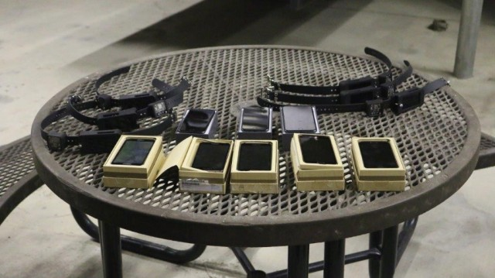
Model Implemented as Wearable Device
Device sensors: accelerometer, environmental sensors
Android-based user interface
Wireless connection from device worn on MWD to handler’s smart phone
Current form factor: device worn as dog collar
Sponsored by United States Army Medical Materiel Development Activity
Initially implemented by MIT Lincoln Laboratory
Advanced development and deployment preparation led by Johns Hopkins University Applied Physics Lab (JHU/APL)
Source: https://www.army.mil/article/238740/canine_thermal_monitor_mobile_application_and_collar_operational_assessment

Slide 12
Efficient Device Testing
JHU/APL refining and rigorously testing CTM device prior to deployment
Primary assessment and validation of overall system from field tests with MWDs wearing devices
  Substantial time costs
  Missed training opportunities for MWDs
Making efficient use of field test opportunities by first testing individual components in-house
  Environmental testing
  Shaker table accelerometer testing
Device development / model implementation
Simulation studies
Environmental testing
Accelerometer testing
Field test assessments
In-house component tests provide preliminary assurance prior to field tests

Slide 13
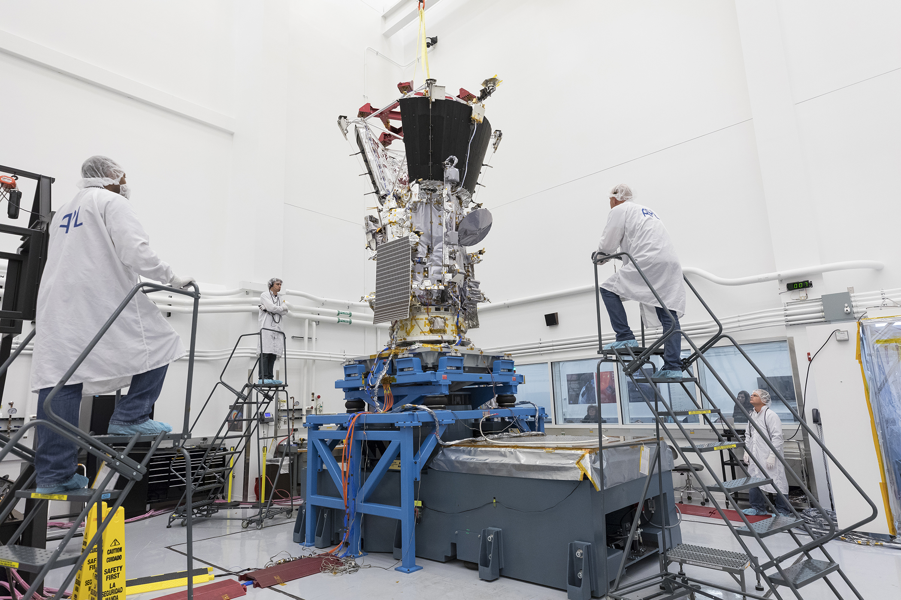
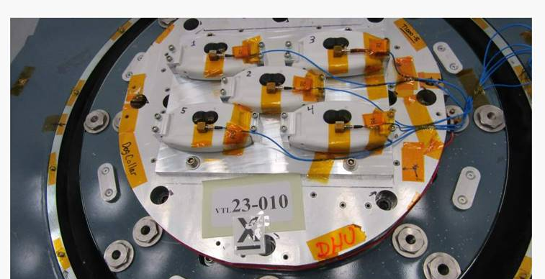
Shaker Table Accelerometer Testing
Shaker Table
Electrodynamic shaker table
Accelerometer subjected to specified acceleration profile
High-frequency sinusoidal variations in acceleration
Each CTM device paired with a reference accelerometer
  Acceleration measured separately on CTM device and reference accelerometer
  Values from reference accelerometer regarded as “ground truth”
  Possible non-alignment in timestamps
Source: http://parkersolarprobe.jhuapl.edu/News-Center/Show-Article.php?articleID=50
Devices on Shaker Table
CTM accelerometers validated by comparing values with reference accelerometers’ measurements

Slide 14
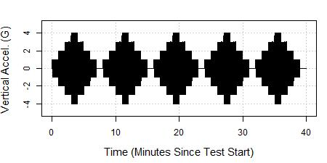
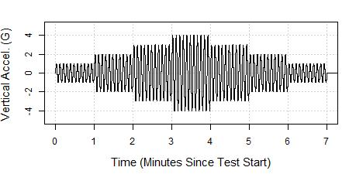
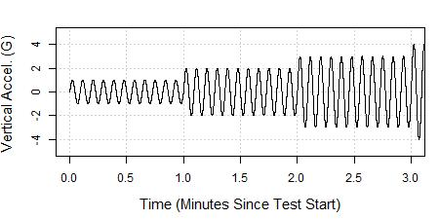
Specified Acceleration Profile
Base Pattern – repeated 5 times
Acceleration in vertical dimension only
Sinusoidal base pattern with “steps’ of different maximum amplitude
Base pattern repeated multiple times to increase collected data
Base Pattern
Base Pattern – first 3 minutes

Slide 15
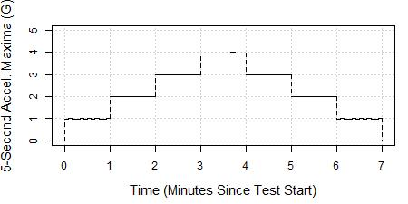
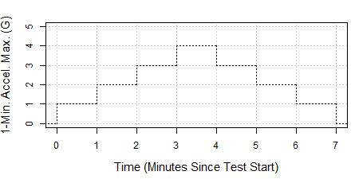
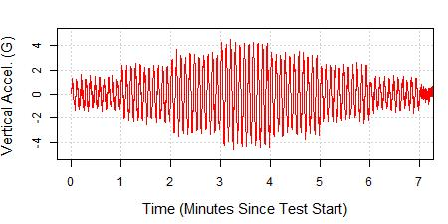
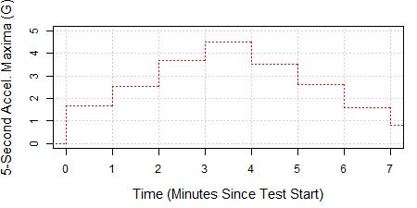
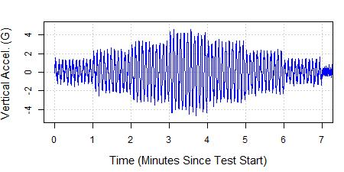
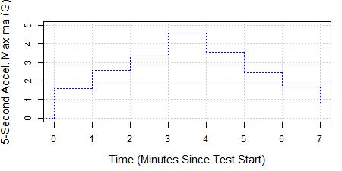
Acceleration Test Data (Simulated)
Raw Values
5-Second Maxima
1-Minute Maxima
Specified Profile
Simulated Ref. Device
Simulated CTM Device
Specified base pattern repeated five times – these plots include the first repetition
Data are motivated by real test results but have been simulated to more easily illustrate time series comparison methods

Slide 16
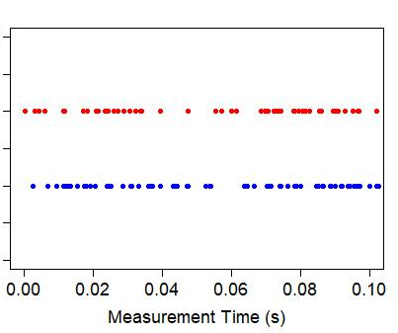
Complication #1: Non-aligned Time Stamps
Example of Time Stamps from Simulated Acceleration Measurements
Reference Accelerometer Measurement Times
No guarantee that accelerometers will measure acceleration at same time points
Prevents direct comparison of raw data
CTM Accelerometer Measurement Times
Non-aligned time stamps complicate direct comparison of the two accelerometers’ data

Slide 17
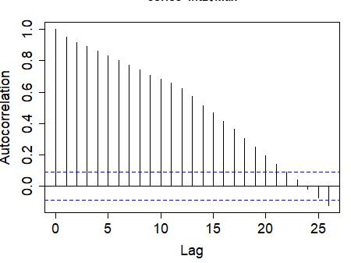
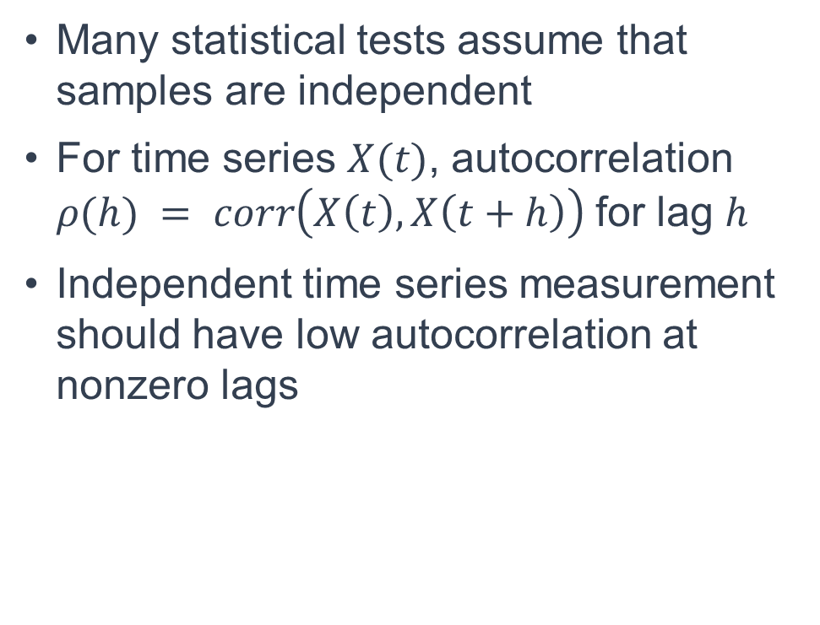
Complication #2: Autocorrelation
Autocorrelation for CTM 5-Second Maxima
Many statistical tests assume that samples are independent
For time series $X(t)$, autocorrelation $ρ(h) = corr\left(X\left(t\right), X\left(t+h\right)\right)$for lag $h$
Independent time series measurement should have low autocorrelation at nonzero lags
High autocorrelation values at nonzero lags indicate strong temporal dependence
Questionable results from statistical tests assuming independence, given high autocorrelation

Slide 18
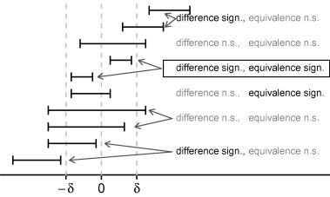
Testing for Difference vs. Equivalence
Results for Difference vs. Equivalence Tests
Potentially weaker conclusions from hypothesis tests of differences
Subjective thresholds required for equivalence tests
sign. = test result is statistically significant
n.s. = test results not statistically significant
Source: Meyners, Michael. "Equivalence tests–A review." Food quality and preference 26.2 (2012): 231-245.

Slide 19
Analysis Considerations
Possible Attempts
Unpaired t-test with raw data
Paired t-test of 5-second maxima
Paired t-test of 1-minute maxima
One-sample t-test of absolute differences of 1-minute maxima
(Paired) Wilcoxon signed rank test of 1-minute maxima
Equivalence test of 1-minute maxima
Kolmogrov-Smirnov 2-sample test of distributions of values
Unpaired vs. paired tests
Tests of raw data vs. binned data
Assumptions of hypothesis tests
Tests of difference vs. equivalence
Point comparisons vs. distributions comparisons
Hypothesis tests vs. exploratory analysis

Slide 20
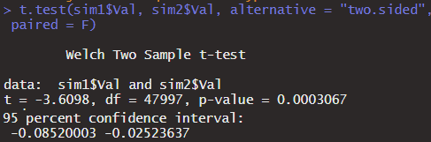
Attempt #1: Unpaired t-Test of Raw Values
Test
Results
p = 0.0003 → strong evidence that difference in means is not zero
Simulated Ref. Device
vs.
Considerations (* = assumed by test)
Simulated CTM Device
Independent data* | No
Normal distribution* | No
Equal variance* | Yes
Reflects paired data | No
Shows equivalence | No
Utilizes all available data | Yes
H0: difference in means = 0
Difference in means = -0.055
Utilizes all available data — but fails to incorporate simultaneous measurement

Slide 21
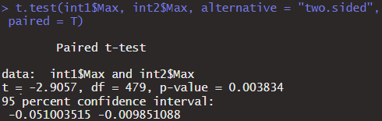
Attempt #2: Paired t-Test of 5-Second Maxima
Test
Results
Simulated Ref. Device
p = 0.004 → strong evidence that mean difference is not zero
vs.
Simulated CTM Device
Considerations (* = assumed by test)
Independent data* | No
Normal distribution* | No
Equal variance* | Yes
Reflects paired data | Yes
Shows equivalence | No
H0: mean difference = 0
Mean difference = -0.030
Reflects simultaneous measurement — but falsely assumes independent data

Slide 22
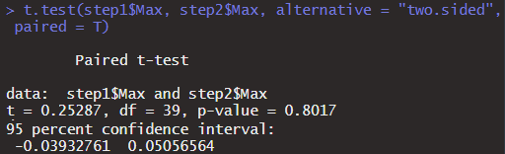
Attempt #3: Paired t-Test of 1-Minute Maxima
Test
Results
Simulated Ref. Device
p = 0.802 → no evidence that mean difference is not zero
vs.
Simulated CTM Device
Considerations (* = assumed by test)
Independent data* | Yes
Normal distribution* | No
Equal variance* | Yes
Reflects paired data | Yes
Shows equivalence | No
H0: mean difference = 0
Mean difference = -0.006
Autocorrelation reduced — but would fail to detect differences of alternating signs

Slide 23
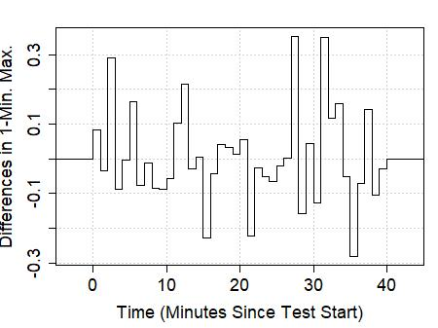
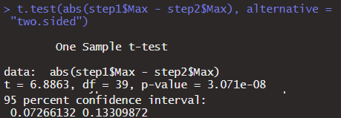
Attempt #4: One-Sample t-Test of Abs. Differences
Test
Results
p = 10⁻⁸ → strong evidence that mean absolute difference is not zero
Considerations (* = assumed by test)
Independent data* | Yes
Normal distribution* | No
Reflects paired data | Yes
Shows equivalence | No
Utilizes all available data | No
H0: mean absolute difference = 0
Mean absolute difference = 0.103
Assesses absolute differences — but falsely assumes normally distributed data

Slide 24
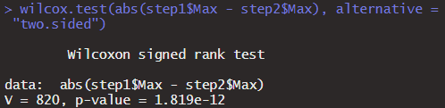
Attempt #5A: Wilcoxon Test of Absolute Differences
Test
Results
p = 10⁻¹² → strong evidence that mean absolute difference is not zero
Considerations (* = assumed by test)
Independent data* | Yes
Reflects paired data | Yes
Shows equivalence | No
Utilizes all available data | No
H0: mean absolute difference = 0
Mean absolute difference = 0.103
Doesn’t require assuming normality — but may not show equivalence

Slide 25
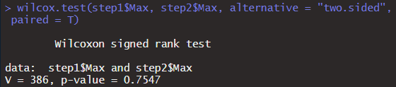
Attempt #5B: Paired Wilcoxon Test of 1-Minute Max.
Test
Results
Simulated Ref. Device
p = 0.754 → no evidence that mean difference is not zero
vs.
Simulated CTM Device
Considerations (* = assumed by test)
Independent data* | Yes
Equal variance* | Yes
Reflects paired data | Yes
Shows equivalence | No
Utilizes all available data | No
H0: mean difference = 0
Mean difference = -0.006
Doesn’t require assuming normality — but may not show equivalence

Slide 26
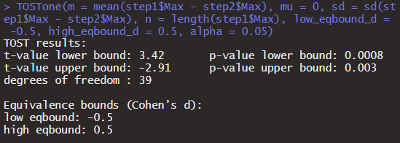
Attempt #6: Paired Equivalence Test of 1-Min. Max.
Test
Results
Simulated Ref. Device
p < 0.003 → evidence that mean difference is within set equiv. bounds
vs.
Simulated CTM Device
Considerations (* = assumed by test)
Independent data* | Yes
Reflects paired data | Yes
Shows equivalence | Yes
Utilizes all available data | No
H0: mean difference < -0.5 SD or mean difference > 0.5 SD
Mean difference = -0.006
Directly checks for equivalence — but doesn’t utilize all available data

Slide 27
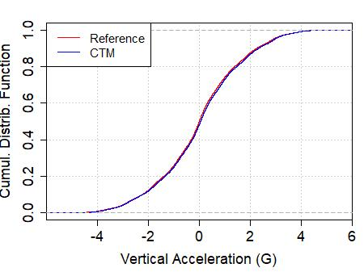
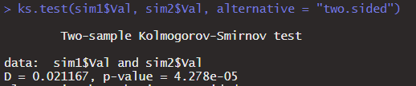
Attempt #7: Comparison of Distribution
Test
Results
p = 10⁻⁵ → strong evidence that samples are not from same distributions
Considerations (* = assumed by test)
Reflects paired data | No
Shows equivalence | No
Utilizes all available data | Yes
H0: accelerometers’ samples of measured values come from the same distribution
Utilizes all available data — but fails to incorporate simultaneous measurement

Slide 28
Comparison of Analysis Options
Data | Raw values | 5-second maxima | 1-minute maxima | Abs. diff. of 1-min. maxima | Abs. diff. of 1-min. maxima | 1-minute maxima | 1-minute maxima | Raw values
Test | Unpaired t-test | Paired t-test | Paired t-test | 1-sample t-test | 1-sample WSR test | Paired WSR test | Paired equiv. test | K-S test
Satisfies Independent Data Assumption |  |  | ✓ | ✓ | ✓ | ✓ | ✓ | N/A
Satisfies Normality Assumption |  |  |  |  | N/A | N/A |  | N/A
Reflects Paired Data |  | ✓ | ✓ | ✓ | ✓ | ✓ | ✓
Could Detect Differences of Alternating Signs |  |  |  | ✓ | ✓
Shows Equivalence |  |  |  |  |  |  | ✓
Utilizes All Available Data | ✓ |  |  |  |  |  |  | ✓
Test Result Supporting Similar Time Series? | No | No | Yes | No | No | Yes | Yes | No
WSR = Wilcoxon Signed Rank, K-S = Kolmogorov-Smirnov

Slide 29
Test Planning with Power Analysis
Power Analysis for Paired t-Test with 1-Minute Maxima
Targeted Power | Significance Level | Standard Deviation / Mean Ratio | Number of Samples Needed | Profiles Needed
0.95 | 0.05 | 2 | 54 | 8
0.95 | 0.1 | 2 | 45 | 7
0.9 | 0.05 | 2 | 44 | 7
0.9 | 0.1 | 2 | 36 | 6
0.8 | 0.05 | 2 | 34 | 5
0.8 | 0.1 | 2 | 27 | 4
Since we obtain 1 sample for each maximum amplitude step and there are 7 steps per profile, we need to run the profile 4-8 times
Recommended sample count varies with targeted power, desired significance level, and assumed standard deviation
Power = P(detecting significant difference | significant difference actually present)
= 1 – P(Type II error) = 1 – P(fails to reject a null hypothesis that is actually false)
Power analysis aids planning by guiding how many times to run the acceleration profile

Slide 30
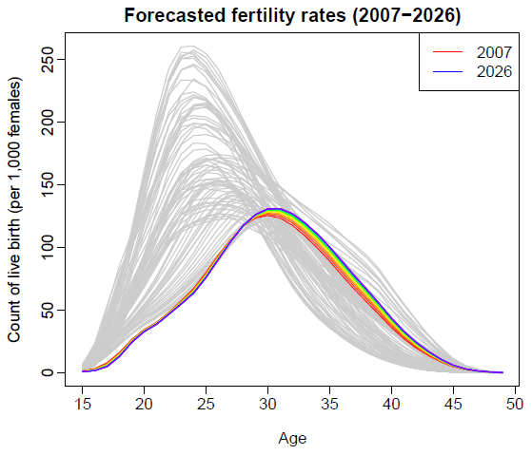
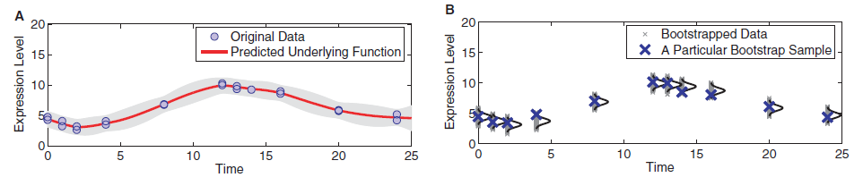
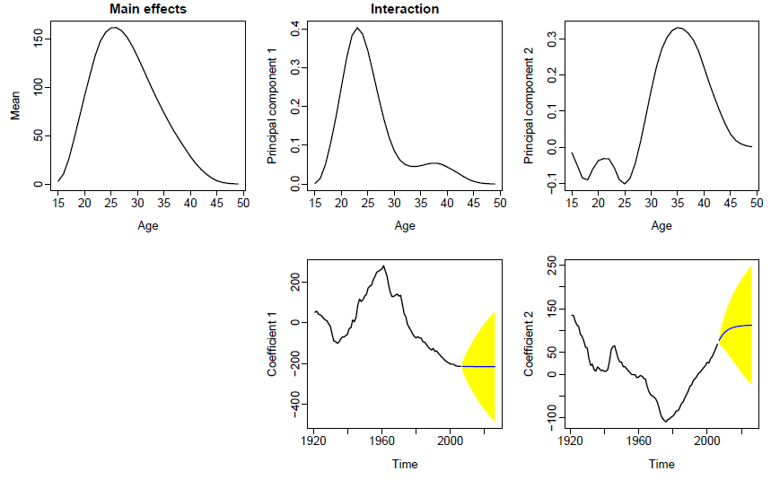
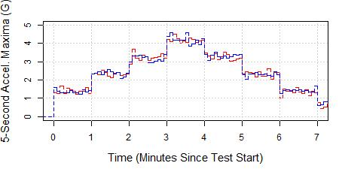
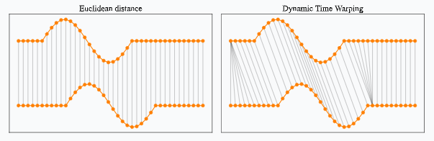
Additional Approaches
Functional Data Analysis
Bootstrapping
Source: https://openresearch-repository.anu.edu.au/handle/1885/196579
Source: Kirk, Paul DW, and Michael PH Stumpf. "Gaussian process regression bootstrapping: exploring the effects of uncertainty in time course data." Bioinformatics 25.10 (2009): 1300-1306.
Correlation
Dynamic Time Warping
Source: https://rtavenar.github.io/blog/dtw.html

Slide 31
Closing Thoughts
MWD core temperature estimates from canine thermal model (CTM) based on acceleration and environmental conditions
JHU/APL validating MWD-worn device through in-house component testing (including accelerometers)
Want to check if CTM acceleration values “matches” reference accelerometer
Various options for comparing these two time series
Ultimately need to balance test applicability, validation priorities, and statistical power
Recommend searching for consensus among candidate analysis approaches
Source: https://www.defense.gov/Multimedia/Experience/Four-Legged-Fighters/
We welcome suggestions on the best way to compare time series!

Slide 33
Submitted Abstract
Several years ago, the US Army Research Institute of Environmental Medicine developed an algorithm to estimate core temperature in military working dogs (MWDs). This canine thermal model (CTM) is based on thermophysiological principles and incorporates environmental factors and acceleration. The US Army Medical Materiel Development Activity is implementing this algorithm in a collar-worn device that includes computing hardware, environmental sensors, and an accelerometer. Among other roles, Johns Hopkins University Applied Physics Laboratory (JHU/APL) is coordinating the test and evaluation of this device.
The device’s validation is ultimately tied to field tests involving MWDs. However, to minimize the burden to MWDs and the interruptions to their training, JHU/APL seeks to leverage non-canine laboratory-based testing to the greatest possible extent.
For example, JHU/APL is testing the device’s accelerometers with shaker tables that vertically accelerate the device according to specified sinusoidal acceleration profiles. This test yields time series of acceleration and related metrics, which are compared to ground-truth measurements from a reference accelerometer.
Statistically rigorous comparisons between the CTM and reference measurements must account for the potential lack of independence between measurements that are close in time. Potentially relevant techniques include downsampling, paired difference tests, hypothesis tests of absolute difference, hypothesis tests of distributions, functional data analysis, and bootstrapping.
These considerations affect both test planning and subsequent data analysis. This talk will describe JHU/APL’s efforts to test and evaluate the CTM accelerometers and will outline a range of possible methods for comparing time series.

