Slide 1
Test and Evaluation of AI Cyber Defense Systems
April 26, 2023
Shing-hon Lau
DATAWorks 2023

Slide 2
Copyright 2023 Carnegie Mellon University.
This material is based upon work funded and supported by the Department of Defense under Contract No. FA8702-15-D-0002 with Carnegie Mellon University for the operation of the Software Engineering Institute, a federally funded research and development center.
The view, opinions, and/or findings contained in this material are those of the author(s) and should not be construed as an official Government position, policy, or decision, unless designated by other documentation.
NO WARRANTY. THIS CARNEGIE MELLON UNIVERSITY AND SOFTWARE ENGINEERING INSTITUTE MATERIAL IS FURNISHED ON AN "AS-IS" BASIS. CARNEGIE MELLON UNIVERSITY MAKES NO WARRANTIES OF ANY KIND, EITHER EXPRESSED OR IMPLIED, AS TO ANY MATTER INCLUDING, BUT NOT LIMITED TO, WARRANTY OF FITNESS FOR PURPOSE OR MERCHANTABILITY, EXCLUSIVITY, OR RESULTS OBTAINED FROM USE OF THE MATERIAL. CARNEGIE MELLON UNIVERSITY DOES NOT MAKE ANY WARRANTY OF ANY KIND WITH RESPECT TO FREEDOM FROM PATENT, TRADEMARK, OR COPYRIGHT INFRINGEMENT.
[DISTRIBUTION STATEMENT A] This material has been approved for public release and unlimited distribution. Please see Copyright notice for non-US Government use and distribution.
This material may be reproduced in its entirety, without modification, and freely distributed in written or electronic form without requesting formal permission. Permission is required for any other use. Requests for permission should be directed to the Software Engineering Institute at permission@sei.cmu.edu.
Carnegie Mellon® is registered in the U.S. Patent and Trademark Office by Carnegie Mellon University.
DM23-0403

Slide 3
Intersection of AI and cyber
Methodology for test and evaluation of AI cyber defenses

Slide 4
Intersection of AI and cyber
AI for defending cyber systems
Network defense, endpoint protection, malware detection
AI for attacking cyber systems
Decision support, automating of portions of attacks
Cyber defense for AI systems
AI is ultimately just software on a computer
Cyber offense against AI systems
Identifying code, models, data, etc., after owning AI box
Adversarial AI / ML
Attack an AI system through cleverly selected valid inputs
Cyber attacks for adversarial AI effects
E.g., buffer overflows to realize adversarial AI attacks

Slide 5
Thinking about AI systems
Consider AI at several levels:
the model level
the system level
the mission level
Gaining an understanding of AI at a system or mission level provides more accurate insights, but is considerably more difficult
Mission
System
Model

Slide 6
AI for defending cyber systems
Network defense
Use network traffic to determine malicious activity
Endpoint behavior detection
Observe local execution to determine malicious activity
Malware detection
E.g., Heuristic-based anti-virus or anti-malware
More on this later…

Slide 7

AI for attacking cyber systems
Decision support for red teams
Automated and semi-automated tools for well-defined activities
Continuous automated red teaming
Researchers have developed proofs of concept of machine learning or AI-based malware
It looks like you’re trying to hack a system…

Slide 8
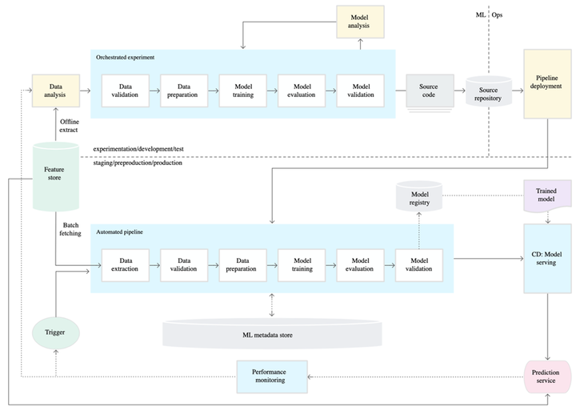
Cyber defense for AI systems
AI systems are software running on computers
Data is a first-order concept in machine learning systems
Control of data can allow attacker to have arbitrary control of system behavior
Use of AI expands the attack surface
https://insights.sei.cmu.edu/blog/a-hitchhikers-guide-to-ml-training-infrastructure/

Slide 9

Cyber offense against AI systems
What do you steal when you own the AI box?
How do you identify key AI components?
What information is revealed by stolen materials?
Neutral network architecture
Pre-trained models
Code
Fully trained models
Training data
Testing data
Training parameters
Documentation

Slide 10
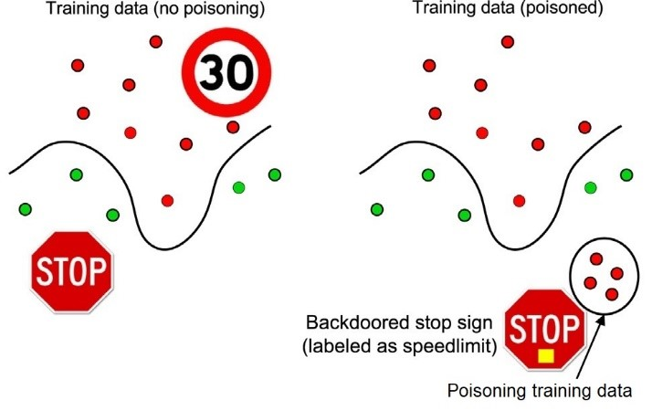
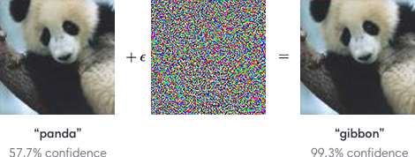
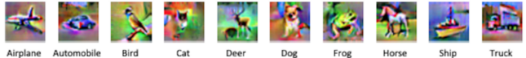
Adversarial AI and ML
Do the wrong thing https://openai.com/blog/adversarial-example-research/
Learn the wrong thing
https://smartcities.ieee.org/newsletter/june-2021/explainable-machine-learning-for-secure-smart-vehicles
Reveal the wrong thing
https://gab41.lab41.org/robust-or-private-model-inversion-part-ii-94d54fd8d4a5

Slide 11
Adversarial AI and ML
What does adversarial AI and ML look like for network data, static binary analysis, dynamic binary analysis, firmware, etc.?
What are the data sources?
What are the right set of features and architectures for cyber domains?
How can red teams or adversaries map ML feature level changes back to a cyber domain while respecting constraints, e.g.,
Cyber attacks must still be effective
Executables must be valid and must execute with correct effect
Firmware must not brick devices

Slide 12
Cyber attacks for adversarial AI effects
Cyber attacks are often treated as orthogonal to adversarial AI
An adversarial AI attack can be the objective of a cyber attack:
Insert a backdoor into an ML model by introducing poisoned data into the ML dataloader process during training
Cause misclassifications of test samples by adding adversarial noise during testing
Common AI software is typically research-quality code, with plenty of security flaws

Slide 13
Intersection of AI and cyber
Methodology for test and evaluation of AI cyber defenses

Slide 14
AI for defending cyber systems
Network defense
Use network traffic to determine malicious activity
Endpoint behavior detection
Observe local execution to determine malicious activity
Malware detection
E.g., Heuristic-based anti-virus or anti-malware

Slide 15
Organizations are turning to AI-powered network defenses
There is a significant shortage of qualified cybersecurity staff
The US has a shortfall of 700k+ cybersecurity staff (https://www.cyberseek.org/heatmap.html)
AI can act as significant force multiplier
AI can address “easy” alerts, freeing human analysts to handle harder problems
AI may be able to catch complex threats that may elude analyst detection (e.g., SolarWinds)
Cyber attacks can be so rapid that human response is impractical
NotPetya attack took down an entire Ukrainian bank in 45 seconds
Human reaction to the threat is slow; the damage can be irreversible

Slide 16
Test and evaluation of AI defenses
AI defenses pose a test and evaluation challenge unlike those posed by traditional cybersecurity defenses
Organizations might need to evaluate tools in a black-box or gray-box environment, without direct access to the innards of the defense
AI defense designers intend for systems to learn from their network environment, necessitating creation of a realistic testbed
Designers intend for defenses to learn and change over time, so a singular evaluation is insufficient
Adversarial manipulation can fool AI defenses, creating vulnerabilities an adversary may exploit

Slide 17
Creating a testing and evaluation methodology
Based on the identified challenges, our methodological approach:
Creates a realistic network environment where an AI defense can be deployed
Populates the network environment with sufficiently realistic background traffic to allow the AI to learn
Tests AI defense performance against realistic cyber attacks
Tests AI defense performance when exposed to adversarial manipulation
Tooling development to expedite and partially automate testing

Slide 18
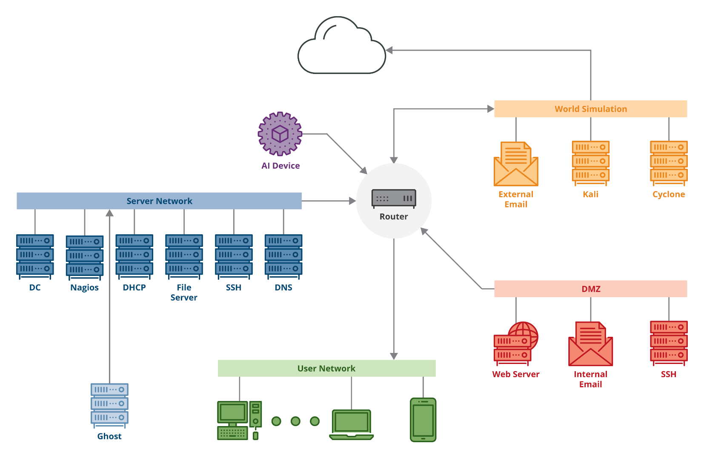
Creating a network environment

Slide 19
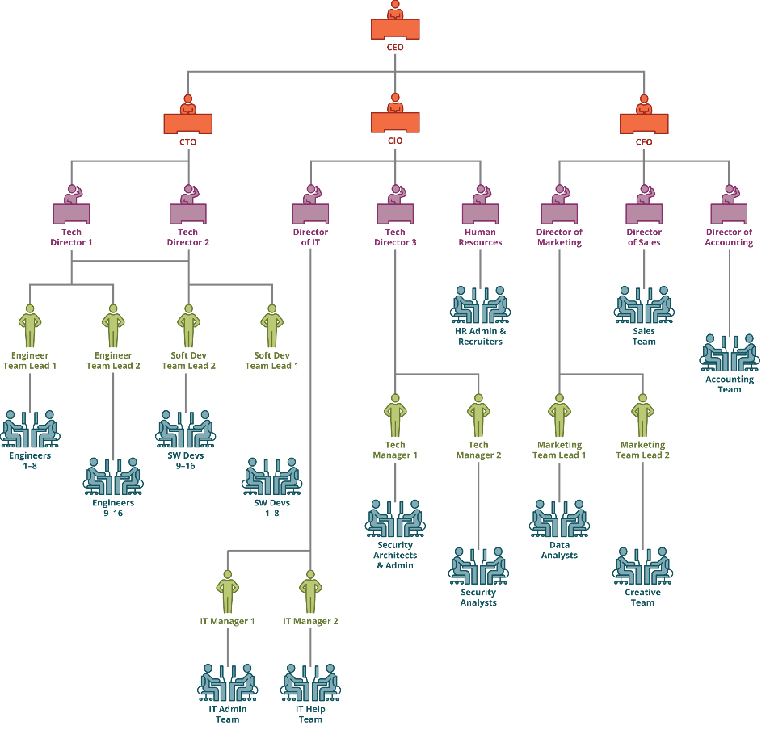
Simulating realistic user behavior (background traffic)
99 employees split across 5 divisions
We provided a unique behavior for each user
Customized work schedules
Role-specific work tasks
Hobbies that influence personal use
We set privileges and access by role
Traffic results from simulated behavior–it is not directly simulated

Slide 20
Realistic network user behaviors
SEI GHOSTS software used as the foundation of network traffic generation (available on public GitHub repository)
GHOSTS was initially designed to create realistic background traffic to support cyber training exercises
We repurposed it to run indefinitely to generate background traffic on our network
GHOSTS permits definition of a user’s behavior throughout the day using “timelines”
Developed timeline generator that permits fine-grained control of user behavior on a day-to-day basis. This can be customized for each user

Slide 21
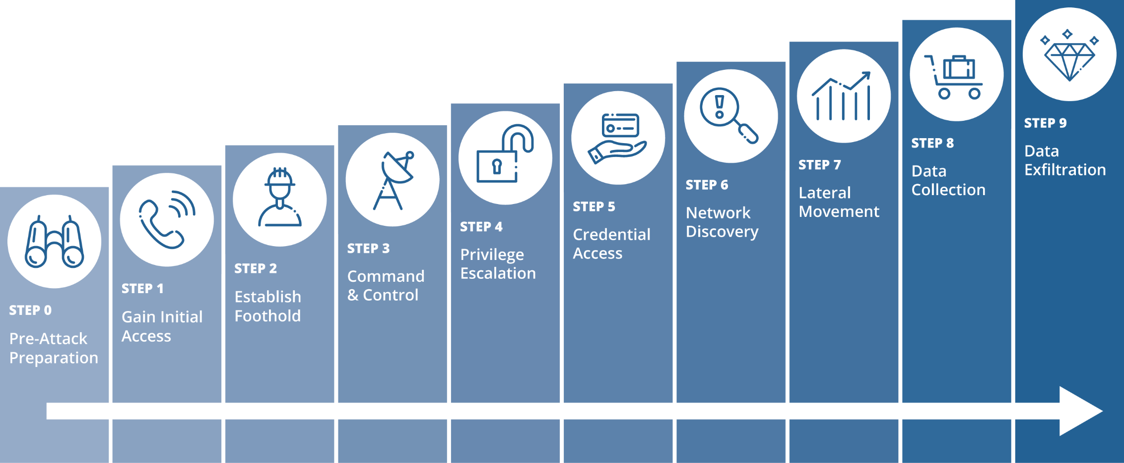
Testing with meaningful cyberattacks (malicious traffic)

Slide 22
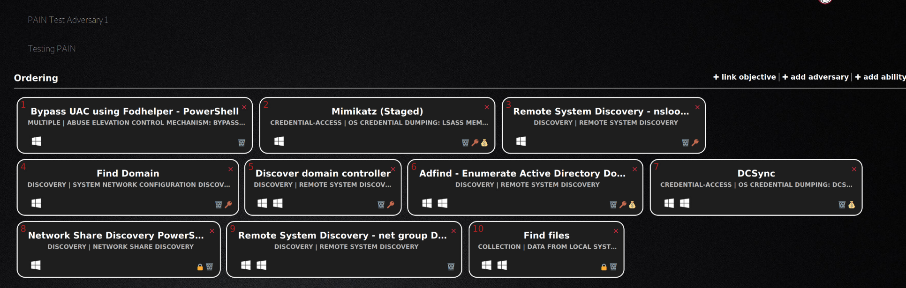
Automated testing (MITRE CALDERA)

Slide 23
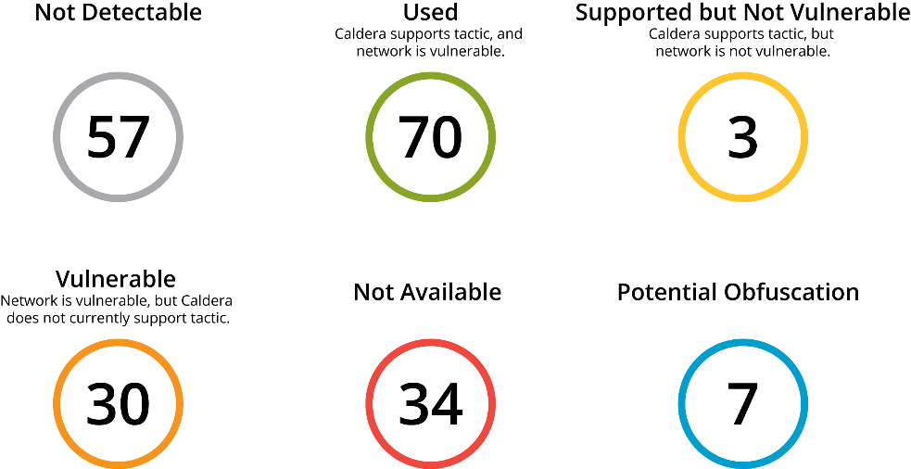
Cyber attack test coverage
We have mapped our cyber attack test suite to the MITRE ATT&CK framework
Not all attacks with the ATT&CK framework are detectable by the types of AI defenses we consider
A total of 70 techniques are covered so far in our methodology

Slide 24
Test cases
Four meaningful cyberattacks were defined and implemented using the functionality in CALDERA and using publicly-available knowledge and tools:
Creation of a domain administrator account
Creation of a local administrator account
Disabling a public-facing webserver
Exfiltration of user files
Tests were performed in a baseline condition and obfuscated conditions
An initial test was performed, followed by a test after one month

Slide 25
Looking ahead
Testbed improvements
Collect sensor data to facilitate other avenues of research, particularly involving adversarial machine learning
Create a more “modern” test network that is likely closer to what was envisioned when designing AI defenses
Improved automation
Automation at the “above-VM” level to facilitate more types of cyberattacks with minimal human intervention and to offer coordination with blue-team results
Accommodating replay traffic
Results on the best simulated data are no substitute for results using real data
Increasing the set of test attacks
The broader the set of test attacks, the more we understand AI defense capabilities

Slide 26
Dr. Shing-hon Lau
slau@sei.cmu.edu
U.S. Mail
Software Engineering Institute
4500 Fifth Avenue
Pittsburgh, PA 15213-2612 USA
Website
https://www.sei.cmu.edu/contact-us/index.cfm

