Slide 1

Introducing Self-Validated Ensemble Models (SVEM) – Bringing Machine Learning to DOEs
Chris Gotwalt, JMP
Phil Ramsey, Univ. New Hampshire
Trent Lemkus, Univ. New Hampshire

Slide 2


INTRODUCING SVEM
Most DoE analysis in industry still based on Least Sq. & ANOVA
Machine learning has made great strides, still little impact on DoE analysis. More accurate models lead to more rapid innovation in less time and lower cost.
SVEM (Self Validating Ensemble Models) was developed to bring machine learning predictive accuracy improvements to small datasets
SVEM is inspired by random forests/bagging , but uses the fractionally weighted bootstrap rather than resampling
Notes:
I am going to introduce the idea of self-validating ensemble modeling or SVEM. I am going to keep it fairly, basic. I’ll assume that you have some experience of design and analysis of experiments. Most importantly, you should understand that the statistical modeling process boils down to fitting functions to data that predict a response variable as a function of input variables.
At a high level, SVEM is bridge between machine learning algorithms used in big data applications and design of experiments. Machine learning and DOE each have a long history, but until now they were somewhat separate traditions.
Our research indicates that you can get more accurate models, using fewer observations using SVEM. This means that product and process improvement can happen in less time, using fewer resources. So, if you are in a competitive business environment where being the first to market is critical, then you may want to hear what we have to say. We believe SVEM has tremendous promise in the pharma/biotech industries, high-technology like semiconductor manufacturing, and in the development of consumer products.
In my role as a research and development director for JMP I have something of a birds-eye view of how data is handled in a lot of industries and areas of application. I have developed algorithms for constructing optimal designed experiments, as well as related analysis procedures like mixed models and generalized linear models. On the other hand, I am also the developer of JMP Pro’s neural network algorithms as well as some of the other machine learning techniques that are in the product.
Over the last twenty years I’ve seen machine learning become more prominent when modeling large observational and observed as many exciting new algorithms have been developed.
At the same time, the analysis of designed experiments also changed, incrementally over the last 20 years. However, the overall statistical methodology of industrial experimentation would be recognizable to anyone that read Box, Hunter, and Hunter in the 1970s.
Machine learning and design of experiments are generally applied in industry to solve problems that are predictive in nature. Is the sensor data indicating a faulty batch? How do we tweak the product so that we maximize yield while minimizing cost?
Although they are both predictive in nature, machine learning and design of experiments are applied to rather different types of data. What am going to do now is give a quick overview of both. Then I’ll escribe how we have blended them into SVEM. I’ll analyze data from some real experiments to show how it works and why we think it is doing very well.
Then I’ll go over the results of simulations done by Trent Lemkus at the university of new Hampshire and then discuss open questions and next steps in the research that needs to be followed up on.

Slide 3
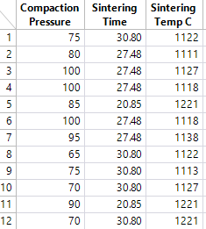


MACHINE LEARNING 101
$$f(pressure, time,temp)$$

Slide 4
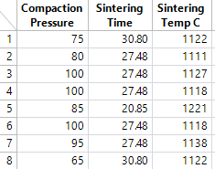



MACHINE LEARNING 101
Fit models to the training set
Assess models using the validation set

Slide 5
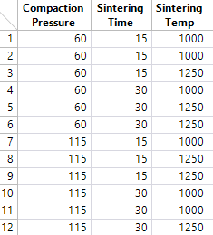


DOE MODELING 101
$$f(pressure, time,temp)$$

Slide 6
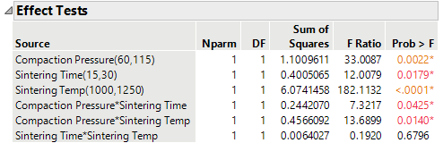
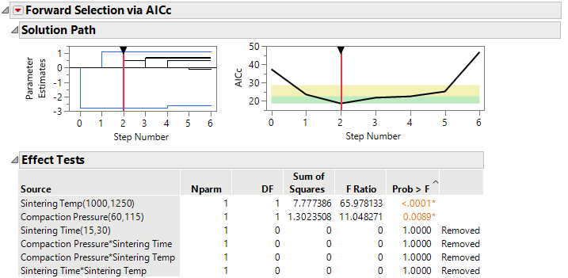
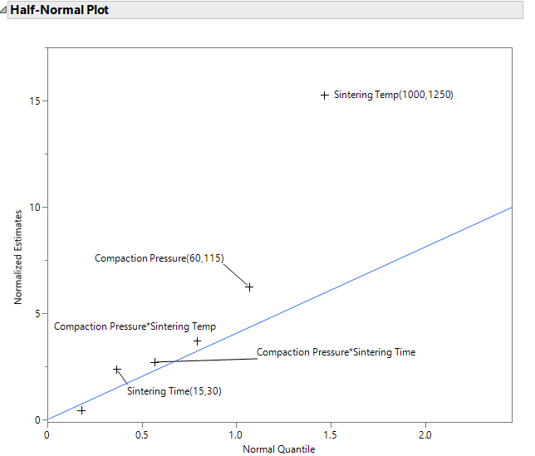
DOE MODELING 101

Slide 7
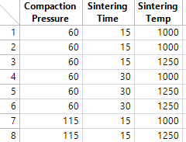



WHY NOT APPLY MACHINE LEARNING TO DOEs?
Training Set
Validation Set

Slide 8
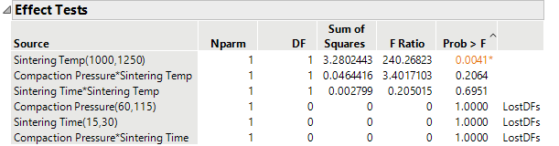
WHY NOT APPLY MACHINE LEARNING TO DOEs?

Slide 9
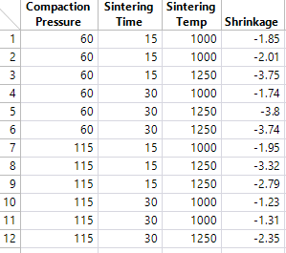
WHY NOT APPLY MACHINE LEARNING TO DOEs?
Notes:
Another idea is why not just create two copies of the data, and make one copy the training set and the other the validation set

Slide 10
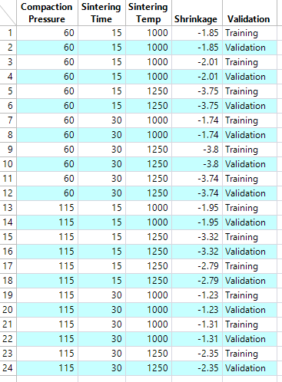
WHY NOT APPLY MACHINE LEARNING TO DOEs?

Slide 11

WHY NOT APPLY MACHINE LEARNING TO DOEs?

Slide 12
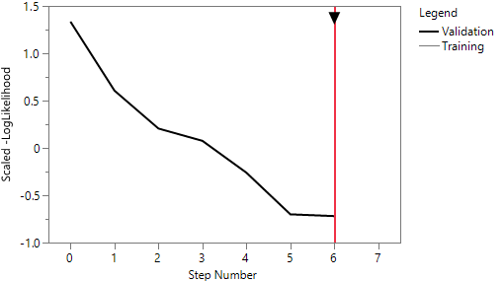
WHY NOT APPLY MACHINE LEARNING TO DOEs?

Slide 13
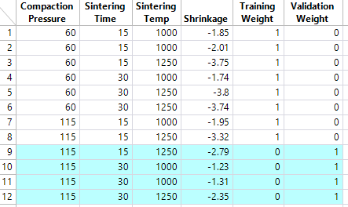
HOLDBACK AS A WEIGHTING SCHEME

Slide 14
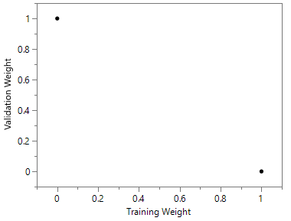
HOLDBACK AS A WEIGHTING SCHEME

Slide 15
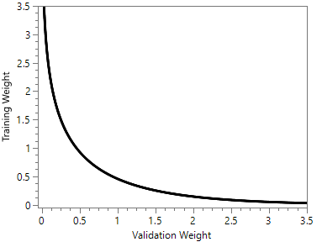
HOLDBACK AS A WEIGHTING SCHEME

Slide 16
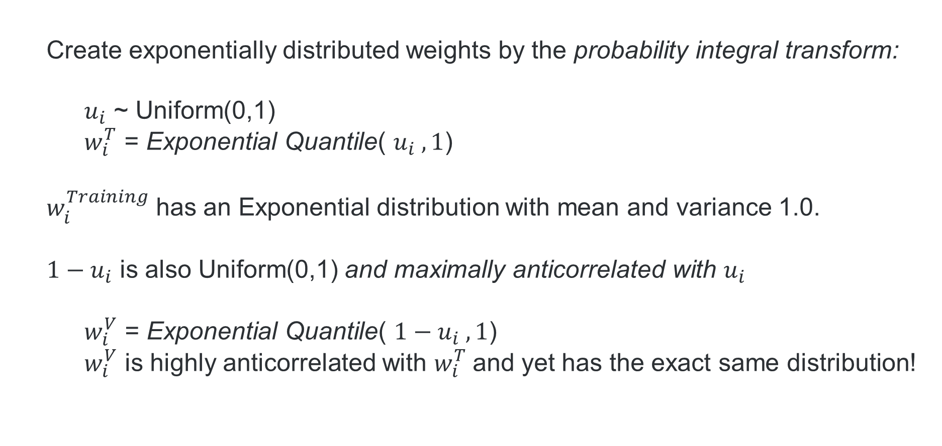
AUTOVALIDATION WEIGHTS
  Create exponentially distributed weights by the probability integral transform:
    $u_{i}$ ~ Uniform(0,1)
    $w_{i}^{T}$ = Exponential Quantile( $u_{i} ,1$)
  $w_{i}^{Training}$ has an Exponential distribution with mean and variance 1.0.
  $1−u_{i}$ is also Uniform(0,1) and maximally anticorrelated with $u_{i}$
    $w_{i}^{V}$ = Exponential Quantile( ${1−u}_{i} ,1$)
    $w_{i}^{V}$ is highly anticorrelated with $w_{i}^{T}$and yet has the exact same distribution!
Notes:
The Fractionally Weighted Bootstrap (FWB) suggests one way to do this.
In the standard FWB we generate weights that are Gamma distributed
JMP Pro normalizes them which leads to a scaled Dirichlet, but for our purposes the results will be the same.

Slide 17
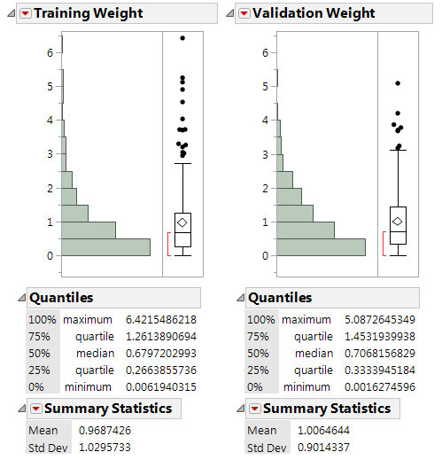
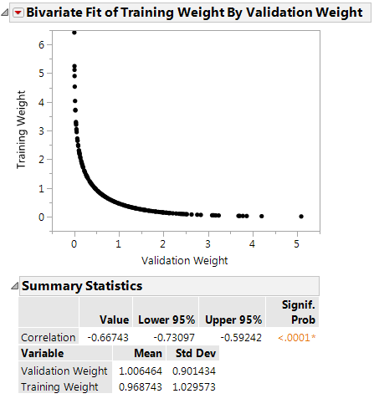
AUTOVALIDATION WEIGHTS

Slide 18
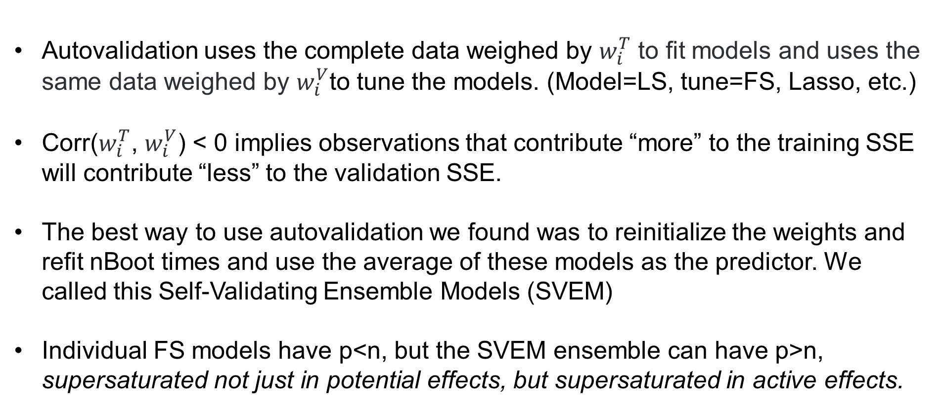
AUTOVALIDATION WEIGHTS
Autovalidation uses the complete data weighed by $w_{i}^{T}$ to fit models and uses the same data weighed by $w_{i}^{V}$to tune the models. (Model=LS, tune=FS, Lasso, etc.)
Corr($w_{i}^{T}$, $w_{i}^{V}$) < 0 implies observations that contribute “more” to the training SSE will contribute “less” to the validation SSE.
The best way to use autovalidation we found was to reinitialize the weights and refit nBoot times and use the average of these models as the predictor. We called this Self-Validating Ensemble Models (SVEM)
Individual FS models have p<n, but the SVEM ensemble can have p>n, supersaturated not just in potential effects, but supersaturated in active effects.
Notes:
The Fractionally Weighted Bootstrap (FWB) suggests one way to do this.
In the standard FWB we generate weights that are Gamma distributed
JMP Pro normalizes them which leads to a scaled Dirichlet, but for our purposes the results will be the same.

Slide 19
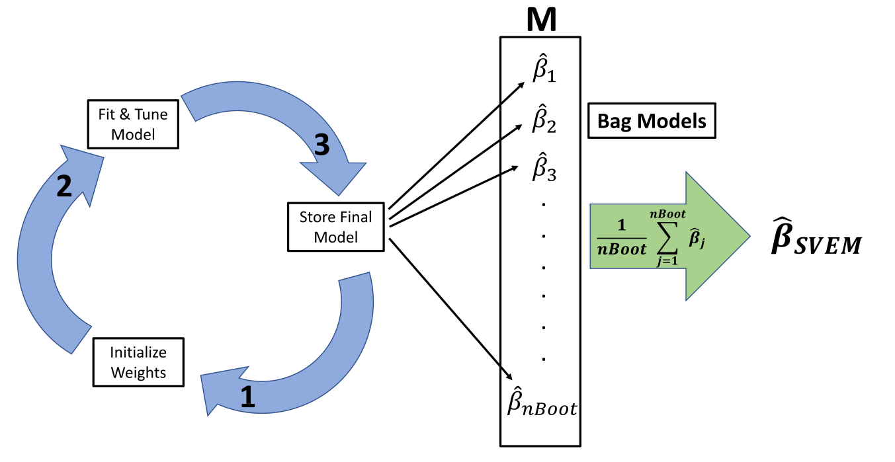
SVEM DIAGRAM

Slide 20
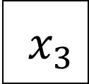
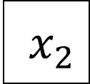
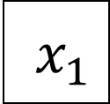
SVEM DIAGRAM
x$x_{1}$
x$x_{2}$
x$x_{3}$

Slide 21
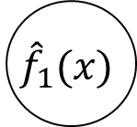
SVEM DIAGRAM
$${\hat{f}}_{1}(x)$$
x$x_{1}$
x$x_{2}$
x$x_{3}$

Slide 22
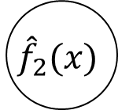
SVEM DIAGRAM
$${\hat{f}}_{1}(x)$$
x$x_{1}$
$${\hat{f}}_{2}(x)$$
x$x_{2}$
x$x_{3}$

Slide 23

SVEM DIAGRAM
$${\hat{f}}_{1}(x)$$
x$x_{1}$
$${\hat{f}}_{2}(x)$$
x$x_{2}$
$${\hat{f}}_{3}(x)$$
x$x_{3}$

Slide 24
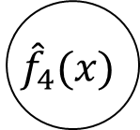
SVEM DIAGRAM
$${\hat{f}}_{1}(x)$$
x$x_{1}$
$${\hat{f}}_{2}(x)$$
x$x_{2}$
$${\hat{f}}_{3}(x)$$
$${\hat{f}}_{4}(x)$$
x$x_{3}$

Slide 25

SVEM DIAGRAM
$${\hat{f}}_{1}(x)$$
x$x_{1}$
$${\hat{f}}_{2}(x)$$
x$x_{2}$
$${\hat{f}}_{3}(x)$$
$${\hat{f}}_{4}(x)$$
x$x_{3}$
$${\hat{f}}_{5}(x)$$

Slide 26
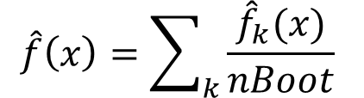
SVEM DIAGRAM
$${\hat{f}}_{1}(x)$$
x$x_{1}$
$${\hat{f}}_{2}(x)$$
x$x_{2}$
$${\hat{f}}_{3}(x)$$
$$\hat{f}\left(x\right)=\sum_{k}{\frac{{\hat{f}}_{k}(x)}{nBoot}}$$
$${\hat{f}}_{4}(x)$$
x$x_{3}$
$${\hat{f}}_{5}(x)$$

Slide 27
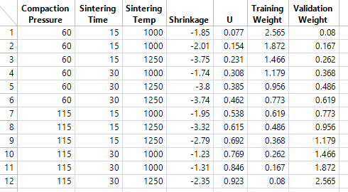
AUTOVALIDATION WEIGHTS

Slide 28
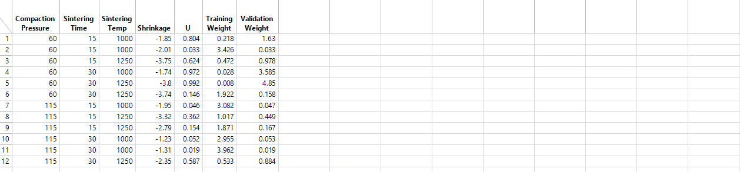
ROAD TO SVEM

Slide 29
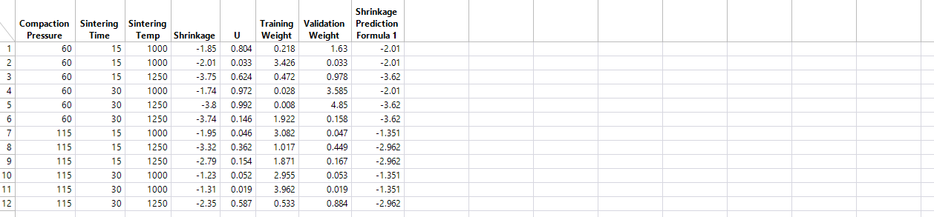
ROAD TO SVEM

Slide 30

ROAD TO SVEM

Slide 31
ROAD TO SVEM

Slide 32
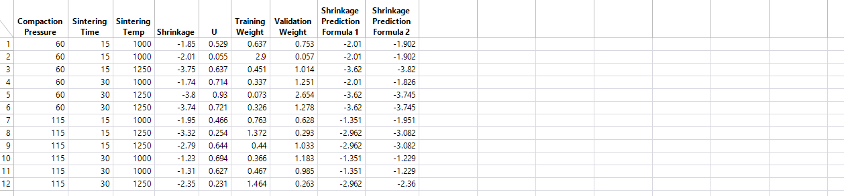
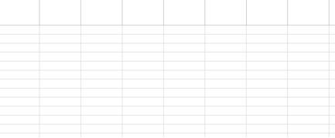
ROAD TO SVEM

Slide 33
ROAD TO SVEM

Slide 34
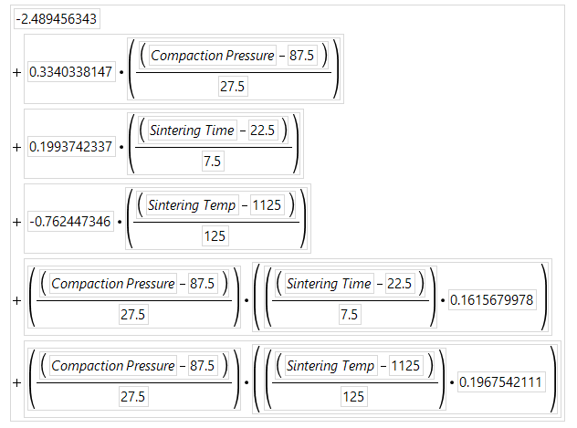
ROAD TO SVEM

Slide 35
ROAD TO SVEM

Slide 36
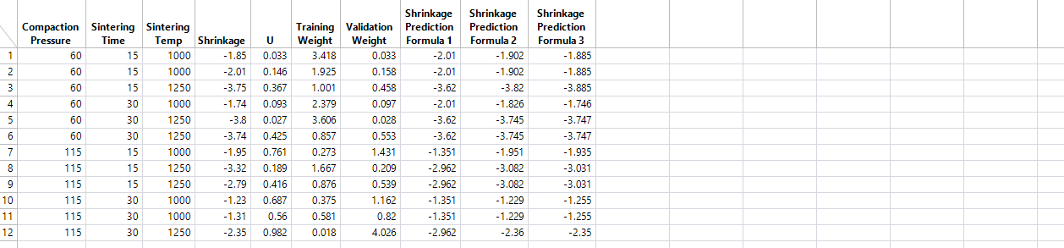
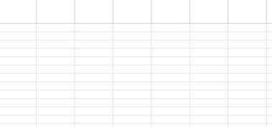
ROAD TO SVEM

Slide 37
ROAD TO SVEM

Slide 38
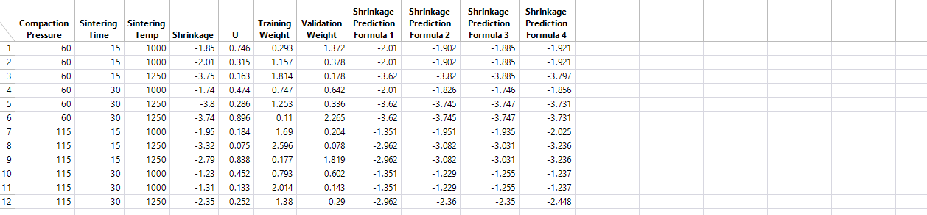
ROAD TO SVEM

Slide 39
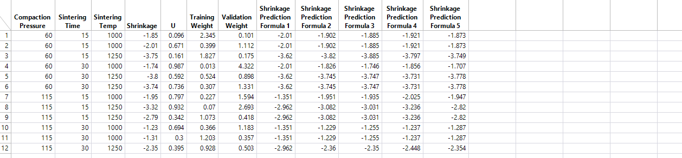
ROAD TO SVEM

Slide 40
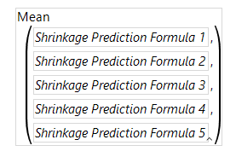
ROAD TO SVEM

Slide 41
ROAD TO SVEM

Slide 42
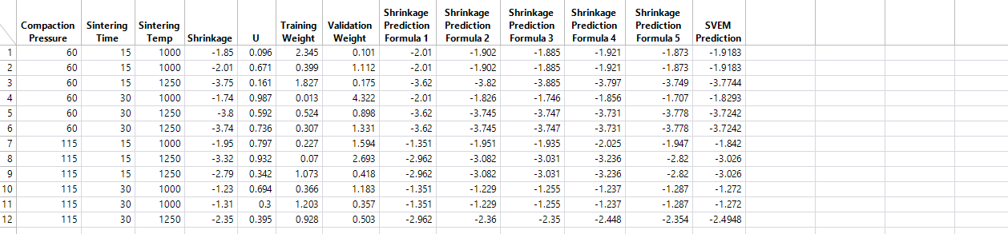
ROAD TO SVEM

Slide 43
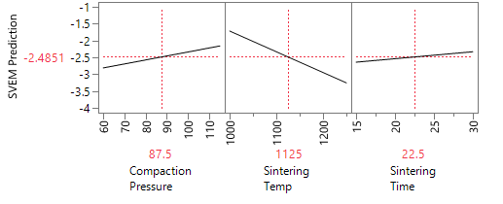
ROAD TO SVEM

Slide 44
EARLY SVEM
We considered many ways to apply autovalidation:
  Combine with Lasso, Dantzig selector, Forward Selection
  “Single-shot” Autovalidation ( single set of weights )
  Prune the model (after initial fit) with a null factor or column sampling, ala Random Forests (before each bootstrap replicate)
  Early simulations indicated that model averaging with no pruning led to models with the best test set accuracy. FS & Lasso did best
  Later we found that debiasing (centering and scaling predictions) after regressing the model average on Y improved performance in small samples, and didn’t hurt otherwise

Slide 45
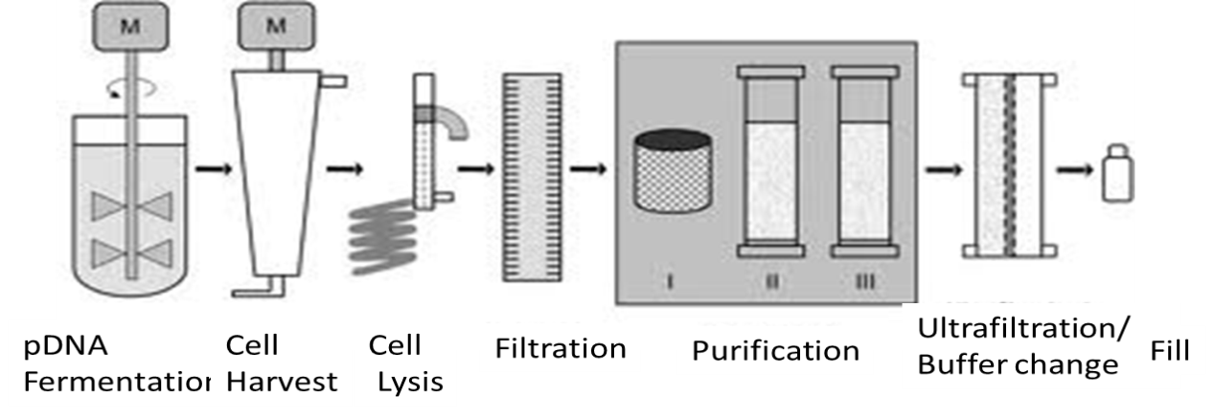
THE PLASMID DNA (pDNA) EXPERMENT
Fermentation
Genome E. coli
Cell Harvest
Continuous centrifugation
Cell Lysis
Continuous chemical lysis
Final Product
pDNA
Purification
HPLC based
Clarification & Concentration
Flocculation / RNA Precipitation
Notes:
Now I will show a case study from an example in the biotech industry for the purification of a pharma product.

Slide 46
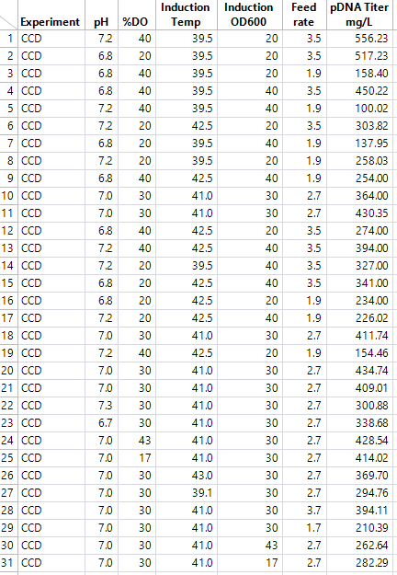
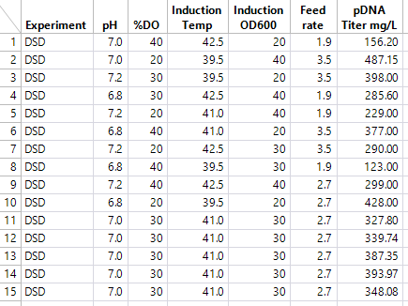
THE PLASMID DNA (pDNA) EXPERMENT
Notes:
The response is the pDNA yield, which is something we would want to maximize.
Factors are: pH, percent dissolved oxygen, temperature, Microbial mass of E Coli, in units of optimal density at 600 nM at the point where Protein X induction is initiated, feed rate of glucose
Percent dissolved Oxygen target value for the run.
The experiment was done twice on the same equipment. Once as a definitive screening design once as a CCD for a proof of concept evaluating whether DSD could complete with CCDs. Here we are using the DSD runs as a training set and the CCD runs as an independent test set to compare SVEM with established approaches like the Jones/Nachtsheim DSD analysis approach and FS+AICc

Slide 47
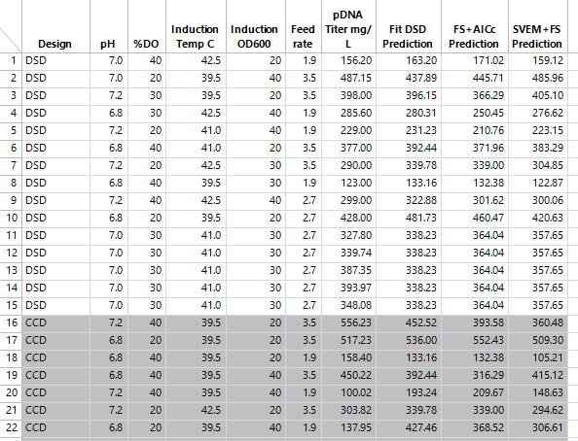
THE PLASMID DNA (pDNA) EXPERMENT
Copyright © 2018, SAS Institute, Inc. All rights reserved.
Notes:
We used the Fit DSD method, Forward Selection + AICc, and SVEM-FS applied to just the DSD rows

Slide 48
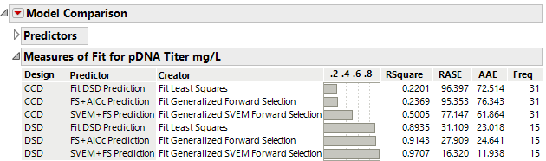
THE PLASMID DNA (pDNA) EXPERMENT

Slide 49
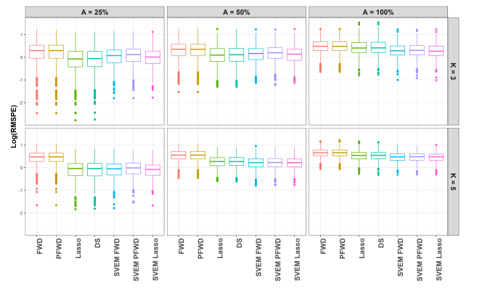
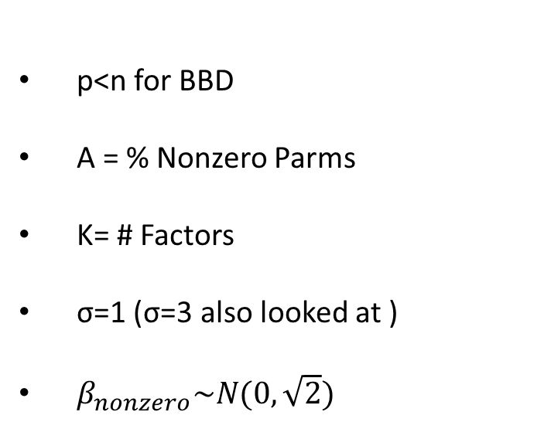
BOX BEHNKEN SIMULATIONS
p<n for BBD
A = % Nonzero Parms
K= # Factors
σ=1 (σ=3 also looked at )
$β_{nonzero}\sim N(0,\sqrt{2})$
Test Set

Slide 50
BOX BEHNKEN SIMULATIONS
SVEM performs similarly to Lasso and Dantzig Selector
Test Set

Slide 51
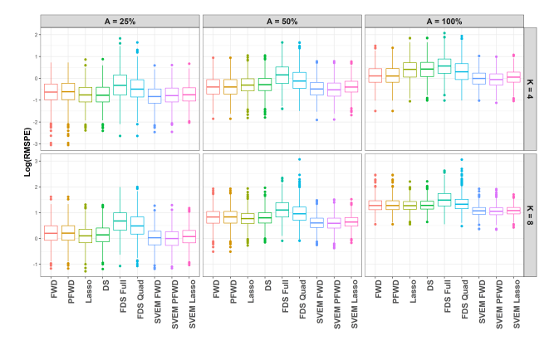
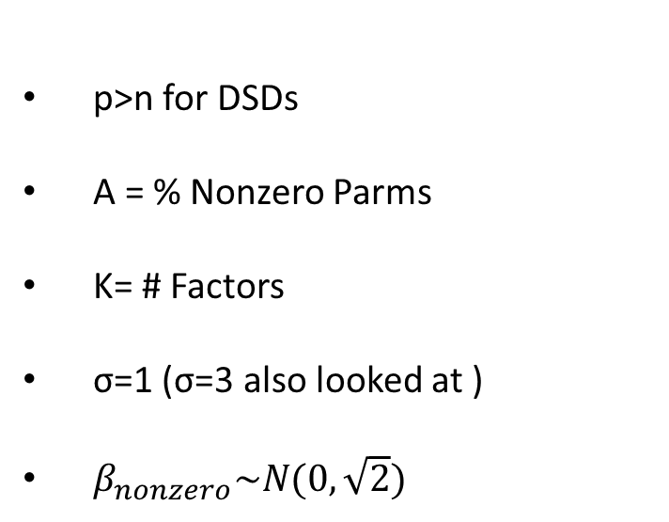
DEFINITIVE SCREENING DESIGN SIMULATIONS
p>n for DSDs
A = % Nonzero Parms
K= # Factors
σ=1 (σ=3 also looked at )
$β_{nonzero}\sim N(0,\sqrt{2})$
Test Set

Slide 52
DEFINITIVE SCREENING DESIGN SIMULATIONS
SVEM generally among the best
SVEM separates as non-sparsity increases
Small differences among SVEM types
Test Set

Slide 53
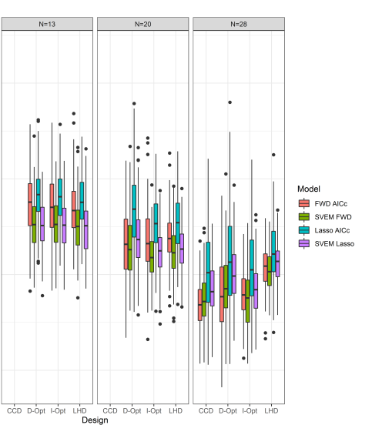

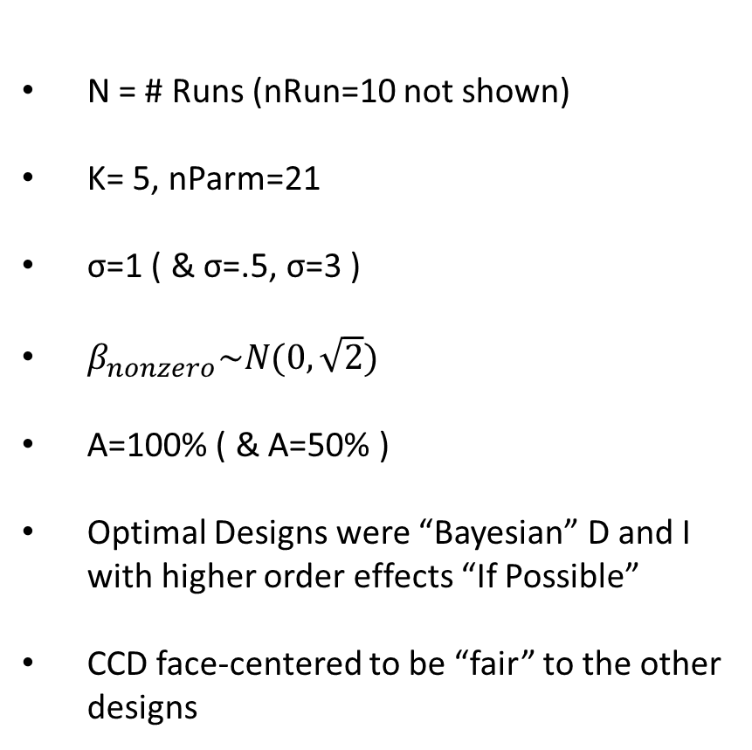
SAMPLE SIZE AND DESIGN TYPE STUDY
N = # Runs (nRun=10 not shown)
K= 5, nParm=21
σ=1 ( & σ=.5, σ=3 )
$β_{nonzero}\sim N(0,\sqrt{2})$
A=100% ( & A=50% )
Optimal Designs were “Bayesian” D and I with higher order effects “If Possible”
CCD face-centered to be “fair” to the other designs

Slide 54
SAMPLE SIZE AND DESIGN TYPE STUDY
Design Type mattered little for SVEM, when nParm > nRun
SVEM+FWD best when nParm > nRun
CCD and FWD+AICc best when n=28, but not far from SVEM+FWD

Slide 55


SAMPLE SIZE AND DESIGN TYPE STUDY
N = 10, D-Opt FWD+AICc and Lasso+AICc median Test Set Rsq<0
D-Opt still risky all the way to N=28
I-Opt and LHD with SVEM best designs for supersaturated cases
N=13 & 20 SVEM does well, but always a risk of a terrible model
Test Set Rsq

Slide 56
CONCLUSIONS
SVEM+FS ( and +Lasso ) generally was as good or better than any other method as measured by test set prediction accuracy in supersaturated RSM cases, particularly when nActiveParm > nRuns. After early simulations we used only the debiased version.
Anecdotal, less formal studies suggest that SVEM offers no advantage on 2-level screening designs. This should be studied more rigorously.
There has been a lot of interest in other base learners like neural networks and generalized linear models.
We did look at many SVEM variants, with effect pruning and column sampling. Simple model averaging worked the best.
To be used more widely we need to develop model diagnostics and uncertainty quantification. We don’t even really have a reasonable estimate of the error variance.

