Slide 1
Infusing Statistical Thinking into the NASA Quesst Community Test Campaign
Nathan B. Cruze, Kathryn M. Ballard
NASA Langley Research Center
Defense and Aerospace Testing and Analysis Workshop
Alexandria, VA
April 25-27, 2023

Slide 2
Outline
History
Statistical thinking in sampling and survey
Statistical thinking in dose estimation
Statistical thinking in modeling
Future needs and conclusions

Slide 3
History and Statistics Literature
1961 St. Louis Sonic Boom Study (Nixon and Borsky 1966)
  N=1,157; 1,043 reinterviews. 76 booms
1964 Oklahoma City Sonic Boom Study (Borsky 1965)
  N=3,200; 8,997 interviews. ~1,200 booms
1966-67 Sonic Boom Studies at Edwards Air Force Base (Kryter et al. 1968)
  “Representative” Midwest home, majority women in experimental sample
2011 Waveforms and Sonic Boom Perception and Response (Page et al. 2014)
  Convenient sample, N=49 volunteers; surveys for 89 planned (14 unplanned) booms
2018 Quiet Supersonic Flights (Page et al. 2020a,b)
  Systematic sample, capped at N=500 households; repeated surveys for 52 booms

Slide 4
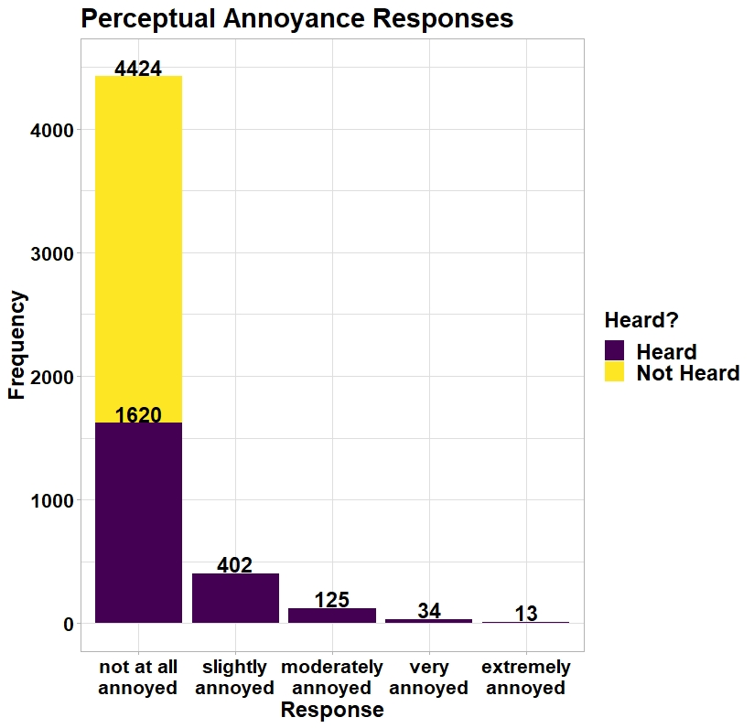
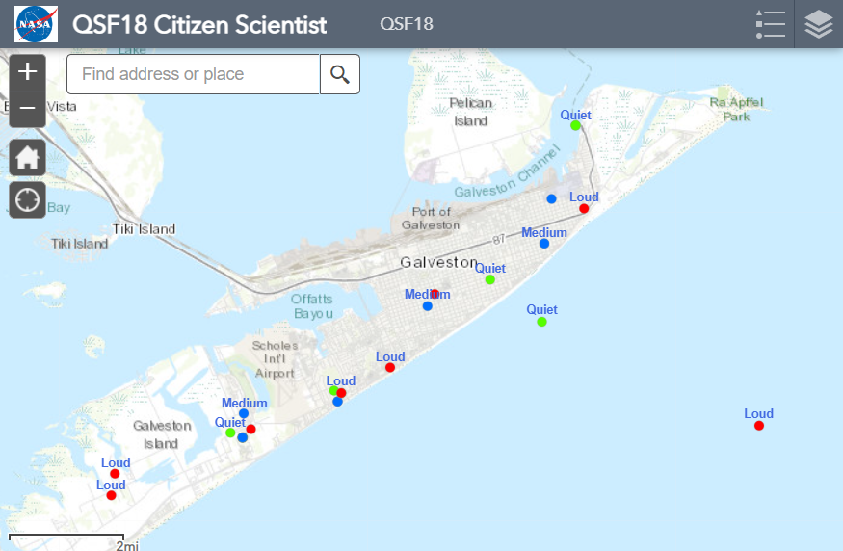
“What did you hear?” Versus “Did you hear…”
Image source: https://www.nasa.gov/qsfscientist
The way we select and reach a sample matters

Slide 5
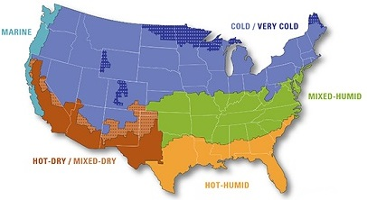
Statistical Thinking in Sampling: Site Selection
Purposive in lieu of balanced sampling
Airfield and community test selection
  Aircraft requirements
  Data collection requirements
  Geography, climate (Doebler et al. 2022b)
  Demographic characteristics
Dedicated geospatial processing procedure (Czech et al. 2022)
Source: US Department of Energy
Purposive, non-probability selection of test sites due to constraints

Slide 6




Statistical Thinking in Sampling: Longitudinal Surveys
Deceleration
Population: all residents in 20 NM x 30 NM (blue) region
  Union of Census Blocks within region
  Sampling frame—list of postal addresses
Sample: recruit panel of ~1,000 residents
  Take every n^{th} household on sorted list
  Within-household sampling (Rizzo, Brick, Park 2004)
Deploy repeated single-event and daily summary surveys
  Paper, IVR modes (Fidell and Horonjeff 2019)
  Use internet, smart phone app modes
Acceleration
(Notional figure)
Valid inferences about population within recruitment region

Slide 7
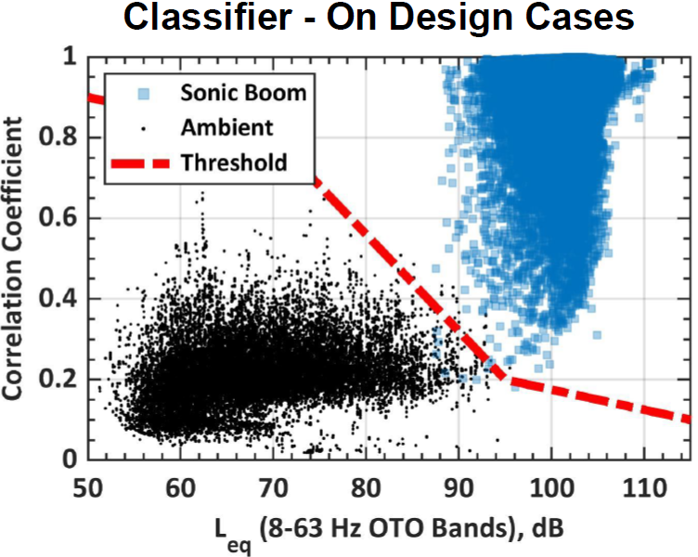
Statistical Thinking in Dose Estimation: Classification
Goal: in situ detection of sonic thump at sensor
Contractor team developed detector algorithm (Harker et al. 2022a,b)
  Cross-correlation of observed, template waveforms
  High classification accuracies for X-59 simulations injected into ambient recordings
    Accuracy of +/- 100 ms in 99.98% of cases
    True-positive rate 0.9999 when false-positive rate is 0.0024
Source: Harker et al. (2022b)
Interplay between operational decisions and Type I and Type II errors

Slide 8
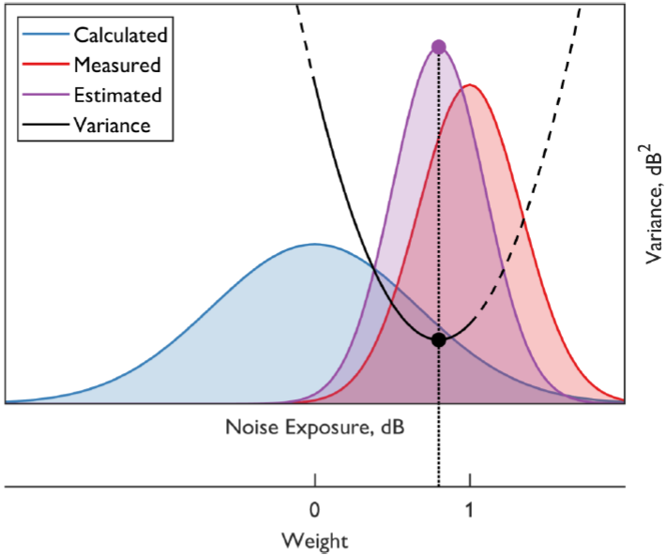
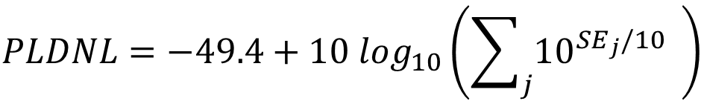
Statistical Thinking in Dose Estimation: Data Fusion
Sparse network of sensors over large area
  Interpolation (Klos 2020) compared to spatial Kalman filter (Lympany et al. 2022a,b)
Challenge: nonlinearities in cumulative dose
  Proposal: propagate single-event doses, uncertainty in a Bayesian cumulative dose-response model
$$PLDNL=−49.4+10 \log_{10}\left(\sum_{j}{{10}^{{SE}_{j}/10}} \right)$$
Source: Lympany et al. (2022b)
Kalman filter estimates single event doses, variances for many metrics

Slide 9

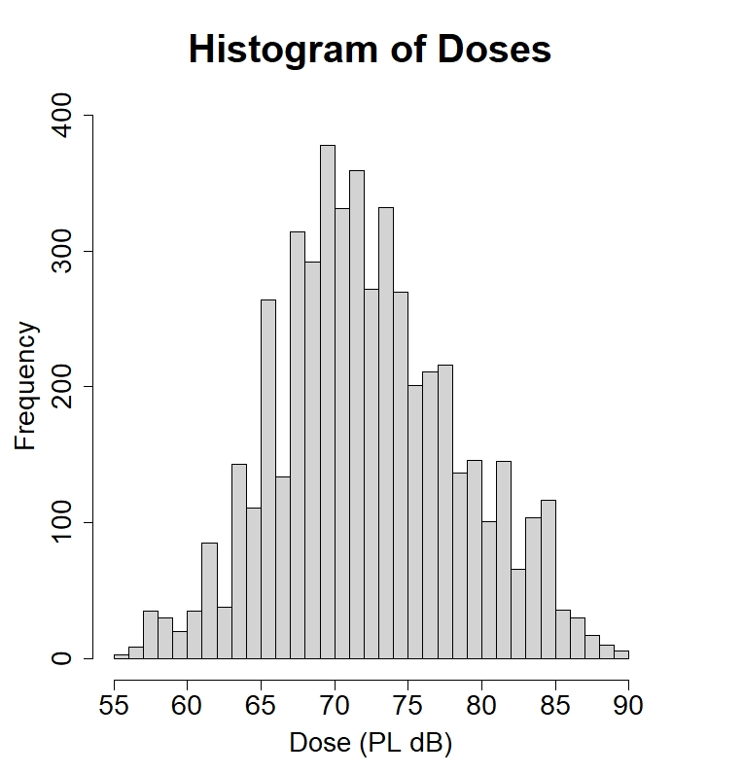
Statistical Thinking in Modeling: Single Event Data
Regulatory emphasis on “Highly Annoyed”

Slide 10
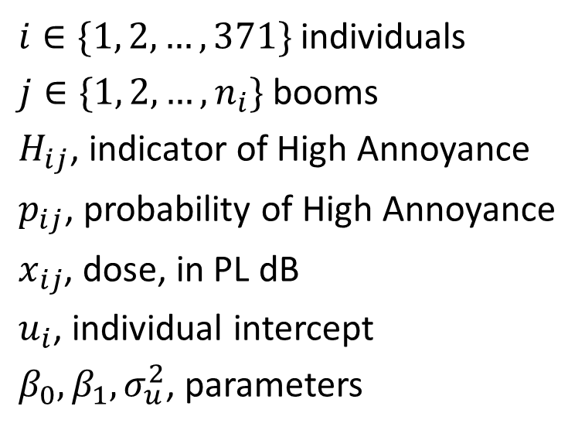
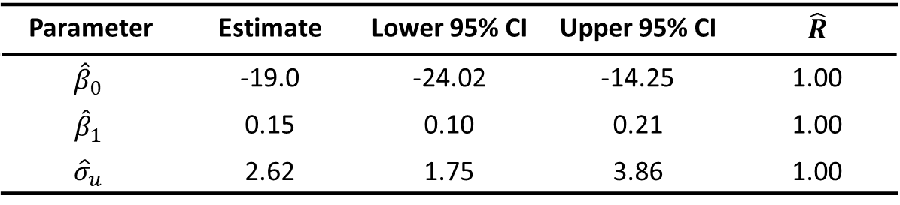

Statistical Thinking in Modeling: Conditional Model
Reproducing a Bayesian random intercept model (Lee et al. 2020)
$i∈\{1, 2,…, 371\}$ individuals
$j∈\{1, 2,…,n_{i}\}$ booms
$H_{ij}$, indicator of High Annoyance
$p_{ij}$, probability of High Annoyance
$x_{ij}$, dose, in PL dB
$u_{i}$, individual intercept
$β_{0}, β_{1}, σ_{u}^{2}$, parameters
$$H_{ij}|p_{ij} \sim Bernoulli\left(p_{ij}\right)$$
$$p_{ij}|β_{0},β_{1},u_{i}=logit^{−1}\left(\left(β_{0}+u_{i}\right)+β_{1}x_{ij}\right)$$
$$u_{i} \sim N\left(0, σ_{u}^{2}\right)$$
$$β_{0} \sim N\left(0, 100\right)$$
$$β_{1} \sim N\left(0, 100\right)$$
$$σ_{u}^{2} \sim IG\left(0.01, 0.01\right)$$
Parameter | Estimate | Lower 95% CI | Upper 95% CI | $$\hat{R}$$
$${\hat{β}}_{0}$$ | -19.0 | -24.02 | -14.25 | 1.00
$${\hat{β}}_{1}$$ | 0.15 | 0.10 | 0.21 | 1.00
$${\hat{σ}}_{u}$$ | 2.62 | 1.75 | 3.86 | 1.00
This model relates probability of annoyance to dose and subject effect

Slide 11
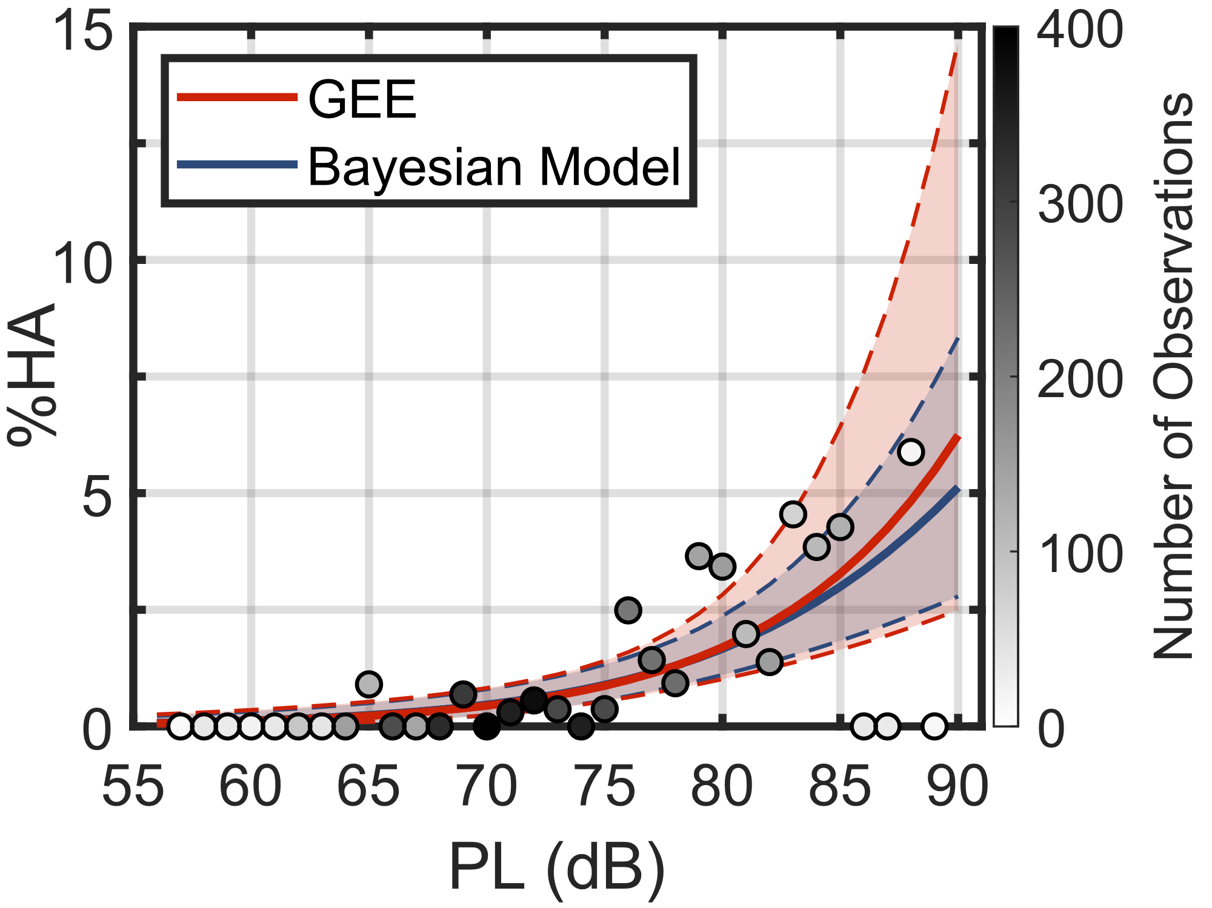

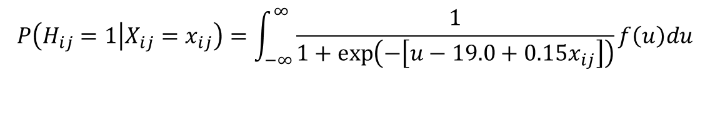
Statistical Thinking in Modeling: Marginal Model
Want population average curve, rather than subject-specific curves
  GEE and alternatives (Vaughn et al. 2021)
Let ; marginalize with respect to random effect (Pavlou et al. 2015)
$$f\left(u\right)=N(0,{2.62 }^{2})$$
$$P\left(H_{ij}=1 | X_{ij}=x_{ij}\right)=\int_{−∞}^{∞}{\frac{1}{1+\exp\left(−\left[u−19.0+0.15x_{ij}\right]\right)}f\left(u\right)du}$$
Probability of annoyance in general population as a function of dose

Slide 12
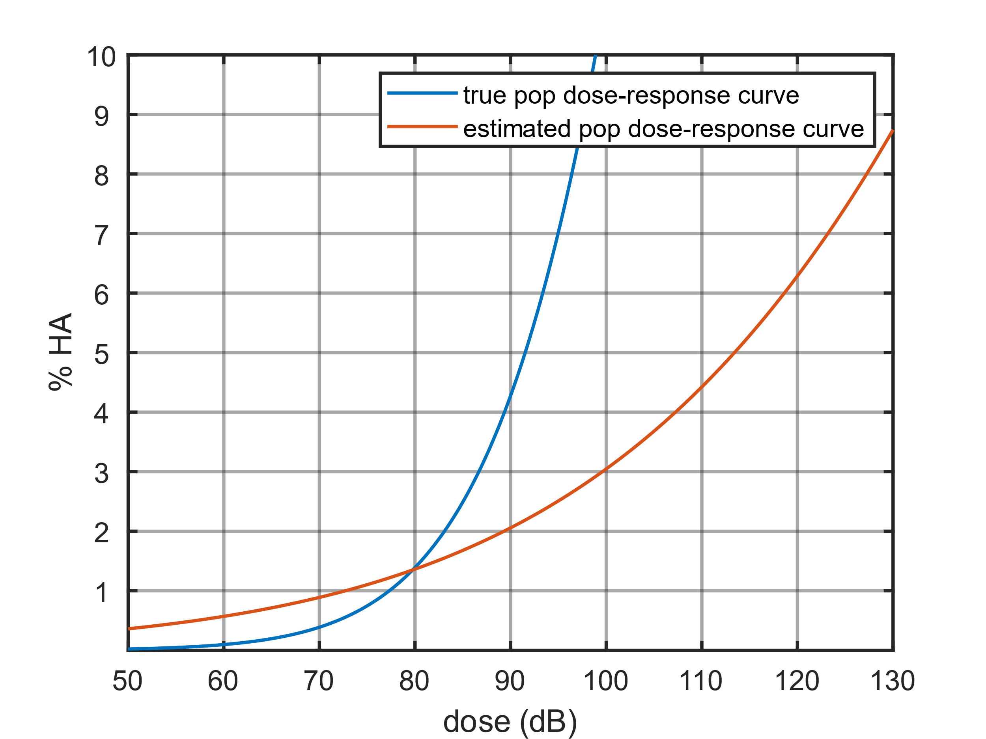
Statistical Thinking in Modeling: Measurement Error
Attenuation bias (regression dilution)
Effects on logistic regression
  “Underestimate the…probability for high-risk cases and overestimate for low-risk cases” (Stefanski and Carroll 1985, p. 1336)
Underestimation → policy may subject public to unacceptable levels of noise
Study of measurement error models in recent acoustics literature and NASA emphasis
  (Doebler et al. 2022a; Horonjeff 2020,2021)
If severe, untreated measurement error has policy implications

Slide 13
Statistical Thinking in Modeling: More Thinking
Multilevel regression with postsratification (MRP) (Gelman and Little 1997)
  An MRP use case: adjustment to nonrepresentative samples
  Demonstrated using QSF18 data (Ferg and Opsomer 2022)
Rarity of ‘highly annoyed’ outcome and impacts on logistic regression
  Zero-inflation (Ferg and Opsomer 2022), analogs (e.g., Kelley and Anderson 2008)
  Monotonic regression
  Alternative link functions (Wang and Dey 2010, Diop et al. 2023)
Truncated regression (limited dependent variables) for narrow dose range
Rationale for a dose design—administer doses so as to maximize information
Many opportunities for continued research in support of campaign

Slide 14
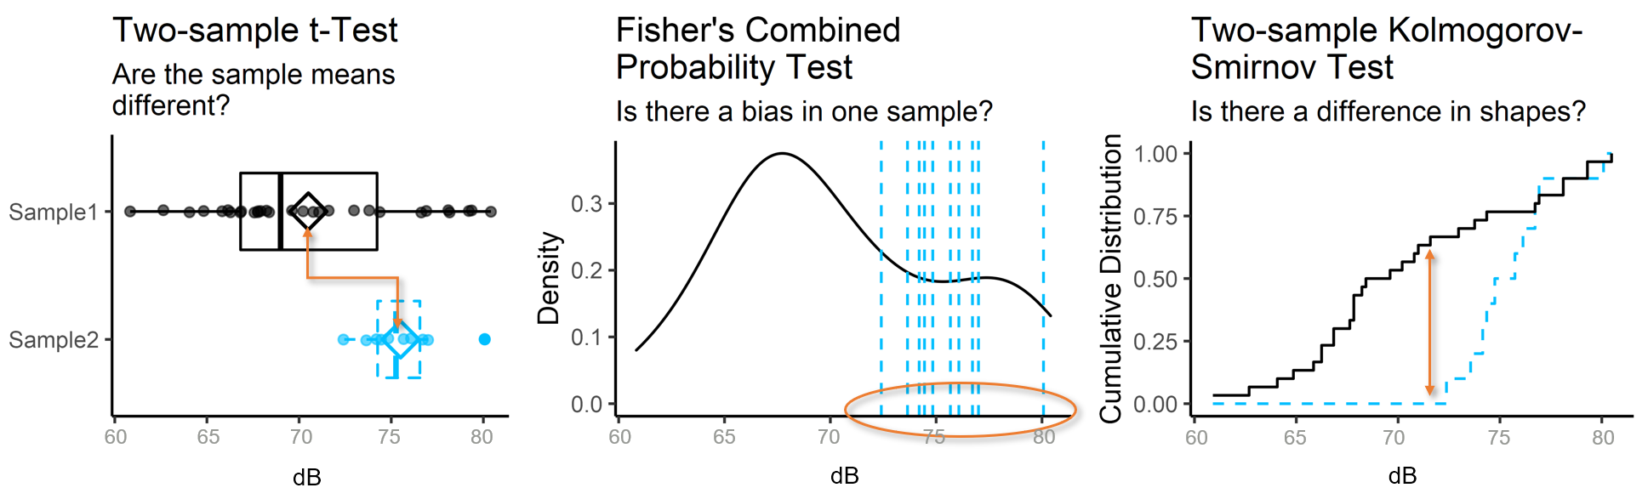
The Future: New Phenomenon, New Need
En route noise certifications likely entail validation of predictive models
  Validate on test day conditions, use model to certify at reference day conditions
  A candidate procedure uses combination of hypothesis tests (Wojton et al., p. 78)
Techniques for model/simulation validation may apply to certification

Slide 15
Conclusion
Quesst mission community test campaign benefits from statistical thinking
  Campaign planning, post-execution analysis, beyond
Like operational test and evaluation, constraints shape viability of approaches
  How will we know for ourselves that results are fit for use in policy decisions?
  How will we communicate choices, including limitations, to stakeholders?
Highlighted a number of areas ripe for continued research
  Audience questions and feedback are much appreciated

Slide 16
Statistics Literature
Breslow, N. & Clayton, D. (1993). Approximate Inference in Generalized Linear Mixed Models. Journal of the American Statistical Association, 88(421), 9–25. https://doi.org/10.1080/01621459.1993.10594284
Diop, A., Deme, E. H., & Diop, A. (2023). Zero-Inflated Generalized Extreme Value Regression Model for Binary Response Data and Application in Health Study. Journal of Statistical Computation and Simulation, 93(1), 1–24. https://doi.org/10.1080/00949655.2022.2089673
Fong, Y., Rue, H., & Wakefield, J. (2010). Bayesian Inference for Generalized Linear Mixed Models. Biostatistics, 11(3), 397–412. https://doi.org/10.1093/biostatistics/kxp053
Gelman, A. & Little, T. (1997). Postsratification into Many Categories Using Hierarchical Logistic Regression. Survey Methodology, 23(2), 127–135. https://www150.statcan.gc.ca/n1/en/pub/12-001-x/1997002/article/3616-eng.pdf?st=7A90FEwx
Kelley, M. E. & Anderson, S. J. (2008). Zero Inflation in Ordinal Data: Incorporating Susceptibility to Response Through the Use of a Mixture Model. Statistics in Medicine, 27(18), 3674–3688. https://doi.org/https://doi.org/10.1002/sim.3267
Korn, E. L. & Whittemore, A. S. (1979). Methods for Analyzing Panel Studies of Acute Health Effects of Air Pollution. Biometrics, 35(4), 795–802. https://doi.org/10.2307/2530111
Pinheiro, J. C. & Bates, D. M. (1995). Approximations to the Log-Likelihood Function in the Nonlinear Mixed-Effects Model. Journal of Computational and Graphical Statistics, 4(1), 12–35. https://doi.org/10.1080/10618600.1995.10474663
Rizzo, L., Brick, J. M., & Park, I. (2004). Sampling persons in random digit dial surveys. Public Opinion Quarterly, 68(2), 267–274. https://doi.org/https://doi.org/10.1093/poq/nfh014
Stefanski, L. A. & Carroll, R. J. (1985). Covariate Measurement Error in Logistic Regression. The Annals of Statistics, 13(4), 1335 – 1351. https://doi.org/10.1214/aos/1176349741
Stiratelli, R., Laird, N., & Ware, J. H. (1984). Random-Effects Models for Serial Observations with Binary Response. Biometrics, 40(4), 961–971. https://doi.org/10.2307/2531147
Wang, X. & Dey, D. K. (2010). Generalized Extreme Value Regression for Binary Response Data: An Application to B2B Electronic Payments System Adoption. The Annals of Applied Statistics, 4(4), 2000 – 2023. https://doi.org/10.1214/10-AOAS354
Wojton, H., Avery, K. M., Freeman, L. J., Parry, S. H., Whittier, G. S., Johnson, T. H., & Flack, A. C. (2019). Handbook on Statisticial Design and Analysis Techniques for Modeling and Simulation Validation. Institute for Defense Analyses. IDA Document NS D-10455. https://www.ida.org/-/media/feature/publications/h/ha/handbook-on-statistical-design-and-analysis/d-10455.ashx

Slide 17
References
Borsky, P. N. (1965). Community Reactions to Sonic Booms in the Oklahoma City Area. Research Report, National Opinion Research Center. Accession Number: AD0613620. https://apps.dtic.mil/sti/citations/AD0613620
Cruze, N. B., Ballard, K. M., Vaughn, A. B., Doebler, W. J., Rathsam, J., & Parker, P. A. (2022). Comparison of Likelihood Methods for Generalized Linear Mixed Models with Application to Quiet Supersonic Flights 2018 Data. Technical Memorandum, NASA Langley Research Center. NASA/TM–20220014998. https://ntrs.nasa.gov/citations/20220014998
Czech, J. J., Shah, G. H., & Richwine, D. M. (2022). NASA Quesst Mission–Site Selection Process for Community Testing. 183rd Meeting of the Acoustical Society of America. [Conference Presentation]. https://ntrs.nasa.gov/citations/20220018320
Doebler, W. J., Vaughn, A. B., , Ballard, K. M., & Rathsam, J. (2022a). Simulation and Application of Bayesian Dose Uncertainty Modeling for Low-Boom Community Noise Surveys. Proceedings of Meetings on Acoustics, Volume 45. https://doi.org/10.1121/2.0001592
Doebler, W. J., Wilson, S. R., Loubeau, A., & Sparrow, V. W. (2022b). Simulation and Regression Modeling of NASA’s X-59 Low-Boom Carpets Across America. Journal of Aircraft, 1–12. [First Online Access, October 10, 2022]. https://doi.org/10.2514/1.C036876
Ferg, R. & Opsomer, J. (2022). Modeling Approaches to Estimate Community Annoyance Due to Sonic Booms Using Data from Repeated Surveys. Seventh Italian Conference on Survey Methodology (ITACOSM 2022). [Presentation Slides]. https://ntrs.nasa.gov/citations/20220008195
Fidell, S. & Horonjeff, R. D. (2019). Field Evaluation of Sampling, Interviewing, and Flight Tracking of NASA’s Low Boom Flight Demonstrator Aircraft. Contractor Report, NASA Langley Research Center. NASA/CR-2019-220257. https://ntrs.nasa.gov/citations/20190001426
Harker, B. M., Lympany, S. V., & Page, J. A. (2022a). Performance Evaluation of a Shaped Sonic Boom Detector and Classifier. The Journal of the Acoustical Society of America, 152(4), A86. [Conference Presentation Abstract]. https://doi.org/10.1121/10.0015631
Harker, B. M., Lympany, S. V., & Page, J. A. (2022b). Performance Evaluation of a Shaped Sonic Boom Detector and Classifier. 183rd Meeting of the Acoustical Society of America. [Conference Presentation]. https://ntrs.nasa.gov/citations/20220017378
Klos, J. (2020). Recommendations for Using Noise Monitors to Estimate Noise Exposure During X-59 Community Tests. Technical Report, NASA Langley Research Center. NASA/TM–20205007926 Corrected Copy. https://ntrs.nasa.gov/citations/20205007926

Slide 18
References
Kryter, K. D., Johnson, P. J., & Young, J. R. (1968). Pyschological Experiments on Sonic Booms Conducted at Edwards Air Force Base. Research Report, Stanford Research Institute, Menlo Park, CA. Final Report, AD689844.
Lee, J., Rathsam, J., & Wilson, A. (2020). Bayesian Statistical Models for Community Annoyance Survey Data. The Journal of the Acoustical Society of America, 147(4), 2222–2234. https://doi.org/10.1121/10.0001021
Lympany, S. V. & Page, J. A. (2022a). Estimating Sonic Boom Metrics Across a Community Using a Kalman Filter. The Journal of the Acoustical Society of America, 152(4), A86. [Conference Presentation Abstract]. https://doi.org/10.1121/10.0015632
Lympany, S. V. & Page, J. A. (2022b). Estimating Sonic Boom Metrics Across a Community Using a Kalman Filter. 183rd Meeting of the Acoustical Society of America. [Conference Presentation]. https://ntrs.nasa.gov/citations/20220017380
Nixon, C. W. & Borsky, P. N. (1966). Effects of Sonic Boom on People: St. Louis, Missouri, 1961–1962. The Journal of the Acoustical Society of America, 39(5B), S51–S58. https://doi.org/10.1121/1.1914044
Page, J. A., Hodgdon, K. K., Hunte, R. P., Davis, D. E., Gaugler, T., Downs, R., Cowart, R. A., Maglieri, D. J., Hobbs, C., Baker, G., Collmar, M., Bradley, K. A., Sonak, B., Crom, D., & Cutler, C. (2020a). Quiet Supersonic Flights 2018 (QSF18) Test: Galveston, Texas Risk Reduction for Future Community Testing with a Low-Boom Flight Demonstration Vehicle. Contractor Report, NASA Langley Research Center. NASA/CR-2020-220589/Volume I. https://ntrs.nasa.gov/citations/20200003223
Page, J. A., Hodgdon, K. K., Hunte, R. P., Davis, D. E., Gaugler, T., Downs, R., Cowart, R. A., Maglieri, D. J., Hobbs, C., Baker, G., Collmar, M., Bradley, K. A., Sonak, B., Crom, D., & Cutler, C. (2020b). Quiet Supersonic Flights 2018 (QSF18) Test: Galveston, Texas Risk Reduction for Future Community Testing with a Low-Boom Flight Demonstration Vehicle. Contractor Report, NASA Langley Research Center. NASA/CR-2020-220589/Appendices/Volume II. https://ntrs.nasa.gov/citations/20200003224
Page, J. A., Hodgdon, K. K., Krecker, P., Cowart, R., Hobbs, C., Wilmer, C., Koening, C., Holmes, T., Gaugler, T., Shumway, D. L., Rosenberger, J. L., & Philips, D. (2014). Waveforms and Sonic Boom Perception and Response (WSPR): Low-Boom Community Response Program Pilot Test Design, Execution, and Analysis. Contractor Report, NASA Langley Research Center. NASA/CR-2014-218180. https://ntrs.nasa.gov/citations/20140002785

Slide 19

Thank You!
https://www.nasa.gov/quesst
nathan.b.cruze@nasa.gov

Slide 20
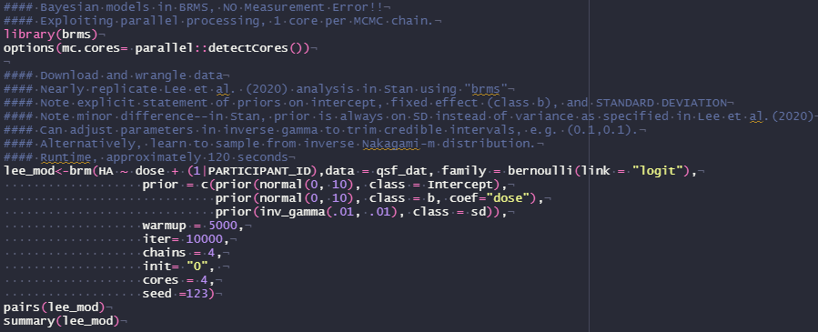
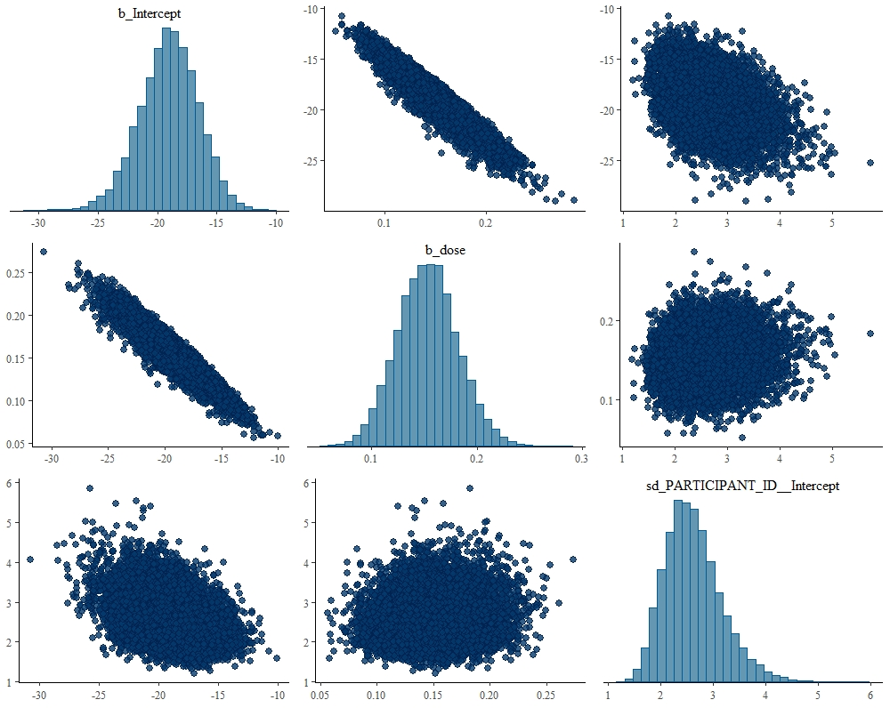
Supplemental Slide: Template Code and Model Output

