Slide 1
Dose-Response Data Considerations for the
NASA Quesst Community Test Campaign
Aaron B. Vaughn and William J. Doebler
NASA Langley Research Center
April 25-27, 2023
DATAWorks

Slide 2
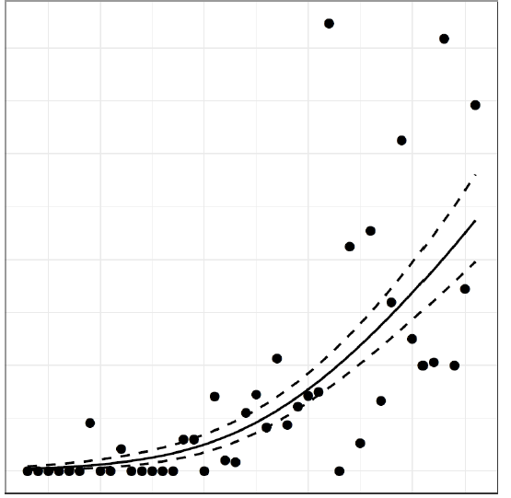
Overview
Brief History of Dose-Response in Community Noise Studies
  Schultz Curve, FAA Neighborhood Environmental Survey
Dose (Noise Level) “x-axis”
  What is it?
  How do we measure it?
  What are sources of error and variability?
Response (Annoyance) “y-axis”
  What is it?
  How do we measure it?
  What are sources of error and variability?
Response (% Annoyed)
Dose (Noise Level)
Notes:
This talk will go over the high level aspects of variability in community noise survey data in the context of future community studies with the X-59 aircraft, starting first with a history of the quantification of transportation noise dose and human annoyance response, after which I’ll speak briefly to recent subsonic civilian aircraft noise survey results.
We will then focus on the noise dose from supersonic aircraft: explaining what it is, how we go about measuring it, and identifying a handful of sources of error and variability.
Similarly, we will discuss the human annoyance response: what it is, how it is measured, and the challenges in accurately measuring it.
A key result of these data collection efforts is to produce a dose-response relationship, perhaps similar to the figure on the right, which will inform regulators in their efforts to replace the current ban on overland supersonic flight with a permissible noise standard.

Slide 3
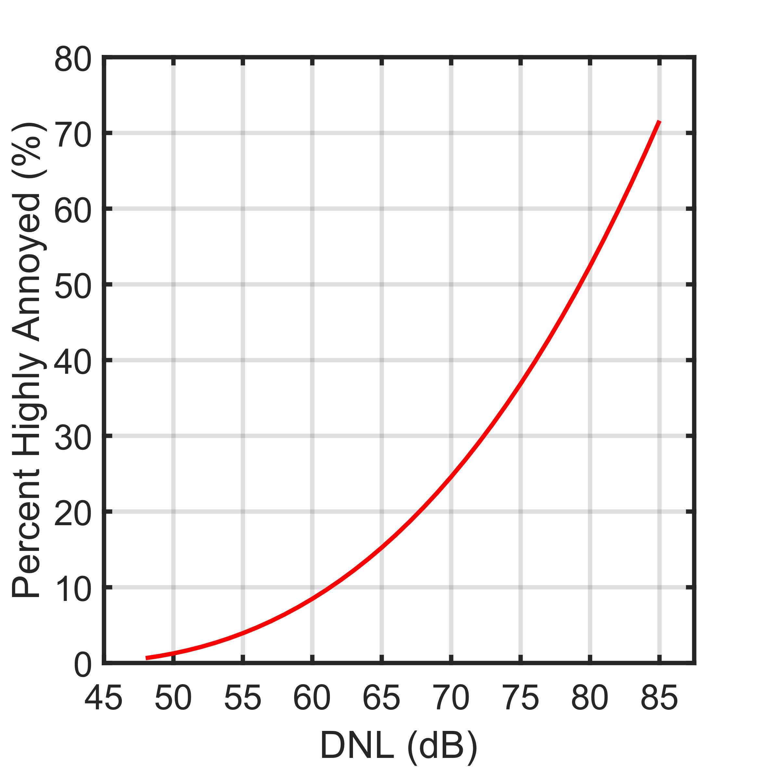



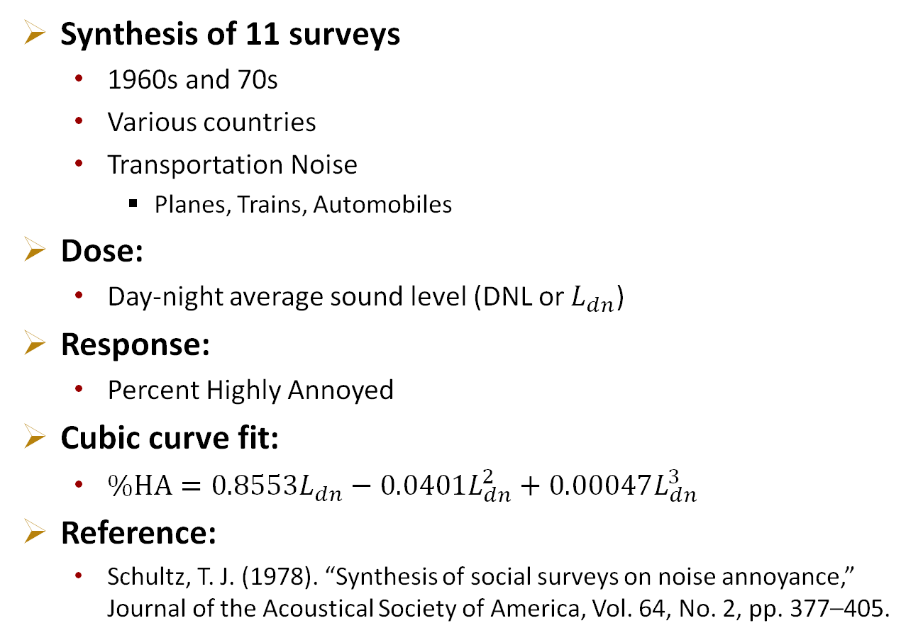
The Schultz Curve – A Formative Community Noise Study
Synthesis of 11 surveys
  1960s and 70s
  Various countries
  Transportation Noise
    Planes, Trains, Automobiles
Dose:
  Day-night average sound level (DNL or $L_{dn}$)
Response:
  Percent Highly Annoyed
Cubic curve fit:
  $\%HA=0.8553L_{dn}−0.0401L_{dn}^{2}+0.00047L_{dn}^{3}$
Reference:
  Schultz, T. J. (1978). “Synthesis of social surveys on noise annoyance,” Journal of the Acoustical Society of America, Vol. 64, No. 2, pp. 377–405.
Notes:
In the context of community noise studies, dose-response relationships commonly trace their roots to the Schultz curve.
Given the problem of noise as an environmental pollutant, social surveys were conducted to measure the noise and characterize the communities response.
In his work, Schultz utilized 11 community noise surveys from various countries the 1960s and 70s of various transportation noise sources, which are simply planes, trains, and automobiles.
These noise sources were measured in day-night average sound level, which is abbreviated DNL or noted symbolically as L subscript dn.
The human annoyance response was characterized as the percent highly annoyed. Some justification for this response metric is that “when people are highly annoyed by the noise, the effects of nonacoustical variables are reduced, and the correlation between the noise [dose] and the expressed subjective reaction is high, for both individuals and groups.”
The resulting fit to the dose and response data was a cubic curve fit, given in the expression below and plotted on the right.
In more recent studies, it is much more common to focus in on a single noise source and a particular population.

Slide 4
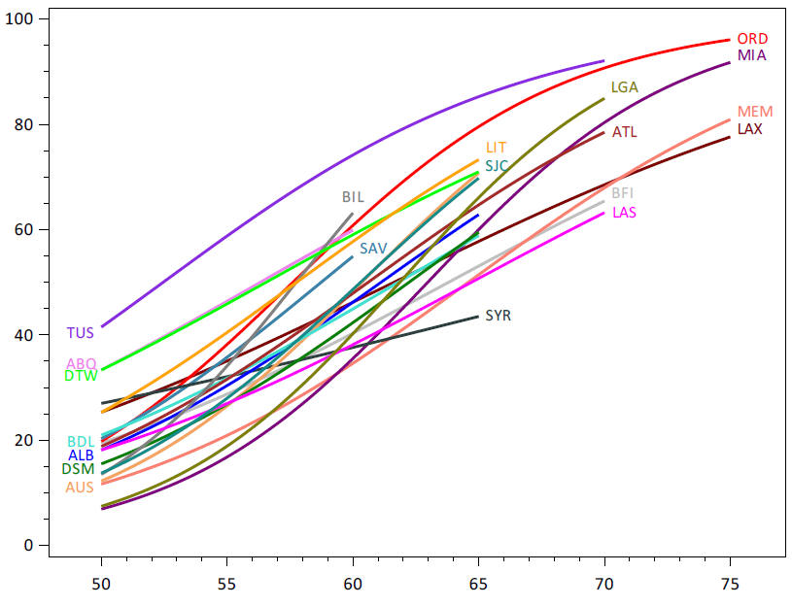
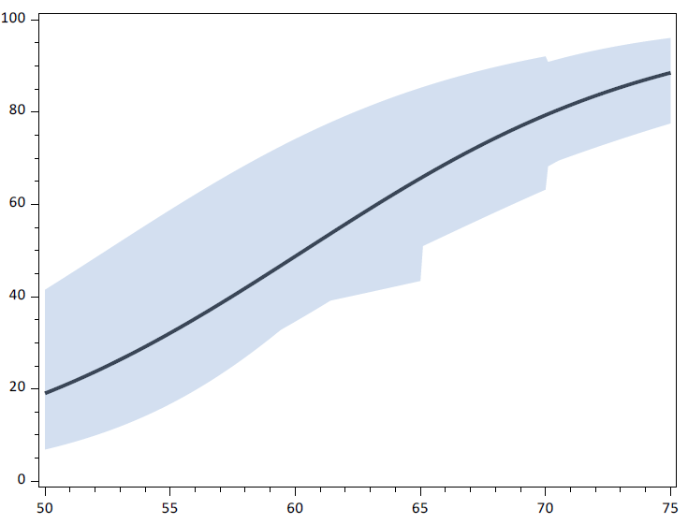
FAA Neighborhood Environmental Survey
Surveyed 20 airports across the U.S.
Updated national dose-response relationship for aircraft noise
Figure 8-1 from Miller, N. P. et al. (2021)
Figure 8-3 from Miller, N. P. et al. (2021)
Estimated Percent Highly Annoyed
Estimated Percent Highly Annoyed
DNL (dB)
DNL (dB)
Miller, N. P. et al. (2021). “Analysis of the Neighborhood Environmental Survey,” DOT/FAA/TC-21/4
Notes:
A more recent example of dose-response relationship in community noise is that of the Neighborhood Environmental Survey conducted by the Federal Aviation Agency.
The FAA conducted this community noise survey of 20 airports of varying size across the US to serve as an update to the 45 year old Schultz curve.
The figure on the right shows the estimated percent highly annoyed for each community as a function of noise dose given in DNL.
On the left, we see the updated national dose-response relationship for aircraft noise, with confidence bounds based on the spread of individual airports.
These results show that people are considerably more annoyed by aircraft noise than suggested by the original Schultz curve, and that there is a fair amount of variability in the public perception of noise depending on location.

Slide 5


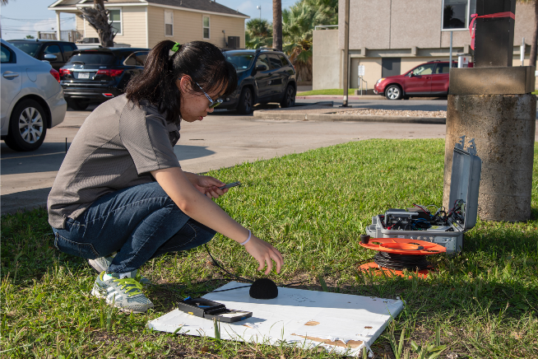

What is Noise Dose for Supersonic Overflights?
Sound level
  People are primarily annoyed by the loudness of the sonic boom
Outdoor Measurement
  Precedent of other community noise
Estimated by a combination of measurement and predictions
Notes:
Now switching gears to commercial supersonic aircraft, what is the noise dose?
Similar to the previous studies, the noise dose is a loudness measurement, in this case, of a sonic boom, though given the design of the X-59 aircraft, the sonic boom will be reduced to a quieter sonic thump.
This noise dose will be the outdoor sound level, rather than the interior noise of a dwelling, similar to other community studies.
The noise dose is estimated for each individual for each supersonic flyover via a combination of field measurements with microphones and predictions from NASA-developed simulation tools. Because supersonic aircraft produce a brief, impulsive noise rather than a longer building drone of a subsonic aircraft overflight, other metrics than DNL may be needed.

Slide 6
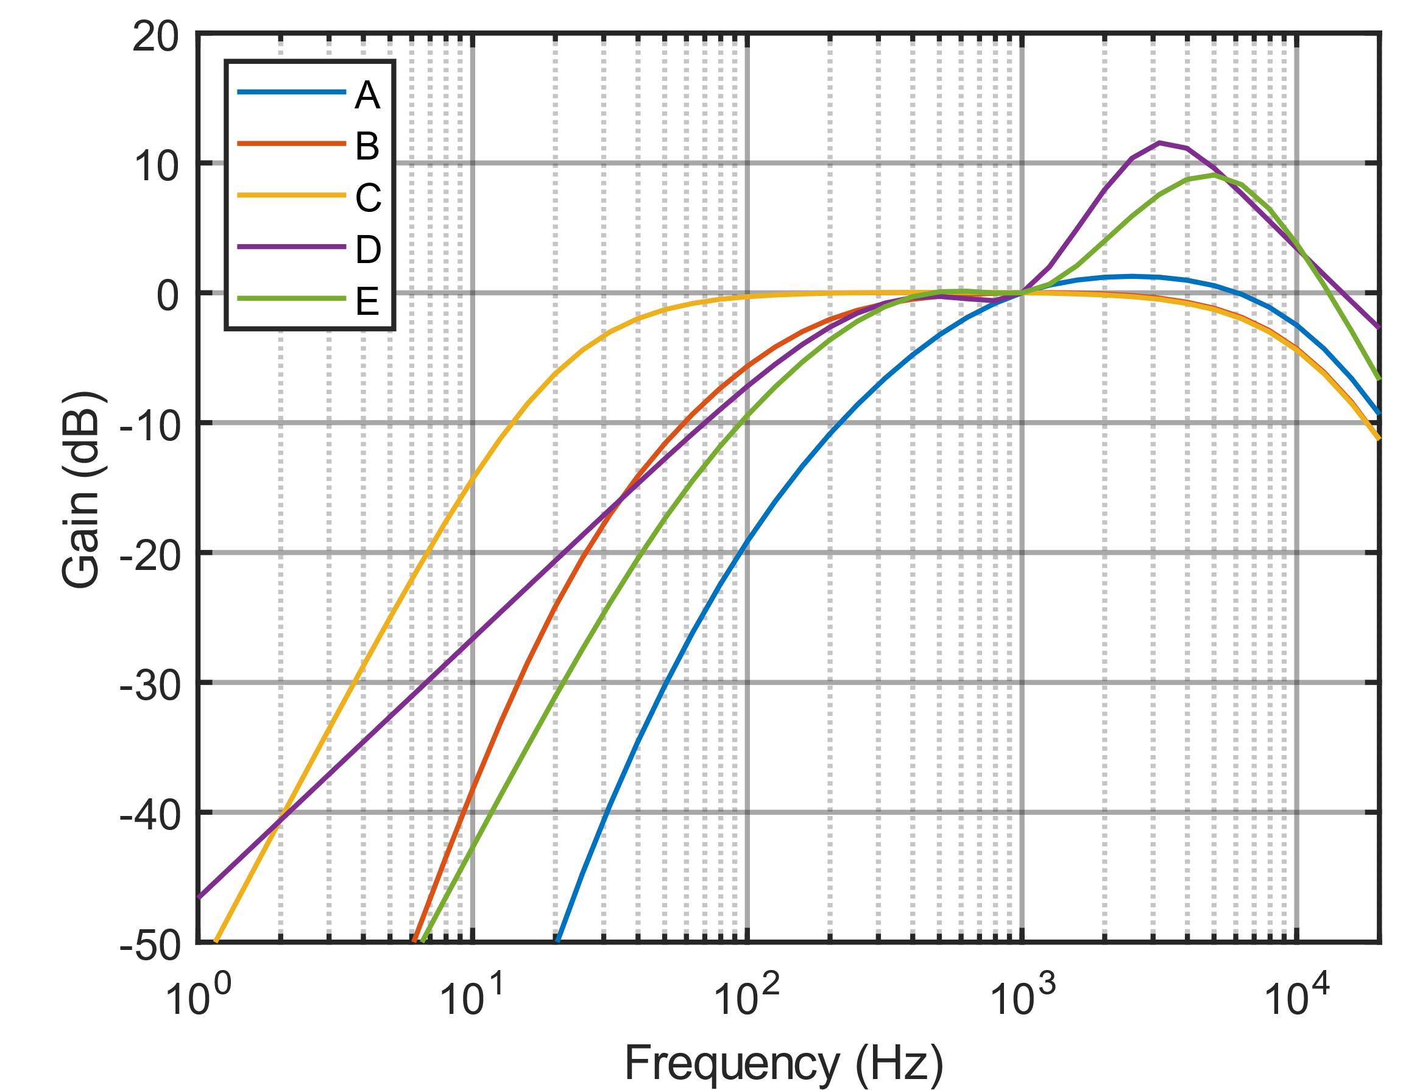
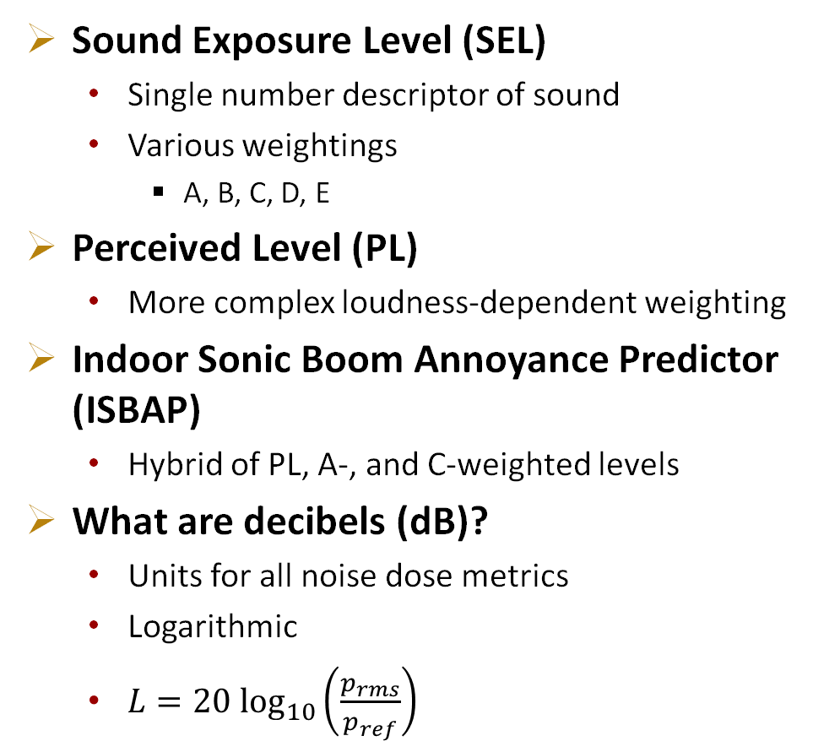
Noise Dose Metric
Sound Exposure Level (SEL)
  Single number descriptor of sound
  Various weightings
    A, B, C, D, E
Perceived Level (PL)
  More complex loudness-dependent weighting
Indoor Sonic Boom Annoyance Predictor (ISBAP)
  Hybrid of PL, A-, and C-weighted levels
What are decibels (dB)?
  Units for all noise dose metrics
  Logarithmic
  $L=20 \log_{10}\left(\frac{p_{rms}}{p_{ref}}\right)$
Notes:
Now what metric and units do we go about measuring quiet supersonic noise signatures?
The acoustic response of the human ear is rather complex. It is both frequency-dependent and loudness-dependent. It also varies from person to person, making it difficult to simply correlate a noise dose metric with human response to sonic thumps.
Therefore, we currently have a handful of candidate metrics from which we can distill a sonic thump waveform into a single number that corresponds to a loudness measure that correlates with human annoyance.
There are several different frequency-weighted acoustic energy summation metrics, which are called weighted Sound Exposure Level metrics. These each attempt a different approximation of how humans respond to sound.
There is also the Perceived Level metric, which differs from the other sound level metrics because it has level-dependent frequency weighting and summation as well as a max loudness adjustment in its computation.
There is also the Indoor Sonic Boom Annoyance Predictor metric, which includes PL and an additional penalty for low frequency sound that may cause rattle or vibration of objects indoors.
These metrics are all described on a decibel scale, which is logarithmic. At its simplest, sound level is given as 20 log 10 of your root mean squared pressure over a reference pressure of 20 micropascals. This means that two events measuring 70 dB do not linearly sum to 140 dB, more like 73 dB.

Slide 7
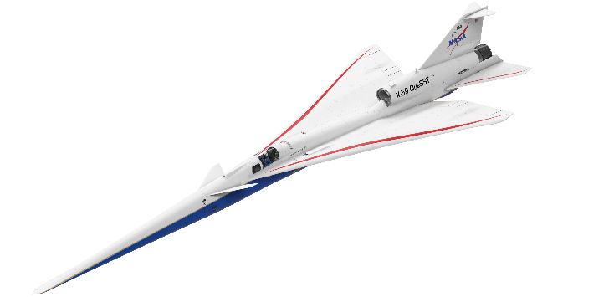
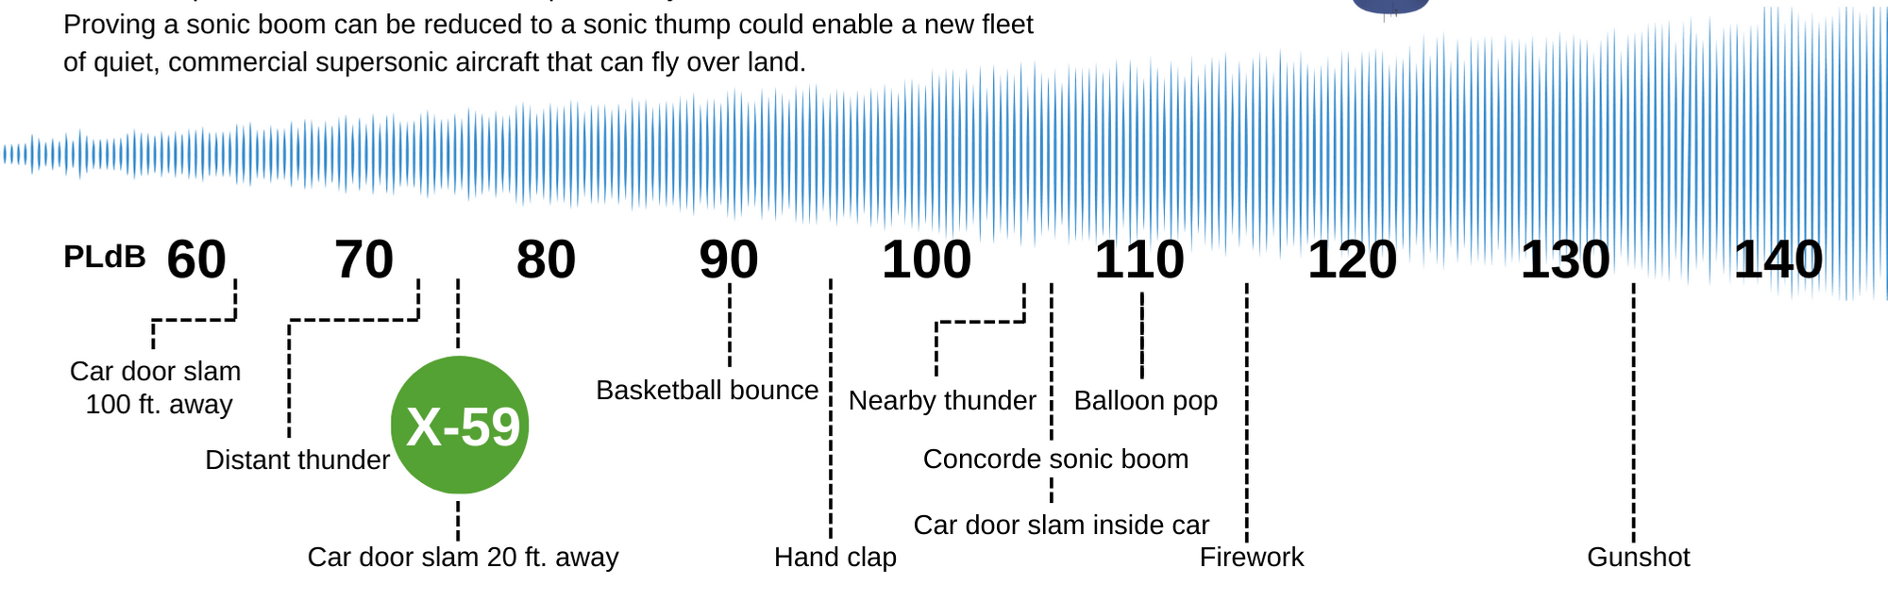
Just how quiet will the NASA X-59 be?
PL (dB)
Quiet
Supersonic
Transit
W. Doebler and J. Rathsam, Proc. Mtgs. Acoustics 36, 040005 2019.
7
Notes:
So just how quiet will the NASA X-59 be? In terms of Perceived level, or PL, which is one of the candidate metrics, a decibel scale is shown here with common impulse event sounds to put these values in context.
The Concorde, a commercial supersonic aircraft that flew from the 1970’s to early 2000’s, produced a conventional sonic boom on the order of 105 dB, which is comparable to the nearby clap of thunder or a car door slamming while inside the car. These types of sound can be quite startling, especially when you are not expecting them.
By contrast, the sonic thump produced by the X-59 and other future quiet supersonic aircraft is designed to be 75 dB, which is comparable to distant thunder, or a car door slam from across the street. These levels are much less intrusive, and if noticed, less likely to cause startle or annoyance.

Slide 8

Single-Event and Cumulative Dose-Response Data
Longitudinal (panel) Study Design: each participant responds to multiple events
  Single Event (SE)
    Responses to individual flyovers
    Perceived Level (PL) [dB]
  Cumulative
    Response from end-of-day survey
    Perceived Day-Night Level (PLDNL) [dB]
      Summation of single events (${SE}_{i}$) in one day:
      $$L_{dn}=10 \log_{10}\left(\sum_{i}{{10}^{{{SE}_{i}}/{10}}}\right)−49.4$$
Participant ID | Event Number | Dose (PL) [dB] | Annoyance Response
001 | 1 | 70 | Not at all
001 | 2 | 81 | Extremely
001 | 3 | 74 | Slightly
002 | 1 | 72 | Slightly
002 | 2 | 78 | Not at all
Participant ID | Day | Dose (PLDNL) [dB] | Annoyance Response
001 | 1 | 32.7 | Very
002 | 1 | 29.6 | Slightly
Notes:
Now, given the design of these community studies, there are actually two noise doses we’re interested in collecting and understanding. The surveys will implement a longitudinal (or panel) design in which the same group of recruited participants reports their annoyance to multiple supersonic overflights each test day. In this way we can capture people’s reaction to both individual single events as well as their daily or cumulative response.
For single events, as previously stated, survey responses are collected shortly after each event, and the single event doses are shown here in PL, one of the candidate metrics to correlate human response to these supersonic events.
Cumulative responses are gathered from end-of-day surveys where participants are asked about their overall annoyance to the sounds from that day. So far, the metric of choice for the cumulative dose has been a day-night level summation of the single events in one day, as given by the equation. This formulation nonlinearly combines the single event doses. And Even though we use a day-night level, events for previous and future low-boom studies only occur during daytime hours.
The tables below illustrate the single-event data in red and how they combine into the cumulative data in blue.

Slide 9
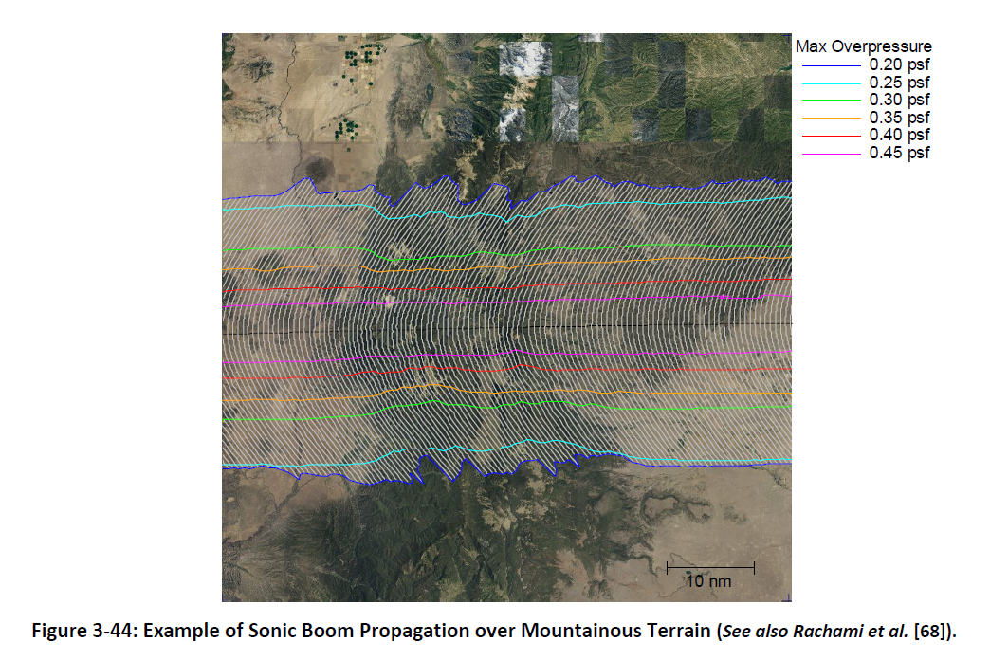
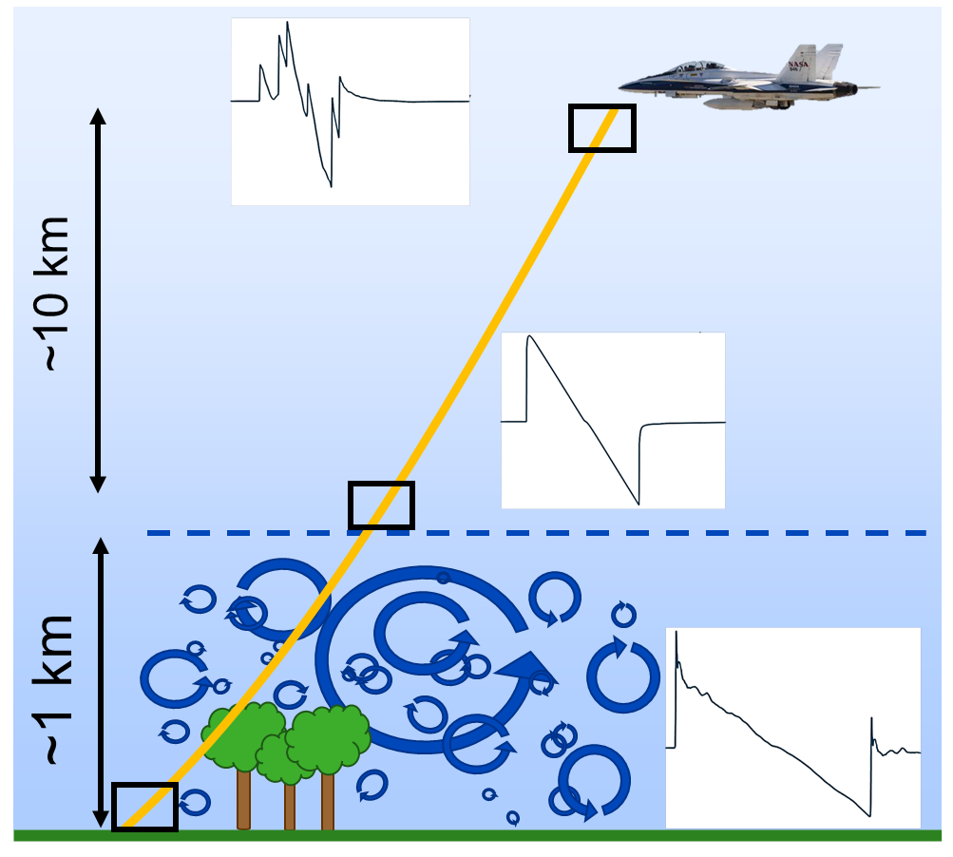



Sources of Variability in Noise Dose
Turbulence
Terrain
Ambient Noise
Source
Path
Atmospheric Boundary Layer
Contours of equal loudness
Receiver
Notes:
Some sources of variability in measuring noise dose are turbulence, terrain, and ambient noise.
A common simplification in acoustics is to speak in terms of source, path, and receiver. Turbulence deals with the path. Random perturbations in the atmosphere change the loudness of a sonic boom or sonic thump. On days with high turbulence, microphones just a few hundred feet away from each other can measure significantly different loudness even though there is essentially little to no variation in the aircraft source noise. You can think of turbulence as the acoustic analog to the focusing and defocusing of light intensity on the bottom of a pool.
Terrain deals with the path very close to the receiver. For example, foliage can absorb sound, while buildings and other terrain can cause reflections or shield a person or a microphone from the noise.
Ambient, or background, noise deals with the receiver’s ability to distinguish the noise source from other sounds in its environment. In noisy environments, a quiet supersonic noise signature might be masked by other noises, which may be good in the sense that the noise is not louder than an individuals’ current environment but makes it harder to measure its level with a microphone. Therefore we want to either remove ambient noise from our measurements or ensure that we get good signal to noise ratio of our supersonic event to the background noise.

Slide 10
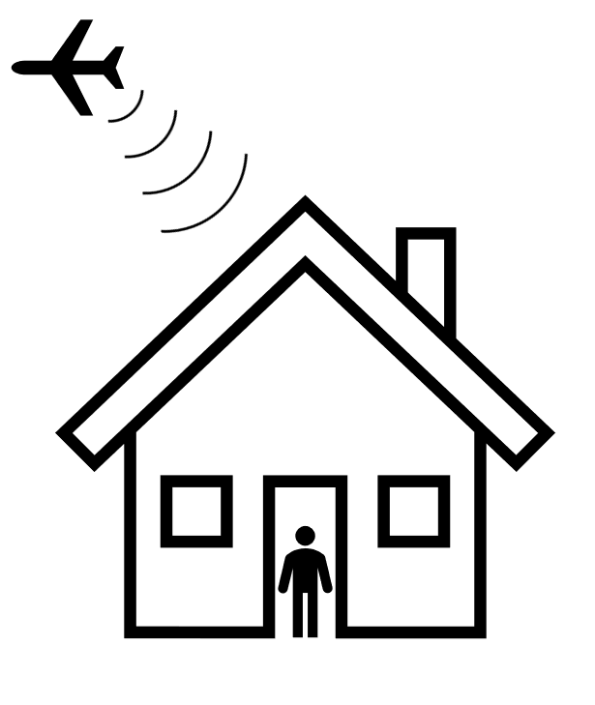
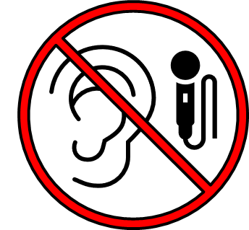

Nuance in Noise Dose Estimate
NASA will measure, predict, and estimate outdoor noise dose
  Not recording noise at participant’s ear
  Cannot account for all aspects of participant’s indoor environment
Notes:
During the X-59 community noise surveys, the noise dose needs to be estimated at each participant location for every X-59 flyover. It is not possible to place a microphone on every participant to record what they actually heard. Instead, noise monitors will be placed sparsely throughout the community, and recordings of the loudness of each supersonic flyover event will be combined with physics-based noise model predictions to estimate a noise dose for each participant.
In addition, we recognize that we won’t be able to measure all aspects of a person’s environment, either indoors or outdoors, but we attempt to capture some of this information via the survey that will be discussed later.

Slide 11
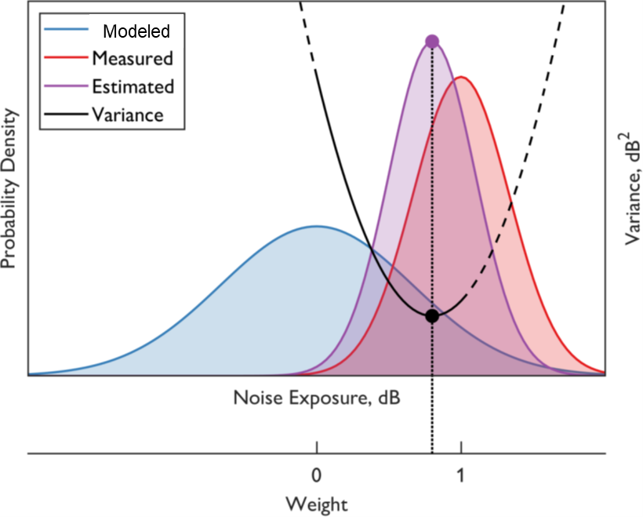
Combining Measured and Predicted Noise Dose
Estimating noise dose from:
  Sparse network of microphones over a large area
  Physics-based prediction tools
Measurements and model predictions
include uncertainty
Kalman filter fuses model predictions and measurements to minimize the variance
of the combined data
Lympany, S., Page, A., “Estimating Sonic Boom Metrics Across a Community Using a Kalman Filter,” J. Acoust. Soc. Am. 152, A86 (2022); https://ntrs.nasa.gov/citations/20220017380
Notes:
To reiterate, it is important to capture a participant’s location, to be able to best assign them an estimated outdoor noise dose, which is a combination of measurements and predictions.
A sparse network of acoustic sensors are distributed across the community, on the order of 150 of these ground recording systems, are used to collect acoustical measurements of the supersonic overflights. These are combined with physics-based prediction tools where each supersonic event includes a measure of uncertainty.
The current method we are considering for estimating the noise dose at a participant location is used commonly when assimilating meteorological inputs for weather models. The method uses a Kalman filter or variance-weighted average to estimate the dose based on mean and variance of predictions and measurements. As shown in the plot, the blue notes the physical model and the red denotes the measurements, with the purple as the combined estimate for the given dose for that particular individual.

Slide 12
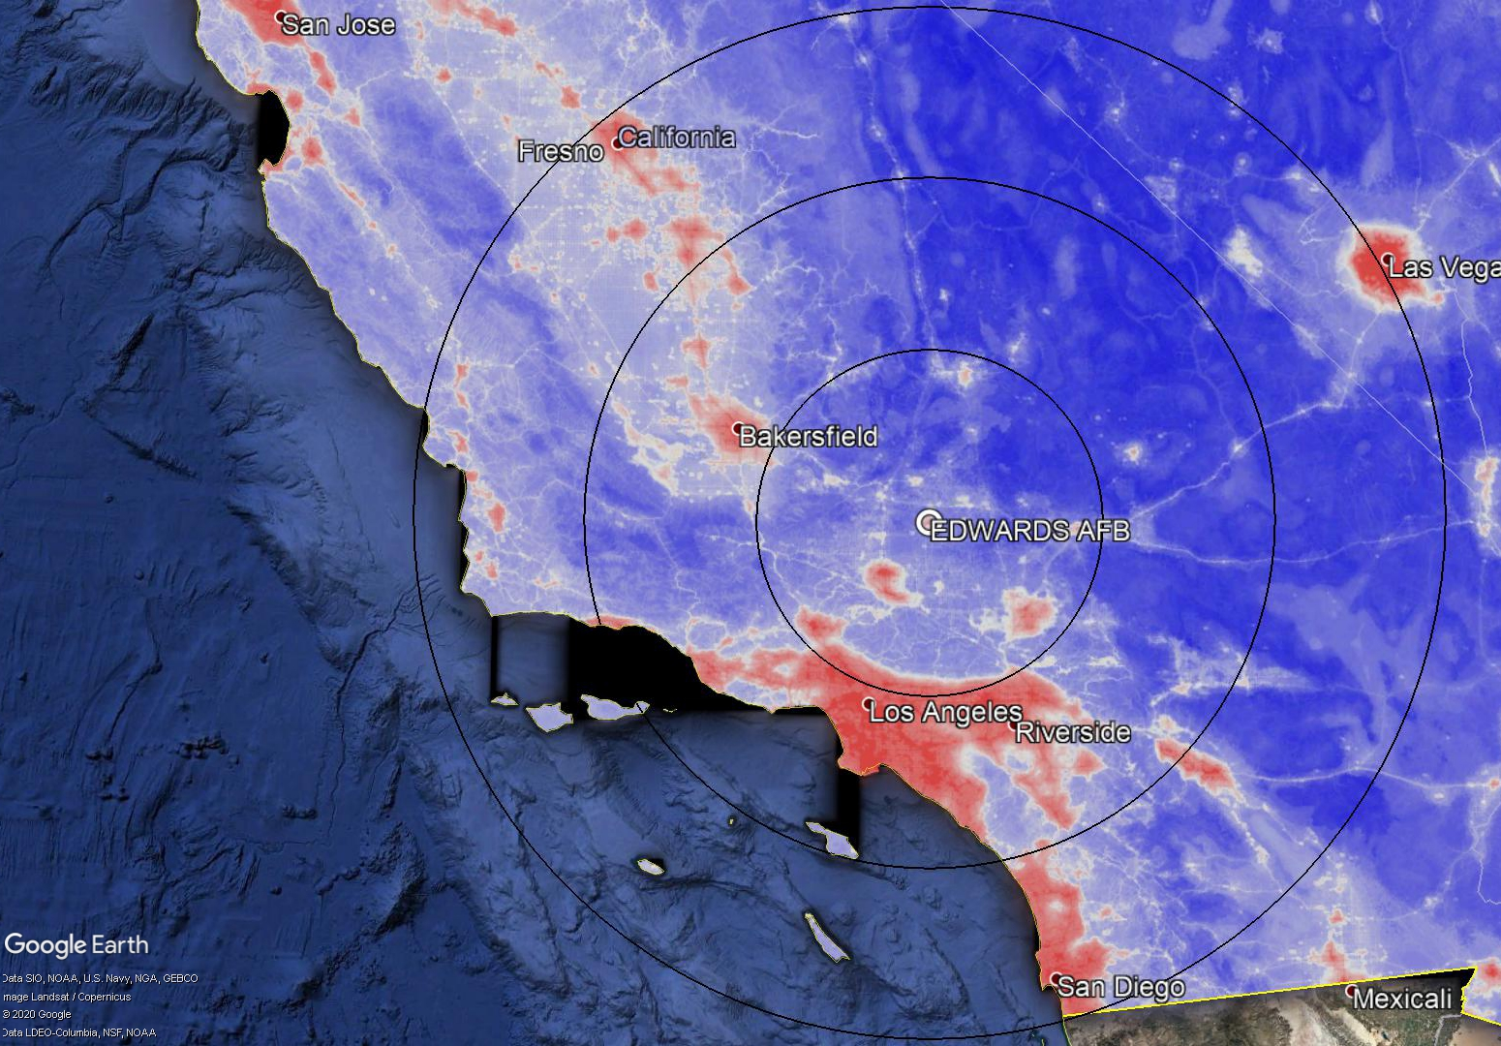
Summary of Key Challenges for Dose
Sparse measurements over a large area
Signal-to-noise ratio of quiet signals
Estimating uncertainty of predictions and measurements
Combining measured and predicted levels
with uncertainty
Strategies to address challenges include:
  Ambient noise correction methods
  Kalman filter assimilation approach for noise dose estimation
  Quesst Mission Phase 2: Acoustic Validation
Ambient noise level
Notes:
In summary, our key challenges include:
-the sparsity of our microphones throughout the large communities
-extracting the low noise signals from ambient noise contamination
-ensuring good estimates of uncertainty in both predictions and measurements
-developing methods to accurately estimate doses in locations where we did not measure using a combination of predictions and measurements
Our strategies to address these challenges are to develop ambient noise correction methods, make use of the Kalman filter assimilation technique, and to practice these during the acoustic validation phase of the X-59 mission, which happens prior to the community survey tests.

Slide 13
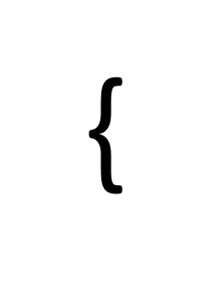
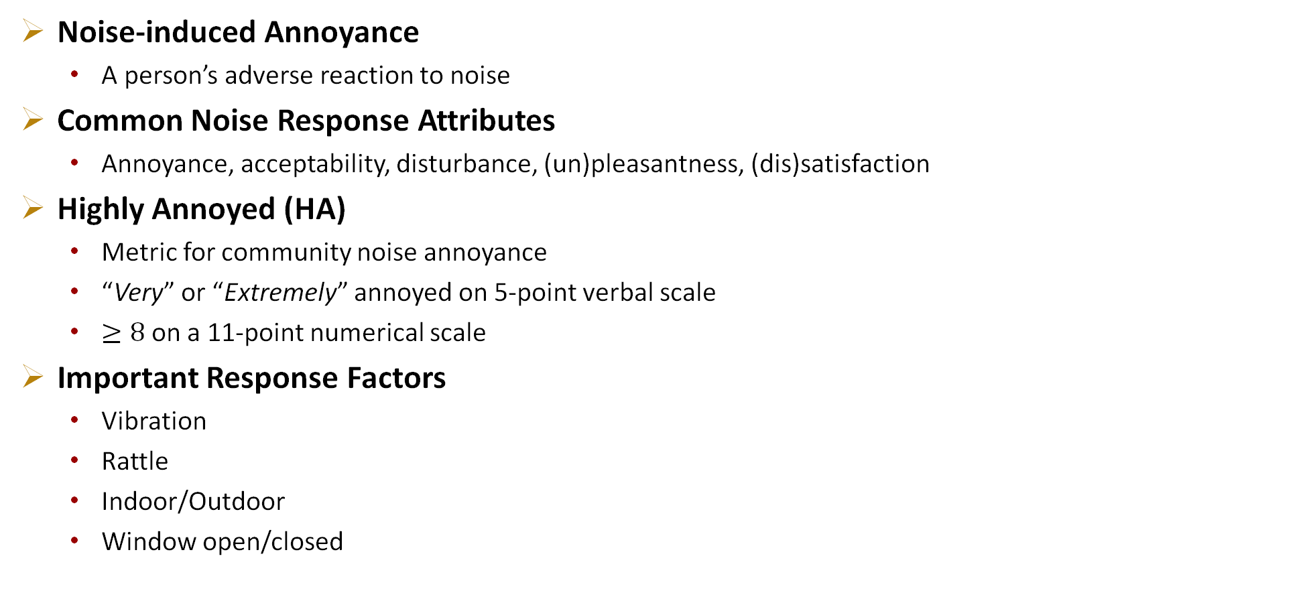
What is Response for Supersonic Overflights?
Noise-induced Annoyance
  A person’s adverse reaction to noise
Common Noise Response Attributes
  Annoyance, acceptability, disturbance, (un)pleasantness, (dis)satisfaction
Highly Annoyed (HA)
  Metric for community noise annoyance
  “Very” or “Extremely” annoyed on 5-point verbal scale
  $≥8$ on a 11-point numerical scale
Important Response Factors
  Vibration
  Rattle
  Indoor/Outdoor
  Window open/closed
Verbal Annoyance Scale
Not at all
Slightly
Moderately
Very
Extremely
{
Highly Annoyed
Numerical Annoyance Scale
0 | 1 | 2 | 3 | 4 | 5 | 6 | 7 | 8 | 9 | 10
Highly Annoyed
Notes:
Now we’re switching gears to the response. We are planning to collect a representative response from just a handful of community studies, and the response we’re talking about here is the noise-induced annoyance, which is a descriptor of a person’s adverse reaction to noise.
There are a handful of attributes often used to describe noise response in the community noise literature. Some examples are annoyance, acceptability, disturbance, unpleasantness, and dissatisfaction.
Here, we’re seeking to characterize annoyance, specifically, whether or not someone is highly annoyed. This is the de facto metric for community noise annoyance, with its roots in the earlier mentioned Schultz curve.
There are two scales commonly used to measure annoyance, a 5-pt verbal scale (shown in red) and an 11-pt numerical scale noted in blue. The cutoff for high annoyance is set by an international technical standard where the “very” and “extremely” annoyed responses or greater than or equal to 8 are considered highly annoyed and other responses are considered “not highly annoyed.”
Furthermore, there are other important response factors to consider for sonic booms and sonic thumps. Vibration and rattle sometimes occur in addition to the thump. And whether you are outdoors or indoors with windows opened or closed can drastically change your listening environment and consequently your response.

Slide 14
Survey Questions
The thump occurred at approximately (TIME). Where were you at approximately (TIME)?
  Home/Work/Somewhere else
(IF SOMEWHERE ELSE) Please enter your location at approximately (TIME). You can provide an approximate address, named location, e.g., a store or other landmark, or cross street
Did you hear a sonic thump that occurred at (TIME)? Y/N [If No, skip to 8]
How much did the sonic thump bother, disturb, or annoy you?
Did the sonic thump startle you? Y/N
Vibration is motion. The motion may be seen, felt, or heard. Did you see, feel or hear vibration from the thump? Y/N
Rattle is a type of noise that can occur when objects move due to vibration. Did you hear rattle from the thump? Y/N
Were you indoors or outdoors at (TIME)? Indoors/Outdoors
(If indoors) Was there at least one window open in the room at the time?
Please enter any additional comments
Annoyance
Not at all
Slightly
Moderately
Very
Extremely
Notes:
So now, we’re going to walk through the survey questions we are currently considering for future X-59 community tests. These questions will be asked for each flyover event and an additional one at the end of the day, which means that over the course of a few weeks, participants could be responding to upwards of a hundred surveys.
The first question notifies an individual when the event happened. They are to respond with their location at said time. They can choose home or work, which will be documented, or they can input an alternative location via address or noting it on a map. This is important for assigning an appropriate dose.
Next, they respond whether or not they heard the sonic thump event.
If no, they skip the response questions, but if yes, we go to the key question of “How much did the sonic thump bother, disturb, or annoy you?” to which they provide a response from the 5-point verbal scale.
We then collect additional data, such as whether the thump startled them, whether they experienced vibration, which is motion that may be seen, felt, or heard, or heard rattle, which is a type of noise that can occur when objects move due to vibration.
They then respond about their environment, the key ones being whether they were indoors or outdoors and if indoors, whether there were any windows open. This windows open or closed question is something the Europeans are interested in, as they more commonly than Americans will have open windows during pleasant weather.
Lastly, we offer the opportunity to provide any additional comments.

Slide 15

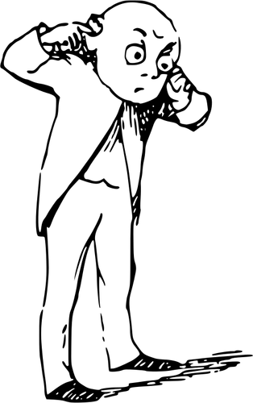






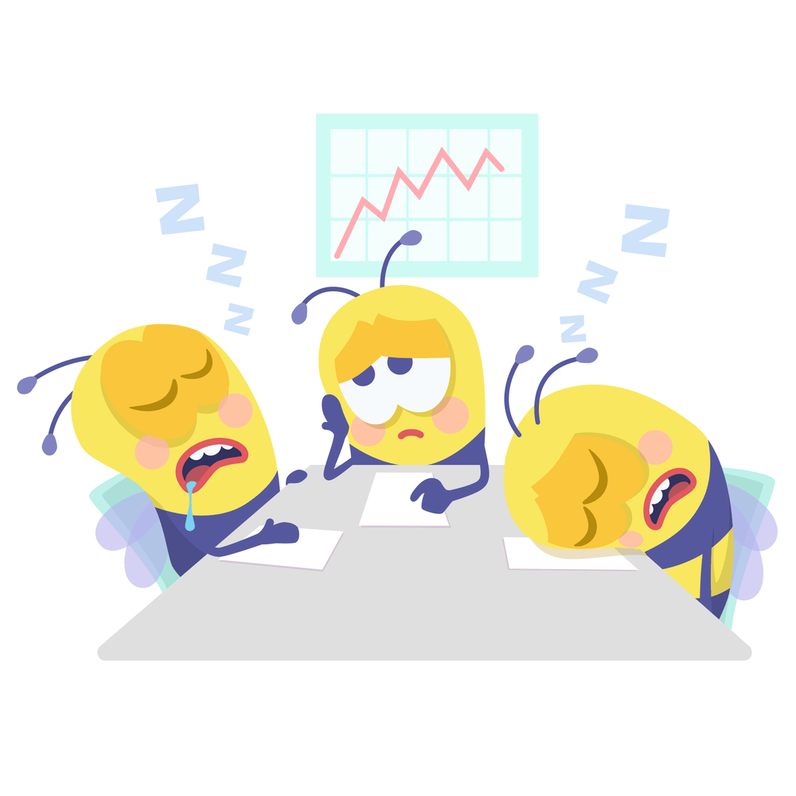
Variability in Annoyance Response and Nonacoustic Factors
Response Latency
Listening Environment
Activity during flyover event
Temperament of the day
Annoyance: an abstract concept
Survey fatigue and satisficing
Carryover effects
-
+
Notes:
Aside from the variability in the dose estimate, there are several potential sources in annoyance response variability between and within subjects. Some of these are unquantifiable or inestimable.
One aspect is response latency, which is the time difference between responding to a survey and experiencing the boom. Perhaps their perception of the event is clouded or changes over time.
The participant’s listening environment may impact their perception, maybe they were in the basement and could barely hear the boom. Their activity and expectations of quietness during the boom may also have an impact, perhaps a quiet boom would be more annoying to someone trying to finish their DATAWorks slide deck and script before the deadline.
Or maybe they just slept poorly and woke up on the wrong side of the bed, so any little thing is generally more annoying today than yesterday.
There may also be difference in house each person defines their annoyance thresholds and there may not be a clear transition between the non-continuous annoyance rating scale.
We will also be asking the participants to respond to more than 100 surveys over the course of a month, with up to 7 per day. This could result in survey fatigue or trying to rush through each survey. Or maybe there will be attrition. We will mitigate this with a monetary incentive that will hopefully not introduce bias.
Finally, there could be other effects such as a person’s previous response or previous boom event influencing their perception of the current boom event.

Slide 16
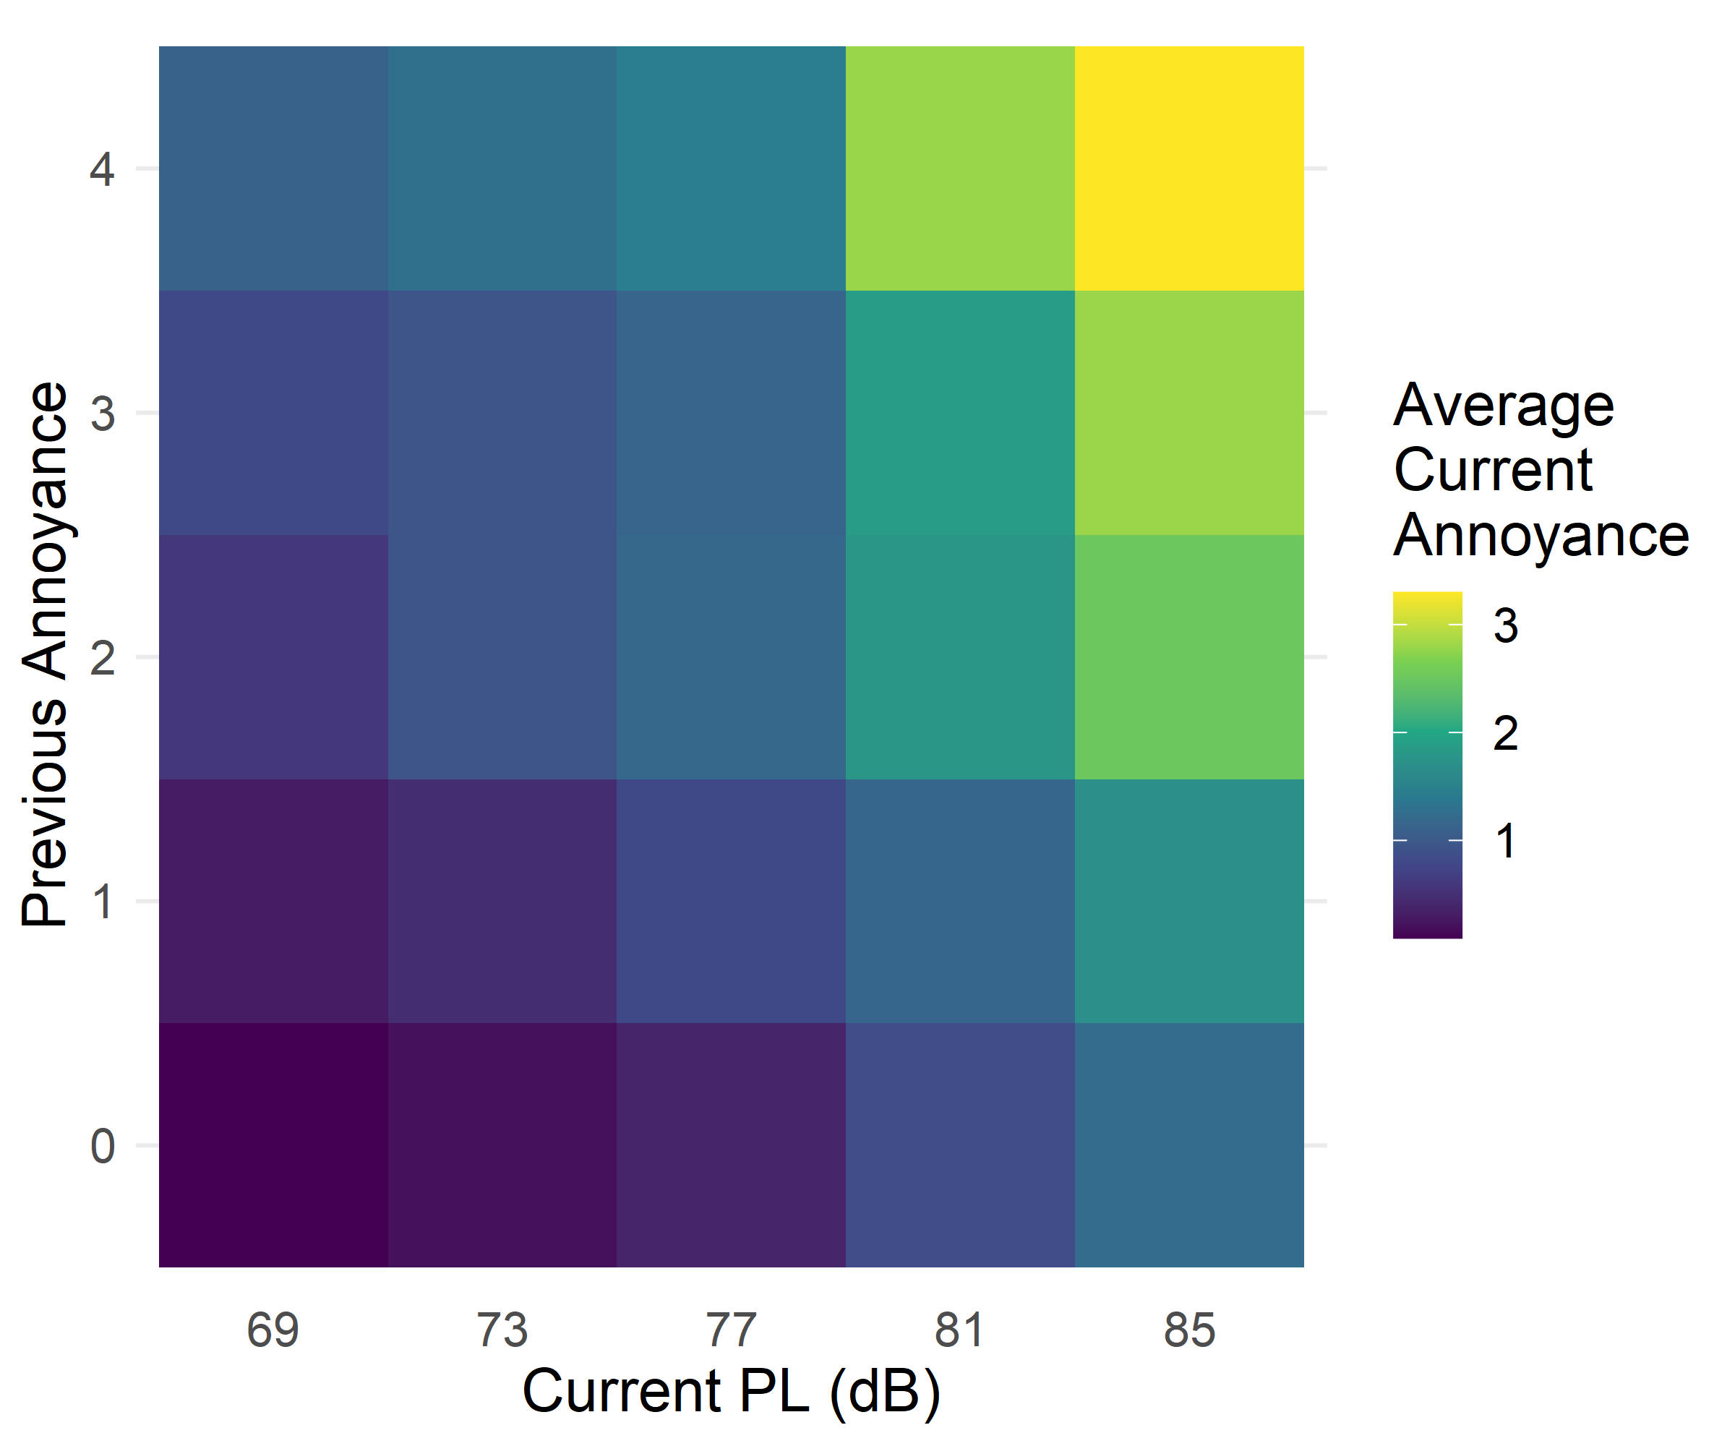
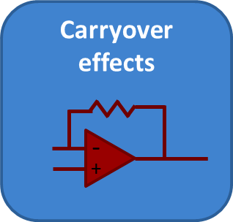
Response Bias due to Carryover Effect
Carryover effect: previous stimuli affect response to current stimulus
Graphical analysis
  Horizontal trend depicts direct effect, i.e., annoyance increase with dose
  Vertical trend depicts carryover effect, i.e., previous annoyance increases current annoyance
Mitigation strategies
  Vary order of doses
  Check data for carryover effects via graphical and regression analyses
Lab Data Results
Previous Annoyance Rating
Current Dose (dB)
Notes:
Because X-59 data will be longitudinal, where the same group of participants will be responding multiple times, we’re going to take a look at possible bias in longitudinal studies in the form of carryover effects. Carryover effects are where previous stimuli affect the response to the current stimulus, in this case, our stimulus is the quiet supersonic noise signature. Potential examples include the previous dose level impacting your current response, becoming more or less annoyed over time, and your previous annoyance response affecting your current response.
The plot shown here comes from an analysis of quiet sonic boom laboratory listener data where the color of each square notes the current annoyances as a function of the current dose and the previous annoyance rating. Ideally, you would only see a horizontal trend – a direct effect of annoyance increasing with dose, but we see a vertical pattern arising, which indicates that previous annoyance responses cause participants to respond more annoyed. Essentially, annoyance is breeding annoyance.
Some strategies we are attempting to mitigate this and other carryover effects are to vary the order of doses, which allows for the checking of data for carryover effects through graphical analysis as shown here or through statistical regresssional analysis.

Slide 17
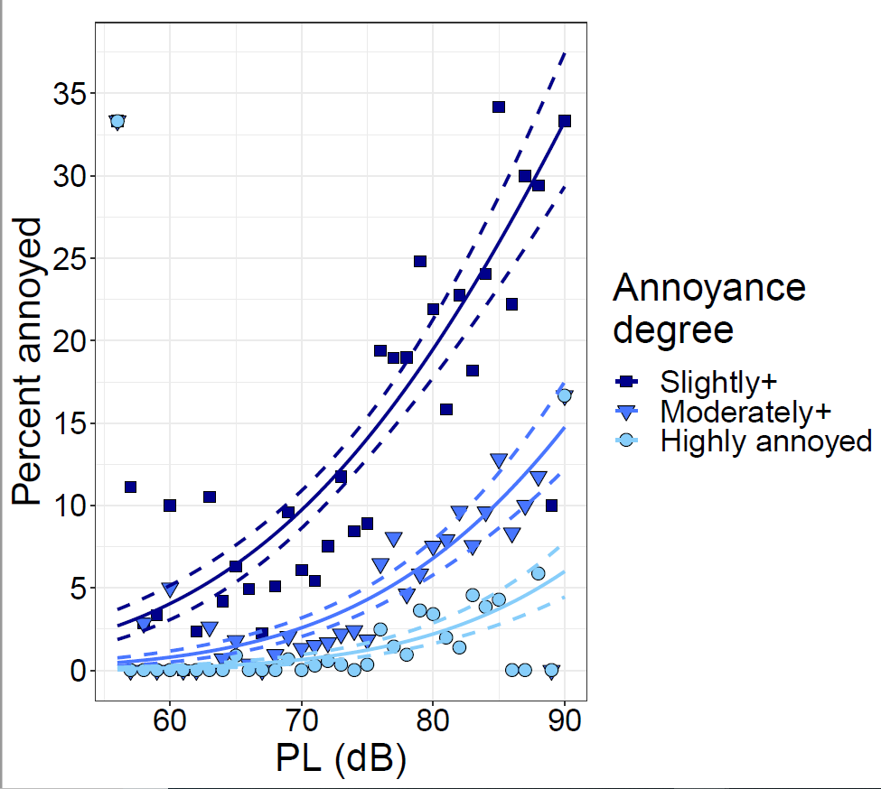
Summary of Key Challenges for Response
Representative sample from few community studies
Instantaneous survey collection
Location information
Avoiding bias
Attrition
Strategies to address challenges include:
  Survey risk reduction test
  Focused media strategy
  Cash incentive
Notes:
There are a handful of challenges in the survey design as well, which impacts the vertical axis of the dose-response curve, including
Representative sample from few community studies – we only have 5 communities that we can test
Instantaneous survey collection – we want to collect responses after each aircraft overflight
Location information – location required to assign a dose value
Statistical analysis to handle collected data – Same group of participants responding over the course of weeks requires a different method than many other community noise surveys that often just have 1 response over a longer period of time
Avoiding bias – We don’t want people to never say they’re annoyed because they want commercial supersonic flight, we need honest answers to accurately model representative annoyance
Some mitigation strategies to address these challenges include:
Testing/validation of survey methods and instruments through small-scale studies
Testing of automated processing methods to achieve target levels of usable/valid survey data

Slide 18
Summary
Dose (Noise Level) “x-axis”
  What is it?
    Outdoor noise level
  How do we measure it?
    Field microphones and modeling predictions
    Variety of candidate noise level metrics
  What are sources of error and variability?
    Sparse measurements over a large area
    Signal-to-noise ratio of quiet signals
    Estimating uncertainty of predictions and measurements
    Combining measured and predicted levels
    with uncertainty
Response (Annoyance) “y-axis”
  What is it?
    Noise-induced annoyance
  How do we measure it?
    Collect responses via phone/internet surveys
    High annoyance and percent highly annoyed
  What are sources of error and variability?
    Representative sample from few community studies
    Instantaneous survey collection
    Location information
    Nonacoustic factors
    Attrition
Notes:
In conclusion, this talk went over several aspects of variability in community noise survey data in the context of future community studies with the X-59 aircraft.
We looked at the noise dose, which is the outdoor sound level of the quiet supersonic overflight noise signatures. We measure the dose with microphones in the field and modelled predictions using a variety of candidate noise level metrics. Some source of error and variability include:
Sparse measurements over a large area
Signal-to-noise ratio of quiet signals
Estimating uncertainty of predictions and measurements
Combining measured and predicted levels
with uncertainty
On the response side, we are collecting noise-induced annoyance through surveys in order to measure high annoyance and the percent highly annoyed as a function of dose. Some sources of error and variability include:
Representative sample from few community studies
Instantaneous survey collection
Location information
Non-acoustic factors
Attrition
Thank you for your time and attention, I’d be happy to answer questions

Slide 19
References
Schultz, T. J. (1978). “Synthesis of social surveys on noise annoyance,” Journal of the Acoustical Society of America, Vol. 64, No. 2, pp. 377–405.
Miller, N. P. et al. (2021). “Analysis of the Neighborhood Environmental Survey,” DOT/FAA/TC-21/4; https://www.airporttech.tc.faa.gov/Products/Airport-Safety-Papers-Publications/Airport-Safety-Detail/ArtMID/3682/ArticleID/2845/Analysis-of-NES
Page, J. A. et al. (2020). “Quiet Supersonic Flights 2018 (QSF18) Test: Galveston, Texas Risk Reduction for Future Community Testing with a Low-Boom Flight Demonstration Vehicle,” NASA/CR-2020-220589/Volume I https://ntrs.nasa.gov/citations/20200003223
American National Standard Institute (2016). “Design Response of Weighting Networks for Acoustical Measurement,” ANSI S1.42-2001 (R2016).
Loubeau, A., Naka, Y., Cook, B., Sparrow, V., and Morgenstern, J. (2015). “A new evaluation of noise metrics for sonic booms using existing data,” AIP Conference Proceedings, Vol. 1685, 0900105; doi: 10.1063/1.4934481
Stevens, S. S. (1972). “Perceived Level of Noise by Mark VII and Decibels (E),” Journal of the Acoustical Society of America, Vol. 51, No. 2B, pp. 575-601; doi: 10.1121/1.1912880
Doebler, W. J. and Rathsam, J., “How loud is X-59’s shaped sonic boom?,” Proceedings of Meetings on Acoustics, Vol. 36, 040005; doi: 10.1121/2.0001265
Lympany, S. V. and Page, J. A. (2022). “Estimating sonic boom metrics across a community using a Kalman filter,” Journal of the Acoustical Society of America, Vol. 152, No. 4, A86; doi: 10.1121/10.0015632. https://ntrs.nasa.gov/citations/20220017380
Ballard, K. M., Vaughn, A. B., Doebler, W. J., and Rathsam, J. (2021). “Analysis of carryover effects in a low boom laboratory listener study,” Proceedings of Meetings on Acoustics, Vol. 45, 040002; doi: https://doi.org/10.1121/2.0001566
Chintam, A., Ballard, K. M., Doebler, W. J., and Vaughn, A. B. (2022). “Consistency of annoyance perception of sonic booms and survey satisficing,” NASA/TM-20220012593. https://ntrs.nasa.gov/citations/20220012593
Ref Bech & Zacharov Perceptual Audio Evaluation

Slide 20

Thank You!
nasa.gov/quesst
aaron.b.vaughn@nasa.gov
william.j.doebler@nasa.gov

Slide 21
Abstract
Key outcomes for the NASA Quesst mission are noise dose and perceptual response data to inform regulators on their decisions regarding noise certification standards for the future of overland commercial supersonic flight. Dose-response curves are commonly utilized in community noise studies to describe the annoyance of a community to a particular noise source. The X-59 aircraft utilizes shaped-boom technology to demonstrate low noise supersonic flight. For X-59 community studies, the sound level from X-59 overflights constitutes the dose, while the response is an annoyance rating selected from a verbal scale, e.g., “slightly annoyed” and “very annoyed.” Dose-response data will be collected from individual flyovers (single event dose) and an overall response to the accumulation of single events at the end of the day (cumulative dose). There are quantifiable sources of error in the noise dose due to uncertainty in microphone measurements of the sonic thumps and uncertainty in predicted noise levels at survey participant locations. Assessing and accounting for error in the noise dose is essential to obtain an accurate dose-response model. There is also a potential for error in the perceptual response. This error is due to the ability of participants to provide their response in a timely manner and participant fatigue after responding to up to one hundred surveys over the course of a month. This talk outlines various challenges in estimating noise dose and perceptual response and the methods considered in preparation for X-59 community tests.

