Slide 1

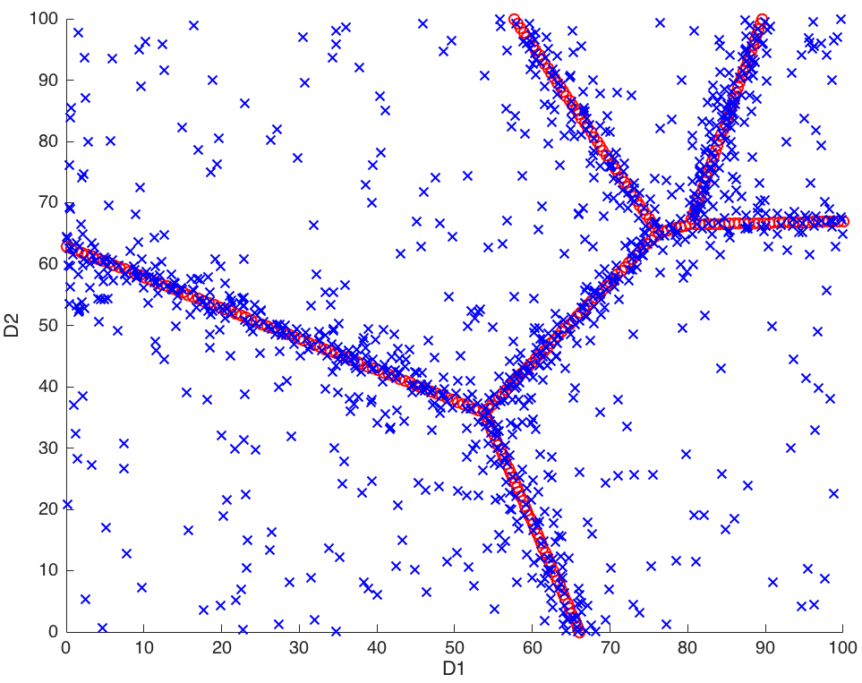
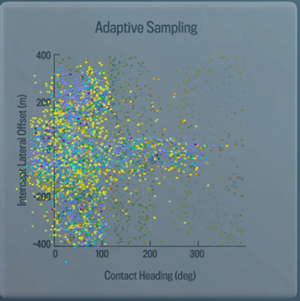

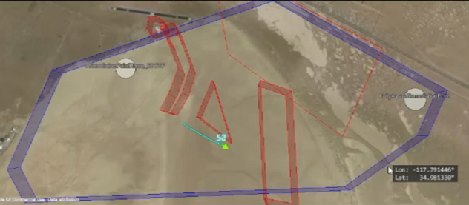
Advanced Autonomy T&E Updates and Focus
Kathryn Lahman, Program Manager
Advanced Autonomy Test & Evaluation
Kathryn.lahman@jhuapl.edu
(240) 228-7765

Slide 2
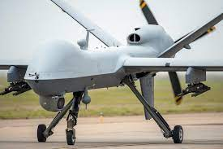
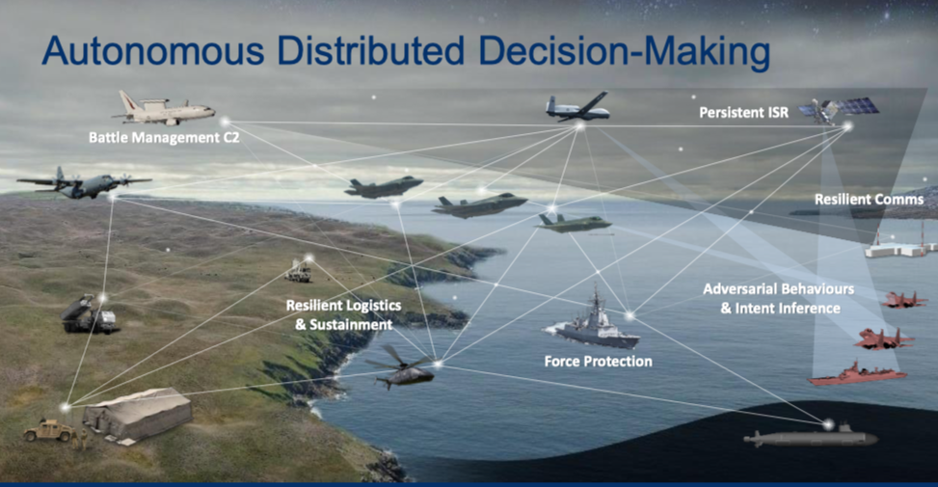
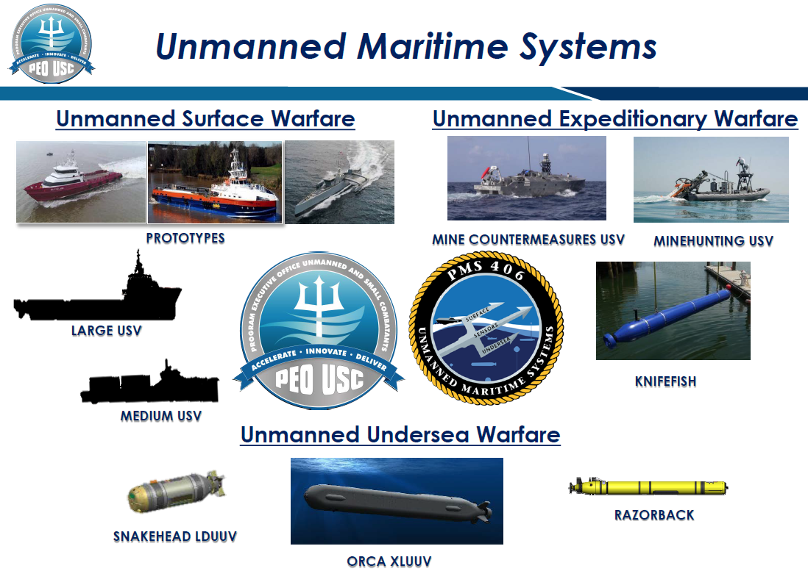
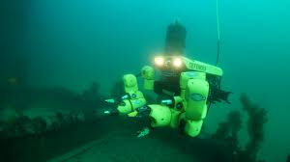
Investments in autonomy and AI are a major push for the Navy and military as a whole
Put video of our big orange boat testing – should be some stock video from comms on this – can also use some stock video from the recent EP3 video made by Toni Salter and her team
Complex autonomy investments have significantly increased over the years
Navy has the goal of adding autonomous systems to the fleet construct, but we are still working through the value proposition for them
Still trying to understand in what ways to use these advanced systems
Test protocols are nascent for the truly autonomous system

Slide 3
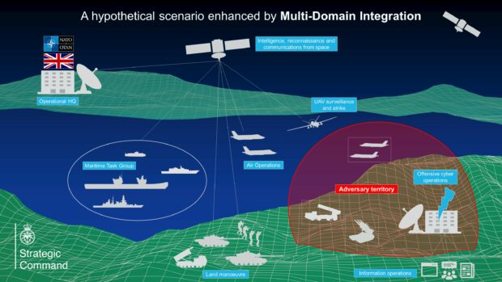
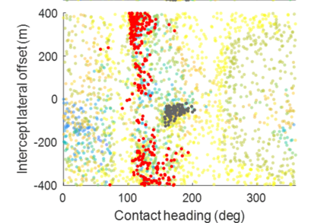
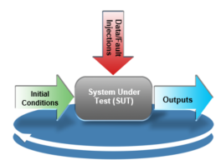
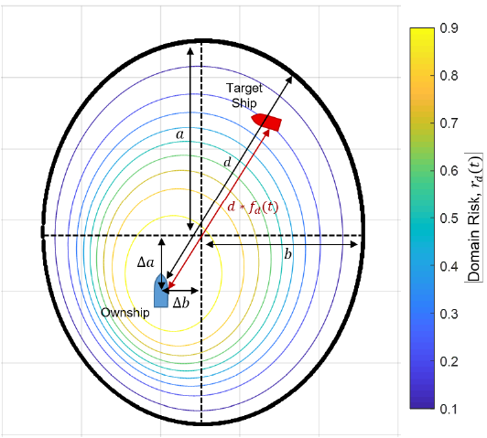
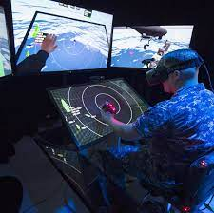
But there are some primary gaps within autonomy T&E
Supporting validated, cross autonomy M&S environments
Building technologies to support full range testing within M&S environments
Streamlining test capabilities for faster and more structured test flows
Building data analytics to better sift through massive amounts of data generated through autonomy testing
Measuring stakeholder and calibration of trust, for optimal assurance of systems in the field

Slide 4
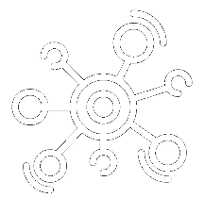

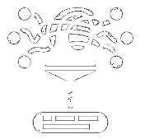
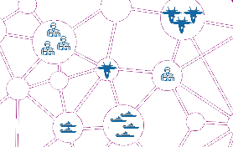
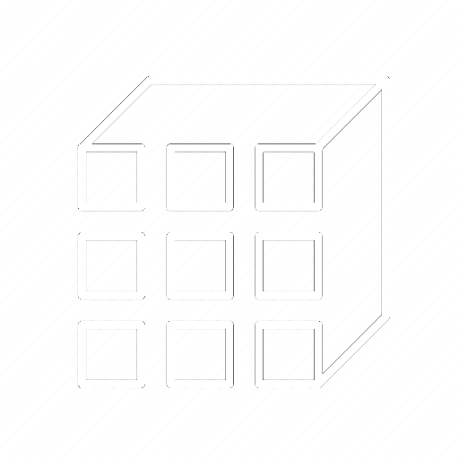
Modeling & Simulation is critical to testing autonomous systems at full scale
Complex autonomous systems perform complicated tasks in unpredictable environments
The more autonomy a system is given, the more flexible the behavior
increasing both the number of possible and appropriate behaviors
“State-space explosion”
What tasks a system can do?
Autonomy
Autonomous System
Complex Tasks
Complex Environments
Teaming Complexity
Non-Deterministic Decisions
Multiple Viable Solutions
What tasks a system can do?
Quantitatively define outcomes and thresholds of success
Testing early to find obvious areas of test focus and move to higher fidelity test constructs
Wind Funnel
4

Slide 5
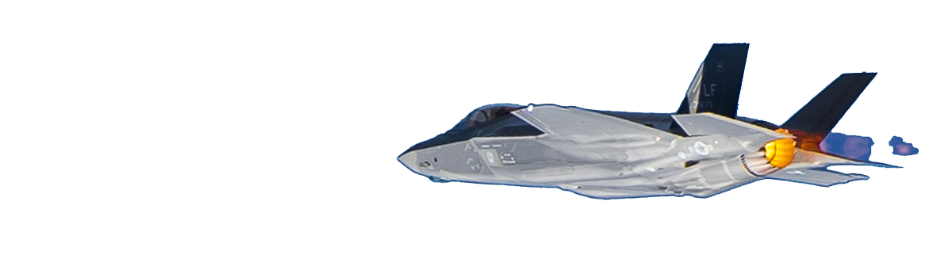

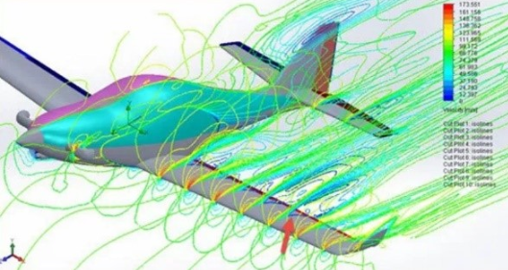
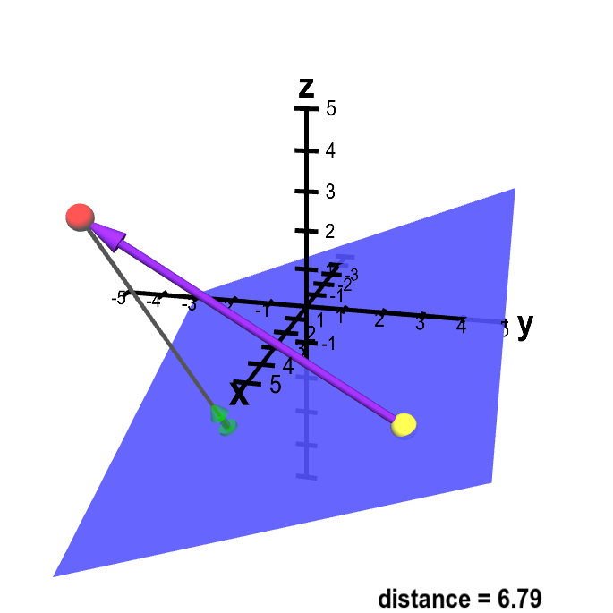
We can increment M&S fidelity to minimize risk and maximize testing
Lack of Scalability!
Simulations are made to only support specific autonomies that the developers are building
Sim environments and models are often only as high in fidelity as required to meet the minimum viable product fort the contract
Different sim fidelity can provide value at different stages
High Fidelity
Medium Fidelity
- Larger swaths of test runs - Large acceptance spaces - Lower fidelity - Generalizability
Low Fidelity
- Smaller singular test runs - More detailed task flows - Higher fidelity
- Individually complex
Increment
5

Slide 6
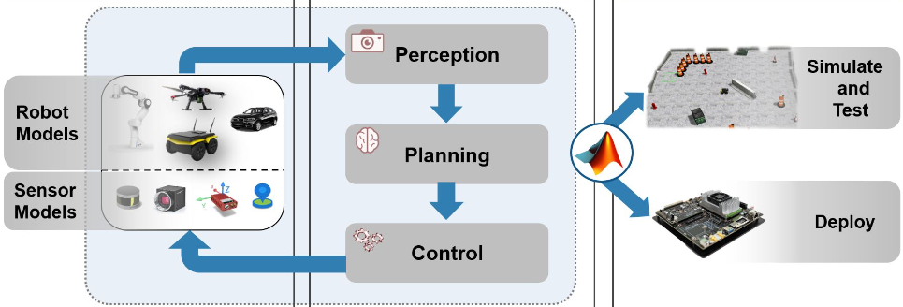
But added integration introduces new issues
Integration is HARD!
Each autonomy, test tool, simulation requires specific integration tasks that are rarely repeatable to other systems
Standardization can help!
Testers and developers make structural choices
Enable replacement of systems with minimal disruption to interfaces
Facilitate common understanding and cross program comparison
Known standardization efforts
HLA – High Level Architecture
UMAA - Unmanned Maritime Autonomy Architecture
CODE – Collaborative Operations in Denied Environments
Welcome to the Autonomous Systems Blog! » Autonomous Systems - MATLAB & Simulink (mathworks.com)
Increment -> Integrate
6

Slide 7
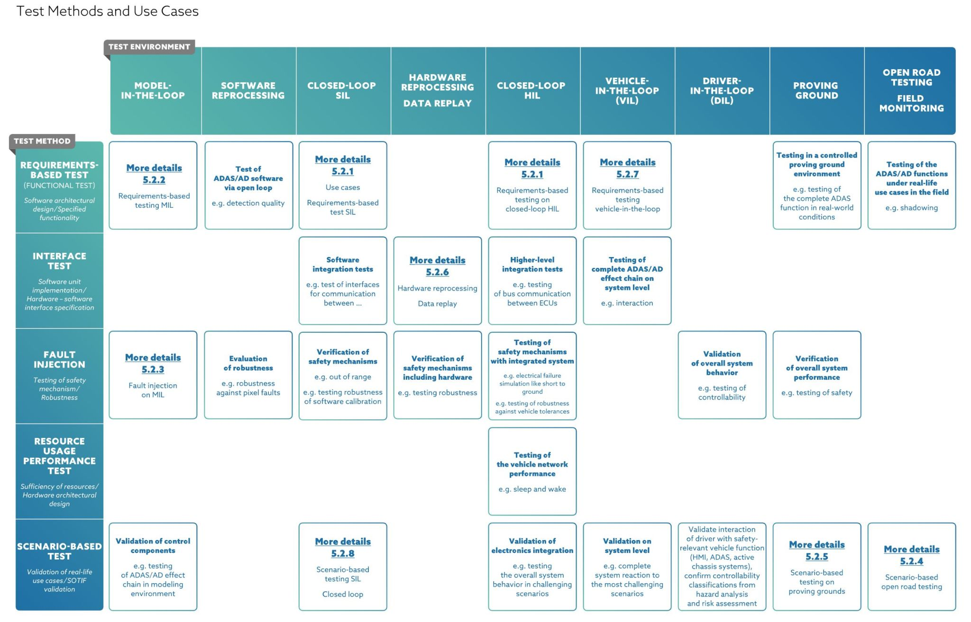
Standardization will support modularity
Challenges associated with T&E include ad-hoc and inconsistently applied procedures
Require the adoption of policies, standards, and metrics
Standardized modeling framework spanning the lifecycle for autonomous systems does not exist
Non-standard criteria contribute to an inconsistently applied validation process
Ambiguity in modeling framework creates problems for development
Lack of centralization and non-compliance can impede users to understand and monitor complex systems
Help combine evaluations of independent components
COLREGS assessment often looks at the navigation autonomies, but sensor and world models play a critical role in this
Home (asam.net)
Increment -> Integrate -> Modularize

Slide 8
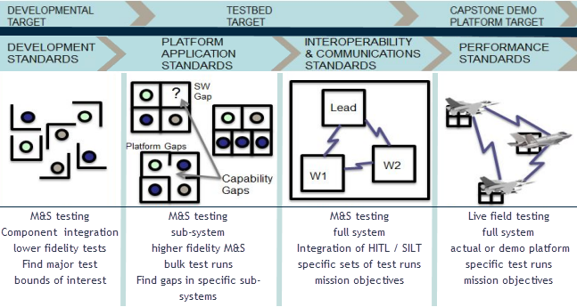
Modularity supports improved T&E throughout the lifecycle
Live Virtual Constructive (LVC) test tool suite
Development environment -> integration test bed environment -> operational test or demonstration platform
Utilize multiple M&S fidelities to meet needs of a given phase
Increment to higher fidelity M&S environments
Integration of other systems or tools as testing progresses
Incorporate test tools to support each phase & maximize output
Large scale testing to find test areas of focus
Metrics and measures for assessing and understanding autonomy decision making
Assessing and measuring human teaming constructs
Safety performance envelopes for HITL or human teaming test runs
lvc-enabled-testbed-for-autonomous-system-testing-docx.pdf (wordpress.com)
Increment -> Integrate -> Modularize -> Build

Slide 9
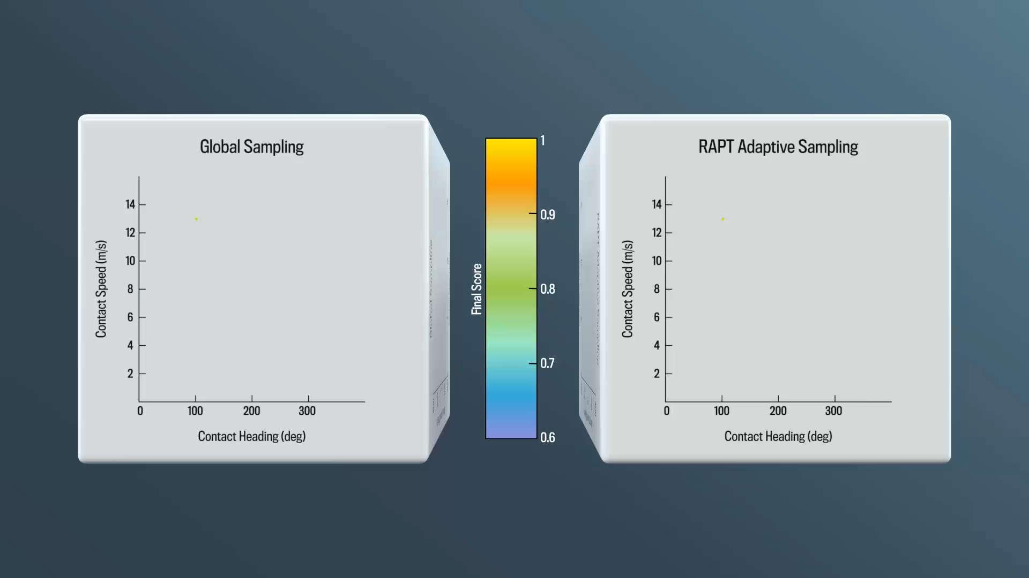

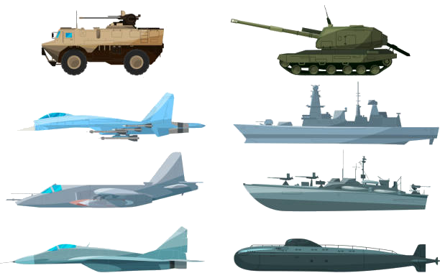
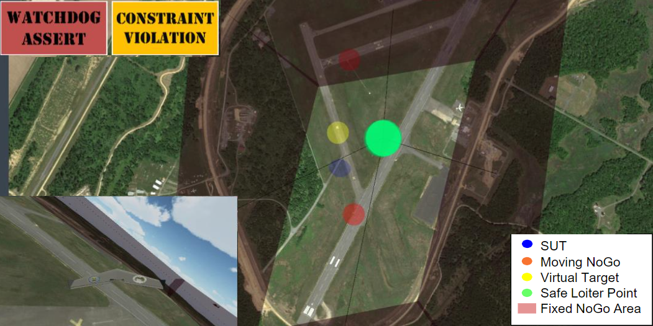

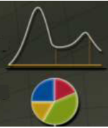

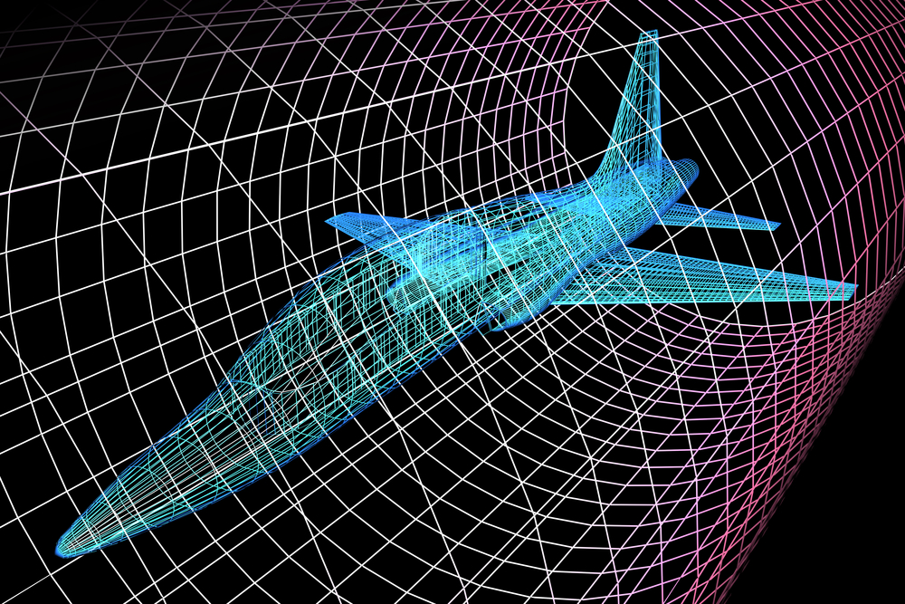

Advanced test technologies are leveraged by test suites
Honing in on performance bounds across any number of dimensions
Utilizing ML to replicate resource intensive autonomies or sims
Maximizing bulk testing for faster state space assessments
Less in depth analysis to find the patterns
Injection of realistic faults to autonomy inputs
RAPT
MIMIC
RIOT
TACE
….
Surrogate Testing
Agent Library
Runtime Monitoring
Lightweight Digital Surrogates
Sensitivity and Uncertainty
White Boxing
Simulation & Models
Human Teaming
Increment -> Integrate -> Modularize -> Build -> Support

Slide 10

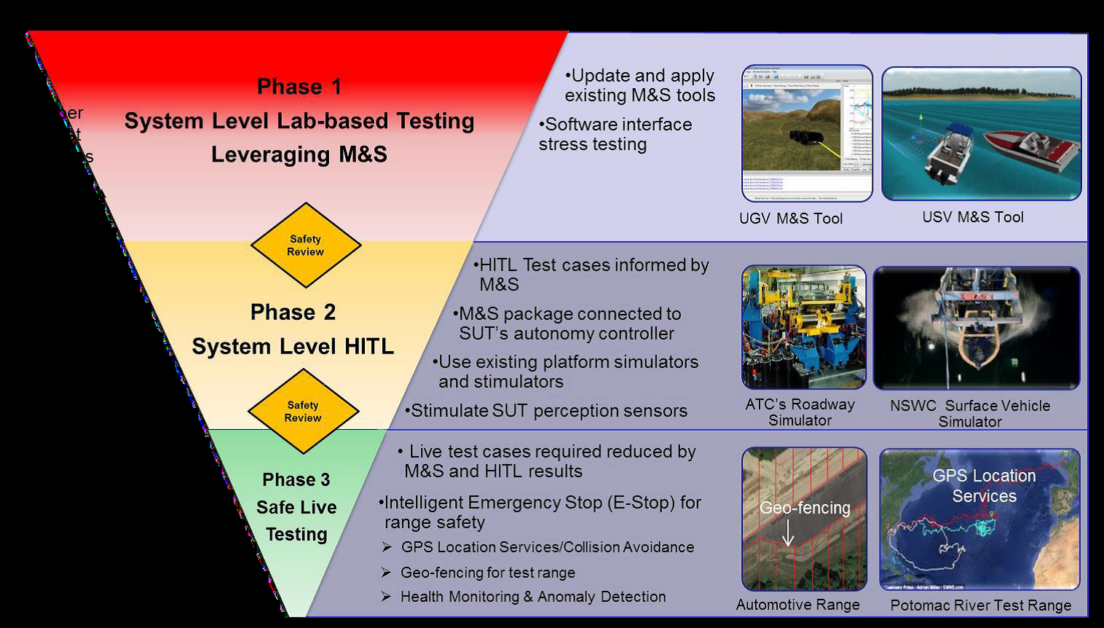
We can build on what is already in place
Army
Lab based testing
NSWC & Aberdeen Test Center HILT sims
ATC and Potomac Test Ranges
Air force
Golden Horde
TACE
Navy
Navy ATC
RAIL
SURFDEVRON / UUVRON
Live Virtual Constructive Training: integrated and autonomous (iai.co.il)
Autonomous Systems Test Capability (ASTC) - PEO STRI (army.mil)
Increment -> Integrate -> Modularize -> Build -> Support -> Execute

Slide 11
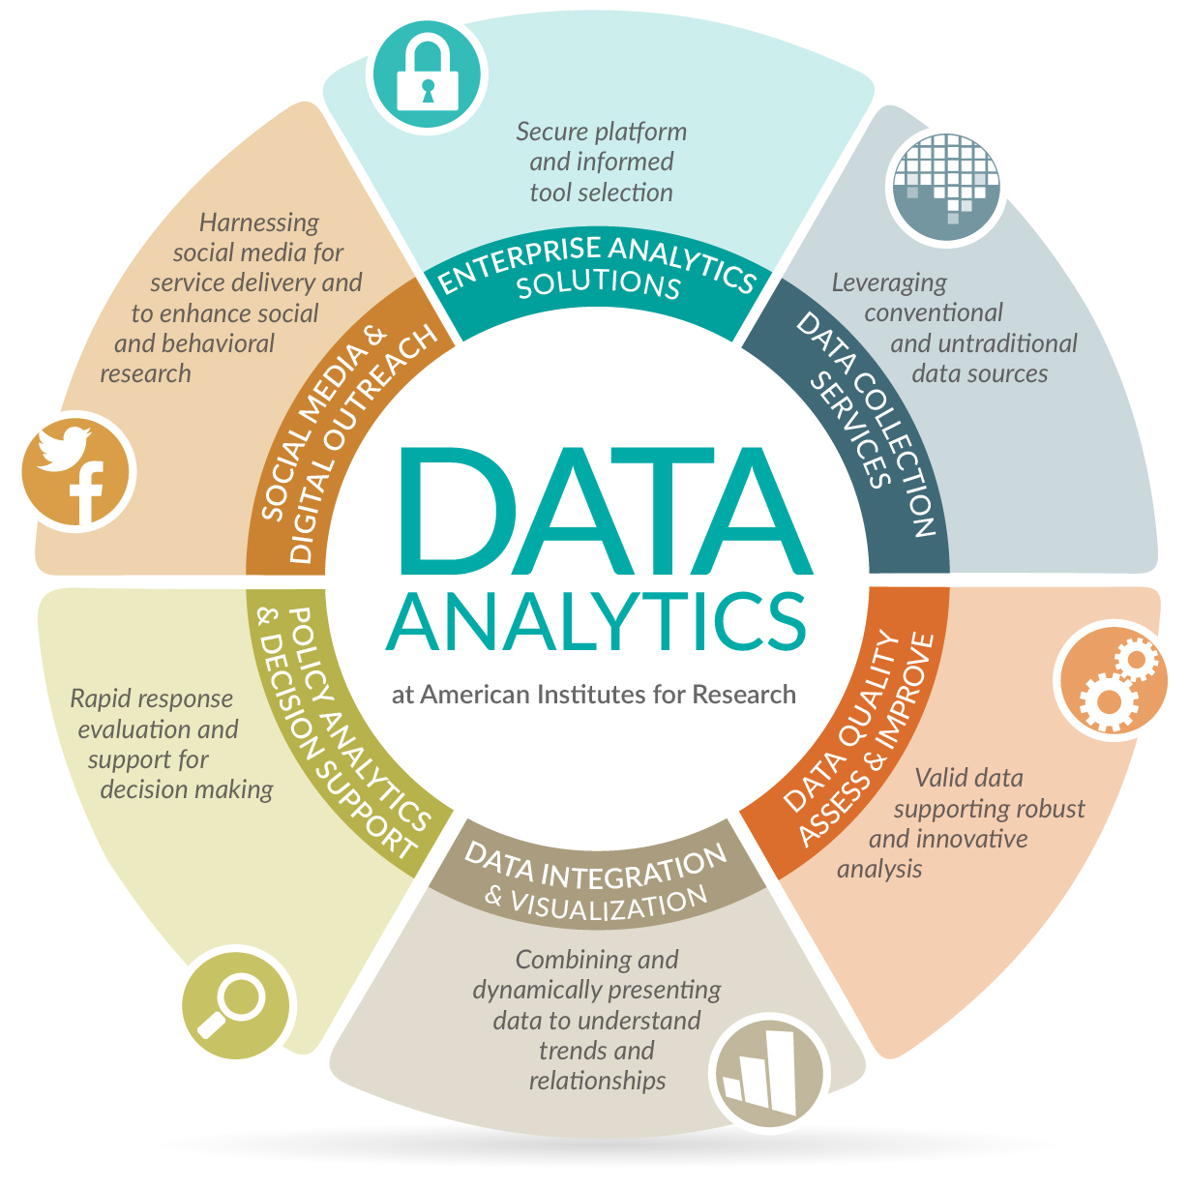
Data is the lynchpin to pushing success
Areas of focus in regards to test and evaluation of autonomous systems include:
Data Collection
Data Quality
Data Integration & Visualization
Trusted & Responsible Data Sharing
Data Science & Technology | American Institutes for Research (air.org)
11

Slide 12
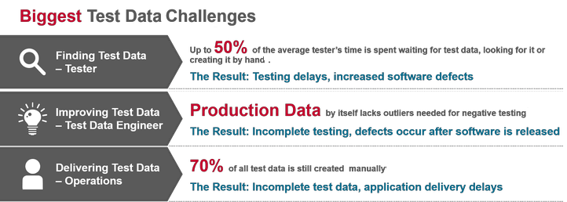
Proper data collection, format, and storing
M&S and other efforts produce massive quantities of data
Need methods and procedures for managing, handling, and analyzing data at the T&E level
Data sensitivities and access (IP, Classifications, etc)
If systems are recording data about their own decisions and internal processing, then stakeholders, including developers, testers, and even users, can gain more transparency into the system.
Test Data Management (broadcom.com)
12

Slide 13
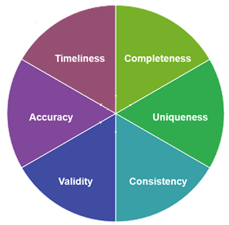
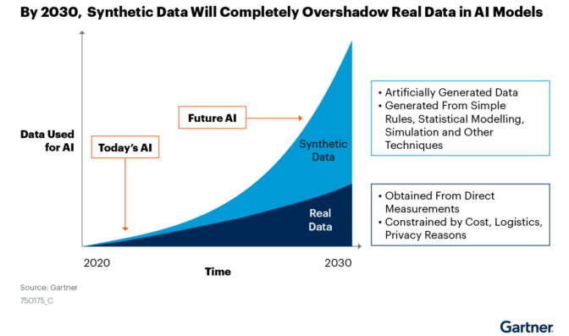
Data quality, quantity, and accessibility
Validation of data quality and accuracy
Availability and validity of data
Format
Accuracy
Consistent
Synthetic Data
Assess performance of algorithms for real data, with little real data available
Reporting of accuracy through modeling domain gap within the algorithm
Develop better synthetic data generation models
Training and evaluation use
Data Quality Rules – Lean-Data
What Is Synthetic Data? | NVIDIA Blogs
13

Slide 14
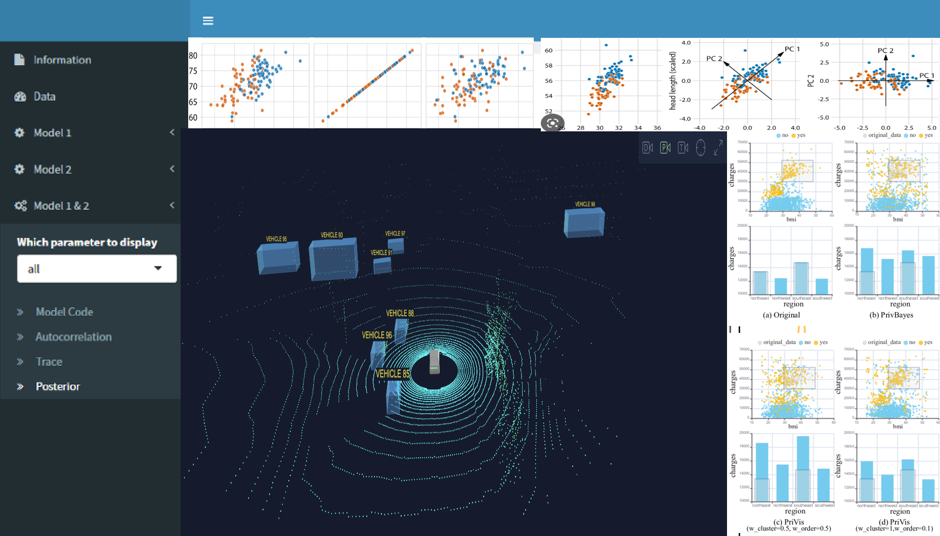
Processing and presenting the right data for decision maker’s needs
User support for complex topics
Understanding of technical concepts
Aids in decision making and reporting
Autonomy Transparency
Demystify decision spaces
Generalizes decision structures
Allow testers to predict and test outcomes
Metrics & Analytics
Supports analysis and exploration
Answers set objectives & quantifiable support for certification
14

Slide 15
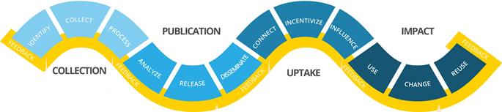
Data Sharing is Data Caring
Stove piping of activities and data causes issues
Different arms of the T&E community
Contractor Testing (CT)
Developmental Testing (DT)
Operational Testing (OT)
Difficulty tracing & transferring data, evidence, and knowledge across these tests
Duplicated efforts and create numerous opportunities for conflicts over resources such as range time, compute cycles, talent
Leaving them separate will make coordinating activities across the different sites and workforces too difficult
Maintaining the traditional distinction between CT, DT, and OT will likely be unsustainable
Centralizing the data repositories to support R&D, T&E for autonomous systems
Establishing partnerships between stakeholders and sectors could help combat stove piping and the scattering of talent across groups.
The Data Value Chain: Moving from Production to Impact – Open Data Watch
15

Slide 16
Looking at autonomy development through the lens of trust
What is at Stake?
What is the impact and what are the ripple effects of that impact?
What is at stake if trusted?
Acquisition Lifecycle Urgent, Middle Tier, or Major Capability?
How does the lifecycle evolve based on the other factors?
Intrinsic System Characteristics What are additional attributes of the system that can impact trust?
Intrinsic
System
Characteristics
Acquisition Lifecycle
Legal & Ethical Policies What are the legal and ethical ramifications of an autonomous system? How does application and operation affect legal and ethical policies?
Legal Ethics Policies
Stakeholders Who are the stakeholders at each lifecycle phase? What responsibility do they have? Who is responsible for a failure?
Dynamic Dimensions of Trust
Stakeholders
Task Interaction & Complexity What is the intended use of the system? What is the delegation distance? What is the level of abstraction?
Task & Interaction Complexity
Calibration Mechanisms What type of calibration is required to ensure confidence (e.g. personal experience, certification from T&E, training)?
Calibration Mechanisms
Knowledge Sharing
Knowledge Sharing How is information (system’s purpose, performance, underlying processes) communicated to ALL stakeholders?
Test & Evaluation
Test & Evaluation What testing is required?
What is the right mix between modeling & simulation and live testing?
The lifecycle of the systems needs to establish an appropriate... | Download Scientific Diagram (researchgate.net)
16

Slide 17
Other areas of need for T&E Support
Learning systems
Continuous and iterative methodologies
Cyber security
Resiliency against complexity,
Staffing, skills development, and Outreach for T&E domain
Ease of entry
17

