Slide 1


Digital Transformation Through Automation
Nathan Pond
BES Program Manager
Edaptive Computing, Inc.

Slide 2















About Edaptive Computing
Customers & Partners
26 years pioneering innovative R&D solutions
Software/hardware solutions to optimize, assure, automate, and integrate complex systems/processes
  Enabling cost, time, security benefits
Appraised at highest CMMI Maturity, Level 5
  Among top 3% of appraised companies in U.S.
  ECI quantitative techniques deliver quality solutions on time, within budget
Several Phase III SBIRs transitioning innovative ECI solutions
  No licensing fee for Government
KEYS TO SUCCESS: People, Processes, and Partnerships
© 2023 Edaptive Computing, Inc.

Slide 3

What is Digital Transformation?

Slide 4


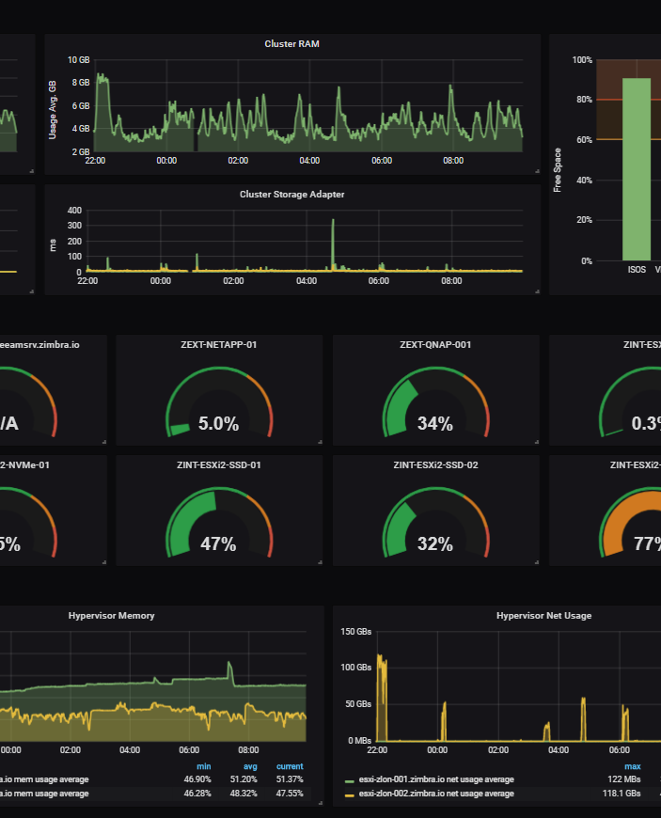

The objective of digital transformation in the DoD is to improve military readiness, agility, and effectiveness while optimizing resource allocation. This requires reimagining traditional military processes and practices, identifying areas for improvement, and implementing digital solutions that can enable greater efficiency and effectiveness in operations.
© 2023 Edaptive Computing, Inc.

Slide 5
DoD Digital Modernization Strategy
Improving data quality and consistency, and establishing data standards and governance processes to ensure that data is accurate, timely, and relevant to the mission.
Developing a data architecture that supports data sharing and interoperability across the DoD's various systems and platforms, enabling integration of data from different sources to support decision making.
Increasing the use of advanced analytics, machine learning, and artificial intelligence to analyze and derive insights from DoD data, supporting more effective decision making and mission execution.
Strengthening data security and privacy protections to ensure that sensitive and classified information is appropriately secured and protected, while also enabling data sharing and collaboration where stakeholders possess the needed clearance and a need to know.
https://media.defense.gov/2019/Jul/12/2002156622/-1/-1/1/DOD-DIGITAL-MODERNIZATION-STRATEGY-2019.PDF
© 2023 Edaptive Computing, Inc.

Slide 6
How Does Automation Fit?

Slide 7

Automation benefits the DoD by improving operations, security, agility, and decision-making while reducing costs.
© 2023 Edaptive Computing, Inc.

Slide 8
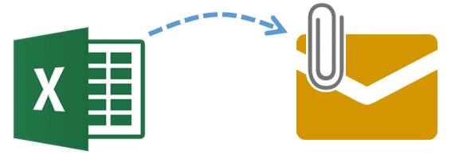
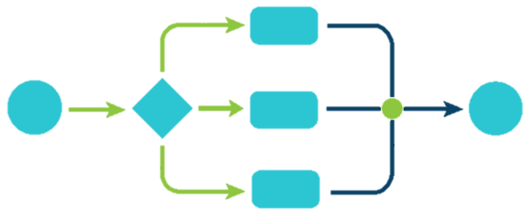
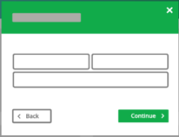
What needs to change
Less of this
More of this
© 2023 Edaptive Computing, Inc.

Slide 9





Automation Outcomes
0
0
0
0
0
0
0
0
0
0
0
0
0
0
0
0
0
0
0
0
0
0
0
0
1
1
1
0
1
0
1
1
1
0
1
0
1
1
1
0
1
0
1
1
1
1
1
Processes are modeled, not just documented
Models are executable
Human interaction only when necessary
Current data always available to leadership
Enables the Digital Thread
1
1
1
© 2023 Edaptive Computing, Inc.

Slide 10
How do we enable Digital Transformation?

Slide 11


Digital Transformation with ECI Automate
Capabilities
Foundation for customizable process automation
Visualization Dashboards
Configurable form-based workflows enforce compliance and consistency
Real-time Task Management, Notification, and Monitoring
Collects process data during execution and stores in central location
Real-time identification and reporting of abnormalities and process optimizations
Outcomes
Saves time by digitizing previously manual processes
Preserves pre-existing processes by integrating into current systems
Automatically coalesces information from multiple sources
Reduces cost, time, and errors to ensure data consistency and accuracy
Optimizes process workflows to efficiently use limited resources
Data
Content
Analytics
Workflow
Visualization
Tech Transition / Deployment / Support
External Data Sources &
COTS/GOTS Integration
Enabling Digital Transformation through Automation and Analytics
© 2023 Edaptive Computing, Inc.

Slide 12
© 2023 Edaptive Computing, Inc.

Slide 13
ECI Automate Benefits
Greater Efficiency
Reduced Risk
Enhanced Decision-Making
Improved collaboration and information sharing
More effective training
Greater agility
Improved data management
Increased Automation
Minimizes errors
Increased awareness
Streamlined processes
Greater data control and security
Optimize resources
Real-time data availability and analysis
Predictive analytics and machine learning
Collaborative decision making
Leadership oversight
Data visualization
Establish level of rigor to conduct multi-tiered analyses for gleaning mission-level effects
© 2023 Edaptive Computing, Inc.

Slide 14
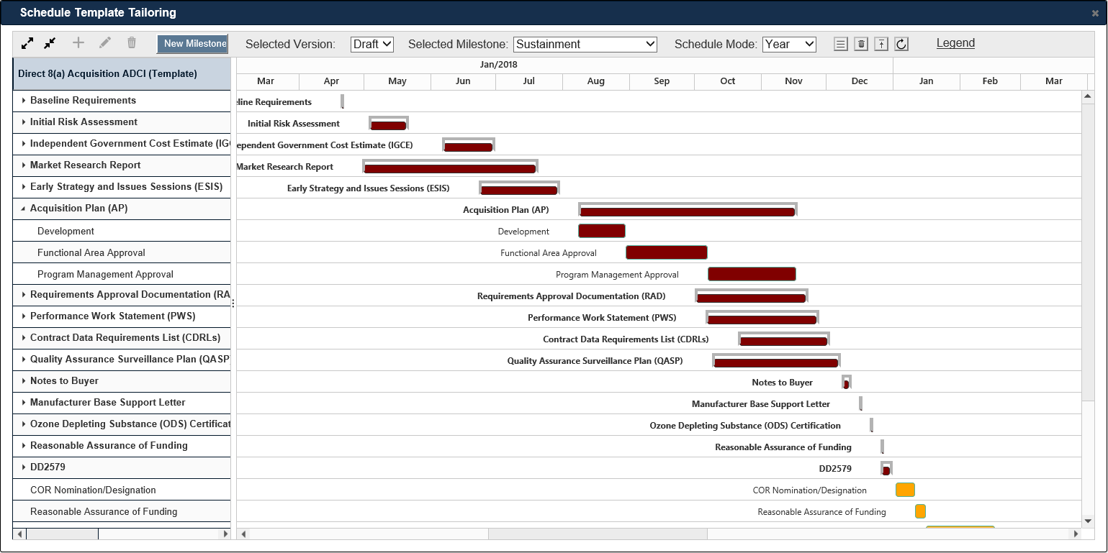
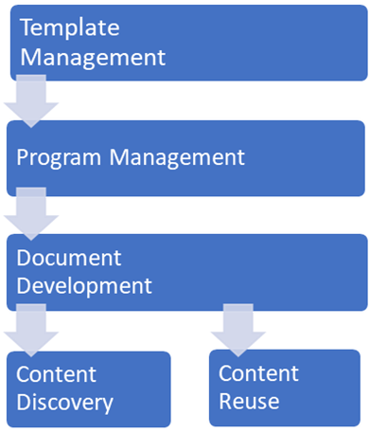
Enterprise Smart Documentation
Overview
  Manage document & content “best-practice” templates
  Tailor recommended data for program-specific needs
  Monitor documentation health & status throughout development, review cycles
  Collaboratively develop documentation leveraging content reuse & discovery
  Insert external data into content via connected sources
  Automatic generation of MS Word documents
Capability
  Leverage SME-curated templates for high-confidence, tailorable documentation schedules
  Establish documentation schedules with minimal setup
  Improve situational awareness through visualization dashboards
  Reduce development, review overhead and avoid content duplication
  Jump start development of MBTEMP documents
Data Insertion
Supports T&E Document Development & Management
© 2023 Edaptive Computing, Inc.

Slide 15
ECI Automate Advantage
Developed through SBIR Program – No licensing fees for gov’t use
Built with DoD use-cases in mind
Framework enables rapidly building customized solutions for the DoD
Interoperability with existing systems
Customer engagement throughout entire customization cycle
© 2023 Edaptive Computing, Inc.

Slide 16


Thank You
Nathan Pond
n.pond@edaptive.com
http://www.edaptive.com

