Slide 1
Space-Filling Designs and Metamodeling for Understanding Modeling & Simulation Behavior
Curtis Miller
April 26, 2023

Slide 2
Introduction

Slide 3
Background
Evaluations of systems increasingly rely on M&S to supplement the data collected from live test events.
Before results from M&S are used in DOT&E reports, we want confidence that these numbers mean something!
The process of establishing credibility and trust in a model is called Verification, Validation, and Accreditation (VV&A).
SME input is necessary but not sufficient for VV&A.
Eyeballs are not the best measurement tools for comparing numbers and identifying complex trends.
Two DOT&E memos outline these concerns.
M&S: Modeling and Simulation; SME: Subject Matter Expert

Slide 4
Motivation
The VV&A process should provide a quantitative understanding of how accurate an M&S capability is and identify limitations of the M&S across the factor space of interest.
This requires statistical analysis techniques that can precisely model the M&S output across a set of inputs and compare those results to live test results.
This requires a data collection strategy for both the M&S and the live test data.
The right data collection strategy (test design) depends on the goal
M&S: Modeling and Simulation; VV&A: Verification, Validation, and Accreditation

Slide 5










A metamodel is a useful product in and of itself
Operations and Planning
T&E
VV&A
Campaign Analysis
Test Planning
Exercise Planning
Performance Prediction
Wargaming
M&S
Tactical Planning
M&S Calibration
Statistics
M&S Development
$$\hat{β}$$
Parameter Estimation
M&S: Modeling and Simulation; T&E: Test and Evaluation; VV&A: Verification, Validation, and Accreditation

Slide 6
Motivating Example

Slide 7
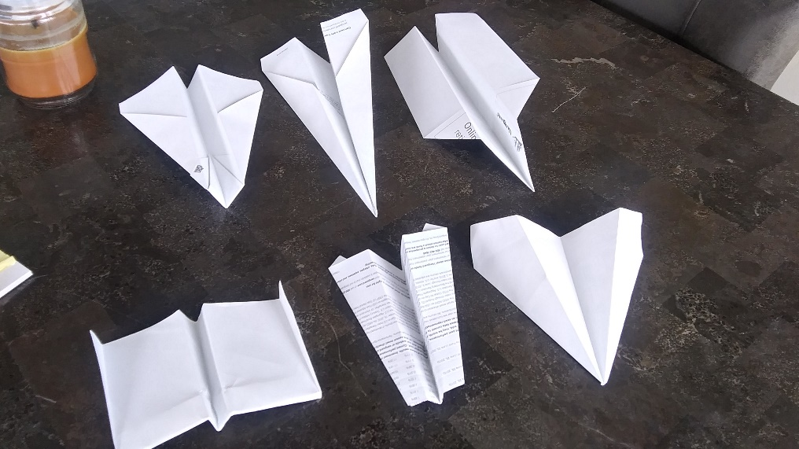
Our Toy (Motivating) Example Will Be a Paper Airplane Simulator
DART
CLASSIC
BULLDOG
WORLD RECORD PAPER AIRPLANE (WRPA)
HAMMER
HARRIER

Slide 8
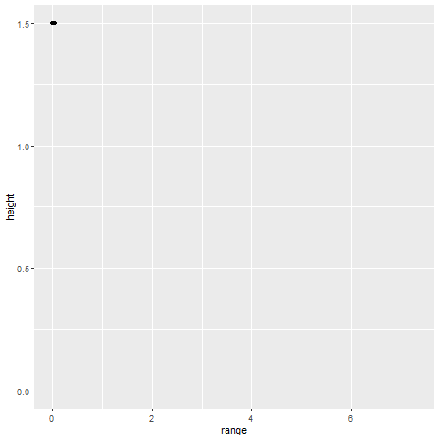
Flight Simulation
Example flight (dart)
USLWUG: Ultra-Small Light Weight Unguided Glider

Slide 9
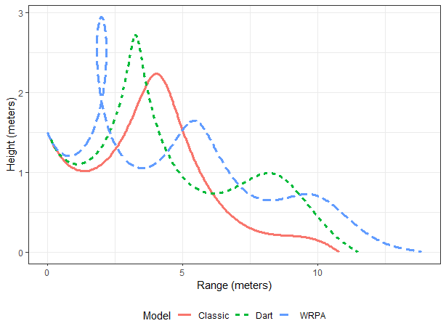
From a paper plane flight, we can record discrete and continuous response variables
WRPA: World Record Paper Airplane

Slide 10
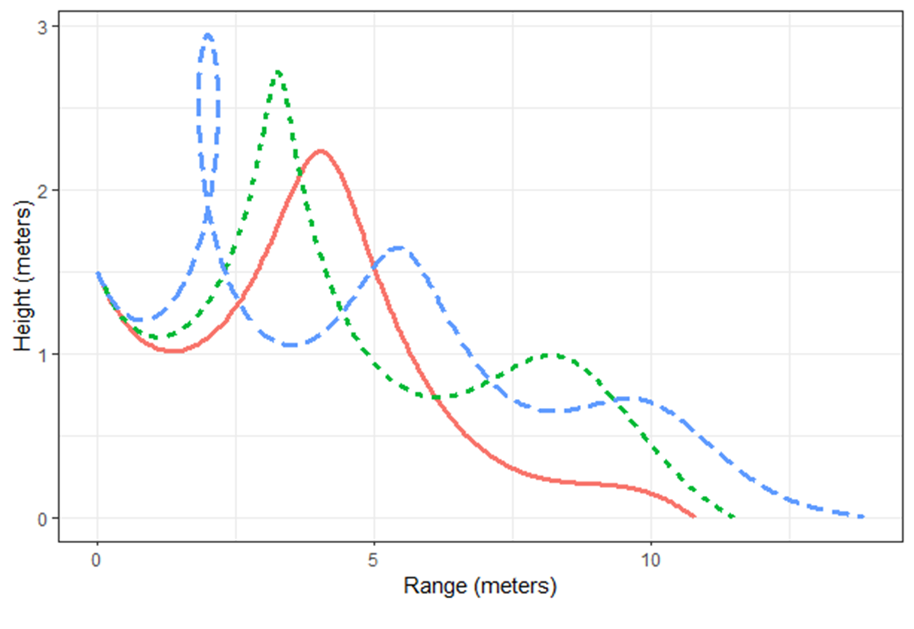
From a paper plane flight, we can record discrete and continuous response variables
Loop
Bumps
Range
WRPA: World Record Paper Airplane

Slide 11
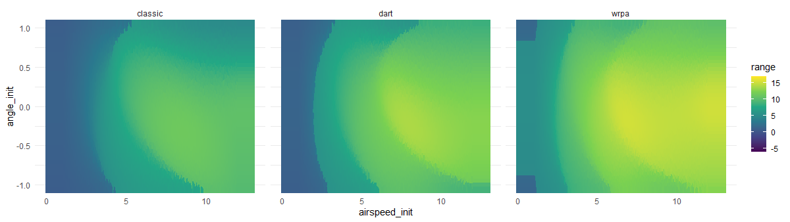
Model, Airspeed, and Angle Study
Consider a study of the effects of initial airspeed and angle of flight (continuous factors) on flight terminal range (continuous), while also looking for differences in models (a categorical factor).
WRPA: World Record Paper Airplane

Slide 12
Model, Airspeed, and Angle Study
Consider a study of the effects of initial airspeed and angle of flight (continuous factors) on flight terminal range (continuous), while also looking for differences in models (a categorical factor).
NONLINEAR INCREASE
NUMERICAL ARTIFACTS
GLOBAL MAXIMUM
TWO LOCAL EXTREMA
SURFACE “RIDGES”
WRPA: World Record Paper Airplane

Slide 13
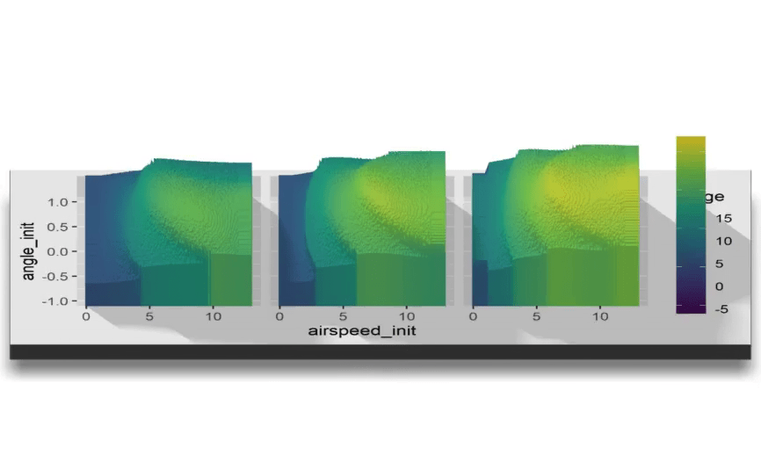
Model, Airspeed, and Angle Study

Slide 14
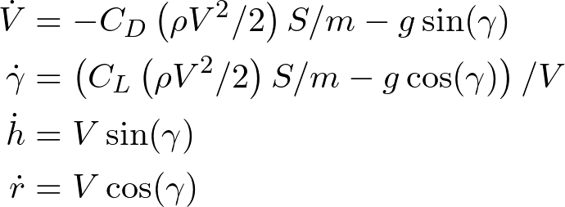
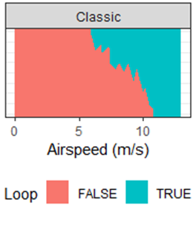
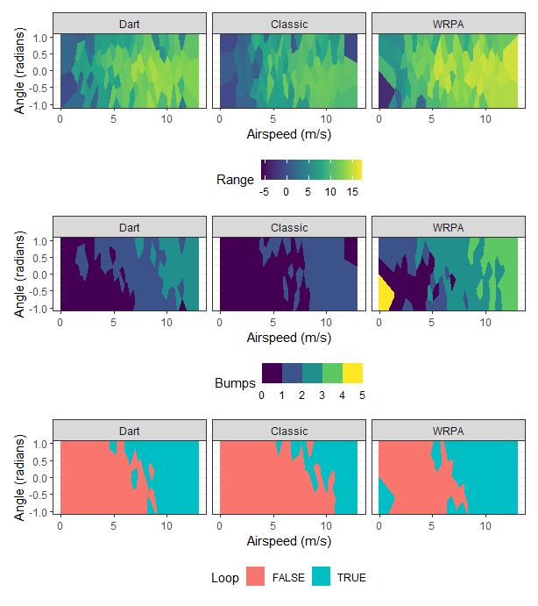
Our simulation becomes random when we randomize the inputs
Randomize initial conditions for random output (i.e. variance in toss)
DETERMINISTIC
STOCHASTIC (RANDOM)

Slide 15
Space-Filling Designs

Slide 16
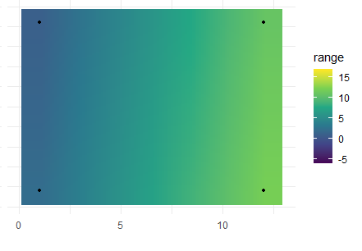
Space-filling design of experiments helps recover more trends in simulation outputs
A factorial design with a simple linear model fitted will not accurately describe the M&S system’s behavior.
True response surface of simulated projectile range
Estimated response surface of simulated projectile range
Initial angle (radians)
Initial angle (radians)
Initial airspeed (m/s)
Initial airspeed (m/s)
M&S: Modeling and Simulation; SFD: Space-Filling Design; WRPA: World Record Paper Airplane

Slide 17
Space-filling design of experiments helps recover more trends in simulation outputs
A factorial design with a simple linear model fitted will not accurately describe the M&S system’s behavior.
True response surface of simulated projectile range
Estimated response surface of simulated projectile range
INTERIOR PREDICTIONS TERRIBLE
NOT TRUE MAXIMUM
Initial angle (radians)
Initial angle (radians)
Initial airspeed (m/s)
TOO SMOOTH
Initial airspeed (m/s)
INCREASES FOREVER
M&S: Modeling and Simulation; SFD: Space-Filling Design; WRPA: World Record Paper Airplane
Notes:
Remember to talk about how power will not describe our inability to detect interior nonlinearities, or that there are interesting phenomena we want to discover that simply are not covered by thinking about power alone. “We care about power, and a lot of things other than power. Power is not everything.”

Slide 18
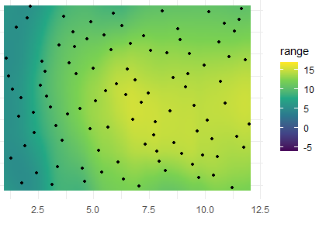
Space-filling design of experiments helps recover more trends in simulation outputs
Analyzing the flights with a Gaussian Process model via a Space-Filling Design yields a good approximation to simulation output.
True response surface of simulated projectile range
Estimated response surface of simulated projectile range
Initial angle (radians)
Initial angle (radians)
Initial airspeed (m/s)
Initial airspeed (m/s)
GP: Gaussian Process; SFD: Space-Filling Design; WRPA: World Record Paper Airplane

Slide 19
Space-Filling design of experiments helps recover more trends in simulation outputs
Analyzing the flights with a Gaussian Process model via a Space-Filling Design yields a good approximation to simulation output.
True response surface of simulated projectile range
Estimated response surface of simulated projectile range
REDISCOVERY OF LOCAL MAX
Initial angle (radians)
Initial angle (radians)
Initial airspeed (m/s)
Initial airspeed (m/s)
IRREGULAR INCREASE
GP: Gaussian Process; SFD: Space-Filling Design; WRPA: World Record Paper Airplane

Slide 20
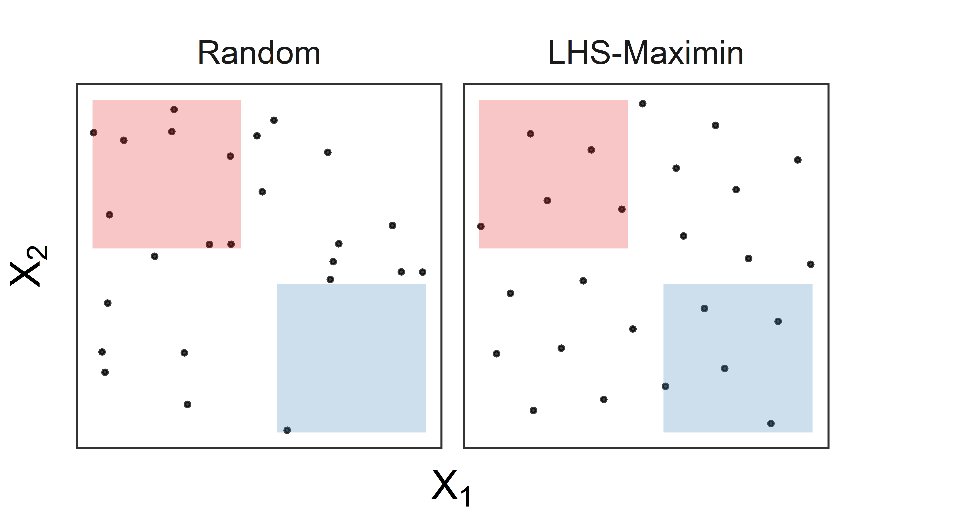
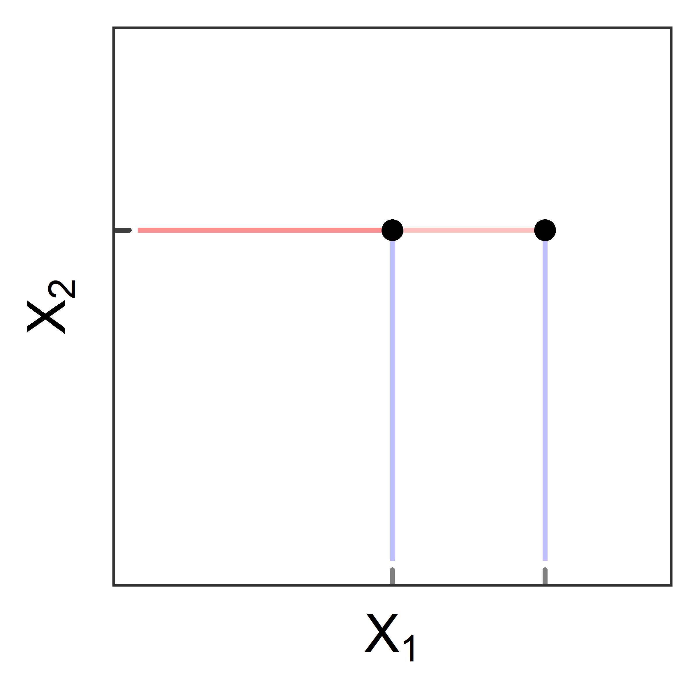
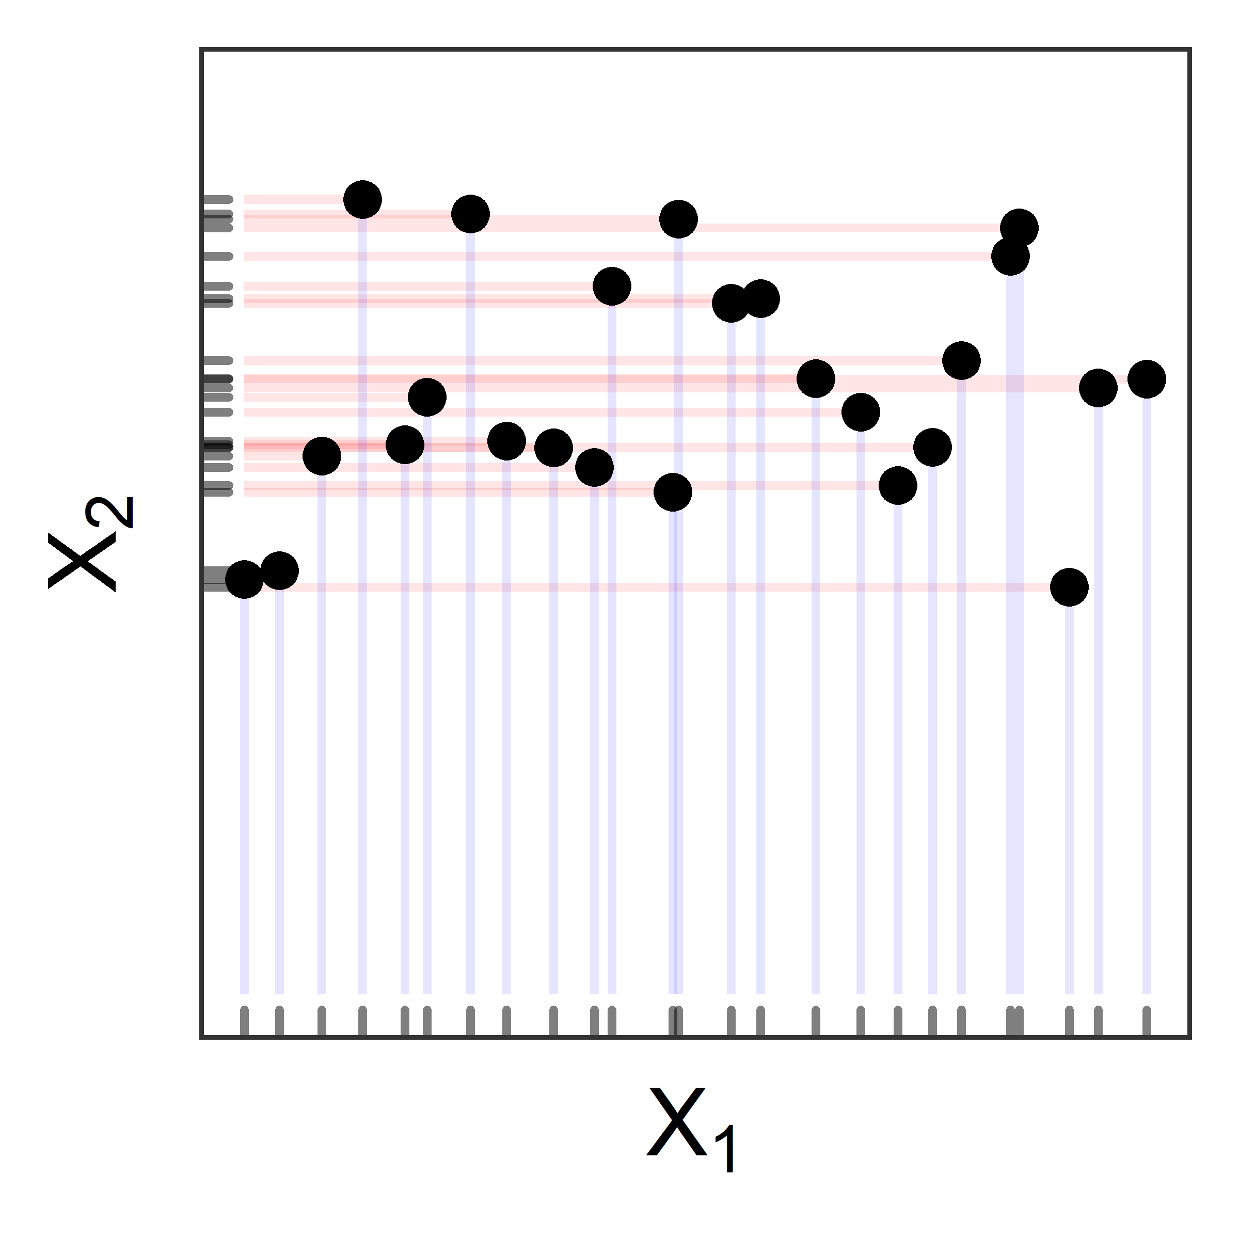
Just like with classical DOE, there are quantitative ways to evaluate a specific design
Many criteria exist, but it is particularly important that an SFD satisfy the following three criteria in order to be useful:
Point-distance: Samples are placed as far apart from each other as possible. [Maximin]
Uniformity: All regions of the design space are equally well represented. [Center L² Discrepancy]
Projection: The design is robust to variables being collapsed. [MaxPro]
A
B
C
D
DOE: Design of Experiments; SFD: Space-Filling Design
Notes:
So WHY do I claim that some of the designs on the previous slide are better than others? Just like there are measures of merit or ways to measure goodness for classical DOE (power, confidence, prediction variance, etc.) there are DIFFERENT evaluation criteria for SFD because the goals are different. We are trying to fill the space to support reconstructing a complex surface, not trying to control for noise and identify simple trends.
Explain 3 criteria. Uniformity – each box (red and blue) is approximately 25% of the space and thus should contain about 25% of the points to achieve good uniformity. You can see here that the random design does this poorly, while LHS-Maximin does this well.
Projection is all about efficiency and maximizing the information gained from your design. Oftentimes not all factors or inputs will matter. If this is the case, we still want the test points to give us useful information in the other dimensions. So for example, on the left, if X1 ends up not mattering, or 2 data points might as well be 1 data point because we only get 1 piece of information about X2. This is why factorials are bad for space filling! Similarly, if X1 ends up not mattering on the right side picture, we only get information about a small region of the X2 space. This is likely to happen for random designs that end up in clusters.

Slide 21
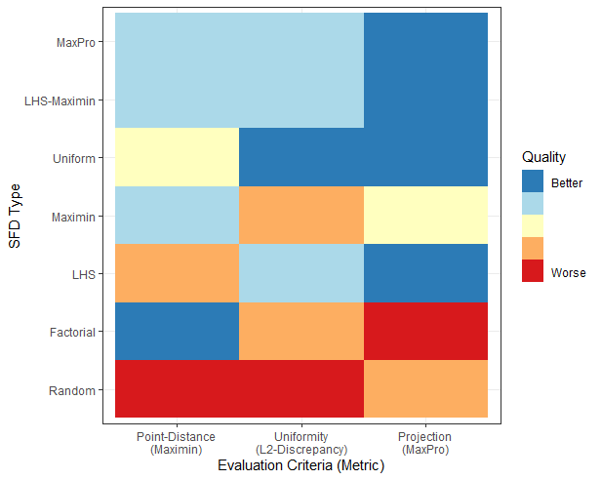
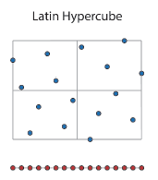
We prefer maximin sliced Latin hypersquare designs (maximin SLHD) and MaxPro SFDs
General recommendations: Maximin (Sliced) LHD or MaxPro
Latin Hypersquare
SFD: Space-Filling Design

Slide 22
We prefer maximin sliced Latin hypersquare designs (maximin SLHD) and MaxPro SFDs
General recommendations: Maximin (Sliced) LHD or MaxPro
Good spread in the design space
Handles more categorical factors better, while also resembling maximin SLHD
Handles a small (<5) number of categorical factors
Latin Hypersquare
Spread preserved if a factor is dropped
SFD: Space-Filling Design

Slide 23
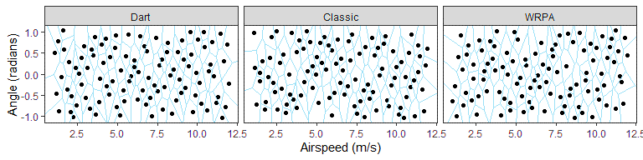
We will use maximin SLHDs when generating all M&S outputs
M&S: Modeling and Simulation; SLHD: Sliced Latin Hypersquare Design; WRPA: World Record Paper Airplane

Slide 24
We recommend different analysis procedures based on the M&S output
CONTINUOUS OUTPUT
DISCRETE OUTPUT
DETERMINISTIC
GAUSSIAN PROCESS (GP)
NEAREST NEIGHBOR (NN)
DECISION TREE
STOCHASTIC
GENERALIZED ADDITIVE MODEL (GAM)
M&S: Modeling and Simulation

Slide 25
Stochastic Outputs

Slide 26
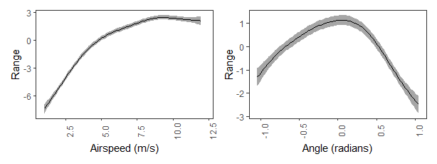

An additive model fits smooth, mostly unspecified functions to the data
$${\text{range}}_{i}=β_{0}+ β_{cl}{\text{classic}}_{i}+β_{\text{wr}}{\text{wrpa}}_{i}+$$
$$f_{\text{as}}\left({\text{airspeed}}_{i}\right)+f_{\text{an}}\left({\text{angle}}_{i}\right)+ε_{i}$$

Slide 27
An additive model fits smooth, mostly unspecified functions to the data
$${\text{range}}_{i}=β_{0}+ β_{cl}{\text{classic}}_{i}+β_{\text{wr}}{\text{wrpa}}_{i}+$$
$$f_{\text{as}}\left({\text{airspeed}}_{i}\right)+f_{\text{an}}\left({\text{angle}}_{i}\right)+ε_{i}$$
Coefficients like those in traditional linear models

Slide 28
An additive model fits smooth, mostly unspecified functions to the data
$${\text{range}}_{i}=β_{0}+ β_{cl}{\text{classic}}_{i}+β_{\text{wr}}{\text{wrpa}}_{i}+$$
$$f_{\text{as}}\left({\text{airspeed}}_{i}\right)+f_{\text{an}}\left({\text{angle}}_{i}\right)+ε_{i}$$
Arbitrary smooth functions discovered from the data

Slide 29
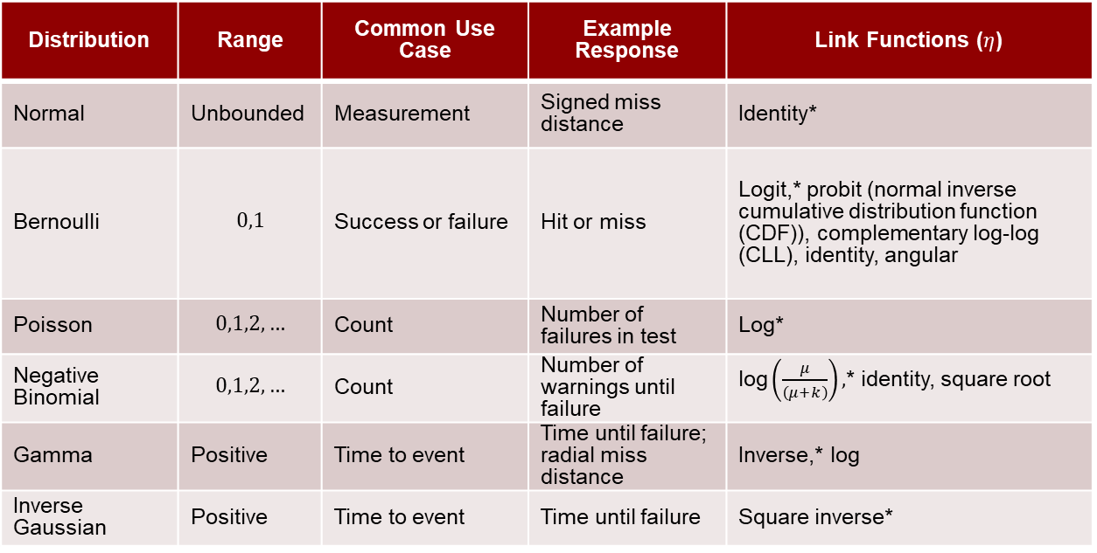
Generalized additive models (GAMs) allow fitting models with different response types
$$η\left(\text{E}\left({\text{range}}_{i}\right)\right)=β_{0}+f\left({\text{airspeed}}_{i}\right)$$
Distribution | Range | Common Use Case | Example Response | Link Functions ($η$)
Normal | Unbounded | Measurement | Signed miss distance | Identity*
Bernoulli | $$0,1$$ | Success or failure | Hit or miss | Logit,* probit (normal inverse cumulative distribution function (CDF)), complementary log-log (CLL), identity, angular
Poisson | $$0,1,2,…$$ | Count | Number of failures in test | Log*
Negative Binomial | $$0,1,2,…$$ | Count | Number of warnings until failure | $\text{log}\left(\frac{μ}{\left(μ+k\right)}\right),$* identity, square root
Gamma | Positive | Time to event | Time until failure; radial miss distance | Inverse,* log
Inverse Gaussian | Positive | Time to event | Time until failure | Square inverse*
* Canonical link function

Slide 30
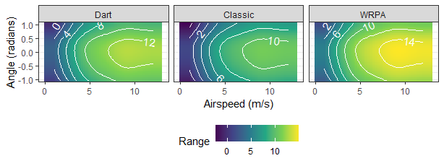
We can fit an additive model to the training data
$${\text{range}}_{i}=β_{0}+ β_{cl}{\text{classic}}_{i}+β_{\text{wr}}{\text{wrpa}}_{i}+f_{\text{as}}\left({\text{airspeed}}_{i}\right)+f_{\text{an}}\left({\text{angle}}_{i}\right)+ε_{i}$$
Average Range:
Dart: 9.3 m
Classic: 7.4 m
WRPA: 11.3 m
WRPA: World Record Paper Airplane

Slide 31
We can fit an additive model to the training data
$${\text{range}}_{i}=β_{0}+ β_{cl}{\text{classic}}_{i}+β_{\text{wr}}{\text{wrpa}}_{i}+f_{\text{as}}\left({\text{airspeed}}_{i}\right)+f_{\text{an}}\left({\text{angle}}_{i}\right)+ε_{i}$$
Average Range:
Dart: 9.3 m
Classic: 7.4 m
WRPA: 11.3 m
Add values of functions to average range to get average range for some airspeed or angle
WRPA: World Record Paper Airplane

Slide 32
We can fit an additive model to the training data
$${\text{range}}_{i}=β_{0}+ β_{cl}{\text{classic}}_{i}+β_{\text{wr}}{\text{wrpa}}_{i}+f_{\text{as}}\left({\text{airspeed}}_{i}\right)+f_{\text{an}}\left({\text{angle}}_{i}\right)+ε_{i}$$
How do we know we are not overfitting and can predict flights well?
Average Range:
Dart: 9.3 m
Classic: 7.4 m
WRPA: 11.3 m
WRPA: World Record Paper Airplane

Slide 33
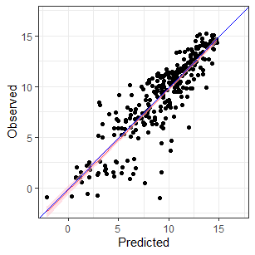
We can compare predicted values to observed values in a calibration plot

Slide 34
We can compare predicted values to observed values in a calibration plot
Training set observed value
Training set predicted value

Slide 35
We can compare predicted values to observed values in a calibration plot
Scatterplot of observed and predicted values
Low spread implies small deviation between observations and predictions (a confident metamodel)
Linear, one-to-one relationship implies expected observed values are predicted values

Slide 36
We can compare predicted values to observed values in a calibration plot
Blue line represents ideal one-to-one relationship between a prediction and the observed response
Red line is a GAM fitted to observed values’ relationship with predictions
Shaded region is a confidence region for the relationship between observed and predicted
GAM: Generalized Additive Model

Slide 37

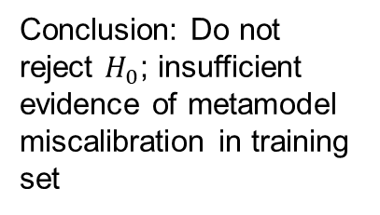

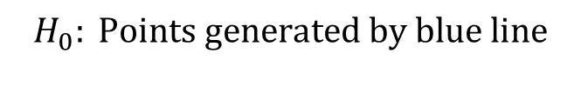
We can do a statistical test to see if the relationship between observed and predicted values is the identity relationship
$$H_{0}: \text{Points} \text{generated} \text{by} \text{blue} \text{line}$$
$$H_{A}: H_{0} \text{is} \text{false}$$
$$p_{\text{val}}≈0.7674$$
Conclusion: Do not reject $H_{0}$; insufficient evidence of metamodel miscalibration in training set
Red line is an estimate of the relationship between observed and predicted values

Slide 38
We can do a statistical test to see if the relationship between observed and predicted values is the identity relationship
$$H_{0}: \text{Points} \text{generated} \text{by} \text{blue} \text{line}$$
$$H_{A}: H_{0} \text{is} \text{false}$$
$$p_{\text{val}}≈0.7674$$
This is all the training set; what about OOS performance?
Conclusion: Do not reject $H_{0}$; insufficient evidence of metamodel miscalibration in training set
Red line is an estimate of the relationship between observed and predicted values
OOS: Out of Sample

Slide 39
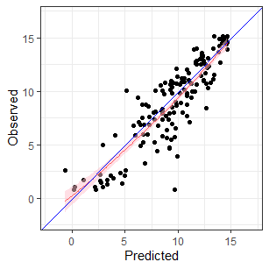

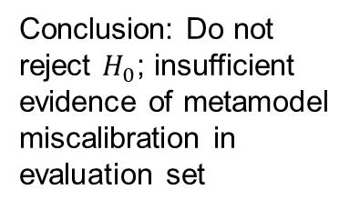
The metamodel appears to be properly calibrated in a separate set of outputs not used in fitting
$$H_{0}: \text{Points} \text{generated} \text{by} \text{blue} \text{line}$$
$$H_{A}: H_{0} \text{is} \text{false}$$
$$p_{\text{val}}≈0.3266$$
Conclusion: Do not reject $H_{0}$; insufficient evidence of metamodel miscalibration in evaluation set

Slide 40
Applications

Slide 41

Without live data, metamodels allow for qualitative assessment of M&S environment performance
$${\text{range}}_{i}=β_{0}+ β_{cl}{\text{classic}}_{i}+β_{\text{wr}}{\text{wrpa}}_{i}+f_{\text{as}}\left({\text{airspeed}}_{i}\right)+f_{\text{an}}\left({\text{angle}}_{i}\right)+ε_{i}$$
Average Range:
Dart: 9.3 m
Classic: 7.4 m
WRPA: 11.3 m
THIS CAN’T BE RIGHT!
M&S: Modeling and Simulation; WRPA: World Record Paper Airplane

Slide 42
Metamodels can help identify regions where testing should take place

Slide 43
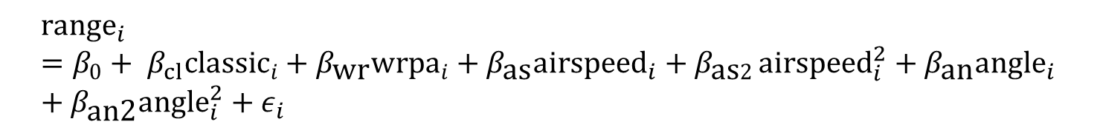
Metamodels can imply what statistical model should be used for test planning
$${\text{range}}_{i}=β_{0}+ β_{cl}{\text{classic}}_{i}+β_{\text{wr}}{\text{wrpa}}_{i}+β_{\text{as}}{\text{airspeed}}_{i}+β_{\text{as}2}{\text{airspeed}}_{i}^{2}+β_{\text{an}}{\text{angle}}_{i}+β_{\text{an}\text{2}}{\text{angle}}_{i}^{2}+ε_{i}$$

Slide 44
Summary

Slide 45
Recap
To avoid putting inaccurate predictions in reports, test designs should support capturing M&S behavior and building a metamodel
  Supports predictions across tested and untested conditions
  Ability to quantify uncertainty
  Potential to save time and money by not having to re-run the M&S itself
M&S: Modeling and Simulation

Slide 46
Resources and coming attractions
Space-Filling paper: https://testscience.org/wp-content/uploads/formidable/20/SFD_Literature_Review_Final.html
M&S Handbook: https://testscience.org/wp-content/uploads/formidable/20/Handbook-on-Statistical-Design-Analysis-Techniques-for-Modeling-Simulation-Validation-Reduced.pdf
Metamodeling paper: Public soon!
M&S: Modeling and Simulation

Slide 47
BACKUP

Slide 48
Different M&S architectures have characteristics influencing analysis
Simulation Environment | Acronym | Description
Digital Simulation | DSIM | A full digital representation of the physical system and intended operational environment. Can be deterministic or stochastic.
Hardware-in-the-Loop | HITL | A simulation that includes actual physical system hardware. Can be deterministic or stochastic, but often is stochastic due to the architecture of such simulations.
Software-in-the-Loop | SITL | A simulation incorporating actual physical system software. May be deterministic or stochastic.
Operator-in-the-Loop | OITL | A simulation that includes inputs and decisions from at least one operator. Highly stochastic.
M&S: Modeling and Simulation

Slide 49


How will we analyze this data?
How will we connect the points and quantify our uncertainty of predictions between points?
The simulation outputs are not random
WRPA: World Record Paper Airplane

Slide 50
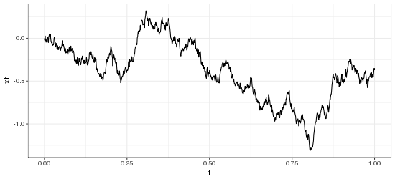
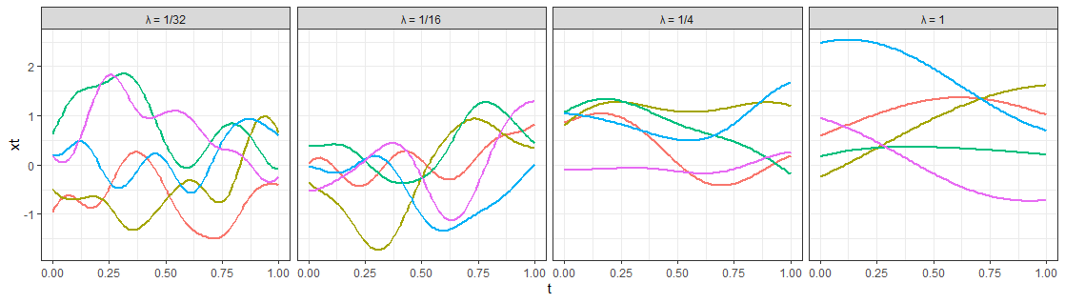




A GP is a probability model describing random functions
$$f∼\text{GP}\left(μ,K\right)$$
$$⇒$$
$$f\left(t\right)∼\text{N}\left(μ\left(t\right),K\left(t,t\right)\right)$$
$$\text{COV}\left(f\left(s\right),f\left(t\right)\right)=K\left(s,t\right)$$
COV: Covariance; GP: Gaussian Process; N: Normal

Slide 51
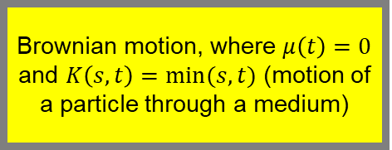
A GP is a probability model describing random functions
Brownian motion, where $μ\left(t\right)=0$ and $K\left(s,t\right)=min⁡(s,t)$ (motion of a particle through a medium)
$$f∼\text{GP}\left(μ,K\right)$$
$$⇒$$
$$f\left(t\right)∼\text{N}\left(μ\left(t\right),K\left(t,t\right)\right)$$
$$\text{COV}\left(f\left(s\right),f\left(t\right)\right)=K\left(s,t\right)$$
Random functions (mean zero, Gaussian kernel)
COV: Covariance; GP: Gaussian Process; N: Normal

Slide 52
A GP is a probability model describing random functions
$$f∼\text{GP}\left(μ,K\right)$$
$$⇒$$
The mean function; mean value at each point (often 0)
$$f\left(t\right)∼\text{N}\left(μ\left(t\right),K\left(t,t\right)\right)$$
$$\text{COV}\left(f\left(s\right),f\left(t\right)\right)=K\left(s,t\right)$$
COV: Covariance; GP: Gaussian Process; N: Normal

Slide 53
A GP is a probability model describing random functions
$$f∼\text{GP}\left(μ,K\right)$$
The covariance kernel; describes the correlation between two points, thus controlling continuity and smoothness
$$⇒$$
$$f\left(t\right)∼\text{N}\left(μ\left(t\right),K\left(t,t\right)\right)$$
$$\text{COV}\left(f\left(s\right),f\left(t\right)\right)=K\left(s,t\right)$$
COV: Covariance; GP: Gaussian Process; N: Normal

Slide 54
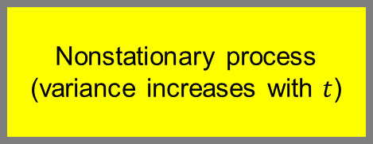
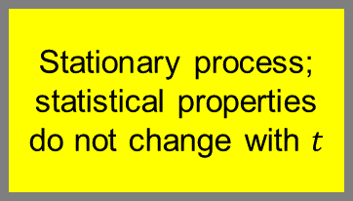
A GP is a probability model describing random functions
Nonstationary process (variance increases with $t$)
$$f∼\text{GP}\left(μ,K\right)$$
$$⇒$$
$$f\left(t\right)∼\text{N}\left(μ\left(t\right),K\left(t,t\right)\right)$$
$$\text{COV}\left(f\left(s\right),f\left(t\right)\right)=K\left(s,t\right)$$
Stationary process; statistical properties do not change with $t$
COV: Covariance; GP: Gaussian Process; N: Normal

Slide 55

GP interpolation is Bayesian inference on a function
$$p\left(H | D\right)∝p\left(D | H\right)p\left(H\right)$$
GP: Gaussian Process

Slide 56
GP interpolation is Bayesian inference on a function
$$p\left(H | D\right)∝p\left(D | H\right)p\left(H\right)$$
The posterior: what we believe about the M&S output’s potential values after observing output
The prior: our belief about M&S output’s potential values and behavior before collecting outputs
The likelihood: how likely the M&S output is given that our belief about the output is true
GP: Gaussian Process; M&S: Modeling and Simulation

Slide 57
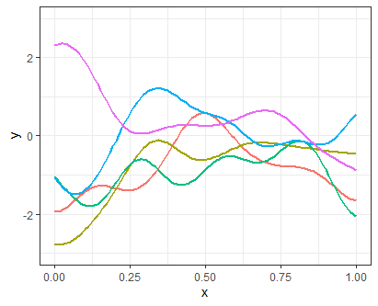
GP interpolation is Bayesian inference on a function
$$p\left(H | D\right)∝p\left(D | H\right)p\left(H\right)$$
GP: Gaussian Process

Slide 58
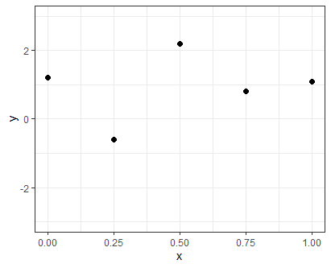

GP interpolation is Bayesian inference on a function
$$p\left(H | D\right)∝p\left(D | H\right)p\left(H\right)$$
$$×$$
GP: Gaussian Process

Slide 59
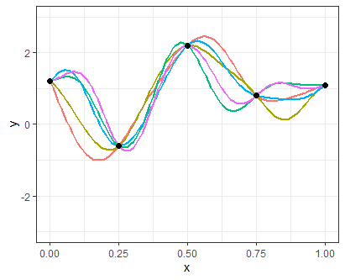

GP interpolation is Bayesian inference on a function
$$p\left(H | D\right)∝p\left(D | H\right)p\left(H\right)$$
$$=$$
$$×$$
GP: Gaussian Process

Slide 60
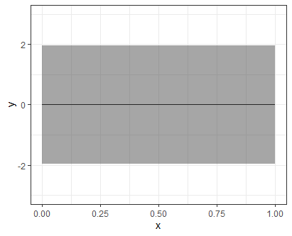
GP interpolation is Bayesian inference on a function
$$p\left(H | D\right)∝p\left(D | H\right)p\left(H\right)$$
$$=$$
$$×$$
OR
GP: Gaussian Process

Slide 61
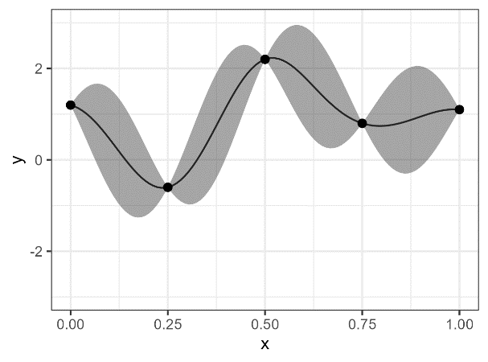


GP interpolation is Bayesian inference on a function
$$p\left(H | D\right)∝p\left(D | H\right)p\left(H\right)$$
$$=$$
$$×$$
OR
$$=$$
$$×$$
GP: Gaussian Process

Slide 62
GP interpolation is Bayesian inference on a function
$$p\left(H | D\right)∝p\left(D | H\right)p\left(H\right)$$
$$=$$
$$×$$
Posterior: only functions connecting observed points could be “right”
Observe M&S output
Prior: any one of these functions could be the “right” function
OR
$$=$$
$$×$$
GP: Gaussian Process; M&S: Modeling and Simulation

Slide 63
GP interpolation is Bayesian inference on a function
$$p\left(H | D\right)∝p\left(D | H\right)p\left(H\right)$$
Posterior credible regions; at observed output, no uncertainty, but there is at unobserved regions
$$=$$
$$×$$
Observe M&S output
(Pointwise) credible regions for the function’s value under the prior
OR
$$=$$
$$×$$
GP: Gaussian Process; M&S: Modeling and Simulation

Slide 64
GP interpolation is Bayesian inference on a function
$$p\left(H | D\right)∝p\left(D | H\right)p\left(H\right)$$
$$=$$
$$×$$
OR
$$=$$
$$×$$
This process is also known as kriging
GP: Gaussian Process

Slide 65
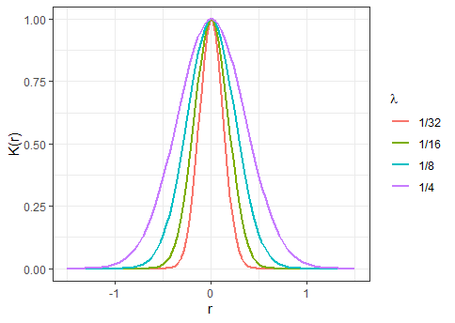
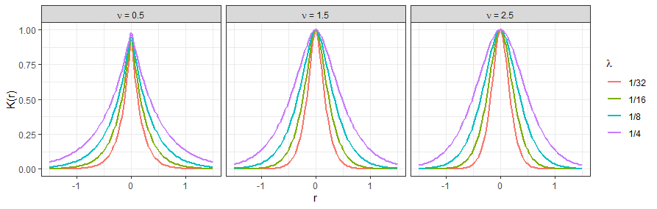
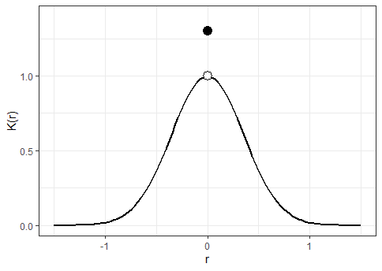
GP interpolation requires picking a family of covariance kernels
Stationary Kernel: $K\left(s,t\right)=K\left(r\right)$, where $r$ is the distance between $s$ and $t$
Gaussian
Matérn
Nugget Effect
GP: Gaussian Process

Slide 66
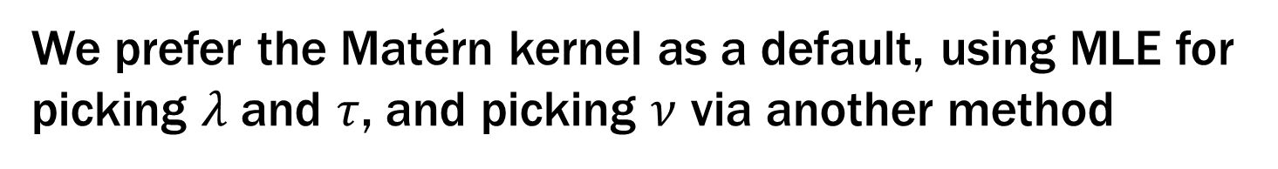
We prefer the Matérn kernel as a default, using MLE for picking $λ$ and $τ$, and picking $ν$ via another method
Stationary Kernel: $K\left(s,t\right)=K\left(r\right)$, where $r$ is the distance between $s$ and $t$
Gaussian
Matérn
Nugget Effect
GP: Gaussian Process
MLE: Maximum Likelihood Estimation

Slide 67
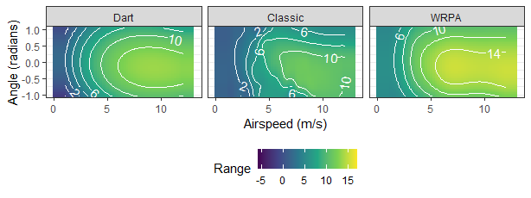
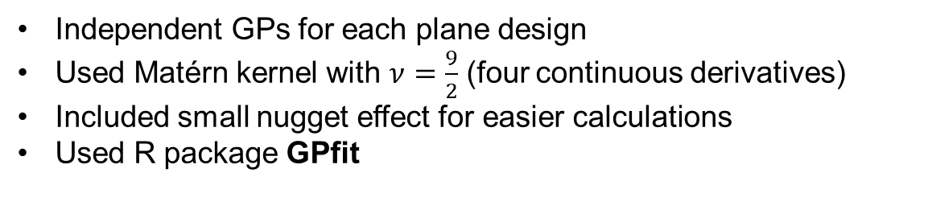
We used a Matérn kernel and GP interpolation to fit the USLWUG range data
Independent GPs for each plane design
Used Matérn kernel with $ν=\frac{9}{2}$ (four continuous derivatives)
Included small nugget effect for easier calculations
Used R package GPfit
GP: Gaussian Process; USLWUG: Ultra-Small Light Weight Unguided Glider; WRPA: World Record Paper Airplane

Slide 68
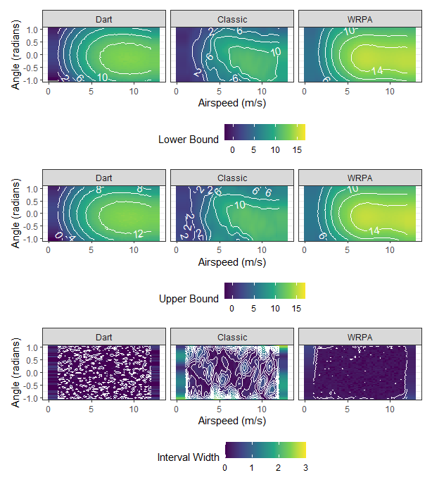
We can obtain confidence bounds for the value of the simulator at unobserved points
WRPA: World Record Paper Airplane

Slide 69
We can obtain confidence bounds for the value of the simulator at unobserved points
The DOE is of sufficient size and density, and the simulation smooth enough, that MOEs are narrow
DOE: Design of Experiments; MOE: Margin of Error

Slide 70
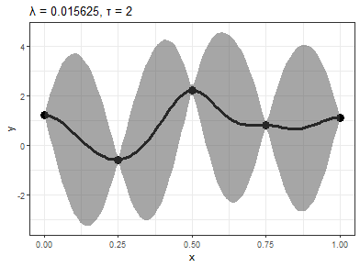
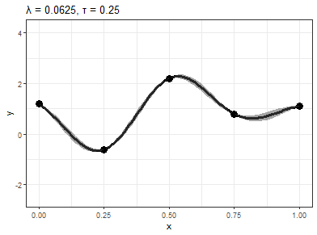

Gaussian kernels are very smooth and depend on two parameters
$$K(r;τ,λ)=τ^{2}\text{exp}\left(−r^{2}/λ\right)$$

Slide 71
Gaussian kernels are very smooth and depend on two parameters
$$K(r;τ,λ)=τ^{2}\text{exp}\left(−r^{2}/λ\right)$$
Mostly responsible for interval width; scales the kernel vertically

Slide 72
Gaussian kernels are very smooth and depend on two parameters
$$K(r;τ,λ)=τ^{2}\text{exp}\left(−r^{2}/λ\right)$$
Controls how correlated two points are; changes the shape of the fit, and width of intervals

Slide 73
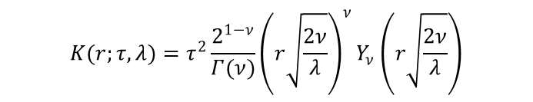
Matérn kernels have varying smoothness and depend on three parameters
$$K(r;τ,λ)=τ^{2}\frac{2^{1−ν}}{Γ(ν)}{\left(r\sqrt{\frac{2ν}{λ}}\right)}^{ν}Y_{ν}\left(r\sqrt{\frac{2ν}{λ}}\right)$$

Slide 74
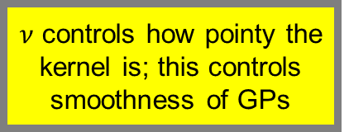
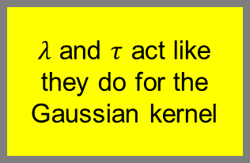
Matérn kernels have varying smoothness and depend on three parameters
$$K(r;τ,λ)=τ^{2}\frac{2^{1−ν}}{Γ(ν)}{\left(r\sqrt{\frac{2ν}{λ}}\right)}^{ν}Y_{ν}\left(r\sqrt{\frac{2ν}{λ}}\right)$$
$ν$ controls how pointy the kernel is; this controls smoothness of GPs
$λ$ and $τ$ act like they do for the Gaussian kernel
GP: Gaussian Process

Slide 75
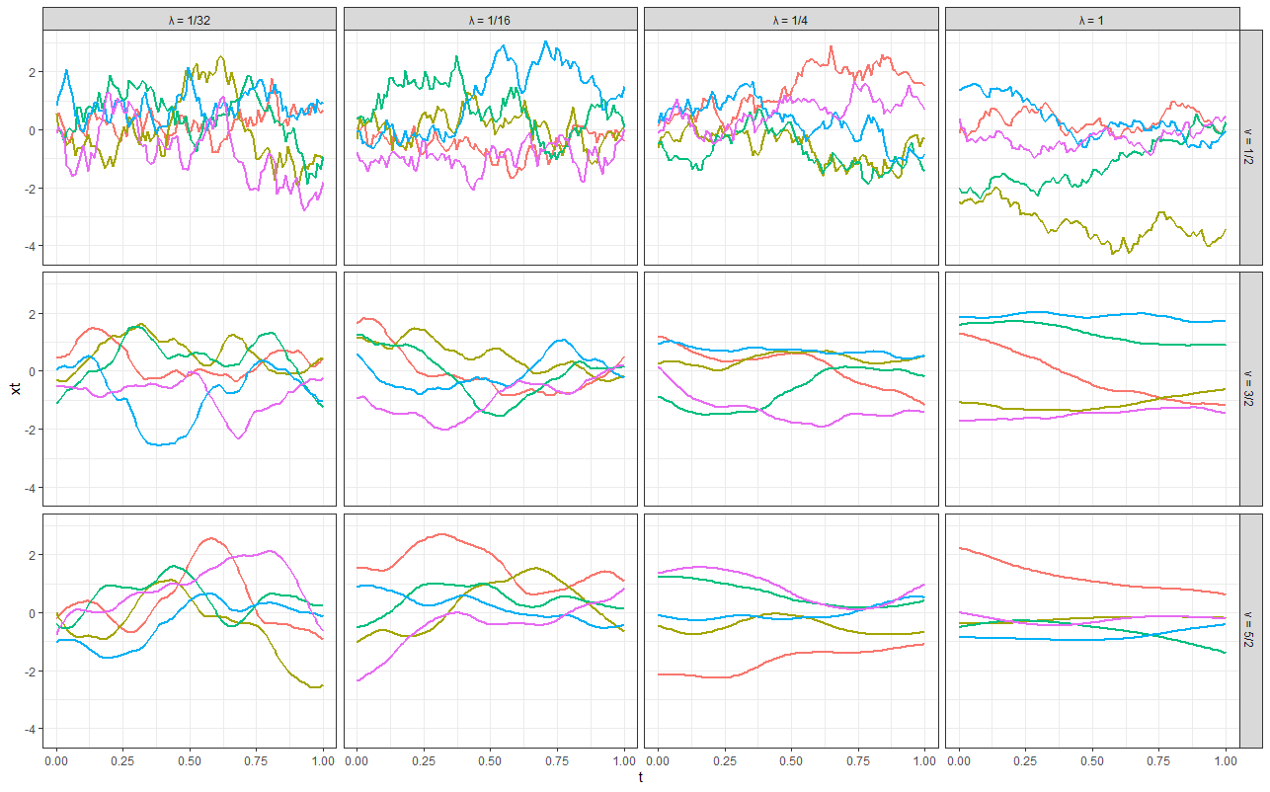
Drawing from the Matérn kernel’s prior shows what it thinks the M&S environment’s output might look like
M&S: Modeling and Simulation

Slide 76

Drawing from the Matérn kernel’s prior shows what it thinks the M&S environment’s output might look like
Increasing $ν ⇒$ increasing smoothness
M&S: Modeling and Simulation

Slide 77

Drawing from the Matérn kernel’s prior shows what it thinks the M&S environment’s output might look like
Increasing $λ⇒$ fewer bumps and wiggles
M&S: Modeling and Simulation

Slide 78



The Matérn kernel offers more options for fitting M&S outputs
M&S: Modeling and Simulation

Slide 79

The Matérn kernel offers more options for fitting M&S outputs
$ν$ controls how smooth the fit is; the bigger it is, the more the kernel behaves like a Gaussian kernel
M&S: Modeling and Simulation

Slide 80

The Matérn kernel offers more options for fitting M&S outputs
$λ$ and $τ$ serve similar roles to those in the Gaussian kernel
M&S: Modeling and Simulation

Slide 81



Adding a nugget effect drops the need to interpolate M&S outputs
$$K\left(r;σ\right)=K\left(r\right)+σ^{2}δ\left(r\right)$$
Reasons for a nugget effect include: making the problem numerically easier; analyzing stochastic data
M&S: Modeling and Simulation

Slide 82
Adding a nugget effect drops the need to interpolate M&S outputs
$$K\left(r;σ\right)=K\left(r\right)+σ^{2}δ\left(r\right)$$
Take any kernel and augment it with a nugget effect
Reasons for a nugget effect include: making the problem numerically easier; analyzing stochastic data
M&S: Modeling and Simulation

Slide 83

Adding a nugget effect drops the need to interpolate M&S outputs
$$K\left(r;σ\right)=K\left(r\right)+σ^{2}δ\left(r\right)$$
Reasons for a nugget effect include: making the problem numerically easier; analyzing stochastic data
The kernel becomes discontinuous at $r=0$ and the GP is no longer continuous; the mean no longer interpolates
GP: Gaussian Process; M&S: Modeling and Simulation

Slide 84
Common situations can be addressed
PROBLEM
SOLUTION
Transform the output (log, logit, etc.)
The output is bounded
Some factors are categorical
Fit GPs for each combination
GP: Gaussian Process

Slide 85



An initial linear model estimate has clear deficiencies
$${\text{range}}_{i}=β_{0}+ β_{cl}{\text{classic}}_{i}+β_{\text{wr}}{\text{wrpa}}_{i}+β_{\text{as}}{\text{airspeed}}_{i}+β_{\text{an}}{\text{angle}}_{i}+ε_{i}$$
Added variable plots show the relationship between a factor and the response variable after removing the effects of other factors. This lets us see if the relationships between factors and the response appear right.

Slide 86
An initial linear model estimate has clear deficiencies
$${\text{range}}_{i}=β_{0}+ β_{cl}{\text{classic}}_{i}+β_{\text{wr}}{\text{wrpa}}_{i}+β_{\text{as}}{\text{airspeed}}_{i}+β_{\text{an}}{\text{angle}}_{i}+ε_{i}$$
Residuals tend to be negative at ends and positive in middle, a nonlinear shape; the linear relationship is likely wrong

Slide 87
An initial linear model estimate has clear deficiencies
$${\text{range}}_{i}=β_{0}+ β_{cl}{\text{classic}}_{i}+β_{\text{wr}}{\text{wrpa}}_{i}+β_{\text{as}}{\text{airspeed}}_{i}+β_{\text{an}}{\text{angle}}_{i}+ε_{i}$$
Residuals tend to be negative at ends and positive in middle, a nonlinear shape; the linear relationship is likely wrong

Slide 88
An initial linear model estimate has clear deficiencies
$${\text{range}}_{i}=β_{0}+ β_{cl}{\text{classic}}_{i}+β_{\text{wr}}{\text{wrpa}}_{i}+β_{\text{as}}{\text{airspeed}}_{i}+β_{\text{an}}{\text{angle}}_{i}+ε_{i}$$
Residuals average to zero across but not within model groups

Slide 89
An initial linear model estimate has clear deficiencies
$${\text{range}}_{i}=β_{0}+ β_{cl}{\text{classic}}_{i}+β_{\text{wr}}{\text{wrpa}}_{i}+β_{\text{as}}{\text{airspeed}}_{i}+β_{\text{an}}{\text{angle}}_{i}+ε_{i}$$
Can we estimate the shape of the relationship from the data instead of prescribing it?

Slide 90
When smoothing, we assume the arbitrary function can be decomposed into other functions we know
$${\text{range}}_{i}=β_{0}+f\left({\text{airspeed}}_{i}\right)+ε_{i}$$
This is the “penalized regression” approach to smoothing, not moving average smoothing as done by LOESS and other techniques
LOESS: Locally Estimated Scatterplot Smoothing

Slide 91

When smoothing, we assume the arbitrary function can be decomposed into other functions we know
$${\text{range}}_{i}=β_{0}+f\left({\text{airspeed}}_{i}\right)+ε_{i}$$
$$f\left(x\right)=\sum_{k=1}^{∞}{a_{k}b_{k}\left(x\right)}$$
This is the “penalized regression” approach to smoothing, not moving average smoothing as done by LOESS and other techniques
LOESS: Locally Estimated Scatterplot Smoothing

Slide 92
When smoothing, we assume the arbitrary function can be decomposed into other functions we know
$${\text{range}}_{i}=β_{0}+f\left({\text{airspeed}}_{i}\right)+ε_{i}$$
Basis functions; we choose these
$$f\left(x\right)=\sum_{k=1}^{∞}{a_{k}b_{k}\left(x\right)}$$
The set of basis functions is called a basis; when picking this set we are picking a basis
Coefficients; we need to estimate these

Slide 93

When smoothing, we assume the arbitrary function can be decomposed into other functions we know
$${\text{range}}_{i}=β_{0}+f\left({\text{airspeed}}_{i}\right)+ε_{i}$$
We substitute infinite with a number
$$f\left(x\right)≈\sum_{k=1}^{K}{a_{k}b_{k}\left(x\right)}$$
The set of basis functions is called a basis; when picking this set we are picking a basis

Slide 94


We add basis functions together to get a smooth fit
$$f\left(x\right)≈\sum_{k=1}^{K}{a_{k}b_{k}\left(x\right)}$$

Slide 95
We add basis functions together to get a smooth fit
$$f\left(x\right)≈\sum_{k=1}^{K}{a_{k}b_{k}\left(x\right)}$$
Notice that later functions added make little changes to the sum

Slide 96

Many basis options exist

Slide 97

We use the least squared error principle for fitting additive models
$${\text{range}}_{i}=β_{0}+f\left({\text{airspeed}}_{i}\right)+ε_{i}$$
$$\min_{β_{0},f}{\sum_{i=1}^{n}{{\left({\text{range}}_{i}−β_{0}−f\left({\text{airspeed}}_{i}\right)\right)}^{2}}}$$
This is the “penalized regression” approach to smoothing, not moving average smoothing as done by LOESS and other techniques
LOESS: Locally Estimated Scatterplot Smoothing

Slide 98


We need more restrictions
$${\text{range}}_{i}=β_{0}+f\left({\text{airspeed}}_{i}\right)+ε_{i}$$
$$\min_{β_{0},f}{\sum_{i=1}^{n}{{\left({\text{range}}_{i}−β_{0}−f\left({\text{airspeed}}_{i}\right)\right)}^{2}}}$$

Slide 99

Least square objective alone leads to overfitting
$${\text{range}}_{i}=β_{0}+f\left({\text{airspeed}}_{i}\right)+ε_{i}$$
$$\min_{β_{0},f}{\sum_{i=1}^{n}{{\left({\text{range}}_{i}−β_{0}−f\left({\text{airspeed}}_{i}\right)\right)}^{2}}}$$

Slide 100
Least square objective alone leads to overfitting
$${\text{range}}_{i}=β_{0}+f\left({\text{airspeed}}_{i}\right)+ε_{i}$$
Squared error is zero since this function connects all points; it has very low predictive ability and is maximum overfitting
$$\min_{β_{0},f}{\sum_{i=1}^{n}{{\left({\text{range}}_{i}−β_{0}−f\left({\text{airspeed}}_{i}\right)\right)}^{2}}}$$

Slide 101

We need extra cost associated with bad fits
$${\text{range}}_{i}=β_{0}+f\left({\text{airspeed}}_{i}\right)+ε_{i}$$
$$\min_{β_{0},f}{\sum_{i=1}^{n}{{\left({\text{range}}_{i}−β_{0}−f\left({\text{airspeed}}_{i}\right)\right)}^{2}}+\text{Cost}\left(f\right)}$$
This is the “penalized regression” approach to smoothing, not moving average smoothing as done by LOESS and other techniques
LOESS: Locally Estimated Scatterplot Smoothing

Slide 102

We will penalize functions that are very wiggly
$${\text{range}}_{i}=β_{0}+f\left({\text{airspeed}}_{i}\right)+ε_{i}$$
$$\min_{β_{0},f}{\sum_{i=1}^{n}{{\left({\text{range}}_{i}−β_{0}−f\left({\text{airspeed}}_{i}\right)\right)}^{2}}+λ\int_{D}^{ }{{\left(f^{′′}\left(x\right)\right)}^{2}ⅆx}}$$
This is the “penalized regression” approach to smoothing, not moving average smoothing as done by LOESS and other techniques
LOESS: Locally Estimated Scatterplot Smoothing

Slide 103
We will penalize functions that are very wiggly
$${\text{range}}_{i}=β_{0}+f\left({\text{airspeed}}_{i}\right)+ε_{i}$$
Controls how “bad” wiggle is
$$\min_{β_{0},f}{\sum_{i=1}^{n}{{\left({\text{range}}_{i}−β_{0}−f\left({\text{airspeed}}_{i}\right)\right)}^{2}}+λ\int_{D}^{ }{{\left(f^{′′}\left(x\right)\right)}^{2}ⅆx}}$$
This is the “penalized regression” approach to smoothing, not moving average smoothing as done by LOESS and other techniques
Zero for straight lines
LOESS: Locally Estimated Scatterplot Smoothing

Slide 104



$λ$is the primary means to control fit quality
$$\min_{β_{0},f}{\begin{aligned}\sum_{i=1}^{n}{{\left(y_{i}−β_{0}−f\left(x_{i}\right)\right)}^{2}} \\ +λ\int_{D}^{ }{{\left(f^{′′}\left(x\right)\right)}^{2}ⅆx}\end{aligned}}$$

Slide 105





$λ$can be chosen via cross-validation or restricted maximum likelihood (REML)
Generalized Cross-Validation (GCV)
Restricted Maximum Likelihood (REML)
Leave out an observation
Estimate model
Compute error on left-out observation
Pick $λ$ minimizing total error
Tends to pick smaller $λ$
Obtain a likelihood for $λ$
Pick $λ$ maximizing the likelihood
Tends to pick larger $λ$

Slide 106

$λ$can be chosen via cross-validation or restricted maximum likelihood (REML)
Generalized Cross-Validation (GCV)
Restricted Maximum Likelihood (REML)
Obtain a likelihood for $λ$
Pick $λ$ maximizing the likelihood
Tends to pick larger $λ$
Leave out an observation
Estimate model
Compute error on left-out observation
Pick $λ$ minimizing total error
Tends to pick smaller $λ$

Slide 107
Additive models permit lots of functional forms
$${\text{range}}_{i}=β_{0}+ β_{cl}{\text{classic}}_{i}+β_{\text{wr}}{\text{wrpa}}_{i}+f_{\text{as}}\left({\text{airspeed}}_{i}\right)+f_{\text{an}}\left({\text{angle}}_{i}\right)+ε_{i}$$
Smooth main effects only

Slide 108
Additive models permit lots of functional forms
$${\text{range}}_{i}=β_{0}+ β_{cl}{\text{classic}}_{i}+β_{\text{wr}}{\text{wrpa}}_{i}+f_{\text{as}}\left({\text{airspeed}}_{i}\right)+f_{\text{an}}\left({\text{angle}}_{i}\right)+ε_{i}$$
$${\text{range}}_{i}=β_{0}+ β_{cl}{\text{classic}}_{i}+β_{\text{wr}}{\text{wrpa}}_{i}+f_{\text{as},\text{an}}\left({\text{airspeed}}_{i},{\text{angle}}_{i}\right)+ε_{i}$$
Interaction surface

Slide 109

Additive models permit lots of functional forms
$${\text{range}}_{i}=β_{0}+ β_{cl}{\text{classic}}_{i}+β_{\text{wr}}{\text{wrpa}}_{i}+f_{\text{as}}\left({\text{airspeed}}_{i}\right)+f_{\text{an}}\left({\text{angle}}_{i}\right)+ε_{i}$$
$${\text{range}}_{i}=β_{0}+ β_{cl}{\text{classic}}_{i}+β_{\text{wr}}{\text{wrpa}}_{i}+f_{\text{as},\text{an}}\left({\text{airspeed}}_{i},{\text{angle}}_{i}\right)+ε_{i}$$
$${\text{range}}_{i}=β_{0}+f_{\text{as},\text{an}}\left({\text{airspeed}}_{i},{\text{angle}}_{i}\right)+f_{\text{as},\text{an}\text{,}\text{cl}}\left({\text{airspeed}}_{i},{\text{angle}}_{i}\right){\text{classic}}_{i}+f_{\text{as},\text{an},\text{wr}}\left({\text{airspeed}}_{i},{\text{angle}}_{i}\right){\text{wrpa}}_{i}+ε_{i}$$
Fully saturated smooth

Slide 110


Additive models permit lots of functional forms
$${\text{range}}_{i}=β_{0}+ β_{cl}{\text{classic}}_{i}+β_{\text{wr}}{\text{wrpa}}_{i}+f_{\text{as}}\left({\text{airspeed}}_{i}\right)+f_{\text{an}}\left({\text{angle}}_{i}\right)+ε_{i}$$
$${\text{range}}_{i}=β_{0}+ β_{cl}{\text{classic}}_{i}+β_{\text{wr}}{\text{wrpa}}_{i}+f_{\text{as},\text{an}}\left({\text{airspeed}}_{i},{\text{angle}}_{i}\right)+ε_{i}$$
$${\text{range}}_{i}=β_{0}+f_{\text{as},\text{an}}\left({\text{airspeed}}_{i},{\text{angle}}_{i}\right)+f_{\text{as},\text{an}\text{,}\text{cl}}\left({\text{airspeed}}_{i},{\text{angle}}_{i}\right){\text{classic}}_{i}+f_{\text{as},\text{an},\text{wr}}\left({\text{airspeed}}_{i},{\text{angle}}_{i}\right){\text{wrpa}}_{i}+ε_{i}$$
$${\text{range}}_{i}=β_{0}+ β_{cl}{\text{classic}}_{i}+β_{\text{wr}}{\text{wrpa}}_{i}+β_{\text{as}}{\text{airspeed}}_{i}+f_{\text{as}}\left({\text{airspeed}}_{i}\right)+β_{\text{a}\text{n}}{\text{a}\text{ngle}}_{i}+f_{\text{an}}\left({\text{angle}}_{i}\right)+ε_{i}$$
Decomposed* main effects
* We are not talking about the identifiability constraints today.

Slide 111

Additive models permit lots of functional forms
$${\text{range}}_{i}=β_{0}+ β_{cl}{\text{classic}}_{i}+β_{\text{wr}}{\text{wrpa}}_{i}+f_{\text{as}}\left({\text{airspeed}}_{i}\right)+f_{\text{an}}\left({\text{angle}}_{i}\right)+ε_{i}$$
$${\text{range}}_{i}=β_{0}+ β_{cl}{\text{classic}}_{i}+β_{\text{wr}}{\text{wrpa}}_{i}+f_{\text{as},\text{an}}\left({\text{airspeed}}_{i},{\text{angle}}_{i}\right)+ε_{i}$$
$${\text{range}}_{i}=β_{0}+f_{\text{as},\text{an}}\left({\text{airspeed}}_{i},{\text{angle}}_{i}\right)+f_{\text{as},\text{an}\text{,}\text{cl}}\left({\text{airspeed}}_{i},{\text{angle}}_{i}\right){\text{classic}}_{i}+f_{\text{as},\text{an},\text{wr}}\left({\text{airspeed}}_{i},{\text{angle}}_{i}\right){\text{wrpa}}_{i}+ε_{i}$$
$${\text{range}}_{i}=β_{0}+ β_{cl}{\text{classic}}_{i}+β_{\text{wr}}{\text{wrpa}}_{i}+β_{\text{as}}{\text{airspeed}}_{i}+f_{\text{as}}\left({\text{airspeed}}_{i}\right)+β_{\text{a}\text{n}}{\text{a}\text{ngle}}_{i}+f_{\text{an}}\left({\text{angle}}_{i}\right)+ε_{i}$$
Fully linear model
$${\text{range}}_{i}=β_{0}+ β_{cl}{\text{classic}}_{i}+β_{\text{wr}}{\text{wrpa}}_{i}+β_{\text{as}}{\text{airspeed}}_{i}+β_{\text{an}}{\text{angle}}_{i}+ε_{i}$$

Slide 112
Additive models permit lots of functional forms
$${\text{range}}_{i}=β_{0}+ β_{cl}{\text{classic}}_{i}+β_{\text{wr}}{\text{wrpa}}_{i}+f_{\text{as}}\left({\text{airspeed}}_{i}\right)+f_{\text{an}}\left({\text{angle}}_{i}\right)+ε_{i}$$
$${\text{range}}_{i}=β_{0}+ β_{cl}{\text{classic}}_{i}+β_{\text{wr}}{\text{wrpa}}_{i}+f_{\text{as},\text{an}}\left({\text{airspeed}}_{i},{\text{angle}}_{i}\right)+ε_{i}$$
$${\text{range}}_{i}=β_{0}+f_{\text{as},\text{an}}\left({\text{airspeed}}_{i},{\text{angle}}_{i}\right)+f_{\text{as},\text{an}\text{,}\text{cl}}\left({\text{airspeed}}_{i},{\text{angle}}_{i}\right){\text{classic}}_{i}+f_{\text{as},\text{an},\text{wr}}\left({\text{airspeed}}_{i},{\text{angle}}_{i}\right){\text{wrpa}}_{i}+ε_{i}$$
And many more!
$${\text{range}}_{i}=β_{0}+ β_{cl}{\text{classic}}_{i}+β_{\text{wr}}{\text{wrpa}}_{i}+β_{\text{as}}{\text{airspeed}}_{i}+f_{\text{as}}\left({\text{airspeed}}_{i}\right)+β_{\text{a}\text{n}}{\text{a}\text{ngle}}_{i}+f_{\text{an}}\left({\text{angle}}_{i}\right)+ε_{i}$$
$${\text{range}}_{i}=β_{0}+ β_{cl}{\text{classic}}_{i}+β_{\text{wr}}{\text{wrpa}}_{i}+β_{\text{as}}{\text{airspeed}}_{i}+β_{\text{an}}{\text{angle}}_{i}+ε_{i}$$

Slide 113
GAMs can be extended to other situations
Shape-constrained additive models (SCAMs) incorporate smoothing functions that cannot take an arbitrary shape and need to satisfy some condition, such as being an increasing function (Pya and Wood 2015).
Additive quantile models estimate conditional percentiles of the response variable (Koenker 2011).
Functional additive models (FAMs) allow the factors or even the M&S outputs to be a function rather than a single number or label. For example, such a model could use as a predictor not only whether a missile hit or missed, or its miss distance; but also the missile’s entire flight path, or it could even predict what the typical flight path will look like based on input factors (Yao and Müller 2008).
Additive models and GAMs can model both location and dispersion, rather than location only. These models allow output variation to depend on the factors rather than be constant over the operational space.
Multiclass additive models determine the probability that an outcome is one of a number of potential outcome classes (Zhang et al. 2019).
GAM: Generalized Additive Model; M&S: Modeling and Simulation

Slide 114



Model metrics can also reveal fit quality
$$\text{p}\text{rediction} \text{error}=\text{observed}−\text{predicted}=y−\hat{y}$$
Maximum Error (MxE)
Mean Square Error (MSE)
Mean Absolute Error (MAE)
$$\frac{1}{n}\sum_{i=1}^{n}{(}y_{i}−{\hat{y}}_{i})^{2}$$
$$\frac{1}{n}\sum_{i=1}^{n}{\left|y_{i}−{\hat{y}}_{i}\right|}$$
$${\text{max}}_{i}\left|y_{i}−{\hat{y}}_{i}\right|$$
Worst-case-scenario error
Exclusively the error of outliers
Training set value: 6.7 m
Evaluation set value: 6.8 m
Minimized by average output
Influenced by outlier errors
Training set value: 3.1 m²
Evaluation set value: 3.8 m²
Minimized by median output
Insensitive to outlier errors
Training set value: 1.4 m
Evaluation set value: 1.5 m

Slide 115
Model metrics can also reveal fit quality
$$\text{p}\text{rediction} \text{error}=\text{observed}−\text{predicted}=y−\hat{y}$$
Maximum Error (MxE)
Mean Square Error (MSE)
Mean Absolute Error (MAE)
$$\frac{1}{n}\sum_{i=1}^{n}{(}y_{i}−{\hat{y}}_{i})^{2}$$
$$\frac{1}{n}\sum_{i=1}^{n}{\left|y_{i}−{\hat{y}}_{i}\right|}$$
$${\text{max}}_{i}\left|y_{i}−{\hat{y}}_{i}\right|$$
Worst-case-scenario error
Exclusively the error of outliers
Training set value: 6.7 m
Evaluation set value: 6.8 m
Minimized by average output
Influenced by outlier errors
Training set value: 3.1 m²
Evaluation set value: 3.8 m²
Minimized by median output
Insensitive to outlier errors
Training set value: 1.4 m
Evaluation set value: 1.5 m
No significant degradation between training and evaluation value; no evidence of overfitting

Slide 116
We will analyze loop existence next (binary response)
How will we estimate the expected range, expected bumps, and probability of a loop?
Simulation outputs are now random; surfaces are irregular
The inputs are now the average rather than what was actually thrown due to “throw error”
WRPA: World Record Paper Airplane

Slide 117
Before metamodeling, compute basic summary statistics
Design | Loop Probability | Sample Size
Dart | 0.40 | 100
Classic | 0.25 | 100
WRPA | 0.48 | 100
WRPA: World Record Paper Airplane

Slide 118

We need to pick the functional form of the GAM
Description | Functional Form
Smooth Main Effects | $$η\left(P\left({\text{loop}}_{i}\right)\right)=β_{0}+ β_{\text{cl}}{\text{classic}}_{i}+β_{\text{wr}}{\text{wrpa}}_{i}+f_{\text{as}}\left({\text{airspeed}}_{i}\right)+f_{\text{an}}\left({\text{angle}}_{i}\right)$$
Smooth Interaction | $$η\left(P\left({\text{loop}}_{i}\right)\right)=β_{0}+ β_{\text{cl}}{\text{classic}}_{i}+β_{\text{wr}}{\text{wrpa}}_{i}+f_{\text{as}\text{,}\text{an}}\left({\text{airspeed}}_{i},{\text{angle}}_{i}\right)$$
Plane-Design-Specific Smooth Terms | $$η\left(P\left({\text{loop}}_{i}\right)\right)=β_{0}+f_{\text{as}}\left({\text{airspeed}}_{i}\right)+f_{\text{an}}\left({\text{angle}}_{i}\right)+\left( f_{\text{as}\text{,}\text{cl}}\left({\text{airspeed}}_{i}\right)+f_{\text{an}\text{,}\text{cl}}\left({\text{angle}}_{i}\right)\right){\text{classic}}_{i}+\left( f_{\text{as}\text{,}\text{wr}}\left({\text{airspeed}}_{i}\right)+f_{\text{an}\text{,}\text{wr}}\left({\text{angle}}_{i}\right)\right){\text{wrpa}}_{i}$$
Smooth Saturated | $$η\left(P\left({\text{loop}}_{i}\right)\right)=β_{0}+f_{\text{as}\text{,}\text{an}}\left({\text{airspeed}}_{i},{\text{angle}}_{i}\right)+{f_{\text{as}\text{,}\text{an}\text{,}\text{cl}}\left({\text{airspeed}}_{i},{\text{angle}}_{i}\right)\text{classic}}_{i}+f_{\text{as}\text{,}\text{an}\text{,}\text{wr}}\left({\text{airspeed}}_{i},{\text{angle}}_{i}\right){\text{wrpa}}_{i}$$
Fully Linear Main Effects | $$η\left(P\left({\text{loop}}_{i}\right)\right)=β_{0}+ β_{\text{cl}}{\text{classic}}_{i}+β_{\text{wr}}{\text{wrpa}}_{i}+β_{\text{as}}{\text{airspeed}}_{i}+β_{\text{an}}{\text{angle}}_{i}$$
GAM: Generalized Additive Model

Slide 119

We need to pick the response distribution and link function
Distribution
Name | Description
Binomial | The usual binomial distribution
Quasibinomial | Allows for overdispersion (more variance than innate to the binomial distribution)
Link Function
Name | Formula
Logistic* | $$η\left(p\right)=\log\left(\frac{p}{1−p}\right)$$
Complementary Log-Log (CLL) | $$η\left(p\right)=\text{log}\left(−\text{log}\left(1−p\right)\right)$$
Probit | $$η\left(p\right)=Φ^{−1}\left(p\right)$$
* The canonical link function

Slide 120




We have additional metrics for assessing binary predictions
Accuracy
Precision
Recall
Brier Score
$$\frac{\text{Correct} \text{classification}}{n}$$
$$\frac{\text{Correctly} \text{predicted} C}{\text{\# }\text{of} \text{cases} \text{of} C}$$
$$\frac{\text{Correctly} \text{predicted} C}{\text{\# }\text{of} \text{predictions} \text{of} C}$$
$$\frac{1}{n}\sum_{i=1}^{n}{(}y_{i}−{\hat{p}}_{i})^{2}$$
Proportion of correct predictions
How frequently a class was correctly predicted
How frequently predictions were correct
Squared prediction error

Slide 121
These metrics may encourage overfitting
Accuracy
Precision
Recall
Brier Score
$$\frac{\text{Correct} \text{classification}}{n}$$
$$\frac{\text{Correctly} \text{predicted} C}{\text{\# }\text{of} \text{cases} \text{of} C}$$
$$\frac{\text{Correctly} \text{predicted} C}{\text{\# }\text{of} \text{predictions} \text{of} C}$$
$$\frac{1}{n}\sum_{i=1}^{n}{(}y_{i}−{\hat{p}}_{i})^{2}$$
Proportion of correct predictions
How frequently a class was correctly predicted
How frequently predictions were correct
Squared prediction error
None of these metrics degrade in the training sample if we add irrelevant factors (that is bad)

Slide 122

The Bayesian information criterion (BIC) can appropriately penalize complex metamodels
Accuracy
Precision
Recall
Brier Score
$$\frac{\text{Correct} \text{classification}}{n}$$
$$\frac{\text{Correctly} \text{predicted} C}{\text{\# }\text{of} \text{cases} \text{of} C}$$
$$\frac{\text{Correctly} \text{predicted} C}{\text{\# }\text{of} \text{predictions} \text{of} C}$$
$$\frac{1}{n}\sum_{i=1}^{n}{(}y_{i}−{\hat{p}}_{i})^{2}$$
Proportion of correct predictions
How frequently a class was correctly predicted
How frequently predictions were correct
Squared prediction error
BIC
$$−2\text{log}(L_{n})+d\text{log}(n)$$
Rewards fit but punishes complexity

Slide 123



We will use the screening set to help pick a metamodel based on OOS performance
We used training outputs to fit the metamodel
We use the screening set to help pick metamodels
TRAINING
SCREENING
EVALUATION
For estimating a metamodel
For seeing OOS performance and guiding metamodel choice
For computing final performance metrics
Used constantly
Used infrequently for helping choose between metamodel candidates
Used once, at the end
OOS: Out of Sample

Slide 124
We narrow our selection down to three candidate metamodels (best BIC, best Brier score, and best accuracy)
Formula | Distribution | Link | BIC | OOS Brier | OOS Accuracy | OOS Recall (No Loop) | OOS Recall (Loop) | OOS Precision (No Loop) | OOS Precision (Loop)
Smooth Main Effects | Binomial | Logit | 163.516 | 0.063 | 0.92 | 0.97 | 0.86 | 0.90 | 0.95
Smooth Main Effects | Binomial | Probit | 171.206 | 0.061 | 0.90 | 0.95 | 0.83 | 0.88 | 0.93
Smooth Main Effects | Binomial | CLL | 148.437 | 0.067 | 0.90 | 0.97 | 0.81 | 0.87 | 0.95
BIC: Bayesian Information Criterion; CLL: Complementary Log-Log; OOS: Out of Sample

Slide 125
Only the link function is in dispute
Formula | Distribution | Link | BIC | OOS Brier | OOS Accuracy | OOS Recall (No Loop) | OOS Recall (Loop) | OOS Precision (No Loop) | OOS Precision (Loop)
Smooth Main Effects | Binomial | Logit | 163.516 | 0.063 | 0.92 | 0.97 | 0.86 | 0.90 | 0.95
Smooth Main Effects | Binomial | Probit | 171.206 | 0.061 | 0.90 | 0.95 | 0.83 | 0.88 | 0.93
Smooth Main Effects | Binomial | CLL | 148.437 | 0.067 | 0.90 | 0.97 | 0.81 | 0.87 | 0.95
BIC: Bayesian Information Criterion; CLL: Complementary Log-Log; OOS: Out of Sample

Slide 126
Cross-validation (CV) can also reveal OOS performance and imply its distribution
Demonstration: 5-fold CV (5-CV)
OOS: Out of Sample

Slide 127

Cross-validation (CV) can also reveal OOS performance and imply its distribution
Demonstration: 5-fold CV (5-CV)
Train metamodel
OOS
$${\text{score}}_{1}$$
OOS: Out of Sample

Slide 128

Cross-validation (CV) can also reveal OOS performance and imply its distribution
Demonstration: 5-fold CV (5-CV)
Train metamodel
OOS
$${\text{score}}_{1}$$
$${\text{score}}_{2}$$
OOS: Out of Sample

Slide 129

Cross-validation (CV) can also reveal OOS performance and imply its distribution
Demonstration: 5-fold CV (5-CV)
Train metamodel
OOS
$${\text{score}}_{1}$$
$${\text{score}}_{2}$$
$${\text{score}}_{3}$$
OOS: Out of Sample

Slide 130

Cross-validation (CV) can also reveal OOS performance and imply its distribution
Demonstration: 5-fold CV (5-CV)
Train metamodel
OOS
$${\text{score}}_{1}$$
$${\text{score}}_{2}$$
$${\text{score}}_{3}$$
$${\text{score}}_{4}$$
OOS: Out of Sample

Slide 131

Cross-validation (CV) can also reveal OOS performance and imply its distribution
Demonstration: 5-fold CV (5-CV)
Train metamodel
OOS
$${\text{score}}_{1}$$
$${\text{score}}_{2}$$
$${\text{score}}_{3}$$
$${\text{score}}_{4}$$
$${\text{score}}_{5}$$
OOS: Out of Sample

Slide 132
Cross-validation (CV) can also reveal OOS performance and imply its distribution
Demonstration: 5-fold CV (5-CV)
We now have a distribution of OOS performance scores
$${\text{score}}_{1}$$
$${\text{score}}_{2}$$
$${\text{score}}_{3}$$
$${\text{score}}_{4}$$
$${\text{score}}_{5}$$
OOS: Out of Sample

Slide 133

We can use CV to visualize OOS performance and make a metamodeling strategy decision
The metrics vary widely among the link functions considered; our choice likely makes little difference to resulting fit quality
BIC: Bayesian Information Criterion; CV: Cross-Validation; OOS: Out of sample

Slide 134
We will choose CLL link since it minimizes the BIC
Formula | Distribution | Link | BIC | OOS Brier | OOS Accuracy | OOS Recall (No Loop) | OOS Recall (Loop) | OOS Precision (No Loop) | OOS Precision (Loop)
Smooth Main Effects | Binomial | Logit | 163.516 | 0.063 | 0.92 | 0.97 | 0.86 | 0.90 | 0.95
Smooth Main Effects | Binomial | Probit | 171.206 | 0.061 | 0.90 | 0.95 | 0.83 | 0.88 | 0.93
Smooth Main Effects | Binomial | CLL | 148.437 | 0.067 | 0.90 | 0.97 | 0.81 | 0.87 | 0.95
BIC: Bayesian Information Criterion
CLL: Complementary Log-Log
OOS: Out of Sample

Slide 135

Plotting the effect functions suggests improvements

Slide 136
Plotting the effect functions suggests improvements
Huge smoothness penalty; this is basically a line, so replace smooth function with a linear effect

Slide 137
Plotting the effect functions suggests improvements
$$η\left(P\left({\text{loop}}_{i}\right)\right)=β_{0}+ β_{\text{cl}}{\text{classic}}_{i}+β_{\text{wr}}{\text{wrpa}}_{i}+f_{\text{as}}\left({\text{airspeed}}_{i}\right)+f_{\text{an}}\left({\text{angle}}_{i}\right)$$
$$η\left(P\left({\text{loop}}_{i}\right)\right)=β_{0}+ β_{\text{cl}}{\text{classic}}_{i}+β_{\text{wr}}{\text{wrpa}}_{i}+β_{\text{an}}{\text{angle}}_{i} +f_{\text{as}}\left({\text{airspeed}}_{i}\right)$$

Slide 138

We can plot prediction regions of the metamodel
WRPA: World Record Paper Airplane

Slide 139


We can construct a calibration plot to compare predicted probabilities versus observed outcomes
$$H_{0}: \text{Points} \text{generated} \text{by} \text{blue} \text{line}$$
$$H_{A}: H_{0} \text{is} \text{false}$$
$$p_{\text{val}}≈0.777$$
Conclusion: Do not reject $H_{0}$; insufficient evidence of metamodel miscalibration in training set

Slide 140


A GAM struggled to construct a smooth relationship in the screening set
$$H_{0}: \text{Points} \text{generated} \text{by} \text{blue} \text{line}$$
$$H_{A}: H_{0} \text{is} \text{false}$$
$$p_{\text{val}}≈0.0345$$
Conclusion: Reject $H_{0}$; evidence of metamodel miscalibration in screening set
???
GAM: Generalized Additive Model

Slide 141
Metrics computed in evaluation set imply added predictive value and low evidence of overfitting
Accuracy
Precision
Recall
Brier Score
$$\frac{\text{Correct} \text{classification}}{n}$$
$$\frac{\text{Correctly} \text{predicted} C}{\text{\# }\text{of} \text{cases} \text{of} C}$$
$$\frac{\text{Correctly} \text{predicted} C}{\text{\# }\text{of} \text{predictions} \text{of} C}$$
$$\frac{1}{n}\sum_{i=1}^{n}{(}y_{i}−{\hat{p}}_{i})^{2}$$
Proportion of correct predictions
Screen. set value: 0.9
Eval. set value: 0.89
How frequently a class was correctly predicted
Screen. set value (no loop): 0.87
Eval. set value (no loop): 0.89
Screen. set value (loop): 0.95
Eval. set value (loop): 0.88
How frequently predictions were correct
Screen. set value (no loop): 0.97
Eval. set value (no loop): 0.92
Screen. set value (loop): 0.81
Eval. set value (loop): 0.83
Squared prediction error
Screen. set value: 0.067
Eval. set value: 0.11
Design | Loop Probability | Sample Size
Dart | 0.40 | 100
Classic | 0.25 | 100
WRPA | 0.48 | 100
WRPA: World Record Paper Airplane

Slide 142
Metrics computed in evaluation set imply added predictive value and low evidence of overfitting
Accuracy
Precision
Recall
Brier Score
$$\frac{\text{Correct} \text{classification}}{n}$$
$$\frac{\text{Correctly} \text{predicted} C}{\text{\# }\text{of} \text{cases} \text{of} C}$$
$$\frac{\text{Correctly} \text{predicted} C}{\text{\# }\text{of} \text{predictions} \text{of} C}$$
$$\frac{1}{n}\sum_{i=1}^{n}{(}y_{i}−{\hat{p}}_{i})^{2}$$
Proportion of correct predictions
Screen. set value: 0.9
Eval. set value: 0.89
How frequently a class was correctly predicted
Screen. set value (no loop): 0.87
Eval. set value (no loop): 0.89
Screen. set value (loop): 0.95
Eval. set value (loop): 0.88
How frequently predictions were correct
Screen. set value (no loop): 0.97
Eval. set value (no loop): 0.92
Screen. set value (loop): 0.81
Eval. set value (loop): 0.83
Squared prediction error
Screen. set value: 0.067
Eval. set value: 0.11
The metrics are better than if we predicted the most common outcome based on plane design
Design | Loop Probability | Sample Size
Dart | 0.40 | 100
Classic | 0.25 | 100
WRPA | 0.48 | 100
WRPA: World Record Paper Airplane

Slide 143


The calibration plot for the evaluation set looks fine
$$H_{0}: \text{Points} \text{generated} \text{by} \text{blue} \text{line}$$
$$H_{A}: H_{0} \text{is} \text{false}$$
$$p_{\text{val}}≈0.726$$
Conclusion: Do not reject $H_{0}$; insufficient evidence of metamodel miscalibration in evaluation set

Slide 144


The calibration plot for the evaluation set looks fine
$$H_{0}: \text{Points} \text{generated} \text{by} \text{blue} \text{line}$$
$$H_{A}: H_{0} \text{is} \text{false}$$
$p_{\text{val}}≈0$.x
Conclusion: Do not reject $H_{0}$; insufficient evidence of metamodel miscalibration in evaluation set

Slide 145

The M&S Handbook contains a number of methods for validating M&S models…
M&S: Modeling and Simulation

Slide 146

… we have seen another tool for doing VV&A…
VV&A: Verification, Validation, and Accreditation

Slide 147

… and metamodeling provides more tools for both test planning and VV&A
$$W={\left({\hat{β}}_{sim}−{\hat{β}}_{live}\right)}^{T}V^{−1}({\hat{β}}_{sim}−{\hat{β}}_{live})$$
VV&A: Verification, Validation, and Accreditation

Slide 148






Two-sample tests ask if the distance between M&S typical behavior and behavior seen in live test data is large enough to discredit an M&S environment
$$H_{0}: \text{Sim}\text{=}\text{Live}$$
$$H_{A}: H_{0} \text{is} \text{false}$$
THRESHOLD:
$$W=\frac{{\left({\overline{Y}}_{sim}−{\overline{Y}}_{live}\right)}^{2}}{Var\left({\overline{Y}}_{sim}−{\overline{Y}}_{live}\right)}$$
DATA:
$${\overline{Y}}_{sim}$$
$${\overline{Y}}_{live}$$
In this illustration, the distance between the live and simulation mean estimates exceeds the threshold distance; reject $H_{0}$
M&S: Modeling and Simulation

Slide 149



Two-sample tests ask if the distance between M&S typical behavior and behavior seen in output is large enough to discredit an M&S environment
$$H_{0}: \text{Sim}\text{=}\text{Live}$$
$$H_{A}: H_{0} \text{is} \text{false}$$
THRESHOLD:
$$W=\frac{{\left({\overline{Y}}_{sim}−{\overline{Y}}_{live}\right)}^{2}}{Var\left({\overline{Y}}_{sim}−{\overline{Y}}_{live}\right)}$$
DATA:
$${\overline{Y}}_{sim}$$
$${\overline{Y}}_{live}$$
$$W={\left({\hat{β}}_{sim}−{\hat{β}}_{live}\right)}^{T}V^{−1}({\hat{β}}_{sim}−{\hat{β}}_{live})$$
$${\hat{β}}_{sim}$$
$${\hat{β}}_{live}$$
M&S: Modeling and Simulation

Slide 150



Two-sample tests ask if the distance between M&S typical behavior and behavior seen in output is large enough to discredit an M&S environment
$$H_{0}: \text{Sim}\text{=}\text{Live}$$
$$H_{A}: H_{0} \text{is} \text{false}$$
THRESHOLD:
$$W=\frac{{\left({\overline{Y}}_{sim}−{\overline{Y}}_{live}\right)}^{2}}{Var\left({\overline{Y}}_{sim}−{\overline{Y}}_{live}\right)}$$
DATA:
$${\overline{Y}}_{sim}$$
$${\overline{Y}}_{live}$$
$$W={\left({\hat{β}}_{sim}−{\hat{β}}_{live}\right)}^{T}V^{−1}({\hat{β}}_{sim}−{\hat{β}}_{live})$$
$${\hat{β}}_{sim}$$
$${\hat{β}}_{live}$$
$${\hat{f}}_{sim}$$
$${\hat{f}}_{live}$$
$$W={\left\|{\hat{f}}_{sim}−{\hat{f}}_{live}\right\|}_{V^{−1}}^{2}$$
M&S: Modeling and Simulation

Slide 151
Two-sample tests ask if the distance between M&S typical behavior and behavior seen in output is large enough to discredit an M&S environment
$$H_{0}: \text{Sim}\text{=}\text{Live}$$
$$H_{A}: H_{0} \text{is} \text{false}$$
THRESHOLD:
$$W=\frac{{\left({\overline{Y}}_{sim}−{\overline{Y}}_{live}\right)}^{2}}{Var\left({\overline{Y}}_{sim}−{\overline{Y}}_{live}\right)}$$
DATA:
$${\overline{Y}}_{sim}$$
$${\overline{Y}}_{live}$$
Should these be
Regression model coefficients?
Response functions (e.g. GAM smooth)?
Average response at select factor combinations?
$$W={\left({\hat{β}}_{sim}−{\hat{β}}_{live}\right)}^{T}V^{−1}({\hat{β}}_{sim}−{\hat{β}}_{live})$$
$${\hat{β}}_{sim}$$
$${\hat{β}}_{live}$$
$${\hat{f}}_{sim}$$
$${\hat{f}}_{live}$$
$$W={\left\|{\hat{f}}_{sim}−{\hat{f}}_{live}\right\|}_{V^{−1}}^{2}$$
GAM: Generalized Additive Model; M&S: Modeling and Simulation

