Slide 1

Covariate Software Vulnerability Discovery Model to Support
Cybersecurity Test & Evaluation
Julia Sorrentino, Priscila Silva, Baye Gaspard, Gokhan Kul, and Lance Fiondella

Slide 2
Background and Introduction
Software highly versatile
  Provides wide variety of functionality in applications and software-enabled systems
Potentially negative impacts of software exploitation cast dark shadow over otherwise promising nature of software
  Monitor and control infrastructure, homeland defense, and national security
Effort dedicated to vulnerability taxonomies, techniques, and tools
Some attention to vulnerability discovery models (VDM)
Only consider amount of time spent testing
  Prevents more detailed guidance on relative effectiveness of alternative vulnerability testing tools and techniques

Slide 3
Contributions
Study comparing software VDM incorporating covariates and Alhazmi-Malaiya Logistic (AML) model
  Covariate VDM links specific test activities and tools to vulnerability discovery, organizations
  AML flexible and highly cited VDM without covariates
Target application identified and subjected to multiple vulnerability discovery tools and techniques
Software VDM incorporating covariates
  More accurately tracked and predicted number of vulnerabilities discovered in future intervals as function of penetration testing activities performed
  Achieved significantly better goodness of fit, despite information theoretic measures penalized covariate models for additional parameters

Slide 4
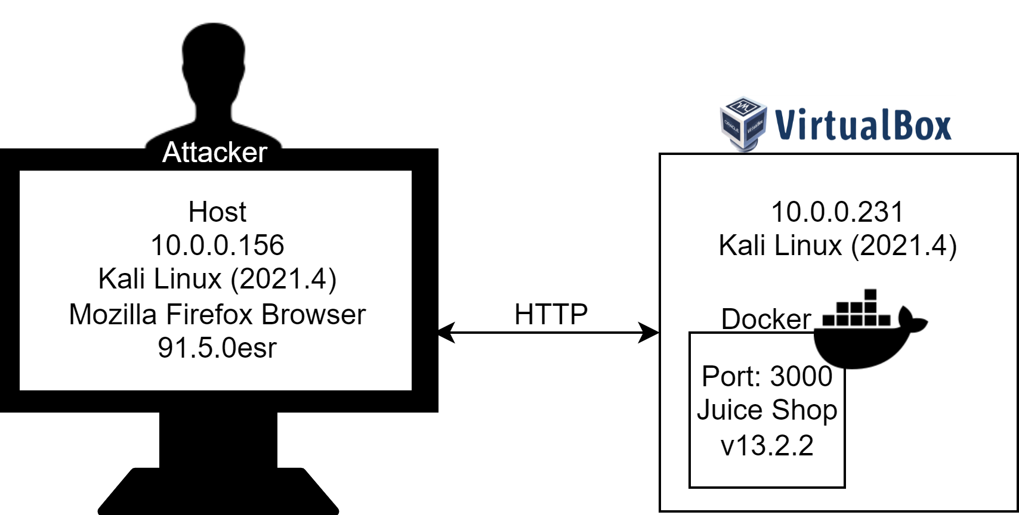
Environment Architecture Setup
Application emulates modern day web application for an online Juice Shop marketplace with complex functionality, containing a wide variety of vulnerabilities

Slide 5

A01: Broken Access Control
A02: Cryptographic Failures
A03: Injection
A04: Insecure Design
A05: Security Misconfiguration
A06: Vulnerable and Outdated Components
A07: Identification and Authentication Failures
A08: Software and Data Integrity Failures
A09: Security Logging and Monitoring Failures
A10: Server-Side Request Forgery

Slide 6
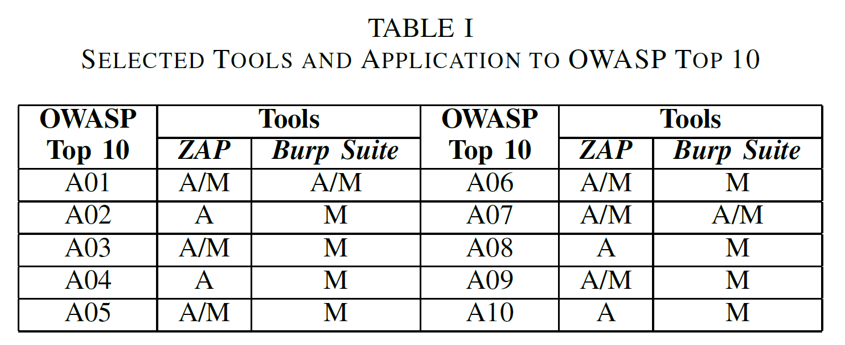
Tools and Application to OWASP Top 10
  Testing modes enabled by tools
    A (automated) or M (manual)

Slide 7
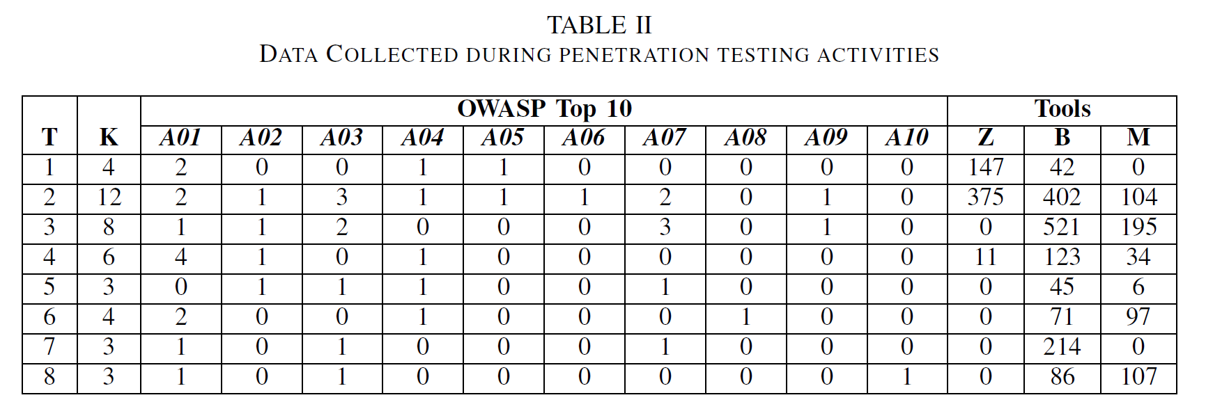
Data Collection
  T – vector of discrete time interval (approximately 5 hours each)
  K – vector of number of vulnerabilities discovered in each time interval
  A## – Number of OWASP Top 10 category vulnerabilities discovered
  Z, B, M – vector of seconds spent executing tools (Zap, Burp, or manual inspection)

Slide 8
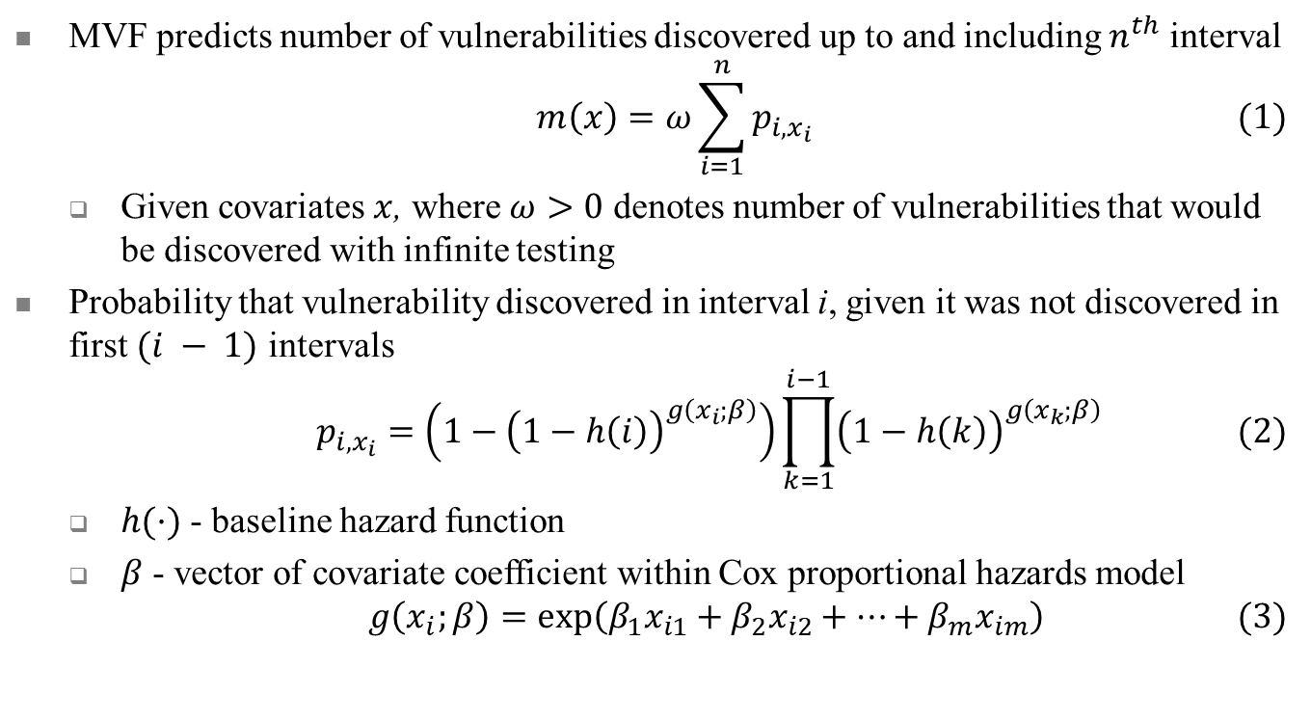
Discrete Cox Proportional Hazards NHPP SRGM
MVF predicts number of vulnerabilities discovered up to and including $n^{th}$ interval
$$m\left(x\right)=ω\sum_{i=1}^{n}{p_{i,x_{i}} } (1)$$
  Given covariates $x$, where $ω>0$ denotes number of vulnerabilities that would be discovered with infinite testing
Probability that vulnerability discovered in interval i, given it was not discovered in first $(i − 1)$ intervals
$$p_{i,x_{i}}=\left(1−{\left(1−h\left(i\right)\right)}^{g\left(x_{i};β\right)}\right)\prod_{k=1}^{i−1}{{\left(1−h\left(k\right)\right)}^{g\left(x_{k};β\right)}} (2)$$
  $h(·)$ - baseline hazard function
  $β$ - vector of covariate coefficient within Cox proportional hazards model
$$g\left(x_{i};β\right)=\exp\left(β_{1}x_{i1}+β_{2}x_{i2}+…+β_{m}x_{im}\right) (3)$$

Slide 9
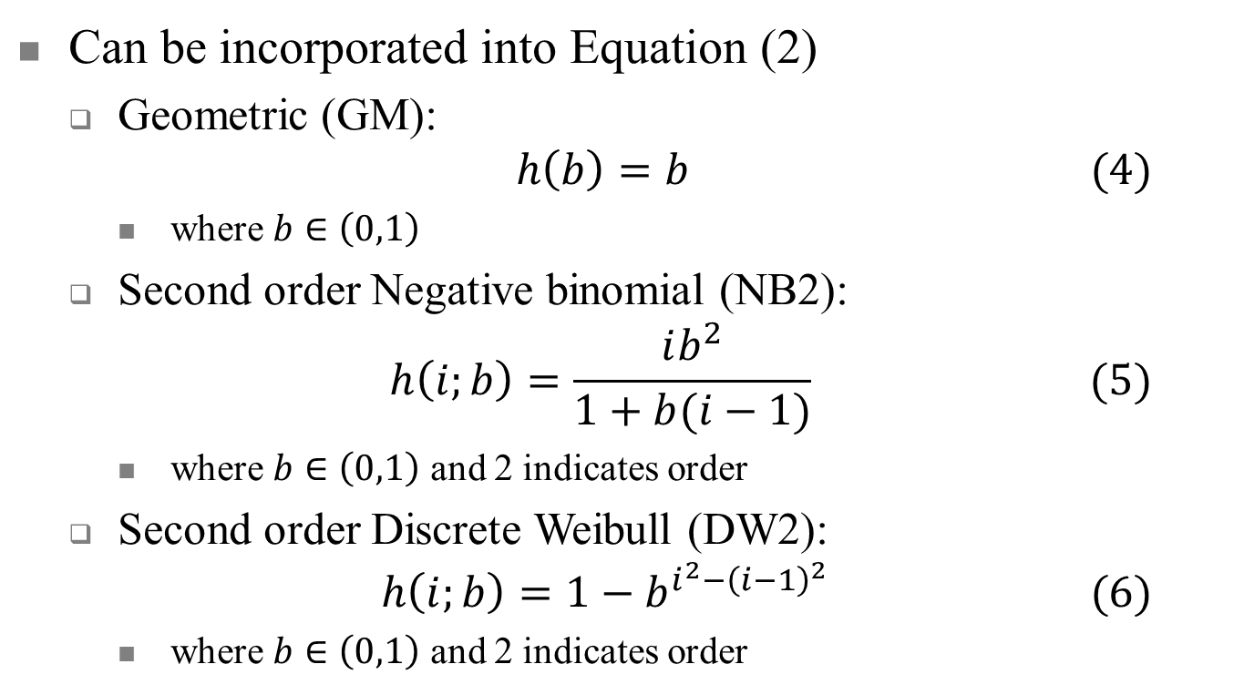
Hazard Functions
Can be incorporated into Equation (2)
  Geometric (GM):
  $$h\left(b\right)=b (4)$$
    where $b∈\left(0,1\right)$
  Second order Negative binomial (NB2):
  $$h\left(i;b\right)=\frac{ib^{2}}{1+b(i−1)} (5)$$
    where $b∈\left(0,1\right)$ and 2 indicates order
  Second order Discrete Weibull (DW2):
  $$h\left(i;b\right)=1−b^{i^{2}−{\left(i−1\right)}^{2}} (6)$$
    where $b∈\left(0,1\right)$ and 2 indicates order

Slide 10
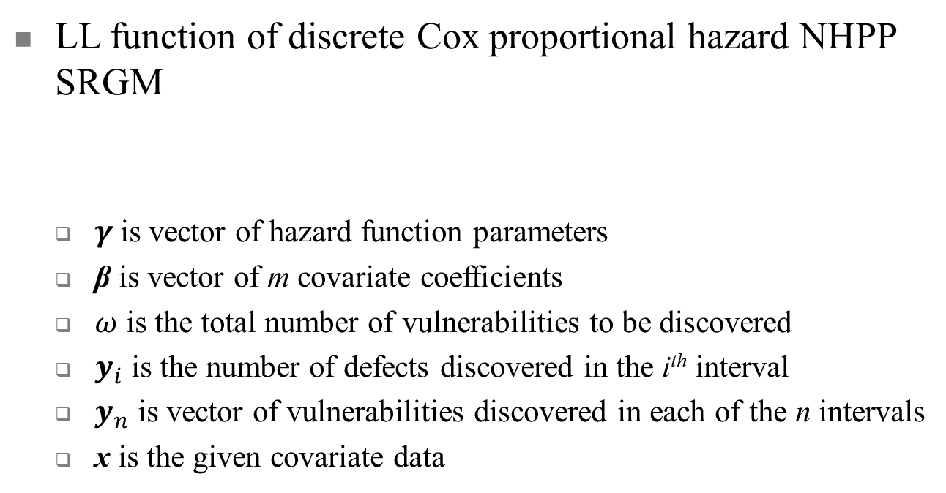
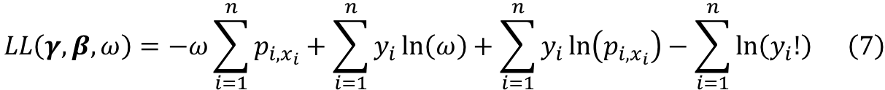
Log-Likelihood Function
LL function of discrete Cox proportional hazard NHPP SRGM
  $γ$is vector of hazard function parameters
  β is vector of m covariate coefficients
  $ω$ is the total number of vulnerabilities to be discovered
  $y_{i}$ is the number of defects discovered in the i^{th} interval
  $y_{n}$ is vector of vulnerabilities discovered in each of the n intervals
  x is the given covariate data
$$LL\left(γ,β,ω\right)=−ω\sum_{i=1}^{n}{p_{i,x_{i}}+\sum_{i=1}^{n}{y_{i}\ln\left(ω\right)+\sum_{i=1}^{n}{y_{i}\ln\left(p_{i,x_{i}}\right)−\sum_{i=1}^{n}{\ln\left(y_{i}!\right) }}}}\left(7\right)$$
Notes:
The log-likelihood function shown in equation 7 is used to estimate the parameters of the discrete cox proportional hazard model with covariates.
Substituting one of the hazard functions specified on the previous slide into Equation 2 produces unique log-likelihood functions.
Thus, given covariate data x and the vector of vulnerabilities discovered in each of the intervals, the model fitting step identifies the numerical values of the total number of vulnerabilities to be discovered omega, vector of m covariate coefficients beta, and hazard function parameters gamma.

Slide 11
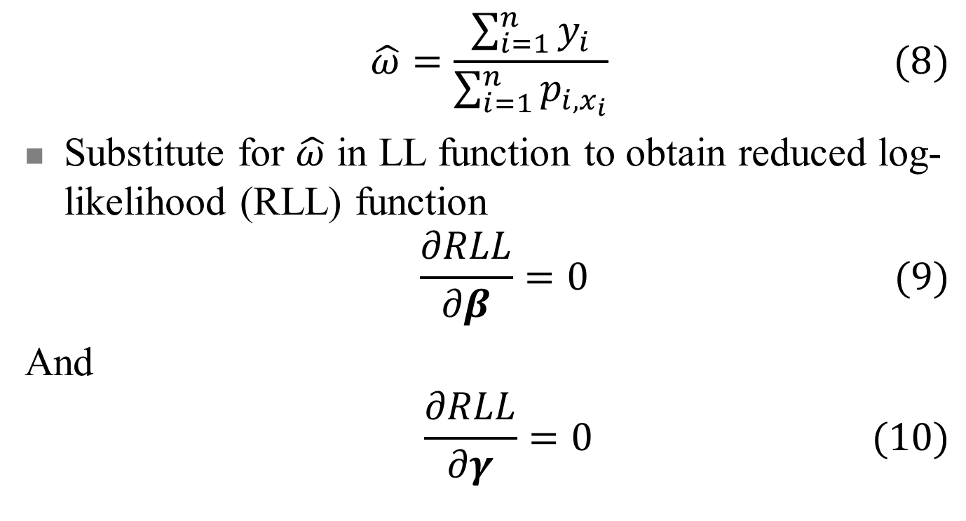
Log-Likelihood Function (2)
$$\hat{ω}=\frac{\sum_{i=1}^{n}{y_{i}}}{\sum_{i=1}^{n}{p_{i,x_{i}}}} (8)$$
Substitute for $\hat{ω}$ in LL function to obtain reduced log-likelihood (RLL) function
$$\frac{∂RLL}{∂β}=0 (9)$$
And
$$\frac{∂RLL}{∂γ}=0 (10)$$
Notes:
The reduced log-likelihood function eliminates the omega parameter, giving one less parameter that needs to be estimated.
This is done by differentiating the NON-reduced log-likelihood function with respect to omega, setting the results equal to 0, and then solving for omega, which gives omega hat as shown in equation 8.
Then, omega hat is substituted into the log-likelihood function to produce the reduced log-likelihood function.
The maximum likelihood estimates are obtained by solving the 2 system of equations shown in equations 9 and 10. The first obtains the hazard function parameters, beta, and the second obtains the model parameters associated with each covariate.

Slide 12
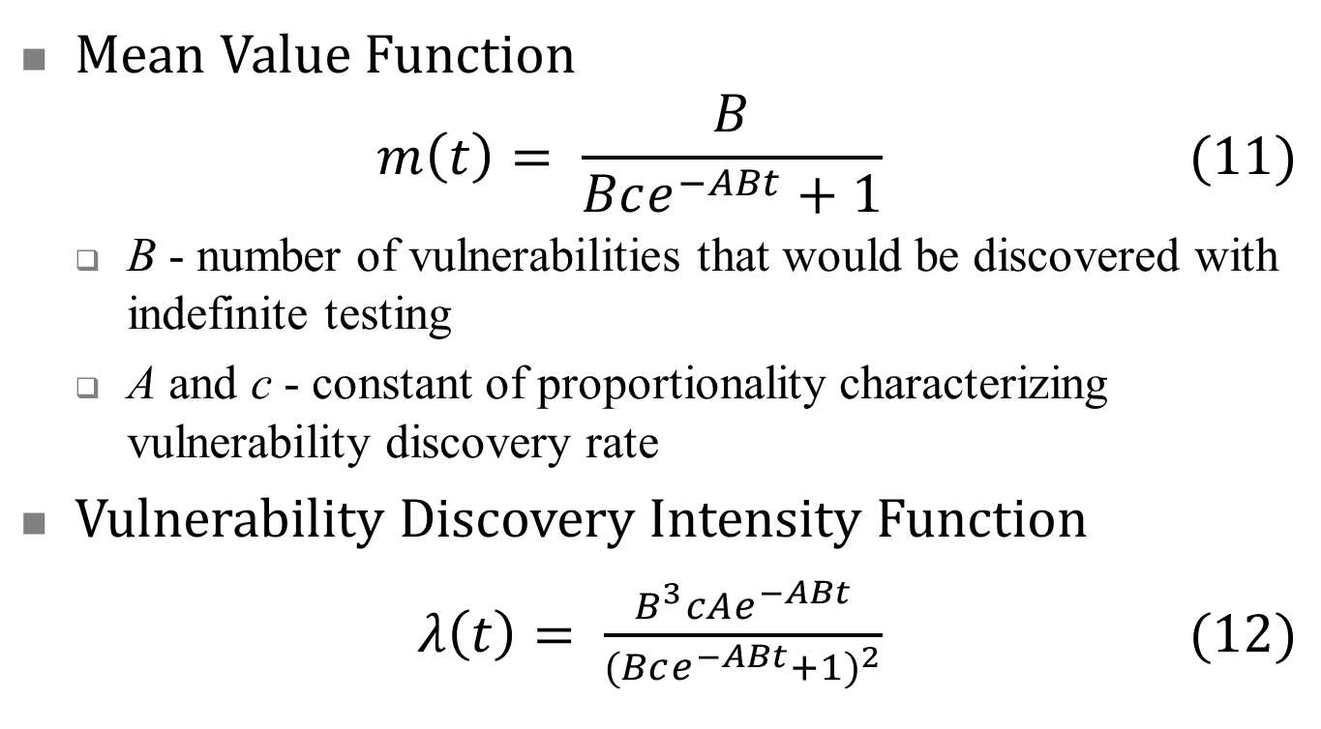
Alhazmi-Malaiya Logistic (AML) Model
Mean Value Function
$$m\left(t\right)= \frac{B}{Bce^{−ABt}+1} (11)$$
  B - number of vulnerabilities that would be discovered with indefinite testing
  A and c - constant of proportionality characterizing vulnerability discovery rate
Vulnerability Discovery Intensity Function
$λ\left(t\right)= \frac{B^{3}cAe^{−ABt}}{(Bce^{−ABt}+1)^{2}} (12)$

Slide 13
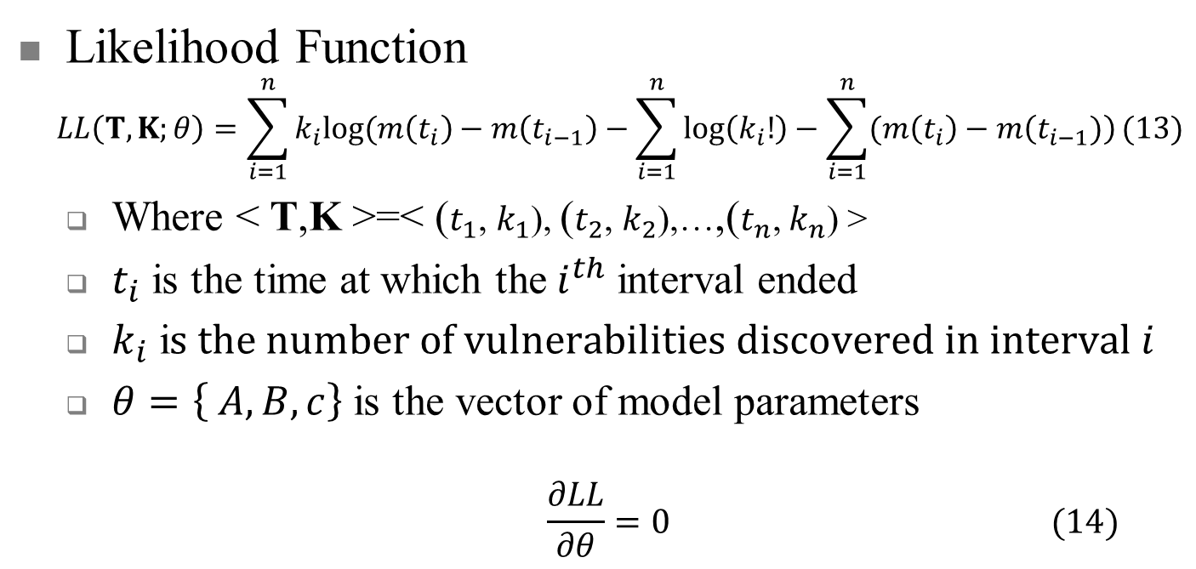
Alhazmi-Malaiya Logistic (AML) Model (2)
Likelihood Function
$$LL\left(T, K;θ\right)=\sum_{i=1}^{n}{k_{i}log⁡(m\left(t_{i}\right)−m\left(t_{i−1}\right)−\sum_{i=1}^{n}{\log\left(k_{i}!\right)−\sum_{i=1}^{n}{(m\left(t_{i}\right)−m\left(t_{i−1})\right)}}}(13)$$
  Where < T,K >=< ($t_{1}$, $k_{1}$), ($t_{2}$, $k_{2}$),…,($t_{n}$, $k_{n}$) >
  $t_{i}$ is the time at which the$i^{th}$ interval ended
  $k_{i}$ i$s the number of vulnerabilities discovered in interval i$
  $θ=\left\{ A, B, c\right\}$ is the vector of model parameters
  $$\frac{∂LL}{∂θ}=0 (14)$$
Notes:
In order to estimate the parameters of the AML given vulnerability, the grouped data form of the likelihood function is expressed as shown in equation 13.
Where T and K correspond to columns in Table 2. T is the time at which the interval ended. K is the number of vulnerabilities discovered in that interval and theta is the vector of model parameters.
The maximum likelihood estimates the AML model parameters determined by solving the system of equations in equation 14.

Slide 14
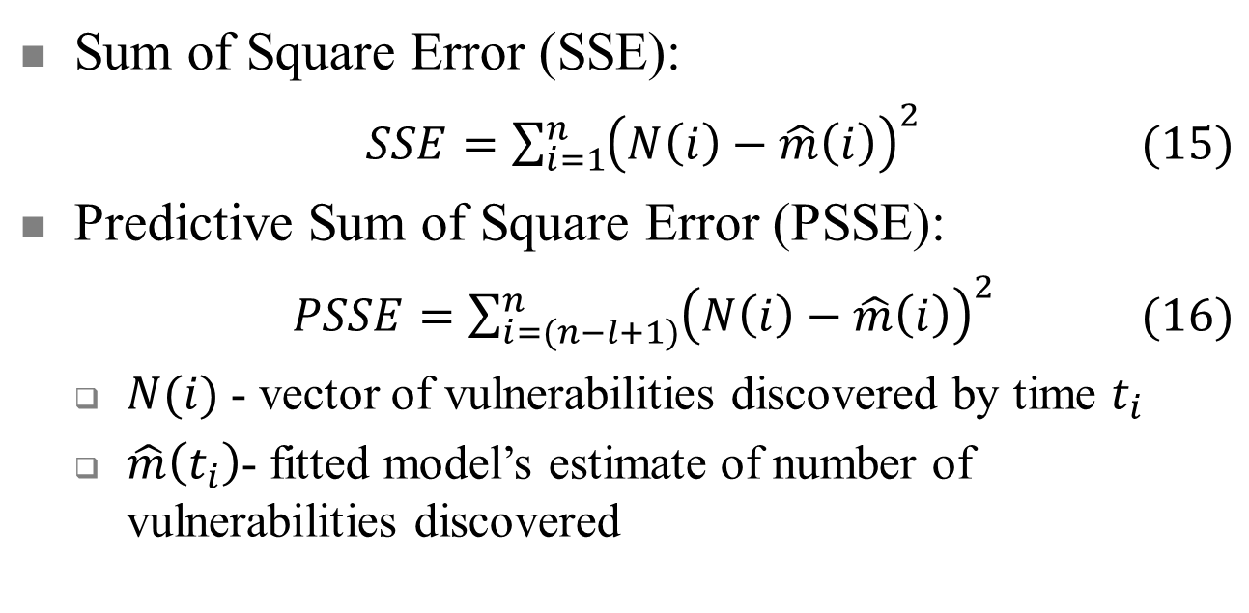
Model Assessment
Sum of Square Error (SSE):
$SSE=\sum_{i=1}^{n}{{\left(N\left(i\right)−\hat{m}\left(i\right)\right)}^{2}} (15)$
Predictive Sum of Square Error (PSSE):
$PSSE=\sum_{i=(n−l+1)}^{n}{{\left(N\left(i\right)−\hat{m}\left(i\right)\right)}^{2}} (16)$
  $N(i)$- vector of vulnerabilities discovered by time $t_{i}$
  $\hat{m}\left(t_{i}\right)$- fitted model’s estimate of number of vulnerabilities discovered
Notes:
Now I will move into the equations used for model assessment. These describe quantitative goodness of fit measures to assess how well a model performs on a given data set.
The sum of squares error calculates the difference, in each interval, between the estimated number of vulnerabilities discovered according to the model’s mean value function, and the cumulative number of vulnerabilities discovered according to the data.
The differences in each interval are squared and then added together to produce the sum of squares error.
The predictive sum of squares error is calculated using essentially the same equation as the sum of squares error. However, the model is fit to only a subset of the data, and the accuracy of its predictions on the remaining data are considered as well.

Slide 15
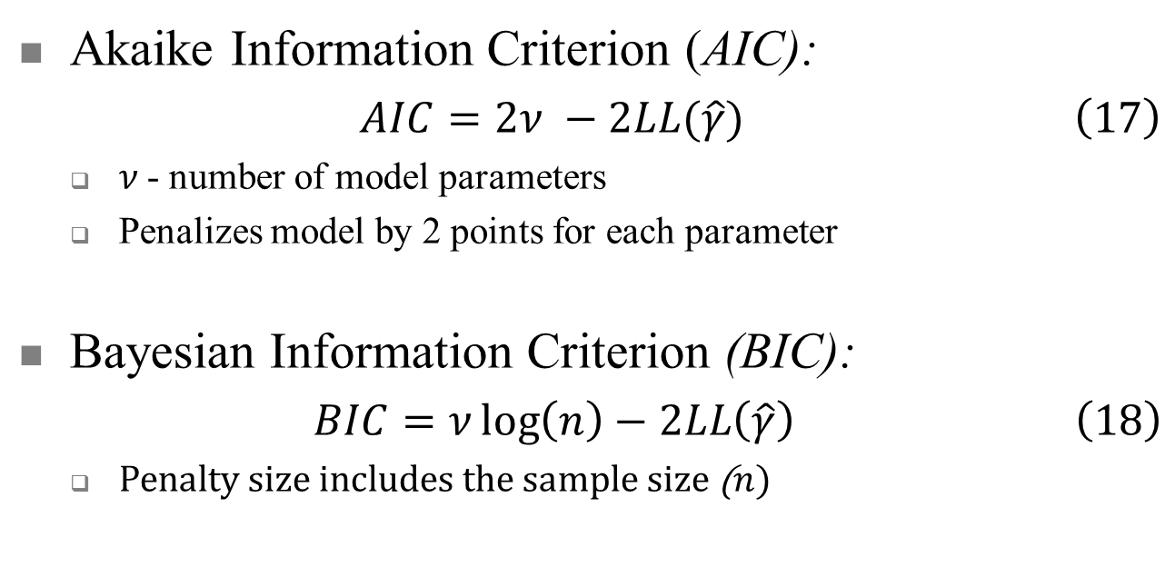
Model Assessment (2)
Akaike Information Criterion (AIC):
$AIC=2ν −2LL(\hat{γ}) \left(17\right)$
  $ν$- number of model parameters
  Penalizes model by 2 points for each parameter
Bayesian Information Criterion (BIC):
$BIC=ν\log\left(n\right)−2LL\left(\hat{γ}\right) \left(18\right)$
  Penalty size includes the sample size ($n$)
Notes:
AIC and BIC, quantify the tradeoff between the characterization of the observed data, represented by the log-likelihood function value, and model complexity.
Models incur a penalty of 2 for each of their parameters, which discourages overly complex models. BIC also considers the sample size.

Slide 16
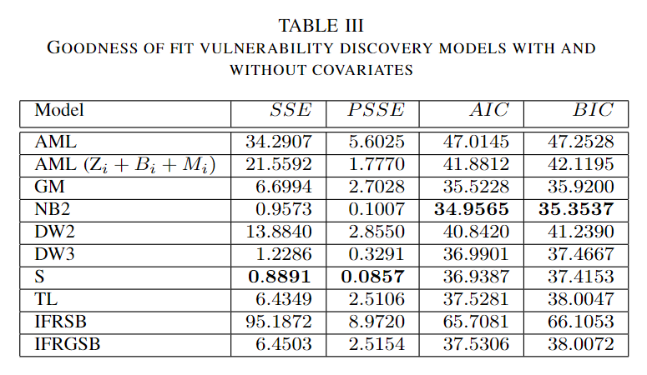
Goodness of Fit Model Assessment
VDM with covariates performed substantially better, despite AIC and BIC measures penalized inclusion of additional parameters for covariates associated with vulnerability discovery activities

Slide 17
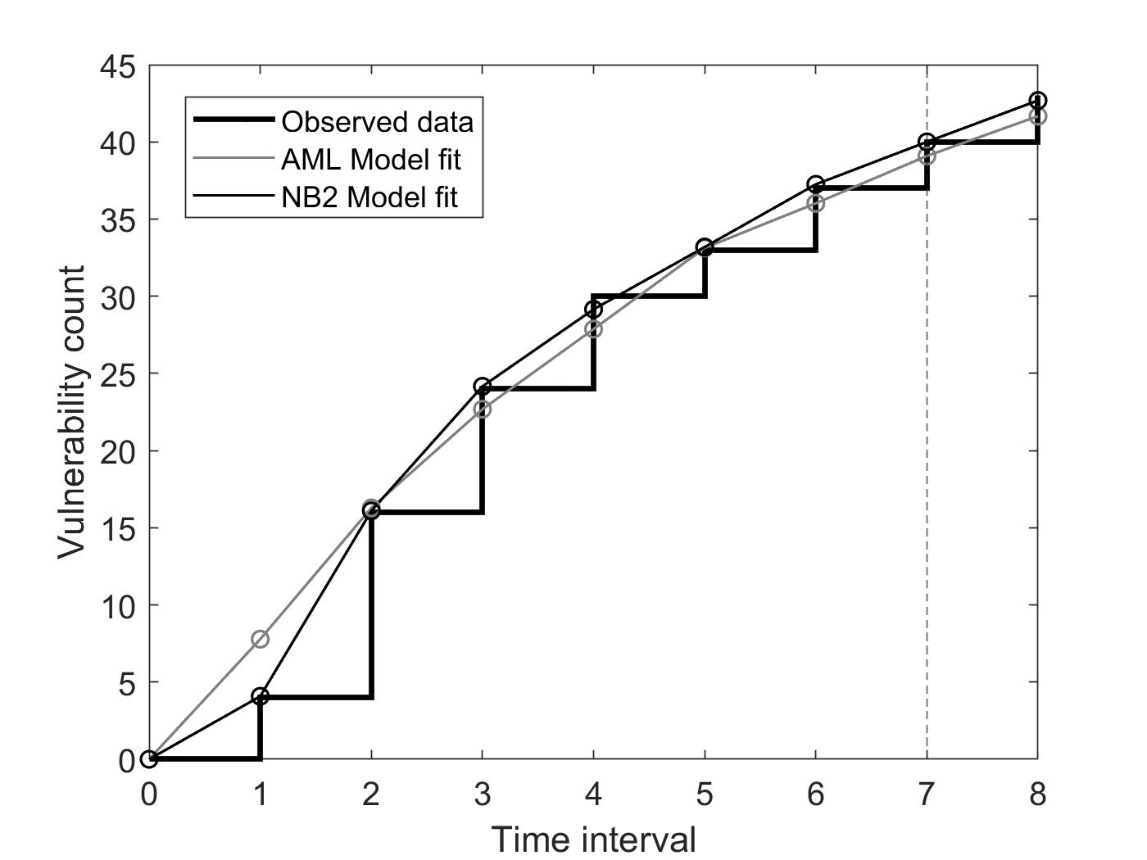
Model Fit
Covariate VDM with NB2 hazard function tracked and predicted better than AML model

Slide 18
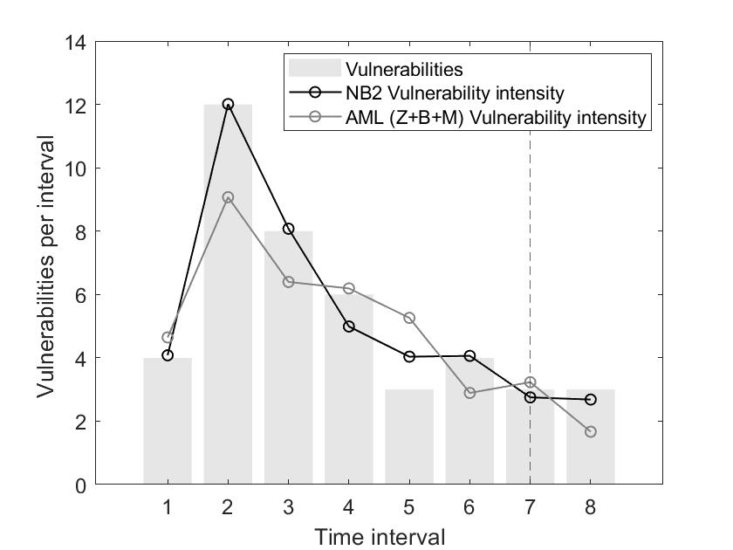
Vulnerability Discovery Intensity
Covariate VDM with NB2 hazard function tracked and predicted better than AML model

Slide 19
Summary & Conclusion
Presented comparative study of software VDM incorporating covariates with Alhazmi-Malaiya Logistic (AML) model
Software VDM incorporating covariates
  More accurately tracked and predicted number of vulnerabilities discovered in future intervals as function of penetration testing activities performed
  Achieved significantly better goodness of fit, despite information theoretic measures penalized covariate models for additional parameters

Slide 20
Next Steps and Future Work
Combine techniques presented here with other reliability engineering techniques to provide more comprehensive, accurate, and usable methods that support systematic test and evaluation of software
Demonstrating applicability of models to test & evaluation of machine learning with domain specific techniques and tools such as adversarial machine learning, generative adversarial training, and incremental learning

Slide 21



Acknowledgements
This research was supported by the National Science Foundation under Grant Number 1749635 and the Homeland Security Community of Best Practices (HS CoBP) through the U.S. Department of the Air Force through under award number SCR1158132. Any opinions, findings, and conclusions or recommendations expressed in this material are those of the author(s) and do not necessarily reflect the views of the National Science Foundation, U.S. Department of Homeland Security or U.S. Department of the Air Force.

