Slide 1
Uncertainty Quantification of Heat Microbial Reduction for NASA Planetary Protection Session: Applications of Bayesian Statistics
Presenter: Michael DiNicola, Jet Propulsion Laboratory, California Institute of Technology
April 27, 2023
Contributors: Zach Dean, Emily Klonicki, Scott Roberts, Brian Clement and Lisa Guan
Jet Propulsion Laboratory, California Institute of Technology
© 2023 California Institute of Technology. Government sponsorship acknowledged.
Notes:
Planetary Protection is the practice of:
Protecting solar system bodies from harmful contamination by Earth life
Protecting Earth from possible life forms or bioactive molecules that may be returned from other solar system bodies.
Reducing the risk of false positives and false negatives on missions searching for evidence of life or biosignatures on other worlds
Microbiologists and engineers at NASA’s Jet Propulsion Laboratory (JPL) design microbial reduction and sterilization protocols that reduce the number of microorganisms on spacecraft or eliminate them entirely

Slide 2
Overview
Demonstrate how Bayesian statistics and experimentation can be used to quantify uncertainty in phenomenological models
How experiment and model can be brought together to determine risk
How modeling can help stakeholders make better risk-informed decisions and avoid the unwarranted conservatism that is often prescribed when processes are not well understood
Ramifications to current NASA planetary protection sterilization specifications and current missions under development such as the Europa Clipper Mission, Europa Lander concept and Mars Sample Return
© 2023 California Institute of Technology. Government sponsorship acknowledged.

Slide 3
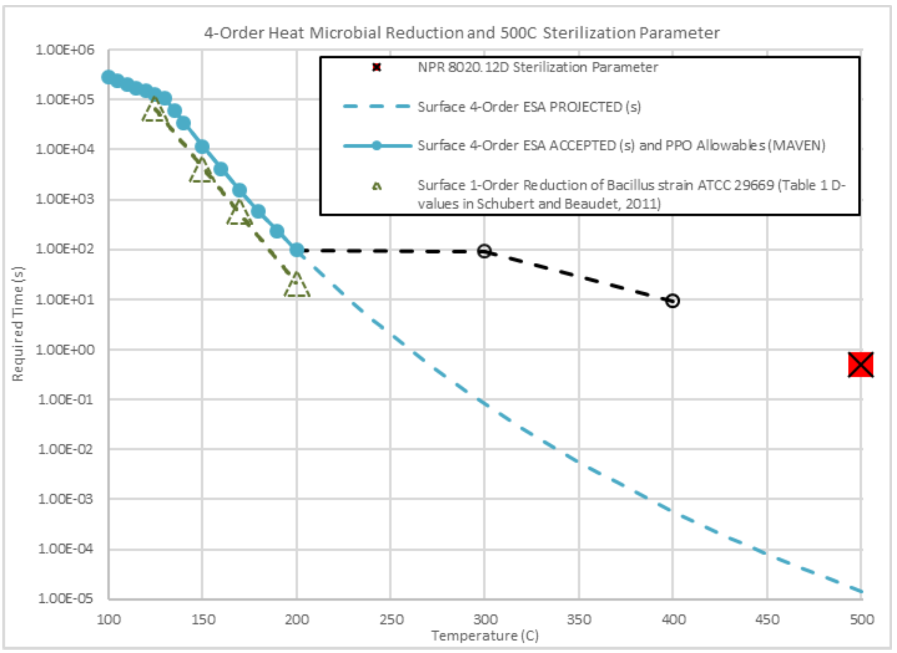
Background
How do these curves compare with the SAL?
No uncertainty quantification
Sterility Assurance Level (SAL): the probability that a product, after being exposed to a given sterilization process, contains one or more viable organisms
A standard metric in the sterilization industry for quantifying risk
Objective: Use experimental results and mathematical modeling to bound the time-temperature at which the SAL reaches 10⁻⁶
Current NASA specs: Heat sterilization occurs when temperatures reach 500°C for 0.5 sec
This is a key sizing metric for development of in-flight sterilization systems and for allowing sterilization credit from NASA PP
No validation of these curves with experimental data
Current spec has no statistical interpretation
Unclear how to make credible predictions
Current heat microbial reduction specifications corresponding to acquired data are shown on the solid black and blue lines. Circled markers present current NASA Planetary Protection Office projected encapsulated 4-order log reduction values, with the X representing the 500 °C for 0.5 seconds value. Dashed lines present projected high temperature microbial reduction curves that follow the current specifications, but that do not have data.
© 2023 California Institute of Technology. Government sponsorship acknowledged.

Slide 4
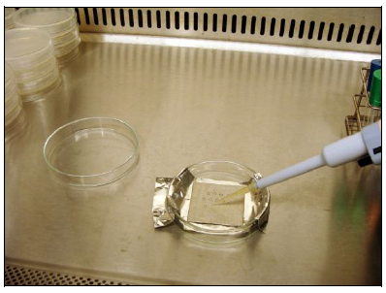
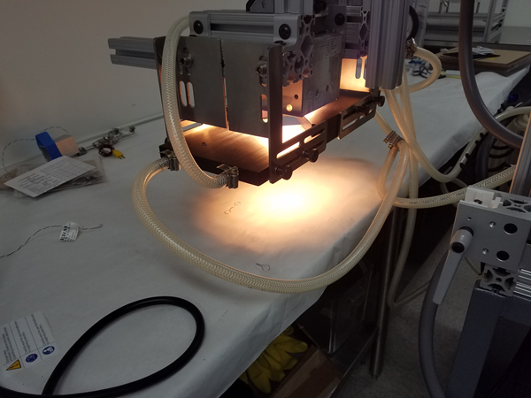
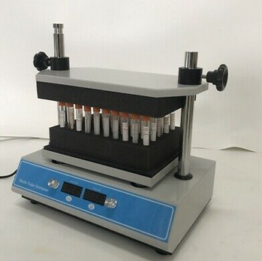
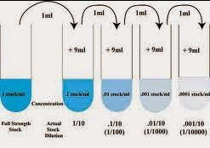
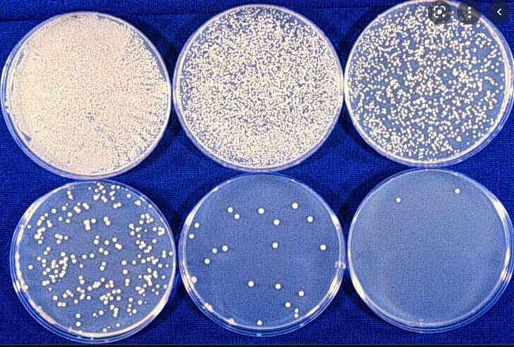
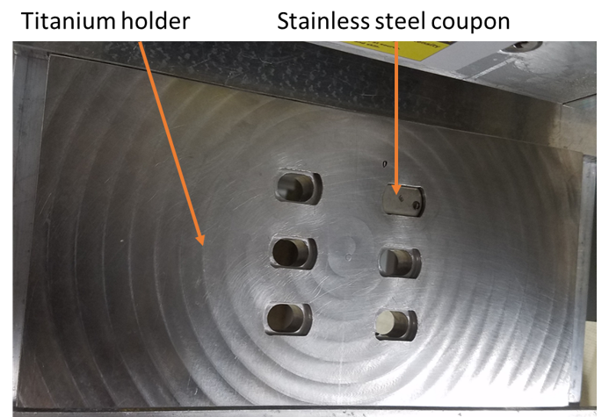
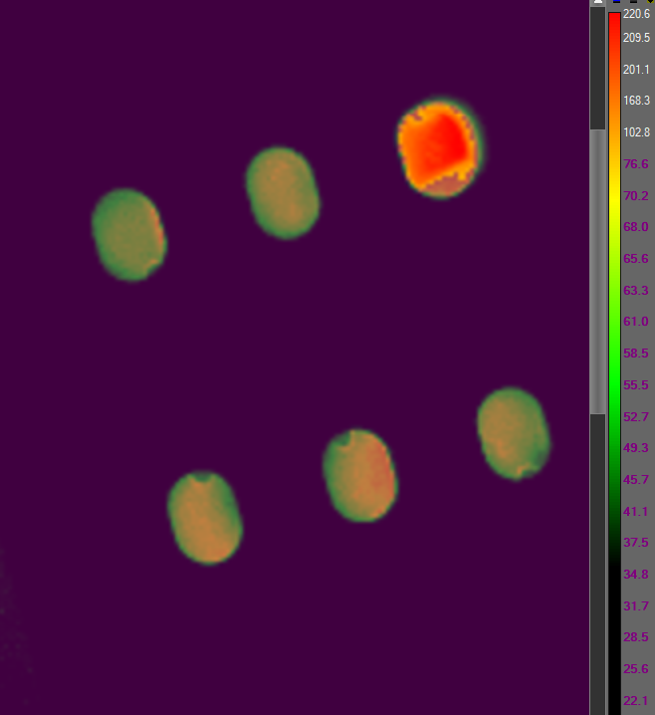

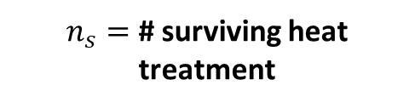

The Data Generating Process Survivor Ratio Experiments
Also perform “Fraction Negative” experiments here to record growth / no growth observations; no extraction, dilution series or transfer to petri dishes
Extract spores, dilute, plate and observe CFU
Seeding of Coupon
Heat Treatment
1 mL sterile deionized water added to test tubes, then vortexed and sonicated
Diluted samples plated in TSA.
Colonies incubated at 32 C and counted @ 96 hrs.
Coupons inoculated with CFU
Placed into coupon holder
Heat treatment applied via IR lamp
Treated coupons placed in 10 mL test tubes
$n=$ # seeded onto a coupon
$n_{s}=$ # surviving heat treatment
$r=$ # recovered
We can perform control experiments to predict this, but we do not observe the actual CFU on the coupon prior to heat treatment
This is what we are actually interested in but cannot observe directly
This is the outcome we observe
© 2023 California Institute of Technology. Government sponsorship acknowledged.

Slide 5
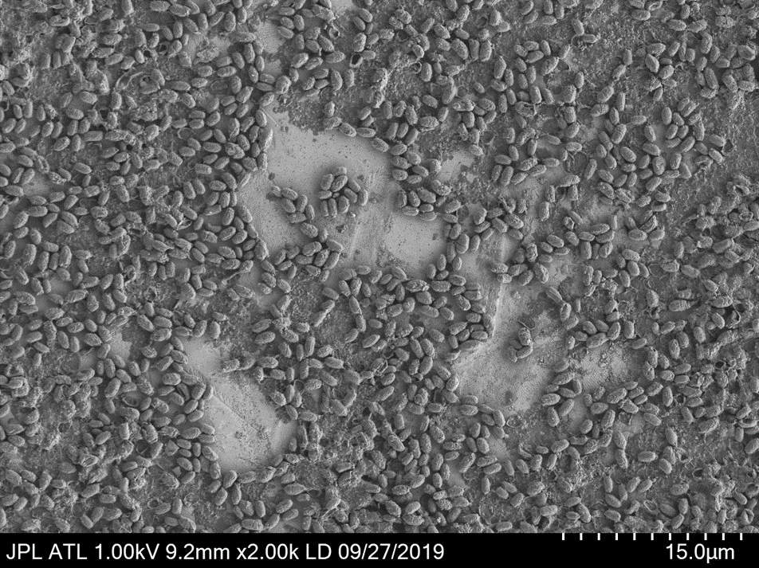
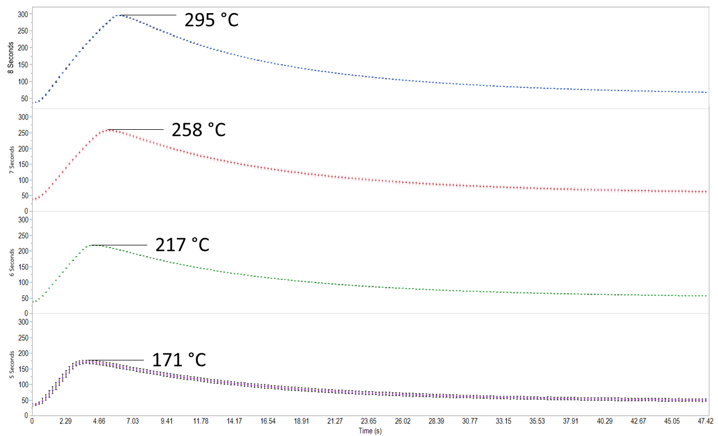
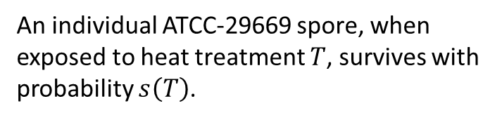

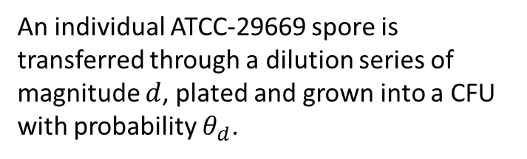
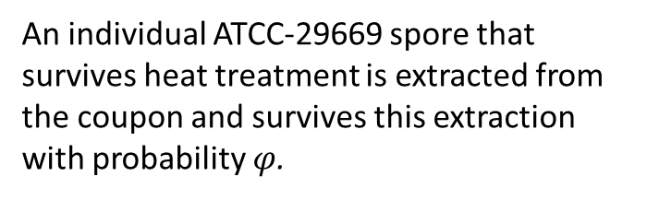
Spore survival, extraction and plating
An individual ATCC-29669 spore, when exposed to heat treatment $T$, survives with probability $s\left(T\right)$.
An individual ATCC-29669 spore that survives heat treatment is extracted from the coupon and survives this extraction with probability $φ$.
An individual ATCC-29669 spore is transferred through a dilution series of magnitude $d$, plated and grown into a CFU with probability $θ_{d}$.
The mean number of ATCC-29669 spores seeded onto a coupon prior to heat treatment is λ.
Actual time temperature profiles, $T$
© 2023 California Institute of Technology. Government sponsorship acknowledged.

Slide 6
Important Terms: Survival Ratio, D-values and z-values
Memoryless Assumption: Survival of a microorganism exposed to a temperature over any time interval depends on the length of the time interval and the temperature on that interval, but not on the exposure to temperature the microorganism has survived up to that time.
1
Survival Ratio @ temp T = N(T,t) / N(T,0) = 10^{-Δt/D-value}
1
D-value Ratio @ temp T = δ(T) / δ(T₀) = 10^{-ΔT/z-value}
0.1
0.1
1-order reduction in survival ratio
1-order reduction in D-value
N(T,t) / N(T,0)
δ(T) / δ(T₀)
0.01
0.01
D-value at temp T = δ(T)
z-value
Number of spores that have survived temp T up to time t
0.001
0.001
Time, t
Temperature, T
Given a reference D-value and the functional form of the z-value, we can calculate all other D-values for survival calculations.
© 2023 California Institute of Technology. Government sponsorship acknowledged.
Notes:
Survival ratio is independent of the initial number of microorganisms.

Slide 7
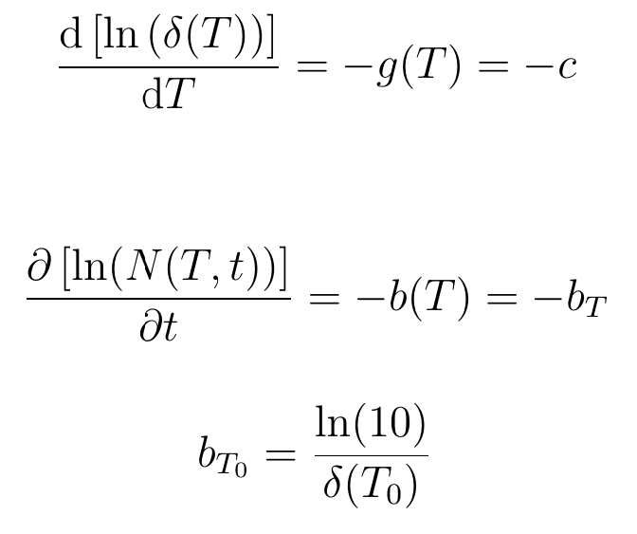
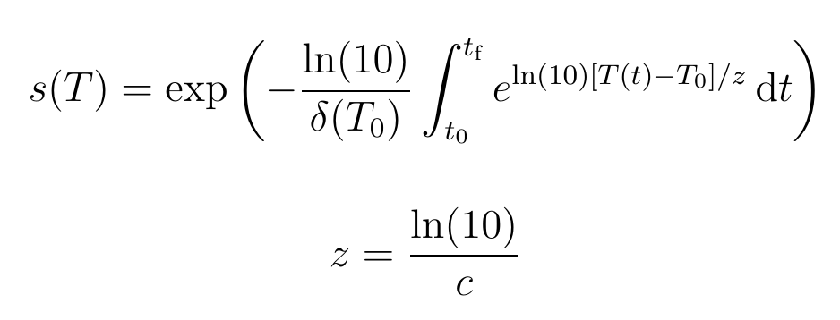
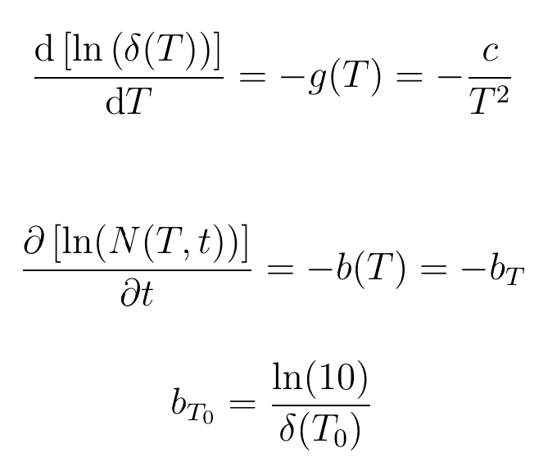
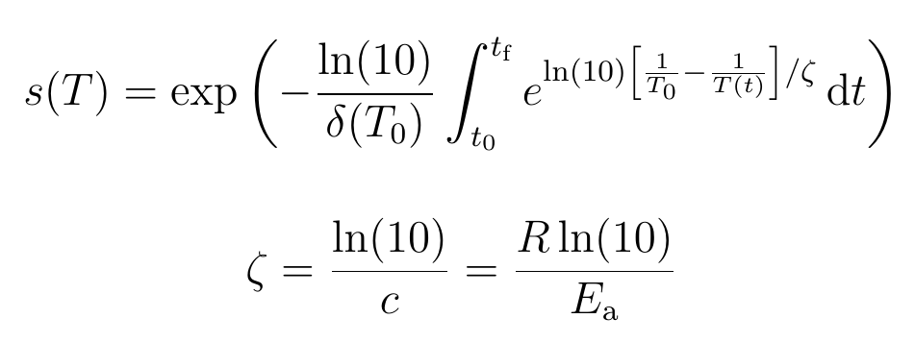
Phenomenological Models
constants
Constant z-value model
reference “D-value” (initial condition)
Selected for further modeling
“z-value”
Future research
Arrhenius
model
Gas constant
Activation energy
© 2023 California Institute of Technology. Government sponsorship acknowledged.
Notes:
Equivalent survival when T(t) = 1/T_0

Slide 8
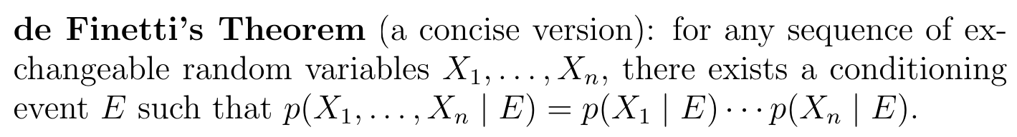
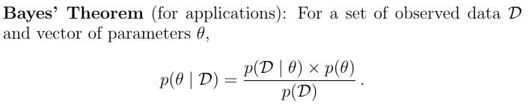
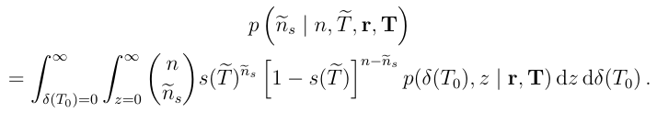
From Phenomenological Model to Probabilistic Model
The independence afforded by di Finetti allows the data generating process to be described by a binomial distribution
The binomial distribution allows us to interpret the survival fraction s(T) as a probability (the probability of individual microorganism survival)
Phenomenological model of physical processes
Probabilistic model generating data
Calibrated model with experimental data
de Finetti’s Theorem and the design of experiments provide the bridge from a phenomenological model to a probabilistic model
Bayes’ Theorem allows us to calibrate (“teach”) these models with data
Predictive model for applications
© 2023 California Institute of Technology. Government sponsorship acknowledged.
Notes:
Solution used to seed coupon is sonicated and vortexed prior to seeding
Coupons seeded with the same species according to the same protocols
Coupons of the same material type, size and from the same manufacturer
Same heating and recovery procedure applied to all replicates of a given experiment
Reagents tested for sterility according to manufacturer’s recommendations

Slide 9
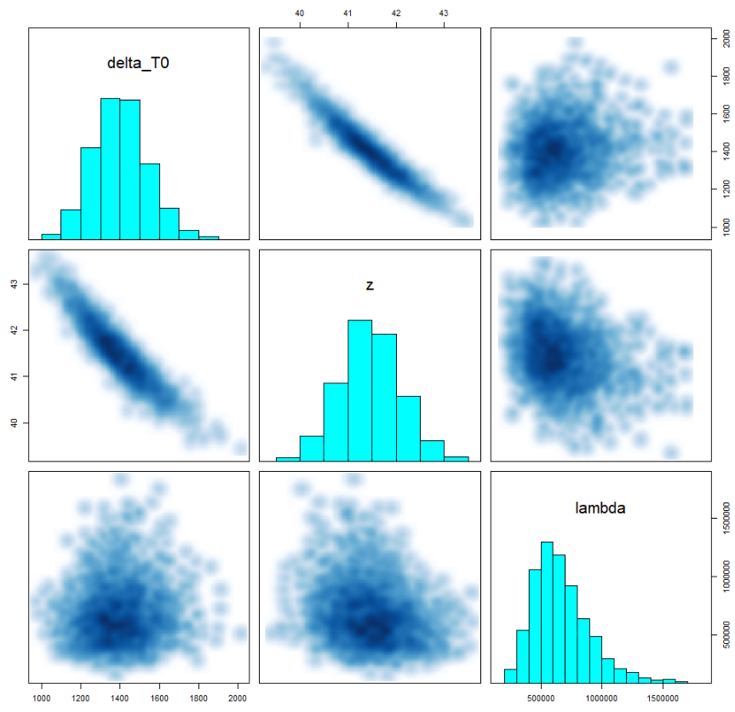
D-value, z-value and mean CFU seeded on coupon
Strong correlation between D-value (@ 150 °C) and z-value
D-value from model is smaller than that found in previous experiments, an indicator of a non-constant z-value (a lower z-value at lower temperatures)
Further research required to evaluate this, but model appears to be validating well within the temperatures evaluated, so does not seem to be especially problematic
D-value @ 150 °C
D-value ranges between 1,142-1,699 sec (19-28 min) with mean value 1,401 sec (23 min)
z-value
z-value ranges between 40-43 °C with mean value 41 °C
mean # CFU seeded onto coupon
Mean # of CFU seeded onto a coupon ranges between 3.1×10⁵-1.3×10⁶ with mean value 6.7×10⁵
Includes data from all survival ratio and fraction negative experiments
© 2023 California Institute of Technology. Government sponsorship acknowledged.

Slide 10
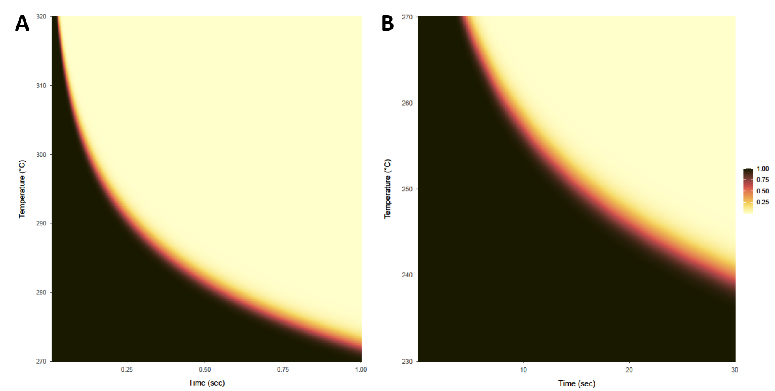
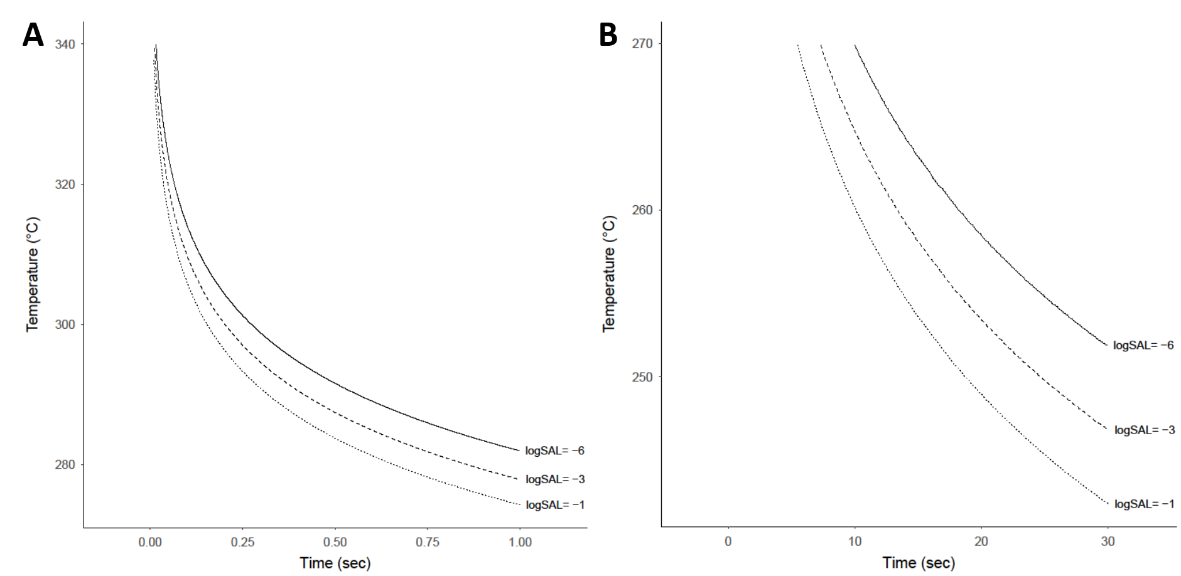
Predicted Sterility Assurance Level (SAL) Bioburden = 1 × 10⁶ ATCC-29669 spores
Example: SAL = 10⁻² when T is the constant time temp profile of 300°C for 0.18 sec
Probabilities are integrated (“averaged”) over all possible D-values and z-values
SAL ≈ 0
“cliff” where SAL plummets
Recall: NASA spec uses 500 C for 0.5 sec for sterilization. These results show this is extremely conservative for terrestrial microbes
SAL ≈ 1
Temperatures from 270 to 320°C and exposure times from 0.01 to 1 s, based on survival ratio and fraction-negative experiments
Temperatures from 230 to 270°C for exposure times from 0.1 to 30s, based on survival ratio experiments only
© 2023 California Institute of Technology. Government sponsorship acknowledged.

Slide 11
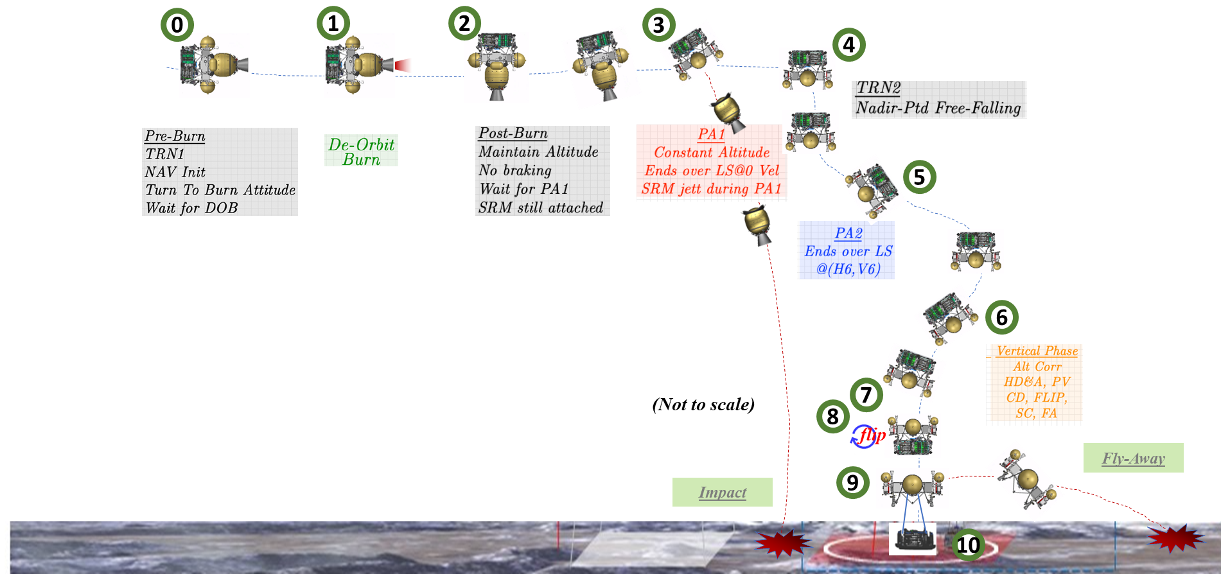
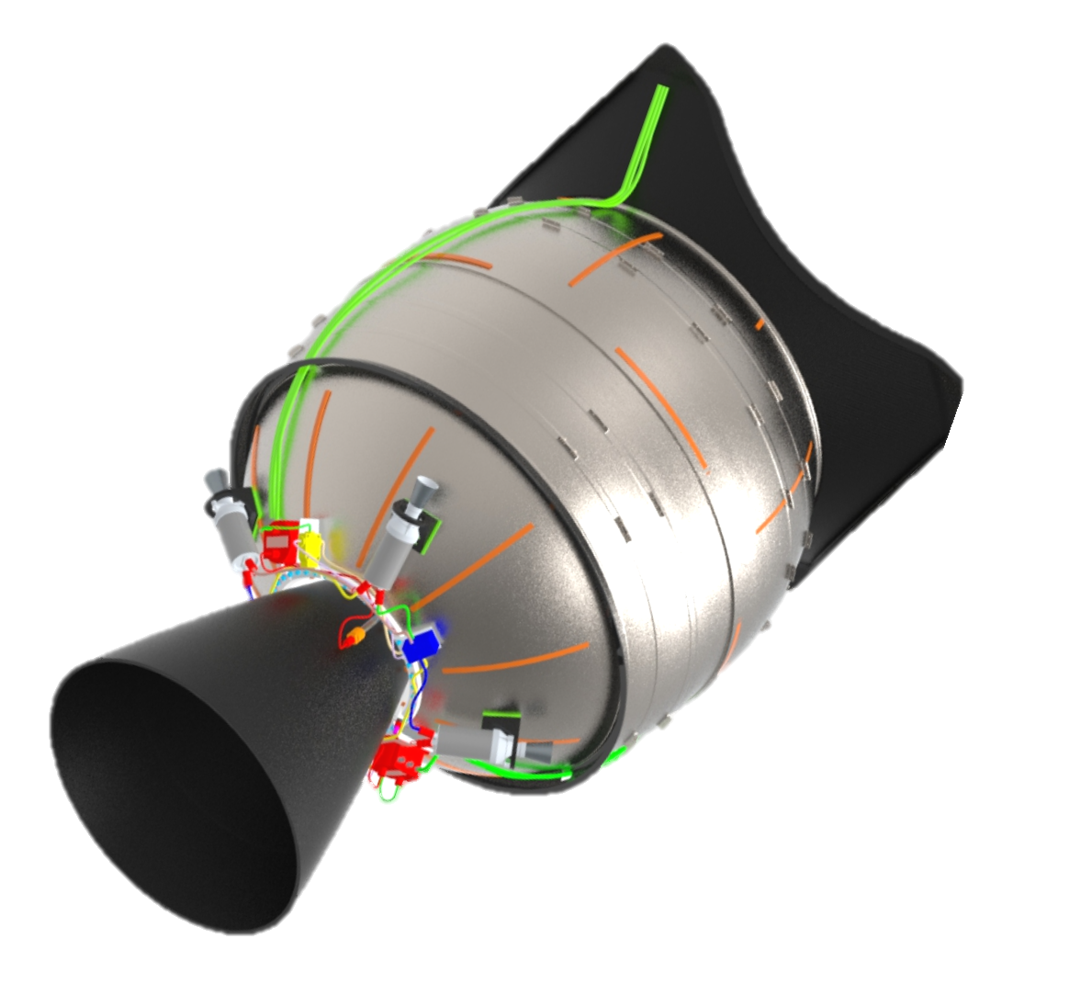
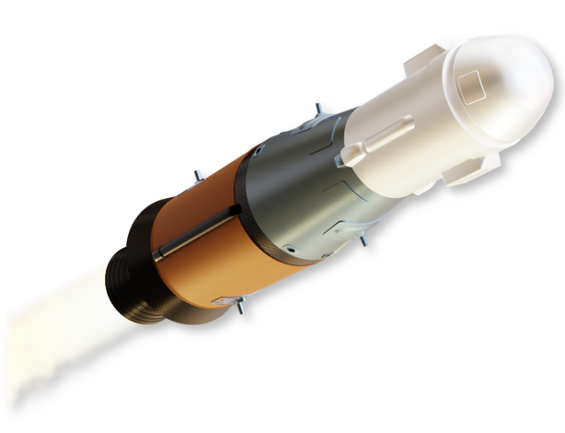
Removing Unwarranted Conservatism
Direct In-flight Sterilization
On-board sterilization systems
Reduced sterilization temperature implies less energetic material → less mass → free up resources, increase margins
Minimize technology development
Can optimize system design for the risk posture of the mission
Surface Impact after hot firing
125 m/s @ 40 deg
7.5 km up-track of landing site
Indirect In-flight sterilization
Examples: Rocket burn, entry-decent-landing (EDL) operations
Avoid mission design complexity → save delta-V and mass → free up resources, increase margins
Can optimize system design for the risk posture of the mission
© 2023 California Institute of Technology. Government sponsorship acknowledged.

Slide 12
Summary
Demonstrated a Bayesian model that used phenomenological models in a probabilistic framework to quantify uncertainty
Differential equations describing a phenomenon → probabilistic model → experiments that inform the model → probabilistic predictions
Demonstrated how this model “learns” from experiments to help us determine risk
Sterility Assurance Level
Demonstrated how our decisions at NASA related to Planetary Protection can avoid unwarranted conservatism in engineering of flight systems
Broad spectrum of time-temp values can be applied to optimize pre-launch sterilization protocols, inform hardware trades during mission formulation and reduce risk to mission performance
Discussed ramifications to NASA Planetary Protection sterilization specifications as well as current and future missions
Experimental evidence supports a re-evaluation of the current Planetary Protection time and temperature overkill bioburden reduction requirement from 500°C for 0.5 seconds to a sterility curve where time to sterility can be calculated based on the given high-heat temperature (>200 °C).
Further modeling work includes:
Exploring model sensitivity to different survival functions and z-value assumptions
Continued model validation
© 2023 California Institute of Technology. Government sponsorship acknowledged.

Slide 13
THANK YOU!
References
Dean ZS, DiNicola M, Klonicki E, Roberts S, Clement BG and Guan L (2022) Establishing Sterility Assurance for Bacillus canaveralius 29669 Spores Under High Heat Exposure. Front. Microbiol. 13:909997. doi: 10.3389/fmicb.2022.909997
Stan Development Team (2021). Stan Modeling Language Users Guide and Reference Manual, 2.29. Stan Development Team.
RStudio Team(2021). RStudio: Integrated Development Environment for R. Boston, MA: RStudio, PBC.
© 2023 California Institute of Technology. Government sponsorship acknowledged.

Slide 14
Backup
Survival Function
Memoryless Property
Model Validation and Assumptions
Experimental design and modeling process
Derivation of the survival function
Event trees for survival and recovery
Outline of Mathematical Model
Sensitivity of SAL to bioburden
© 2023 California Institute of Technology. Government sponsorship acknowledged.

Slide 15
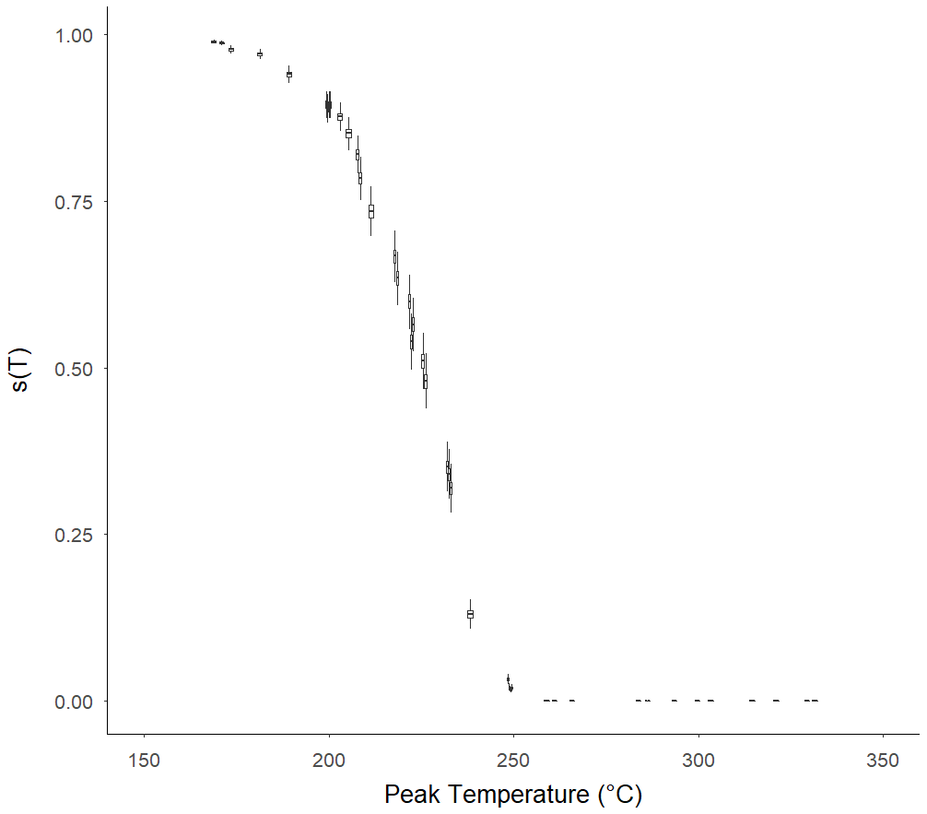
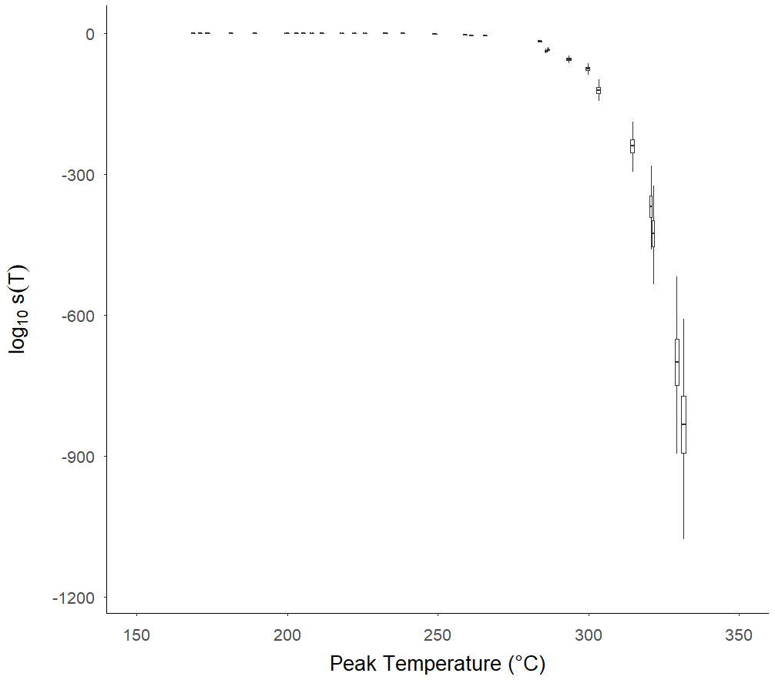

Survival Function, $s\left(T\right)$
Box and whiskers represent 50% and 95% credibility intervals, respectively. Horizontal line in box represents the mean.
On a linear scale, sigmoidal behavior is observed as the survival function decreases with peak temperature
On a log scale, the survival function can be seen to decrease at an accelerated rate, especially at higher peak temperatures
Same data, different vertical axis scale
Linear Scale
Log Scale
© 2023 California Institute of Technology. Government sponsorship acknowledged.

Slide 16
Why is “memorylessness” important?
It allows us to apply the D-value and z-values from the model to assess survival for differently shaped time-temperature profiles than those used in these experiments
The temperatures and duration of the heat treatment should be within range of those used in the experiments
The memoryless property allows us to assess the SAL for these time-temp profiles; in particular the constant temp profile
temp
temp
temp
time
time
time
Similar time-temp profile to experiments
More erratic time-temp profile
Constant time-temp profile
© 2023 California Institute of Technology. Government sponsorship acknowledged.

Slide 17
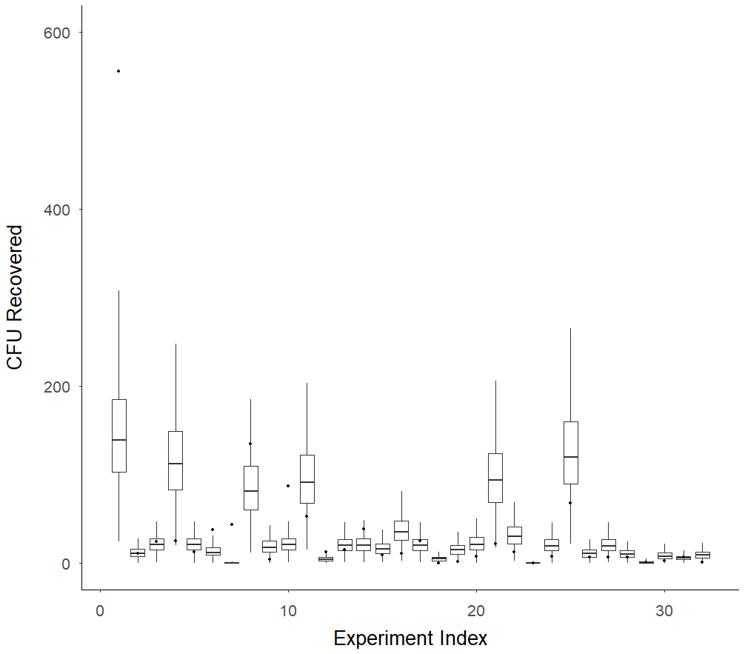
Model Validation
The model appears to be capturing the dispersion in the data well
Only 5 of the 34 experiments have actual observations falling outside the 95% credibility intervals of the model
Experiment indexes 1, 6, 7 and 10 fall outside credibility intervals
© 2023 California Institute of Technology. Government sponsorship acknowledged.

Slide 18
Are these assumptions justified?
Is a constant z-value assumption justified?
This is a standard assumption made in practice,^{1,2} at least on a piecewise basis (over certain intervals of temperature)
Other models exist: ESA assumes a z-value that is proportional to the square of temperature;³ biophysics models derived from Arrhenius and Eyring equations may provide additional insights
Future work can explore other options, but the current model appears to validate well under a constant z-value assumption for this application
Is the memoryless assumption justified?
This assumption is reasonable because the temperatures to which ATCC-29669 spores are exposed to in this study render biological repair mechanisms ineffective.
Many survival models implicitly assume this as well.²
¹ Moldenhauer, J. (2019). Disinfection and Decontamination: A Practical Handbook (CRC Press)
² Pistolesi, D., Mascherpa, V. (1988, revised 2014). F₀ A technical note (R&D Fedegari)
³ European Space Agency for the members of European Cooperation for Space Standardization (2013). Space Product Assurance; Dry Heat Bioburden reduction for flight hardware.
© 2023 California Institute of Technology. Government sponsorship acknowledged.

Slide 19

Model Assumptions: Seeding
How Experimental Design Validates Assumption
Model Assumption
Independence: A given CFU being transferred from the solution to the coupon does not affect the chances of this event occurring for another CFU
Uniformity & Large Numbers: A large number of CFU are distributed uniformly in the solution sampled from, and that each individual CFU has the same small probability of being transferred to the coupon.
Poisson Model: Under these conditions, the probability that $N=n$ CFU are seeded on a coupon is given by the Poisson distribution with mean $λ$:
$$e^{−λ}\frac{λ^{n}}{n!}$$
Solution is sonicated and vortexed prior to seeding
Avoids clumping of CFU (independence)
Mixes solution providing uniform titer
Solution prepared with the same species according to the same protocols
Uniformity of species
Reagents tested for sterility according to manufacturer’s recommendations
Avoids outside contamination that could introduce non-uniformities/heterogeneity of species
Same seeding procedure applied to each coupon
Uniformity/consistency of seeding process; avoids outside contamination
Spore stock solution titer is 10⁸ CFU/mL and has large volume compared to the amount seeded onto coupon
The number of CFU in the stock is much larger than the number of CFU seeded
The probability that an individual microorganism is seeded is small
© 2023 California Institute of Technology. Government sponsorship acknowledged.
Notes:
Hypergeometric distribution if large number assumption fails.

Slide 20

Model Assumptions: Survival & Recovery
How Experimental Design Validates Assumption
Model Assumption
Independence: A given CFU’s survival and recovery does not affect the chances of another CFU’s survival and recovery
Uniformity: Each CFU has the same probability of survival and recovery, $x$, when exposed to the same temperature profile and plated from a dilution of the same magnitude
$$x= s\left(T\right)×φ×θ_{d}$$
Binomial Model: Under these conditions, the probability that $r$ of $n$ CFU survive and are recovered is given by the Binomial model:
$$\left({n \atop r}\right)x^{r}{\left(1−x\right)}^{n−r}$$
Solution used to seed coupon is sonicated and vortexed prior to seeding
Avoids clumping of CFU or CFU attaching to other materials; e.g. hair (independence)
Coupons seeded with the same species according to the same protocols
Uniformity of inoculant
Coupons of the same material type, size and from the same manufacturer
Uniformity of the surface sampled
Same heating and recovery procedure applied to all replicates of a given experiment
Uniformity/consistency of process; avoids outside contamination
Reagents tested for sterility according to manufacturer’s recommendations
Avoid outside contamination that could introduce non-uniformities/heterogeneity of species
© 2023 California Institute of Technology. Government sponsorship acknowledged.
Notes:
Check text in red

Slide 21
Define
Objectives
Preliminary Research
Spore Strain Selection
Develop Experimental Apparatus
Establish a data-driven time-at-temperature sterilization requirement¹
Literature search
Previous experiments
NASA Procedural Requirements
Selection Criteria: those with a D-value at 150 C similar to the 29669 culture used to determine current NPR heat sterilization parameters
Selection for use in HHMR experiment: Batch M4-6
5080 High Temp IR Lamp
FLIR T650c camera
Stainless Steel Coupons, w/polyimide tape
Titanium Coupon Holder (holds 6 coupons)
Support Structure
This is what we want the model to inform. But what data do we need to do this?
This gives us information to use prior to seeing the data from our experiments
Informs model assumptions; e.g. uniformity, independence
Calibrate
Apparatus
Perform HHMR Experiment
Take
Measurements
Analyze Data, Make Recommendations
IR Lamp and Coupon separated by 0.2’’ to heat fast enough
Use position #1 of Coupon Holder for best precision and most rapid heating
Calibrate emissivity of materials, especially spores
Positive and negative controls for coupon spore counts
Coupons inoculated and placed into coupon holder
Heat treatment applied via IR lamp (spores facing away from lamp)
Treated coupons placed in 10 mL test tubes
For Survivor Ratio Measurements: 1 mL sterile deionized water added to test tubes. Test tubes vortexed, sonicated, diluted and plated in TSA.
For Fraction Negative Measurements: 10mL TSA added to each test tube.
Colonies incubated at 32 C and counted @ 96 hrs.
Use the model to predict what answers to the objective: as long as the data is useful for predicting this (by design, it is), then our model will predict what we want
This is what we model: we model the process that generates the observed data
1. Determine the temperature at which ATCC-29669 spores are rendered unable to germinate or replicate when exposed to temperatures over 200 °C for less than 30 seconds.
© 2023 California Institute of Technology. Government sponsorship acknowledged.

Slide 22
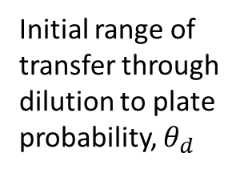
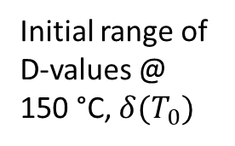
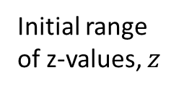
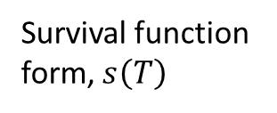
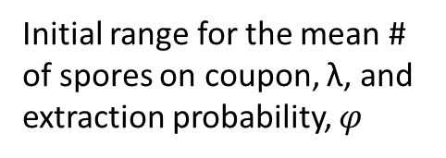
Overview
Seeding, Survival & Recovery Model Form
Model “learns” in 2 steps
1
2
Update initial ranges for parameters based observations from SR experiments
Update parameters from (1) based on observations from FN experiments at higher temps
Survival function form, $s\left(T\right)$
Independence and Uniformity Assumptions
Experiment Process
Preliminary Research
Spore Selection
Experimental Design
Perform High Heat Experiments
Analysis
Survival Ratio (SR)
Controls
Survival Ratio
Fraction Negative (FN)
Controls: Coupon Inoculation, Extraction Efficiency
Initial range of z-values, $z$
Initial range of D-values @
150 °C, $δ(T_{0})$
Initial range of transfer through dilution to plate probability, $θ_{d}$
Initial range for the mean # of spores on coupon, λ, and extraction probability, $φ$
Use model to inform the Sterility Assurance Level (SAL) for HHMR
© 2023 California Institute of Technology. Government sponsorship acknowledged.

Slide 23
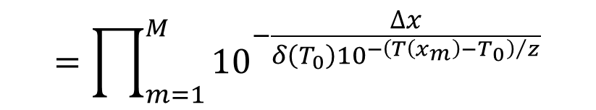

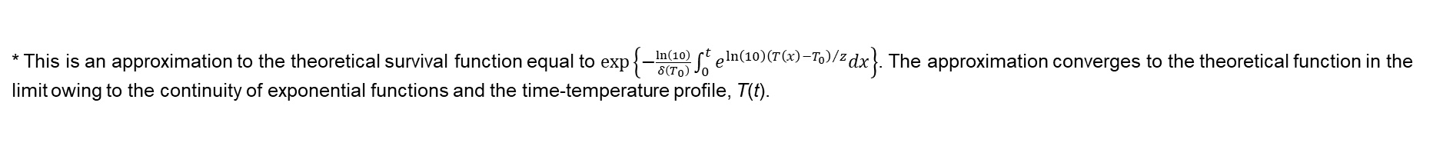
The Survival Function, $s\left(T\right)$
Memoryless Assumption: Survival of a microorganism exposed to a temperature over any time interval depends on the length of the time interval and the temperature on that interval, but not on the exposure to temperature the microorganism has survived up to that time.
Probability a microorganism survives exposure to temperature T(x_{m}) for time duration Δx
The number of time intervals reported by the IR camera for the time-temperature profile
Time duration of temperature T(x_{m})
Probability an individual microorganism survives exposure to the entire time-temperature profile*
$$=\prod_{m=1}^{M}{{10}^{−\frac{∆x}{δ\left(T_{0}\right){10}^{{−\left(T\left(x_{m}\right)−T_{0}\right)}/z}}}}$$
Constant z-value Assumption
… survives exposure to temperature T(x₀) for time Δx and exposure to temperature T(x₁) for time Δx and exposure to temperature T(x₂) for time Δx and so on…
D-value at temperature T₀.
Change in D-value by going from temperature T₀ to T(x_{m}).
D-value at temperature T(x_{m}).
* This is an approximation to the theoretical survival function equal to $exp\left\{−\frac{\ln\left(10\right)}{δ\left(T_{0}\right)}\int_{0}^{t}{e^{\ln\left(10\right){\left(T\left(x\right)−T_{0}\right)}/z}dx}\right\}$. The approximation converges to the theoretical function in the limit owing to the continuity of exponential functions and the time-temperature profile, T(t).
© 2023 California Institute of Technology. Government sponsorship acknowledged.

Slide 24
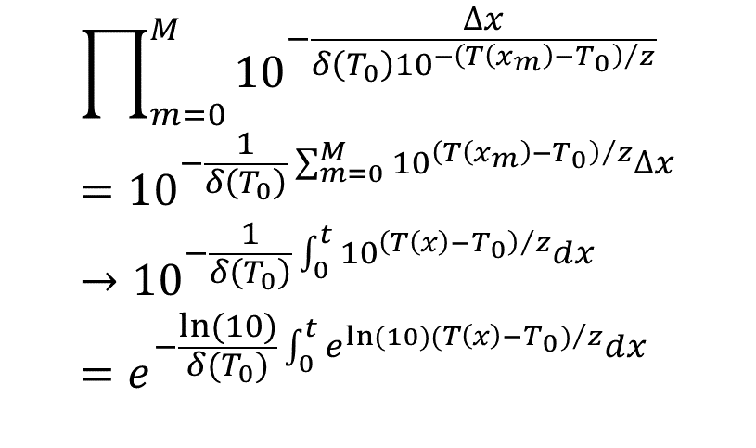
Probability of an Individual Microorganism Survives Exposure to Heat Treatment, T
$$\prod_{m=0}^{M}{{10}^{−\frac{∆x}{δ\left(T_{0}\right){10}^{{−\left(T\left(x_{m}\right)−T_{0}\right)}/z}}}}={10}^{−\frac{1}{δ\left(T_{0}\right)}\sum_{m=0}^{M}{{10}^{{\left(T\left(x_{m}\right)−T_{0}\right)}/z}∆x}}→{10}^{−\frac{1}{δ\left(T_{0}\right)}\int_{0}^{t}{{10}^{{\left(T\left(x\right)−T_{0}\right)}/z}dx}}=e^{−\frac{ln⁡(10)}{δ(T_{0})}\int_{0}^{t}{e^{ln⁡(10){(T\left(x\right)−T_{0})}/z}dx}}$$
Formula from previous slide
Apply rules of exponents
Take limits as M goes to infinity and Δx (an interval around x_{m}) goes to zero*
Put in base e as a mathematical convention; this is the theoretical form of the survival function
*We are justified in taking limits of the Reimann sums by the continuity of exponential functions and time-temperature function, T(t).
© 2023 California Institute of Technology. Government sponsorship acknowledged.

Slide 25











Survival Ratio Experiment Event Tree
Event is TRUE
Event is FALSE
Initial condition
Microorganism is viable
Survives heat treatment
Extracted from coupon and survives extraction
Transferred through dilution, plated and grown
Outcome
$$s\left(T\right)φθ_{d}$$
Recovered via observed CFU
$$θ_{d}$$
$$φ$$
$$1−θ_{d}$$
Not recovered via observed CFU
$$s(T)$$
$$s(T)φ(1−θ_{d})$$
$$1−φ$$
Not recovered via observed CFU
$$1−s\left(T\right)φθ_{d}$$
$$s\left(T\right)(1−φ)$$
$$1−s(T)$$
Not recovered via observed CFU
$$1−s(T)$$
© 2023 California Institute of Technology. Government sponsorship acknowledged.

Slide 26


Fraction Negative Experiment Event Tree
Event is TRUE
Event is FALSE
Initial condition
Microorganism is viable
Survives heat treatment and grows
Outcome
$$s(T)$$
Recovered via observed CFU
Not recovered via observed CFU
$$1−s(T)$$
© 2023 California Institute of Technology. Government sponsorship acknowledged.

Slide 27
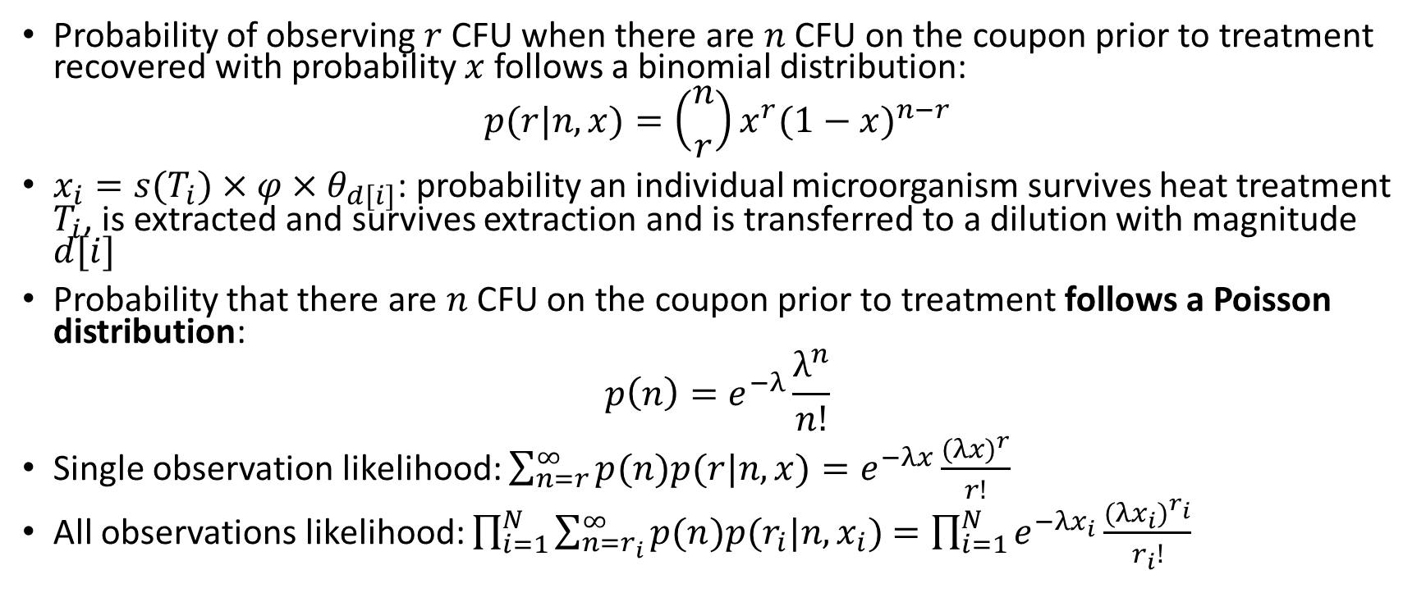
Mathematical Model Outline
Probability of observing $r$ CFU when there are $n$ CFU on the coupon prior to treatment recovered with probability $x$ follows a binomial distribution:
$$p(r|n, x)=\left({n \atop r}\right)x^{r}{(1−x)}^{n−r}$$
$x_{i}=s(T_{i})×φ×θ_{d[i]}$: probability an individual microorganism survives heat treatment $T_{i}$, is extracted and survives extraction and is transferred to a dilution with magnitude $d[i]$
Probability that there are $n$ CFU on the coupon prior to treatment follows a Poisson distribution:
$$p\left(n\right)=e^{−λ}\frac{λ^{n}}{n!}$$
Single observation likelihood: $\sum_{n=r}^{∞}{p(n)p(r|n, x)}=e^{−λx}\frac{{(λx)}^{r}}{r!}$
All observations likelihood: $\prod_{i=1}^{N}{\sum_{n=r_{i}}^{∞}{p(n)p(r_{i}|n, x_{i})}}$ $=\prod_{i=1}^{N}{e^{−λx_{i}}\frac{{(λx_{i})}^{r_{i}}}{r_{i}!}}$
© 2023 California Institute of Technology. Government sponsorship acknowledged.

Slide 28
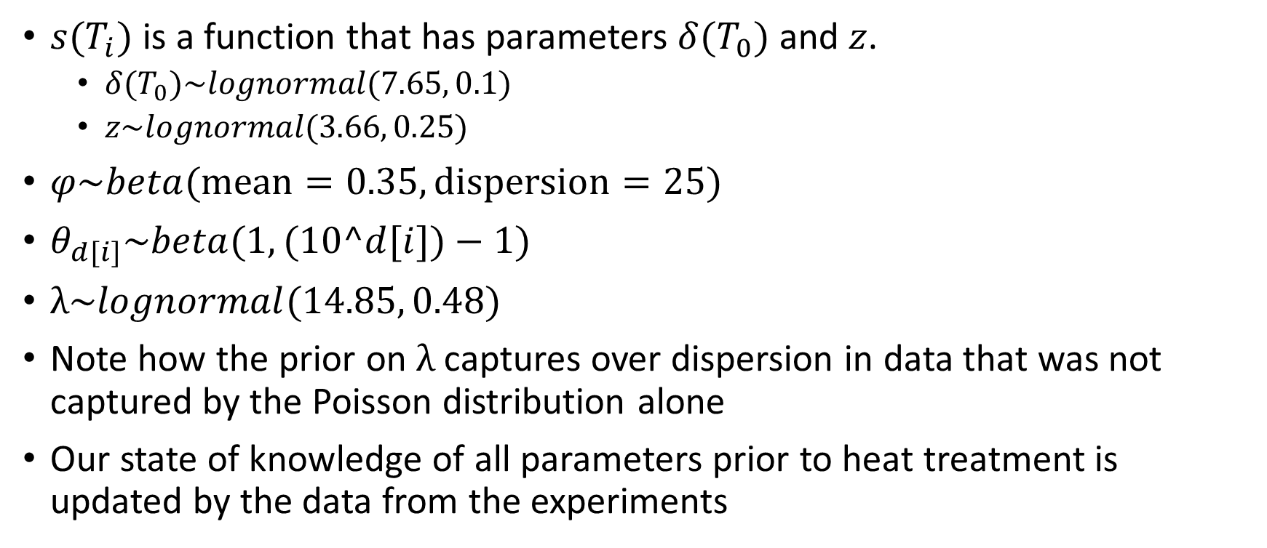
Mathematical Model Outline
$s(T_{i})$ is a function that has parameters $δ(T_{0})$ and $z$.
$δ(T_{0})\sim lognormal(7.65, 0.1)$
$z\sim lognormal(3.66, 0.25)$
$φ\sim beta(\text{mean}=0.35,\text{dispersion}=25)$
$θ_{d[i]}\sim beta(1, (10^d[i])−1)$
$λ\sim lognormal(14.85, 0.48)$
Note how the prior on $λ$ captures over dispersion in data that was not captured by the Poisson distribution alone
Our state of knowledge of all parameters prior to heat treatment is updated by the data from the experiments
© 2023 California Institute of Technology. Government sponsorship acknowledged.

Slide 29
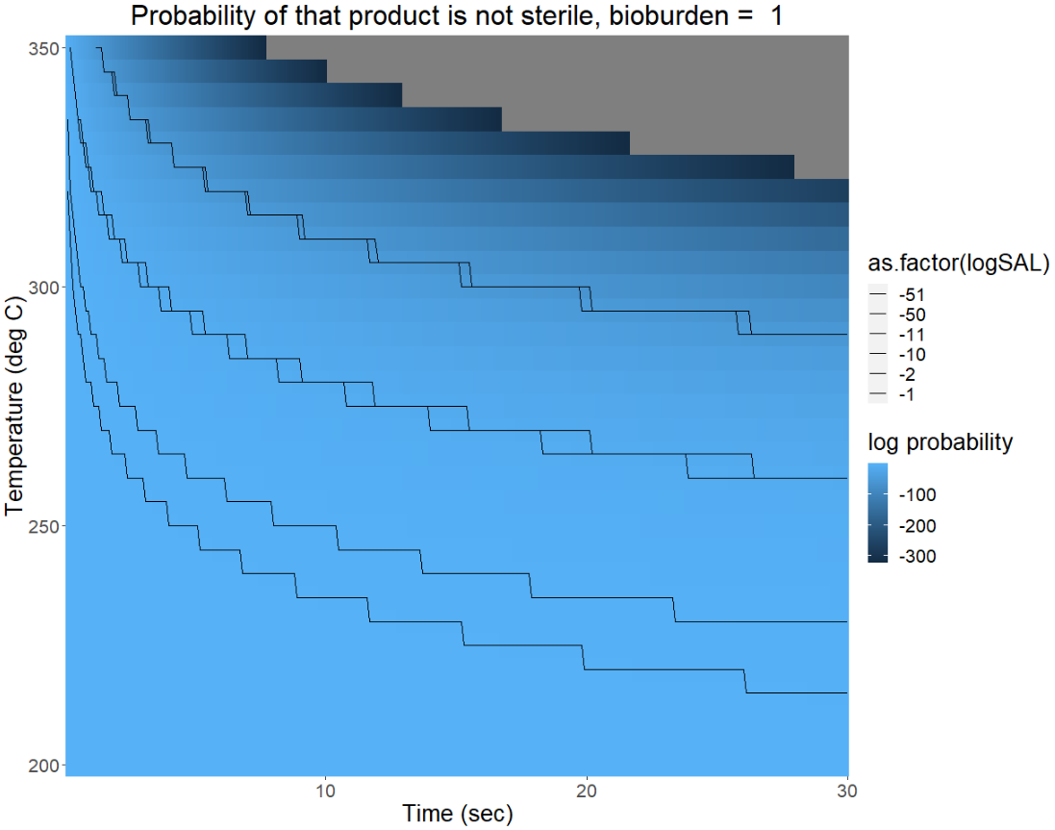
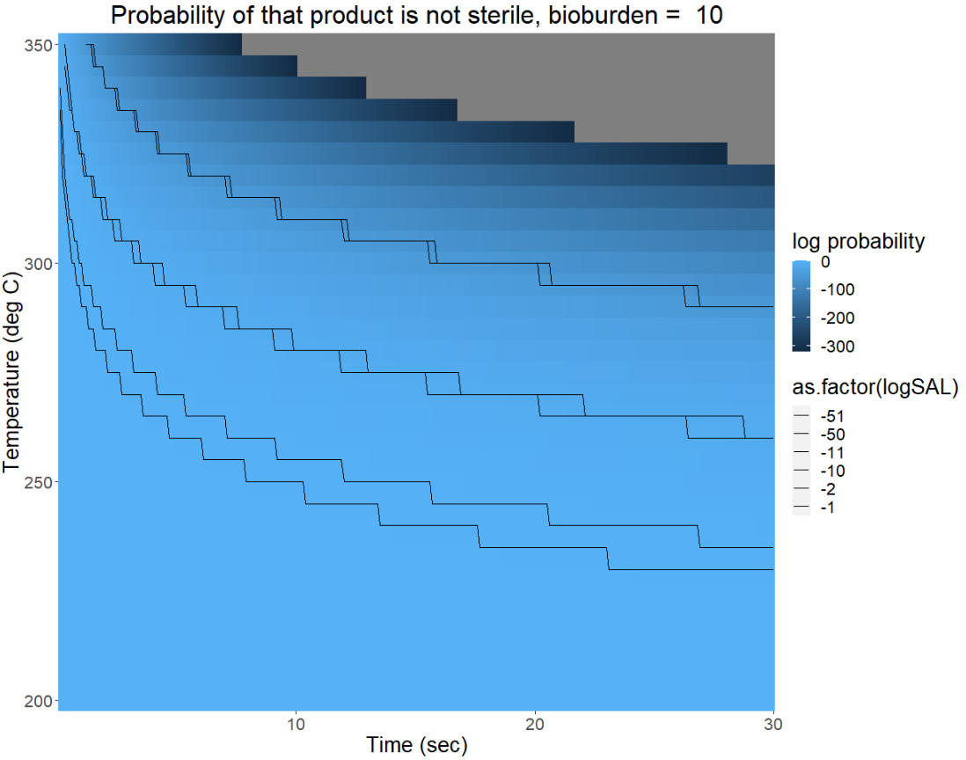
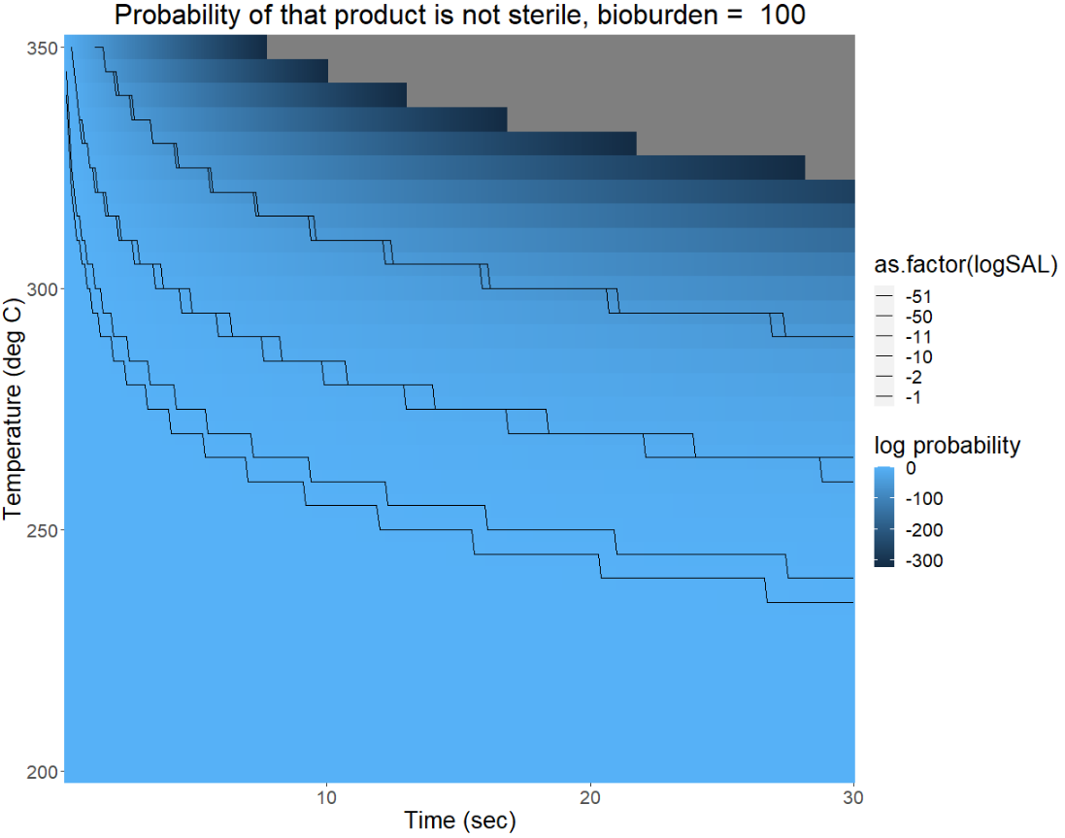

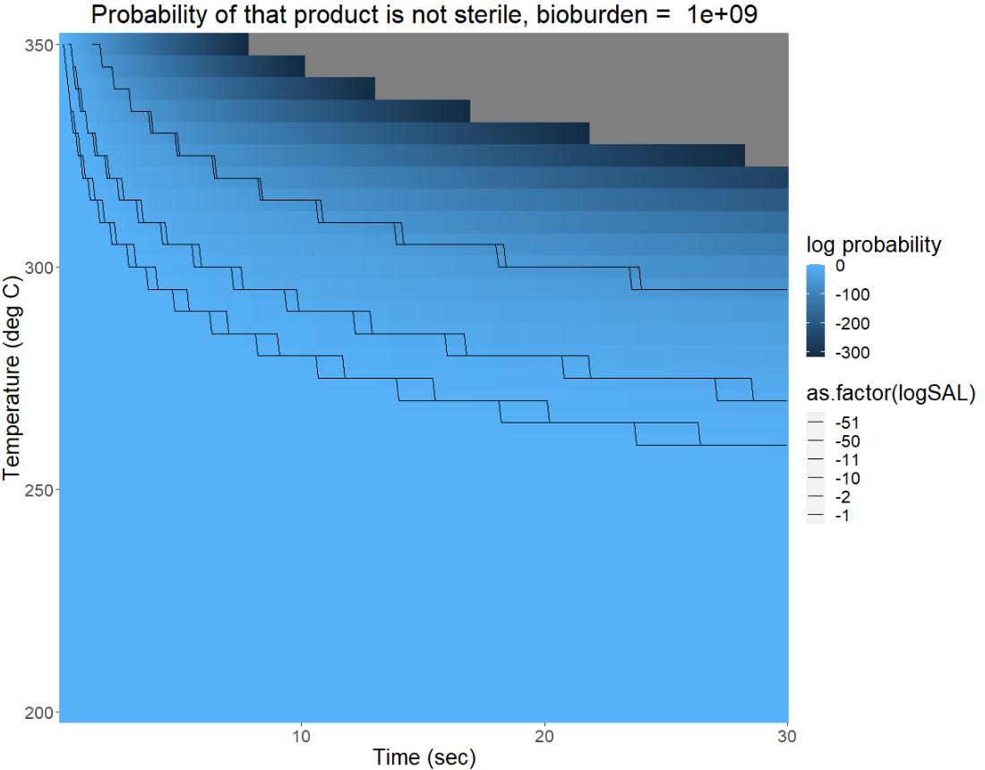
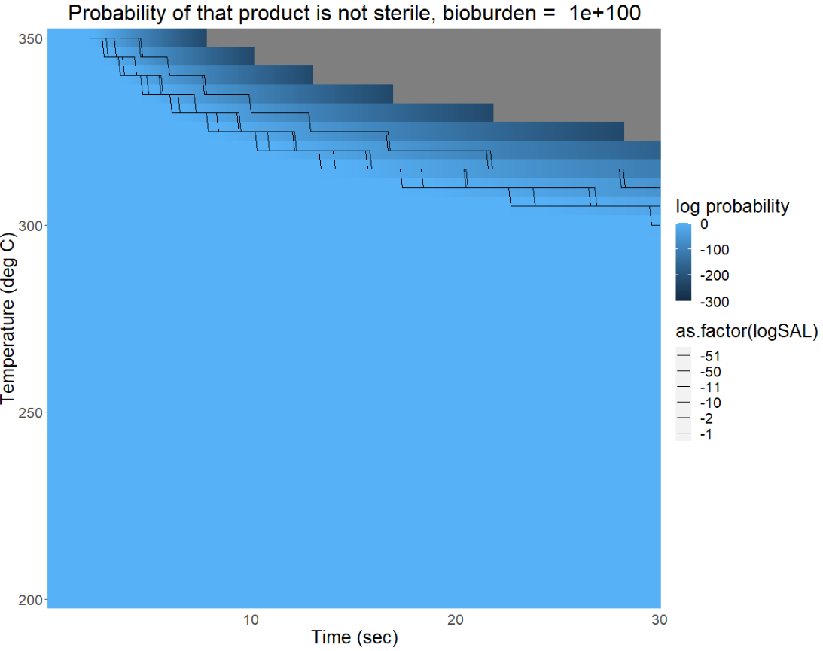
Sensitivity of SAL to bioburden
© 2023 California Institute of Technology. Government sponsorship acknowledged.

