Slide 1

A Stochastic Petri Net Model of
Continuous Integration and Continuous Delivery
Sushovan Bhadra, University of Massachusetts Dartmouth
Bikram Das, University of Massachusetts Dartmouth
Priscila Silva, MS, University of Massachusetts Dartmouth
Vidhyashree Nagaraju, PhD, Bastion Technologies Inc
Lance Fiondella, PhD, University of Massachusetts Dartmouth

Slide 2
Introduction
Modern software development practices
Continuous integration and continuous delivery (CI/CD)
Allows developers to continuously integrate code in single shared repository
Automates delivery process of product to user
Relevant past studies
Applied Machine learning to improve different CI/CD stages
Proposed modeling language and frameworks
Automates delivery process of product to user
Quantitatively guide process and product improvement

Slide 3
Introduction
A comprehensive model of the CI/CD pipeline is needed to establish baseline measurements of process effectiveness and efficiency as well as guide process improvement efforts
Contributions
Developed a Petri net model for the CI/CD pipeline
Proposed an enhanced model
Performed test based on probability of successful product delivery
Sensitivity analysis to identify which stage can impact the process performance most

Slide 4
CI/CD Pipeline
State P1:
Creation of unique coding
Branch.
State P4:
Ensure software produces expected results
State P2:
Push code to version control.
State P9:
Software deployed to production.
State P5:
Test performance of entire software.
State P3:
Compile code and execute tests.
State P10:
Software released to customer.
State P8:
Test application in working environment.
State P6:
Compile code to a file format
State P7:
Reviewer provides feedback from user perspective
(P1)
Developers
Push Code
Pull Code
(P2)
Version Control
(P3)
Build
(P4)
Unit Test
(P5)
Integration Test
(P6)
Packaging
Continuous
Integration
(P10)
Product user
(P9)
Deploy in Production
(P8)
Auto Test
(P7)
Acceptance Test
Continuous
Delivery

Slide 5

Petri net model
A bipartite graph with two subsets that
Analyze and describe concurrent and sequential events. A Petri net is denoted by
$PN=(P,T,I,O,M)$
Places: $P=\{P1,P2…Pn\}$
Transitions: $T=\{T1,T2,…,Tn\}$
I and O: sets of vectors of input and output places
$M$: marking

Slide 6
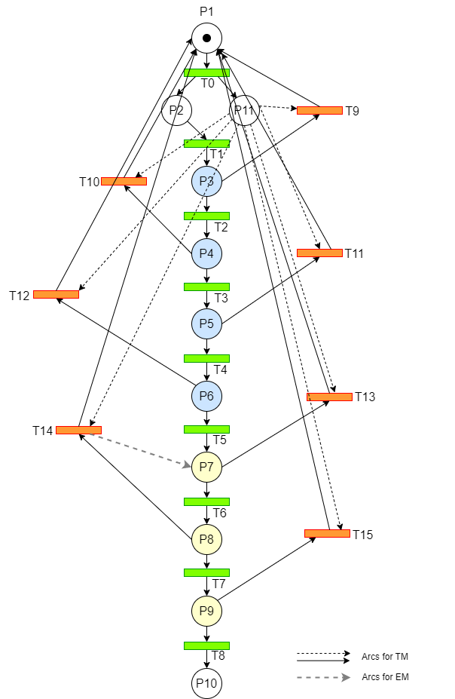
```
SPN model for CI/CD pipeline
Places P1 to P10 represent sequential CI/CD pipeline stages
Transitions T0 to T8 indicate the forward path and T9 to T15 indicate feedback paths
Enhanced approach indicated by arc from T14 to place P7 with dashed gray line

Slide 7
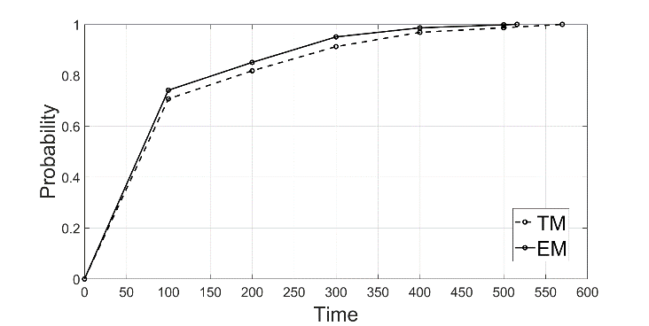
Illustration
Performance measured in terms of probability of product release by a specified time
Deadline = 150-time units
Probability of on product delivery under traditional (enhanced) model 77.4% (80.02%)
Enhanced model delivers product with nearly 100% probability around time 516. Traditional model requires 570-time units

Slide 8
Illustration
Under the enhanced model the forward transition rate improved significantly
T6 (acceptance test) increased 27.5% (7.64/5.99)
T7 (auto test) increased 40.8% (6.89/4.89)
T8 (deploy in production) increased 18.4% (5.66/4.78)
Indicating improvement of forward transitions eventually improve the CI/CD process performance

Slide 9
Illustration
Sensitivity analysis: Considering the 150 time units
Transition | Prob. (%) | Transition | Prob. (%)
T9 | 80.30 | T13 | 82.41
T10 | 80.44 | T14 | 82.89
T11 | 80.72 | T15 | 84.10
T12 | 81.98
Reducing failure rate of later states in production such as auto test (T14) and deploy (T15) increase probability of successful product delivery most significantly because it does not have to go all the way back

Slide 10
Summary & Conclusion
Presented a CI/CD pipeline model using stochastic Petri net modeling techniques
Two SPN models are considered for performance evaluation
Sensitivity analyses are performed based on reduction of transition parameters in different CI/CD testing stages
Results suggest that
The enhanced approach delivered product faster than traditional CI/CD pipeline
Enhanced approach reduced delivery time by about 10%
Sensitivity analysis suggested that errors in later stages can impact the system performance most

Slide 11

Acknowledgement
This material is based upon work supported by the Office of Naval Research under Award Number N00014-22-1-2012. Any opinions, findings, and conclusions or recommendations expressed in this material are those of the authors and do not necessarily reflect the views of the Office of Naval Research

Slide 12
Thank you.

