Slide 1
A data-driven approach of uncertainty quantification on Reynolds stress based on DNS turbulence data
Zheming Gou¹, Roger Ghanem^{1,2}
¹Department of Aerospace & Mechanical Engineering, University of Southern California
²Sonny Astani Department of Civil Engineering, University of Southern California
Defense and Aerospace Test and Analysis Workshop, April 25-27, 2023

Slide 2
Background
Goal:
Retrieve (learn) useful information from high-fidelity simulation data.
Difficulty:
Multi-variate (velocity, pressure, temperature, density, oxygen concentration…)
Spatially-temporally variate
High dimensional (1024³)

Slide 3
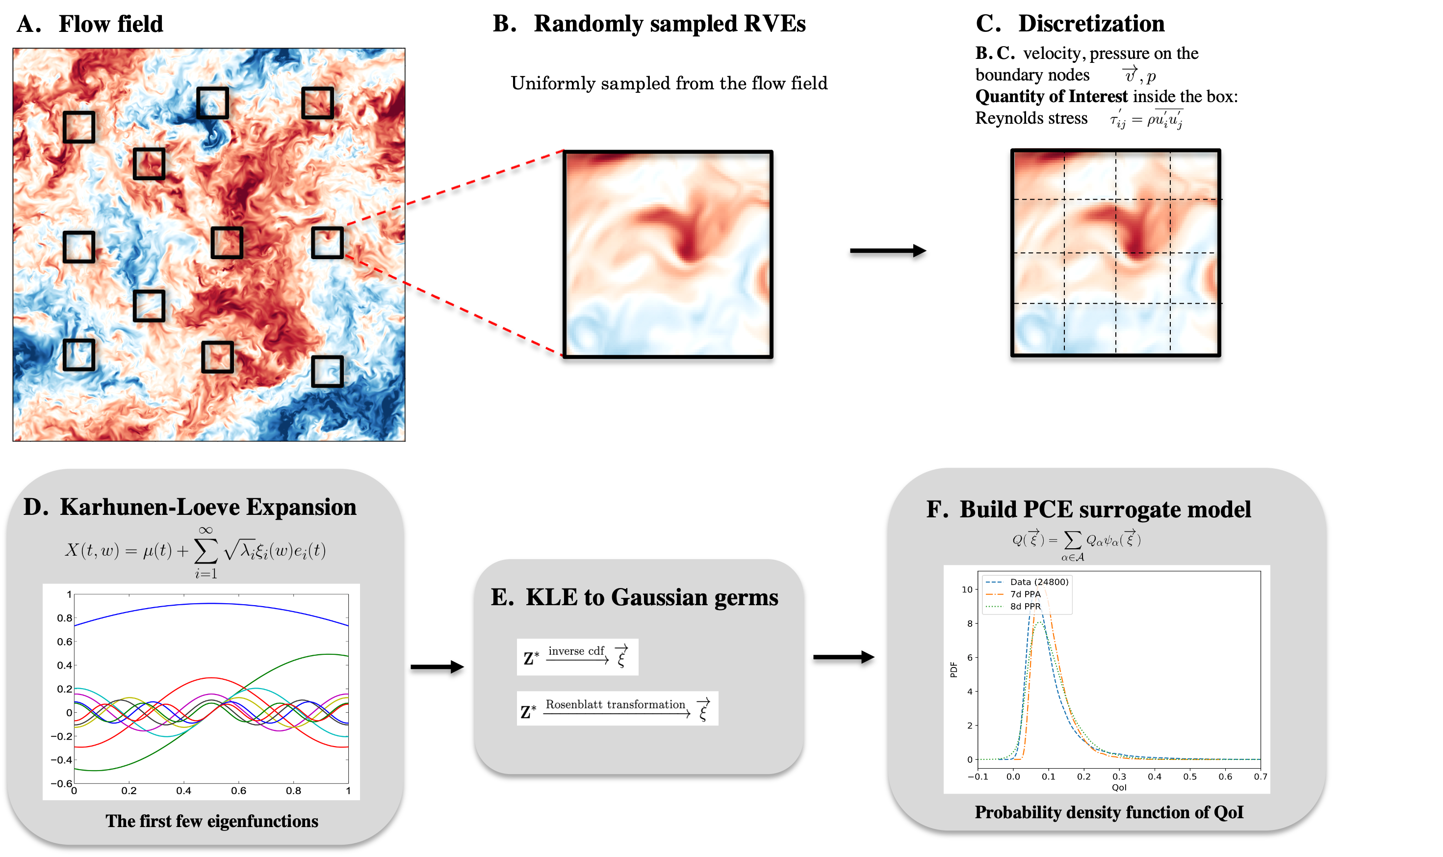
Framework

Slide 4
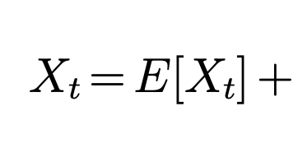
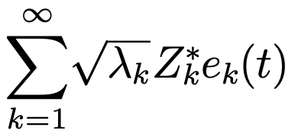
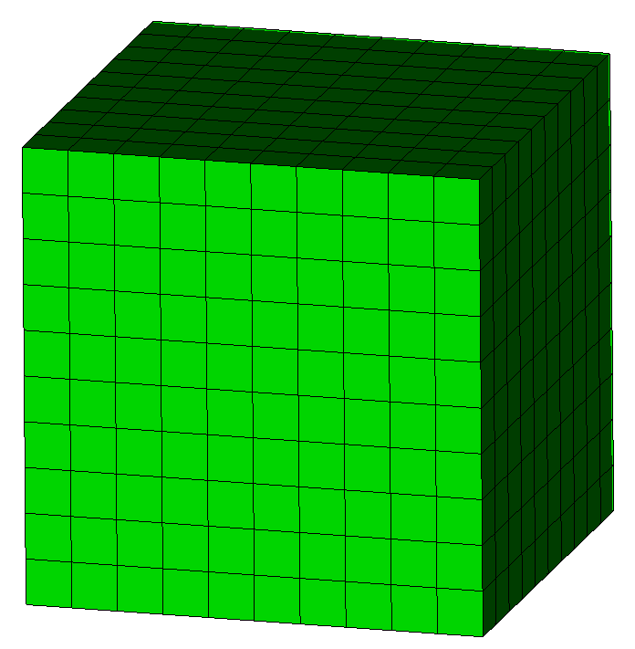
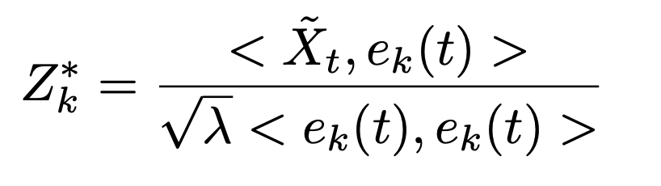
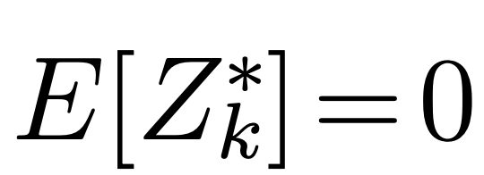
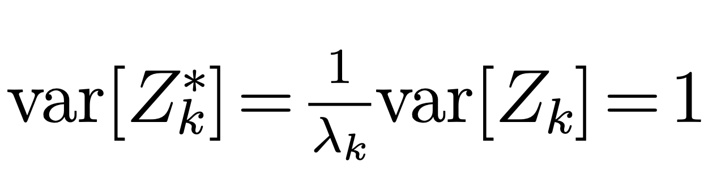
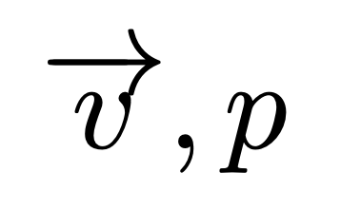
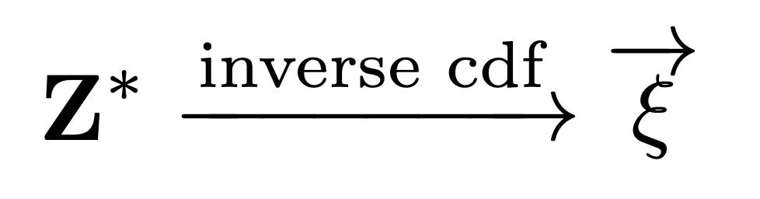
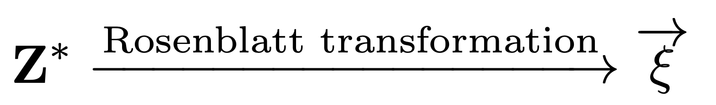
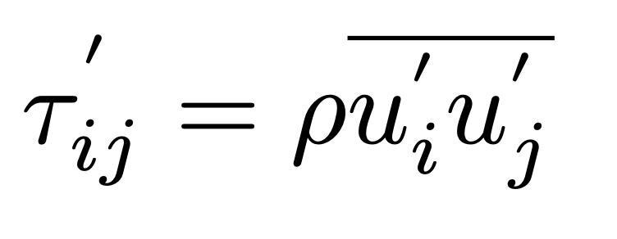
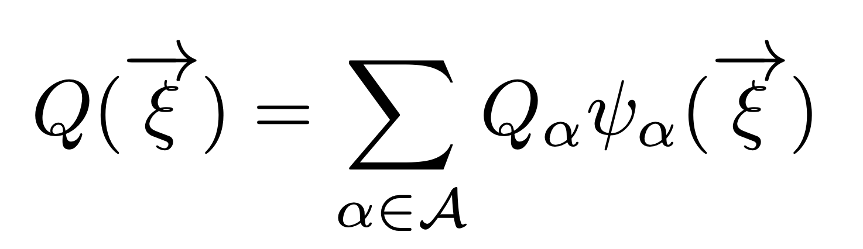
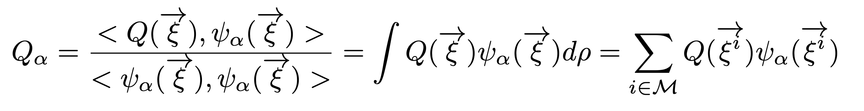
Mathematical foundation
Step D: Karhunen-Loeve Expansion for random field
Step E: KLE coefficients to independent Gaussian germs
Step F: PCE on the reduced dimension parameters (PPA)
Where,
Conditions on boundary nodes
under the assumption of independence
Reynolds stress on the whole domain

Slide 5
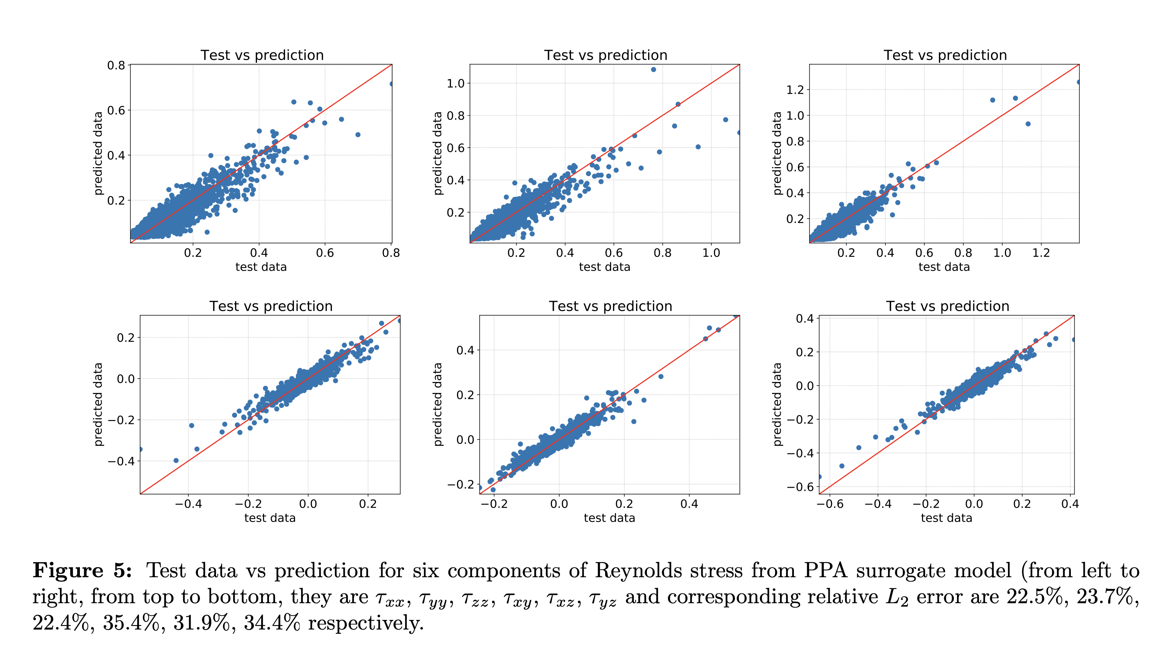
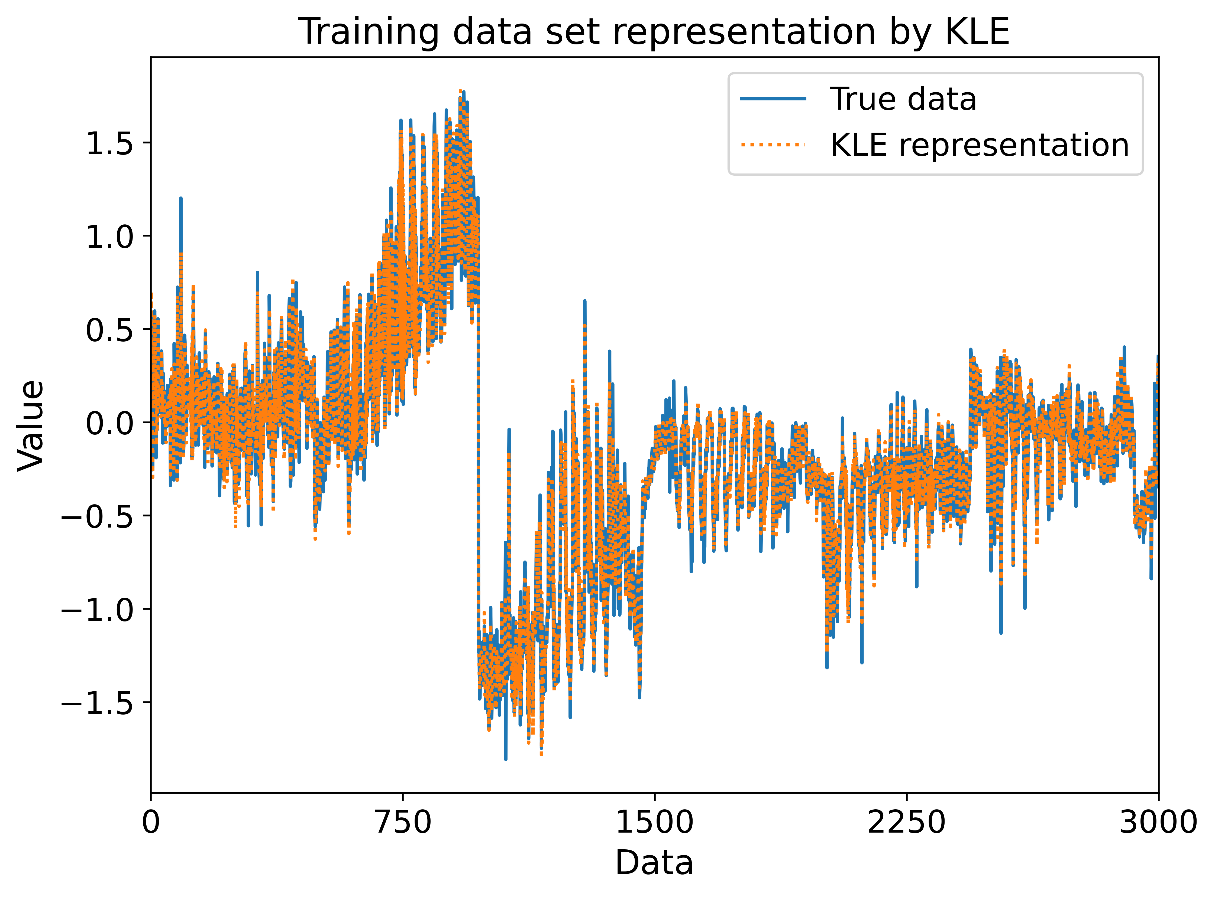
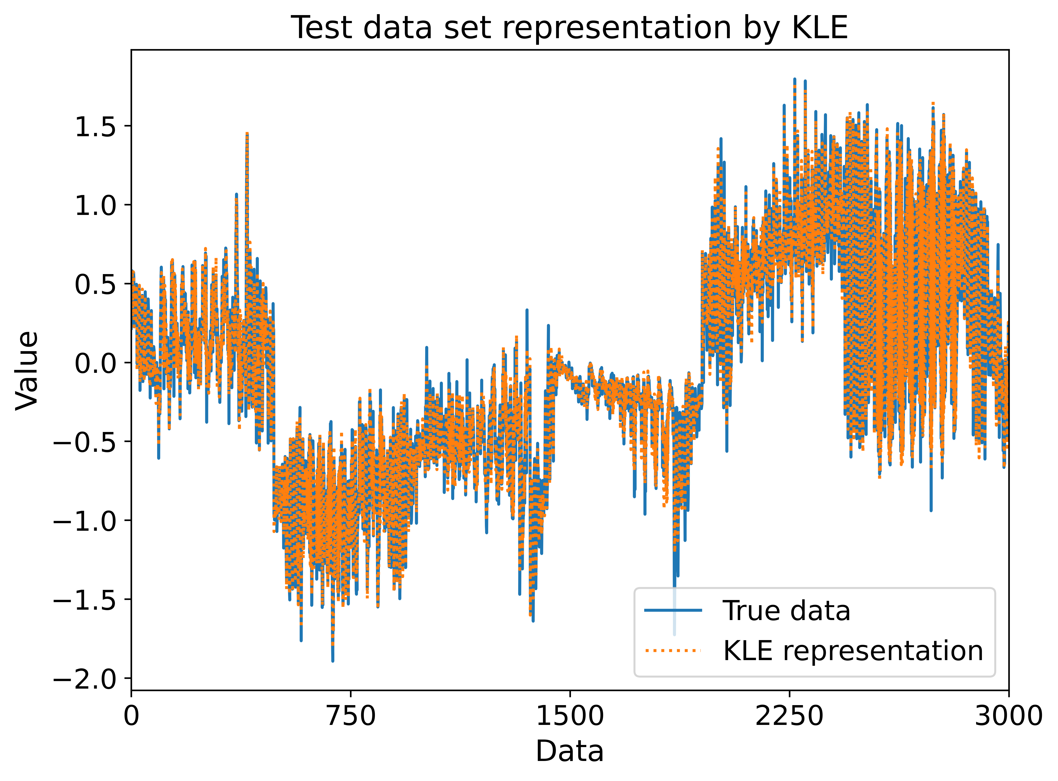
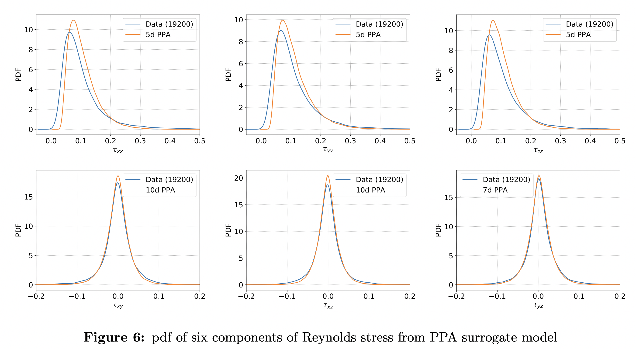
Results: isotropic turbulence flow
KLE representation
(773 eigenvalues to preserve 99%
cumulative energy)
Prediction by PCE
relative L₂ error 0.996%
relative L₂ error 1.165%

Slide 6
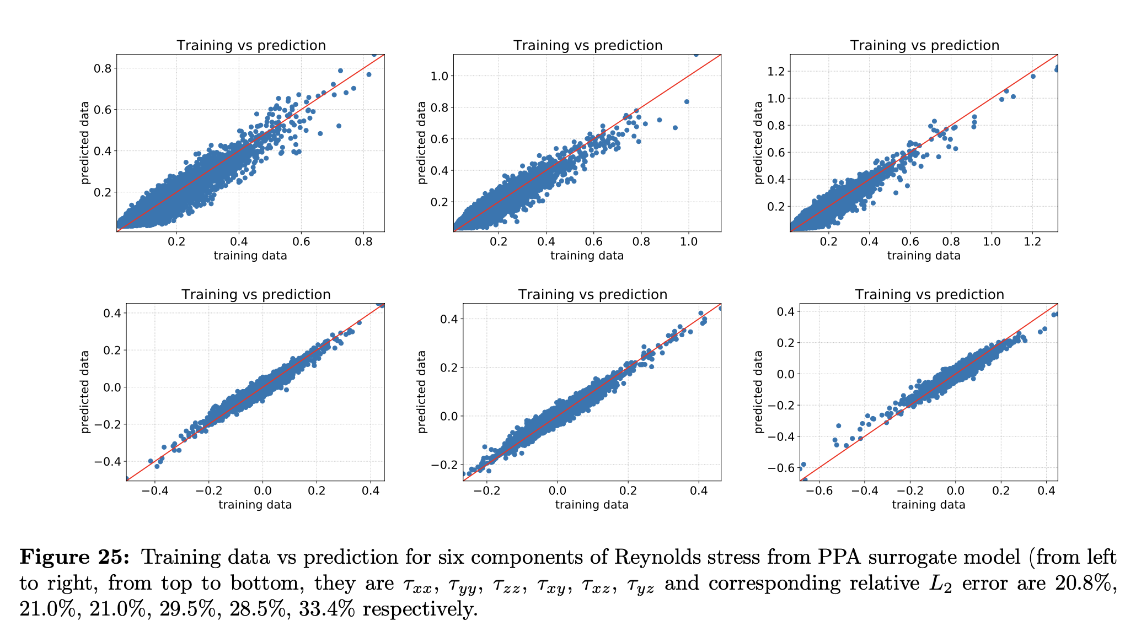
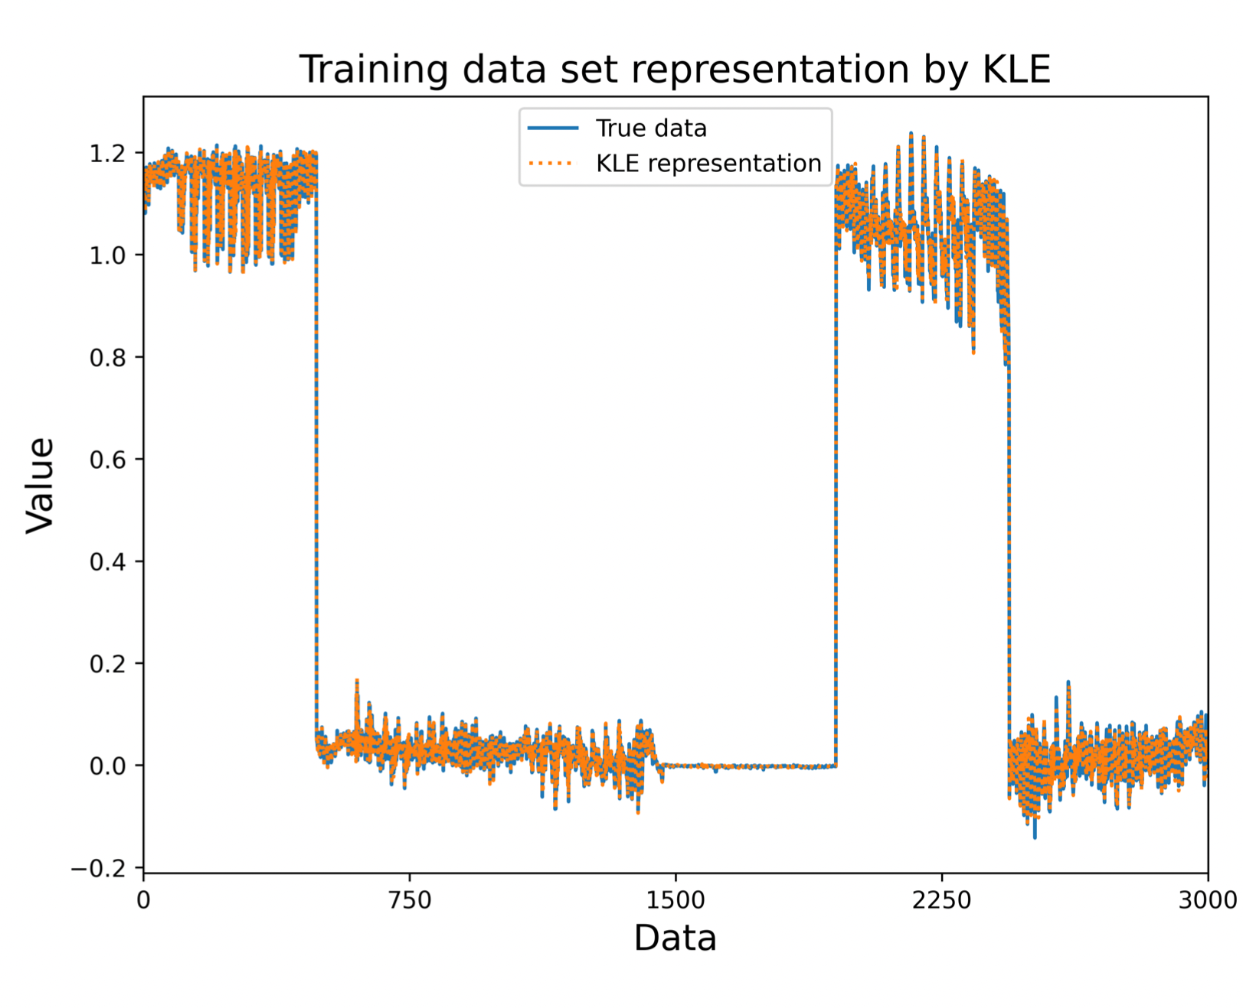
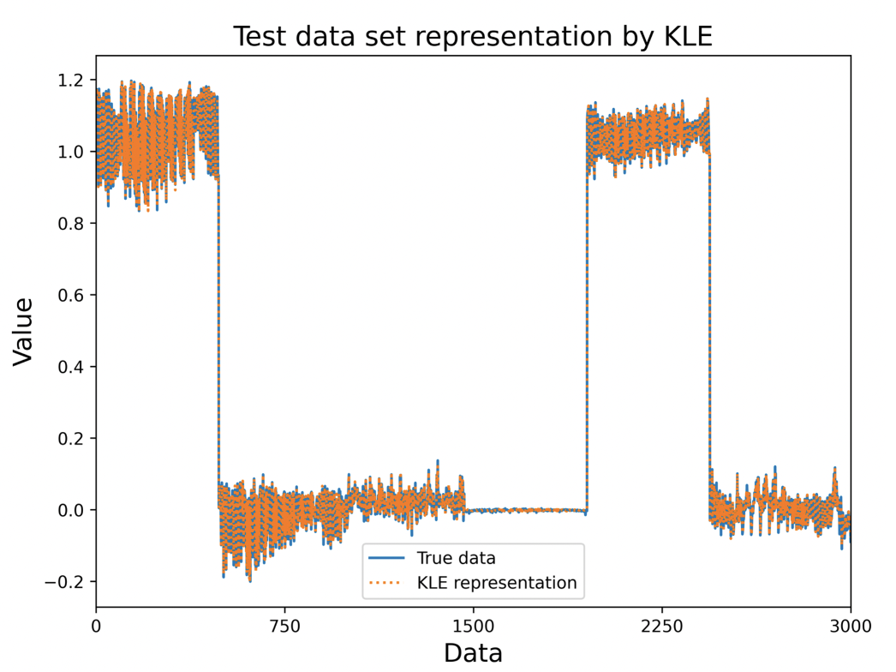
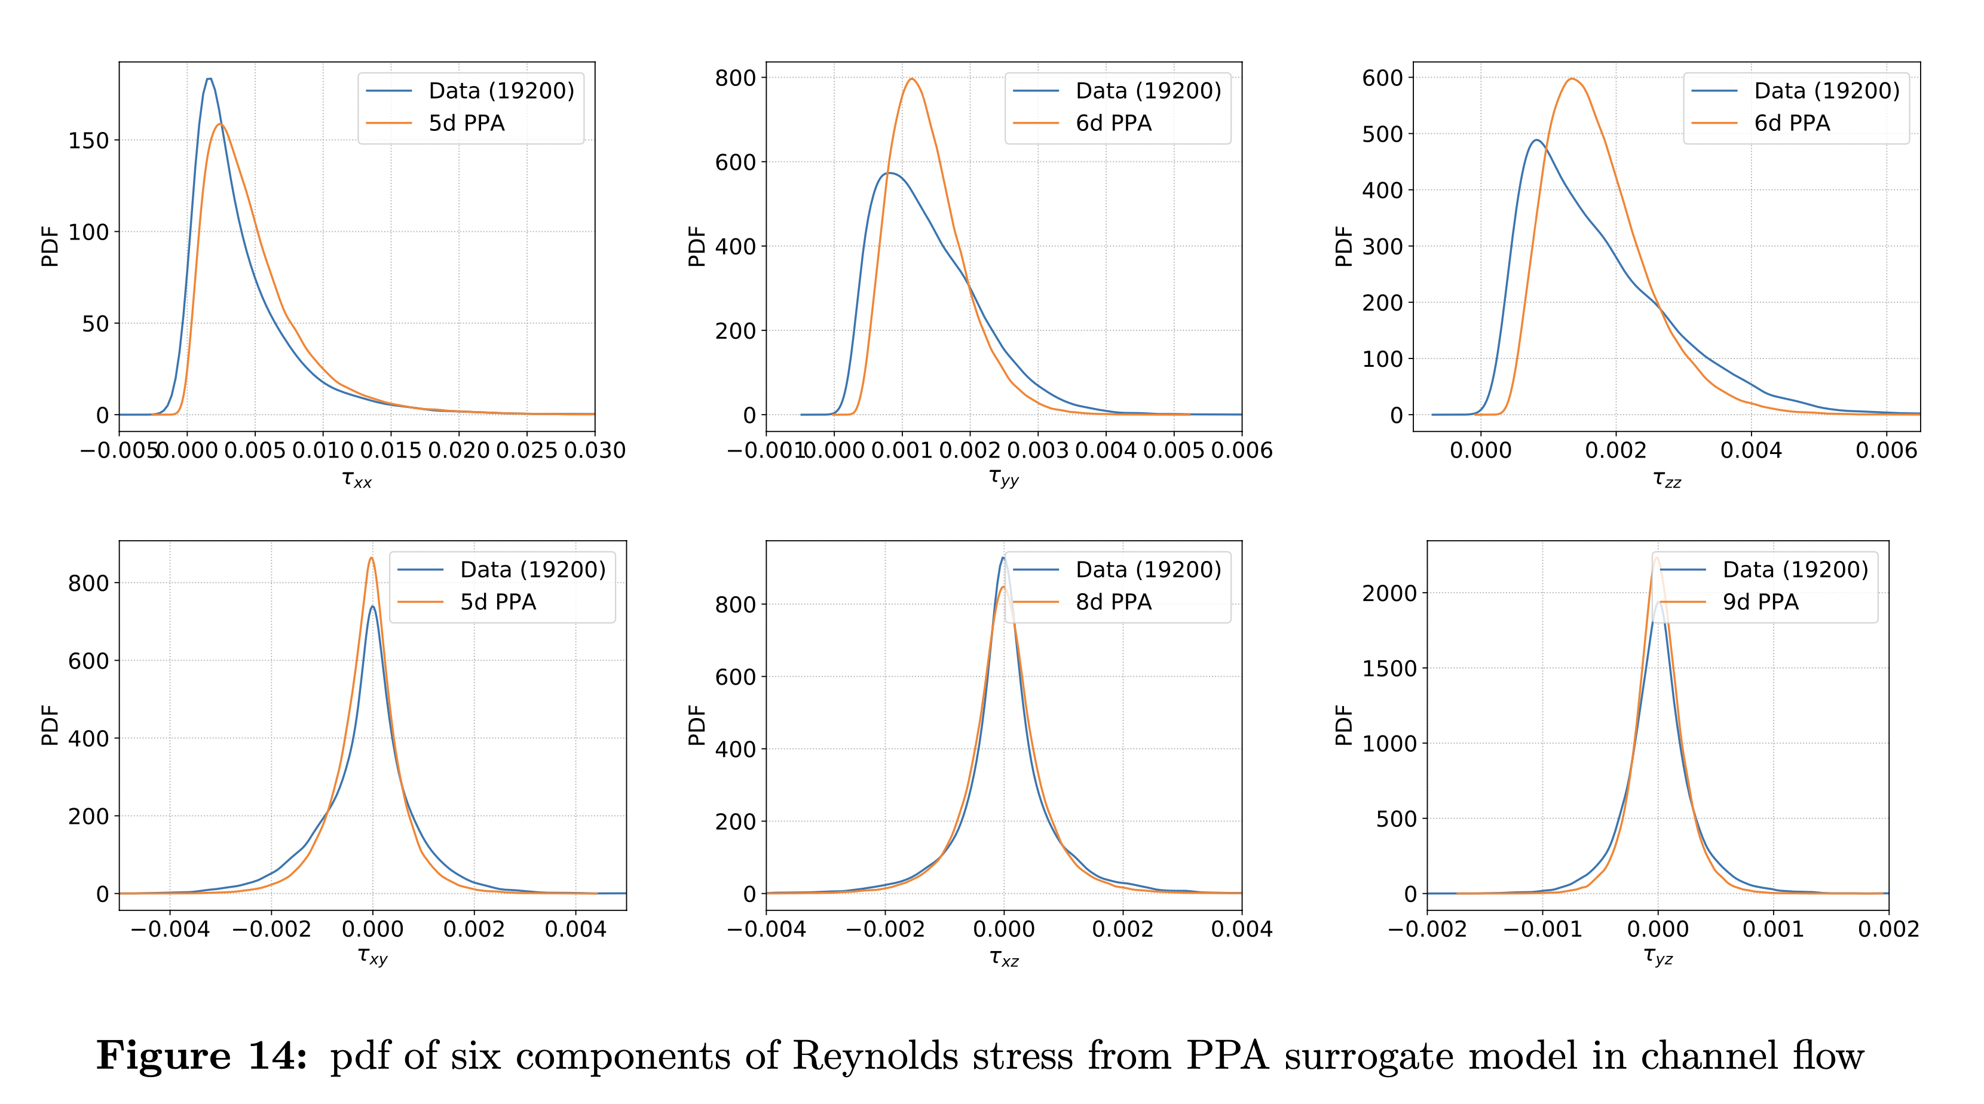
Results: channel flow
KLE representation
(850 eigenvalues to preserve 99%
cumulative energy)
Prediction by PCE
relative L₂ error 0.014%
relative L₂ error 0.017%

Slide 7
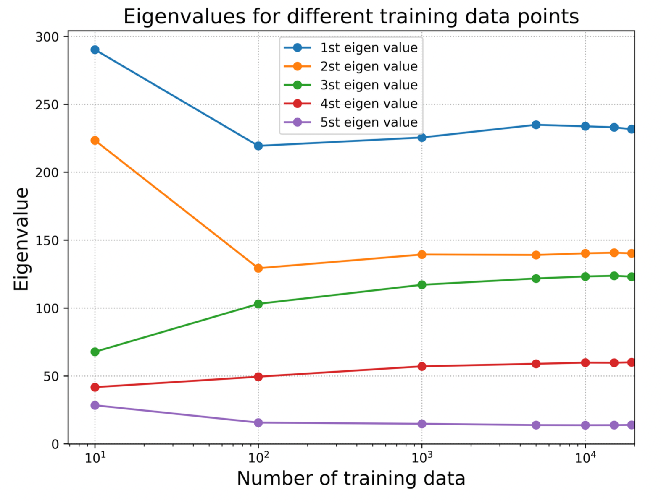
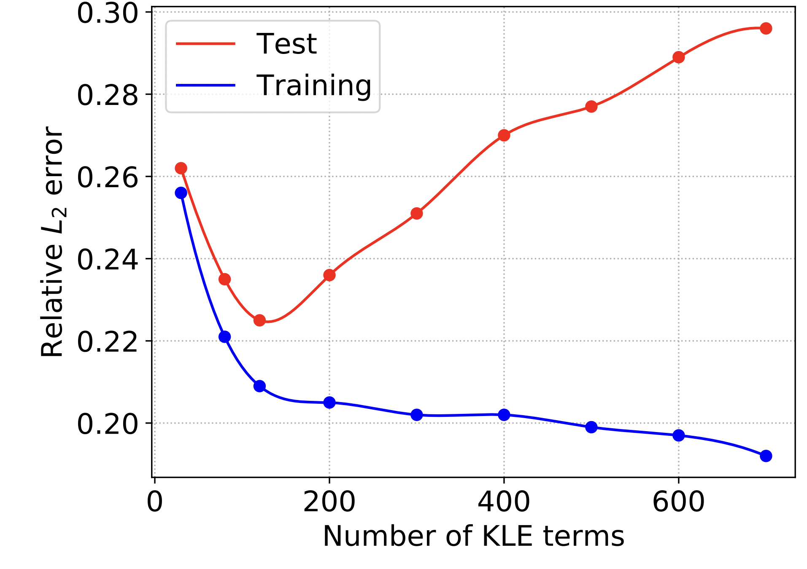
Convergence study
Convergence in KLE basis
Convergence in number of KLE
terms to construct PCE

Slide 8
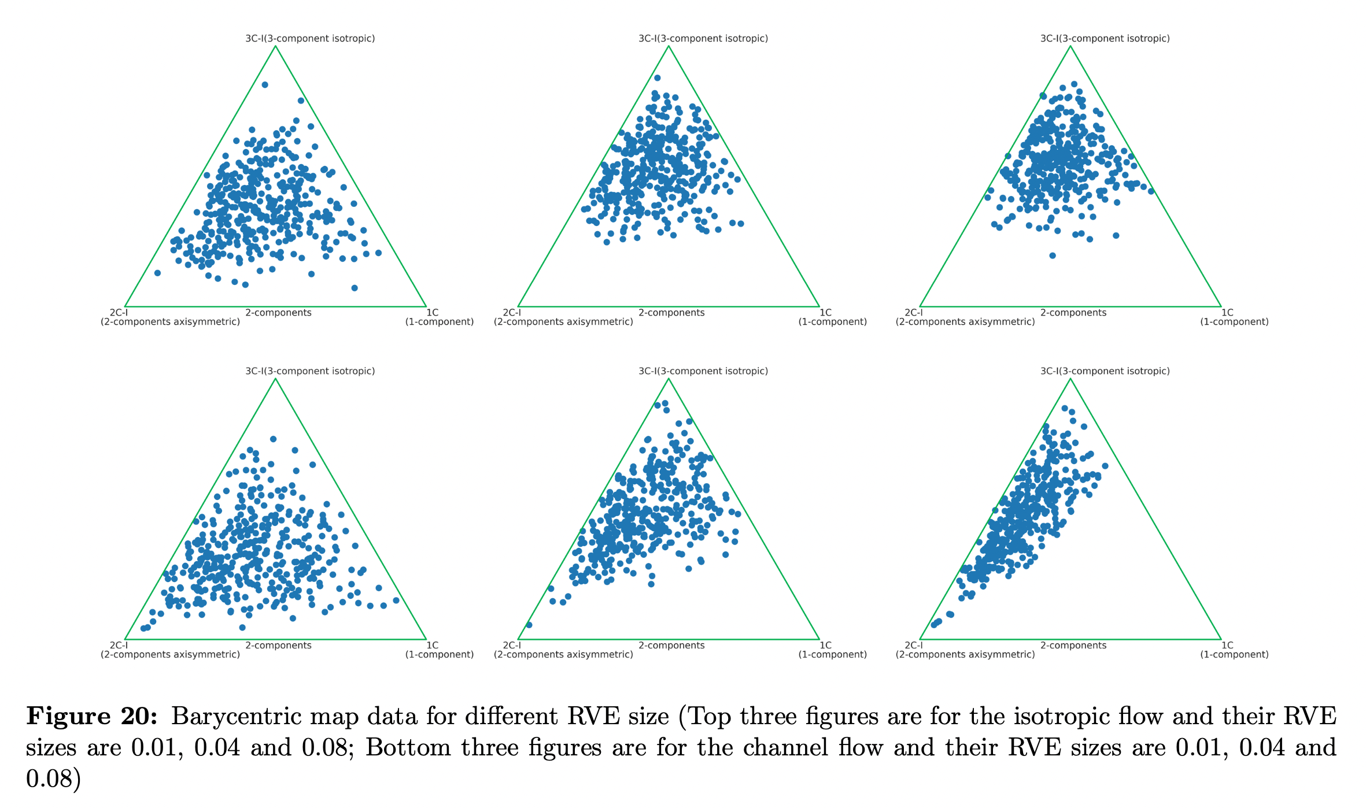
RVE size effect
RVE size effects different levels of information

Slide 9
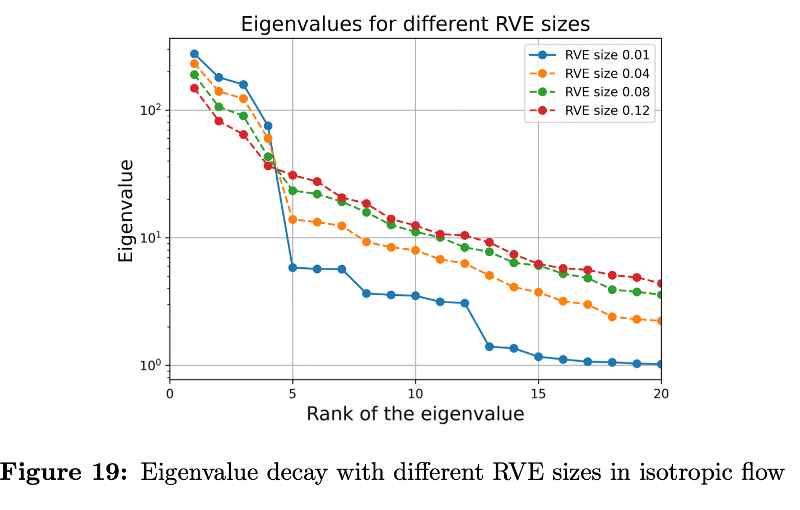
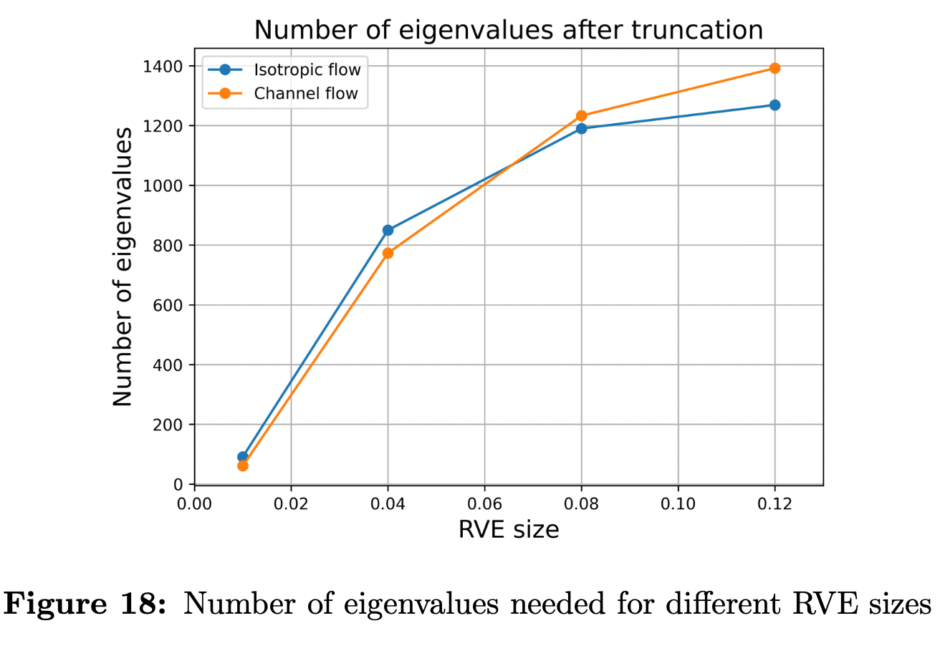
RVE size effect
RVE size effects the decay trend of eigenvalues

Slide 10
Summary
Summary:
Built PCE for isotropic turbulence flow and channel flow.
Finished isotropic turbulence flow and channel flow analysis.
Conducted convergence study.
Investigated RVE size effect.

Slide 11
Questions
Questions

