Slide 1
An Evaluation Of Periodic Developmental Reviews Using Natural Language Processing (NLP)
Researcher: Cadet Dominic Rudakevych
Advisors: LTC(P) Andrew Lee
CPT John Scudder
COL Archie Bates
Notes:
Introduction

Slide 2
Objectives
Question 1: Can written statements in PDRs be used to predict the overall rating of a cadet?
Question 2: Is there evidence of copying / pasting PDR written responses?
2
Notes:
We’re interested in using written statements within PDRs to predict the overall rating of a cadet
- overall rating being qualification status (not qualified, qualified, highly qualified, most qualified)

Slide 3
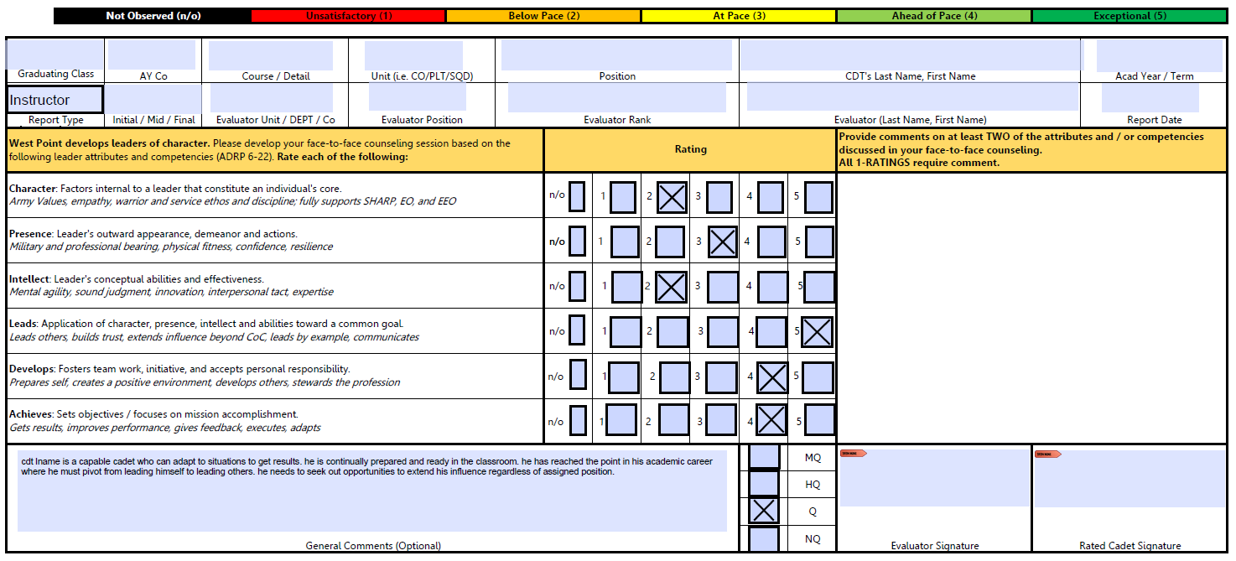
PDR Orientation
MQ = 4
HQ = 3
Q = 2
NQ = 1
3
Notes:
Show of hands– who has filled out a PDR?
Three areas of interest

Slide 4
Background
Why is this work important?
Academy wants to reexamine PDRs
USMA G5 – Institutional Effectiveness Office
Why NLP?
Offers insights beyond what human text analysis can perceive
The Army is already using Language Processing
4
Notes:
One of our primary stakeholders for this research is West Point’s G5 Institutional Effectiveness office
- they’ve been assessing this process for almost a decade now– NLP offers some new lenses for this analysis

Slide 5
Example
PDR 1:
“***** is an excellent cadet! he works hard and possesses tremendous potential to serve our nation and army well and faithfully as a 2lt! give him leadership opportunities; he will excel!”
Overall Rating = 3 (Highly Qualified)
5

Slide 6
Example (Cont)
PDR 2:
“***** is an excellent cadet! she works hard and possesses tremendous potential to serve our nation and army well and faithfully as a 2lt! give her leadership opportunities; she will excel!”
Overall Rating = 4 (Most Qualified)
6

Slide 7
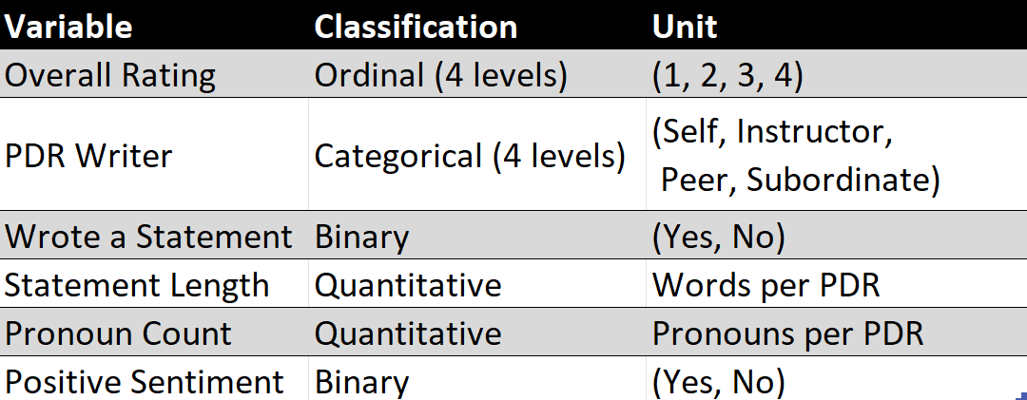
Data
PDRs from 2018 – 2019
38,519 PDRs, 10,315 have written statements
7
Notes:
X axis is rater group
Y axis is proportion of the group that wrote
Can presence of writing alone predict rating?

Slide 8
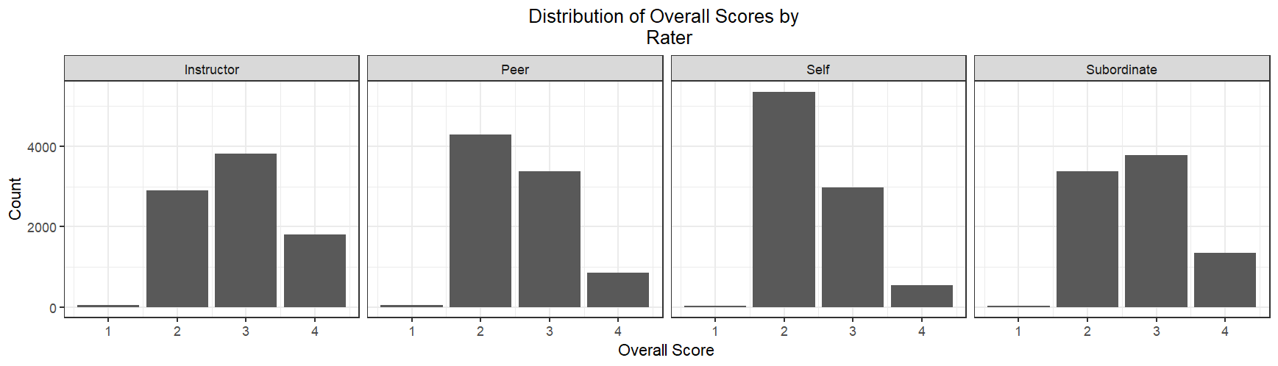
Exploration
Rating distributions change by rater.
Are different distributions an issue?
8
Notes:
Left graph x axis
Left graph y axis
Right graph x axis
Right graph y axis
Should we be seeing these changes? Will we see differences in content? Does class year predict rating?

Slide 9
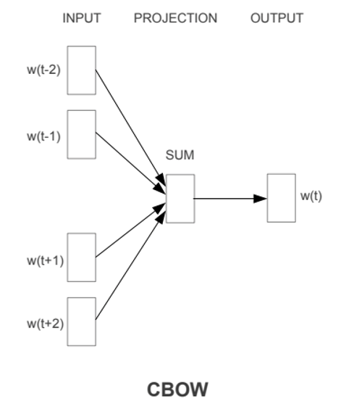
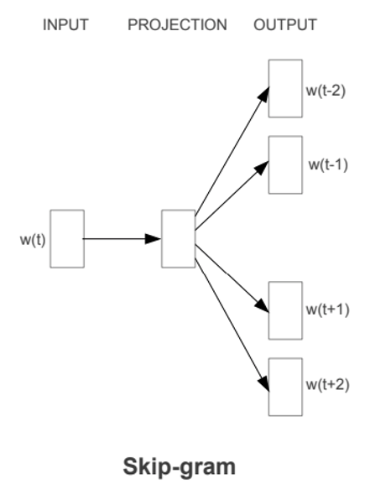
Methods
Word2Vec Representation
Vector representation of words rather than documents
Two methods: CBOW and Skip-gram
9
Notes:
Produces n x 1 matrix of each word
n specified by Word2Vec model
Provides contextual meaning
Combinatorial signals are better captured

Slide 10
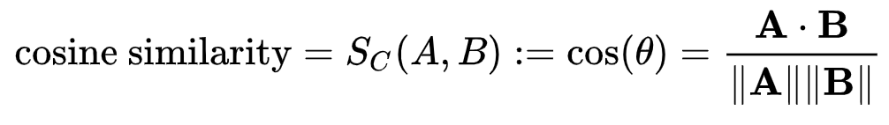
Methods (Cont)
Cosine Similarity
What is it?
Measures the similarity of two vectors using a dot product and the vector magnitudes
Uses of Cosine Similarity
Show similarity between text documents
0.00 = no similarity, 1.00 = identical
10

Slide 11
Methods (Cont)
Ordinal Logistic Regression
Ordinal Data
Response variable with ordinal categories (e.g. PDR overall scores)
Multinomial Logistic Regression
Allows classifying probability of achieving a higher overall score
Requires a reference case for comparison
11

Slide 12
Cos Sim Analysis
Reference: ***** has done well this semester in all three pillars
and i have no doubt of his continued success. (100%)
.
Most similar PDRs by Word2Vec Cosine Similarity:
***** has done well this semester across the three pillars. i have no doubt of his continued success (98.8%)
2. ***** has done well across the three pillars this semester. i have
no doubt of his continued success (98.8%)
…
10. ***** has been a true pleasure to teach this semester. i have no doubt that he will continue to excel during his time here at west
point (87.2%)
12

Slide 13

Cos Sim Analysis (Cont)
Question: Is there evidence of copy / pasting PDRs?
Number of PDR pairs = 10,315² = 106,399,225
PDR pairs with cosine similarity > 90% = 214,216
Similarity Ratio$=\frac{Number of document pairs above threshold}{Total number of document pairs}$
$$\frac{214,216}{106,399,225}=0.020=0.2\%$$

Slide 14
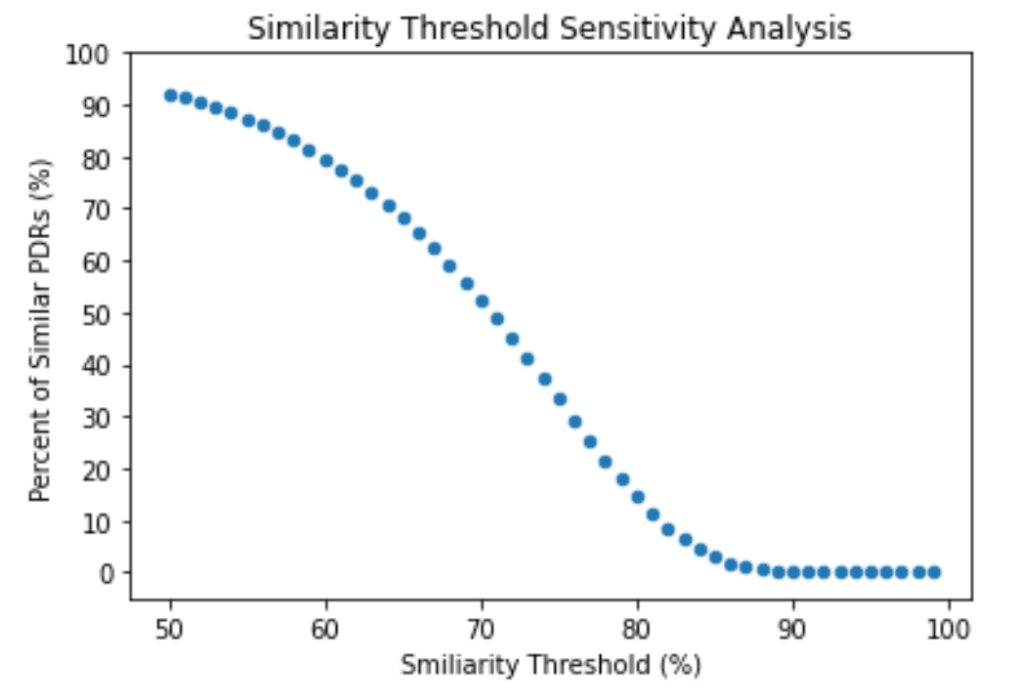
Cos Sim Analysis (Cont)
The 90% threshold yields a Similarity Percent of 0.2%.
14

Slide 15
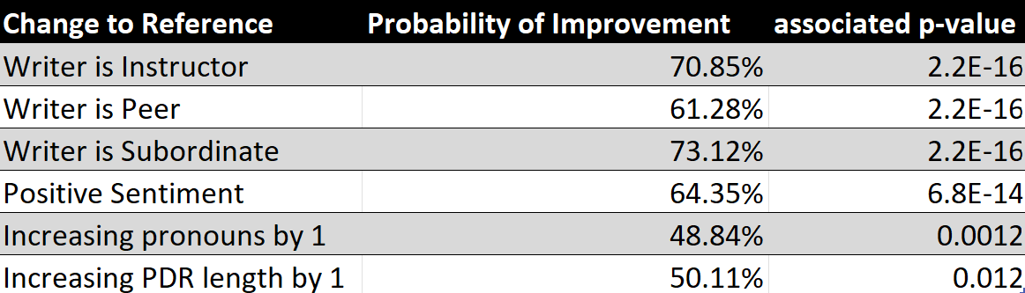
Ordinal Log Reg
Reference Case: Self-written PDR without positive sentiment
15

Slide 16
Summary
Key Findings
No significant evidence of copy / pasting PDRs
PDR writer and overall sentiment of PDR provide strong insights to overall score
Recommendation for G5 Effectiveness Office
Standardize scoring expectations across populations
Require written statement in PDRs
16

Slide 17
Questions?
17

Slide 18
18

Slide 19
Literature Review
Army pilots using AI to streamline selection boards – Lohr A
When small words foretell academic success: The case of college admissions essays - Pennebaker J, Chung C, et al.
Sentiment analysis on large scale Amazon product reviews – Haque T, Saber N, Shah F
Predicting Final Course Performance From Students’ Written Self-Introductions – Robinson R, Navea R, Ickes W
How Reliable are Letters of Recommendation? – Rim Y
A deep learning approach in predicting products’ sentiment ratings: a comparative analysis – Balakrishnan V, Shi Z, et al.
Advances in Natural Language Processing – Hirschberger J, Manning C
19

