Slide 1
DATAWorks 2023
I-TREE: a tool for characterizing research using taxonomies
Aayushi Verma
Data Science Fellow, IDA
April 26, 2023

Slide 2
IDA’s Data Initiative Strategy combines data governance and data management to provide resources for our researchers.
Data Strategy
Data Management and Governance
Research Taxonomies
I-TREE
Notes:
Today I'll be talking to you about my work supporting IDA's Data Strategy, and how the Data Strategy uses data management and governance techniques to deliver key insights to our researchers.

Slide 3


IDA Data Strategy
IDA answers challenging questions about U.S. national security and science policy through rigorous analyses
The core component of our work is data!
IDA’s Data Strategy aims to build a data-centric culture
  Development of solid and sustainable infrastructures and practices
IDA is currently working on numerous initiatives to create a data-centric culture:
  Making data accessible
  Creating a common language around data
  Streamlining data flows
  Investing in data literacy
  Improving and measuring effects of these initiatives
IDA – Institute for Defense Analyses
Notes:
As a research institution, IDA answers challenging questions about US national security and science policy for our sponsors and business. The core component of our objective and rigorous analyses is data. As a business, we deal with and depend on a lot of data for our research.
That's why IDA is leading a Data Strategy to establish a data-centric culture and to leverage data for efficiently responding to business and sponsor needs.
This strategy develops solid and sustainable infrastrcutures and practices to promote a data-first approach to our work through multiple initiatives, like making data accesible, creating common language around data, streamlining data flows, investing in data literacy, and improving and measuring the effects of these initiatives.

Slide 4
Data Strategy Initiative: Research Taxonomies
Derived from IDA’s four core competencies
Evolving set of hierarchies of organized terms to describe research done at IDA
4 core competencies
(currently) 8 taxonomies
Systemic Capability
DoD Systems
Geographical and Geo-Political Entities
Resource and Analysis
Analytical Methods
Military and Policy
Technical Assessments
Domain
Weapon Systems
Strategy and Forces
Science and Technology
Mission Areas
Notes:
One of the key initiatives of the Data Strategy has been the development of a set of research taxonomies. These taxonomies are an organized hierarchy of keywords that desribe the research done at IDA across 8 broad domains.

Slide 5



Relating Taxonomies to Products
Research projects have deliverable products
Combine metadata for products with research taxonomies
+
=
Products tagged with taxonomy terms
Research Products
Tags from taxonomies
Notes:
Our research divisions work on different business and sponsor projects, and these projects have deliverable products, like reports or memos. We can use the metadata for these projects and products, and combine them with the research taxonomy terms to quantify and describe our research!

Slide 6



Research Dataset
Periodic tagging effort
  Authors of products are asked to tag their products with relevant terms from the taxonomy
This creates a dataset of products, authors, and taxonomy terms that describes IDA research!
Created a web application to interactively display this dataset
+
+
=
Products tagged with taxonomy terms
Authorship data
Project data
Filterable dataset
Notes:
This works through another initiative, which is a periodic tagging effort. Authors of products tag them with relevant terms from the taxonomy, such that it descibes that body of work. This creates a dataset of products, authors, and taxonomy terms. We combine this with other data sources, like project, author and division data, to produce a dataset describing IDA research.
This research dataset brings together a cohesive and quantitative picture of the researh done here, which is bringing new insights to our research staff and management. We also created an interactive web application that graphically shows this data.

Slide 7
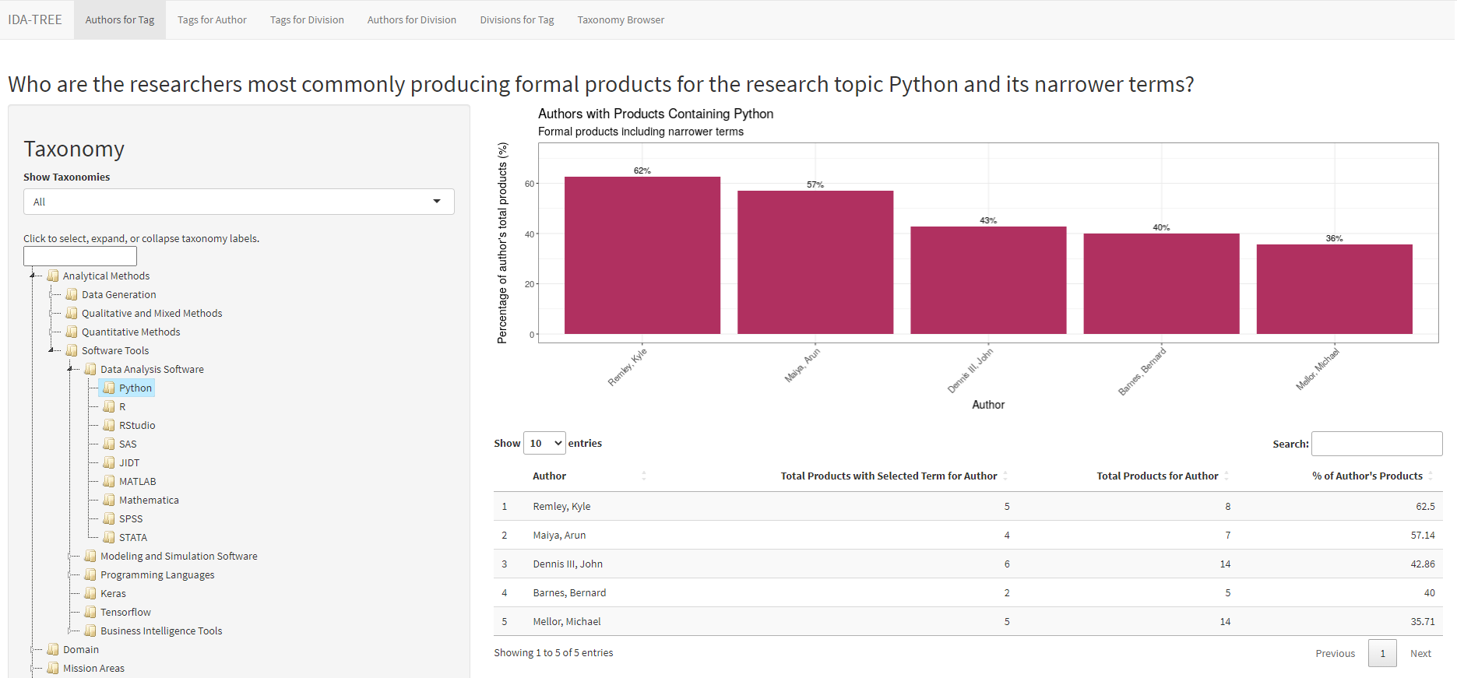
I-TREE (IDA-Taxonomical Research Expertise Explorer)
Notes:
This RShiny application is called I-TREE, short for IDA Taxonomical Research Expertise Explorer. I'll walk you through the app soon.

Slide 8



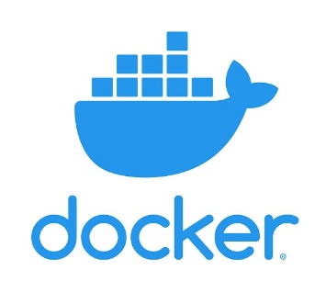

Data Science Techniques
Used ETL techniques in R to create dataset
Data extracted from different sources (SQL server, SQLite files, CSV files, and Rds objects)
Reproducible pipeline scripts to continue dataset curation
RShiny application deployed on IDA’s Shiny server through a Docker container
Notes:
In order to create the dataset itself, we used ETL techniques in R for data from different sources. We also developed reproducible pipelines that will continue to curate this dataset. The application itself is an RShiny web app that is available on our internal Shiny server.

Slide 9
I-TREE: Questions Answered
Who are the top N researchers producing products tagged with a term and its related terms?
What are the top N areas of expertise for a chosen researcher?
What is a chosen research division’s top N areas of expertise?
What are the rankings of the 9 research divisions for a chosen term?
Who are the researchers who have produced the most products in a chosen division?
Notes:
Fianlly, on to the application! The app has 5 tabs at the top, each of which answer a very specific question.

Slide 10
Who are the top n researchers for a research area?
Notes:
This is the first tab, which answers the question of who are the top researchers for a research area. On the left panel here is the research taxonomy and other data filtering options, and on the right is a graph and table showing the results - which is percentage of an author's products that were tagged with the selected term from the taxonomy.

Slide 11
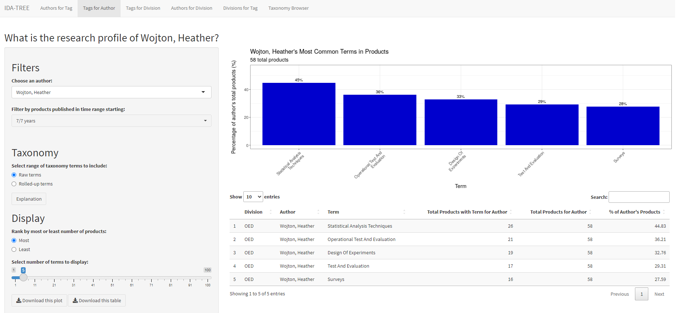
What is the research expertise of an author?
Notes:
The second tab answers the question of what is the research expertise of an author - the percentage of an author's products tagged with terms.

Slide 12
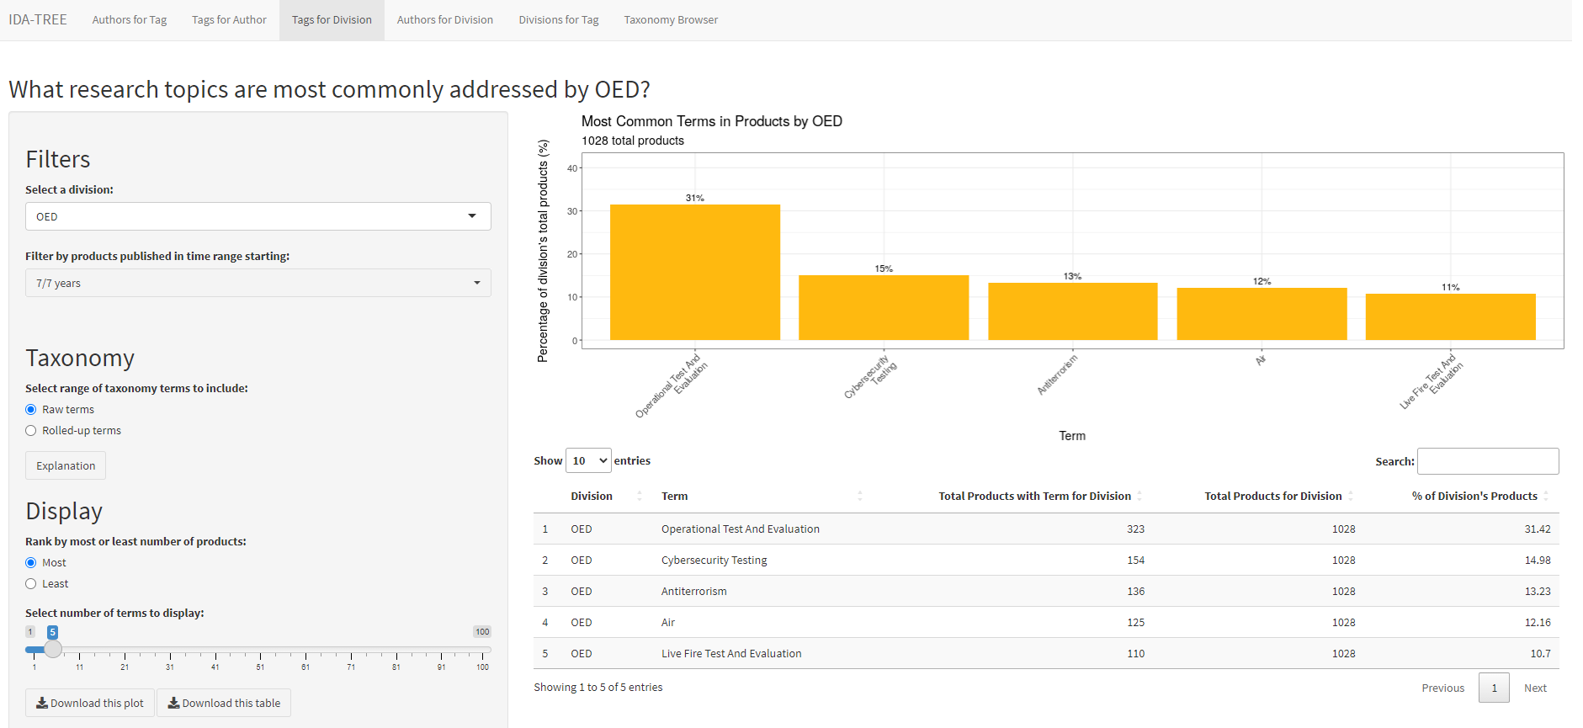
What research does a division produce?
Notes:
The third tab answers the question of what research does a division produce - percentage of a division's products tagged with terms.

Slide 13
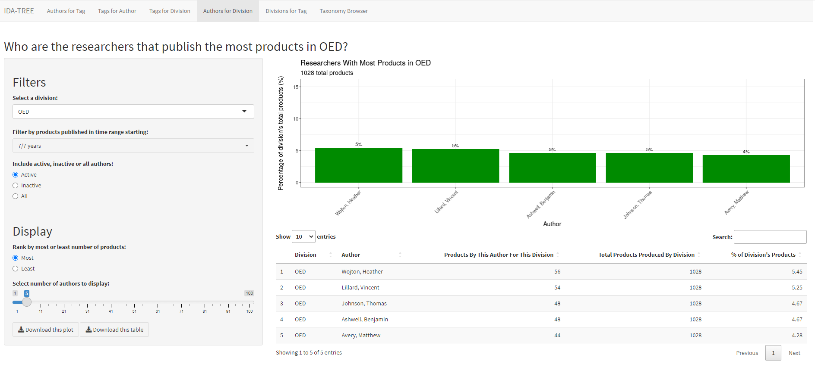
Who are the top researchers in a division?
Notes:
The fourth tab answers the question of who are the top researchers in a division - percentage of the division's products with that author.

Slide 14
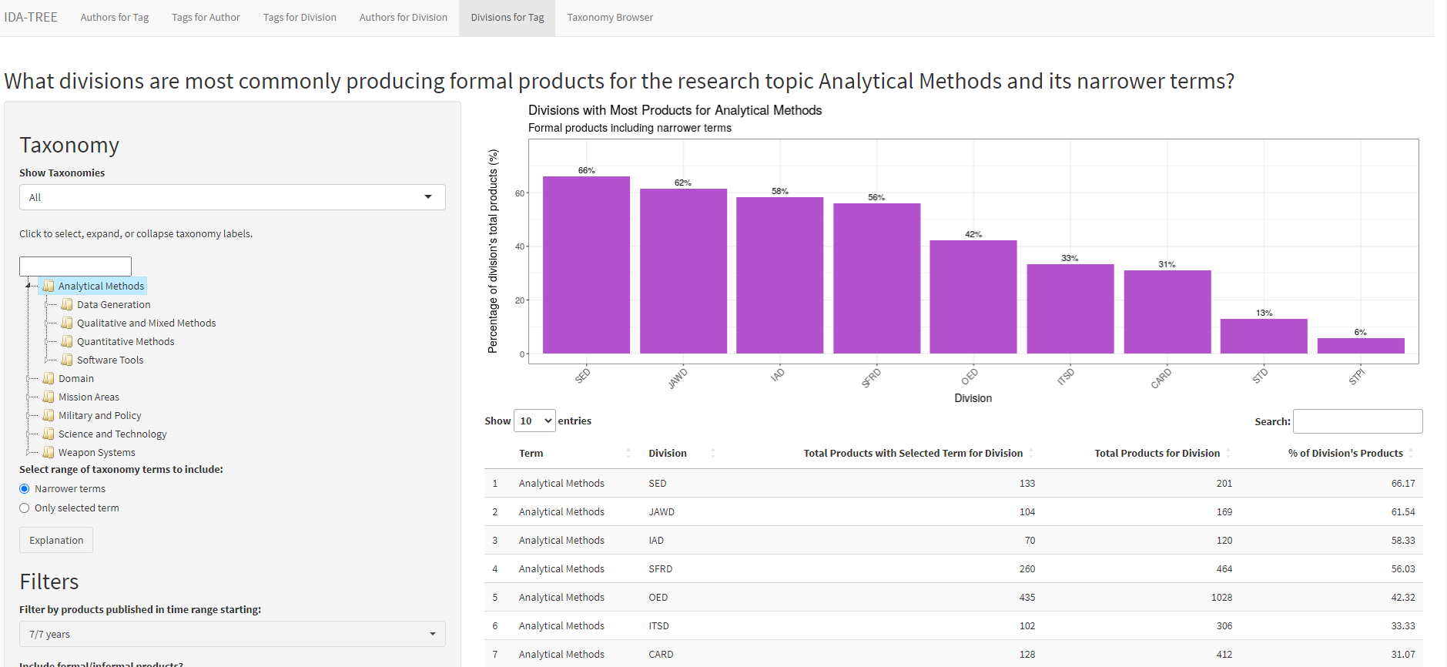
How do the divisions produce research for an area?
Notes:
Finally, the fifth tab answers the question of how do the divisions produce research for an area, i.e. what percentage of a division's products were tagged with selected terms.

Slide 15
Impact and Future of I-TREE
I-TREE was deployed at IDA in Jan. 2023
Researchers are actively using I-TREE to:
  Find SMEs across divisions to collaborate with
  Quantitatively understand research done across divisions
Current iteration of I-TREE lays the groundwork for bringing more rigorous insights to our researchers
Next steps include:
  Integrating more data streams to provide a holistic view of the data
SME (Subject-Matter Expert)
Notes:
This app was launched earlier this year in January, and researchers are already using it for many different things, like finding subject matter experts across divsions, like a netowrking tool, to quantify the research done, and more.
This current iteration of I-TREE is a stepping stone for bringing more insights to our research staff, to enable them to do their job - the research.
Further work on I-TREE includes integrating more data streams and answering more questions about our business.
This is an example of how IDA’s data strategy is using data management, data governance, and data science techniques to quantify our research.

Slide 16
Thank you!
Questions?

