Slide 1
Optimal Release Policy for Covariate Software Reliability Models
Ebenezer Yawlui, UMass Dartmouth
Priscila Silva, MS, UMass Dartmouth
Vidhyashree Nagaraju, PhD, University of Tulsa
Lance Fiondella, PhD, UMass Dartmouth

Slide 2
Background and introduction
Optimal Release Policy
  Identify the additional amount of testing before software release
  Past studies considered Software Reliability Growth Models (SRGM)
    Do not identify specific test activities underlying defect discovery
    Often fail to consider uncertainty or iterative application during the software testing process
Optimal Release Policy for Covariate Software Reliability Models
  Explicitly links test activities to defect discovery
  Determine the optimal allocation of multiple test activities that minimizes the overall cost of producing the software

Slide 3


Discrete cox proportional hazards NHPP SRGM
Number of defects that would be detected with indefinite testing
Mean value function
$$m(x)=ω\sum_{i=1}^{n}{p_{i,x_{i};γ,β}}$$
where
$p_{i,x_{i};γ,β}=\left(1−{\left(1−h_{i;θ}^{0}\right)}^{g\left(x_{i};β\right)}\right)\prod_{k=1}^{i−1}{{\left(1−h_{k;θ}^{0}\right)}^{g\left(x_{k};β\right)}}$
Covariates associated with $y_{i}$ at the time of testing
Discrete Cox Proportional Hazard model
Vector of Cox model
parameters
Baseline hazard function
Vector of model parameters

Slide 4


Hazard functions and MLE ESTIMATION WITH COVARIATES
Can be incorporated into $p_{i,x_{i};γ,β}$
  Geometric (GM)
  Negative binomial of order two (NB2)
  Discrete Weibull of order two (DW2)
  The log-likelihood function is used to estimate the parameters of the discrete Cox proportional hazard model (DCPH) with covariates.
  MLE of model with$r$covariates and $γ$ paramaters obtained by solving system of equations.

Slide 5

Optimal test allocation based on cost criterion (1)
Given model $\hat{m}(x)$ fitted to test activities $x_{n×r}$and vector of observed failures $y$, we seek to allocate resources to test activities in interval ($n + 1)$ in a manner that minimizes cost
$$\operatorname{argmin}{C\left(X\right)}{ }$$
subject to
$$\sum_{i=1}^{r}{α_{i}X_{i},_{n+1}≤B}$$
  where
  $C(X)$ – Total cost to release the software
  $B>0$ – Budget constraint

Slide 6

Optimal test allocation based on cost criterion (2)
Cost function for optimal release model based on cost criteria incorporating covariate software defect detection model
$$C\left(X\right)=α_{pre}\hat{m}(X)+α_{post}\left(\hat{m}\left(x\right)−\hat{m}\left(X\right)\right)+\sum_{i=1}^{r}{α_{i}\sum_{j=1}^{n+1}{X_{i,j}}}$$
  where
  $\hat{m}(X)$- estimated number of defects to be discovered prior to release according to the fitted model.
  $\hat{m}(x)$- estimated number of defects to be discovered throughout the software lifecycle.
  $α_{pre}$- cost of removing a defect before release
  $α_{post}$- cost of removing a defect after release

Slide 7
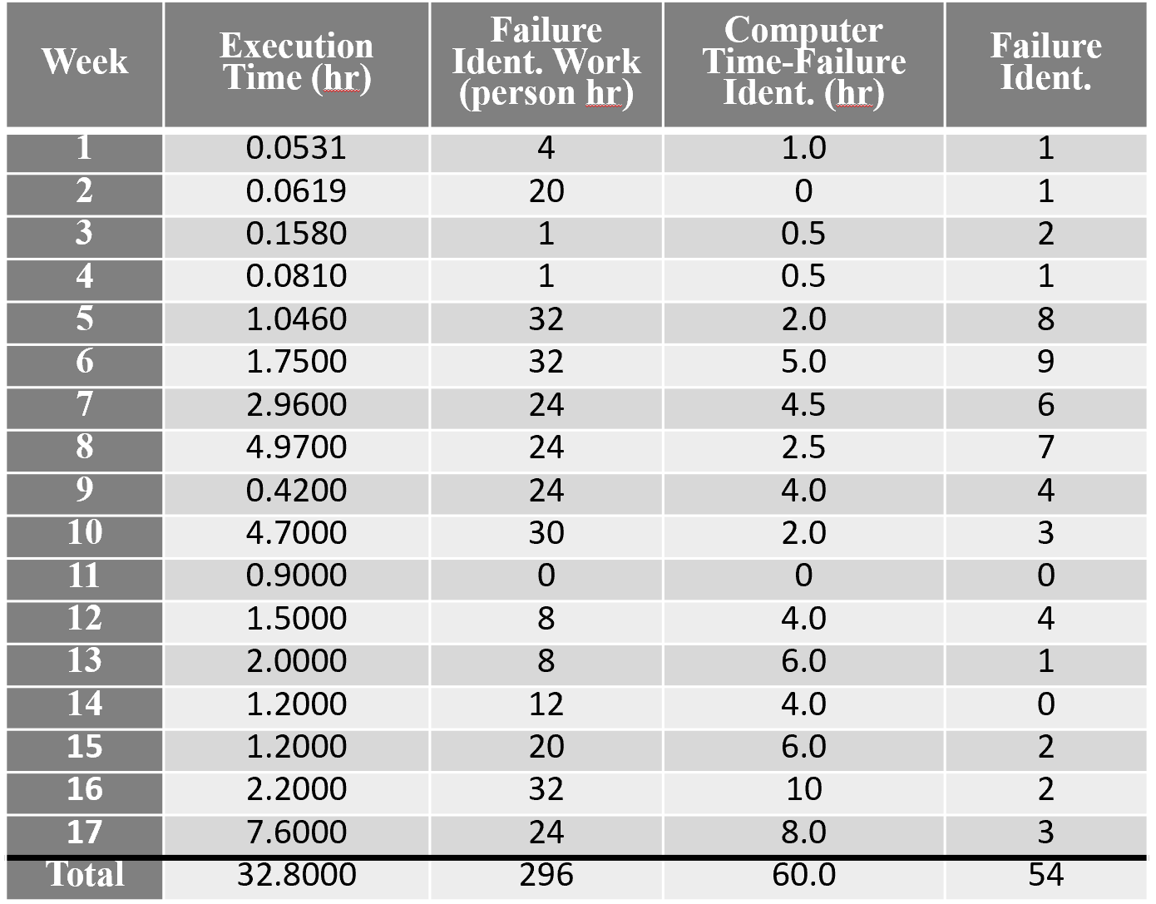
Illustrations: Dataset DS1
DS1 (Shibata et al., 2006): $n=17$ weeks of observation
Covariates E (Execution Time) and C (Computer Time-Failure Ident.) are used

Slide 8
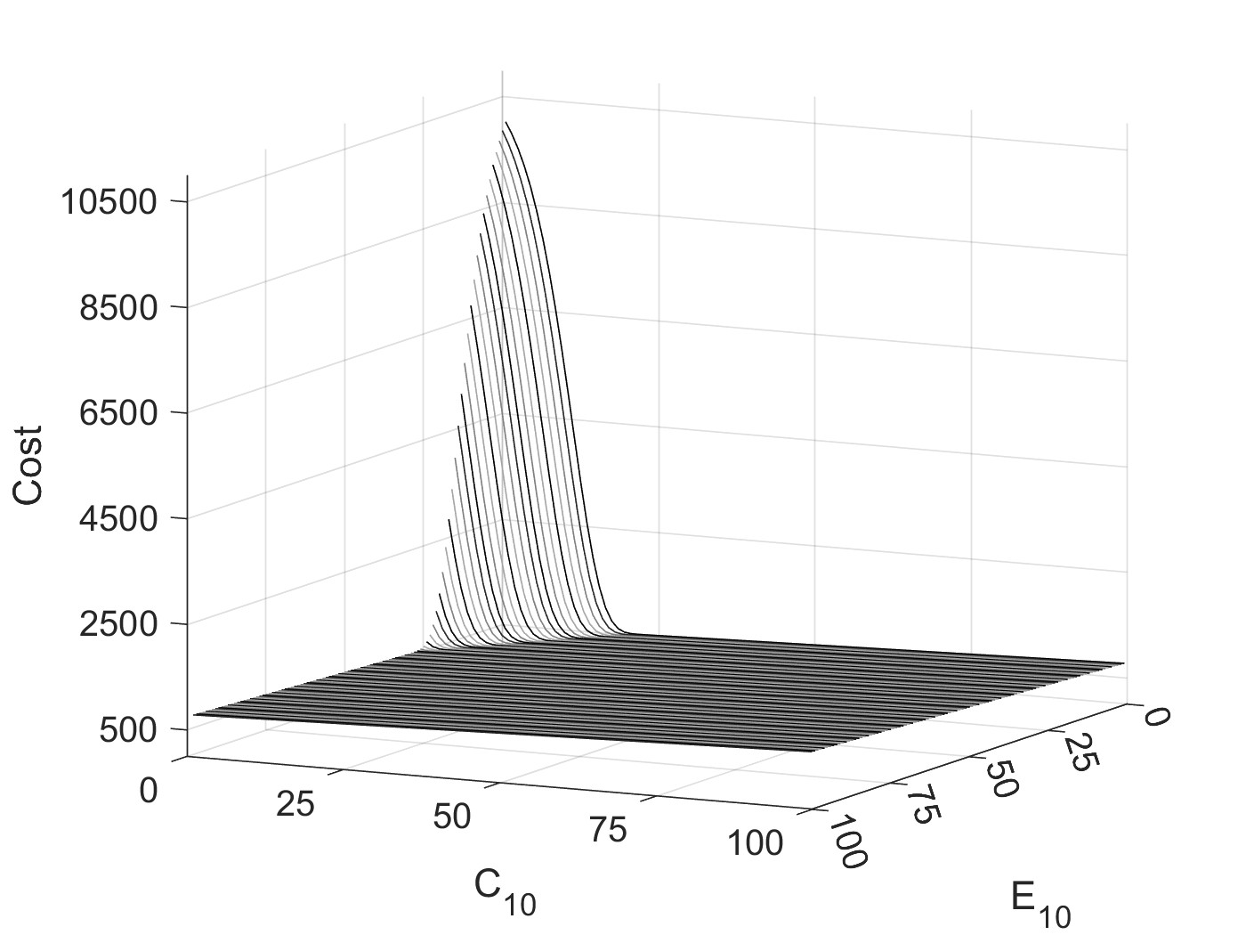
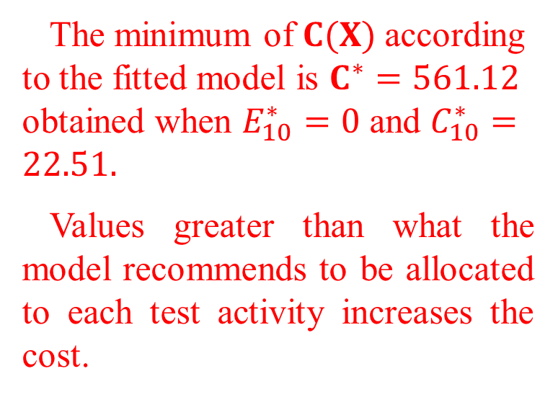
Optimal test activity allocation based on cost criterion
The minimum of $C(X)$ according to the fitted model is $C^{∗}=561.12$ obtained when $E_{10}^{∗}=0$ and $C_{10}^{∗}=22.51.$
Values greater than what the model recommends to be allocated to each test activity increases the cost.
Figure 1 - Impact of test allocation on cost under negative binomial hazard function fitted to E and C covariates of DS1.

Slide 9
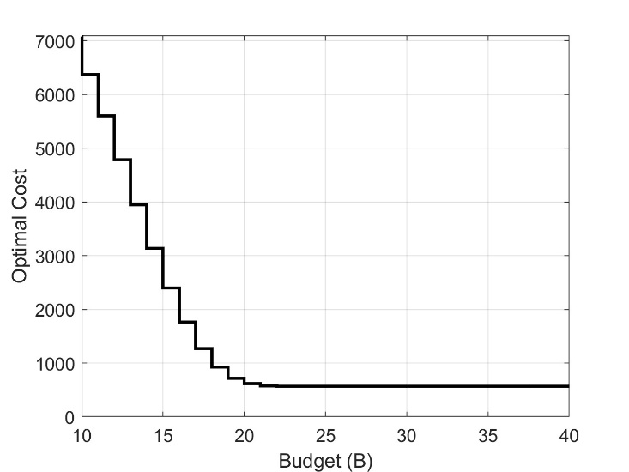
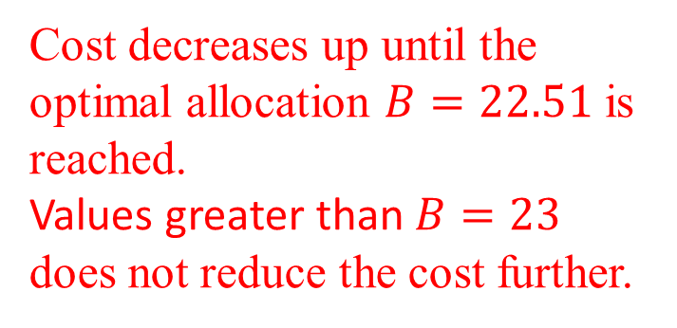

Sensitivity of optimal cost to test activity allocation under various budget constraints
Cost decreases up until the optimal allocation $B=22.51$ is reached.
Values greater than $B=23$ does not reduce the cost further.
Figure 2 – Minimum cost attainable under optimal test activity allocation given budget $B$.

Slide 10
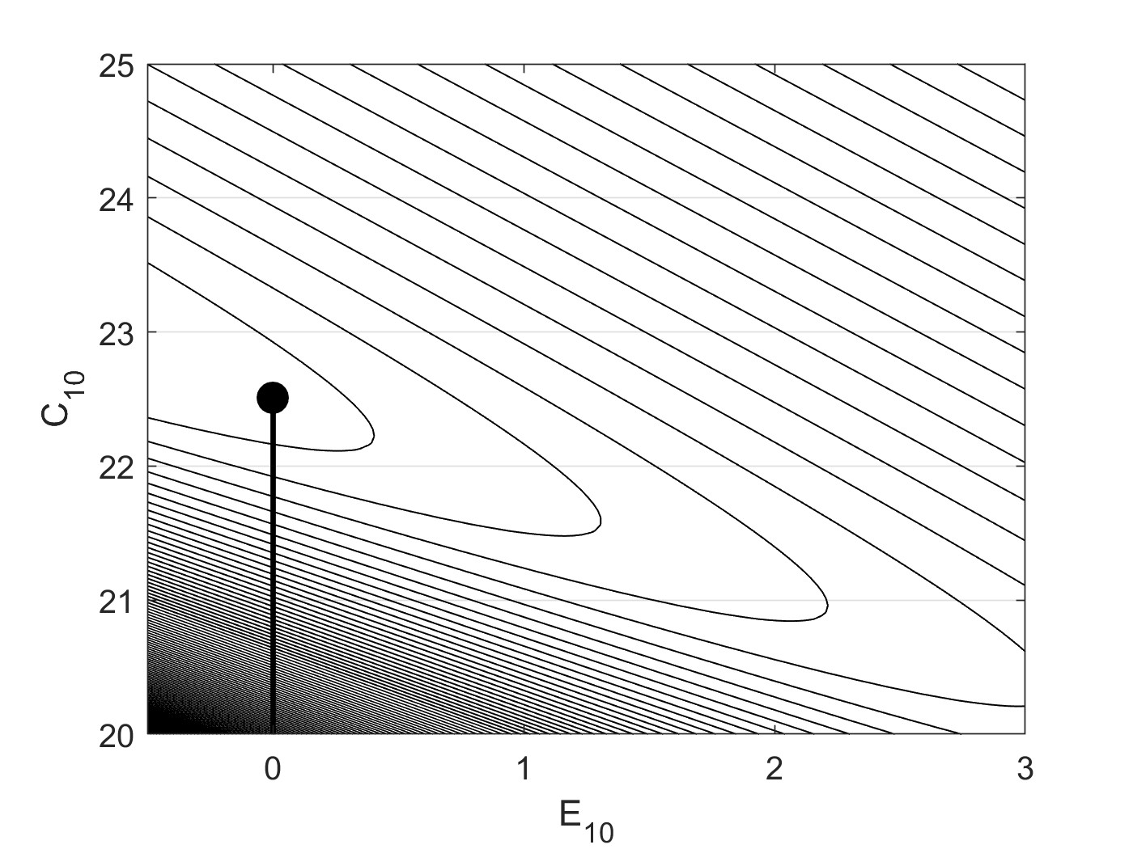

Sensitivity of optimal cost to test activity allocation under various budget constraints
Allocating additional time to test activity E (Execution Time) will not compensate for the cost of performing the testing.
Figure 3 - Contour plot of cost function with optimal test activity allocation given budget $B$ superimposed.

Slide 11
Summary & Conclusion
This research presented a software optimal release model based on cost criterion
  Incorporating covariate software defect detection model
  Allocating multiple alternative test activities based on a budget constraint in order to maximize defect discovery
Results suggest that optimal release policy based on covariates model provides direct guidance to software engineers on how to allocate efforts across multiple test activities in order to
  minimize cost
  maximize defect discovery
Future Work
  Add more covariates where the dimensionality of the problem increases
  Develop stable and efficient algorithms
  Online procedures to iteratively allocate test activities

Slide 12

Acknowledgement
This material is based upon work supported by the National Science Foundation under Grant Number 1749635. Any opinions, findings, and conclusions or recommendations expressed in this material are those of the authors and do not necessarily reflect the views of the National Science Foundation.

