Slide 1


Energetic Defect Characterizations
Naomi Edegbe, George Wang
Advisors: Dr. Garo Sarajian, Dr. Ryan Allaire, MAJ Thomas Mussmann
USCC – United States Military Academy – Department of Mathematical Sciences
APR 2023

Slide 2

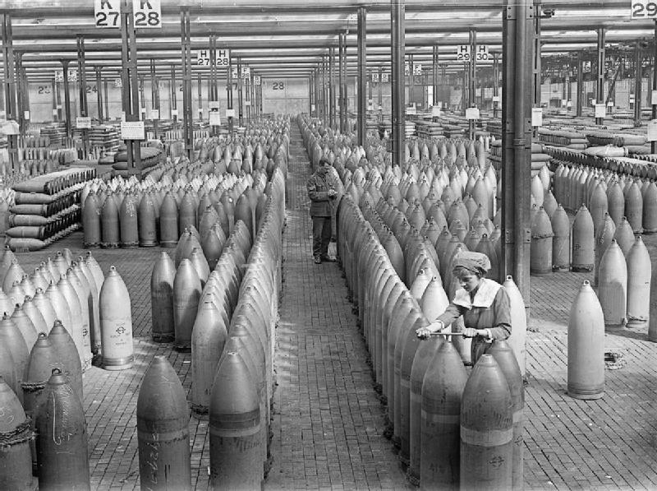
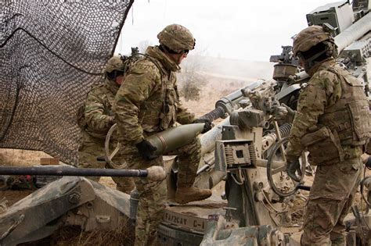
Munitions
Munitions are imperative to the warfighter
Applicable use in Field Artillery, Air Defense, and Engineers
The everyday soldier has either employed a munition or been in close proximity to its activation
So what if the munitions you thought could do this…

Slide 3
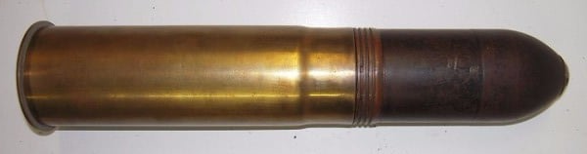
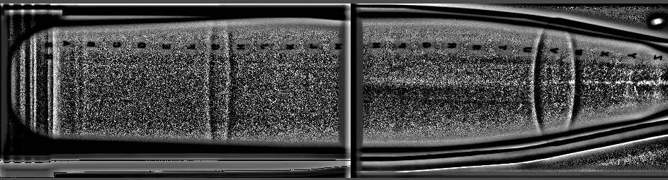

And looked like this in x-ray scanning…
Disclaimer: Two separate X Ray Images of Munitions. https://www.researchgate.net/figure/The-neural-network-architecture-of-the-proposed-defect-detection-system-The-system_fig5_327392506

Slide 4
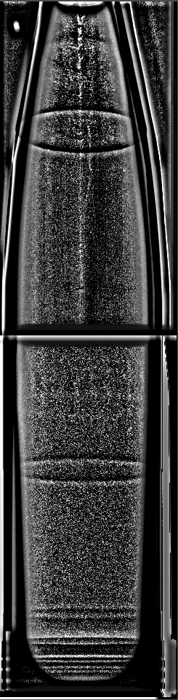
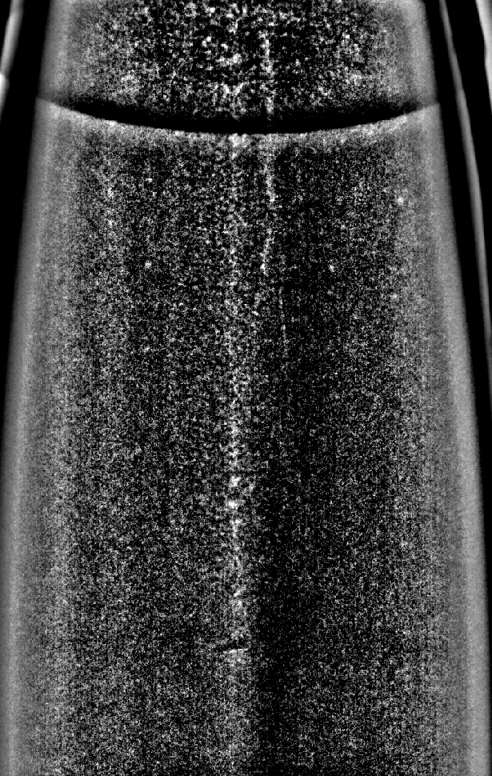
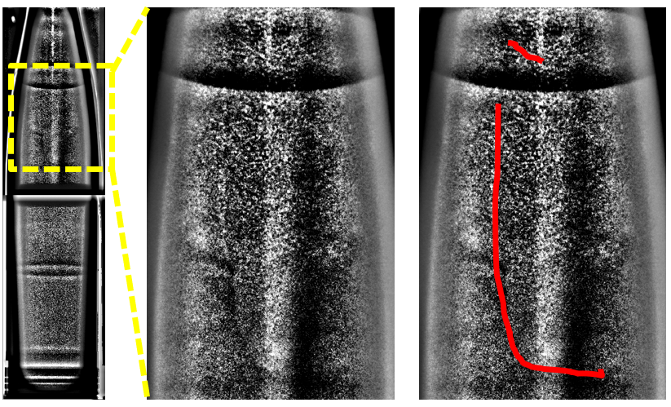
Actually Reported with this…
Pipping
Porosity
Crack
Disclaimer: Two separate X Ray Images of Munitions. https://www.researchgate.net/figure/The-neural-network-architecture-of-the-proposed-defect-detection-system-The-system_fig5_327392506

Slide 5
Our Project overview and problem Statement
Defects in high explosive shell interiors may cause catastrophic failures with consequences resulting in fatalities
Objective: Utilize a computational process that assesses ammunition defects with Feature Extraction
1st Order: Anomaly Detector
Manufacturing
X-ray image collection
2nd Order: Feature Extractor
CNN learning Prediction
Data Curation
Current Process: Human-in-the-loop
3rd Order: Human-in-the Loop
Classify
Deploy

Slide 6
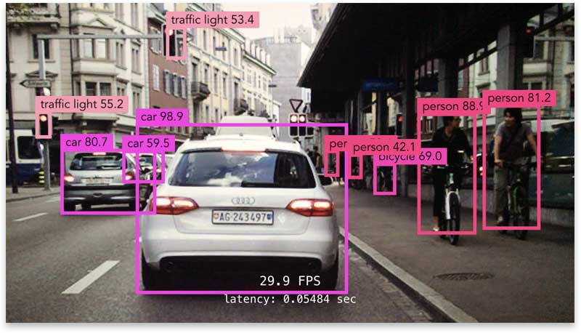
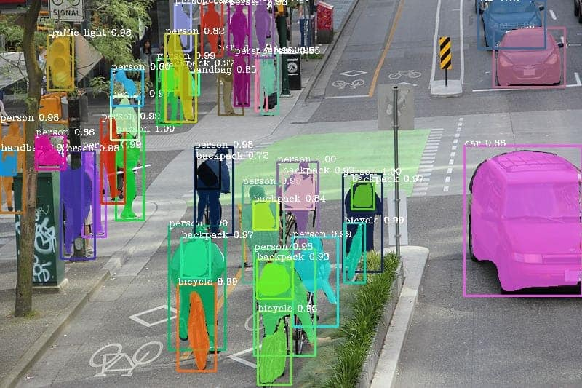
Computer Vision
Object Detection
  Place a tight bounding box around each defect or characteristic of the image.
Semantic Segmentation
  Place filters on recognized objects
Instance Segmentation
  Place bounding box with labeled feature

Slide 7
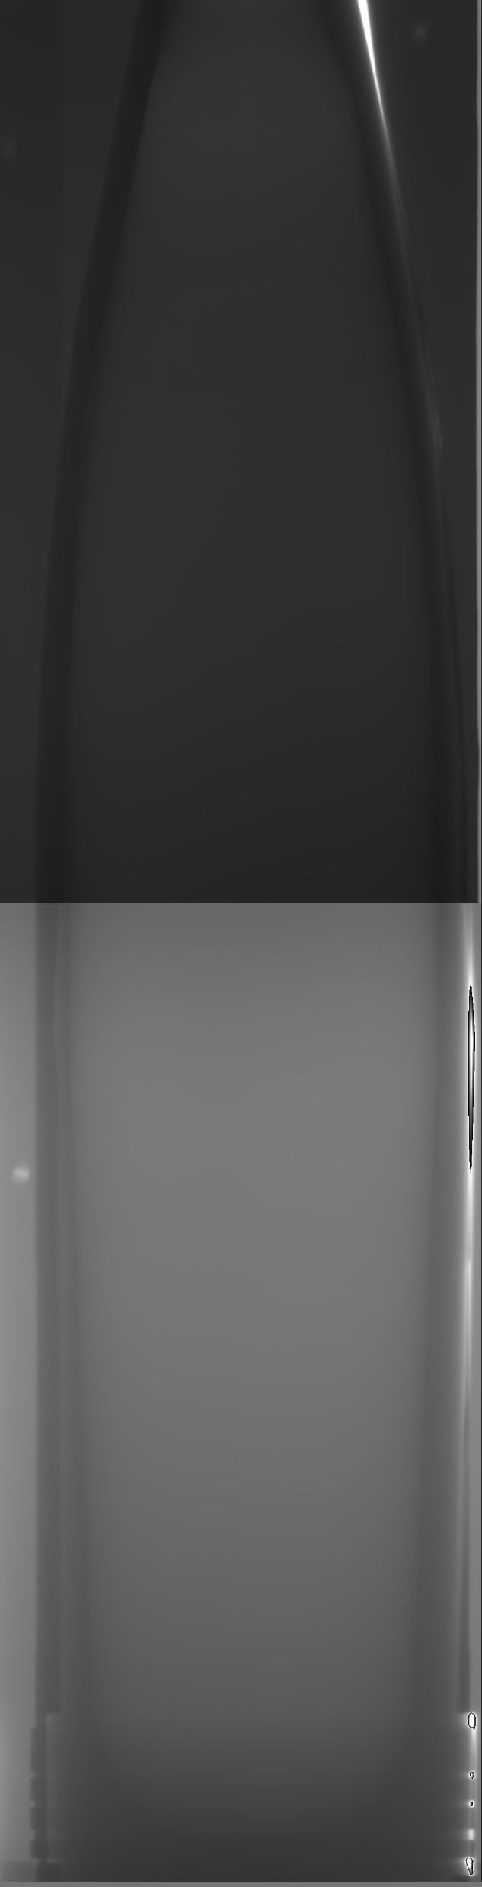
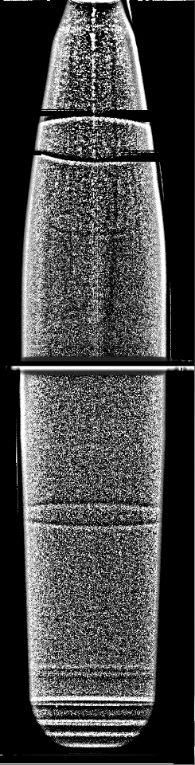
Data Structure
79,141 annotated images
619 GB
992 x 3878 Pixels
348 rejected
  22 Dispositioned features
  15 Casting features

Slide 8

Forming the data
Match preprocessed image labels with annotations
FINAL SET
Images Stored in HPC
Date | ID | Label
2021-09-15 | 1 | Accept
2021-09-15 | 2 | Accept
2021-09-15 | 3 | Reject
78,000 Images
245 Defects
Annotations Summary

Slide 9

PReProcessing
Step 1. Input image.
Step 2. Utilize Wallis Filter for black and white effect.
Step 3. Highlights edges and details much better.
Step 4. Cut unnecessary background data. Then pad and Resize image to 784 x 784
Step 1
Step 2
Step 3
Step 4

Slide 10
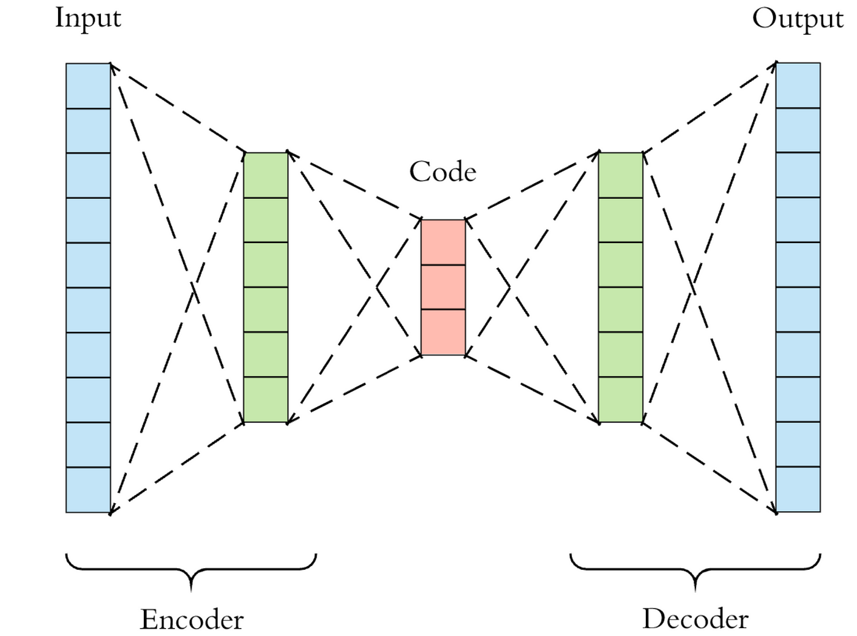
Autoencoder
Encoder - Decoder
  Input: 784/128 Size image
  Sequential Autoencoder
  Convolutional Layers
  ReLU Activation
Training
  50 Epochs
  500 Batch Size
Validation
  200 Batch Size
Anomaly
  50 Batch Size

Slide 11
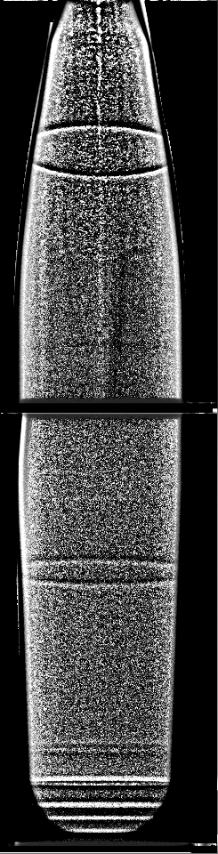
Barriers and Progress
Autoencoder processes and reconstructs images
Images with incorrect edges placed in training file
Reconstruction error does not account for distorted preprocessed images

Slide 12
Conclusions
Annotations matched
Wallis Filter applied
Edges detected
Additional preprocessing and resizing
Autoencoder reconstructs
Curation anomalies identified

Slide 13
QUESTIONS?

