Slide 1
Application of Software Reliability and Resilience Models to Machine Learning
Zakaria Faddi, UMass Dartmouth
Karen da Mata, UMass Dartmouth
Priscila Silva, MS, UMass Dartmouth
Vidhyashree Nagaraju, PhD, Stonehill College
Susmita Ghosh, PhD, Jadavpur University, Kolkata
Lance Fiondella, PhD, UMass Dartmouth

Slide 2
Problem Statement & Past Research
There is a need to prevent the learning component of ML-enabled systems from becoming a means of attack
Research studies propose enhanced techniques to improve defenses of ML algorithms against adversarial attacks
This research proposes a method for quantifying the reliability and resilience of a machine learning model considering NHPP SRGMs and resilience models
Notes:
The deployment of ML models in real-world scenarios requires that these models can adapt to changing conditions and handle uncertainties effectively. This ability to be resilient is critical, especially when dealing with complex tasks. ML models must be able to perform well even when faced with incomplete or ambiguous information and make decisions that are robust to uncertainty. Without solutions to address these challenges, the reliability of ML models will remain uncertain, leaving many industries vulnerable to potential failures.

Slide 3
Contributions
Apply Software Reliability Growth Models (SRGM) to characterize defects discovery in ML-enabled applications
Apply resilience models to track and predict ML-systems performance under adversarial scenarios
Develop data collection technique to promote risk quantification that can provide best practices in order to conserve resources

Slide 4
Introduction & Background
Machine Learning Techniques
Convolutional Neural Networks (CNNs)
Generative Adversarial Attacks (GAAs)
Defensive Measures (Adaptive Adversarial Training)
Reliability & Resilience modeling
Non-Homogeneous Poisson Process (NHPP) Software Reliability Growth Models (SRGM)
Discrete cox proportional hazard SRGM
Discrete resilience models incorporating covariates
Notes:
Deep learning model used for image classification and object recognition task
Creates attacks designed to deceive the target model into making incorrect predictions
Incorporate adversarial examples into the training data as it becomes available and update the model in real-time
Statistical models that describe the number of failures or defects in a software system over time.
Characterize failure and defect discovery as a function of test activities and related software metrics
Models used to analyze the relationship between a set of covariates and a discrete measure of performance over time

Slide 5
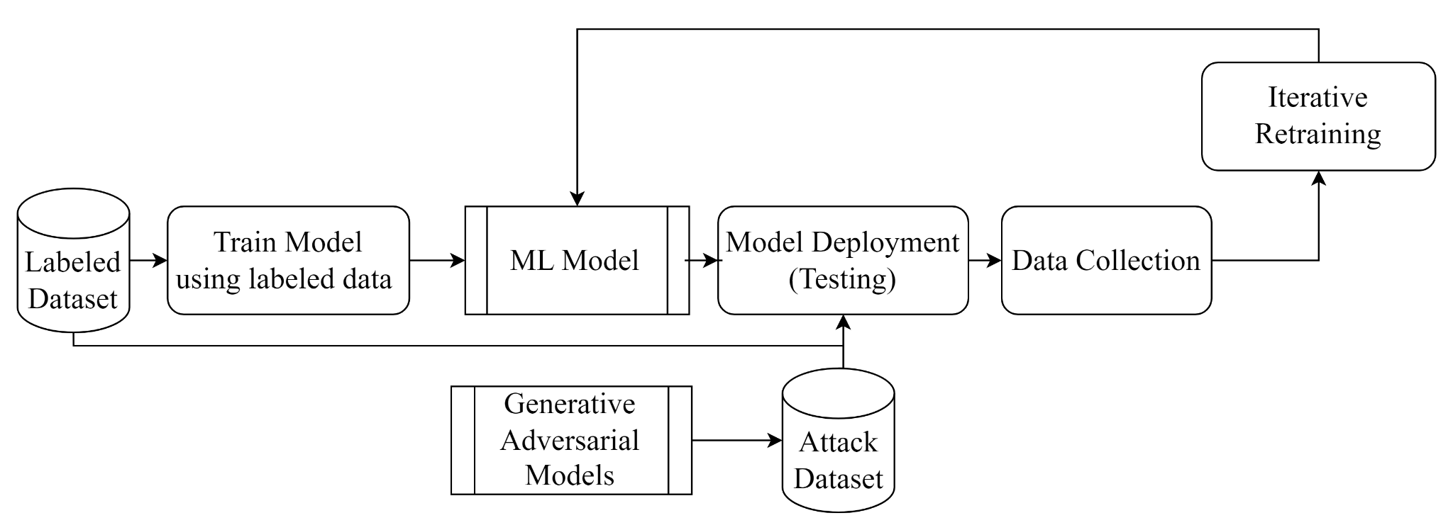
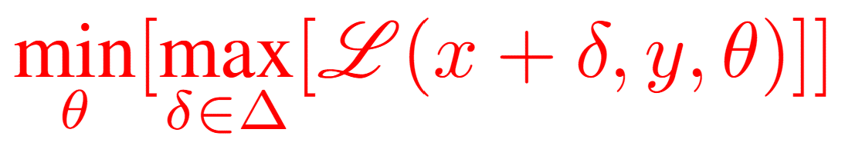
Adaptive Adversarial Training Model Architecture

Slide 6
Data Collection
NHPP SRGM
FN | Failure Number
FT | Failure Time
Discrete Cox Hazard & Resilience Models
T | Number of Iterations
FC | Failure Count
Alpha | Learning Rate
Overall F1 Score | Average F1 score of all classes
Epsilon | Perturbation amount added to the image
FGSM | % of FGSM Attack
PGD | % of PGD Attack
Training Accuracy | Accuracy during training
Training Loss | Loss during training
Validation Accuracy | Accuracy of validation data during training
Validation Loss | Loss of validation data during training
Testing Accuracy | Accuracy during unknown attack
Testing Loss | Loss during unknown attack
Memory | Memory usage of AAT

Slide 7
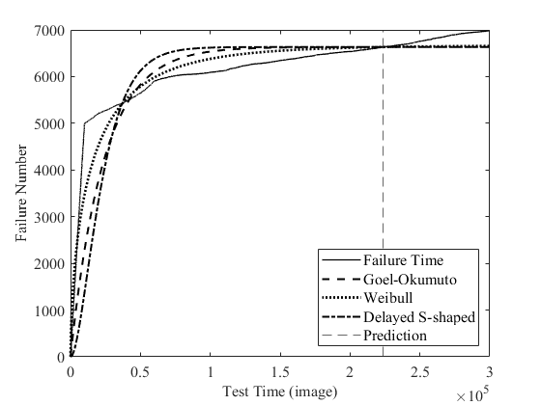
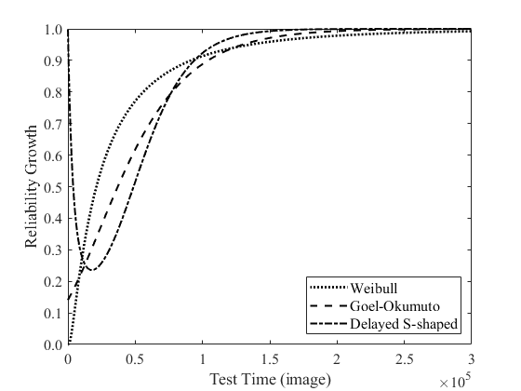
Illustrations: NHPP SRGM
Identify trends in defect discovery
and to identify bottlenecks in the
defect resolution process
Identify trends in failure rate and
to identify the effectiveness of
corrective actions
Notes:
Figure to the left shows the empirical cumulative failure count in each test time iteration as well as the overall best-fitting models using NHPP models without covariates. The dashed vertical line at t = 2.25 × 105 indicates when the model predictions start

Slide 8
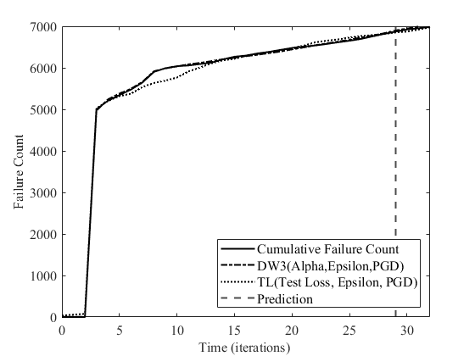
Illustrations: Discrete cox proportional hazard SRGM Models
Covariate models are more accurate at fitting data, making predictions,
and have a lower relative error than the other models.
Notes:
Figure 7 shows the model fit of the two covariates models that achieved the best goodness of fit. The dashed vertical line at t = 29 indicates when the model predictions start

Slide 9
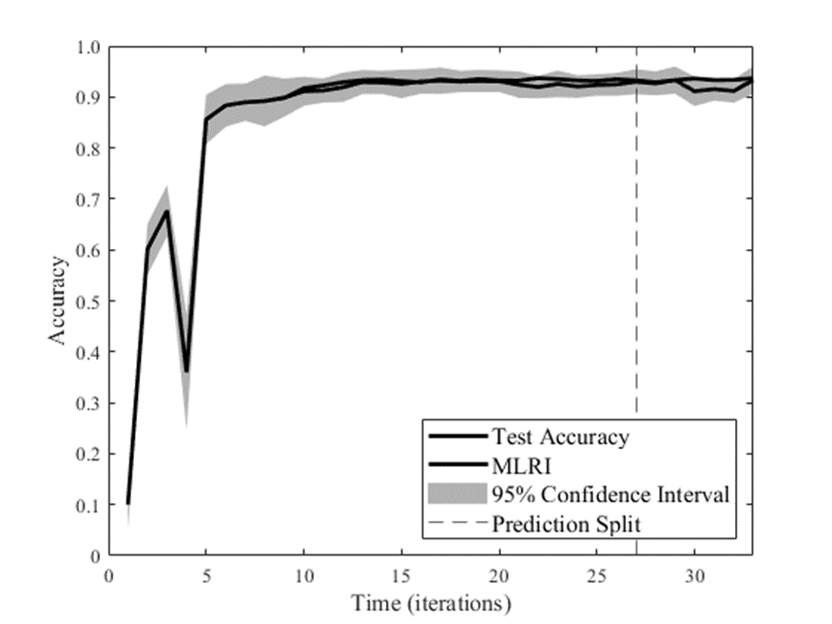
Illustrations: Resilience Model
Figure demonstrates the efficacy of the resilience models in assessing
and predicting the performance of ML models under adversarial scenarios
Notes:
The resilience models utilized accuracy as a performance measure of the CNN system. The resulting displays the expected trend, with an initial drop in accuracy on the third iteration following the CNN model's first introduction to adversarial attacks. However, through the use of Adaptive Adversarial Training (AAT), the model was able to adapt to this disruptive event and return to a nominal performance level.
For the remaining iterations, minimal drops in accuracy were observed due to changes in the amount of noise added to the images. Despite these variations, the CNN model's performance, as indicated by accuracy, remained consistently above 0.8. The resilience figure demonstrates the efficacy of the resilience models in assessing and predicting the performance of ML models under adversarial scenarios, further highlighting the importance of software reliability and resilience assessment for trustworthy deployment of such systems.

Slide 10
Summary, Conclusion, and Future Research
This research :
Developed data collection technique to apply traditional NHPP models with and without covariates
Successfully characterized the deterioration and recovery of the ML-based model using resilience modeling approaches
Future research could explore :
Advanced statistical techniques
Applications to cyber physical systems
Applications to pre-existing ML-based systems

Slide 11

Acknowledgement
This material is based upon work supported by the National Science Foundation under Grant Number (#1749635). Any opinions, findings, and conclusions or recommendations expressed in this material are those of the authors and do not necessarily reflect the views of the National Science Foundation.

