Slide 1
Application of Recurrent Neural Networks to Covariate Software Defect Prediction
Fatemeh Salboukh, MS, University of Massachusetts Dartmouth, US
Priscila Silva, MS, University of Massachusetts Dartmouth, US
Vidhyashree Nagaraju, PhD, Bastion Technologies, TX, US
Lance Fiondella, PhD, University of Massachusetts Dartmouth, US

Slide 2
Introduction
Software Reliability
Software Reliability is the probability of failure-free operation for a specified period of time
Covariate Software defect prediction
Predicting future faults as a function of testing time or effort, to improve maintenance scheduling to avoid future defects is a solution to raise the reliability
Relevant past studies
Non-Homogeneous Poisson Process (NHPP) software reliability growth models (SRGM)
Contributions
Predicting the defects using Recurrent Neural Networks and its variation, Long-Short Term Memory
Results
Neural networks are able to track and predict defect trends, specifically 6 and 9 times reduction in prediction error than Covariate SRGM

Slide 3
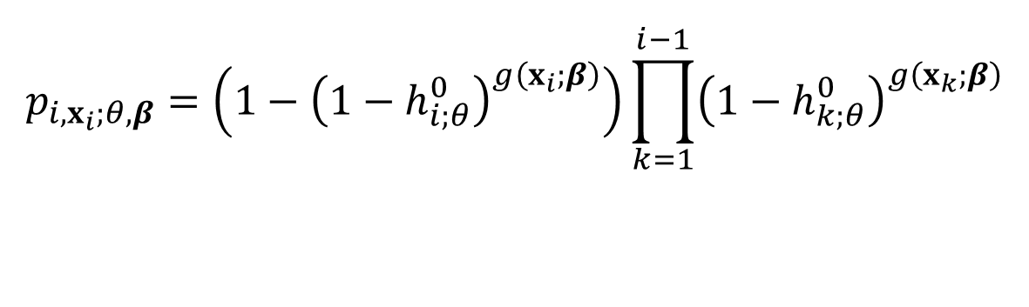
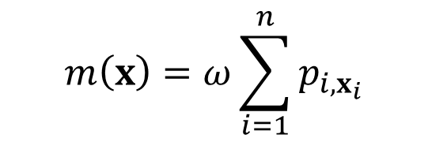

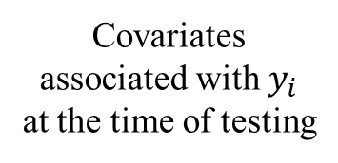
A. Covariate Software Reliability Growth Models (SRGM)
Covariates associated with $y_{i}$ at the time of testing
Discrete Cox Proportional Hazard model
Mean Value Function
Mean Value Function
$$p_{i,x_{i};θ,β}=\left(1−{\left(1−h_{i;θ}^{0}\right)}^{g\left(x_{i};β\right)}\right)\prod_{k=1}^{i−1}{{\left(1−h_{k;θ}^{0}\right)}^{g\left(x_{k};β\right)}}$$
$$m\left(x\right)=ω\sum_{i=1}^{n}{p_{i,x_{i}}}$$
Vector of covariates coefficient parameters
Baseline hazard function
Vector of model parameters
Number of defects discovered with infinite testing
Number of defects discovered with infinite testing
Probability of a defect discovery in the $ⅈ^{th}$ interval

Slide 4
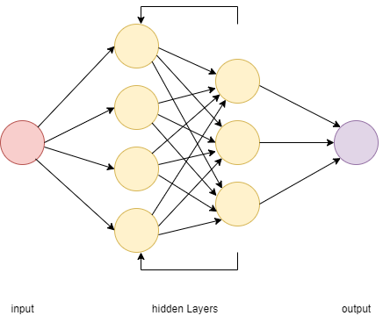
B. Neural Network
Recurrent Neural Network (RNN)
A type of artificial neural network that allows information from prior inputs, known as lookback period, to influence the subsequent input of the same node, and consequently the output of the neural network.

Slide 5
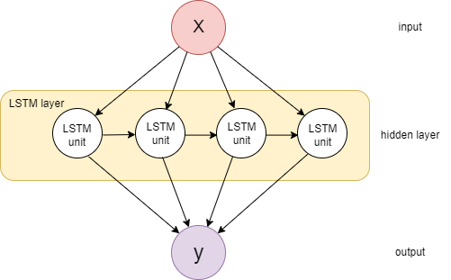
Long-short Term Memory (LSTM)
LSTM (Long Short-Term Memory) is a type of recurrent neural network architecture designed to handle the limitations of simple RNN and capture long-term dependencies in sequential data.

Slide 6
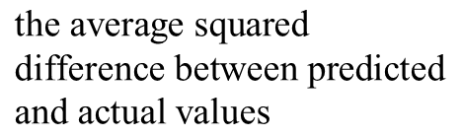
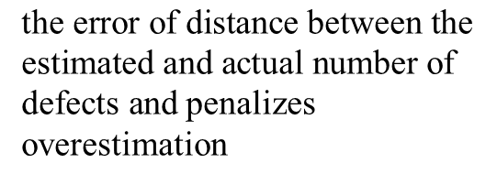
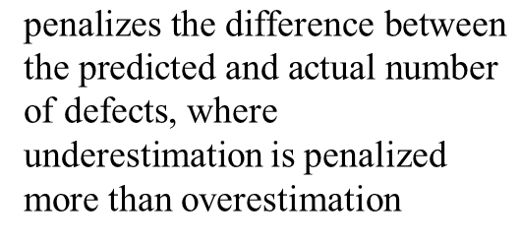
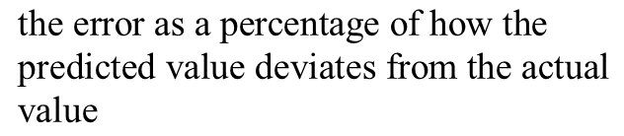
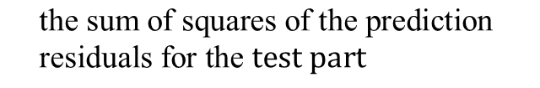
Goodness of Fit Measures
1. Mean Squared Error (MSE)
2. Predictive Mean Squared Error (PMSE)
3. Mean Absolute Percentage Error (MAPE)
$$\text{the} \text{average} \text{squared} \\ \text{difference} \text{between} \text{predicted} \text{and} \text{actual} \text{values}$$
$$\text{the} \text{sum} \text{of} \text{squares} \text{of} \text{the} \text{prediction} \text{residuals} \text{for} \text{the} test part$$
$$\text{the} \text{error} \text{as} \text{a} \text{percentage} \text{of} \text{how} \text{the} \text{predicted} \text{value} \text{deviates} \text{from} \text{the} \text{actual} \text{value}$$
4. Predictive Ratio Risk (PRR)
5. Predictive Power (PP)
$\text{penalizes} \text{the} \text{difference} \text{between} \text{the} \text{predicted} \text{and} \text{actual} \text{number} \text{of} \text{defects}$, where underestimation is penalized more than overestimation
$\text{the} \text{error} \text{of} \text{distance} \text{between} \text{the} \text{estimated} \text{and} \text{actual} \text{number} \text{of} \text{defects} \text{and}$ penalizes overestimation

Slide 7
To illustrate the applicability of neural networks to covariate software defect discovery, a new data set was generated based on the DS1 data set with three covariates. So, this hypothetical data includes three covariates and the correspond number of failures for each interval. The generated data set used as an input for different models.
Illustrations

Slide 8
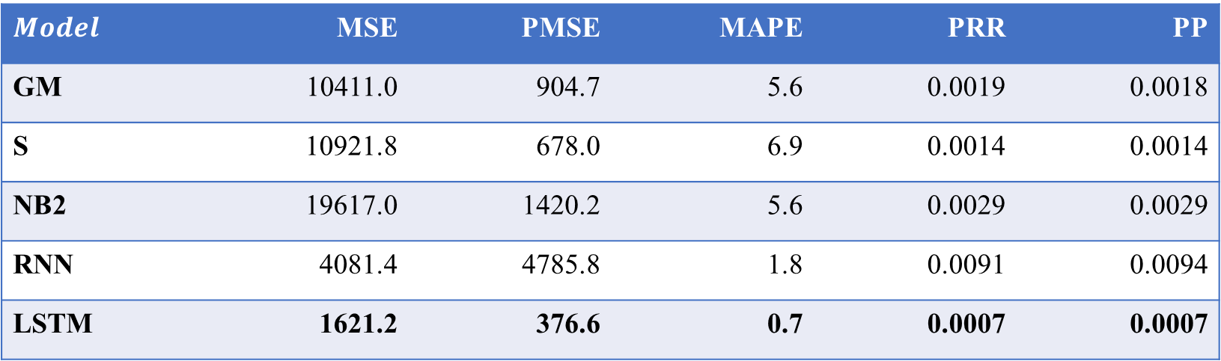
Table 1: Goodness of fit of measures
$$Model$$ | MSE | PMSE | MAPE | PRR | PP
GM | 10411.0 | 904.7 | 5.6 | 0.0019 | 0.0018
S | 10921.8 | 678.0 | 6.9 | 0.0014 | 0.0014
NB2 | 19617.0 | 1420.2 | 5.6 | 0.0029 | 0.0029
RNN | 4081.4 | 4785.8 | 1.8 | 0.0091 | 0.0094
LSTM | 1621.2 | 376.6 | 0.7 | 0.0007 | 0.0007
*Different types of covariate NHPP models were applied, using various hazard functions, including GM, NB2, and S shaped.
*LSTM achieved better overall goodness-of-fit, such as approximately 6 and 9 times smaller MSE and MAPE, respectively, compared to traditional covariate models.

Slide 9
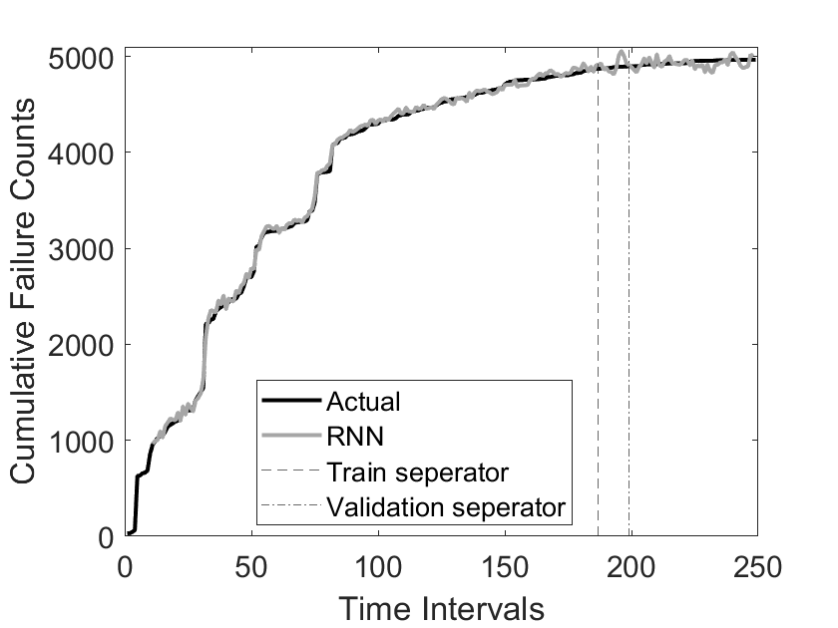
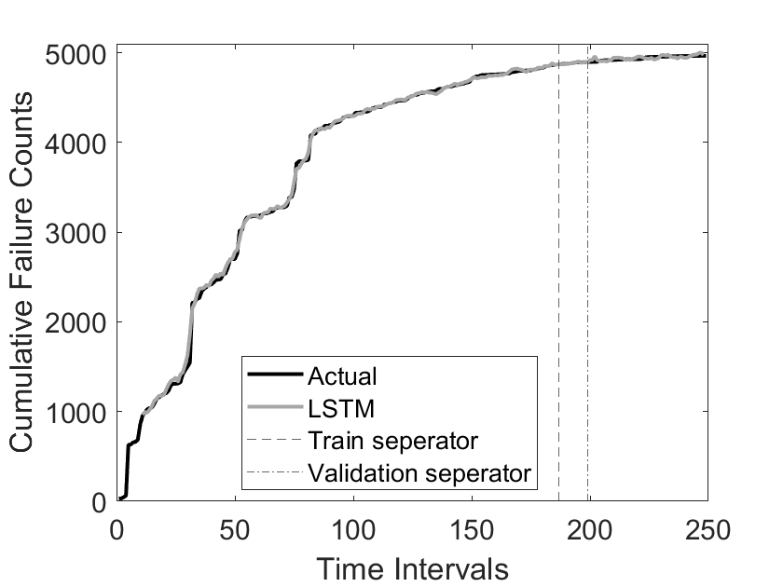
Fig 1. Models fitted by Neural Networks. From left to right: 1) RNN and 2) LSTM

Slide 10
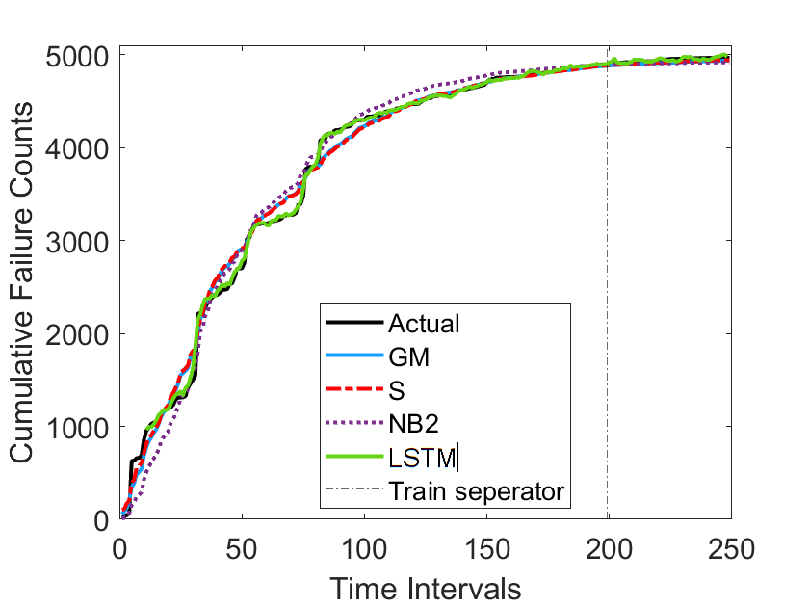
* The Best model fit among traditional covariate models achieved by S function. However, LSTM outperformed.
Fig 2. Model fitted by three traditional models and LSTM.

Slide 11
Conclusion
Summary
This study presented Recurrent Neural Networks and its variation, LSTM to predict the covariate software defects and the results were compared with the traditional models
Results
LSTM outperformed compared with covariate NHPP models
Future Research
Examine effectiveness of feature selection methods to evaluate the stability of RNN and its variations on more complex data sets including more covariates

