Slide 1
Covariate Resilience Modeling
Priscila Silva, MS, University of Massachusetts Dartmouth
Andrew Bajumpaa, University of Massachusetts Dartmouth
Drew Borden, University of Massachusetts Dartmouth
Christian Taylor, University of Massachusetts Dartmouth
Lance Fiondella, PhD, University of Massachusetts Dartmouth

Slide 2
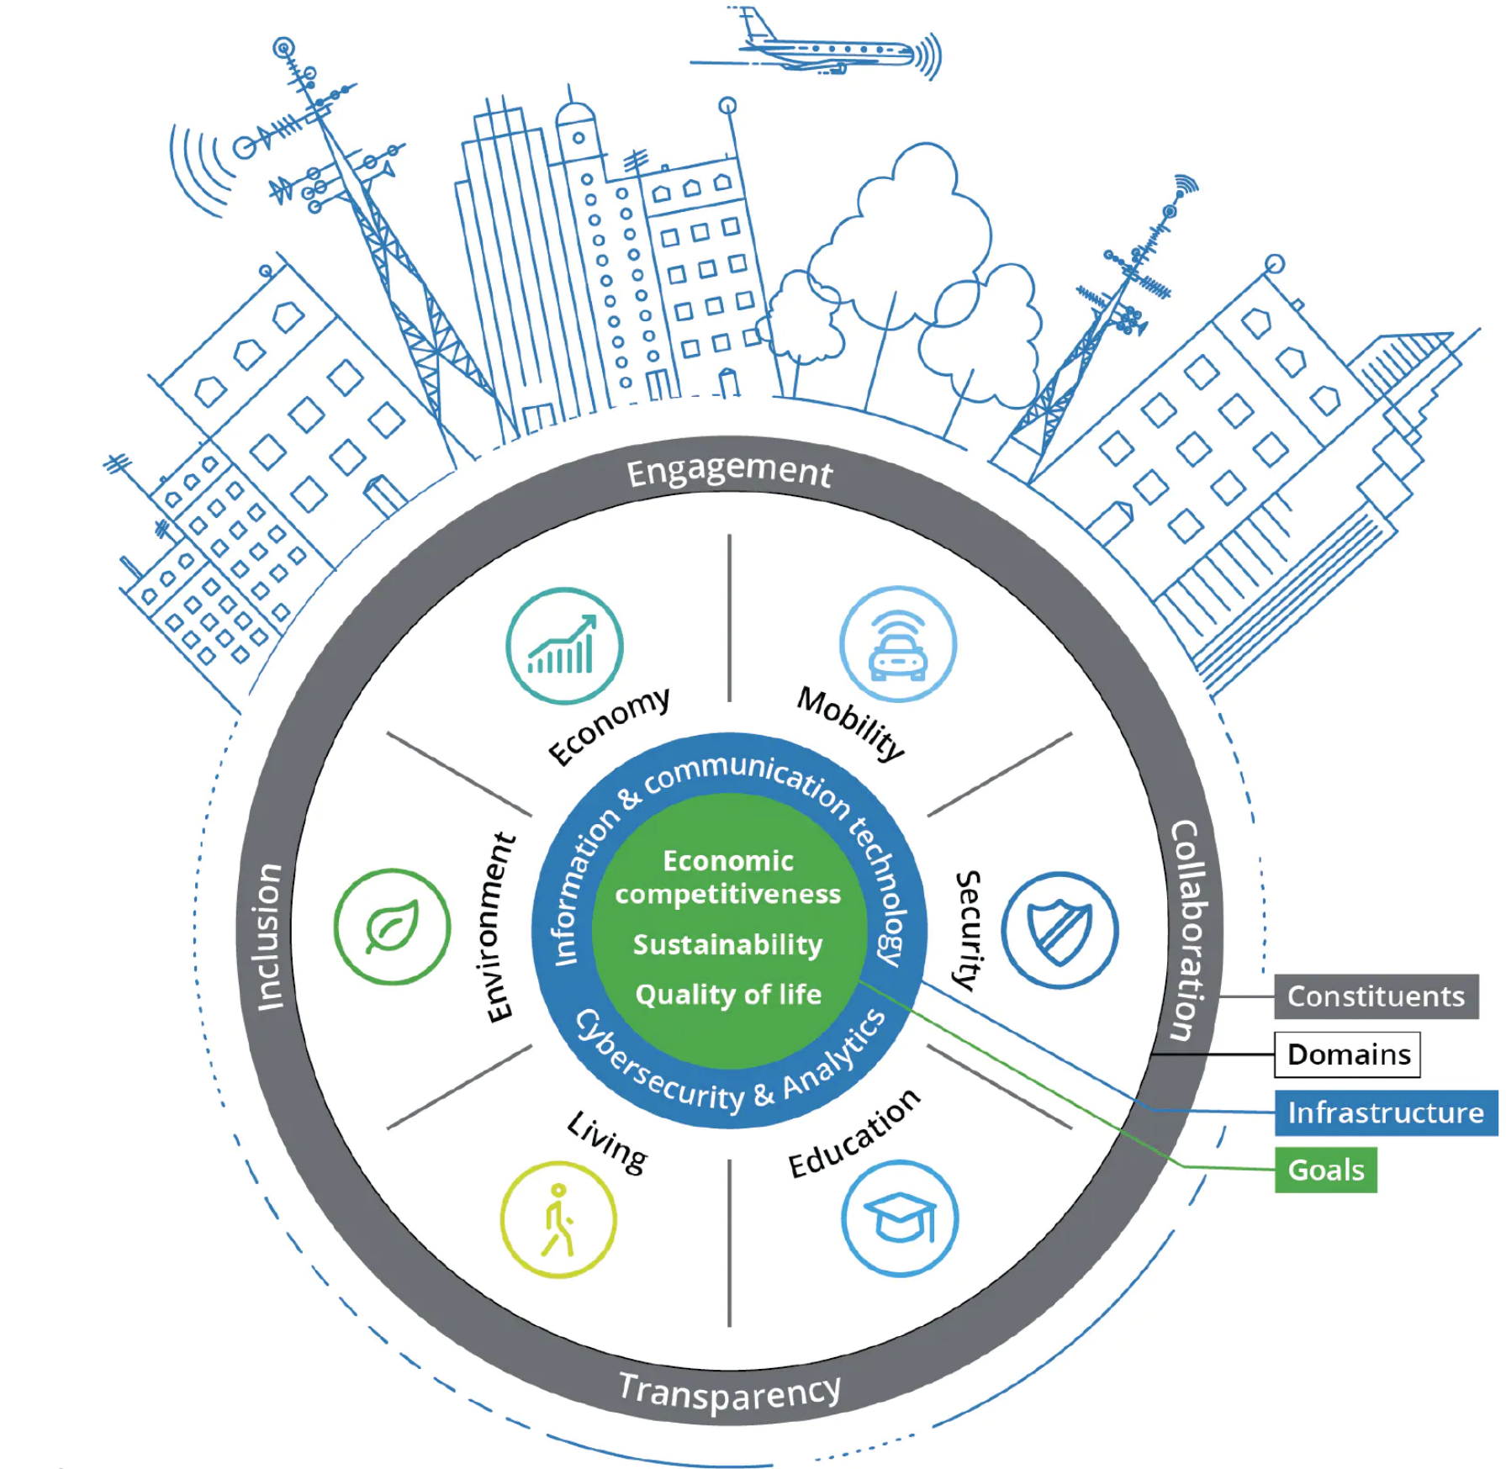
Introduction
System Resilience
Ability to recover from failures
Lack of resilience is dangerous
Northeast blackout of 2003: software errors
Megawatt load reduced 80%
45 million people in the US affected
$4 - $10 billion of implications
Mortality rate increased 28%
Common Practices
Quantitative resilience metrics
Contributions
Mathematical models to track and predict change in performance
RESILIENCE

Slide 3

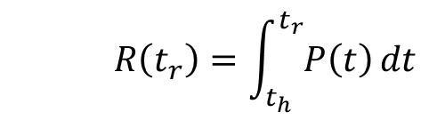
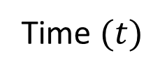



Resilience Concept
Prepare
Absorb
Recover
Adapt
1
Common resilience metric
Performance preserved
$$R\left(t_{r}\right)=\int_{t_{h}}^{t_{r}}{P\left(t\right)}dt$$
Performance $P(t)$
$$t_{h}$$
$$t_{d}$$
$$t_{r}$$
Time $(t)$
Real world disaster management does not look like a textbook curve

Slide 4








Resilience Modeling Approaches
Bathtub-Shaped Functions & Mixture Distributions
Canonical trends: J, L, U, V
Single shock
Covariate Models
Explanatory factors
Variety of trends
Single and multiple shocks
1
1
$$P(t)$$
$$P(t)$$
$$t_{h}$$
$$t_{d}$$
$$t_{r}$$
$$t_{h}$$
$$t_{d}$$
$$t_{r}$$

Slide 5
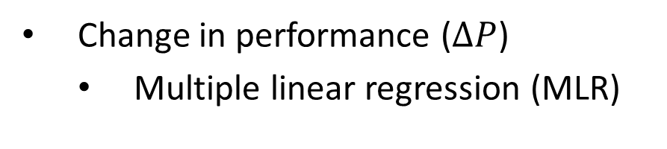

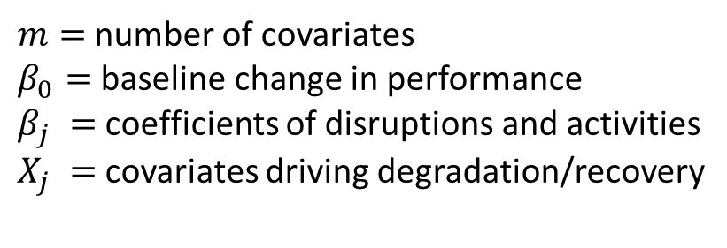
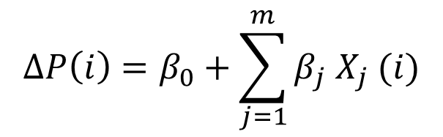
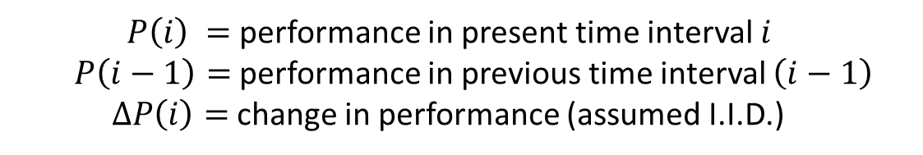
Covariate Resilience Modeling
Performance
Variable performance intensity
Change in performance ($∆P$)
Multiple linear regression (MLR)
$$∆P\left(i\right)=β_{0}+\sum_{j=1}^{m}{β_{j}{ X}_{j} (i)}$$
$$P\left(i\right)=P\left(i−1\right)+∆P(i)$$
$P\left(i\right) =$ performance in present time interval $i$
$P\left(i−1\right)=$ performance in previous time interval $\left(i−1\right)$
$∆P\left(i\right)=$ change in performance (assumed I.I.D.)
$m=$ number of covariates
$β_{0}=$ baseline change in performance
$β_{j} =$ coefficients of disruptions and activities
$X_{j} =$covariates driving degradation/recovery
MLR interaction and polynomials

Slide 6
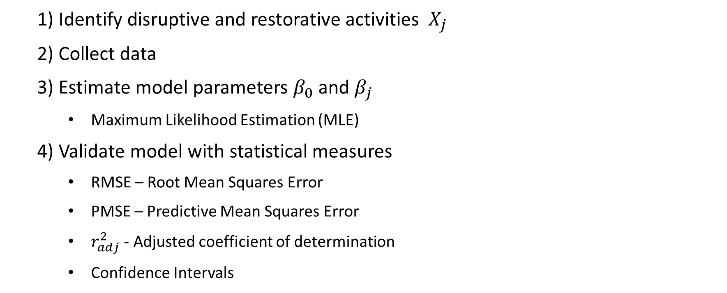
Steps to Apply Resilience Models
1) Identify disruptive and restorative activities ${ X}_{j}$
2) Collect data
3) Estimate model parameters $β_{0}$ and $β_{j}$
Maximum Likelihood Estimation (MLE)
4) Validate model with statistical measures
RMSE – Root Mean Squares Error
PMSE – Predictive Mean Squares Error
$r_{adj}^{2}$ - Adjusted coefficient of determination
Confidence Intervals

Slide 7

Illustration: 1980 US Recession – Energy Crisis
Performance $P\left(i\right)$ is the number of employments in the US
Covariates in bold are selected by forward stepwise procedure
Covariates | Description | Covariates | Description
X1 | Treasury Yield Curve | X5 | Personal Consumption Expenditures
X2 | Industrial Production | X6 | S&P 500 Index Stock Market
X3 | Federal Funds Rate | X7 | Consumer Price Index
X4 | Mortgage Rate | X8 | Crude Oil Prices
Order of inclusion: -X8, --X2, -X1, ++X4, +X3
+/- indicates sign of coefficients ($β$) on change in performance ($ΔP$) (positive/negative)

Slide 8
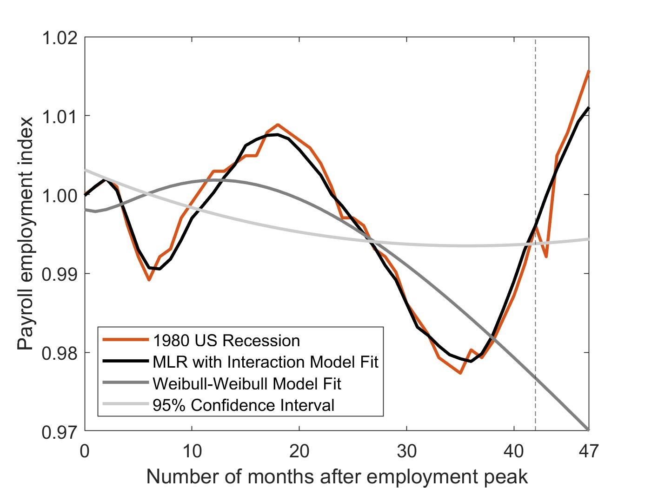
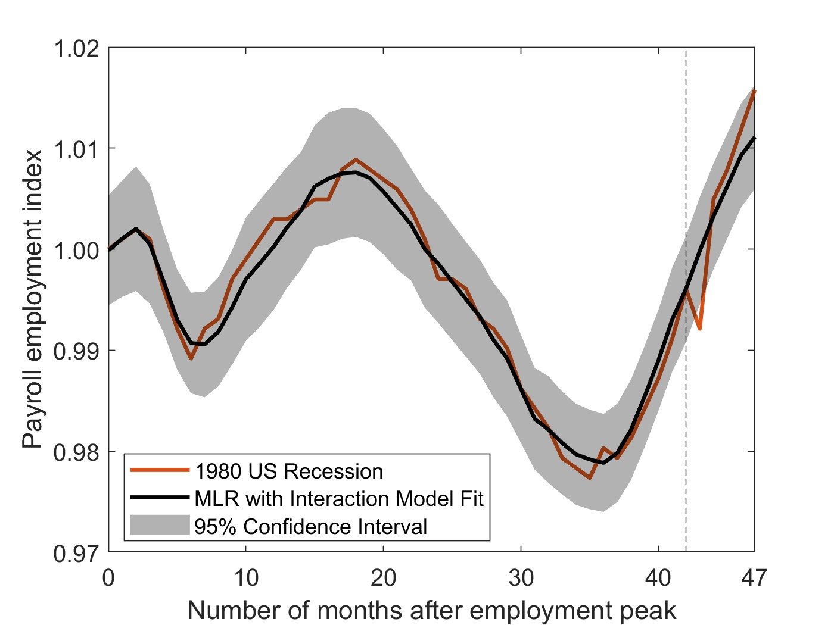
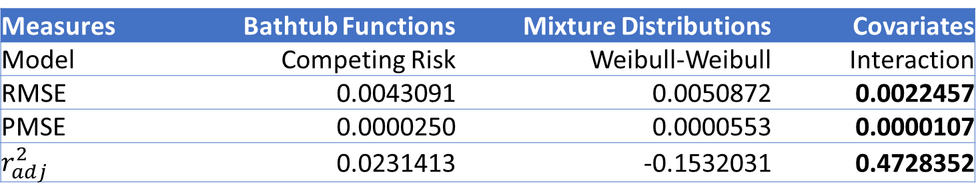
Illustration: 1980 US Recession – Energy Crisis
Measures | Bathtub Functions | Mixture Distributions | Covariates
Model | Competing Risk | Weibull-Weibull | Interaction
RMSE | 0.0043091 | 0.0050872 | 0.0022457
PMSE | 0.0000250 | 0.0000553 | 0.0000107
$$r_{adj}^{2}$$ | 0.0231413 | -0.1532031 | 0.4728352

Slide 9
Illustration: Resilience Metrics
Recession | Metric | Data | Bathtub Functions | Mixture Distributions | Covariates
1980 | Performance Preserved | Actual | 5.0324 | 5.0324 | 5.0324
 |  | Fitted | 4.9704 | 4.8638 | 5.0431
Relative Error | 0.0123 | 0.0335 | 0.0021
Covariate models predict system performance more accurately and
achieve lower relative error on resilience metrics

Slide 10
Conclusion
This talk presented
Mathematical modeling approaches to track and predict system resilience
Results suggest that
Bathtub-shaped functions and mixture distributions fit well canonical curves
Covariate models characterizes well deterioration and recovery processes
Improving tracking and prediction abilities
Lower relative errors for resilience metrics
Future research
Time series analysis
Optimal allocation of activities to achieve performance threshold on timeline
Development of a predictive system resilience tool

Slide 11

Acknowledgement
This material is based upon work supported by the National Science Foundation under Grant Number (#2050972). Any opinions, findings, and conclusions or recommendations expressed in this material are those of the authors and do not necessarily reflect the views of the National Science Foundation

