Slide 1
Empirical Calibration for a Linearly Extrapolated Lower Tolerance Bound
Caleb King Peter Parker Derek Young
Jmp Statistical Discovery NASA University of Kentucky
DATAWorks 2023

Slide 2
Motivation
Tolerance bounds are a common tool for assessing product reliability and constructing product specifications.
i.e. 95% confidence that at least 90% of a material must withstand a breaking force of 2200 Newtons (~500 pounds) of force
The usual approach to constructing tolerance bounds is to first fit an assumed distribution model, then use the estimated parameters to construct the bound
This approach is perfectly reasonable…if you have enough data

Slide 3
Motivation
What if you don’t have enough data? If you continue with the parametric approach…
Your tolerance bound’s coverage could be inaccurate if the assumed model is incorrect
You may not be able to adequately distinguish the correct distribution model
What are some ways we can address this issue??

Slide 4

Available methods

Slide 5

Nonparametric Methods
Distribution-free methods based on order statistics are an enticing alternative!
$\operatorname{Pr}\left(X_{(1)}≤x_{p}\right)={\left(1−F\left(x_{p}\right)\right)}^{n}={\left(1−p\right)}^{n}=γ$, where n is the sample size, p is the percentile, $γ$ is the confidence level/coverage, and F(x) is the cumulative distribution function of the underlying distribution model
The catch? You have no control over the actual coverage, outside of adjusting p or n.

Slide 6
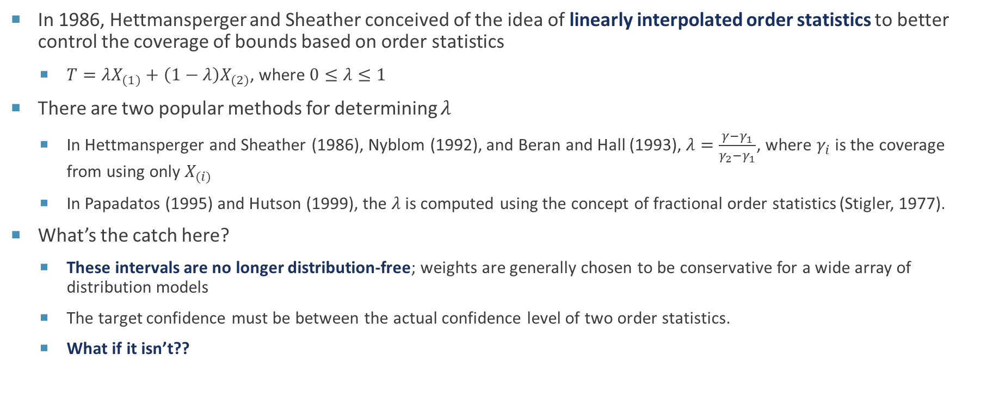
Semiparametric Extensions
In 1986, Hettmansperger and Sheather conceived of the idea of linearly interpolated order statistics to better control the coverage of bounds based on order statistics
$T=λX_{(1)}+\left(1−λ\right)X_{(2)}$, where $0≤λ≤1$
There are two popular methods for determining $λ$
In Hettmansperger and Sheather (1986), Nyblom (1992), and Beran and Hall (1993), $λ=\frac{γ−γ_{1}}{γ_{2}−γ_{1}}$, where $γ_{i}$ is the coverage from using only $X_{(i)}$
In Papadatos (1995) and Hutson (1999), the $λ$is computed using the concept of fractional order statistics (Stigler, 1977).
What’s the catch here?
These intervals are no longer distribution-free; weights are generally chosen to be conservative for a wide array of distribution models
The target confidence must be between the actual confidence level of two order statistics.
What if it isn’t??

Slide 7
Extrapolation
The simplest approach is to perform linear extrapolation on the closest two order statistics
Young and Mathew (2014) showed that this could result in actual coverage much smaller than desired
Scholz (1995) derived a procedure based “linearizing” the relationship between order statistics and their actual coverage
The resulting relationship can then be used to create extrapolated bounds
A tuning parameter is used to determine the linearization
Banfi et. al. (2022) ran a comparison study between Scholz and Hutson in the context of hydrology applications and found the results highly depending on the underlying true distribution model, with no clear recommendation

Slide 8
Calibration
In recent years, attempts have been made to address conservative interpolated intervals by calibrating the target coverage
Ho and Lee (2005) provided calibration techniques for the Beran and Hall class of intervals based on an assumed normal distribution model
Goldman and Kaplan (2017) did the same for Hutson’s class of intervals
To the best of our knowledge, no one has considered calibration procedures for extrapolation

Slide 9
The calibration procedure

Slide 10
What to Calibrate?
Both Ho and Lee (2005) and Goldman and Kaplan (2017) sought to calibrate the target confidence level to achieve accuracy
An initial investigation determined that, for extrapolated intervals, this approach may not work as the required confidence level may fall outside 0 or 1.
Rather than calibrate the confidence level, we instead focus on calibrating the extrapolation weight
Specifically, we will determine the appropriate weight needed to achieve an actual confidence level at or above the target confidence level
As there is no limit on the weight and our focus is on positive data, we will use the weight on log-transformed data but assess coverage on the original data scale

Slide 11
Pilot Study
We expected that the calibrated weight would be a function of several inputs:
Distribution Model (including shape and scale parameters); Target Confidence Level; Quantile; Sample Size
We conducted an initial pilot simulation study to assess the impact of these factors
Distribution Models: Weibull, Lognormal, Gamma, Log-logistic
Target Confidence Levels: 90%, 95%
Quantiles: 1e-6, 0.1
Sample Sizes: 5, 10
Scale Parameters: 1, 2
Shape Parameters: 2, 3

Slide 12
Pilot Study
We ran a full factorial design in the factors with the “correct” weight as the response
For each run, we simulated 10 000 simulated experiments at the given factor inputs and computed a log-linear extrapolated bound with an initial guess for the weight
The weight is then adjusted, and the simulations repeated, until the actual coverage is within 0.001 of the target coverage
We record the final weight as the “correct” weight
There were two key findings from the study
Of the four distribution models considered, the most extreme weights were found under the Gamma and Weibull models
Of the distribution parameters, only the shape parameter seemed to have a meaningful impact

Slide 13
Simulation Experiment
For the official experiment, we ran a full-factorial design under the following factor settings
Distribution Models: Weibull, Gamma
Target Confidence Levels: 90%, 95%
Quantiles: 1e-6, 1e-4, 0.1
Sample Sizes: 5, 15, 20
Shape Parameters: 2, 3, 4
Each run was conducted in a similar manner to the pilot study
The experiment was run in R and the data analyzed in JMP.

Slide 14
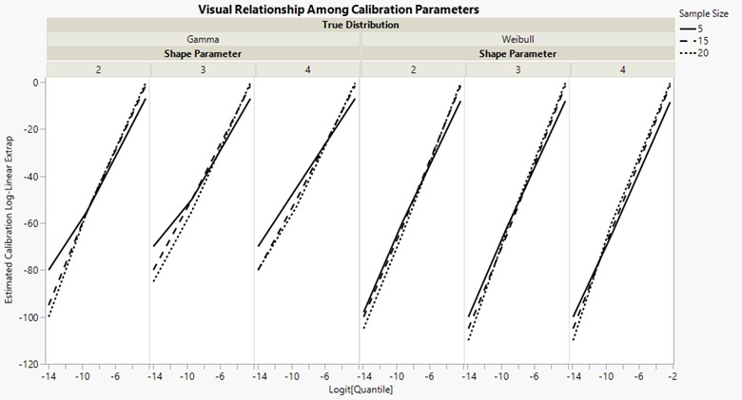
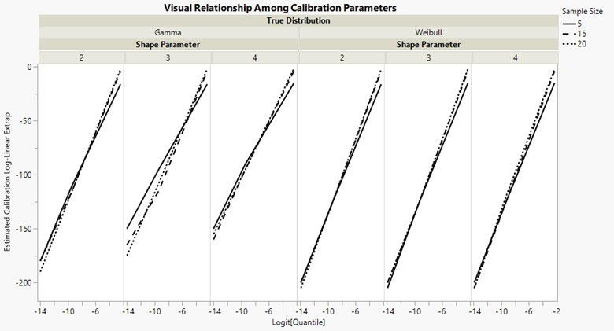
Results
Decreasing change in slope with increasing sample size
90% Target Confidence
95% Target Confidence
Different scales based on confidence

Slide 15
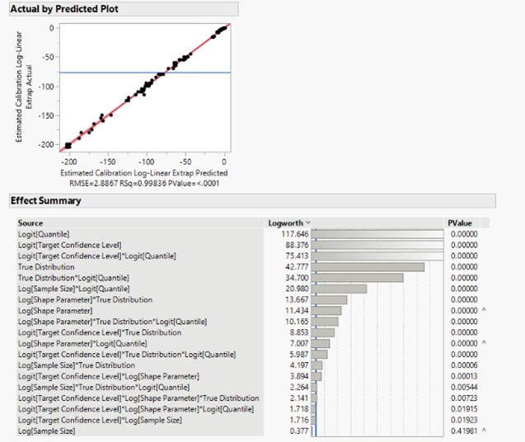
Analysis
The quantile and target confidence are overwhelmingly the top factors here.

Slide 16
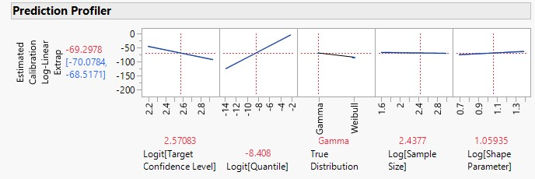
Analysis
We want a model that is robust across distribution models
Choosing the parameter estimates associated with the Weibull distribution should lead to conservative estimates (more negative weights = more conservative coverage)
Choosing a shape parameter of 1 is an easy way to “remove” it as an effect
In essence, we are implicitly assuming an Exponential distribution model for our calibration procedure

Slide 17
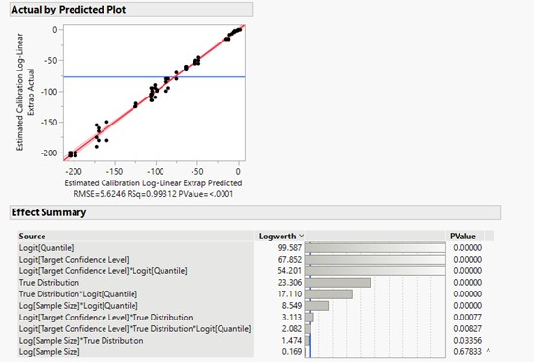
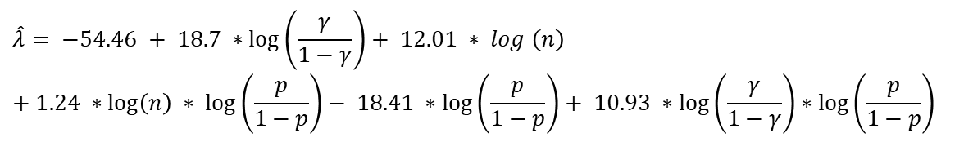
Analysis
Removing the shape causes more discrepancy at extreme quantiles.
Similar coefficients; opposite sign
$$\hat{λ}= −54.46 + 18.7 ∗\log\left(\frac{γ}{1−γ}\right)+ 12.01 ∗ log \left(n\right) \\ + 1.24 ∗\log\left(n\right) ∗ log⁡\left(\frac{p}{1−p}\right)− 18.41 ∗log⁡\left(\frac{p}{1−p}\right)+ 10.93 ∗log⁡\left(\frac{γ}{1−γ}\right)∗log⁡\left(\frac{p}{1−p}\right)$$

Slide 18
Performance assessment

Slide 19
Confirmation Experiment
To assess the performance of the calibration model, we ran another full-factorial design under the following extended factor settings
Distribution Models: Weibull, Gamma, Lognormal, Log-logistic
Target Confidence Levels: 90%, 95%
Quantiles: 1e-6, 1e-5, 1e-4, 1e-3, 0.01, 0.1
Sample Sizes: 5, 10, 15, 20
Shape Parameters: 1, 2, 3, 4
Scale Parameters: 1, 2
In addition to our calibrated bound, we also included a log-linear extrapolation version of the Beran and Hall method and parametric methods assuming lognormal and Weibull distribution models (courtesy of the tolerance package in R)

Slide 20
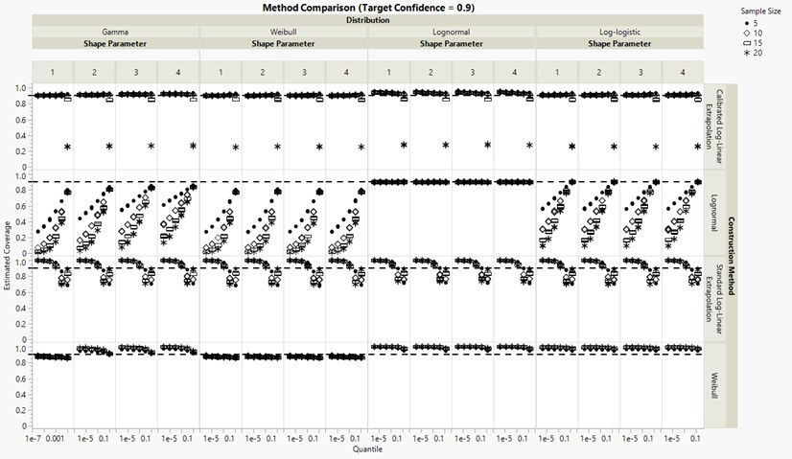
Confirmation/Comparison Results
Similar results for target confidence = 0.95

Slide 21
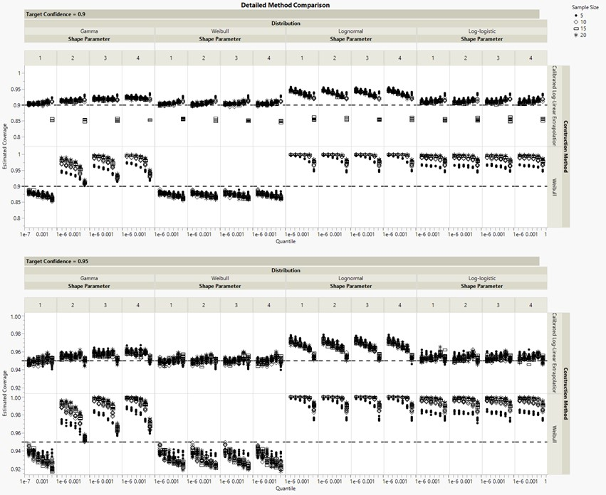
Confirmation/Comparison Results
We beat the Weibull method at its own game?!

Slide 22
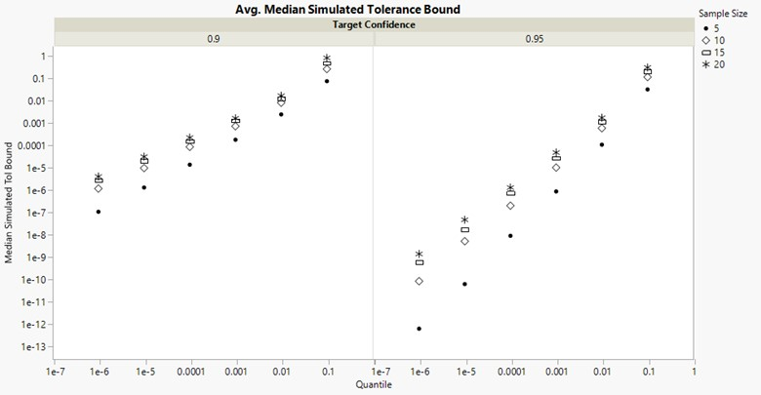
Confirmation/Comparison Results

Slide 23
Summary
Our calibration procedure succeeds at creating tolerance bounds with accurate or conservative coverage levels.
Outperforms standard log-linear extrapolation and is more robust to model misspecification than parametric methods
This empirical approach is not meant to be the final answer
We hope this lays the groundwork for future improvements with stronger theoretical underpinnings
The model itself hints at possible avenues for better calibration models

Slide 24
Questions

