Slide 1
DATAWorks 2024 Development, Test, and Evaluation of Small-Scale Artificial Intelligence (AI)
Dr. David Bauer
MAJ David Niblick
Dr. Daniel Owens
Notes:
5 min intro, context, goals – David N
Mission of AI team at ATEC
Real world purpose for model; also great “test case” for methodologies
What is AI, really? For TE, consider black box, data centric, “new”, user trust
5 min data explanation – David B
5 min model explanation – David B
5 min TE approach explanation – David N
Identify needs/conditions of user and system, limitations of test data amount, external affect -> sensitivity analysis w/ aug data (wind, event clustering, height, type of event); must explain risk associated with each
5 min results – David N
5 min themes, lessons learned – David N
AI includes much more not covered here (ethics, traceability, dynamic learning, etc)
When limited in TE capabilities (unavoidable in AI/ML), must focus on managing risk
“Test loop” must be as “easy” as possible while being thorough -> starts in system requirements (be in DevSecOps loop)
Deep understanding of data (and flaws) is critical for both sides

Slide 2
Agenda
Purpose
Dataset
Solution
Test and Evaluation Approach
Results
Observations and Lessons Learned

Slide 3
Purpose
Mission of ATEC, AI Team
Small scale model could solve real-world problems at ATEC while serving as “test case”
What is AI in the context of Test and Evaluation?
Notes:
AI considerations:
Novel Techniques
Understandability and Predictability
Data centric
Safety / Operational / Ethical Risk – low risk, so good test case
User Interaction with AI component

Slide 4
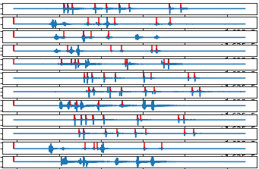
Dataset
Example Triangulation Data
Acoustic trilateration using real data from 12 sensor array
Each sensor identifies events; time differences between sensors used to calculate location
Event detection nontrivial – lends itself to AI solution
Acoustic Magnitude
Time
Note: Blue lines depict acoustic signals across 12 sensors. Red dashes depict manually-determined event labels.

Slide 5
Problem Complexity
Imperfect, inconsistent “labels” for training and testing
Lack location “ground truth”; only hand-labeled impact times
Matching order of events across sensors significantly affects location calculation
Limited amount of data
Different types of events and sensors complicate process
Sample of labeled data from single test containing multiple sensors (rows) and events (columns). Labels are depicted with red lines. Discrepancies in the labeled data are highlighted with red boxes.
Notes:
Imperfect “labels” – YPG engineers selected labels that were good enough for their tests, but suffered inconsistencies; very few “ground truths” based on location
Lacked location “ground truth” – only hand-labeled impact times
Matching order of impacts across sensors – due to temporal proximity of some impacts, the order at which their sound “hits” the sensors might be mixed; this creates significant error in triangulation calculations
Limited amount of data
Different types of sensors shape different “signatures” in acoustic measurements

Slide 6
Evolution of Detection Algorithm
DNN
64-sample blocks
Looks for event in middle of block only
DNN
512-sample blocks
Returns a set of probabilities and positions of potential events
Hybrid
Uses a spectrogram to find rough area of potential events
Uses medium block DNN to scan areas found by spectrogram
Peaks
Filtering + Peaks
Uses a purely time-domain peak-finder library
Uses a series of filters and peak-finding steps
Combines results from two parallel algorithms
Genetic ML
Used (evolutionary) genetic algorithm to find optimal parameters for the filtering + peak detection algorithm.
Very slow!
Slow!
Accuracy issues with close and complex events
Fast
Fast
Fast
Fast
Improving accuracy
Notes:
** Why? What drove changes?
Notes:
Didn’t continue short-block DNN development long enough to compare with later methods.
Medium block DNN accuracy improved over time, especially when labeling

Slide 7
Evolution of Event Location Estimation Algorithm
Simulated Annealing
Masking
Heuristics
Matching Detections
Position Estimation
Direct Generation
Integer programming problem (hard). Does not handle detection misses and false positives well.
Single Path
Many Candidates
Expanded Searches
Continuous optimization problem (easier). Natural handling of detection misses.
Recursive Grid Search
Direct Position Generation
Weather Compensation
Faster methods for generating event location candidates.

Slide 8
Test and Evaluation Approach
Data
Plan
Execute
Evaluate
Refine
Requirements
Environment
Conditions
Capabilities
Limitations
Risks
Notes:
Opportunity for us to practice our T&E method in “sandbox” fashion
Identify
needs/conditions of user and system,
limitations of test data amount,
external affects on system
Does plan change if model is “AI”?
sensitivity analysis w/ augment data (wind, event clustering, height, type of event);
Must explain risk associated with conditions – test can’t cover it all
For example, if system needs to triangulate new type of “event’, needs portable T&E to validate
Must be as rapid/automated as possible – users ideally

Slide 9
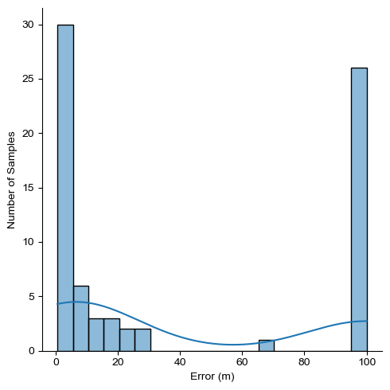
Results
Location Error Histogram
Location Error
Average: 121 m
Median: 10.5 m
Model produces mix of acceptable results and extreme outliers
+

Slide 10
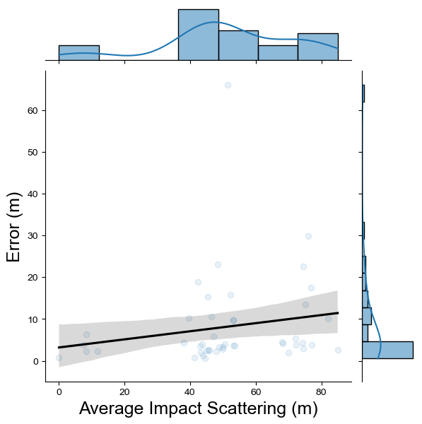
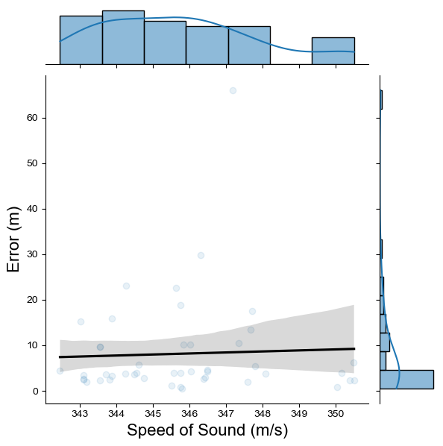
Results
Location Error vs Event Spread
Atmospheric Effect on Error
Pearson P-Value: 0.23
Pearson P-Value: 0.78
Event Spread and Atmospheric Conditions have little impact on accuracy

Slide 11
Results
Box Plot Comparing Air to Ground Events
Error By Elevation Type
Metric | Air | Ground
Location Error (Mean, m) | 314 | 8.15
Location Error (Median, m) | 285 | 3.91
T-Test P-Value: 1.15e-16
Model fails at air events!

Slide 12
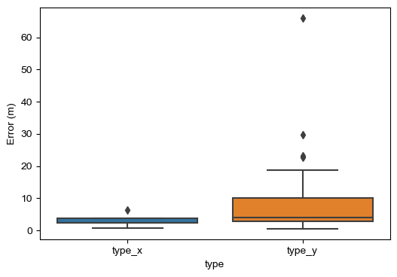
Results
Box Plot Comparing Type X and Type Y Events (Ground Only)
Error (Ground) By Event Type
Metric | Type X | Type Y
Location Error (Mean, m) | 3.11 | 8.87
Location Error (Median, m) | 2.29 | 4.01
T-Test P-Value: 0.28
Possible increased risk with Type Y,
but both meet standard.

Slide 13
Evaluation
System meets requirements (under certain conditions)
Event clustering and atmospheric conditions have little effect on error
Current model not usable with air events
Possible increased risk for Event Type Y; Need to validate with every new event type

Slide 14
Observations
Data understanding central to both development and T&E
Manage risk through lens of environment and conditions – communicate through capabilities and limitations
“Test loop” must be as automated as possible
Starts in system requirements
Ideally user can validate on location after deployment
Notes:
T&E of AI includes much more not covered here (ethics, traceability, dynamic learning, etc)… each one of those could be an entire symposium

