Slide 1
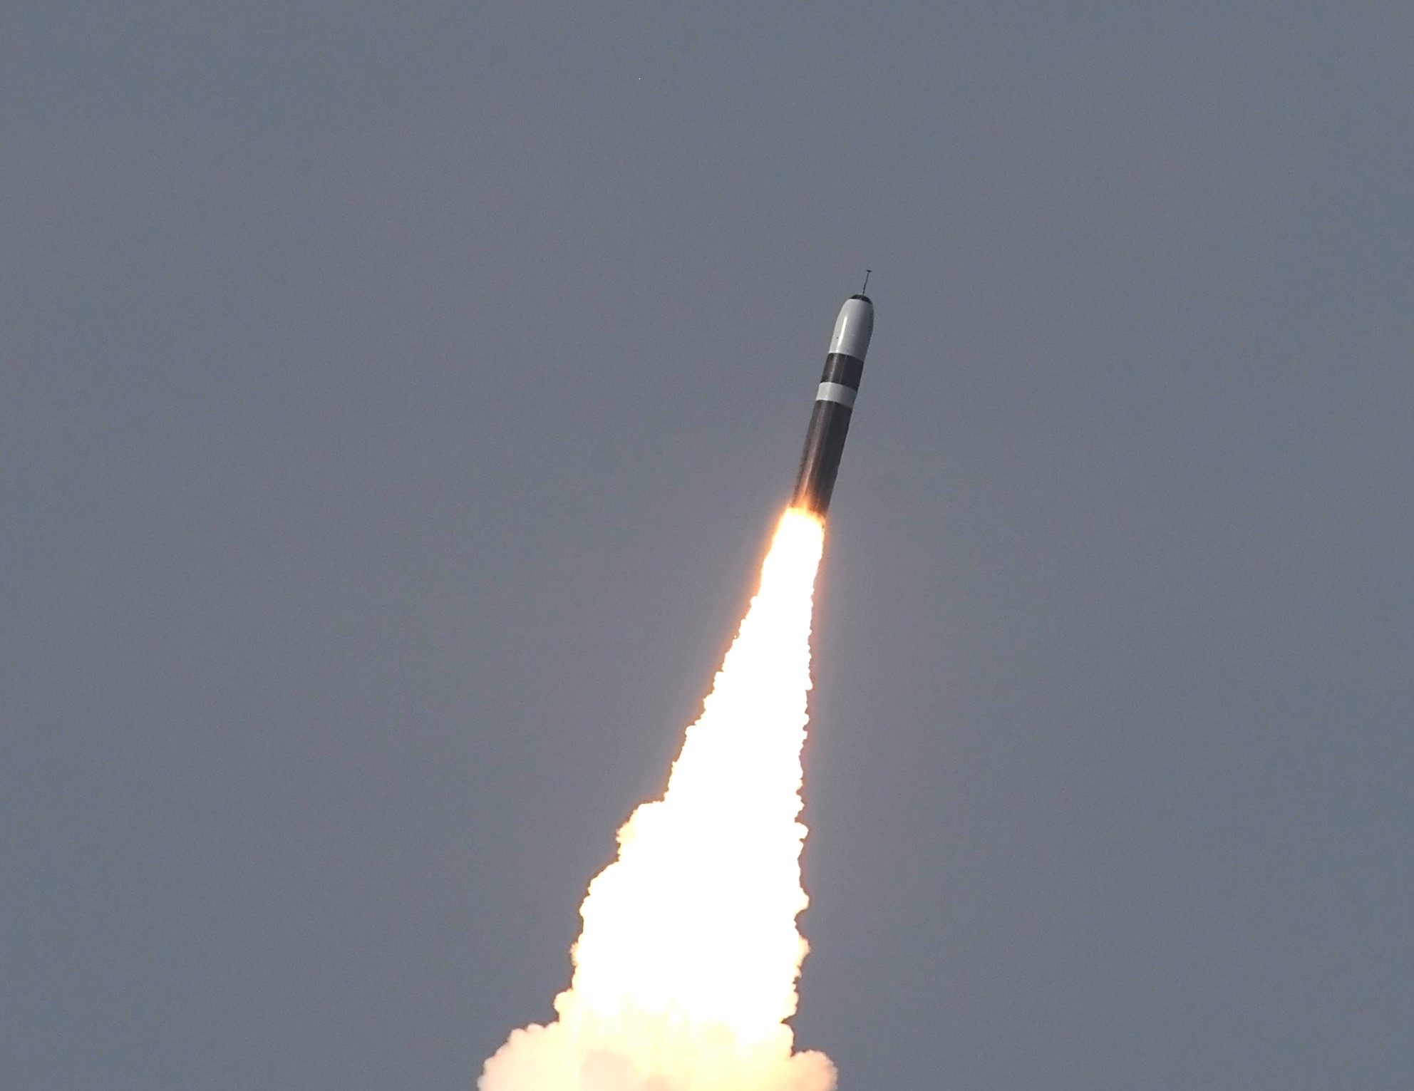
Rocket Motor Design Qualification Through Enhanced Reliability Assurance Testing
Improving Test Efficiency
Todd Remund
Northrop Grumman
Dr. Richard Warr
BYU Stats Dept
April 18, 2024
Approved for Public Release: NG24-0585 © 2024 Northrop Grumman Systems Corporation

Slide 2

Thought Exercise – Balloon Burst Strength
Date
Inflate 20 balloons of the same type with five breaths
None of them pop
Informal Inference
Are we confident that future balloons will not pop with four breaths? Yes
Why? Because the typical number of breaths that will overinflate the balloons must be greater than five breaths, hence four should be just fine
Approved for Public Release: NG24-0585 © 2024 Northrop Grumman Systems Corporation

Slide 3
Motivating Example – Pressure Vessel Burst Strength (Composite Fiber)
Data
Inflate 20 pressure vessels of the same type to 500 psi
None of them pop
Informal Inference
Are we confident that future pressure vessels will not pop with 400 psi pressure? Yes
Why? Because the typical psi pressure that will overinflate the vessels must be greater than 500 psi, hence 400 psi should be just fine
Design Qualification — Formal Inference
Demonstration testing
Reliability assurance testing
Possible Obstacle
Competing material (metal) fails when required to qualify in composite fiber
Fiber Burst
Metal Burst
Approved for Public Release: NG24-0585 © 2024 Northrop Grumman Systems Corporation

Slide 4

Demonstration Testing (Weibull NDT Testing)
Demonstration testing investigates behavior to help understand if—
WC Strength > Requirement
Quantifies confidence with trade-off between:
  Number of test articles
  Test load
Demonstration tests are typically too demanding
  Budget limits number of test articles
  Strength limits load we can induce
    Competitive edge
    Lighter = Cheaper & Better Performance
$$Test Level={Requirement×\left[\frac{\ln\left(1−Confidence\right)}{n×\ln\left(Reliability\right)}\right]}^{1/Shape}$$
Burst Hides Good Designs – Fails to Qualify Using Demonstration
Approved for Public Release: NG24-0585 © 2024 Northrop Grumman Systems Corporation
Notes:
A lot of info that I need to be ready to discuss. The pr(burst) is for a single test article. All we need is one out of n to burst to ruin the purpose of the demonstration test. The actual probability we would need to worry about is Pr(at least 1 of n bursts), this creates a no-win scenario because all of them will be high with respect to this.

Slide 5
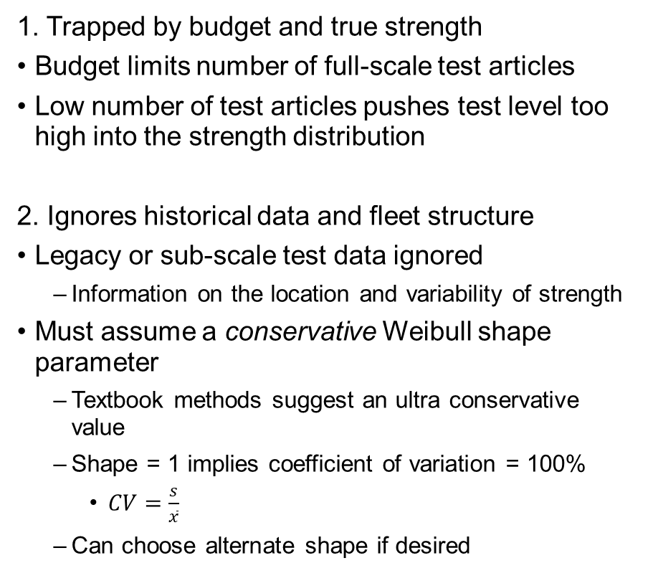
Two Problems with Demonstration Testing
1. Trapped by budget and true strength
Budget limits number of full-scale test articles
Low number of test articles pushes test level too high into the strength distribution
2. Ignores historical data and fleet structure
Legacy or sub-scale test data ignored
  Information on the location and variability of strength
Must assume a conservative Weibull shape parameter
  Textbook methods suggest an ultra conservative value
  Shape = 1 implies coefficient of variation = 100%
    $CV=\frac{s}{\overline{x}}$
  Can choose alternate shape if desired
Fleet Structure
Fleets are made up of random group-to-group behavior—graph is subscale ring burst tests
NOTIONAL DATA
Approved for Public Release: NG24-0585 © 2024 Northrop Grumman Systems Corporation
Notes:
Shape = 1 simplifies the Weibull to an exponential failure model. The hazard function for shape = 1 is for a constant failure rate which we would expect it to be increasing with more load applied not the same failure rate for just above zero load compared to 1 million load units. Also, a shape < 1 corresponds to a hazard rate that is higher for loads closer to zero rather than loads that are much higher. The hazard for failure should always increase for load. This is where time to failure differs quite a bit from load to failure data. This offers some good conventional wisdom in choosing less informative priors.

Slide 6


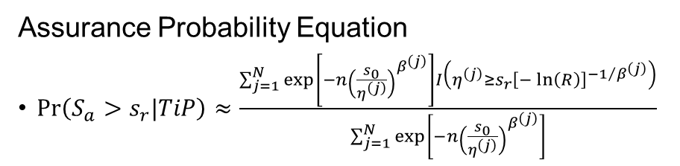
Reliability Assurance Testing (Weibull Model)
Textbook Approach – Simple NDT
Model (Information Delivery from Data to Method)
Bayesian Hierarchical Weibull Model: sub-scale data, fleet structure, w/ conservative scaling factor
N posterior distribution draws$\left[η^{\left(j\right)},β^{\left(j\right)}\right]$
Assurance Probability Equation
$\operatorname{Pr}\left(S_{a}>s_{r}|TiP\right)≈\frac{\sum_{j=1}^{N}{\exp\left[−n{\left(\frac{s_{0}}{η^{\left(j\right)}}\right)}^{β^{\left(j\right)}}\right]I\left(η^{\left(j\right)}≥s_{r}{\left[−\ln\left(R\right)\right]}^{{−1}/{β^{\left(j\right)}}}\right)}}{\sum_{j=1}^{N}{\exp\left[−n{\left(\frac{s_{0}}{η^{\left(j\right)}}\right)}^{β^{\left(j\right)}}\right]}}$
$s_{0}$: Test Level
$s_{r}$: Requirement
$S_{a}$: Actual Strength
$R$: Reliability (0.99)
$n$: # Test Articles (n = 2)
$N$: # Posterior Draws
$TiP$: Test is Passed
Need n = 2 test articles to test above min test level.
What if it bursts in competing material?
NOTIONAL DATA
Approved for Public Release: NG24-0585 © 2024 Northrop Grumman Systems Corporation

Slide 7
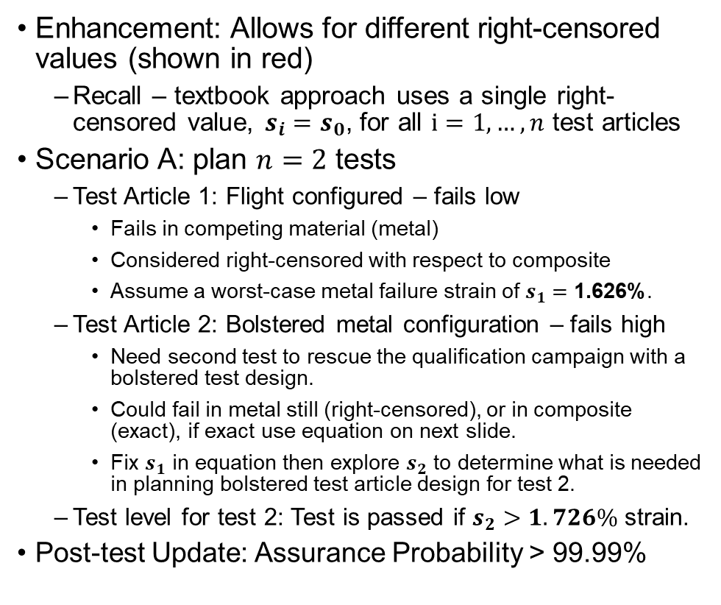


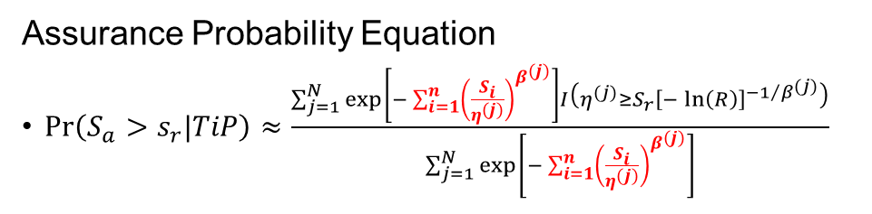
Reliability Assurance Testing (Weibull Model)
Enhancement 1 – Modified NDT
Enhancement: Allows for different right-censored values (shown in red)
  Recall – textbook approach uses a single right-censored value, $s_{i}=s_{0}$, for all $i=1,…,n$ test articles
Scenario A: plan $n=2$ tests
  Test Article 1: Flight configured – fails low
    Fails in competing material (metal)
    Considered right-censored with respect to composite
    Assume a worst-case metal failure strain of $s_{1}=\text{1.626\%}$.
  Test Article 2: Bolstered metal configuration – fails high
    Need second test to rescue the qualification campaign with a bolstered test design.
    Could fail in metal still (right-censored), or in composite (exact), if exact use equation on next slide.
    Fix $s_{1}$ in equation then explore $s_{2}$ to determine what is needed in planning bolstered test article design for test 2.
  Test level for test 2: Test is passed if $s_{2}>1.726\%$ strain.
Post-test Update: Assurance Probability > 99.99%
Assurance Probability Equation
$\operatorname{Pr}\left(S_{a}>s_{r}|TiP\right)≈\frac{\sum_{j=1}^{N}{\exp\left[−\sum_{i=1}^{n}{{\left(\frac{S_{i}}{η^{(j)}}\right)}^{β^{(j)}}}\right]I\left(η^{(j)}≥S_{r}{\left[−\ln\left(R\right)\right]}^{{−1}/{β^{(j)}}}\right)}}{\sum_{j=1}^{N}{\exp\left[−\sum_{i=1}^{n}{{\left(\frac{S_{i}}{η^{(j)}}\right)}^{β^{(j)}}}\right]}}$
$$S_{1}$$
$$S_{2}$$
Burst in Competing Material Doesn’t Kill the Qualification
Approved for Public Release: NG24-0585 © 2024 Northrop Grumman Systems Corporation

Slide 8
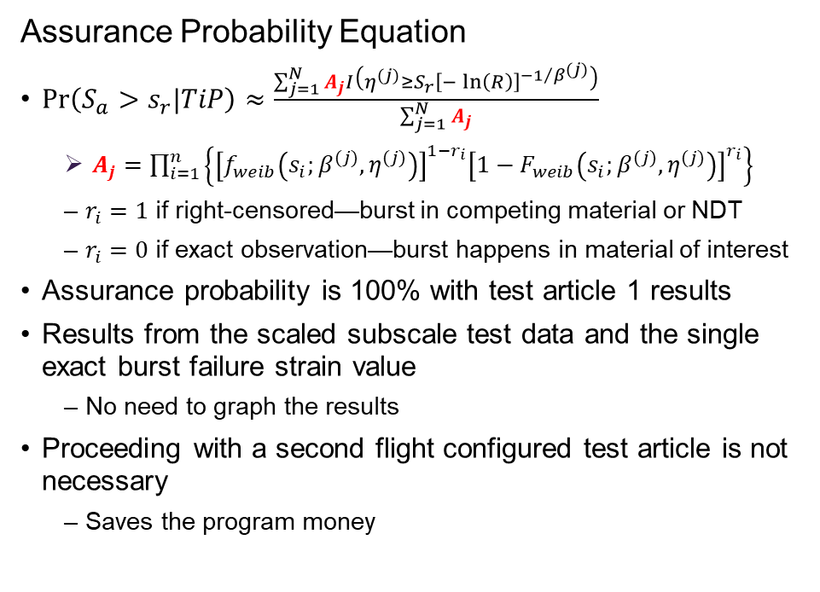
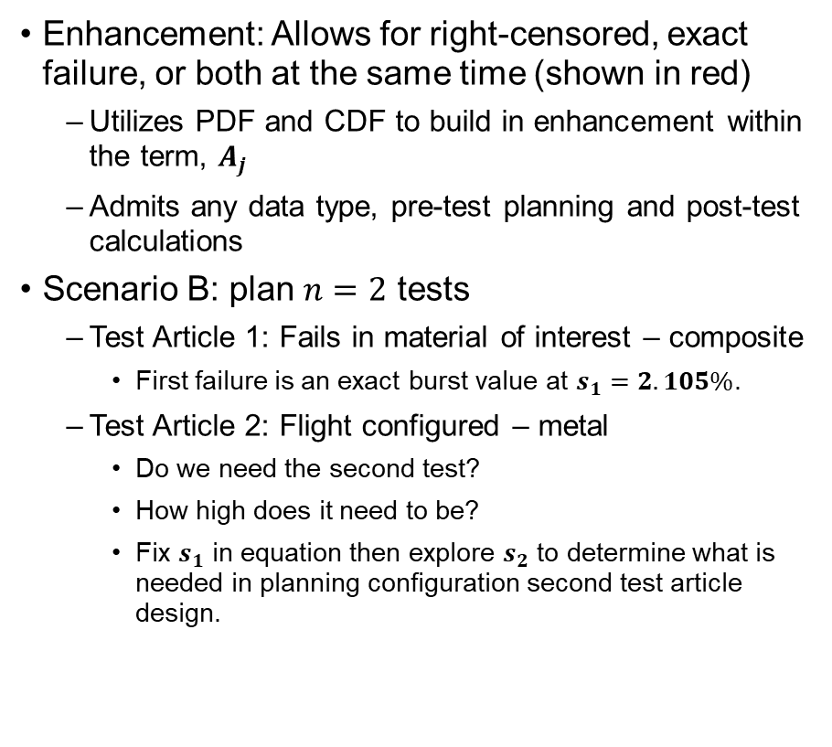



Reliability Assurance Testing (Weibull Model)
Enhancement 2 – Versatile NDT/DT
Enhancement: Allows for right-censored, exact failure, or both at the same time (shown in red)
  Utilizes PDF and CDF to build in enhancement within the term, $A_{j}$
  Admits any data type, pre-test planning and post-test calculations
Scenario B: plan $n=2$ tests
  Test Article 1: Fails in material of interest – composite
    First failure is an exact burst value at $s_{1}=2.105\%$.
  Test Article 2: Flight configured – metal
    Do we need the second test?
    How high does it need to be?
    Fix $s_{1}$ in equation then explore $s_{2}$ to determine what is needed in planning configuration second test article design.
Assurance Probability Equation
$\operatorname{Pr}\left(S_{a}>s_{r}|TiP\right)≈\frac{\sum_{j=1}^{N}{A_{j}I\left(η^{(j)}≥S_{r}{\left[−\ln\left(R\right)\right]}^{{−1}/{β^{(j)}}}\right)}}{\sum_{j=1}^{N}{A_{j}}}$
  $A_{j}=\prod_{i=1}^{n}{\left\{{\left[f_{weib}\left(s_{i};β^{(j)},η^{(j)}\right)\right]}^{1−r_{i}}{\left[{1−F}_{weib}\left(s_{i};β^{(j)},η^{(j)}\right)\right]}^{r_{i}}\right\}}$
  $r_{i}=1$ if right-censored—burst in competing material or NDT
  $r_{i}=0$ if exact observation—burst happens in material of interest
Assurance probability is 100% with test article 1 results
Results from the scaled subscale test data and the single exact burst failure strain value
  No need to graph the results
Proceeding with a second flight configured test article is not necessary
  Saves the program money
$$r_{i}=1$$
NDT—Pressurize to test level, right-censored
Exact in composite
right-censored in metal
$$r_{i}=0$$
$$r_{i}=1$$
Approved for Public Release: NG24-0585 © 2024 Northrop Grumman Systems Corporation

Slide 9
Summary
Tests are costly in many industries — especially the rocket motor industry
Reduce program risk and make the most of the data obtained
  Reduced chance of “no-test” – failure to qualify good design
  Assurance testing accounts for better representation of fleet structure using hierarchical modeling of data
  Good, informed planning, that guides test levels and even can aid in choosing successful test configurations
Further benefits come from being able to revise our assurance probability
  Revision comes from post-test results
  Further revision can come from production proof tests with say a 1.1 safety factor testing that occur routinely in a program
Practical implementation
  Distribution parametrization changed from textbook application to suit implementation in R and Rstudio
  Rstan, brms as workhorse functions (Could use JAGS as well)
Approved for Public Release: NG24-0585 © 2024 Northrop Grumman Systems Corporation

Slide 10
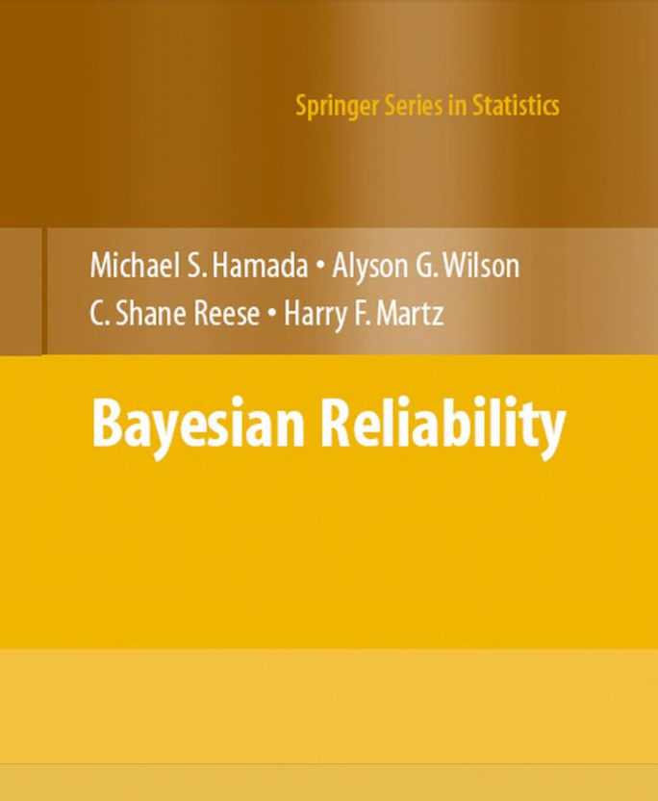
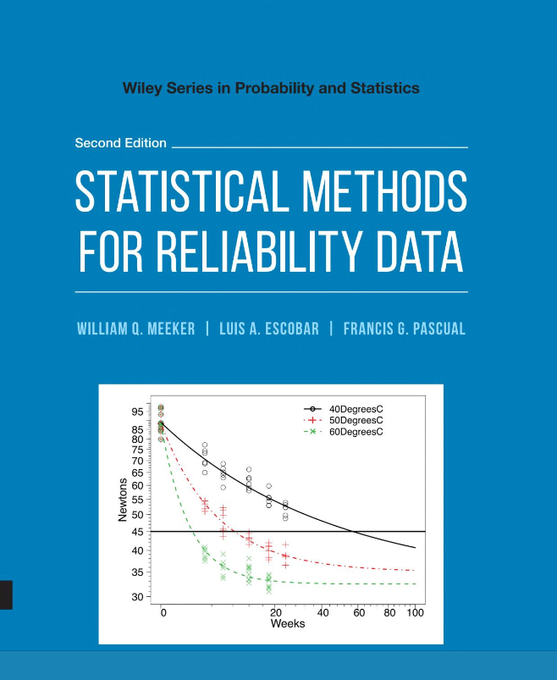
References
Approved for Public Release: NG24-0585 © 2024 Northrop Grumman Systems Corporation

Slide 11
Approved for Public Release: NG24-0585 © 2024 Northrop Grumman Systems Corporation

