Slide 1
An Overview of Methods, Tools, and Test Capabilities for T&E of Autonomous Systems
DataWorks 2023
Charlie Middleton
Lenny Truett, PhD
April 27.2023
Distribution Statement A. Approved for public release; distribution unlimited. Case Number: 88ABW-2023-0421; Cleared 19 Apr 2023
ATEAS DataWorks Tutorial
Notes:
This presentation is intended for Public Release --- awaiting approval for release.
Updated: April 12, 2023 cjm

Slide 2
Objectives for this Presentation
Review Origin of this Guide effort
Community collaboration on challenges from 2015-2019
Clear need to address the challenges and document solutions
Describe Current Content and Format
Explore Alternative Formats
Guidebooks
Manuals
Format flexible
Wikipedia / online resource
Identify Additional Content
Obtain Feedback on Current Format and Content

Slide 3
Overview
Outline of the Draft T&E Companion Guide for Autonomy
Introduction and Background Material
Central and Specific Challenges for Autonomous Military Systems (AMS) T&E
Frameworks for Addressing Autonomy T&E Challenges
Specific Methods for Addressing Challenges
T&E Infrastructure, Tools and Resources
Path Ahead for the Draft Guide

Slide 4
T&E Companion Guide for Autonomy Draft Outline and Content
T&E Companion Guide - Outline
1. Introduction
2. Autonomy Policies
3. Background and Context for AMS T&E
3.1 T&E Context
3.2 Autonomy Relation with AI & ML
4. AMS T&E Challenges
4.1 Central T&E Challenges
4.2 Specific AMS T&E Challenges
Methods Addressing Challenges
5.1 Where to begin
5.2 Methods and Lessons Learned by Test Phase
AMS T&E Resources
6.1 Test labs & test range support for AMS T&E
6.2 Software tools for AMS T&E
6.3 Expertise in DoD for AMS T&E
Summary and Way Ahead
A-1 Lexicon
A-2 References
12 AMS T&E Challenges
Data
Requirements & measures
Infrastructure & personnel
Exploitable vulnerabilities
Safety
Simulation
Example Methods
Assurance cases
LVC testing
Automated requirements
Continuous testing
Formal verification
Surrogate platforms
Example Tools
TACE, R2U2
Boundary Explorer
MARGInS, AdaStress
+ TRMC Toolkit
Human system teaming
Post-acceptance testing
Design for test
Test adequacy & integration
Testing continuum
Testing for ethics & legal
Fuzzing
Runtime assurance
Automated software test
STAT for autonomy
Autonomy measures
Automate outlier search
Adversarial testing
Human teaming measures
RAPT, RIOT
FRET, IKOS
ACedit, AdvoCATE
+ DARPA Assured Autonomy site
The guide is the primary means of capturing autonomy T&E lessons learned
Key contributors include Dr. David Tate and Dr. David Sparrow, Institute for Defense Analyses

Slide 5
STAT COE Overview
Mission: Provide independent, integrated STAT consultation to acquisition programs and projects to improve test & evaluation (T&E) rigor, effectiveness, & efficiency
Chartered to apply science at point of need
Established 2012 by (now) DTE&A
Located at Air Force Institute of Tech., WPAFB, OH
Skilled team ready on demand
8 PhDs, 12 MS in Statistics, Engineering, Sciences
Certifications in DAWIA T&E, PM, STM, ENG
From all services, FFRDC, AFRL, industry, academia
T&E
Challenge
STAT COE
Scientific Test and Analysis Techniques (STAT)
are the scientific and statistical methods and processes used to develop efficient, rigorous
test strategies that yield defensible results
We bring STAT expertise and tools to bear
to help you solve your most difficult
T&E challenges

Slide 6
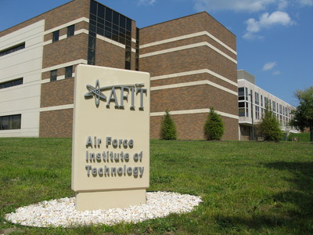
STAT COE Lines of Effort Consulting—Research—Education
Direct STAT Consultation
Ask-a-STAT
Task-oriented engagement
Enduring integration with test team
Enterprise-Wide Contributions
Applied research
Support to strategy and guidance
T&E with emerging tech, new domains, and advanced STAT
Workforce Development
Mentoring during consultation
Coordination with DAU credentials and AFIT programs
Tailored class development and delivery for sponsoring orgs
Experience from direct consultation is foundational for relevant, effective enterprise-wide contributions and workforce development.

Slide 7
Advancing T&E of Autonomous Systems ATEAS Project Motivation
We stand at the start of a new era in human culture and modern warfare. Machines may ‘soon’ do nearly all physical tasks that humans historically have.
AI-Enabled Autonomy is a revolutionary technology.
Cheaper unit cost
Larger quantity
Less human capital/training
Faster execution
Safer to humans
Survivability
Endurance
Challenges focused on determining its suitability, lethality sustainability, adaptability, and ethical use.
T&E
S&T
Autonomy
S&T
AI S&T
Autonomy
T&E
Autonomous
System Dev
Autonomy
Projects
Autonomy
Programs
Autonomy
DT&E
Autonomy
OT&E
Operational
Autonomy
Test and Evaluation (T&E) is a critical linchpin between S&T research, tech maturation, system program offices, and warfighters.
Goal: Advance scientific practices for conducting T&E of Autonomous Military Systems (AMS) that lead to mission assurance as demonstrated by effective, reliable, and ethical employment of modern, innovative autonomous capabilities

Slide 8
Introduction to T&E of Autonomy
New analytical methods are
required because…
Statistical analysis of autonomous
systems operating in adversarial
conditions is not valid without an
accurate model of the adversary’s
cognitive performance. - D. Scheidt
Why do Autonomous Systems require research into T&E methods?
Autonomous systems have great interest and investment in the Department of Defense
Specific capabilities at the core of Autonomy require innovative application of T&E methods include perception, reasoning, deciding, learning, teaming, and emergent behavior
Due to their capabilities to operate independently and coexistence with human actors, autonomous systems pose new challenges associated with proper T&E to ensure developmental and operational mission assurance that are more complex than typical weapons systems mission assurance through adequate performance, safety, ethics (and the law of armed conflict), and cybersecurity outcomes
Methods and processes to mitigate these challenges are very limited and not readily available to the test community
Autonomy will require testing and evaluation of system tasks that are traditionally performed by human operators; such as application of combat rules of engagement, threat avoidance and mitigation, risk management, mission integration in a large strike package, emergency management, degraded systems management, reporting of critical intelligence events, and more
These tasks have no clear, existing way of being tested and evaluated as traditional systems require an operator to perform them, whose performance is historically evaluated through training and proficiency, not through system T&E
Who is the audience for this T&E Companion Guide for Autonomy?
Developed to provide guidance to test and evaluation practitioners, to include program managers, test planners, test engineers, and analysts with test strategies, applicable methodologies, and tools that will help to improve rigor in addressing the challenges unique to the T&E of Autonomous Military Systems (AMS)
T&E professionals who are unfamiliar with the capabilities and challenges of autonomous systems
Autonomy and/or AI professionals who are unfamiliar with the T&E context, challenges, methods and tools
Useful for researchers into advanced T&E methods and tools, to inform them about where the most urgent gaps are in current capabilities and where innovations are still needed – and to aid in bridging the gap from research to application
How was this Guide developed?
STAT Center of Excellence, under direction from Director, DTE&A, conducted past workshops (2015 & 2019) on advancements in T&E of autonomous systems – brought together community of willing participants to share challenges, methods, and priorities
This Guide brings together S&T research into autonomy and T&E; test planners and engineers from test ranges; autonomy project and program managers and testers; operational testers; development and oversight staffs to merge perspectives

Slide 9
Advancing T&E of Autonomous Systems Approach and Key Impacts
DTE&A through the STAT COE is bridging the gap between S&T of autonomy T&E, and application of T&E methods in DoD programs
Objectives:
Define and refine current challenges/gaps in DoD methods, processes, and test ranges to rigorously test and evaluate (T&E) Autonomous Systems (AS)
Identify and develop methods and processes for T&E of AS
Identify lessons learned to enable rigorous T&E of AS
Increase collaboration among Joint, Service, and external organizations
Provide T&E practitioners tools to address challenges of T&E of AS
Efforts:
Develop a T&E of AS Companion Guide to provide testers with information on current methods and tools to address challenges
Conduct ATEAS workshops to share and improve on methods and tools
Collaborate with researchers, pilot programs, and testers to expose and expand upon best practices and lessons learned
Collaboration with Joint, Service, Federal, Industry, and Academic organizations
OUSD Research and Engineering (R&E) | Developmental Test, Evaluation, & Assessments (DTE&A) | Test Resource Management Center (TRMC) | STAT Center of Excellence (STAT COE) | Chief Digital and Artificial Intelligence Office (CDAO)
Director, Operational Test and Evaluation (DOT&E) | DoD Autonomy Community of Interest (CoI) | National Air and Space Administration (NASA) | Defense Advanced Research Projects Agency (DARPA) | Air Force Research Laboratory (AFRL)
Army Test and Evaluation Command (ATEC) | Naval Surface Warfare Center (NSWC) | PEO Unmanned & Small Combatants (PEO USC) | Combat Capabilities Development Command (DEVCOM) | Naval Research Laboratory (NRL)
Johns Hopkins Univ Applied Physics Lab (JHU APL) | The MITRE Corporation | Air Force Institute of Technology (AFIT) | Institute for Defense Analyses (IDA) | Air Force Operational T&E Center (AFOTEC)
Air Force Office of Scientific Research (AFOSR) | Program Executive Office Ground Combat Systems (PEO GCS) | Air Force Test Center (AFTC) | Commander Operational T&E Force (COTF) | Office of Naval Research (ONR)
Autonomy / T&E Industry | Naval Air Warfare Center (NAWC) | Department of Homeland Security (DHS) | Aberdeen Test Center (ATC) | Naval Postgraduate School (NPS)
Key Impacts:
2015 workshop: began identifying autonomy T&E challenges - 24 participants across 11 DoD and academic organizations
2019 workshop: refined challenges, began identifying solutions - 65 participants across 17 DoD, academic, and industry organizations
2020 Advancements in T&E of Autonomous Systems report – defined current state of the art in autonomy T&E challenges and solutions
2022 virtual workshop: shared autonomy T&E solutions w/ broad audience - 182 pax across 40 DoD, academic, and industry organizations

Slide 10
Autonomous Systems Policy and Education
Limited amount of published policy and education for Autonomy
DoDI 3000.09 “Autonomy in Weapon Systems” (updated Jan 2023)
Defines Autonomous Weapons Systems (AWS) as “A weapon system that, once activated, can select and engage targets without further intervention by an operator. This includes, but is not limited to, operator-supervised autonomous weapon systems that are designed to allow operators to override operation of the weapon system but can select and engage targets without further operator input after activation.”
Also known as “human out of the loop” or “fully autonomous” weapons systems; includes "human on the loop" systems
Semi-autonomous, or “human in the loop,” weapon systems that “only engage individual targets or specific target groups that have been selected by a human operator”
Also known as “fire and forget” weapons systems
Requires T&E to establish system reliability, effectiveness, and suitability under realistic conditions, including possible adversary actions, to sufficient standard consistent with potential consequences of unintended engagement or loss of control of system
Does NOT apply to "unarmed platforms," or to "autonomous or semi-autonomous systems that are not weapon systems"
Recent update includes the 5 DoD Ethical Principles for AI (formerly published as a memo)
Recent update expands and clarifies DoD oversight roles and responsibilities, including for required Senior Reviews of systems
DAU online course CLE 002 “Introduction to the T&E of Autonomous Systems”
Establishes a baseline of autonomy T&E knowledge with terminology and background
Outlines challenges for autonomy T&E including safety, security, instrumentation, data, assurance, robust coverage of the operational environment, and emergent or unexpected behavior
Introduces methods including cognitive instrumentation, run-time assurance, adversarial testing, and agile and DevSecOps
Open Question to the Workshop Audience:
Should the T&E Companion Guide list or reference to external (non-DoD) related guidance? E.g. FCC, FAA, other agencies

Slide 11
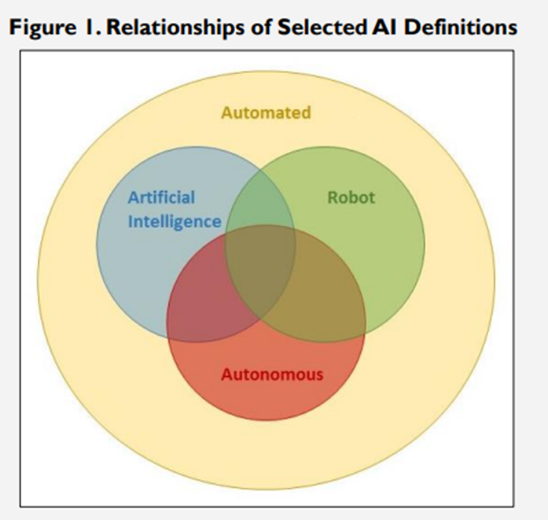
Autonomy Relation with AI and ML
Autonomy refers to an agent or machine being delegated to perform a task – capable of independent operation without external control
Autonomy is NOT only about making systems “adaptive”, “intelligent”, “smart”, or “unmanned / uncrewed” -- autonomy is about making systems self-directed & self-sufficient
Autonomous Military Systems will need to be evaluated in a system and mission context, emphasizing measures of effectiveness and suitability to characterize the system’s integrated capabilities and limitations including software, hardware, and the synergies and/or disconnects between them
Artificial Intelligence (AI) refers to the ability of machines to perform tasks that normally require human intelligence; AI may be an element in a system pursuing a goal
AI contribution is evaluated primarily in terms of measures of performance
T&E of AI techniques or models under development will include broad characterization of the performance measures, without necessarily having an application in mind. This characterization of performance is an important stage in making AI components understood and available for inclusion in systems
Machine learning refers to the ability of machines to learn from data without being explicitly programmed; subset of AI techniques
AI that does not utilize machine learning goes by different names, such as expert AI, rule-based AI, symbolic AI, domain ontology and reasoning, multi-agent planners, etc.
AI & ML are integral to autonomy, so multiple portions of this guide discuss considerations for T&E of AI and ML as integrated into an autonomous defense system
Autonomous systems are sometimes referred to as “AI in motion” to differentiate from “AI at rest”

Slide 12
Autonomy Example with AI and ML
NOTIONAL Autonomous Automobile System
See – Hear – Monitor vehicle status – Maintain road – Avoid obstacles – Avoid traffic – Comply with laws – Navigate
Road database
Expert AI: Navigate to destination
Training Data
Traffic updates
Desirable routes
Onboard camera
Machine Learning (AI): Computer vision processing
Expert AI: Prioritize goals/threats to decide control actions
Brakes, Gas
Road, traffic, obstacle, signal
Steering
Road database
Signals
Autonomous system: Integration of all HW and SW in representative environment

Slide 13
Background and Context for Autonomy T&E
Regulatory and guidance documentation historically linked to Milestone Decisions in the Defense Acquisition System
Section 804, National Defense Authorization Act (NDAA) for 2020 provides for a Rapid Acquisition Process which greatly decreases acquisition timelines -- will also require accelerated test plans and execution
Exploratory testing adds value from learning relationships between variables, rather than evaluation of the effectiveness and suitability of the system under test
Inform design trades with knowledge of performance, safety, cyber and other consequences, and operational testing – especially early testing – ensures that delivered performance under operational conditions user expects for employment
Necessarily iterative learning continues throughout development, to include post fielding changes
Contractor Test
Operational Test
Developmental Test
Live Fire Test
Simulation Test
Lab Test
Subsystem Test
System Test
End-to-end FUSL Test
Component Test
Integration Test
Sys-of-Sys Test

Slide 14
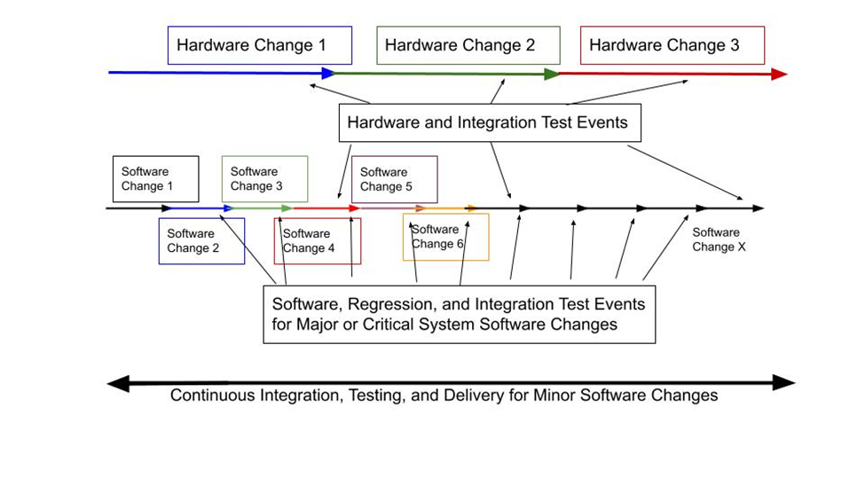
Central Autonomy T&E Challenges
Paradigm change from traditional, more segregated T&E of hardware processes to concept of continuous testing for autonomous system whose core is software
Hardware forms the basis for the physical features of the system -- more traditional T&E processes typically apply, such as the ‘waterfall’ alignment of T&E responsibilities
Contractor T&E, DT&E, IOT&E, follow-on OT&E
Software T&E community often (but not always) utilizes small, quick “sprints” of development, testing and fielding
Agile processes and development-for-security-and-operations (DevSecOps) construct, flow very rapidly from contractor T&E through DT&E, OT&E, and fielding, on a short development cycle, to enable rapid responsiveness to the user needs
As autonomous defense systems will be comprised of both hardware and software development and capabilities, the practitioner must recognize that a hybrid approach may in some situations be needed necessary, where some test events occur on a pace with hardware development, but other test events occur at the higher frequency of software development.
Autonomous system capabilities are new
CONOPS for employment are new
Human teaming coordination and control are new
Adversary responses are new
Strategic, operational, and tactical risks are new
Test methods and tools are new
Behavior and outcomes will be unexpected

Slide 15
Specific Autonomy T&E Challenges
Data: Files use internal algorithms/states with vendor-specific formats; very large file sizes; simulation data is common; training data may not exhaustively cover real operations; simulations too big; metadata problems.
Requirements and Measures: Autonomy requirements too broad or not defined; coverage impossible; measures of success (trust) not well defined; Concept of Operations (CONOPS) incomplete; sound behavior too subjective; decision systems highly abstract – not explainable; interoperability lacking.
Infrastructure and Personnel: Autonomy experts are few; test experts do not have autonomy knowledge; lack of sophisticated software and testing tools; test ranges not prepared for autonomy needs; LVC support; instrumentation ad hoc.
Exploitable Vulnerabilities: Large cyber attack surfaces; use of commercial/open-source code; too complex to exhaustively test; adversaries may implement Autonomy sooner.
Safety: Decisions underlying routine safety taken out of the hands (and minds) of operators; Lack of T&E methods for complex software that allows the system to “operate” itself; . Very few active research programs today for applications with highly asymmetric hazard functions.
Simulation: Modeling and simulation are critical components for mission assurance; In some instances, these techniques are the only ones available to test and evaluate a system; Sparse development of high-quality models and simulations to test system behavior.
Human Systems Teaming: Need to address the ability of any combination of humans and machines to perform as partners and to determine how to measure the effectiveness of that team; currently no standard for measuring trust in automated systems.
Post-Acceptance Testing: Systems will continue to change their behavior over time; need to develop periodic regression testing and for predictive models of how post-fielding learning might affect system (or team) behavior.
Design for Test: T&E of autonomous systems is made difficult by the system’s internal decision‐making process, which essentially operates like a “black box”; Need to develop T&E methods when the reasons for decision making are not transparent.
Test Adequacy and Integration: Interaction not only with their environment but also with other systems, lead to emergent, unanticipated behaviors that are difficult for humans to track; Lack of T&E methods to analyze the potential for undesirable emergent behavior in order to avoid it.
Testing Continuum: Requires testing throughout the system life cycle; Necessary to decide when, how, and what aspects of a system to test under initial assumptions; How to retest after learning has occurred.
Testing for Ethical and Legal Requirements: Must be responsible, equitable, traceable, reliable, and governable and meet the same legal, ethical, and policy standards; Currently no T&E methodologies exist.
Test planning for complex adaptive systems requires all current T&E challenges to be met in addition to addressing new challenges associated with these AI-enabled systems

Slide 16
ATEAS 2022 Workshop Findings and Recommendations - Confirm & Clarify Challenges
 | Finding |  | Finding
1 | Widespread recognition of a need for holistic test strategies to integrate developers, testers, and users across autonomous defense system life cycles with continuous, agile testing | 5 | Workshop surveys identified autonomous defense system safety as the most critical challenge and the highest-ranked topic for further R&D. Formal assurance argument framework may provide a consistent method to obtain calibrated operator and certifier trust in system safety
2 | Open architecture and other autonomy standards are developing to support modular application of autonomy, including standards in metrics, requirements, instrumentation, interfaces & more | 6 | Test infrastructure may require enterprise-level investment to meet future autonomy demand and support multiple simultaneous autonomous defense system programs with mature and reusable test surrogates
3 | Government organizations are acting as the “prime contractor” for autonomous defense system development and taking on the systems integrator role | 7 | Participants expressed strong desires to improve the ability to collaborate and to have web-based resource references, including test range support, community contacts, tools, data repositories, and other frequent collaboration
4 | Autonomy imposes new burdens on operators and human teammates. Quantifying trust requires identification and application of effective requirements, metrics, and T&E methods, such as early iterative testing. Quantifying user trust to calibrate trust in autonomous defense systems have advanced, but trusted autonomy remains a challenge | 8 | Autonomous defense systems currently lack clearly defined pathways for a variety of system certifications

Slide 17
Autonomy T&E Methods to address central and specific challenges
Where to begin?
STAT Process
Analogy to human operators
Holistic look at sequential events to produce assurance
Specific individual methods and techniques
Organized somewhat in sequence for applicability throughout the program and test lifecycles
Methods are intended to communicate and disseminate best practices from across DoD and other experts
No claims that this guarantees success
No claims that this exhaustively covers all known methods
Inputs and feedback on additions / expansion / improvement are welcomed

Slide 18
STAT Process
DEFINE
Why?
Capability/Mission/Requirement (KPP, KSA, COI, etc.)
Leadership Level
Evaluation Frameworks
IDSK
Kill Chains
Gather Previous Information
Basic Test Process
Perform Decomposition
STAT Infusion
Determine Testable Question(s)
Product
What?
Define Output Variables
Measures (MOE, MOP, MOS)
Responses
Dependent Variables
Test Continuum: Phases of testing may cycle back at any time as all products are living documents.
Factors/levels
Independent Variables
List Input Variables
Discuss Limitations
How?
Reliability
Survey
DOE
Time Series
Observational Study
Identify STAT Candidates
Randomization
Blocking
Replication
Choose T&E Method
Identify Constraint(s)
$
Time
Resources
Develop Data Analysis Plan
KNOWLEDGEBASE
DP
CREATE
DOE Matrix
Covering Array
Survey
Build Product(s)
Reliability Test Plan
Assessment Strategy
Finalize Test Plan
FINAL APPROACH & TEST PLAN
DP
EXECUTE
Record Deviations
Collect Data
Perform Test
DATA & LOG
DP
ANALYZE
Distribution Fitting
Hypothesis Testing
Monte Carlo Simulation
Optimization
Apply Statistical Methods
Report Analysis Product & Insight
ANALYSIS PRODUCT
DP
Decision Points (DP) mark when questions should be posed to move on to the next phase, go back to a previous phase, or exit the process.
Informed Decision(s)

Slide 19
Methods and Tools to Address Autonomy T&E Challenges
Helpful to have a framework for understanding how possible solutions can fit together to provide a comprehensive strategy for T&E of autonomy
Since capabilities of interest replace former functions performed by human operators, useful to consider how a human operator develops and is evaluated over time
Common-sense requirement for an autonomous system might pose the question:
Can the system perform at least as well as a human could?
To understand how a human is evaluated, we need to examine how a human operator is developed and trained as well, since evaluators also provide training feedback
This may provide insight into how autonomous systems could be or should be developed (and ‘trained’) which will affect the strategies for test and evaluation and other verification and validation methods
End result envisioned that a military commander has confidence in how they can deploy and employ the system effectively and can understand and manage risks involved
Autonomous Military System
What is comparable?

Slide 20
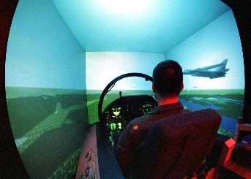
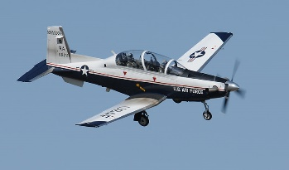
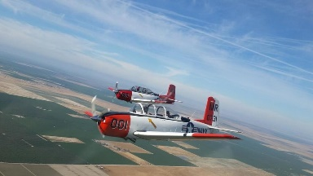
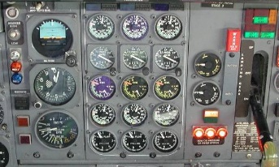
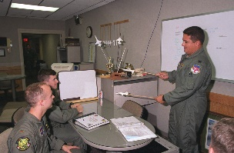
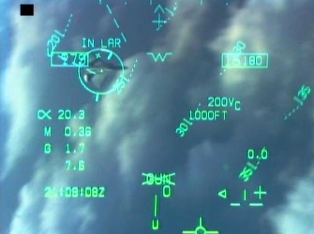
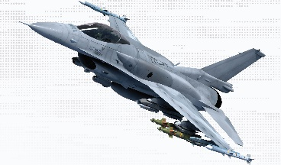
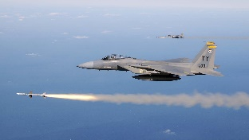
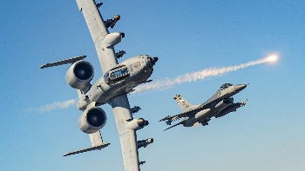
How to develop and evaluate a Fighter Pilot
Screening in small, light plane
Academics on aerodynamics, FAA rules
Closed-book examinations
Training syllabus
Simulator training
Training aircraft
Flight training with instructor pilot sitting beside
Daily flight debriefs
Ops limits
Emergency procedures and prohibited maneuvers
Flight training with instructor pilot as wingman
Check-rides with evaluator pilot
Graduation to mission airplane
Mission qualification training
Wingman – flight lead – mission commander
Daily flight debriefs and tactics development
Red air / adversarial training
Threat study and regional combat spin-up

Slide 21
Analogy: How to develop and evaluate an Autonomous Military System
Fighter Pilot
Autonomous Military System
Screening in small, light plane | Initial development in small unmanned systems
Academics on aerodynamics, weather, physiology, FAA rules | Accepted world and state models
Closed-book examinations | Formal verification / Formal methods
Training syllabus | Training data sets
Simulator training | Simulation for testing
Training aircraft | Surrogate platforms
Flight training with instructor pilot sitting beside | Runtime assurance and recovery
Flight training with instructor pilot in formation | Layered runtime monitoring
Ops limits | Adaptive, outlier search, and boundary testing
Practice emergency procedures and prohibited maneuvers | Failure path testing
Daily flight debriefs | Continuous testing
Check-rides with evaluator pilot | Operational mission testing
Graduation to mission airplane | Evolved certifications and accreditation Open architecture
Mission qualification training | Agile development and new training data
Wingman – flight lead – mission commander | Testing continuum
Daily flight debriefs and tactics development | Post acceptance testing
Red air / adversarial training | Adversarial testing
Threat study and regional combat spin-up | Retraining for mission threats and tactics
In this order
Not in this order

Slide 22
Analogy: How to develop and evaluate an Autonomous Military System
Fighter Pilot
Autonomous System
Screening in small, light plane | Initial development in small unmanned systems
Academics on aerodynamics, weather, physiology, FAA rules | Accepted world and state models
Closed-book examinations | Formal verification / Formal methods
Training syllabus | Training data sets
Simulator training | Simulation for testing
Training aircraft | Surrogate platforms
Flight training with instructor pilot sitting beside | Runtime assurance and recovery
Flight training with instructor pilot in formation | Layered runtime monitoring
Ops limits | Adaptive, outlier search, and boundary testing
Practice emergency procedures and prohibited maneuvers | Failure path testing
Daily flight debriefs | Continuous testing
Check-rides with evaluator pilot | Operational mission testing
Graduation to mission airplane | Evolved certifications and accreditation Open architecture
Mission qualification training | Agile development and new training data
Wingman – flight lead – mission commander | Testing continuum
Daily flight debriefs and tactics development | Post acceptance testing
Red air / adversarial training | Adversarial testing
Threat study and regional combat spin-up | Retraining for mission threats and tactics
CAVEAT EMPTOR: While we can draw parallels and similarities between training a fighter pilot and testing an autonomous system, they are not the same thing. Many methods are analogous, but only loosely! This idea is primarily intended to inform on the broad range of techniques involved and help aid those unfamiliar with autonomy and AI test.
In this order
Not in this order

Slide 23
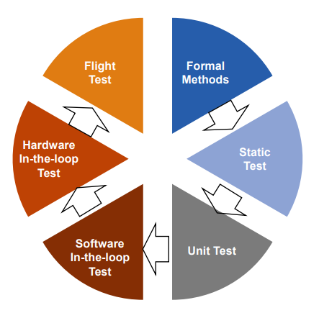
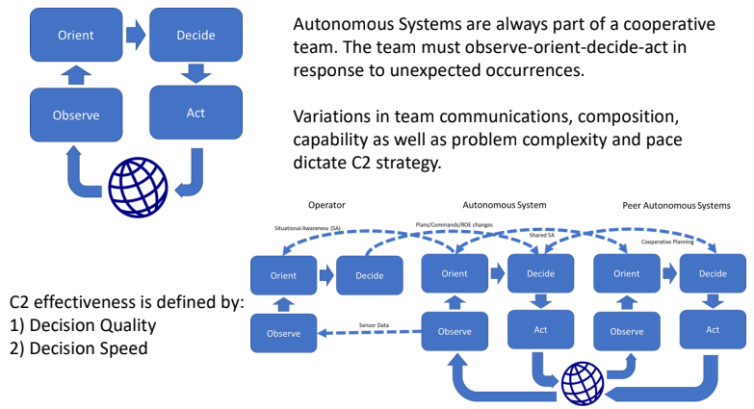
Autonomy T&E Where to Begin?
Integrated system test
Autonomy TEV&V involves evaluating the impact of autonomous decisions (a form of C2) on the “system” which is the world
Autonomy evaluation is game-theoretic; with the information
characteristics dictating the form of game being played. Does the game
involve?
• Complex uncertainty? Then decision quality matters
• Dynamic uncertainty? Then decision speed (entropic drag) matters
• Systemic adaptation? Then system learning (entropic evolution) matters
• Random events? Then statistical evidence is relevant
• Adversaries? Then statistical evidence is not relevant
The information paradox:
a) The more information used to make a decision, the better the
decision.
b) The longer it takes to make a decision, the worse the decision.
c) Using more information takes longer.
D. Scheidt, Workshop presentation, 2022

Slide 24
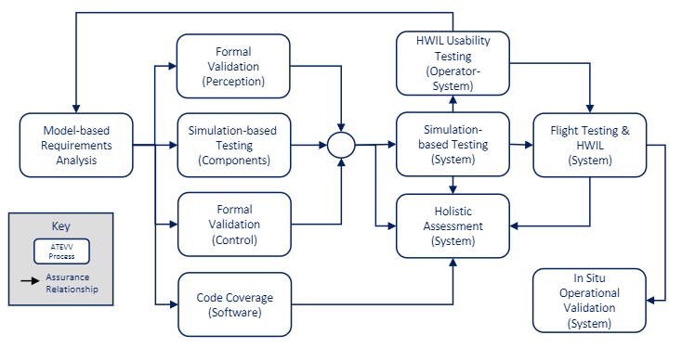
Autonomy T&E Where to Begin?
Autonomy TEV&V Processes utilize a sequence of ATEVV events to produce a chain of evidence that provides an assurance argument for the System Under Test
D. Scheidt, Workshop presentation, 2022

Slide 25
Methods for Addressing Autonomy T&E Challenges
Draft T&E Companion Guide for Autonomy provides a discussion of background, challenges, methods and tools in the context of the overarching T&E lifecycle of a program, as divided into T&E Phases
T&E Phases start with earliest beginnings of a program at development of acquisition strategy and development strategy for ADS projects, proceed through test strategy development, test planning, test design, test execution, data analysis, and certification and accreditation processes
Scientific Test and Analysis Techniques (STAT) Process is referenced as the framework for organizing the Test Phases for application of these ADS T&E solutions
Each phase also includes a general discussion of considerations and lessons learned
Methods Discussion by T&E Phases
Acquisition Strategy and Development Strategy
Test Strategy
Test Planning
Test Design
Test Execution
Data Analysis
Certification and Accreditation

Slide 26
Methods for Addressing Challenges with Acquisition and Development Strategy
Method for Acquisition and Development Strategy | Short description
Operational Modeling | Provide a model of the desired system behavior in operational context (similar to a use case)
Small scale development | Use of small, cheap, simple platforms and assets to speed development and scale up
Open architecture | Use of non-proprietary, open architecture standards for integrating subsystems and services into the mission package with government-owned interfaces
Automated requirements | Automate translation of English-language requirements into logical code
Continuous Testing | Testing the system throughout the development process and the entire system operational lifecycle
Code isolation | Use of a code development framework that enables code isolation for safety and security
Assurance cases | A structured argument, supported by evidence, intended to justify that a system is acceptably assured relative to a concern (such as safety or security) in the intended operating environment

Slide 27
Acq and Dev Strategy Method: Operational Modeling
Description:
Provide a model of the desired system behavior in operational context (similar to a use case)
Analogous to human training:
Early ground training involves classroom academics on fundamentals - Students must understand the flying environment, overarching principles, and basics such as aerodynamic principles, FAA rules, physiology, communication.
Intended Results:
System developers and T&E practitioners understand the desired and undesired system behaviors.
Best Practices
Use of accepted world and state models to accurately and comprehensively define the basic system states to match their operating modes and phases with their operational environments.
Challenges Addressed:
Requirements and measures
Test adequacy and integration
Method Benefits:
Accurate Perception, valid Reasoning, and effective Decisions and Teaming by the autonomous system based on correct, consistent, logical use of operational modeling.
Test objectives and evaluation criteria are consistent, precise, and traceable to operational mission impacts.
Costs, Limitations, Assumptions:
Limitation that the system state and world state models must have T&E or V&V of their logic, processes, and effectiveness.

Slide 28
Acq and Dev Strategy Method: Small scale development
Description:
Use of small, cheap, simple platforms and assets to speed development and scale up
Analogous to human training:
Beginning pilots undergo flight screening and first start training in a small, light, single-engine civilian airplane
Intended Results:
System development and system testing are made as safe, quick, cheap, and efficient as possible
Best Practices
Documenting progress over time with small scale assets that can reduce risk and speed acceptance of more costly and sparse test assets
Challenges Addressed:
Safety Data
Requirements and measures Testing continuum
Method Benefits:
System assets and test assets are low cost, low risk, less complex to understand and use. T&E can quickly identify early, major deficiencies.
Costs, Limitations, Assumptions:
Assumption that a small-scale asset can realistically represent the intended end system in useful ways.
Tools that Support this Method:
Examples: Wasp Micro Air Vehicle, Dragon Eye, Raven

Slide 29
Acq and Dev Strategy Method: Open architecture
Description:
Use of non-proprietary, open architecture standards for integrating subsystems and services into the mission package with government-owned interfaces
Analogous to human training:
Transferable skills and experience from training aircraft allow quicker, cheaper achievement of basic flying proficiency in complex mission aircraft
Intended Results:
Accurate T&E insight into internal system processes.
Portable T&E instrumentation and measures able to be re-used.
Best Practices
Standardized government-owned open architectures that include built-in hooks and capacity for internal (cognitive) instrumentation.
Challenges Addressed:
Requirements and measures Data
Infrastructure Design for test
Method Benefits:
Use of non-proprietary, open architecture standards for integrating subsystems and services into the mission package with government-owned interfaces
Costs, Limitations, Assumptions:
Cost of infrastructure and personnel to organize, design, manage, implement, and maintain open architecture standards, interfaces, and tools.
Limitations on system design uniqueness and potential efficiency.
Tools that Support this Method:
Open Mission Architecture (OMA) (USAF), Unmanned Maritime Autonomy Architecture (UMAA) (Navy), AFSIM, NATS

Slide 30
Acq and Dev Strategy Method: Automated requirements
Description:
Automate translation of English-language requirements into logical code
Analogous to human training:
No
Intended Results:
Clear, concise and accurate test objectives traced directly from clearly written system requirements.
Best Practices
Standardized formats for defining requirements that minimize or eliminate ambiguity in product or process results.
Challenges Addressed:
Requirements and measures
Design for test
Method Benefits:
Alignment with compliance and policy requirements; increased speed and repeatability of requirements and objectives interpretation and usage; better understanding of requirements.
Costs, Limitations, Assumptions:
Costs and time to setup and implement automated requirements software tools, and training for requirements authors. Limited to firm requirements that are objectively definable.
Tools that Support this Method:
Formal Requirements Elicitation Tool (FRET) (NASA)

Slide 31
Acq and Dev Strategy Method: Continuous Testing
Description:
Testing the system throughout the development process and the entire system operational lifecycle
Analogous to human training:
Humans are quizzed, progress-checked and evaluated throughout their selection, education, training, and operational phases of consequential professional activities
Intended Results:
Timely and accurate T&E results that respond to highly variable and/or continuous integration and continuous delivery of capability.
Best Practices
Use of agile and DevSecOps (a la DevTestOps) processes for development with continuous integration and continuous testing, to support continuous delivery of updated capabilities.
Challenges Addressed:
Testing continuum Data
Infrastructure Test adequacy and integration
Method Benefits:
Use of automated software integration and regression testing through 24/7 software test labs; no single test phase, but testing throughout the life cycle; seamless integrated CT, DT, OT, and user training for system updates
Costs, Limitations, Assumptions:
Assumption that contractor testing (CT), developmental testing (DT), operational testing (OT), and operator training can be efficiently integrated across the lifecycle of the system.
Tools that Support this Method:
Rapid Autonomy Integration Lab (RAIL) (Navy)

Slide 32
Acq and Dev Strategy Method: Code isolation
Description:
Use of a code development framework that enables code isolation for safety and security
Analogous to human training:
No
Intended Results:
Assurance that critical features of software are not susceptible (or less susceptible) to safety and/or security risks. Reduced T&E cost/schedule.
Best Practices
Isolation of safety-critical software from other task software (e.g. flight control software).
Isolation of security-critical software from other task software.
Challenges Addressed:
Safety Exploitable vulnerabilities
Design for test
Method Benefits:
Physical ("air-gap") separation of software development platforms to reduce risks of critical failures from continuous updates to minor / non-critical software within a system. Allows T&E to be rapid and responsive to software changes without the burdens of extensive testing. Allows software changes at a rapid pace, while protecting key software from flaws and threats to software integrity.
Costs, Limitations, Assumptions:
Costs and time to setup and implement code isolation solutions.
Assumes that open, modular architecture exists to implement code isolation benefits .

Slide 33
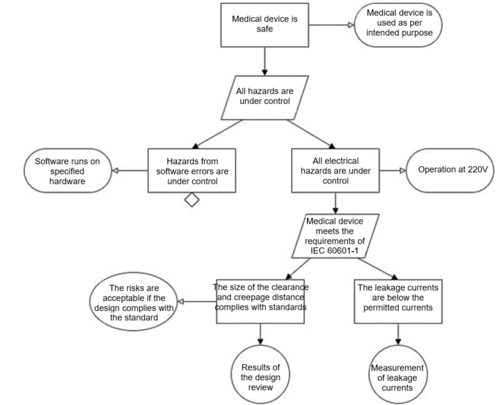
Acq and Dev Strategy Method: Assurance cases
Description:
A structured argument, supported by evidence, intended to justify that a system is acceptably assured relative to a concern (such as safety or security) in the intended operating environment
Analogous to human training:
No
Intended Results:
Clear, persistent, dynamic justification that establishes assurance of system safety, security, mission capabilities, or other critical concerns
Best Practices
Utilizing combinations of system test results, subsystem and component test results, modeling and simulation results, and formal verification to leverage all available evidence on autonomy performance and suitability.
Challenges Addressed:
Requirements and measures Safety Data
Security Test adequacy and integration
Method Benefits:
Allows use of evidence about the autonomous system from a wide range of sources, that together produce consistent, logical reasoning for system assurance. Holistic assurance cases are potentially able to address numerous, varied concerns simultaneously.
Costs, Limitations, Assumptions:
Costs and time to setup and implement the assurance case argument structure, documentation and maintenance over time. Limitation on weighting the value of evidence from disparate sources.
Tools that Support this Method:
SAFE (TRMC), AdvoCATE (NASA), ACedit (Google)

Slide 34
Methods for Addressing Challenges with Test Strategy
Method for Test Strategy | Short description
LVC testing | Use of Live-Virtual-Constructive simulation and testing for safety, security, and efficiency
Surrogate platforms | Use of test surrogate platforms (with or without human operators) for development and sequential integration
Formal verification | Use of formal methods to verify system models, capabilities and operation
Software pedigree evaluation | Use of CMMI level, ISO 9000, and other software quality and pedigree evaluations to inform software code quality

Slide 35
Test Strategy Method: LVC testing
Description:
Use of Live-Virtual-Constructive simulation and testing for safety, security, and efficiency
Analogous to human training:
Simulators provide a safe, secure, repeatable way of training, where operators can attempt to do things that you never would do for real, due to high-risk of safety, security, cost, realism, or other limitations. As part of an integrated, comprehensive training program, they allow controlled build up of performance capabilities.
Intended Results:
Accurate T&E insight into autonomy tasks, components, subsystems, and capabilities that inform autonomous military system performance, effectiveness, and suitability.
Best Practices
Use of government-owned and -managed platforms and frameworks for constructive simulation and testing, virtual testing mixing simulation with actual hardware, and live testing of systems under test.
Challenges Addressed:
Almost all of them!
Method Benefits:
Early, frequent, and efficient T&E at all levels of the system development, evaluation and sustainment that optimizes use of scarce resources at minimum risk.
Costs, Limitations, Assumptions:
Cost of infrastructure and personnel to organize, design, manage, implement, and maintain LVC infrastructure, standards, interfaces, and tools. Risks and costs include V&V of the simulation, including intended vs non-intended use -- due to varying levels of fidelity for tasks/components
Tools that Support this Method:
Test surrogate platforms, threat emulators, testbeds, etc. AFSIM and NATS simulation frameworks. Software integration labs (SIL), High-performance computing clusters (HPC), desktop simulators.

Slide 36
Test Strategy Method: Surrogate platforms
Description:
Use of test surrogate platforms (with or without human operators) for development and sequential integration
Analogous to human training:
Operators first learn and develop skills and performance on training platforms (trainer aircraft, weapons, etc.), which allows transferable skills and experience from training platforms to allow quicker, cheaper achievement of combat proficiency with more complex mission assets.
Intended Results:
Cheaper, safer, faster and more effective development and integration through rapid T&E on a test surrogate platform.
Best Practices
Standardized government-owned testbeds and test surrogates that are well-characterized, highly available, and include instrumentation.
Challenges Addressed:
Infrastructure and personnel Design for test Testing continuum
Data Safety Human-sys teaming
Method Benefits:
Allows more rapid, sequential development, integration, and testing of autonomy and AI technologies by streamlining test hardware planning, safety, security, and cost. Enables early human interface, teaming and coordination with the system under test.
Costs, Limitations, Assumptions:
Costs of integrating autonomy technologies with surrogate platforms. Limitations on availability and realism of surrogates and their capabilities. Risk of missing key issues in transfer.
Tools that Support this Method:
TPS VISTA, LearJet, Centaur OPA, UTAP-22.

Slide 37
Test Strategy Method: Formal verification
Description:
Use of formal methods to verify system models, capabilities and operation
Analogous to human training:
Humans take closed-book examinations where students must prove knowledge of basic rules, procedures, regulations, fundamentals and other knowledge required to operate and employ systems. Mathematical proofs are well-established.
Intended Results:
Documented assurance of correct outcomes and rules, evidence supporting arguments for system safety, security, effectiveness, ethics, etc. Can be both fast and rigorous.
Best Practices
Categories of proving theorems with axioms and inference, model checking by searching for counterexamples of model properties, state space enumeration, proof obligations, and abstract interpretation to construct and analyze software representations.
Challenges Addressed:
Requirements and measures Data
Testing for legal and ethical requirements
Method Benefits:
Systems are mathematically proven that certain inputs will always produce certain outputs; employed for modeling requirements, code, and architecture, as well as for analyzing compliance, traceability, robustness, completeness, and consistency of a system.
Costs, Limitations, Assumptions:
Limitations that complex systems can be impossible to formally verify, and that practitioners need training and organization to implement methods in evaluation strategies.
Tools that Support this Method:
SPARK programming language

Slide 38
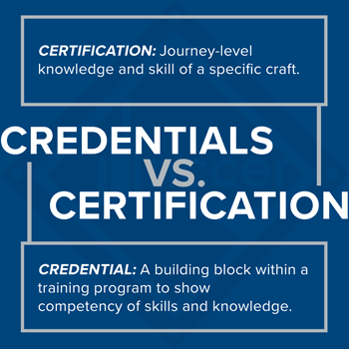
Test Strategy Method: Software pedigree evaluation
Description:
Use of CMMI level, ISO 9000, and other software quality and pedigree evaluations to inform software code quality
Analogous to human training:
Operators with desirable education and training pedigree are given more trust, or less thorough verification and validation of their abilities, based on a high standard of historical performance.
Intended Results:
Streamlined T&E that leverages the high-performing historical credibility of software coders to save cost and schedule.
Best Practices
Use of established, government-issued credentials and trust.
Challenges Addressed:
Testing continuum Test adequacy and integration
Infrastructure Data
Method Benefits:
Allows acceptance of contractor testing or other credible verification or validation activities that reduce the burden of independent government T&E.
Costs, Limitations, Assumptions:
Limitations on acceptable credentials and acceptable trust in information from those sources. Costs to setup and maintain credentialing criteria and processes.

Slide 39
Methods for Addressing Challenges with Test Planning
Method for Test Planning | Short description
Training data set management for ML | Management scheme for operational scenario data that ensures training, validation, and testing
STAT for autonomy | Efficient testing and evaluation of the autonomous system's operational space using Scientific Test and Analysis Techniques
Adversarial testing | Use of adversarial test forces and adversary AI to probe system vulnerabilities and consequences
Operational mission testing | Operationally realistic testing of the autonomous system integrated in a mission with other representative manned and unmanned assets
Post acceptance testing | Follow-on testing, evaluation, and tactics development after autonomous system fielding

Slide 40
Test Planning Method: Training data set management for ML-enabled subsystems
Description:
Management scheme for operational scenario data that ensures training, validation, and testing
Analogous to human training:
Students learn from educational materials, and their progress is periodically checked by quizzes and tests. The final exams may need to use different test questions than prior quizzes to accurately test usable knowledge, not just memorization of the correct answer.
Intended Results:
Robust T&E that recognizes and exposes over-fitting or other ineffective but difficult to detect deficiencies in machine learning.
Best Practices
Reservation of portions of datasets as government-only to ensure independent T&E with robust assurance.
Challenges Addressed:
Data Exploitable vulnerabilities
Infrastructure
Method Benefits:
Allows the ML performance to be accurately characterized, as long as the ML training data covers the operational space and conditions expected in employment.
Costs, Limitations, Assumptions:
Assumption that T&E will use the same types of data for testing of ML as the developers used, and that this relationship will continue as additional data is discovered and utilized.
Tools that Support this Method:
Model cards and Data cards (TRMC / CDAO)

Slide 41
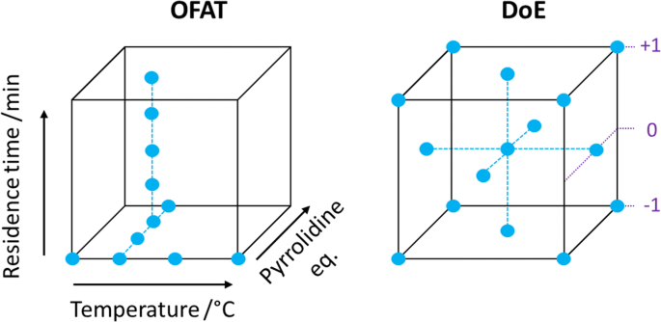
Test Planning Method: STAT for Autonomy
Description:
Efficient testing and evaluation of the autonomous system's operational space using Scientific Test and Analysis Techniques
Analogous to human training:
No
Intended Results:
Robust characterization of autonomy system capabilities across the entire operational space, while using minimum testing resources.
Best Practices
Application of STAT processes such as design of experiments, sequential testing, and Bayesian statistics, throughout the test strategy, test planning, test execution, and test data analysis processes for maximum T&E impact with minimum costs.
Challenges Addressed:
Requirements and measures Test adequacy and integration
Simulation Design for test
Method Benefits:
Complex autonomous systems can have extremely numerous factors that can influence performance depending on combinations and interactions. STAT can scientifically maximize test information value while minimizing cost and schedule resources.
Costs, Limitations, Assumptions:
Limitation that not all testable features are appropriate for STAT processes.
Assumption that STAT expertise is available to the test team.
Tools that Support this Method:
JMP, R, RAPT

Slide 42
Test Planning Method: Adversarial testing
Description:
Use of adversarial test forces and adversary AI to probe system vulnerabilities and consequences
Analogous to human training:
Red force or adversarial training against opposing forces enables quasi-realistic training where adversary assets are simulated to challenge operators' performance and help develop realistic and effective tactics, techniques, and procedures
Intended Results:
Effective autonomous military system performance capabilities in a contested environment that involves an unpredictable adversary.
Best Practices
Cyclical testing of the system and its attack surfaces using varying attack vectors for disruption of operations as system understanding grows.
Challenges Addressed:
Exploitable vulnerabilities Test adequacy and integration
Post-acceptance testing Testing continuum
Method Benefits:
Adaptive red-teaming or usage of AI as a test event generator for T&E of AMS capabilities, can provide insight into vulnerabilities or failure modes that might otherwise be difficult to detect. Reinforcement learning uses feedback from the repeated trials to improve over time.
Costs, Limitations, Assumptions:
Cost of infrastructure and personnel to organize, design, manage, implement, and maintain adversarial testing assets and tools.

Slide 43
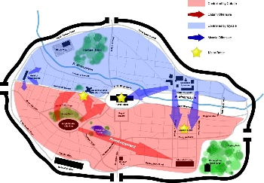
Test Planning Method: Operational mission testing
Description:
Operationally realistic testing of the autonomous system integrated in a mission with other representative manned and unmanned assets
Analogous to human training:
Human operators have a final check-ride that serves as a capstone evaluation at the end of a phase of training, where the evaluator observes the trainee in a fully operational mission scenario.
Intended Results:
Final evaluation to confirm the autonomous system's effectiveness and suitability in an integrated, system-of-systems mission test scenario.
Best Practices
Mission Concept of Operations (CONOPS) and desirable tactics are defined early in development and incorporated into the design and realization of the autonomous system.
Challenges Addressed:
Test adequacy and integration Testing continuum Human-sys teaming
Requirements and measures Design for test
Method Benefits:
Validation the AMS works in realistic operational scenarios including relevant threats and integrated with (manned) friendly support and coordination assets. AMS models/simulations validated by tests of the integrated system, difficult to validate robustly without a full scenario.
Costs, Limitations, Assumptions:
Cost of infrastructure and personnel to plan and execute realistic system-of-systems tests.
Limitations on threat, friendly, and neutral asset participation based on availability.
Tools that Support this Method:
Orange Flag (USAF)

Slide 44
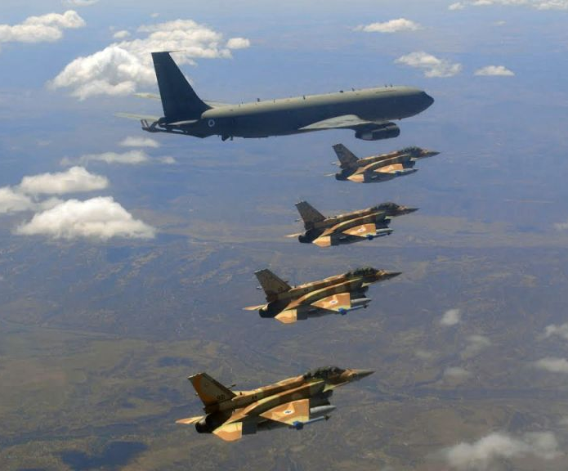
Test Planning Method: Post-acceptance testing
Description:
Follow-on testing, evaluation, and tactics development after autonomous system fielding
Analogous to human training:
For operators, thoughtful analysis of mission training, well past initial mission-ready certification, identifies execution errors and lessons learned that provide the basis for continuous improvement and U.S. battlefield dominance.
Intended Results:
Autonomous system performance optimized under iterative tests as system matures over time.
Best Practices
Operational instrumentation and data gathering post-acceptance, including cognitive instrumentation with truth source and meta-data information.
Challenges Addressed:
Post-acceptance testing Testing continuum
Test adequacy and integration Design for test
Method Benefits:
Data about AMS usage and conditions that may not have been tested prior to fielding. Because of the enormous state space of possible operational conditions, developmental and operational tests will likely be unable to exhaustively cover all operational conditions.
Costs, Limitations, Assumptions:
Costs include design and maintenance of operational instrumentation features.
Limitations include recognition that systems using unsupervised learning or other adaptive control algorithms during operations will continue to change their behavior over time, and unexpected responses or performance may occur.

Slide 45
Methods for Addressing Challenges with Test Execution
Method for Test Execution | Short description
Cognitive Instrumentation for Explainable AI | Tracking and monitoring of the internal workings of autonomy (especially AI-enabled) capabilities providing information that is understandable to humans
Runtime assurance | Automate safety and security reporting by using runtime monitoring and feedback tools to manage risk and allow graceful degradation
Layered runtime monitoring/assurance | Multiple nested layers of monitoring provide runtime assurance at different levels based on information and authority to allow graceful degradation
Trust measures | Calibrated measures of the human operator’s or commander’s confidence in relying on the system
Fuzzing | Minor variations in input conditions that ensure any unintended overtraining is mitigated

Slide 46
Test Execution Method: Cognitive Instrumentation for Explainable AI
Description:
Tracking and monitoring of the internal workings of autonomy (especially AI-enabled) capabilities providing information that is understandable to humans
Analogous to human training:
Fighter Pilots learn and improve every single day of training, which continues throughout the entire career. Learning and improvement occurs primarily in the mission debrief, when mission execution can be evaluated against truth sources for understanding what the operator perceived and decided, versus the actions taken and resulting outcomes.
Intended Results:
Ability for T&E practitioners (and developers and operators) to correctly identify and characterize the root causes of observed deficiencies in performance.
Best Practices
Embedded system instrumentation (for testing and for operations) that can distinguish coding errors from inadequate algorithms or inadequate training data or sensor/hardware problems.
Challenges Addressed:
Design for test Human-system teaming
Infrastructure Test adequacy and integration
Method Benefits:
Cognitive instrumentation to diagnose the causes of incorrect behavior or inadequate performance. The internal workings refers to the machine's ability to perceive, reason, decide, and team -- can be viewed as the understanding how it observes, orients, decides, and acts.
Costs, Limitations, Assumptions:
Costs include the effort to design for and implement the internal system framework that provides for cognitive instrumentation.
Tools that Support this Method:
IKOS (NASA)

Slide 47
Test Execution Method: Runtime assurance
Description:
Automate safety and security reporting by using runtime monitoring and feedback tools to manage risk and allow graceful degradation
Analogous to human training:
Instructor pilot in an aircraft where the instructor is constantly watching performance, can make inputs or corrections, and can take the controls if necessary.
Intended Results:
Reliably detect problems (hardware, software, or environmental) and switch to recovery/safe mode in event of failure.
Best Practices
Provide a backup for safe recovery of test vehicle if unanticipated problems occur; allows re-starts. Provide back-up of mission data.
Challenges Addressed:
Safety Human-system teaming Design for test
Infrastructure Test adequacy and integration Data
Method Benefits:
Automates safety and security reporting by using monitoring and feedback tools to manage risk and allow graceful degradation. Enables test of any algorithm that meets its interface requirements, regardless of complexity.
Costs, Limitations, Assumptions:
Costs include the overhead to setup and implement, V&V of the runtime assurance system, and matching assurance against the complexity of scenarios and/or services provided.
Limitations on the availability of infrastructure to support the runtime assurance solutions.
Tools that Support this Method:
TACE (TRMC and JHU APL), R2U2 (NASA)

Slide 48
Test Execution Method: Layered runtime monitoring/assurance
Description:
Multiple nested layers of monitoring provide runtime assurance at different levels based on information and authority to allow graceful degradation
Analogous to human training:
An instructor pilot in formation flight with a student pilot, where the instructor can monitor to assist the student, but not take over the controls. Able to provide inputs to aid in unexpected events or direct mission cancellation / return to base.
Intended Results:
Increased test safety and mission assurance when more layers are utilized.
Allows graceful degradation of assurance. Permits decreased levels of assurance at locations or missions where all layers are impossible or impractical (such as OT or post acceptance).
Best Practices
Standardized government-owned runtime assurance "wrappers" that integrate easily, combined with internal runtime monitors/assurance designed within the autonomous system.
Challenges Addressed:
Safety Human-system teaming Design for test
Infrastructure Test adequacy and integration Data
Method Benefits:
Multiple nested layers of monitoring provide runtime assurance at different levels based on information and authority, and allow graceful degradation from deficiencies. Layers can be removed as system development proceeds and confidence in the system increases.
Costs, Limitations, Assumptions:
Costs include the overhead to setup and implement, V&V of the runtime assurance systems, and matching assurance against the complexity of scenarios and/or services provided.

Slide 49
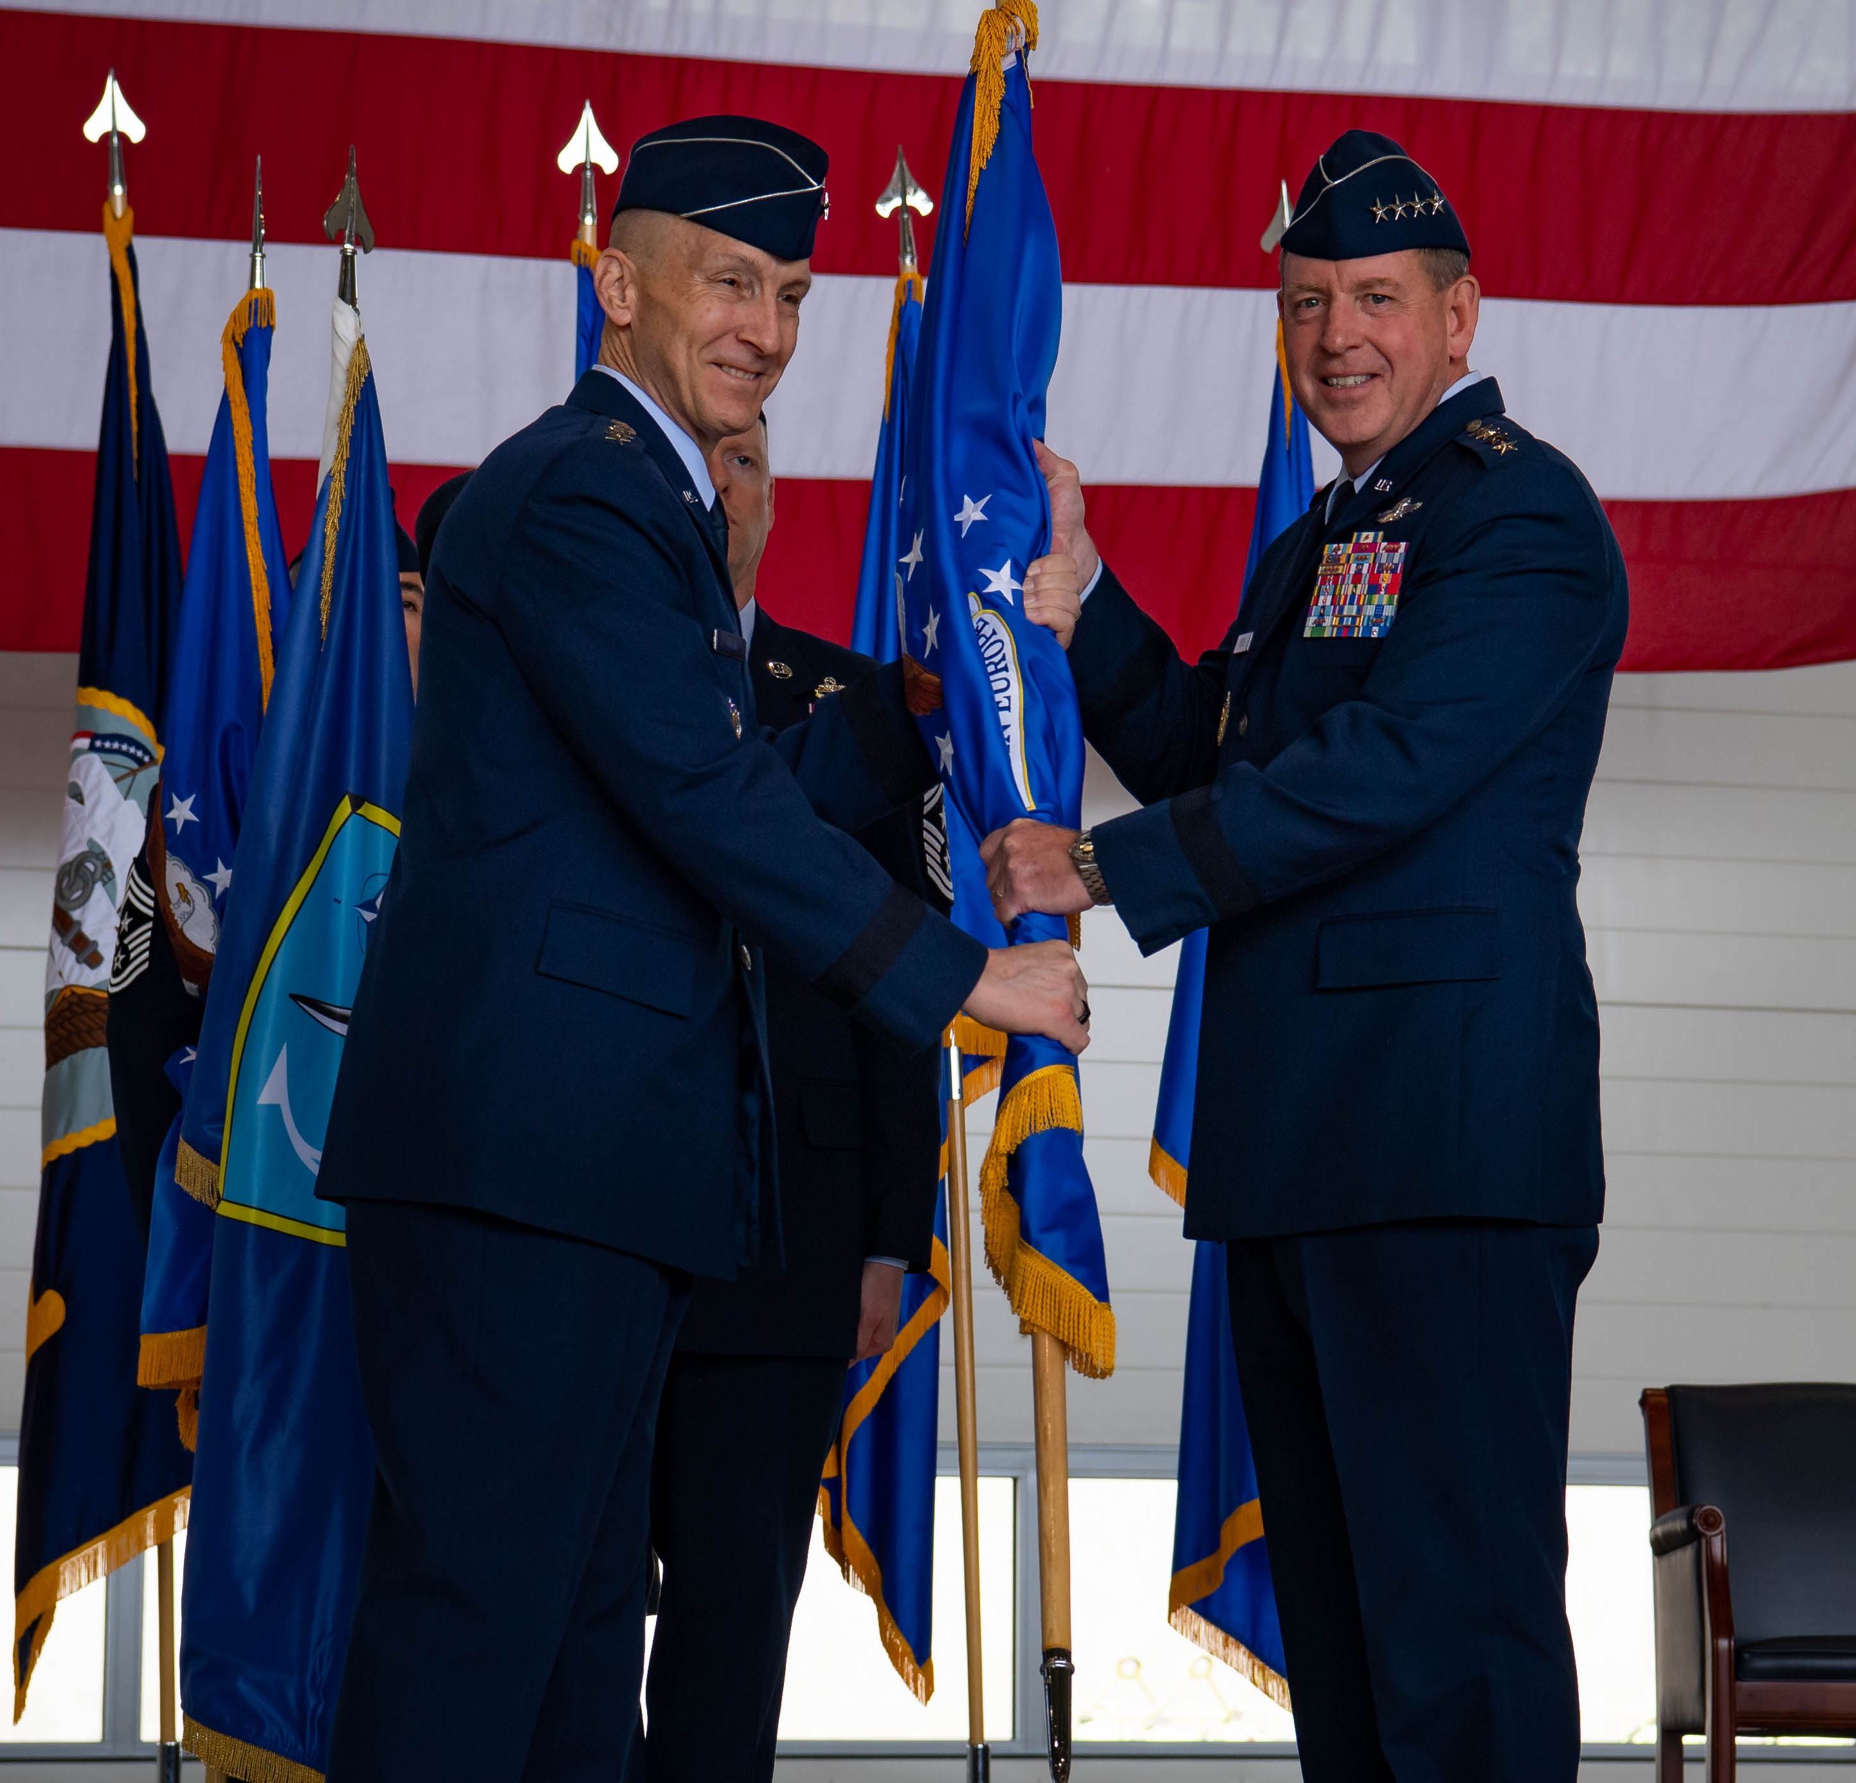
Test Execution Method: Trust measures
Description:
Calibrated measures of the human operator’s or commander’s confidence in relying on the system
Analogous to human training:
Combat commanders deploy and employ combat forces based on their understanding of combat units' and platforms capabilities and limitations, which may differ among individuals. Operators' capabilities grow with time and experience.
Intended Results:
Commanders and operators can appropriately delegate authority to and employ AMS, based on correct capability performance and suitability, as system performance changes over time.
Best Practices
Use of emerging human trust and teaming measures that specify the types or categories of trust involved, throughout the stages of system development and employment.
Challenges Addressed:
Human-system teaming Test adequacy and integration
Requirements and measures Testing continuum
Method Benefits:
Calibration of human trust in autonomous military systems enables appropriate matching of AMS capabilities with missions and tasks, without unnecessary cost or risk.
Costs, Limitations, Assumptions:
Limitations on the current state of the art for human trust calibration, categorization, and measurement. Assumption that all relevant human-system interactions are identified.

Slide 50
Methods for Addressing Challenges with Data Analysis
Method for Data Analysis | Short description
Automated outlier search and Boundary testing | Automate the search for outliers in the system response/outputs or for the safe or effective boundaries of system operational conditions by using statistical tools
Failure path testing | Automate the search for conditions or inputs that can cause unexpected system failure
Human operator performance standards | Apply specific measures of performance, suitability and effectiveness based on human operator training standards and proficiency standards

Slide 51
Data Analysis Method: Automated outlier search and Boundary testing
Description:
Automate the search for outliers in the system response / outputs or for the safe or effective boundaries of system operational conditions by using statistical tools
Analogous to human training:
Operators' employment of their systems are bounded by the systems' operations limits, such as min and max airspeed, altitude, G-loading, engine limits, flight control limits, and weapon employment limits.
Operators also must avoid prohibited maneuvers, such as unusual attitudes, spins, stalls, and abrupt maneuvers.
Intended Results:
Testers can efficiently characterize the safe and effective regions of autonomous system operation within the full, physics-based operating environment.
Best Practices
Automate the search for outliers or nonlinearities in the system response/outputs by using statistical tools such as rapid sequential testing.
Challenges Addressed:
Safety Data
Simulation Test adequacy and integration
Method Benefits:
Application of STAT processes can allow efficient, effective, robust test planning and execution that provides maximum T&E information with minimum costs.
Costs, Limitations, Assumptions:
Assumption that sufficiently representative models and simulations exist for the AMS that can provide adequate response results. Costs to integrate AMS models with statistical tools.
Tools that Support this Method:
RAPT (TRMC), Boundary Explorer (STAT COE), MARGInS (NASA)

Slide 52
Data Analysis Method: Failure path testing
Description:
Automate the search for conditions or inputs that can cause unexpected system failure
Analogous to human training:
Operators study and practice emergency procedures to deal with system and subsystem failures that occur. Operators train with processes like Crew Resource Management that walk-through emergency indications, initial actions, checklist procedures, and considerations for breaking a chain of events that can lead to catastrophic failures, and to recover successfully after one.
Intended Results:
Accurate T&E insight into AMS failure inputs and conditions, including the steps to avoid or steps to take to ensure failures do not occur.
Best Practices
Use of automated failure path testing tools to efficiently and robustly evaluate the autonomous system and its operations.
Challenges Addressed:
Safety Simulation
Human-system teaming Test adequacy and integration
Method Benefits:
Allows efficient and robust methods for testing all combinations of operating environments, system conditions, inputs, and interactions, which otherwise would likely be either prohibitively costly or insufficiently robust. Designed to detect unit-level faults and work
backwards to expose them at the system level.
Costs, Limitations, Assumptions:
Assumption that sufficiently representative models and simulations exist for the AMS that can provide adequate results. Costs to integrate AMS models with test tools.
Tools that Support this Method:
Robustness Inside Out Testing (RIOT) (TRMC), AdaStress (NASA)

Slide 53
Data Analysis Method: Human operator performance standards
Description:
Apply specific measures of performance, suitability and effectiveness based on human operator training standards and proficiency standards
Analogous to human training:
Human operators have training and proficiency standards that they are evaluated against for mission and system control tasks.
Intended Results:
T&E insights into autonomy Perception, Reasoning, Deciding, Learning, Teaming, judgment, and control based on proven, measurable standards of performance for human operators.
Best Practices
Established operator and system standards applied in novel ways to evaluate the performance of autonomous military systems.
Challenges Addressed:
Requirements and measures
Human-systems teaming
Method Benefits:
Utilizes proven and accepted standards of human performance for evaluation of similar tasks that the system now performs autonomously.
Costs, Limitations, Assumptions:
Assumption that human operator standards exist and are relevant to the autonomous system. Limitation that some typically more subjective standards will require expert interpretation.

Slide 54
Methods for Addressing Challenges with Certifications and Accreditation
Method for Certification and Accreditation | Short description
Task based certification and evolution of standards | Certification of the autonomous system for limited operation of specific tasks with growth expected over time
Quantified risks and autonomy performance growth curves | Quantify various types of risks by using statistical techniques such as ones similar to reliability growth curves

Slide 55
Certifications and Accreditation Method: Task based certifications and evolution of standards
Description:
Certification of the autonomous system for limited operation of specific tasks with growth expected over time
Analogous to human training:
Operator certifications are not usually monolithic in scope, but role-based or task-based, such as co-pilot vs aircraft commander vs mission force commander; day-only vs night; SEAD; forward-air-controller; laser IR pod; or other advanced subsystems.
Intended Results:
Certification and standards tailored or calibrated to appropriately match AMS performance and suitability for specific missions and tasks.
Best Practices
Evolve certification standards as autonomy capabilities evolve, and as T&E and V&V methods for autonomy evolve
Challenges Addressed:
Requirements and measures Test continuum
Test adequacy and integration Human-systems teaming
Method Benefits:
Allows autonomous system performance tailoring for mission tactics and threats, such as theater-specific or mission-specific tactics and threats that may prompt tailored T&E and re-training events and subsequent certifications.
Costs, Limitations, Assumptions:
Assumptions that the AMS will improve and expand capabilities over time, through continuous development, continuous integration, continuous test, and continuous delivery processes.

Slide 56
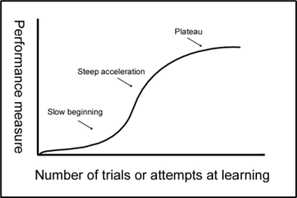
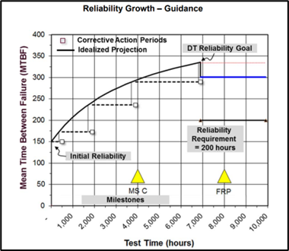
Certifications and Accreditation Method: Quantified risks and autonomy performance growth curves
Description:
Quantify various types of risks by using statistical techniques such as ones similar to reliability growth curves
Analogous to human training:
Humans have a "learning curve" for their speed and proficiency levels at learning and performing difficult tasks. Learning curves can vary depending on the task, the individual, and factors involved.
Intended Results:
Accurate, calibrated and quantified evaluation of autonomous military system risks and performance outcomes.
Best Practices
Differentiate between critical failures, major failures, and minor failures or deficiencies in mission effectiveness.
Challenges Addressed:
Requirements and measures
Human-systems teaming
Method Benefits:
Commanders and operators gain insight into autonomy improvement rates, not just a static snapshot.
Costs, Limitations, Assumptions:
Assumptions that the AMS will improve and expand capabilities over time, through continuous development, continuous integration, continuous test, and continuous delivery processes.
Notes:
May have different categories of trust to measure (MTBF) based on risk:
Critical failures – put friendlies or non-combatants in increased danger
Major failures – cause ineffective missions
Minor failures – make effective missions more costly, time-consuming, or difficult

Slide 57
Autonomy T&E Infrastructure, Tools, and Resources
Test labs & test range support for AMS T&E
Guide will include contact information
Software tools for AMS T&E
TRMC
DARPA
NASA and other sources

Slide 58
Test Labs & Test Range Support for AMS T&E Land System Test Labs and Ranges
Army Test and Evaluation Command, Aberdeen Test Center
ASTC-DRIVE: Autonomous Systems Test Capability – Digital Robotic and Autonomous Systems Integrated Virtual Environment
Unmanned Ground Vehicle Unreal M&S Tool – virtual environment
Virtual Leader with Live Follower link
Range Adversarial Planning Tool (RAPT) – TRMC software tool
Data Collection, Reduction, Validation, Analysis tool
Robustness Inside-Out Testing (RIOT) – TRMC software tool
VANE – Weather Obstacles, Time of Day, Sensors tool
Software integration lab
High-performance computing lab
Hardware in the Loop test capabilities
ATC Roadway Simulator - Land vehicle test treadmill
ATC EMI Chamber – Electromagnetic interference test
5G wireless communications
ASTC-SEER: Safety Environment, Engagement and Response
Intelligent Emergency Stop
Anomaly Detection
Mobile Safety Zone
Geo Fencing
Current as of summer 2022

Slide 59
Test Labs & Test Range Support for AMS T&E Maritime System Test Labs and Ranges
Naval Surface Warfare Center, Carderock Division
SAFENAV – Modular Architecture and Mission Use-Case
Wave field sensing
Traffic density and waterspace management
Platform specifications
NATS – Naval Autonomous Systems Testing Capabilities
Digital Test Range Web Interface
Metrics and Scenario Design Tools
Simulation, live, virtual, and constructive
Range Adversarial Planning Tool (RAPT) – TRMC software tool
Hardware in the Loop testing
ALICe – Autonomy Lab and Integration Center
Lab afloat and lab ashore
Perception lab
Hardware in the Loop enclave
Test surrogate platforms and safety boats
MACSUV – Maneuvering and Control Simulator for Underwater Vehicles
Design and performance prediction and optimization
Control and dynamics applications
Current as of summer 2022

Slide 60
Test Labs & Test Range Support for AMS T&E Maritime System Test Labs and Ranges (Cont.)
Laboratory for Autonomous Systems Research, NRL
LASR Facility Environments
Desert High Bay – Sand pit and climbing walls
Tropical High Bay – Jungle environment, canopy catwalk, water feature
Woodland – Rock canyon, water feature, boulders, vegetation
Littoral High Bay – Wave pool, shoreline, sediment tank
Prototyping High Bay – Localization system for air/ground testing, acoustics
Laboratories and Equipment
Sensor testing – Anechoic chamber, air testing, wind tunnel
Robot interaction labs – ceiling infrastructure
Power and energy development labs – Battery dry room, glovebox, solar simulator
Specification tools and database for autonomous system behaviors
Rapid Autonomy Integration Lab, PMS-406
Development process and infrastructure for autonomy algorithm development.
Continuous authority-to-operate (c-ATO)
DevSecOps software test environment,
Simulation testbeds for software and hardware in the loop tests
Data integration
Mission planning frameworks
Current as of summer 2022

Slide 61
Test Labs & Test Range Support for AMS T&E Additional Test Labs and Ranges
Sensors and Autonomous Systems Experimental Facility, Adelphi Laboratory Center, MD
Emerging Technologies Combined Test Force, Air Force Test Center, Edwards AFB, CA
96th Operations Group, Air Force Test Center, Eglin AFB, FL
Naval Test Wing Pacific, Naval Air Warfare Center, NAS China Lake, CA
Others … ?

Slide 62
Tools for Autonomous Military Systems T&E
Each tool listed is assessed for basic criteria of interest to test practitioners
Name and source of the tool
Which specific challenges does it help address, and how?
What additional benefits can be gained in using it?
What assumptions, limitations or costs does the tool involve?
How easy is the tool to setup and use?
Example: R2U2
R2U2 (Realizable, Responsive, Unobtrusive, Unit)
NASA Ames/Iowa State University/Aero Space Engineering http://r2u2.temporallogic.org/
Runtime assurance/monitoring engine bringing system health and safety management to mission critical systems. Uses temporal logic runtime observers, in combinations with tiny Bayes Nets for System Health Management
Extensible to different architectures (hardware and software) including FPGA, software on a microcontroller, in software on the flight computer, or both hardware and software on a hybrid cyber-physical system
Reconfiguration without resynthesis, monitoring without software instrumentation
Limitations: Relies on other software packages to convert the Bayesian network into an Arithmetic Circuit; No GUI; Signal processing filters must be customized; Observation tree models must be set up individually for each new application
Cost: Free download available on website
Ease of Use : Requires familiarity with other tools to develop prerequisites (convert Bayesian network); not currently GUI based and therefore has a steeper learning curve; Linux-based

Slide 63
Autonomy T&E TRMC Toolkit
Test Resource Management Center (TRMC) has developed several autonomy and AI test tools through their science and technology program. These tools are intended to improve DoD’s ability to test autonomous, unmanned, artificial intelligence, and machine learning systems.
Tool Name | Related Method | Tool Description
RAPT – Range Adversarial Planning Tool | Automated outlier search and Boundary testing | Completed in 2019, provides a suite of test scenario inputs that would normally be too large to select from manually. Test selection tool runs thousands of simulations to seek out boundary conditions in performance based on initial parameter values to direct live testing and focus on tests where performance is uncertain. Necessary requirements to implement use of RAPT include a simulation for the system under test and a scalable computing resource like a high-performance computing cluster.
RIOT – Robustness Inside-Out Testing | Failure path testing | Completed in 2020, provides scalable robustness testing for node-based autonomous systems. Allows the test practitioner to define invariant safety rules that should never be violated, and identifies bug-triggering inputs that cause invariants to be violated. Enables search for the minimal test cases that cause the bug to facilitate generalization of the bug causes into a broader rule. Necessary requirements to implement RIOT include having a node-based or message-based autonomous system.
MIMIC – Modeling Intelligent Machines in Complex Environments | LVC and simulation testing | In development through Johns Hopkins University Applied Physics Lab. The tool provides scalable testing of autonomous systems in simulation. It operates by creating a deep learning imitator of the system under test, which can then be used for large scale parallel testing, discovery of uncertainty conditions, or use in multi-agent simulation. Necessary requirements include a simulation of the system under test.
SAFE – Automated MIL-STD-882E Safety Case Evaluation for UxSs | Failure path testing | In development. Addresses safety on complex autonomous systems which cannot achieve exhaustive testing, by automating creation of complex fault trees for predicting probability of safety faults during tests. Necessary requirements include a functional model of the system under test, and hazards for traceability.
ICE-T – Image Classifier Evaluation Technology | Quantified risks | In development. Addresses validation data and test data for image-based classifiers and detectors. Intended to stress test machine learning systems to find example cases where system performance is brittle by developing a continuous risk analysis platform to validate the reliability of machine learning across a range of conditions, including new post-fielding conditions.
BAST – Built-In Adaptive Systems Test | Quantified risks | In development. Addresses monitoring and testing of adaptive systems that continue to learn after deployment. It is intended to detect when the autonomous system’s operating environment is out of domain by characterizing the domain of operation and determining if prior verification and validation conditions hold.

Slide 64
Autonomy T&E DARPA Assured Autonomy Toolkit
Defense Advanced Research Projects Agency (DARPA) developed several software-based tools to aid in autonomy T&E. Some tools apply more to software developers than to independent testers. The below tools (and more) are available at the DARPA ASSURED AUTONOMY TOOLS PORTAL found at: https://assured-autonomy.org/tools
Tool Name | Related Method | Tool Description
VerifAI | Formal verification | A software toolkit for the formal design and analysis of systems that include VerifAI artificial intelligence (AI) and machine learning (ML) components.
Marabou | Formal verification | A framework for verifying deep neural networks. It can answer queries about a network's properties by transforming them into constraint satisfaction problems, accommodate networks with different activation functions and topologies, and perform high-level reasoning on the network to reduce search space and improve performance.
ReachModelPlex | Formal verification | Integrates the ModelPlex monitor and reachability analysis for monitoring a reinforcement-learning-based Dubins path following controller and recovering from unsafe control.
Scenic | LVC and simulation testing | A domain-specific probabilistic programming language for modeling the environments of cyber-physical systems like robots and autonomous cars.
Trinity-PC | Quantified risks | A tool to quantify uncertainty in machine learning models using predictive coding.
AAHAA | Quantified risks | Architecture and Analysis for High-Assurance Autonomy.
AdvoCATE | Assurance cases | Supports the development and management of safety/assurance cases.
RAA-LEC | Adversarial testing | Robustness to Adversarial Attacks in Learning-Enabled Controllers. Finds adversarial attacks and synthesizes shields to defend the system against them.

Slide 65
Autonomy T&E Tools from NASA and other sources
Other DoD organizations, and the National Air and Space Administration (NASA) branch at the Ames research center, Intelligent Systems Division, have developed several tools for T&E of autonomous systems. Additionally, commercial and industry sources like Google have published some potentially useful T&E tools.
Tool Name | Related Method | Tool Source
Boundary Explorer | Boundary and outlier search | STAT COE
AFSIM | Multi-domain simulation | AFRL
DAD | Autonomy Requirements | CNA
R2U2 | Runtime assurance | NASA Ames
IKOS | Static code analysis | NASA Ames
FRET | Automated requirements analysis | NASA Ames
AdaStress | Automated outlier search | NASA Ames
MARGInS | Failure path testing | NASA Ames
ACedit | Assurance case usage | Google

Slide 66
Autonomy T&E Lexicon
For the purposes of providing a common reference to enable education, learning, and collaboration among DoD T&E, autonomy and AI organizations, a lexicon is put forth
Authoritative references within the DoD, US government, and industry were consulted in that order of precedence
As such, these definitions should be considered “in use” definitions for relevant organizations within the AI-enabled autonomy T&E community, rather than immutable facts
Terms include: (not exhaustive list)
accuracy | algorithmic bias | Bayesian learning | black box testing | computer vision
cyber-physical system | deciding | deep learning | emergent behavior | explainable AI
formal methods | genetic algorithm | generative adversarial network | gradient descent | human in the loop
human on the loop | inference | label | LVC | machine learning
natural language processing | neural network | online learning | offline learning | overfitting
perception | precision | reasoning | recall | supervised learning
unsupervised learning | training data | transfer learning | unit testing | validation data
66

Slide 67
Future and Related Topics
STAT Approach to AI Datasets
Autonomy as C2 Modeling the OODA Loop

Slide 68
STAT Approach to AI Datasets
Challenge: Ensuring ML systems perform in robust conditions – avoiding “brittle” solutions
Often data used to create machine learning algorithms is uncharacterized, or worse unlabeled
A large data set may be considered ‘representative’ without understanding the full range of features of the data set
This may cause failures or problems when real-world data includes variation not present or under-represented in the data set
Notional Example: Facial recognition algorithm developed using college student pictures
Method: Design of Experiments approach to characterizing ML datasets
By characterizing the data using DOE methods, features of the data become understood
Requires effort to label (meta)data
This may allow some evaluation of ML systems without even performing testing
Could prioritize testing of under-represented features of the data
Result: More effective understanding of system capabilities, limitations, and risks
Helps operators use the system appropriately and developers focus on improving shortcomings
Index | Wrinkles | White hair | Bald | Data Points
1 | + | - | + | 0%
2 | + | + | - | 0%
3 | + | - | - | 0%
4 | - | + | + | 0.1%
5 | - | + | - | 0.4%
Index | Day | Clutter | Precip | Data Points
1 | + | - | + | 6%
2 | + | + | - | 18%
3 | + | - | - | 4%
4 | - | + | + | 12%
5 | - | + | - | 9%

Slide 69
Autonomy as C2 Modeling the OODA Loop
Shared CONOPS
MDO Scenario Coverage
Observe
Orient
Decide
Act
Sensors
PNT
System status
Comms
Teammates
Engage
Abort
Delay
Communicate
Adjust
Independently
Cooperatively
Approvals
Monitoring
Triggers to adjust
Time constants
Threats
Protected
Neutral
Environment
Shared Operational View
Standardized C2 and Interfaces
Prioritization of Threats
Priority Comms for Cooperation
Prioritization of Tasks
Noise, Uncertainty, Deception
Understanding Team Capabilities
Trust and Exploitability
Safety of Test
Local Optimal Solutions
Safety of Operations
Global Optimal Solutions
Human Intervention
Success Criteria
Truth Data /
Test Oracle
Forecasting Future States

Slide 70
Autonomy T&E Community Resources
Access to subject matter experts from across the DoD, US government, industry and academia will enable continued sharing of lessons and methods
Continued coordination, collaboration and cooperation will facilitate the continued joint effort needed to update, maintain, and expand best practices and lessons
Draft Test and Evaluation Companion Guide for Autonomous Defense Systems is a community effort intended to serve the greater DoD community
The Guide is incomplete
Challenges can be better defined and characterized
Methods can be added, expanded, clarified, or combined
Tools must be identified, referenced, assessed, and disseminated
This document ought to be available online, through proper channels, to all members
Our vision for this document is as a living, expanding resource
By allowing collaboration in this manner, this guide will leverage the collective networked expertise federated throughout the DoD
Welcome Feedback, Recommendations, and Suggestions to improve the guide

Slide 71
T&E Companion Guide for Autonomy Draft Outline and Content
T&E Companion Guide - Outline
1. Introduction
2. Autonomy Policies
3. Background and Context for AMS T&E
3.1 T&E Context
3.2 Autonomy Relation with AI & ML
4. AMS T&E Challenges
4.1 Central T&E Challenges
4.2 Specific AMS T&E Challenges
Methods Addressing Challenges
5.1 Where to begin
5.2 Methods and Lessons Learned by Test Phase
AMS T&E Resources
6.1 Test labs & test range support for AMS T&E
6.2 Software tools for AMS T&E
6.3 Expertise in DoD for AMS T&E
Summary and Way Ahead
A-1 Lexicon
A-2 References
12 AMS T&E Challenges
Data
Requirements & measures
Infrastructure & personnel
Exploitable vulnerabilities
Safety
Simulation
Example Methods
Assurance cases
LVC testing
Automated requirements
Continuous testing
Formal verification
Surrogate platforms
Example Tools
TACE, R2U2
Boundary Explorer
MARGInS, AdaStress
+ TRMC Toolkit
Human system teaming
Post-acceptance testing
Design for test
Test adequacy & integration
Testing continuum
Testing for ethics & legal
Fuzzing
Runtime assurance
Automated software test
STAT for autonomy
Autonomy measures
Automate outlier search
Adversarial testing
Human teaming measures
RAPT, RIOT
FRET, IKOS
ACedit, AdvoCATE
+ DARPA Assured Autonomy site
The guide is the primary means of capturing autonomy T&E lessons learned
Key contributors include Dr. David Tate and Dr. David Sparrow, Institute for Defense Analyses

Slide 72
Discussion / Questions
Outline of the Draft T&E Companion Guide for Autonomous Systems
Introduction, Background, and Challenges for Autonomy T&E
Framework and Analogy for Addressing Autonomy T&E Challenges
Specific Methods for Addressing Challenges and Tools for Implementing Methods
Additional Content
Other Formats
Path Ahead for the Draft Guide
Distribution
Hosting
Other community feedback is desired on Guide organization, content, and details

Slide 73
Visit, www.AFIT.edu/STAT
Email, AFIT.ENS.STATCOE@us.af.mil

