Slide 1
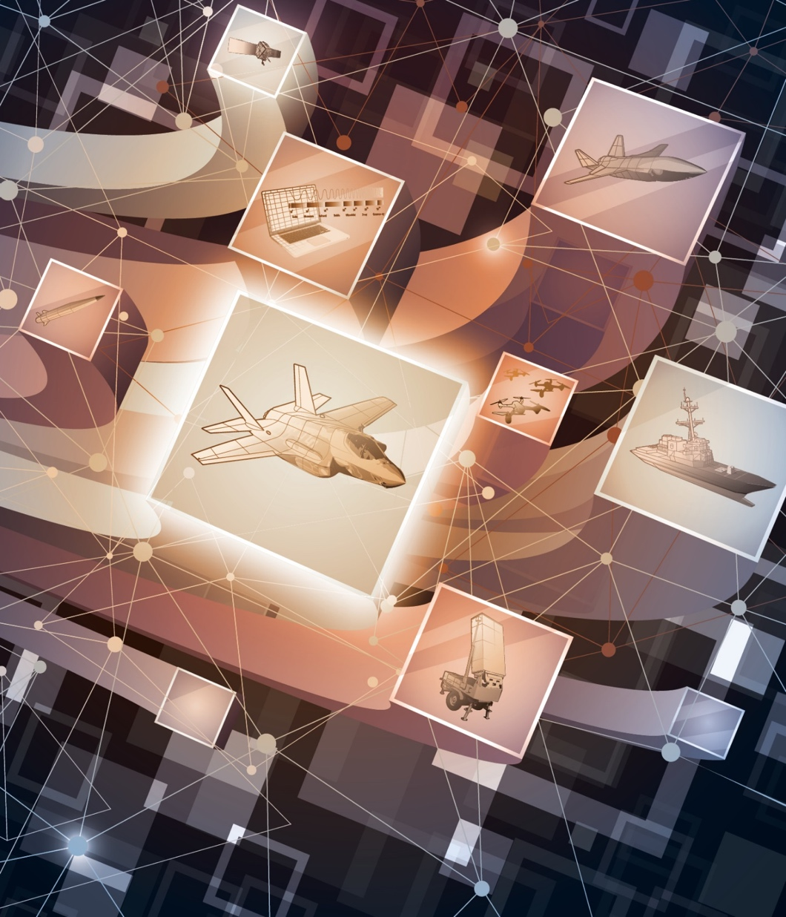
Necessary DoD Range Capabilities to Ensure Operational Superiority of U.S. Defense Systems
MITRE SLIDES Approved for Public Release; Distribution Unlimited, 22-2123
Notes:
The future viability of DoD’s range enterprise depends on addressing dramatic changes in
technology, rapid advances in adversary military capabilities, and the evolving approach the United States
will take to closing kill chains in a Joint All Domain Operations environment. This recognition led DoD’s
Director of Operational Test and Evaluation (OT&E), the Honorable Robert Behler, to request that the
National Academies of Science, Engineering and Medicine examine the physical and technical suitability
of DoD’s ranges and infrastructure through 2035.

Slide 2
“Everyone will have weapons we have – key is how we integrate it into combined arms”
- Mr. Behler, former Dir DOT&E

Slide 3
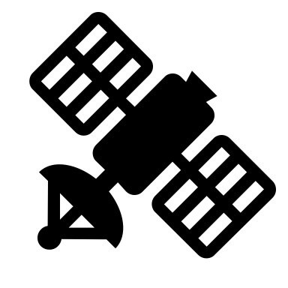
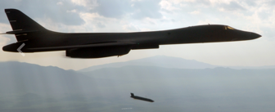
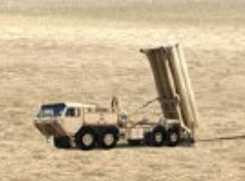
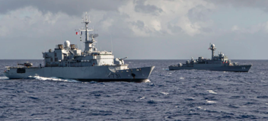
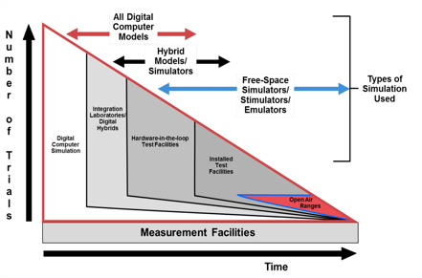
What is different with Multi-Domain?
System Focus
Mission Focus
Fusion Decision
Shooter
Sensor
?
3
© 2022 THE MITRE CORPORATION. ALL RIGHTS RESERVED.
Notes:
Photo – af.mil/photos; army.mil/photo; navy.mil/resources
Test to answer questions/inform decisions:
Data Fusion? Fires logic?
CONOPS? Timing?
Authorities? HMI?
Scenarios at scale
What is the mechanism to drive a MD test?
Current test forces are largely aligned to weapon systems
There exists a need for means to support sustained funding of multi-domain exercises and environment for test aligned to multi-domain threads and requirements
“Success no longer goes to the country that develops a new technology first, but rather to the one that better integrates it and adapts its way of fighting”
What is different today is how
capabilities in different domains are tightly integrated, how much more effective operations can be by
taking advantage of such integration, the speed at which information is exchanged, and how new
technologies affect the effectiveness of this integrated capability.

Slide 4
NECESSARY DOD RANGE CAPABILITIES TO ENSURE OPERATIONAL SUPERIORITY OF U.S. DEFENSE SYSTEMS
Phase 1 Study Objective - Unclassified
Assess the physical and technical suitability of DoD’s ranges, infrastructures, and tools used for test and evaluation of military systems’ operational effectiveness, suitability, survivability, and lethality across all domains in the 2025-2035 timeframe
4
Notes:
Behler guidance “everyone will have the weapons we have, secret is how to integrate it into combined arms?”
Committee
DANA “KEOKI” JACKSON, MITRE Corporation, Chair
DARRYL AHNER, Air Force Institute of Technology
KAREN BUTLER-PURRY, Texas A&M University
GRAHAM V. CANDLER, University of Minnesota
GORDON FORNELL, United States Air Force, Retired
DERRICK HINTON, Scientific Research Corporation
ROB KEWLEY, stimlytics.cloud, LLC
LAURA J. MCGILL, Sandia National Laboratories
HANS MILLER, MITRE Corporation
HEIDI C. PERRY, Massachusetts Institute of Technology Lincoln Laboratory
GARY POLANSKY, Sandia National Laboratories
KARL F. SCHNEIDER, Department of the Army, Retired
WILLIAM WILSON, Carnegie Mellon University

Slide 5
Key Findings – Major Themes
Future combat will demand connected kill chains in a joint all-domain operations (JADO) environment;
Digital technologies are dramatically reshaping the nature, practice, and infrastructure of test; and
Speed-to-field is today’s measure of operational relevance.
Aggressive action is required by the DoD
otherwise the test ranges will be physically and technically inadequate to address the future fight
5
Notes:
Future combat will demand connected kill chains in a joint all-domain operations (JADO)
environment. DoD acquisition processes,
organizational stovepipes, test methods, and range infrastructure that were optimized for the
testing of individual weapon systems in single domains will be inadequate to test future
integrated weapon systems in the way that they will be operated in machine-speed warfare that
crosses all combat domains, including land, sea, air, space, cyber and the electromagnetic
spectrum.
Digital technologies not only changing the nature of what we test but the advent of digital twins and high-performance
modeling and simulation (M&S) is enabling new ways of testing, and combinations of new
domains and operational constraints increasingly make virtual testing the only practical
approach for certain applications.
And speed to field is driving different acquisition practices and a constantly sharing

Slide 6
Key Challenges Raised
Developing new testing capabilities
Limited space and encroachment
Integration
Modeling & simulation
Measurement and data
Digital infrastructure
Cybersecurity
Workforce
Financial challenges
6

Slide 7
Recommendation Themes
Develop the “range of the future” to test complete kill chains in JADO environments.
Restructure the range capability requirements process for continuous modernization and sustainment.
Bootstrap a new range operating system for ubiquitous M&S throughout the weapon system development and test life-cycle.
Create the “TestDevOps” digital infrastructure for future operational test and seamless range enterprise interoperability.
Reinvent the range enterprise funding model for responsiveness, effectiveness, and flexibility.
7

Slide 8
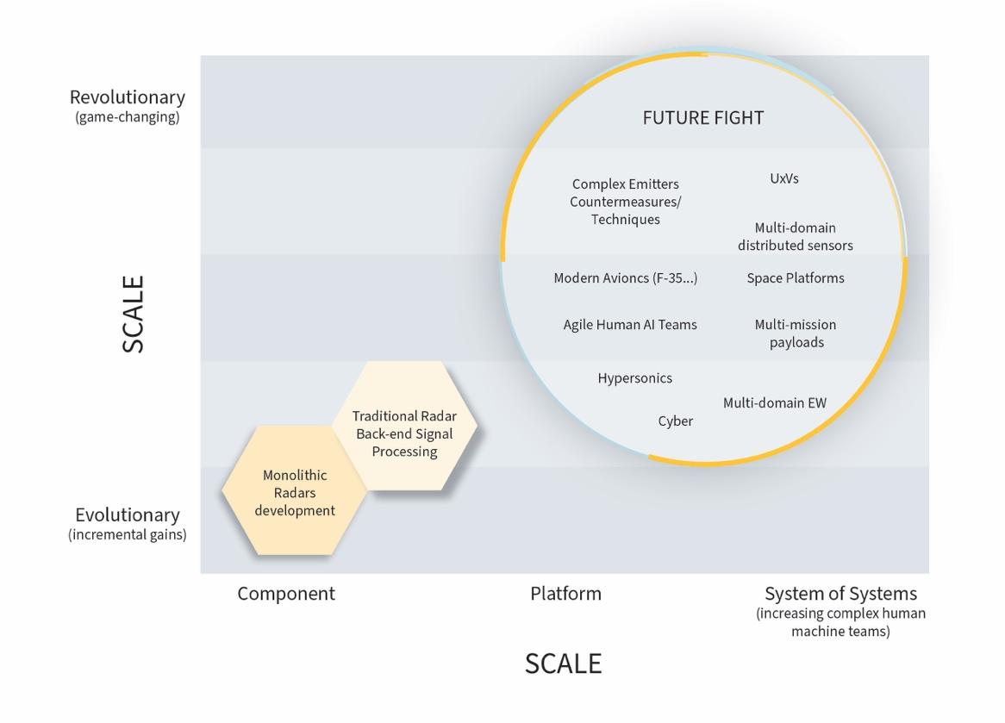
The Envisioned Future of Operational T&E Addresses:
Novel weapons and domains
Multi-domain operations and kill chains
Modeling & simulation
Data sharing, repositories, and accessibility
Funding and acquisition
Encroachment Mitigation
8

Slide 9
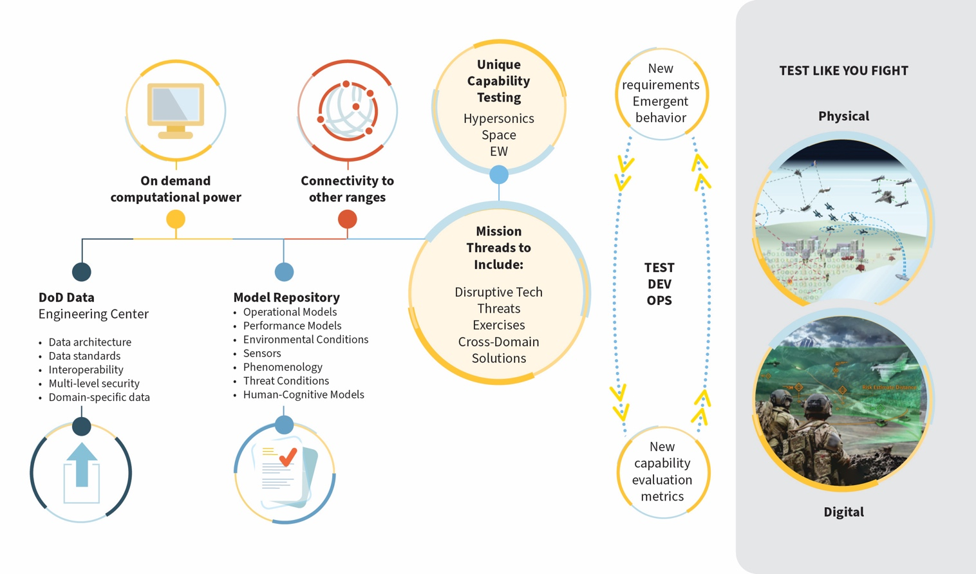
Notional Concept of the Test Range of the Future
9

Slide 10
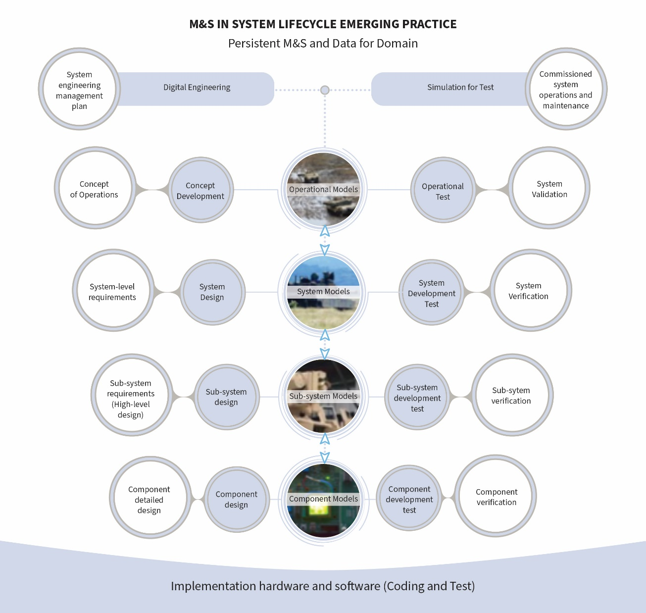
A New Paradigm for Integrating Testing with Simulation
10
Notes:
Office of the Secretary of Defense addressed the committee at the public workshop and shared successes
realized in the AEGIS combat system’s use of an onboard digital twin that can operate simultaneously with
the operational system.
An opportunity exists to further accelerate the pace of testing and to improve understanding of the performance of advanced technology systems by embracing a more integrated approach to development, testing, and simulation. In this approach, illustrated in Figure 4-3, DoD develops and sustains a persistent M&S and data environment for a particular military domain. As shown in the figure, a persistent M&S and data environment supports all phases of the life-cycle.
In the early phase, M&S supports concept development and digital engineering to inform requirements and rapidly assess the effectiveness of engineering choices. As system development begins, M&S supports developmental testing to verify the performance of components and sub-systems. Finally, M&S supports operational testing to validate the
system itself using realistic models of its operating environment throughout deployment to assess emerging operational uses as well as the effects of aging on system performance. Furthermore, M&S data and results are shared by different levels in M&S abstraction. For example, component and sub-system models are not necessarily re-used in system models, but their data and results enable the development of more abstract models suitable for system validation. Finally, M&S is not simply used to predict test results; it is used to focus testing in particular areas with the goal of driving down uncertainties in system-level understanding. Under this approach, M&S is sustained and evolves through the program life-cycle to support the system throughout its life-cycle deployment.
In considering the approach illustrated in Figure 4-3, it is important to keep in mind that programs
do not need to decide between testing and simulation. The issue is often framed in terms of the question
“Can simulation be used to replace testing (and reduce cost)?” when the better framing is to ask “How can
simulation be used with testing to maximize the effectiveness of advanced technology systems for the
warfighter?” The optimal strategy may involve integrating testing and simulation in a way that produces
the greatest value, maximizing understanding and minimizing the cost for testing the program.

Slide 11
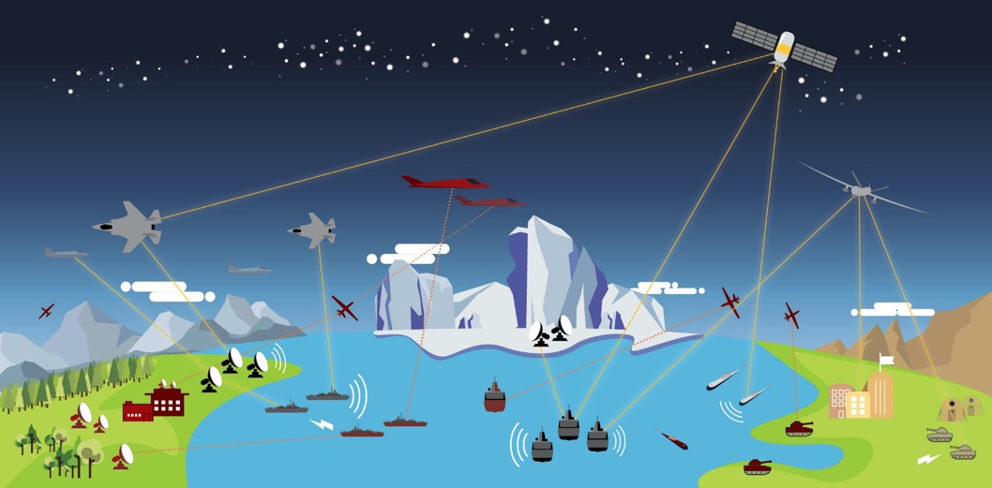
Test Complete Kill Chains in JADO Environments
Recommendation 3-1: To enable a range of the future that is capable of testing kill chains and multi-domain operations (MDOs) that can integrate effects across National Defense Strategy modernization areas, the Secretary of Defense should address the need to enable the DoD ranges to provide regular venues to “test as we fight” for acquisition and prototyping programs in a joint multi-domain battlespace of integrated systems.
11
Notes:
Current test forces are largely aligned to weapon systems
There exists a need for means to support sustained funding of multi-domain exercises and environment for test aligned to multi-domain threads and requirements
“Success no longer goes to the country that develops a new technology first, but rather to the one that better integrates it and adapts its way of fighting”
What is different today is how
capabilities in different domains are tightly integrated, how much more effective operations can be by
taking advantage of such integration, the speed at which information is exchanged, and how new
technologies affect the effectiveness of this integrated capability.

Slide 12
Joint Level Office for Multi Domain
A new organizational construct embodied in a joint program office is recommended to manage the framework for testing kill chains across systems and technologies. This office could:
Lead an effort across Joint Staff elements to define representative multi-domain use cases and to prioritize MDO and kill chain tests and associated test resources;
Provide inputs to prototypes, programs, and services on needed future developments based on MDO test results (Continuous “TestDevOps”)
Provide and advocate for funding to support execution of multi-domain test events and sustainment of capabilities needed to execute those events;
Establish a shared, accessible, and secure modeling and simulation (M&S) and data ecosystem to drive integrated development and testing across the life cycles of multiple supporting programs.
12
Notes:
without a
DoD infrastructure to provide common and maintained M&S, each program develops or acquires its own
models and emulators to support integration and test against various system interfaces and threats, including
command-and-control systems, cues from multiple sources, threat radars, targets, etc. This is inefficient
and will likely result in system deficiencies from the use of outdated or inaccurate model representations,
which are often developed by organizations that may not have expertise or full insight into those systems.
There must be a single, managed, trustworthy source for common DoD models that is maintained as part
of a core DoD infrastructure. One

Slide 13
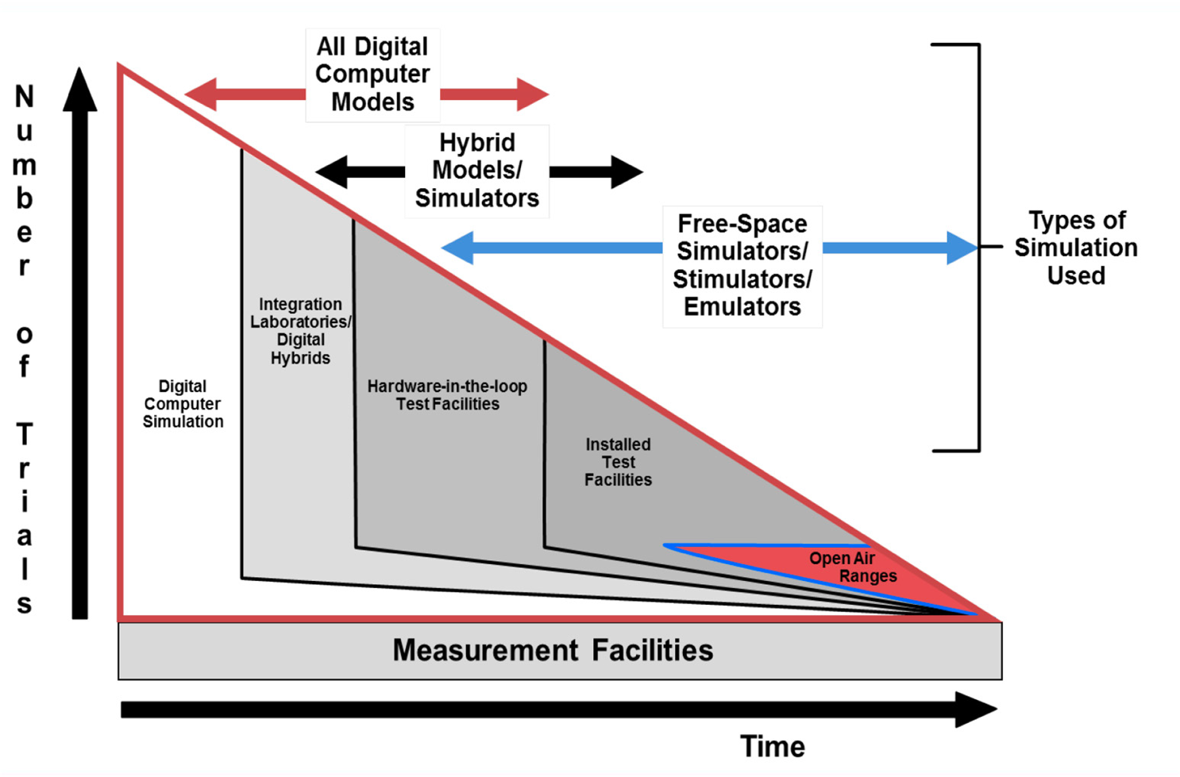
Time to Evolve The Image For T&E
This does not fully capture the relationships between M&S and physical testing and cyclic nature of those relationships
SOURCE: DAU
13
Notes:
M&S developed early in a program often not sustained – not a digital thread
Highlights role of M&S at program outset but with a diminishing role over time

Slide 14
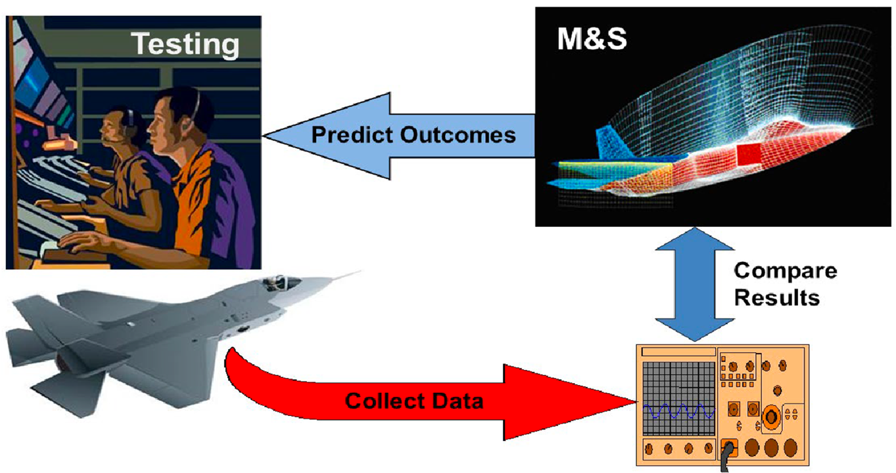
Time to Evolve The Image For T&E
SOURCE: DAU
This view does not fully exploit the power of modern M&S
14

Slide 15
Virtual or Physical?
Virtual and Physical
To use M&S to greatest effect, it will be necessary to integrate testing and simulation more closely than is currently the case.
15
Notes:
Simulation should not be viewed only as a replacement for testing or as an alternative that is less expensive or more convenient or that can be carried out in situations where physical testing cannot. Rather, simulation is a fundamentally different approach to testing systems that has its own benefits and advantages that are different from and complement those of physical testing. This means, in particular, that a thoughtful combination of simulation with testing can be much more powerful and effective than either simulation or physical testing alone.
A robust simulation environment provides understanding that physical testing cannot.
- the simulation environment can help a user understand the system’s margin in successful tests and identify—through Monte Carlo analysis, for example—those those systems that might have been on the edge of failure. Thus, integrating simulation with physical testing will yield a richer characterization of the system and its performance for the warfighter.
Embracing simulation will drive some testing needs.
The discipline of uncertainty quantification has matured to the point that it is possible both to understand the uncertainty in a simulation result and to understand what parameters drive that uncertainty. Testing can then be focused in a manner that maximizes its value in terms of driving down the overall uncertainty in a simulation and that consequently improves the understanding of the system.
Increased use of simulation at the program level can create opportunities at the campaign
level.
The increased use of simulation is unlikely to reduce the load on test ranges.
The flexibility offered by emerging systems increases the challenges in operational
test in demonstrating that the systems function properly across their entire potential application
space. A well-formed operational testing program will integrate simulation with live testing to maximize the demonstrated capability of the system. For many of the advanced technology systems, the threshold testing requirements to develop good confidence in the system will be substantial.

Slide 16
Representing the Operational Environment
Can we physically represent the Operational conditions in our live ranges?
Limitations
10111011101010010001000
Distances
Densities
Reserve Modes
Non-Kinetic Combined Effects
Dynamic Threat
10111011101010010001000
16
Notes:
Performance and credibility can only be demonstrated though testing of productive representative system in operational conditions, what are the operational conditions and can we physically represent them?

Slide 17
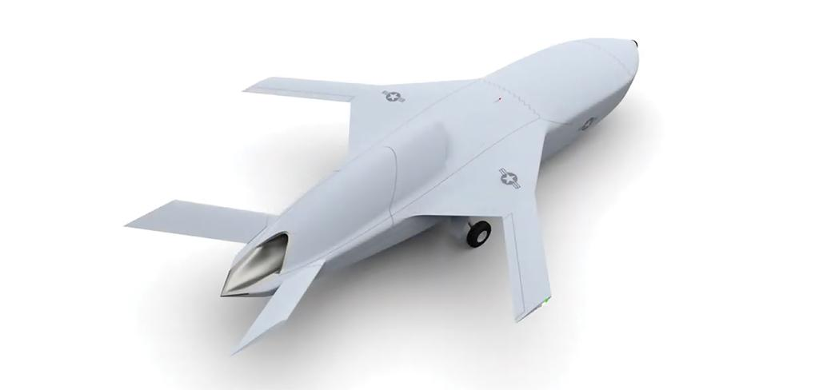
The Changing System Under Test
5000.2 Clear Production representative Milestone
5000.87 Rapid Software Iteration
How should test and evaluation SMEs inform a program to build data capture into the system?
Mission Environment
What data is collected and presented to “train” a machine learning system?
17
Notes:
Future systems inevitably change and evolve throughout testing, which makes it difficult to characterize their performance in a repeatable manner. (From Mr Cate) Overcoming this issue will require the testing enterprise to work closely with the system developers so that the AI-enabled and autonomous systems are designed from the start with tests in mind; in particular, he suggested, it would be useful to design these systems to collect all
the data that will be needed to characterize and judge their performance (NASEM, 2021).
Other top level decisions to support: (Not Just Program Decisions)
- Operational Feedback/Debrief
- What are maintenance reliability
- AI/ML training
- Mission optimization (which capability to use in given scenario)

Slide 18
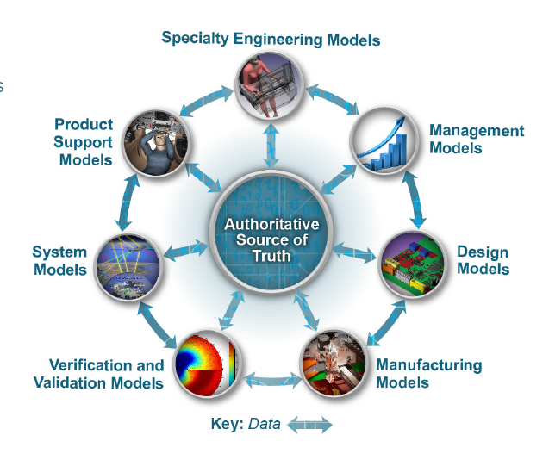
The Digital Thread
Physical
Virtual
Model Updates Over Lifecycle
https://www.acq.osd.mil/se/initiatives/init_de.html
18
Notes:
There will be multiple variants of the models and they will evolve with the lifecycle of the physical system

Slide 19
Continuous Test and Evaluation
Design
Build
Test
Release
Operate
Contractor
Gov’t
Contractor
& Gov’t
DATA
Gov’t
R&D
DT&E
OT&E
DATA
DATA
DATA
DT&E
User stories
Physical Test
OT&E
Automated Test Scripts
MODELING
SIMULATION
19

Slide 20
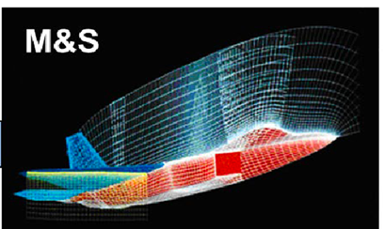
Design and Methodology to Reduce Model Uncertainty
Identify areas of uncertainty
Physical
Virtual
Prototype
SUT
Fielded System
Design test and data strategy
SUT = System Under Test
20

Slide 21
Evolving from the Wedge Model
Mission
Environment
Modeling and
Virtual Environments
Open
Air Ranges
Ground Test
Model and data Repositories
Physical World
21
Notes:
The future will have unexpected use-cases and unknown potential outcomes

Slide 22
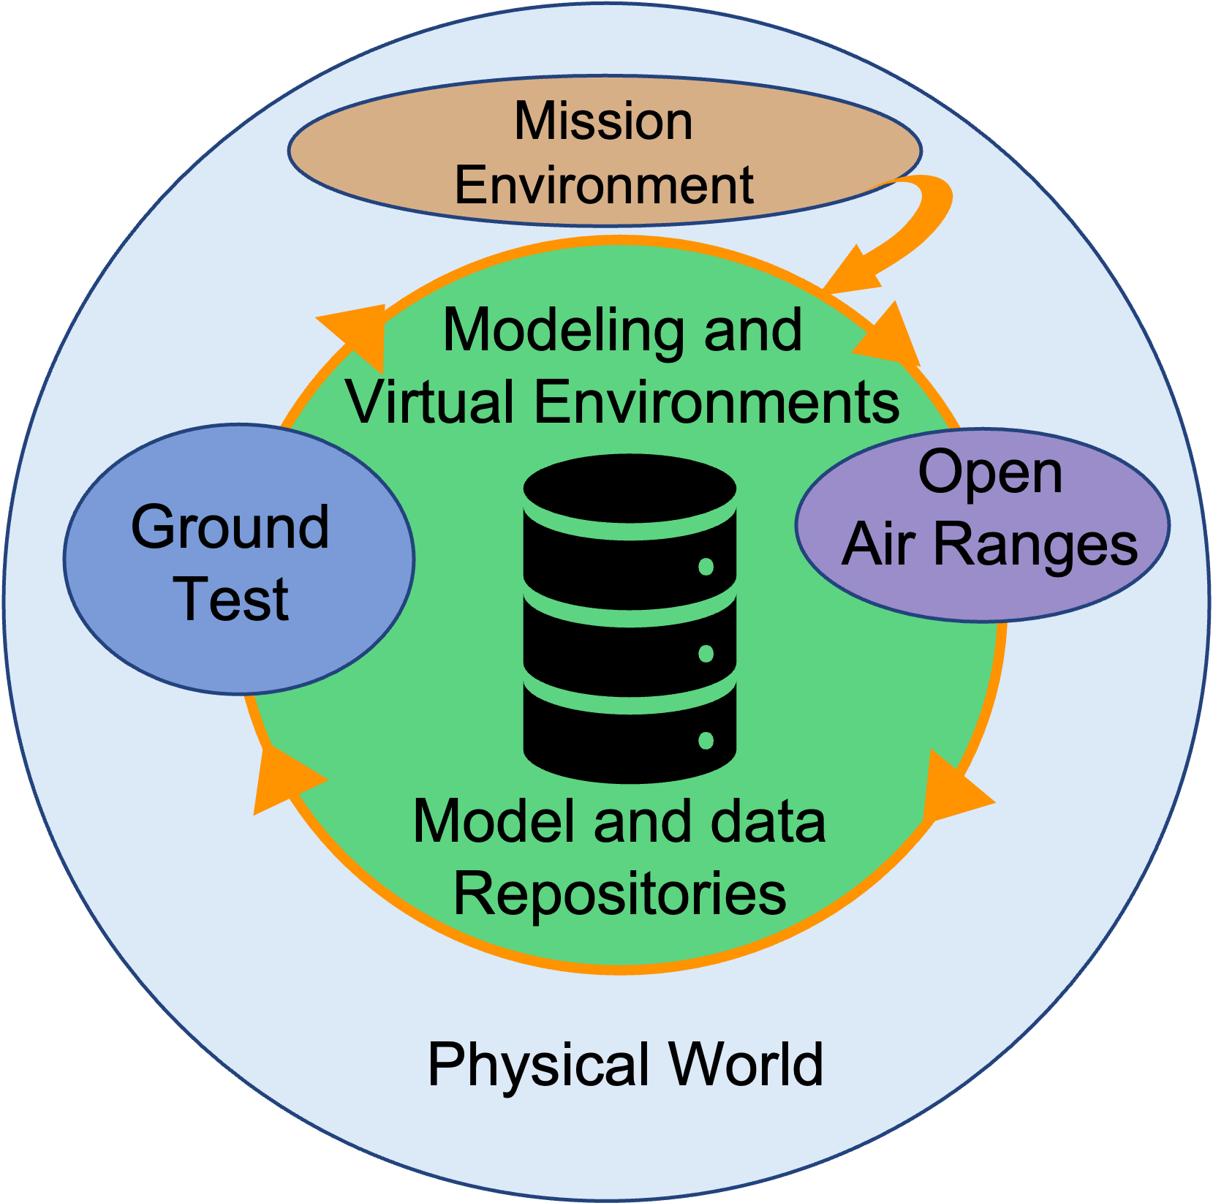
What is different with Multi-Domain?
System Focus
Mission Focus
Fusion Decision
Shooter
Sensor
22
© 2022 THE MITRE CORPORATION. ALL RIGHTS RESERVED.
Notes:
Photo – af.mil/photos; army.mil/photo; navy.mil/resources
Test to answer questions/inform decisions:
Data Fusion? Fires logic?
CONOPS? Timing?
Authorities? HMI?
Scenarios at scale
What is the mechanism to drive a MD test?
Current test forces are largely aligned to weapon systems
There exists a need for means to support sustained funding of multi-domain exercises and environment for test aligned to multi-domain threads and requirements
“Success no longer goes to the country that develops a new technology first, but rather to the one that better integrates it and adapts its way of fighting”
What is different today is how
capabilities in different domains are tightly integrated, how much more effective operations can be by
taking advantage of such integration, the speed at which information is exchanged, and how new
technologies affect the effectiveness of this integrated capability.

Slide 23
Questions / Discussion
23
© 2022 THE MITRE CORPORATION. ALL RIGHTS RESERVED.

