Slide 1

Digital Engineering as an Enhancement to Test & Evaluation
Dr. Nicole Hutchison
Research Associate Professor,
Virginia Tech National Security Institute
April 23, 2026

Slide 2
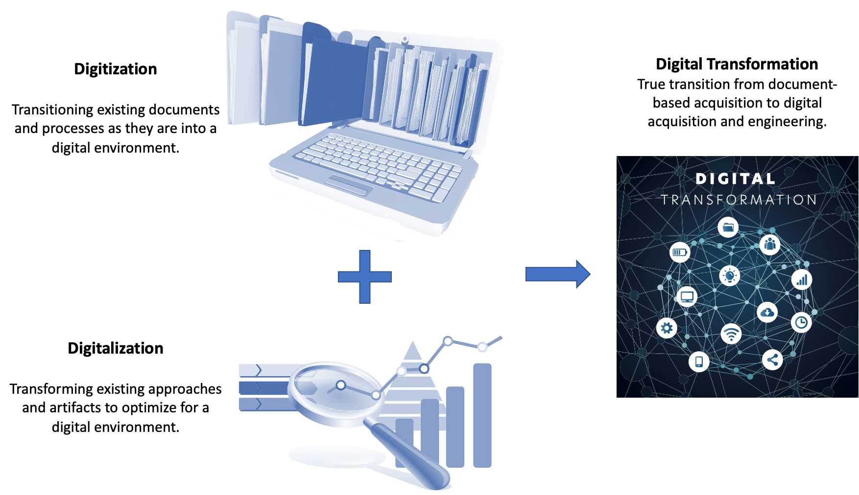
Paradigm Shift
Notes:
DT is NOT
Not tool adoption
Not a maturity ladder
Not a purely technical problem

Slide 3
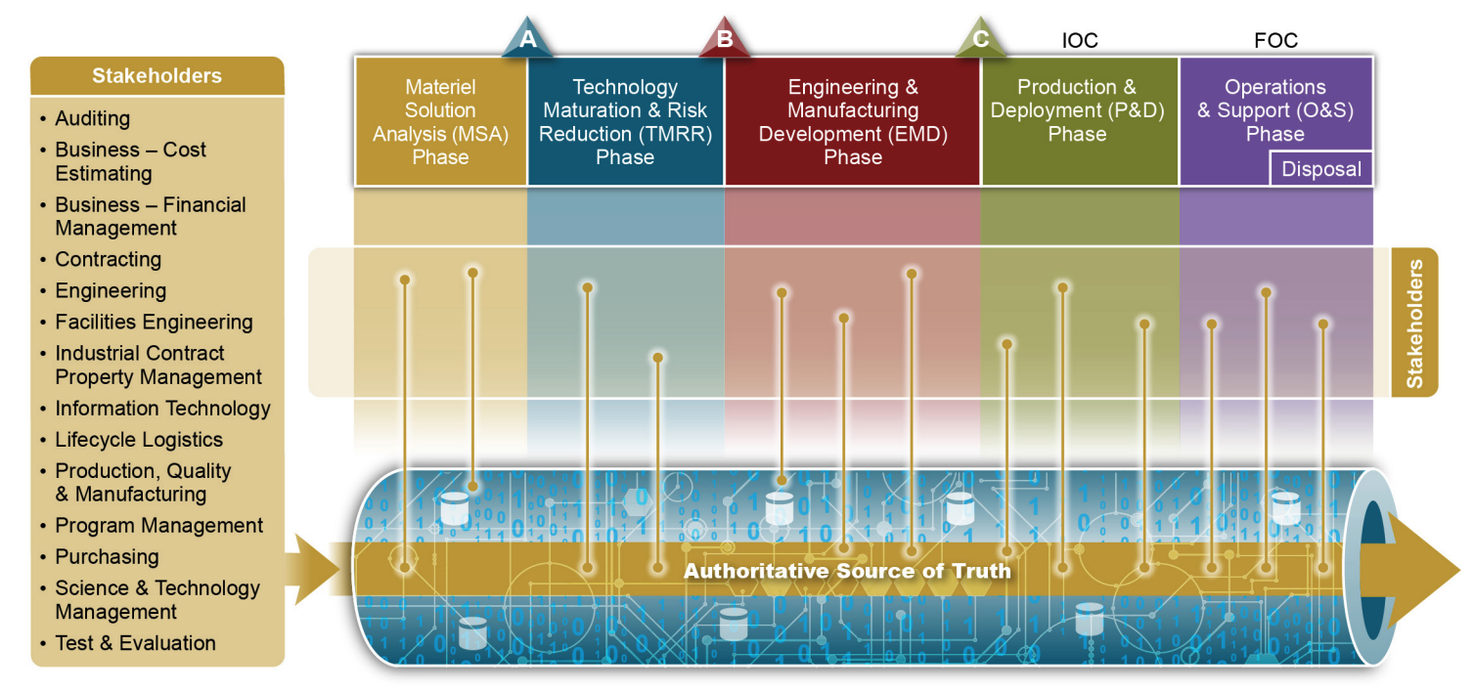
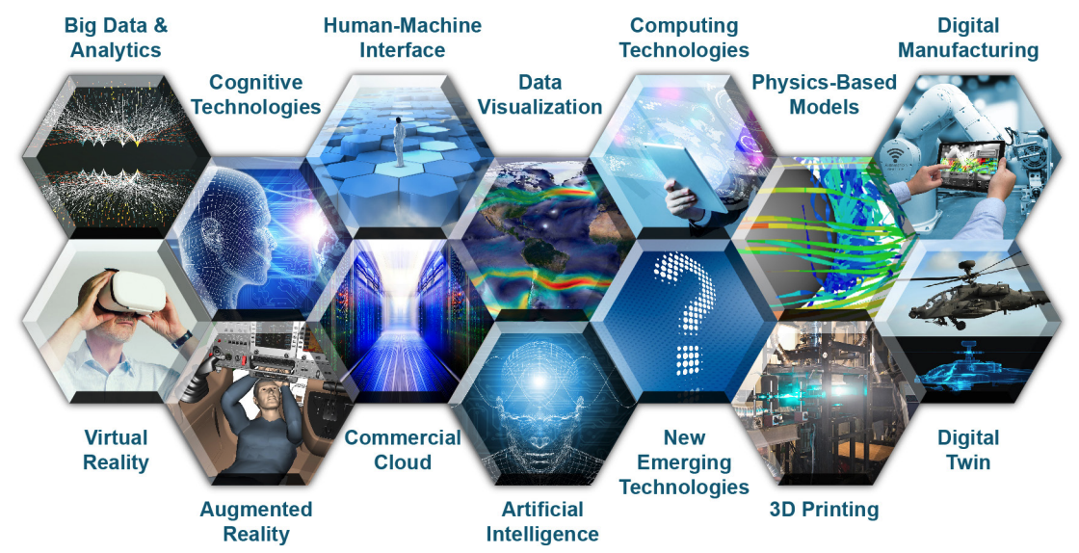
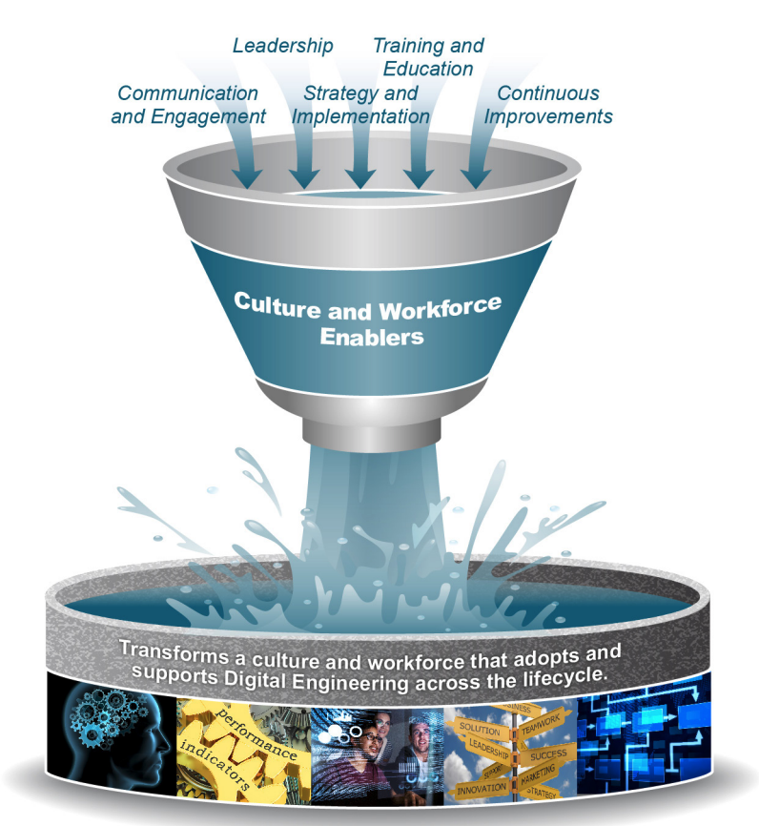
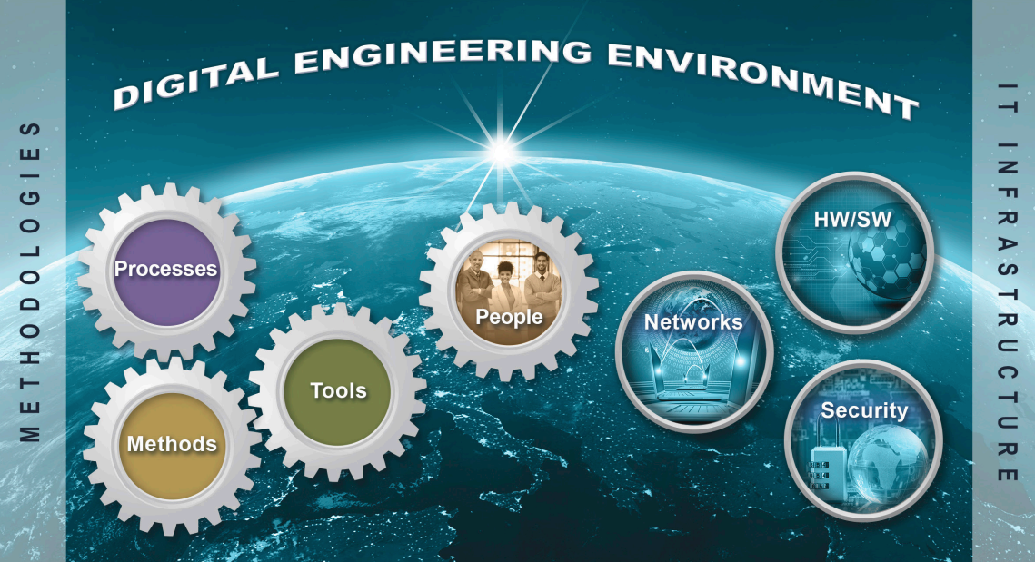
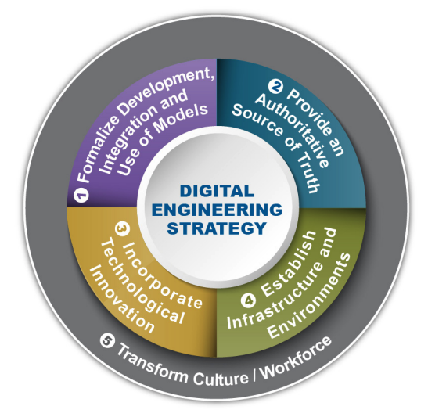
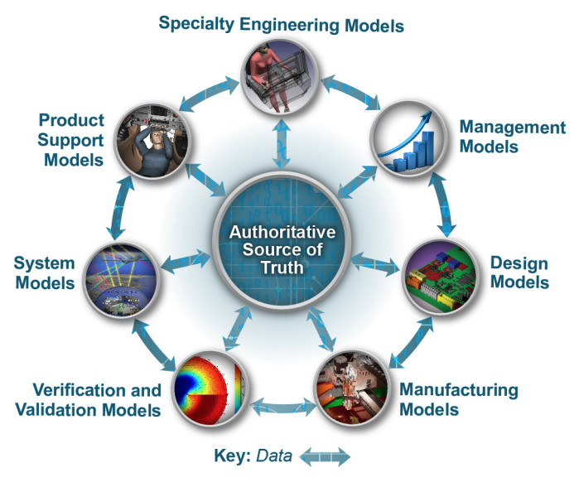
2018 Digital Engineering Strategy
Notes:
1. Formalize the development, integration, and use of models to inform enterprise and program decision making. The first goal establishes the formal planning, development and use of models as an integral part of performing engineering activities as a continuum across the lifecycle. Such ubiquitous use of models will result in a continuous end-to-end digital representation of the system of interest. This will support consistent analysis and decision making for programs and across the enterprise.
2. Provide an enduring, authoritative source of truth. This goal moves the primary means of communication from documents to digital models and data. This enables access, management, analysis, use, and distribution of information from a common set of digital models and data. As a result, authorized stakeholders have the current, authoritative, and consistent information for use over the lifecycle.
3. Incorporate technological innovation to improve the engineering practice. This goal extends beyond the traditional model-based approaches to incorporate advancements in technology and practice. Digital engineering approaches also supports rapid implementation of innovations within a connected digital end-to-end enterprise.
4. Establish a supporting infrastructure and environments to perform activities, collaborate, and communicate across stakeholders. This goal promotes the establishment of robust infrastructure and environments to support the digital engineering goals. It incorporates an information technology (IT) infrastructure and advanced methods, processes, and tools, as well as collaborative trusted systems that enforce protection of intellectual property, cybersecurity, and security classification.
5. Transform the culture and workforce to adopt and support digital engineering across the lifecycle. The final goal incorporates best practices of change management and strategic communications to transform the culture and workforce. Focused efforts are needed to lead and execute the change, and support the organization’s transition to digital engineering.
DoD Digital Engineering Strategy (2018): https://ac.cto.mil/wp-content/uploads/2019/06/2018-Digital-Engineering-Strategy_Approved_PrintVersion.pdf
Image credits DoD Digital Engineering Strategy (2018)

Slide 4
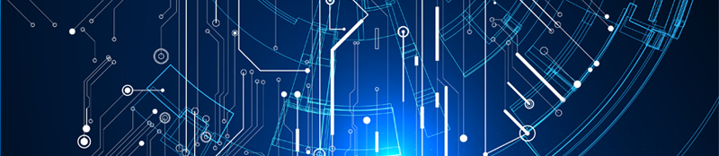
Digital Engineering
An integrated digital approach that uses authoritative sources of systems’ data and models as a continuum across disciplines to support lifecycle activities from concept through disposal.
DAU Glossary
DE is more than just a set of tools. It is meant to be a holistic approach to the entire systems lifecycle from concept to deployment.
Notes:
Quick Pause: How confident are you in your understanding of what digital engineering is?
Integrated digital approach using authoritative data and models across lifecycle. DE is how we connect data, models, and decisions.
In plain English: DE is more than just a set of tools. It is meant to be a holistic approach to the entire systems lifecycle from concept to deployment. Done well, DE is also an enabler for cutting-edge technologies like Artificial Intelligence (AI), Machine Learning (ML), and the Internet of Things (IoT), creating opportunities to streamline processes, enhance collaboration, and drive unprecedented efficiencies.

Slide 5
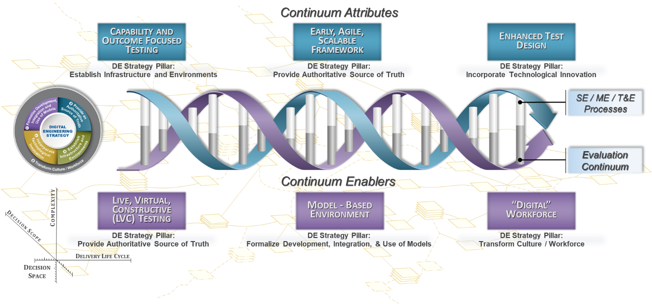
T&E as a Continuum (Collins and Senechal 2023)
Notes:
My original framework was V&V …
More than verification
Independent evidence for decisions
Operational effectiveness & suitability
Survivability & mission risk
Confidence under uncertainty
I like this diagram because that double helix really represents a continuous flow of data, models, and evidence across the lifecycle. And I think that’s what DE brings here – the ability to better interconnect design, build, test, and operate systems through shared digital artifacts.
Last box - ”digital” workforce. Note the things on the bottom aren’t optional “nice to haves”, they’re pre-conditions. You cannot do all of this unless you have the people who can actually use and make sense of all of this interconnected data and all of these models. And for T&E, you need the people who can help to create the TEMPs that help to evaluate systems - from detailed specs up through the mission. This illustrates how DE connects data, models, and people into a continuous evidence pipeline so T&E can generate better, earlier, and more mission-relevant insight.

Slide 6
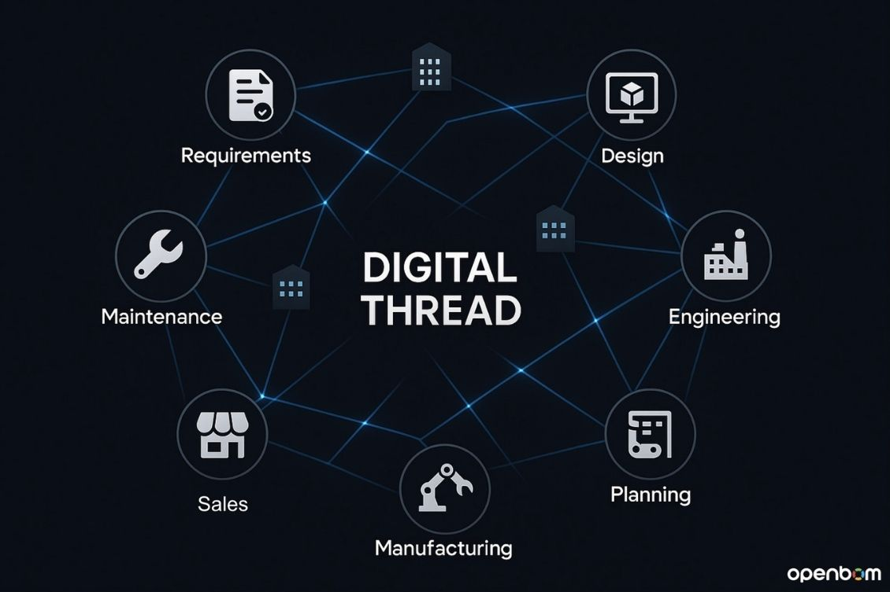
Digital Threads
An extensible and configurable analytical framework that seamlessly expedites the controlled interplay of technical data, software, information, and knowledge in the digital engineering ecosystem, based on the established requirements, architectures, formats, and rules for building digital models. It is used to inform decision makers throughout a system's life cycle by providing the capability to access, integrate, and transform data into actionable information.
DAU
Why Digital Threads?
Enable organizations to break down silos, streamline workflows, and achieve interoperability across departments, functions, and systems.
Notes:
An interconnected flow of relevant data that defines a system throughout its lifecycle. A digital thread helps to ensure the quality and consistency of product-related data, keeping everyone up-to-date and on the same page. Ultimately it allows organizations to extract value from, or make use of, product data that was previously inaccessible, underutilized, or hidden to unlock business value and opportunities.
Definition from: https://www.ptc.com/en/industry-insights/digital-thread
Digital Thread vs Twin article from IBM - very helpful: https://www.ibm.com/think/topics/digital-thread-vs-digital-twin

Slide 7
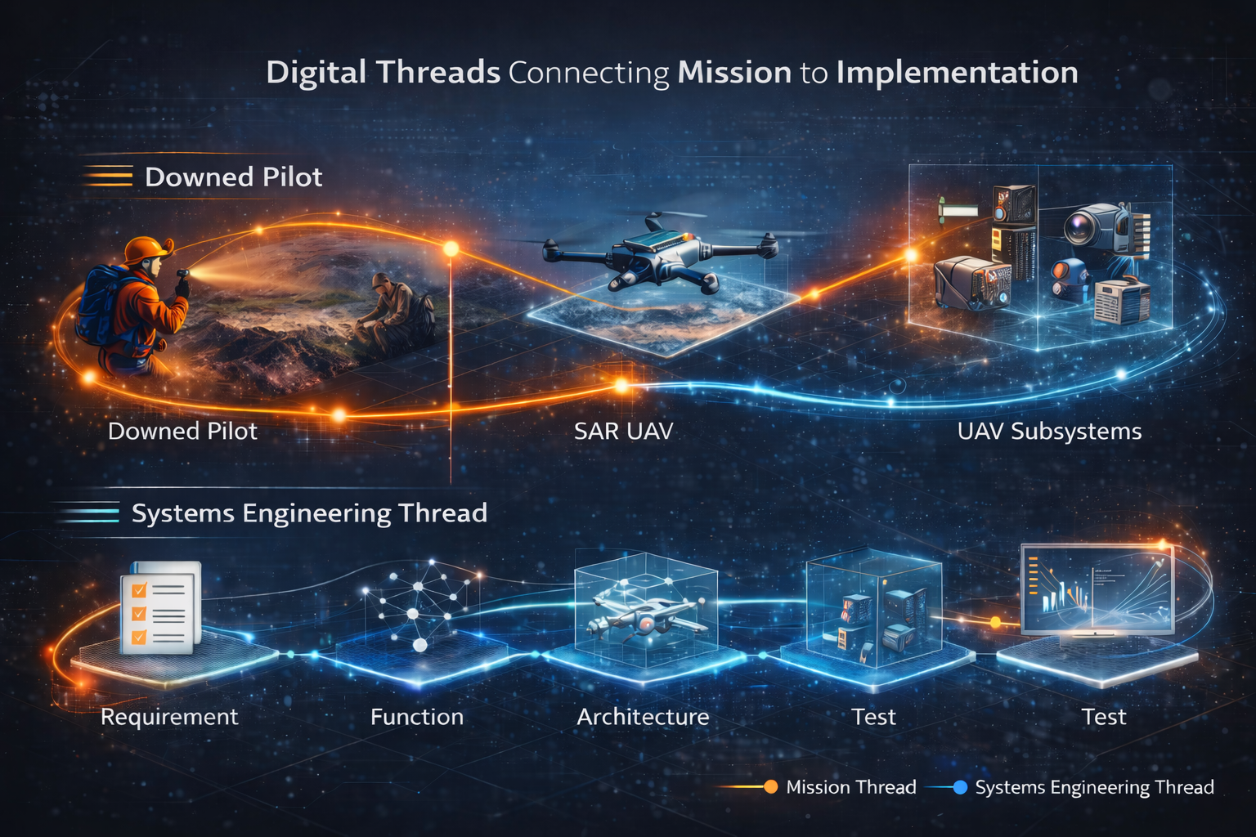

DE Enables Horizontal and Vertical Integration
Test & Evaluation
Verification &
Validation
Notes:
This is a place where we can lightly mention ontology as well as the need to set up an integrated DE ecosystem. The details don’t make sense here, but introducing the concepts in prep for 2 and 3 is reasonable.
Ontology = interconnected data
Updated label on first “test” to “design”. Explore further in the deeper application this week – data is critical and a lot of the work is about making this understandable to both humans and machines. Does this make us go faster? With more rigor?
“The new oil” – refined, standardized, etc.

Slide 8
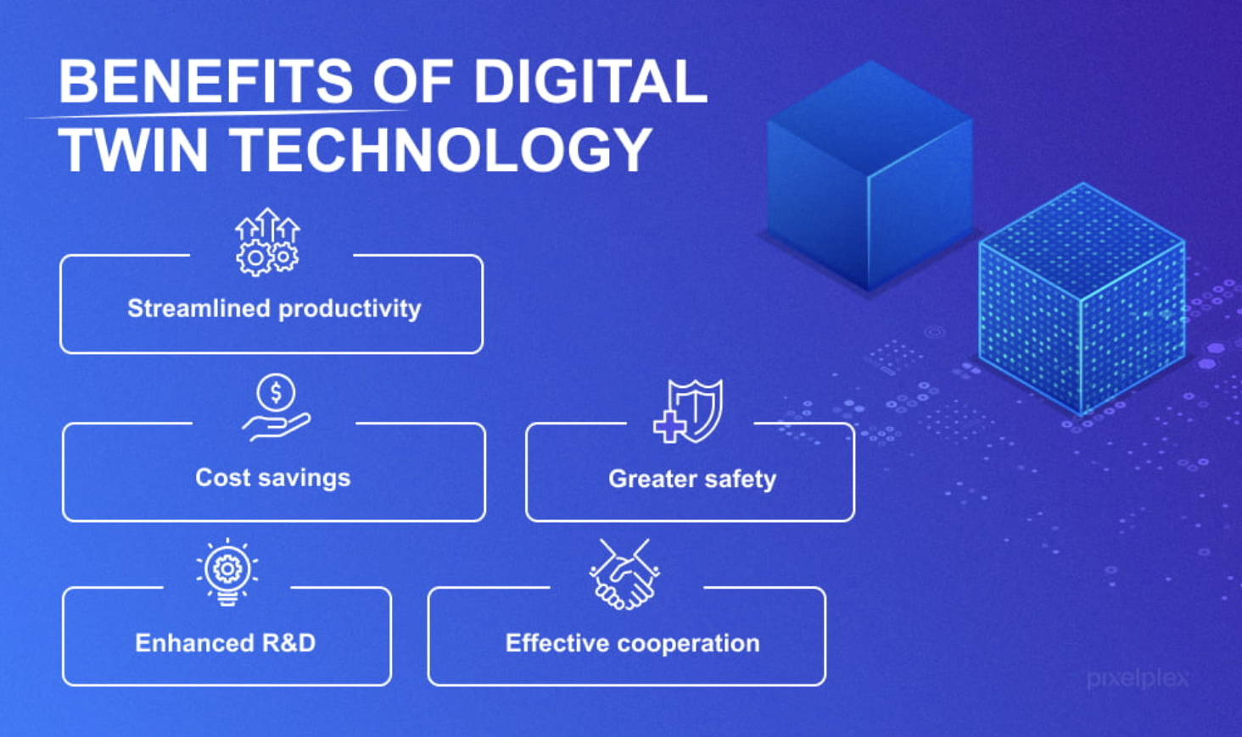
Digital Twin
A virtual replica of a physical entity that is synchronized across time. Digital twins exist to replicate configuration, performance, or history of a system. Two primary sub-categories of digital twin are digital instance and digital prototype. DAU
Notes:
A dynamic, virtual replica of a physical system that updates in real time using real world data. A digital thread secures the quality and consistency of product-related data, keeping everyone up-to-date and on the same page. Ultimately it allows organizations to extract value from, or make use of, product data that was previously inaccessible, underutilized, or hidden to unlock business value and opportunities.
Traceability: It allows companies to track the history and performance of parts, from initial design specs to physical production and maintenance in the field.Data Integration: Connects disparate systems including Product Lifecycle Management (PLM), Manufacturing Execution Systems (MES), and Computer-Aided Design (CAD) to create a continuous data flow.
Authoritative Source of Truth: Provides a unified view of data, ensuring that teams (engineering, production, service) use the same up-to-date information.Product Evolution: Tracks changes throughout the "infinity loop" of product development, from requirements gathering to operational use.
Image credit: https://pixelplex.io/blog/what-is-digital-twin/
Definition from: https://www.ptc.com/en/industry-insights/digital-thread
Relevant article: https://pixelplex.io/blog/what-is-digital-twin/
Digital Thread vs Twin article from IBM - very helpful: https://www.ibm.com/think/topics/digital-thread-vs-digital-twin

Slide 9
Digital Twin Examples
Simulation
Predictive Maintenance
Uses historical and representative data to simulate behavior
Not continuously connected to a specific fielded system
Supports what-if analysis and planning
Often used early in lifecycle or for mission rehearsal
Continuously updated with live or near-real-time data
Represents the actual system in the field
Supports monitoring, prediction, and decision support
Often used during operations and sustainment
Notes:
Simulating UAV coverage, endurance, and sensor performance in a contested environment
Can we find and track the pilot in time?
Predictive Maintenance:
Monitoring a specific UAV’s engine health during the mission/Predicting failure risk or maintenance needs
Can this aircraft safely complete the mission?
Digital Thread vs Twin article from IBM - very helpful: https://www.ibm.com/think/topics/digital-thread-vs-digital-twin

Slide 10
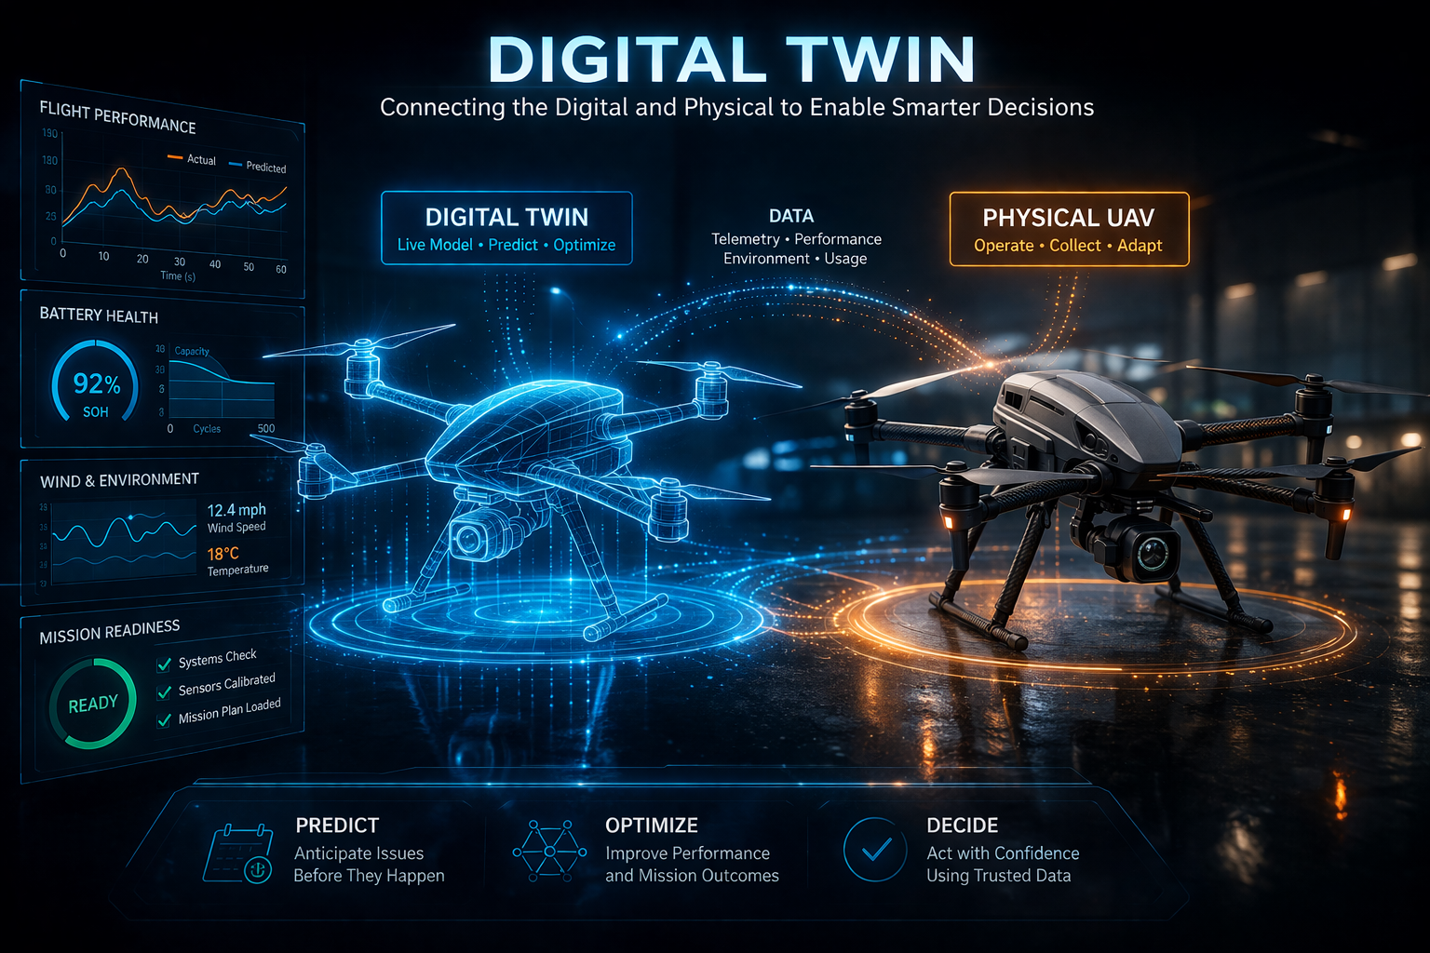
Digital Twin Examples
Notes:
Simulating UAV coverage, endurance, and sensor performance in a contested environment
Can we find and track the pilot in time?
Predictive Maintenance:
Monitoring a specific UAV’s engine health during the mission/Predicting failure risk or maintenance needs
Can this aircraft safely complete the mission?
Digital Thread vs Twin article from IBM - very helpful: https://www.ibm.com/think/topics/digital-thread-vs-digital-twin

Slide 11
What do people need to know?
(Hutchison et al. 2021)

Slide 12
What do people need to know?
FY 2019 DoD T&E Workforce Competency Model
Planning
(Risk ID, Capability Assessment, T&E Strategy, Test Cost Est.)
Evaluation
(Test Adequacy, Validation of Results, Conclusions)
Preparation
(Coordination, Test Readiness)
Reporting
(Tech Review, Lessons Learned, Documentation)
Execution
(Risk Mgt, Test Control Mgt, Data Mgt)
Professional
(Customer Service, External Awareness)
Analysis
(Data V&V, Data Reduction & Assimilation)
FY 2019 DoD T&E Workforce Competency Model
Notes:
https://asc.army.mil/web/wp-content/uploads/2018/08/TE-Competency-Model-as-of-20180626.pdf
https://www.aeropm.net/uploads/1/1/8/6/118630415/te_competency_framework_.pdf

Slide 13
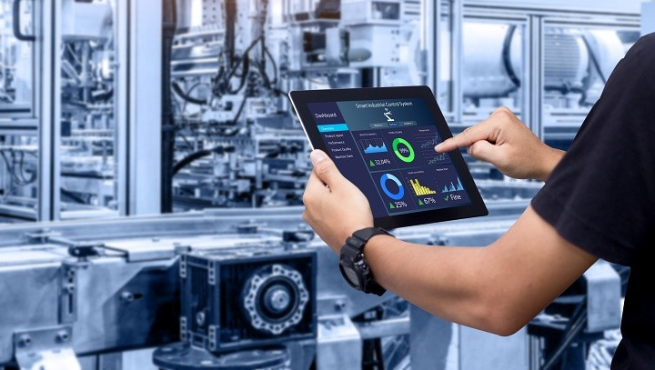
Strengths to Build on
Data Interpretation & Analytical Reasoning
Model & Simulation Application (at appropriate fidelity)
Test Design & Experimental Thinking
Requirements Interpretation & Evaluation
Uncertainty Management & Risk Assessment
Technical Communication & Decision Support
Cross-Disciplinary Coordination
Notes:
These are digital engineering competencies. You’ve been building them for years.
Data Interpretation & Analytical Reasoning - Turning raw test data into defensible conclusions
Model & Simulation Application (at appropriate fidelity) - Using sims to design tests, explore scenarios, and augment physical testing
Test Design & Experimental Thinking - Structuring activities to answer specific questions under constraints
Requirements Interpretation & Evaluation - Understanding what is being tested and whether it was met
Uncertainty Management & Risk Assessment - Making decisions with incomplete or imperfect data
Technical Communication & Decision Support - Translating results into actionable insight for leadership
Cross-Disciplinary Coordination - Working across SE, operators, labs, and program offices
Image Source: https://www.linkedin.com/pulse/test-evaluation-reducing-risk-through-better-charles-alexi/

Slide 14
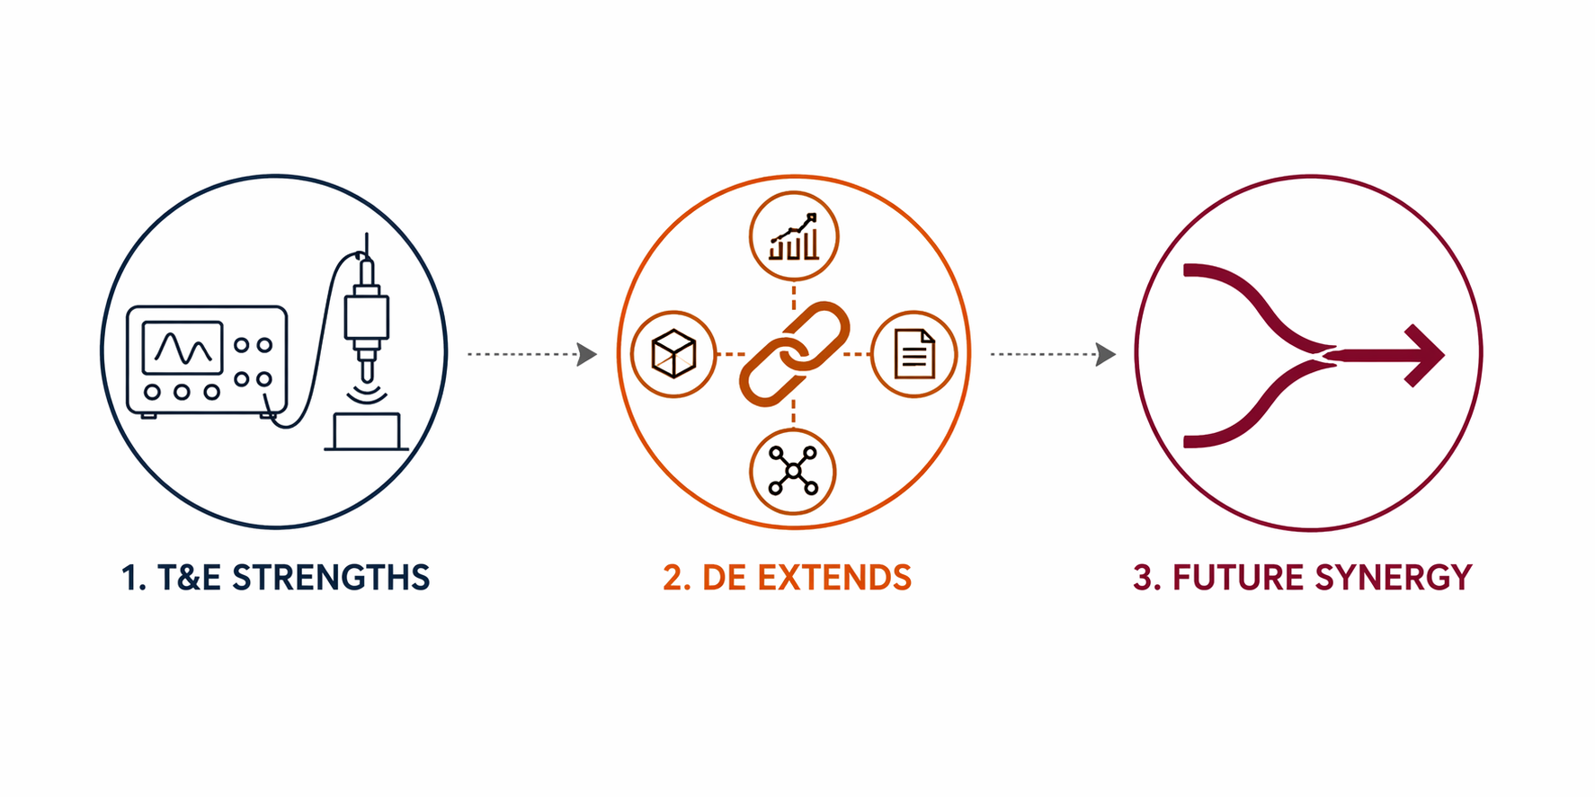
Where DE Enables T&E
Data Interpretation → Data Lineage & Traceability
Model & Simulation Use → Model Literacy & Integration
Test Design → Evidence Strategy Design
Requirements Evaluation → Requirement Contextualization
Uncertainty Management → Quantified Confidence in Hybrid Evidence
Communication → Digital Artifact Communication
Coordination → Digital Thread Navigation
Notes:
Data Interpretation → Data Lineage & Traceability
→ Not just analyzing data, but understanding where it came from and how it connects across the lifecycle
Model & Simulation Use → Model Literacy & Integration
→ Understanding assumptions, limitations, and how models connect to other artifacts
Test Design → Evidence Strategy Design
→ Designing when and how evidence is generated across the lifecycle—not just at test events
Requirements Evaluation → Requirement Contextualization
→ Connecting requirements back to mission intent (your UAV example lives here)
Uncertainty Management → Quantified Confidence in Hybrid Evidence
→ Combining model + simulation + physical test into a coherent confidence statement
Communication → Digital Artifact Communication
→ Using models, visualizations, and traceability to explain why, not just what
Coordination → Digital Thread Navigation
→ Moving across data, models, and systems seamlessly

Slide 15
Where DE Can Enable Growth
Model Evaluation & Credibility Assessment
Data Governance & Stewardship
Digital Traceability & Lifecycle Awareness
Evidence Integration Across Modalities
Early Lifecycle Engagement
Cyber & Software-Aware Testing Competency
Digital Communication & Visualization
Notes:
1. Model Evaluation & Credibility Assessment
How do we determine if a model is valid for its intended use?
What evidence supports trusting it?
T&E strength adjacent—but not consistently formalized
2. Data Governance & Stewardship
Understanding data provenance, versioning, and authority
Knowing what is “authoritative” vs “convenient”
This is a big gap across DoD, not just T&E
3. Digital Traceability & Lifecycle Awareness
Following the thread from mission → requirement → design → test → ops
Understanding how a test result propagates upstream/downstream
This is where DE really changes the game
4. Evidence Integration Across Modalities
Combining:
physical test results
simulation outputs
analytical models
Into a single, defensible conclusion
5. Early Lifecycle Engagement
Applying T&E thinking before formal test phases
Influencing requirements and design earlier
This directly addresses your requirements gap pain point
6. Cyber & Software-Aware Testing Competency
Understanding software-driven behavior
Integrating cyber testing earlier and continuously
Direct hit on your cyber lag issue
7. Digital Communication & Visualization
Explaining results through:
models
dashboards
interactive artifacts
Not just reports
This isn’t about replacing your competencies. It’s about extending them into a digital environment where the scale and complexity are higher.
Instead of:
“We test 40 knots vs 38 knots…”
Frame it as:
Traditional competency application:
Requirements evaluation → requirement not met
Data analysis → measured 38 knots
DE-enabled competency application:
Traceability competency → where did 40 knots come from?
Model integration competency → what system behavior caused the shortfall?
Mission context competency → does this affect mission success?
Evidence integration competency → what do models + test data say together?
Data competencies → already strong in T&E
Modeling competencies → already present, but uneven
Engineering/analysis competencies → core to T&E
Digital environment competencies → where gaps emerge

Slide 16
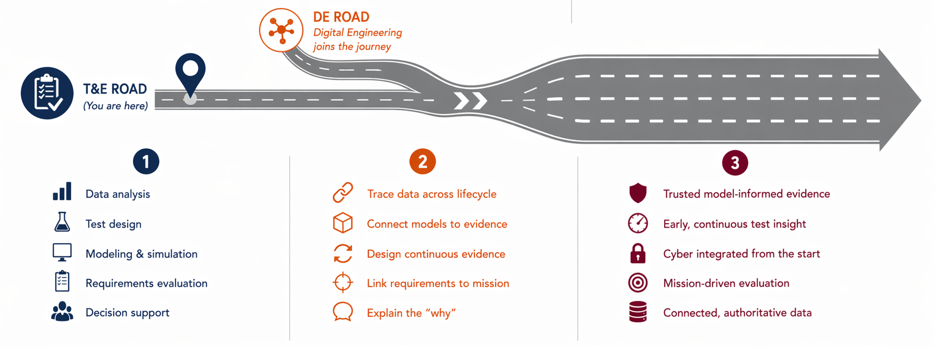
What You Should Take with You
DE and T&E are stronger - if we get the workforce and integration right.
Notes:
This is the road you’re already on and it’s a solid one. (Image doesn’t show all the hard work and growth that got you to here in the first place)
DE has been somewhat of a parallel road but it’s time for them to intersect. Digital engineering doesn’t replace your road - it joins it and extends it.
With the two together, we’re going to be able to tackle challenges in new ways.

Slide 17
What You Should Take with You
DE and T&E together are stronger - if we get the workforce and integration right.
Notes:
This is the road you’re already on and it’s a solid one. (Image doesn’t show all the hard work and growth that got you to here in the first place)
DE has been somewhat of a parallel road but it’s time for them to intersect. Digital engineering doesn’t replace your road - it joins it and extends it.
With the two together, we’re going to be able to tackle challenges in new ways.

Slide 18
Questions?
Feel free to reach out to Nicole at nlong@vt.edu

Slide 19
Relationships between Terms
Digital Transformation
Digital Engineering
MBSE
Languages (e.g. SysML)
Notes:
Take-Home: MBSE is not DE, tools are not DE, models alone are not DE
Talk about tooling – part of the solution but not the solution in and of themselves. E.g. Cameo
INCOSE: MBSE is the formalized application of modeling to support system requirements, design, analysis, verification, and validation activities, beginning in the conceptual design phase and continuing throughout development and later life cycle phases.
OMG: A standardized, graphical modeling language used to specify, analyze, design, and verify complex, multi-domain systems.

