Slide 1
Data Analytics – Training the Workforce
21 April 2026
Controlled by: ​[Organization]
Controlled by: ​[Office]
Category(ies): [Consult DoD CUI Registry]
Distribution/Dissemination Controls: [CLASSIFICATION] ​
POC: [Name]
Operational Evaluation Command | Shane Hall

Slide 2
Agenda
Who is OEC
Organizational Structure
Analytics Expertise
The Vision
Upskilling Efforts
Lessons Learned
UNCLASSIFIED

Slide 3

Operational Evaluation Command
Army Evaluation Center and Operational Test Command merged in 2026 to form Operational Evaluation Command – Both organizations under Army Test and Evaluation Command (2-star)
700+ MIL & CIV personnel
  Testers
  Evaluators (Analysts) ~250
Mission: Provide the Army capabilities to test equipment/systems and the independent evaluator of data across the campaign of learning
200+ systems aligned directly to Program Acquisition Executives
Data is many forms coming from qualitative and quantitative sources or instrumented systems; in scales from small to hundreds of thousands of rows, requiring both simple statistical summaries and complex multi-variable analysis.
OEC’s job is Data
UNCLASSIFIED

Slide 4
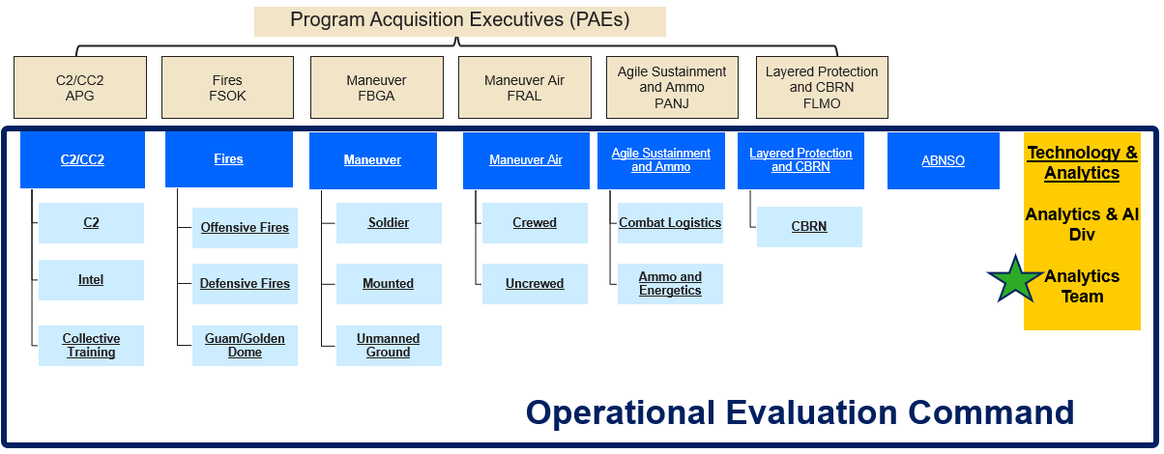
Organizational Structure
* Each Evaluation Directorate (ED) is ~40 Evaluators
* Analytics Team is 6-8 Statisticians/Data Scientists
UNCLASSIFIED

Slide 5
Analytics expertise
Skills Desired
Coding & Analytics Platform Skills: R, Python, JMP, SQL, Grafana
AEC has attempted to consolidate analytics platforms to improve standardization
Data preprocessing
Data Analytics: hypothesis testing, experimental design, regression & other statistical modeling, basic ML
Data Visualization
We acknowledge not all ~250 should have this skillset
We acknowledge there are other skillsets needed and likely not reasonable for one person to have all required skillsets → we can’t be generalists at all required expertise
UNCLASSIFIED

Slide 6
The analytics vision
Analytics-oriented personnel are the majority, not the minority – personnel that 1) understand their data and 2) can translate their evaluation goals to proper data analytics and visualization methods OR recognize when there is a need to engage with analytics experts …
Layman’s terms – an individual can receive a dataset and use analytics platforms to clean data, analyze data, and visualize data
Proficiently uses R, JMP, Python, Grafana, Vantage, etc…
  Excel
Why:
Reduce contractor support,
Improve accuracy of data demands,
Speed of analysis,
Reputation with customers
OEC Analytics Expertise
AEC
OEC
Analytics
Team
Current
☒
☑
OEC
Vision
☒
☑
UNCLASSIFIED

Slide 7
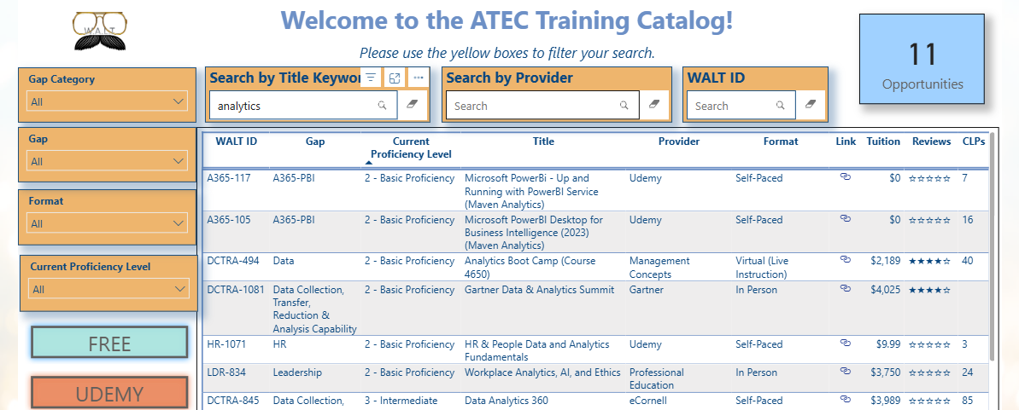
Upskilling efforts – Pt. 1
Workforce Learning Tool (WALT) – repository of ATEC-promoted trainings. Internal Yelp-like rating scheme. Searchable by topic/gap. Different proficiency levels. In person or virtual → Analytics courses available from many platforms.
Coursera – funded through DAU. Although the emphasis is on acquisition employees, there is nothing that precludes non-acquisition personnel to enroll into courses.
Udemy – The Udemy platform is funded/managed by ACCMA for all Army Civilian employees, thus there are no separate costs for Commands.
DAU Credentials
  CTST001: Applying scientific test and analysis techniques
  2nd credential coming soon: T&E of Evaluating Data
UNCLASSIFIED

Slide 8
Upskilling efforts – Pt. 2
JMP Inspire - catered JMP training for AEC based on requested needs
  Users will increase their knowledge of the capabilities of the software through live, online presentations by JMP staff experts.
  New users will get an efficient, interactive introduction to JMP.
  Experienced users will gain a deeper understanding of JMP and learn about features they haven't used yet. These skilled users will also have an opportunity to ask questions and share knowledge and feedback with JMP staff.
Developmental assignments – 6mo assignments with the analytics team to learn what we do and get hands-on experience in analysis and coding
STATNews – monthly newsletters or videos published by our team for the workforce. Topics include video demos, analysis methods, clarification memos, new workflows, etc. → anything related to data analytics that is relevant to our organization
Army Operational Research Symposium (AORS) – held each year at APG
UNCLASSIFIED

Slide 9
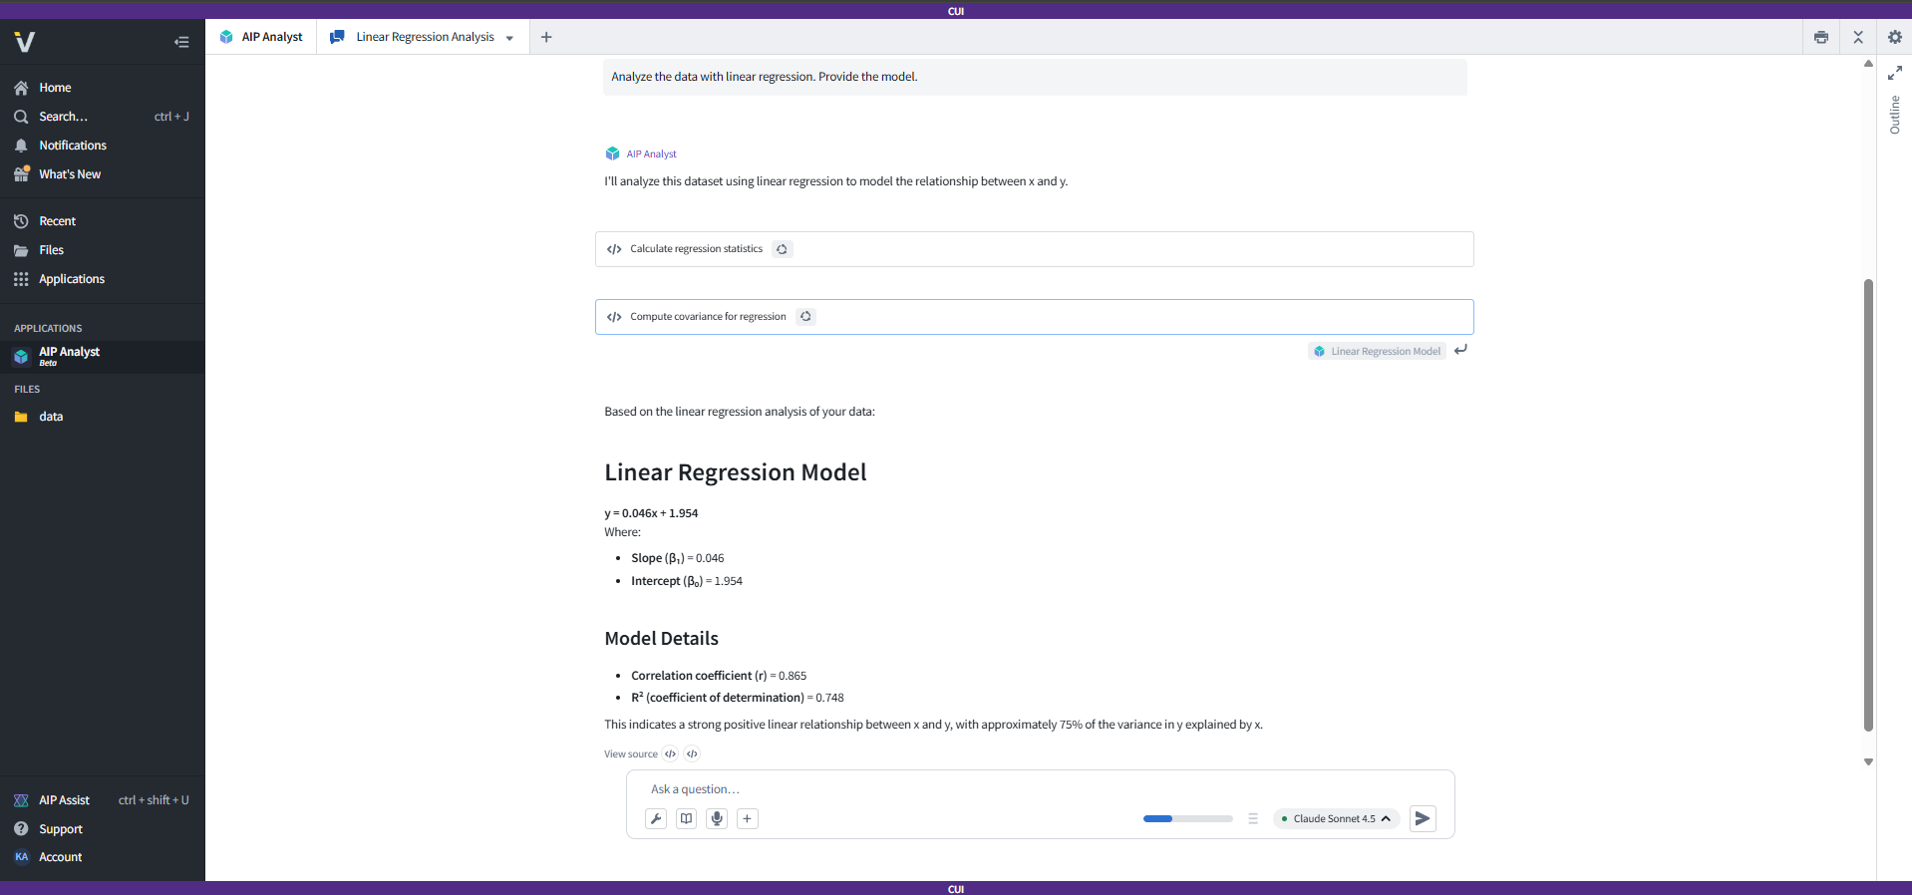
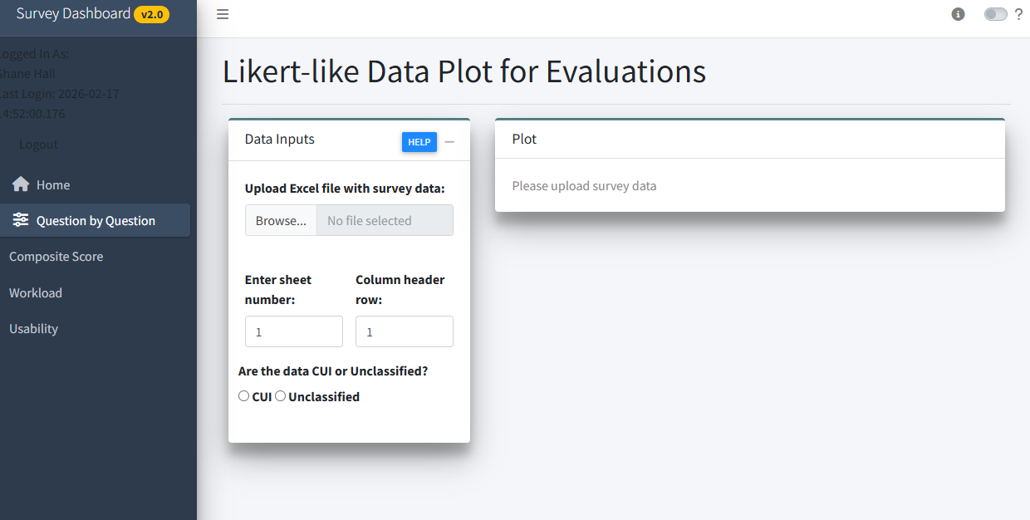
Upskilling efforts - pt. 3
Evaluation Framework & Data Governance Councils → putting data and evaluation metric ownership in hands of evaluators
Utilization of AI Tools – coding co-pilots, Vantage AI Analyst
Utilization of Pre-built analysis tools like Rshiny
UNCLASSIFIED

Slide 10
Lessons learned & Reactions
Excel is engrained into our educational/work-lives early – sell your platforms/capabilities in comparison to Excel
Employees have different appetites for complexity and duration education – trainings need to reflect that
Online training = opens many windows of opportunity, but not always the most conducive learning environment.
Metrics! JMP, R, and Python installations, R & JMP user groups, less contract $$ spent
What have you done to increase your Organization’s analytics proficiency?
What other resources are out there (preferably FREE ☺) that we should endorse?
How do you measure proficiency?
UNCLASSIFIED

Slide 11
Shane Hall
Shane.hall4.civ@army.mil

