Slide 1
Test Design for the Integrated Head Protection System
POC: U.S. ARMY OPERATIONAL EVALUATION COMMAND | Allison Holston
21-23 April 2026

Slide 2
AGENDA
Organization and Role
Background
Test Concept
ORCA
Metrics and Conditions
Test Design Process
Test Scoping
Lessons Learned

Slide 3
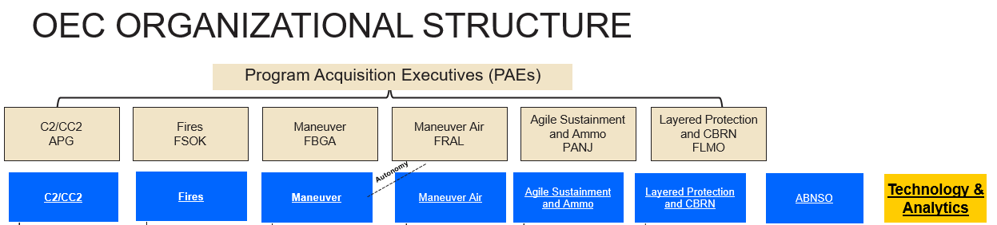
Organization and Role
U.S. Army Operational Evaluation Command (OEC)
Merger of Army Evaluation Center and Operational Test Command in 2026
New Digital Technology and Analytics Directorate
Division Mission Statement: To serve as the command’s premier internal resource for AI and data analytics, developing advanced analytics and AI tools and solutions that enhance the effectiveness, efficiency, and rigor of the campaign of learning for Army programs.
Analytics Team
6 Statisticians, 1 Military ORSA/FA49
Team Expertise: R, JMP, data visualization, surveys, data analytics, statistical modeling, test designs (design of experiments), Azure Devops, data management
Statisticians on 70+ ASTs
Develop R shiny apps to solve analytical or visualization problems across command
Command-wide analytical training

Slide 4
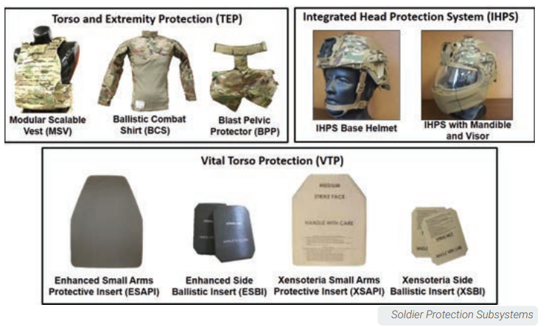
Background
Soldier Protection System (SPS)
Scalable subsystems
Provide improved fragmentation, ballistic, impact protection and fit over previous helmets.
Components:
Integrated Head Protection System (IHPS)
Torso and Extremity Protection (TEP)
Vital Torso Protection (VTP)
Live Fire Integrated Product Team (IPT) coordination:
Army Test and Evaluation Command: Operational Evaluation Command (OEC) and Aberdeen Test Center (ATC)
Director Operational Test and Evaluation (DOT&E)
Institute for Defense Analyses (IDA)
Product Manager Soldier Protective Equipment (PdM SPE)
Combat Capabilities Development Command (DEVCOM) Analysis Center (DAC) and Army Research Laboratory (ARL)
IPT planning for various Full Up System Level (FUSL) testing since ~2018
Notes:
SPS info from here: https://www.peosoldier.army.mil/Equipment/Equipment-Portfolio/Project-Manager-Soldier-Survivability-Portfolio/Soldier-Protection-System/
Picture from here: https://www.dote.osd.mil/Portals/97/pub/reports/FY2022/army/2022sps1.pdf?ver=KuYeJLhAIn9uqxWoAqakmg%3d%3d
Army began fielding the NG-IHPS in 2024 with plans to equip 190,000 soldiers by 2028.

Slide 5
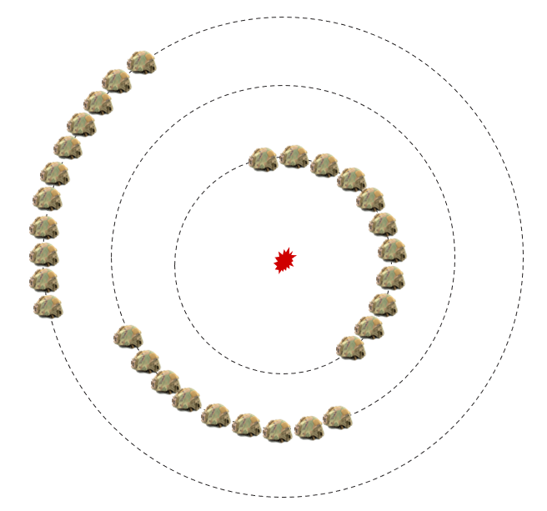
Test Concept
Goal: Determine if there were any significant differences in live fire injuries between IHPS Gen I and Gen II
Initial Concept:
2-3 circles of helmets around a threat
2 blasts of each threat
Up to 48 helmets available per blast
Randomize helmet conditions for each blast
Process:
Blast
Test
Model w/ ORCA
Analyze
Damage assessment
Get AIS results
Compare Gen I vs. Gen II
Test Design
Determine # of helmets needed
ORCA: Operations Requirement-Based Casualty Assessment
AIS: Abbreviated Injury Scale
Notes:
Specifically fragment impact injuries not blast overpressure
Gen I vs. Gen II – superior protection, improved retention/suspension, better fragmentation (reduced deformation)

Slide 6
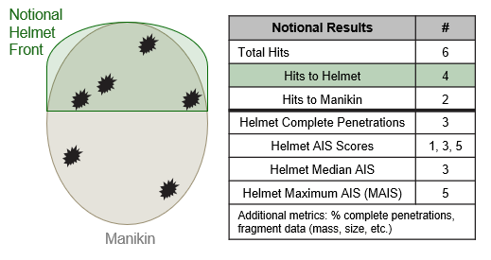
Operations Requirement-based Casualty Assessment (ORCA)
High-resolution human vulnerability model to assess the effect of casualty-causing insults on personnel
ORCA inputs include fragment impact location, width, and depth
Determines injury severity metrics from projectile or fragment impacts
Abbreviated Injury Scale (AIS)
AIS | Injury Level | Description
0 | No injury | None (Extremely small fragment)
1 | Minor | Superficial
2 | Moderate | Reversible injury, medical attention needed
3 | Serious | Reversible injury, hospitalization needed
4 | Severe | Life threatening, can recover with care
5 | Critical | Non-reversible injury, cannot fully recover with care
6 | Maximum | Virtually unsurvivable
Notes:
Model developer: DEVCOM Analysis Center
** Credit to Lindsey Butler & others at IDA for the notional helmet graphic concept – hard/soft armor FUSL data slides
No blast overpressure
Info from here: https://www.army.mil/article/266344/u_s_army_updates_anatomical_representation_to_improve_modeling

Slide 7
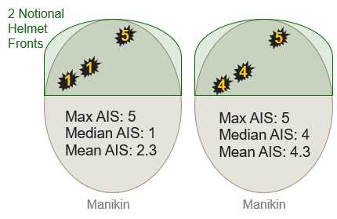
Metrics and Conditions
Metrics: Max and Median AIS per helmet (0-6)
Also record individual AIS results per complete penetration
Assume that each helmet gets at least one AIS result
Conditions:
Threats (2 considered separately)
Standoff / Distance from Threat (2-3 levels for each threat)
System (IHPS Gen I, IHPS Gen II)
Orientation (Front, Side, Back, Crown)
Height (Held constant)
Helmet size (Held constant - Medium)
Questions we considered:
Mean, median, or max AIS?
Do we treat AIS as binary?
Do we do just one threat?
Are standoffs different for each threat?
Should we do 2 or 3 standoffs?
Is the crown less important?

Slide 8
Test Design PROCESS
Threat | Blast | Distance | Gen I |  |  |  | Gen II
 |  |  | Front | Side | Back | Crown | Front | Side | Back | Crown
Threat 1 | 1 | X m
 |  | Y m
 |  | Z m
 | 2 | X m
 |  | Y m
 |  | Z m
X_NEW m
Y_NEW m
X_NEW m
Y_NEW m
1 Threat or 2 Threats
1, 2, or 3 standoff distances
No crown, less crown, or no crown on 2nd blast
Less helmets on 2nd blast
Different standoff distances
Questions we considered:
Does the pre-shot modeling confirm that all helmets will get hit at these distances?
Can adjust standoff distance?
But now… how many helmets fit in a circle?
FINAL: 2 standoff distances, but different values
Notes:
Preshot predictions done with AJEM – Advanced Joint Effectiveness Model

Slide 9
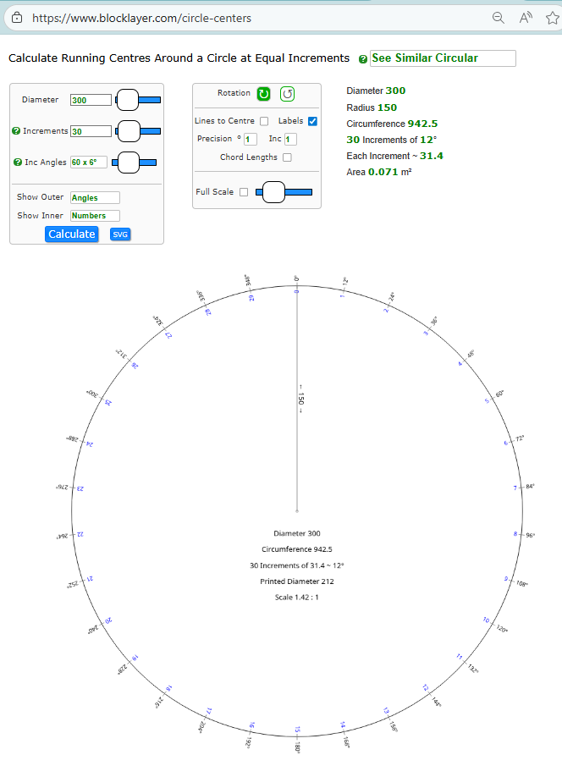
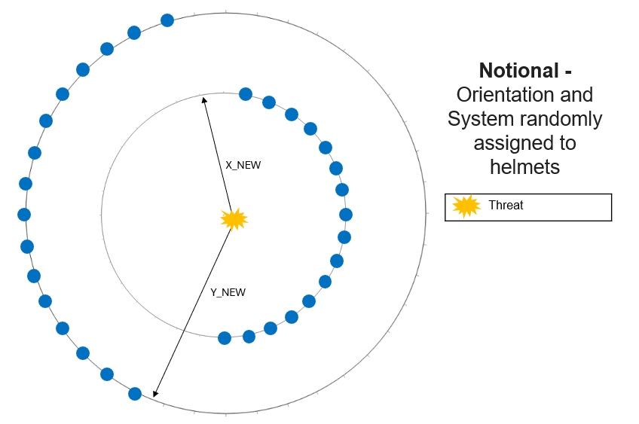
How many helmets fit in a circle?
At the new standoff distances (circle radius), determine how many helmets could we fit in that size circle
Questions we didn’t consider:
How big are the helmet stands?
Is there any instrumentation?
How big is the instrumentation?
Questions we considered:
How long and wide are helmets?
How much space do we need between helmets?

Slide 10
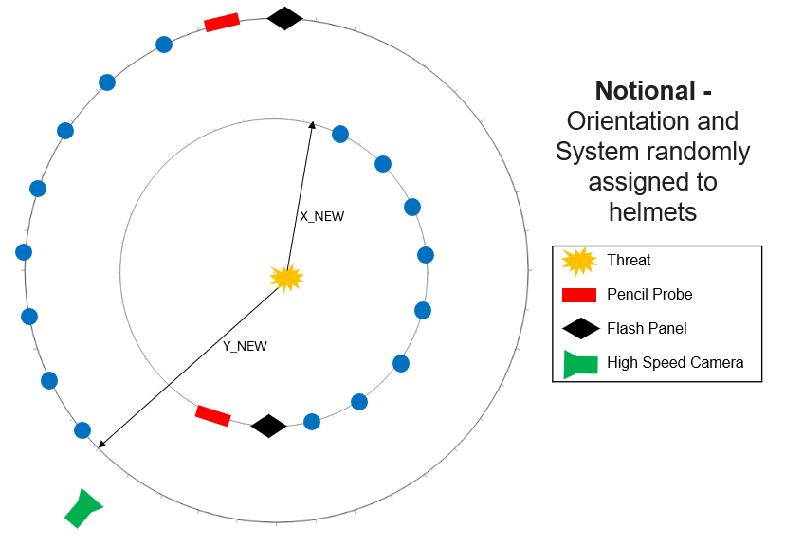
Test Infrastructure
More than just the helmets needed to be in the circles
Instrumentation for data collection: pencil probes, flash panels, and high-speed cameras
Stands and mounts that the helmets sit on
If we use the current helmet stands, we could fit about half as many helmets
Test team developed a plan to modify helmet stands so we could fit more

Slide 11
Final Test Matrix
16 fewer helmets per blast
16 helmets per circle, 2 standoff distances or 32 total helmets per blast
Helmets far enough apart based on SME judgement
New helmet stands
All instrumentation included
Threat | Blast | Distance | Gen I |  |  |  | Gen II
 |  |  | Front | Side | Back | Crown | Front | Side | Back | Crown
Threat 1 | 1 | X_NEW m | 2 | 2 | 2 | 2 | 2 | 2 | 2 | 2
 |  | Y_NEW m | 2 | 2 | 2 | 2 | 2 | 2 | 2 | 2
 | 2 | X_NEW m | 2 | 2 | 2 | 2 | 2 | 2 | 2 | 2
 |  | Y_NEW m | 2 | 2 | 2 | 2 | 2 | 2 | 2 | 2
16

Slide 12
Test scoping
Calculated power in JMP 17 w/ conservative adjustment
80-90% confidence
Utilized historical data to set signal-to-noise ratio
Model fit for main effects and select two-way interactions
Two-Way Interactions: System x Distance, System x Orientation, Distance x Orientation
>85% and >74% power (for 80/90% confidence respectively)
2 continuous placeholder factors so we could incorporate features of fragments
If we needed to analyze as binary, marginally adequate power (76% at 80% confidence) for System and System x Distance, but not adequate to detect differences for Orientation
Results to be analyzed by threat using ANOVA or ordinal logistic regression depending on output data

Slide 13
Lessons learned
You can only keep 3:
Instrumentation for data collection
Number of helmets the math says we need
Current test hardware
There are a lot of questions to consider
Key people need to be in the room
Live Fire/Helmet SMEs, Testers, Statisticians
Test design was iterative with a combination of what was feasible for test up and what is the minimum data collection
Helmet stands could be changed so we didn’t sacrifice instrumentation or number of helmets
Next STEPS
Test not yet conducted, expect that IPT may expand to a live fire test with all SPS components in 2026
The questions, process, and lessons learned are beneficial to next planning event

Slide 14
Allison Holston
Mathematical Statistician
U.S. Army Operational Evaluation Command
allison.a.holston.civ@army.mil

