Slide 1
Validation Metrics for Applications with Mixed Uncertainty
Dr. Laura White
NASA Langley Research Center
DATAWorks 2026
4/23/2026

Slide 2
What is Validation?
“All models are wrong, but some are useful.”
-George Box, 1976¹
¹Box, G. E. P. (1976). Science and Statistics. Journal of the American Statistical Association, 71(356), 791-799

Slide 3
What is Validation?
“All models are wrong, but some are useful.”
-George Box, 1976¹
Oberkampf et al². address three aspects of validation:
A comparison between computed system response quantities (SRQs) of interest and measured SRQs that provides a quantifiable measurement of accuracy
Uses interpolation or extrapolation of computer models to make predictions for conditions within the models domain of use
Determination of whether the estimated accuracy of the computational model results satisfies the accuracy requirements for the SRQs of interest
¹Box, G. E. P. (1976). Science and Statistics. Journal of the American Statistical Association, 71(356), 791-799
²Oberkampf, William L., and Timothy G. Trucano. "Verification and validation benchmarks." Nuclear engineering and Design 238.3 (2008): 716-743.4444

Slide 4
What is Validation?
“All models are wrong, but some are useful.”
-George Box, 1976¹
Oberkampf et al. address three aspects of validation:
A comparison between computed system response quantities (SRQs) of interest and measured SRQs that provides a quantifiable measurement of accuracy
Uses interpolation or extrapolation of computer models to make predictions for conditions within the model's domain of use
Determination of whether the estimated accuracy of the computational model results satisfies the accuracy requirements for the SRQs of interest
¹Box, G. E. P. (1976). Science and Statistics. Journal of the American Statistical Association, 71(356), 791-799
²Oberkampf, William L., and Timothy G. Trucano. "Verification and validation benchmarks." Nuclear engineering and Design 238.3 (2008): 716-743.4444

Slide 5
What is Validation?
“All models are wrong, but some are useful.”
-George Box, 1976¹
Oberkampf et al. address three aspects of validation:
A comparison between computed system response quantities (SRQs) of interest and measured SRQs that provides a quantifiable measurement of accuracy
Uses interpolation or extrapolation of computer models to make predictions for conditions within the model's domain of use
Determination of whether the estimated accuracy of the computational model results satisfies the accuracy requirements for the SRQs of interest
¹Box, G. E. P. (1976). Science and Statistics. Journal of the American Statistical Association, 71(356), 791-799
²Oberkampf, William L., and Timothy G. Trucano. "Verification and validation benchmarks." Nuclear engineering and Design 238.3 (2008): 716-743.4444
Notes:
Quote was introduced in a paper by George in 1976

Slide 6
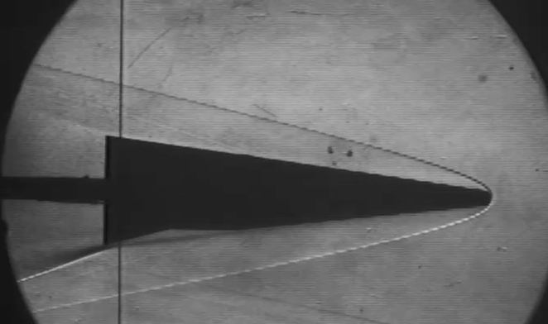
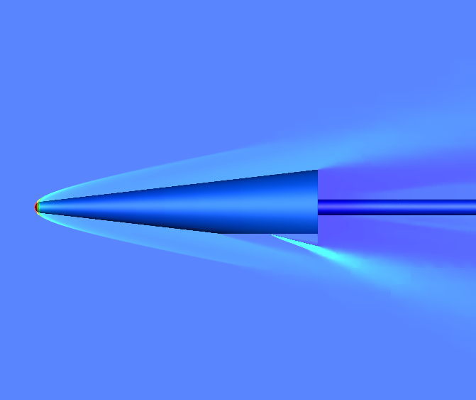
Model Validation – In this Context
Model validation determines the degree of accuracy between the real world and the simulation
The validation method captures differences between experimental and simulation data with aleatory and epistemic uncertainty included in the data
Uncertainty
Validation
Uncertainty

Slide 7
Introduction – Uncertainty Quantification
Aleatory Uncertainty
  aka stochastic uncertainty
  Irreducible variability inherent in nature
  Ex: flipping a coin, measurement error
Epistemic Uncertainty
  aka systematic uncertainty
  Lack of knowledge
  Ex: impact of radiation on humans, human error in trajectory
Mixed Uncertainty
  A combination of aleatory and epistemic uncertainty exist corresponding to different inputs into the system
  The end form is a probability box with multiple possible distributions that could be represent the true quantity of interest distribution
Model-form Uncertainty
  Modeling and quantification of the uncertainties about the ability of a computational model to truly represent the physics underlying the problem to be solved

Slide 8
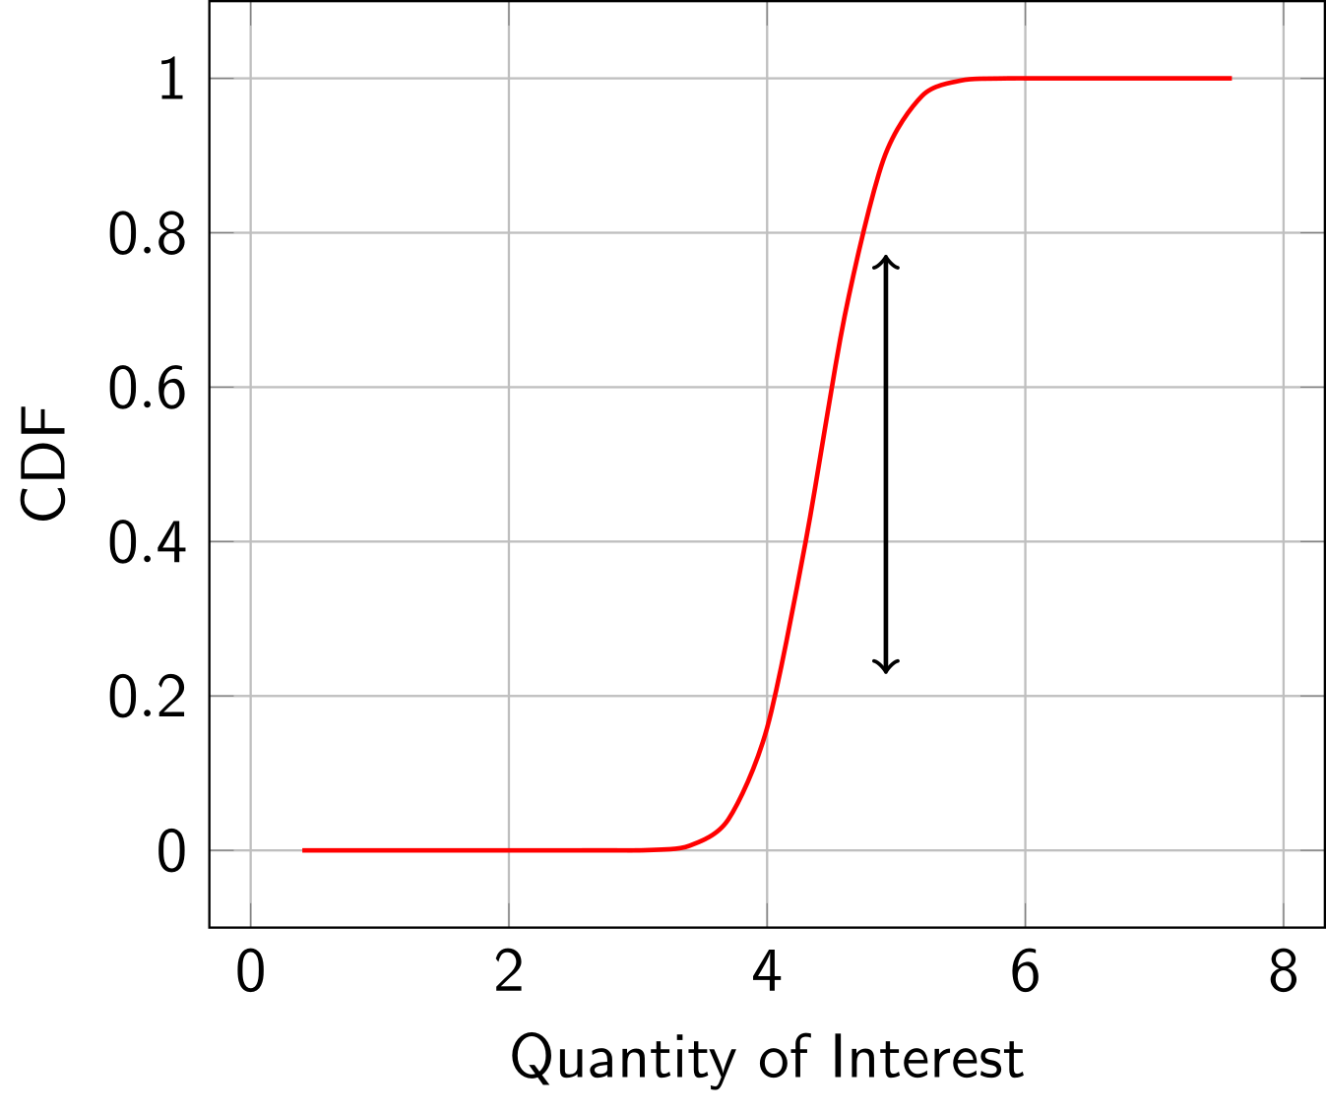
Introduction – Uncertainty Quantification
Aleatory Uncertainty
  aka stochastic uncertainty
  Irreducible variability inherent in nature
  Ex: flipping a coin, measurement error
Epistemic Uncertainty
  aka systematic uncertainty
  Lack of knowledge
  Ex: impact of radiation on humans, human error in trajectory
Mixed Uncertainty
  A combination of aleatory and epistemic uncertainty exist corresponding to different inputs into the system
  The end form is a probability box with multiple possible distributions that could be represent the true quantity of interest distribution
Model-form Uncertainty
  Modeling and quantification of the uncertainties about the ability of a computational model to truly represent the physics underlying the problem to be solved

Slide 9
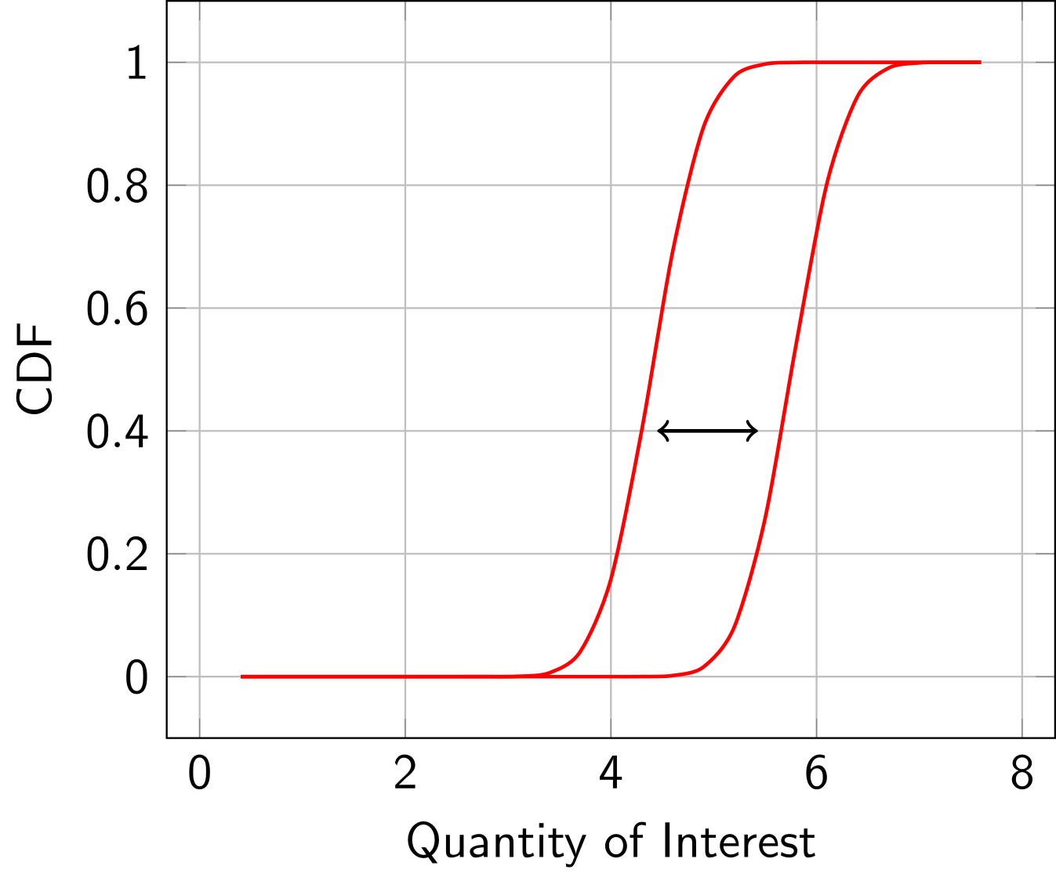
Introduction – Uncertainty Quantification
Aleatory Uncertainty
  aka stochastic uncertainty
  Irreducible variability inherent in nature
  Ex: flipping a coin, measurement error
Epistemic Uncertainty
  aka systematic uncertainty
  Lack of knowledge
  Ex: impact of radiation on humans error in trajectory
Mixed Uncertainty
  A combination of aleatory and epistemic uncertainty exist corresponding to different inputs into the system
  The end form is a probability box with multiple possible distributions that could be represent the true quantity of interest distribution
Model-form Uncertainty
  Modeling and quantification of the uncertainties about the ability of a computational model to truly represent the physics underlying the problem to be solved

Slide 10
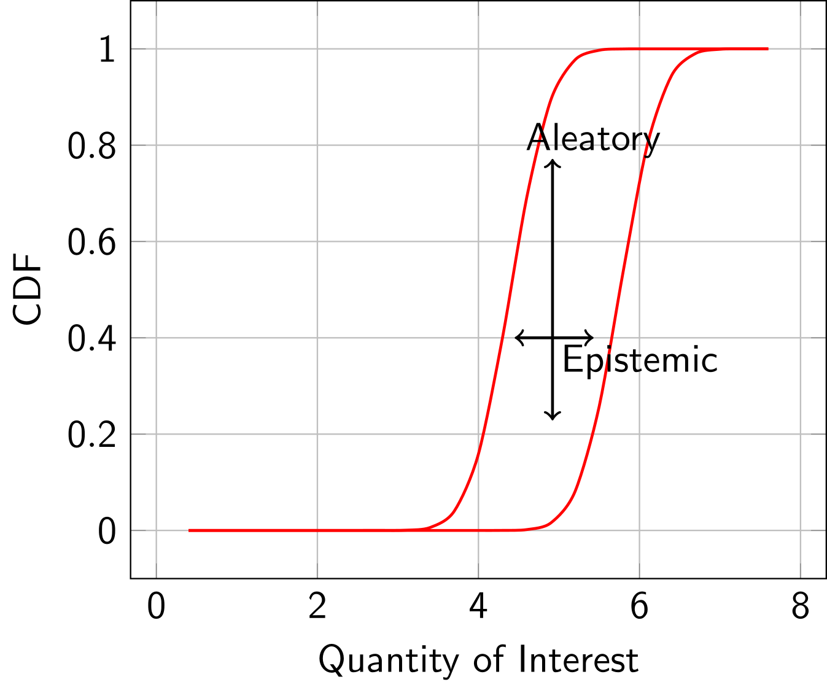
Introduction – Uncertainty Quantification
Aleatory Uncertainty
  aka stochastic uncertainty
  Irreducible variability inherent in nature
  Ex: flipping a coin, measurement error
Epistemic Uncertainty
  aka systematic uncertainty
  Lack of knowledge
  Ex: impact of radiation on humanserror in trajectory
Mixed Uncertainty
  A combination of aleatory and epistemic uncertainty exists corresponding to different inputs into the system
  The end form is a probability box with multiple possible distributions that could represent the true quantity of interest distribution
Model-form Uncertainty
  Modeling and quantification of the uncertainties about the ability of a computational model to truly represent the physics underlying the problem to be solved

Slide 11
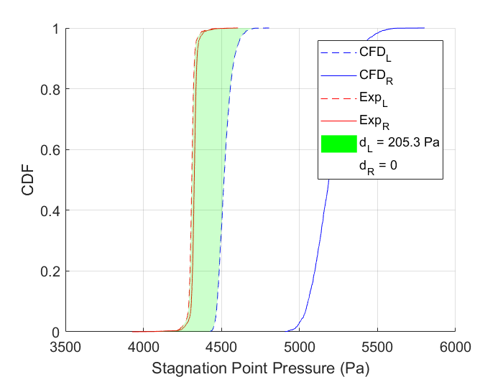
Introduction – Uncertainty Quantification
Aleatory Uncertainty
  aka stochastic uncertainty
  Irreducible variability inherent in nature
  Ex: flipping a coin, measurement error
Epistemic Uncertainty
  aka systematic uncertainty
  Lack of knowledge
  Ex: impact of radiation on humans
Mixed Uncertainty
  A combination of aleatory and epistemic uncertainty exists corresponding to different inputs into the system
  The end form is a probability box with multiple possible distributions that could represent the true quantity of interest distribution
Model-form Uncertainty
  Modeling and quantification of the uncertainties about the ability of a computational model to truly represent the physics underlying the problem to be solved

Slide 12
Quantify Model-Form Uncertainty by Validation Metric
Defn: A mathematical operator that measures the difference between the SRQ obtained from a simulation result and one obtained from experimental measurements [Oberkampf, Roy, 2010¹]
Metric Options:
Hypothesis Testing
Comparison of Means
Area Metrics
¹Oberkampf, William L., and Christopher J. Roy. Verification and validation in scientific computing. Cambridge university press, 2010.

Slide 13
Quantify Model-Form Uncertainty by Validation Metric
Defn: A mathematical operator that measures the difference between the SRQ obtained from a simulation result and one obtained from experimental measurements [Oberkampf, Roy, 2010¹]
Metric Options:
Hypothesis Testing
Comparison of Means
Area Metrics
¹Oberkampf, William L., and Christopher J. Roy. Verification and validation in scientific computing. Cambridge university press, 2010.

Slide 14

Area Metric Operator – Aleatory Uncertainty
Defined as the area between the prediction distribution $S$ and the data distribution $F_{n}$ which measures the mismatch between them.
$$d\left(S,F_{n}\right)=\int_{−∞}^{∞}{\left|S\left(x\right)−F_{n}\left(x\right)\right|dx}$$

Slide 15
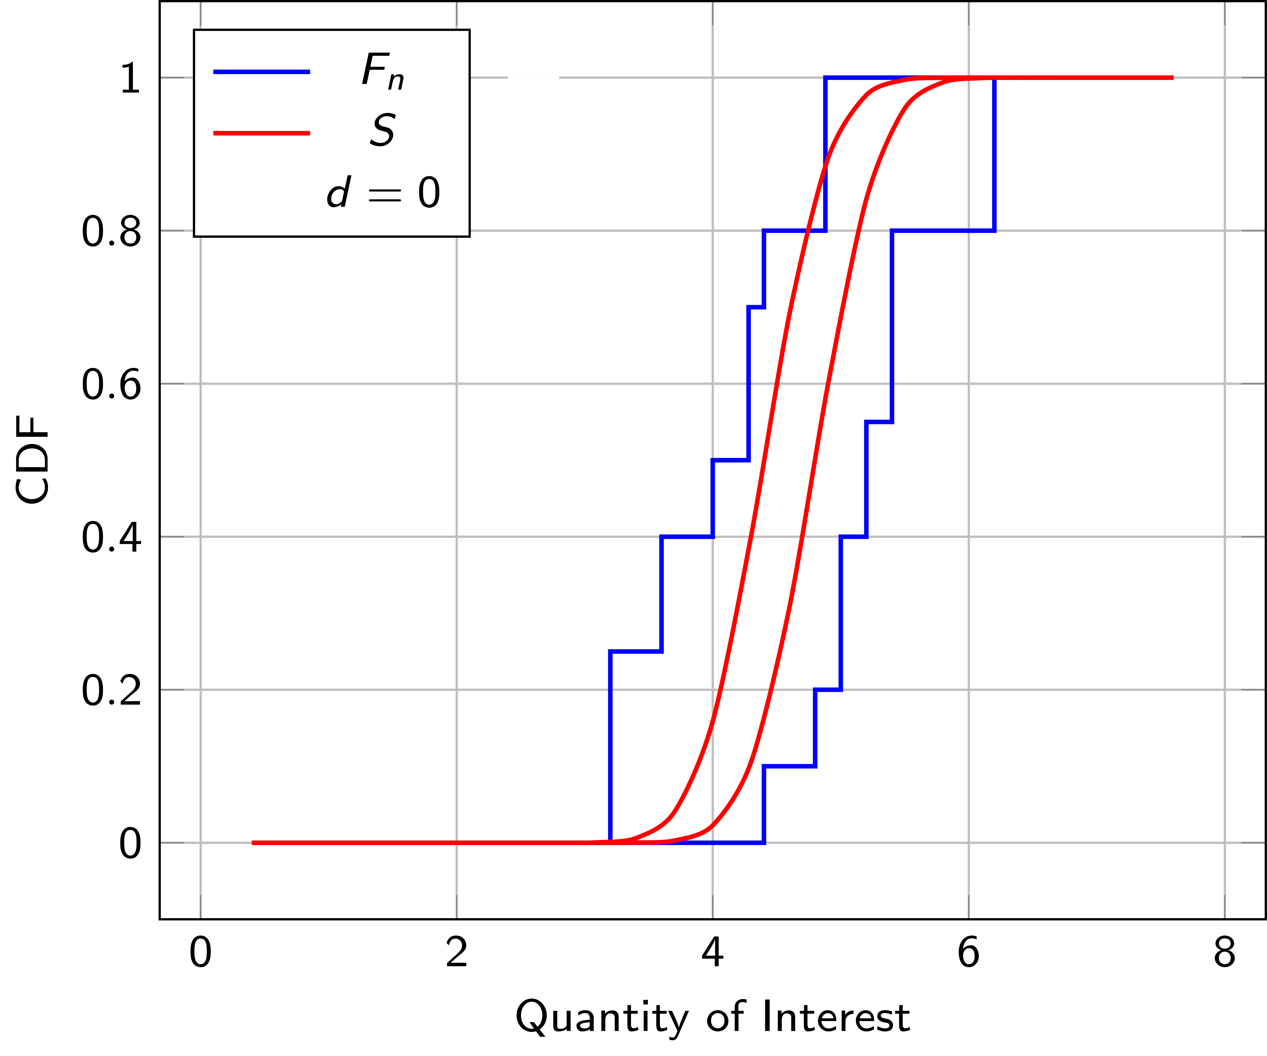
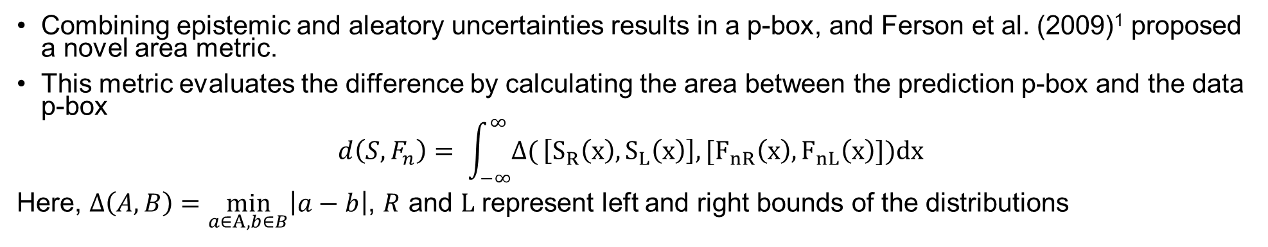


Area Metric Operator – Mixed Uncertainty
Combining epistemic and aleatory uncertainties results in a p-box, and Ferson et al. (2009)¹ proposed a novel area metric.
This metric evaluates the difference by calculating the area between the prediction p-box and the data p-box
$$d\left(S,F_{n}\right)= \int_{−∞}^{∞}{Δ(}\left[S_{R}\left(x\right),S_{L}\left(x\right)\right],[F_{nR}\left(x\right),F_{nL}\left(x\right)])dx$$
Here, $Δ\left(A,B\right)=\min_{a∈A,b∈B}\left|a−b\right|$, $R$ and $L$ represent left and right bounds of the distributions
$$S_{L}$$
$$S_{R}$$
¹Ferson, Scott, and William L. Oberkampf. "Validation of imprecise probability models." International Journal of Reliability and Safety 3.1-3 (2009): 3-22.

Slide 16
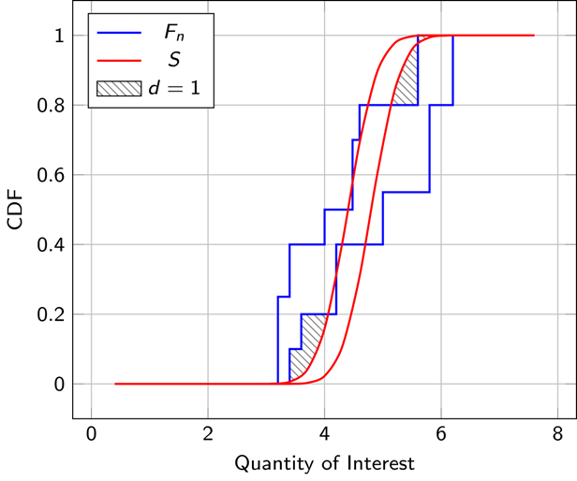

Validation Metric Operator Shortcomings
$d$ can be used to quantify the model form uncertainty and is appended to the p-box

Slide 17
Validation Metric Operator Shortcomings
$d$ can be used to quantify the model form uncertainty and is appended to the p-box

Slide 18
Validation Metric Operator Shortcomings
$d$ can be used to quantify the model form uncertainty and is appended to the p-box

Slide 19
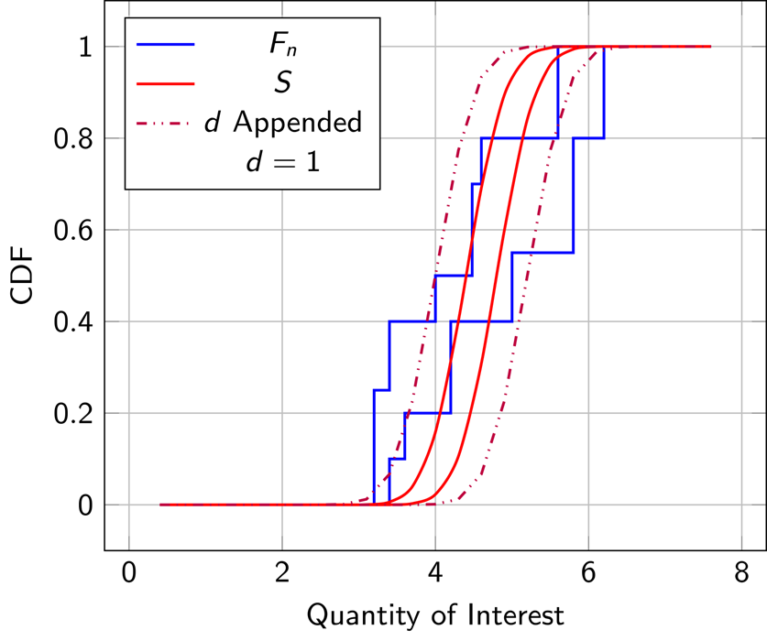
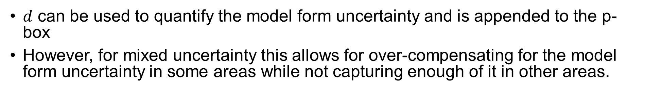
Validation Metric Operator Shortcomings
$d$ can be used to quantify the model form uncertainty and is appended to the p-box
However, for mixed uncertainty this allows for over-compensating for the model form uncertainty in some areas while not capturing enough of it in other areas.

Slide 20
Validation Metric Operator Shortcomings
$d$ can be used to quantify the model form uncertainty and is appended to the p-box
However, for mixed uncertainty this allows for over-compensating for the model form uncertainty in some areas while not capturing enough of it in other areas.
Ideal
Current

Slide 21
Validation Metric Operator Shortcomings
$d$ can be used to quantify the model form uncertainty and is appended to the p-box
However, for mixed uncertainty this allows for over-compensating for the model form uncertainty in some areas while not capturing enough of it in other areas.
Ideal
Current

Slide 22
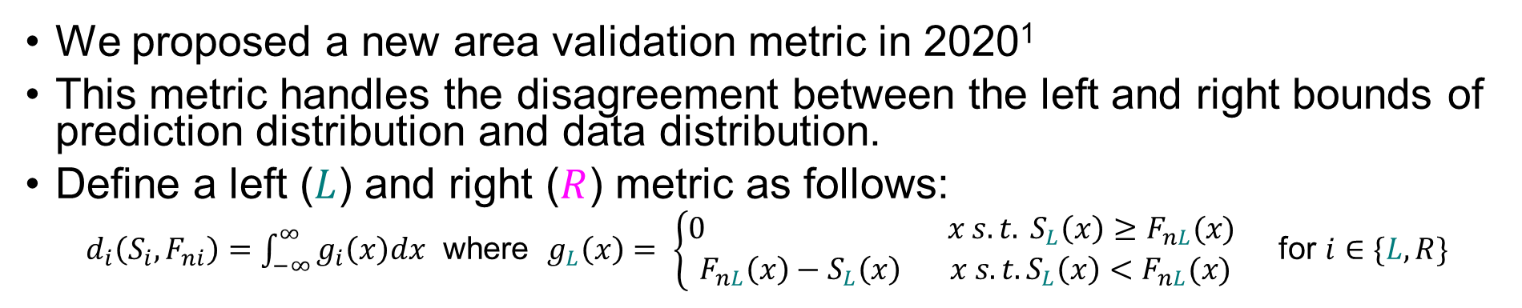
Alternative Area Validation Metric – Mixed Uncertainty
We proposed a new area validation metric in 2020¹
This metric handles the disagreement between the left and right bounds of prediction distribution and data distribution.
Define a left ($L$) and right ($R$) metric as follows:
$d_{i}\left(S_{i},F_{ni}\right)=\int_{−∞}^{∞}{g_{i}\left(x\right)dx}$ where $g_{L}\left(x\right)= \left\{\begin{aligned}0 x s.t. S_{L}\left(x\right)≥F_{nL}(x) \\ F_{nL}\left(x\right)−S_{L}\left(x\right) x s.t. S_{L}\left(x\right)<F_{nL}(x)\end{aligned}\right.$ for $i∈\{L,R\}$
¹Brune, Andrew J., Thomas K. West IV, and Laura M. White. "Calibration probe uncertainty and validation for the hypersonic material environmental test system." Journal of Thermophysics and Heat Transfer 34.2 (2020): 404-420.

Slide 23
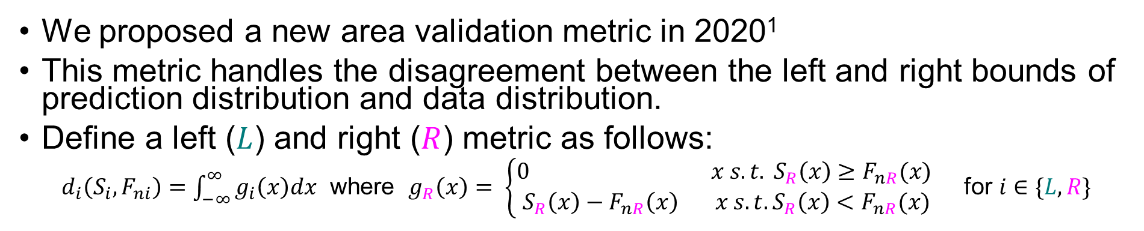
Alternative Area Validation Metric – Mixed Uncertainty
We proposed a new area validation metric in 2020¹
This metric handles the disagreement between the left and right bounds of prediction distribution and data distribution.
Define a left ($L$) and right ($R$) metric as follows:
$d_{i}\left(S_{i},F_{ni}\right)=\int_{−∞}^{∞}{g_{i}\left(x\right)dx}$ where $g_{R}\left(x\right)= \left\{\begin{aligned}0 x s.t. S_{R}\left(x\right)≥F_{nR}(x) \\ S_{R}\left(x\right)−F_{nR}\left(x\right) x s.t. S_{R}\left(x\right)<F_{nR}(x)\end{aligned}\right.$ for $i∈\{L,R\}$
¹Brune, Andrew J., Thomas K. West IV, and Laura M. White. "Calibration probe uncertainty and validation for the hypersonic material environmental test system." Journal of Thermophysics and Heat Transfer 34.2 (2020): 404-420.

Slide 24
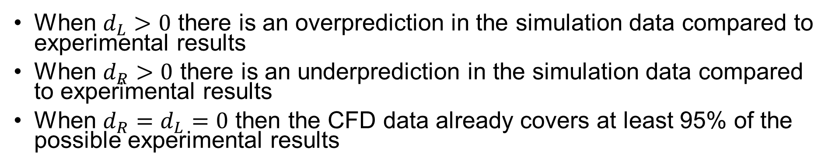
Alternative Area Validation Metric – Mixed Uncertainty
When $d_{L}>0$ there is an overprediction in the simulation data compared to experimental results
When $d_{R}>0$ there is an underprediction in the simulation data compared to experimental results
When $d_{R}=d_{L}=0$ then the CFD data already covers at least 95% of the possible experimental results

Slide 25
Comparison
Ferson et al. Metric
Brune et al. Metric

Slide 26
Comparison
Ferson et al. Metric
Brune et al. Metric

Slide 27
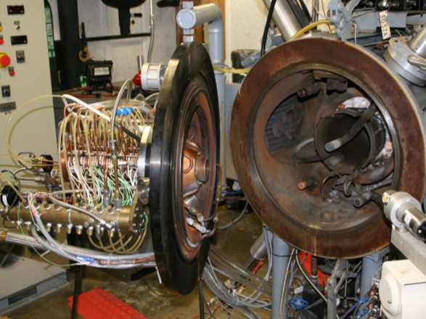
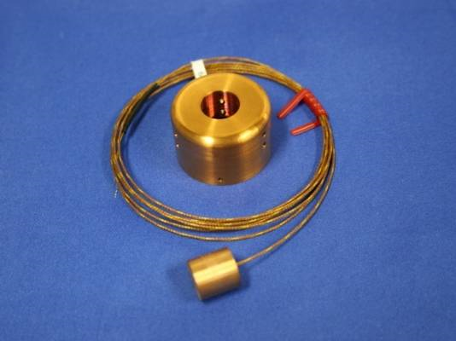
Applications
Stagnation Point Calibration [Brune et al.¹]
  Experimental data: from NASA Langley Hypersonic Materials Environmental Test System (HyMETS) facility
  Simulation data: from Langley Aerothermodynamic Upwind Relaxation Algorithm (LAURA-5) to compute the flow-field
  47 mixed uncertainty parameters
¹Brune, Andrew J., Thomas K. West IV, and Laura M. White. "Calibration probe uncertainty and validation for the hypersonic material environmental test system." Journal of Thermophysics and Heat Transfer 34.2 (2020): 404-420.

Slide 28
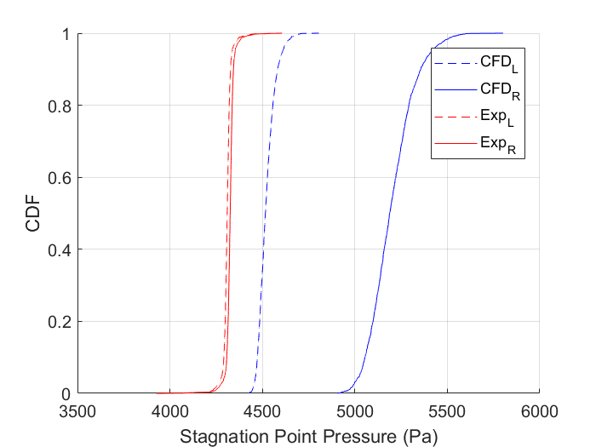
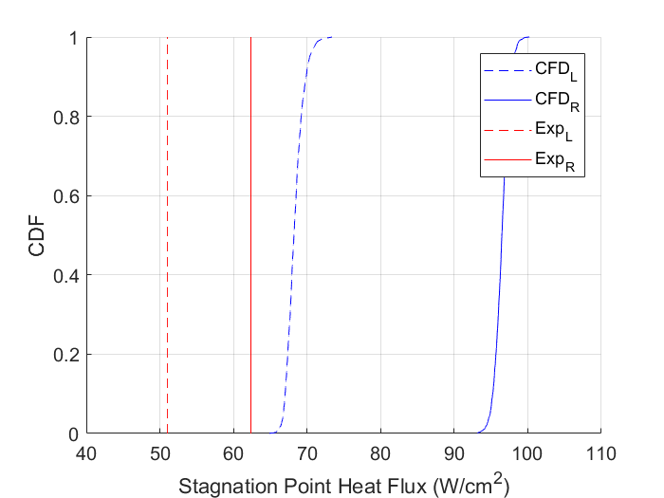
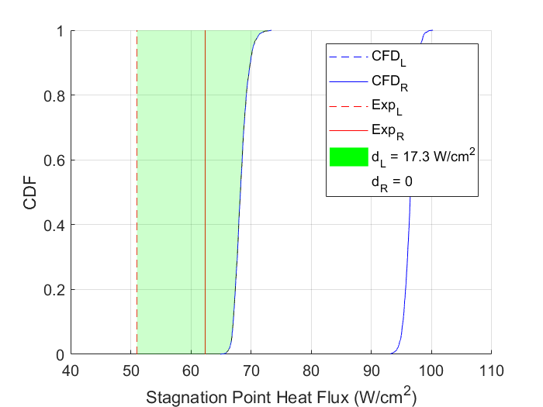
Validation Metric Results
Original P-boxes:
Validation Metric:
Stagnation Point Pressure
Stagnation Point Heat Flux

Slide 29
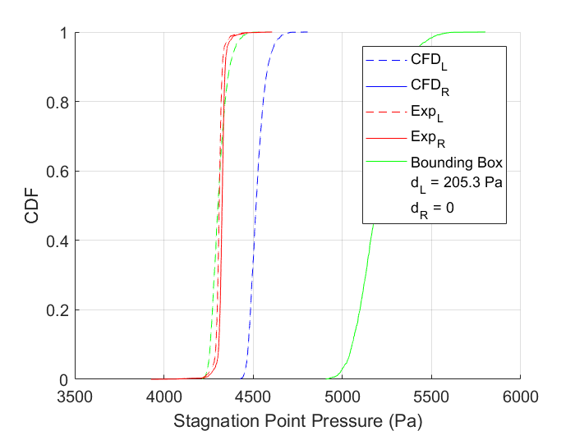
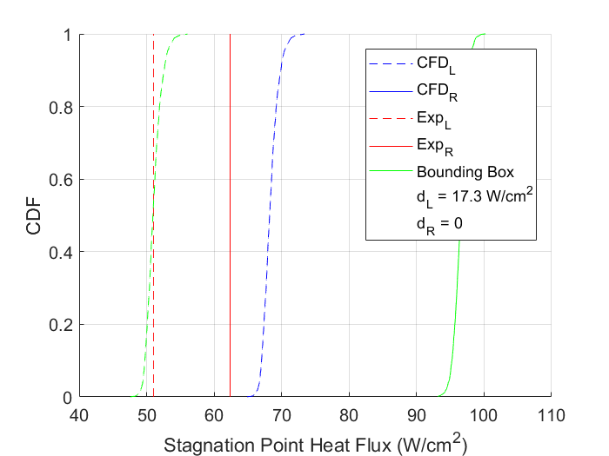
Validation Metric Results
Original P-boxes:
Validation Metric:
Stagnation Point Pressure
Appended d
Stagnation Point Heat Flux
Appended d

Slide 30
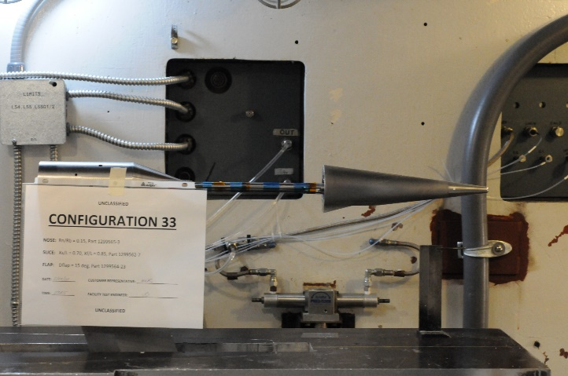
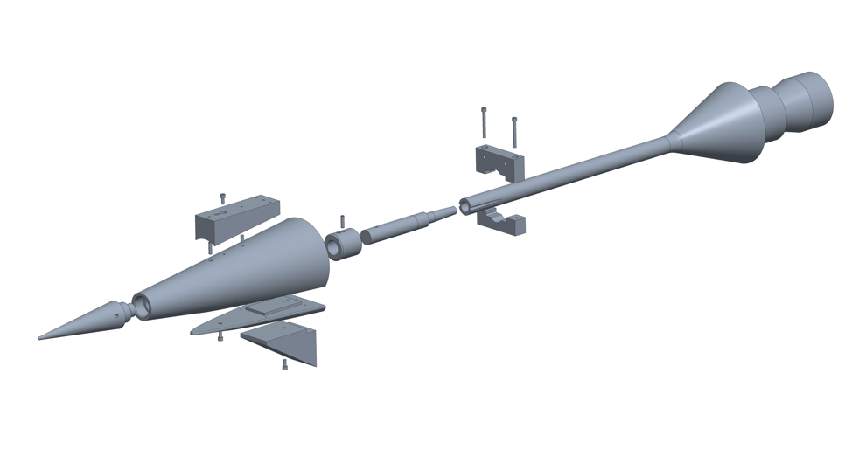
Applications
Multi-configurable Cone-Slice-Flap Hypersonic Wind Tunnel Model¹
  Experimental data: from the 20-inch Mach 6 Tunnel at NASA Langley Research Cener
  Simulation data: from NASA’s Cart3D inviscid software and VULCAN-CFD Spalart-Allmaras (SA) and Menter Shear-Stress Transport (SST) models
  Mixed and epistemic uncertainty
¹White, Laura, et al. "CFD validation study of a hypersonic cone-slice-flap configuration." AIAA Scitech 2021 Forum. 2021.

Slide 31
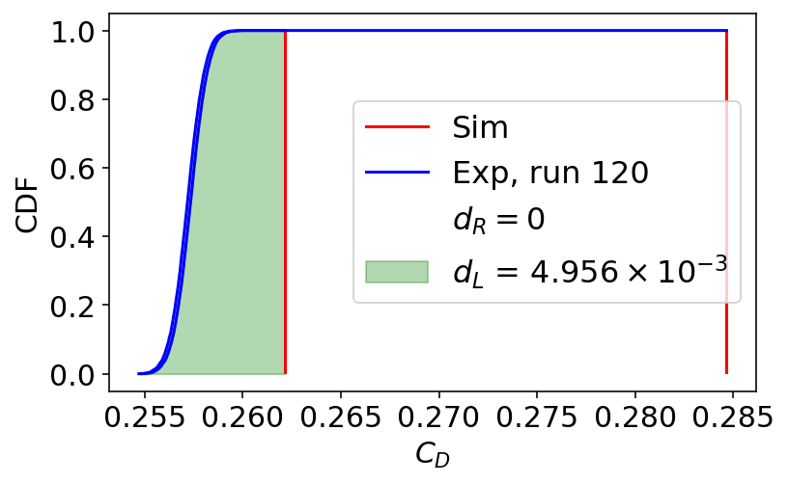
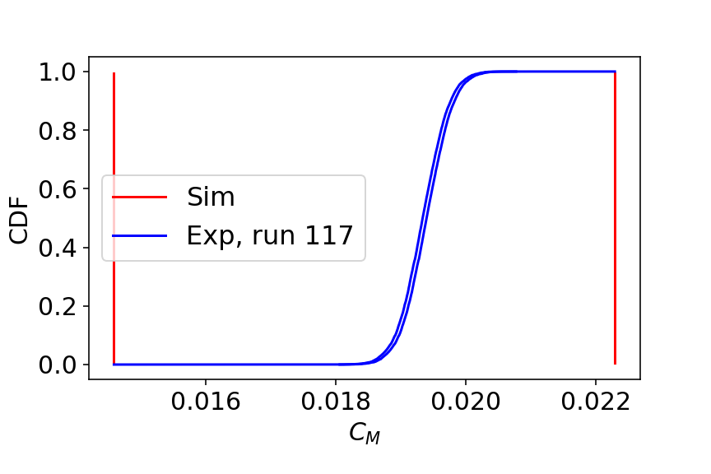
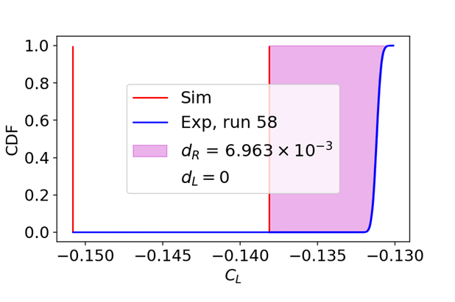
Validation Metric Results

Slide 32

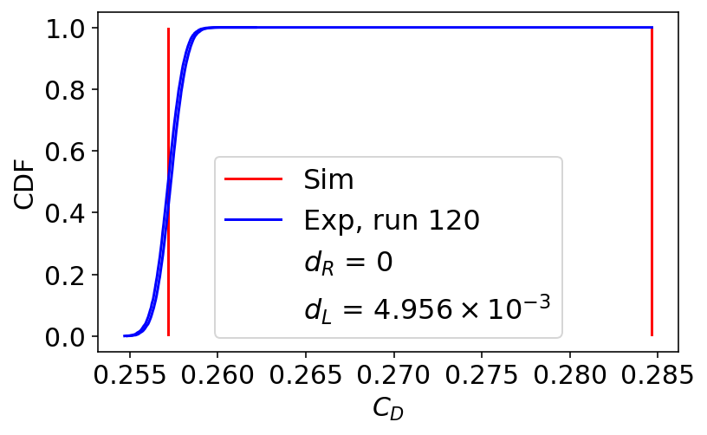
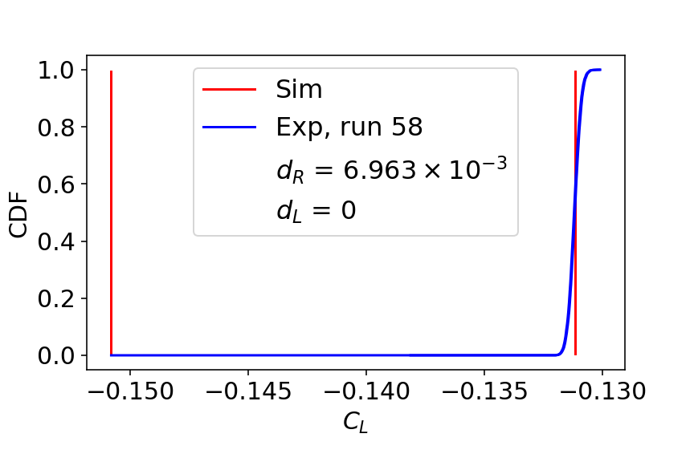
Validation Metric Results
New Bounds
New Bounds

Slide 33
Conclusions
Validation metrics quantify model‑form uncertainty for systems with aleatory, epistemic, or mixed uncertainty.
Standard area metrics can misrepresent disagreement in mixed‑uncertainty cases.
The alternative area metric more accurately captures left/right bound differences between simulation and experimental data.
Applications demonstrate improved characterization of model‑form uncertainty for hypersonic configurations and aerothermal heating.

Slide 34
Questions?

