Slide 1
Estimating Sparsely and Irregularly Observed Multivariate Functional Data
Maximillian Chen
Johns Hopkins University Applied Physics Laboratory
Maximillian.Chen@jhuapl.edu
Defense and Aerospace Test and Analysis Workshop (DATAWorks) 2023
April 27, 2023

Slide 2
Agenda
Introduction & Motivation
  Functional data analysis (FDA)
Methods
  Functional principal components analysis (FPCA)
    Principal components analysis through conditional expectation (PACE)
  Multivariate functional principal components analysis (MFPCA)
Results
  Statistical model based simulated data
  Ballistic missile trajectory dataset (simulated based on a physics model)
  Northern California flight tracks data (publicly available data)
Conclusions and Future Work

Slide 3
Motivation
With the rise in availability of big data, there is a growing need for tools and methods to help inform data-driven decisions to gain insights from these large scale datasets – in particular for datasets that exist on a continuum (such as time).
These datasets span a wide variety of fields across many industries:
  Medicine (e.g., EKG or fMRI data collected for the same patient over multiple time points)
  Finance (e.g., stock market data over time)
  Sports (e.g., player or team performance data taken over time)
  Defense (e.g., tracking and surveillance)
In addition to the large scale nature, we require methods that can account for:
  Dependencies over a continuum
  Dependence between multiple variables
  Partially observed data (only a portion of the functions are observed)
  Measurement error

Slide 4
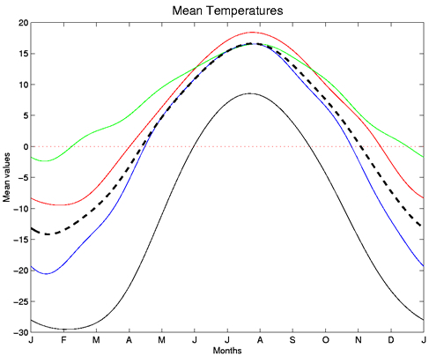

Functional Data Analysis (FDA)
Branch of statistics that analyzes data providing information about curves, surfaces, or anything else varying over a continuum
A single function is typically written as $X(t)$, where $t$ is the continuum quantity (such as time).
If we have a collection of functions [$X_{1}\left(t\right), X_{2}\left(t\right), …, X_{n}(t)$], then we can estimate:
  Mean function: $\overline{x}\left(t\right)= \frac{1}{n}\sum_{i=1}^{n}{x_{i}(t)}$
  Covariance function: $σ\left(s,t\right)= \frac{1}{n}\sum_{i=1}^{n}{(x_{i}\left(s\right)−\overline{x}\left(s\right))(x_{i}\left(t\right)−\overline{x}\left(t\right))}$
Source: “Summarizing the Functional Data.” https://www.psych.mcgill.ca/misc/fda/ex-weather-b2.html
Source: Hooker, Giles. “Introduction to Functional Data Analysis: A CSCU Workshop.”
In functional data, each observation is a function, rather than a single quantity (scalar/vector/array).

Slide 5
Functional Data Analysis: Assumptions
Functional data are seen as independent and identically distributed (i.i.d.) random variables in the separable Hilbert space of square integrable functions on a bounded domain.
In practice, functional data consists of discretely observed points.
Assume data is densely and regularly observed.
We have a set of functions for one variable.
If we have multiple variables, they are independent of one another.
Questions:
If we have functions from multiple variables, how do we account for dependencies between variables?
How do we handle sparsely and irregularly observed functional data?
  How do we reconstruct partially observed functional data that are also sparsely and irregularly observed?

Slide 6
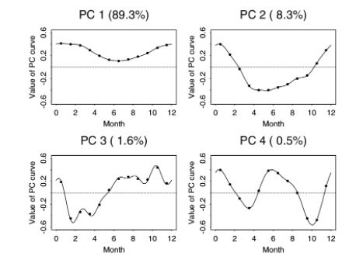
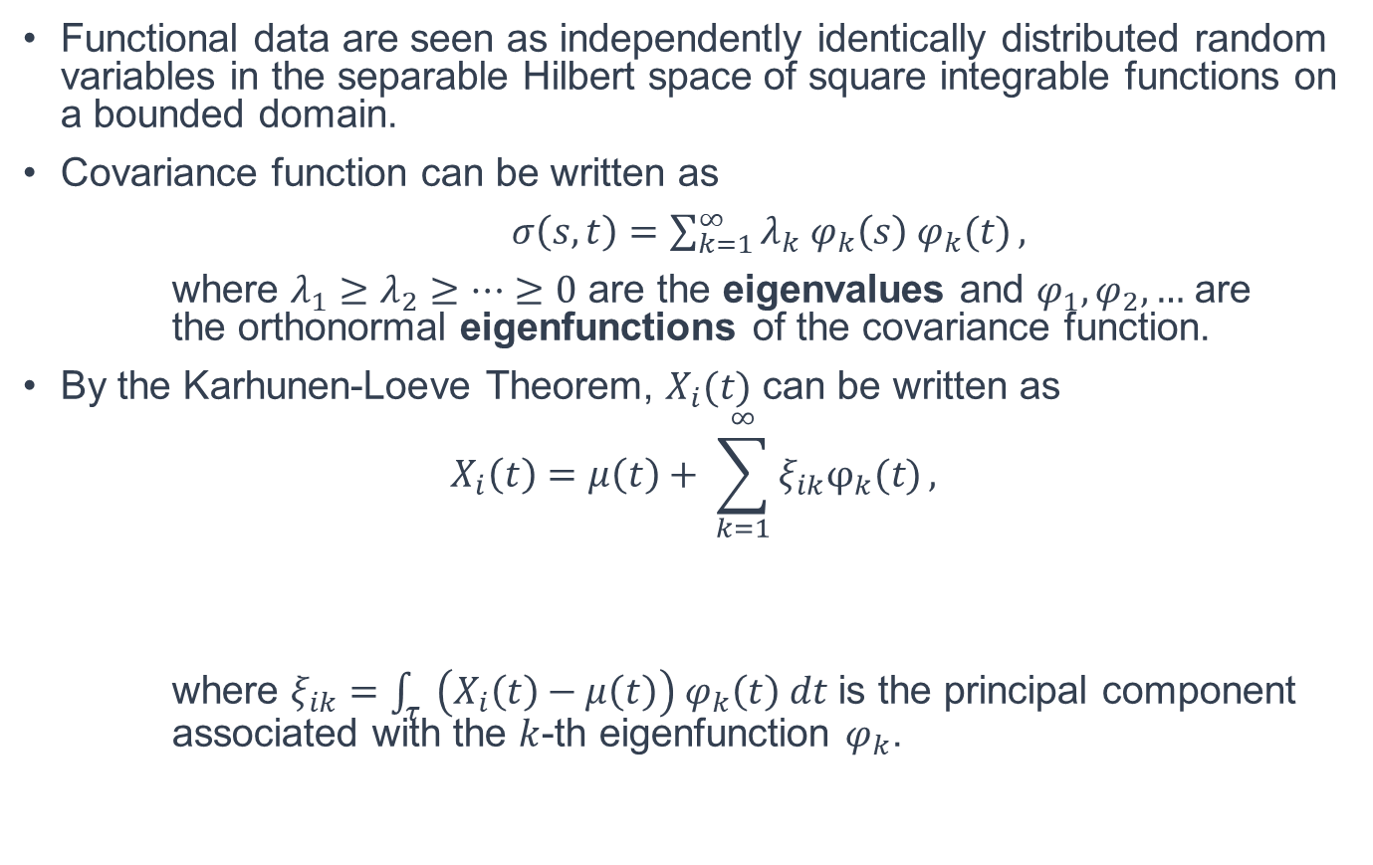
Functional Principal Components Analysis (FPCA)
Functional data are seen as independently identically distributed random variables in the separable Hilbert space of square integrable functions on a bounded domain.
Covariance function can be written as
$σ\left(s,t\right)=\sum_{k=1}^{∞}{λ_{k}{ φ}_{k}\left(s\right){ φ}_{k}(t)},$
where $λ_{1}≥λ_{2}≥…≥0$ are the eigenvalues and $φ_{1}, φ_{2},…$ are the orthonormal eigenfunctions of the covariance function.
By the Karhunen-Loeve Theorem, $X_{i}(t)$ can be written as
$$X_{i}\left(t\right)=μ\left(t\right)+ \sum_{k=1}^{∞}{ξ_{ik}φ_{k}(t)},$$
where $ξ_{ik}=\int_{τ}{ \left(X_{i}\left(t\right)−μ\left(t\right)\right){ φ}_{k}\left(t\right) dt}$ is the principal component associated with the $k$-th eigenfunction $φ_{k}$.
Source: Ramsay, J.O. and Silverman, B.W. “Functional Data Analysis.”
FPCA is analogous to “regular” PCA.
Principal component/
score
Eigenfunctions
In practice,
  Functional data is observed at discrete points along t, but observations are regular and sufficiently dense.
  Principal components/scores are computed via numerical integration.

Slide 7
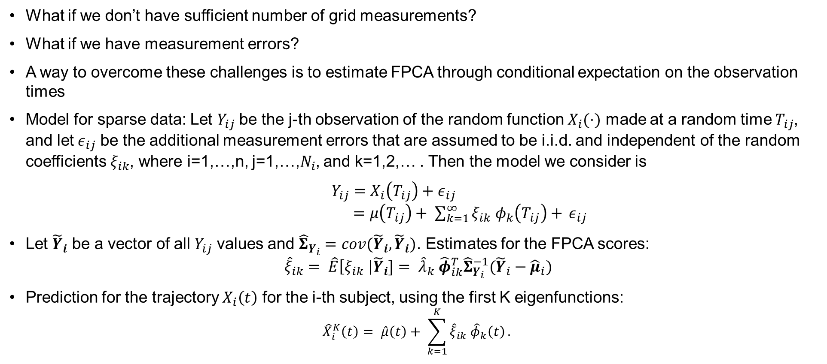
Principal Component Analysis Through Conditional Expectation (PACE) [Yao et al, 2006]
What if we don’t have sufficient number of grid measurements?
What if we have measurement errors?
A way to overcome these challenges is to estimate FPCA through conditional expectation on the observation times
Model for sparse data: Let $Y_{ij}$ be the j-th observation of the random function $X_{i}(⋅)$ made at a random time $T_{ij}$, and let$ε_{ij}$ be the additional measurement errors that are assumed to be i.i.d. and independent of the random coefficients $ξ_{ik}$, where i=1,…,n, j=1,…,$N_{i}$, and k=1,2,… . Then the model we consider is
$Y_{ij}=X_{i}\left(T_{ij}\right)+ε_{ij}$
$=μ\left(T_{ij}\right)+ \sum_{k=1}^{∞}{ξ_{ik} φ_{k}\left(T_{ij}\right)+ }ε_{ij}$
Let ${\tilde{Y}}_{i}$ be a vector of all $Y_{ij}$ values and ${\hat{Σ}}_{Y_{i}}=cov({\tilde{Y}}_{i},{\tilde{Y}}_{i})$. Estimates for the FPCA scores:
$${\hat{ξ}}_{ik}= \hat{E}\left[ξ_{ik} \right|{\tilde{Y}}_{i}]= {\hat{λ}}_{k} {\hat{φ}}_{ik}^{T}{\hat{Σ}}_{Y_{i}}^{−1}({\tilde{Y}}_{i}−{\hat{μ}}_{i})$$
Prediction for the trajectory $X_{i}\left(t\right)$ for the i-th subject, using the first K eigenfunctions:
$${\hat{X}}_{i}^{K}\left(t\right)= \hat{μ}\left(t\right)+ \sum_{k=1}^{K}{{\hat{ξ}}_{ik} {\hat{φ}}_{k}\left(t\right)}.$$
FPCA can be computed for sparse and irregular functional data.

Slide 8
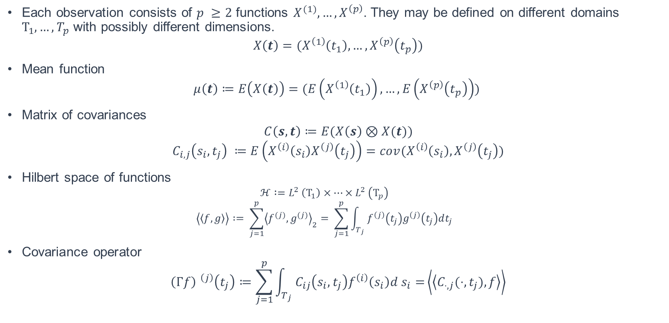
Multivariate Functional Data (Happ and Greven, 2018)
Each observation consists of $p ≥2$ functions $X^{(1)},…,X^{\left(p\right)}$. They may be defined on different domains $Τ_{1},…, T_{p}$ with possibly different dimensions.
$$X\left(t\right)=(X^{\left(1\right)}\left(t_{1}\right), …,X^{\left(p\right)}\left(t_{p}\right))$$
Mean function
$$μ\left(t\right)≔E\left(X\left(t\right)\right)=(E\left(X^{\left(1\right)}\left(t_{1}\right)\right), …,E\left(X^{\left(p\right)}\left(t_{p}\right)\right))$$
Matrix of covariances
$$C\left(s,t\right)≔E(X\left(s\right)⊗X(t))$$
$$C_{i,j}\left(s_{i}, t_{j}\right) ≔E\left(X^{\left(i\right)}\left(s_{i}\right)X^{\left(j\right)}\left(t_{j}\right)\right)=cov(X^{\left(i\right)}\left(s_{i}\right),X^{\left(j\right)}\left(t_{j}\right))$$
Hilbert space of functions
  $$ℋ :=L^{2} \left(Τ_{1}\right)×…×L^{2} \left(Τ_{p}\right)$$
  $$\left\langle \left\langle f,g\right\rangle \right\rangle := \sum_{j=1}^{p}{{\left\langle f^{(j)},g^{(j)}\right\rangle }_{2}= \sum_{j=1}^{p}{\int_{T_{j}}{f^{\left(j\right)}\left(t_{j}\right)g^{\left(j\right)}\left(t_{j}\right)dt_{j}}}}$$
Covariance operator
$${\left(Γf\right) }^{\left(j\right)}\left(t_{j}\right)≔\sum_{j=1}^{p}{\int_{T_{j}}{C_{ij}\left(s_{i},t_{j}\right)f^{\left(i\right)}\left(s_{i}\right)d s_{i}=}}\left\langle \left\langle C_{⋅,j}(⋅, t_{j}),f\right\rangle \right\rangle$$
In multivariate functional data, each observation is a tuple of functions, which all describe the same single event.

Slide 9

Multivariate Functional Principal Components Analysis (MFPCA) (Happ and Greven, 2018)
By the Hilbert-Schmidt Theorem, it follows that there exists a complete orthonormal basis of eigenfunctions $ψ_{m }∈ℋ$ such that
$$Γψ_{m}=ν_{m}ψ_{m.}$$
By the Spectral Theorem, it holds that
$$Γf= \sum_{m=1}^{∞}{ν_{m}\left\langle \left\langle f, ψ_{m}\right\rangle \right\rangle ψ_{m} ∀ f∈ℋ}$$
Mercer’s Theorem: For $j=1,…,p$ and $s_{j}, t_{j}∈Τ_{j}$ , it holds that
$$cov\left(X^{\left(j\right)}\left(s_{i}\right),X^{\left(j\right)}\left(t_{j}\right)\right)= C_{jj}\left(s_{j},t_{j}\right)= \sum_{m=1}^{∞}{ν_{m}ψ_{m}^{\left(j\right)}(s_{j})ψ_{m}^{\left(j\right)}(t_{j})}$$
Multivariate Karhunen-Loeve Theorem:
  $$X\left(t\right)=\sum_{m=1}^{∞}{ρ_{m}ψ_{m}\left(t\right), ρ_{m}= \left\langle \left\langle X, ψ_{m}\right\rangle \right\rangle }$$
Finite Karhunen-Loeve Decomposition:
$$X\left(t\right):=\sum_{m=1}^{M}{ρ_{m}ψ_{m}\left(t\right)}$$
Score
Eigenfunctions
In multivariate functional data, each observation is a tuple of functions, which all describe the same single event.

Slide 10
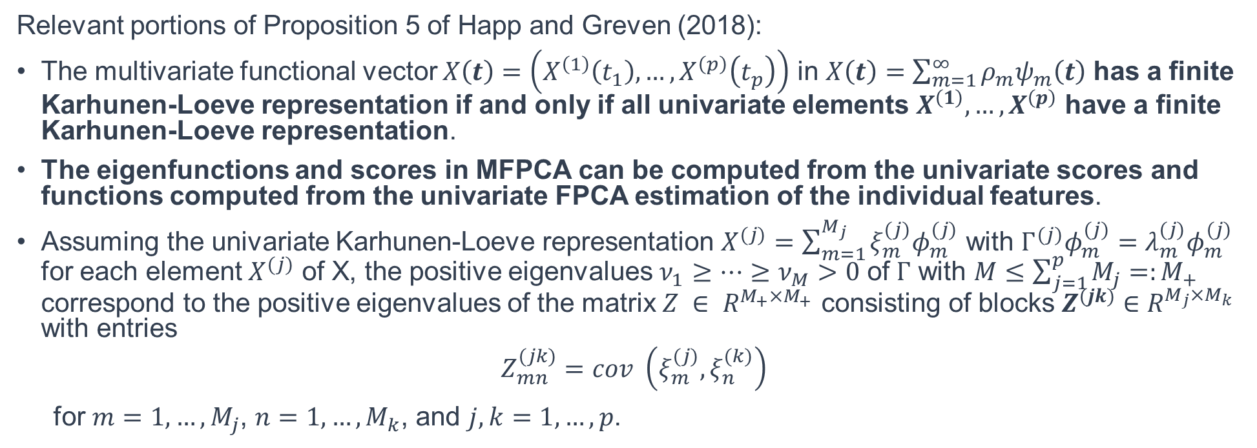
Relationship Between Univariate FPCA (UFPCA) and MFPCA
Relevant portions of Proposition 5 of Happ and Greven (2018):
The multivariate functional vector $X\left(t\right)=\left(X^{\left(1\right)}\left(t_{1}\right), …,X^{\left(p\right)}\left(t_{p}\right)\right)$ in $X\left(t\right)=\sum_{m=1}^{∞}{ρ_{m}ψ_{m}\left(t\right)}$ has a finite Karhunen-Loeve representation if and only if all univariate elements $X^{\left(1\right)},…,X^{\left(p\right)}$ have a finite Karhunen-Loeve representation.
The eigenfunctions and scores in MFPCA can be computed from the univariate scores and functions computed from the univariate FPCA estimation of the individual features.
Assuming the univariate Karhunen-Loeve representation $X^{(j)}=\sum_{m=1}^{M_{j}}{{ξ_{m}^{(j)}φ}_{m}^{(j)}}$ with $Γ^{(j)}φ_{m}^{(j)}=λ_{m}^{(j)}φ_{m}^{(j)}$ for each element $X^{(j)}$ of X, the positive eigenvalues $ν_{1}≥…≥ν_{M}>0$ of $Γ$ with $M≤\sum_{j=1}^{p}{M_{j}}=:M_{+}$ correspond to the positive eigenvalues of the matrix $Z ∈ R^{M_{+}×M_{+}}$ consisting of blocks $Z^{(jk)}∈R^{M_{j}×M_{k}}$ with entries
$$Z_{mn}^{(jk)}=cov \left(ξ_{m}^{(j)}, ξ_{n}^{(k)}\right)$$
for $m=1,…,M_{j}$, $n=1,…,M_{k}$, and $j,k=1,…,p$.
Key Takeaways:
1. Components of MFPCA are computed from the components of the UFPCA estimates of each feature.
2. Dependencies between features are captured through covariance computed between scores estimated by univariate FPCA of two features.
3. The dependencies between features are accounted for in the matrix Z.

Slide 11
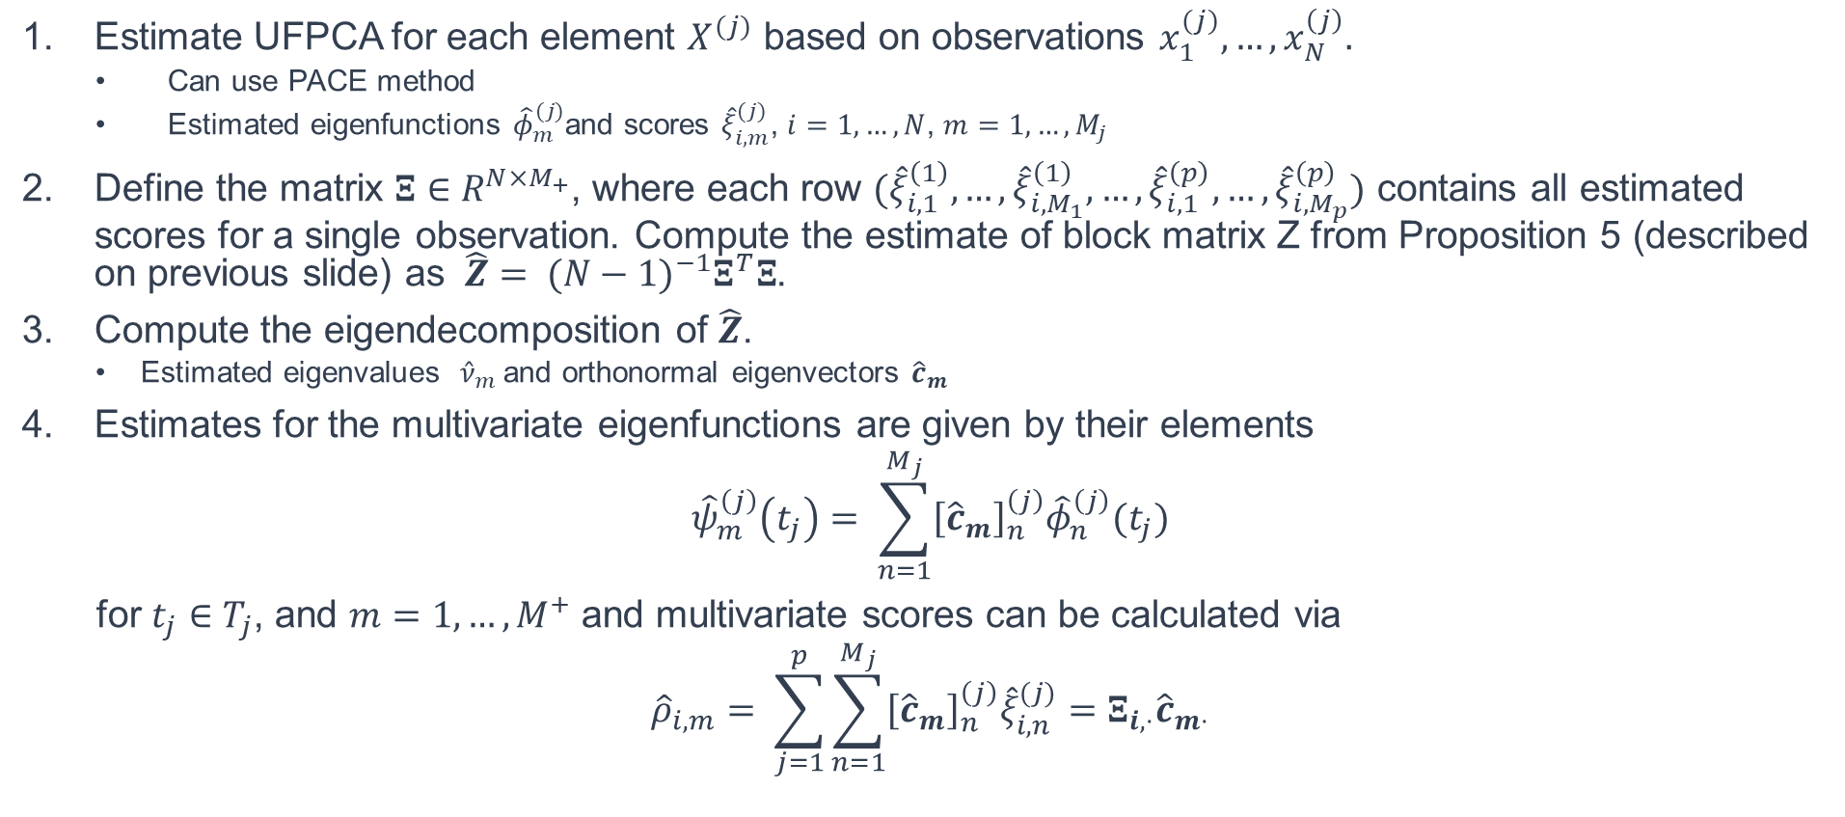
Estimating MFPCA (Happ and Greven, 2018)
Estimate UFPCA for each element $X^{(j)}$ based on observations $x_{1}^{(j)},…,x_{N}^{\left(j\right)}.$
  Can use PACE method
  Estimated eigenfunctions ${\hat{φ}}_{m}^{(j)}$and scores ${\hat{ξ}}_{i,m}^{(j)}$, $i=1,…,N$, $m=1,…,M_{j}$
Define the matrix $Ξ∈R^{N×M_{+}}$, where each row $({\hat{ξ}}_{i,1}^{\left(1\right)},…,{\hat{ξ}}_{i,M_{1}}^{\left(1\right)},…,{\hat{ξ}}_{i,1}^{\left(p\right)},…,{\hat{ξ}}_{i,M_{p}}^{\left(p\right)})$ contains all estimated scores for a single observation. Compute the estimate of block matrix Z from Proposition 5 (described on previous slide) as $\hat{Z}= {(N−1)}^{−1}Ξ^{T}Ξ$.
Compute the eigendecomposition of $\hat{Z}$.
  Estimated eigenvalues ${\hat{ν}}_{m}$ and orthonormal eigenvectors ${\hat{c}}_{m}$
Estimates for the multivariate eigenfunctions are given by their elements
$${\hat{ψ}}_{m}^{\left(j\right)}\left(t_{j}\right)= \sum_{n=1}^{M_{j}}{{\left[{\hat{c}}_{m}\right]}_{n}^{\left(j\right)}{\hat{φ}}_{n}^{\left(j\right)}(t_{j})}$$
for $t_{j}∈T_{j}$, and $m=1,…,M^{+}$ and multivariate scores can be calculated via
$${\hat{ρ}}_{i,m}= \sum_{j=1}^{p}{\sum_{n=1}^{M_{j}}{{\left[{\hat{c}}_{m}\right]}_{n}^{\left(j\right)}{\hat{ξ}}_{i,n}^{(j)}=Ξ_{i,⋅}{\hat{c}}_{m⋅}}}$$
MFPCA can be computed from the univariate FPCA computed for each feature.
The dependencies between features are accounted for in the matrix Z.

Slide 12


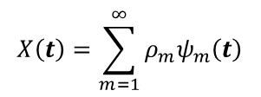
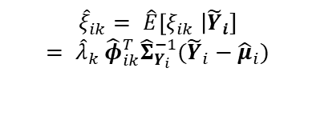
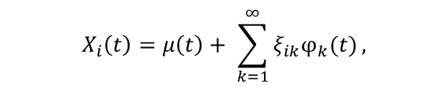
Methods Overview
Observed functional data for one variable
Univariate Functional Principal Components Analysis (UFPCA)
Principal Component Analysis Through Conditional Expectation (PACE) [Yao et al, 2006]
Representation of (densely and regularly observed) functional data
Representation of irregularly and sparsely observed functional data with measurement error
$$X\left(t\right)$$
$$X_{i}\left(t\right)=μ\left(t\right)+ \sum_{k=1}^{∞}{ξ_{ik}φ_{k}(t)},$$
$${\hat{ξ}}_{ik}= \hat{E}\left[ξ_{ik} \right|{\tilde{Y}}_{i}]$$
$$= {\hat{λ}}_{k} {\hat{φ}}_{ik}^{T}{\hat{Σ}}_{Y_{i}}^{−1}({\tilde{Y}}_{i}−{\hat{μ}}_{i})$$
Principal component/
score
Eigenfunctions
Observed functional data for multiple variables
Compute FPCA estimates for each variable
Multivariate Functional Principal Components Analysis (MFPCA)
[Happ and Greven, 2018]
Representation of functional data for each variable
Combine/synthesize FPCA results for each variable to get equivalent FPCA estimates over a multivariate tuple of functions that account for dependencies between variables
$$X\left(t\right)=\sum_{m=1}^{∞}{ρ_{m}ψ_{m}\left(t\right)}$$
$$X\left(t\right)=(X^{\left(1\right)}\left(t_{1}\right), …,X^{\left(p\right)}\left(t_{p}\right))$$
PACE can be used if data is irregularly and sparsely observed
Score
Eigenfunctions

Slide 13
Implementation of Methods
Evaluated methods on multiple datasets
  Statistical model simulated datasets (based on MFPCA model)
  Ballistic missile trajectory dataset
    Generated by a physics-informed model to notionally propagate objects according to a path of a ballistic missile
  Northern California flight tracks
    Publicly available NASA dataset
For all datasets, varied the degree of sparsity:
  Full data
  Medium sparsity (50-70% of data missing)
  High sparsity (80-90% of data missing)
Methods
  MFPCA
  UFPCA

Slide 14
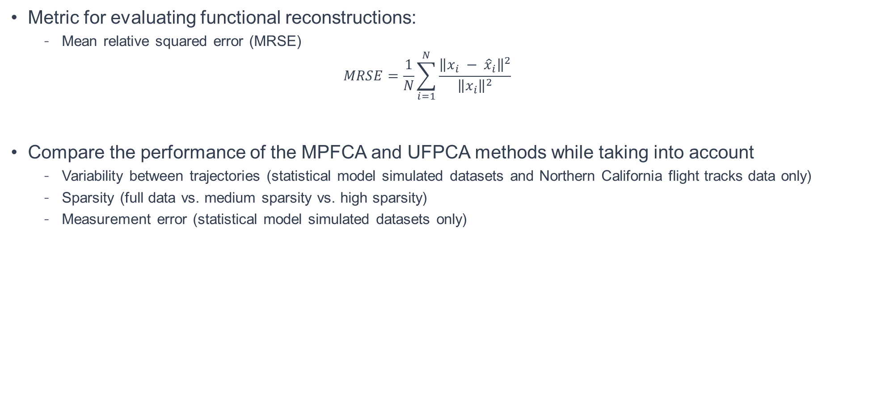
Performance Evaluation
Metric for evaluating functional reconstructions:
  Mean relative squared error (MRSE)
  $$MRSE=\frac{1}{N}\sum_{i=1}^{N}{\frac{{\left\|x_{i} − {\hat{x}}_{i}\right\|}^{2}}{{\left\|x_{i}\right\|}^{2}}}$$
Compare the performance of the MPFCA and UFPCA methods while taking into account
  Variability between trajectories (statistical model simulated datasets and Northern California flight tracks data only)
  Sparsity (full data vs. medium sparsity vs. high sparsity)
  Measurement error (statistical model simulated datasets only)

Slide 15
Statistical Model Simulated Data Results

Slide 16
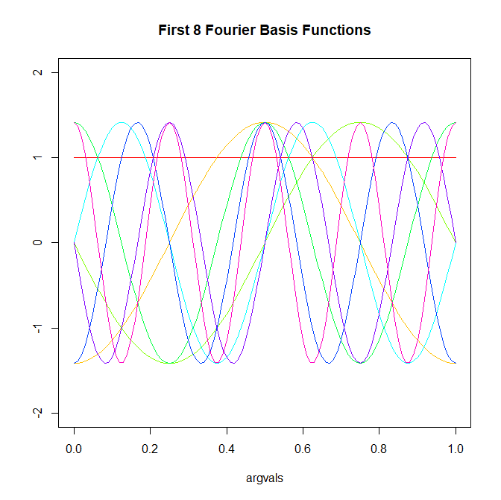
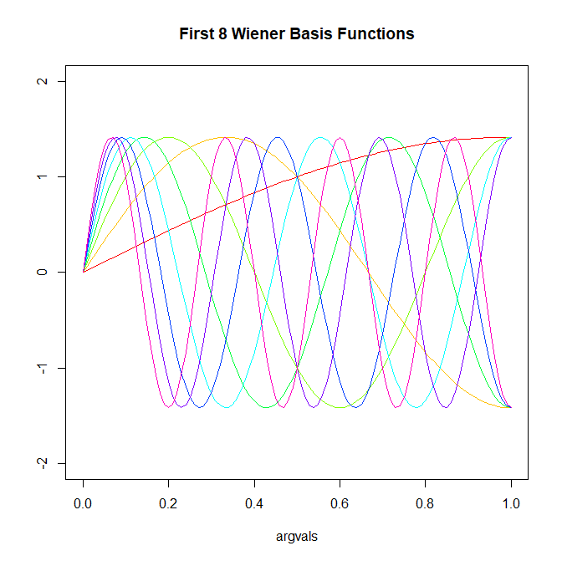
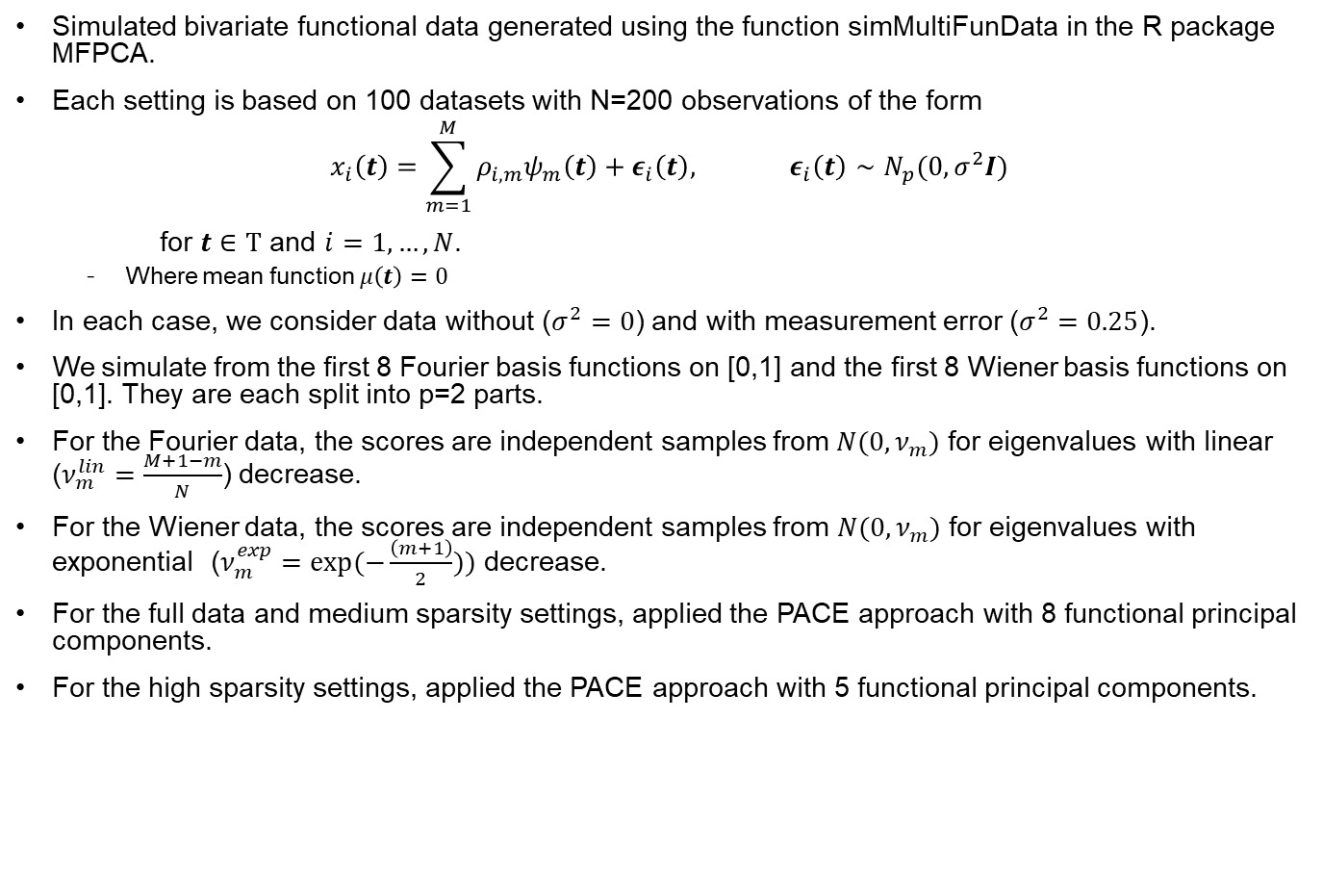
Statistical Model Simulated Data Generation
Simulated bivariate functional data generated using the function simMultiFunData in the R package MFPCA.
Each setting is based on 100 datasets with N=200 observations of the form
$$x_{i}\left(t\right)=\sum_{m=1}^{M}{ρ_{i,m}ψ_{m}\left(t\right)+ε_{i}\left(t\right), ε_{i}\left(t\right)∼N_{p}(0, σ^{2}I)}$$
for $t∈Τ$ and $i=1,…,N$.
  Where mean function $μ\left(t\right)=0$
In each case, we consider data without ($σ^{2}=0$) and with measurement error ($σ^{2}=0.25$).
We simulate from the first 8 Fourier basis functions on [0,1] and the first 8 Wiener basis functions on [0,1]. They are each split into p=2 parts.
For the Fourier data, the scores are independent samples from $N(0, ν_{m})$ for eigenvalues with linear ($ν_{m}^{lin}=\frac{M+1−m}{N}$) decrease.
For the Wiener data, the scores are independent samples from $N(0, ν_{m})$ for eigenvalues with exponential ($ν_{m}^{exp}=exp⁡(−\frac{\left(m+1\right)}{2}))$ decrease.
For the full data and medium sparsity settings, applied the PACE approach with 8 functional principal components.
For the high sparsity settings, applied the PACE approach with 5 functional principal components.

Slide 17
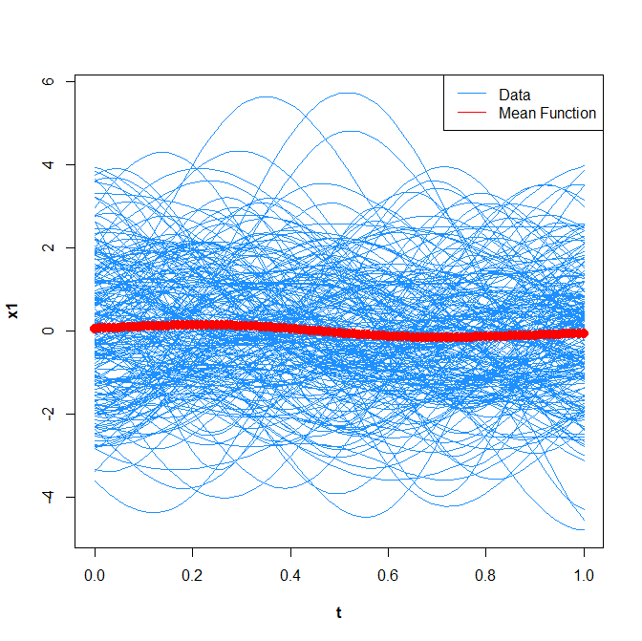
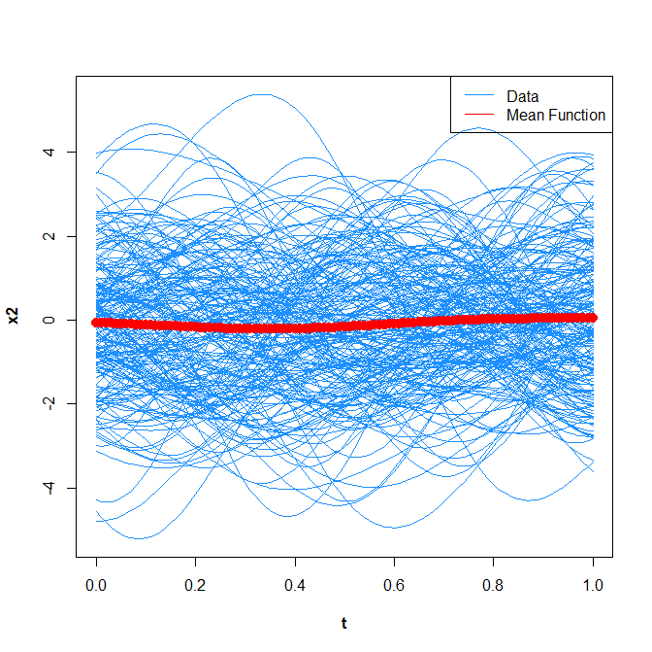
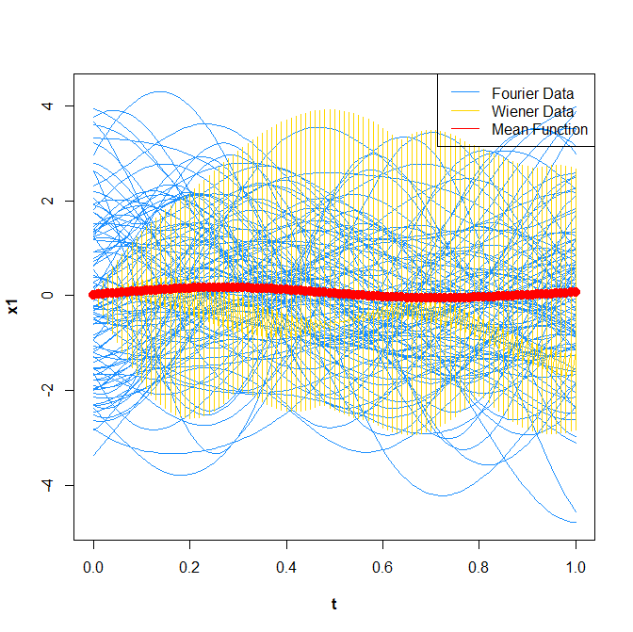
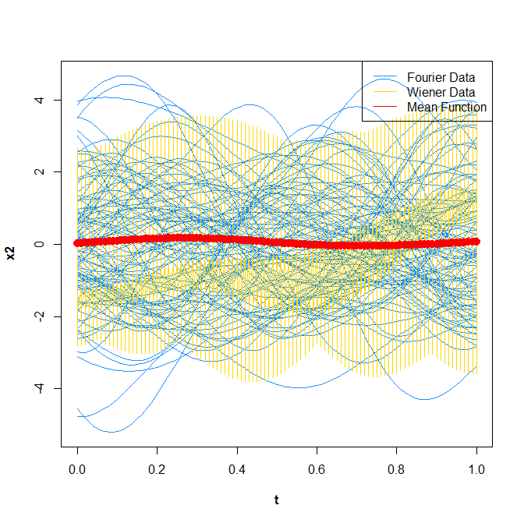
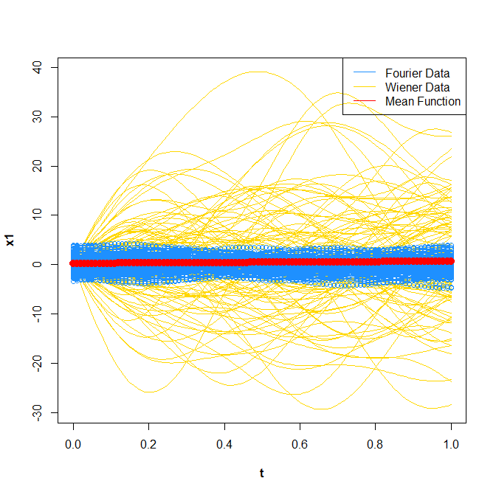
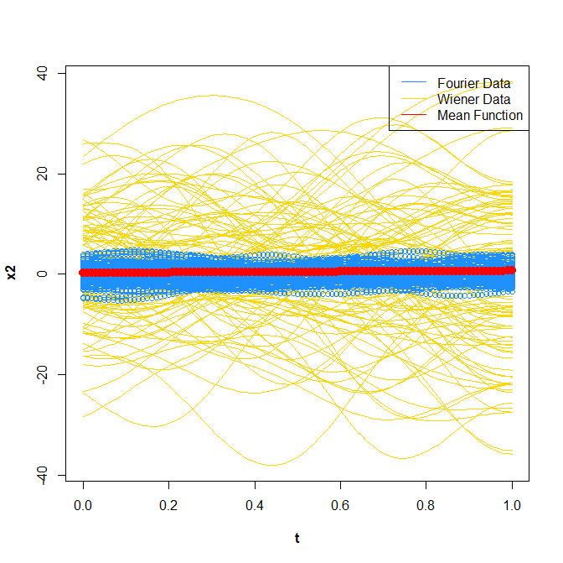
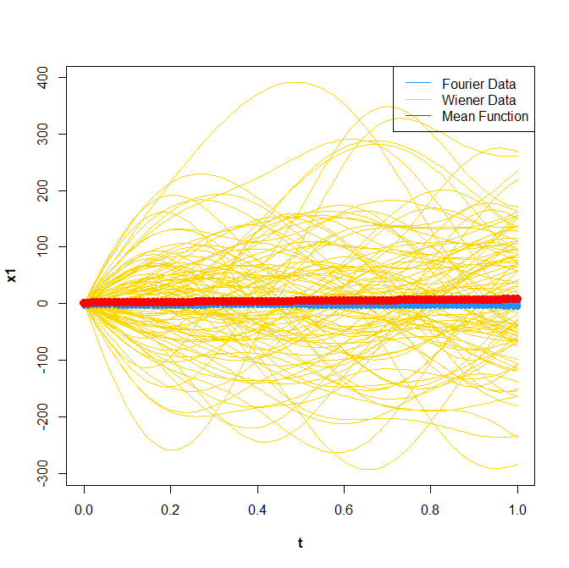
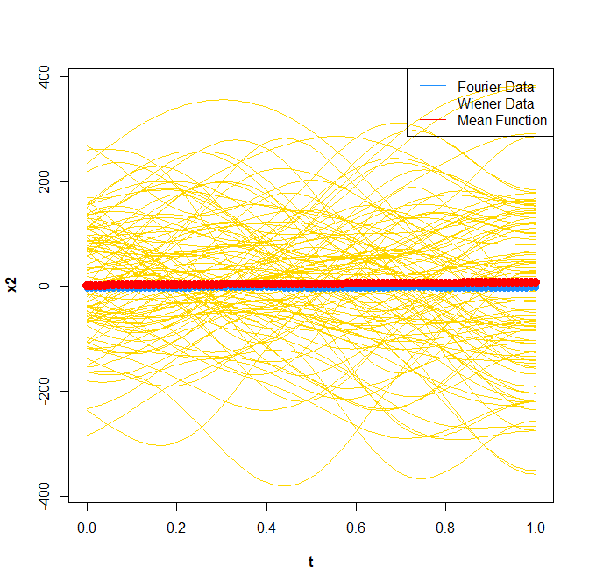
Statistical Model Simulated Data Analysis Settings
Fourier (200 observations):
Fourier + Wiener (100 observations each):
x1 Functions:
x2 Functions:
x1 Functions:
x2 Functions:
Fourier + Wiener x 10 (100 observations each):
Fourier + Wiener x 100 (100 observations each):
x1 Functions:
x2 Functions:
x1 Functions:
x2 Functions:

Slide 18
Statistical Model Simulated Data Analysis Results (Average MRSE Values)
Dataset | Full Data, No Measure-ment Error, MFPCA | Full Data, No Measure-ment Error, UFPCA | Full Data, With Measure-ment Error, MFPCA | Full Data, With Measure-ment Error, UFPCA | Medium Sparsity, No Measure-ment Error, MFPCA | Medium Sparsity, No Measure-ment Error, UFPCA | Medium Sparsity, With Measure-ment Error, MFPCA | Medium Sparsity, With Measure-ment Error, UFPCA | High Sparsity, No Measure-ment Error, MFPCA | High Sparsity, No Measure-ment Error, UFPCA | High Sparsity, With Measure-ment Error, MFPCA | High Sparsity, With Measure-ment Error, UFPCA
Fourier | 0.00284 | 0.002821 | 0.126228 | 0.125008 | 0.005749 | 0.005884 | 0.023072 | 0.027001 | 0.468063 | 0.051878 | 0.472821 | 0.136443
Fourier + Wiener (100 observa-tions each) | 0.025695 | 0.003217 | 0.188 | 0.169513 | 0.028455 | 0.006379 | 0.05044 | 0.038547 | 0.427267 | 0.068913 | 0.429469 | 0.124431
Fourier + Wiener x 10 (100 observa-tions each) | 0.045145 | 0.030446 | 0.102414 | 0.08907 | 0.052675 | 0.034494 | 0.061559 | 0.044444 | 0.452839 | 0.136372 | 0.474834 | 0.202709
Fourier + Wiener x 100 (100 observa-tions each) | 0.093695 | 0.068702 | 0.141213 | 0.119127 | 0.202036 | 0.125201 | 0.210061 | 0.13446 | 3.173803 | 0.889492 | 3.259918 | 1.051794

Slide 19
Statistical Model Simulated Data Analysis Results (Average MRSE Values)
Setting | Full Data, No Measure-ment Error, MFPCA | Full Data, No Measure-ment Error, UFPCA | Full Data, With Measure-ment Error, MFPCA | Full Data, With Measure-ment Error, UFPCA | Medium Sparsity, No Measure-ment Error, MFPCA | Medium Sparsity, No Measure-ment Error, UFPCA | Medium Sparsity, With Measure-ment Error, MFPCA | Medium Sparsity, With Measure-ment Error, UFPCA | High Sparsity, No Measure-ment Error, MFPCA | High Sparsity, No Measure-ment Error, UFPCA | High Sparsity, With Measure-ment Error, MFPCA | High Sparsity, With Measure-ment Error, UFPCA
Fourier | 0.00284 | 0.002821 | 0.126228 | 0.125008 | 0.005749 | 0.005884 | 0.023072 | 0.027001 | 0.468063 | 0.051878 | 0.472821 | 0.136443
Fourier + Wiener (100 observa-tions each) | 0.025695 | 0.003217 | 0.188 | 0.169513 | 0.028455 | 0.006379 | 0.05044 | 0.038547 | 0.427267 | 0.068913 | 0.429469 | 0.124431
Fourier + Wiener x 10 (100 observa-tions each) | 0.045145 | 0.030446 | 0.102414 | 0.08907 | 0.052675 | 0.034494 | 0.061559 | 0.044444 | 0.452839 | 0.136372 | 0.474834 | 0.202709
Fourier + Wiener x 100 (100 observa-tions each) | 0.093695 | 0.068702 | 0.141213 | 0.119127 | 0.202036 | 0.125201 | 0.210061 | 0.13446 | 3.173803 | 0.889492 | 3.259918 | 1.051794
Variability: Increased average MRSE values in many cases, but not always.

Slide 20
Statistical Model Simulated Data Analysis Results (Average MRSE Values)
Setting | Full Data, No Measure-ment Error, MFPCA | Full Data, No Measure-ment Error, UFPCA | Full Data, With Measure-ment Error, MFPCA | Full Data, With Measure-ment Error, UFPCA | Medium Sparsity, No Measure-ment Error, MFPCA | Medium Sparsity, No Measure-ment Error, UFPCA | Medium Sparsity, With Measure-ment Error, MFPCA | Medium Sparsity, With Measure-ment Error, UFPCA | High Sparsity, No Measure-ment Error, MFPCA | High Sparsity, No Measure-ment Error, UFPCA | High Sparsity, With Measure-ment Error, MFPCA | High Sparsity, With Measure-ment Error, UFPCA
Fourier | 0.00284 | 0.002821 | 0.126228 | 0.125008 | 0.005749 | 0.005884 | 0.023072 | 0.027001 | 0.468063 | 0.051878 | 0.472821 | 0.136443
Fourier + Wiener (100 observa-tions each) | 0.025695 | 0.003217 | 0.188 | 0.169513 | 0.028455 | 0.006379 | 0.05044 | 0.038547 | 0.427267 | 0.068913 | 0.429469 | 0.124431
Fourier + Wiener x 10 (100 observa-tions each) | 0.045145 | 0.030446 | 0.102414 | 0.08907 | 0.052675 | 0.034494 | 0.061559 | 0.044444 | 0.452839 | 0.136372 | 0.474834 | 0.202709
Fourier + Wiener x 100 (100 observa-tions each) | 0.093695 | 0.068702 | 0.141213 | 0.119127 | 0.202036 | 0.125201 | 0.210061 | 0.13446 | 3.173803 | 0.889492 | 3.259918 | 1.051794
Method: UFPCA has lower average MRSE values in many cases, but not always (medium sparsity cases for Fourier data).
In high sparsity cases, UFPCA has significantly lower average MRSE values than MFPCA.

Slide 21
Statistical Model Simulated Data Analysis Results (Average MRSE Values)
Setting | Full Data, No Measure-ment Error, MFPCA | Full Data, No Measure-ment Error, UFPCA | Full Data, With Measure-ment Error, MFPCA | Full Data, With Measure-ment Error, UFPCA | Medium Sparsity, No Measure-ment Error, MFPCA | Medium Sparsity, No Measure-ment Error, UFPCA | Medium Sparsity, With Measure-ment Error, MFPCA | Medium Sparsity, With Measure-ment Error, UFPCA | High Sparsity, No Measure-ment Error, MFPCA | High Sparsity, No Measure-ment Error, UFPCA | High Sparsity, With Measure-ment Error, MFPCA | High Sparsity, With Measure-ment Error, UFPCA
Fourier | 0.00284 | 0.002821 | 0.126228 | 0.125008 | 0.005749 | 0.005884 | 0.023072 | 0.027001 | 0.468063 | 0.051878 | 0.472821 | 0.136443
Fourier + Wiener (100 observa-tions each) | 0.025695 | 0.003217 | 0.188 | 0.169513 | 0.028455 | 0.006379 | 0.05044 | 0.038547 | 0.427267 | 0.068913 | 0.429469 | 0.124431
Fourier + Wiener x 10 (100 observa-tions each) | 0.045145 | 0.030446 | 0.102414 | 0.08907 | 0.052675 | 0.034494 | 0.061559 | 0.044444 | 0.452839 | 0.136372 | 0.474834 | 0.202709
Fourier + Wiener x 100 (100 observa-tions each) | 0.093695 | 0.068702 | 0.141213 | 0.119127 | 0.202036 | 0.125201 | 0.210061 | 0.13446 | 3.173803 | 0.889492 | 3.259918 | 1.051794
Sparsity: Increased data sparsity, in particular high data sparsity, results in increased average MRSE values.

Slide 22
Statistical Model Simulated Data Analysis Results (Average MRSE Values)
Setting | Full Data, No Measure-ment Error, MFPCA | Full Data, No Measure-ment Error, UFPCA | Full Data, With Measure-ment Error, MFPCA | Full Data, With Measure-ment Error, UFPCA | Medium Sparsity, No Measure-ment Error, MFPCA | Medium Sparsity, No Measure-ment Error, UFPCA | Medium Sparsity, With Measure-ment Error, MFPCA | Medium Sparsity, With Measure-ment Error, UFPCA | High Sparsity, No Measure-ment Error, MFPCA | High Sparsity, No Measure-ment Error, UFPCA | High Sparsity, With Measure-ment Error, MFPCA | High Sparsity, With Measure-ment Error, UFPCA
Fourier | 0.00284 | 0.002821 | 0.126228 | 0.125008 | 0.005749 | 0.005884 | 0.023072 | 0.027001 | 0.468063 | 0.051878 | 0.472821 | 0.136443
Fourier + Wiener (100 observa-tions each) | 0.025695 | 0.003217 | 0.188 | 0.169513 | 0.028455 | 0.006379 | 0.05044 | 0.038547 | 0.427267 | 0.068913 | 0.429469 | 0.124431
Fourier + Wiener x 10 (100 observa-tions each) | 0.045145 | 0.030446 | 0.102414 | 0.08907 | 0.052675 | 0.034494 | 0.061559 | 0.044444 | 0.452839 | 0.136372 | 0.474834 | 0.202709
Fourier + Wiener x 100 (100 observa-tions each) | 0.093695 | 0.068702 | 0.141213 | 0.119127 | 0.202036 | 0.125201 | 0.210061 | 0.13446 | 3.173803 | 0.889492 | 3.259918 | 1.051794
Measurement Error: The presence of measurement error results in increased average MRSE values. In some high sparsity cases, the presence of measurement error only results in small increases in average MRSE values.

Slide 23
Ballistic Missile Trajectory Data Results

Slide 24
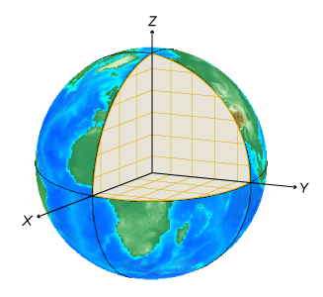
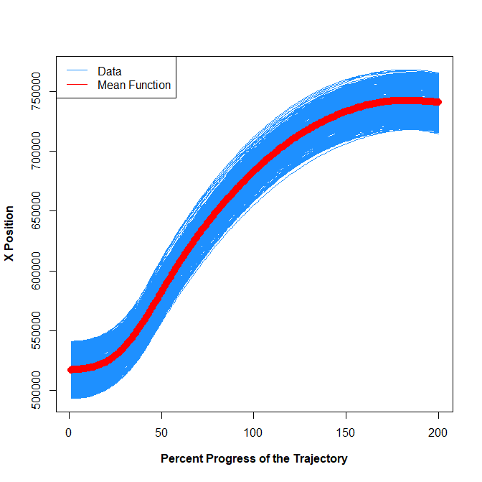
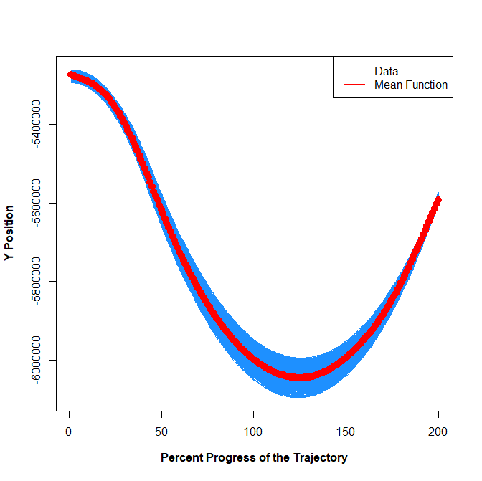
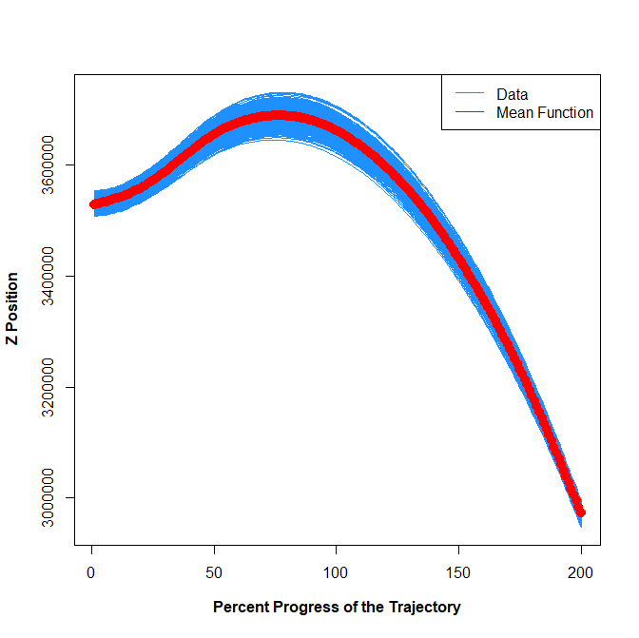
Ballistic Missile Trajectory Dataset
Generated by a physics model to notionally propagate objects according to a path of a ballistic missile
Dataset: 500 trajectories, each with 200 discrete observed points.
Six covariates on Earth-Center Earth-Fixed (ECEF) coordinate system:
  Positions: X, Y, Z
  Velocities: X, Y, Z
All trajectory times are standardized to [0,1]. Think of this as a “percent progress of the trajectory.”
Source: “Choose a 3-D Coordinate System.” Mathworks Help Center. https://www.mathworks.com/help/map/choose-a-3-d-coordinate-system.html
X Position Functions:
Y Position Functions:
Z Position Functions:

Slide 25
Ballistic Missile Trajectory Data Analysis Results (MRSE Values)
Full Data, MFPCA | Full Data, UFPCA | Medium Sparsity, MFPCA | Medium Sparsity, UFPCA | High Sparsity, MFPCA | High Sparsity, UFPCA
7.35118E-08 | 7.11116E-08 | 8.11026E-08 | 8.00473E-08 | 7.72053E-08 | 8.02807E-08
Method: For full data and medium sparsity, UFPCA has lower MRSE values than MFPCA. For high sparsity, MFPCA has lower MRSE values than UFPCA.
Sparsity: For MFPCA, high sparsity has lower MRSE values than medium sparsity. For UFPCA, MRSE values increase as sparsity increases.

Slide 26
Northern California Flight Tracks Data Results

Slide 27
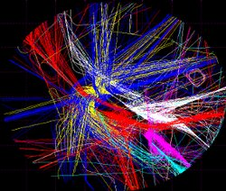
Northern California Flight Tracks Data
Dataset available at: https://catalog.data.gov/dataset/flight-tracks-northern-california-tracon
Radar flight tracks over San Francisco Bay area in January-March 2006
Covers the Northern California terminal radar approach control (TRACON) (NCT), a cylinder radius of 80 km and height 6,000 m centered at Oakland International Airport (OAK).
NCT covers three main airports, Oakland, San Francisco (SFO) and San Jose (SJC) International Airports, as well as many smaller airports.
Focus on 423 tracks of flights originating from SJC and a random sample of 10,000 flights originating from SFO.
For all tracks, interpolate to 101 points in [0,1], so our continuum is “percent progress of the trajectory.”
Source: “Flight Tracks, Northern California TRACON. https://c3.ndc.nasa.gov/dashlink/resources/132/

Slide 28
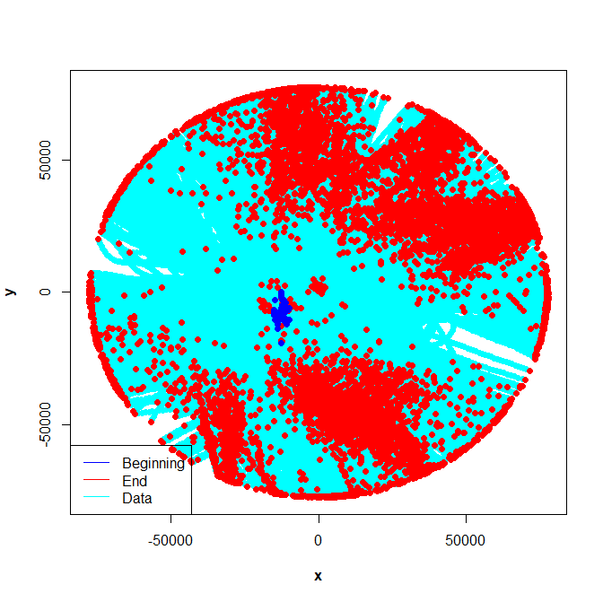
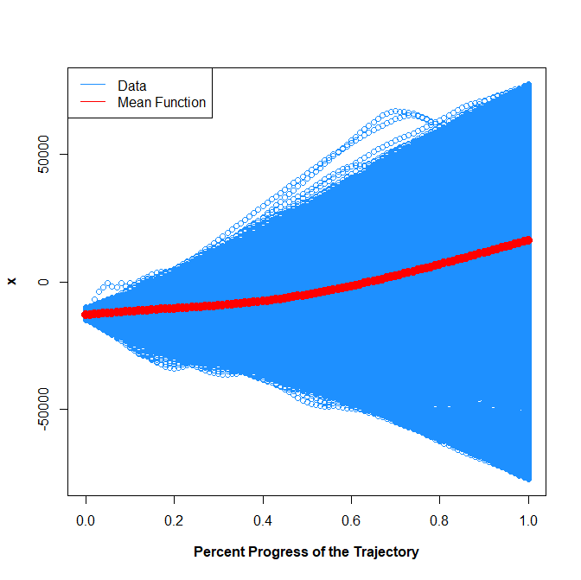
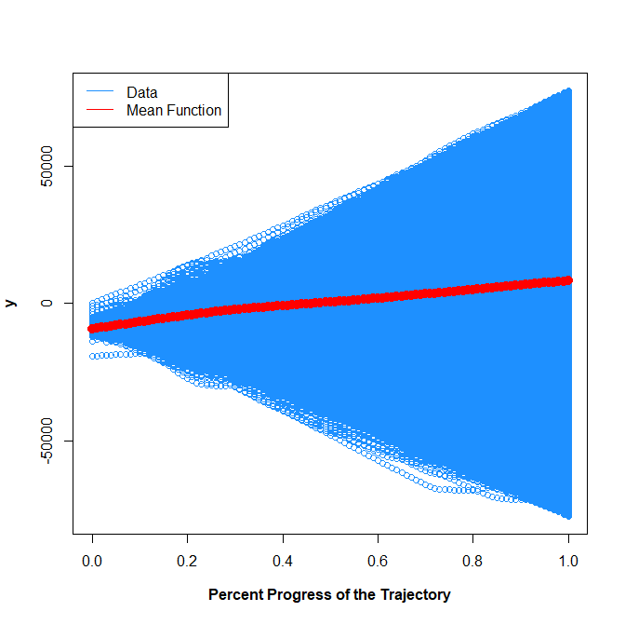
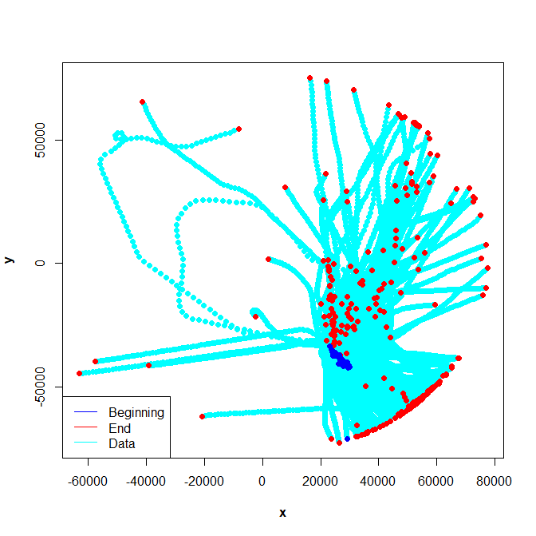
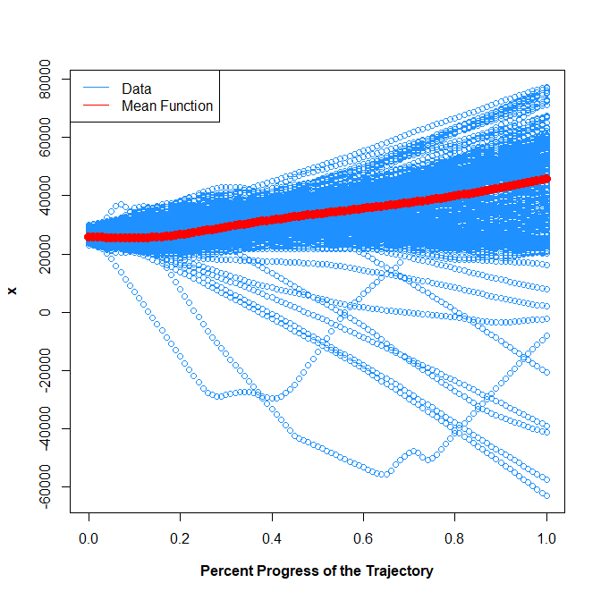
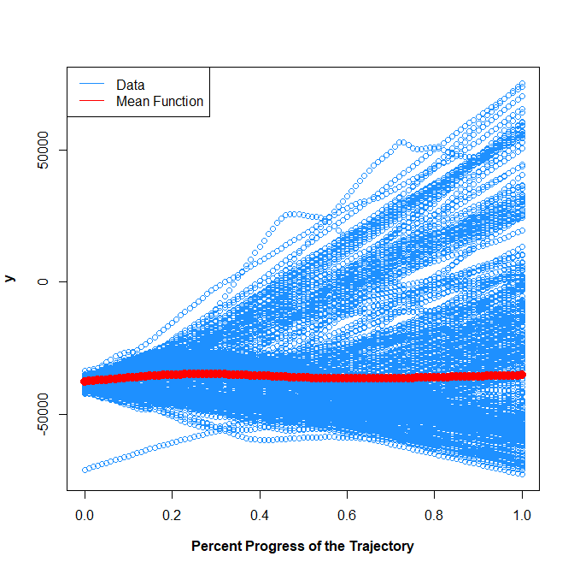
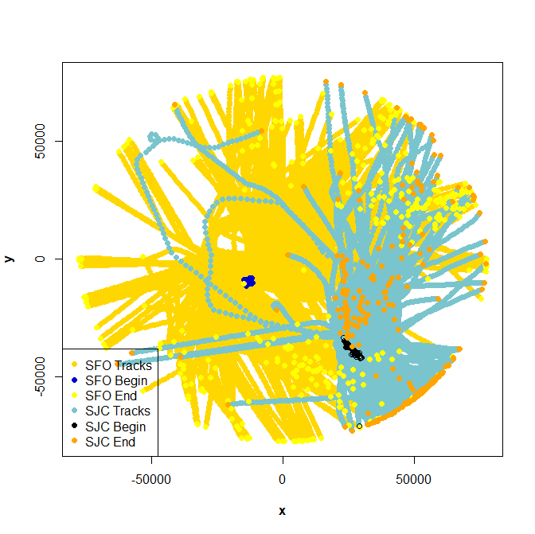
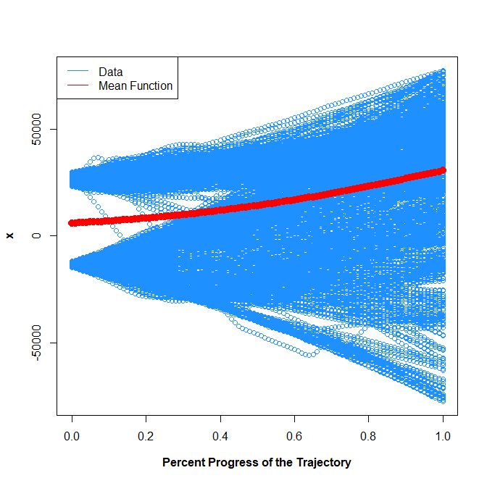
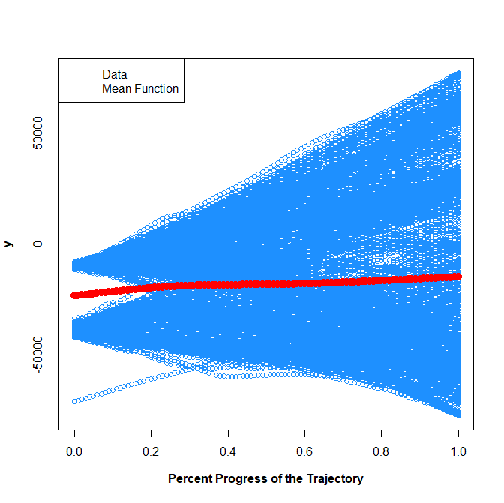
Northern California Flight Tracks Data Analysis Settings
SFO Origin Tracks (10,000 tracks):
SJC Origin Tracks (423 tracks):
(x, y) Plot:
x Functions:
y Functions:
(x, y) Plot:
x Functions:
y Functions:
Beginning: Blue
End: Red
Track: Cyan
Track: Blue
Mean Function: Red
Beginning: Blue
End: Red
Track: Cyan
Track: Blue
Mean Function: Red
SFO + SJC Origin Tracks (423 tracks each):
SFO (10,000) + SJC (423) Origin Tracks:
(x, y) Plot:
x Functions:
y Functions:
(x, y) Plot:
x Functions:
y Functions:
SFO Beginning: Blue
SFO End: Yellow
SFO Track: Gold
SJC Beginning: Black
SJC End: Orange
SJC Track: Teal
Track: Blue
Mean Function: Red
SFO Beginning: Blue
SFO End: Yellow
SFO Track: Gold
SJC Beginning: Black
SJC End: Orange
SJC Track: Teal
Track: Blue
Mean Function: Red

Slide 29
Northern California Flight Tracks Data Analysis Results (MRSE Values)
Setting | Full Data, MFPCA | Full Data, UFPCA | Medium Sparsity, MFPCA | Medium Sparsity, UFPCA | High Sparsity, MFPCA | High Sparsity, UFPCA
SFO Origin Tracks (10,000 Tracks) | 0.005033 | 0.004984 | 0.00525 | 1.051036 | 0.006379 | 1.051732
SJC Origin Tracks (423 Tracks) | 0.001398 | 0.000697 | 0.001481 | 1.167057 | 0.001984 | 1.166021
SFO + SJC Origin Tracks (423 Tracks Each) | 0.006498 | 0.006092 | 0.004529 | 1.10268 | 0.00704 | 1.10765
SFO (10,000 Tracks) + SJC (423 Tracks) Origin Tracks | 0.005819 | 0.005143 | 0.00607 | 1.05447 | 0.00522 | 1.055745

Slide 30
Northern California Flight Tracks Data Analysis Results (MRSE Values)
Setting | Full Data, MFPCA | Full Data, UFPCA | Medium Sparsity, MFPCA | Medium Sparsity, UFPCA | High Sparsity, MFPCA | High Sparsity, UFPCA
SFO Origin Tracks (10,000 Tracks) | 0.005033 | 0.004984 | 0.00525 | 1.051036 | 0.006379 | 1.051732
SJC Origin Tracks (423 Tracks) | 0.001398 | 0.000697 | 0.001481 | 1.167057 | 0.001984 | 1.166021
SFO + SJC Origin Tracks (423 Tracks Each) | 0.006498 | 0.006092 | 0.004529 | 1.10268 | 0.00704 | 1.10765
SFO (10,000 Tracks) + SJC (423 Tracks) Origin Tracks | 0.005819 | 0.005143 | 0.00607 | 1.05447 | 0.00522 | 1.055745
Variability: With the exception of the (Medium Sparsity, UFPCA) and (High Sparsity, UFPCA) cases, SFO origin tracks has higher MRSE values than SJC origin tracks.
With the exception of the (Medium Sparsity, MFPCA) case, including 10,000 SFO origin tracks with the 423 SJC origin tracks results in lower MRSE values.

Slide 31
Northern California Flight Tracks Data Analysis Results (MRSE Values)
Setting | Full Data, MFPCA | Full Data, UFPCA | Medium Sparsity, MFPCA | Medium Sparsity, UFPCA | High Sparsity, MFPCA | High Sparsity, UFPCA
SFO Origin Tracks (10,000 Tracks) | 0.005033 | 0.004984 | 0.00525 | 1.051036 | 0.006379 | 1.051732
SJC Origin Tracks (423 Tracks) | 0.001398 | 0.000697 | 0.001481 | 1.167057 | 0.001984 | 1.166021
SFO + SJC Origin Tracks (423 Tracks Each) | 0.006498 | 0.006092 | 0.004529 | 1.10268 | 0.00704 | 1.10765
SFO (10,000 Tracks) + SJC (423 Tracks) Origin Tracks | 0.005819 | 0.005143 | 0.00607 | 1.05447 | 0.00522 | 1.055745
Method: For full data, UFPCA has lower MRSE values than MFPCA.
For medium sparsity and high sparsity, MFPCA has lower MRSE values than UFPCA.

Slide 32
Northern California Flight Tracks Data Analysis Results (MRSE Values)
Setting | Full Data, MFPCA | Full Data, UFPCA | Medium Sparsity, MFPCA | Medium Sparsity, UFPCA | High Sparsity, MFPCA | High Sparsity, UFPCA
SFO Origin Tracks (10,000 Tracks) | 0.005033 | 0.004984 | 0.00525 | 1.051036 | 0.006379 | 1.051732
SJC Origin Tracks (423 Tracks) | 0.001398 | 0.000697 | 0.001481 | 1.167057 | 0.001984 | 1.166021
SFO + SJC Origin Tracks (423 Tracks Each) | 0.006498 | 0.006092 | 0.004529 | 1.10268 | 0.00704 | 1.10765
SFO (10,000 Tracks) + SJC (423 Tracks) Origin Tracks | 0.005819 | 0.005143 | 0.00607 | 1.05447 | 0.00522 | 1.055745
Sparsity: In many cases, increased sparsity results in increased MRSE.
However, when applying UFPCA for SJC origin tracks with medium to high sparsity observe a decrease in MRSE.
For SFO + SJC origin tracks (423 tracks each), using the MFPCA method, MRSE decreases when comparing the full dataset to medium sparsity dataset.

Slide 33
Conclusions
Our expectations:
  Variability: as variability between functions increases, MRSE values increase
  Method: taking into account dependencies between variables should have an effect on MRSE values, but there is currently no rigorous theory on the nature of these effects
  Sparsity: as sparsity increases, MRSE values increase
  Measurement Error: as measurement error increases, MRSE values increase
What we saw:
  Variability: increased variability between trajectories resulted in higher MRSE values in many cases, but not always true
  Method: UFPCA had lower MRSE values in many cases, but not always true
  Sparsity: increased sparsity resulted in higher MRSE values in many cases, but not always true
  Measurement Error (statistical model simulated datasets only): presence of measurement error resulted in higher MRSE values. Increase in MRSE values were smaller in high sparsity datasets.
All four properties contribute to reconstruction error, and there are likely dependencies between them.

Slide 34
Future Work
Covariance between variables for functional data
  Covariance function looks at pairwise covariances between any two points on a single function.
  Covariance operator in multivariate functional data may not necessarily capture individual pairwise covariances between variables.
  In simulations, covariance between variables is not really accounted for with simulation setup and with MFPCA estimation.
Variability between functions
  Is there a way to quantify overall variance between trajectories without considering variability with respect to t?
Probability density function for functional data
  Can help to define in-distribution or out-of-distribution, as well as variability between functions
  Help to clarify the concept of i.i.d. in functional data
  Theoretical properties of MFPCA and UFPCA
Value of information of certain snippets or points of functions
  Even if a function is irregularly and sparsely observed, if the right portions of the function are observed, that function might be reconstructed well.

Slide 35


Acknowledgements
Missile Defense Agency
APL’s Janney Grants program
Source: “Aegis Ballistic Missile Defense System.” https://en.wikipedia.org/wiki/Aegis_Ballistic_Missile_Defense_System

Slide 36
Thank you for your kind attention!
Questions?

Slide 37
Backup Slides

Slide 38
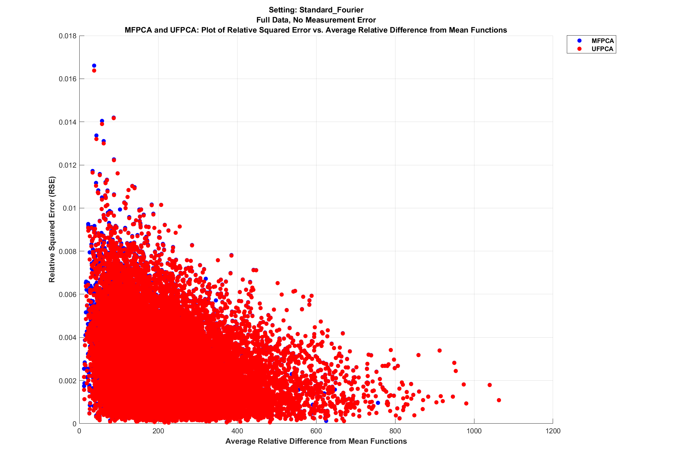
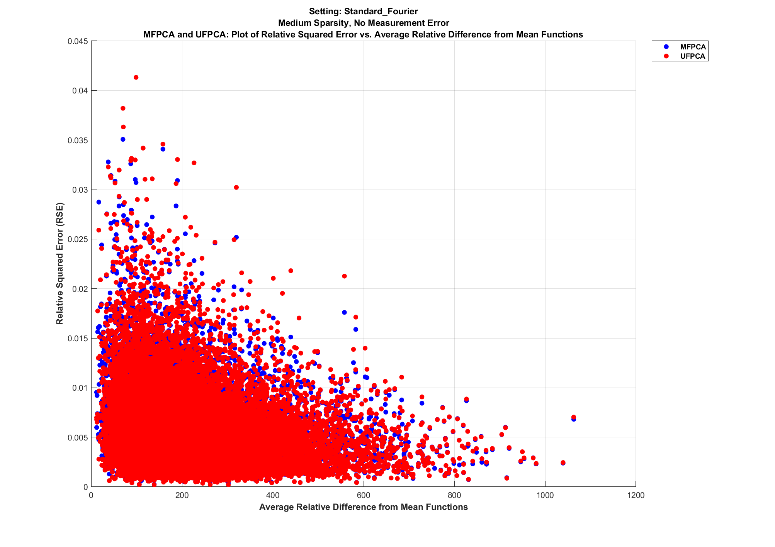
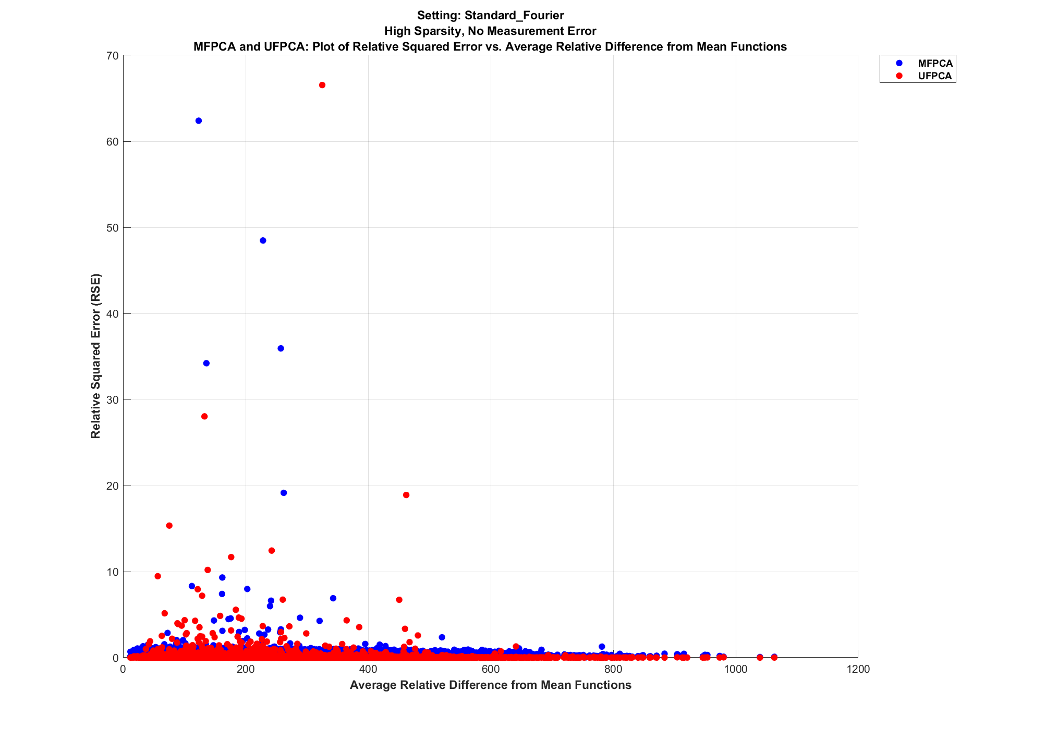
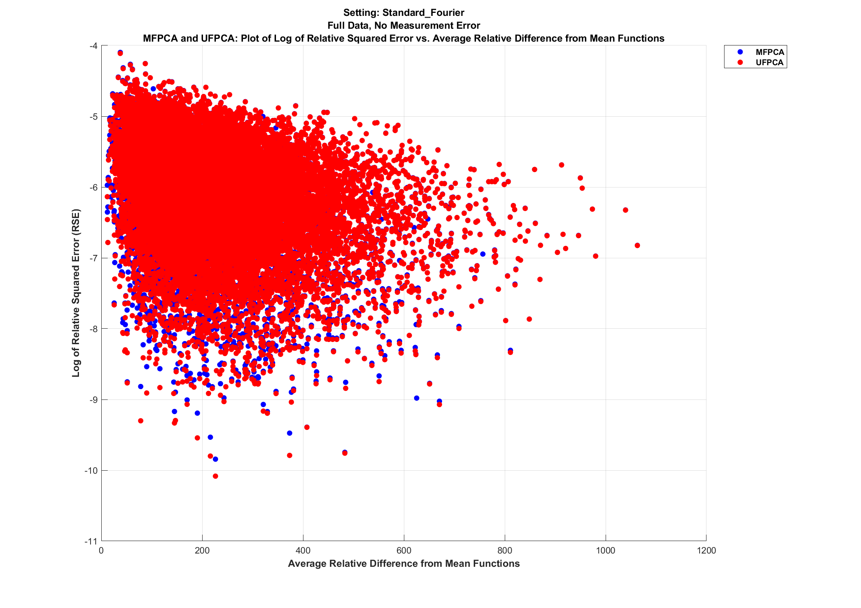
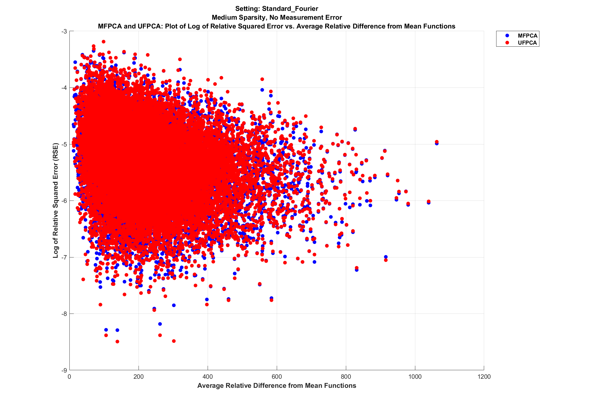
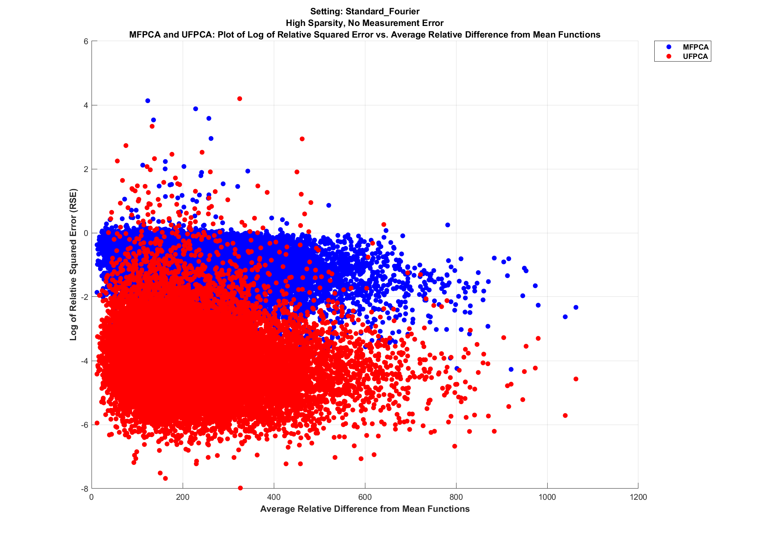
Simulated Dataset: Fourier with No Measurement Error
Plots of Relative Squared Error (RSE) and Log of RSE vs. Average Relative Distance from Mean Functions
Full Data:
Medium Sparsity:
High Sparsity:
RSE:
Log of RSE:
Relatively similar RSE values between MFPCA and UFPCA.
RSE values can go up as data becomes more sparse.
For full data and medium sparsity, there is a general inverse relationship between RSE and average relative distance from mean functions.

Slide 39
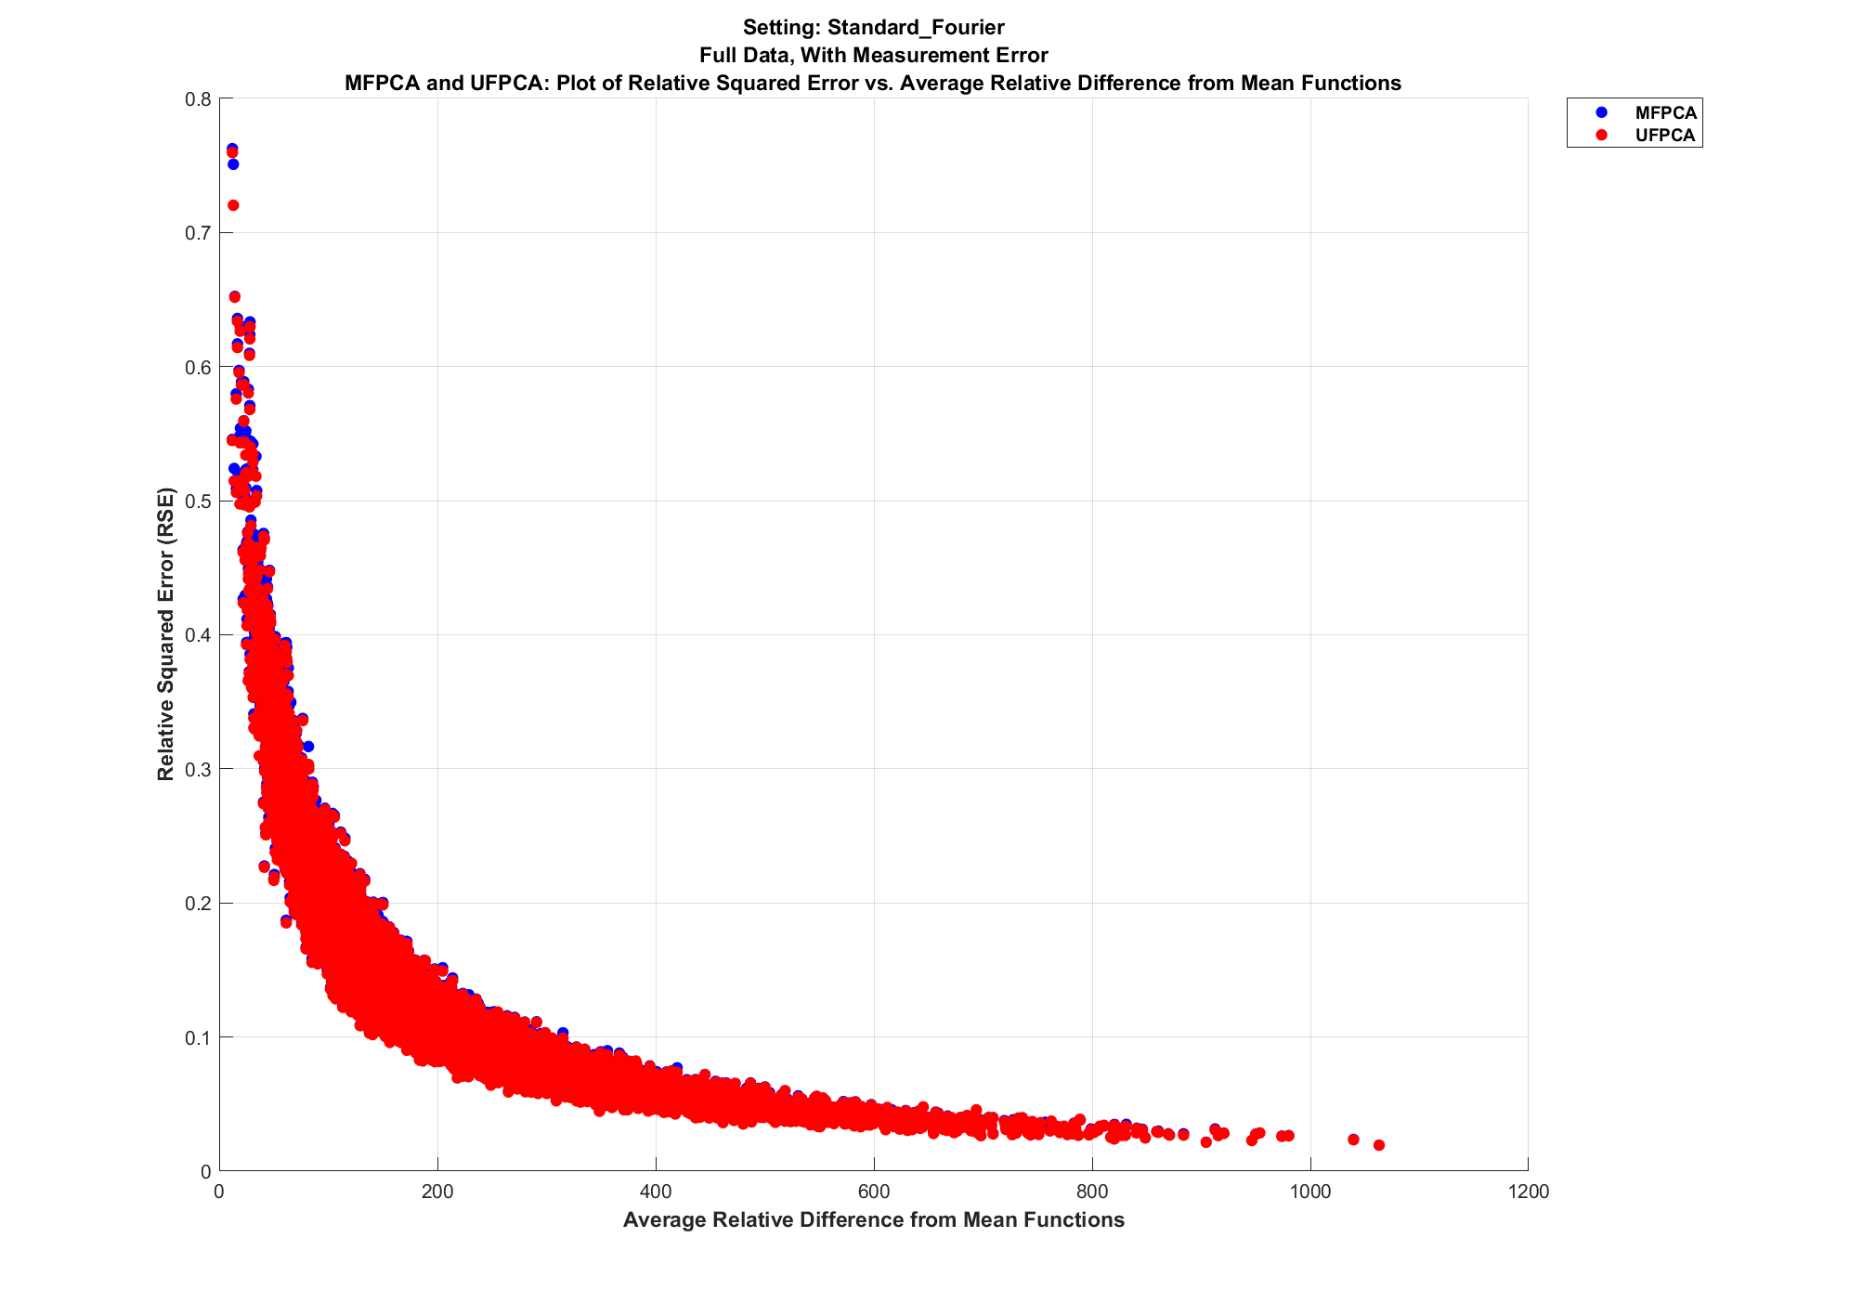
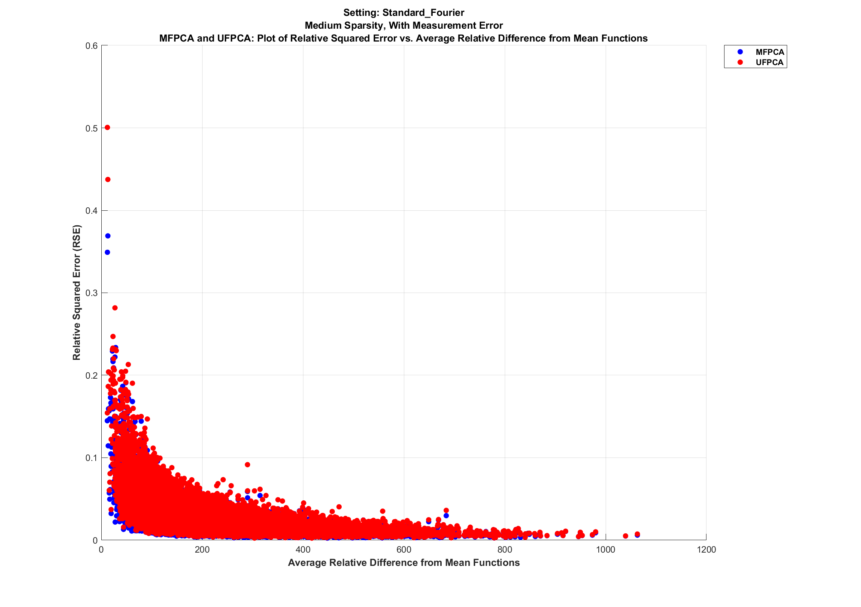
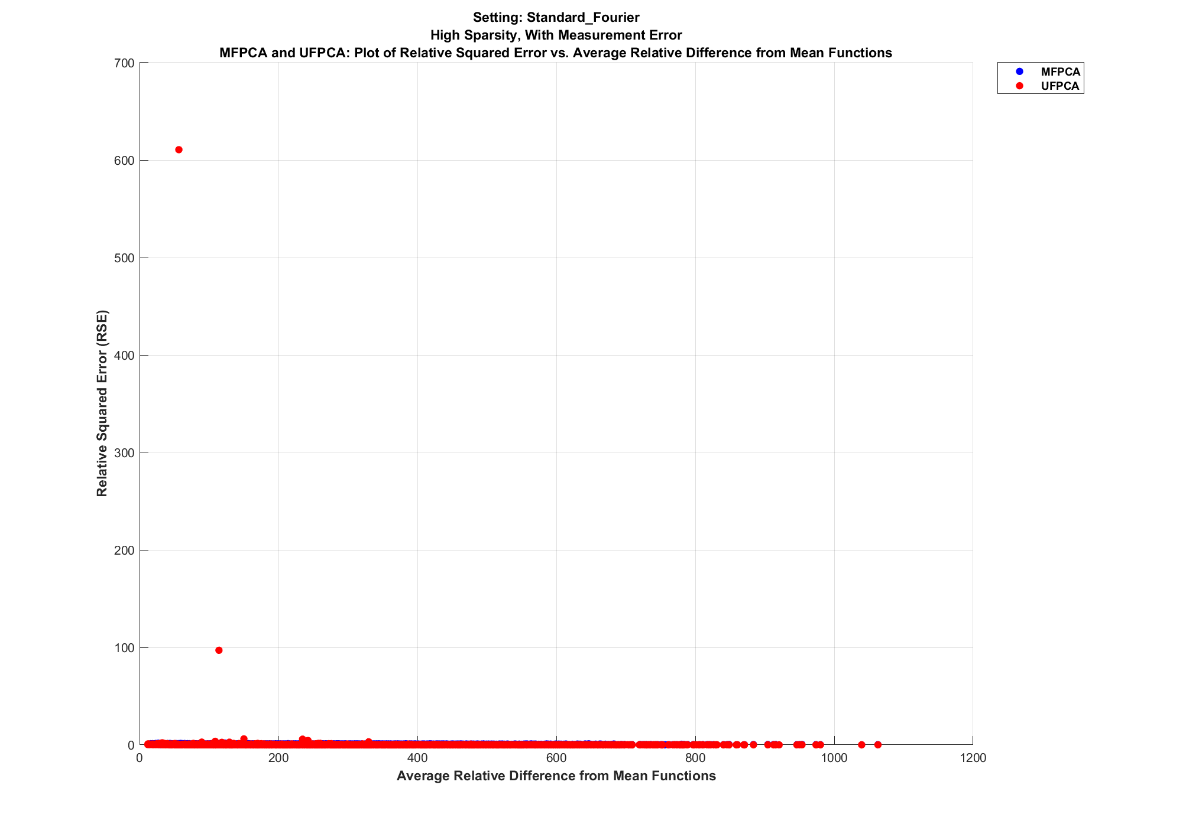
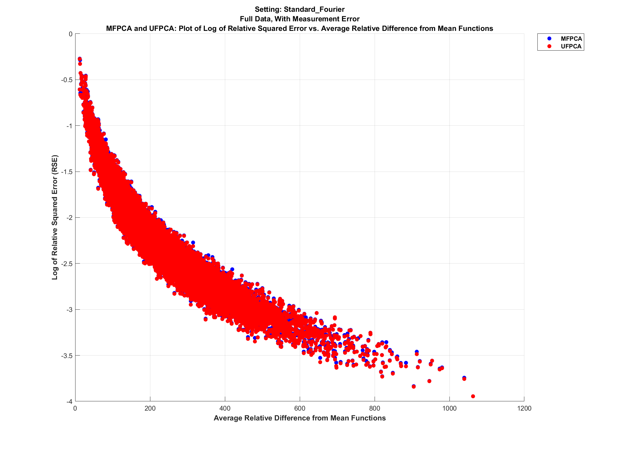
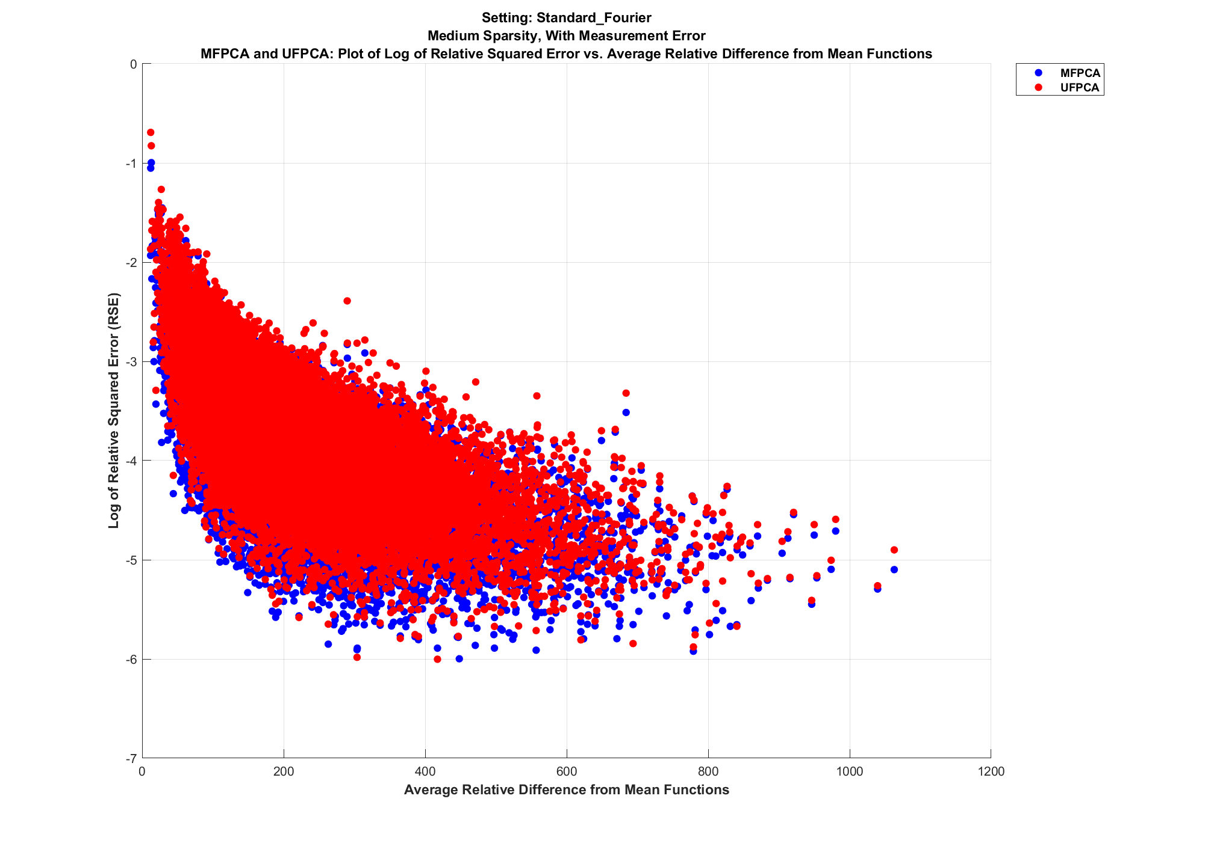
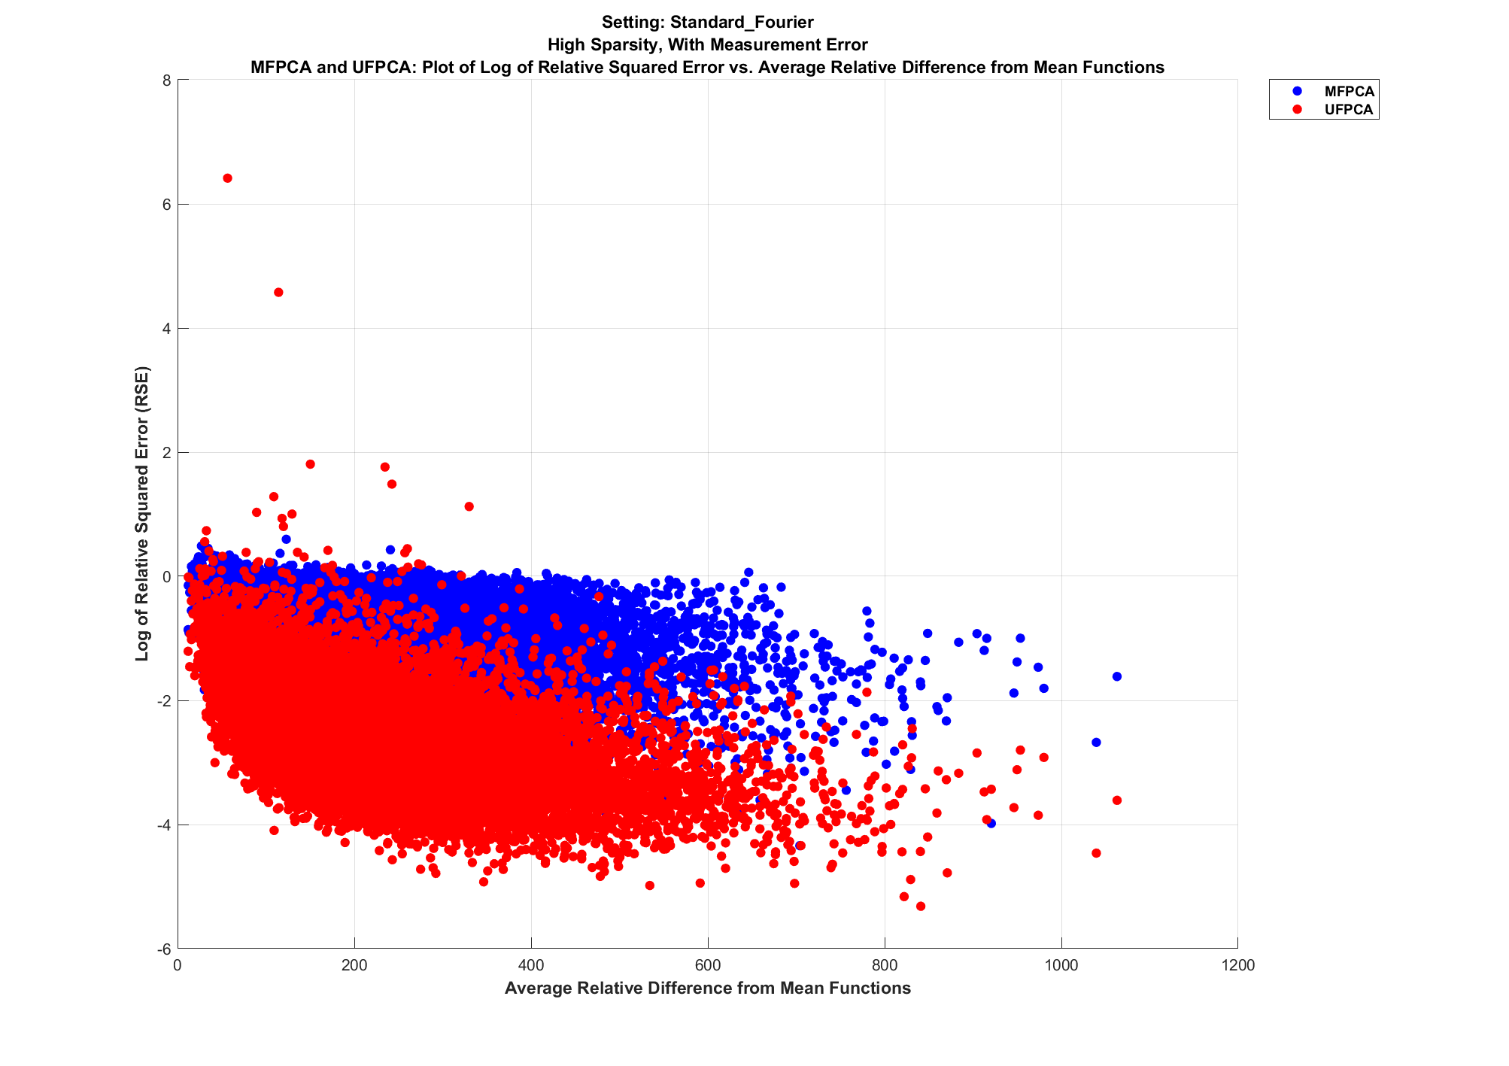
Simulated Dataset: Fourier with Measurement Error
Plots of Relative Squared Error (RSE) and Log of RSE vs. Average Relative Distance from Mean Functions
Full Data:
Medium Sparsity:
High Sparsity:
RSE:
Log of RSE:
Relatively similar RSE values between MFPCA and UFPCA.
RSE values can go up as data becomes more sparse.
For full data and medium sparsity, there is a general inverse relationship between RSE and average relative distance from mean functions.

Slide 40






Simulated Dataset: Fourier + Wiener with No Measurement Error
Plots of Relative Squared Error (RSE) and Log of RSE vs. Average Relative Distance from Mean Functions
Full Data:
Medium Sparsity:
High Sparsity:
RSE:
Log of RSE:
Relatively similar RSE values between MFPCA and UFPCA.
RSE values can go up as data becomes more sparse.
For full data and medium sparsity, there is a general inverse relationship between RSE and average relative distance from mean functions.

Slide 41




Simulated Dataset: Fourier + Wiener with Measurement Error
Plots of Relative Squared Error (RSE) and Log of RSE vs. Average Relative Distance from Mean Functions
Full Data:
Medium Sparsity:
High Sparsity:
RSE:
Log of RSE:
Relatively similar RSE values between MFPCA and UFPCA.
RSE values can go up as data becomes more sparse.
For full data and medium sparsity, there is a general inverse relationship between RSE and average relative distance from mean functions.

Slide 42






Ballistic Missile Trajectory Dataset: Plots of All Features with Mean Functions

Slide 43






Ballistic Missile Trajectory Dataset: Plots of Relative Squared Error (RSE) and Log of RSE vs. Average Relative Distance from Mean Functions
Full Data:
Medium Sparsity:
High Sparsity:
RSE:
Log of RSE:
Relatively similar RSE values between MFPCA and UFPCA.
Similar RSE values across various levels of sparsity.
No apparent relationship between RSE values and average relative distance from mean functions.

Slide 44












Northern California Flight Tracks Data Analysis Settings
SFO Origin Tracks (10,000 tracks):
SJC Origin Tracks (423 tracks):
Beginning: Blue
End: Red
Track: Cyan
Beginning: Blue
End: Red
Track: Cyan
Track: Blue
Mean Function: Red
Track: Blue
Mean Function: Red
SFO + SJC Origin Tracks (423 tracks each):
SFO (10,000) + SJC (423) Origin Tracks:
SFO Beginning: Blue
SFO End: Yellow
SFO Track: Gold
SJC Beginning: Black
SJC End: Orange
SJC Track: Teal
Track: Blue
Mean Function: Red
SFO Beginning: Blue
SFO End: Yellow
SFO Track: Gold
SJC Beginning: Black
SJC End: Orange
SJC Track: Teal
Track: Blue
Mean Function: Red

Slide 45


Northern California Flight Tracks Data:
SFO Origin Tracks (10,000 Tracks) Plots
Beginning: Blue
End: Red
Track: Cyan
Track: Blue
Mean Function: Red

Slide 46


Northern California Flight Tracks Data:
SJC Origin Tracks (423 Tracks) Plots
Beginning: Blue
End: Red
Track: Cyan
Track: Blue
Mean Function: Red

Slide 47


Northern California Flight Tracks Data:
SFO + SJC Origin Tracks (423 Tracks Each) Plots
SFO Beginning: Blue
SFO End: Yellow
SFO Track: Gold
Track: Blue
Mean Function: Red

Slide 48


Northern California Flight Tracks Data:
SFO (10,000 Tracks) + SJC (423 Tracks) Origin Tracks Plots
SFO Beginning: Blue
SFO End: Yellow
SFO Track: Gold
SJC Beginning: Black
SJC End: Orange
SJC Track: Teal
Track: Blue
Mean Function: Red

Slide 49
References
Delaigle, Aurore, Hall, Peter. "Defining probability density for a distribution of random functions." Ann. Statist. 38 (2) 1171 - 1193, April 2010. https://doi.org/10.1214/09-AOS741
“Flight tracks, Northern California TRACON.” https://catalog.data.gov/dataset/flight-tracks-northern-california-tracon
Happ, C., Greven, S. (2018). Multivariate Functional Principal Component Analysis for Data Observed on Different (Dimensional) Domains. Journal of the American Statistical Association 113, 649-659.
Happ-Kurz, C. (2020). Object-Oriented Software for Functional Data. Journal of Statistical Software, 93(5), 1–38. https://doi.org/10.18637/jss.v093.i05.
Müller, Hans-Georg, Stadtmüller, Ulrich, Yao, Fang (2006) Functional Variance Processes, Journal of the American Statistical Association, 101:475, 1007-1018, DOI:10.1198/016214506000000186
Yao, F., Müller, H.G., Wang, J.L. (2005). Functional data analysis for sparse longitudinal data. Journal of the American Statistical Association 100, 577-590.

