Slide 1


Data Stewardship for Machine Learning:
Developing Guidance for Curation, Subdivision, and Completeness of Data for Training, Validation, and Testing of Machine Learning Tools.
Elizabeth Gregory, PhD
NASA Langley Research Center
Elizabeth.D.Gregory@nasa.gov
Artificial Intelligence (AI) Usage Disclosure:
This document was created with assistance from Google Gemini for generating the Lisa-Frank-Style Cat Image on slide 5. The content has been reviewed and edited by Elizabeth Gregory
DATAWorks 2026
Tuesday, April 21, 2026

Slide 2
Outline
Defining Data Stewardship
Hard Detour: Why do I even Care?
Data Curation and Subdivision
Consequences of Failure & Opportunities for Success
An Urgent Plea!
Supervised, Semi-Supervised, Unsupervised Learning Models are all “Data Hungry”!
So……..Data is Important!

Slide 3
Data Stewardship
Data Stewardship – The responsible planning, management, and care of data.
Curation – How we make and make-up our data.
Includes cleaning/preprocessing.
Subdivision – How we divide up our data.
Training/Validation/Testing
Completeness – Which feature space does our data represent? Which space does it NOT represent. What is the quality of that representation?

Slide 4
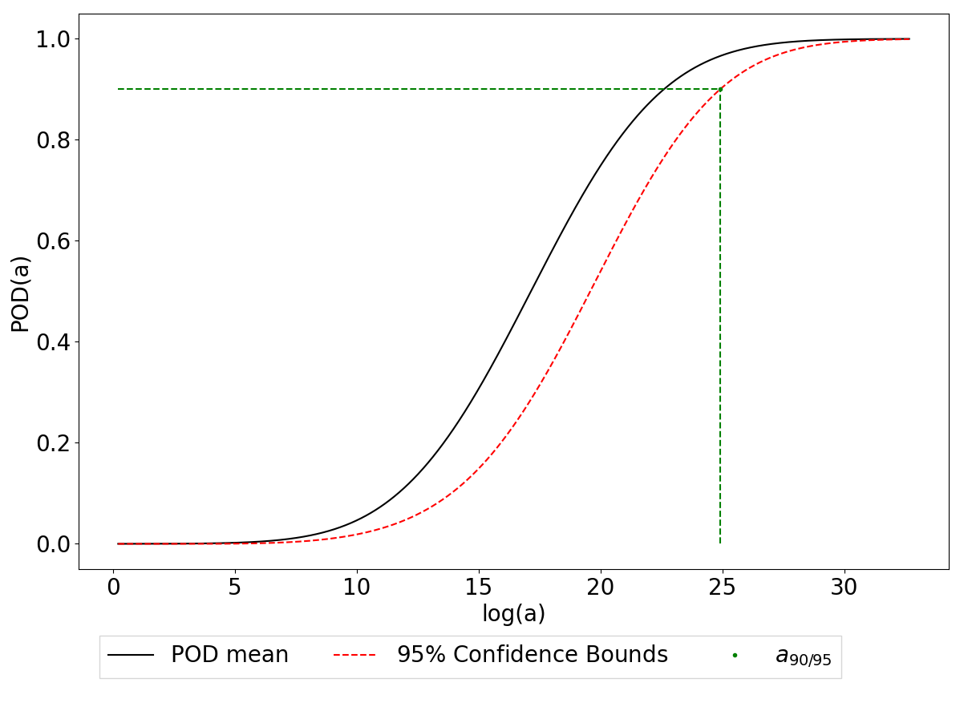

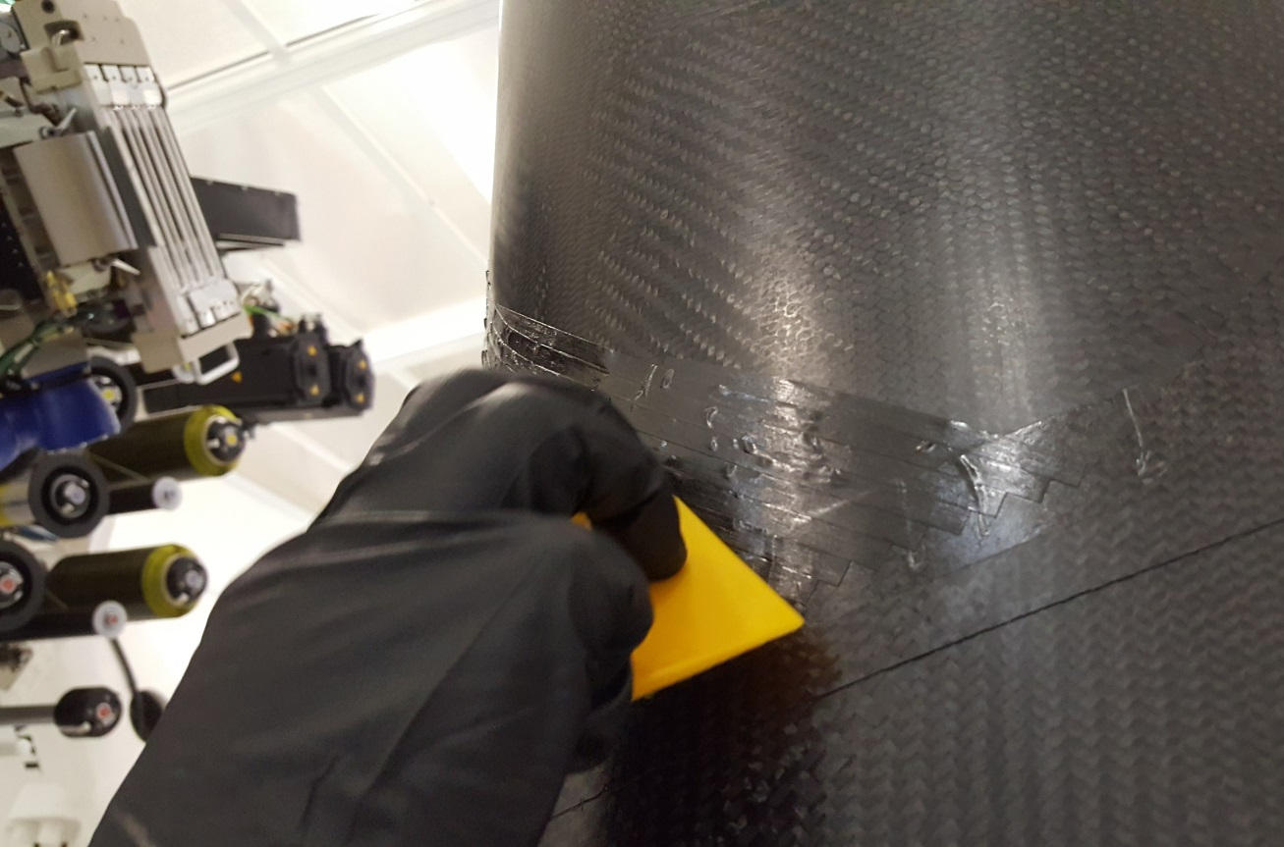
Why Do I Even Care?
Probability of Detection (POD)
Refers to the analysis by which an inspections performance and confidence is quantified.
Nondestructive Evaluation (NDE)
ML in NDE
Detection and Classification
Historically a very manual task
Very High-Stakes
Related to medical applications but different
Inspections occur regularly not just when there is a problem.
No “Patient” feedback.
Has a very clear method for assessing validity of inspections: POD
Seems like an easy fit. ☒
Flaws are very, very rare.
Liability is an issue.

Slide 5


Categories of Data
Data Description
Real Data
Collected in real-world scenario
Collected in a laboratory setting
Augmented Data
Based on real data but transformed in some way.
“Data augmentation refers to the process of automatically enriching and diversifying examples in the training dataset. “*
Synthetic Data
Generative AI
Simulation
*Y. Li, X. Wang, Z. Miao, and W.-C. Tan, “Data augmentation for ML-driven data preparation and integration,” Proc. VLDB Endow., vol. 14, no. 12, pp. 3182–3185, Jul. 2021, doi: 10.14778/3476311.3476403.

Slide 6
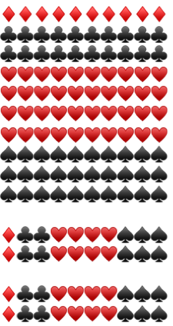
Data Definitions
Data Usage
Training
Used to Train the Model
Validation
Used to Tune the Model
Testing
Used to Test and Evaluate the Model.
Train
Full Dataset
Validation
Test

Slide 7
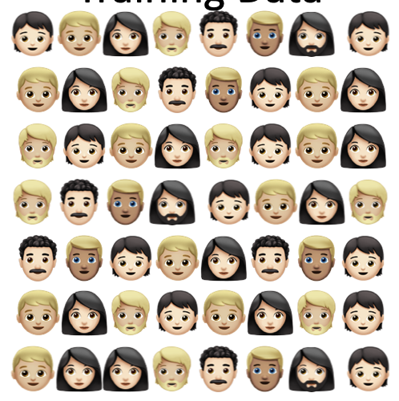
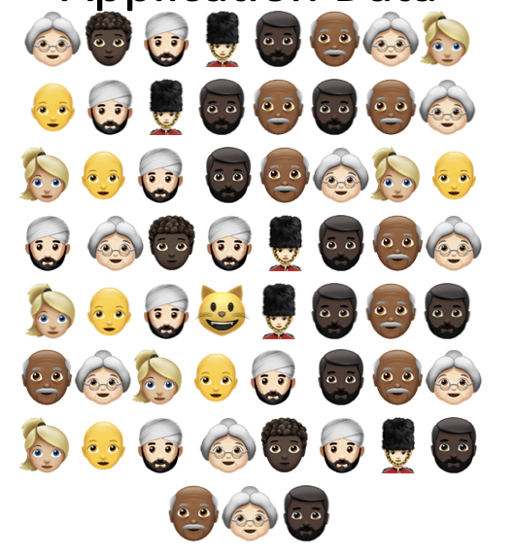
Question to ask yourself about your data
Real Data:
Does this data span the feature space on which you would like your ML model to operate?
If not, what are the bounds on the feature space?
Feature Space
(data range, data domain)
Training Data
Application Data
In the case of lab data, what are the differences between it and data on which your ML model will operate?
Notes:
Anecdotes:
Collapsed lungs in X-rays. Dataset included patients with definitely collapsed lungs that included chest tubes. Model trained on the chest tubes.

Slide 8
Question to ask yourself about your data
Real Data:
Does this data span the feature space on which you would like your ML model to operate?
If not, what are the bounds on the feature space?
Examples of Data:
Image Data
Geometric Transformations
Color Space Transformations
Random Erasing
Mixing features form multiple images
Noise
Natural Language Processing
Synonym Replacement
Structural Changes
Augmented Data:
What are the important features of the data that need to be maintained through the augmentation process?
Is your augmentation process replicating any features that are not of interest and may inadvertently train your model on the “wrong thing”?
Are you over representing some feature merely because it is easy to replicate?
Examples of Data:
Audio
Pitch
Time stretching
Noise
Time Series
Noise
Smoothing
Cropping
In the case of lab data, what are the differences between it and data on which your ML model will operate?
Notes:
Anecdotes:
Collapsed lungs in X-rays. Dataset included patients with definitely collapsed lungs that included chest tubes. Model trained on the chest tubes.

Slide 9
Question to ask yourself about your data
Warnings for AI Generated Data
“Looks good” is not sufficient for synthetic data.
Data used to create a generative model cannot be used to test your model.
Pre-trained Generative AI can introduce features into your synthetic data that may cause issues with your model.
Real Data:
Does this data span the feature space on which you would like your ML model to operate?
If not, what are the bounds on the feature space?
Augmented Data:
What are the important features of the data that need to be maintained through the augmentation process?
Is your augmentation process replicating any features that are not of interest and may inadvertently train your model on the “wrong thing”?
Synthetic Data:
In the case of a physics simulation, has it been verified and validated?
If so, with what data?
Are you simulating cases that are outside the validated scope of the simulation?
In the case a generative AI, what data was used to train and test it?
What metrics were used to determine its performance?
In the case of lab data, what are the differences between it and data on which your ML model will operate?
Notes:
Anecdotes:
Collapsed lungs in X-rays. Dataset included patients with definitely collapsed lungs that included chest tubes. Model trained on the chest tubes.

Slide 10
Question to ask yourself about your data
Real Data:
Does this data span the feature space on which you would like your ML model to operate?
If not, what are the bounds on the feature space?
Augmented Data:
What are the important features of the data that need to be maintained through the augmentation process?
Is your augmentation process replicating any features that are not of interest and may inadvertently train your model on the “wrong thing”?
Synthetic Data:
In the case of a physics simulation, has it been verified and validated?
If so, with what data?
Are you simulating cases that are outside the validated scope of the simulation?
In the case a generative AI, what data was used to train and test it?
What metrics were used to determine its performance?
In the case of lab data, what are the differences between it and data on which your ML model will operate?
Notes:
Anecdotes:
Collapsed lungs in X-rays. Dataset included patients with definitely collapsed lungs that included chest tubes. Model trained on the chest tubes.

Slide 11
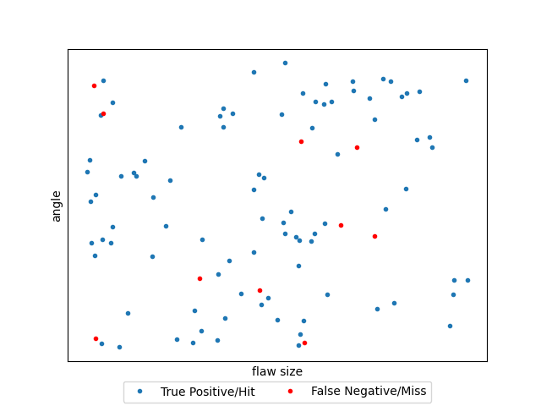
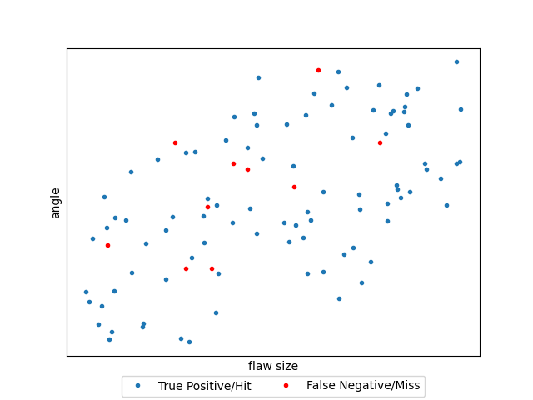
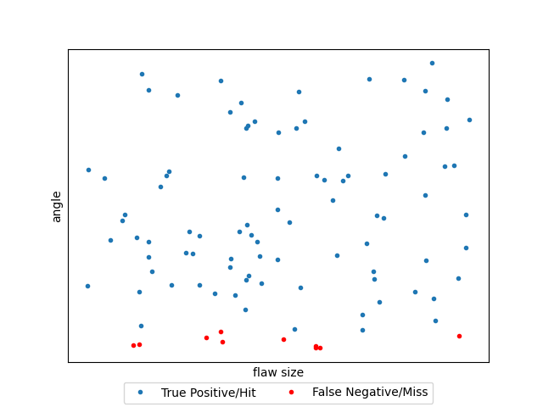
Why is Data Stewardship Important?
Complex feature spaces mean complex data.
Simple: Does this picture contain a cat?
Complex: Does this part contain one of ten flaws with a range of sizes and orientations?
Rare instances of a feature of interest likely means sparse data. ☚ NDE
Certifying a Machine Learning Tool requires quantifiable confidence levels.
Demonstrating performance on a specific dataset should not be sufficient.
Performance metrics without the data used is insufficient.
100 Test instances containing Flaws, and 100 Test instances no containing flaws. True Positives = 90, False Negatives = 10
True Negatives = 95, False Positives = 5. Accuracy = 92.5%, Precision = 94.7%, Recall = 90%, F1-Score = 92.3%

Slide 12
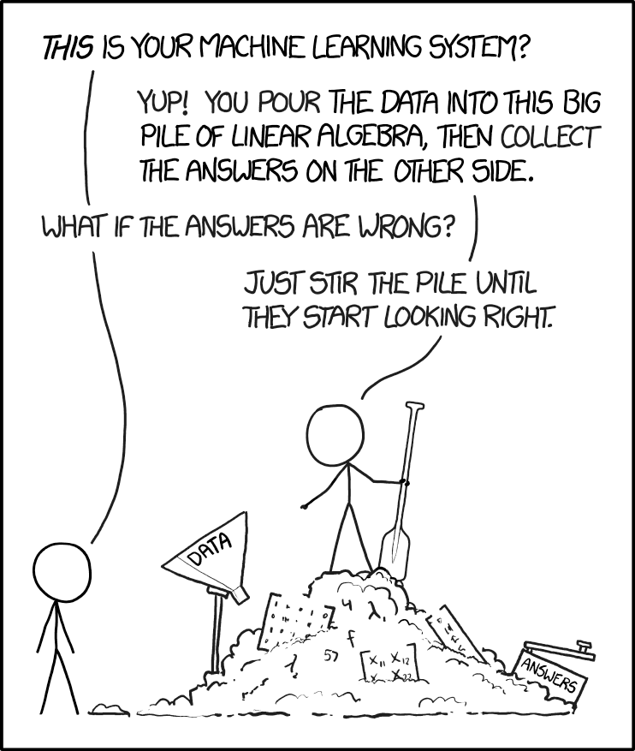
Garbage in, Garbage out
Poor Data management leads to bad Machine Learning Tools!
The Black-Box nature of ML tools makes their certification challenging.
I can make you an ML tool that gives really good results for a demo but in real applications provides no value and can even be a hinderance.
Low Stakes: Is this a picture of a cat?
High Stakes: Is this a child running in front of my self-driving car?
There will always be an economic incentive to automate a task. There needs to be leadership on requirements.
[1]R. Munroe, Machine Learning. Accessed: Feb. 27, 2026. [Comic]. Available: https://xkcd.com/1838/

Slide 13
Repeatability, Reliability, & Robustness
Being mindful about the data we use will allow us to support our performance claims later!
AI/ML is still in its early days and there are not many official or specific regulations or standards for it. Decisions made now will guide behavior moving forward.
Making reliable but limited tools now will pave the way for more versatile tools in the future.
Make users informed and skeptical is safer than ignorant and optimistic.
Regulation and Requirements will be the only thing that prevents risky behavior.

Slide 14
My Urgent Plea!
Apply the Validation tools you already have to your new ML processes.
Even if you cannot supply the entire development dataset when reporting on your new ML algorithm, describe it as best you can.
Highlight where your new ML tools fails.
Augmented and Synthetic Data are great but be mindful of what exactly you are creating.
Be skeptical of tools people are selling that do everything.
Push for standards and guidelines for ML certification in your field.

Slide 15
References
Y. Li, X. Wang, Z. Miao, and W.-C. Tan, “Data augmentation for ML-driven data preparation and integration,” Proc. VLDB Endow., vol. 14, no. 12, pp. 3182–3185, Jul. 2021, doi: 10.14778/3476311.3476403.
S. H. Abdurrahim, S. A. Samad, and A. B. Huddin, “Review on the effects of age, gender, and race demographics on automatic face recognition,” Vis Comput, vol. 34, no. 11, pp. 1617–1630, Nov. 2018, doi: 10.1007/s00371-017-1428-z.
T. Verdonck, B. Baesens, M. Óskarsdóttir, and S. vanden Broucke, “Special issue on feature engineering editorial,” Mach Learn, vol. 113, no. 7, pp. 3917–3928, Jul. 2024, doi: 10.1007/s10994-021-06042-2.
E07 Committee, Practice for Probability of Detection Analysis for Versus a Data, E3023. doi: 10.1520/E3023-21.
E07 Committee, Practice for Probability of Detection Analysis for Hit/Miss Data, E2862. doi: 10.1520/E2862-23.
J. C. Aldrin, D. S. Forsyth, and A. Poudel, “Best Practices for Validation of NDT Techniques Incorporating AI/ML,” in Statistics and Reliability for NDE/NDI, Jun. 25, 2025.
E. Bhardwaj, H. Gujral, S. Wu, C. Zogheib, T. Maharaj, and C. Becker, “Machine learning data practices through a data curation lens: An evaluation framework,” in Proceedings of the 2024 ACM Conference on Fairness, Accountability, and Transparency, in FAccT ’24. New York, NY, USA: Association for Computing Machinery, Jun. 2024, pp. 1055–1067. doi: 10.1145/3630106.3658955.
Y. Li, X. Wang, Z. Miao, and W.-C. Tan, “Data augmentation for ML-driven data preparation and integration,” Proc. VLDB Endow., vol. 14, no. 12, pp. 3182–3185, Jul. 2021, doi: 10.14778/3476311.3476403.
C. Shorten and T. M. Khoshgoftaar, “A survey on Image Data Augmentation for Deep Learning,” J Big Data, vol. 6, no. 1, p. 60, Jul. 2019, doi: 10.1186/s40537-019-0197-0.
C.-H. Lin, C. Kaushik, E. L. Dyer, and V. Muthukumar, “The good, the bad and the ugly sides of data augmentation: An implicit spectral regularization perspective,” Journal of Machine Learning Research, vol. 25, no. 91, pp. 1–85, 2024.
T. Verdonck, B. Baesens, M. Óskarsdóttir, and S. vanden Broucke, “Special issue on feature engineering editorial,” Mach Learn, vol. 113, no. 7, pp. 3917–3928, Jul. 2024, doi: 10.1007/s10994-021-06042-2.
E. Bhardwaj, H. Gujral, S. Wu, C. Zogheib, T. Maharaj, and C. Becker, “Machine learning data practices through a data curation lens: An evaluation framework,” in Proceedings of the 2024 ACM Conference on Fairness, Accountability, and Transparency, in FAccT ’24. New York, NY, USA: Association for Computing Machinery, Jun. 2024, pp. 1055–1067. doi: 10.1145/3630106.3658955.
A. Anaby-Tavor et al., “Do Not Have Enough Data? Deep Learning to the Rescue!,” Proceedings of the AAAI Conference on Artificial Intelligence, vol. 34, no. 05, pp. 7383–7390, Apr. 2020, doi: 10.1609/aaai.v34i05.6233.
R. N. Ndung’u, “Data Preparation for Machine Learning Modelling,” 2022, Accessed: Jan. 09, 2026. [Online]. Available: http://repository.mut.ac.ke:8080/xmlui/handle/123456789/6104

