Slide 1

Wake Up and Smell the Coffee:
Developing Realistic Risk Estimates
Christian B. Smart, Ph.D.
Expert Cost Analyst
Mission Technology Solutions

Slide 2

Presenter Introductions
Presented by:
Christian B. Smart, Ph.D.
Expert Cost Analyst

Slide 3

IT’S ALWAYS RISKIER THAN YOU EXPECT
EVEN TAKING INTO ACCOUNT IT IS RISKIER THAN YOU EXPECT!
COMPUTER CHESS
  Computer programs were first developed in the 1940s
  Belief was that, in ten years, a computer program would be able to defeat the world champion
  This prediction was continually updated to be ten years away
  Did not occur until the 1990s
HOFSTADTER’S LAW
  Inspired by this example, the cognitive scientist Douglas Hofstadter coined the recursive and eponymous Hofstadter’s Law:
  It always takes longer than you expect, even when you take into account Hofstadter’s Law
CONNECTION WITH COST AND RISK
  As time is money, Hofstadter’s Law applies to cost
  Entropy is the general tendency towards disorder in the universe – more can (and does) go wrong than go right
  Due to entropy, a similar law applies to risk

Slide 4
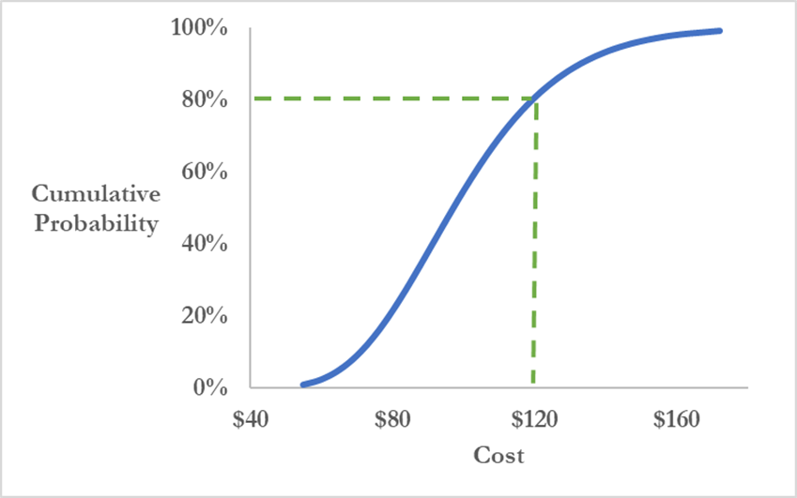
QUANTITATIVE COST AND SCHEDULE RISK IMPERATIVE
RISK IS A MUST, NOT AN OPTION
  High degree and frequency of cost and schedule growth in completed projects means that there is a great deal of resource risk
MORE THAN JUST AVERAGES
  It is not sufficient to develop a single point estimate of cost or schedule
  “Projects that are based on averages are, on average, behind schedule and beyond budget.” – Sam Savage, The Flaw of Averages
NEEDS TO BE QUANTITATIVE
  Qualitative risk assessment alone results in significant underestimation of risk
  Need to move beyond the risk matrix and robustly assess cost and schedule risk with a quantitative analysis
S-CURVES
  Cost and schedule risk are typically displayed graphically as “S-curves”
  Provides probability that cost/schedule will not exceed a specified value

Slide 5
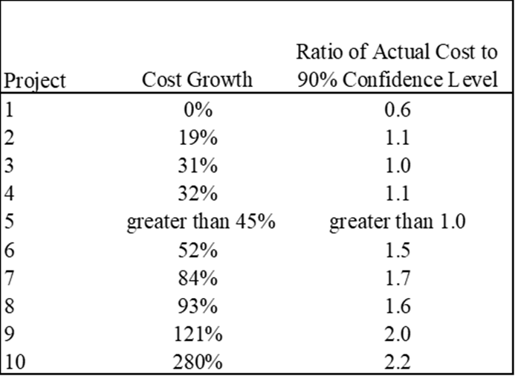
TRACK RECORD FOR RISK ANALYSIS
WORSE THAN RANDOM
SCARCE
  The results of risk analysis are rarely compared to the actual outcome – like a darts player that turns away from the board after throwing a dart
WHAT LITTLE EXISTS IS NOT GOOD
  The limited data available is mainly for cost
  The 90 percent confidence level means there is only a 10% probability that this level will be exceeded
OPPOSITE OF EXPECTED
  For the 10 risk analyses in the table, the actual cost was less than the 90 percent confidence level for only one of the ten
EXTREMELY UNLIKELY
  While a small data set, the odds of such an occurrence is extremely remote – 1 in 2.7 million
  You are more likely to walk outside and be struck by lightning

Slide 6
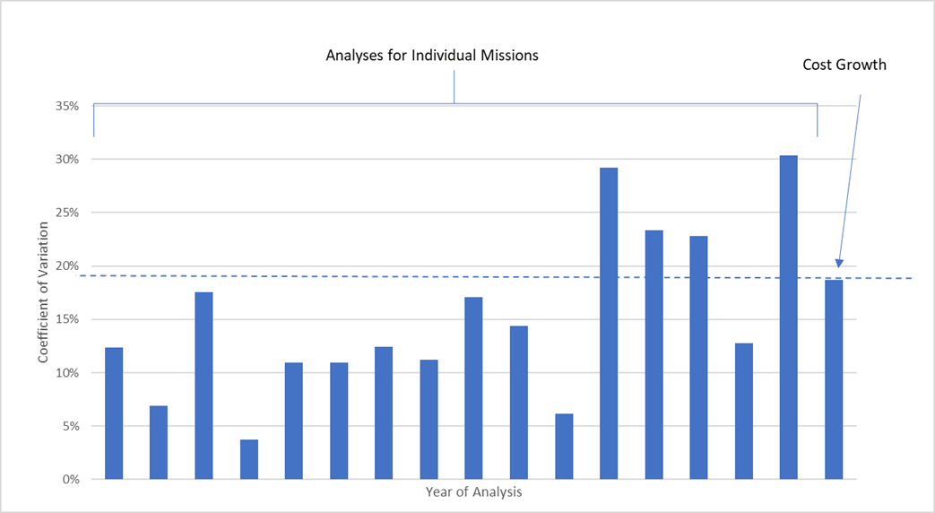
MORE RECENT EVIDENCE
ADDITIONAL EVIDENCE
  16 projects completed in the past 20 years
AVERAGE GROWTH
  Cost risk analyses were conducted at Preliminary Design Review for all 16
  Compared all to the actual development and production cost
BIASED LOW
  Average cost growth was 40% above planned project cost at PDR, including reserves
  Average growth beyond the risk analysis means was 23%
  Average growth beyond the risk analysis 70th percentiles was 15%
BUT RANGES ARE REALISTIC
  The relative risk for the last six analyses are in line with that implied by historical cost growth

Slide 7


THREE SOLUTIONS
CALIBRATION
WBS-LEVEL COST GROWTH
PARAMETRIC
Assign risk distributions based on historical cost growth, estimate type, and project milestone.
Improve this traditional method by anchoring distribution to cost growth
Develop risk analyses based on project characteristics and cost growth.

Slide 8
METHOD 1
CALIBRATION TO HISTORY

Slide 9
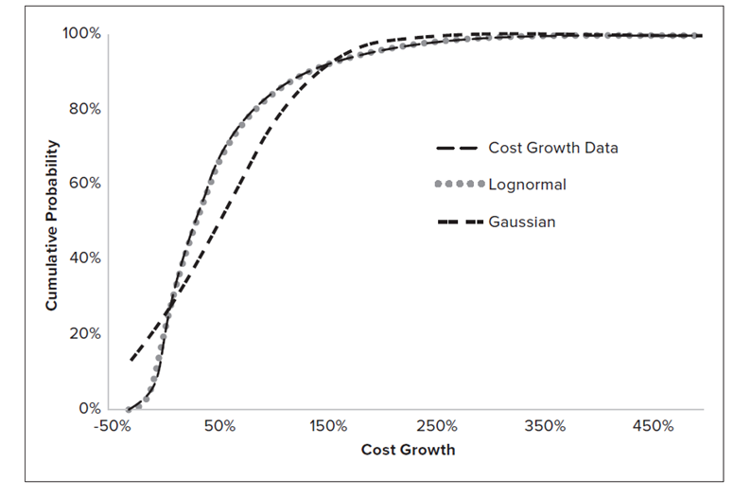
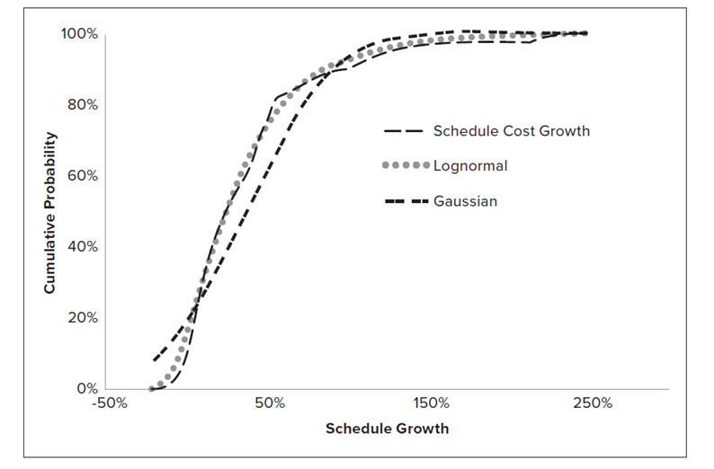
CALIBRATION TO HISTORY
COST GROWTH DATA
SCHEDULE DELAY DATA
Both cost growth and schedule delay data closely follow a three-parameter lognormal distribution (Smart 2020)

Slide 10
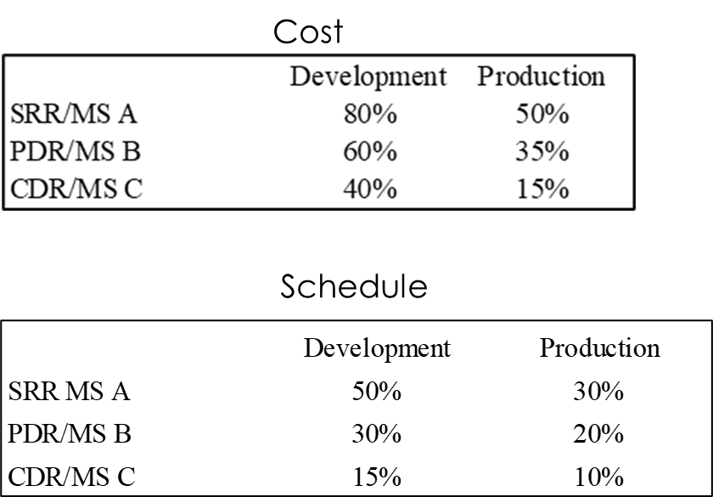
RELATIVE RISK BY MILESTONE
RELATIVE RISK
  Measured by the Coefficient of Variation – Ratio of Standard Deviation to Mean
VARIES BY MILESTONE
  Relative risk declines as the project progresses and avoids, mitigates, or absorbs risks
DIFFERENT FOR COST AND SCHEDULE
  Cost grows more on a percentage basis than schedule (although schedules are more likely to experience delays)

Slide 11
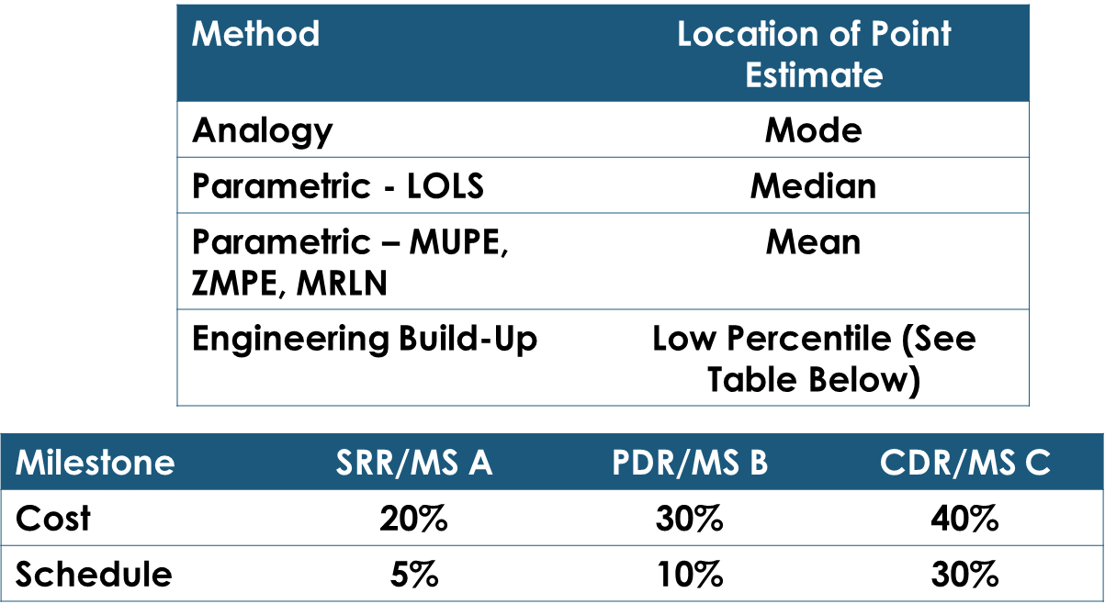
POINT ESTIMATE LOCATION
VARIES BY COST/SCHEDULE ESTIMATING METHOD
ANALOGY
  Analogy estimates represent a “most likely” cost, this is represented by the peak of the distribution, or mode
PARAMETRIC – LOG-TRANSFORMED ORDINARY LEAST SQUARES (LOLS)
  This CER technique produces estimates at the 50th percentile, or median, of the distribution
PARAMETRIC – MUPE/ZMPE/MRLN
  These techniques produce unbiased mean estimates
ENGINEERING BUILD-UP
  This method has a history of underestimating – does not take into account uncertainty and often overlooks items because of the use of vendor quotes that do not capture integration and test activities

Slide 12
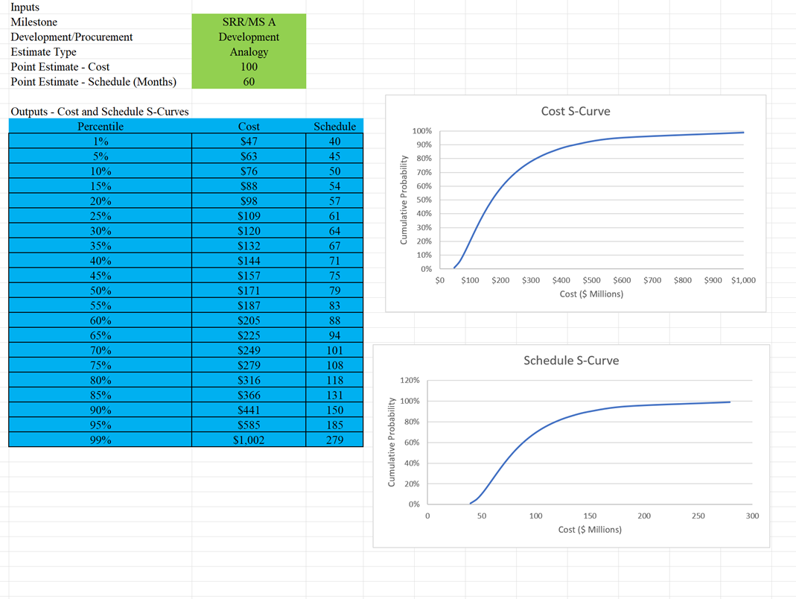
CALIBRATION EXAMPLE

Slide 13
METHOD 2
IMPROVED WBS AGGREGATION WITH WBS-LEVEL COST GROWTH

Slide 14
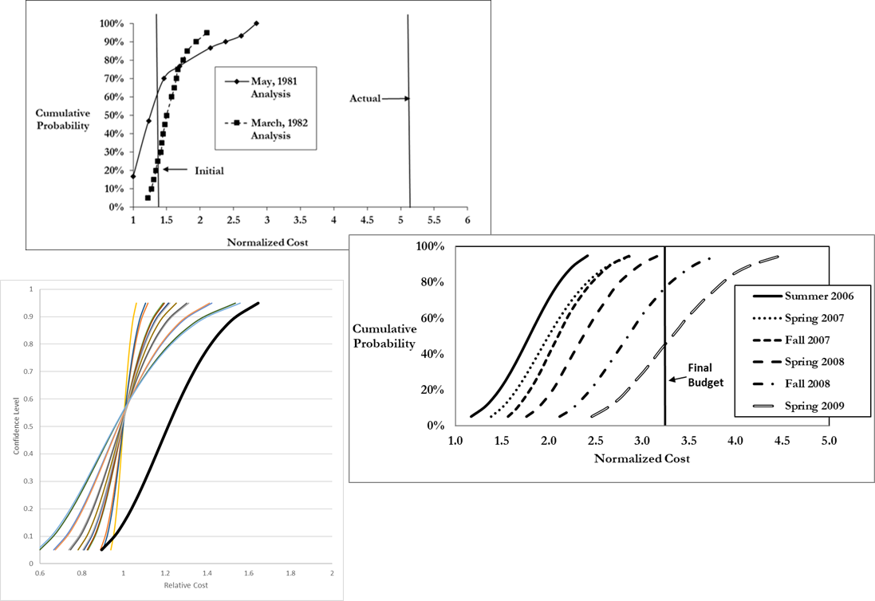
ISSUES WITH CURRENT PRACTICE
TRADITIONAL APPROACH
  Assign ranges at the WBS level (often low, most likely, and high) and then aggregate
TWO ISSUES
  Ranges are too narrow
  Distributions biased low
1976 STUDY
  Ed Capen, a petroleum engineer found that people are overconfident – 90 % confidence intervals are actually 40 % confidence intervals
  Connection to ACE-IT
HOW TO FIX
  Recognize that ranges are too narrow
  Base ranges on objective data, such as cost growth for similar historical missions
  Incorporate correlation
  Use lognormal distributions to represent WBS-level risk

Slide 15
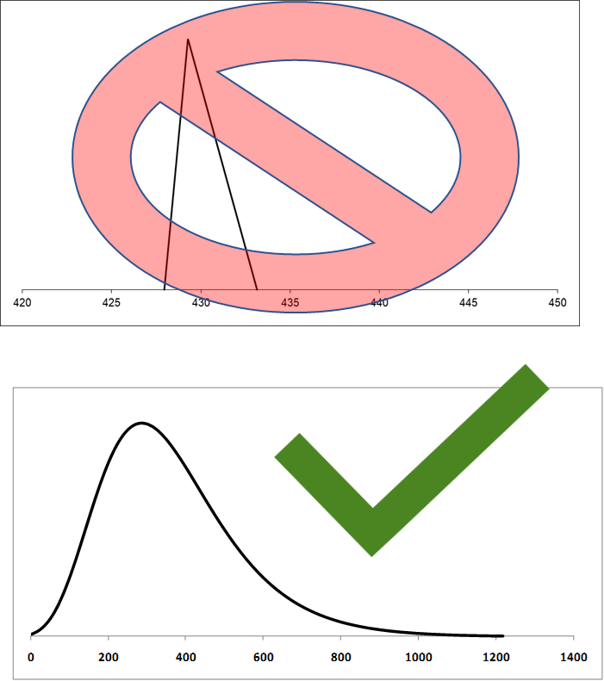
IMPROVING RISK RANGES
ESTABLISH REALISTIC RISK RANGES
  Use historical cost growth data from similar missions or other objective data if possible
LOGNORMAL DISTRIBUTION
  Use lognormal rather than triangular distributions
  Heavy right tail of lognormal captures more uncertainty
MODEL “HIGH” AS A PERCENTILE
  Capen’s paper suggests that a high value would be at the 70th percentile rather than the 95th
HIGH CORRELATION
  Assign 60% correlation among all WBS elements

Slide 16
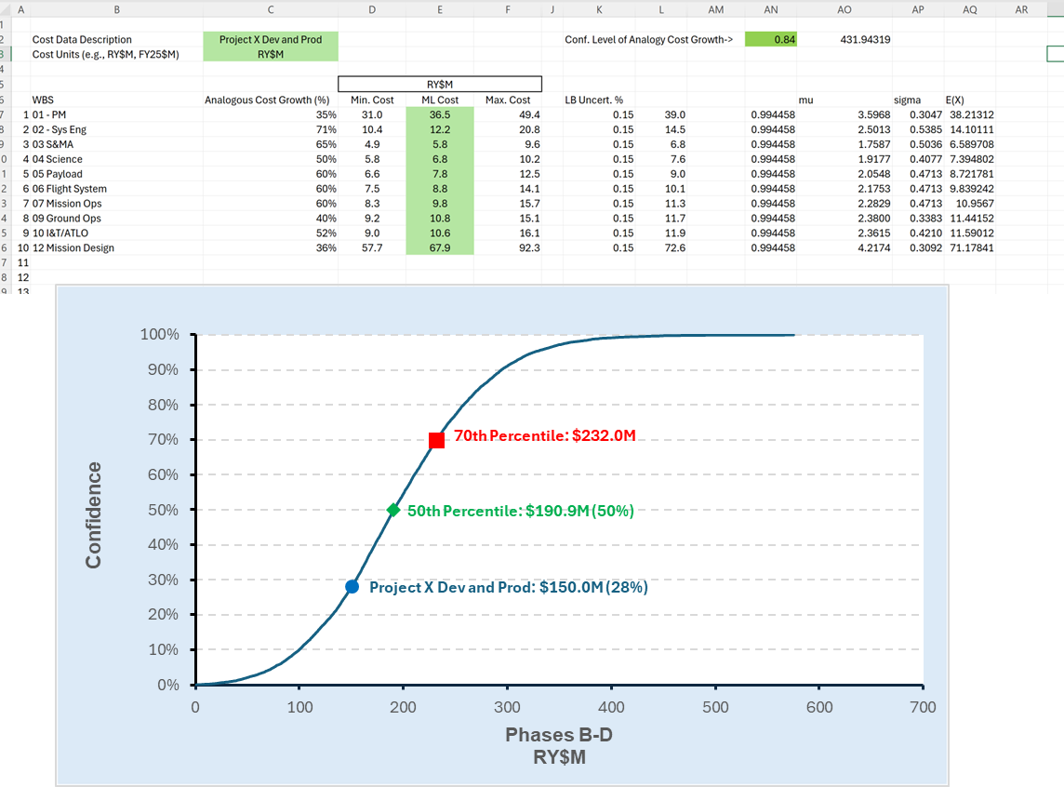
EXCEL IMPLEMENTATION
FIXED SEED PRE-GENERATE RANDOM NUMBERS
  Pre-generate 10,000 random numbers for 24 WBS elements (max size of WBS)
CONFIDENCE LEVEL
  Analogous cost growth confidence level set to 84% (one standard deviation above the mean)
  Provides results in line with cost growth
PROS AND CONS
  Big spreadsheet but avoids the need to run a simulation (saves time)
  Fixed seed so results don’t vary if the inputs are changed

Slide 17
METHOD 3
PARAMETRIC METHOD

Slide 18
“Research is what I’m doing when I don’t know what I’m doing.”
Werner von Braun

Slide 19
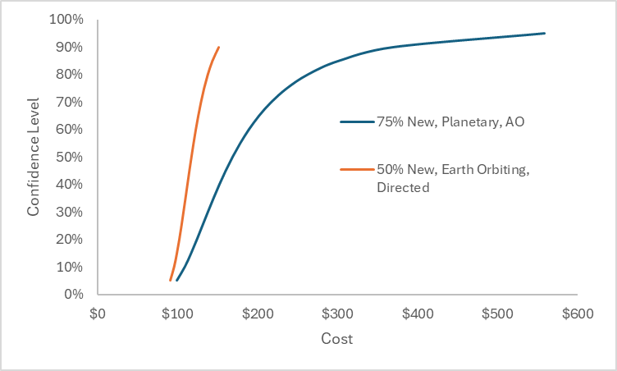
PARAMETRIC EXPERIMENT
LINEAR REGRESSION MODEL
  Estimate/Actual (Est/Act) ~ a+b*%New+c*Dest+d*Comp/Directed
  Est/Act ~ Gaussian
MEAN AND STANDARD DEVIATION
  Mean Produced by Regression Model
  Std. Dev. Is the minimum of recommended contingency and 1-predicted Est/Act
S-CURVE
  Translate to Cost Growth and Multiple by Estimate
  Initial Results Based on Small Data Set
  Based on Hollman (2016)
Comparison of S-Curves for Two Different Projects Project Estimate = $100 Million for Each

Slide 20
CONCLUSIONS
There is a need to improve risk analysis methods
  Spreads are often too narrow and biased low
We have provided three solutions
  First two can be used now
  First method corrects for both bias and spread
  Second method corrects the spread issue – can either calibrate to avoid bias or avoid anchoring to project plans
  Third is in the conceptual/experimental stages
    Has some promise, used in other industries

Slide 21
REFERENCES/FURTHER READING
Some of Christian Smart’s papers related to risk can be found at https://www.iceaaonline.com/publications/solvingprm/
Cost Estimating Body of Knowledge 2.0 (Beta) (www.iceaaonline.com)
E.C. Capen, “The Difficulty of Assessing Uncertainty,” Journal of Petroleum Technology 28 (8) pp 843-850
John Hollmann, Project Risk Quantification (Gainesville: Probabilistic Publishing, 2016)
Christian B. Smart, Solving for Project Risk Management: Understanding the Critical Role of Uncertainty in Project Management, (New York: McGraw-Hill, 2020)

Slide 22

Thank You

