Slide 1
AI Assurance and AI Assurance Cases
23 April 2026
John W. Dennis
DATAWorks April 2026

Slide 2
AI Assurance
“The grounds for sufficient confidence that an AI system,
while operating within its defined scope,
will achieve its intended outcomes
without introducing unacceptable risks,
throughout its lifecycle.”
- CDAO AI Assurance Framework¹
¹ (Kapusta et al. 2025)

Slide 3
AI Assurance Process
Risk Identification and Scoping
How much effort do you need to expend, and where do you need to expend it? What do stakeholders need to know?
Collect Evidence
Audits, STPA, Fault Analysis, T&E, formal methods, documentation, incident reporting, stakeholder feedback, usage logs, guardrail activations, etc. [You likely already do many of these things.]
Iterate and Update
Organize, Document, and Communicate
Write it down in a structured, holistic way (e.g., an AI Assurance Case).
Notice similarities to Map, Measure, Manage, Govern from NIST AI RMF.

Slide 4
T&E versus Assurance
T&E is the sampling and assessment of system responses.
“DT&E is the deliberate exercising of virtual or real components or systems, and the evaluation of responses to generate information on capabilities and limitations.”²
“OT&E is (i) the field test, under realistic combat conditions, of any item of (or key component of) weapons, equipment, or munitions for the purpose of determining the effectiveness and suitability of the weapons, equipment, or munitions for use in combat by typical military users; and (ii) the evaluation of the results of such test.”³
In most cases, T&E is necessary for assurance.
In some cases, T&E may be sufficient for assurance.
In any case, judgment about effectiveness and suitability are assurance arguments, supported heavily by T&E.
² (10 USC §139); ³ (OUSW (R&E) 2026)

Slide 5
T&E, Assurance for AI-Enabled Systems
Complicated input spaces, edge cases, brittleness
Can tests provide adequate coverage?
Data and model drift
How well do evaluations generalize?
Rapid fielding, iterative development, and sustainment
When is retesting with adequate coverage too slow?
Mitigate risk by thinking more broadly than test
Assess the processes for development, monitoring, incidence response
Formal methods
Risk
Assurance

Slide 6
AI Assurance Cases
An assurance case is just a way of organizing all the information that will give stakeholders justified confidence in the AIES.
“Assurance Case: A structured argument, supported by a body of evidence, demonstrating that an assurance claim is [or is not] true.”¹
“Assurance Claim: A statement that relevant stakeholders must have sufficient confidence in for the assurance of an AI system to be established.”¹
An argument is just a claim + evidence.
“T&E is [an] activity that produces … evidence that completes the needed assurance arguments.”⁴
¹ (Kapusta et al. 2025); ⁴ (NASEM 2023)

Slide 7
An Illustrative AI Assurance Case
Retention Prediction Model – Army (RPM-A)
ML-based model used to forecast service member retention
Real model in a DoW cloud environment being actively developed and used
Just a model – no connected components (although it exists in a software and data ecosystem)
Not much ambiguity in the use case
No automated decisions or actions
RPM-A workflow:
Assurance Case Coverage:
Processes
Guardrails
Assumptions
Data content, limitations, mitigations
System effectiveness
Appropriate use
DMDC, Army, …
Army PDE
Data work
Model Training
Evaluation, Use
Vantage

Slide 8
Assurance Case Structure
Top Level Claim
Life Cycle Level Claims
Sub-claims
Evidence and other documentation
Claims for areas of the production (life) cycle
Claims broken down into more manageable pieces
E.g., properties of the data, data handling steps, properties of metrics, guardrails, maintenance cadence
“Evidence” takes a variety of forms
Data tables, metrics, other documentation and discussion

Slide 9
Assurance Case Structure
Top Level Claim
Life Cycle Level Claims
Sub-claims
Evidence and other documentation
“While operating within its defined scope, the system will achieve its intended outcomes without introducing unacceptable risks, throughout its lifecycle.” ¹
“The RPM-A produces accurate and informative forecasts of Active Duty Service Member retention that aid effective force management. The development and use of the RPM-A will protect human subjects and their associated data.”⁵
¹ (Kapusta et al. 2025); ⁵ (Dennis et al. 2025)

Slide 10
Assurance Case Structure
1. Data Policy and Processes: The policies and processes governing data handling are documented, transparent, reproducible, and serve to protect the individuals represented in the data.
2. Data Structure: The structure of the data used for training, validation, testing, and forecasting is appropriate for the chosen algorithm.
3. Data Contents: The data used for training, validation, and forecasting contains the appropriate history and breadth of features to produce accurate forecasts.
4. Model Methodology: The model architecture and learning method are appropriate for the use case and the data.
5. Model Development: The development of the model adheres to regulatory guidelines and is documented, transparent, and reproducible.
6. Model Testing: Model testing is transparent, reproducible, representative, and robust.
7. Model Evaluation: Evaluations indicate that the RPM-A is effective at forecasting active duty retention.
8. User Requirements: Documentation and design of the model facilitate appropriate use.
9. Stakeholder Requirements: Guardrails, communication, and oversight facilitate appropriate confidence among stakeholders.
10. Maintenance: The model and its associated components and processes are regularly maintained.
11. Monitoring: Development and use will be reviewed regularly and integrate user and stakeholder concerns.
Top Level Claim
Life Cycle Level Claims
Sub-claims
Evidence and other documentation
Data
Model
Use

Slide 11
Assurance Case Structure
Examples
(Data Structure 3.) Panel time-consistency: The data should present observations of an individual’s history at regular, consistently spaced intervals and should not contain gaps between the individual’s entrance into service and separation from service that are different from those regular spacings.
(Data Contents 4.) Non-Omniscience: Features in the training data should not inadvertently reflect future states.
(Model Methodology 2.) The model architecture should be appropriate for the use case and other requirements specified in the Use section. Specifically, the architecture should be documented, and statistical theory or empirical work should indicate the appropriateness of: Gradient boosted trees for forecasting future unobserved probabilities; Independent cross-sectional models for capturing sequential time series forecasts.
(Model Testing 2.) Adequate comparisons with other models should be conducted.
(Model Evaluation 4.) The model exhibits sufficient levels of performance within its intended use cases, which are described in the Use section.
Top Level Claim
Life Cycle Level Claims
Sub-claims
Evidence and other documentation

Slide 12
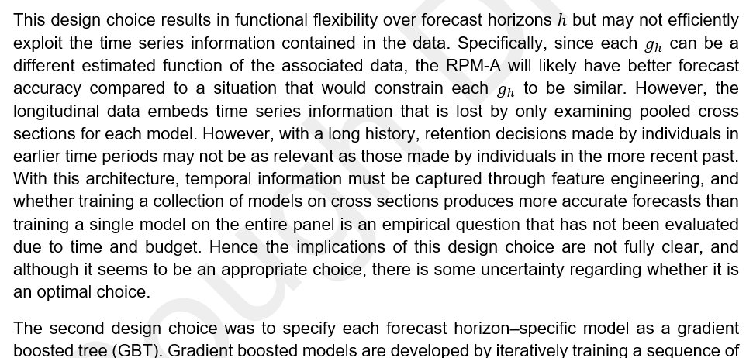
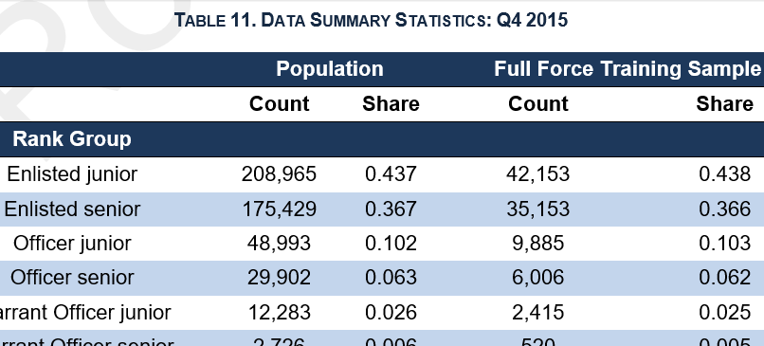
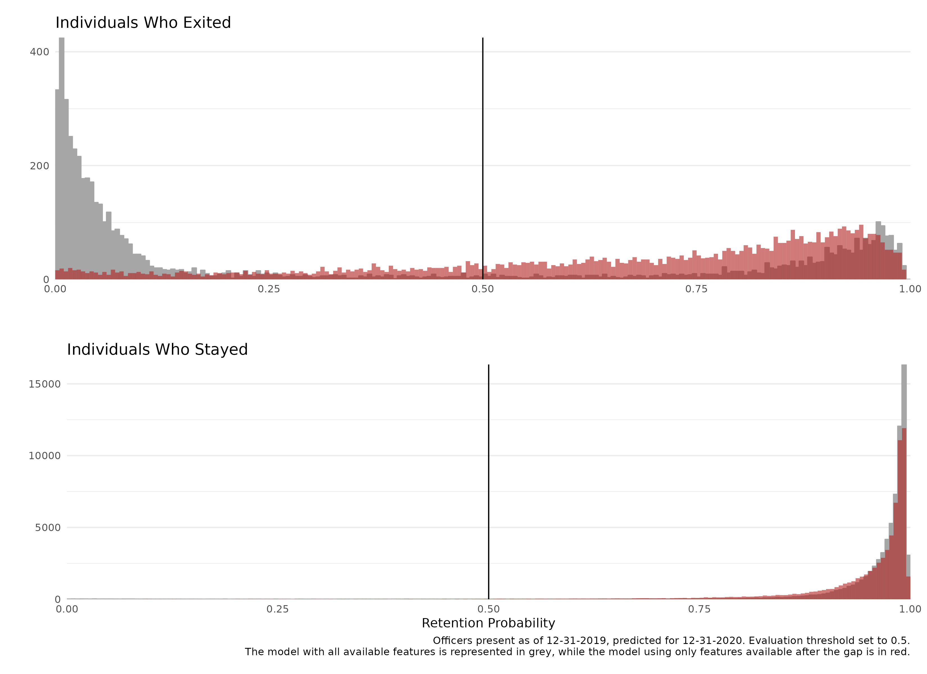
Assurance Case Structure
Top Level Claim
Life Cycle Level Claims
Sub-claims
Evidence and other documentation

Slide 13
Recommendations for Practitioners
Focused on a single point in time: Avoid speculation about future performance when not necessary. Provide arguments about the state of the system at a single point in time. If an argument is outdated, update it.
Always a work in progress: Assurance cases should be started early and recognized as necessarily incomplete with the goal of improving over time. Point out things that need to be improved. Build a path to success rather than simply showing how great the system is.
Reproducible: Tools and appropriate methods should be used to facilitate reproducibility.
Risk-informed: AI assurance cases should be scoped to the risk associated with the capability, and the arguments in the assurance case should be scoped to the risk associated with the claim.
Communicate: Developers and testers should be included regularly in discussions about the assurance case. Assurance necessarily involves communicating across silos. Use the assurance case to facilitate iterative development.
Robust arguments: AI assurance cases can leverage more than T&E, such as transparent documentation, formal methods, and audits for processes and procedures.
Well-defined use case: AI assurance cases should be tailored to a specific, well-defined use case and the associated decisions that will be supported by the AI.
Don’t reinvent the wheel: Use existing frameworks and resources to identify and manage risk.

Slide 14
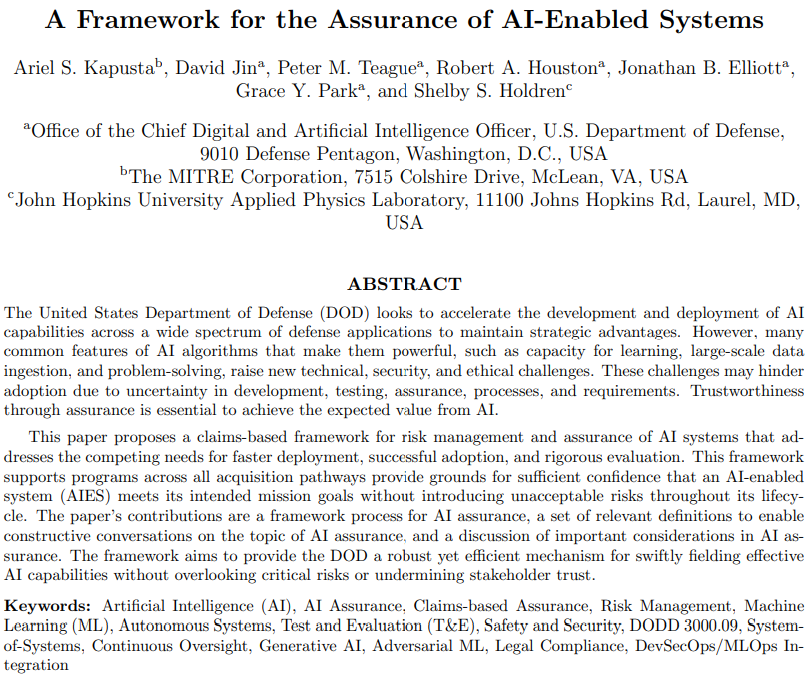
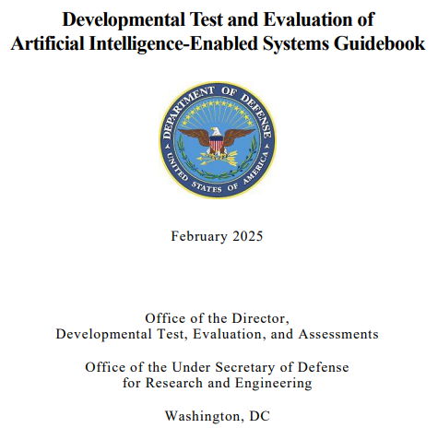
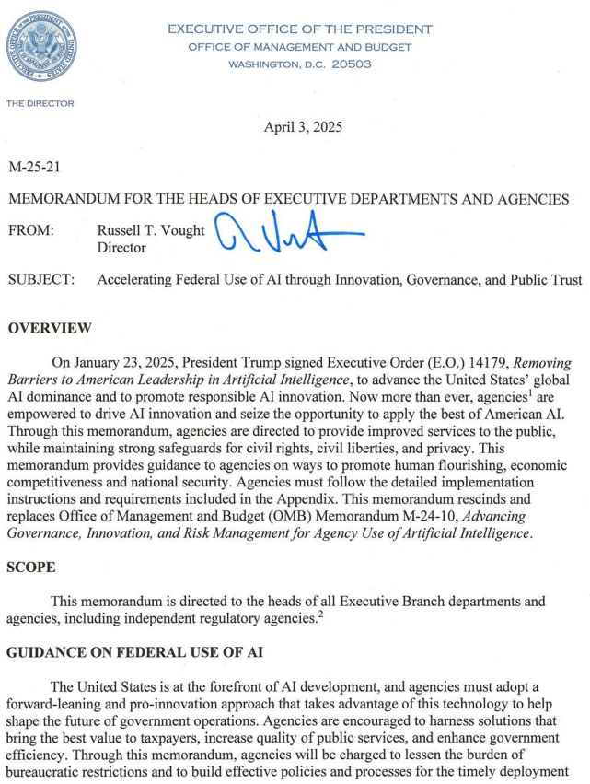
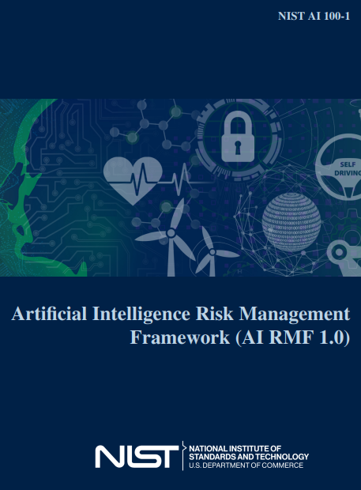
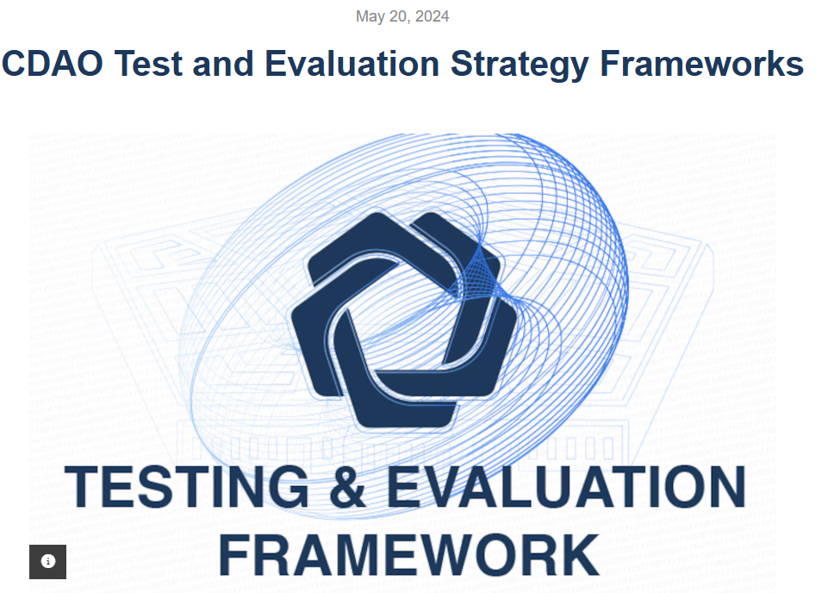
Recommendations for Practitioners
Don’t reinvent the wheel! Many recent frameworks and guidance documents can help, including but not limited to

Slide 15
jdennis@ida.org

Slide 16
References
Kapusta et al. 2025. A Framework for the Assurance of AI-Enabled Systems. https://arxiv.org/pdf/2504.16937
National Academies of Sciences, Engineering, and Medicine (NASEM). 2023. Test and Evaluation Challenges in Artificial Intelligence-Enabled Systems for the Department of the Air Force. Washington, DC: The National Academies Press. https://doi.org/10.17226/27092
Wojton, Heather M., Porter, Daniel J. and Dennis, John W. 2020. Test & Evaluation of AI-Enabled and Autonomous Systems: A Literature Review. IDA Final Publication NS-D-14331.
Office of the Under Secretary of War for Research and Engineering (OUSW (R&E)). 2026. Developmental Test and Evaluation (DT&E). Accessed March 02, 2026. https://www.cto.mil/dtea/dte/
10 USC §139: Director of Operational Test and Evaluation. https://uscode.house.gov/view.xhtml?req=granuleid:USC-prelim-title10-section139&num=0&edition=prelim
ISO/IEC/IEEE 15026-2:2022(en) Systems and software engineering — Systems and software assurance — Part 2: Assurance case https://www.iso.org/obp/ui/en/#iso:std:iso-iec-ieee:15026:-2:ed-2:v1:en
NIST. 2023. NIST AI 100-1: Artificial Intelligence Risk Management Framework (AI RMF 1.0). https://doi.org/10.6028/NIST.AI.100-1
CDAO. 2024. CDAO Test and Evaluation Strategy Frameworks. https://www.ai.mil/Latest/Blog/Article-Display/Article/3940283/cdao-test-and-evaluation-strategy-frameworks/
Office of the Director, Developmental Test, Evaluation, and Assessments. 2025. Developmental Test and Evaluation of Artificial Intelligence-Enabled Systems Guidebook. https://www.cto.mil/wp-content/uploads/2025/08/TE_of_AIES_Guidebook-Feb-2025-1.pdf
Dennis, John W., Chappell, Isaac S., Eifert, Erin P., Larimer, Sarah J. and Marcusse, Jordan R. 2025. AI Assurance Case: A Personnel System Exemplar. IDA Document 3004899.
Executive Office of the President, Office of Management and Budget (OMB). 2025. M-25-21. Accelerating Federal Use of AI through Innovation, Governance, and Public Trust. https://www.whitehouse.gov/wp-content/uploads/2025/02/M-25-21-Accelerating-Federal-Use-of-AI-through-Innovation-Governance-and-Public-Trust.pdf

Slide 17
Trustworthiness of a System
“
when employed correctly, it will dependably do well what it is intended to do;
when employed correctly, it will dependably not do undesirable things;
when paired with humans it is intended to work with, it will dependably be employed correctly. ”
- David Tate⁴
A system is assured when the relevant authorities have sufficient justified confidence in the trustworthiness of the system to authorize its employment in specified contexts.
⁴ (NASEM 2023)

Slide 18
Policy and Guidance Recommendations
Provide templates: Guidance should recommend a standard template or structure for an AI assurance case.
Provide examples: Guidance should provide an illustrative list of claims and evidence for AI assurance cases.
Modularity: Guidance should consider standardizing how an AI assurance case references an accreditation or the assurance case of a system on which it depends.
Risk-informing: Guidance should help practitioners determine the risk of their program so that the assurance case can be appropriately resourced and scoped.
Readability: Guidance should describe methods for presenting and summarizing AI assurance case arguments in a digestible manner.
Participation: Policy should consider incentivizing objectivity and participation in writing AI assurance cases. Guidance should be appropriately targeted to those who will write AI assurance cases and those who will assess the adequacy of assurance cases.

Slide 19
Discussion on the Assessment of a System versus the Assessment of the Processes that Produce that System
We test a system because we want to know how that system will perform. We want confidence that the system will do what we want it to.
The system changes or the environment changes, so we test the system again (or take on additional risk by not testing again).
The changes occur rapidly, so we must test rapidly or accept compounding additional risk.
Testing might reveal symptoms of the underlying processes, for example, inadequate development processes.
Further, because of system complexity, we can reasonably assume that the system will fail in novel ways; exhaustively covering the operating space is costly.
We can mitigate risk by assessing those underlying processes directly for adherence to standards and best practices, appropriate documentation, audits, etc.
For example, we know we take on risk by fielding a brittle system, but we can mitigate that risk by assuring that we have robust processes in place to quickly detect and mitigate failures.
In some sense, we can think of this as expanding the definition of the system to include the development processes and testing the ‘system’ that includes those processes.
But methods of sampling from these processes might not be the most efficient way, on their own, to facilitate justified confidence.
For example, assessing the existence and adequacy of standard operating procedures for investigations into causes of failures.

