Slide 1
Active and Passive Cellular Multi-Static ISAC for White-Space-Aware Drone Tracking
Datawork 2026
Dr. Yan Li
Dr. Adriyel Nieves
Wireless Communication Systems Group JHU APL

Slide 2
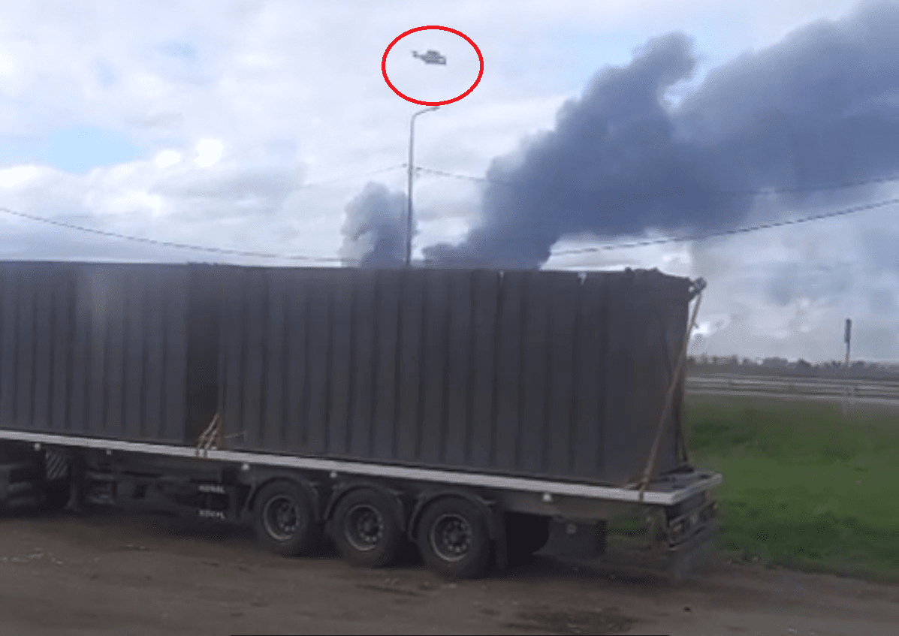
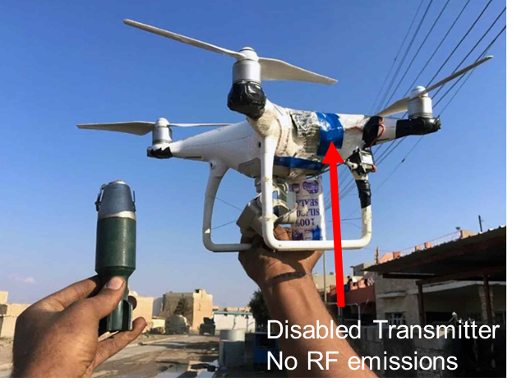
Weaponized drone warfare: Dark, optical fiber, out of band, etc

Slide 3
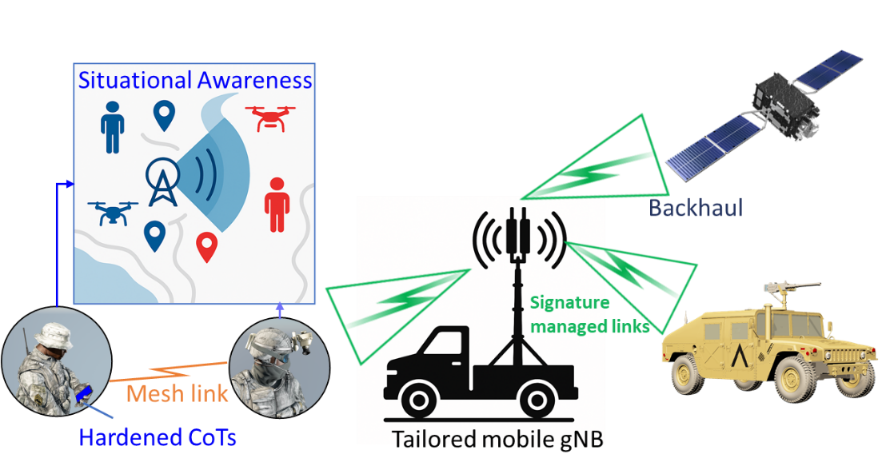
ISAC: Integrated sensing and communications enabling situational awareness

Slide 4
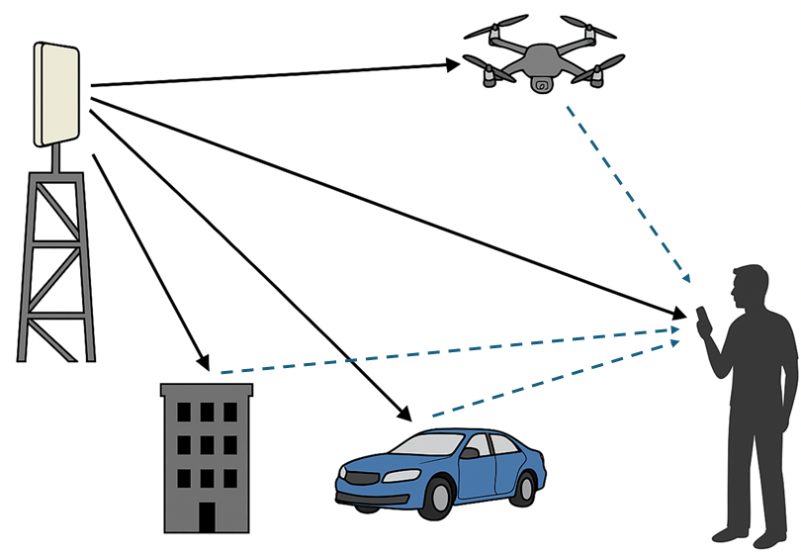
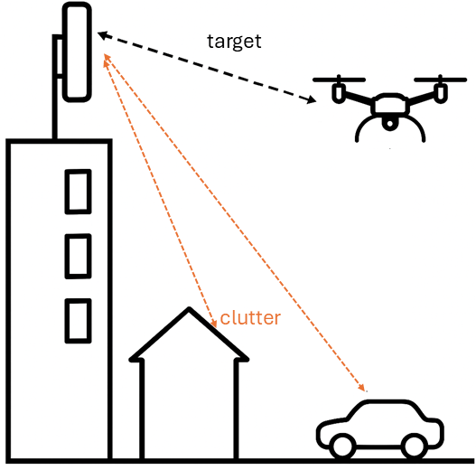
Background: How do radar and communication systems respond to RF reflections?
Multipath
Radar Clutter

Slide 5
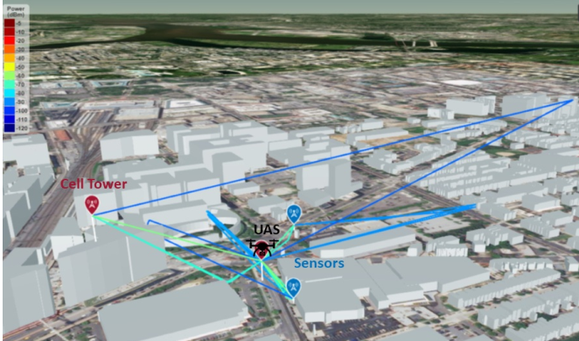
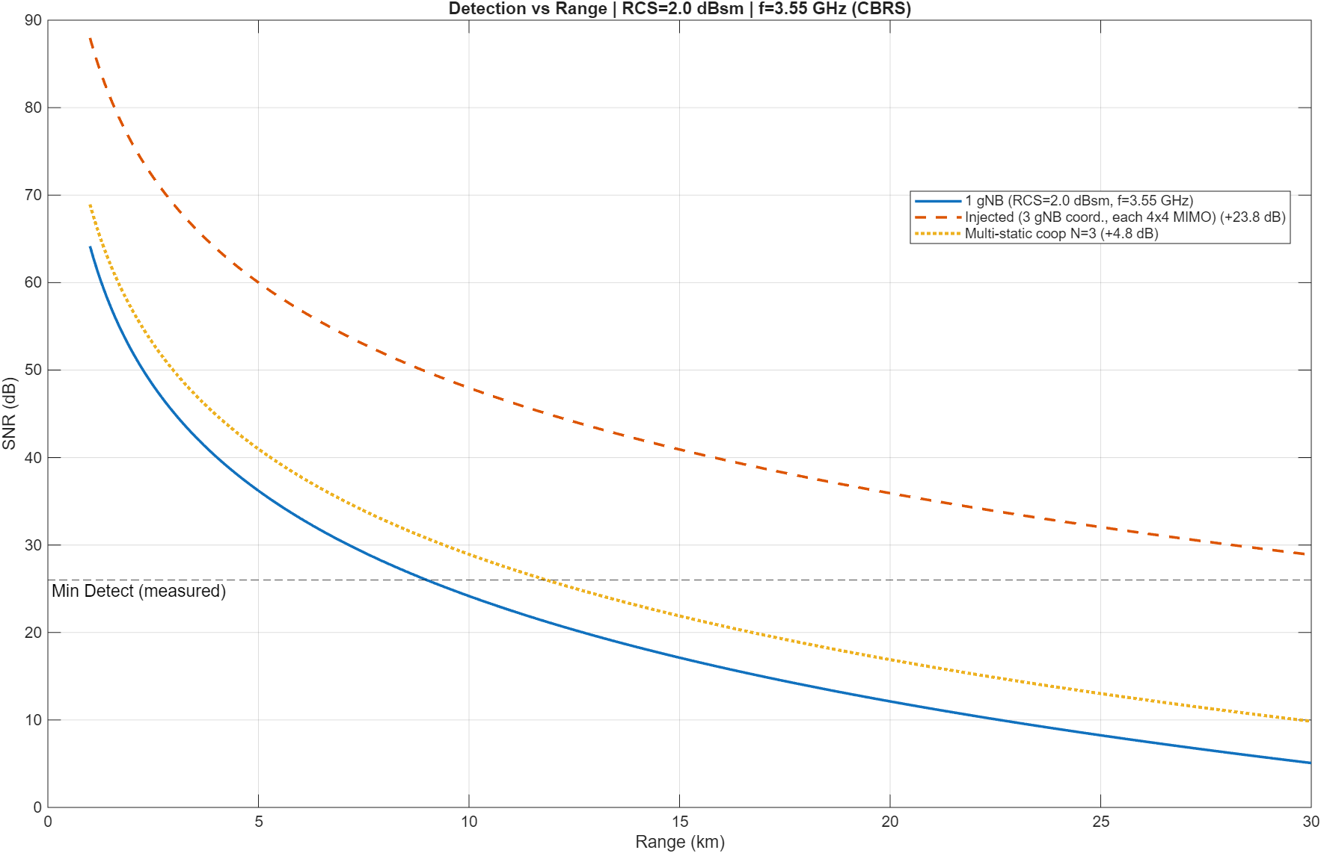
What is the feasibility of using cellular system to detect drones? Digital twin modeling using OpenStreet data
Technical challenges: 1) Clutter and 2) co-channel interference
Radar Range Equation
OpenStreet data

Slide 6
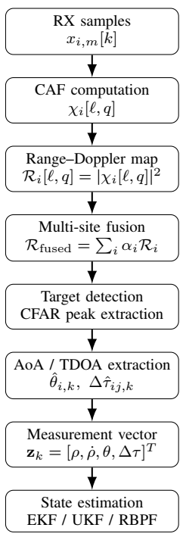
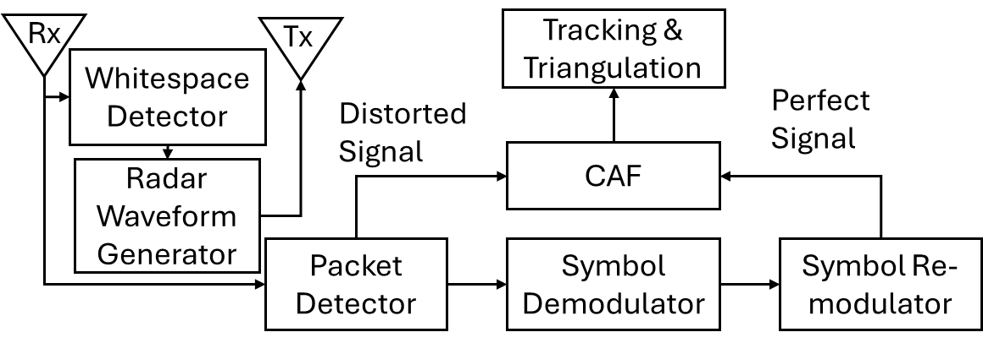
Detecting and tracking RF reflections using remodulated signals with a dual antenna setup

Slide 7
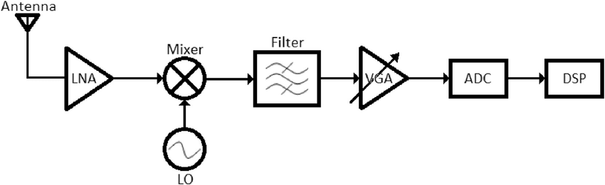
Digital-Twin Engineering and System Performance Analytics
System Specifications
“±20 ppm (parts per million),
though some can be ±50 ppm”
RAG & Knowledge Graph
Empirical Data (Sensor data, spectral data, measurements)
AI Agent Causal Analysis
Digital Twin
(Physics models, Channel simulators, Network simulators)
Modifications
Predicted System Performance Analysis

Slide 8
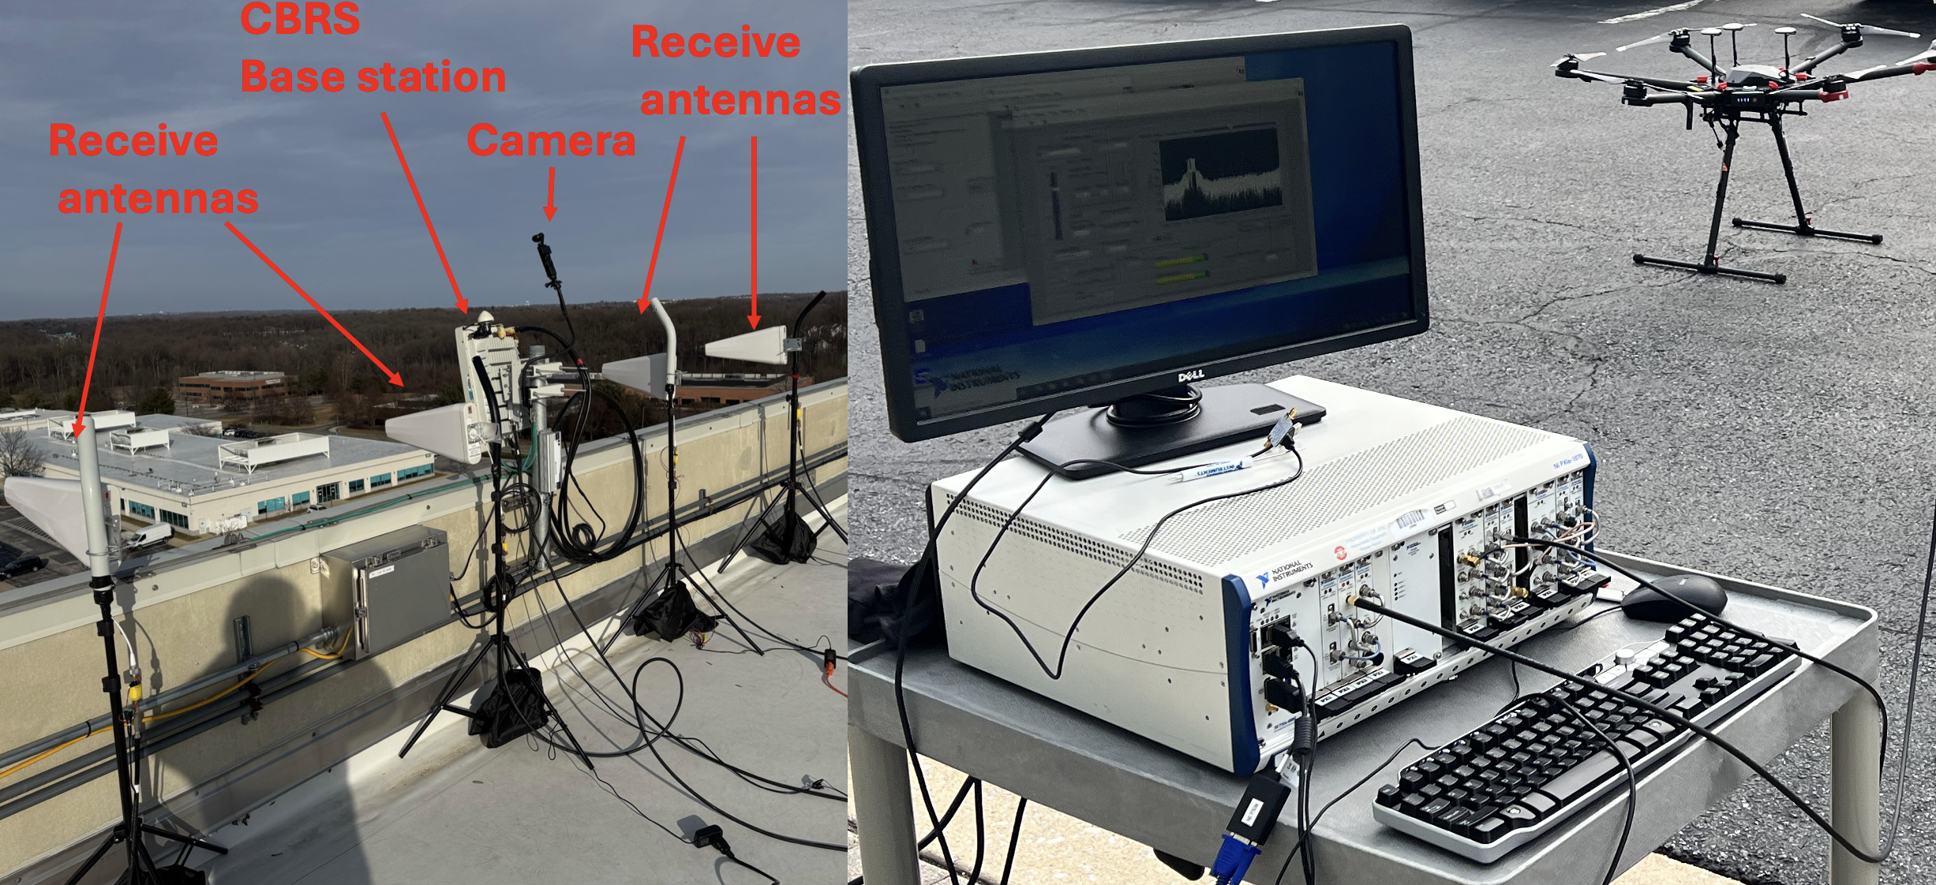
Experimental Setup with an 5G Citizens Broadband Radio Service System
Receive antennas are placed at the null of the transmitter

Slide 9
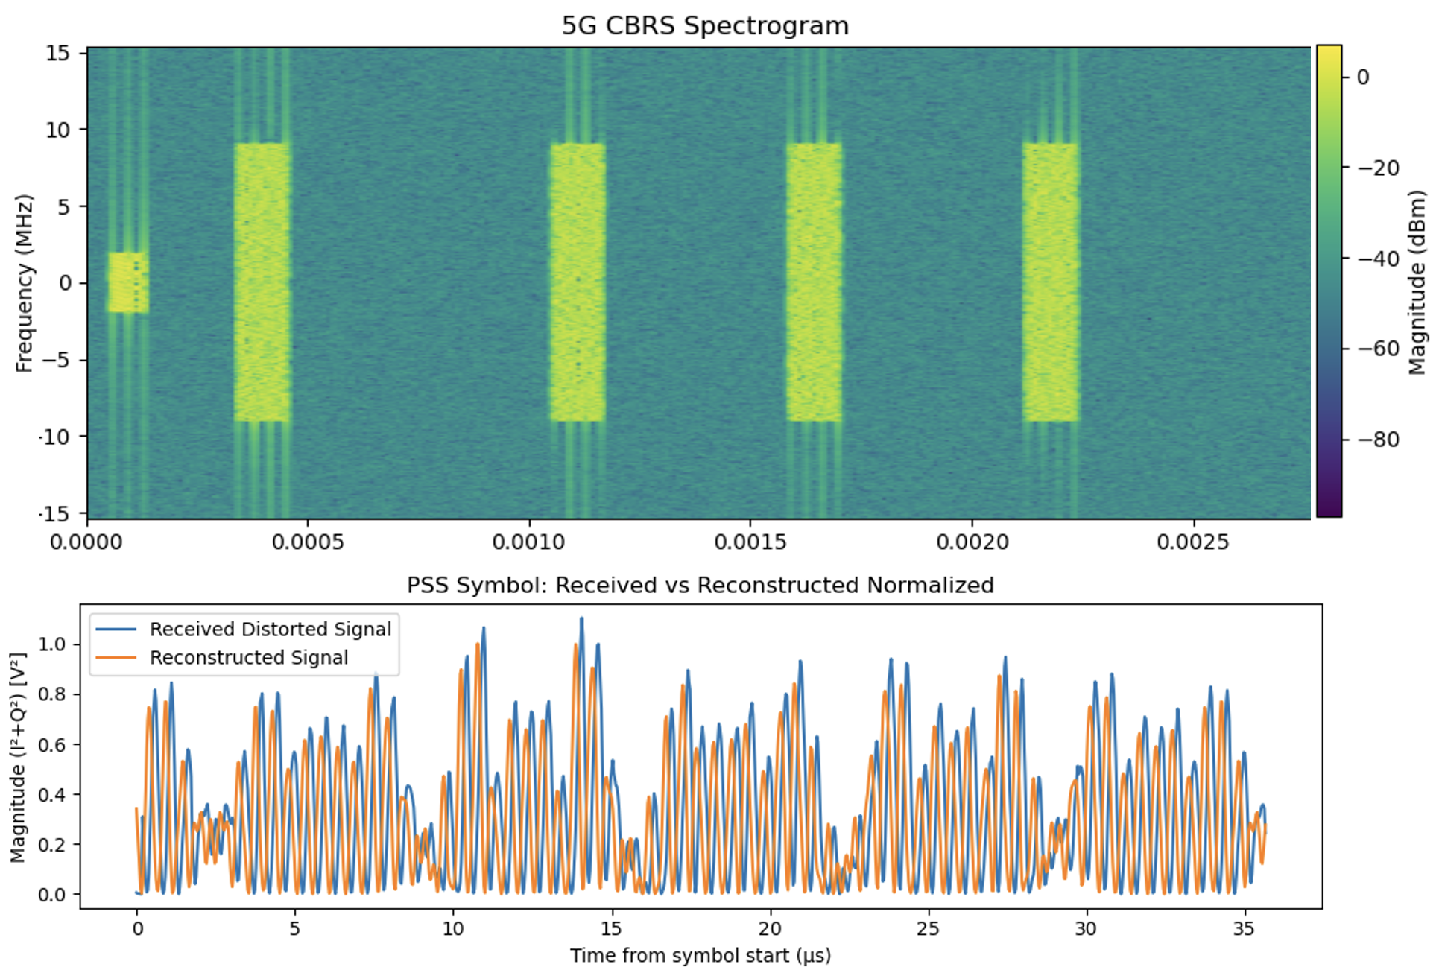
Detected and regenerated 5G signal

Slide 10
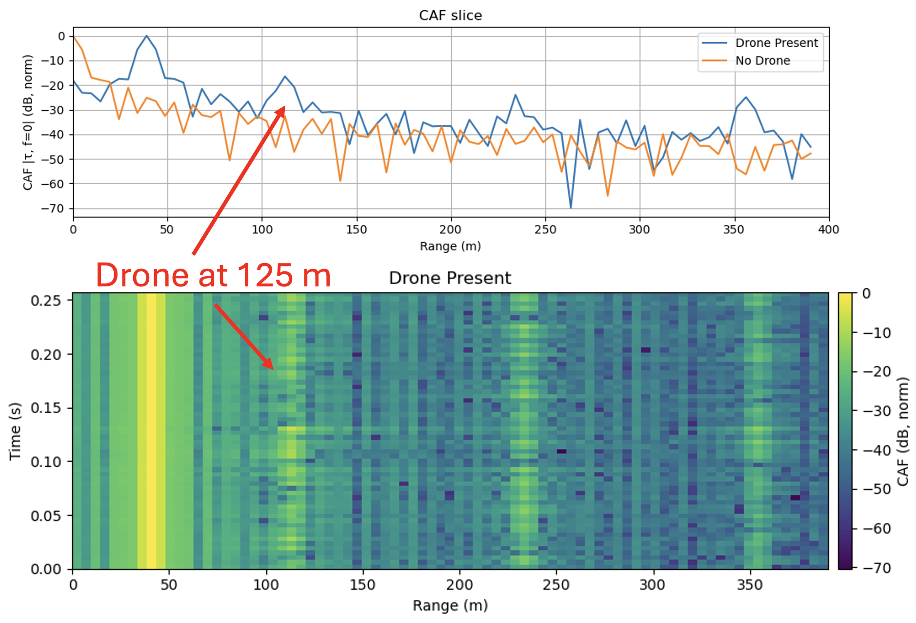
Drone signature detected from RF reflections using the Cross Ambiguity Function
Harmonics from blades

Slide 11
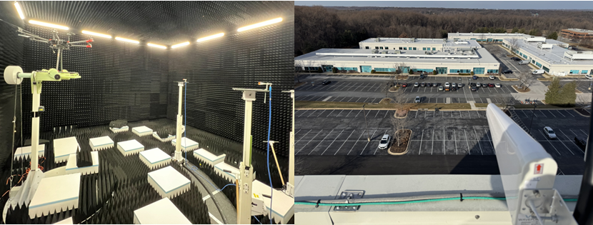
Creation of a Digital Twin using empirical data derived from collections
Anechoic chamber RCS and signature measurements
Drone flight experiments with 5G systems
Measured data for Digital twin

Slide 12
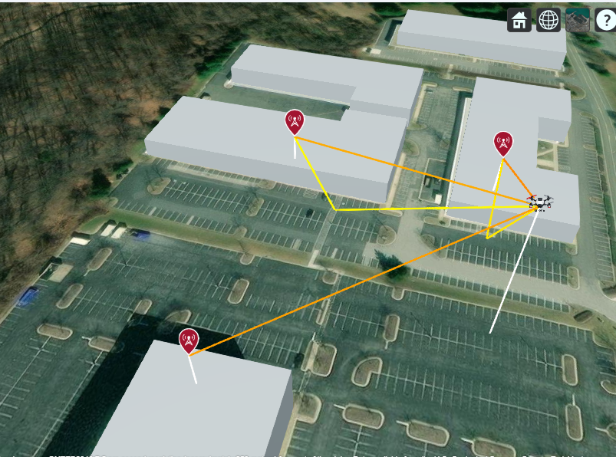
Digital Twin Simulation using ray trace propagation and channel modes
4x10 watt CBRS gNB
RCS: -10 to -20 dBs

Slide 13
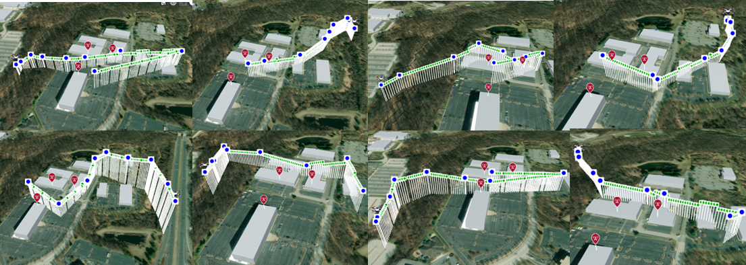
Digital Twin simulating drone flights
gNBs
Waypoints

Slide 14
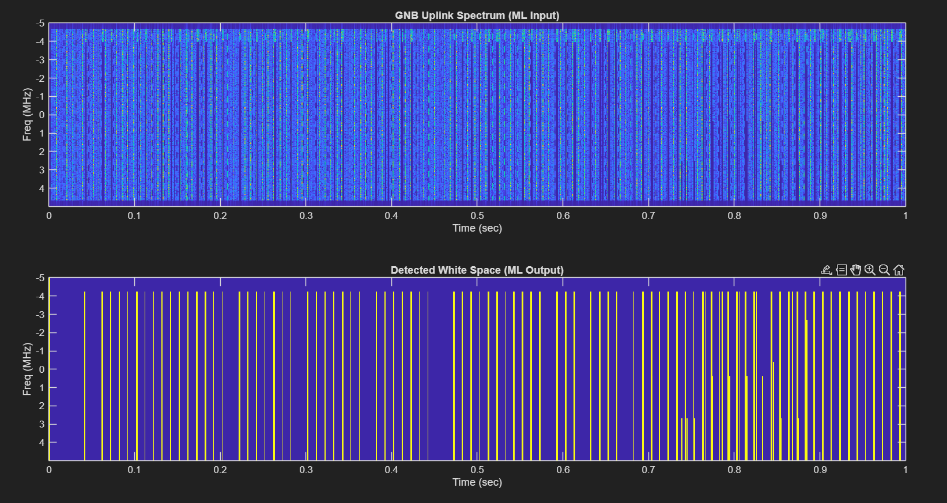
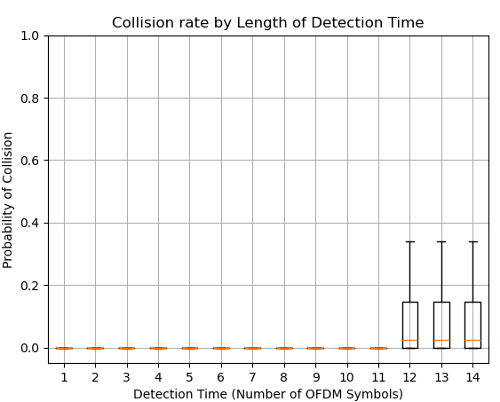
RF baseband simulations: Whitespace Detection for radar waveform injections

Slide 15
RF baseband simulations: Whitespace Detection using neural networks
624x140x32
624x140x16
624x140x16
Input Data
2D spectrogram grid with 3 channels (real, imaginary, power)
Unet Architecture
Conv2D + Batch Normalization + ReLU + MaxPooling
Loss function: Binary Cross Entropy
624x140x3
624x140x1
Concatenate
312x70x32
312x70x64
312x70x16
312x70x32
Concatenate
2d Convolution + Batch Norm + ReLU
Skip Connection
2 D Max Pooling
156x35x32
156x35x64
Conv2DTranspose
Freq x Time x Channel
1x1 Kernel Conv2D
White Space Detection Mask

Slide 16
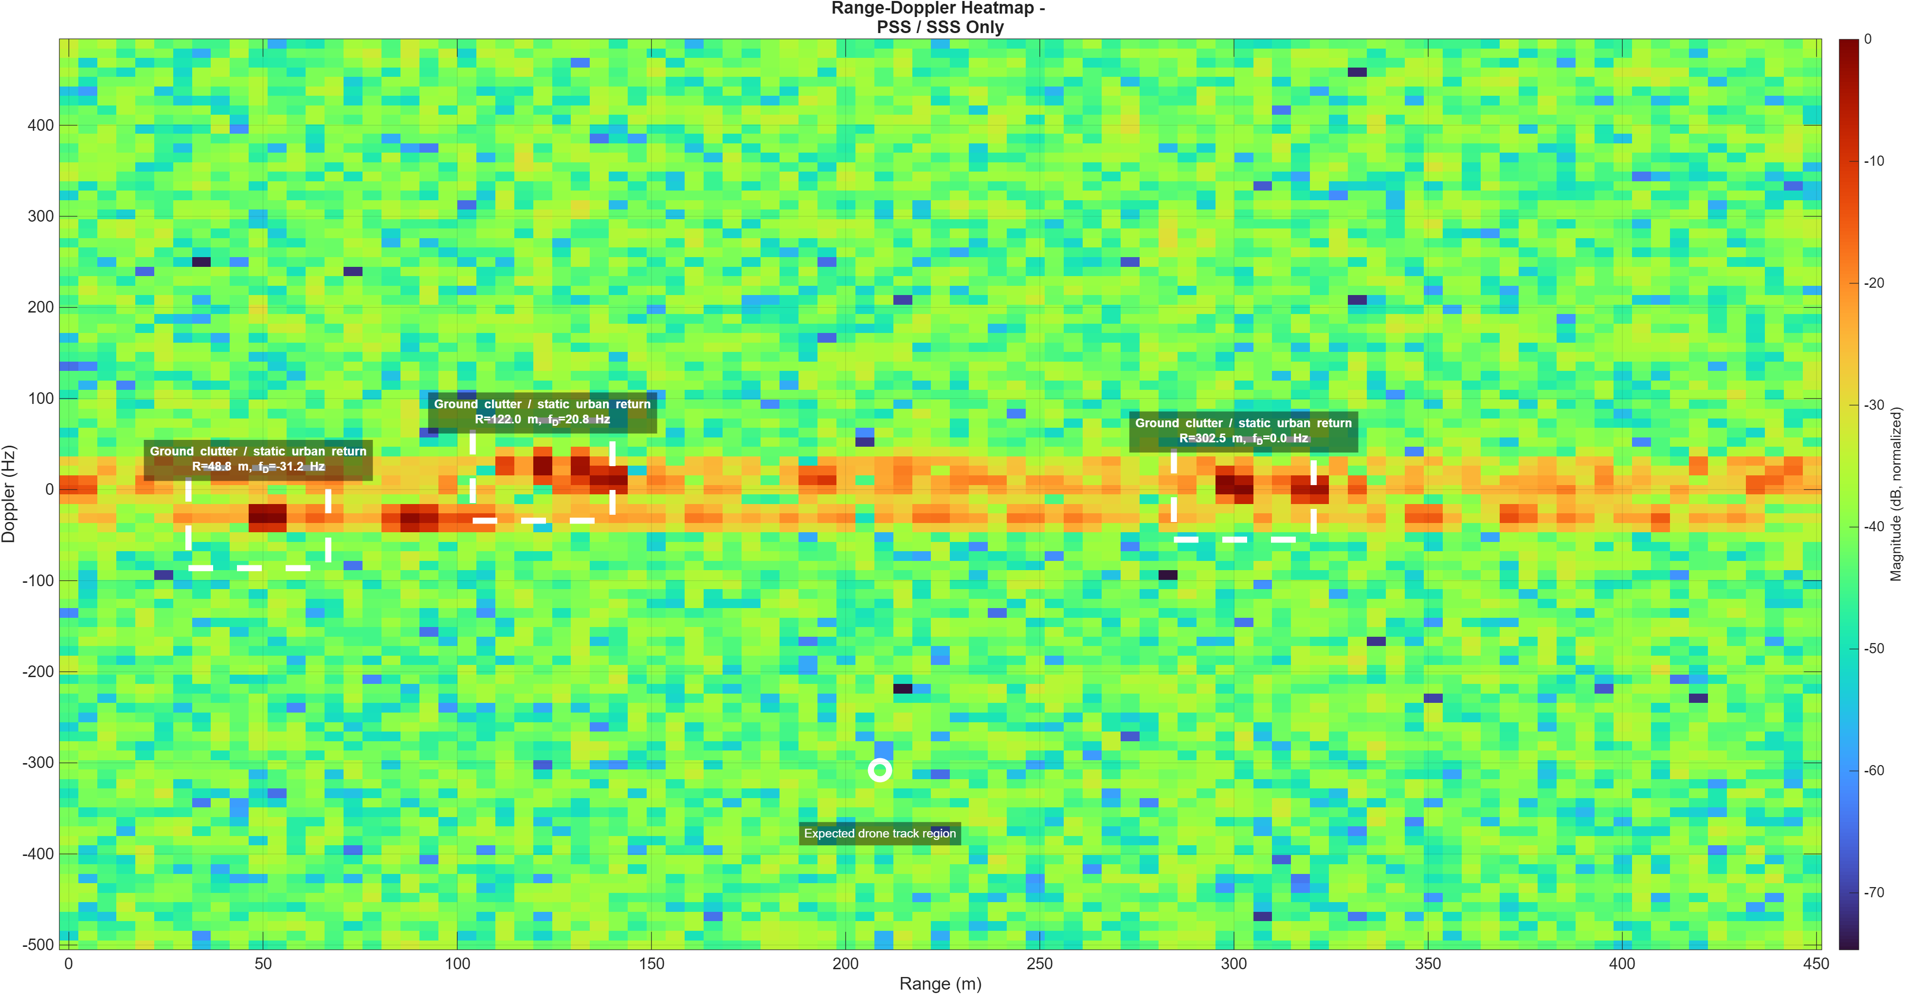
Radar Simulations: No detection with weak PSS/SSS Signals
Drone not detected

Slide 17
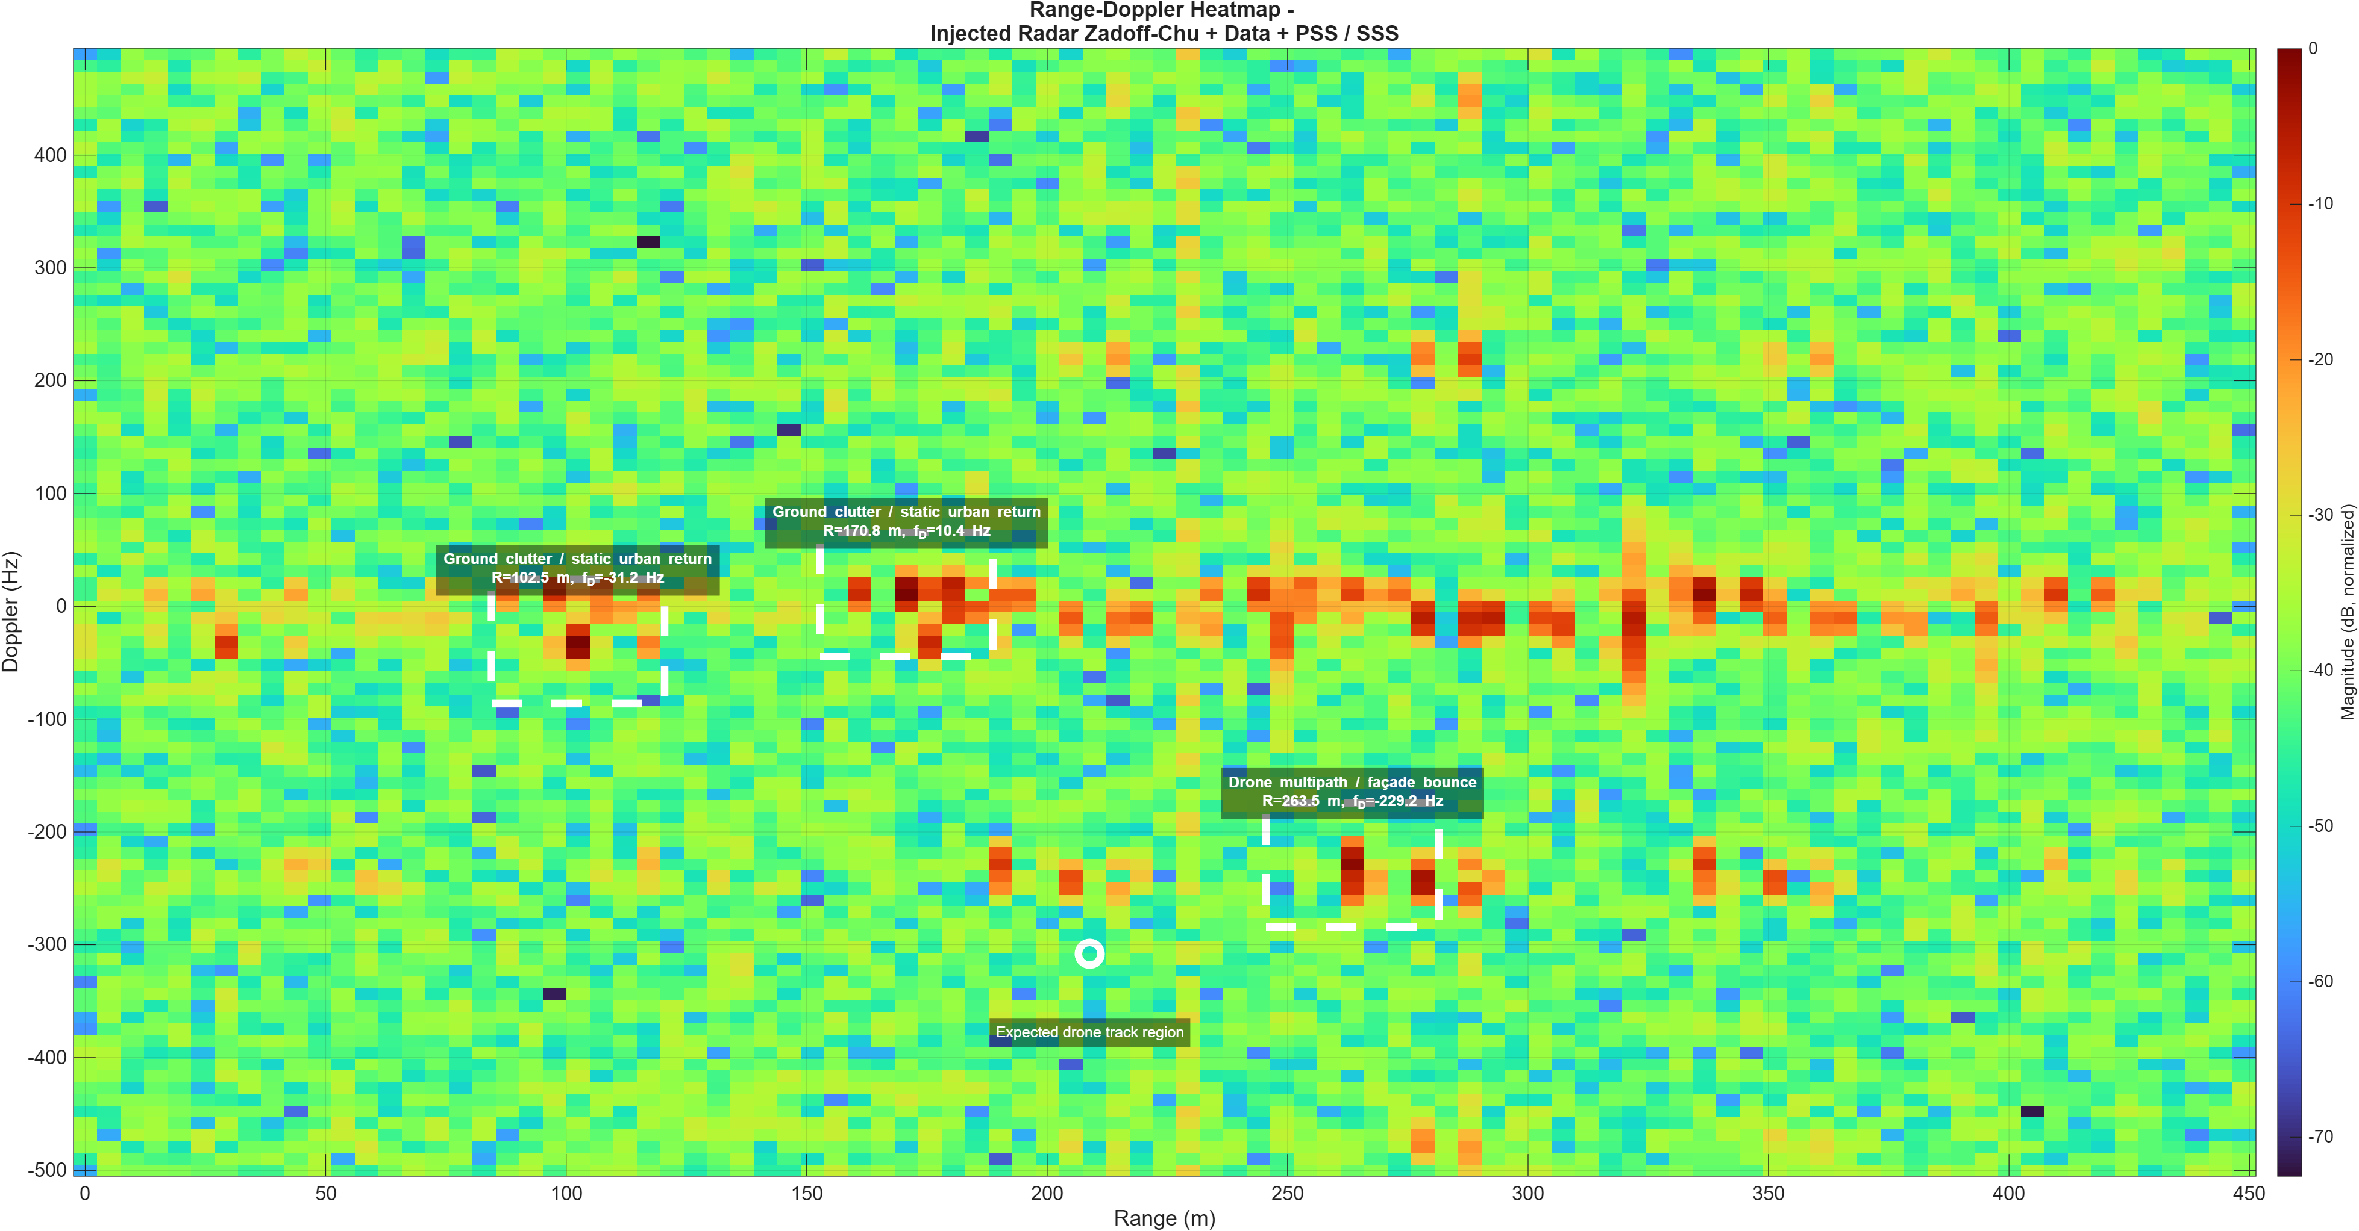
Radar Simulations: PSS/SSS + Data Packets
Multipath Effect

Slide 18
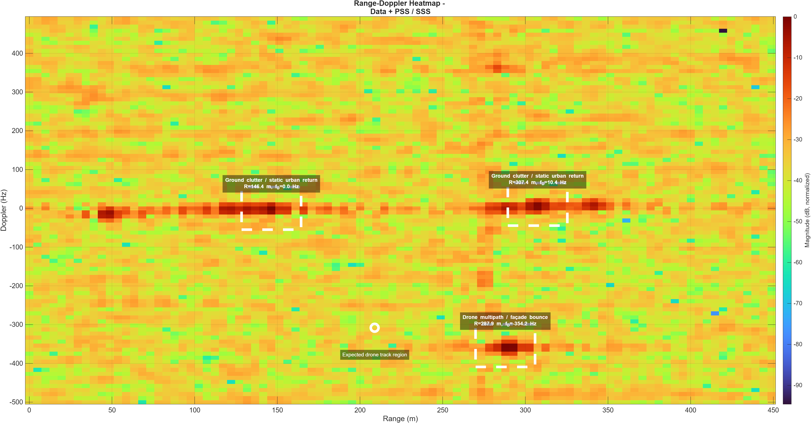
Radar Simulations: PSS/SSS + Data Packets + Injected Radar Signals
Multipath Effect

Slide 19
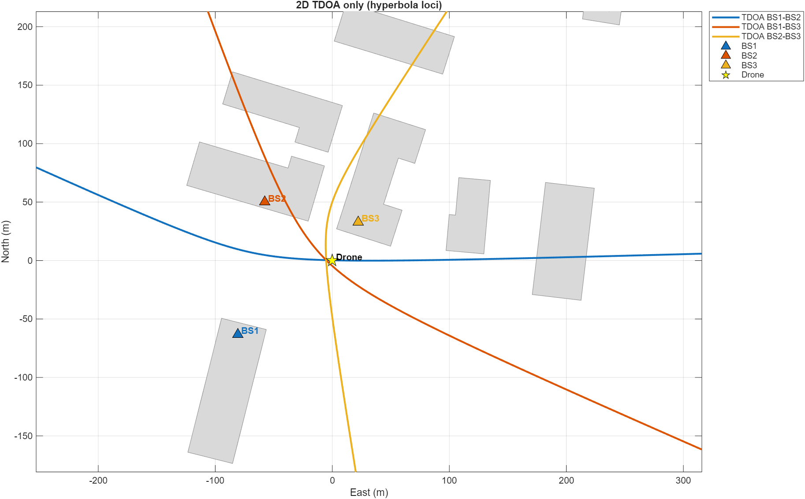
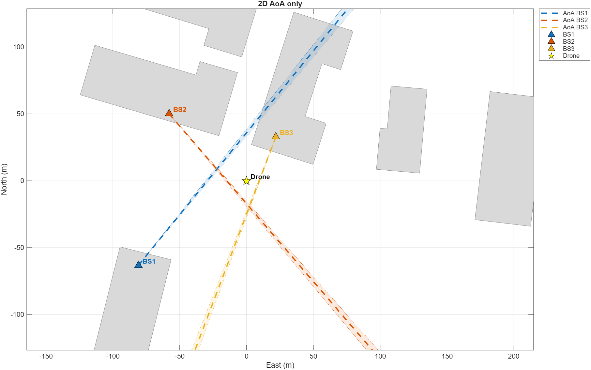
Triangulation AoA and TDOA using cooperating 3 gNBs each with 4x4 MIMO

Slide 20
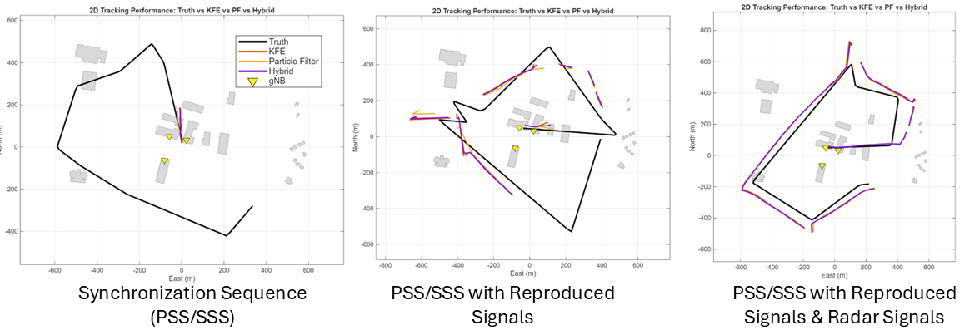
Tracking algorithm comparison: Kalman Filter Extended, Particle Filter, and a Hybrid weighting

Slide 21
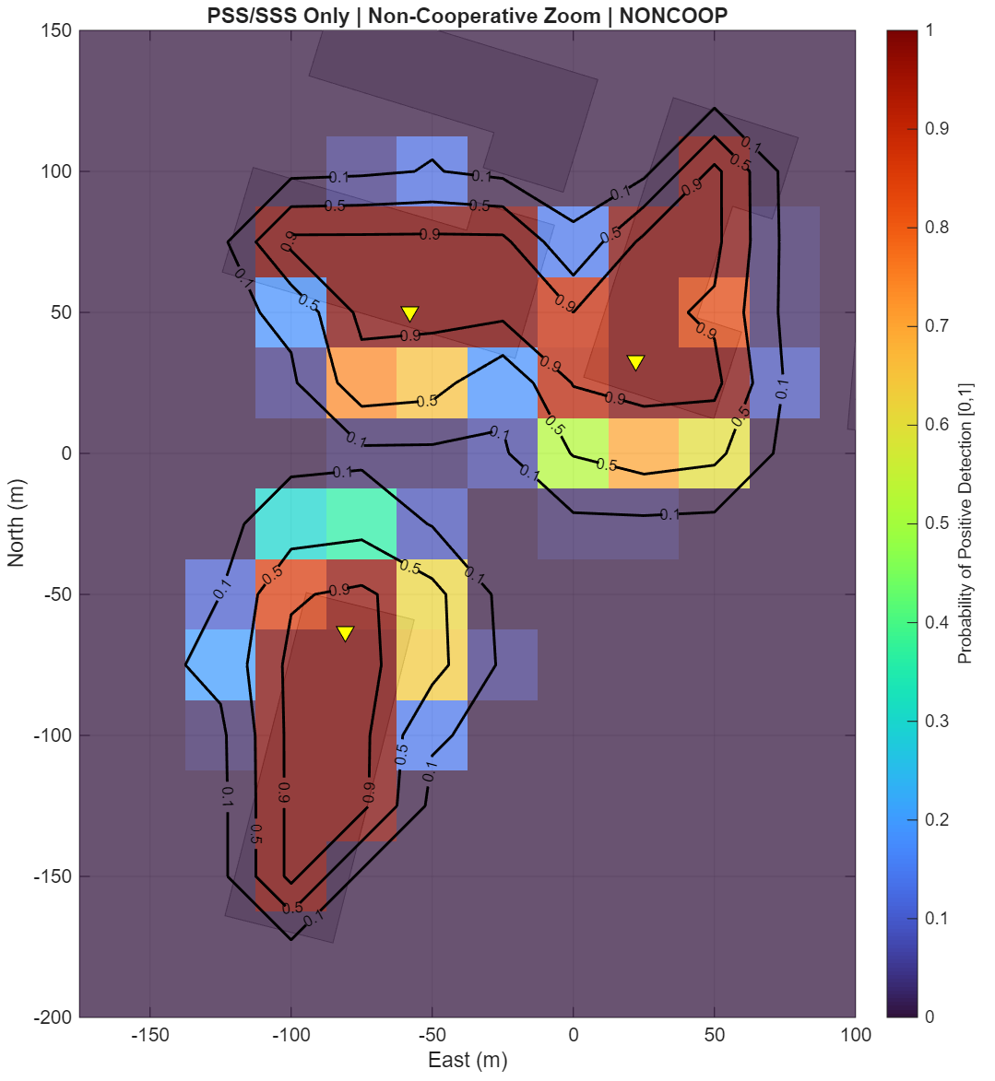
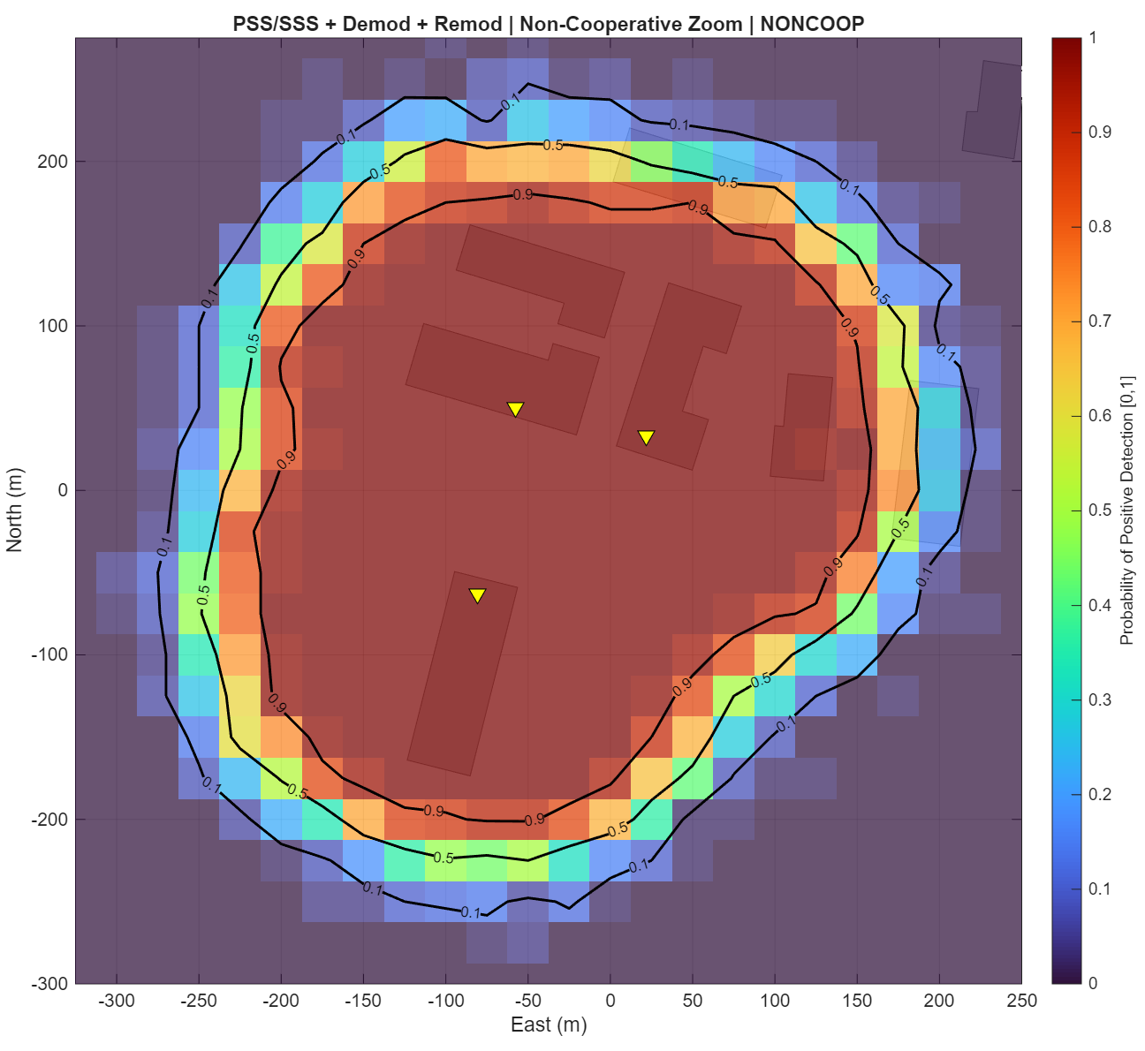
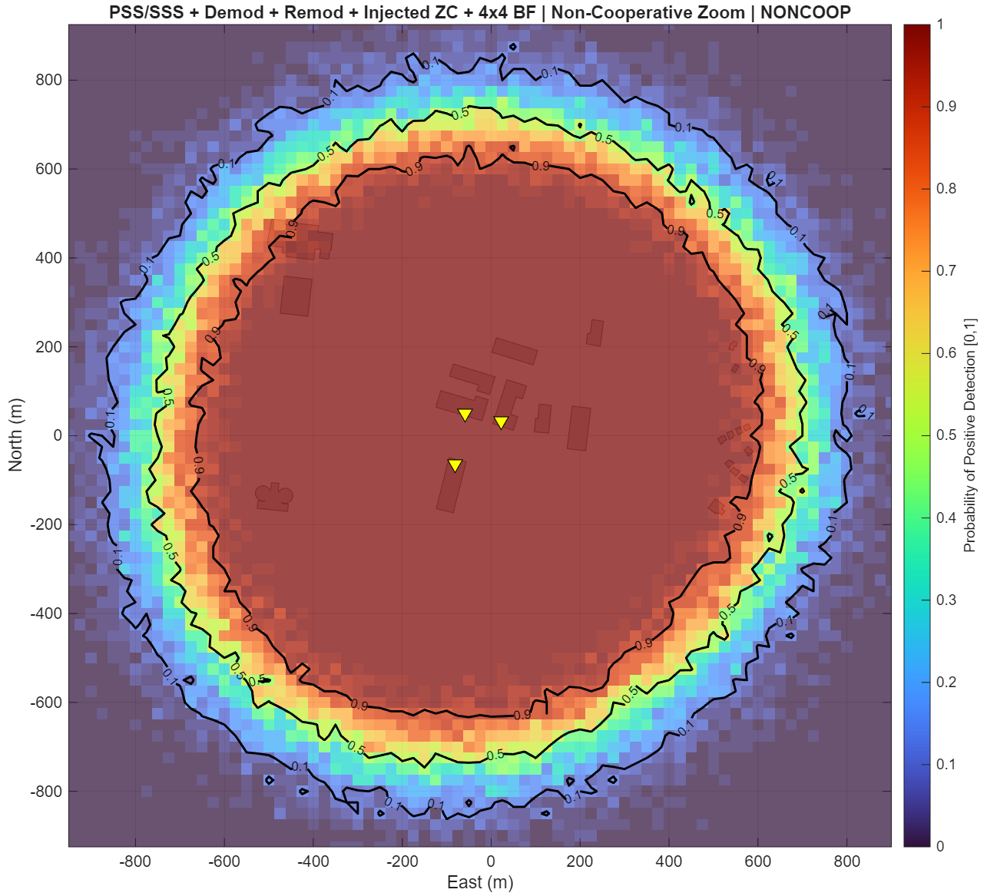
Probability of Detection: Monte Carlo analysis using raying tracing, multipath, and antenna configuration
Injecting Radar waveform into the 4x4 MiMO offers 4x more coverage

Slide 22
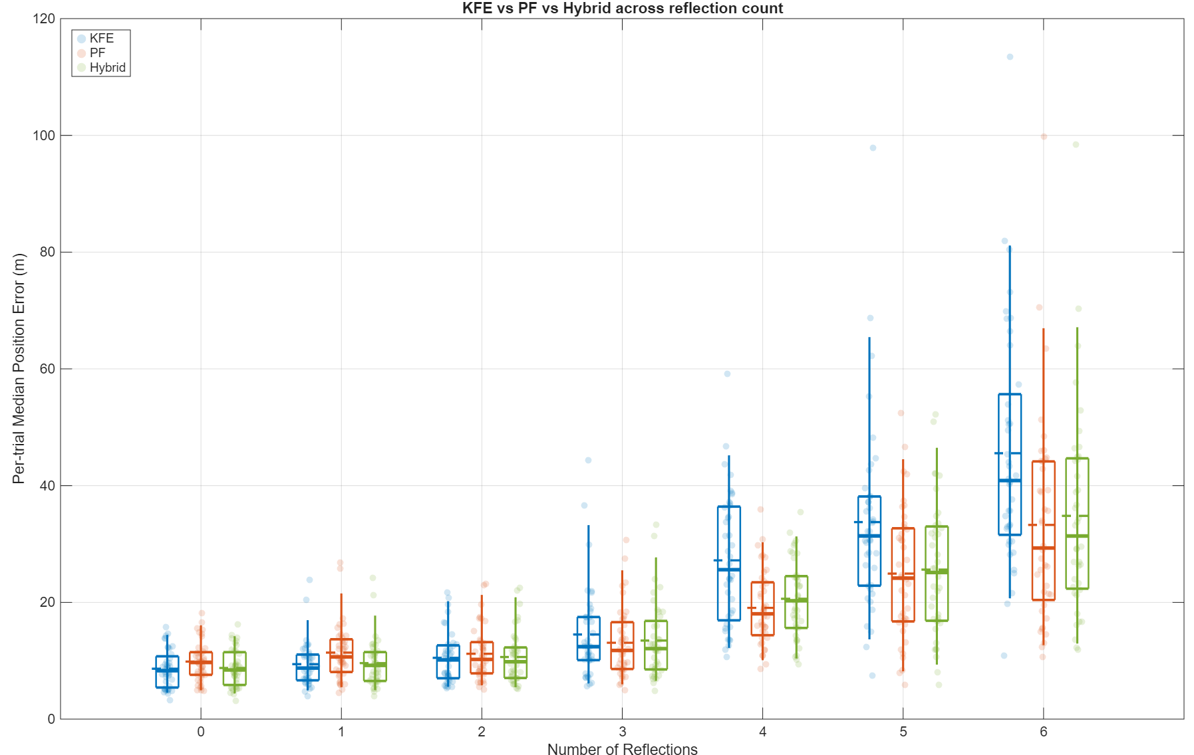
Performance of various tracking algorithm in presence of multipath
PF performs better with handling non-linear multipath
Hybrid a good middle ground
KFE Performs better with low multipath

Slide 23
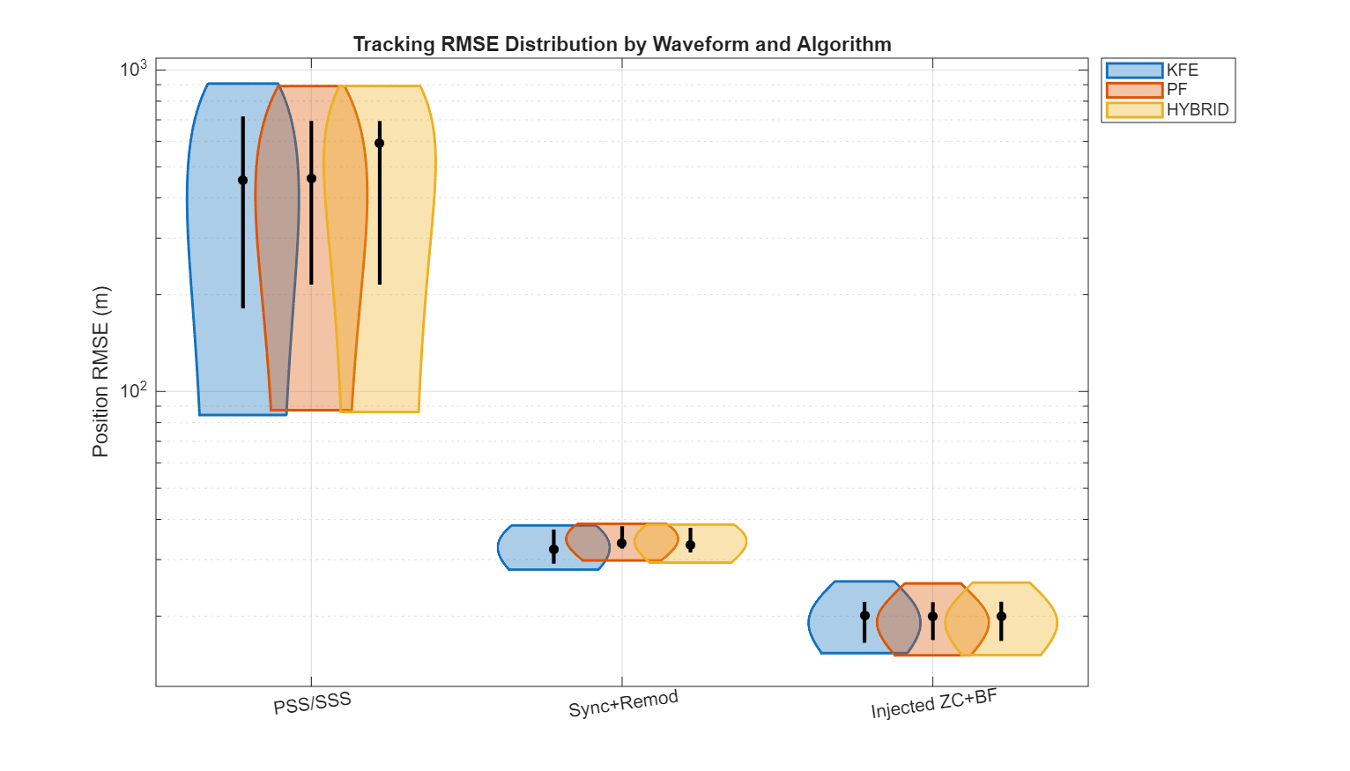
Root Mean Square Error for different tracking algorithms (500 runs)

Slide 24
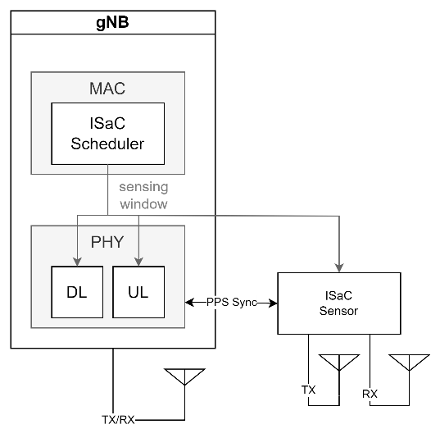
Future work: ISAC Pathway to integrate detection mechanism in to an 5G base station
Technical challenges:
Other moving objects (vehicles and people)
Timing and synchronization on distributed systems
System sensitivity requirements
Radar waveforms design
Sensors (i.e. acoustics & optics) fusion

Slide 25
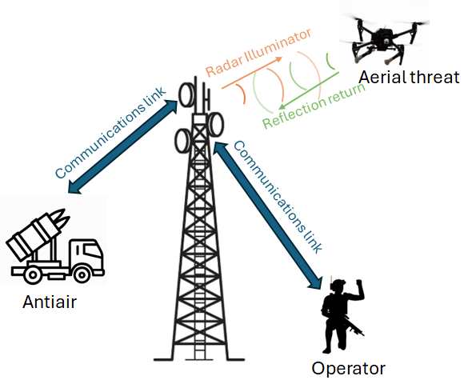
Conclusion: ISAC enables situational awareness
Digital Twin 3D models simulate static multipath environments for multiple gNBs
Reproducing cellular signals for multi-static passive coherent radars and radar waveform whitespace injection
Integration into ISAC for situational awareness to counter drones

