Slide 1
Active Learning with Bayesian Optimization: A Modern Framework for Faster Testing
Tom Donnelly, Systems Engineer
tom.donnelly@jmp.com
Chris Gotwalt, Chief Data Scientist
christopher.gotwalt@jmp.com
DATAWorks 2026
Institute for Defense Analyses
Alexandria, VA

Slide 2
Outline
Bayesian Optimization overview
What it is
How it works
Where is it useful
Potential gotchas
Open-Source Tools
Basic Bayesian Optimization
How the Max Expected Improvement acquisition function works
Examples
Finding one of multiple optima for a complex deterministic process
Rescuing an OFAT experiment and optimizing three responses
Exotic Bayesian Optimization
Benefits/Value

Slide 3
Bayesian Optimization Overview
What is Bayesian Optimization:
Iterative optimization algorithm – an active learning approach – for quickly finding the best combination of factor settings to satisfy your response goals
Method for finding the max or min of functions that are expensive to evaluate, by intelligently choosing the next point to sample based on past results.
Generative learning technique that often uses a Gaussian Stochastic Process (GaSP) model as a base to generate new candidate runs.

Slide 4
Bayesian Optimization Overview
How does Bayesian Optimization work:
Start with some existing data (historical data or designed experiment).
Construct initial GaSP model to approximate unknown function.
Use an acquisition function to decide where to sample next, balancing exploration of uncertain regions with exploitation of promising areas.
Update GaSP model with results for new run(s) and repeat sequence until factor settings satisfying optimization goals are discovered.

Slide 5
Bayesian Optimization Overview
Where is it useful:
Particularly useful for complex processes that have more than one optima
Frequently used with deterministic processes but now seeing use with real-world physical processes with noise
Machine Learning: It excels at tuning hyperparameters for complex models, such as deep neural networks, where training each configuration can take a very long time.
Materials Science and Chemistry: Researchers use it to find new materials with desired properties, such as stronger concrete or new dye laser molecules, by efficiently guiding experimental trials.
Robotics: It can be used to find optimal parameters for robotic movements, such as designing the gait for a locomotive robot.
Hardware Design: It helps in optimizing design parameters and heuristics for hardware, balancing performance and efficiency.
Recommender Systems: It can be used to tune the parameters of recommender systems to improve user recommendations.

Slide 6
Bayesian Optimization Overview
Potential gotchas:
Can’t find an optimum if it doesn’t exist – still need subject matter expertise to set reasonable goals
When using with stochastic processes, if factor ranges are too narrow (so factors generate small effects) acquisition functions may not converge – i.e., it is hard to find an optimum in processes with small S/N ratios
When goals are targets rather than maxima or minima, too tight a target range will overly constrain or “trap” the max desirability optimum making it difficult to achieve the non-target goals
Optimization may run into the end of factor ranges, suggesting that ranges be extended to see if these new regions lead to better performance

Slide 7
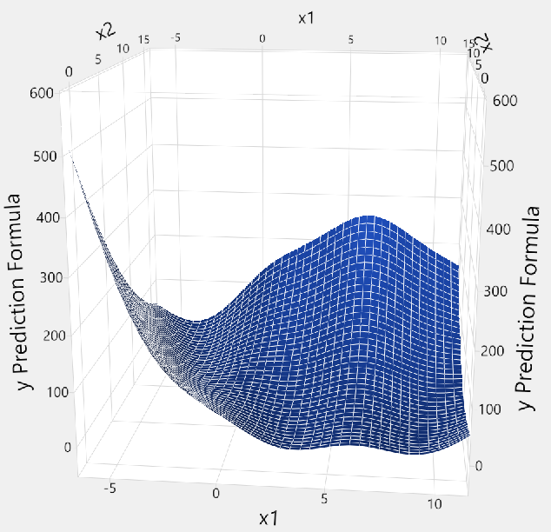
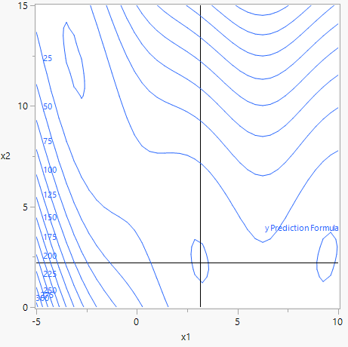
Complex Process with Multiple Minima

Slide 8
How are Space-Filling Designs Different from Traditional Designs?
Rather than emphasizing high leverage trials (“corners”) for a simple polynomial model, space-filling designs “spread” their trials more uniformly through the space to better capture the local complexities of the simulation model.

Slide 9
Active Learning Symposium 2025
Online November 24th. Recording coming soon.
Featured these open-source Bayesian Optimization tools:
Brownie Bee software is an open-source and browser-based tool developed by the Danish Technological Institute (DTI), in collaboration with Novo Nordisk and The Alexandra Institute, to help companies optimize industrial processes using advanced mathematics.
Bayesian Back End (BayBE) is an open-source toolbox by Merck KGaA for Bayesian optimization, featuring custom encodings, chemical knowledge integration, hybrid spaces, transfer learning, simulation tools, and robust, serializable code for real-world experimental campaigns.
Honegumi is a user-friendly, interactive tool designed to simplify the process of creating advanced Bayesian optimization scripts. (Built on Ax which is built on BoTorch and GPyTorch libraries.)
T

Slide 10
https://github.com/materials-data-facility/awesome-bayesian-optimization
Twenty-one actively maintained open-source Bayesian Optimization packages on GitHub:
Adaptive Experimentation Platform (Ax) is a user-friendly, modular, and actively developed general-purpose Bayesian optimization platform with support for simple and advanced optimization tasks such as noisy, multi-objective, multi-task, multi-fidelity, batch, high-dimensional, linearly constrained, nonlinearly constrained, mixed continuous/discrete/categorical, and contextual Bayesian optimization.
BoTorch is the backbone that makes up the Ax platform and allows for greater customization and specialized algorithms such as risk-averse Bayesian optimization and constraint active search.
Dragonfly is an open-source python library for scalable Bayesian optimization with multi-objective and multi-fidelity support.
RayTune offers experiment execution and hyperparameter tuning at any scale with many supported search algorithms and trial schedulers under a common interface.
Aspuru-Guzik Group
Atlas is a Python package that offers Bayesian optimization tailored towards real-world experimental science problems: mixed parameters, multi-objective, noisy, constrained, multi-fidelity, and meta-learning optimization along with search space expansion/contraction. [WIP]
Chimera is a hierarchy-based multi-objective optimization scalarizing function.
Gryffin enables Bayesian optimization of continuous and categorical variables with support for physicochemical descriptors and batch optimization.
Gemini is a scalable multi-fidelity Bayesian optimization technique and is supported by Gryffin.
Golem is an algorithm that helps identify optimal solutions that are robust to input uncertainty (i.e., robust optimization).
Phoenics is a linear-scaling Bayesian optimization algorithm with support for batch and periodic parameter optimization.
Anubis is a Bayesian optimization algorithm that models unknown feasibility constraints and incorporates it into the acquisition function
BoFire is a Bayesian Optimization Framework Intended for Real Experiments (under development) with support for advanced optimization tasks such as mixed variables, multiple objectives, and generic constraints.
NIMS-OS is a Python package (+GUI) for workflow orchestration and multi-objective optimization software that supports BLOX, PDC, random exploration, and a multi-objective variant of PHYSBO.
SLAMD - A web app leveraging data-driven design for cementitious materials via a digital lab twin, complemented by a (materials-agnostic) AI optimization feature. Features UI to interactively explore design spaces. The web app uses Python and Javascript.
Summit is a set of tools for optimizing chemical processes with a wide variety of design of experiments (DoE) and adaptive design methods along with benchmarks.
GPax is a Python package for physics-based Gaussian processes (GPs) built on top of NumPyro and JAX that take advantage of prior physical knowledge and different data modalities for active learning and Bayesian optimization. It supports "deep kernel learning", structured probabilistic mean functions, hypothesis learning workflows, multitask, multifidelity, heteroscedastic, and vector BO and emphasizes user friendliness.
Bayesian Back End (BayBE) is an open-source toolbox by Merck KGaA for Bayesian optimization, featuring custom encodings, chemical knowledge integration, hybrid spaces, transfer learning, simulation tools, and robust, serializable code for real-world experimental campaigns.
Bayesian-Optimization Pure Python implementation of Bayesian global optimization with gaussian processes.
GPFLow GPflow is a package for building Gaussian process models in python, using TensorFlow.
Spearmint: A well-known implementation of Bayesian optimization that has been around for some time and incorporates advancements in the field.
BOXVIA: A GUI-based application from NASA that allows users to perform Bayesian optimization without extensive programming skills and includes visualization tools for interpreting results.

Slide 11
Bayesian Optimization Overview
Gaussian Process Model (GaSP)
Cold Start
No Existing Data
Starting Design
Warm Start with Existing Data
Finished
Yes
Goals Met?
Collect Responses
Model Responses
No
Acquisition Functions
guide search, optimizing balance between exploration & exploitation
Max Expected Improvement, Space-Filling DOE, Max Desirability,
and others
Determine
Next Run(s)

Slide 12
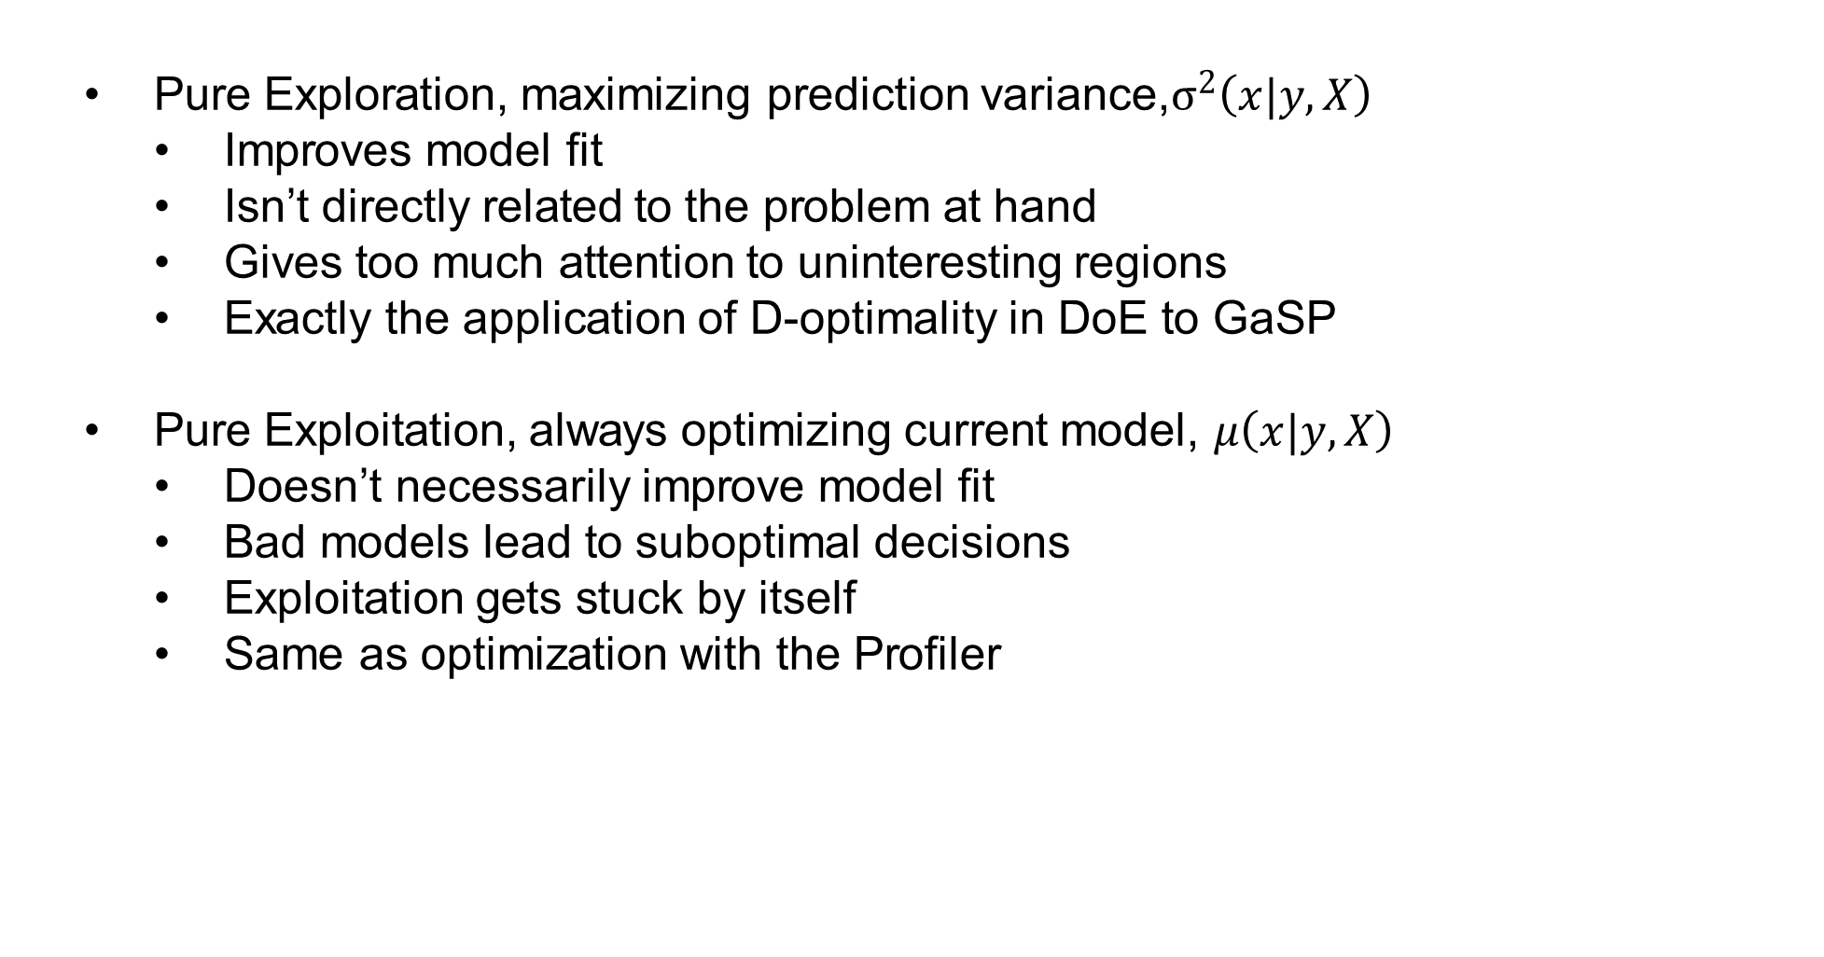
Bayesian Optimization
Pure Exploration, maximizing prediction variance,$σ^{2}\left(x|y,X\right)$
Improves model fit
Isn’t directly related to the problem at hand
Gives too much attention to uninteresting regions
Exactly the application of D-optimality in DoE to GaSP
Pure Exploitation, always optimizing current model, $μ\left(x|y,X\right)$
Doesn’t necessarily improve model fit
Bad models lead to suboptimal decisions
Exploitation gets stuck by itself
Same as optimization with the Profiler

Slide 13

Bayesian Optimization
Acquisition Functions – Trade off Exploration vs Exploitation
Expected Improvement
Upper Confidence Bound
With noisy functions, these both overemphasize optimization early.
We created Auto Mode phases to solve this problem

Slide 14
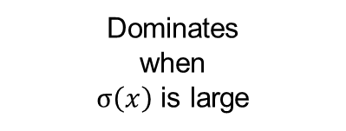
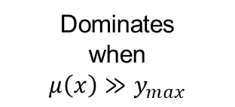
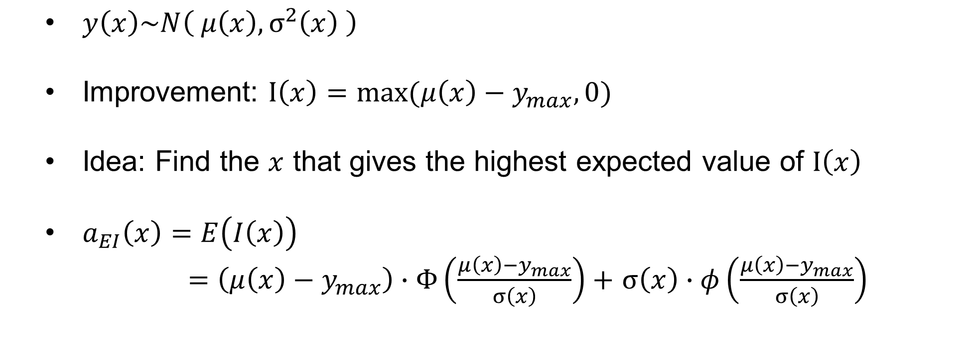
Bayesian Optimization
EXPECTED IMPROVEMENT
$y\left(x\right)\sim N\left( μ\left(x\right), σ^{2}\left(x\right) \right)$
Improvement: $I\left(x\right)=max(μ\left(x\right)−y_{max},0)$
Idea: Find the $x$ that gives the highest expected value of $I\left(x\right)$
$a_{EI}\left(x\right)=$ $E\left(I\left(x\right)\right)$
$=\left(μ\left(x\right)−y_{max}\right)∙Φ\left(\frac{μ\left(x\right)−y_{max}}{σ\left(x\right)}\right)+$ $σ\left(x\right)∙φ\left(\frac{μ\left(x\right)−y_{max}}{σ\left(x\right)}\right)$
Dominates
when
$$μ\left(x\right)≫y_{max}$$
Dominates
when
$σ\left(x\right)$ is large
EI acquisition function recommends 1 run at a time trading off $μ\left(x\right)$and $σ^{2}(x)$

Slide 15
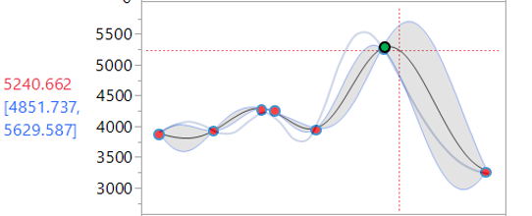
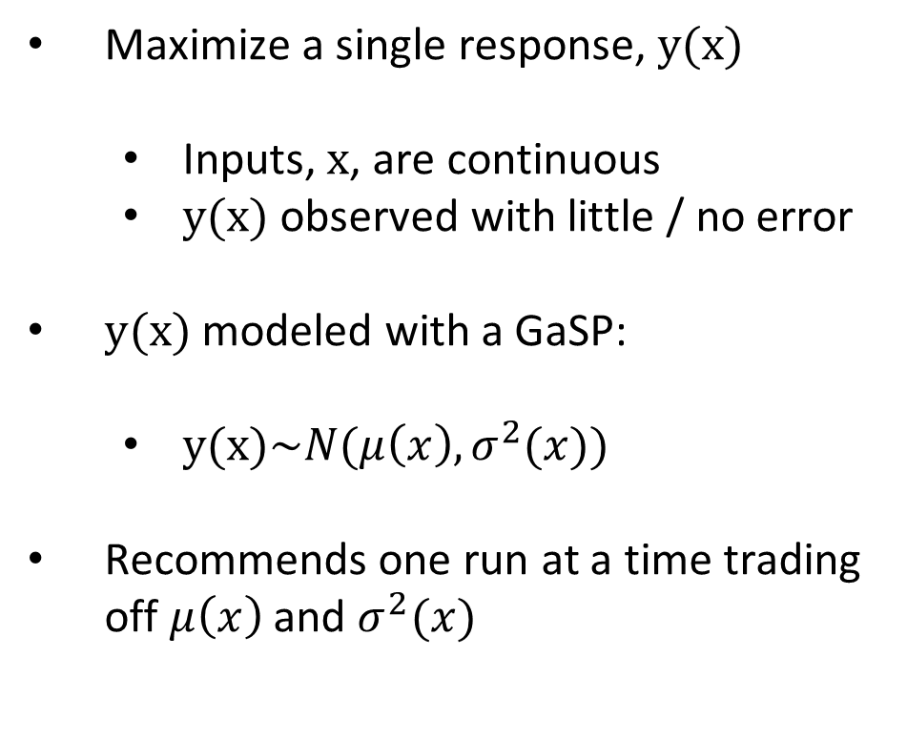
Bayesian Optimization
“BASIC” BAYESIAN OPTIMIZATION
Maximize a single response, $y(x)$
Inputs, $x$, are continuous
$y(x)$ observed with little / no error
$y(x)$ modeled with a GaSP:
$y(x)\sim N(μ\left(x\right),σ^{2}(x))$
Recommends one run at a time trading off $μ\left(x\right)$and $σ^{2}(x)$

Slide 16
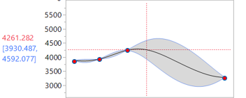
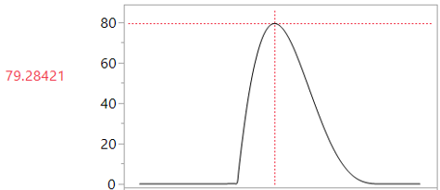

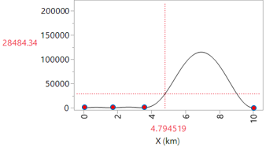

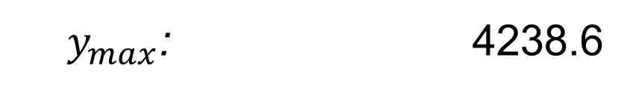



Bayesian Optimization
$y_{max}$: 4238.6
$$Expected Improvement$$
$$\hat{y}(x)$$
$$EI(x)$$
$${\hat{Var}}_{\hat{y}}(x)$$
Notes:
The factor settings with the highest expected information value is the recommended the next run.

Slide 17
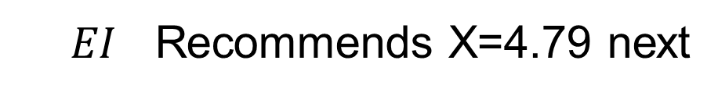
Bayesian Optimization
$y_{max}$: 4238.6
$$Expected Improvement$$
$$\hat{y}(x)$$
$$EI(x)$$
$${\hat{Var}}_{\hat{y}}(x)$$
$EI$ Recommends X=4.79 next
Notes:
The factor settings with the highest expected information value is the recommended the next run.

Slide 18

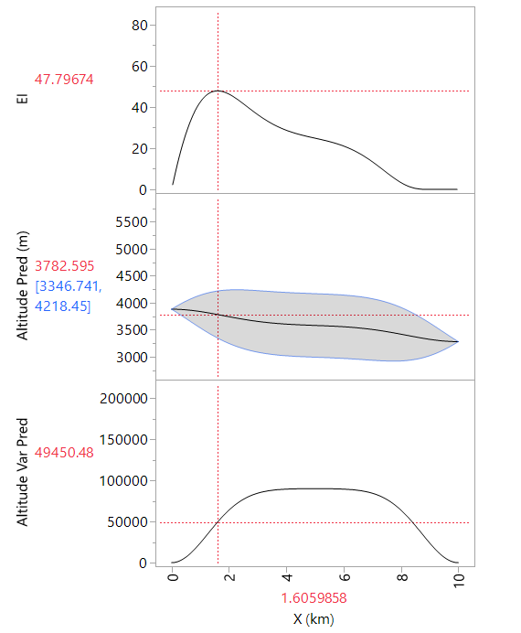
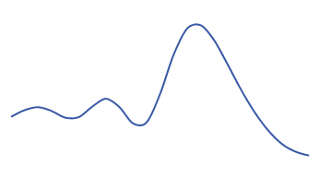

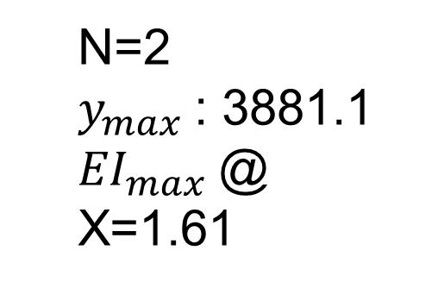


Bayesian Optimization
GASP MOUNTAIN
$$Expected Improvement(x)$$
N=2
$y_{max}$: 3881.1
${EI}_{max}$@ X=1.61
$$\hat{y}(x)$$
$${\hat{Var}}_{\hat{y}}(x)$$
Notes:
Here is a simple example. The true function we want to maximize is overlain in blue in the middle profiler panel. This is a pretend example because in real problems we can’t see the true function. Notice it is a multi modal complicated function that would be difficult to model with a classical approach.
To start we have two points. The model fit is in the middle panel with the uncertainty and data overlain. The bottom panel is the prediction variance, and the top panel is the EI acquisition function which assigns a value to every possible new point to explore, trading off potential optimal solutions to prediction uncertainty. The x value with the largest value is the next run recommended by EI. If we add a measurement at that location

Slide 19

Bayesian Optimization
GASP MOUNTAIN
$$Expected Improvement(x)$$
N=2
$y_{max}$: 3881.1
${EI}_{max}$@ X=1.61
$$\hat{y}(x)$$
$${\hat{Var}}_{\hat{y}}(x)$$
Notes:
Here is a simple example. The true function we want to maximize is overlain in blue in the middle profiler panel. This is a pretend example because in real problems we can’t see the true function. Notice it is a multi modal complicated function that would be difficult to model with a classical approach.
To start we have two points. The model fit is in the middle panel with the uncertainty and data overlain. The bottom panel is the prediction variance, and the top panel is the EI acquisition function which assigns a value to every possible new point to explore, trading off potential optimal solutions to prediction uncertainty. The x value with the largest value is the next run recommended by EI. If we add a measurement at that location

Slide 20
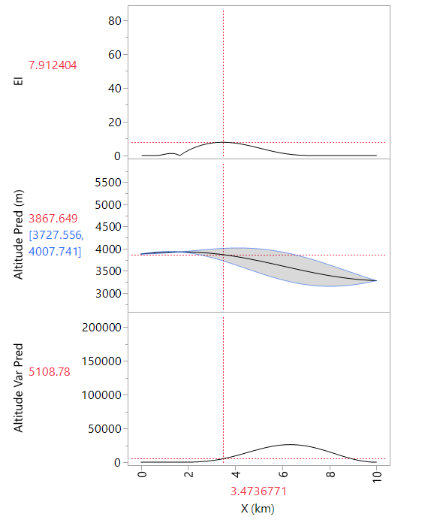

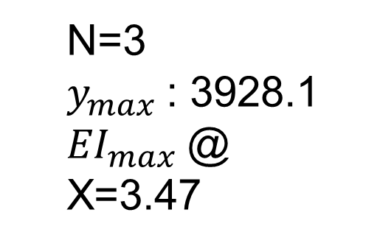
Bayesian Optimization
GASP MOUNTAIN
$$Expected Improvement(x)$$
N=3
$y_{max}$: 3928.1
${EI}_{max}$@ X=3.47
$$\hat{y}(x)$$
$${\hat{Var}}_{}\hat{y}(x)$$
Notes:
We try that point and see it led to little improvement. The expected improvement criterion next recommends a point further away with higher prediction variance

Slide 21
Bayesian Optimization
GASP MOUNTAIN
$$Expected Improvement(x)$$
N=3
$y_{max}$: 3928.1
${EI}_{max}$@ X=3.47
$$\hat{y}(x)$$
$${\hat{Var}}_{\hat{y}}(x)$$
Notes:
We try that point and see it led to little improvement. The expected improvement criterion next recommends a point further away with higher prediction variance

Slide 22
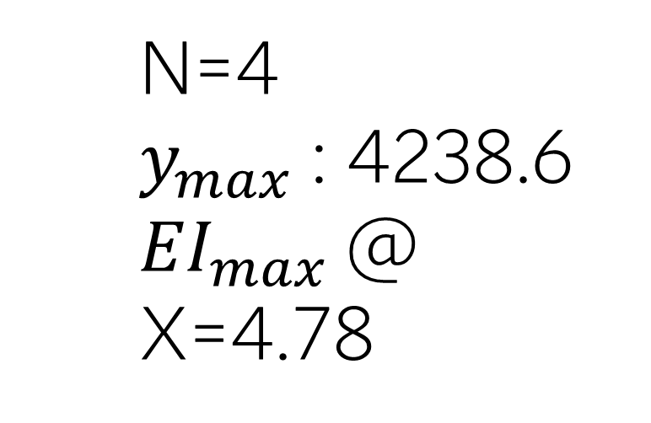
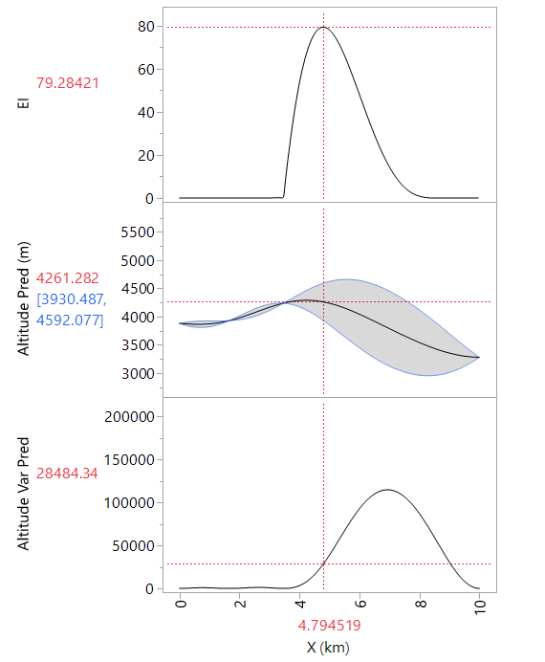
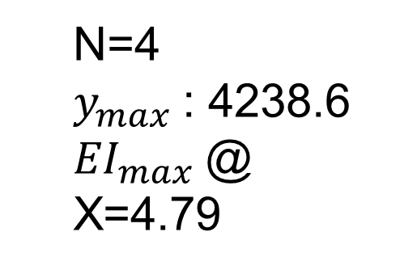
Bayesian Optimization
GASP MOUNTAIN
$$Expected Improvement(x)$$
N=4
$y_{max}$: 4238.6
${EI}_{max}$@ X=4.79
$$\hat{y}(x)$$
$${\hat{Var}}_{\hat{y}}(x)$$
Notes:
This one did a bit better. We continue the search in the same direction

Slide 23
Bayesian Optimization
GASP MOUNTAIN
$$Expected Improvement(x)$$
N=4
$y_{max}$: 4238.6
${EI}_{max}$@ X=4.79
$$\hat{y}(x)$$
$${\hat{Var}}_{\hat{y}}(x)$$
Notes:
This one did a bit better. We continue the search in the same direction

Slide 24
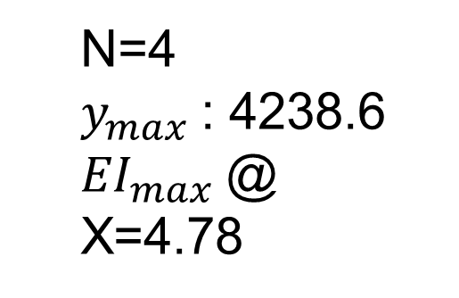
Bayesian Optimization
GASP MOUNTAIN
$$Expected Improvement(x)$$
N=4
$y_{max}$: 4238.6
${EI}_{max}$@ X=4.78
$$\hat{y}(x)$$
$${\hat{Var}}_{\hat{y}}(x)$$
Notes:
This one did a bit better. We continue the search in the same direction

Slide 25
Bayesian Optimization
GASP MOUNTAIN
$$Expected Improvement(x)$$
N=4
$y_{max}$: 4238.6
${EI}_{max}$@ X=4.78
$$\hat{y}(x)$$
$${\hat{Var}}_{\hat{y}}(x)$$
Notes:
This one did a bit better. We continue the search in the same direction

Slide 26
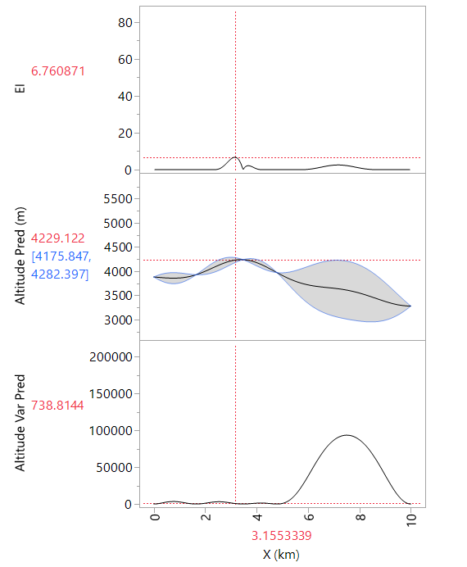
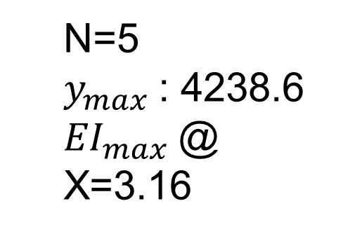
Bayesian Optimization
GASP MOUNTAIN
$$Expected Improvement(x)$$
N=5
$y_{max}$: 4238.6
${EI}_{max}$@ X=3.16
$$\hat{y}(x)$$
$${\hat{Var}}_{\hat{y}}(x)$$
Notes:
This time we did worse than expected, and it recommends a nearby point in the other direction

Slide 27
Bayesian Optimization
GASP MOUNTAIN
$$Expected Improvement(x)$$
N=5
$y_{max}$: 4238.6
${EI}_{max}$@ X=3.16
$$\hat{y}(x)$$
$${\hat{Var}}_{\hat{y}}(x)$$
Notes:
This time we did worse than expected, and it recommends a nearby point in the other direction

Slide 28
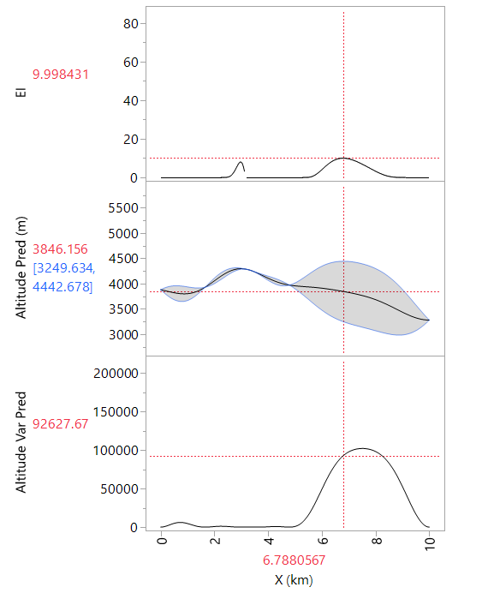
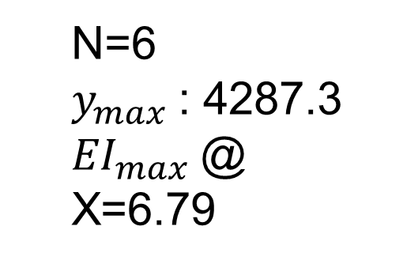
Bayesian Optimization
GASP MOUNTAIN
$$Expected Improvement(x)$$
N=6
$y_{max}$: 4287.3
${EI}_{max}$@ X=6.79
$$\hat{y}(x)$$
$${\hat{Var}}_{\hat{y}}(x)$$
Notes:
The algorithm has identified the local optima and is now recommending giving attention to the unexplored region

Slide 29
Bayesian Optimization
GASP MOUNTAIN
Pure Exploitation
will get stuck!
N=6
$y_{max}$: 4287.3
${EI}_{max}$@ X=6.79
$$\hat{y}(x)$$
$${\hat{Var}}_{\hat{y}}(x)$$
Notes:
The algorithm has identified the local optima and is now recommending giving attention to the unexplored region

Slide 30
Bayesian Optimization
GASP MOUNTAIN
High variance region of interest
N=6
$y_{max}$: 4287.3
${EI}_{max}$@ X=6.79
$$\hat{y}(x)$$
$${\hat{Var}}_{\hat{y}}(x)$$
Notes:
The algorithm has identified the local optima and is now recommending giving attention to the unexplored region

Slide 31
Bayesian Optimization
GASP MOUNTAIN
EI balances all this out!
N=6
$y_{max}$: 4287.3
${EI}_{max}$@ X=6.79
$$\hat{y}(x)$$
$${\hat{Var}}_{\hat{y}}(x)$$
Notes:
The algorithm has identified the local optima and is now recommending giving attention to the unexplored region

Slide 32
Bayesian Optimization
GASP MOUNTAIN
EI balances all this out!
N=6
$y_{max}$: 4287.3
${EI}_{max}$@ X=6.79
$$\hat{y}(x)$$
$${\hat{Var}}_{\hat{y}}(x)$$
Notes:
The algorithm has identified the local optima and is now recommending giving attention to the unexplored region

Slide 33
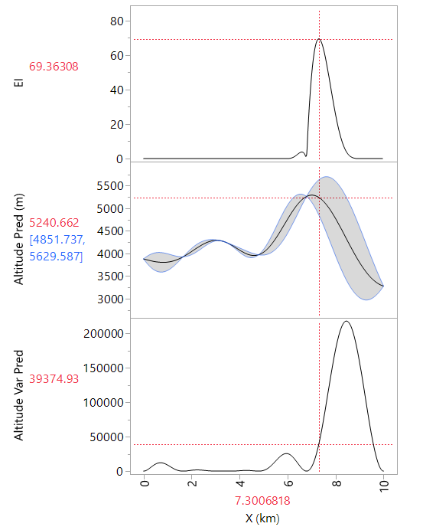
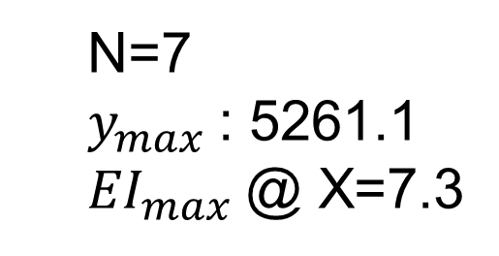
Bayesian Optimization
GASP MOUNTAIN
$$Expected Improvement(x)$$
N=7
$y_{max}$: 5261.1
${EI}_{max}$@ X=7.3
$$\hat{y}(x)$$
$${\hat{Var}}_{\hat{y}}(x)$$
Notes:
We add a point there and obtained a much better than expected result

Slide 34
Bayesian Optimization
GASP MOUNTAIN
$$Expected Improvement(x)$$
N=7
$y_{max}$: 5261.1
${EI}_{max}$@ X=7.3
$$\hat{y}(x)$$
$${\hat{Var}}_{\hat{y}}(x)$$
Notes:
We add a point there and obtained a much better than expected result

Slide 35
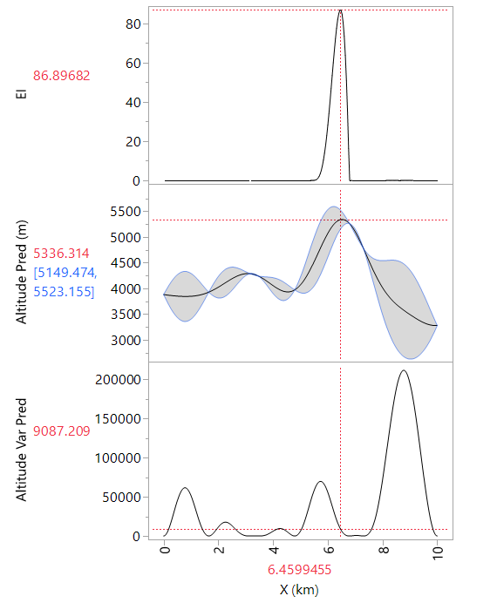
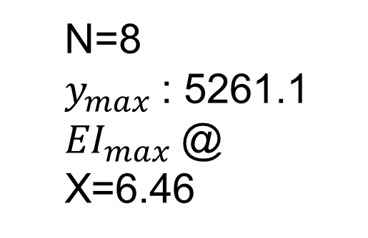
Bayesian Optimization
GASP MOUNTAIN
$$Expected Improvement(x)$$
N=8
$y_{max}$: 5261.1
${EI}_{max}$@ X=6.46
$$\hat{y}(x)$$
$${\hat{Var}}_{\hat{y}}(x)$$
Notes:
It takes another step in the same direction

Slide 36
Bayesian Optimization
GASP MOUNTAIN
$$Expected Improvement(x)$$
N=8
$y_{max}$: 5261.1
${EI}_{max}$@ X=6.46
$$\hat{y}(x)$$
$${\hat{Var}}_{\hat{y}}(x)$$
Notes:
It takes another step in the same direction

Slide 37
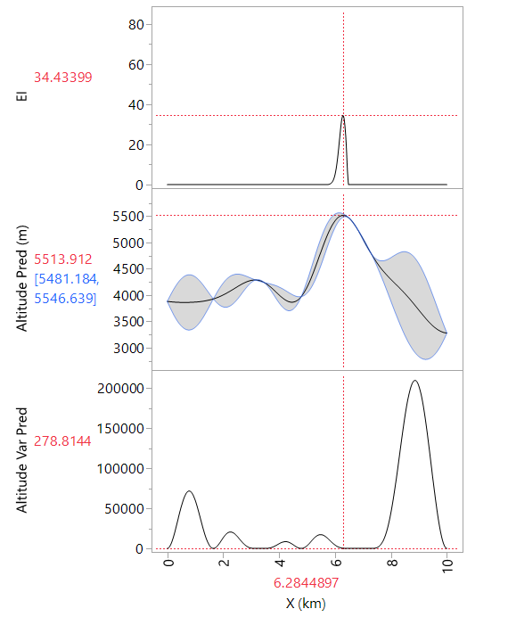
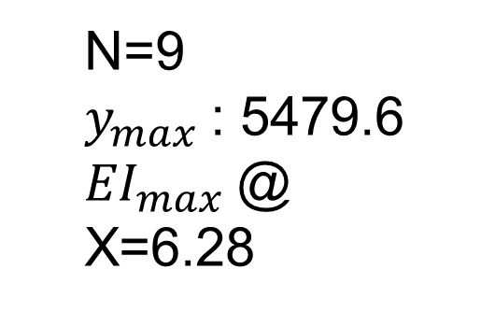
Bayesian Optimization
GASP MOUNTAIN
$$Expected Improvement(x)$$
N=9
$y_{max}$: 5479.6
${EI}_{max}$@ X=6.28
$$\hat{y}(x)$$
$${\hat{Var}}_{\hat{y}}(x)$$
Notes:
The result was lower, so the algorithm backs up

Slide 38
Bayesian Optimization
GASP MOUNTAIN
$$Expected Improvement(x)$$
N=9
$y_{max}$: 5479.6
${EI}_{max}$@ X=6.28
$$\hat{y}(x)$$
$${\hat{Var}}_{\hat{y}}(x)$$
Notes:
The result was lower, so the algorithm backs up

Slide 39
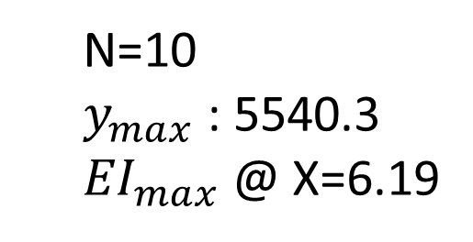
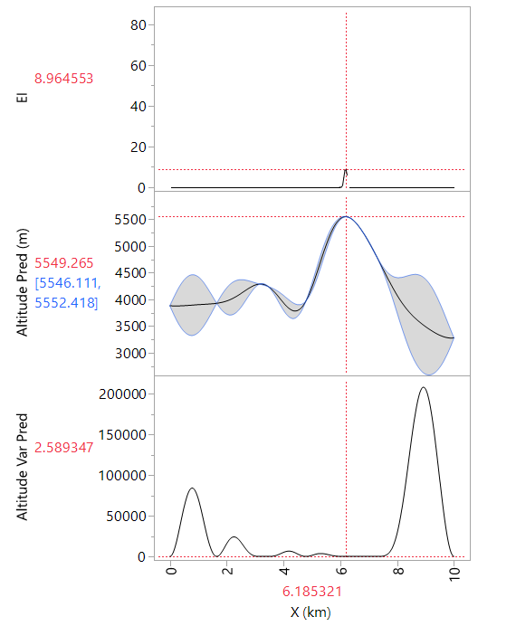
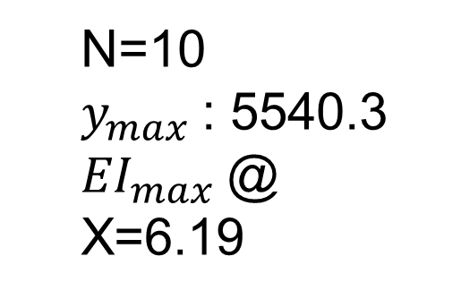
Bayesian Optimization
GASP MOUNTAIN
$$Expected Improvement(x)$$
N=10
$y_{max}$: 5540.3
${EI}_{max}$@ X=6.19
$$\hat{y}(x)$$
$${\hat{Var}}_{\hat{y}}(x)$$
Notes:
It has basically found the optima, and the expected improvement is low across the range of X.

Slide 40
Bayesian Optimization
GASP MOUNTAIN
$$Expected Improvement(x)$$
N=10
$y_{max}$: 5540.3
${EI}_{max}$@ X=6.19
$$\hat{y}(x)$$
$${\hat{Var}}_{\hat{y}}(x)$$
Notes:
It has basically found the optima, and the expected improvement is low across the range of X.

Slide 41
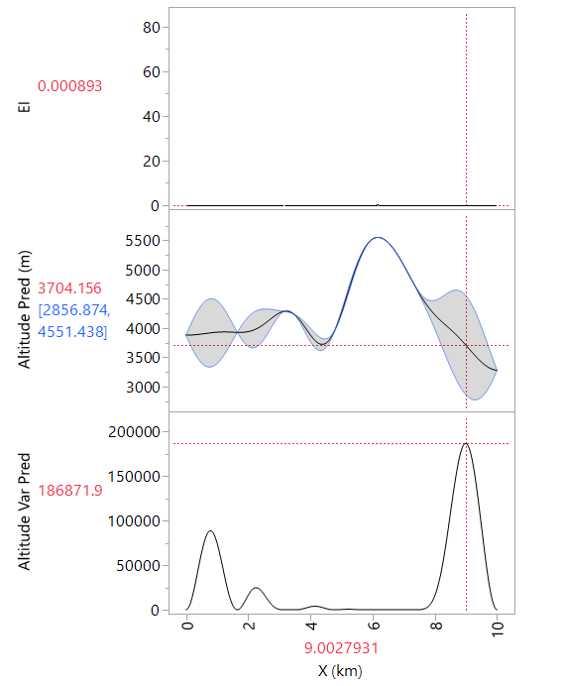

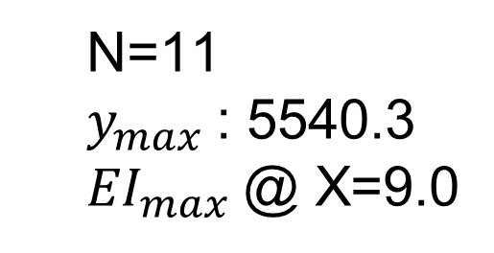
Bayesian Optimization
GASP MOUNTAIN
$$Expected Improvement(x)$$
N=11
$y_{max}$: 5540.3 ${EI}_{max}$@ X=9.0
$$\hat{y}(x)$$
$${\hat{Var}}_{\hat{y}}(x)$$
Notes:
The optima is then confirmed, and the expected improvement criterion is back to recommending high uncertainty points. Notice that the expected improvement is small everywhere, we means we can declare success in maximizing this function. This example shows how Bayesian optimization combines classical statistical thinking with machine learning to create a mathematical optimization algorithm. This idea can easily be applied in the same way to real industrial innovation applications. The approach is adaptive to the response values and goal. As a result, it indicates when your search can stop.

Slide 42
Bayesian Optimization
Flexible to work the way you want to:
Easy to incorporate ad-hoc proposals
Easy to change ranges and add variables
Easy to fix factors, optimize others: “smart OFAT”
Easy mixture/constraint handling

Slide 43
Bayesian Optimization
Faster and more efficient:
Small starting data (8 factors, 2 starting runs!)
Use messy initial starting data
Work iteratively and stop when goals are met
Using responses and goals accelerates innovation

Slide 44
Bayesian Optimization
Problem solving without the statistical machinery:
No p-values, hypothesis tests, or power calcs
Response surface emerges directly from the data
No interaction or curvature effects to declare
No such thing as VIFs, less concern about aliasing
Randomization often the opposite of what you want

Slide 45
Bayesian Optimization
Problem solving without the statistical machinery:
No p-values, hypothesis tests, or power calcs
Response surface emerges directly from the data
No interaction or curvature effects to declare
No such thing as VIFs, less concern about aliasing
Randomization often the opposite of what you want
Statistical analysis is about proving things, Bayesian optimization is about improving things

Slide 46
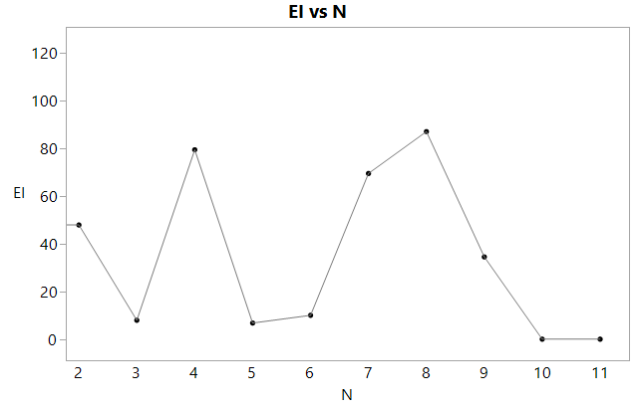
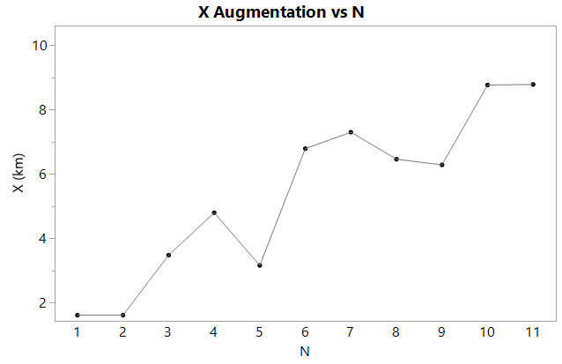
ITERATION HISTORY
EI trends towards zero
X converges: Exploration yields to exploitation

Slide 47
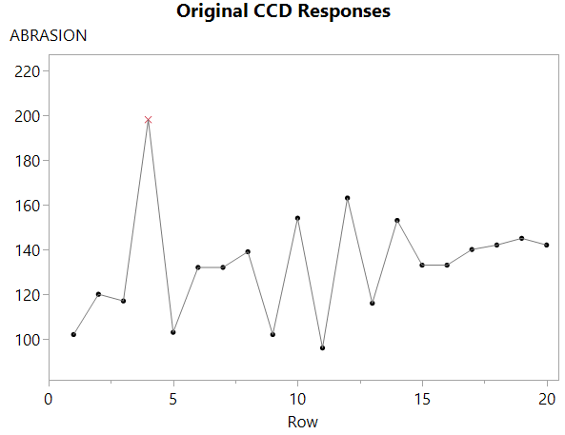
ITERATION HISTORY
Why not look around here?

Slide 48
DECISION CONSIDERATIONS
Practical Considerations:
Are recent response values good enough?
Do we trust the model ( pred & var)?
Are we satisfied with coverage of factor space?
If No to 2 or 3 continue exploring, else:
Model Based Considerations:
Is EI small?
Is the augmentation close to the optima?
Is the interval around EI or the optima small?
If No to any of these, skip EI and keep exploring…

Slide 49
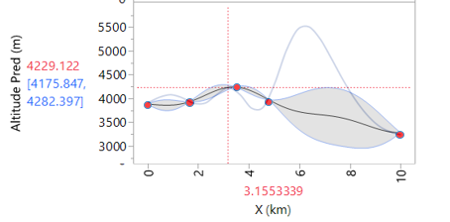
STOPPING CRITERIA
The Model doesn’t know how wrong it is

Slide 50
STOPPING CRITERIA
The Model doesn’t know how wrong it is
This is especially the case when N is small and nX is large

Slide 51
STOPPING CRITERIA
The Model doesn’t know how wrong it is
This is especially the case when N is small and nX is large
It is up to you to guide the project into useful directions

Slide 52
CONCLUSIONS
Acquisition functions are being intensively researched
There isn’t one best one for all situations
It is the practitioner’s responsibility to make decisions based on:
The quality of results, understanding any model is wrong
The resources available
Subject matter knowledge and practical experience
We will work with EI for the remainder of the workshop, but the same principles apply now no matter how you proceed
We are really proposing to have the user make a decision based on EI and varimax considerations

Slide 53
Bayesian Optimization
Auto Mode
Uses simple, conservative run acquisition rules based on model fit and observed response values
Three Phases:
Space-filling (Exploration)
Refine Model (Exploitation)
Confirm/Challenge
Custom Mode
Very flexible in terms of how to choose runs directly from the Profiler or from user-curated candidate sets
Direct user control means that you can solve problems in fewer efforts, but with some effort and subject matter knowledge
Notes:
There are two modes for run selection. The first is Auto Mode, which requires very little on the part of the user once the data table is set up properly. It is intended to be somewhat conservative in that is favors spacefilling approaches until the evidence in the data appears that it is reasonable to use the model more directly
It has three modes, which I will explain as I go through the first example.
The other mode is Custom Mode. This gives the user the ability to choose runs directly using profilers of acquisition functions, and allows the user to set up their own candidate set that may satisfy constraints that are not naturally supported by JMP. You can do a lot with this, for example, you can simply change factor ranges in the profiler and determine runs using the new ranges.
Our goal here is to have an ‘easy path’ for users that don’t want to get into the details, or when the problem fairly standard and not that difficult, while giving another path that is for users that want to understand the machinery of BO in JMP and have harder problems that won’t have an easy out-of-the-box solution.

Slide 54
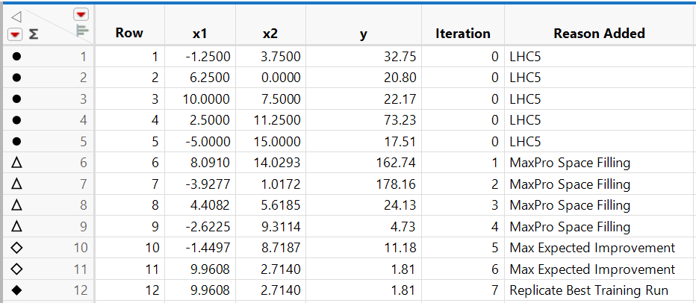
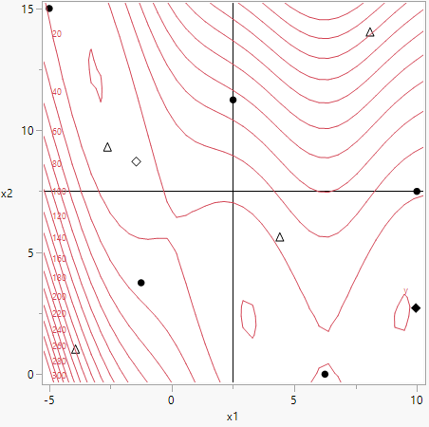
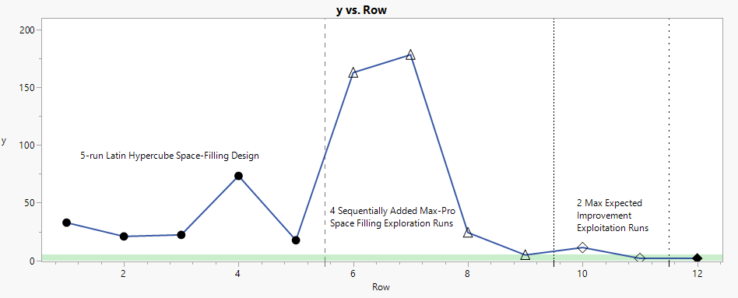
Bayesian Optimization of Branin Function

Slide 55
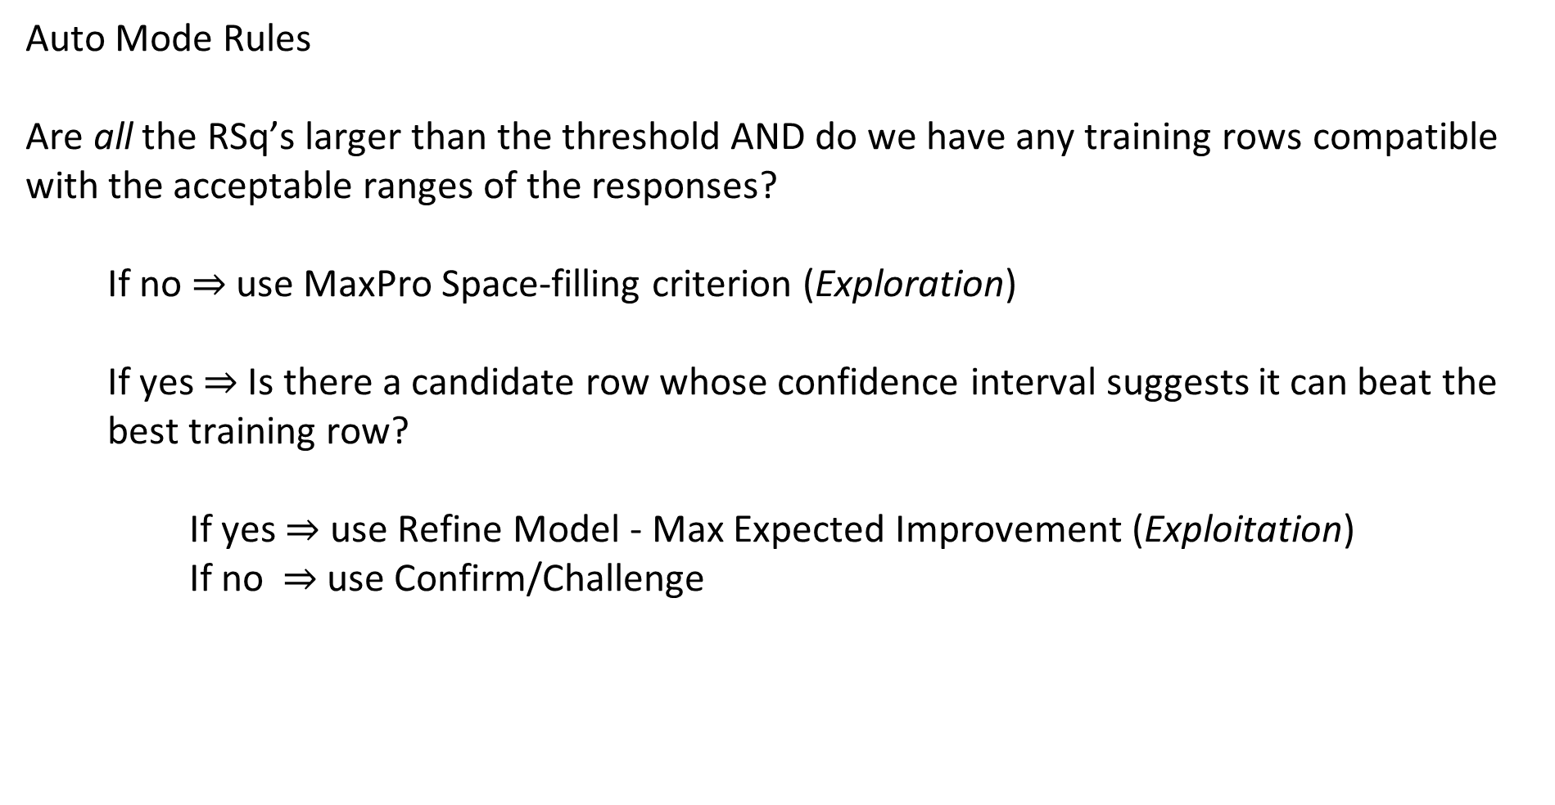
Bayesian Optimization
Auto Mode Rules
Are all the RSq’s larger than the threshold AND do we have any training rows compatible with the acceptable ranges of the responses?
If no $⇒$ use MaxPro Space-filling criterion (Exploration)
If yes $⇒$Is there a candidate row whose confidence interval suggests it can beat the best training row?
If yes $⇒$ use Refine Model - Max Expected Improvement (Exploitation)
If no $⇒$ use Confirm/Challenge

Slide 56
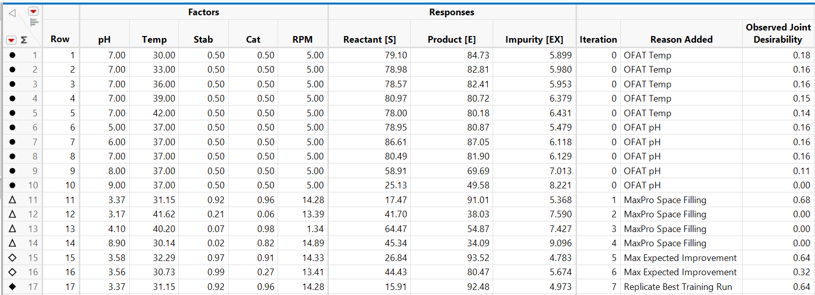
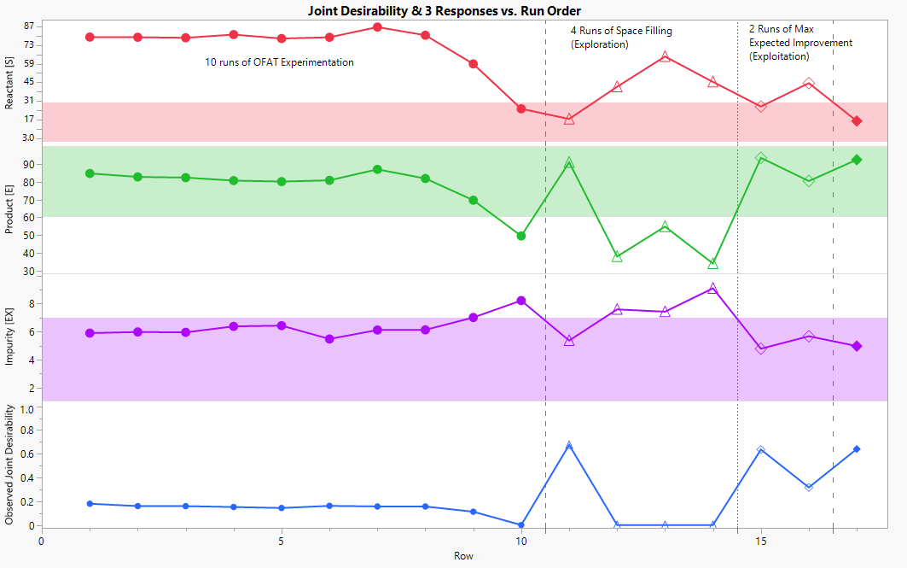
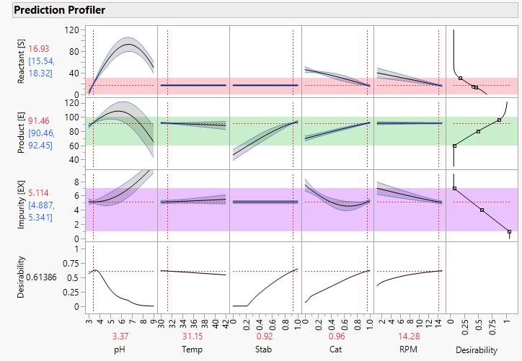
Bayesian Optimization of Process with 3 Responses

Slide 57
Bayesian Optimization
Auto Mode Rules to select a batch of size k:
Space-filling Exploration: Choose k runs by sequentially maximizing the MaxPro Space-filling criterion
Refine Model: Considering only candidates consistent with the response limits:
1) Choose the Max Expected Improvement (MEI) optimal run
2) Choose up to 2 Max Bayes Desirability Std Dev runs sequentially
3) Choose up to k-3 runs that maximize pred variance sequentially
Confirm/Challenge: Considering only candidates consistent with best training row:
Choose the candidate with highest Bayes Desirability
Choose up to k-1 Max Bayes Desirability Std Dev runs sequentially

Slide 58
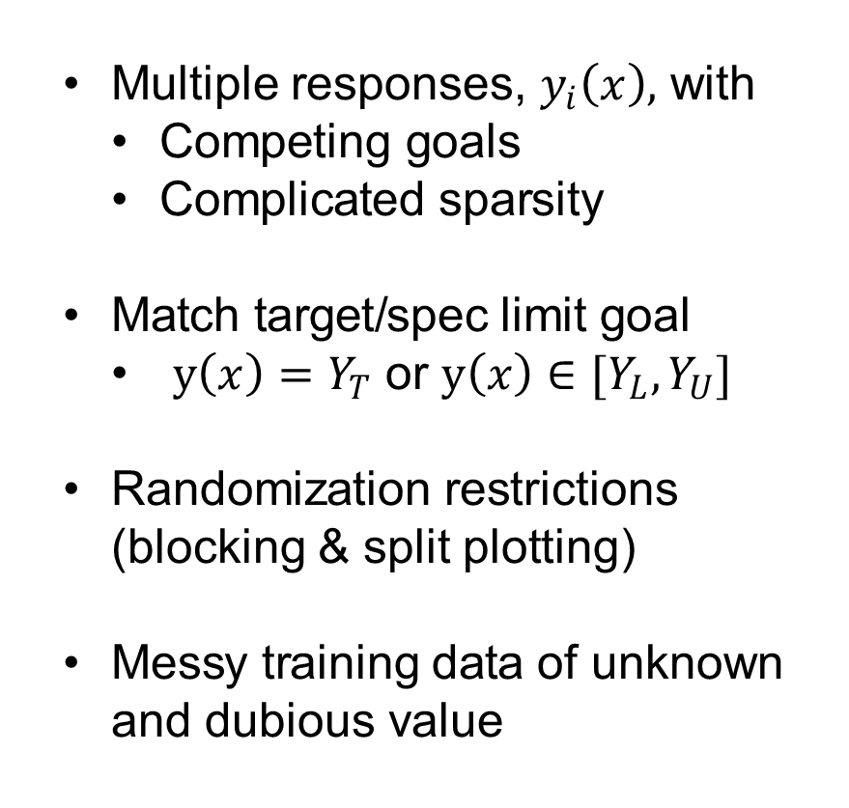
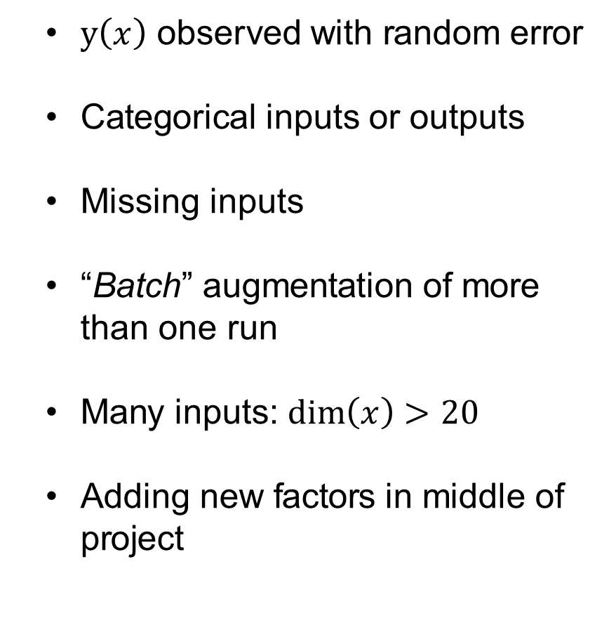
Bayesian Optimization
“EXOTIC” BAYESIAN OPTIMIZATION
Multiple responses, $y_{i}\left(x\right),$ with
Competing goals
Complicated sparsity
Match target/spec limit goal
$y\left(x\right)=Y_{T}$ or ${y\left(x\right)∈[Y}_{L},Y_{U}]$
Randomization restrictions (blocking & split plotting)
Messy training data of unknown and dubious value
$y\left(x\right)$ observed with random error
Categorical inputs or outputs
Missing inputs
“Batch” augmentation of more than one run
Many inputs: $\dim\left(x\right)>20$
Adding new factors in middle of project
Notes:
Now in JMP we have the Profiler, which is a powerful tool for optimizing multiple responses, with different types of goals, which can be arbitrary combinations of maximizing, minimizing and matching targets. It is capable of this using desirability functions which give a score to the predicted values for each response and combines these into an overall desirability score for all the responses.
What we have done here with the new Bayesian Optimization platform in JMP Pro is combine profiler optimization via desirability functions with Bayesian optimization, the value statement being that by starting with either a very small sample from a spacefilling design or with messy historical data pulled from a database of similar projects, we can reduce the time and resources to innovate new products an processes.

Slide 59

Recorded 2-hour workshop – Explains the “Exotic” details
*
*European Network for Business and Industrial Statistics

Slide 60

4-minute video
*

Slide 61

Bayesian Optimization
Adding Optimal Settings to Batch
Notes:
We can use the Profiler to directly optimize these acquisition functions

Slide 62

Bayesian Optimization
Adding Optimal Settings to Batch
Notes:
We can use the Profiler to directly optimize these acquisition functions

Slide 63

Bayesian Optimization
The “Exploration” methods
MaxPro
Spacefilling, only based on X not the model
Useful when the when model fit is not good
Multimodel Std Dev
Spacefilling based on model (X & y)
Conceptually identical to D-optimality on prediction
More likely to explore the edges and vertices
Less used than MaxPro / Bayes Std Dev
Bayesian Desirability Std Dev
Spacefilling based on model & goals (X & y & Goals)
D-optimality to learn Bayesian Desirability
Finds “interesting” unexplored regions
Ignores “uninteresting” regions
Notes:
From there we use Gauss-Hermite quadrature to calculate the mean and variance of the responses desirability functions incorporating the desirability weight. From there we use the rule for calculating the mean and variance of products of independent random variables. This is how we combine all the response models together into a simple single response Bayesian Optimization problem.

Slide 64
Bayesian Optimization
The “Exploitation” methods
MEI
Upper Confidence Bound (UCB)
Both work off the Bayesian Desirability rather than the prediction formulas
There is better theory for UCB, but MEI is better known
Notes:
From there we use Gauss-Hermite quadrature to calculate the mean and variance of the responses desirability functions incorporating the desirability weight. From there we use the rule for calculating the mean and variance of products of independent random variables. This is how we combine all the response models together into a simple single response Bayesian Optimization problem.

Slide 65

Bayesian Optimization
Confirm/Challenge
Convenient way to reset the Profiler to the best training run
Assess the “current” state of the art responses & goals
Useful to force replication of the best settings
Notes:
From there we use Gauss-Hermite quadrature to calculate the mean and variance of the responses desirability functions incorporating the desirability weight. From there we use the rule for calculating the mean and variance of products of independent random variables. This is how we combine all the response models together into a simple single response Bayesian Optimization problem.

Slide 66
Bayesian Optimization Benefits/Value
Small starting designs - stop when goals are met - reduce time & expense
Ease of adoption compared to many classical statistical methods for process optimization - statistically simpler: no p-values, normality tests, etc.
Response surface shape emerges naturally from the Gaussian Process model
No need to do effect selection to determine the form of the model (i.e., interactions, curvature)
Guided iterative approach aligns naturally with how process development engineers think
Accounts for response goals and existing factor space, then optimizes
While computationally complex, results are easy to digest and interpret
Couple of reminders…
1. Statistical analysis is about proving things, Bayesian optimization is about improving things
2. Garbage In – Garbage Out!

Slide 67
Thanks to my colleagues
Charlie Whitman
Byron Wingerd
Greg Flexman
Ben Barosso-Ingham
Mike Anderson
Peter Polito
Sarah Gilyard
Bradley Bowen
Phil Kay
Peter Hersh

Slide 68
Back Up Slides
Full slide deck follows for the 2-hour workshop presented by Chris Gotwalt on December 18, 2024, for the European Network for Business and Industrial Statistics (ENBIS).

Slide 69
BAYESIAN OPTIMIZATION:
A Goal Oriented Approach
to Process Optimization
Notes:
Now I will transition to something coming in JMP Pro 19, Bayesian Optimization. This is a very promising approach that is getting a lot of attention as an AI recommender system for improving products and processes.
It is too early to show the new platform, but I will introduce you to the idea of Bayesian Optimization, why it is so exciting, and talk about our goals for JMP Pro 19.

Slide 70
BAYESIAN OPTIMIZATION INTRO
Innovation is the key to economic growth in advanced economies:
Product formulation for pharma, consumer products, materials
Process innovation in semiconductor manufacturing
Design of mechanical devices: engines, machines, motors
Competitive Innovation Pressure demands companies to innovate quickly to be the first to market

Slide 71

BAYESIAN OPTIMIZATION INTRO
Bayesian Optimization:
Is an integrated modeling/data augmentation methodology
Has the potential to have a transformative impact on innovation
$⟹$ Agile product development
$⟹$ Easier adoption by SMEs ( AI Recommenders are cool)
$⟹$ Head start leveraging existing R&D data lakes
$⟹$ Less starting runs, less total runs
$⟹$ Reduce R&D costs & time-to-market
3) BO’s iterative “filling in the knowledge gaps” approach is highly psychologically appealing to industrial R&D culture

Slide 72
BAYESIAN OPTIMIZATION
Bayesian optimization will be easy to learn and use:
Less statistical machinery:
No p-values, hypothesis tests, or power calculations
Response surface emerges directly from the data:
No need to plan in advance for interaction or curvature effects
Requires less resources:
Small starting designs (8 factors, 2 starting runs!)
Work iteratively and stop as soon as your goals are met
Integrating all the information with product goals accelerates innovation
Notes:
I believe Bayesian Optimization can be made easy to learn and use: there are fewer assumptions, with more time spent learning problem solving rather than statistical machinery like p values and power calculations
Linear statistical models concepts like interactions and curvature terms are much less important, because the machine learning algorithm learns the shape of the response surface directly from the data
Bayesian optimization is appealing because it requires only a very small initial data set and uses less resources because it goal oriented and uses all the information available.

Slide 73
BAYESIAN OPTIMIZATION
Introduction to Bayesian Optimization (BO)
Gaussian Process Models Overview
Intro to JMP (with Phil Kay)
Bayesian Optimization Augmentation (with Chris Gotwalt)
Case Study (with Phil Kay)

Slide 74
BAYESIAN OPTIMIZATION INTRO
About Me:
Lead the Statistics Modeling Dev, Testing, Doc teams for JMP
Developed a lot of the linear algebra, numerical optimization, numerical integration and fitting routines
Mixed Models, Neural Networks, SEM, SVM, early in my career I did optimal design and reliability model fitting algorithm development
We have a “working management” culture in JMP R&D. I am still an algorithms developer
Almost all JMP statistical capabilities are built from scratch in C++

Slide 75
BAYESIAN OPTIMIZATION INTRO
About Me:
Outreach working directly with customers, developing initial training material
Become involved in high value new initiatives to lead and contribute
In 2023 customer meetings and conferences like ENBIS and JMP Discovery led me to believe BO is the most important new thing we must develop
Nearly every one of our customers has asked us “what is your BO solution and when can we have it?”

Slide 76
BAYESIAN OPTIMIZATION
Introduction to Bayesian Optimization (BO)
Gaussian Process Models Overview
Intro to JMP (with Phil Kay)
Bayesian Optimization Augmentation (with Chris Gotwalt)
Case Study (with Phil Kay)

Slide 77

BAYESIAN OPTIMIZATION
Notes:
Bayesian optimization begins by identifying responses that quantify the objectives of the talk at hand, as well as goals like maximizing them, minimizing them, or matching a target value for them.
Then you obtain some data, either starting with observed or historical data or by running an initial starting design. Once you have the data you fit a model using the inputs to predict the responses. This is where the process is in the JMP profiler plot we see here. There are three factors being used to predict three responses, one of which we want to maximize, and two other we want to match to a particular value. The model traces are shown in black, and the grey regions are the confidence intervals on the predictions. This type of graph is called the Profiler in JMP and is a very powerful tool for using models to solve real problems.
Up to this point Bayesian optimization is just like any other statistical or machine learning modeling procedure or DoE. Where it differs is in how we choose which factor combinations to try next.

Slide 78
BAYESIAN OPTIMIZATION
Model Predictions
Notes:
In that you use the model predictions based on fitting the model to the observed response values

Slide 79
BAYESIAN OPTIMIZATION
{
+
Prediction Uncertainty
Model Predictions
Notes:
Along with the prediction uncertainty from the model, which will generally differ at different factor combinations.

Slide 80
BAYESIAN OPTIMIZATION
{
+
Prediction Uncertainty
Model Predictions
+
Model Goals
Notes:
And incorporate the goals you have for the responses, shown here as desirability functions

Slide 81

BAYESIAN OPTIMIZATION
{
{
+
Prediction Uncertainty
Model Predictions
+
Model Goals
=
New Factor Combinations to Try
Notes:
These three components are combined using what are called acquisition functions that identify the most promising new combinations of the inputs to try to optimize your responses in the next iteration.

Slide 82
POPULAR INNOVATION STRATEGIES IN INDUSTRY
Existing data-centric procedures for product/process innovation
Subject Matter Expert driven, ad hoc “artisanal” approaches
Design of Experiments (DoE)
Notes:
Now lets review two of the most common approaches to design products and processes in industry

Slide 83
Subject Matter Expert driven, “artisanal” approaches
Trial and error, using the knowledge and experience of an expert
Often falls into the trap of one factor at a time experimentation
Uncertainty is not quantified
Blind spots in the data are often unidentified and unresolved (thereby inefficient and suboptimal)
Practitioner feels in control, but often hard work leads to no payoff
BAYESIAN OPTIMIZATION INTRO

Slide 84
BAYESIAN OPTIMIZATION INTRO
Design of Experiments (DoE)/ Box Hunter & Hunter (BH2) further developed by many people (e.g. Brad Jones, Peter Goos, Chris Nachtsheim)
Consult with the expert to define goals and factor ranges
Run a screening design to identify important factors
Augment via replicates, foldovers, or optimality criteria
Resolve interactions
Accommodate curvature
Improve precision in estimates
Fit a final response surface model and optimize

Slide 85

BAYESIAN OPTIMIZATION INTRO
Classical BH2 Design of Experiments (DoE)
Built-in handling of variation and uncertainty quantification
Augmentation addresses linear model weaknesses:
Estimability of interactions and curvature
Improving precision via functions of ${Var\left(\hat{β}\right)∝X}^{T}X$
Augmentation is statistically motivated:
Does not leverage the response values!
Does not incorporate the goals
Places points at extremes and centers of ranges (because${ X}^{T}X$)

Slide 86
BAYESIAN OPTIMIZATION INTRO
Classical BH2 Design of Experiments (DoE)
Has had tremendous success for 50+ years, which will certainly continue
BH2 is safe with decades of experience regarding:
How to set up DoE’s, evaluate, and analyze them
How they can fail and be improved with more runs
Lots of well-established books and training material on DoE
Many potential R&D practitioners have had criticisms:
Large up-front sample size requirements
Focus on statistical issues as opposed to problem solving

Slide 87

BAYESIAN OPTIMIZATION
Bayesian Optimization is a mathematical optimization algorithm:
Find settings, $x,$ that maximize (or minimize) $y(x)$
BO selects new $x$’s using Acquisition Rules that combine:
$\hat{y}\left(x | y,X,θ\right)≈y(x)$, a data-derived model
$\hat{Var}\left(\hat{y}\left(x\right)| y,X,θ\right)$, the estimated precision of $\hat{y}\left(x | y,X,θ\right)$
Goal for $y(x)$ goal: augmentation is problem solving oriented

Slide 88

“BASIC” BAYESIAN OPTIMIZATION
Have data $(X, y\left(X\right))$ : single continuous response, continuous inputs
Obtain model $\hat{y}\left(x\right)$ along with ${\hat{Var}}_{\hat{y}}\left(x| y,X,θ\right)$
The Acquisition Function $A(\hat{y}\left(x\right)$, $\hat{Var}\left(\hat{y}\left(x\right)| y,X,θ\right))$ places a numeric value on all candidate $x$’s to try.
We perform a search (somehow…) to find the $x_{new}$ with the best value of the Acquisition.
Obtain $y\left(x_{new}\right)$, update model, and repeat until satisfied

Slide 89


“EXOTIC” BAYESIAN OPTIMIZATION
Multiple responses, $y_{i}\left(x\right),$ with
Competing goals
Complicated sparsity
Match target/spec limit goal
$y\left(x\right)=Y_{T}$ or ${y\left(x\right)∈[Y}_{L},Y_{U}]$
Randomization restrictions (blocking & split plotting)
Messy training data of unknown and dubious value
$y\left(x\right)$ observed with random error
Categorical inputs or outputs
Missing inputs
“Batch” augmentation of more than one run
Many inputs: $\dim\left(x\right)>20$

Slide 90
“EXOTIC” BAYESIAN OPTIMIZATION
Every example I have seen has been “Exotic” in multiple ways

Slide 91
BAYESIAN OPTIMIZATION (POTENTIAL) DISADVANTAGES
The methodology for common types of “exoticness” is not mature
I know of several companies that have spent $100k-$250k for consulting on single BO projects, and have been disappointed
Diagnostics for when things are going wrong and what to do then are not mature
Often Gaussian Process models are the base learner, these are numerically slow and can be “temperamental”
Inference is not the focus (but uncertainty quantification still is)
Notes:
I have already talked about the potential advantages of BO, much of which centers around the lack of maturity in the approach.
Several companies I know of have spent large sums to vendors for single projects that went nowhere, and have come to us looking for a better and more transparent way of doing Bayesian optimization.
BO doesn’t have the rich set of diagnostics that have been worked out for linear statistical models to identify when things are going wrong.
Gaussian Process models can be difficult to work with, although we are working hard on that right now.

Slide 92

THIS WORKSHOP
We will be focusing on “Basic” BO, but with error in y.
Single continuous response
Continuous inputs
The modeling family will be Gaussian Process regression
GaSP models are flexible and have a convenient $\hat{Var}$ for BO with a natural extension to batch augmentation
GaSP interpretability is less than linear models, but higher than pure ML models like NN’s and Tree-based models

Slide 93

JMP Pro 19 Roadmap
BO coming in JMP Pro 19. Developed by Kasia Dobrzycka and contributions from myself
Empower SMEs in industrial R&D (like 6$σ$ Black Belts) to design products and processes w BO efficiently, effectively and safely
Decision process: Comprehendible, transparent, reproducible, trustworthy, and easily trainable to non-expert, intermittent users
Handling of multiple responses with complex sparsity, with different goals ( including matching targets )
Batch augmentation

Slide 94


JMP® Student Edition
Free single-user 12-month license
JMP Student Edition is a free, comprehensive statistical analysis and visualization tool designed for classroom instruction. Based on the powerful JMP Pro software, it offers a user-friendly interface and a wide range of capabilities for teaching and learning statistical concepts.
Ideal for both introductory and advanced statistics courses, JMP Student Edition provides access to a variety of statistical techniques and graphical tools. It’s perfect for demonstrating statistical principles, analyzing real-world data, and helping students develop critical thinking skills.

Slide 95
WE ARE AT THE BEGINNING
BO fits squarely in the industrial product/process innovation space
The techniques are squarely in the realm of statistical modeling and design (it is both a neural network and a linear mixed model, augmentation principles are closely related to G-optimality)
This will have a transformative disruptive effect. BO in some form will occupy an important place in industry in the future
This is a call to action for the industrial statistics community.
We (the stats community) must take the lead, if not others will

Slide 96
BAYESIAN OPTIMIZATION
Gaussian Process Model (GaSP)
Goals Met?
Yes
Starting Design or
Existing Data
Collect Responses
Model Responses
Finished
No
Determine
Next Run(s)
BO Acquisition Function
(such as Expected Improvement)
Notes:
The workflow is an iterative process of data collection and modeling with Gaussian Processes, followed by using acquisition functions such as expected improvement to identify factor combinations to try next.

Slide 97
BAYESIAN OPTIMIZATION
Introduction to Bayesian Optimization (BO)
Gaussian Process Models Overview
Intro to JMP (with Phil Kay)
Bayesian Optimization Augmentation (with Chris Gotwalt)
Case Study (with Phil Kay)

Slide 98

GaSP PRIOR
The “Prior” in BO is that the response surface comes from a Gaussian Process
Notes:
The “Prior” in BO is that mean function of the data are a continuous gaussian stochastic process

Slide 99



GaSP MOUNTAIN
Want to predict altitude using a small number of measurements
Notes:
[Introduce GaSP Mountain]. Ultimately we want to model altitude as a function of location. We know that location and altitude are closely related to one another. So we should be able to find a way to predict altitude using location

Slide 100


GaSP MOUNTAIN
$$μ=4200$$
$$σ\text{=600}$$
Notes:
If we knew the mean and variance of the altitude across the range of X we could use that information to come up with a one size fits all guess (using just the mean) and an uncertainty metric based on the standard deviation of altitude. This doesn’t help us make location based predictions though.

Slide 101

GaSP MOUNTAIN
$Δx=$1.25
$\text{ρ}\text{=}$.33
Notes:
Then suppose we collected equally spaced measurements every 1.25 km across the range of X. We calculate their autocorrelation and find that it is equal to .33.

Slide 102

GaSP MOUNTAIN
$$Δx=.625$$
$\text{ρ}\text{=}$.72
Notes:
Then we halve the interval widths and find that that autocorrelation is .72, much higher than at a stepsize of 1.25.

Slide 103


GaSP MOUNTAIN
$$Δx=.312$$
$\text{ρ}\text{=}$.91

Slide 104


GaSP MOUNTAIN
$$Δx=.156$$
$\text{ρ}\text{=}$.97

Slide 105


GaSP MOUNTAIN
$$Δx=.078$$
$\text{ρ}\text{=}$.98

Slide 106


GaSP MOUNTAIN
$$Δx=.039$$
$\text{ρ}\text{=}$.994

Slide 107


GaSP MOUNTAIN
$$Δx=.019$$
$\text{ρ}\text{=}$.997
Notes:
Ultimately we find that points very near to one another are basically perfectly correlated. So, we should be able to predict locations near a measurement with high accuracy

Slide 108
GaSP MOUNTAIN
Can we:
Take a small set of points
Model the distance-correlation relationship
Combine the correlation model and the data to model y(x)?
This is the essence of Gaussian Process modeling!
Notes:
This suggest an approach we can take to do just that without taking an enormous number of measurements

Slide 109

GaSP MOUNTAIN
Consider single point prediction of $y_{2}$ given $y_{1}$
$y_{1},y_{2}∼Gaussian\left(μ,σ^{2}\right)$ with $corr\left(y_{1},y_{2}\right)=\text{ρ}$
We can use the conditional distribution as our model for $y_{2}$:
$E\left(y_{2} | y_{1}\right)=μ+\text{ρ}∙\left(y_{1}−μ\right)$
$Var\left(y_{2} | y_{1}\right)=σ^{2}∙\left(1−{\text{ρ}}^{2}\right)$

Slide 110

GaSP MOUNTAIN
$$μ=4200$$
$$σ\text{=600}$$

Slide 111
GaSP MOUNTAIN
Predict $y\left(7.312\right)$ given $y\left(7\right)=5025$

Slide 112

GaSP MOUNTAIN
Predict $y\left(7.312\right)$ given $y\left(7\right)=5025$
$$Δx=.312$$
$\text{ρ}\text{=}$.905

Slide 113

GaSP MOUNTAIN
$E\left(y(7.312)| y(7)\right)=μ+.905∙\left(5025−μ\right)$=4940
$Var\left(y\left(7.312\right)|y\left(7\right)\right) =σ^{2}∙\left(1−{.905}^{2}\right)=.18$ $∙ σ^{2}$
$$Δx=.312$$
$\text{ρ}\text{=}$.905

Slide 114



GaSP MOUNTAIN
$E\left(y(7.312)| y(7)\right)=μ+.905∙\left(5025−μ\right)$=4940
$Var\left(y\left(7.312\right)|y\left(7\right)\right) =σ^{2}∙\left(1−{.905}^{2}\right)=.18$ $∙ σ^{2}$
$$\hat{y}=\text{4940}$$
$$\hat{Var}=.18∙σ^{2}$$
$$Δx=.312$$
$\text{ρ}\text{=}$.905

Slide 115
GaSP MOUNTAIN
$E\left(y(7.312)| y(7)\right)=μ+.905∙\left(5025−μ\right)$=4940
$Var\left(y\left(7.312\right)|y\left(7\right)\right) =σ^{2}∙\left(1−{.905}^{2}\right)=.18$ $∙ σ^{2}$
$$\hat{y}=\text{4940}$$
$$\hat{Var}=.18∙σ^{2}$$
$$Δx=.312$$
$\text{ρ}\text{=}$.905

Slide 116

GaSP MOUNTAIN
Predict $y\left(7.625\right)$ given $y\left(7\right)=5025$
$$Δx=.625$$
$\text{ρ}\text{=}$.72

Slide 117


GaSP MOUNTAIN
$E\left(y(7.625)| y(7)\right)=μ+.72∙\left(5025−μ\right)$=4790
$Var\left(y\left(7.625\right)|y\left(7\right)\right) =σ^{2}∙\left(1−{.72}^{2}\right)=.48$ $∙ σ^{2}$
$$\hat{y}=\text{4}\text{7}\text{40}$$
$$\hat{Var}=.48∙σ^{2}$$
$$Δx=.625$$
$\text{ρ}\text{=}$.72

Slide 118
GaSP MOUNTAIN
$E\left(y(7.625)| y(7)\right)=μ+.72∙\left(5025−μ\right)$=4790
$Var\left(y\left(7.625\right)|y\left(7\right)\right) =σ^{2}∙\left(1−{.72}^{2}\right)=.48$ $∙ σ^{2}$
$$\hat{y}=\text{4}\text{7}\text{40}$$
$$\hat{Var}=.48∙σ^{2}$$
$$Δx=.625$$
$\text{ρ}\text{=}$.72

Slide 119

GaSP MOUNTAIN
For real problems we need to:
Use the data to learn the distance vs correlation relationship, $\text{ρ}\text{(}Δx\text{)}$
Predict using multiple points

Slide 120
GAUSSIAN PROCESSES
GaSP – Gaussian Stochastic Process regression (also GP)
Predictor is linear combinations of the y’s, w/ distance-based weights
The “basic” GaSP model interpolates the data perfectly
This observation led to the use of GaSP’s as surrogate models for expensive, deterministic functions ( like computer experiments)
Prediction variance is a (scaled) distance to the rows in the data

Slide 121

$y$ is an unknown deterministic function of $x$ we want to predict
Bold terms are vectors and matrices
$X_{Tr}$, $y_{Tr}=y(X_{Tr})$: known training inputs and vector of responses
$x_{i},y_{i}$: i-th observation in the training set
$x$: a predictor value of we want use to predict $y(x)$ with
Here we are discussion 1-dimensional continuous x, but everything generalizes to higher dimensions and categorical x.
GAUSSIAN PROCESSES

Slide 122

GAUSSIAN PROCESSES
$corr(y\left(x_{i}\right),y(x_{j}))=r_{ϴ}\left(|x_{i}−x_{j}|\right)$
$r_{ϴ}( x,X_{Tr})={\left\{r_{ϴ}\left(|x−x_{i}|\right)\right\}}_{i}$: vector correlations at x with the data,${ X}_{Tr}$
$R_{ϴ}( X_{Tr})$: correlation matrix of the training data,
${R_{ϴ}\left( X_{Tr}\right)=\left\{r_{ϴ}\left(|x_{j}−x_{j}|\right)\right\}}_{i,j}$

Slide 123

GAUSSIAN PROCESSES
The Gaussian Correlation function is common:
$r_{ϴ} \left(|x_{i}−x_{j}|\right)$= exp(- $ϴ{∙(x_{i}−x_{j})}^{2}$)
Implies that the underlying surface is infinitely differentiable
This is often said to be “too” smooth for physical problems
There are others like the Matern family
With these you can specify the number of derivatives that exist
Understood that Matern is more like real physical relationships

Slide 124


GAUSSIAN PROCESSES
$\lim_{x→x_{0}}{r_{ϴ}\left(|x−x_{0}|\right)}→1.0$ and $\lim_{x→∞}{r_{ϴ}\left(|x−x_{0}|\right)}=0.0$

Slide 125

GAUSSIAN PROCESSES
$y\left(X_{Tr}\right)∼Gaussian\left( μ ,σ^{2}∙R_{ϴ}\left(X_{Tr}\right)\right)$
Use the spatial Gaussian model to add unknown prediction point, $y\left(x\right)$, to the distribution of the data
$\left[\begin{matrix}y\left(x\right) \\ y(X_{Tr})\end{matrix}\right]∼Gaussian\left(\left[\begin{matrix}μ \\ μ∙1\end{matrix}\right],σ^{2}∙\left[\begin{matrix}1 & {r_{ϴ}(x)}^{T} \\ r_{ϴ}(x) & R_{ϴ}(X_{Tr})\end{matrix}\right]\right)$
Calculate the conditional distribution of $y\left(x\right)$ given $y\left(X_{Tr}\right)$
Application of Bayes rule in a non-Bayesian context
Predictor is also a Mixed Model BLUP with a spatial correlation

Slide 126


GAUSSIAN PROCESSES
$y\left(x\right) | y(X_{Tr})∼Gaussian$ $\left(E_{ϴ}\left(y\left(x\right)|y_{Tr},X_{Tr}\right),{ Var}_{ϴ}\left(y\left(x\right)|y_{Tr},X_{Tr}\right) \right)$
$\hat{y}\left(x \right|y_{Tr},X_{Tr}) = E_{ϴ}\left(y\left(x\right)|y_{Tr},X_{Tr}\right)$
$=μ+r_{ϴ}^{T}\left(x,X_{Tr}\right)∙R_{ϴ}^{−1}∙(y_{Tr}−μ)$
$\hat{Var}\left(y(x) \right|y_{Tr},X_{Tr})={Var}_{ϴ}\left(y\left(x\right)|{ y}_{Tr},X_{Tr}\right)$
$=σ^{2}∙\left(1−r_{ϴ}^{T}\left(x,X_{Tr}\right)∙R_{ϴ}^{−1}∙r_{ϴ}\left(x,X_{Tr}\right)\right)$

Slide 127

$\hat{y}\left(x \right|y_{Tr},X_{Tr})=r_{ϴ}^{T}\left(x,X_{Tr}\right)∙R_{ϴ}^{−1}∙y_{Tr}$
$=\sum{\left({\left(R_{ϴ}^{−T}\right)}_{.,i}^{T}∙y_{Tr}\right){∙e}^{−{ϴ∙\left(x−x_{i}\right)}^{2}}}$
$=\sum{w_{i}{∙e}^{−{ϴ∙\left(x−x_{i}\right)}^{2}}}$
Same structure as:
Radial basis function (RBF) neural network
Radial basis support vector machine
Kernel Regression
Spatial (Kriging) Linear Mixed Model
The “cubic” correlation function is equivalent to a spline
GAUSSIAN PROCESSES

Slide 128



GAUSSIAN PROCESSES
$$\frac{1}{1+exp⁡(−7∙(x−.5))}$$

Slide 129


GAUSSIAN PROCESSES
$R_{ϴ=1}^{−1} =\left[\begin{matrix} 4.0 & −5.0 & 2.4 \\ −5.0 & 8.8 & −5.0 \\ 2.4 & −5.0 & 4.0\end{matrix}\right]$
$$w=R_{ϴ=1}^{−1}∙y_{Tr}=\left[\begin{matrix} 4.0 & −5.0 & 2.4 \\ −5.0 & 8.8 & −5.0 \\ 2.4 & −5.0 & 4.0\end{matrix}\right]∙\left[\begin{matrix}.0293 \\ 0.5 \\ .9707\end{matrix}\right]$$
$$={\left[\begin{matrix}−0.030 & −6.13 & 1.46\end{matrix}\right]}^{T}$$
$$\hat{y}\left(x\right) = \text{−}0.030∙e^{−{ϴ∙\left(x−0.0\right)}^{2}}$$
$\text{−}0.613∙e^{−ϴ∙{\left(x−0.5\right)}^{2}}$
$\text{+}1.46∙e^{−{ϴ∙\left(x−1.0\right)}^{2}}$
$$ϴ=1.0$$
$$μ=0.0$$

Slide 130


GAUSSIAN PROCESSES
$\hat{y}\left(x\right)= −.0302∙e^{−{\left(x−0.0\right)}^{2}}+\text{−}.613∙e^{−{\left(x−.5\right)}^{2}}$-$1.46∙e^{−{\left(x−1.0\right)}^{2}}$
$${\hat{Var}(x)=σ}^{2}∙\left(1−r_{ϴ}^{T}\left(x,X_{Tr}\right)∙R_{ϴ}^{−1}∙r_{ϴ}\left(x,X_{Tr}\right)\right)$$
$$\hat{Var}\left(x\right)=\begin{matrix} \\ σ^{2}∙\left(1−\left(\begin{matrix}{ e}^{−{\left(x−0.0\right)}^{2}}∙ \\ {+ e}^{−{\left(x−0.5\right)}^{2}}∙ \\ {+ e}^{−{\left(x−1.0\right)}^{2}}∙\end{matrix}\begin{matrix}\text{(}4.0∙e^{−{\left(x−0.0\right)}^{2}} & \text{+}\text{2}∙\text{2.4}∙e^{−{\left(x−0.5\right)}^{2}} & \text{+2}∙\text{(−5.0)}∙e^{−{\left(x−1.0\right)}^{2}}) \\ ( & 8.8∙e^{−{\left(x−0.5\right)}^{2}} & \text{+2}∙\text{(−5.0)}∙e^{−{\left(x−1.0\right)}^{2}}) \\ ( & & \text{+2}∙ 4.0 ∙ e^{−{\left(x−1.0\right)}^{2}})\end{matrix}\right)\right) \\ \end{matrix}$$
$R_{ϴ=1}^{−1} =\left[\begin{matrix} 4.0 & −5.0 & 2.4 \\ −5.0 & 8.8 & −5.0 \\ 2.4 & −5.0 & 4.0\end{matrix}\right]$
$$w ={\left[\begin{matrix}−0.030 & −6.13 & 1.46\end{matrix}\right]}^{T}$$

Slide 131

GAUSSIAN PROCESSES
Major advantages:
GaSP prediction learns response surface directly from data
GaSP prediction uncertainty is based on based on scaled distance from prediction location to the data
$⟹$ Learning the model is based on filling gaps in the data
“Exploration”
“Spacefilling”
#1 Disadvantage: Slow Fitting w large n, this can be creatively mitigated

Slide 132



GaSP “EXPLORATION”
Notes:
Lets see what happens as do what we call “pure exploration” by adding response data sequentially at the points where the a gaussian process model has the highest uncertainty, that is where the confidence interval on the prediction is largest. We’ll start here with just one measurement at X1=0 and add a measurement at X1=1, where the confidence interval width is widest:

Slide 133

GaSP “EXPLORATION”

Slide 134

GaSP “EXPLORATION”

Slide 135

GaSP “EXPLORATION”

Slide 136

GaSP “EXPLORATION”

Slide 137


GaSP “EXPLORATION”

Slide 138


GaSP “EXPLORATION”

Slide 139


GaSP “EXPLORATION”
Notes:
Here is a second example where we use spacefilling exploration to learn another function

Slide 140

GaSP “EXPLORATION”

Slide 141

GaSP “EXPLORATION”

Slide 142

GaSP “EXPLORATION”

Slide 143

GaSP “EXPLORATION”

Slide 144

GaSP “EXPLORATION”

Slide 145

GaSP “EXPLORATION”

Slide 146

GaSP “EXPLORATION”

Slide 147

GaSP “EXPLORATION”

Slide 148


GAUSSIAN PROCESSES
$y\left(X_{Tr}\right)∼Gaussian\left( μ∙1, σ^{2}∙R_{ϴ}\left(X_{Tr}\right)\right)$
$μ$: Overall mean
Model converges to $μ$ as $x$ becomes far from data
$ϴ$: Smoothing parameter
Controls rate of return to $μ$
Indexes how far from the data the model will generalize to new $x$
$σ^{2}$: Variance of $y$, scales the interval width, does not change predictions
Notes:
Now that we have seen some gasp model predictions and how they improve with spacefilling the X region, we will use some visualizations to get some intuition for how the Gaussian Process model parameters impact the predictions and interval widths.

Slide 149


GAUSSIAN PROCESSES
$$ϴ=1.0, μ=0.5$$
Far from the data the predictions converge to $μ$
$ϴ$ scales the return to $μ$

Slide 150

GAUSSIAN PROCESSES
$$ϴ=10.0, μ=0.5$$
Far from the data the predictions converge to $μ$
$ϴ$ scales the return to $μ$

Slide 151

GAUSSIAN PROCESSES
$$ϴ=0.1, μ=0.5$$
Far from the data the predictions converge to $μ$
$ϴ$ scales the return to $μ$

Slide 152

GAUSSIAN PROCESSES
$$ϴ=1.0, μ=0.5$$
$μ$ is the value the model returns to far from the data

Slide 153

GAUSSIAN PROCESSES
$$ϴ=1.0, μ=2.0$$
$μ$ is the value the model returns to far from the data

Slide 154

GAUSSIAN PROCESSES
$$ϴ=1.0, μ=−1.0$$
$μ$ is the value the model returns to far from the data

Slide 155


GAUSSIAN PROCESSES
$$ϴ=1.0, μ=0.5$$
With a good model and sample size, $μ$ often doesn’t impact prediction much inside the hull of $X_{Tr}$

Slide 156

GAUSSIAN PROCESSES
$$ϴ=1.0, μ=5.0$$
With a good model and sample size, $μ$ often doesn’t impact prediction much inside the hull of $X_{Tr}$

Slide 157

GAUSSIAN PROCESSES
$$ϴ=1.0, μ=−5.0$$
With a good model and sample size, $μ$ often doesn’t impact prediction much inside the hull of $X_{Tr}$

Slide 158


GAUSSIAN PROCESSES
$$ϴ=1.0, μ=0.5$$
$ϴ$ smooths by scaling how far an observation influences the predictions

Slide 159

GAUSSIAN PROCESSES
$$ϴ=0.1, μ=0.5$$
$ϴ$ smooths by scaling how far an observation influences the predictions

Slide 160

GAUSSIAN PROCESSES
$$ϴ=100.0, μ=0.5$$
$ϴ$ smooths by scaling how far an observation influences the predictions

Slide 161


GAUSSIAN PROCESSES
$$σ^{2}=3$$
$σ^{2}$ only scales the confidence interval width without impacting predictions

Slide 162

GAUSSIAN PROCESSES
$$σ^{2}=1$$
$σ^{2}$ only scales the confidence interval width without impacting predictions

Slide 163

GAUSSIAN PROCESSES
$$σ^{2}=10$$
$σ^{2}$ only scales the confidence interval width without impacting predictions

Slide 164


GaSPs WITH ERRORS
Modeling with noisy/random data requires another strategy
Notes:
Unfortunately, this doesn’t work with noisy data.

Slide 165

GaSPs WITH ERRORS
$τ$ (the nugget) is added the diagonal of $R_{ϴ}\left(X_{Tr}\right)$ to smooth out noise
$τ$ is unitless, but ${τ∙σ}^{2}$ is analogous to measurement error
$y\left(X_{Tr}\right)∼Gaussian\left( μ ,σ^{2}∙(R_{ϴ}\left(X_{Tr}\right)+τ∙I)\right)$
$Var\left(y\left(x\right)\right)=$ $σ^{2}∙ \left( 1+τ\right)$
$R_{ϴ,τ}\left(X_{Tr}\right)=R_{ϴ}\left(X_{Tr}\right)+τ∙I$

Slide 166


GaSPs WITH ERRORS
$$τ =0.0$$
$τ$ smooths out noise by pulling predictions globally to the mean, even on $X_{Tr}$

Slide 167

GaSPs WITH ERRORS
$$τ =0.01$$
$τ$ smooths out noise by pulling predictions globally to the mean, even on $X_{Tr}$

Slide 168
GaSPs WITH ERRORS
$$τ =0.01$$
$τ$ smooths out noise by pulling predictions globally to the mean, even on $X_{Tr}$

Slide 169

GaSPs WITH ERRORS
$$τ =0.1$$
$τ$ smooths out noise by pulling predictions globally to the mean, even on $X_{Tr}$

Slide 170

GaSPs WITH ERRORS
$$τ =1.0$$
$τ$ smooths out noise by pulling predictions globally to the mean, even on $X_{Tr}$

Slide 171

GaSPs WITH ERRORS
$$τ =10.0$$
$τ$ smooths out noise by pulling predictions globally to the mean, even on $X_{Tr}$

Slide 172

GaSPs WITH ERRORS
$$τ =100.0$$
$τ$ smooths out noise by pulling predictions globally to the mean, even on $X_{Tr}$

Slide 173

GAUSSIAN PROCESSES
$y\left(X_{Tr}\right)∼Gaussian\left( μ ,σ^{2}∙(R_{ϴ}\left(X_{Tr}\right)+τ∙I)\right)$
$Θ:$ scales the correlation over distance in $x$, smooths local to data
$τ$: smooths out the measurement error or noise, smooths globally
$μ$: center of the data and the extrapolation limit as distance grows
$σ^{2}$: Scales the prediction variance multiplicatively but leaves the predictions unchanged

Slide 174

GAUSSIAN PROCESSES
Generalization to multiple inputs:
$y\left(X_{Tr}\right)∼Gaussian\left( μ ,σ^{2}∙(R_{ϴ}\left(X_{Tr}\right)+τ∙I)\right)$
One $ϴ$parameter total, called an isotropic correlation
$r\left(x_{1},x_{2}\right)=r\left(ϴ∙\left\|x_{1}\right.−\left.x_{2}\right\|\right)$
One $ϴ$parameter per $x$ dimension, called separable or anisotropic
$r\left(x_{1},x_{2}\right)=\prod_{k}{∙r\left(ϴ_{k}∙\left|x_{1,k}−x_{2,k}\right|\right)}$

Slide 175
BAYESIAN OPTIMIZATION
Introduction to Bayesian Optimization (BO)
Gaussian Process Models Overview
Intro to JMP (with Phil Kay)
Bayesian Optimization Augmentation (with Chris Gotwalt)
Case Study (with Phil Kay)

Slide 177
BAYESIAN OPTIMIZATION
Introduction to Bayesian Optimization (BO)
Gaussian Process Models Overview
Intro to JMP (with Phil Kay)
Bayesian Optimization Augmentation (with Chris Gotwalt)
Case Study (with Phil Kay)

Slide 178

USING THE SURROGATE WITH UNCERTAINTY
Pure Exploration, maximizing$σ^{2}\left(x|y,X\right)$
Improves model fit
Isn’t directly related to the problem at hand
Gives too much attention to uninteresting regions
Pure Exploitation, always optimizing current $μ\left(x|y,X\right)$
Doesn’t necessarily improve model fit
Bad models lead to suboptimal decisions
Exploitation gets stuck by itself
Notes:
The various strategies for augmenting tend to trade off two extremes. One we have already seen, pure exploration, augments by maximizing the point with the largest variance but it ignored the actual predicted values.
The other approach reverses this, it focuses only on optimizing the prediction model and ignored uncertainty altogether.
Focusing too much on one or the other of these strategies leads is suboptimal.

Slide 179
USING THE SURROGATE WITH UNCERTAINTY
Acquisition Functions – Trade off Exploration vs Exploitation
Probability of Improvement
Upper Confidence Bound
Expected Improvement
In my experience with noisy functions, these all overemphasize optimization early.
Yes, you can add tuning parameters to make EI, etc. Explore more
I find it more intuitive to use the mean and variance model directly in a profiler

Slide 180


GaSP MOUNTAIN WITH 4 SAMPLES

Slide 181

EXPECTED IMPROVEMENT
$y\left(x\right)\sim N\left( μ\left(x\right), σ^{2}\left(x\right) \right)$
Improvement: $I\left(x\right)=max⁡(y\left(x\right)−y_{max},0)$
We don’t know $y\left(x\right)$, but we can use $y\left(x\right) \sim Gaussian(\hat{y}\left(x\right),$ ${\hat{σ}}^{2}\left(x\right)$) to calculate the expected value of $I\left(x\right)$
Idea: Use the $x$ that gives the highest expected value of $I\left(x\right)$
$a_{EI}\left(x\right)=$ $E\left(I\left(x\right)\right)$
$=\left(μ\left(x\right)−y_{max}\right)∙Φ\left(\frac{μ\left(x\right)−y_{max}}{σ\left(x\right)}\right)+$ $σ\left(x\right)∙φ\left(\frac{μ\left(x\right)−y_{max}}{σ\left(x\right)}\right)$

Slide 182



EXPECTED IMPROVEMENT
$y\left(x\right)\sim N\left( μ\left(x\right), σ^{2}\left(x\right) \right)$
Improvement: $I\left(x\right)=max⁡(y\left(x\right)−y_{max},0)$
Idea: Find the $x$ that gives the highest expected value of $I\left(x\right)$
$a_{EI}\left(x\right)=$ $E\left(I\left(x\right)\right)$
$=\left(μ\left(x\right)−y_{max}\right)∙Φ\left(\frac{μ\left(x\right)−y_{max}}{σ\left(x\right)}\right)+$ $σ\left(x\right)∙φ\left(\frac{μ\left(x\right)−y_{max}}{σ\left(x\right)}\right)$
Dominates
when
$$μ\left(x\right)≫y_{max}$$
Dominates
when
$σ\left(x\right)$ is large

Slide 183
GaSP MOUNTAIN
Notes:
Now we will apply EI as an augmentation strategy to the GaSP Mountain example with a goal of finding the location of the highest peak.

Slide 184






BAYESIAN OPTIMIZATION
$y_{max}$: 4238.6
$$Expected Improvement$$
$$\hat{y}(x)$$
$$EI(x)$$
$${\hat{Var}}_{\hat{y}}(x)$$
Notes:
Here is a BO example with a sample of size 4 from GaSP mountain.
Expected Improvement. It assigns a value to all the possible factor combinations we could try next by balancing regions the model believes to be of high value with regions where we have high uncertainty.
You can think of it as completely analogous to looking at a set of stocks and choosing the one with the highest expected return on the investment. EI is the rate of return function across a range of X values.

Slide 185

BAYESIAN OPTIMIZATION
$y_{max}$: 4238.6
$$Expected Improvement$$
$$\hat{y}(x)$$
$$EI(x)$$
$${\hat{Var}}_{\hat{y}}(x)$$
$EI$ Recommends X=4.79 next
Notes:
The factor settings with the highest expected information value is the recommended the next run.

Slide 186



GASP MOUNTAIN
$$Expected Improvement(x)$$
N=2
$y_{max}$: 3881.1
${EI}_{max}$@ X=1.61
$$\hat{y}(x)$$
$${\hat{Var}}_{\hat{y}}(x)$$
Notes:
Here is a simple example. The true function we want to maximize is overlain in blue in the middle profiler panel. This is a pretend example because in real problems we can’t see the true function. Notice it is a multi modal complicated function that would be difficult to model with a classical approach.
To start we have two points. The model fit is in the middle panel with the uncertainty and data overlain. The bottom panel is the prediction variance, and the top panel is the EI acquisition function which assigns a value to every possible new point to explore, trading off potential optimal solutions to prediction uncertainty. The x value with the largest value is the next run recommended by EI. If we add a measurement at that location

Slide 187

GASP MOUNTAIN
$$Expected Improvement(x)$$
N=3
$y_{max}$: 3928.1
${EI}_{max}$@ X=3.47
$$\hat{y}(x)$$
$${\hat{Var}}_{\hat{y}}(x)$$
Notes:
We try that point and see it led to little improvement. The expected improvement criterion next recommends a point further away with higher prediction variance

Slide 188

GASP MOUNTAIN
$$Expected Improvement(x)$$
N=4
$y_{max}$: 4238.6
${EI}_{max}$@ X=4.78
$$\hat{y}(x)$$
$${\hat{Var}}_{\hat{y}}(x)$$
Notes:
This one did a bit better. We continue the search in the same direction

Slide 189

GASP MOUNTAIN
$$Expected Improvement(x)$$
N=5
$y_{max}$: 4238.6
${EI}_{max}$@ X=3.16
$$\hat{y}(x)$$
$${\hat{Var}}_{\hat{y}}(x)$$
Notes:
This time we did worse than expected, and it recommends a nearby point in the other direction

Slide 190

GASP MOUNTAIN
$$Expected Improvement(x)$$
N=6
$y_{max}$: 4287.3
${EI}_{max}$@ X=6.79
$$\hat{y}(x)$$
$${\hat{Var}}_{\hat{y}}(x)$$
Notes:
The algorithm has identified the local optima and is now recommending giving attention to the unexplored region

Slide 191
GASP MOUNTAIN
Pure Exploitation
will get stuck!
N=6
$y_{max}$: 4287.3
${EI}_{max}$@ X=6.79
$$\hat{y}(x)$$
$${\hat{Var}}_{\hat{y}}(x)$$
Notes:
The algorithm has identified the local optima and is now recommending giving attention to the unexplored region

Slide 192
GASP MOUNTAIN
High variance region of interest
N=6
$y_{max}$: 4287.3
${EI}_{max}$@ X=6.79
$$\hat{y}(x)$$
$${\hat{Var}}_{\hat{y}}(x)$$
Notes:
The algorithm has identified the local optima and is now recommending giving attention to the unexplored region

Slide 193
GASP MOUNTAIN
EI balances all this out!
N=6
$y_{max}$: 4287.3
${EI}_{max}$@ X=6.79
$$\hat{y}(x)$$
$${\hat{Var}}_{\hat{y}}(x)$$
Notes:
The algorithm has identified the local optima and is now recommending giving attention to the unexplored region

Slide 194

GASP MOUNTAIN
$$Expected Improvement(x)$$
N=7
$y_{max}$: 5261.1
${EI}_{max}$@ X=7.3
$$\hat{y}(x)$$
$${\hat{Var}}_{\hat{y}}(x)$$
Notes:
We add a point there and obtained a much better than expected result

Slide 195

GASP MOUNTAIN
$$Expected Improvement(x)$$
N=8
$y_{max}$: 5251.1
${EI}_{max}$@ X=6.46
$$\hat{y}(x)$$
$${\hat{Var}}_{\hat{y}}(x)$$
Notes:
It takes another step in the same direction

Slide 196

GASP MOUNTAIN
$$Expected Improvement(x)$$
N=9
$y_{max}$: 5479.6
${EI}_{max}$@ X=6.28
$$\hat{y}(x)$$
$${\hat{Var}}_{\hat{y}}(x)$$
Notes:
The result was lower, so the algorithm backs up

Slide 197
GASP MOUNTAIN
$$Expected Improvement(x)$$
N=10
$y_{max}$: 5540.3
${EI}_{max}$@ X=6.19
$$\hat{y}(x)$$
$${\hat{Var}}_{\hat{y}}(x)$$
Notes:
It has basically found the optima, and the expected improvement is low across the range of X.

Slide 198

GASP MOUNTAIN
$$Expected Improvement(x)$$
N=10
$y_{max}$: 5551.1
${EI}_{max}$@ X=9.0
$$\hat{y}(x)$$
$${\hat{Var}}_{\hat{y}}(x)$$
Notes:
The optima is then confirmed, and the expected improvement criterion is back to recommending high uncertainty points. Notice that the expected improvement is small everywhere, we means we can declare success in maximizing this function. This example shows how Bayesian optimization combines classical statistical thinking with machine learning to create a mathematical optimization algorithm. This idea can easily be applied in the same way to real industrial innovation applications. The approach is adaptive to the response values and goal. As a result, it indicates when your search can stop.

Slide 199
TRBO – TRUST REGION BAYESIAN OPTIMIZATION v 0.1
Once the model looks reasonable the intervals EI & Var Max are non overlapping we consider the model over a “trust region” of the Xs that contains the max predicted value.
This is inspired by “trust region” methods in Newton’s method that restrict the search to “trust” regions where the approximating quadratic is “trusted”
As we gain more information the “trust” region will shrink for the important factors.
We stop when we:
Believe the model is reasonable
The EI point is nearly identical to the predicted optimal point
The region of the X’s whose CI is consistent with the optima is “small”

Slide 200


TRBO – TRUST REGION BAYESIAN OPTIMIZATION v 0.1
Original Ranges
Optimal EI Point
Suppose the new EI Point is close to the previous one
Trust Region: X range whose CI contain the EI Optimal prediction
Select varimax point in Trust Region

Slide 201
TRBO – TRUST REGION BAYESIAN OPTIMIZATION v 0.1
This is a one-run-at-a-time greedy algorithm for optimizing noisy physical phenomena
The approach is very visual and places the choice for the next point completely in the hands of the practitioner.
On simulated data based on larger real dataset, I have been able to optimize responses in much fewer runs than standard DoE approaches.
This is a very much work in progress that while promising, can certainly be improved (hence TRBO v0.1)
In six months, this will have likely evolved and improved (hopefully) a lot

Slide 202
TRBO – TRUST REGION BAYESIAN OPTIMIZATION v 0.1
Three kinds of new runs
Pure Explore Runs: chosen because the maximize the variance of prediction (varimax) on the whole design space. All early runs are like this until the model begins to behave
Expected Improvement Runs: These maximize EI, and should be used only once there is a clear signal in the model
Trust Region Varimax Runs: Find the X ranges whose CI’s contain the EI prediction. Choose the point with the highest prediction variance in the region. These are done to prevent redundant EI and Pure Exploitation runs
As long as you are challenging the model with varimax runs the model will improve. EI makes it possible to “zero in” on regions of interest.

Slide 203


TRBO – TRUST REGION BAYESIAN OPTIMIZATION v 0.1
Factors Silica, Silane, Sulfur, tire rubber ingredients
Want to maximize Abrasion response

Slide 204

TRBO – TRUST REGION BAYESIAN OPTIMIZATION v 0.1
Notes:
I’ll be using an JMP Add-in written by Mark Bailey that we have been using to prototupe BO in JMP. The addin requires JMP Pro, but as I mentioned academics can get JMP Pro for free any time by downloading it from the JMP website.

Slide 205

TRBO – TRUST REGION BAYESIAN OPTIMIZATION v 0.1

Slide 206



TRBO – TRUST REGION BAYESIAN OPTIMIZATION v 0.1
Model traces look reasonable at EI Point, high variance, but LOO Actual By Predicted doesn’t look good -> Pure Explore

Slide 207


TRBO – TRUST REGION BAYESIAN OPTIMIZATION v 0.1
Select Pure Exploration and Save Run to augment

Slide 208

TRBO – TRUST REGION BAYESIAN OPTIMIZATION v 0.1
Row is added with iteration and type of point added
Select recent point to highlight it in the next graph

Slide 209

TRBO – TRUST REGION BAYESIAN OPTIMIZATION v 0.1

Slide 210

TRBO – TRUST REGION BAYESIAN OPTIMIZATION v 0.1
Use recall to rerun the model

Slide 211

TRBO – TRUST REGION BAYESIAN OPTIMIZATION v 0.1
Use recall to rerun the model

Slide 212



TRBO – TRUST REGION BAYESIAN OPTIMIZATION v 0.1
Model traces look reasonable, overstated precision
EI and Pure Explore intervals overlap -> Try Pure Explore Point

Slide 213

TRBO – TRUST REGION BAYESIAN OPTIMIZATION v 0.1

Slide 214



TRBO – TRUST REGION BAYESIAN OPTIMIZATION v 0.1
Model traces look reasonable, overstated precision
EI and Pure Explore intervals overlap -> Try Pure Explore Point

Slide 215

TRBO – TRUST REGION BAYESIAN OPTIMIZATION v 0.1

Slide 216



TRBO – TRUST REGION BAYESIAN OPTIMIZATION v 0.1
Model traces look reasonable,
Highly overstated precision -> Try Pure Explore Point

Slide 217

TRBO – TRUST REGION BAYESIAN OPTIMIZATION v 0.1

Slide 218



TRBO – TRUST REGION BAYESIAN OPTIMIZATION v 0.1
Model traces look reasonable
EI and Pure Explore Cis far apart -> Try EI Point

Slide 219

TRBO – TRUST REGION BAYESIAN OPTIMIZATION v 0.1

Slide 220

TRBO – TRUST REGION BAYESIAN OPTIMIZATION v 0.1

Slide 221



TRBO – TRUST REGION BAYESIAN OPTIMIZATION v 0.1
Model traces look reasonable
EI is going for the same settings. Zoom into Trust Region and maximize Prediction Variance

Slide 222

TRBO – TRUST REGION BAYESIAN OPTIMIZATION v 0.1
Find Factor Ranges that are totally within the CI
This is the Trust Region
Notes:
[PLAY MOVIE]

Slide 223

TRBO – TRUST REGION BAYESIAN OPTIMIZATION v 0.1
Within that Trust Region maximize the Prediction Variance

Slide 224

TRBO – TRUST REGION BAYESIAN OPTIMIZATION v 0.1
Within that Trust Region maximize the Prediction Variance
In this case it is just the EI Optimal point

Slide 225

TRBO – TRUST REGION BAYESIAN OPTIMIZATION v 0.1

Slide 226

TRBO – TRUST REGION BAYESIAN OPTIMIZATION v 0.1

Slide 227

TRBO – TRUST REGION BAYESIAN OPTIMIZATION v 0.1

Slide 228

TRBO – TRUST REGION BAYESIAN OPTIMIZATION v 0.1

Slide 229



TRBO – TRUST REGION BAYESIAN OPTIMIZATION v 0.1
Model is looking good at EI Point, but very narrow CI.
->Try Another Trust Region Step

Slide 230

TRBO – TRUST REGION BAYESIAN OPTIMIZATION v 0.1

Slide 231
TRBO – TRUST REGION BAYESIAN OPTIMIZATION v 0.1

Slide 232

TRBO – TRUST REGION BAYESIAN OPTIMIZATION v 0.1

Slide 233


TRBO – TRUST REGION BAYESIAN OPTIMIZATION v 0.1
Model is looking good at EI Point, but very narrow CI.
->Try Another Trust Region Step

Slide 234


TRBO – TRUST REGION BAYESIAN OPTIMIZATION v 0.1

Slide 235

TRBO – TRUST REGION BAYESIAN OPTIMIZATION v 0.1

Slide 236


TRBO – TRUST REGION BAYESIAN OPTIMIZATION v 0.1
Model is tight at EI Point, and has been consistent the last few runs. This is our proposed Optima

Slide 237

TRBO – TRUST REGION BAYESIAN OPTIMIZATION v 0.1
We have recovered the true optima quite well in 11 runs.

Slide 238

TRBO – TRUST REGION BAYESIAN OPTIMIZATION v 0.1

Slide 239
BAYESIAN OPTIMIZATION
Introduction to Bayesian Optimization (BO)
Gaussian Process Models Overview
Intro to JMP (with Phil Kay)
Bayesian Optimization Augmentation (with Chris Gotwalt)
Case Study (with Phil Kay)

