Slide 1
An Adaptive Bayesian Framework for Risk‐Controlled Skip‐Lot Sampling (SkSP‐B)
CDT Landry Lee

Slide 2

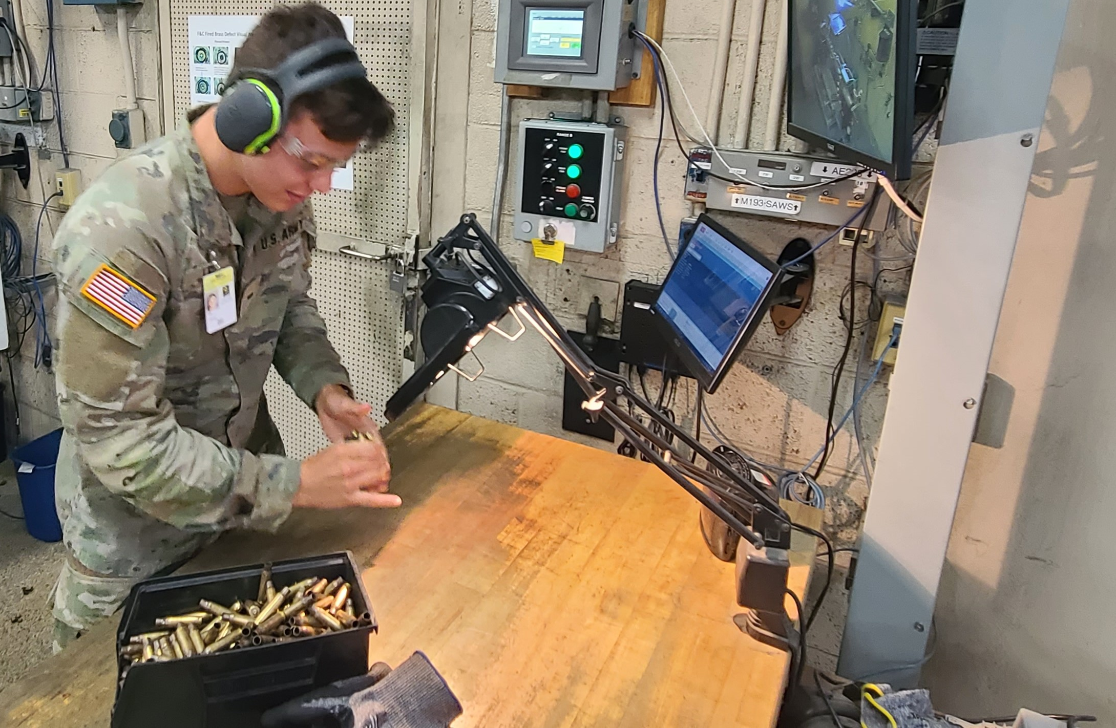

Inspiration
What types of tests might you do?
How do you check ammunition quality when inspection is destructive and/or expensive?

Slide 3


Acceptance Sampling
Normal Inspection Plan
F
P
P
c

Slide 4
What if Quality is Good?
After periods of demonstrated high-quality samples, do we need to keep testing at the same rate?
F
P
P
P
P
P
P
P
P

Slide 5




Traditional Skip-Lot Sampling SkSP-2
After periods of demonstrated high-quality samples, enter a state of reduced testing.
SkSP-2 Skip-Lot Sampling
Normal
Skipping
Normal
Skipping
}
P
P
P
F
P
P
P
S
P
F
}
S
}
}
}
$i$consecutive passes
$f$chance to test
$i$consecutive passes

Slide 6
What Data Does SkSP Miss
Normal
Skipping
Normal
F
P
P
P
S
P
F
P
P
P
S
c
Should these be counted equally?
Risk Introduced by Skipping

Slide 7
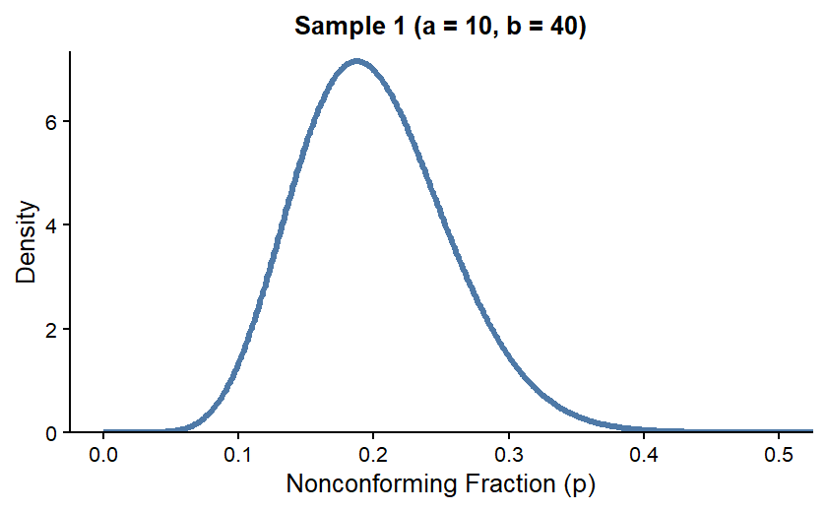
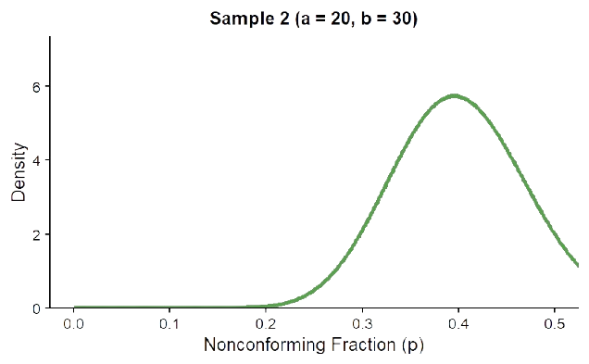
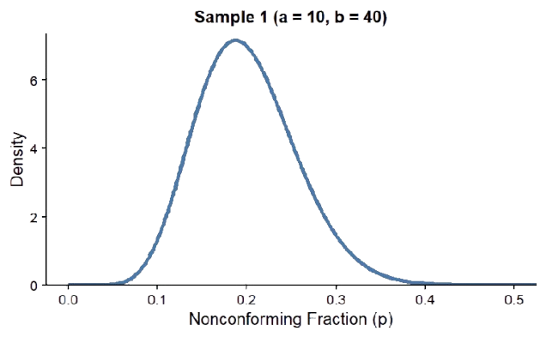
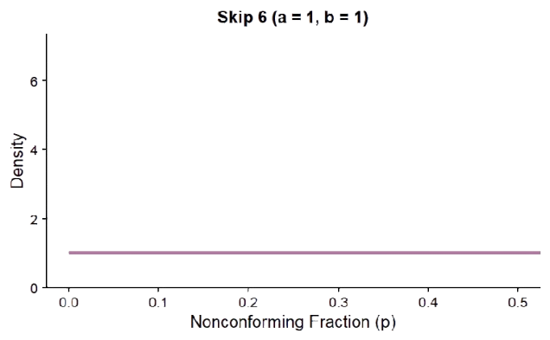
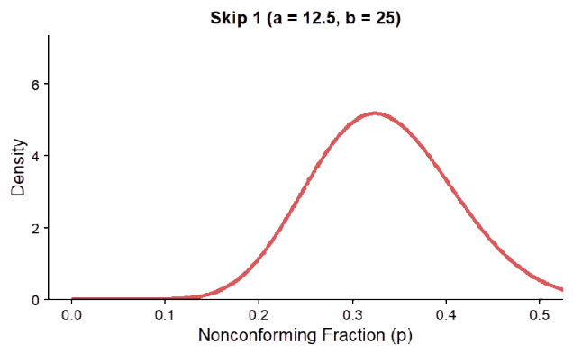
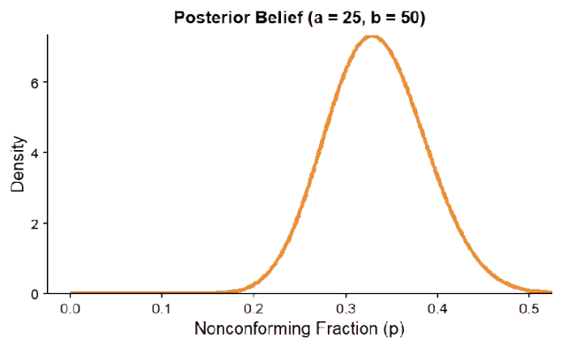
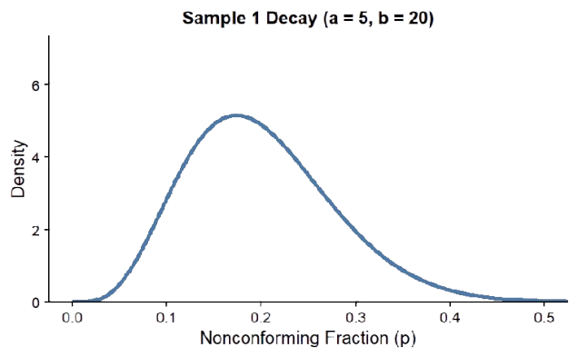
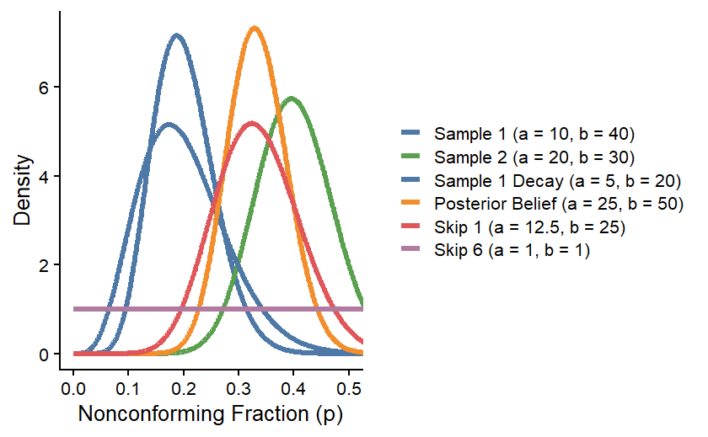
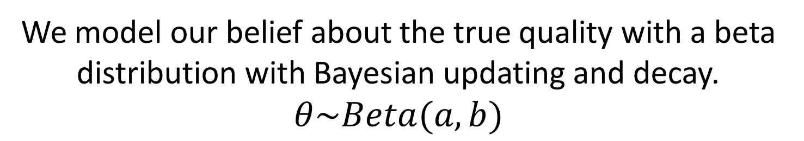
Belief of the Current Quality
We model our belief about the true quality with a beta distribution with Bayesian updating and decay. $θ\sim Beta(a,b)$

Slide 8
Our Risk
Our belief about theta quantifies the risk to the customer.
We model consumer risk: acceptance of a bad lot.
Probability of Skipping a Lot
Probability of Lot Failing and Being Bad
Probability of Lot Passing and Being Bad
$$r=\frac{\left(1−f\right)∗P\left(fail∩bad\right)+P(pass∩bad)}{1−f∗P\left(fail\right)}$$
Probability of an Accepted Lot Being Bad
Probability a Lot is Accepted
Our Goal: Minimize testing while controlling this risk.

Slide 9

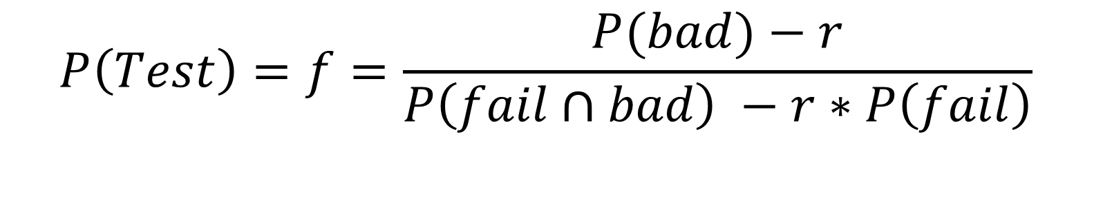
Probability of Testing a Lot
Our objective is to establish the optimal probability for testing a
lot to (1) minimize testing and (2) not exceed a specified risk level.
$$P\left(Test\right)=f=\frac{P(bad)−r}{P\left(fail∩bad\right) −r∗P\left(fail\right)}$$
SkSP-B: After every lot, recalculate
the belief about the quality and $f.$
$$Note:0≤f≤1$$

Slide 10
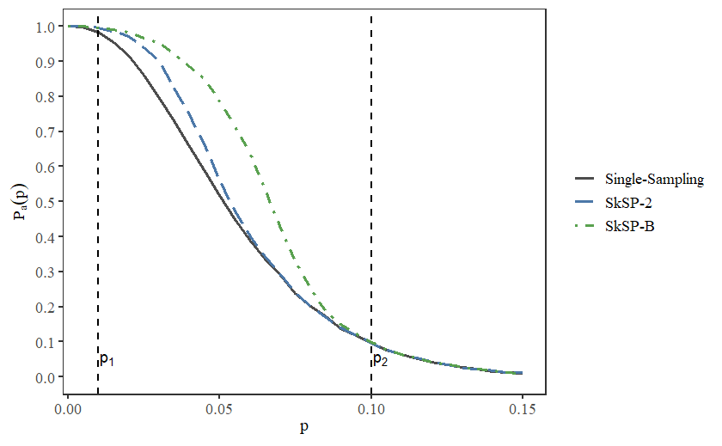
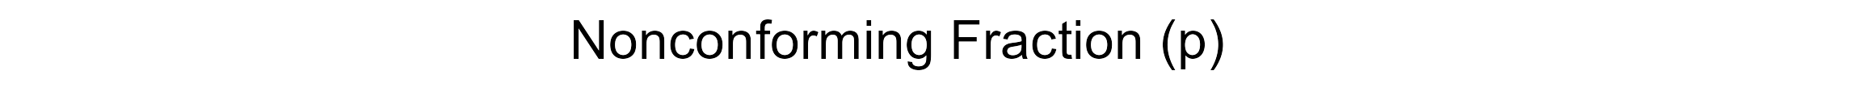
Maximize Correct Acceptance
OC Curve: P(Accepted) vs. Nonconforming Fraction
Accept
Here
Reject
Here
RQL: Rejectable
Quality Level

Slide 11
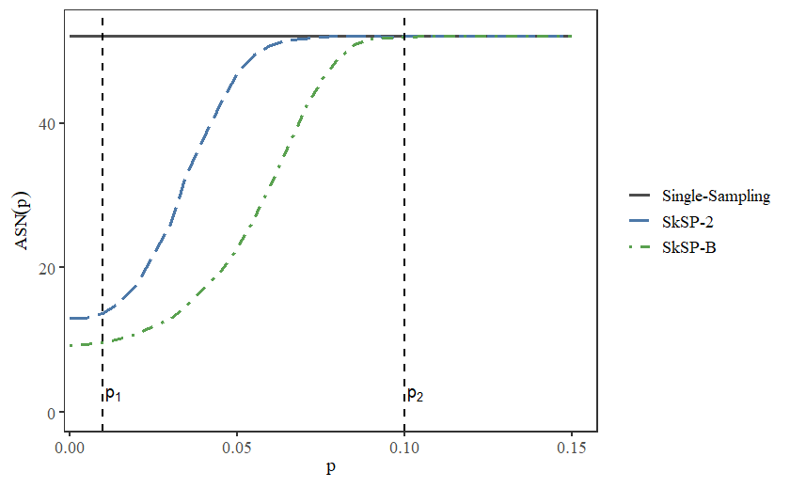
Minimize Cost
Average Sample Number vs. Nonconforming Fraction
52
RQL
40
20
0
0.00
0.05
0.10
0.15

Slide 12
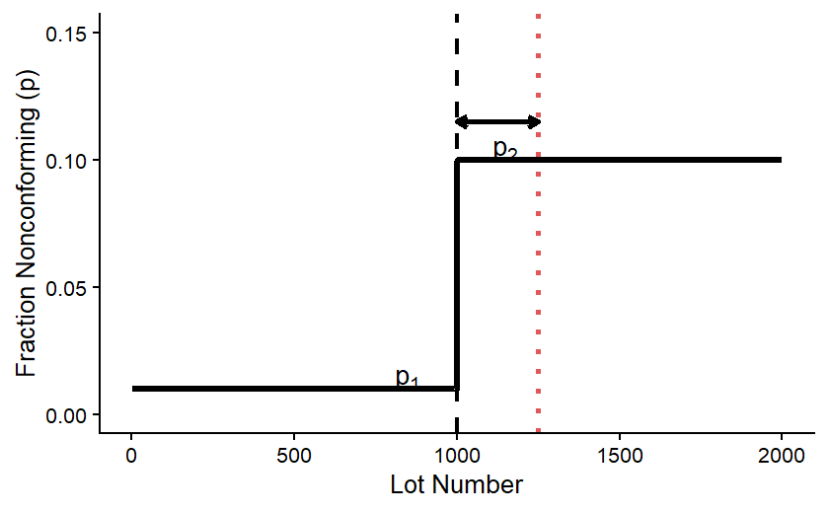
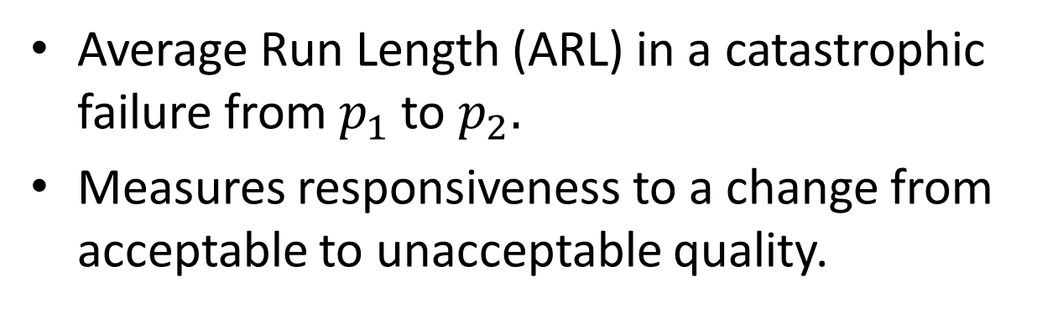


Maximize Responsiveness
Average Run Length (ARL) in a catastrophic failure from $p_{1}$to $p_{2}.$
Measures responsiveness to a change from acceptable to unacceptable quality.
ARL
$$p_{2}$$
1st Fail
$p_{1}$

Slide 13
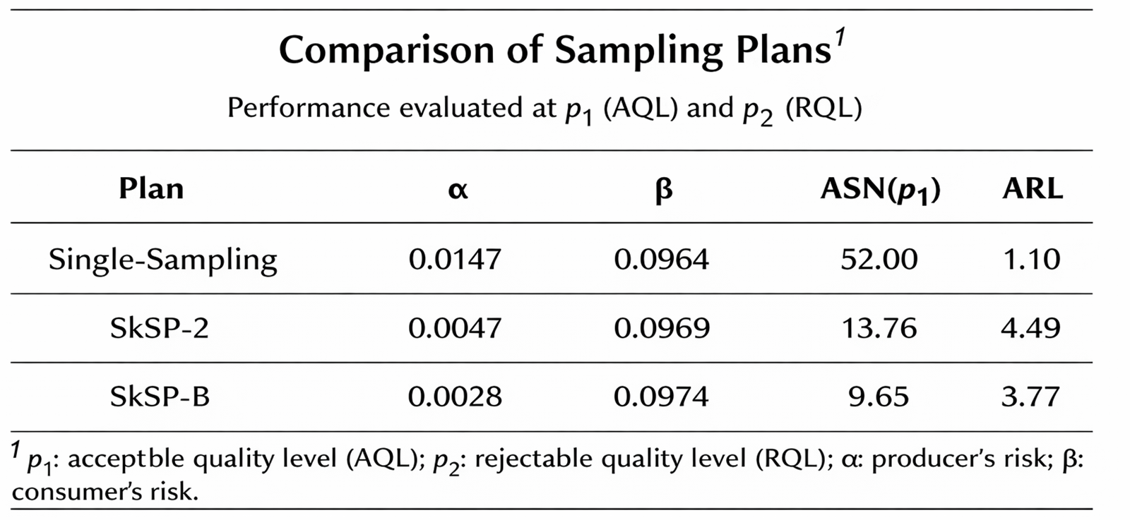
Maximize Responsiveness

Slide 14
Findings
Relative to other skip-lot sampling approaches, SkSP-B facilitates:
  More correct acceptance
  Lower sampling costs
  More responsiveness
Note: There will always be some additional
risk for any skip-lot sampling method.

Slide 15
Questions
Any Questions?

