Slide 1
Convergent Threats through the Intersection of Biotechnology and AI/ML
UNCLASSIFIED//NOT APPROVED FOR PUBLIC RELEASE
DATAWorks
Institute for Defense Analysis
Presenter: Kathleen Bostick
Mentor: Dr. Chenyi Ling
UNCLASSIFIED//NOT APPROVED FOR PUBLIC RELEASE

Slide 2
Problem and Goals
UNCLASSIFIED//NOT APPROVED FOR PUBLIC RELEASE
3
Identify metrics that can be used to assess factors influencing innovation
2
How can the U.S. further develop and sustain strategic advantage in biotechnology and avoid strategic surprise from foreign nations…
Identify factors that influence the rate of innovation
1
Map bio-AI/ML convergent landscape
…to protect
NATIONAL SECURITY?
UNCLASSIFIED//NOT APPROVED FOR PUBLIC RELEASE

Slide 3
UNCLASSIFIED//NOT APPROVED FOR PUBLIC RELEASE
What is Bio-AI/ML convergence?
The integration of biology and AI/ML with digital, computational, and material systems to generate emergent capabilities.
Digital
Emergent Capability
Bio
Computation
  Creates new functionality that none of the component systems could achieve in isolation
    Precision medicine
Material
UNCLASSIFIED//NOT APPROVED FOR PUBLIC RELEASE

Slide 4
Forces Shaping Bioconvergent Advantage
UNCLASSIFIED//NOT APPROVED FOR PUBLIC RELEASE
Geopolitical Biotech Rivalry
National Innovation System
Advantage
Platformization of Biology
AI/ML-Driven Acceleration
Modular scalability
Positioning leverage
Supportive Infrastructure
Accelerates innovation
Reinforcing
UNCLASSIFIED//NOT APPROVED FOR PUBLIC RELEASE

Slide 5

UNCLASSIFIED//NOT APPROVED FOR PUBLIC RELEASE
What is it? Tailored healthcare guided by a patient's genetic, molecular, and environmental attributes
Precision Medicine
Result: Better treatment for disease
Impact: Greater human resilience to health threats
UNCLASSIFIED//NOT APPROVED FOR PUBLIC RELEASE
Photo credits: Mater Private

Slide 6
Key Findings
UNCLASSIFIED//NOT APPROVED FOR PUBLIC RELEASE
Factors influencing innovation
AI in drug development
R&D
  2007-2018:
    China: 17% increase annually
    U.S.: 4% increase annually
  2018-2023:
    China: 9% increase annually
    U.S.: 4.7% increase annually
  10-year timeline
  $880 million average investment
  Exscientia’s AI designed drug was created in 1 year.
  Strategic partnerships, workforce, National strategies, government investment, and financial risk heavily influence innovation
UNCLASSIFIED//NOT APPROVED FOR PUBLIC RELEASE

Slide 7
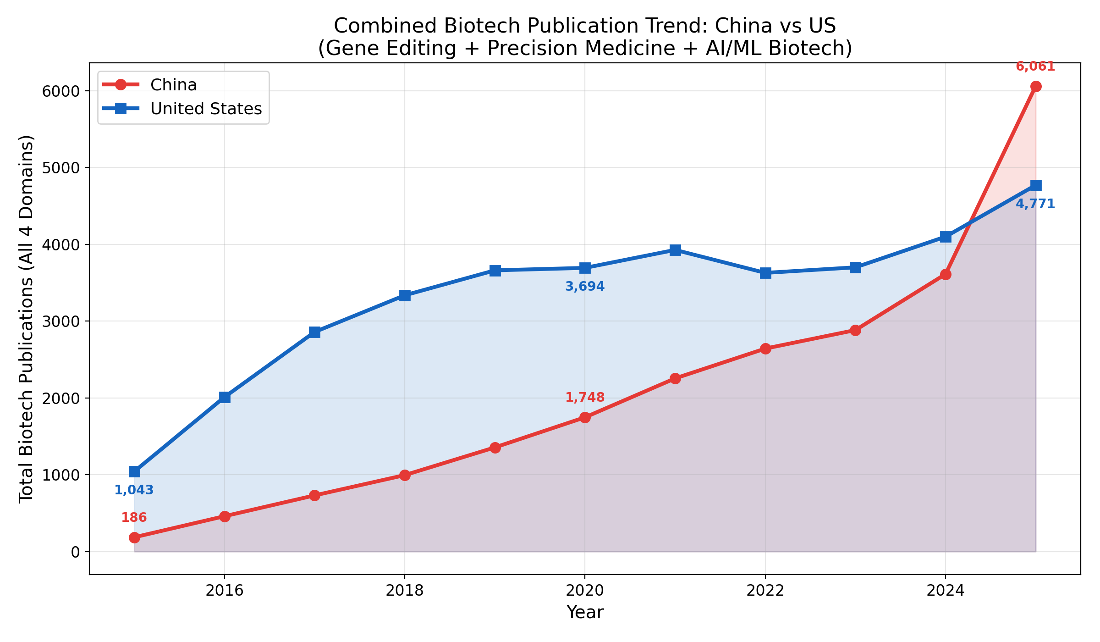
2024 Marked a Pivotal Turning Point
UNCLASSIFIED//NOT APPROVED FOR PUBLIC RELEASE
UNCLASSIFIED//NOT APPROVED FOR PUBLIC RELEASE

Slide 8
Mapping Bio-AI/ML Convergent Capability Ecosystems: U.S. and China
UNCLASSIFIED//NOT APPROVED FOR PUBLIC RELEASE
United States
Domain Prioritization
Actor Typology Mapping
Capability Indicators
Convergence Identification
Threat + Dual Use Detection
Innovation Rate Forecasting
Monitoring Infrastructure
Steps
China
Domain Prioritization
Actor Typology Mapping
Capability Indicators
Convergence Identification
Threat + Dual Use Detection
Innovation Rate Forecasting
Monitoring Infrastructure
Steps
Key
Currently Capable
Capability in Progress
Capability Uncertain
UNCLASSIFIED//NOT APPROVED FOR PUBLIC RELEASE

Slide 9
Future Work
UNCLASSIFIED//NOT APPROVED FOR PUBLIC RELEASE
Expand
Expand efforts in the open data assessment of metrics used to assess accelerators and decelerators
Conduct
Conduct a comparative analysis of the U.S. and China's bio-AI/ML convergent advancements across different domains
Identify
Identify validation approaches to assess the accuracy of project findings
UNCLASSIFIED//NOT APPROVED FOR PUBLIC RELEASE

Slide 10

Thank you!
UNCLASSIFIED//NOT APPROVED FOR PUBLIC RELEASE
UNCLASSIFIED//NOT APPROVED FOR PUBLIC RELEASE
Photo credits: Fast Company

