Slide 1
Deployment of Single Board Computer Mesh Networks for Remote Cyber Operations
CDT Ryan Monagle

Slide 2
Background
JSOC’s Needs
Small, Modular System
Dropoff by Unaffiliated Asset
Wireless Cyber Capabilities
Cannot be Traced Back to USF

Slide 3

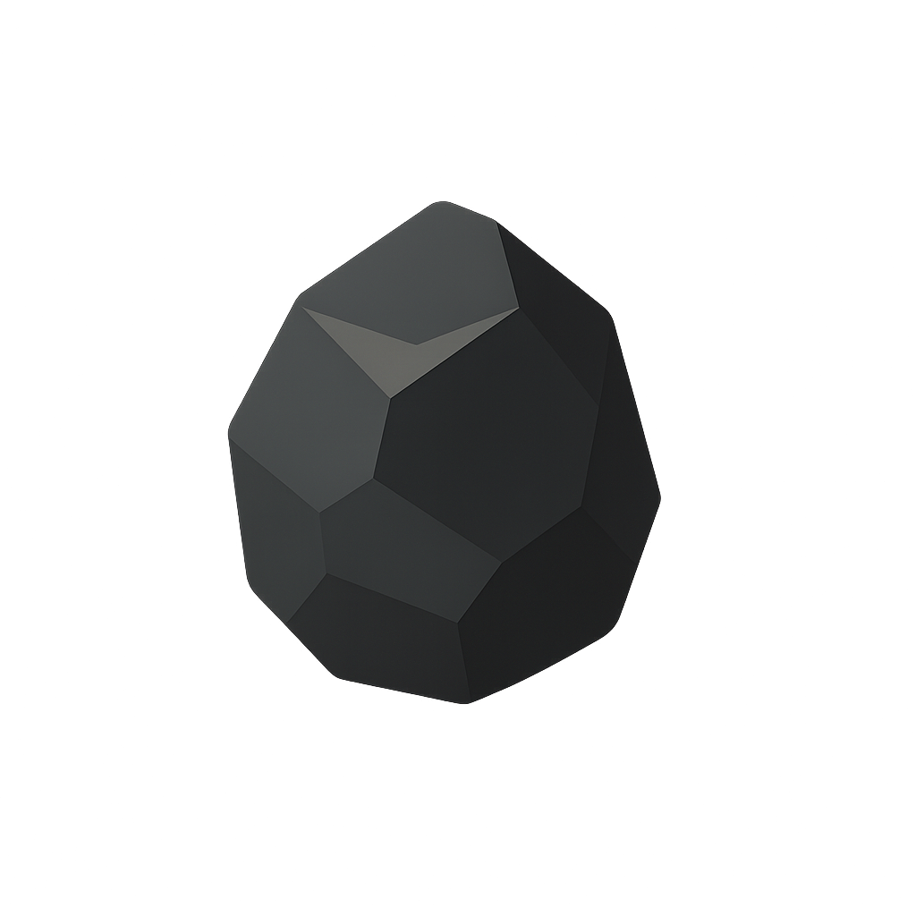

Requirements
Secure Tunnel
Operator
Cyber Nodes
Low Power Draw
Low EW Visibility
Modularity
Tamper Control Mechanisms
Technically and Mechanically Simple
Open-Source & Expendable
Physical Stealth
Sufficient Coverage
Offensive Capabilities
Notes:
From there we defined this device’s requirements. What it needed to do. A way for the operator, remotely, to get in touch with this node network to conduct cyber actions whether defensively or offensively.

Slide 4

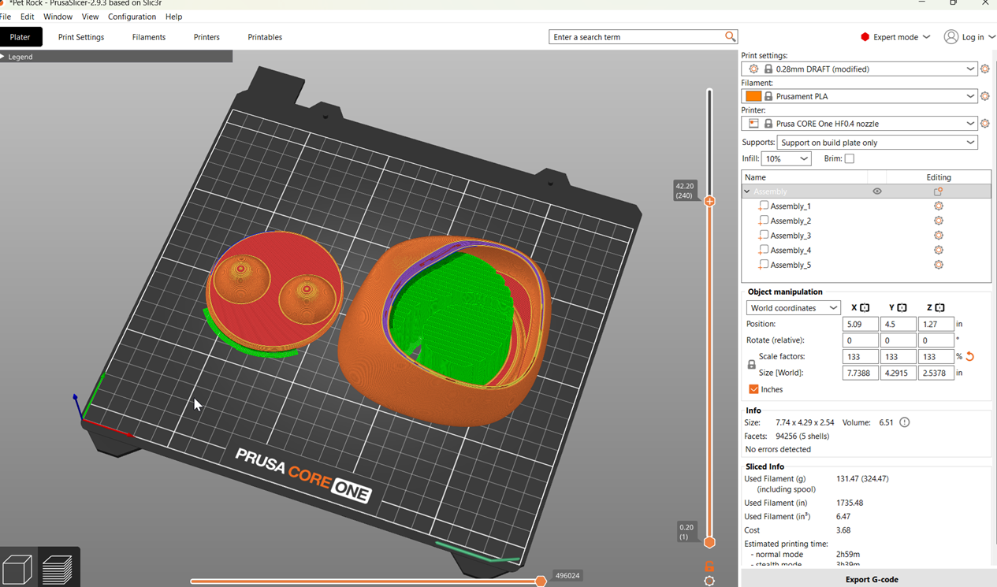
Concealment
Notes:
Another aspect will be looking at the different ways to conceal the cyber device. Something that is discrete, unassuming, and adaptable to its environment. Intially, our ideas was something like a rock, a stone if you will, but with your help and feedback, like the resto f our project, we hope to gain a better understanding of the operating picture to see how we can develop better ways to conceal our device.

Slide 5
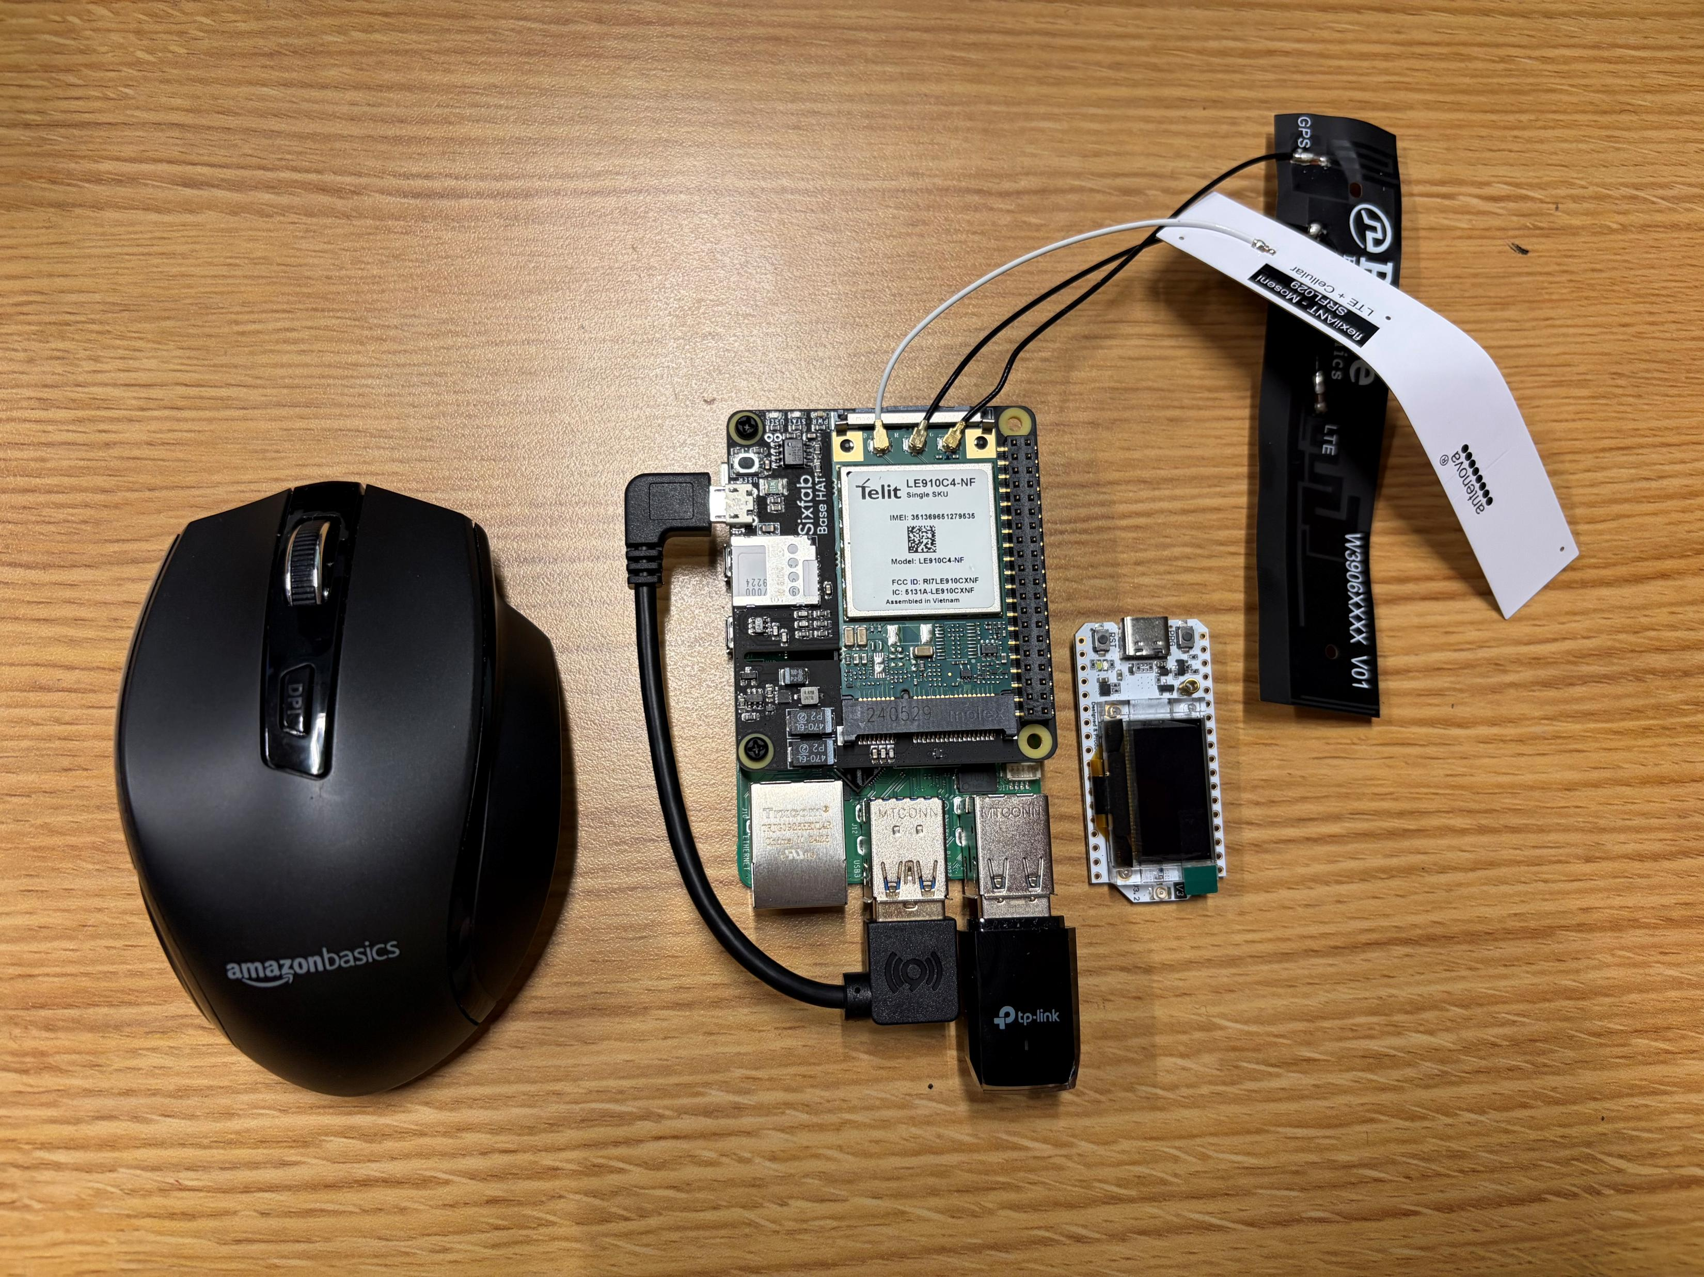
STONE Setup
LTE Antennas
LoRa Module
Wi-Fi Antenna

Slide 6
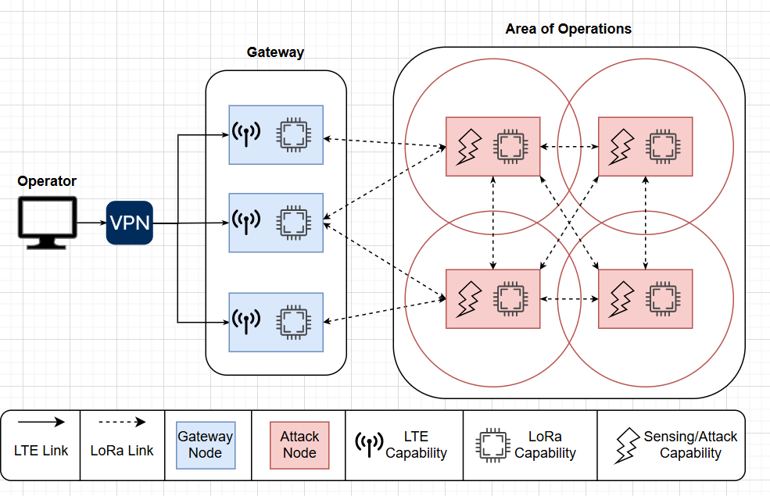
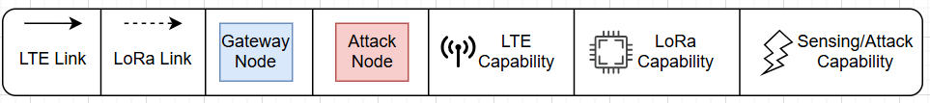
Technical Overview
Phase 3: Engagement
Phase 1: Initial Callback
Phase 2: Traversal
Notes:
From a technical lens, the project framework is broken down into three phases: the Initial Callback, Traversal, and Engagement

Slide 7
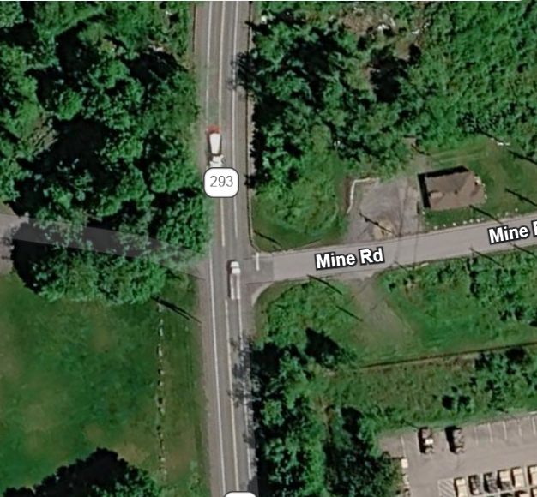
Problem Statement
Image: Google Earth
Notes:
Picture this scenario: We’ve recently received intelligence that an enemy squad will be moving from west to east along Mine Road. We know the enemy uses a man-portable mobile ad-hoc network to communicate. How can we optimally place our STONE devices to shut down this network? Do we need 2? Or do we need 5?

Slide 8


Optimal Placement
Objective Function
$$min\sum_{tc∈T^{C}}{X_{tc}}+α×Stealth_{tc,tm}$$ | (0)
Minimize the number of STONEs placed, accounting for a stealth penalty
Constraints
$$\sum_{tm∈T^{M}}{X_{tc}}≥1 ∀ tm∈T^{M}$$ | (1)
Each demand location must be covered by at least one STONE
$$Y_{tc,tm}×Distance_{\left[tc,tm\right]}≤r_{1} ∀ \left[tc,tm\right]∈\left[T^{C},T^{M}\right]$$ | (2)
Enforce maximum range
$$Distance_{tc,tm}+Stealth_{tc,tm}≥r_{2}×Y_{tc,tm}$$ | (3)
Enforce soft minimum range
Notes:
Here’s some of the math behind linear program that defines our optimal placement algorithm. I’ll explain each component in words. Our goal is to minimize the number of stones placed, accounting for a stealth penalty. The first constraint says that we must cover each demand location. Essentially, we need to cover the entirety of Mine Road. The second constraint enforces the maximum range of our STONEs. The third constraint implements a soft minimum range, incentivizing the model to place STONEs further away from the road, where they are less easily detected.

Slide 9
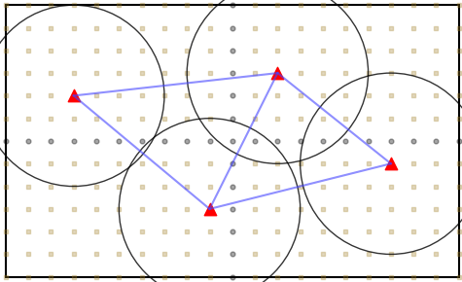
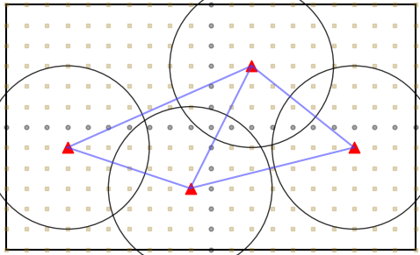
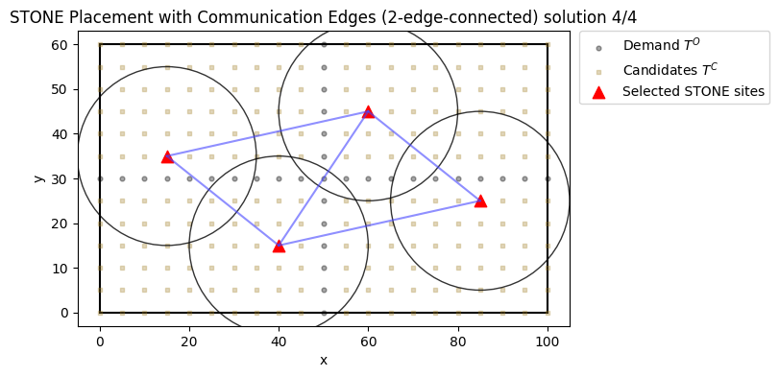
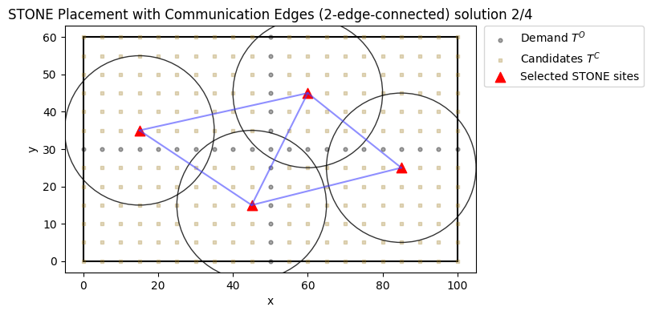
Optimal Placement
Objective Function
Minimize the number of STONEs placed, accounting for a stealth penalty
Constraints
…and 37 more solutions
Each demand location must be covered by at least one STONE
Enforce maximum range
Enforce soft minimum range
Notes:
When we run the model, we get a solution. And another. And another. And another. And 37 more solutions. How do we determine which of these feasible solutions are the best? We conducted a simulation.

Slide 10
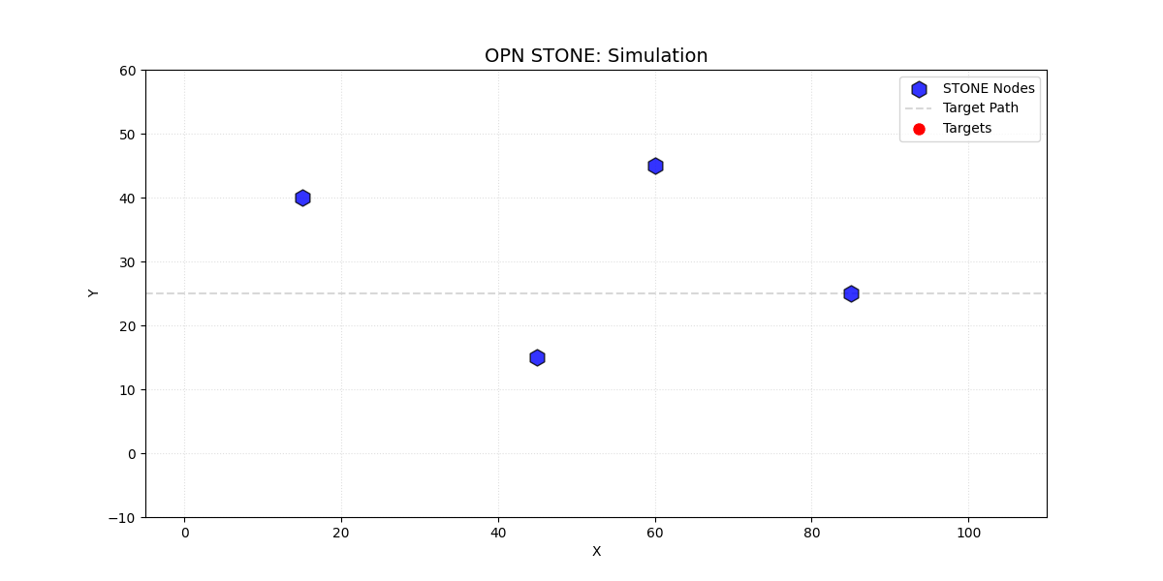
Simulation
Notes:
The simulation tests our configurations under stochastic, or random conditions. We have targets enter the simulation at random times. These targets have differing speeds to represent different categories of targets like soldiers on foot, vehicles, and drones. Once the target enters the range of our STONEs, they must detect, track, and then attack. Each of these steps have probabilities of success based on distance between the target and the STONE.

Slide 11
Simulation Results
Evaluation Metric | Detection Rate | Attack Rate | Energy Cost Per Kill | Longevity
Feasible Solution 1 | 92% | 88% | 13% | 16 hours
Feasible Solution 2 | 81% | 67% | 12% | 12 hours
JSOC operators should select Feasible Solution 1
Notes:
Once we run our simulation, we can calculate metrics that determine which of our feasible solutions is the best. Some examples are detection rate, attack rate, energy cost per kill, and longevity. In this case, JSOC operators should select feasible solution 1.
Next Steps:
Field testing to validate simulation
Test against likely targets – preplanned arrivals
Squad of 9 individuals on foot
Column of 3 vehicles
Swarm of 10 drones

Slide 12
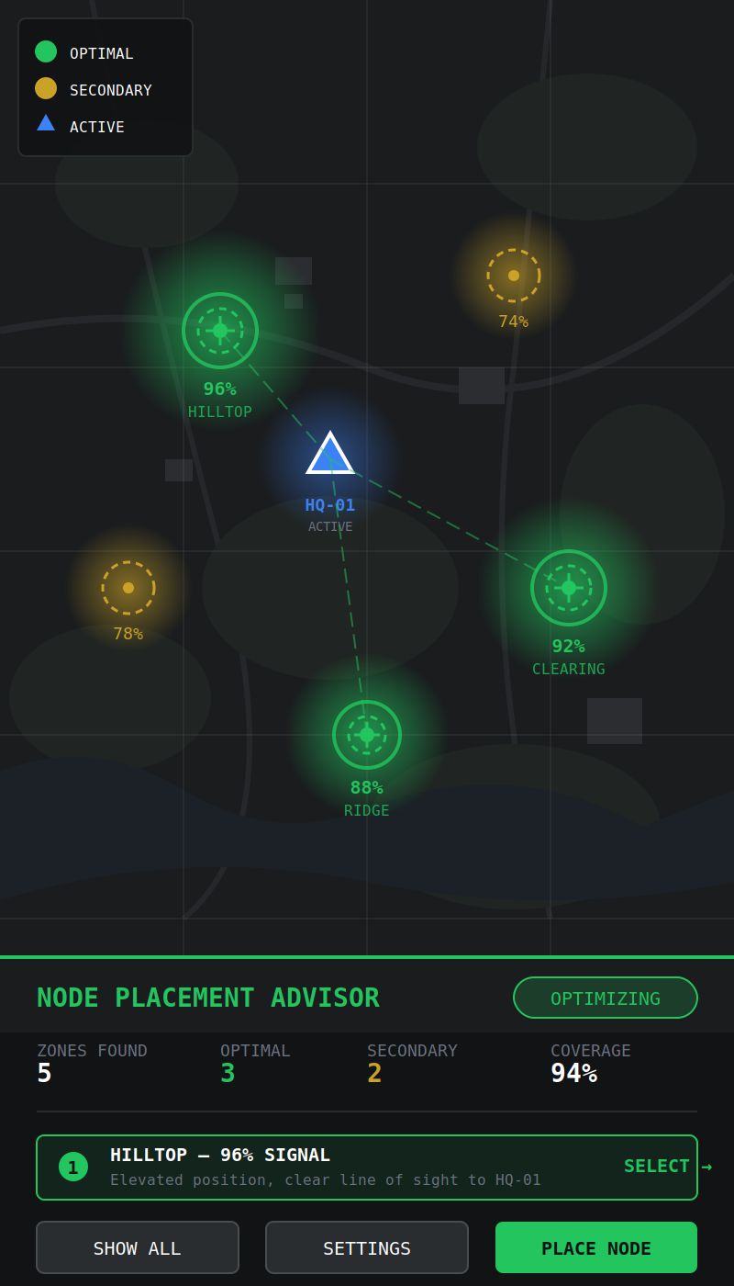
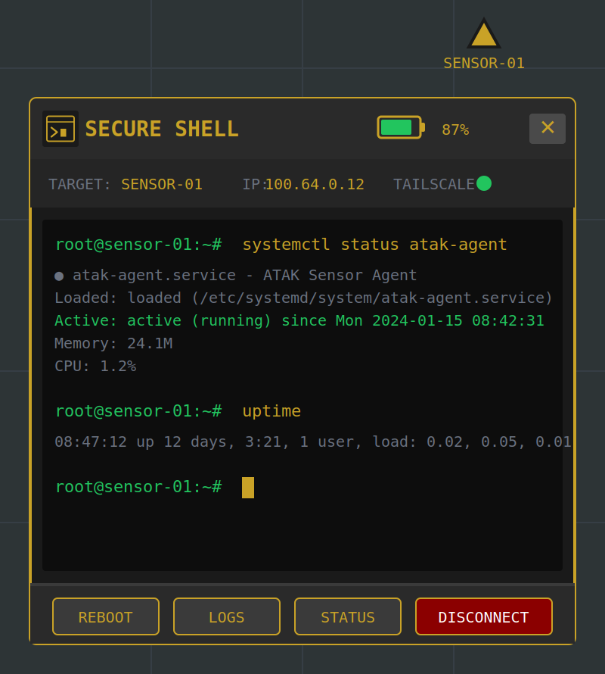
Future Work
More field testing based on environment
UI / ATAK Plugin

Slide 13






Thank You!
Team OPN Stone
CDT Ryan Monagle (‘27)
CDT Karthik Kottapalli (‘28)
CDT Spencer Lynch (‘27)
CDT Logan Dosan (‘26)
Ethan Slick (YSU ‘26)
See More Here!

Slide 14
Appendix and Supporting Materials

Slide 15
Phase 1: Initial Callback
End-to-end encryption + easy accessibility via Tailscale
Pi4 serves as “gateway node”
RISK OF DETECTION:
LOW
Operator remotes in from anywhere
RISK OF FAILURE:
LOW
LTE HAT enables LTE connection

Slide 16
Phase 2: Traversal
LoRa modules provide low-bandwidth connectivity at >10km LoS
RISK OF DETECTION:
LOW
Distance between Gateway and Attack nodes enables anonymity
RISK OF FAILURE:
MEDIUM

Slide 17
Phase 3: Engagement
All nodes equipped w/ LoRa modules for interconnectivity & redundancy
RISK OF DETECTION:
MEDIUM
RISK OF FAILURE:
MEDIUM
Nodes equipped w/ antennae enabling WiFi recon/attack, but are highly customizable

Slide 18
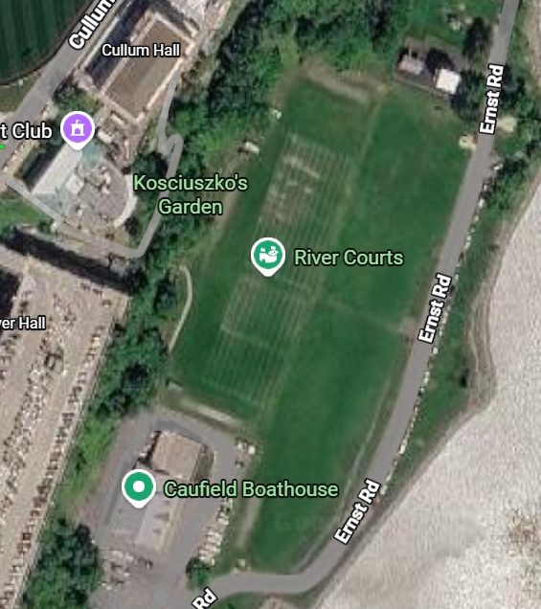

240 meters

Slide 19






Communication Components
OR
OR
Meshtastic
Reticulum
+
+
Mesh Networking Project Options
Wireless Communication Options
Central Processing SBC
Raspberry Pi
LoRa
Wi-Fi HaLow
Wi-Fi HaLow
LoRa
Notes:
We are currently using a single board computer as the brain. Not because it’s fancy, but because it’s cheap, flexible, and replacable. We need to be realistic within the operational environment.
From there, this raspberry pi, capable of conducting cyber actions, needs both wireless communication options (acting as the engine, a quieter alternative to lte or wifi if you will), and the skeleton fo the car being the mesh networking project that actually executes the action).
- This is for passive monitoring, defending, and offensively, left behind and

